Slide 1
ECal 3rd Prototype
Beam Test Analysis
Yen-Chen Wu
Dept. Physics, National Central University
2026/08/24

Slide 2
Energy Resolution Analysis Approach
ADC raw max
ADC max after fitting
ADC waveform integration
TOT
TOA(plot tot vs. toa correlation to see whether toa can serve to represent energy dump)
check resolution of E1x1, E3x3, E4x4, E1x1/E3x3, E1x1/E4x4, E3x3/E4x4 with all variables to find the one give the best resolution
apply different cut, TOT, TOA, event matching to see if resolution improved

Slide 3
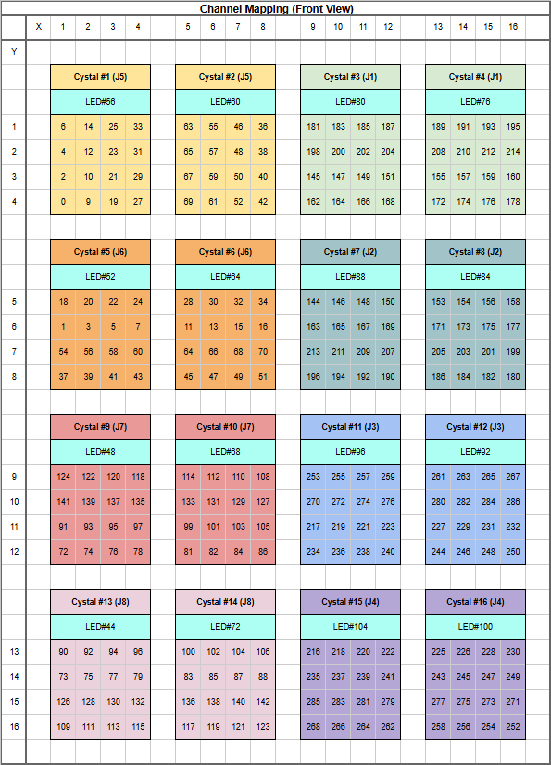
My First Try with Run 481
Channel Mapping
Run 481 @ HV=45V, C=0xA
Positron beam shoot at Crystal 7
Event selection need to be done with tracking from BM 3&4.
However, tracking requires event matching between BM and PbWO4 beforehand, which I will learn later.
My first try will not include tracking & event selection.
Crystal 7
Energy resolution of:
1 X 1,
3 X 3,
4 X 4 crystal
will be studied

Slide 4
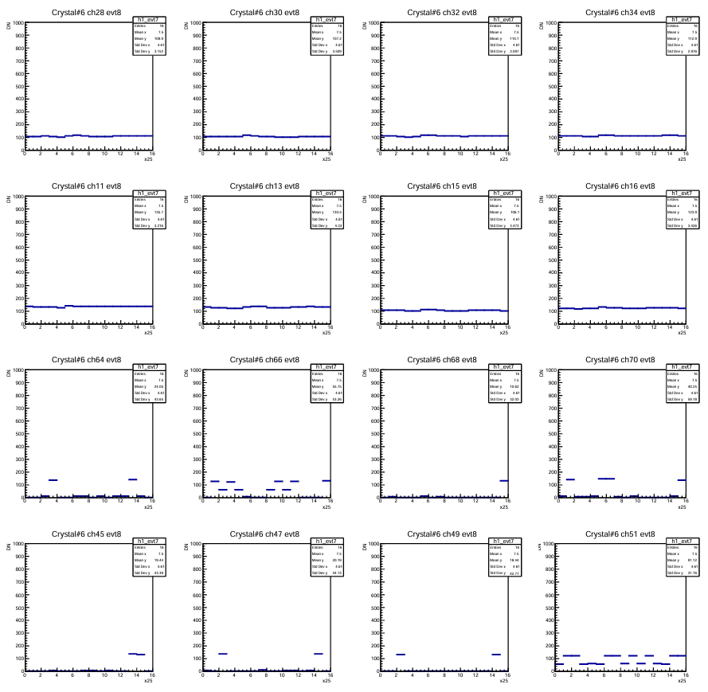
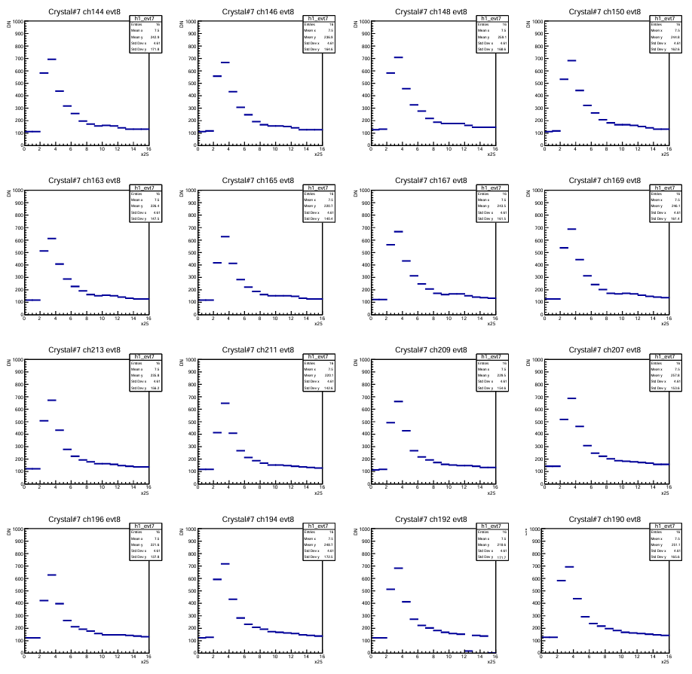
Event observation: Crystal#6&7
Crystal#6 evt8
Crystal#7 evt8
Graphs above are put according to crystal’s relative position.
Crystal#7 is all fired, while right-next-to crystal#6 do not
Form observation of 50 evt, almost no evt with two Crystal fired together found.
Energy dump is constrained mostly within one crystal?
All channel in one Crystal fire in basically the same waveform/magnitude

Slide 5
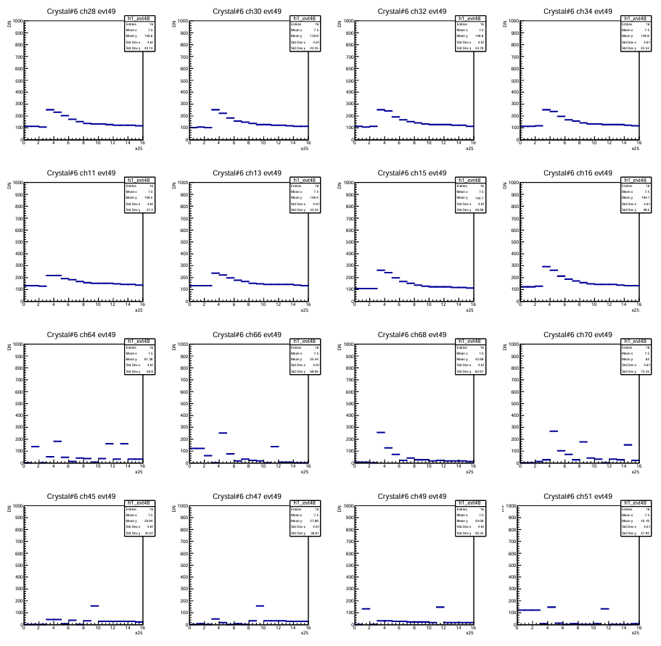
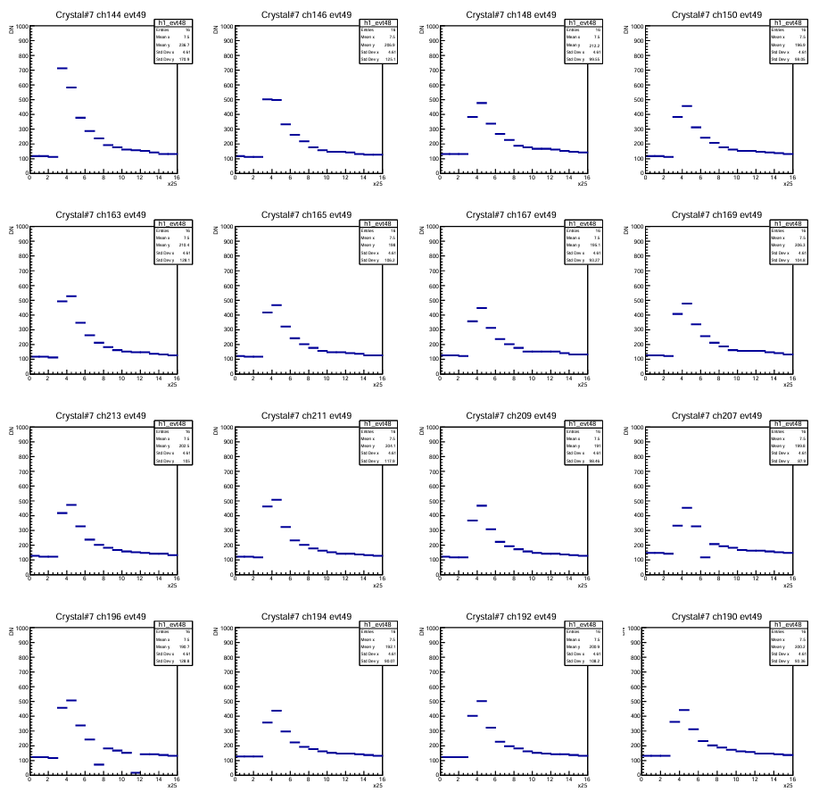
Event observation: Crystal#6&7
Crystal#6 evt49
Crystal#7 evt49
Among 50 evts, Evt49 is the only evt that seems to have signal on both crystal simultaneously.
However, it is hard to determine whether the waveform is really triggered by real firing.

Slide 6
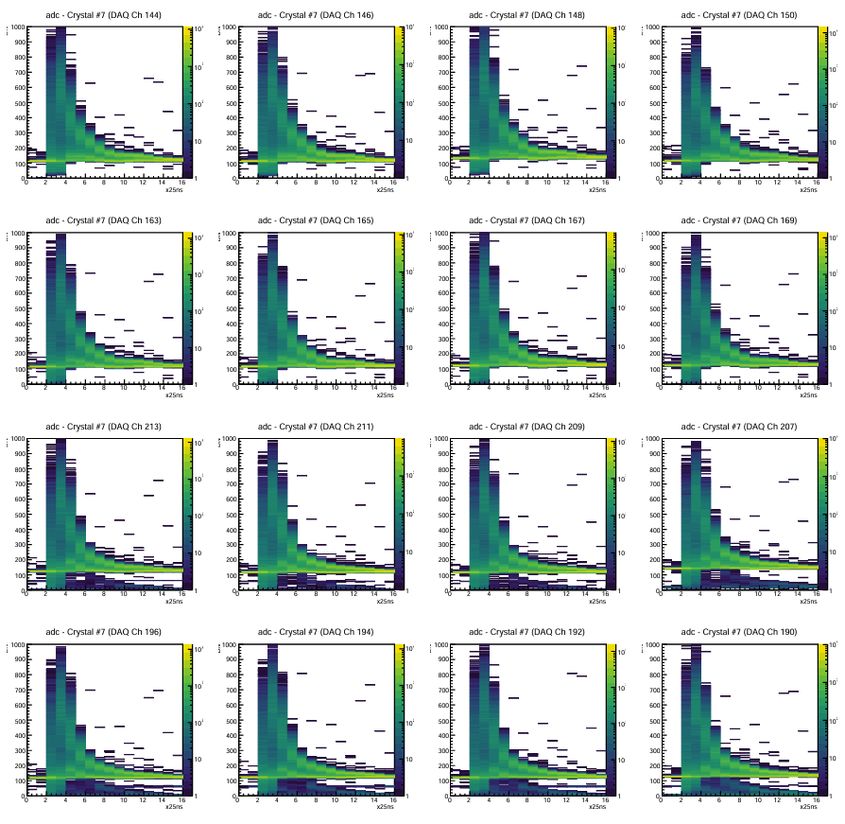
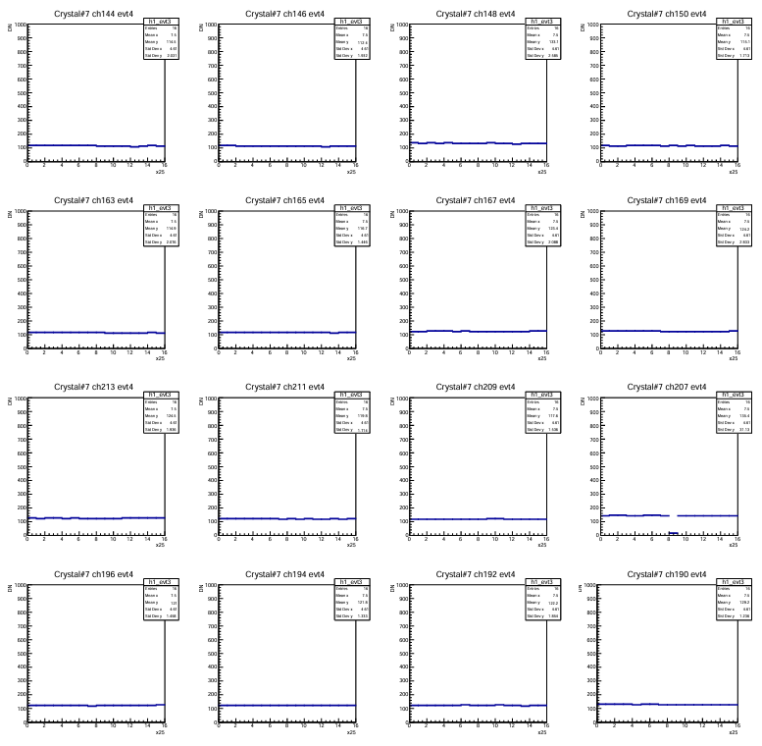
Crystal#7 adc waveform pattern I
Crystal#7 all event
Crystal#7 event4
nothing fired, pedestal only

Slide 7
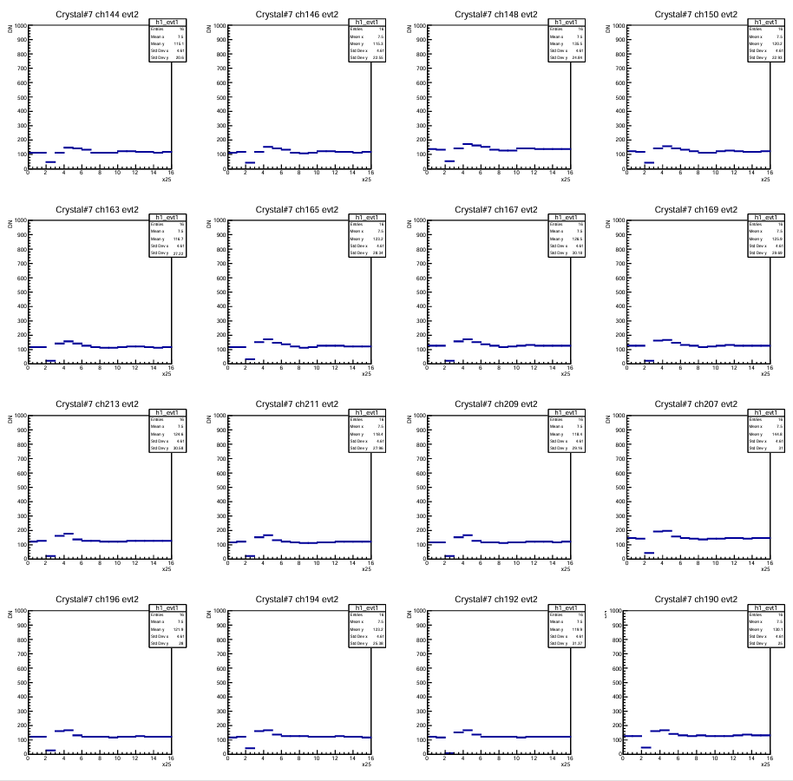

Crystal#7 adc waveform pattern II
Crystal#7 all event
Crystal#7 event2
Small pulse

Slide 8
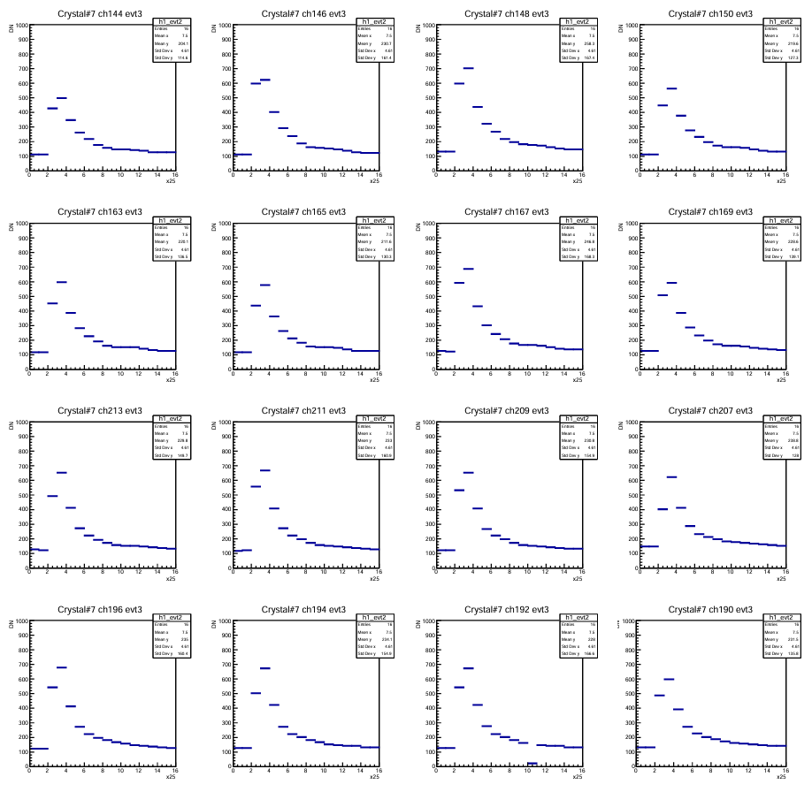
Crystal#7 adc waveform patter III
Crystal#7 all event
Crystal#7 event3
There is no double pedestal issues found in crystal#7.
All channels have basically the same waveform pattern in the same event.
Visual inspection of 50 events revealed no waveforms starting at zero (i.e., no firing waveform with a zero pedestal).

Slide 9
Crystal status overview
All channels have basically the same waveform pattern in the same event.
All channels in crystal#3,4,7,10,11 function well.
There is no double pedestal issues found in crystal#7.
1*1 clustering at crystal#7 should have no problem.
Problems:
dead channels are found in (exclude in later analysis)
crystal#2 : 63, 40, 52, 42 (4 dead)
crystal#6: 64, 45, 47, 49, 51 (5 dead)
crystal#8: 173, 175 (2 dead)
crystal#12: 284, 286, 231, 250 (4 dead)
Abnormal waveform pattern found in
crystal#2,6,8,12
Well-function crystal
3 4
7
10 11

Slide 10
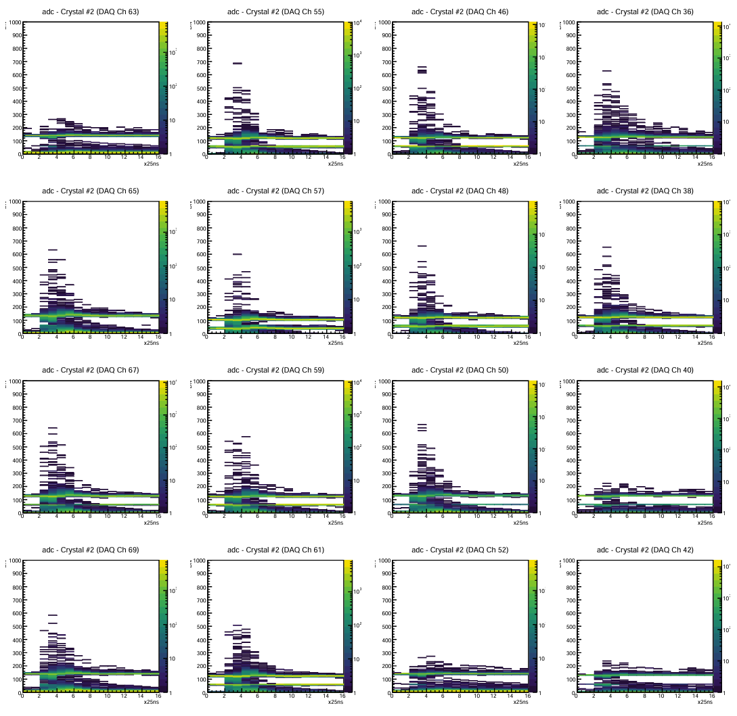
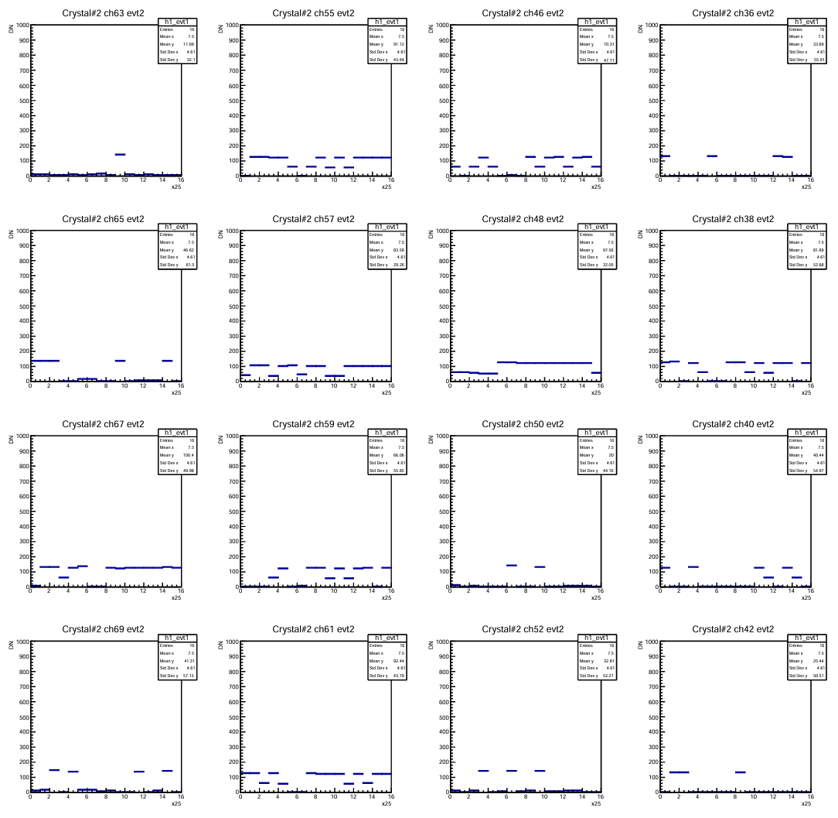
Abnormal channel report Crystal#2
Crystal#2 all event
Crystal#2 event2
Ch#63
Ch#40
Ch#52
Ch#42
crystal#2 : 63, 40, 52, 42 (4 dead)
Double pedestal?

Slide 11
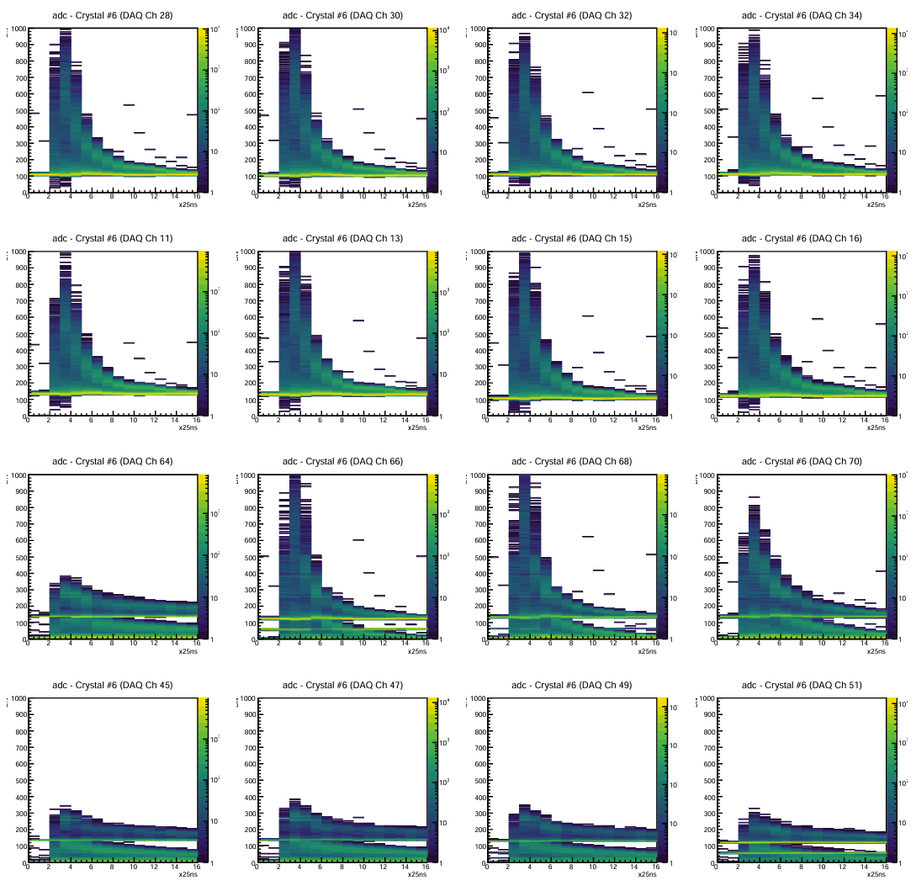
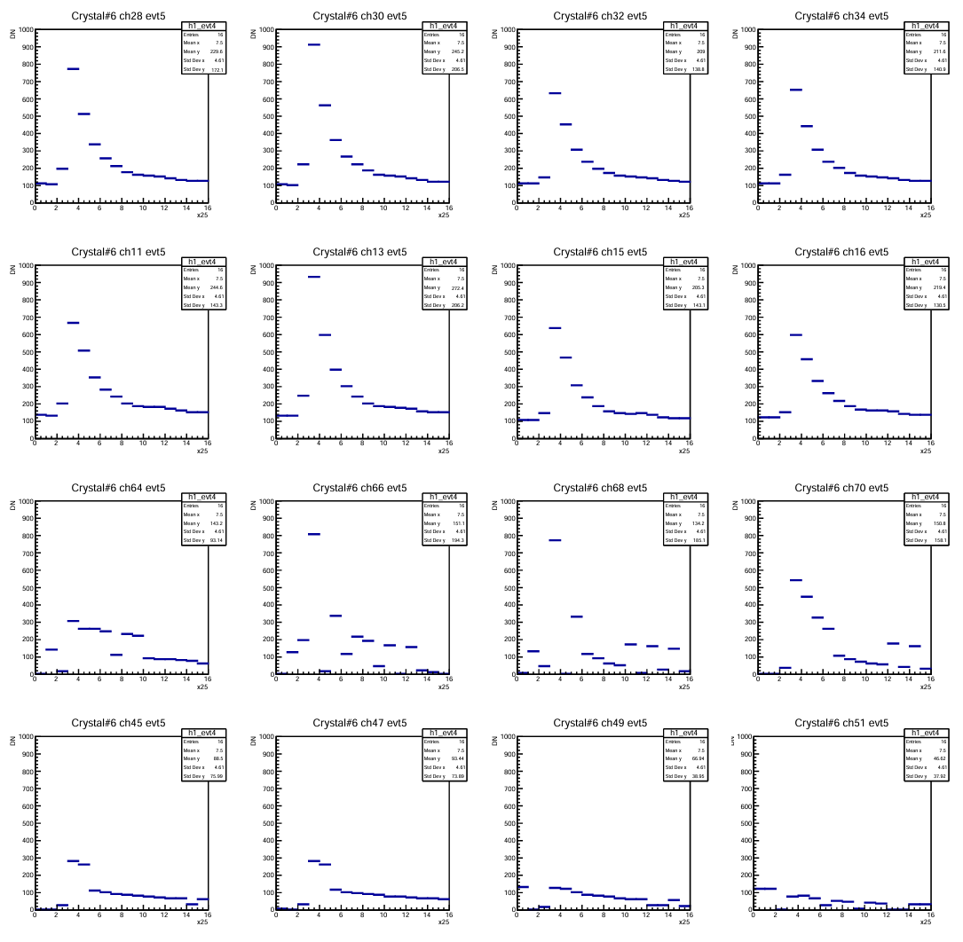
Abnormal channel report Crystal#6
Crystal#6 all event
Crystal#6 event5
Ch#63
Ch#66 Ch#68 Ch#70
Ch#45
Ch#47
Ch#49
Ch#51
crystal#6: 64, 45, 47, 49, 51 (5 dead)
Upper half of the channel should have no problem in later analysis.
For Ch#66, 68, 70, how to fit individual waveform?
Or exclude them ?

Slide 12
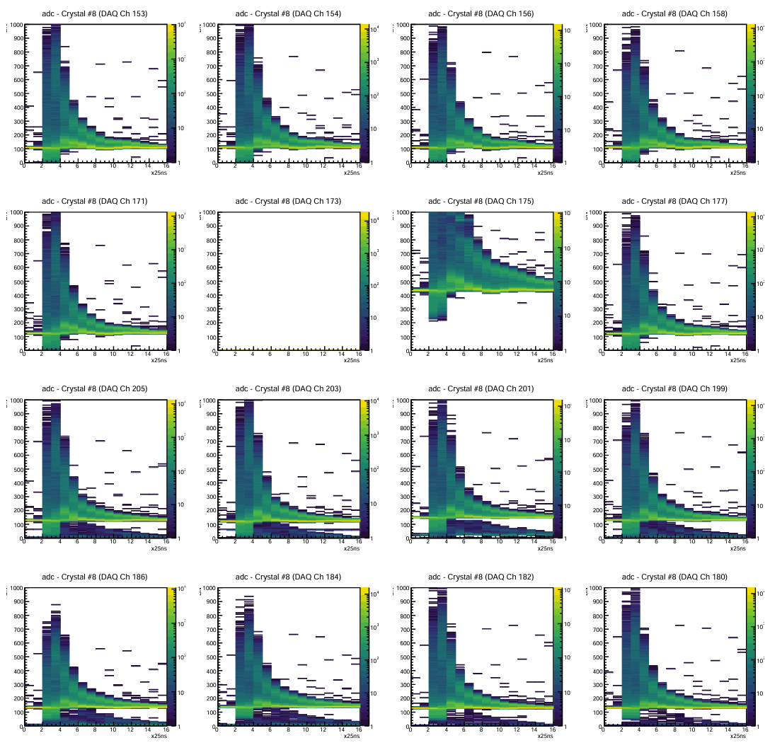
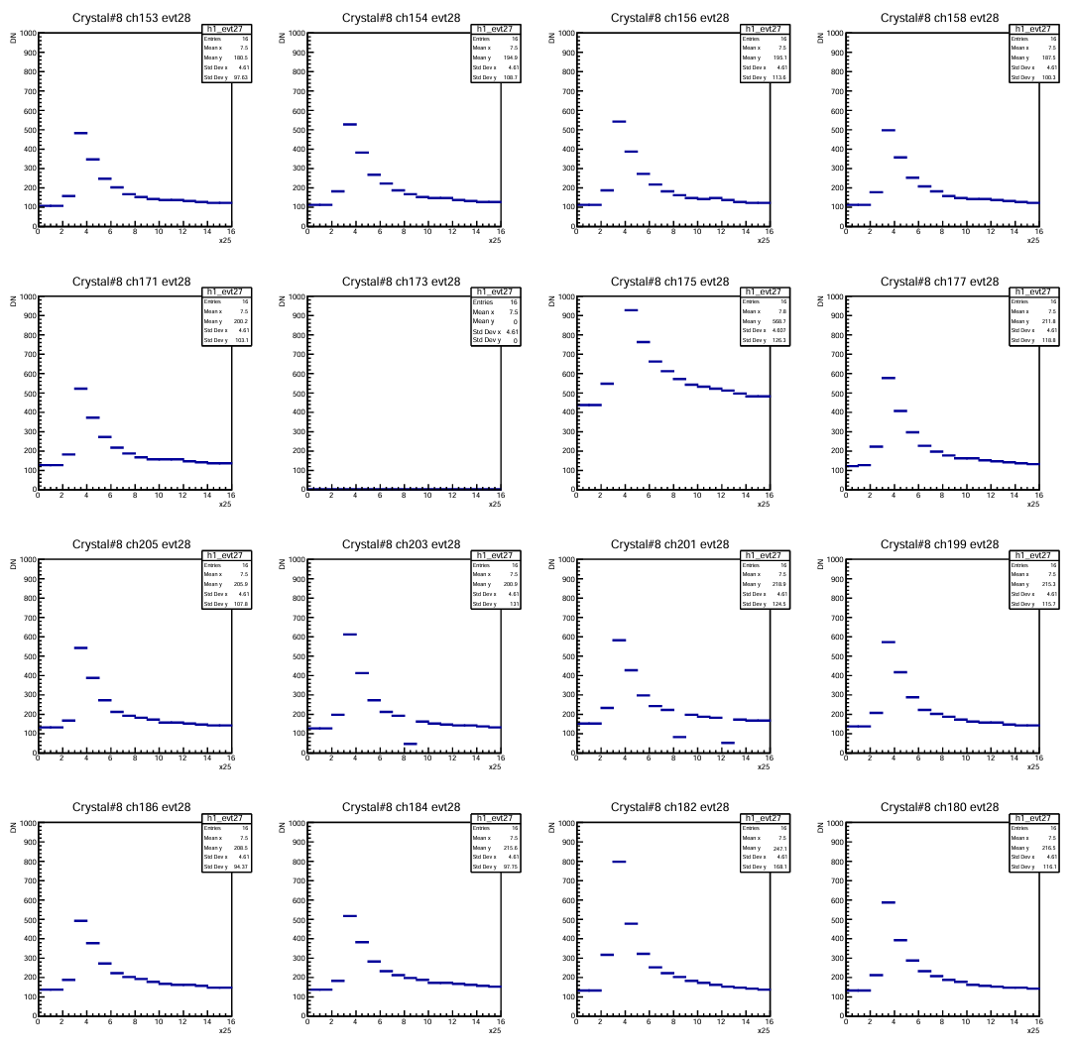
Abnormal channel report Crystal#8
Crystal#8 all event
Crystal#8 event28
Ch#173
Ch#175
crystal#8: 173, 175 (2 dead)
Other channels have no problem.
Data points falling below the pedestal level are rare. They are caused by isolated, random single-sample drops beneath the main pulse waveform."

Slide 13
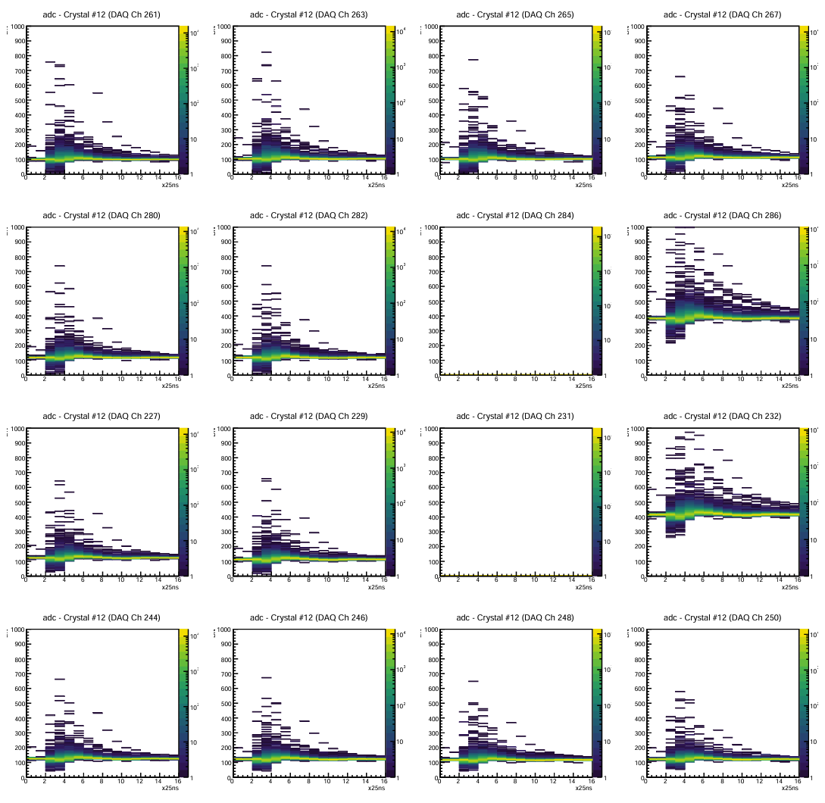
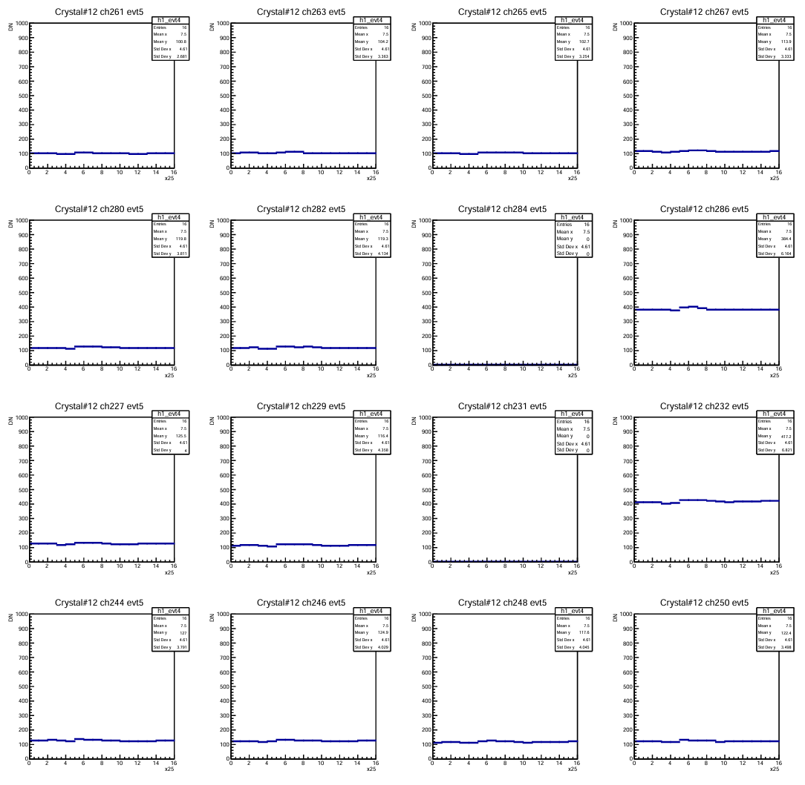
Abnormal channel report Crystal#12
Crystal#12 all event
Crystal#12 event5
Ch#284
Ch#286
Ch#231
Ch#232
crystal#12: 284, 286, 231, 250 (4 dead)
Other channels have no problem

Slide 14
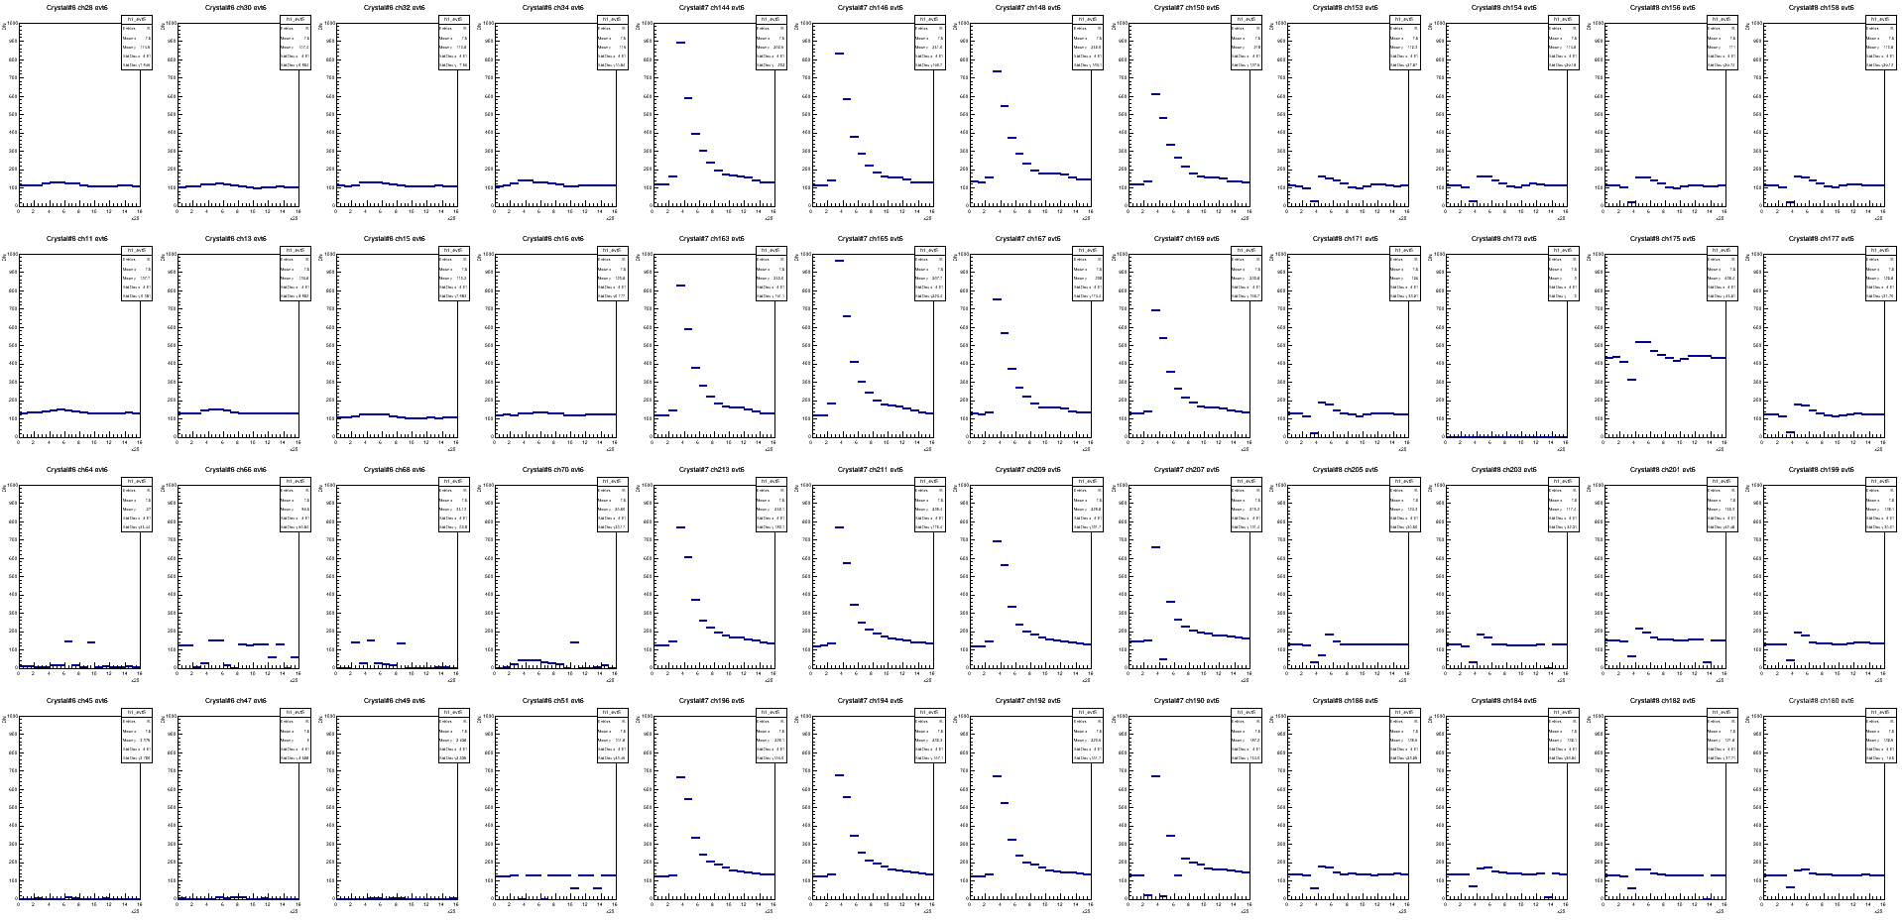
Preliminary efficiency test
Crystal#6
Crystal#7
Crystal#8
efficiency from visual inspection of 50 events: 1*1(crystal#7)=38%, 1*3(crystal#6,7,8):88%, 3*3=88%

Slide 15
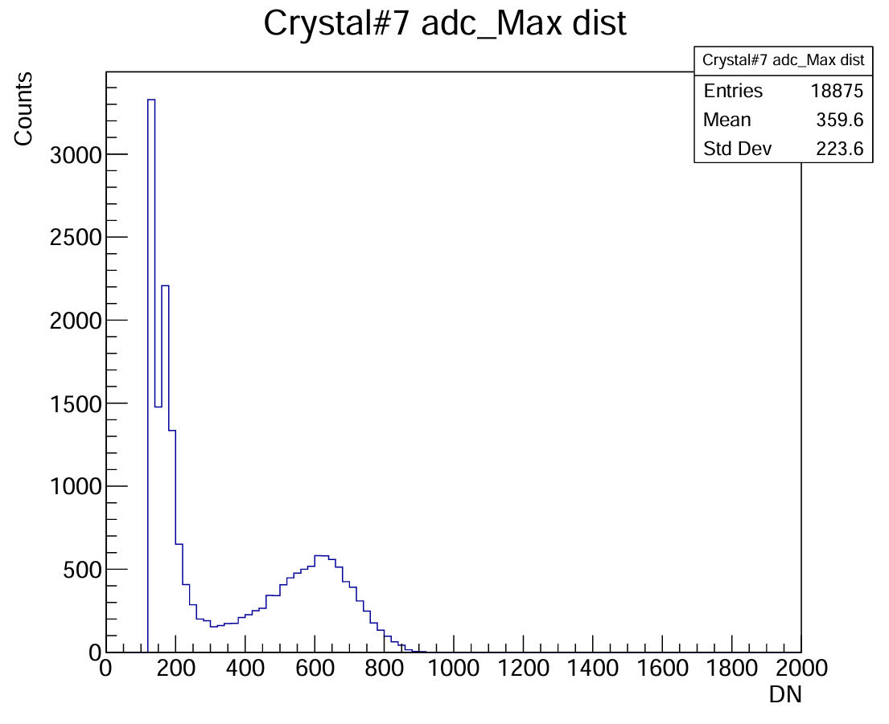
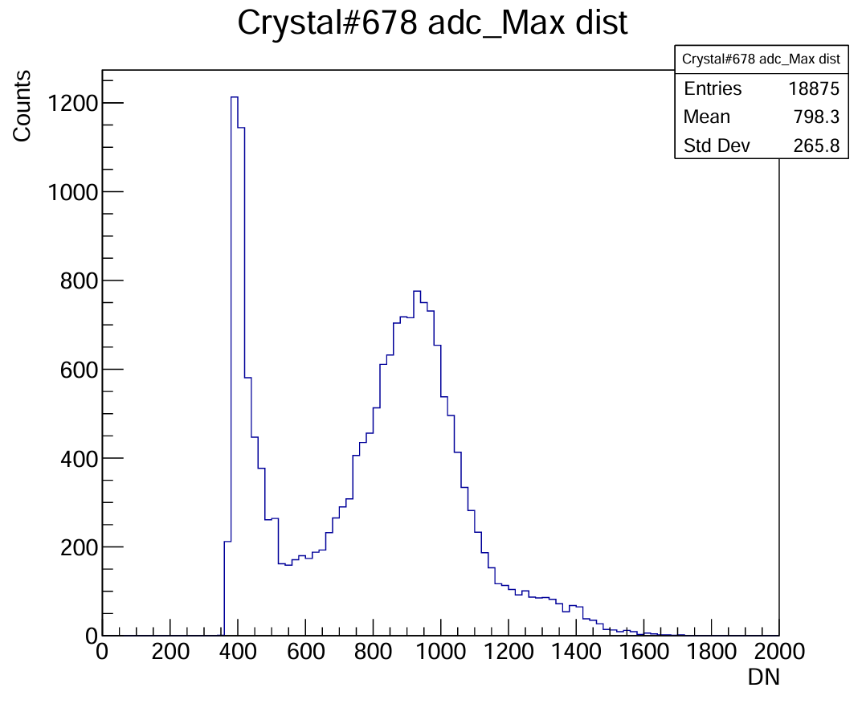
Energy resolution from raw adcMax
Histograms are filled with crystal energy from every event. They are yet to be fit.
Crystal energy is defined as the average of the maximum value from every channels on that crystal.
Histogram “Crystal#678 adc_Max dist” is filled with the sum of crystal energy from #6, #7, #8

Slide 16
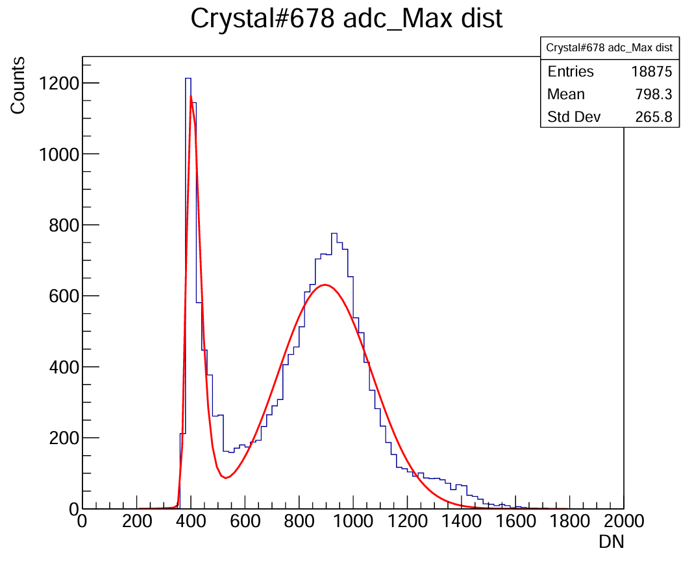
Fitting issue
Right now, I am still struggling with the fitting quality.

Slide 17
Summary & conclusion from meeting
For abnormal channels, simply exclude them in the preliminary analysis.
Observe more events and see if there are firing events with pedestal around zero.

