Slide 1

RPC work
Chia-Yu Hsieh
Academia Sinica, Taiwan

Slide 2
RPC Electronics for JP
Amp production
30 pcs ready
220 pcs under production
Discriminator control code
python-based code is ready by濂宸
problem with setting threshold board by board
Dr. Chu is investigating
Discriminator prototypes (test beam in Oct. 2026)
Dis#1 : change polarity, 2026_v1, 3 boards produced, test beam in Oct.
Dis#2 : change polarity + more stretcher, Dr. Chu still designing
Dis#3 : positive signal, same board as Dis#1 but remove/add capacitors

Slide 3
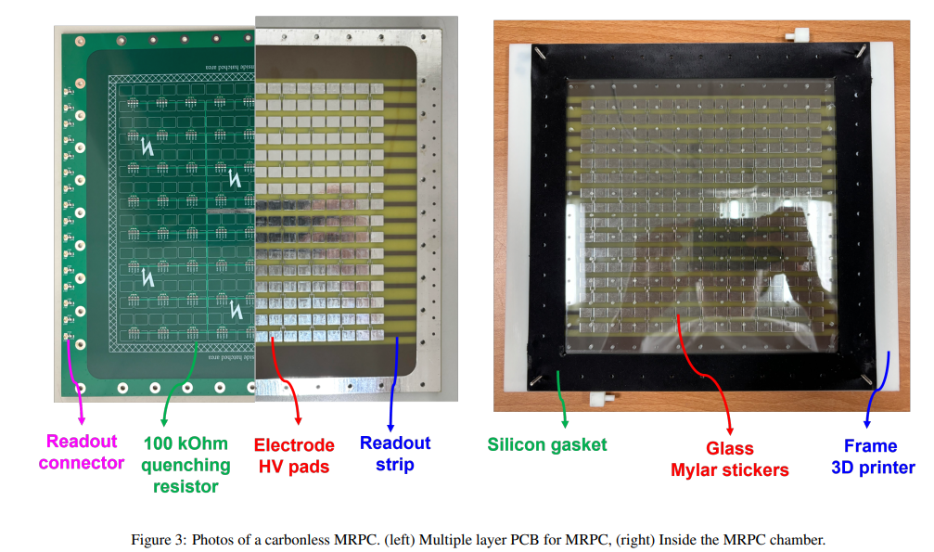
Review Carbonless RPC (1)
https://www.sciencedirect.com/science/article/pii/S0168900225005698

Slide 4
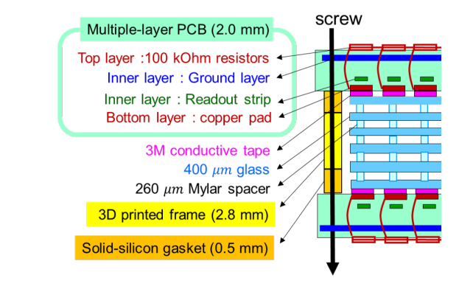
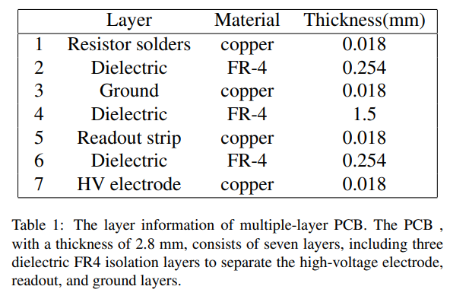
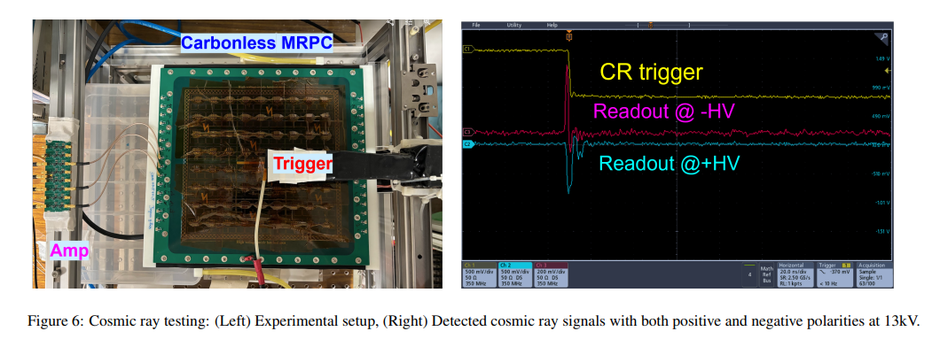
Review Carbonless RPC (2)

Slide 5
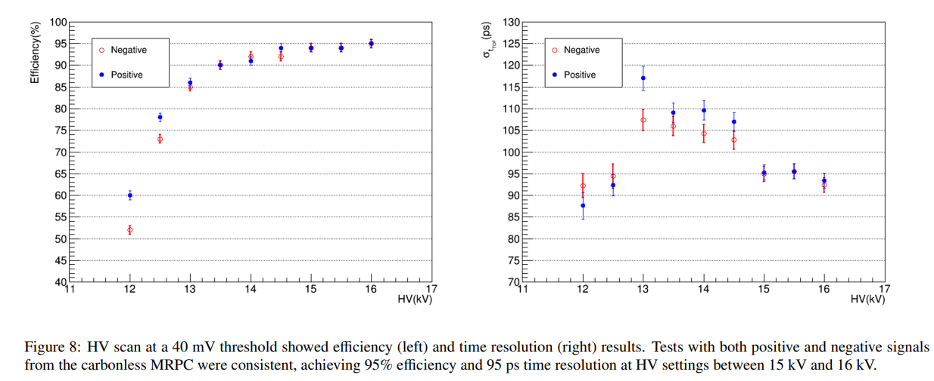
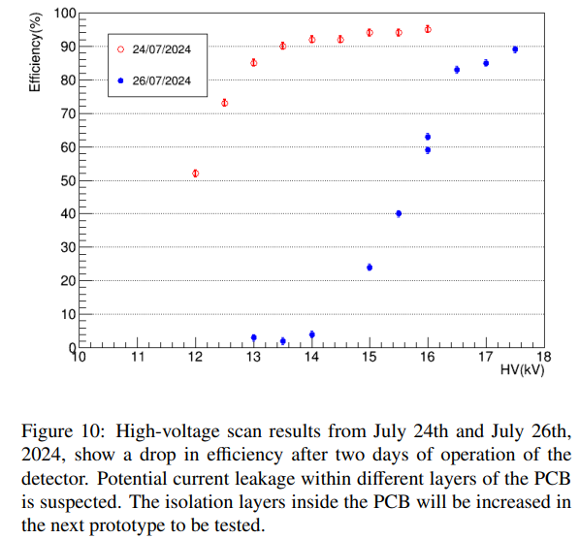
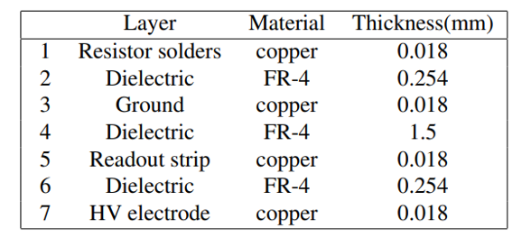
Review Carbonless RPC (3)
Increase the thickness of
FR4 layer

Slide 6
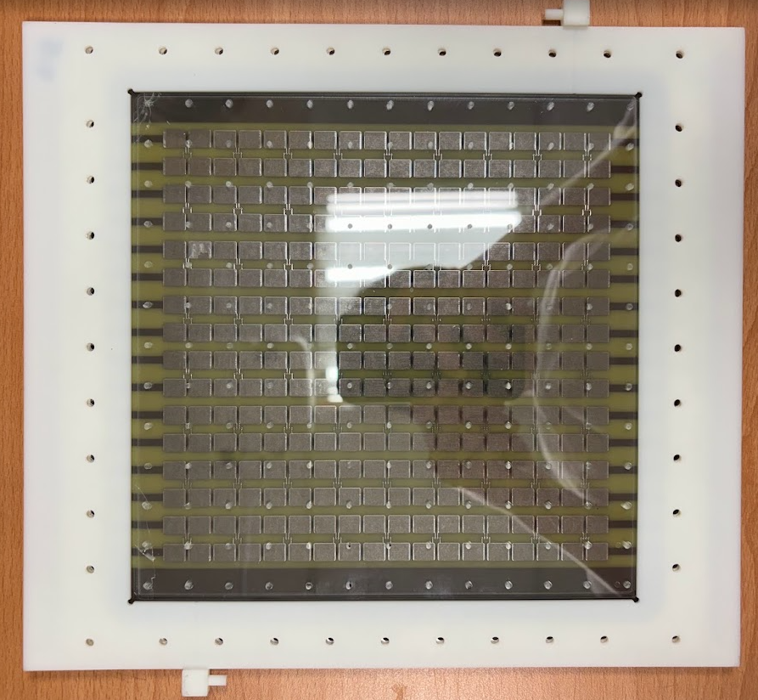
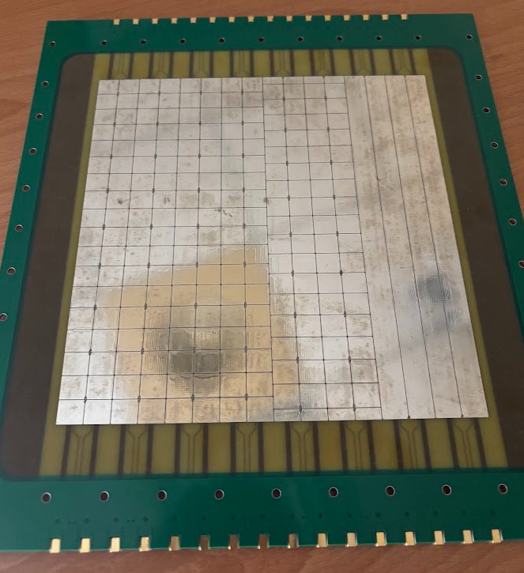
New Carbonless PCB
C
B
A
Increase the thickness of FR4
Change the size of pad : change of size of clustering => change the size of signal?

Slide 7
Carbonless : Study with Oscilloscope
HV +1kV
LV +6V
Scin_top
AND
Carbonless
Amp
Oscilloscope
signal
Scin_bottom
Trigger
res~ns
HV +1kV
HV = +7kV
+ HV= -7kV
翊銘 : please report this study, Eff and signal ADC
Do we have everything to setup this in NCU?

Slide 8
Carbonless : Efficiency and Time Resolution Study
HV +1kV
LV +6V
Scin_top
AND
Carbonless
Amp
TDC
signal#1
Carbonless
Amp
signal#2
@Trigger
matching
mode
Scin_bottom
HV +1kV
HV = +7kV
+ HV= -7kV
Trigger
翊銘 : please report this study, TDC control
Do we have everything to setup this in NCU?

Slide 9
CEAN TDC test
trigger
(TTL)
TDC
(0) trigger matching mode
win. Offset = 0 us
Win. window = 10us
Dis.
(thres. = 100mV)
Fun gen
Fan out
signal
(TTL)
signal
(LVDS)

Slide 10
To Do
翊銘
Study operation principle of RPC
Check modules (w/ 彥震)
Report carbonless work during summer
Test TDC again with better signal input?
濂宸
Prepare document for Spring8 test beam

