Slide 1
Weekly meeting
Yu-Siang Xiao (蕭宇翔)
2026 08/06

Slide 2
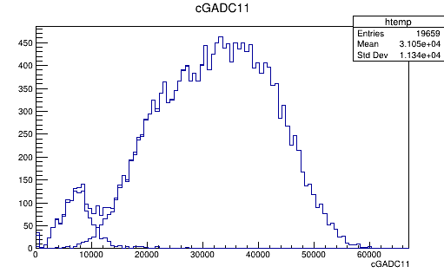
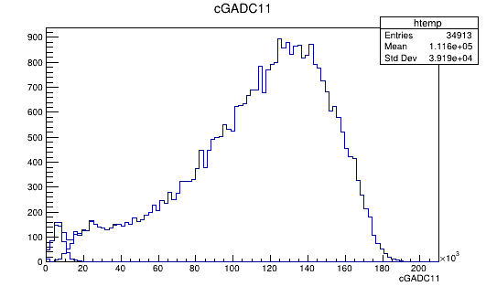
GADC11 THR CUT
VF650 ~ 會讓EMAX<10K的數據掉資料，高能量約在20K以上不會掉資料換句話說，兩頻道都不會被CUT 影響的範圍約在2x 10K = 20k以上:
Condition: Emax 單晶片還是雙晶片觸發
197MeV
796MeV
因此進行MC-DATA 能量重建應由雙晶片觸發事件來決斷，使用該事件類別的
  DATA(ADC)-2OFF = MC(MeV) * GAIN
  MeV *GAIN+2OFF = ADC

Slide 3
MC能量
已知MC能量@796 ~ 450MeV， DATA結果應相似
由於MC 只存晶體能量，不存SIPM光訊號，因此需要人為將訊號分成兩半

Slide 4
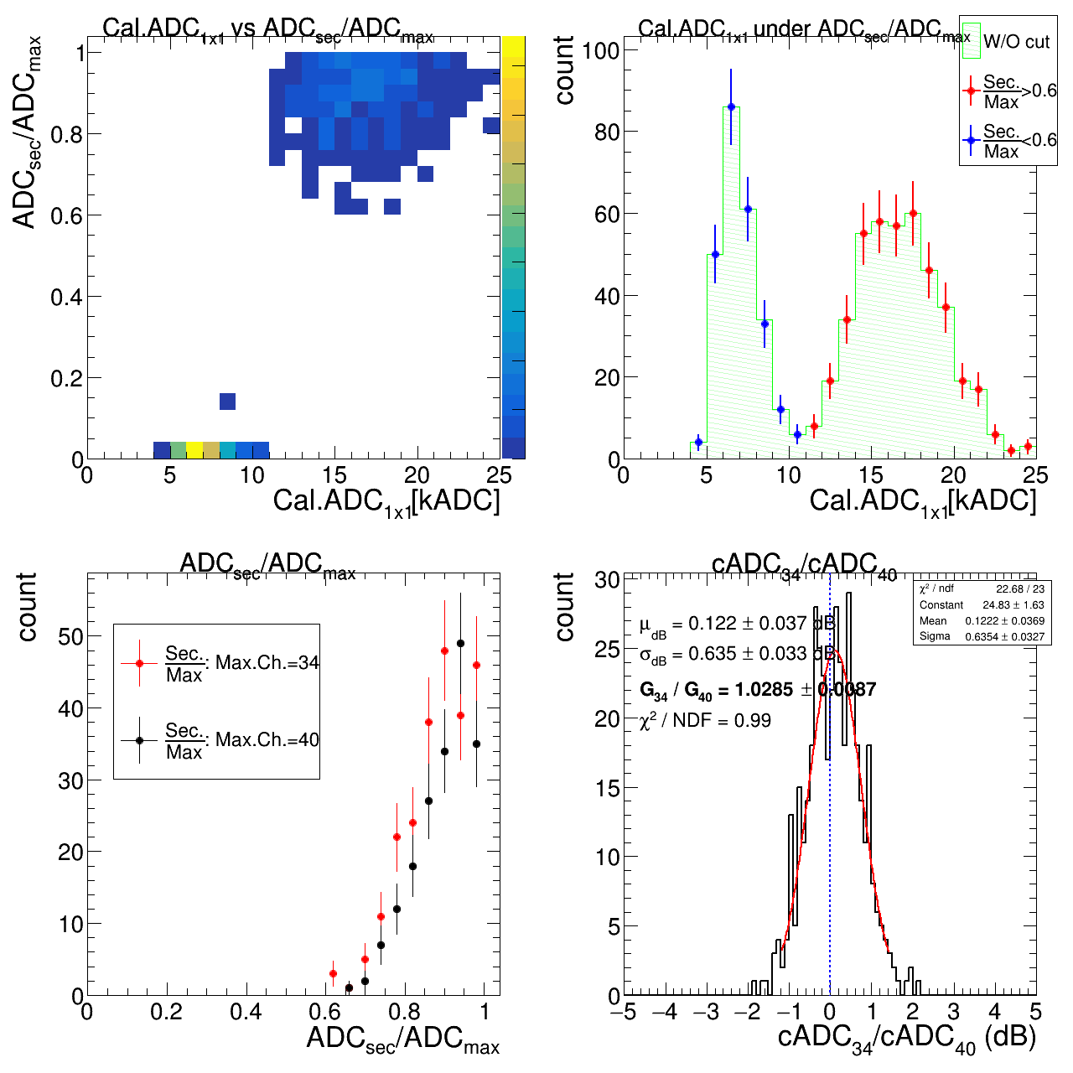
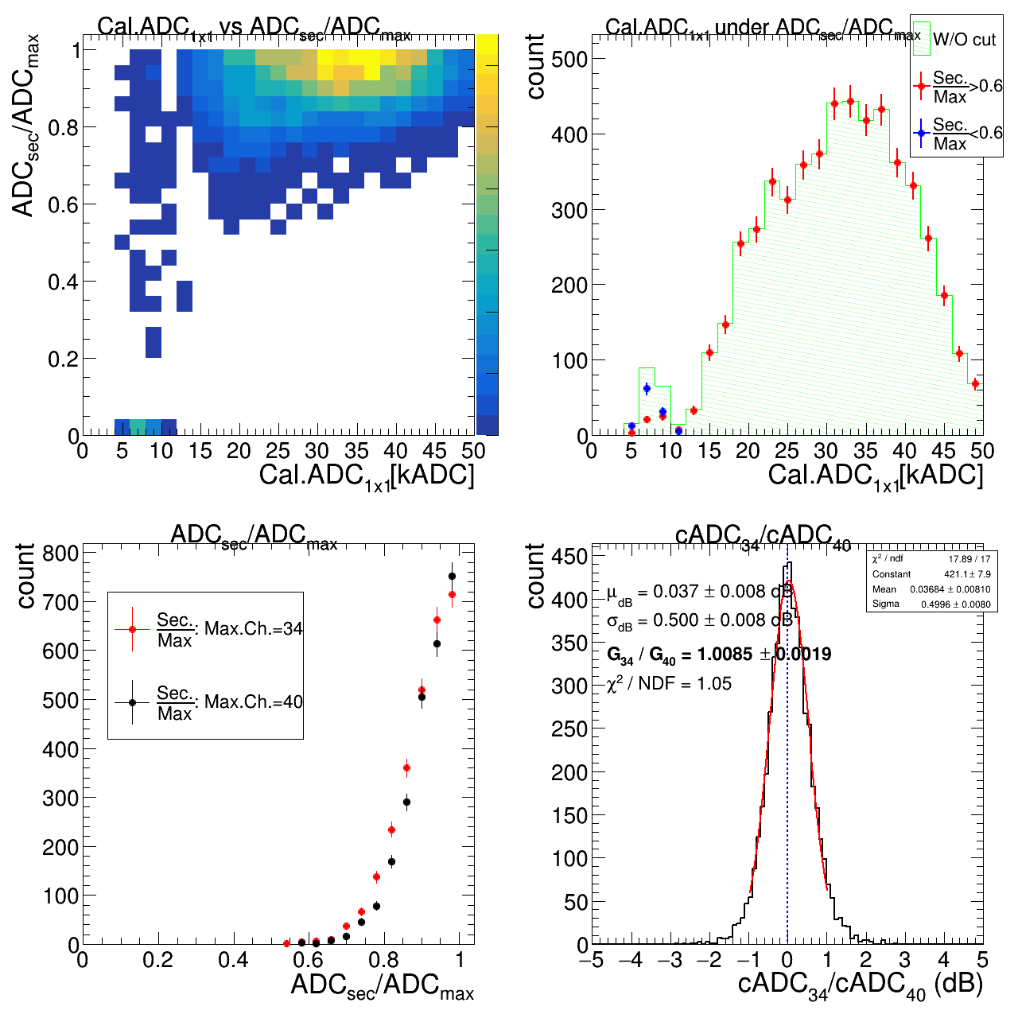
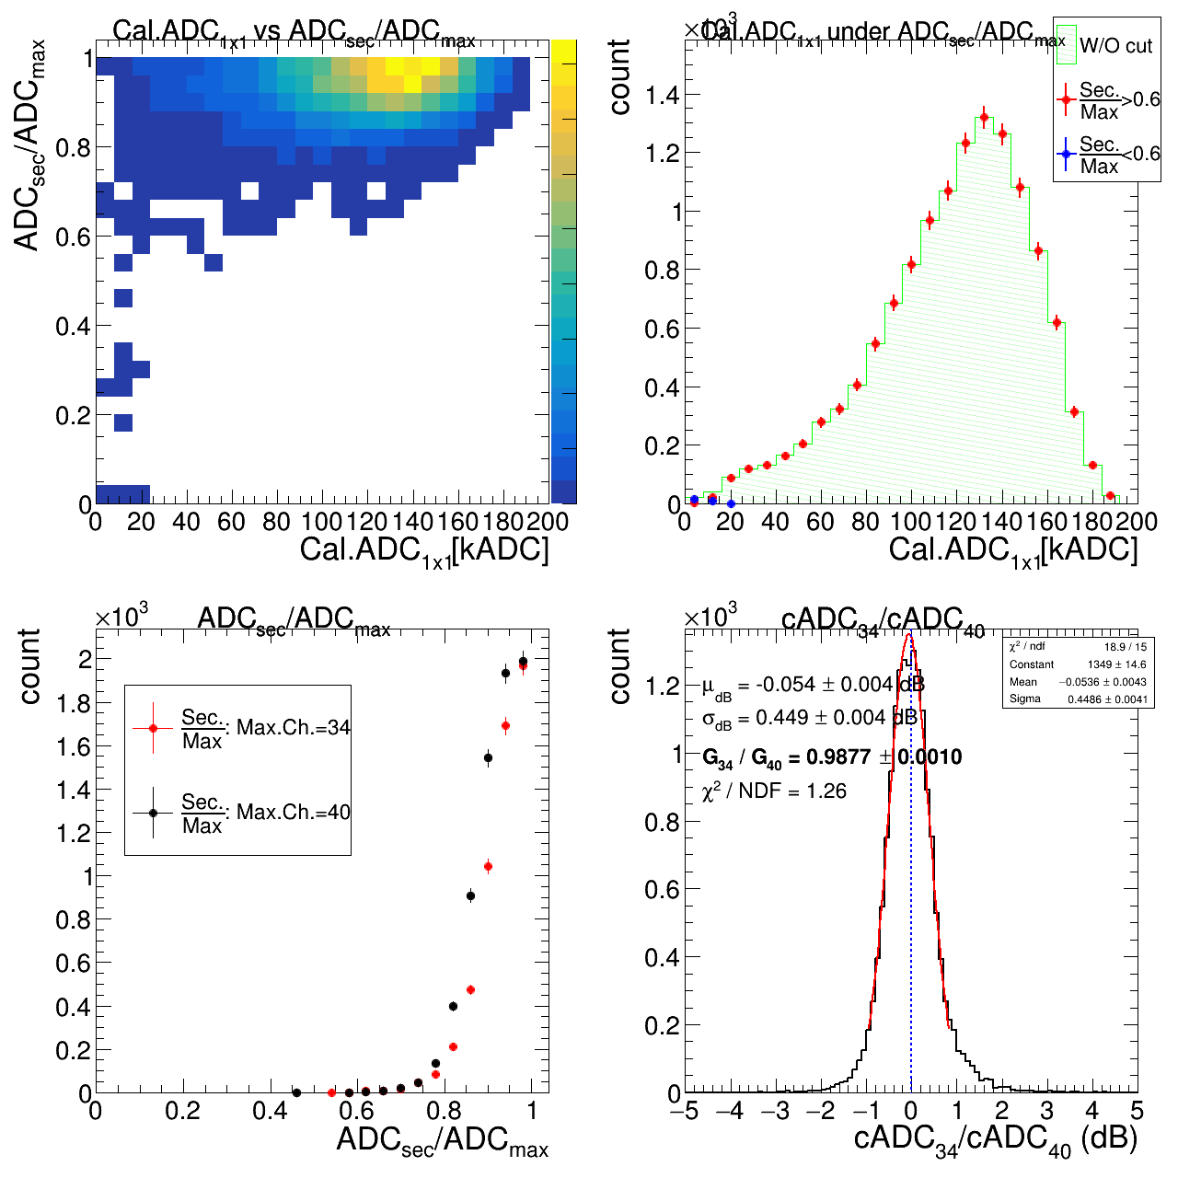
DATA 觀察雙晶片能量比例
觀察 頻道34/40(主晶體)的晶片收到的訊號強度可以觀察到前面說的20kADC問題(上列的圖)
觀察晶片頻道34/40比例變化(下列的圖) 可以觀察到頻道之間還是有些微的增益差距(模擬告訴我們需要一樣)
98
197
796

Slide 5
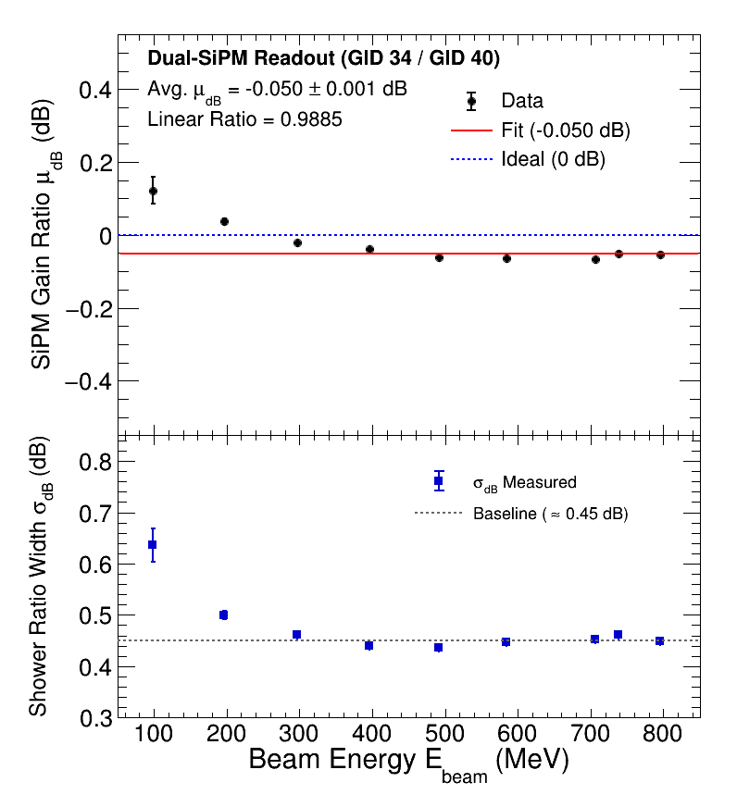
兩頻道間的差距放到模擬裡面
將兩頻道的差距放進模擬裡面有助於同步DATA/MC低能量時由於個別CUT不同對E1x1的影響
  Gain Ratio = -0.05dB = 0.9885x
將比值分布(寬度)放進MC當中有助於讓MC有更接近DATA的解析度
  Signal fluctuation width = 0.45dB = 1.1092x

Slide 6
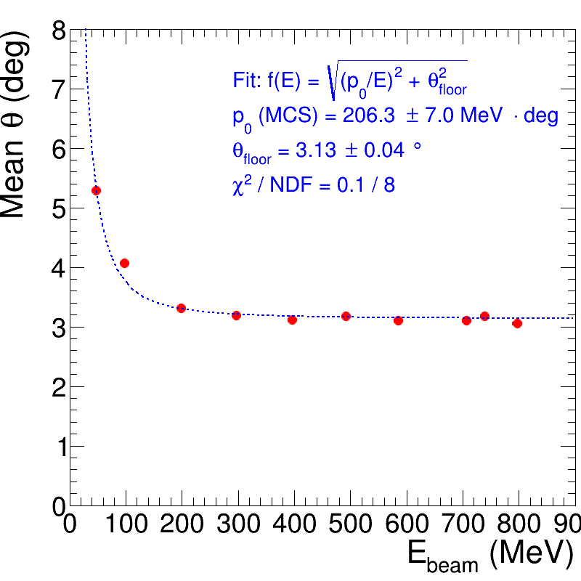
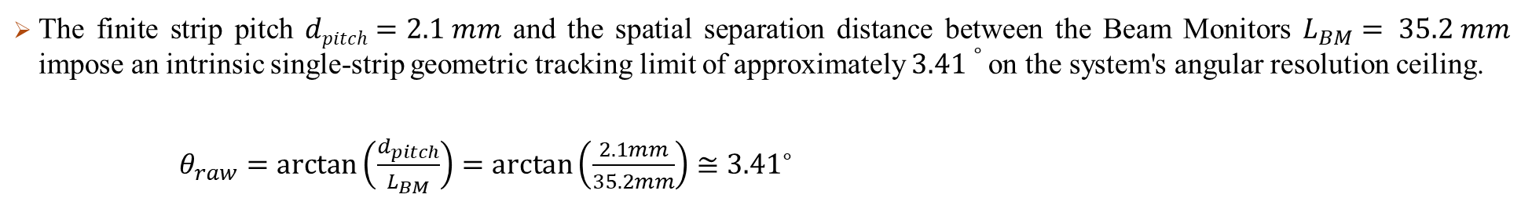
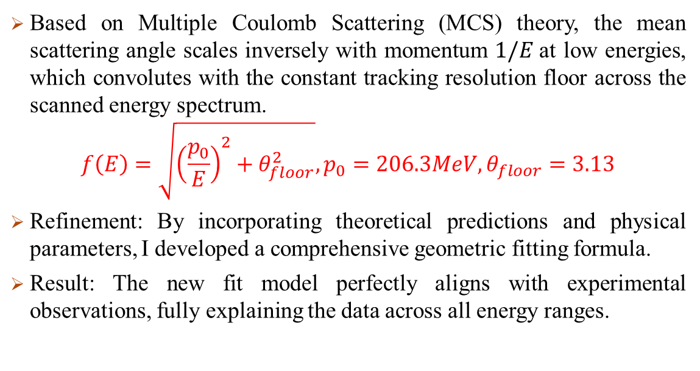
(1st BT)The beam monitor angular result problem
The finite strip pitch $dpitch=2.1 mm$ and the spatial separation distance between the Beam Monitors $L_{BM}= 35.2 mm$ impose an intrinsic single-strip geometric tracking limit of approximately $3.41∘$on the system's angular resolution ceiling.
$θ_{raw}=\arctan\left(\frac{d_{pitch}}{L_{BM}}\right)=\arctan\left(\frac{2.1mm}{35.2mm}\right)≅{3.41}^{∘}$
Based on Multiple Coulomb Scattering (MCS) theory, the mean scattering angle scales inversely with momentum $1/E$at low energies, which convolutes with the constant tracking resolution floor across the scanned energy spectrum.
$$f\left(E\right)=\sqrt{{\left(\frac{p_{0}}{E}\right)}^{2}+θ_{floor}^{2}},p_{0}=206.3MeV, θ_{floor}=3.13$$
Refinement: By incorporating theoretical predictions and physical parameters, I developed a comprehensive geometric fitting formula.
Result: The new fit model perfectly aligns with experimental observations, fully explaining the data across all energy ranges.

