Slide 1
ECal 3rd Prototype
Beam Test Analysis
Yen-Chen Wu
Dept. Physics, National Central University
2026/09/09

Slide 2
Energy Resolution Analysis Approach
ADC raw max
ADC max after fitting
ADC waveform integration
TOT
TOA
check resolution of E1x1, E3x3, E4x4, E1x1/E3x3, E1x1/E4x4, E3x3/E4x4 with all variables to find the one give the best resolution
apply different cut, TOT, TOA, event matching to see if resolution improved

Slide 3
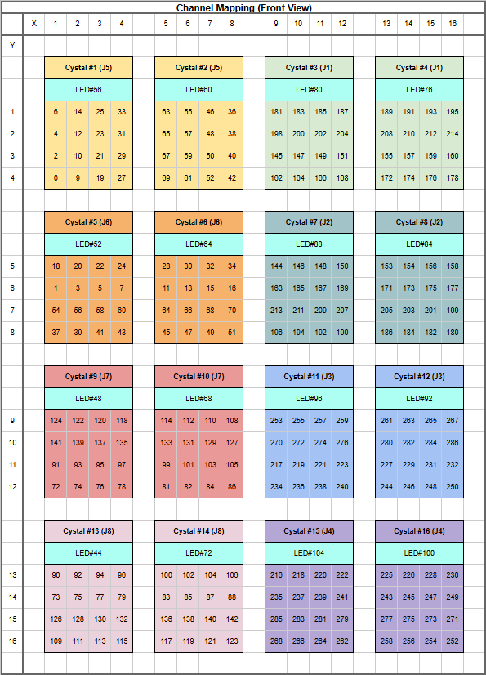
Target run
Channel Mapping
Run 421~434,481,482 @ HV=45V, C=0xA
Positron beam shoot at Crystal 7
Event selection need to be done with tracking from BM 3&4.
However, tracking requires event matching between BM and PbWO4 beforehand, which I will learn later.
My first try will not include tracking & event selection.
Crystal 7
Energy resolution of:
1 X 1,
3 X 3,
crystal clustering
will be studied

Slide 4
Crystal status overview
abnormal channels appear in same channel across different run
All channels have basically the same waveform pattern in the same event.
All channels in crystal#3,4,7,10,11 function well.
Problems:
dead channels are found in (exclude in later analysis)
crystal#2 : 63, 40, 52, 42 (4 dead)
crystal#6: 64, 45, 47, 49, 51 (5 dead)
crystal#8: 173, 175 (2 dead)
crystal#12: 284, 286, 231, 250 (4 dead)
Abnormal waveform pattern found in
crystal#2,6,8,12
Those channels are simply excluded in the analysis
Well-function crystal
3 4
7
10 11

Slide 5
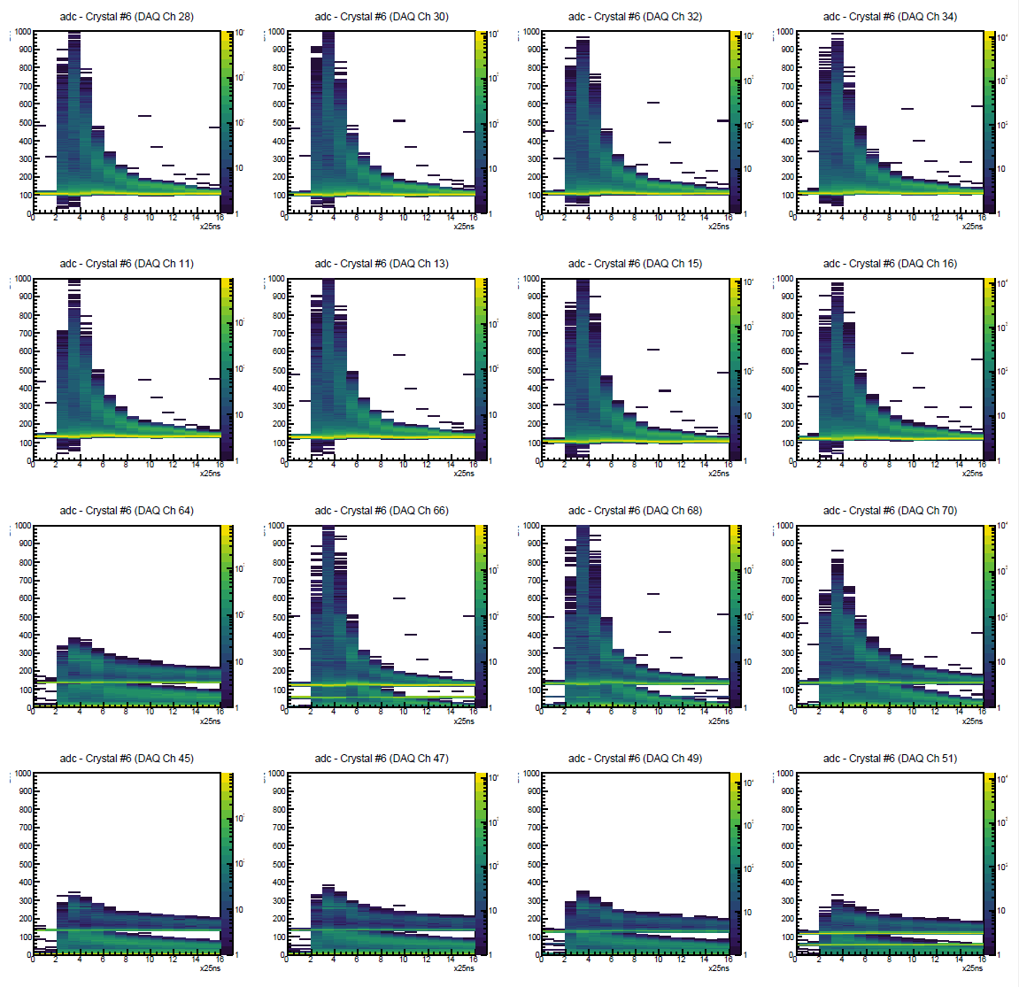
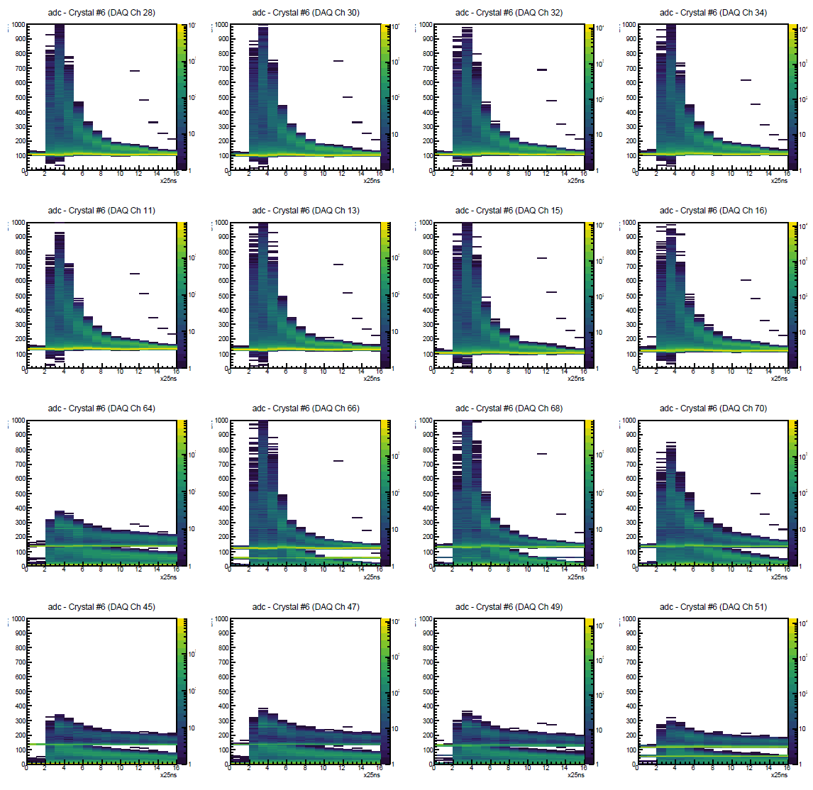
Run481 vs. Run482: crystal#6
Run#481 Crystal#6
Run#482 Crystal#6
Ch#63
Ch#66 Ch#68 Ch#70
Ch#63
Ch#66 Ch#68 Ch#70
Ch#45
Ch#47
Ch#49
Ch#51
Ch#45
Ch#47
Ch#49
Ch#51
crystal#6: 64, 45, 47, 49, 51 (5 dead)
Upper half of the channel have no problem.
abnormal channels appear in same channel across different run

Slide 6
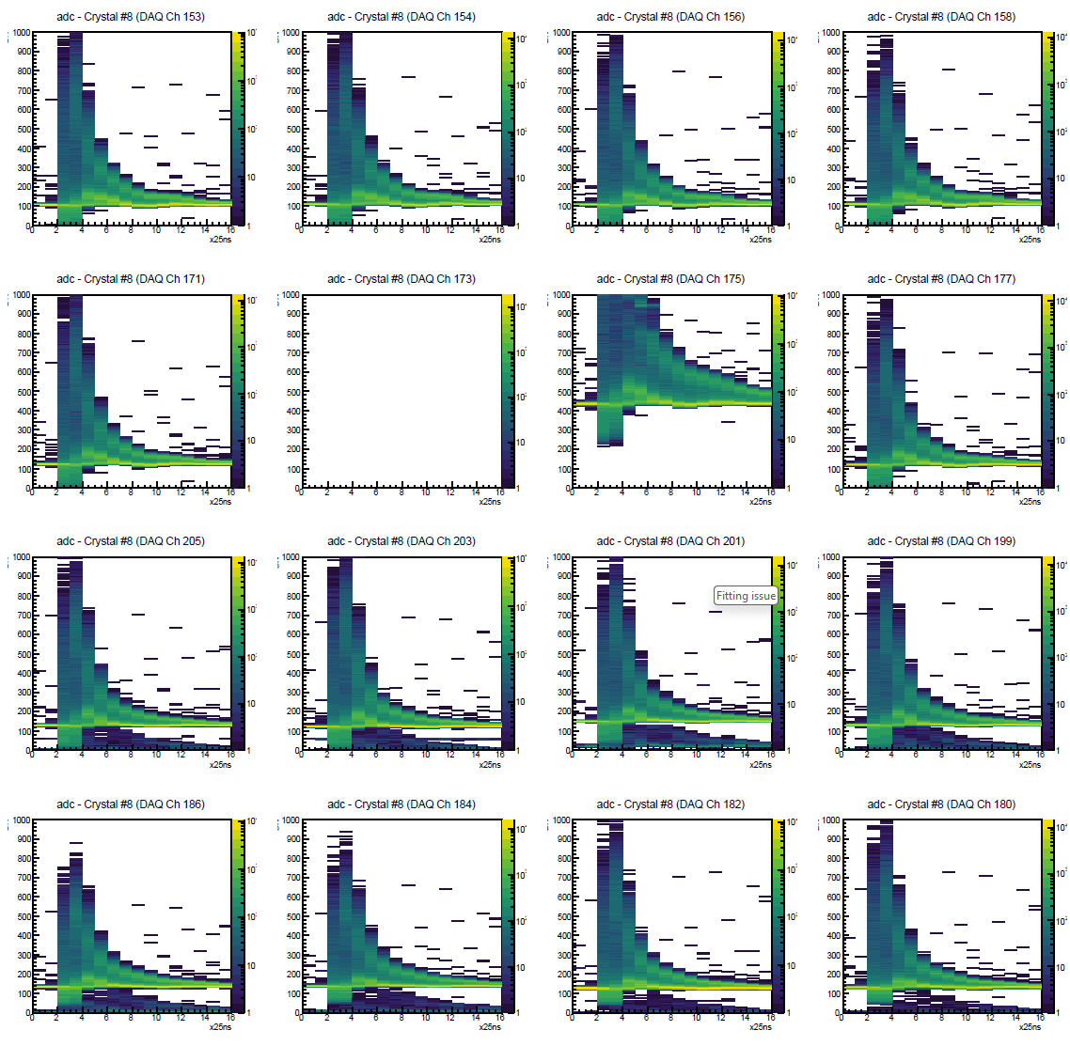
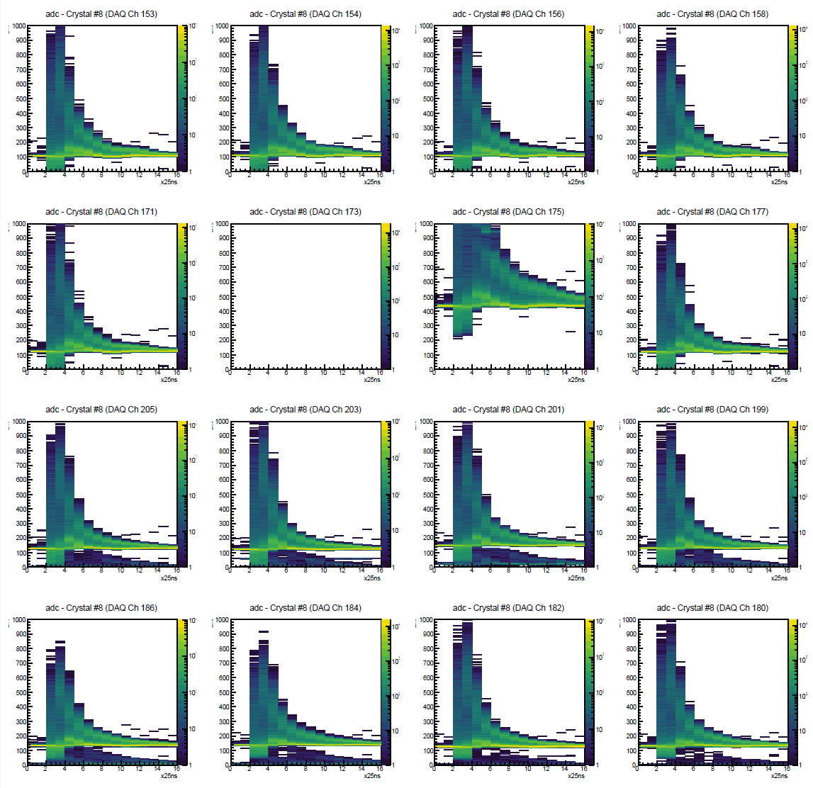
Run481 vs. Run482: crystal#8
Run#481 Crystal#8
Run#482 Crystal#8
Ch#173
Ch#175
Ch#173
Ch#175
crystal#8: 173, 175 (2 dead)
Other channels have no problem.
abnormal channels appear in same channel across different run

Slide 7
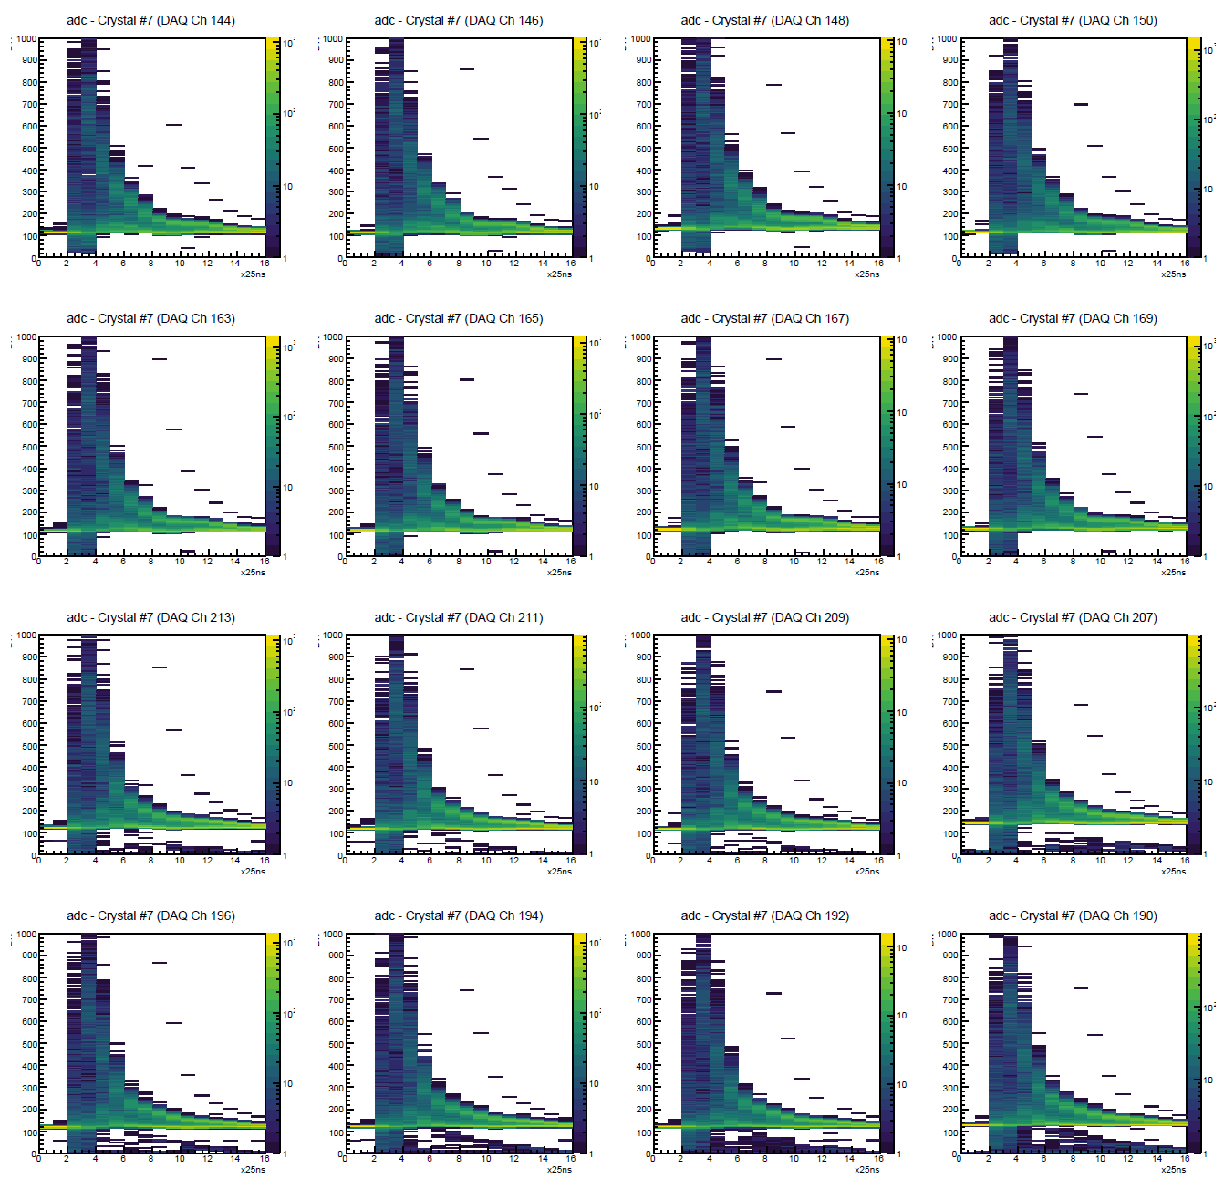
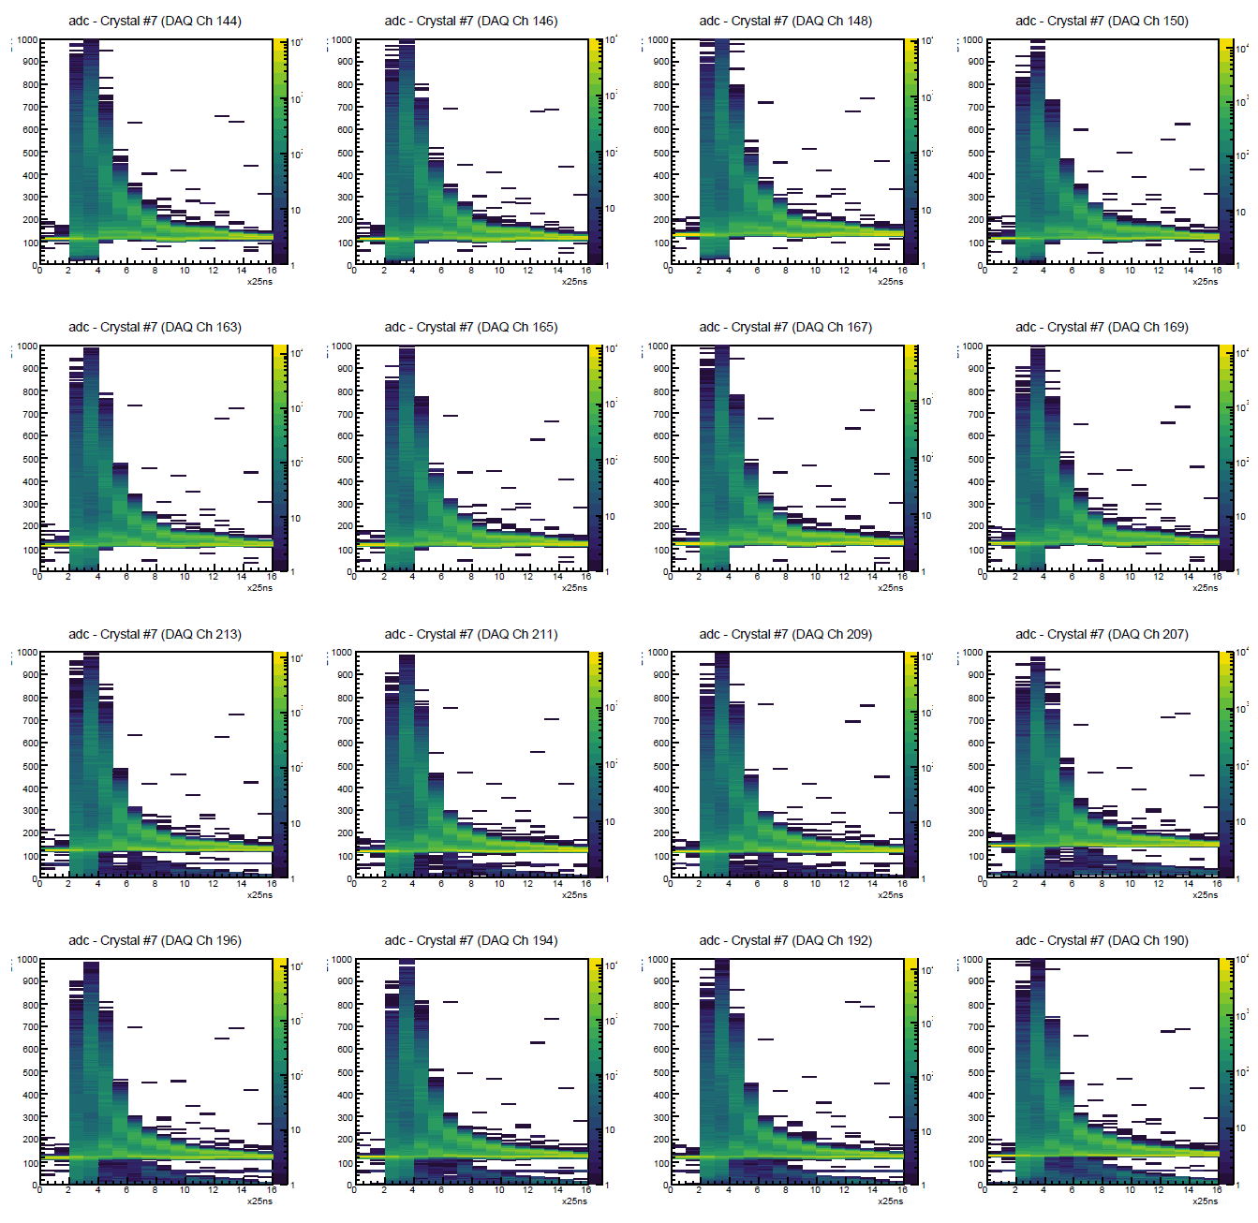
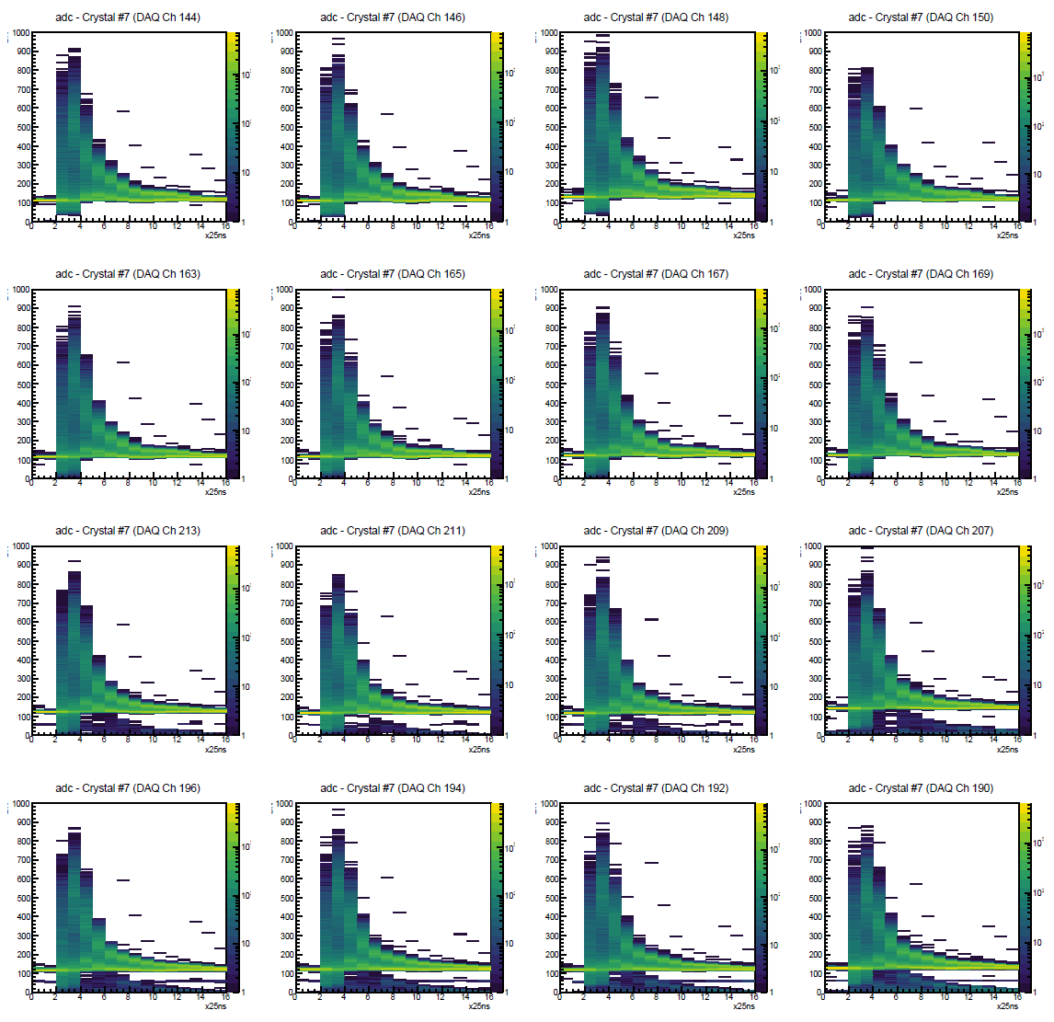
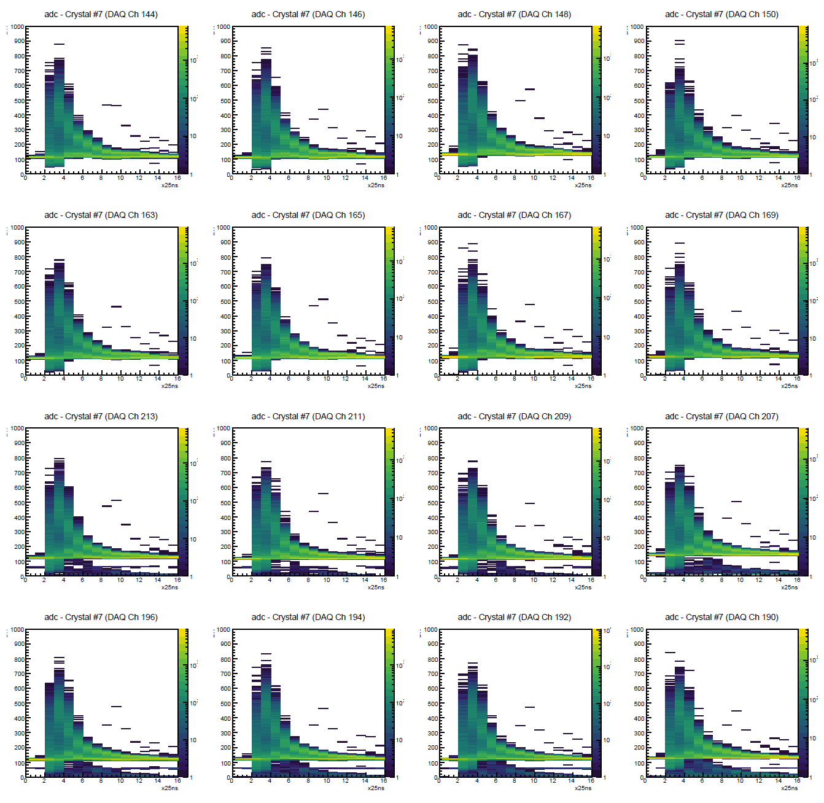
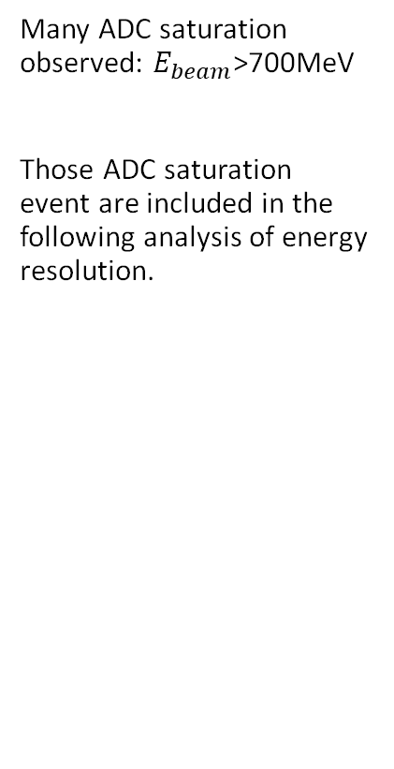
ADC saturation issue
Beam energy: 823 MeV
Beam energy: 705 MeV
Run 422
Run
481
Many ADC saturation observed: $E_{beam}$>700MeV
Those ADC saturation event are included in the following analysis of energy resolution.
Beam energy: 584 MeV
Beam energy: 492 MeV
Run
423
Run
425

Slide 8
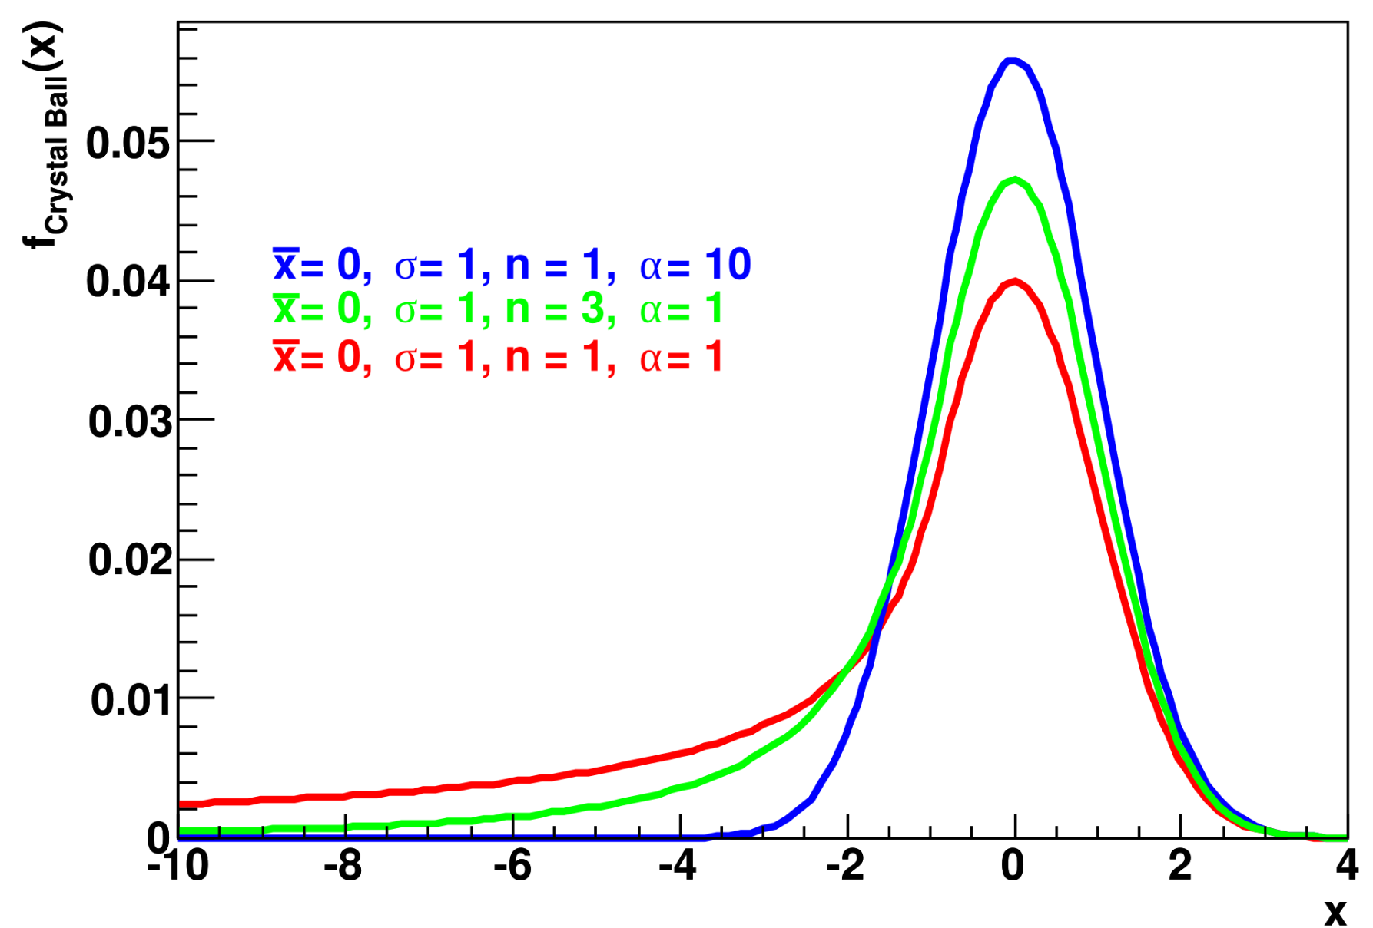
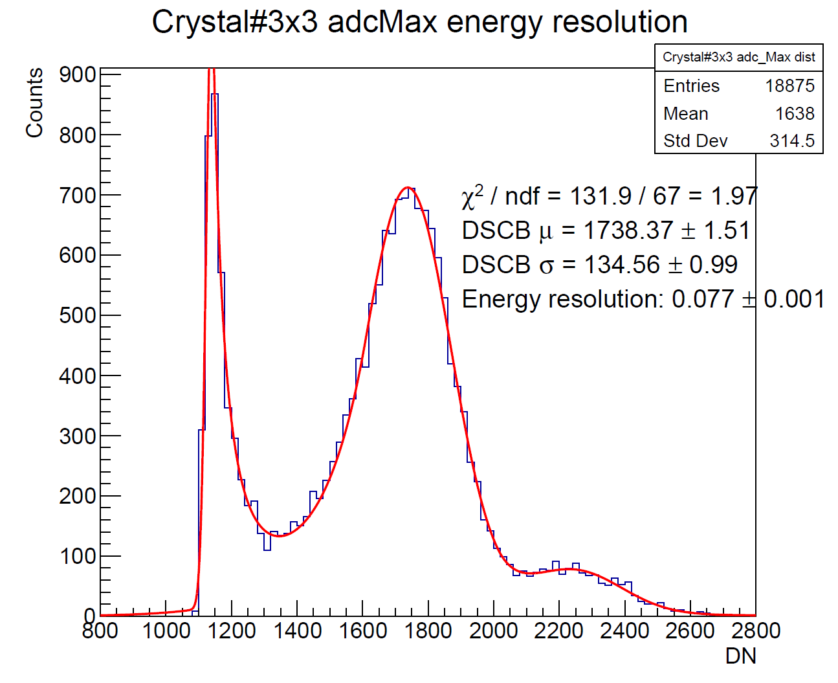


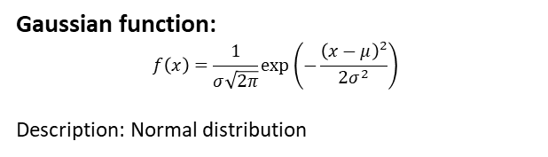
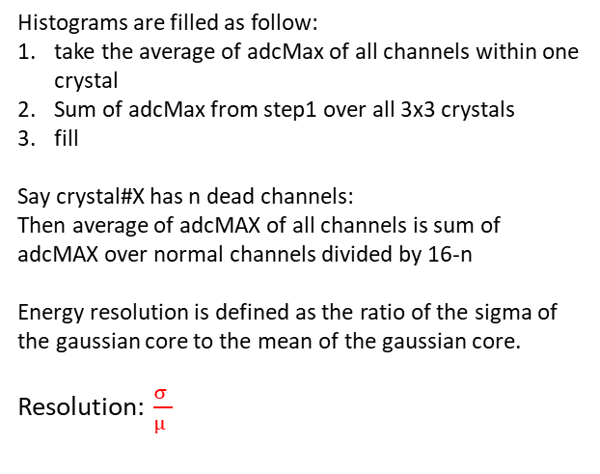
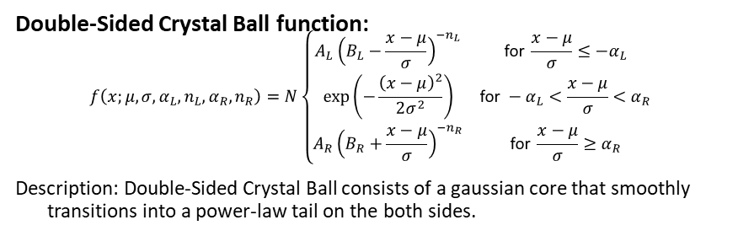
Fitting functions
DSCB
Double-Sided Crystal Ball function:
$$f\left(x;μ,σ,α_{L},n_{L},α_{R},n_{R}\right)=N\left\{\begin{matrix}A_{L}{\left(B_{L}−\frac{x−μ}{σ}\right)}^{−n_{L}} & \text{for }\frac{x−μ}{σ}≤−α_{L} \\ \exp\left(−\frac{{\left(x−μ\right)}^{2}}{2σ^{2}}\right) & \text{for }−α_{L}<\frac{x−μ}{σ}<α_{R} \\ A_{R}{\left(B_{R}+\frac{x−μ}{σ}\right)}^{−n_{R}} & \text{for }\frac{x−μ}{σ}≥α_{R}\end{matrix}\right.$$
Description: Double-Sided Crystal Ball consists of a gaussian core that smoothly transitions into a power-law tail on the both sides.
Gaussian function:
$$f\left(x\right)=\frac{1}{σ\sqrt{2π}}\exp\left(−\frac{{\left(x−μ\right)}^{2}}{2σ^{2}}\right)$$
Description: Normal distribution
Resolution definition
Histograms are filled as follow:
take the average of adcMax of all channels within one crystal
Sum of adcMax from step1 over all 3x3 crystals
fill
Say crystal#X has n dead channels:
Then average of adcMAX of all channels is sum of adcMAX over normal channels divided by 16-n
Energy resolution is defined as the ratio of the sigma of the gaussian core to the mean of the gaussian core.
Resolution: $\frac{σ }{μ }$
DSCB
$$μ$$
DSCB
$$σ$$
Gaussian
Pedestal peak should be fit as Gaussian by prof Guo

Slide 9
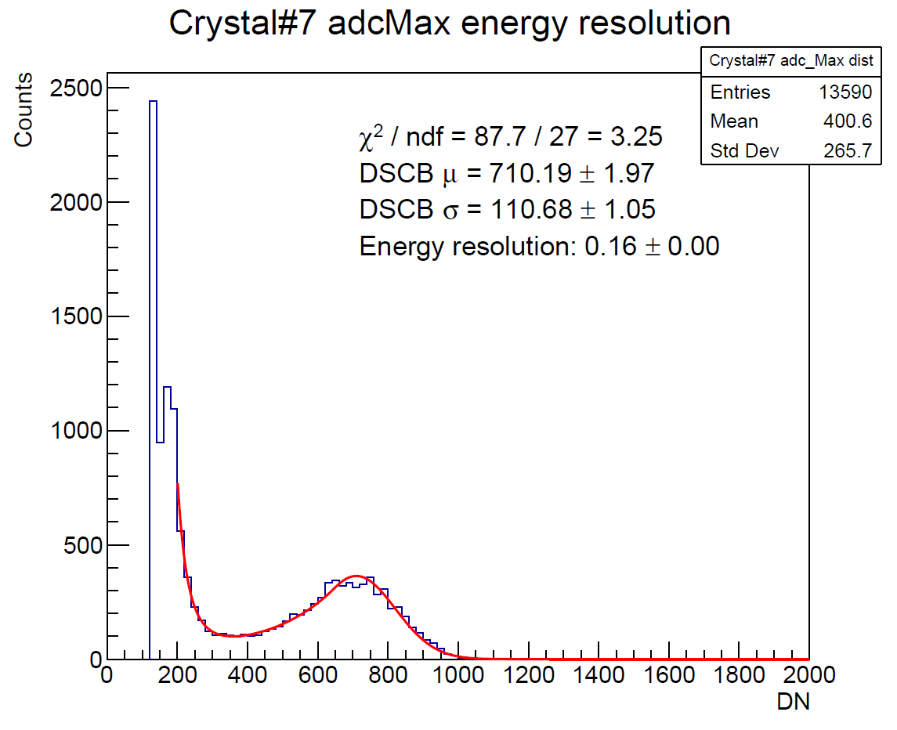
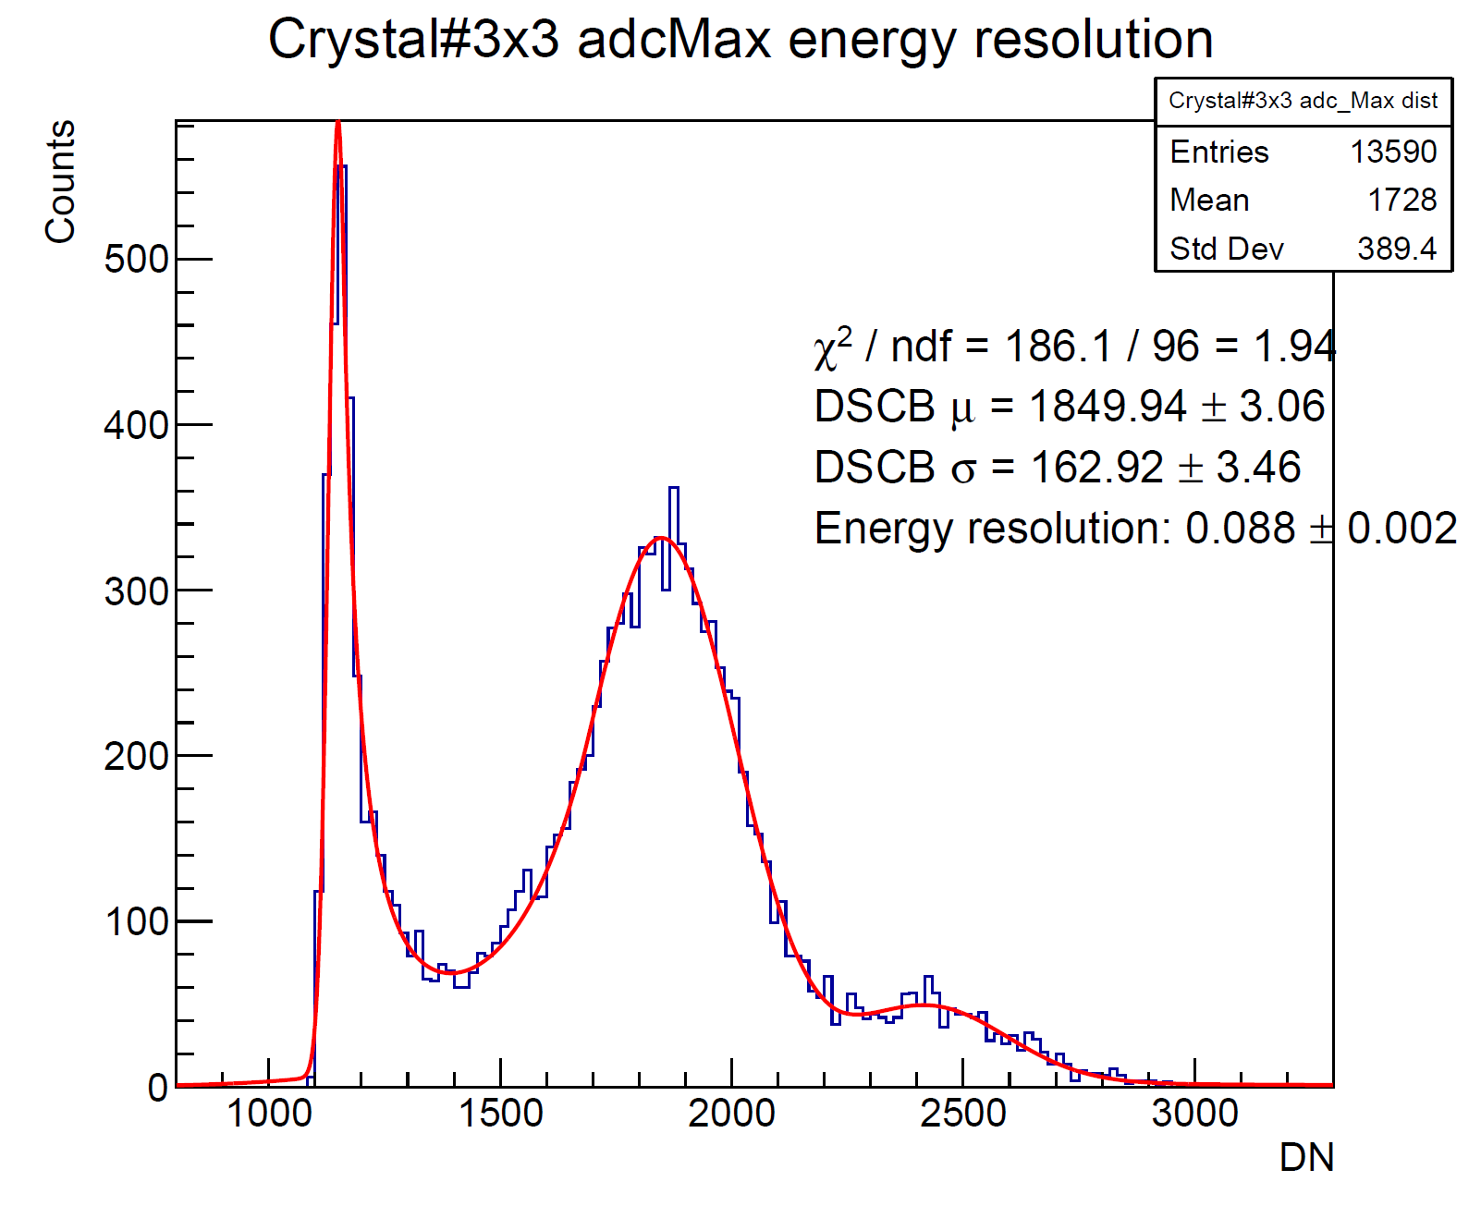
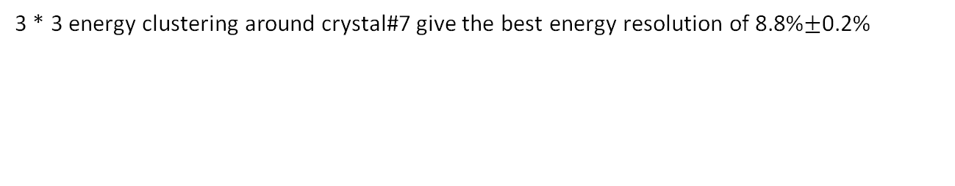

Run#421 energy resolution adcMax
Beam energy: 823MeV
1*1 Crystal#7 (beam center)
3*3 Crystal
ADC
ADC
Energy resolution: 16%
Energy resolution: 8.8%$±$0.2%
3 * 3 energy clustering around crystal#7 give the best energy resolution of 8.8%$±$0.2%

Slide 10
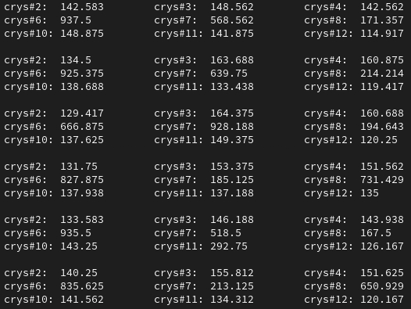
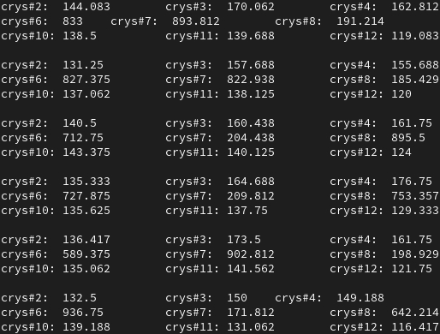
Second peak?
This is one event
If sum over 3x3 crystals adcMax average > 2500
Second peak happens when two crystals fire simultaneously?

Slide 11
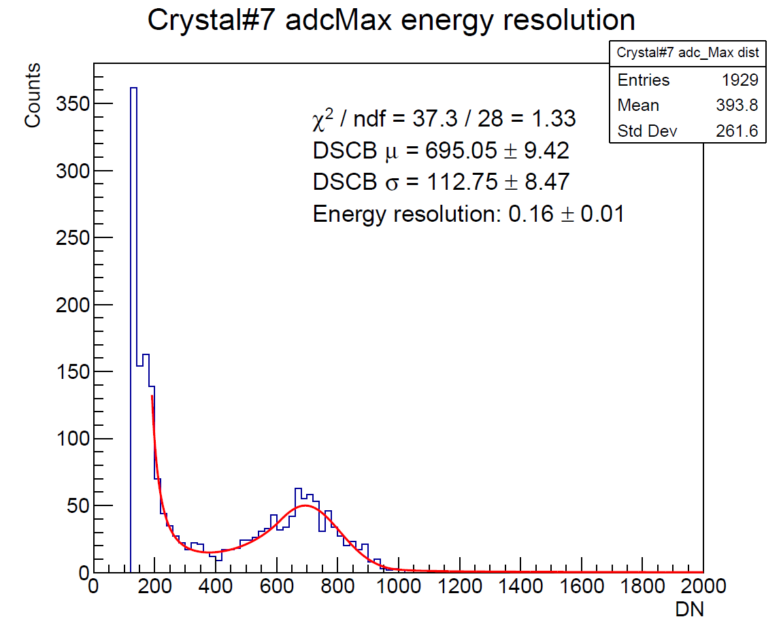
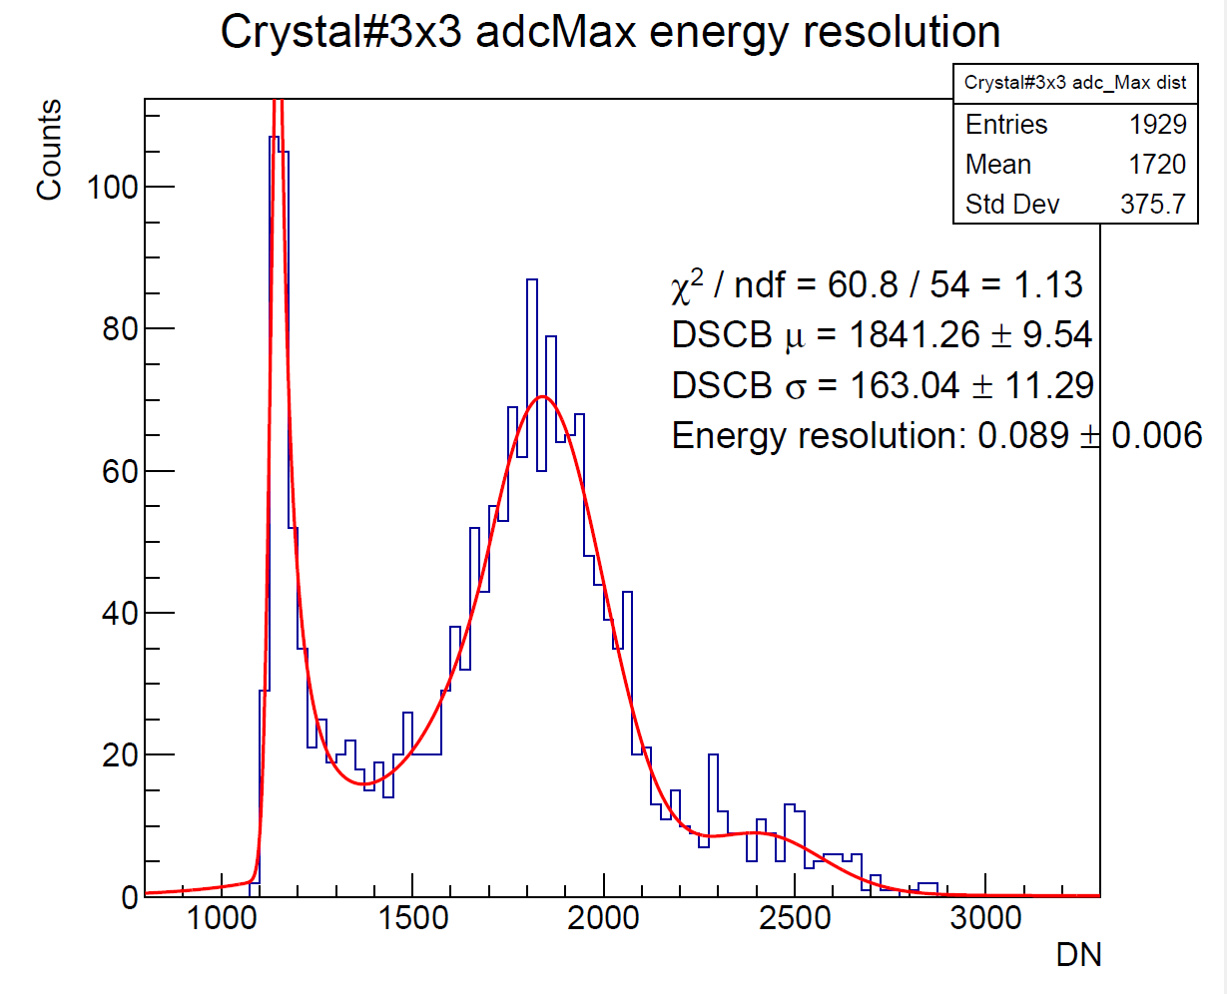
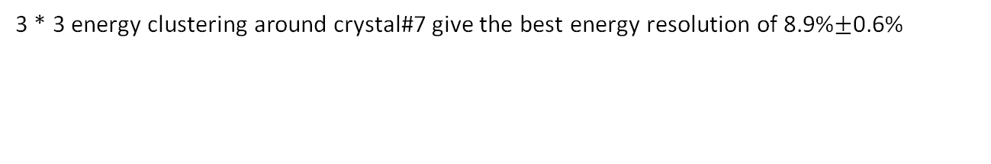


Run#422 energy resolution adcMax
Beam energy: 823MeV
1*1 Crystal#7 (beam center)
3*3 Crystal
ADC
ADC
Energy resolution: 16%$±$0.1%
Energy resolution: 8.9%$±$0.6%
There are only 1929 events in Run#422
3 * 3 energy clustering around crystal#7 give the best energy resolution of 8.9%$±$0.6%

Slide 12
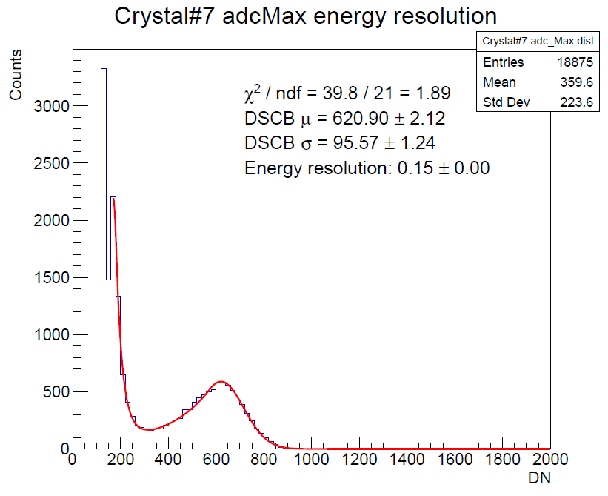
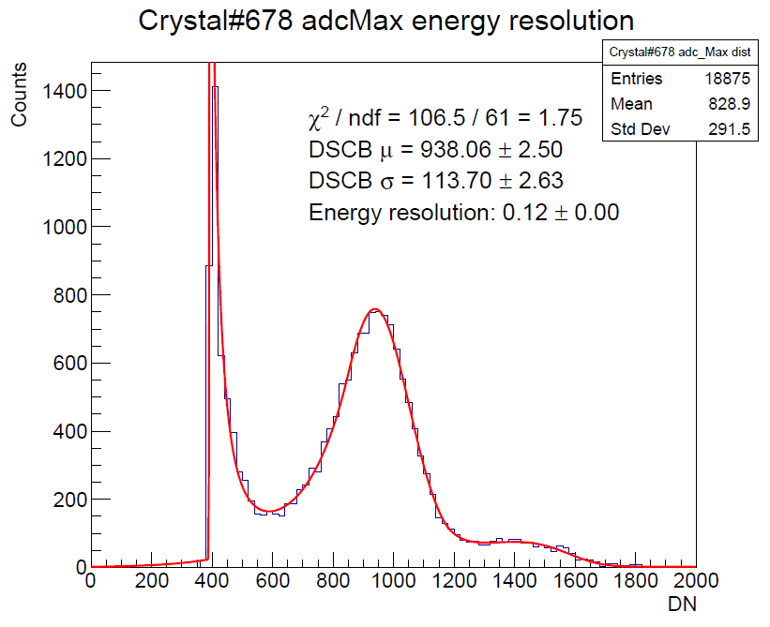

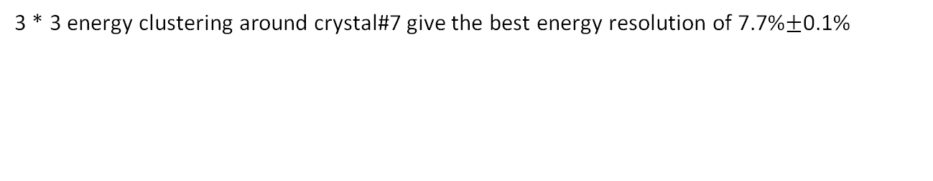
Run#481 energy resolution adcMax
Beam energy: 705MeV
1*1 Crystal#7 (beam center)
Crystal#6,7,8
3*3 Crystal
ADC
ADC
ADC
Energy resolution: 15%
Energy resolution: 12%
Energy resolution: 7.7%$±$0.1%
3 * 3 energy clustering around crystal#7 give the best energy resolution of 7.7%$±$0.1%

Slide 13
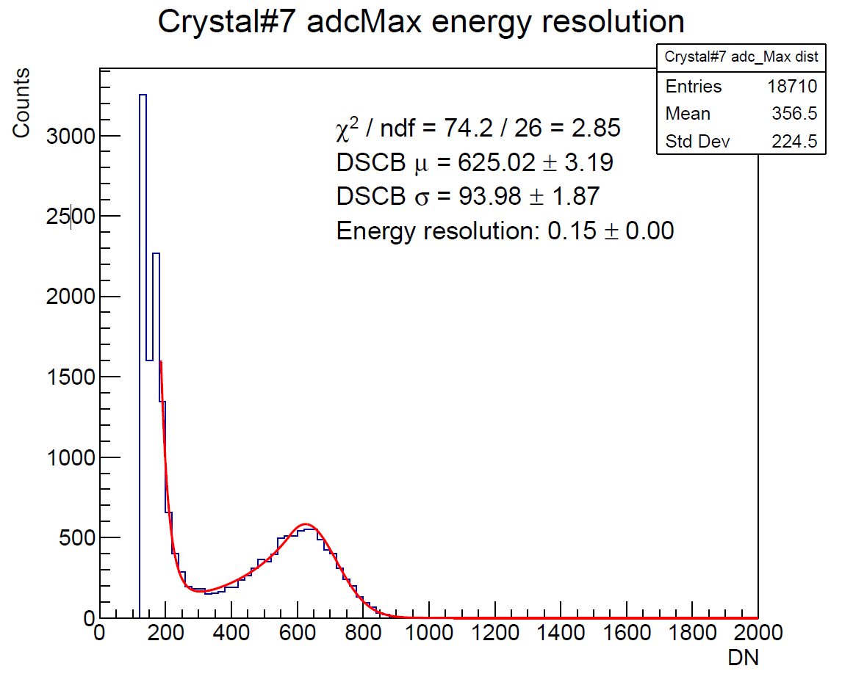
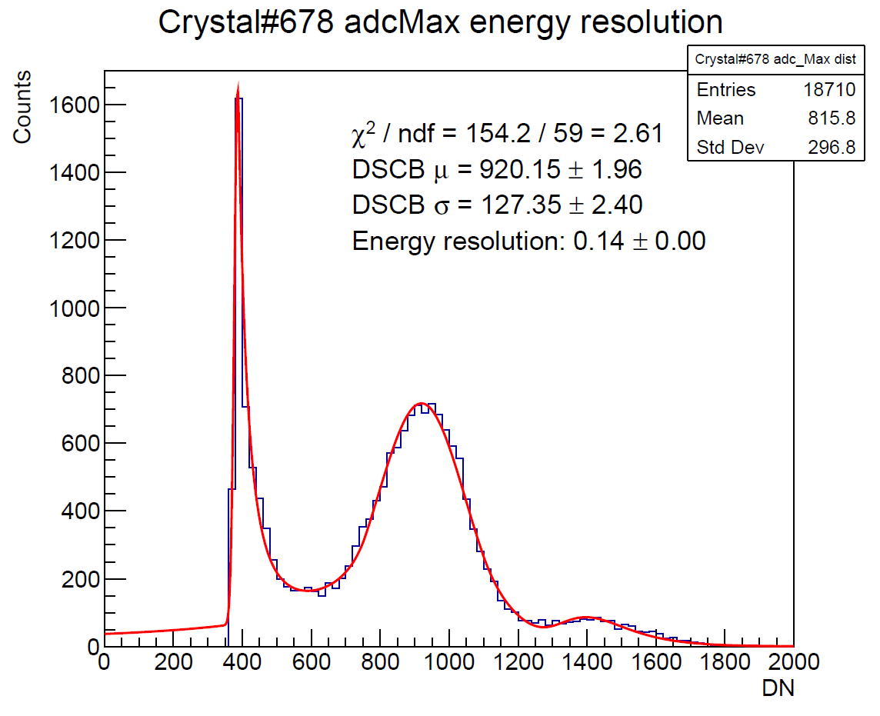
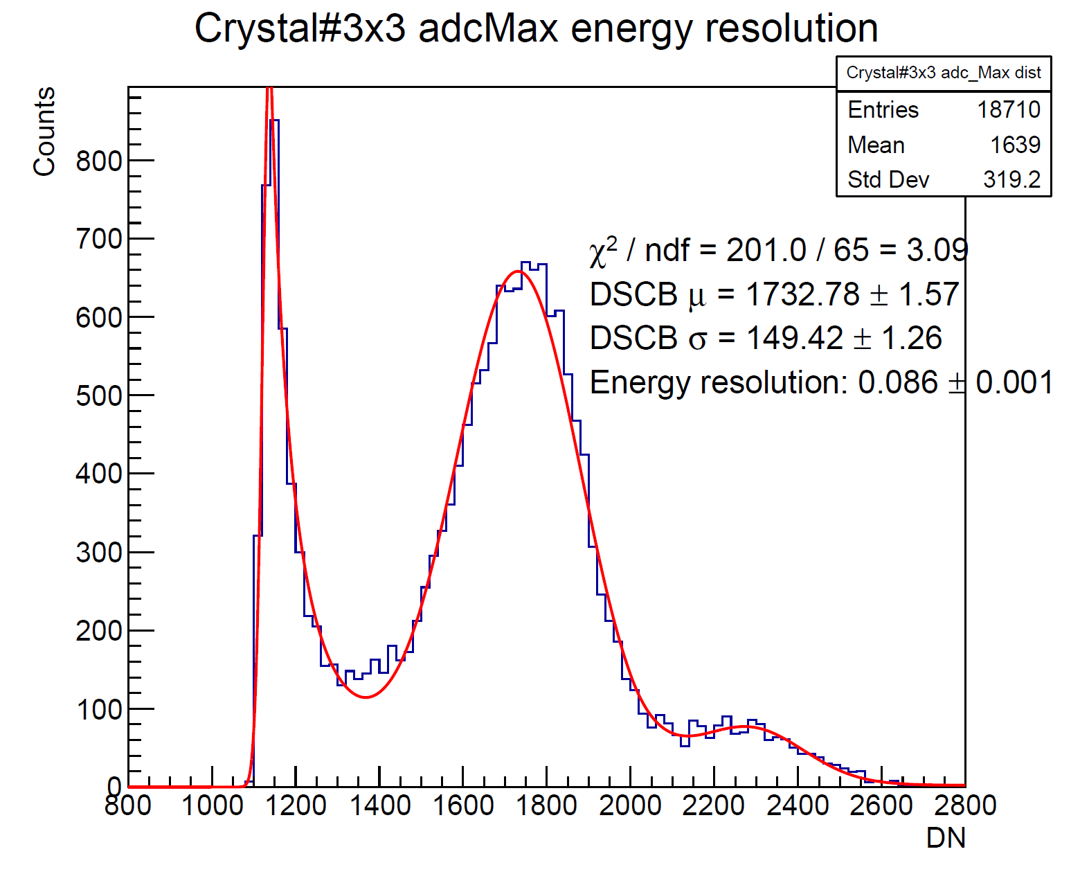

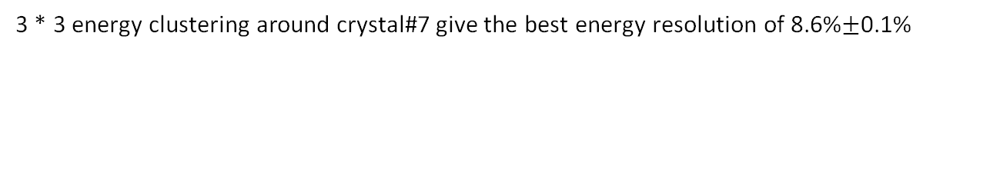
Run#482 energy resolution adcMax
Beam energy: 705MeV
1*1 Crystal#7 (beam center)
Crystal#6,7,8
3*3 Crystal
ADC
ADC
ADC
Energy resolution: 15%
Energy resolution: 14%
Energy resolution: 8.6%$±$0.1%
3 * 3 energy clustering around crystal#7 give the best energy resolution of 8.6%$±$0.1%

Slide 14
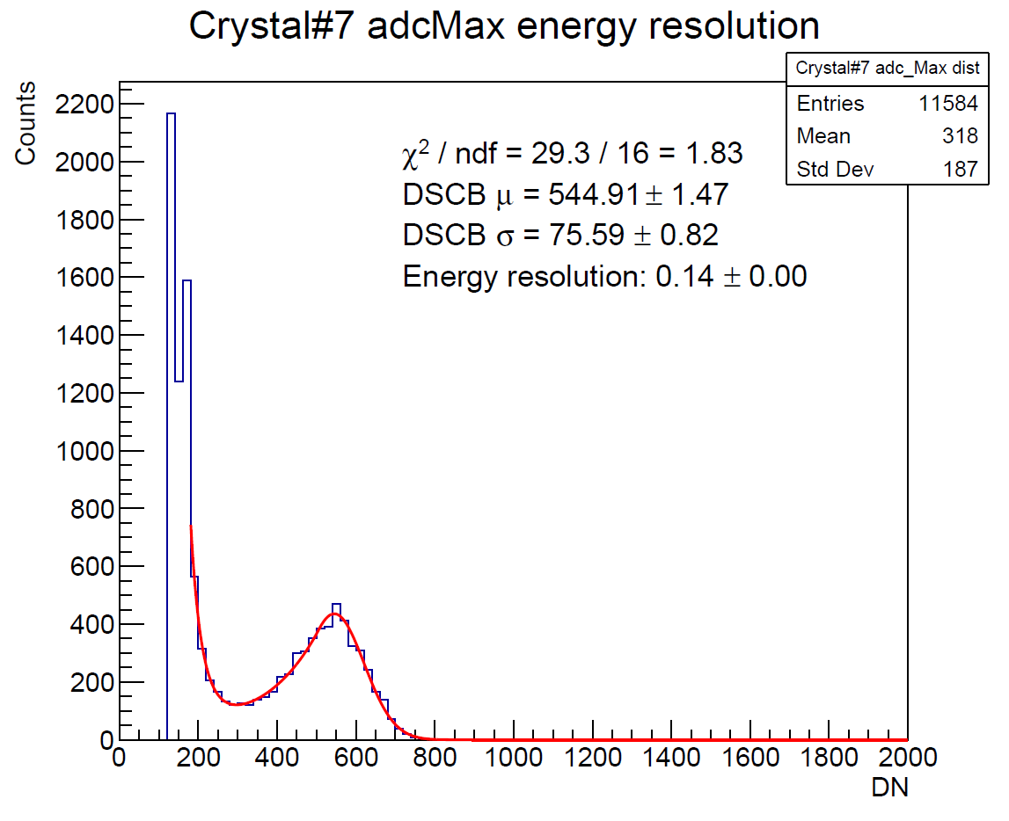
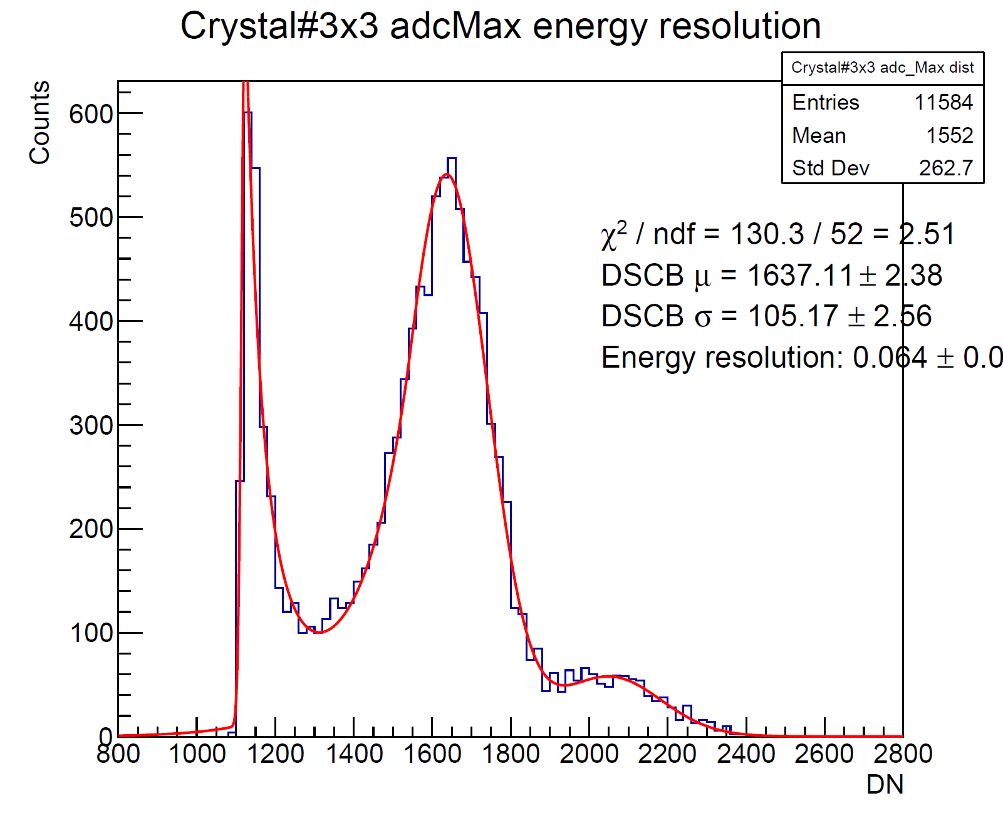
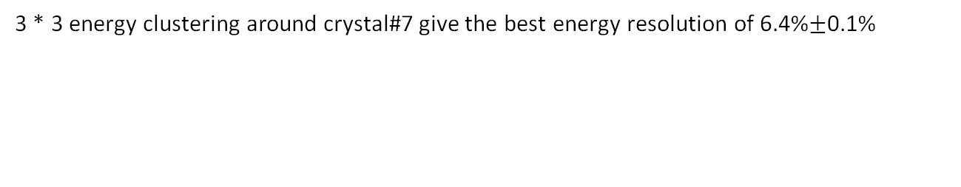
Run#423 energy resolution adcMax
Beam energy: 584MeV
1*1 Crystal#7 (beam center)
3*3 Crystal
ADC
ADC
Energy resolution: 14%
Energy resolution: 6.4%$±$0.1%
3 * 3 energy clustering around crystal#7 give the best energy resolution of 6.4%$±$0.1%

Slide 15
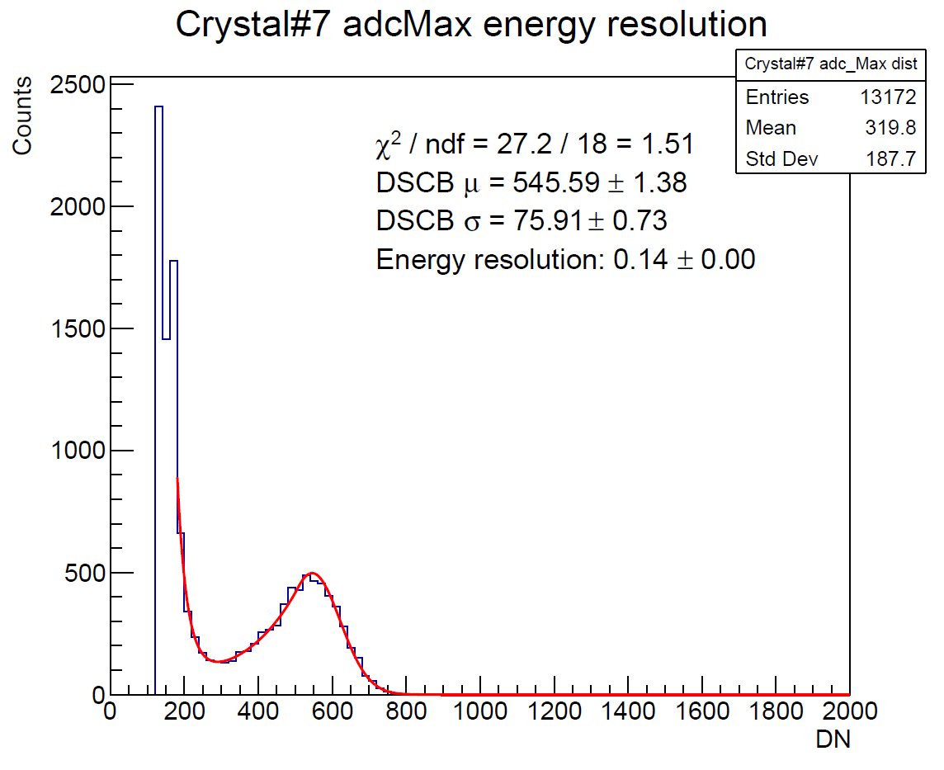
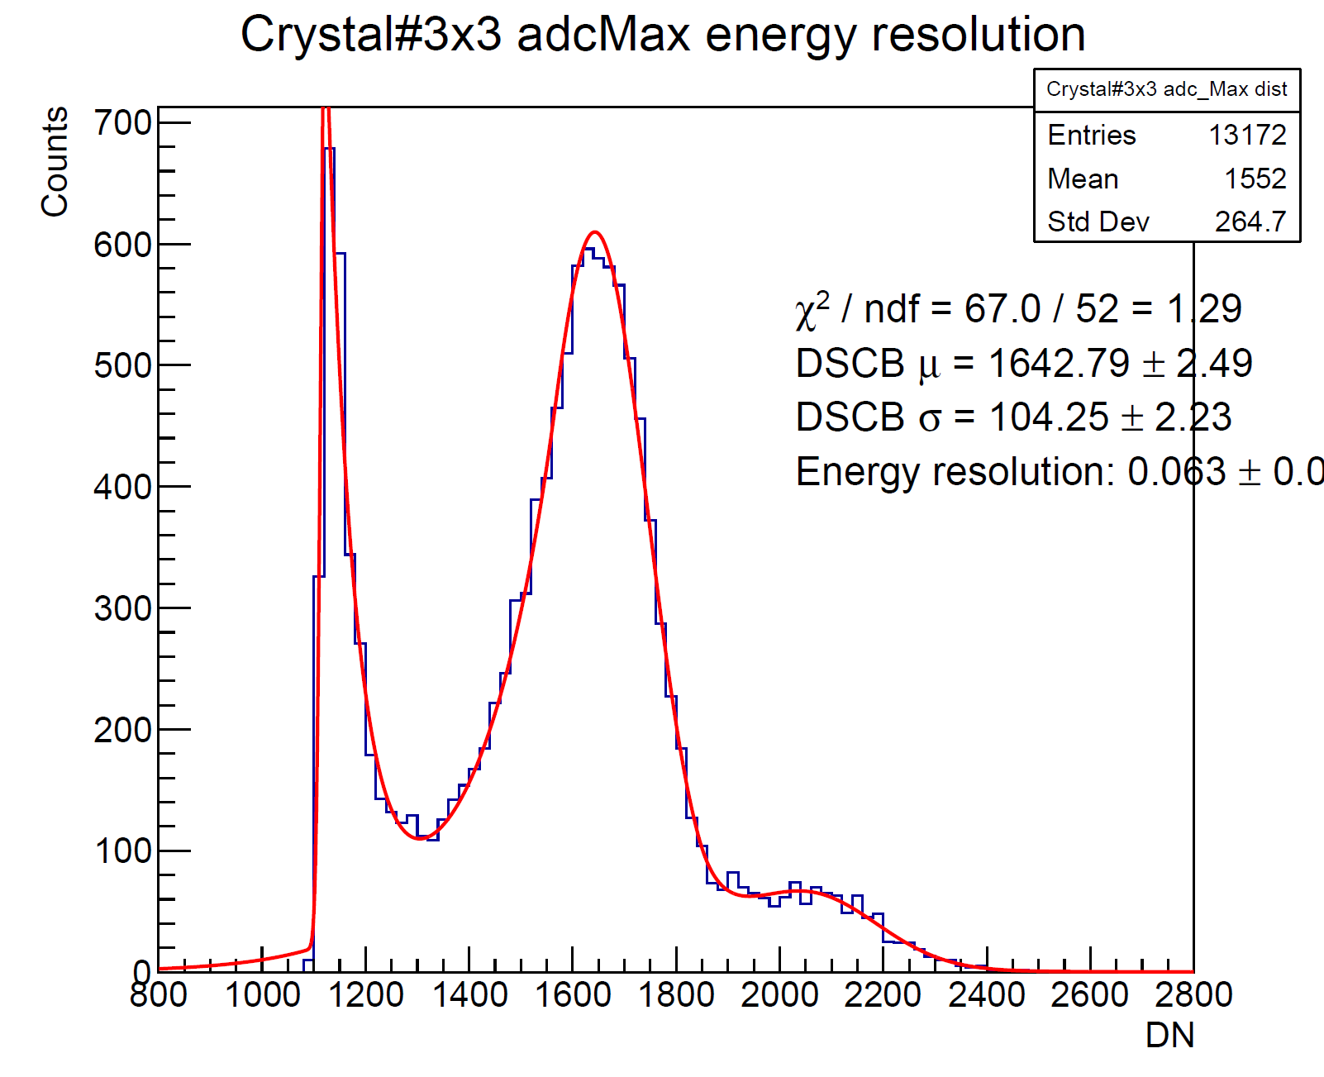
Run#424 energy resolution adcMax
Beam energy: 584MeV
1*1 Crystal#7 (beam center)
3*3 Crystal
ADC
ADC
Energy resolution: 14%
Energy resolution: 6.3%
3 * 3 energy clustering around crystal#7 give the best energy resolution of 6.3%

Slide 16
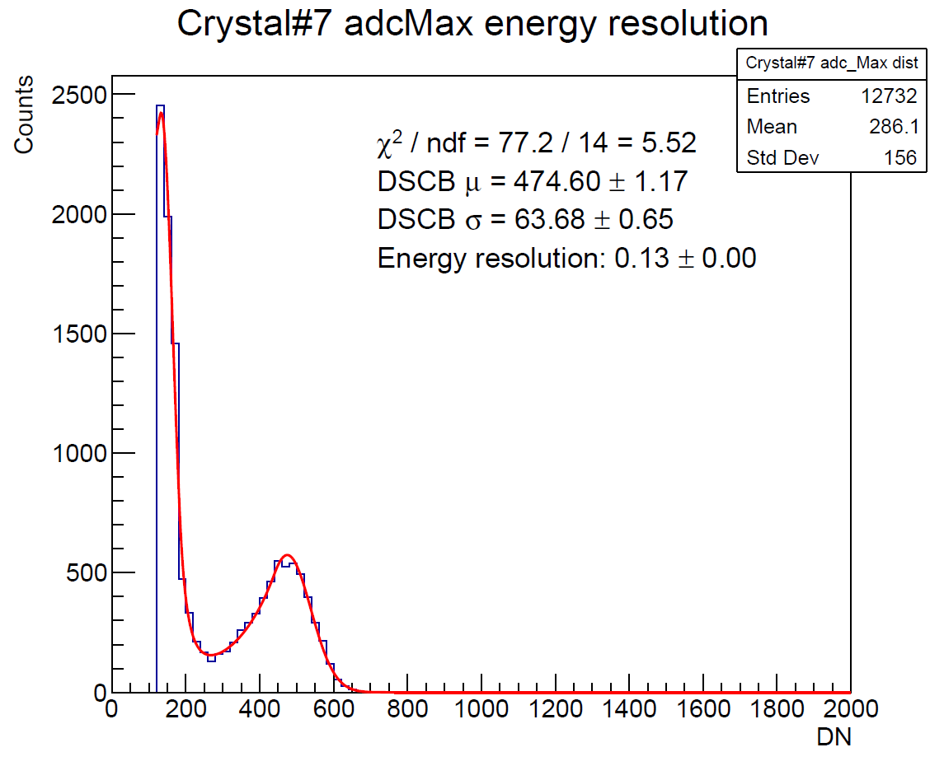
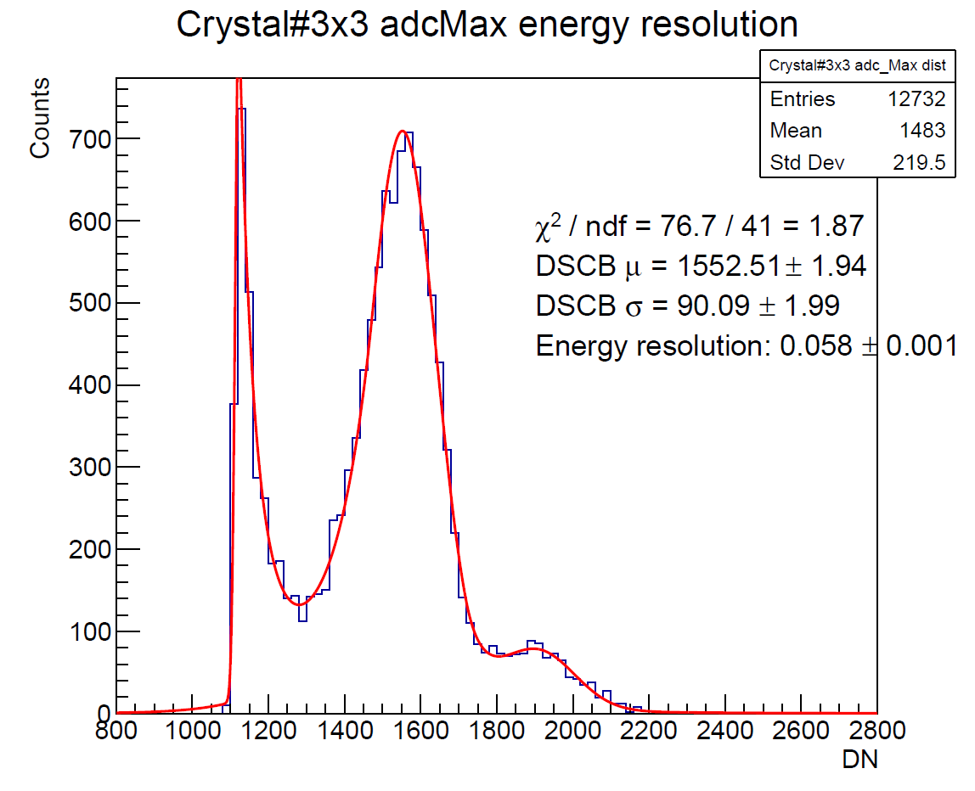

Run#425 energy resolution adcMax
Beam energy: 492MeV
1*1 Crystal#7 (beam center)
3*3 Crystal
ADC
ADC
Energy resolution: 013%
Energy resolution: 5.8%$±$0.1%
3 * 3 energy clustering around crystal#7 give the best energy resolution of 6.3%

Slide 17

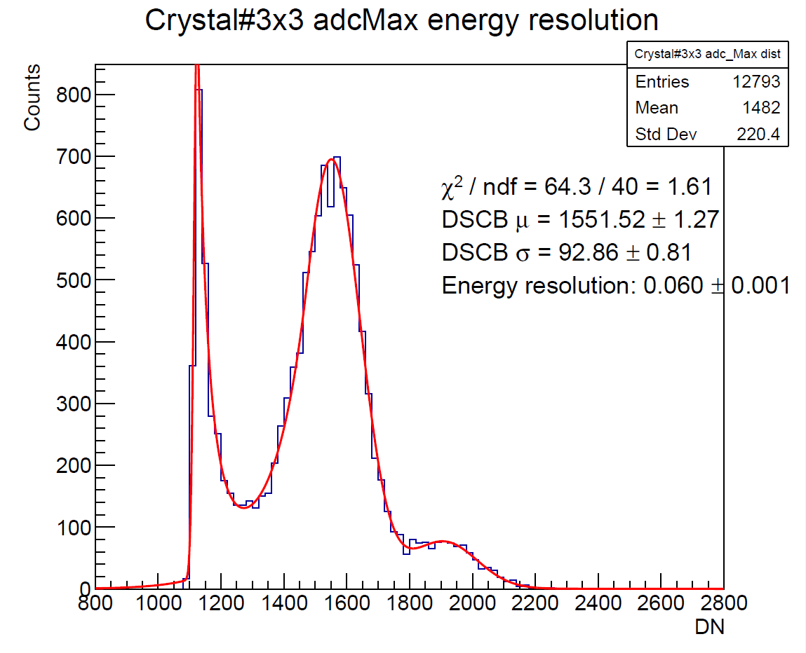
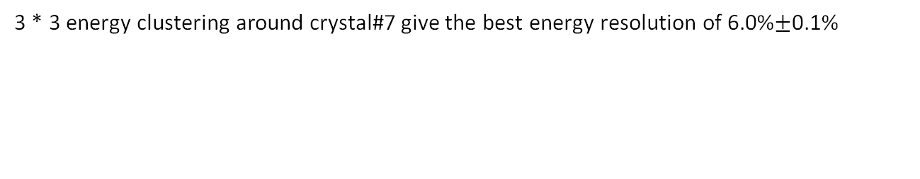

Run#426 energy resolution adcMax
Beam energy: 429MeV
1*1 Crystal#7 (beam center)
3*3 Crystal
ADC
ADC
Energy resolution: 13%
Energy resolution: 6.0%$±$0.1%
3 * 3 energy clustering around crystal#7 give the best energy resolution of 6.0%$±$0.1%

Slide 18
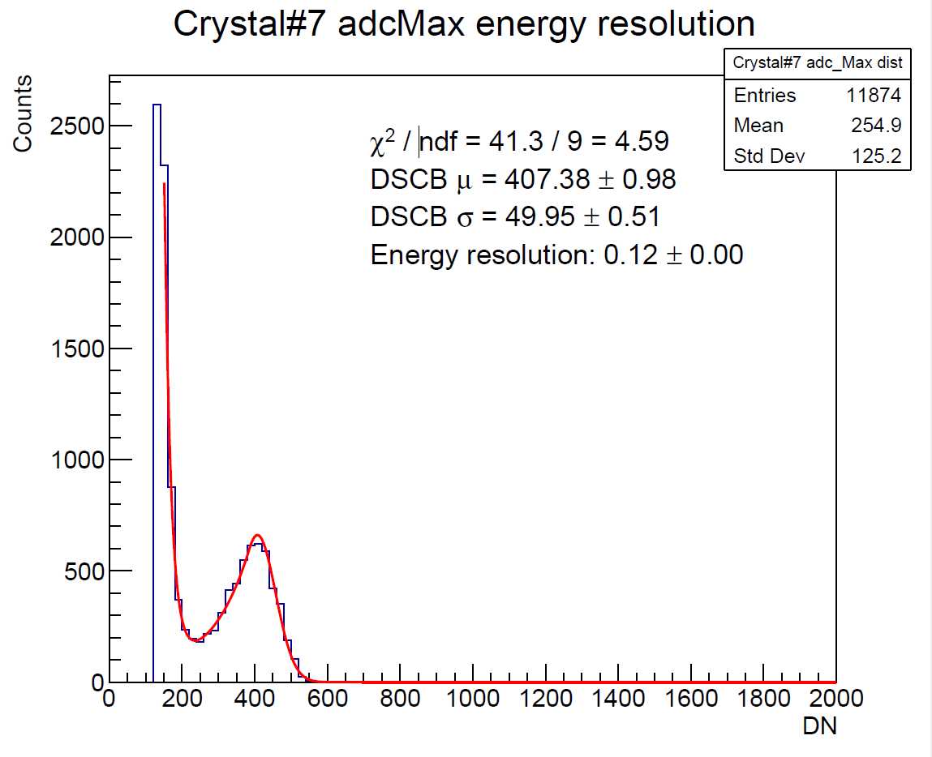
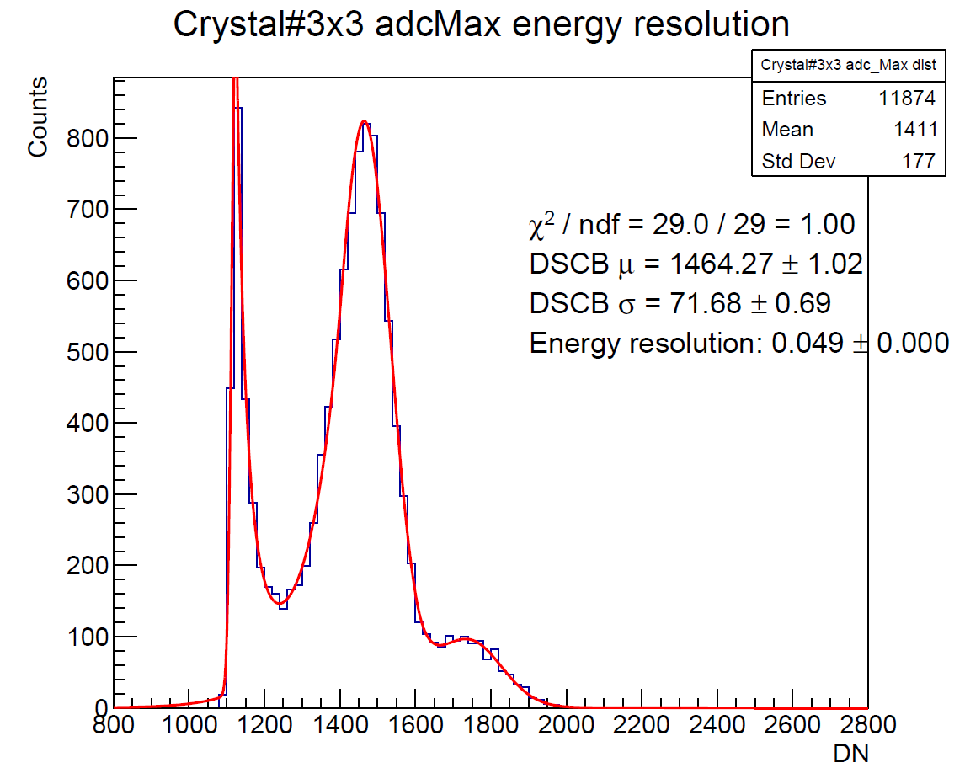
Run#427 energy resolution adcMax
Beam energy: 395MeV
1*1 Crystal#7 (beam center)
3*3 Crystal
ADC
ADC
Energy resolution: 12%
Energy resolution: 4.9%
3 * 3 energy clustering around crystal#7 give the best energy resolution of 6.0%$±$0.1%

Slide 19
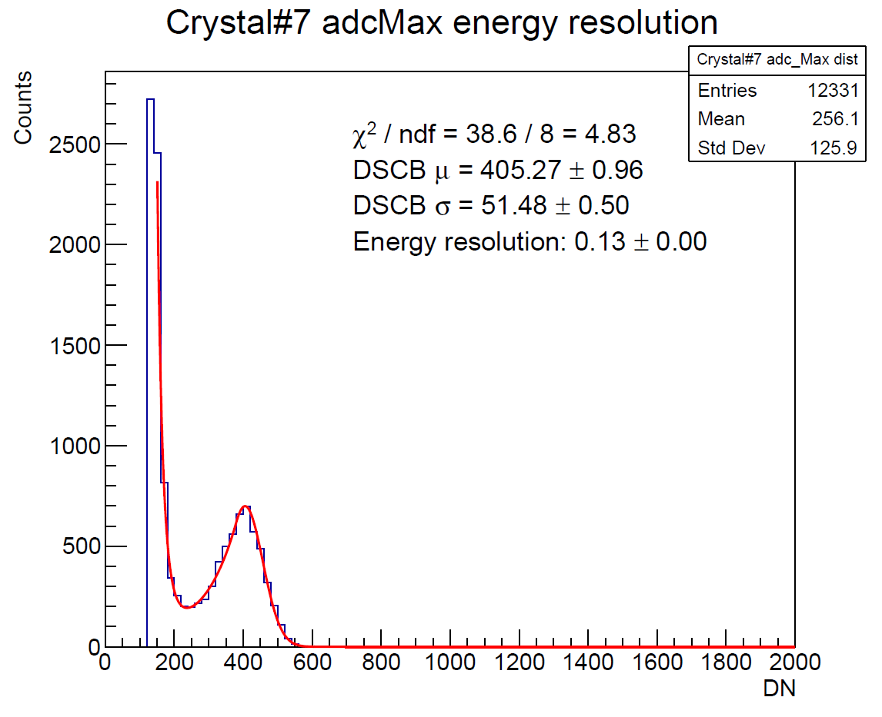

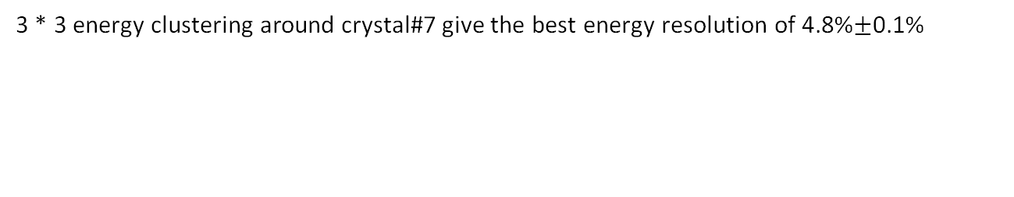

Run#428 energy resolution adcMax
Beam energy: 395MeV
1*1 Crystal#7 (beam center)
3*3 Crystal
ADC
ADC
Energy resolution: 0.13%
Energy resolution: 4.8%$±$0.1%
3 * 3 energy clustering around crystal#7 give the best energy resolution of 4.8%$±$0.1%

Slide 20
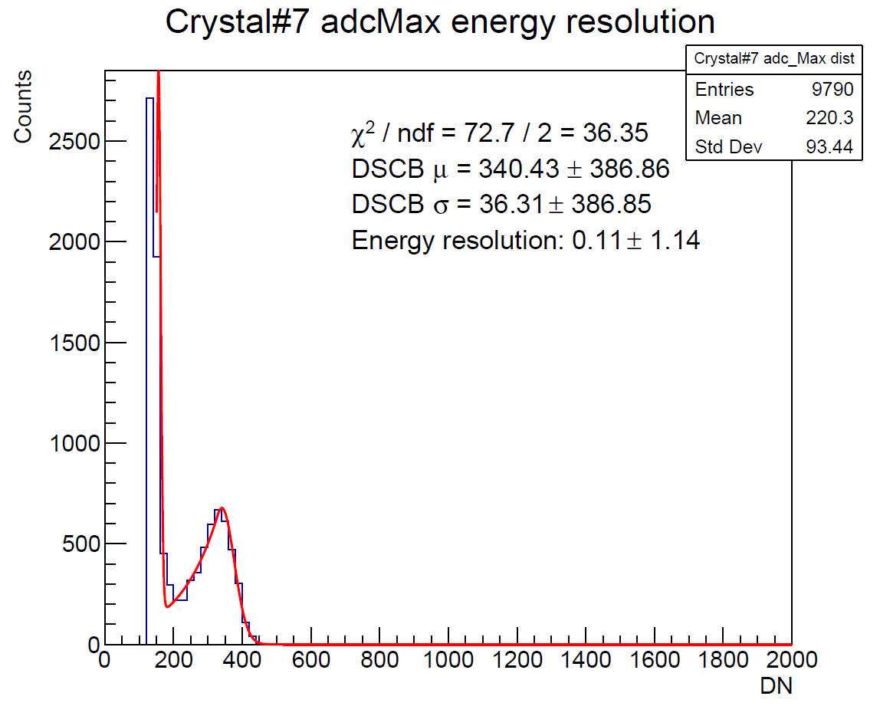
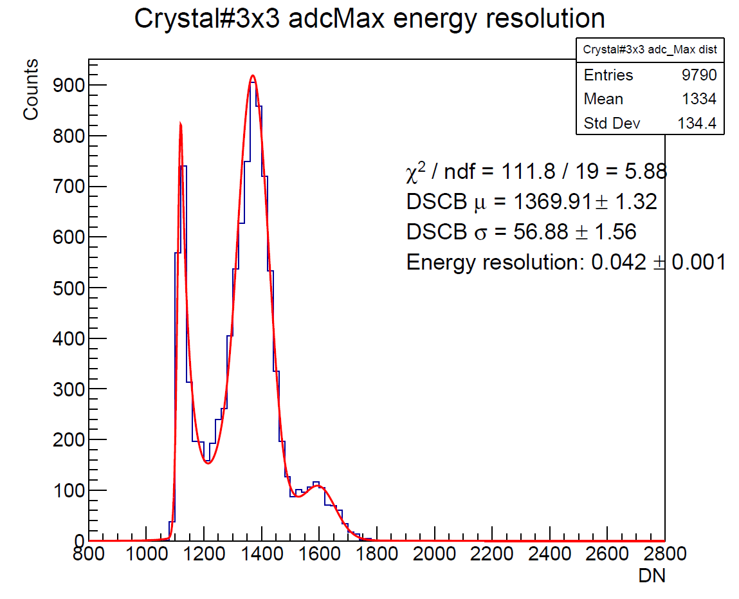


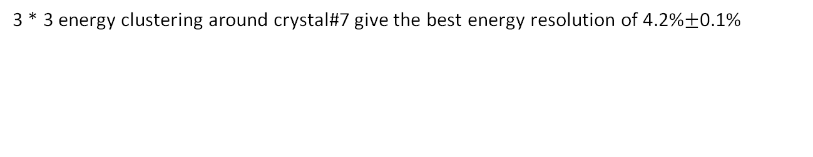
Run#429 energy resolution adcMax
Beam energy: 297MeV
1*1 Crystal#7 (beam center)
3*3 Crystal
ADC
ADC
Energy resolution: 11% $±$114%
Energy resolution: 4.2%$±$0.1%
3 * 3 energy clustering around crystal#7 give the best energy resolution of 4.2%$±$0.1%

Slide 21
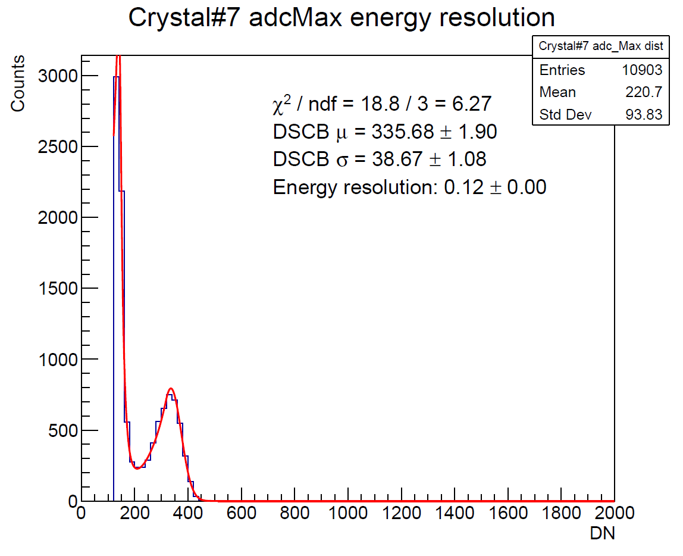
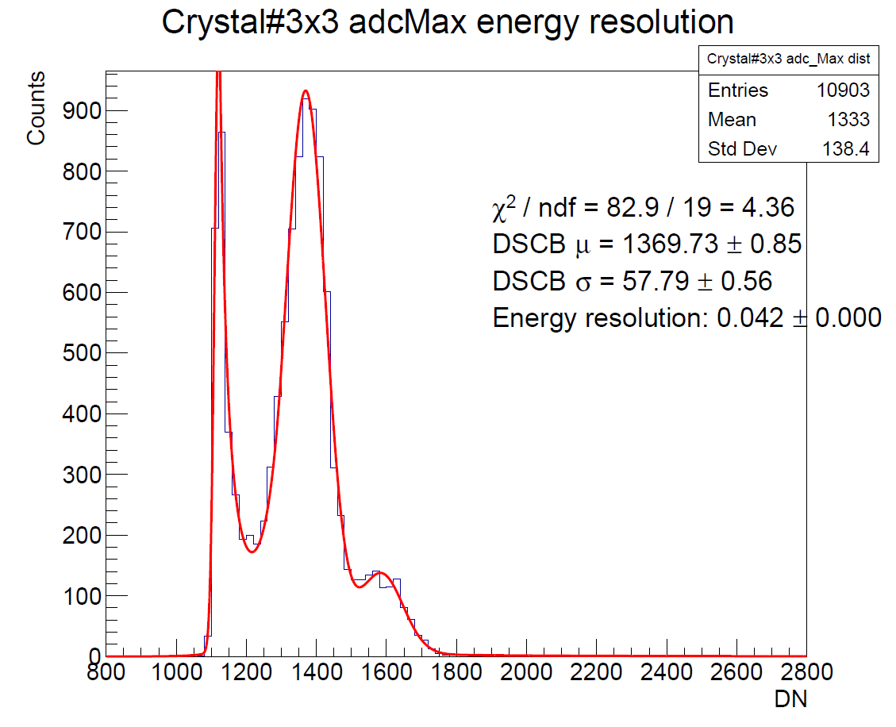
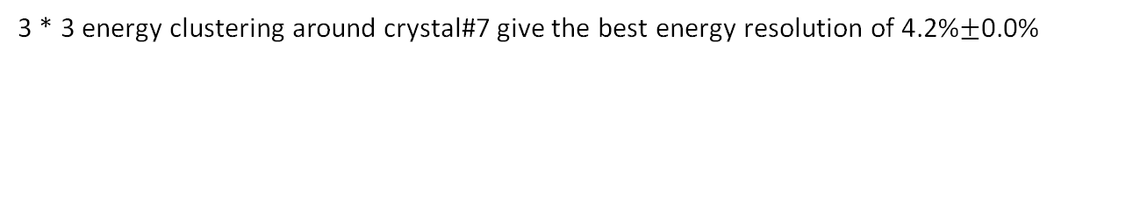

Run#430 energy resolution adcMax
Beam energy: 297MeV
1*1 Crystal#7 (beam center)
3*3 Crystal
ADC
ADC
Energy resolution: 12%
Energy resolution: 4.2%$±$0.0%
3 * 3 energy clustering around crystal#7 give the best energy resolution of 4.2%$±$0.0%

Slide 22
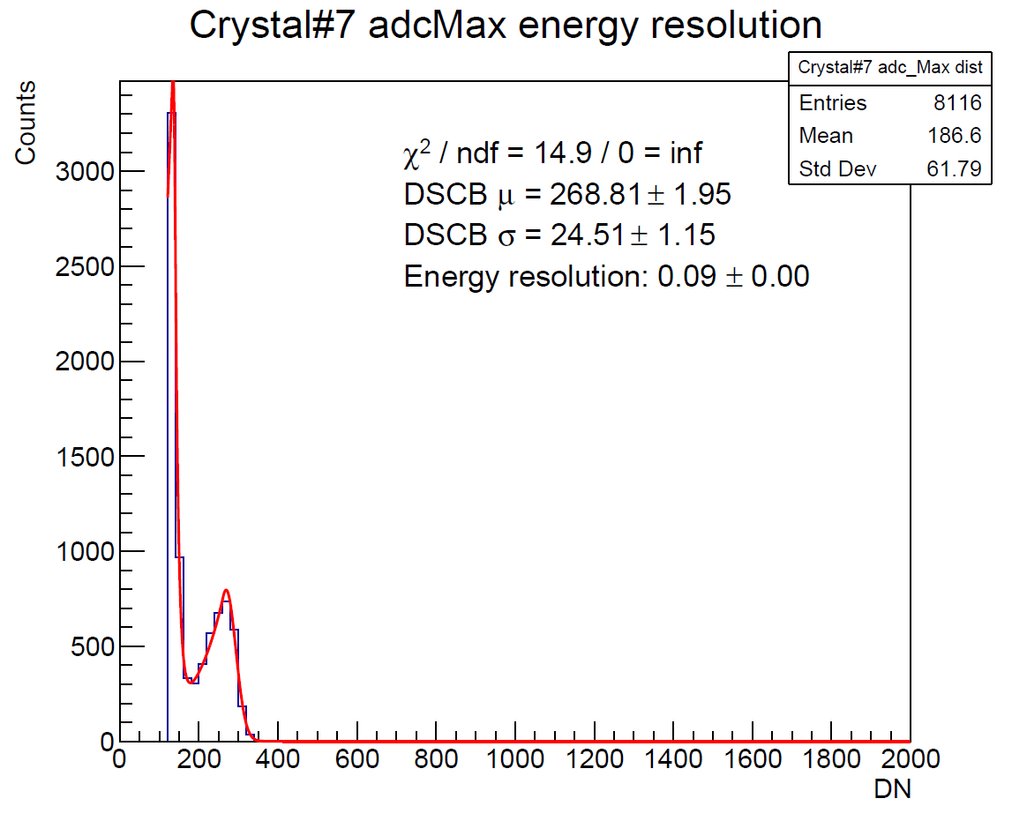



Run#431 energy resolution adcMax
Beam energy: 197MeV
1*1 Crystal#7 (beam center)
3*3 Crystal
ADC
ADC
Energy resolution: 9%
Energy resolution: 3.1%$±$0.1%
3 * 3 energy clustering around crystal#7 give the best energy resolution of 3.1%$±$0.1%

Slide 23





Run#432 energy resolution adcMax
Beam energy: 197MeV
1*1 Crystal#7 (beam center)
3*3 Crystal
ADC
ADC
Energy resolution: 9%$±$0%
Energy resolution: 2.5%$±$0.0%
3 * 3 energy clustering around crystal#7 give the best energy resolution of 2.5%$±$0.0%

Slide 24




Run#433 energy resolution adcMax
Beam energy: 100MeV
1*1 Crystal#7 (beam center)
3*3 Crystal
ADC
ADC
Energy resolution: 0.07 bad fit
Energy resolution: 1.7%$±$0.1%
bad fit
3 * 3 energy clustering around crystal#7 give the best energy resolution of 1.7%$±$0.1%

Slide 25





Run#434 energy resolution adcMax
Beam energy: 100MeV
1*1 Crystal#7 (beam center)
3*3 Crystal
ADC
ADC
Energy resolution: 7% $±$ 0% bad fit
Energy resolution: 1.3% $±$ 0.0%
bad fit
3 * 3 energy clustering around crystal#7 give the best energy resolution of 1.3% $±$ 0.0%

Slide 26



Sanity check
DSCB main peak
maxPedestal peak
Second gaussian peak
3x3 maxPedestal
DSCB main peak mean & sigma are linear under beamE scan.
maxPedestal peak mean is not flat (how about the real pedestal?)

Slide 27


Energy resolution vs. beam energy
Resolution = $σ_{DSCB main}/μ_{DSCB main}$
Resolution = $σ_{DSCB main}/(μ_{DSCB main} − μ_{maxPedestal} )$
Wrong resolution
Pedestal give low beamE run a relatively large denominator in resolution calculation
Say pedestal = 1000
Resolution = sigma/(mean + 1000)
Wrong resolution
In the graph, DSCB main peak mean is subtracted with maxPedestal mean to calculate resolution.
However, maxPedestal cannot represent the true pedestal.
Solution:
Fit the original ADC waveform and define the pedestal then
Simply subtract the first ADC point while extracting ADCMax

