Slide 1
ECal 3rd Prototype
Beam Test Analysis
Yen-Chen Wu
Dept. Physics, National Central University
2026/08/14

Slide 2
Energy Resolution Analysis Approach
ADC raw max
ADC max after fitting
ADC waveform integration
TOT
TOA
check resolution of E1x1, E3x3, E4x4, E1x1/E3x3, E1x1/E4x4, E3x3/E4x4 with all variables to find the one give the best resolution
apply different cut, TOT, TOA, event matching to see if resolution improved

Slide 3
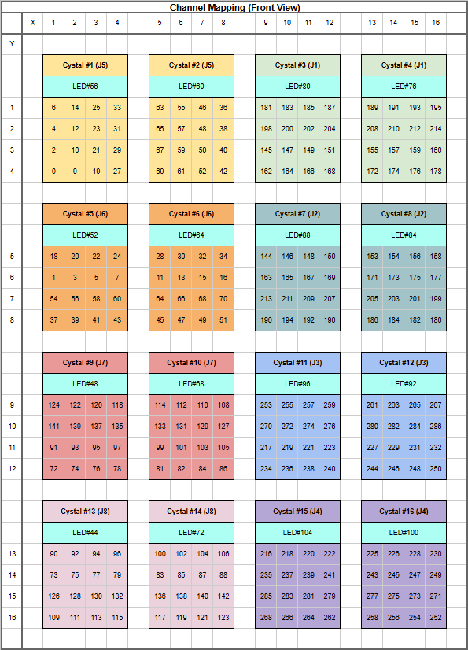
Target run
Channel Mapping
Run 421~434,481,482 @ HV=45V, C=0xA
Positron beam shoot at Crystal 7
Event selection need to be done with tracking from BM 3&4.
However, tracking requires event matching between BM and PbWO4 beforehand, which I will learn later.
My first try will not include tracking & event selection.
Crystal 7
Energy resolution of:
1 X 1,
3 X 3,
crystal clustering
will be studied

Slide 4
Crystal status overview
abnormal channels appear in same channel across different run
All channels have basically the same waveform pattern in the same event.
All channels in crystal#3,4,7,10,11 function well.
Problems:
dead channels are found in (exclude in later analysis)
crystal#2 : 63, 40, 52, 42 (4 dead)
crystal#6: 64, 45, 47, 49, 51 (5 dead)
crystal#8: 173, 175 (2 dead)
crystal#12: 284, 286, 231, 250 (4 dead)
Abnormal waveform pattern found in
crystal#2,6,8,12
Those channels are simply excluded in the analysis
Well-function crystal
3 4
7
10 11

Slide 5
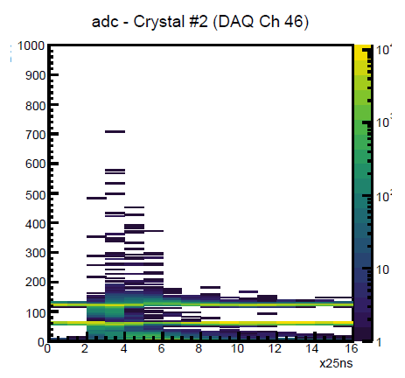
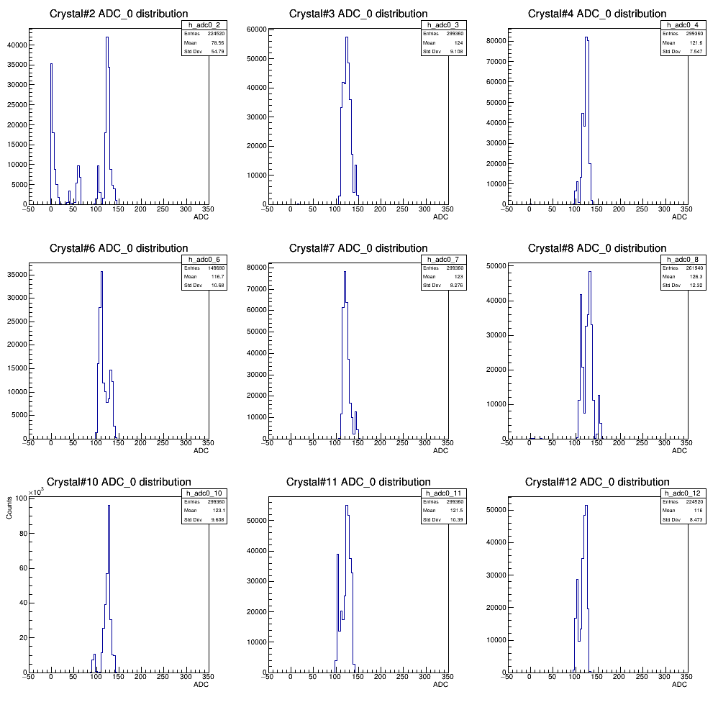
ADC[0] distribution (Run#482)
Crystal#2:
Crystal#2 should be excluded
If we take the energy as “ADCmax-ADC[0]”

Slide 6
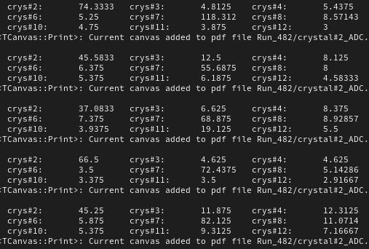
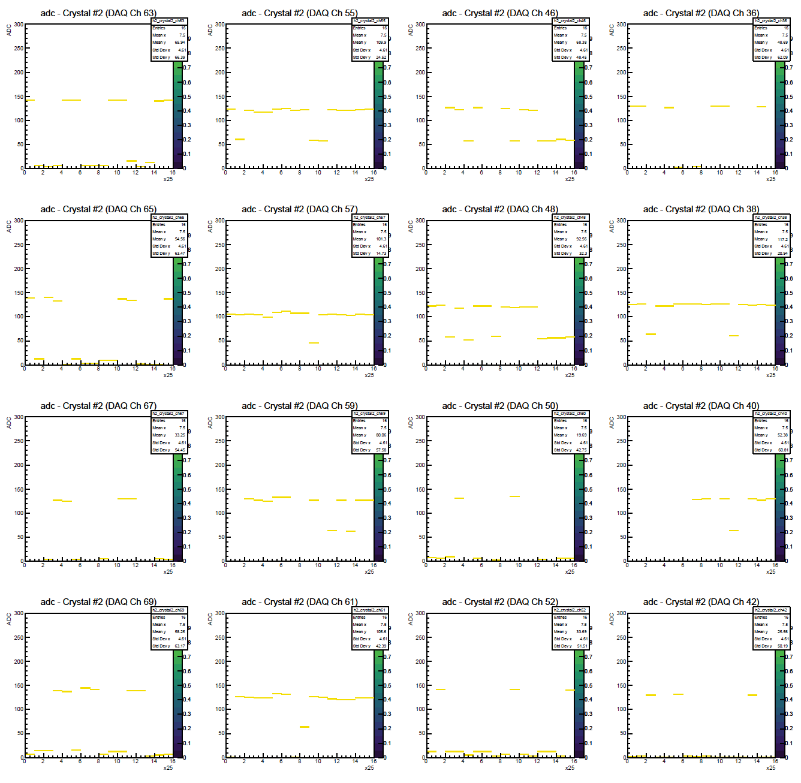
Crystal#2 pedestal issue
Event#1
dead
Adc[0]=0
Event#2
Event#3
Event#4
Adc[0]=0
Adc[0]=0
Adc[0]=0
dead
Event#5
Adc[0]=0
Adc[0]=0
dead
dead
Exclude in the later Crystal#2

Slide 7
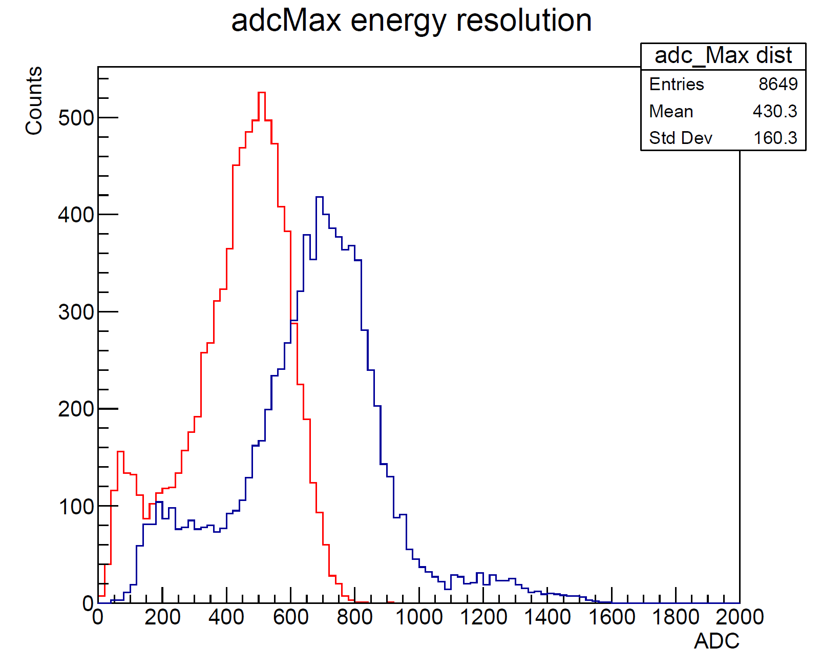
Run#482 1x1 vs. 3x3
Histogram is filled by:
“raw ADCmax – ADC[0]” averaged over all well-function channels in one crystal
summation over all 3x3 crystal
ADCmax – ADC[0] distribution
Crystal#7 1x1
Crystal#7 3x3
Crystal#2 excluded
Beam energy: 705MeV
Small peaks found in both low ADC and high ADC

Slide 8
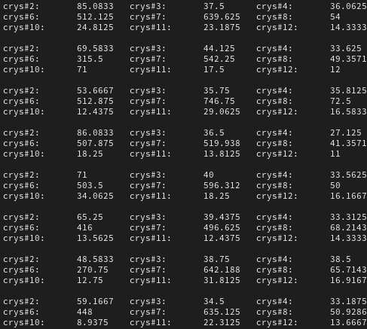
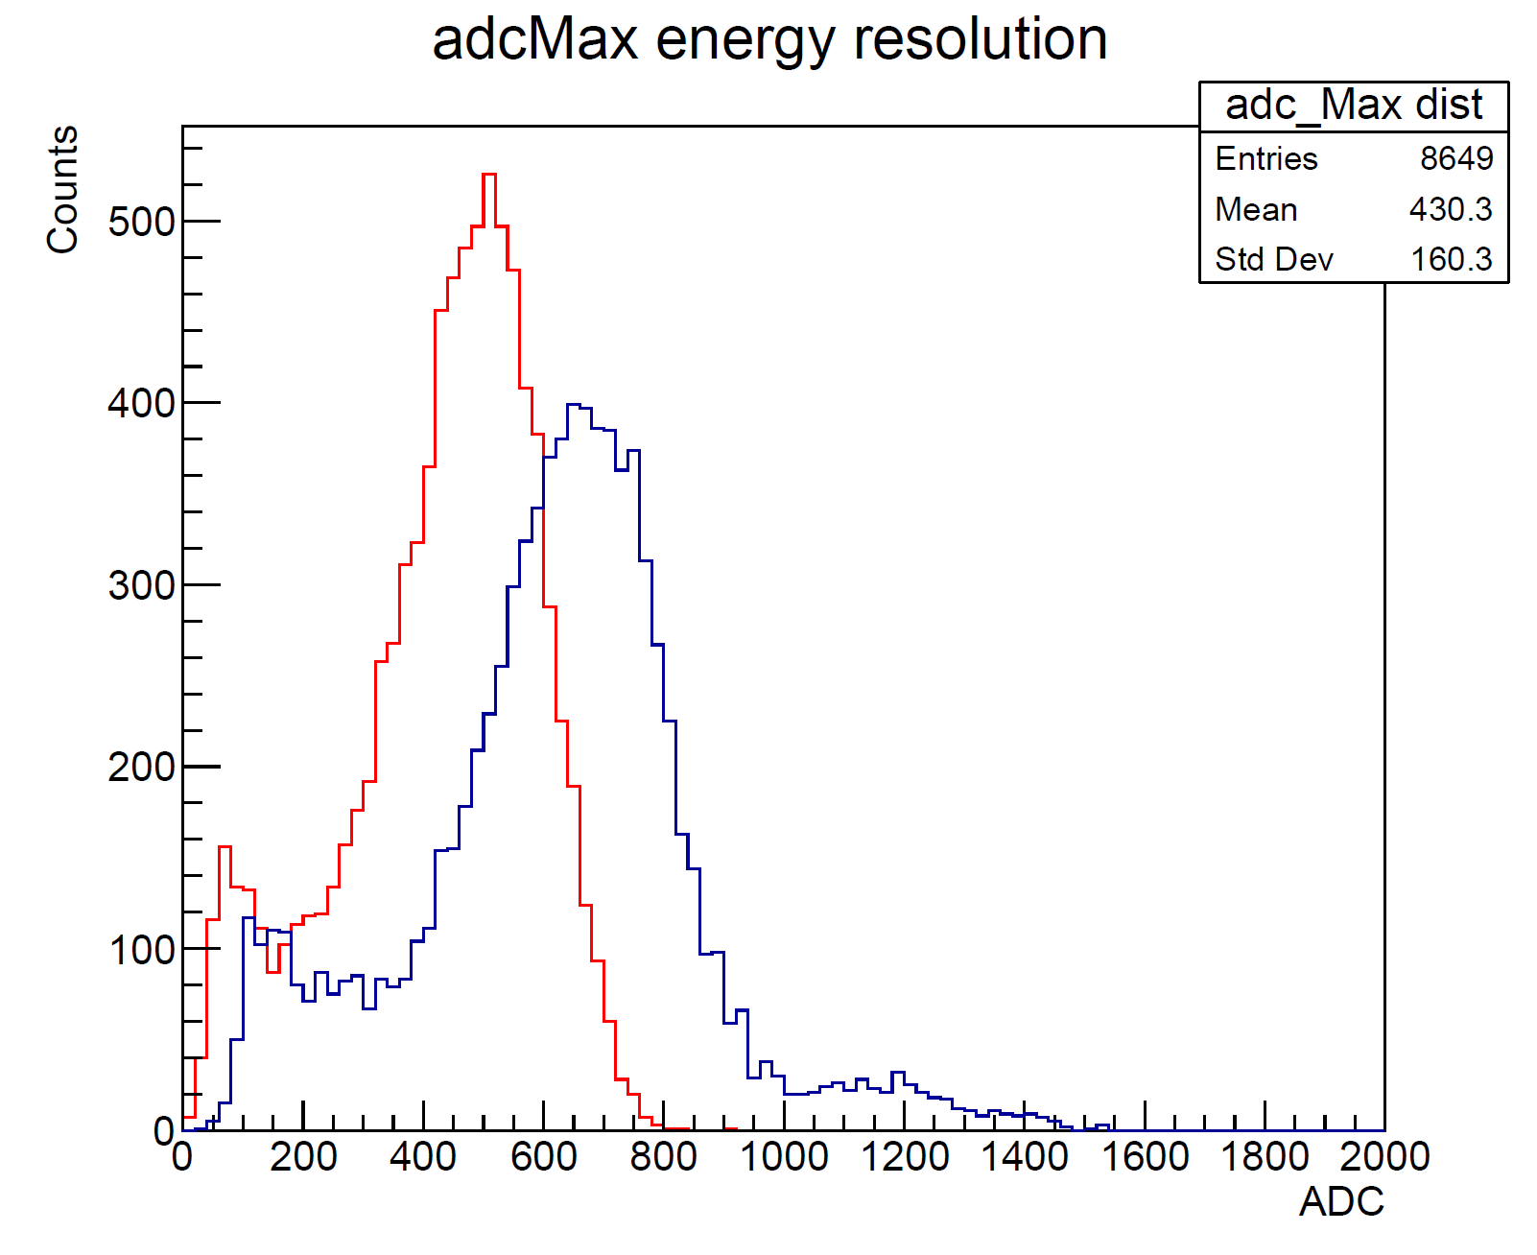
Excluding Crystal#2 does not help
ADCmax – ADC[0] distribution
Again, the second peak is mostly contributed by two crystals.
Strangely, under the condition that crystal#7 must be the lightest, the second largest is always crystal#6
They are from different FPGA!!?

Slide 9
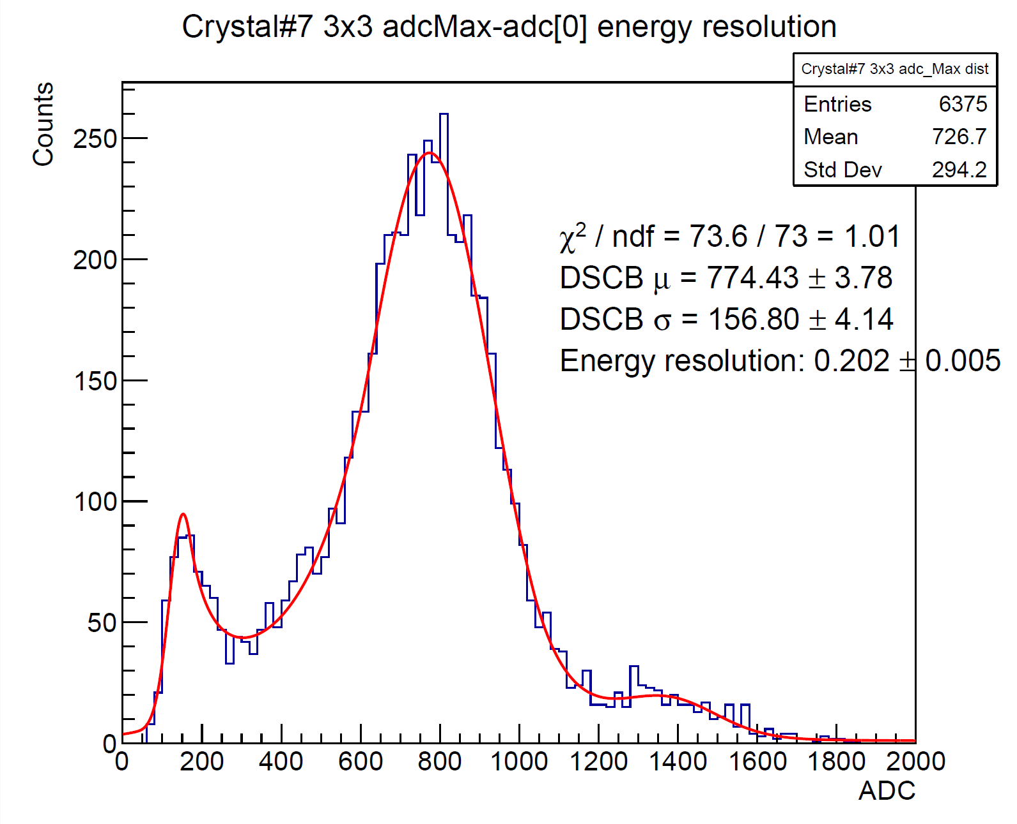
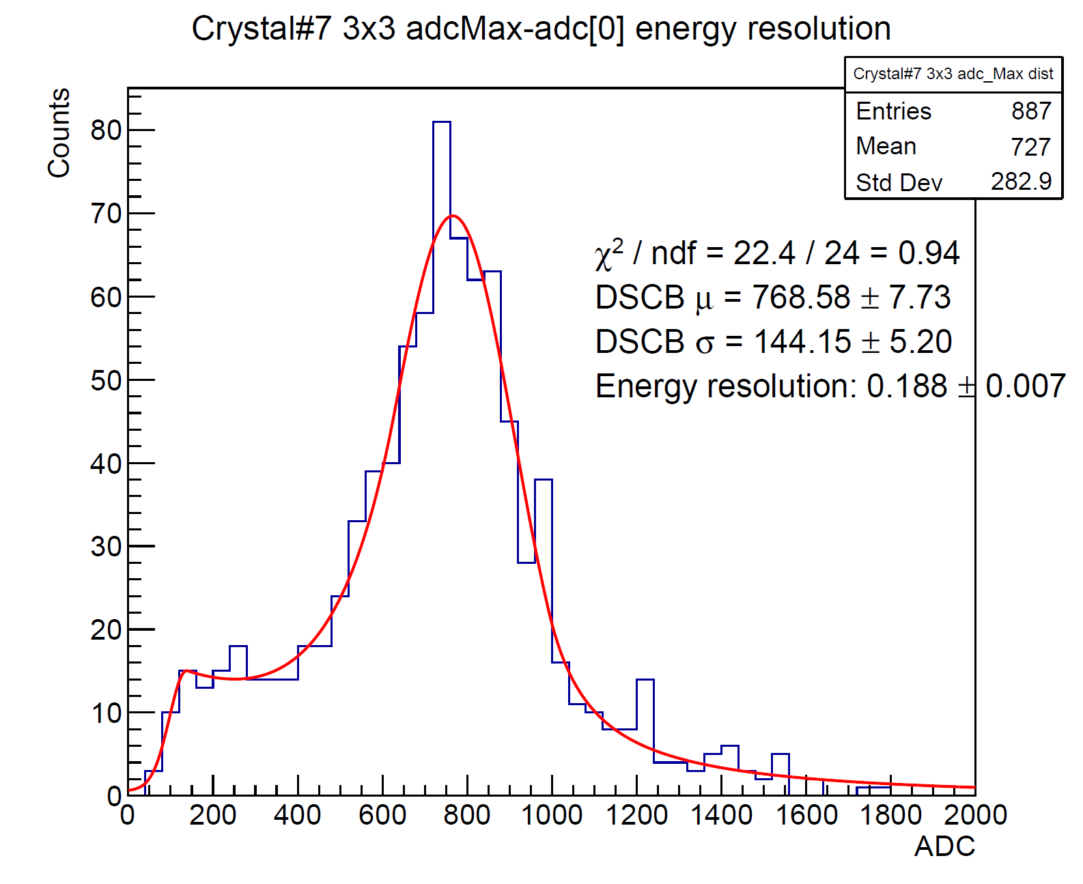


Energy resolution, BeamE = 823MeV
3x3 clustering around Crystal#7
Run#421
Run#422
ADCMax-ADC[0]
ADCMax-ADC[0]
Energy resolution: 20.2%$±$0.5%
Energy resolution: 18.8%$±$0.7%
3x3 clustering around Crystal#7
Crystal#2 excluded
Dead channels excluded

Slide 10
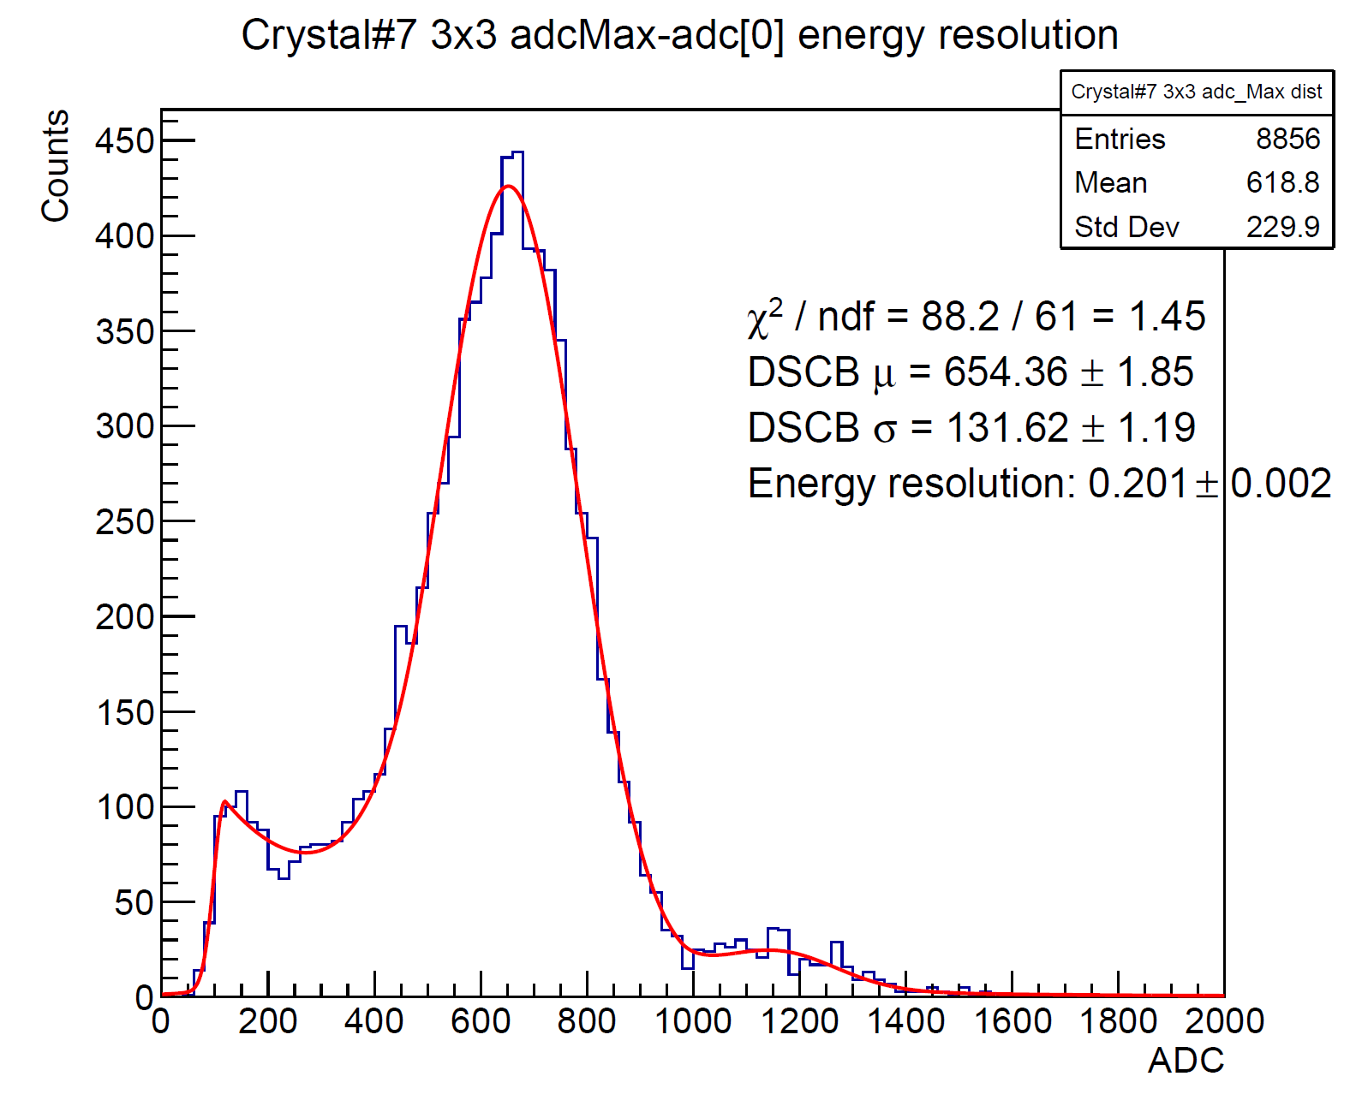
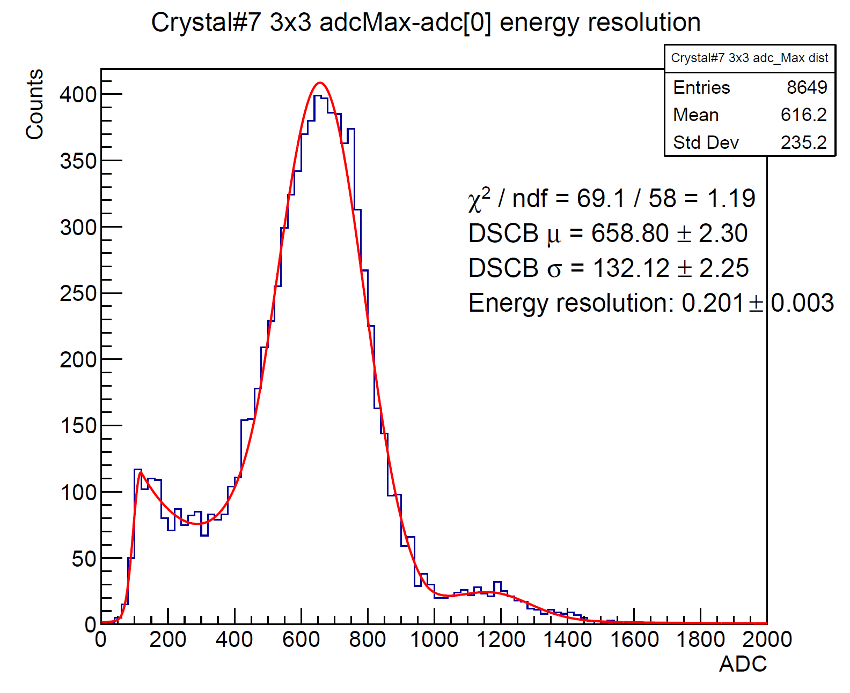


Energy resolution, BeamE = 705MeV
3x3 clustering around Crystal#7
Run#481
Run#482
ADCMax-ADC[0]
ADCMax-ADC[0]
Energy resolution: 20.1%$±$0.2%
Energy resolution: 20.1%$±$0.3%
3x3 clustering around Crystal#7
Crystal#2 excluded
Dead channels excluded

Slide 11
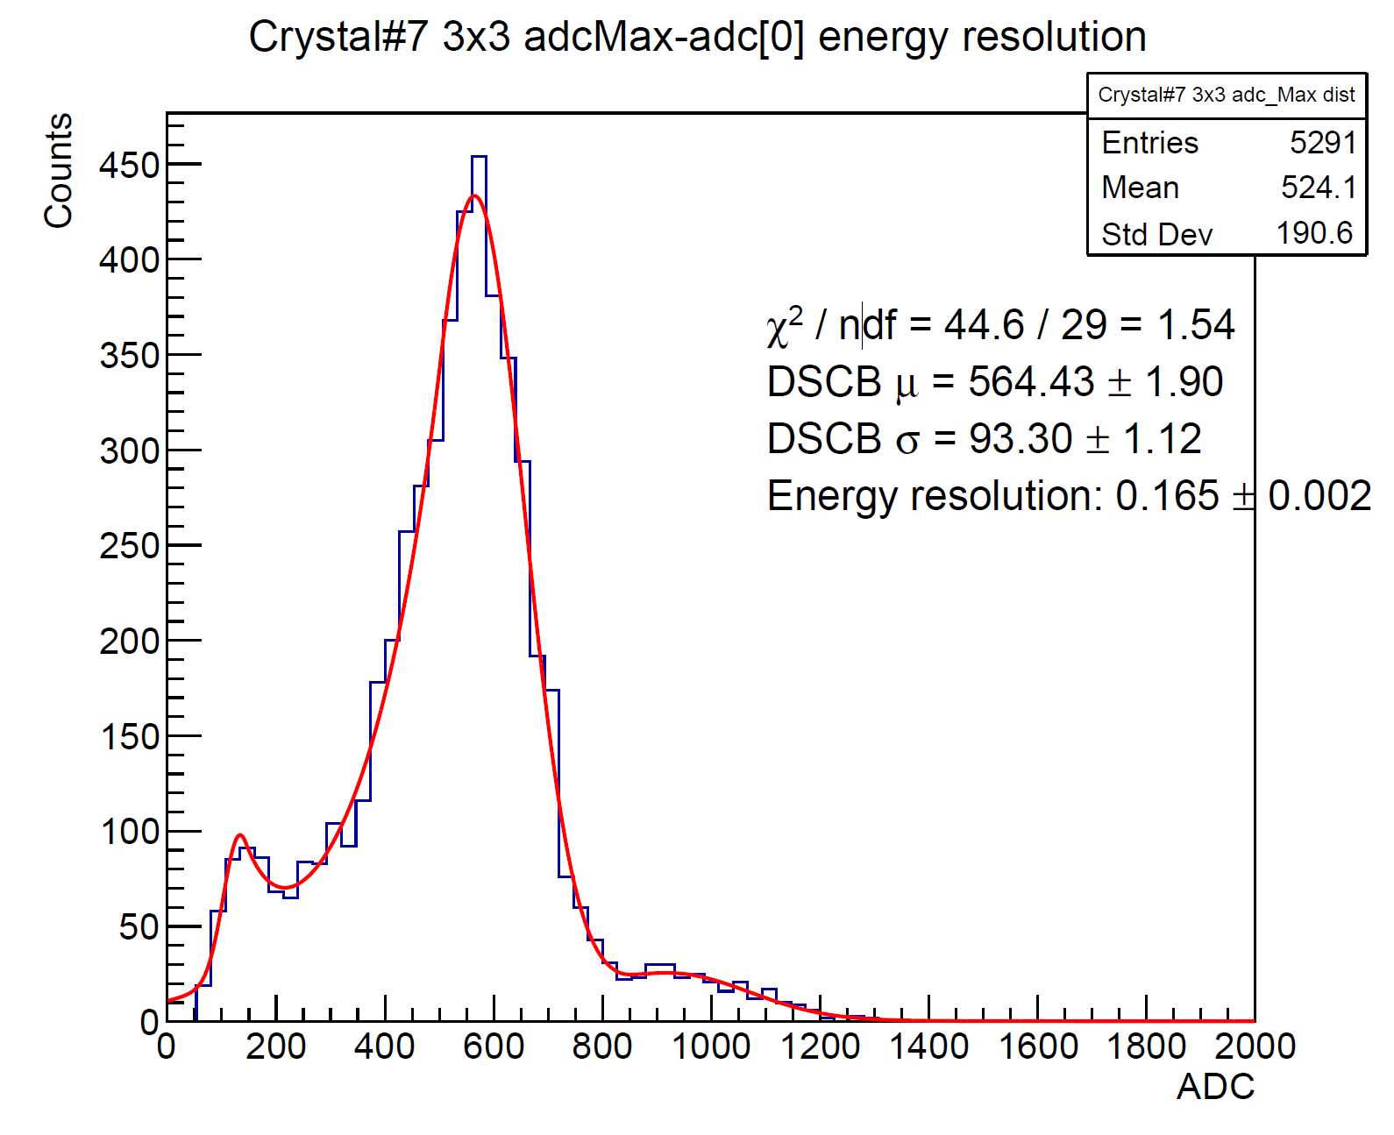
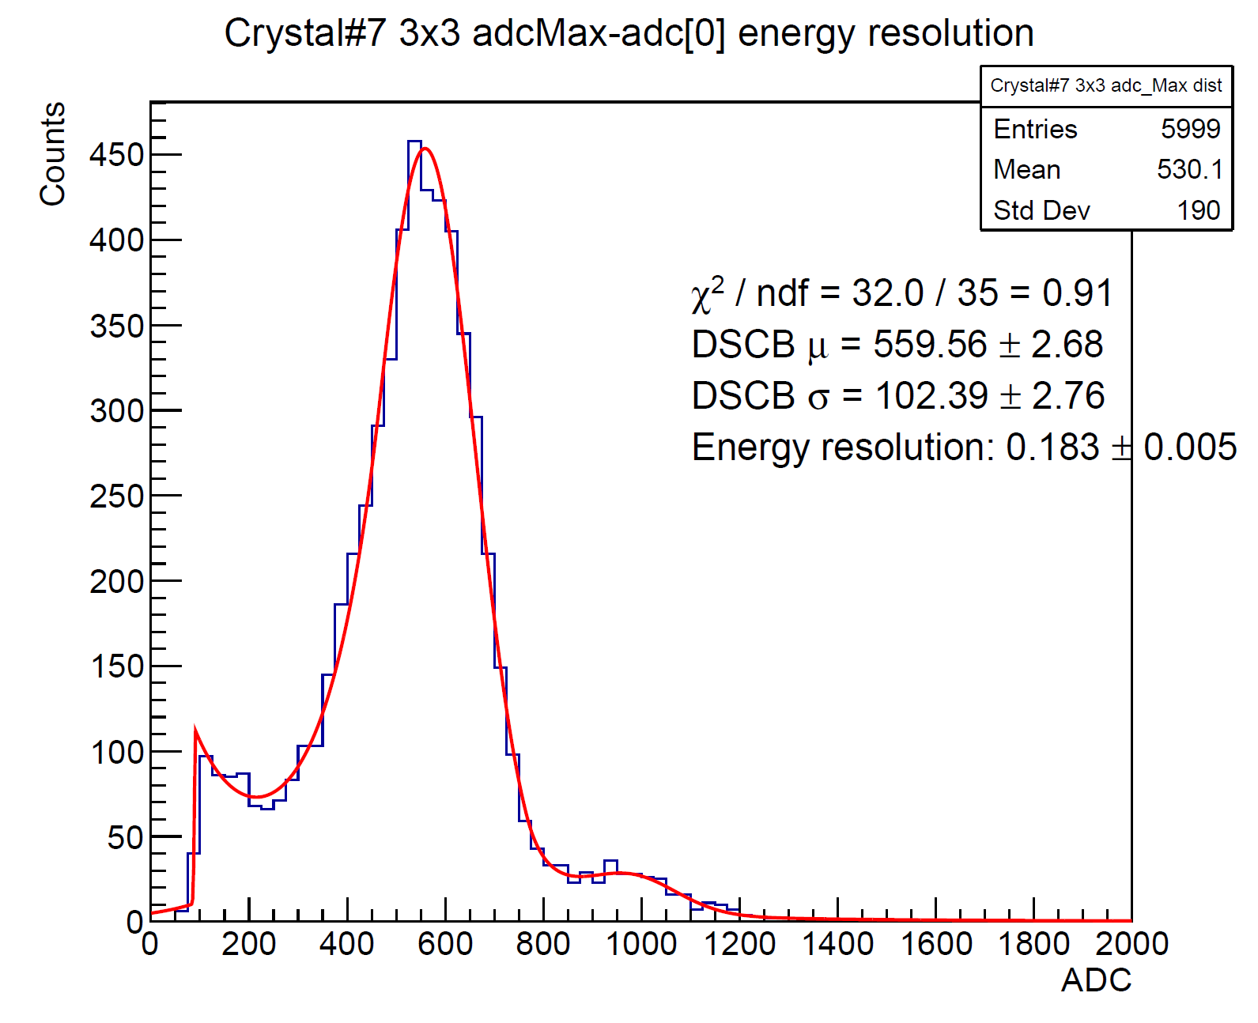


Energy resolution, BeamE = 584MeV
3x3 clustering around Crystal#7
Run#423
Run#424
ADCMax-ADC[0]
ADCMax-ADC[0]
Energy resolution: 16.5%$±$0.2%
Energy resolution: 18.3%$±$0.5%
3x3 clustering around Crystal#7
Crystal#2 excluded
Dead channels excluded

Slide 12
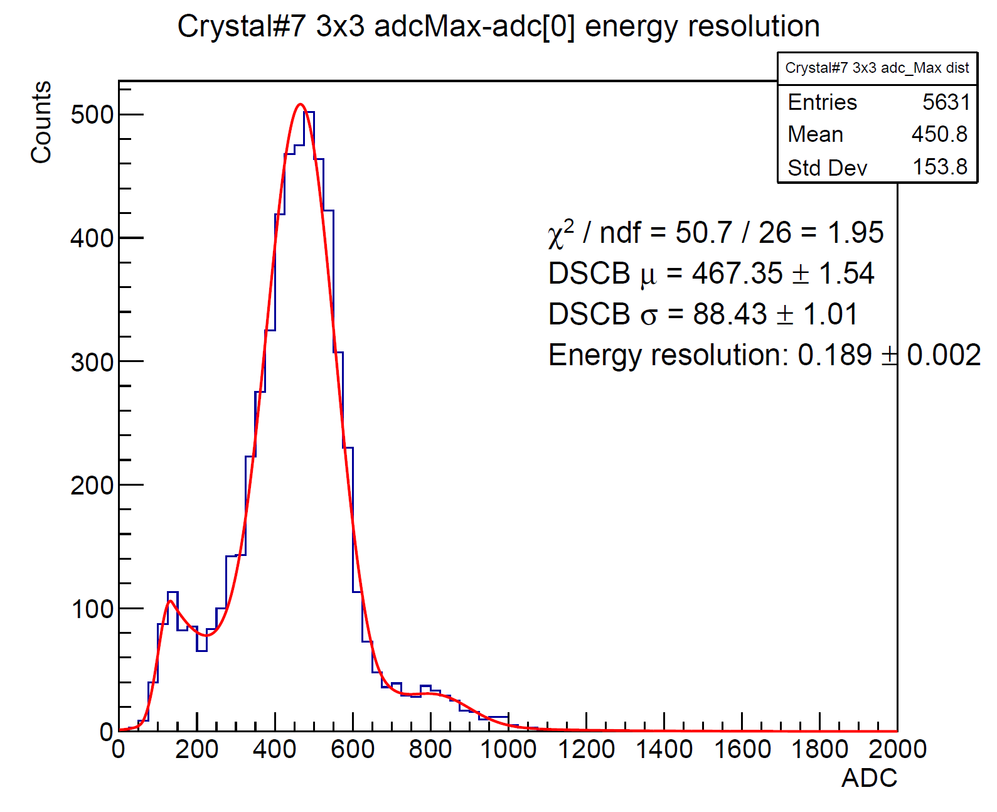
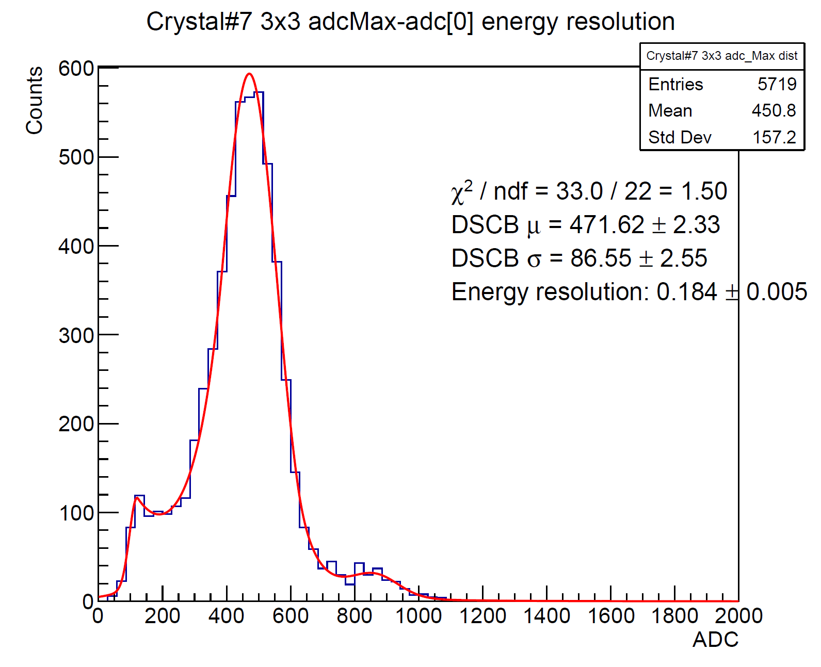


Energy resolution, BeamE = 492MeV
3x3 clustering around Crystal#7
Run#425
Run#426
ADCMax-ADC[0]
ADCMax-ADC[0]
Energy resolution: 18.9%$±$0.2%
Energy resolution: 18.4%$±$0.5%
3x3 clustering around Crystal#7
Crystal#2 excluded
Dead channels excluded

Slide 13
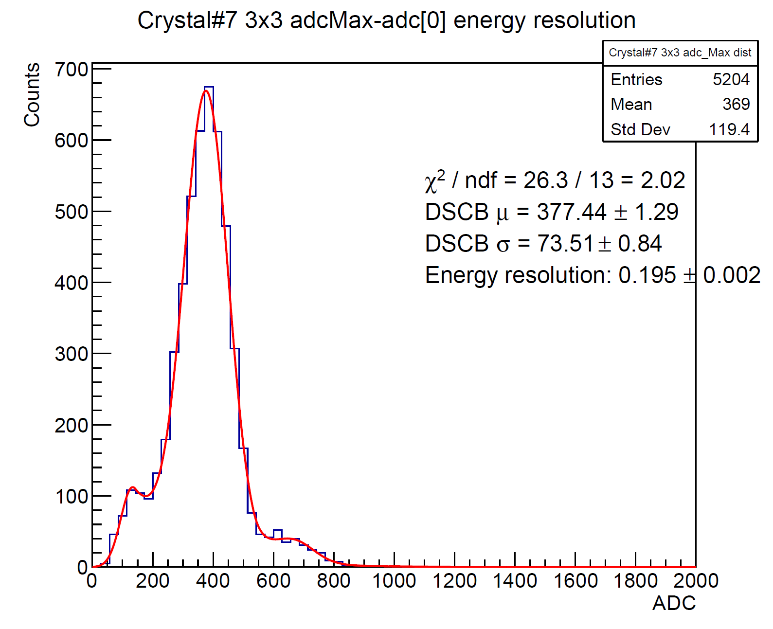
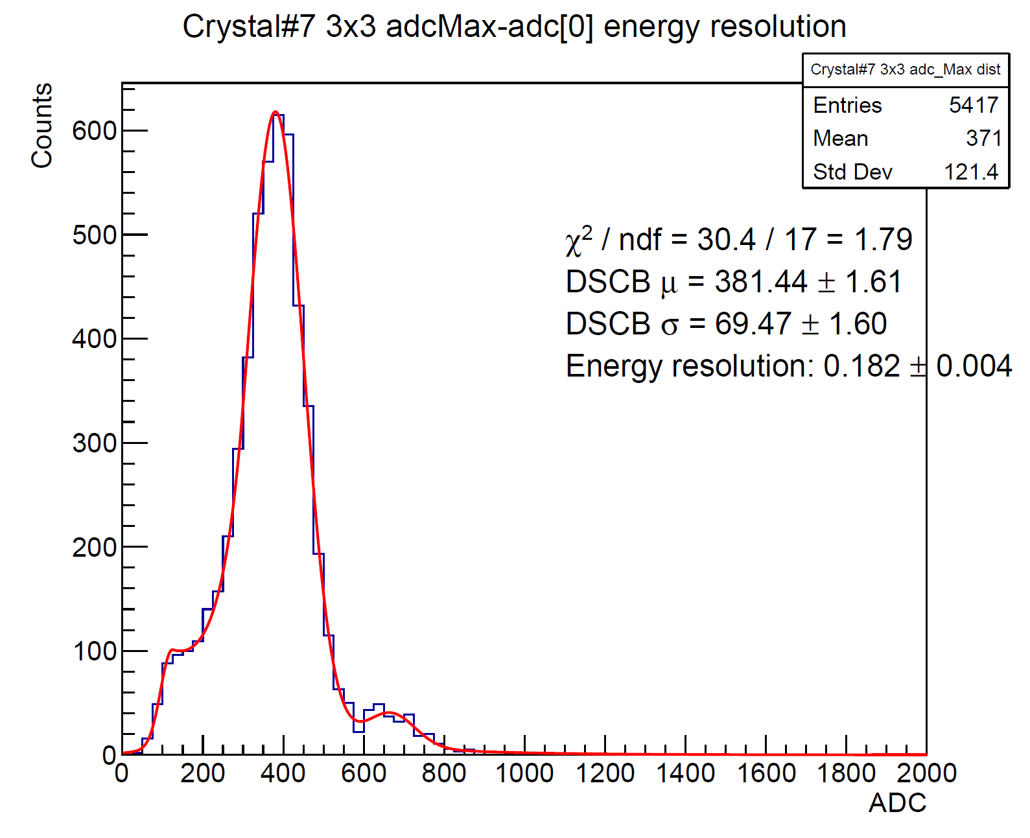


Energy resolution, BeamE = 395MeV
3x3 clustering around Crystal#7
Run#427
Run#428
ADCMax-ADC[0]
ADCMax-ADC[0]
Energy resolution: 19.5%$±$0.2%
Energy resolution: 18.2%$±$0.4%
3x3 clustering around Crystal#7
Crystal#2 excluded
Dead channels excluded

Slide 14
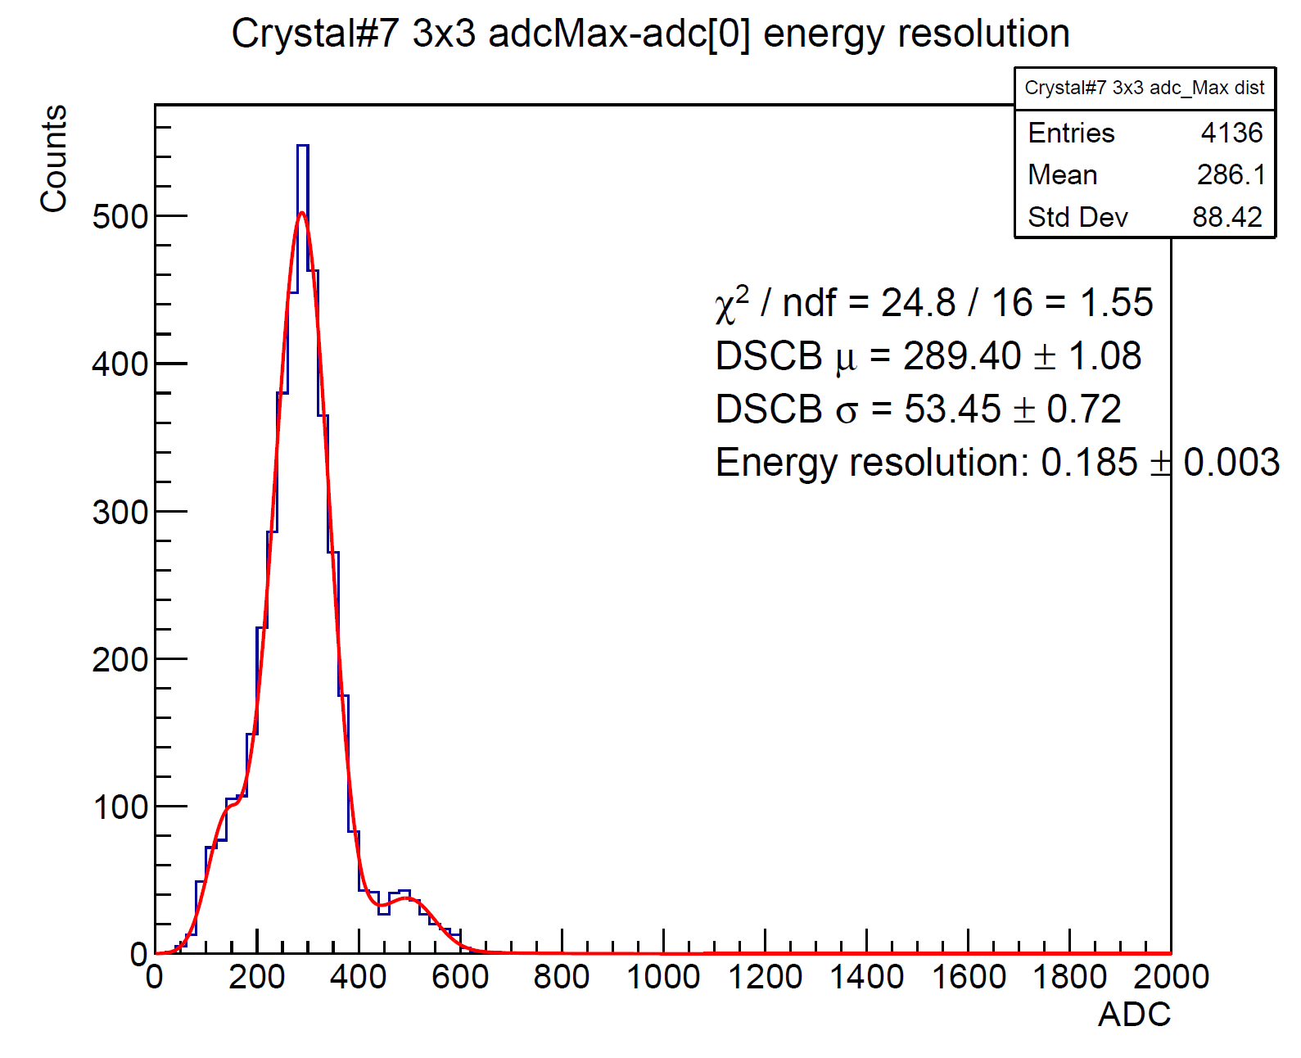
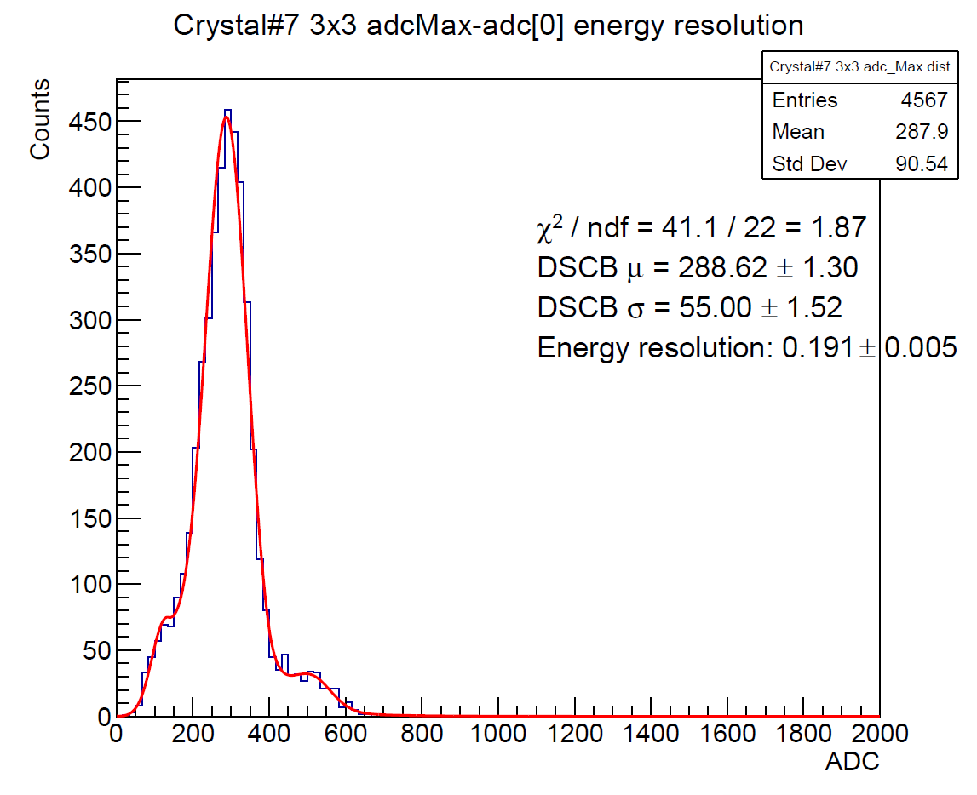


Energy resolution, BeamE = 297MeV
3x3 clustering around Crystal#7
Run#429
Run#430
ADCMax-ADC[0]
ADCMax-ADC[0]
Energy resolution: 18.5%$±$0.3%
Energy resolution: 19.1%$±$0.5%
3x3 clustering around Crystal#7
Crystal#2 excluded
Dead channels excluded

Slide 15
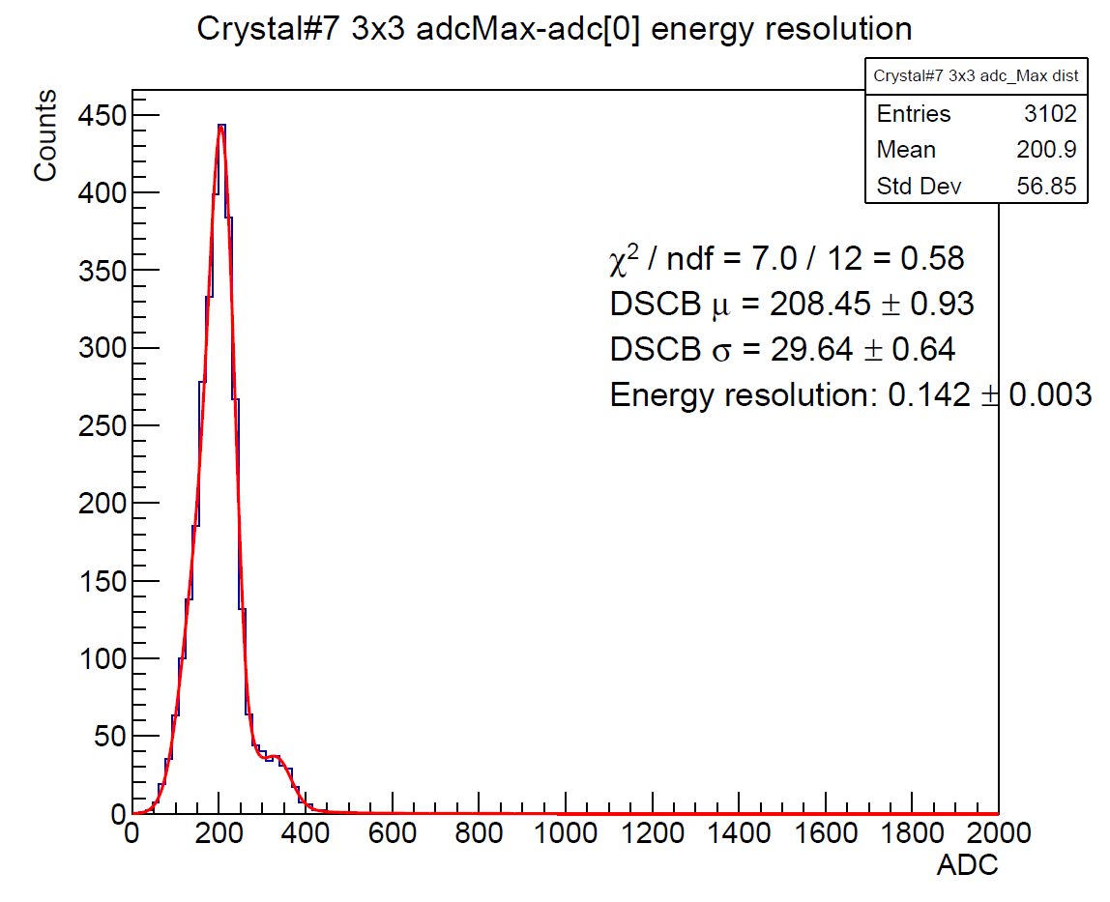
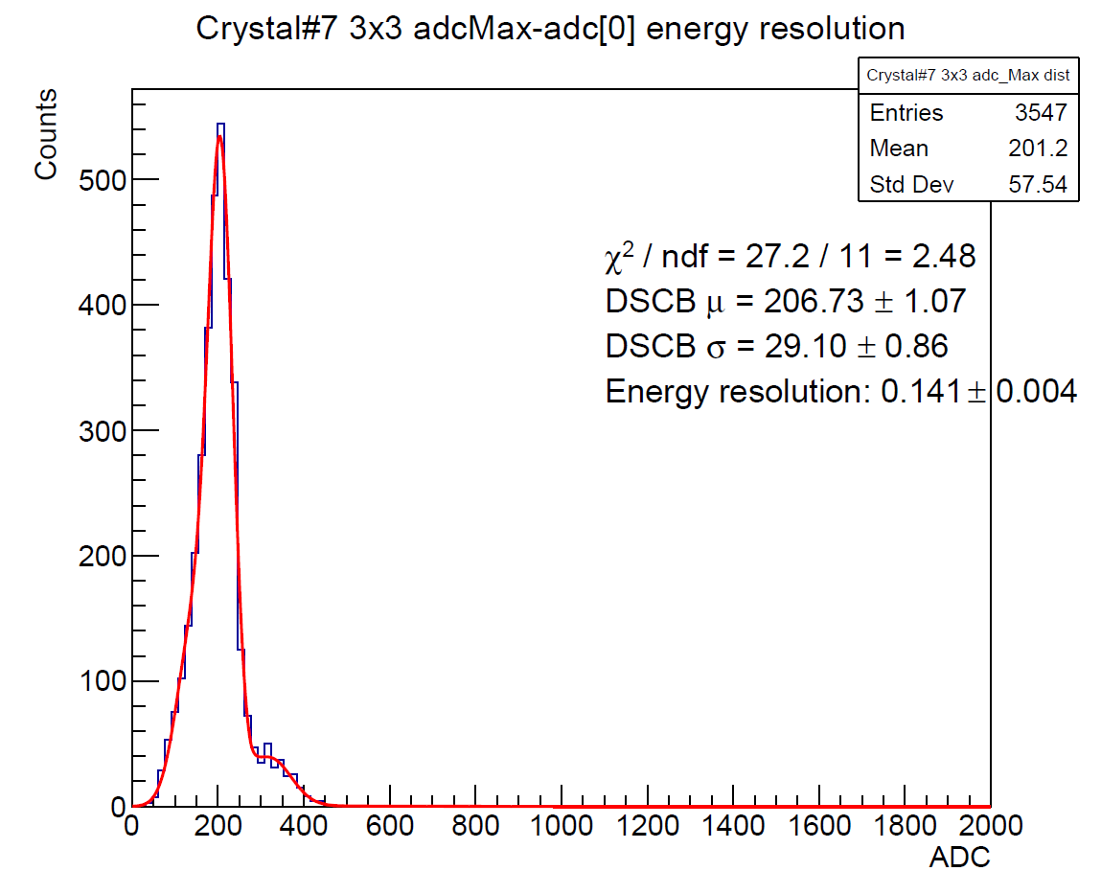


Energy resolution, BeamE = 197MeV
3x3 clustering around Crystal#7
Run#431
Run#432
ADCMax-ADC[0]
ADCMax-ADC[0]
Energy resolution: 14.2%$±$0.3%
Energy resolution: 14.1%$±$0.4%
3x3 clustering around Crystal#7
Crystal#2 excluded
Dead channels excluded

Slide 16
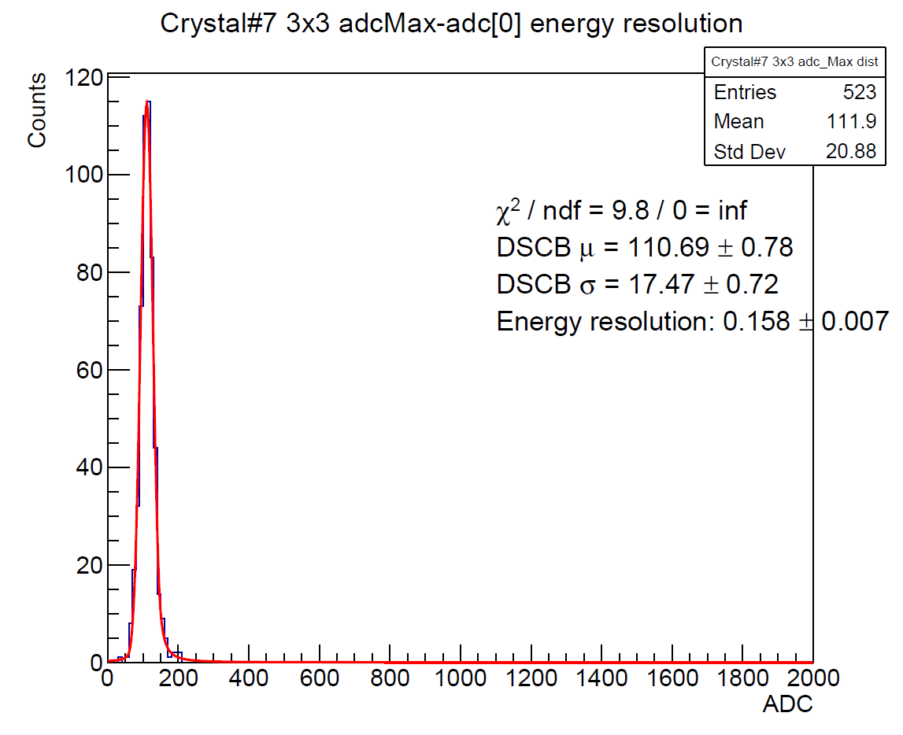
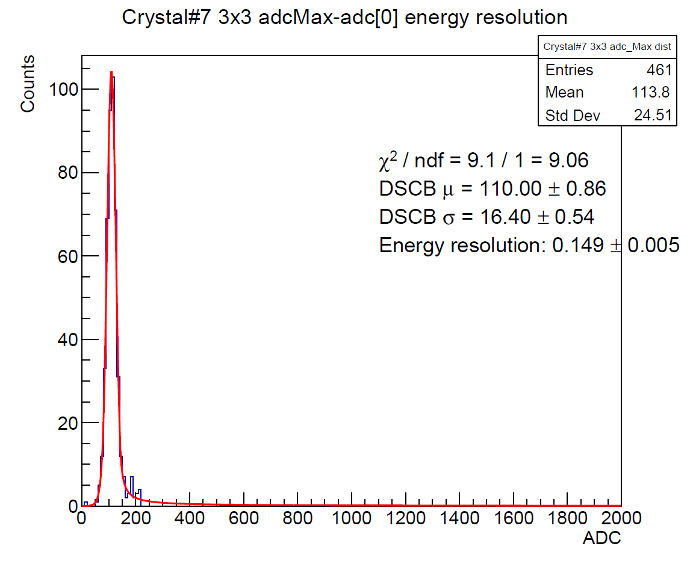


Energy resolution, BeamE = 100MeV
3x3 clustering around Crystal#7
Run#433
Run#434
ADCMax-ADC[0]
ADCMax-ADC[0]
Energy resolution: 15.8%$±$0.7%
Energy resolution: 14.9%$±$0.5%
3x3 clustering around Crystal#7
Crystal#2 excluded
Dead channels excluded

Slide 17
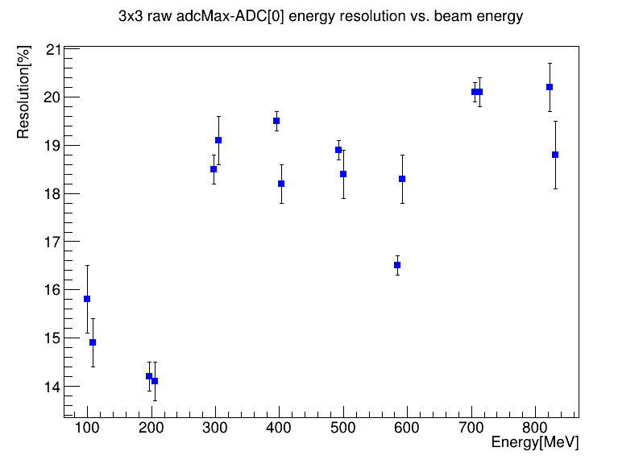
Energy resolution vs. beam energy
Resolution = $σ_{DSCB main}/μ_{DSCB main}$
TO DO:
Fit the original ADC waveform and define the pedestal

Slide 18








ADCMax-ADC[0] 3x3 resolution
For every beam E, there are two run
$$E_{beam}=823MeV$$
$$E_{beam}=705MeV$$
$$E_{beam}=584MeV$$
ADCMax-ADC[0]
$$E_{beam}=492MeV$$
$$E_{beam}=395MeV$$
$$E_{beam}=297MeV$$
$$E_{beam}=197MeV$$
$$E_{beam}=100MeV$$

Slide 19
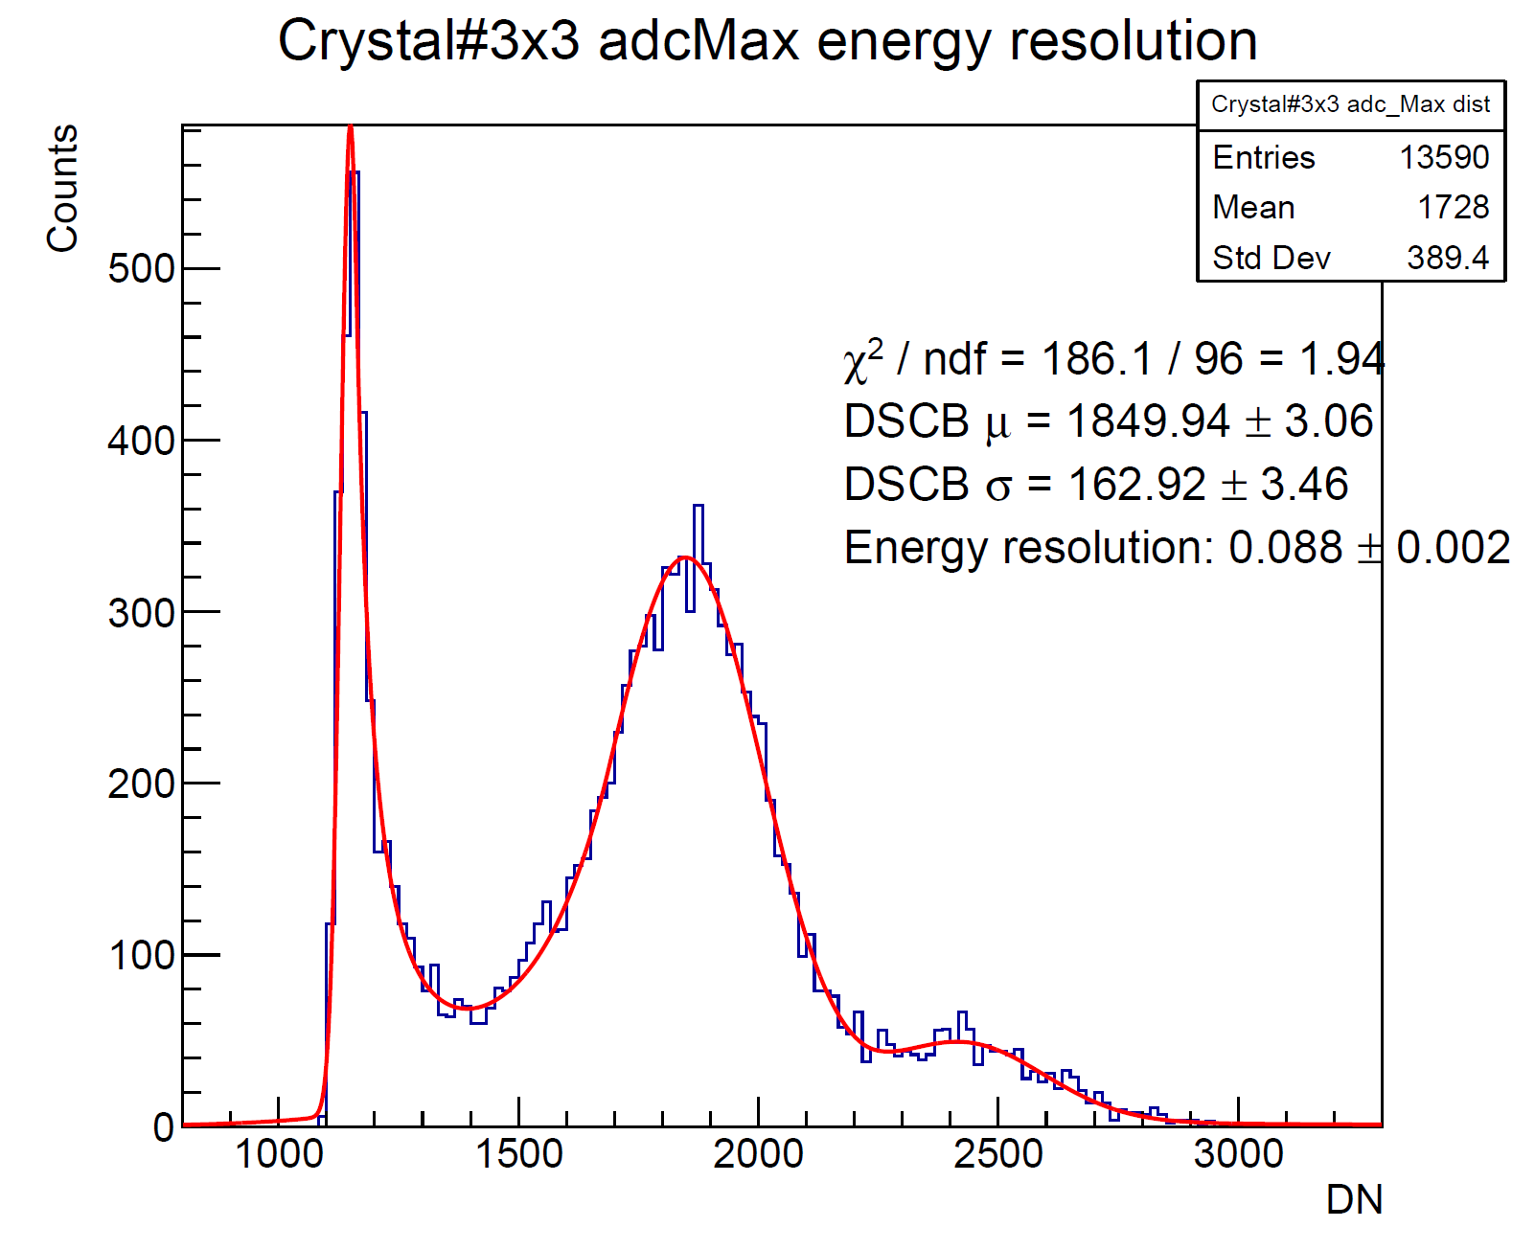
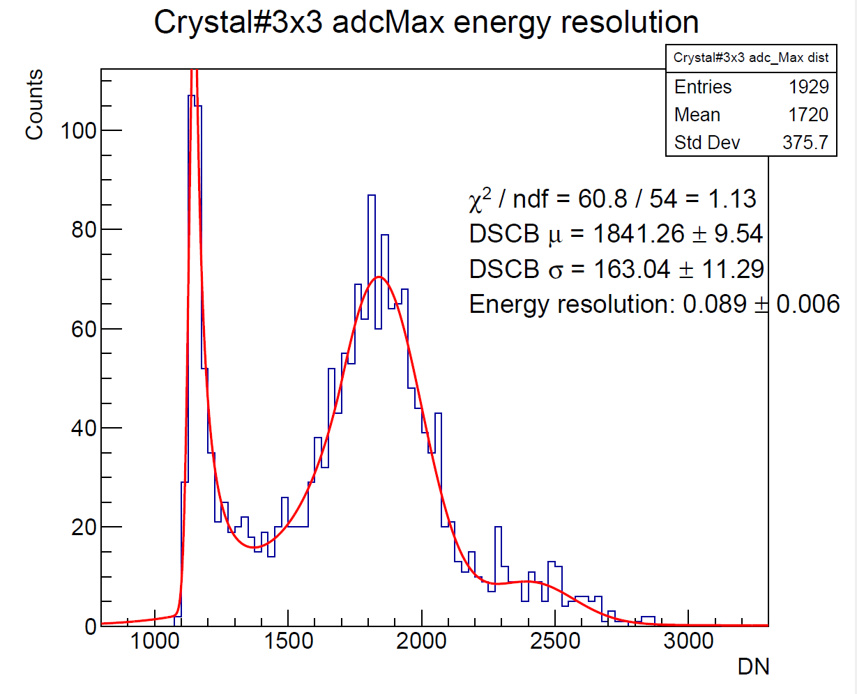
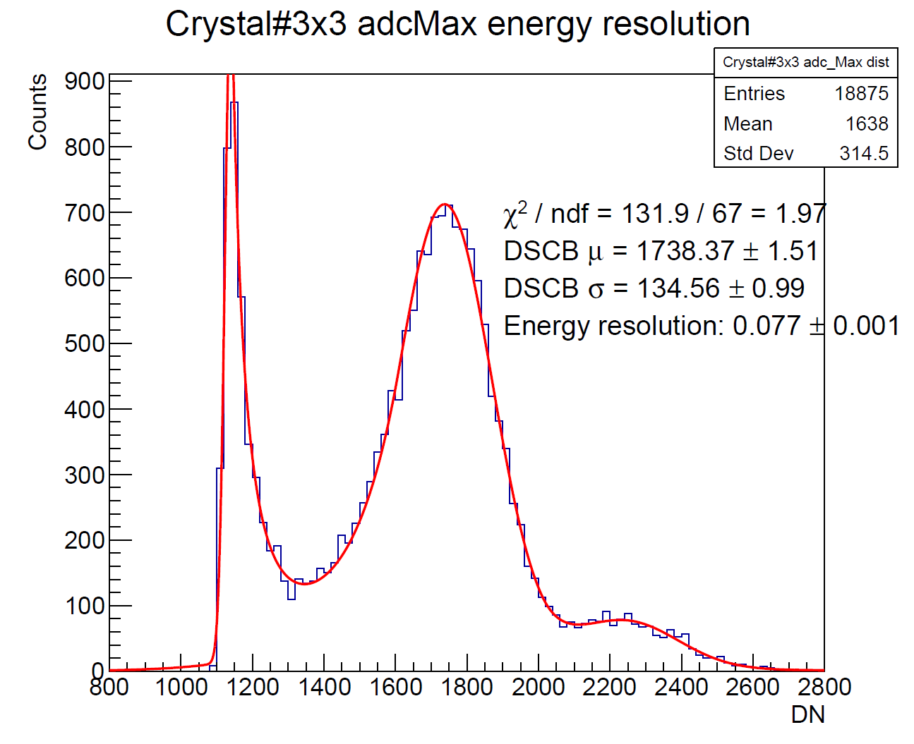
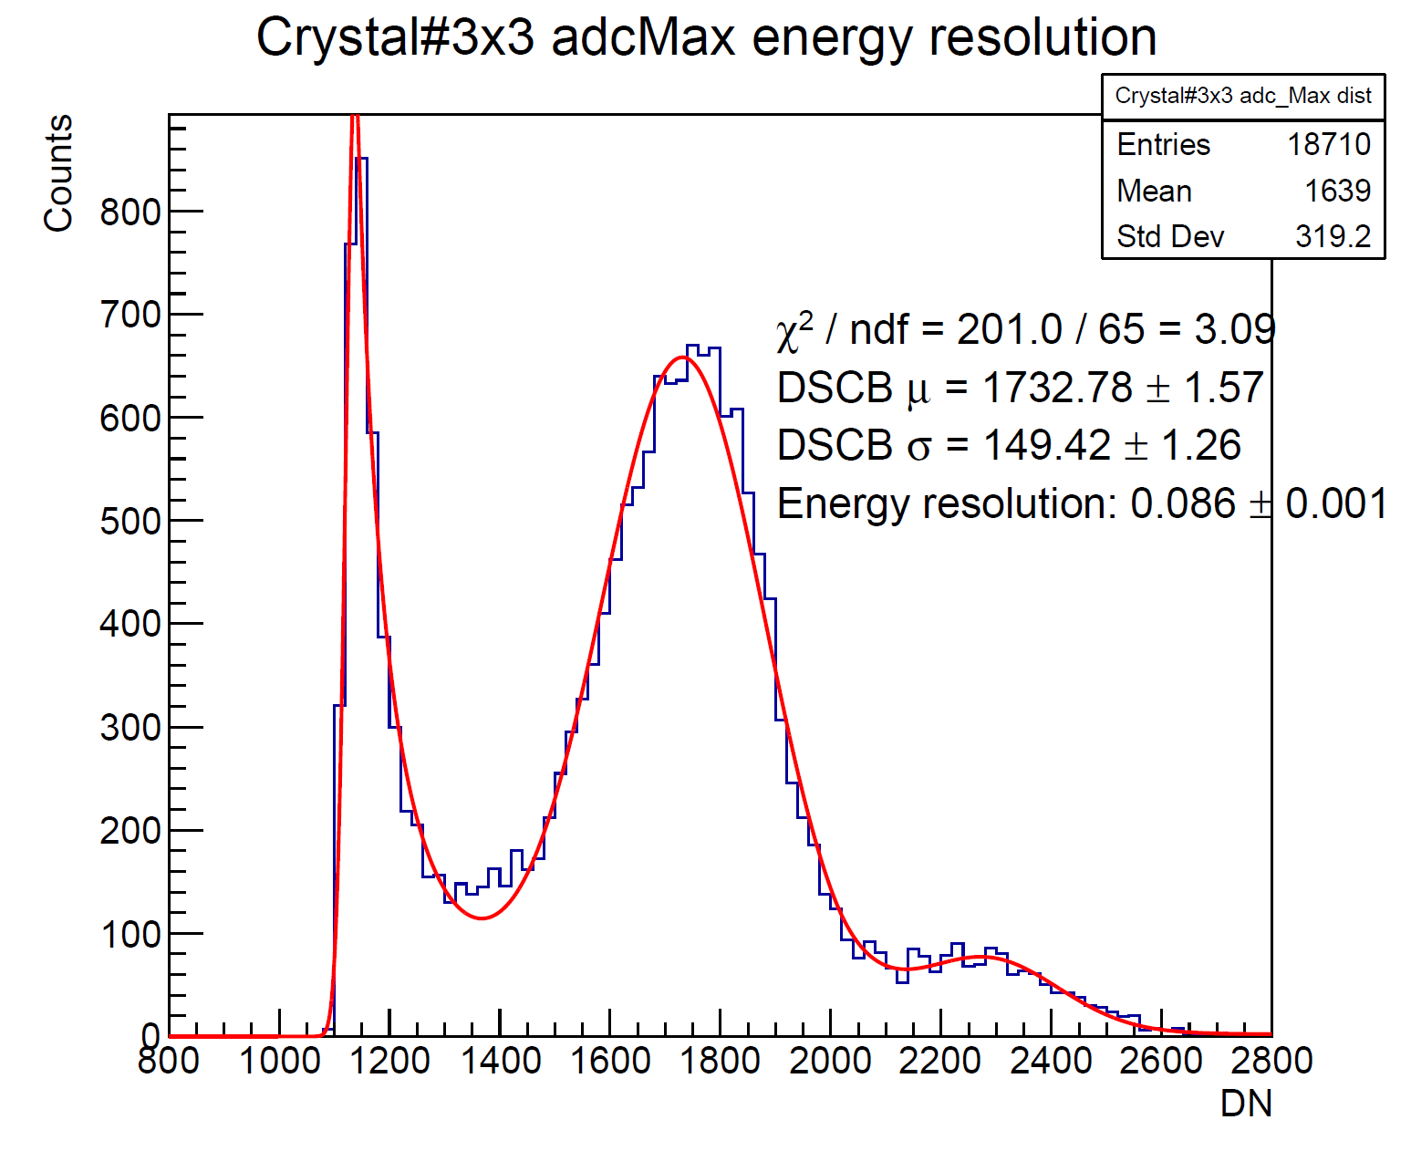
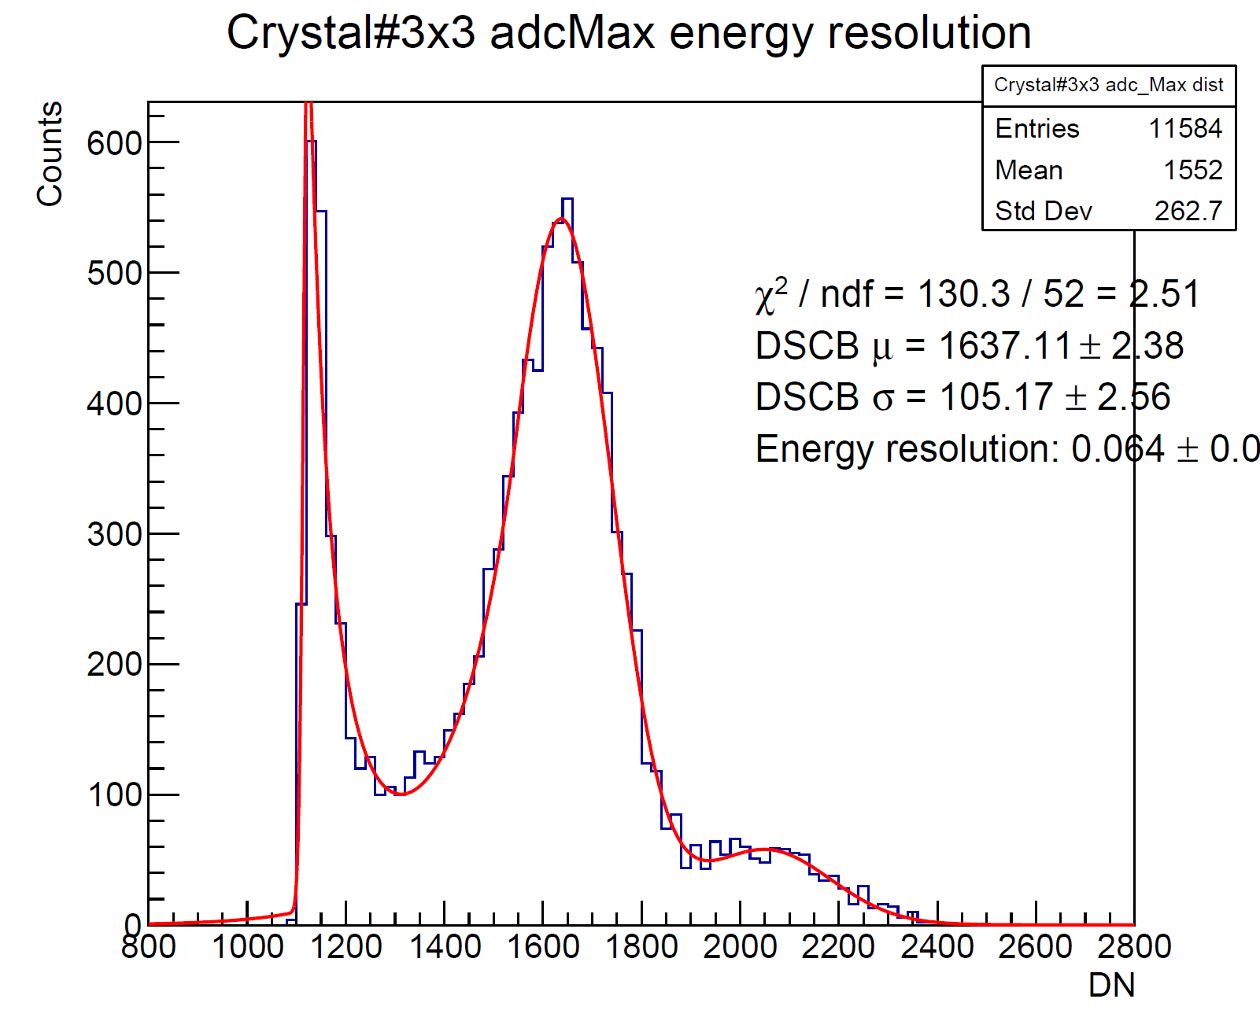
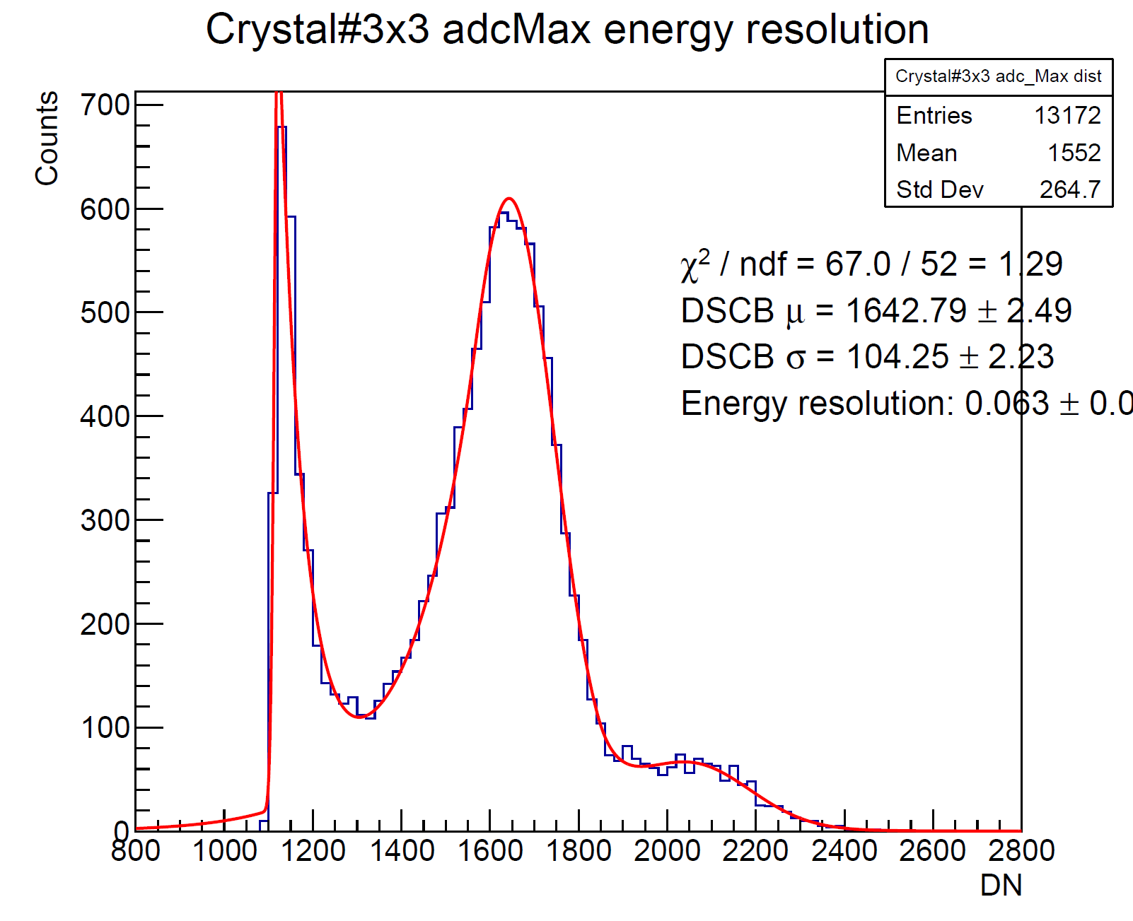
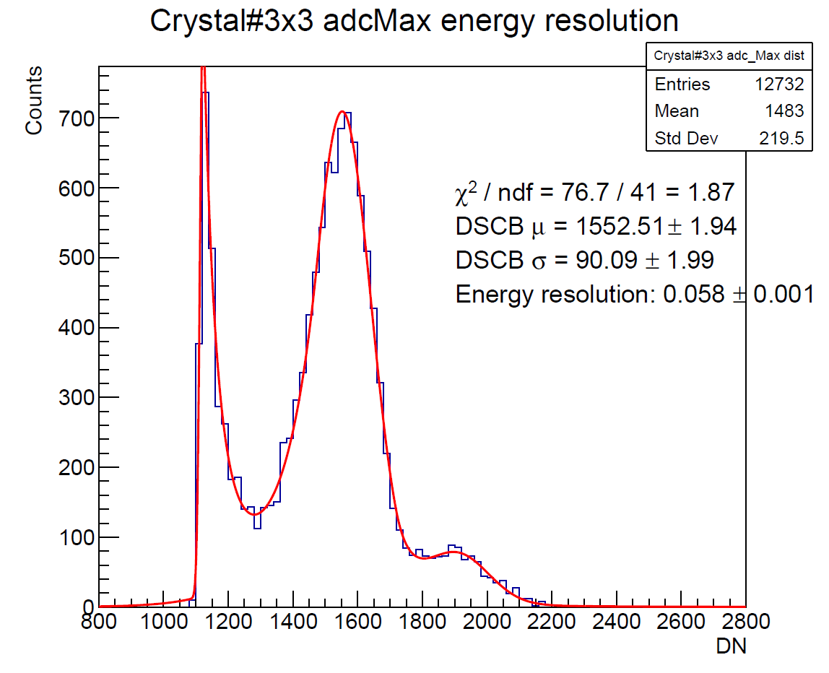
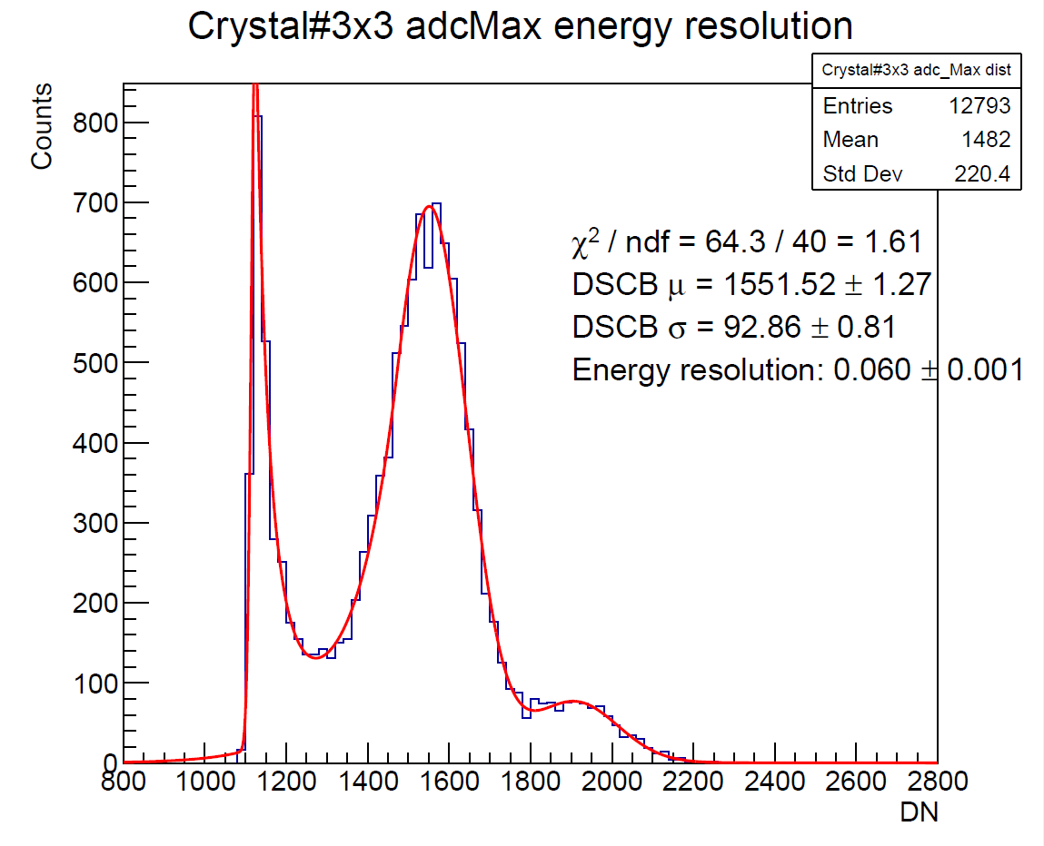
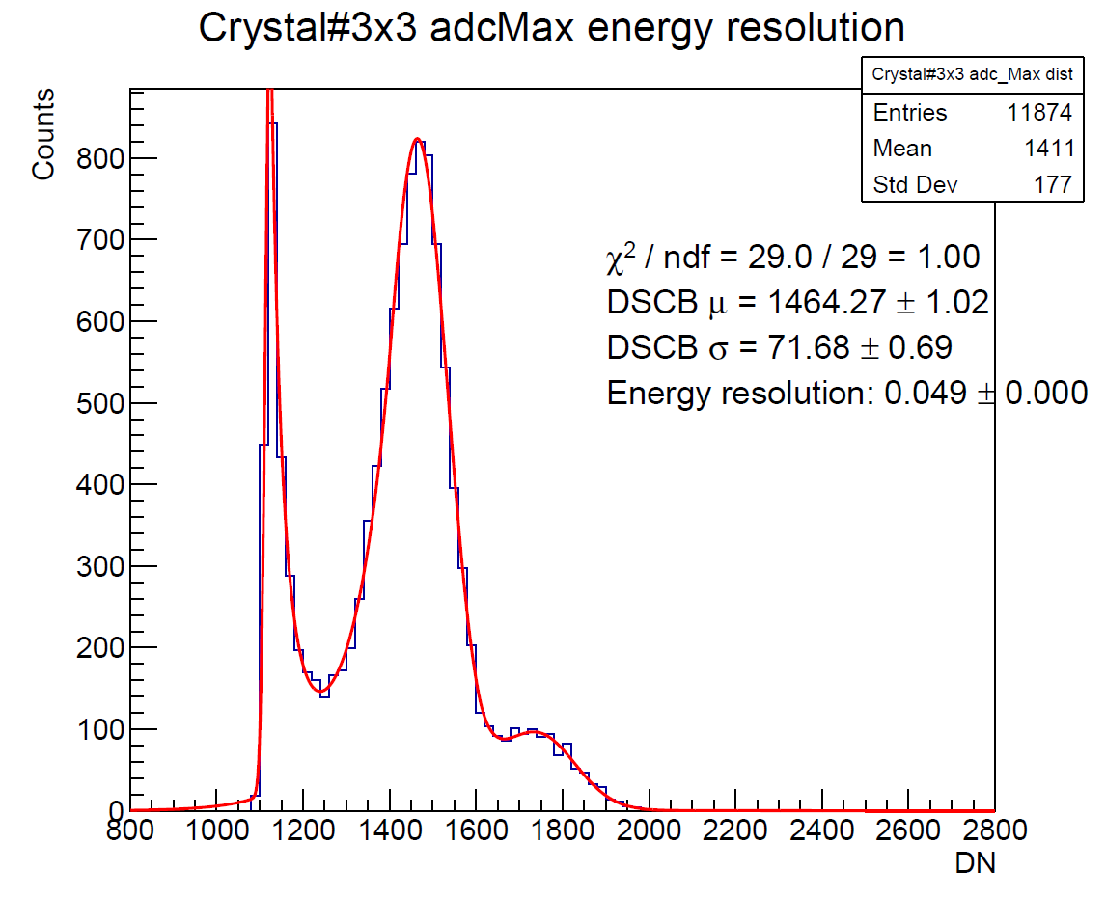

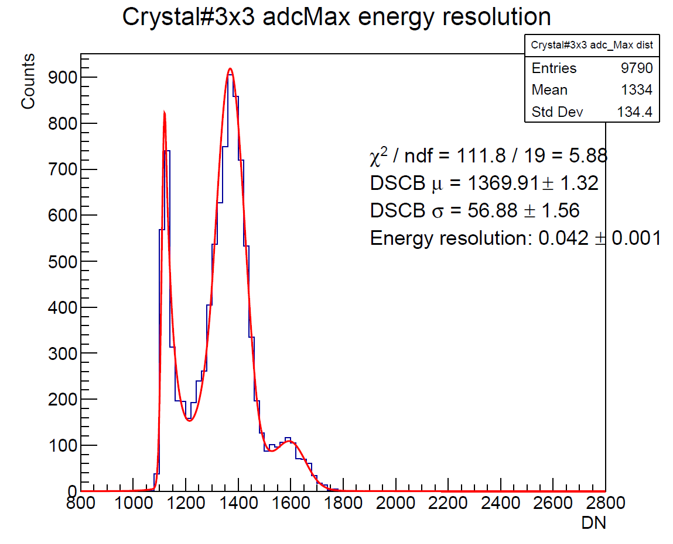
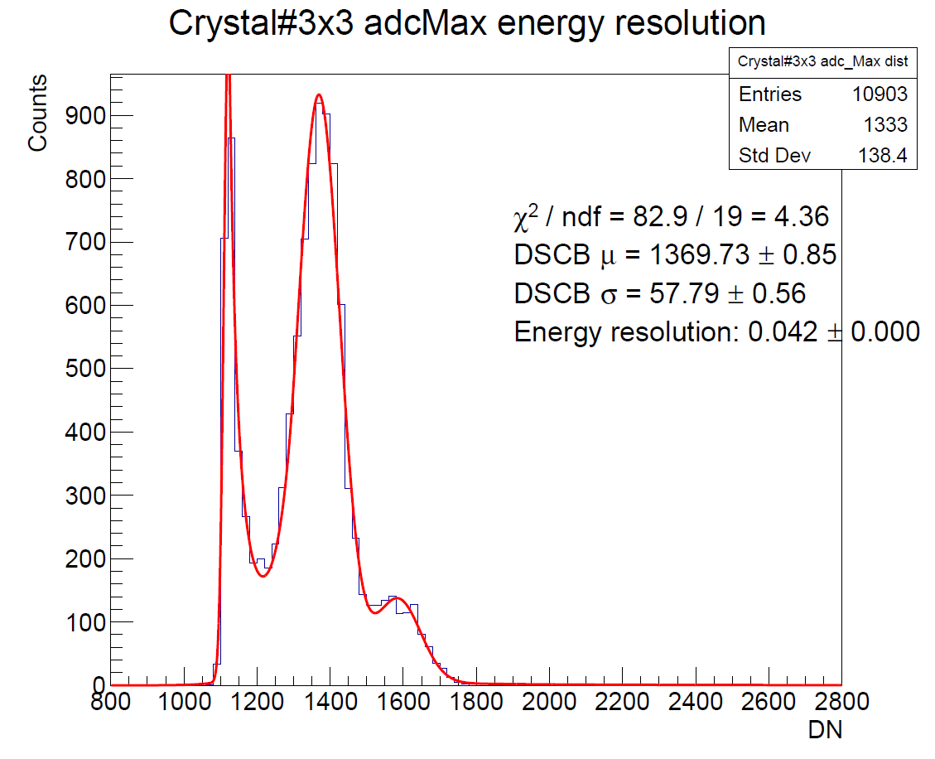
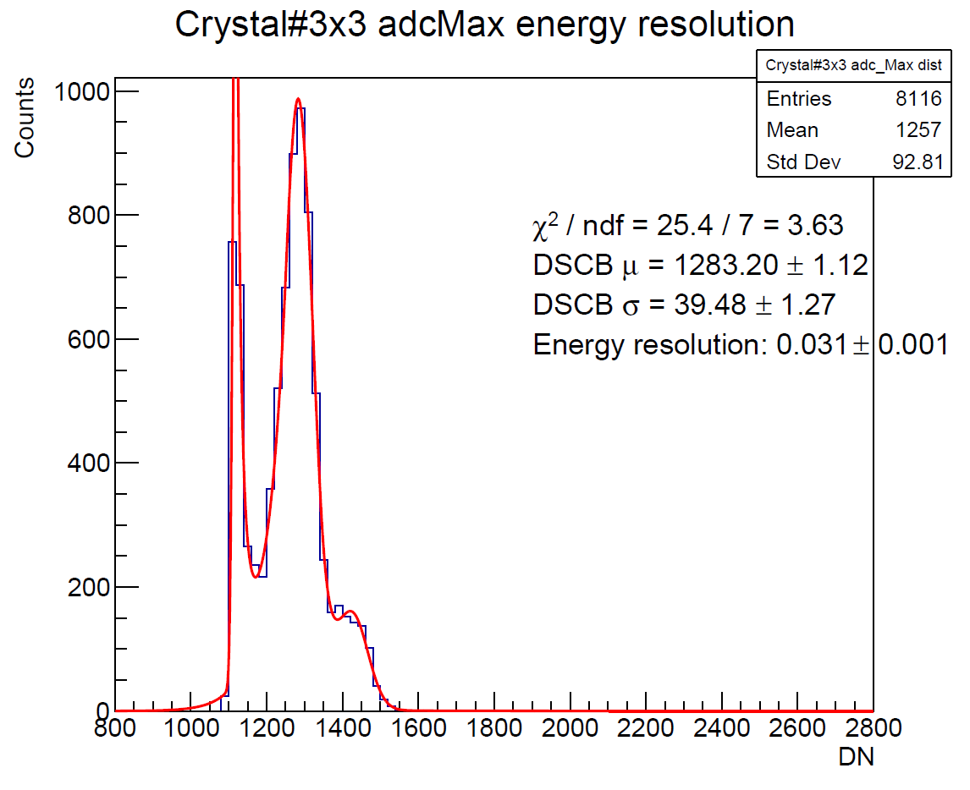
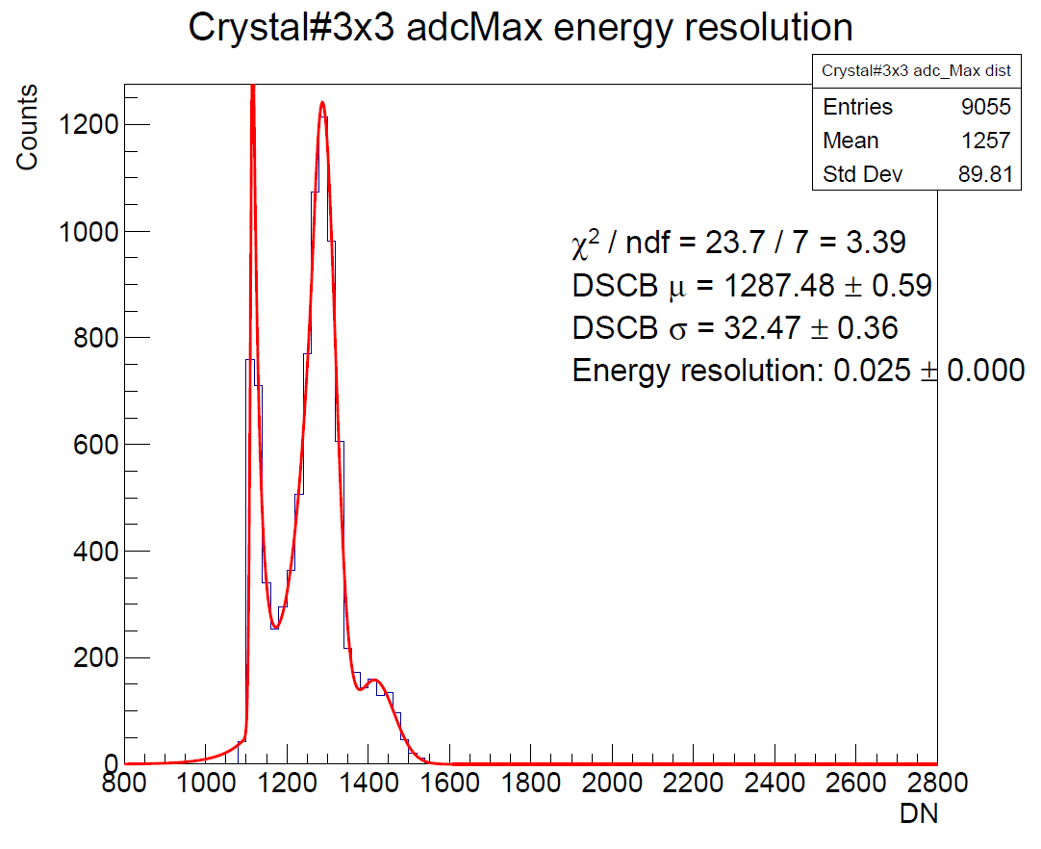
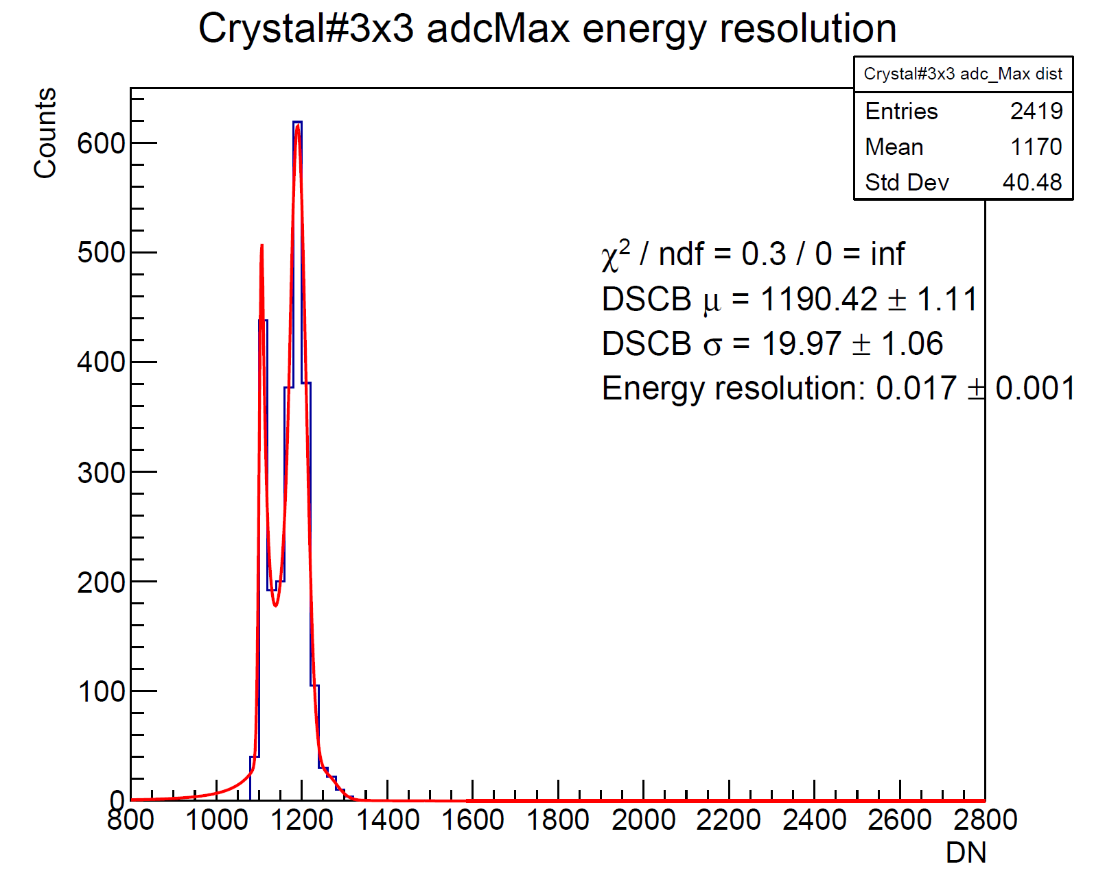
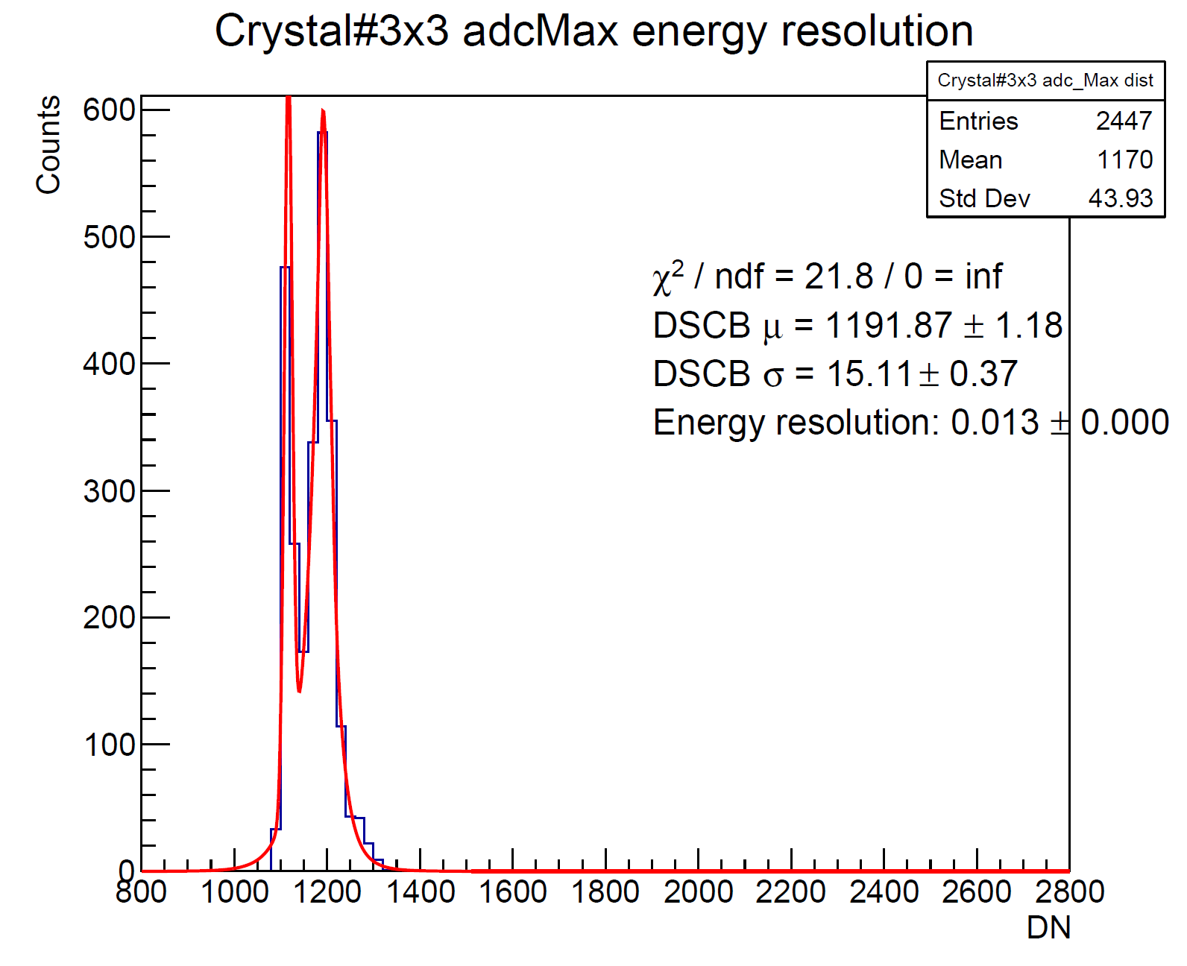

Raw ADCMax 3x3 resolution
For every beam E, there are two run
$$E_{beam}=823MeV$$
$$E_{beam}=705MeV$$
$$E_{beam}=584MeV$$
$$E_{beam}=492MeV$$
$$E_{beam}=395MeV$$
$$E_{beam}=297MeV$$
$$E_{beam}=197MeV$$
$$E_{beam}=100MeV$$

Slide 20
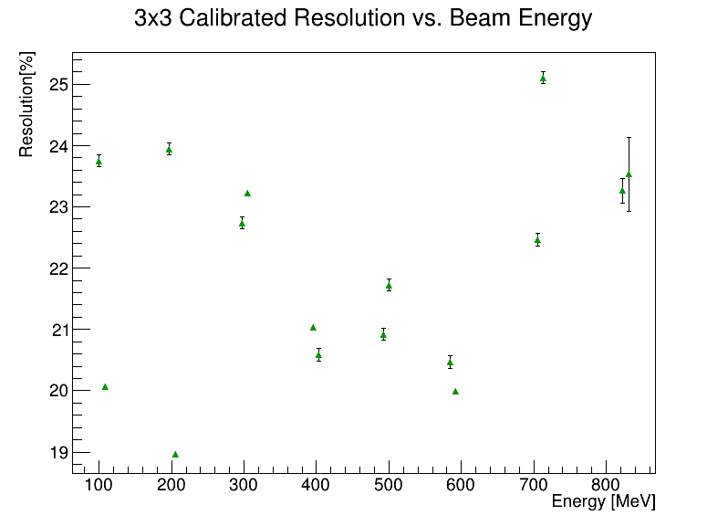
Energy resolution vs. beam energy
Resolution = $σ_{DSCB main}/μ_{DSCB main}$
ADCmax – ADC[0]
Raw ADCmax – pedestal max mean(constant)
By assuming ADC[0] is pedestal, better resolution is obtained from ADCMax-ADC[0] distribution.
Next Step:
Fit the original ADC waveform and define the pedestal
tracking

Slide 21
TO DO
The events in root file were not correctly decoded.
In some events, crystals given by FPGA1 and FPGA2 were not matched together on the correct timing, namely, signal from different events accidentally appear together.
The second peak observed in crystal#7
3x3 clustering energy distribution are
contributed by crystal#6 &7 simultaneously,
however, in reality, they should actually
have come from different events.
Previous analysis on the energy resolution
thus need to be redo on the correctly
decoded data.
FPGA1 FPGA2
2 3 4
6 7 8
10 11 12

