Slide 1
MHEP experiment group meeting
2026-09-29
MHEP Equipment budget TWD 10.4 M all spent
MHEP Operation budget TWD 3M
balance return to IPAS
2027 budget proposal
unless approved by group, spending are itemized to ind. PI
2028 百年慶, Centennial Celebration
to be hosted in Feb, 2028
highlights submit 10/05
history 2018-2028
Workshop with AAC, forum with TW Phys.Annual Conf.

Slide 2
MHEP Annual Operation summary
人員： 8 persons
AMS, Axion: 張元翰 林志勛
ATLAS: 侯書雲 王嵩銘 楊毅
Gravity: Haino 王子敬
Nuclear: 章文箴
Tier: 嚴漢偉 independent funding, exclude from MHEP budget
IPAS personal, per IP TWD 120k traveling, TWD 100k operation
MHEP operation: total TWD 3.125 M = 0.4 M/PI
MHEP 2026 Operation:
MingLi Zhu 0.348 MNT/yr, W.C. Chang
Lu Yun-Ju 0.73 MNT/yr, S.M. Wang
Peirong Tsai 0.348 MNT released after 2026 05/01 to NSTC
2026 Operation closure:
~0.6 M returned to IPAS
general spending items for purchase/labor/electricty are negative,
personal has large sum
you may ask sectary to query funds remains

Slide 3
MHEP Annual Equipment summary
MHEP group equipment > TWD 1M / PI
MHEP 2026 Equipment, under spent (3.52 M),
ATLAS Phase II finalized (5M), loan to Bio, Nano
MHEP 2027 call for proposal
Computing budget, shall be negociated with IT-group, ASGC
Excluded from MHEP group request
M(TWD) Plan/Spent | 2022 | 2023 | 2024 | 2025 | 2026 | 2027
ATLAS (Hou/Wang/Yang) | 0 | 0 | 4 | 4/ 2.965 | 5/ 0.1 | 3
Texono/LIGO (Wong) | 2 | 2 | 1.5 | 1.5/ 1.5 | 2/ 1.0 | 1
KAGRA (Haino) | 0.5 | 0.5 | 2.0 | 0.5/ 0.56 | 0.5/ 0.89 | 1
AMS/TASEH (Chang) | 1.65 | 2.5 | 1.0 | 0.5/ 0 | 1.0/ 0 | 1
Hadron (Chang) | 1.5 | 1.0 | 1.0 | 1.0/ 0.56 | 1.0/ 1.01 | 1
Instru (Lin) | 0.5 | 0.5 | 0.5 | 0.5/ 0.47 | 0.5/ 0.52 | 1
computing | 1.13 | 3.5 | 1.0 | 0.5 | IT/ASGC | IT/ASGC
SUM | 7.28 | 10.0 | 11.0 | 8.5/ 5.5 | 12/3.52 /10.4 | 8
Loan |  |  |  |  | Bio 0.55, Nano 6.3

Slide 4
MHEP 2027 Equipment tabulated
 | 116年度 機械設備概算表 |  |  | (單位：新台幣元)
排序 | 申請人姓名 | 設備名稱 | 數量 | 單價 | 總價 | 需求說明
 | 張元翰 | 搜尋低質量暗物質與軸子實驗，頻譜分析儀讀出元件及超低溫環境機械設備。 | 1 | 1,500,000 | 1,500,000 | 升級設備提，供測量讀出系統，真空及低溫實驗環境控制。
 | 王嵩銘 | ATLAS 升級探測器訊號處理電子設備與數據庫存取設備 | 1 | 1,500,000 | 1,500,000 | 高能組實驗室共用之基礎研究設施建構、維護及更新
 | 灰野禎一 | 重力波實驗雷射儀器系統 | 1 | 1,000,000 | 1,000,000 | 重力波實驗—刻度探測器計畫之用
 | 王子敬 | 重力實驗光學系統，訊號處理精密電子與數據擷取儀器 | 1 | 1,000,000 | 1,000,000 | 重力實驗之數據擷取，及實驗室之低溫環境
 | 王子敬 | 微中子探測器昇級 | 1 | 500,000 | 500,000 | 增強微中子探測器
 | 章文箴 | 可編程邏輯晶片電子開發系統及探測器高壓系統 | 1 | 1,500,000 | 1,500,000 | 矽探測器和氣體探測器的供電系統及 讀出電子元件之研發
 | 王嵩銘 | 網格 CPU及GPU 計算處理器 | 1 | 2,000,000 | 2,000,000 | 配合物理研究需求,擴充高效能 GPU 計算資源設備
 | 侯書雲 | ATLAS升級與CEPC碰撞束流LumiCal探測器研發電子讀出設備 | 1 | 1,500,000 | 1,500,000 | 提供LumiCal原型材料及開發器械之設備
 | 楊毅 | EIC 探測器研發數據截取系統 | 1 | 1,500,000 | 1,500,000 | 探測器測試與Prototype的性能測試設備
 | 申請總額 |  |  |  | 12,000,000

Slide 5
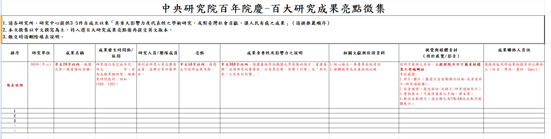
AS, IPAS 百年慶, Centennial Celebration
to be hosted in Feb, 2028
highlights submit 10/05
history 2018-2028
Workshop with AAC, forum with TW Phys. Annual Conf.
發現Higgs粒子 及 實驗粒子物理研究的生根與成就 (20字)
Dark Matter
Neutrino
Nuclear
Gav. Wave

