Slide 1
ECal 3rd Prototype
Beam Test Analysis
Yen-Chen Wu
Dept. Physics, National Central University
2026/09/30

Slide 2
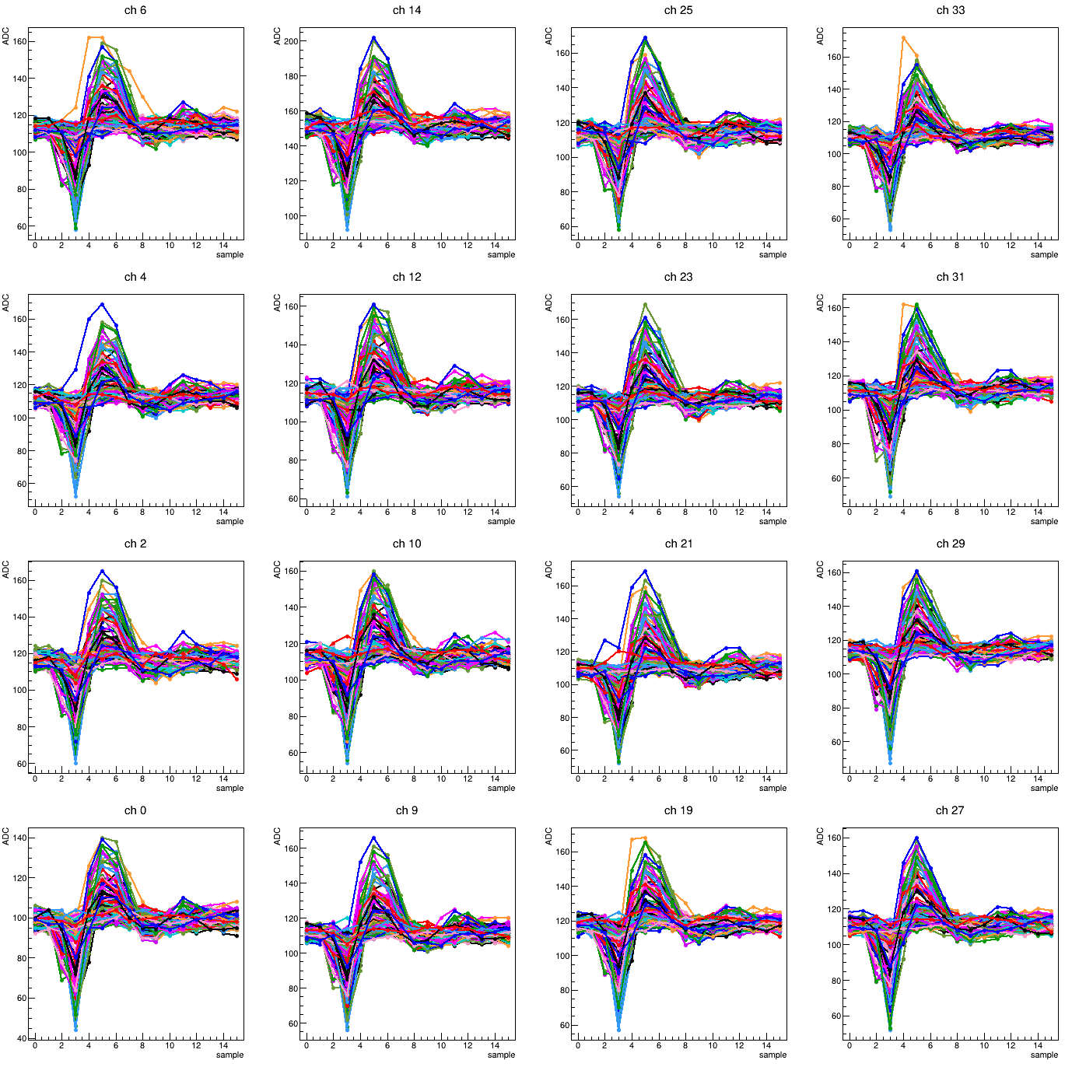
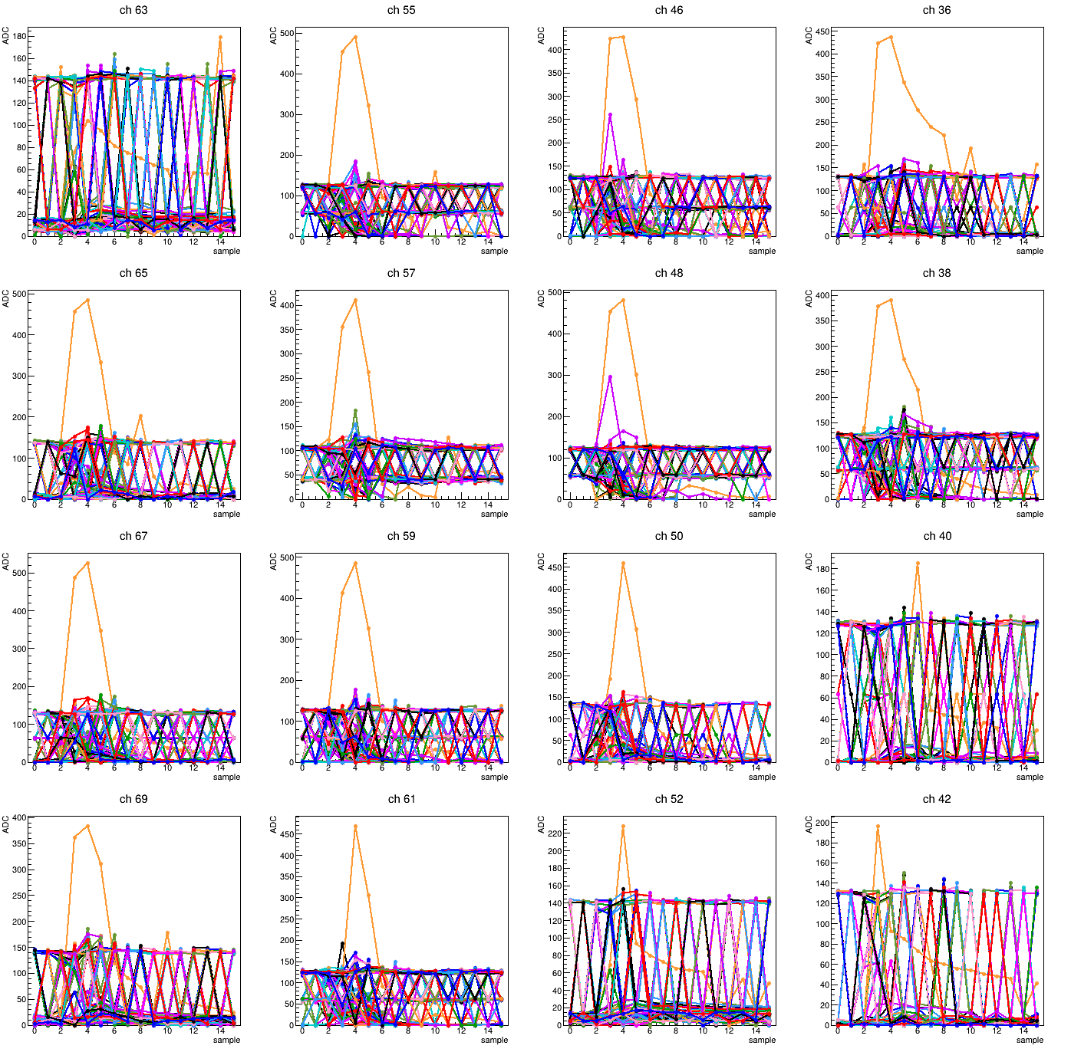
Pedestal issue report
Crystal#1
Crystal#2

Slide 3
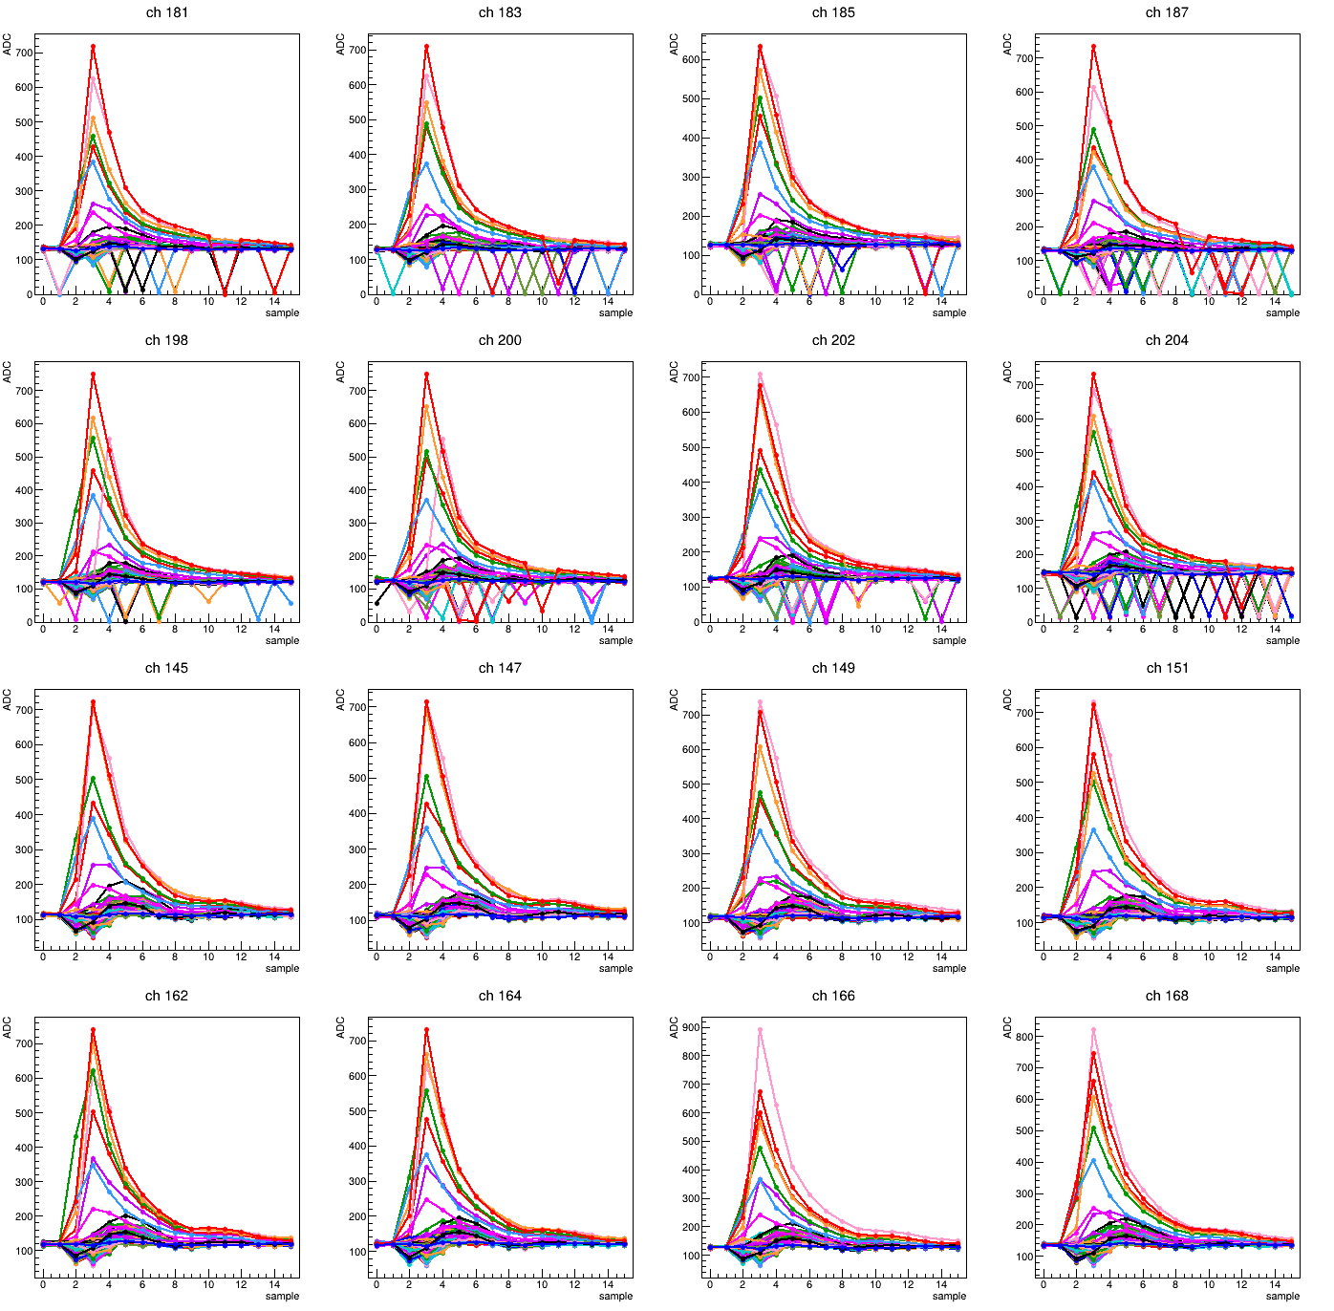
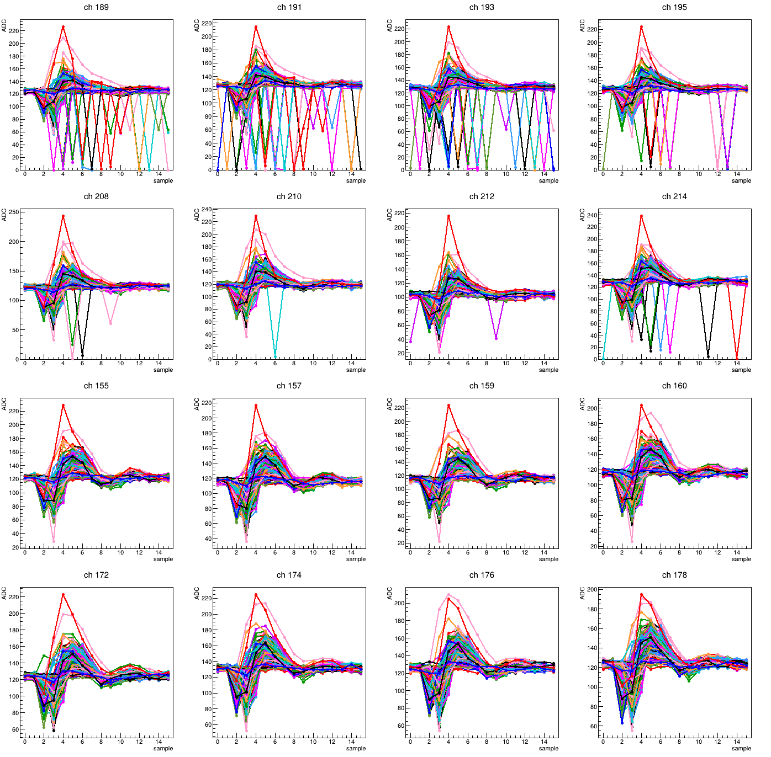
Pedestal issue report
Crystal#3
Crystal#4

Slide 4
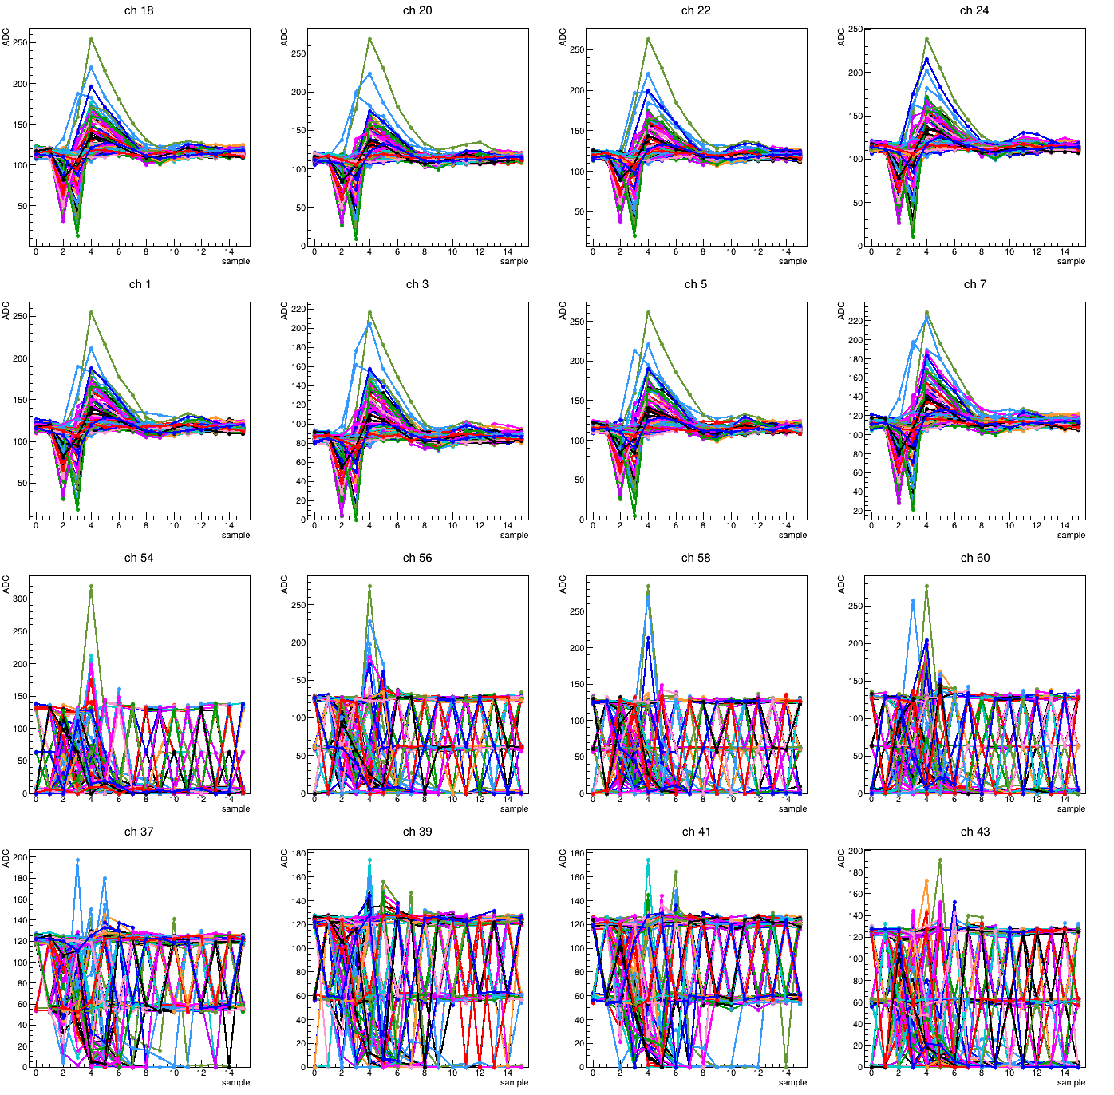
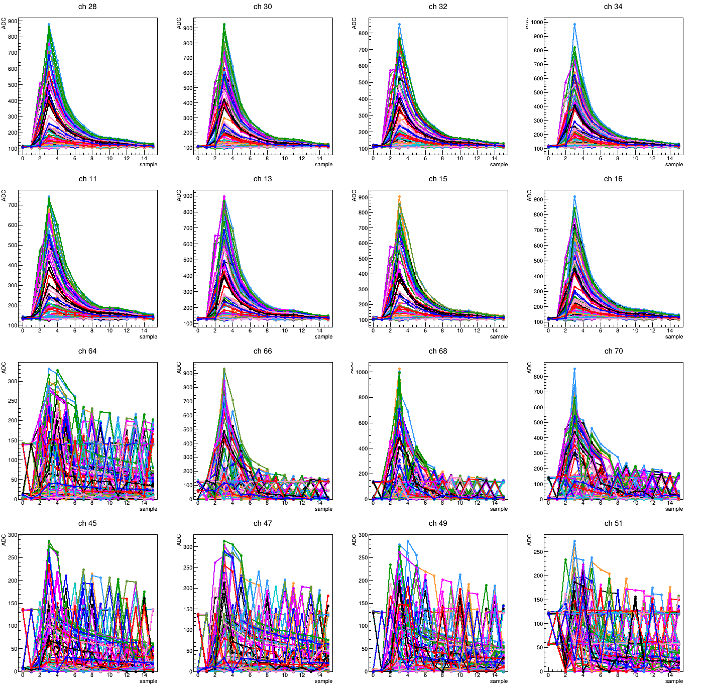
Pedestal issue report
Crystal#5
Crystal#6
Channel:
Channel:

Slide 5
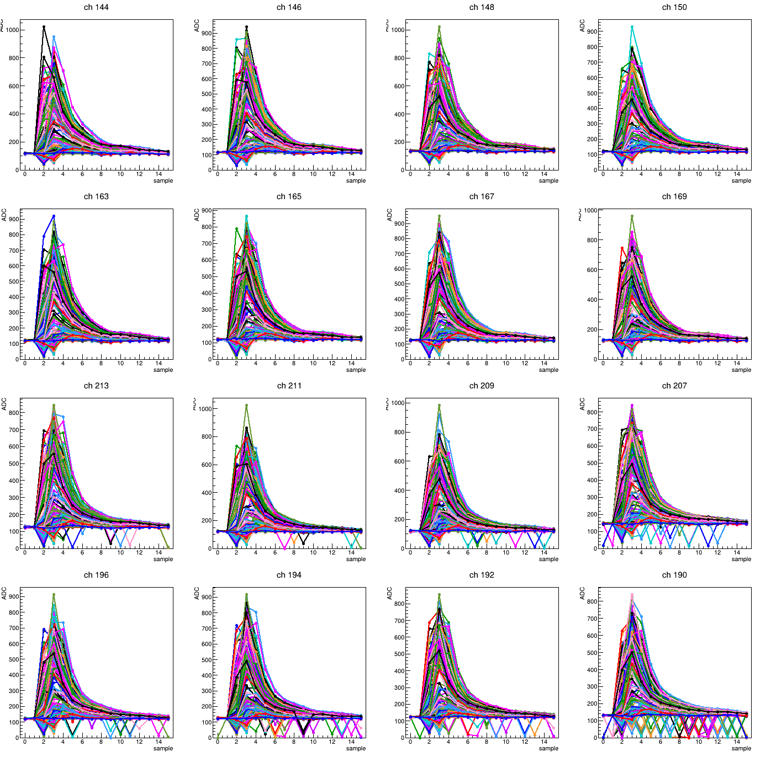
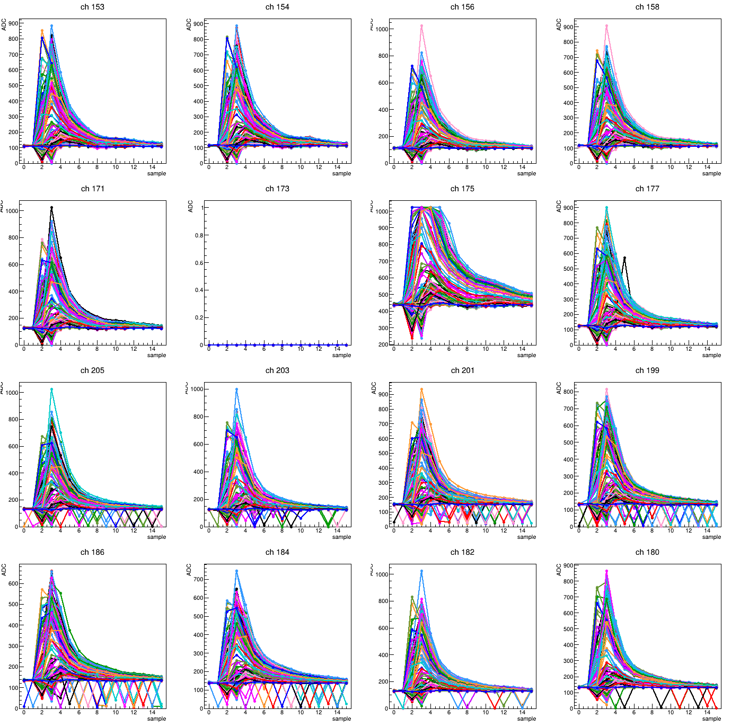
Pedestal issue report
Crystal#7
Crystal#8

Slide 6
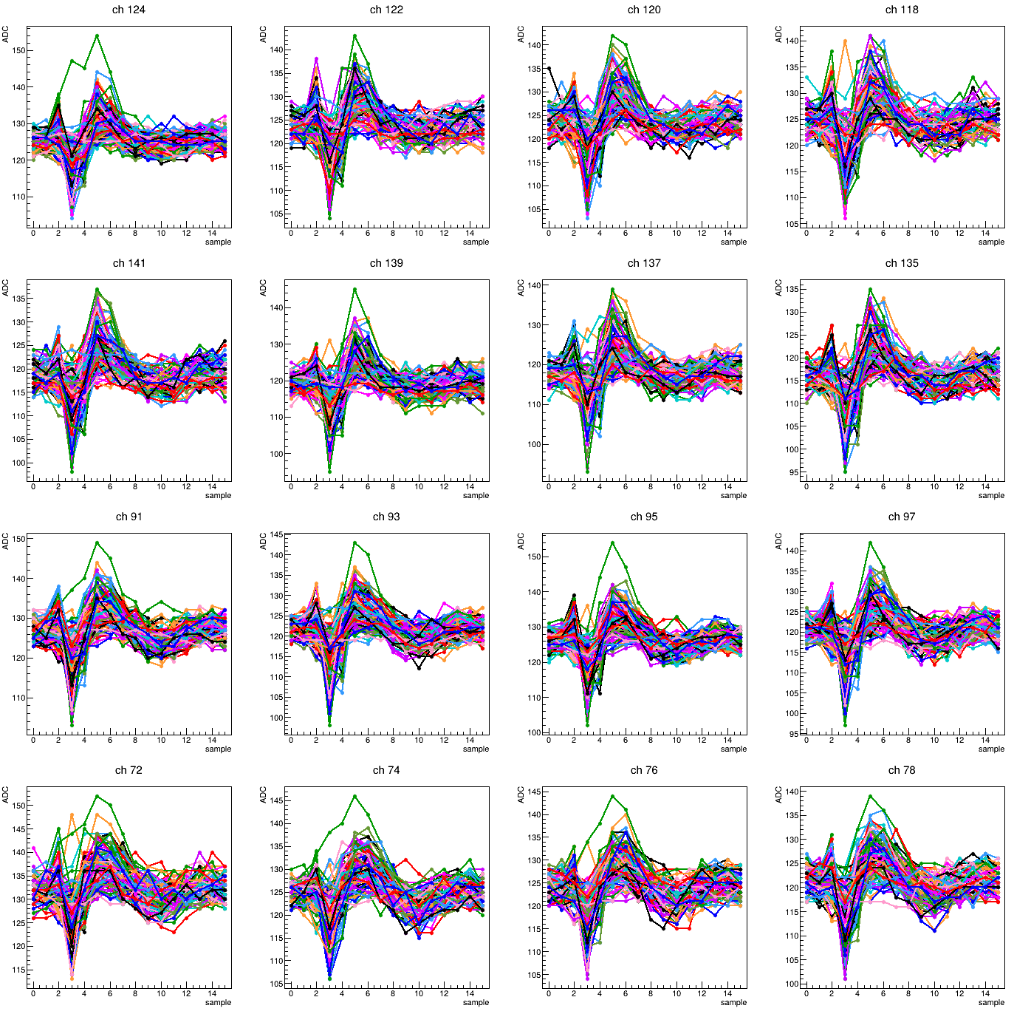
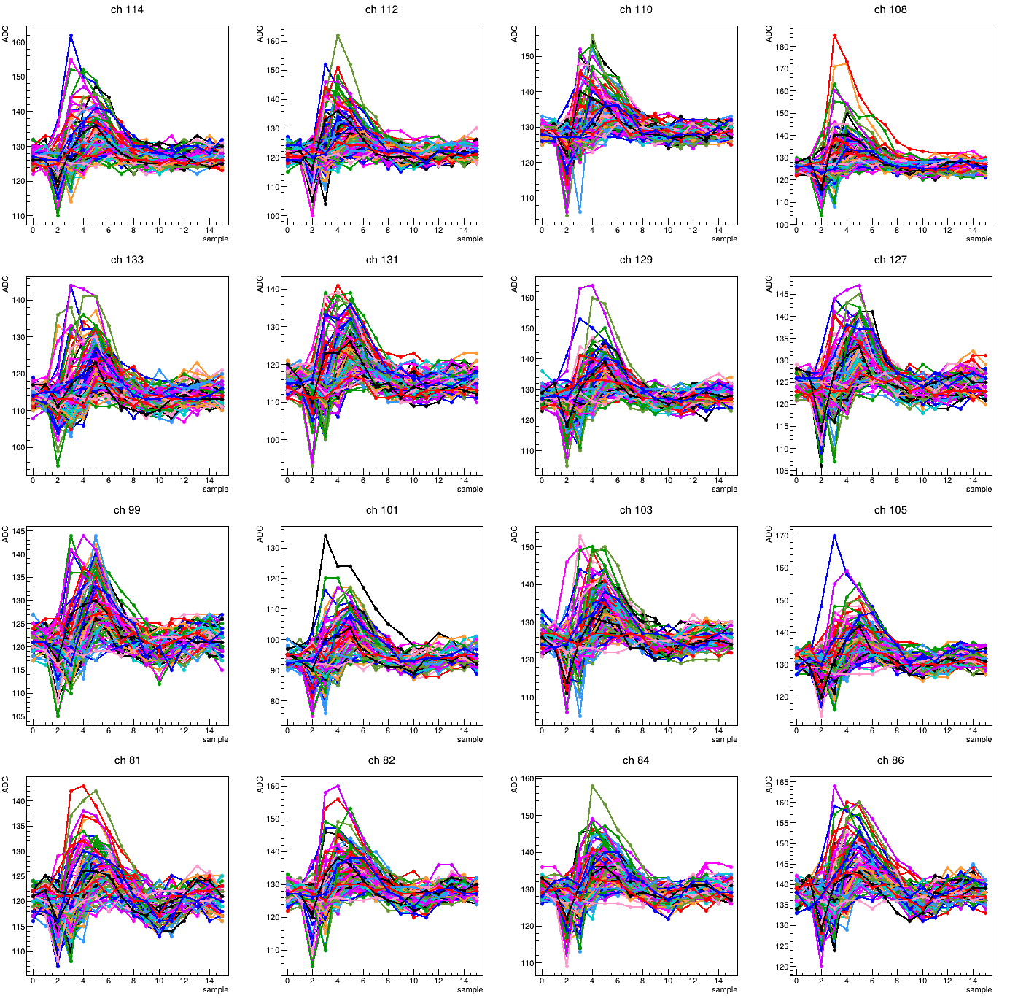
Pedestal issue report
Crystal#9
Crystal#10

Slide 7
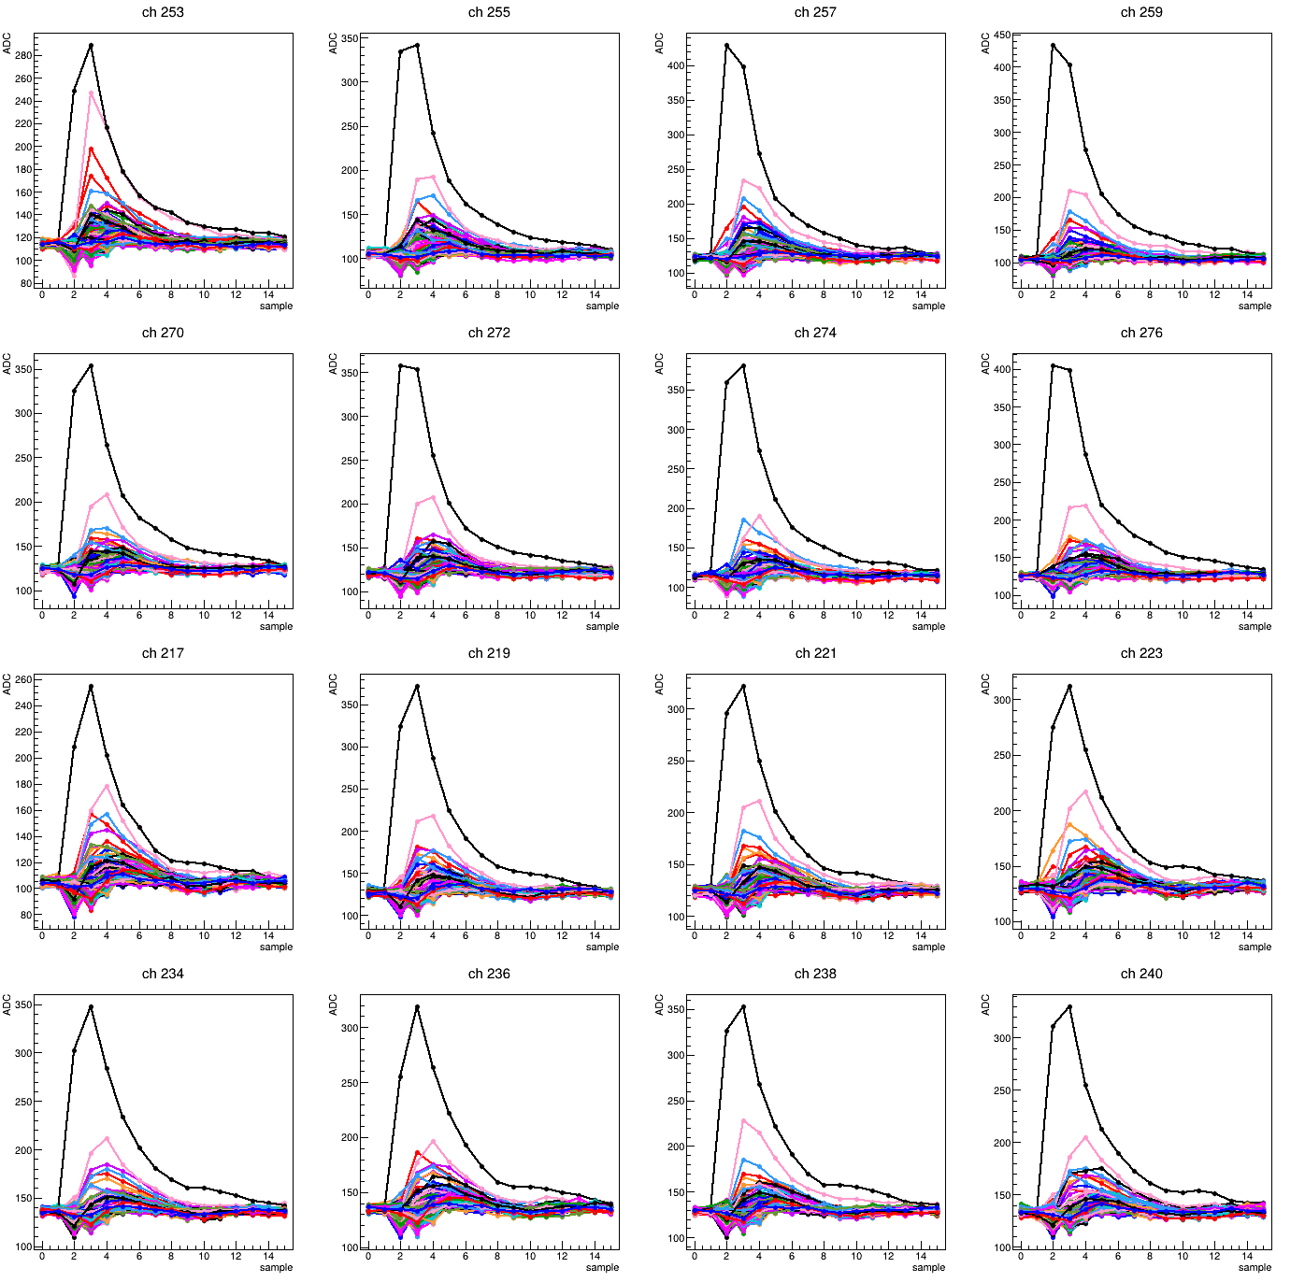
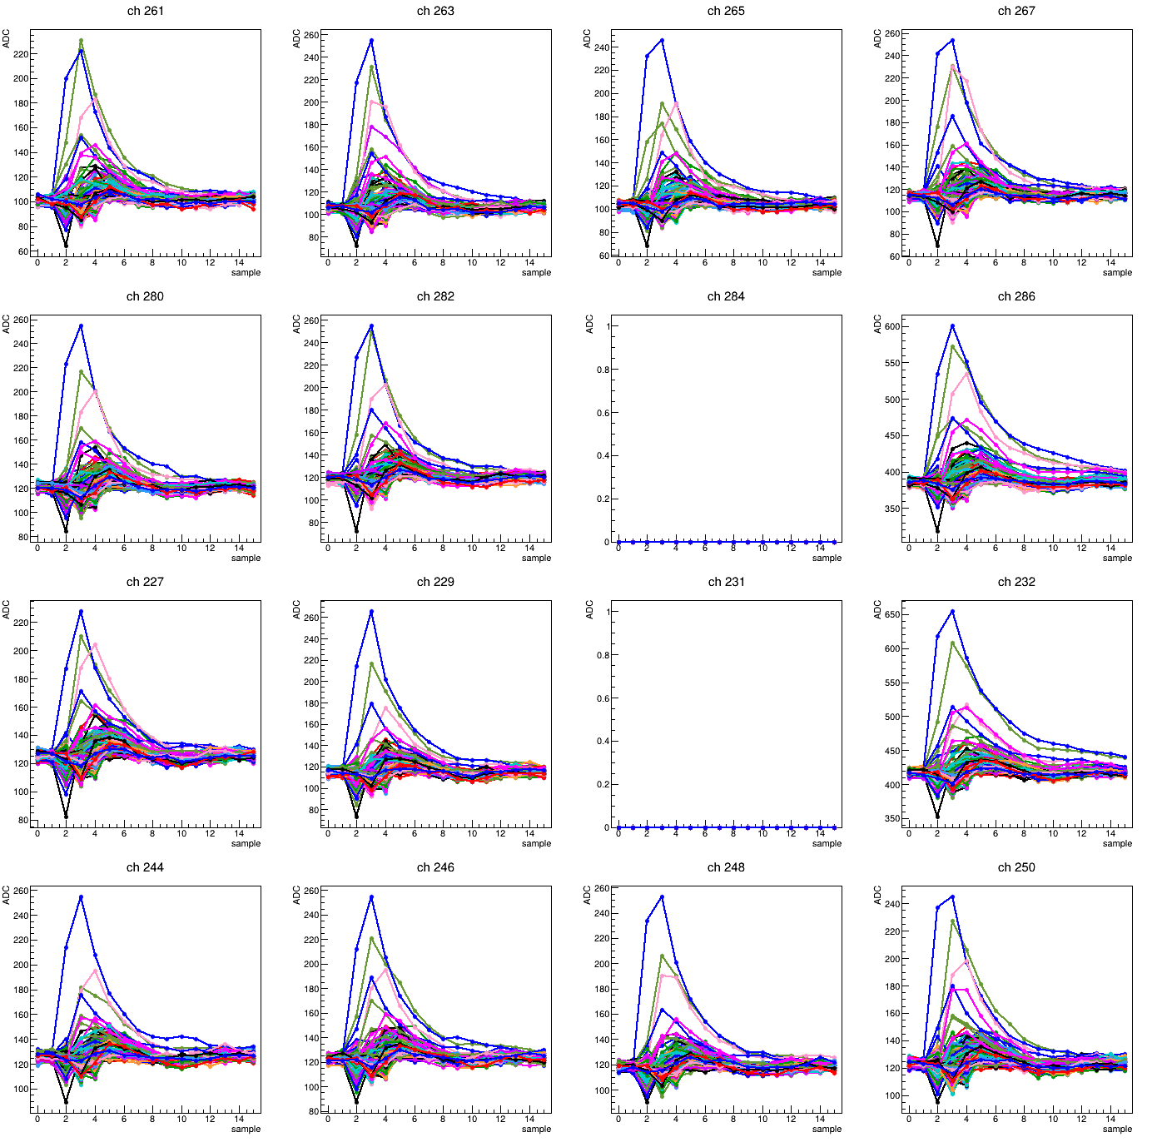
Pedestal issue report
Crystal#11
Crystal#12

Slide 8
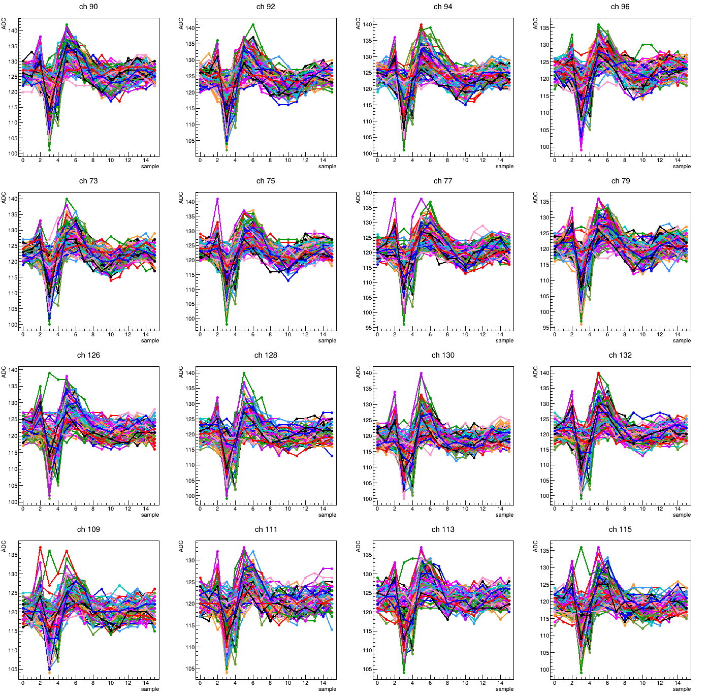
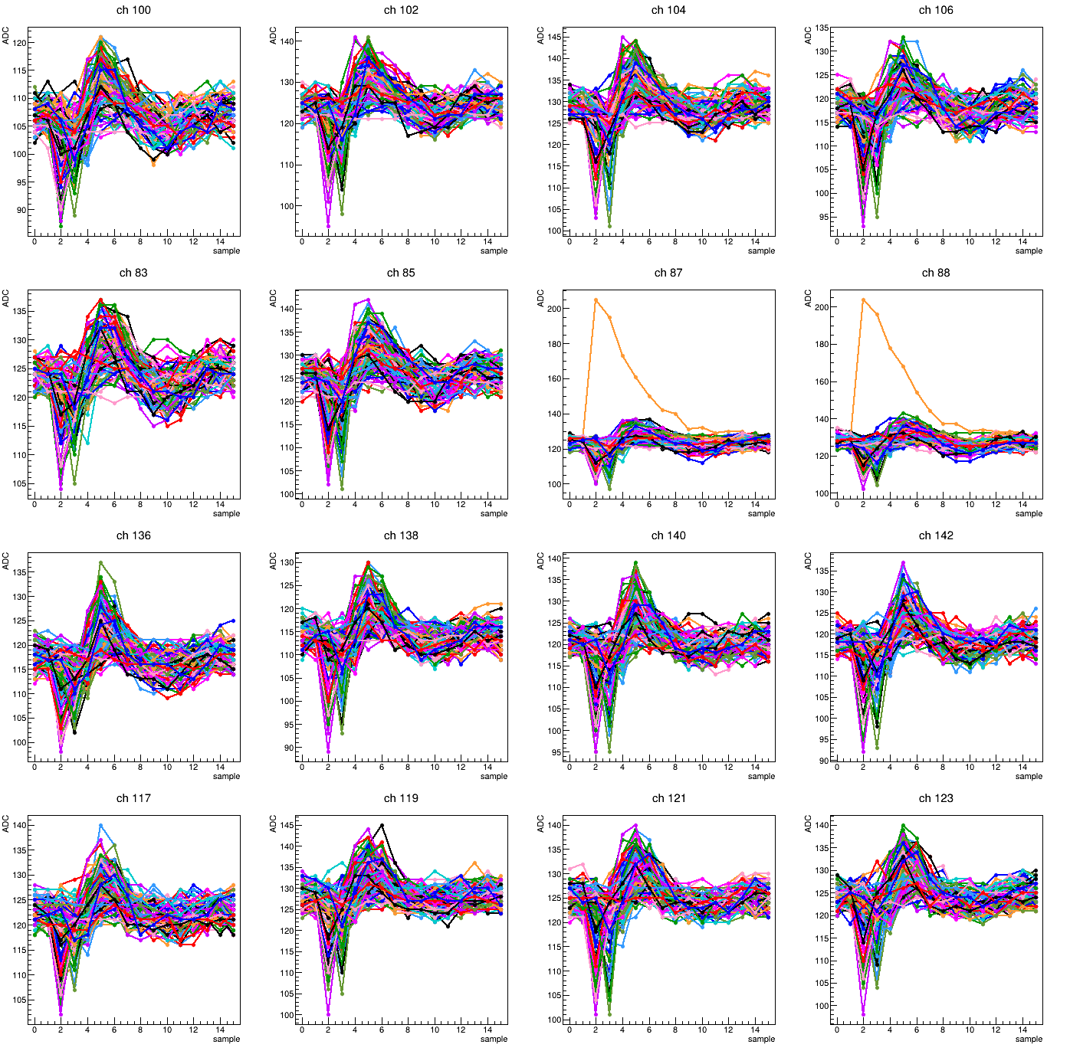
Pedestal issue report
Crystal#13
Crystal#14

Slide 9
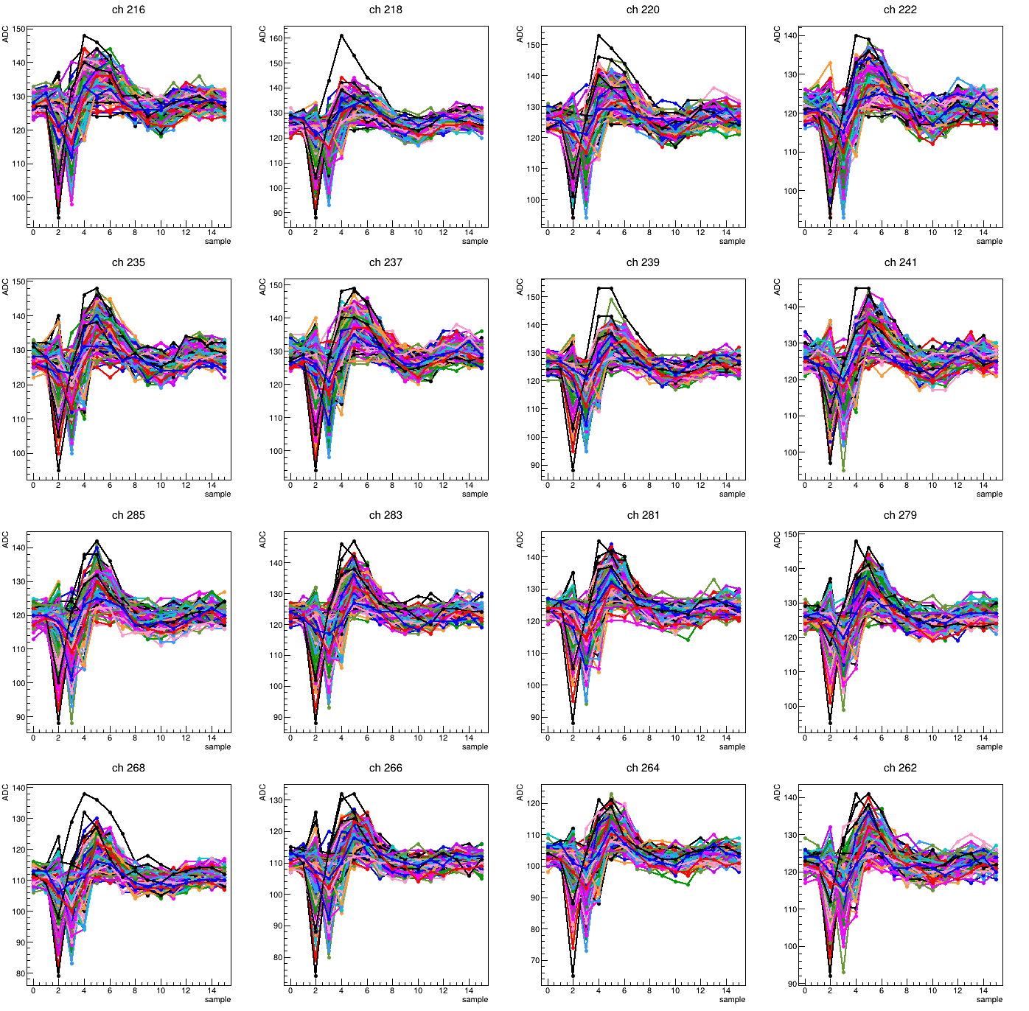
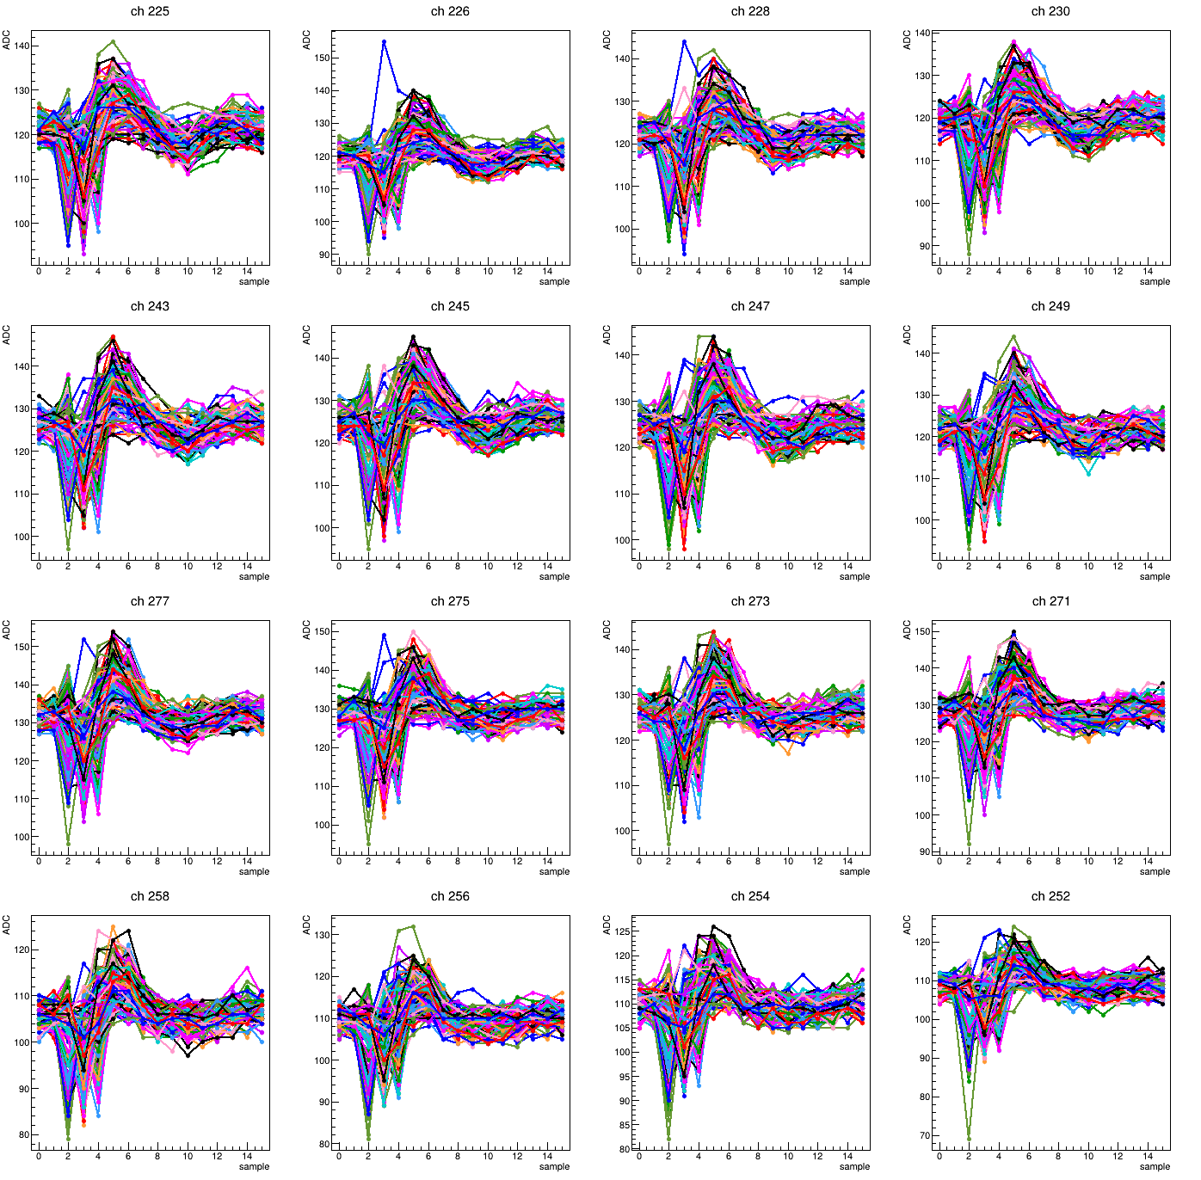
Pedestal issue report
Crystal#15
Crystal#16

Slide 10
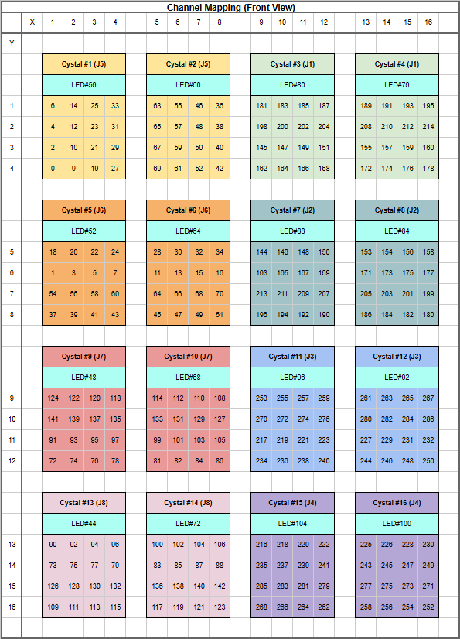
Dead channels by hardware unit
IC1:
0~8, 9~17,
18~26,27~35,
36~44, 45~53,
54~62, 63~71
IC3:
144~152,153~161,
162~170, 171~179,
180~188, 189~197,
198~206, 207~215
IC2:72~143
IC4:216~287
Individual dead channel
(eg: offset, no signal, weak signal)

Slide 11
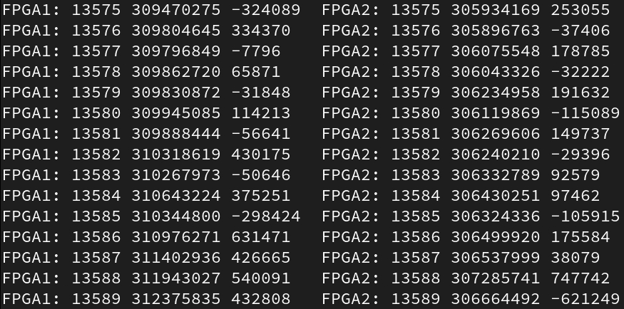
FPGA1 FPGA2 time mismatch
FPGA1
FPGA2
Evt number
timestamps_r
t[i]-t[i-1]
evt number
timestamps_r
t[i]-t[i-1]

Slide 12
Time-aligned event matching
Run421:total evt: 13590 matched evt: 13417 evt discarded: 173 recover rate: 0.98727
Run422:total evt: 1929 matched evt: 1894 evt discarded: 35 recover rate: 0.981856
Run423:total evt: 11584 matched evt: 11454 evt discarded: 130 recover rate: 0.988778
Run424:total evt: 13172 matched evt: 13022 evt discarded: 150 recover rate: 0.988612
Run425:total evt: 12732 matched evt: 12591 evt discarded: 141 recover rate: 0.988926
Run426:total evt: 12793 matched evt: 12658 evt discarded: 135 recover rate: 0.989447
Run427:total evt: 11874 matched evt: 11752 evt discarded: 122 recover rate: 0.989725
Run428:total evt: 12331 matched evt: 12205 evt discarded: 126 recover rate: 0.989782
Run429:total evt: 9790 matched evt: 9685 evt discarded: 105 recover rate: 0.989275
Run430:total evt: 10903 matched evt: 10781 evt discarded: 122 recover rate: 0.98881
Run431:total evt: 8116 matched evt: 8028 evt discarded: 88 recover rate: 0.989157
Run432:total evt: 9055 matched evt: 8962 evt discarded: 93 recover rate: 0.989729
Run433:total evt: 2419 matched evt: 2392 evt discarded: 27 recover rate: 0.988838
Run434:total evt: 2447 matched evt: 2428 evt discarded: 19 recover rate: 0.992235
Run481:total evt: 18875 matched evt: 18672 evt discarded: 203 recover rate: 0.989245
Run482:total evt: 18710 matched evt: 18511 evt discarded: 199 recover rate: 0.989364
Event recover rate are all above 98%
Successful cross-check with 家城

Slide 13
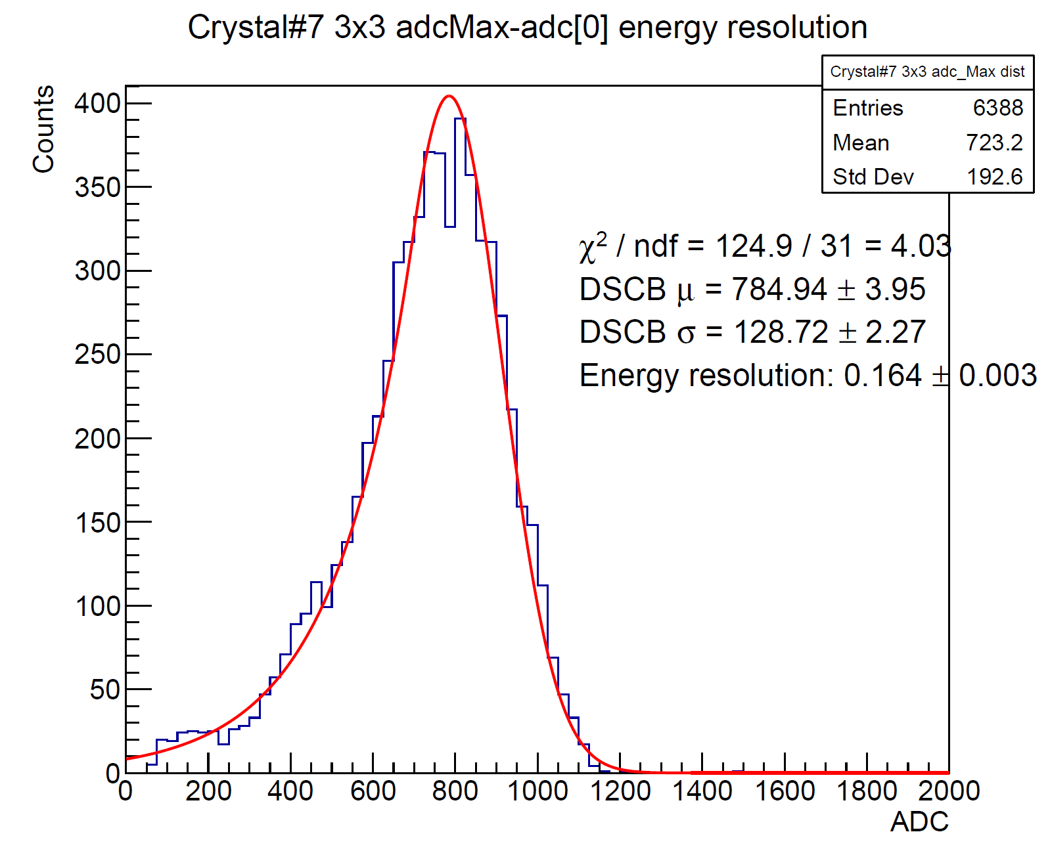
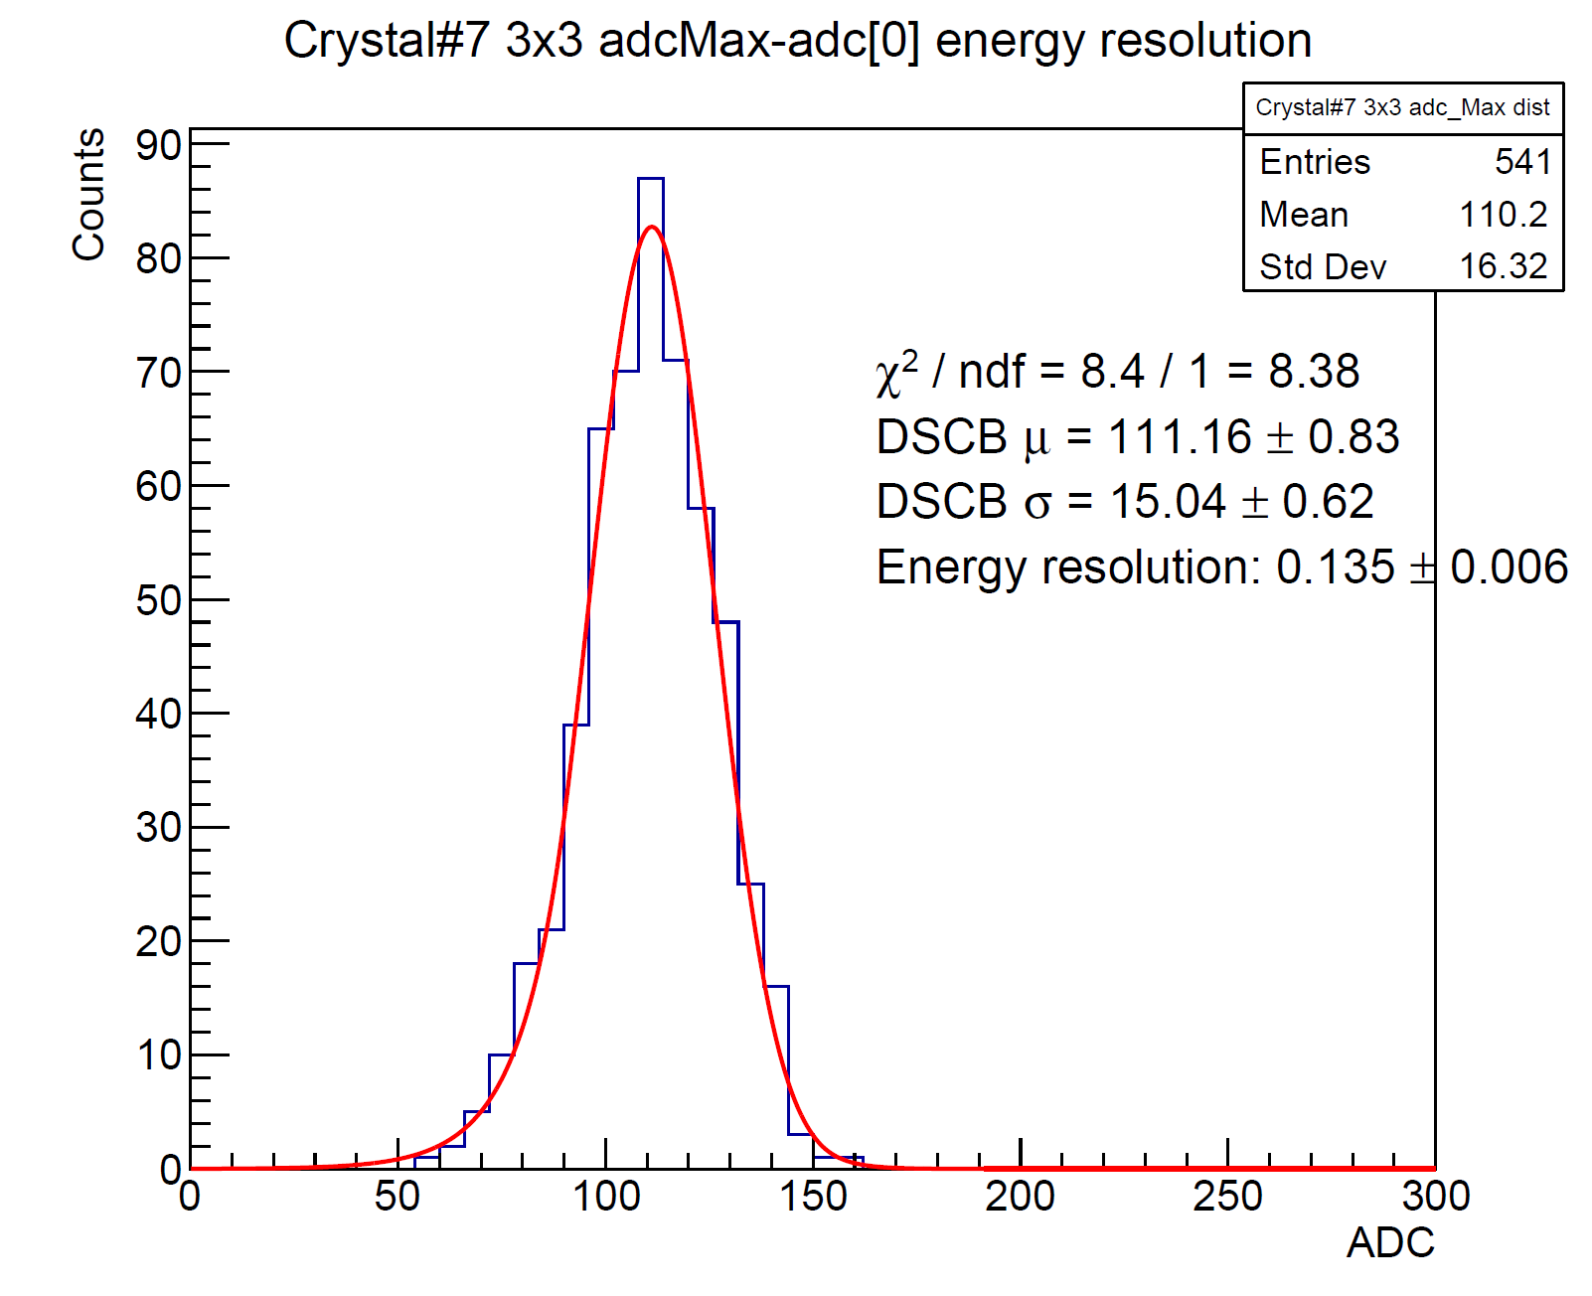
3x3 energy clustering
Run421 E_beam=823MeV
Run433 E_beam=100MeV
Energy in one crystal is defined as “(raw ADCmax – ADC[0])/number of good channel”
Summation over all 3x3 crystals around crystal#7
Fit with DSBC
No second peak found!

Slide 14
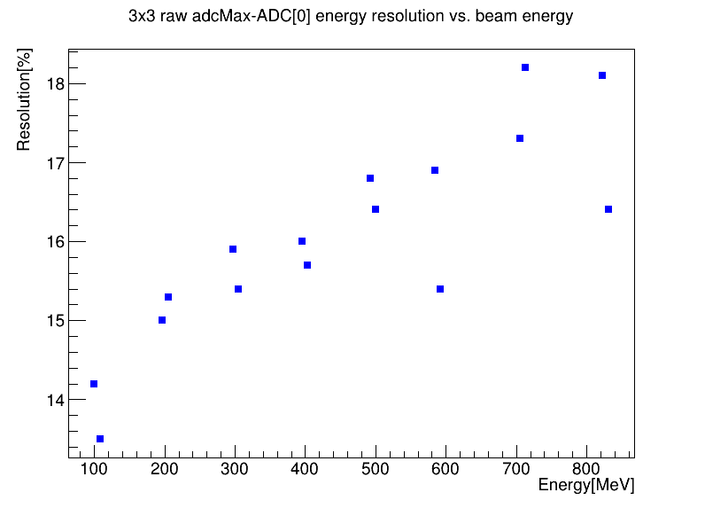
Energy resolution vs. beam energy
Energy in one crystal is defined as “(raw ADCmax – ADC[0])/number of good channel”
Summation over all 3x3 crystals around crystal#7
Fit with DSBC
Energy resolution is defined as DSBC sigma/mean

