Slide 1
RPC development weekly progress
Yi-Min Lee, Meng-Hsin Yeh, Yen-Chen Wu
Dept. Physics, National Central University
2026/08/24

Slide 2
Outline
Cosmic ray trigger setting
  Thin scintillator bar (for individual channel scan)
  Square scintillator bar (cover 3 channels)
High Voltage module usage
Experiment Setup
RPC signal
RPC efficiency test /HV scan

Slide 3
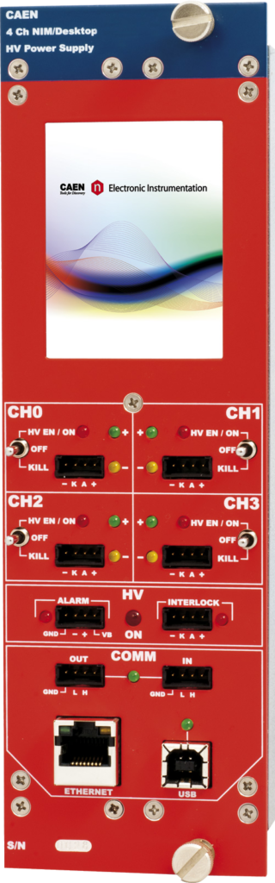
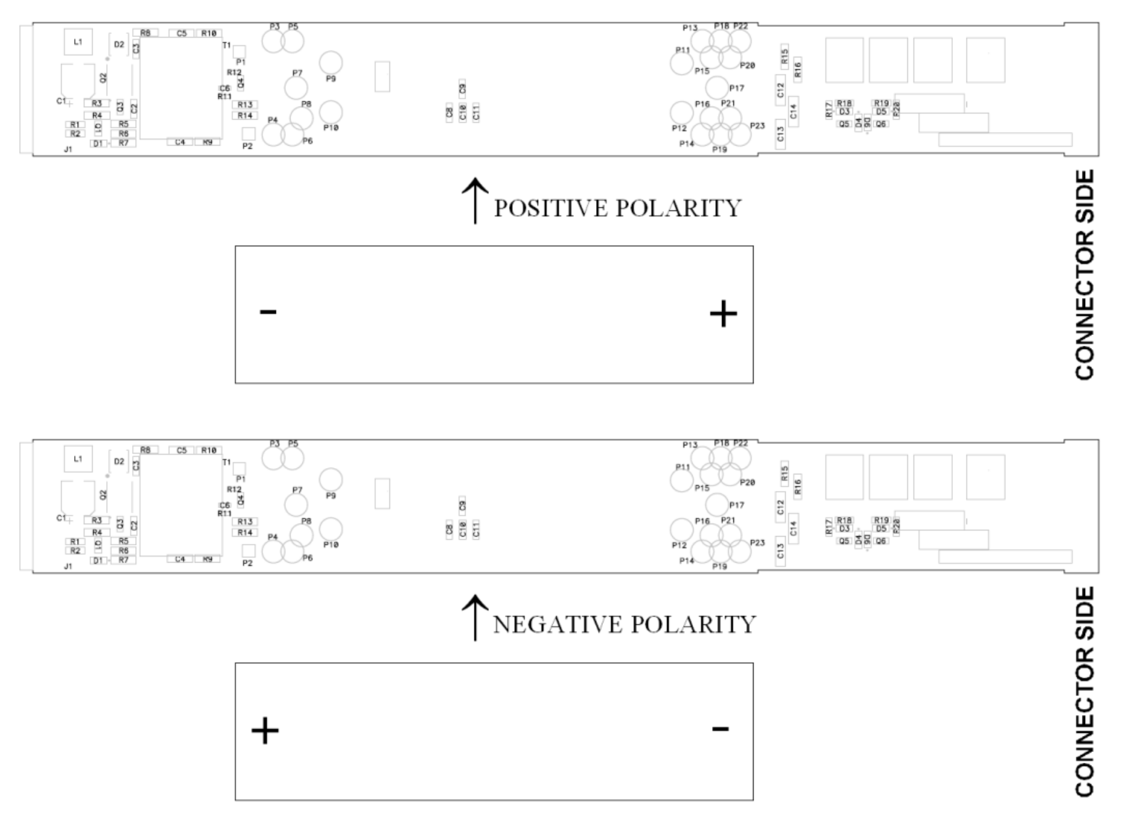
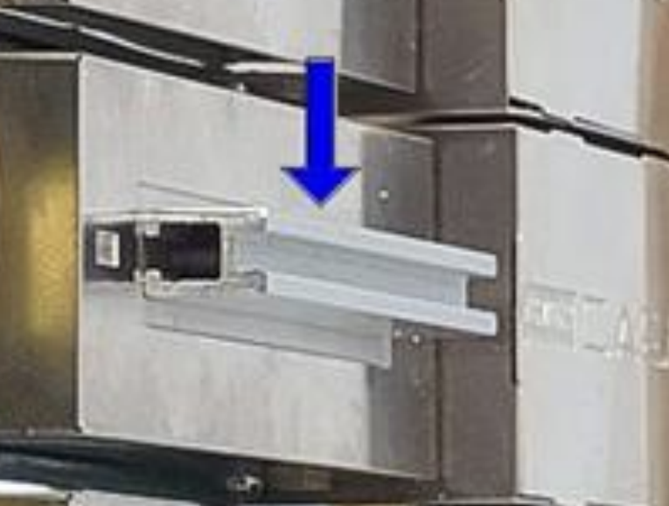
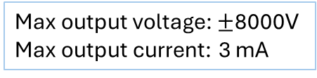
HV module (CAEN NDT1470 )
High-voltage power supply
Polarization setting
  The output polarity is independently selectable for each channel.
  Lift the side cover, and plug the diode bridge box with the desired symbol (+ or -) facing the connector side.
Max output voltage: $±$8000V
Max output current: 3 mA

Slide 4
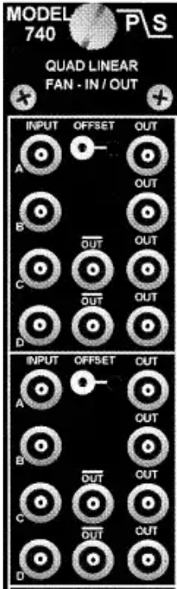
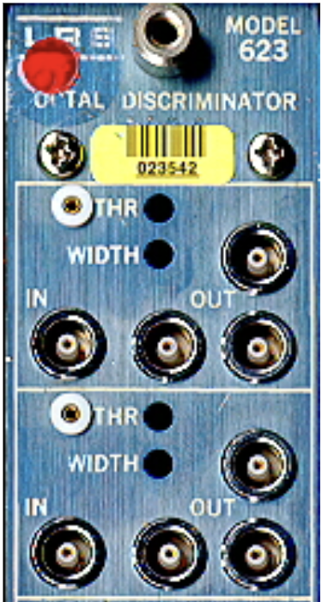
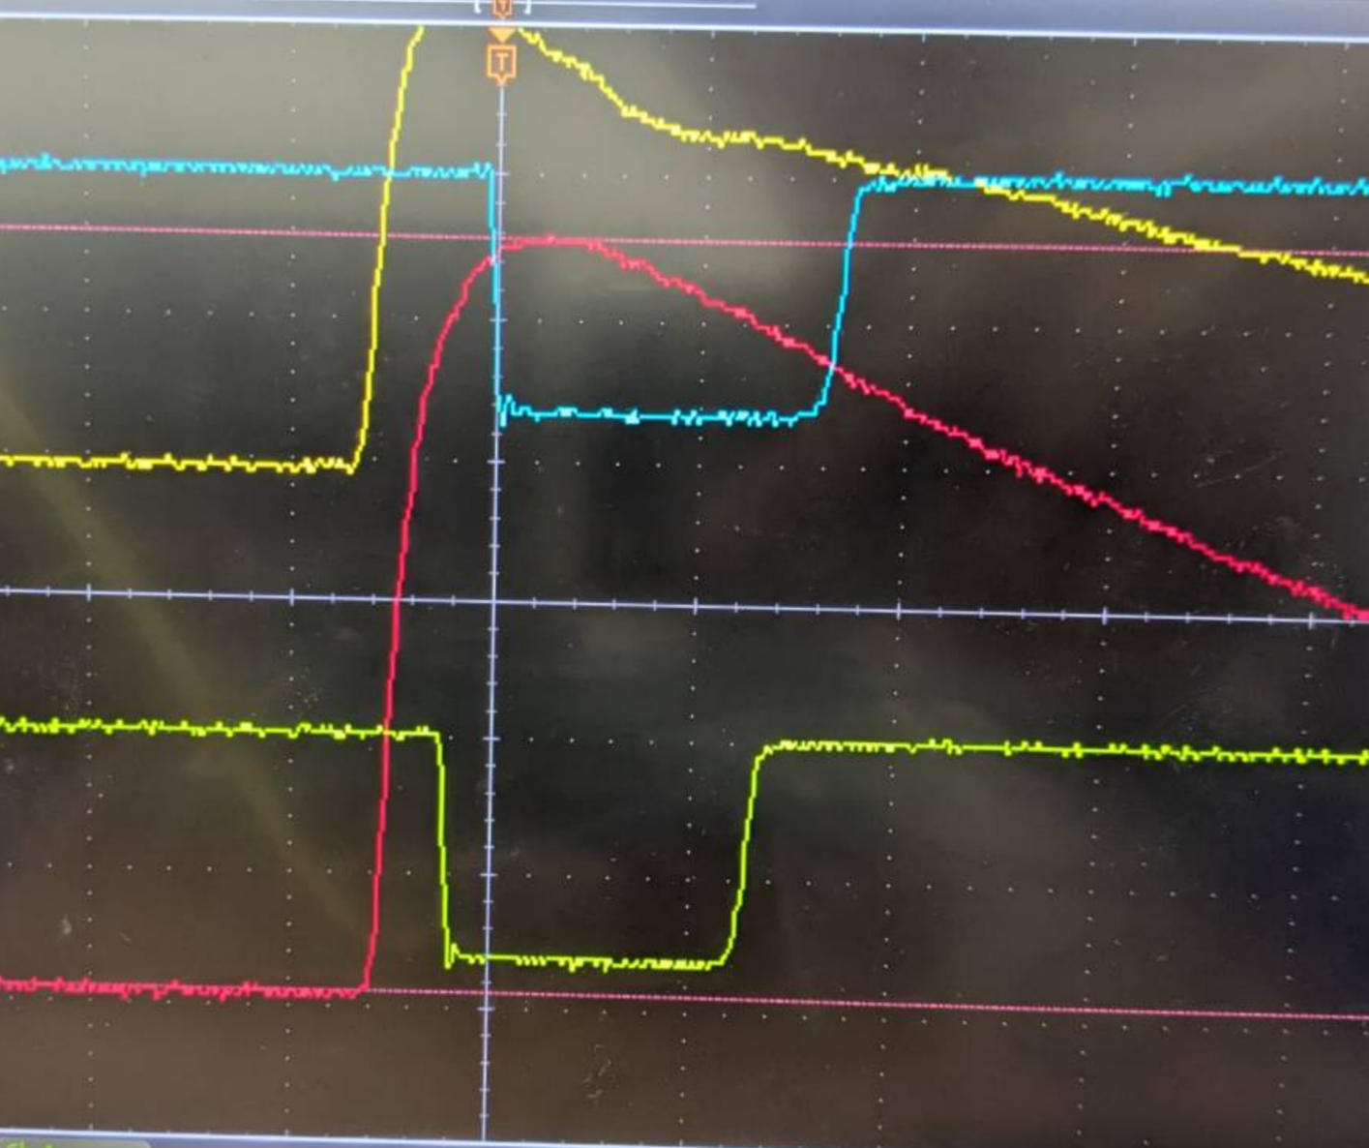
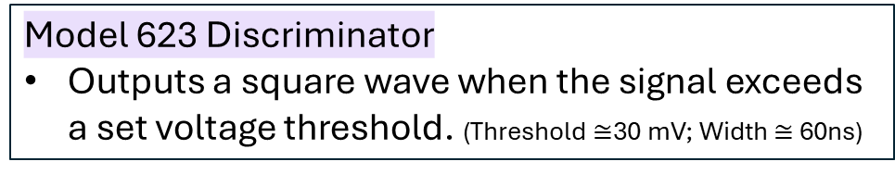
NIM System Module
Model 740 Quad Linear Fan In/Out
Replicates the input signal and distributes it to multiple outputs.
Supports +/ -voltage inputs and provides inverting and non-inverting outputs.
Signal 1
Signal 1
offset =0
Signal 2
Signal 2
offset =0
Model 623 Discriminator
Outputs a square wave when the signal exceeds a set voltage threshold. (Threshold $≅$30 mV; Width $≅$ 60ns)

Slide 5
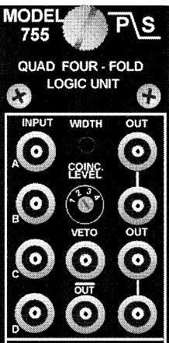
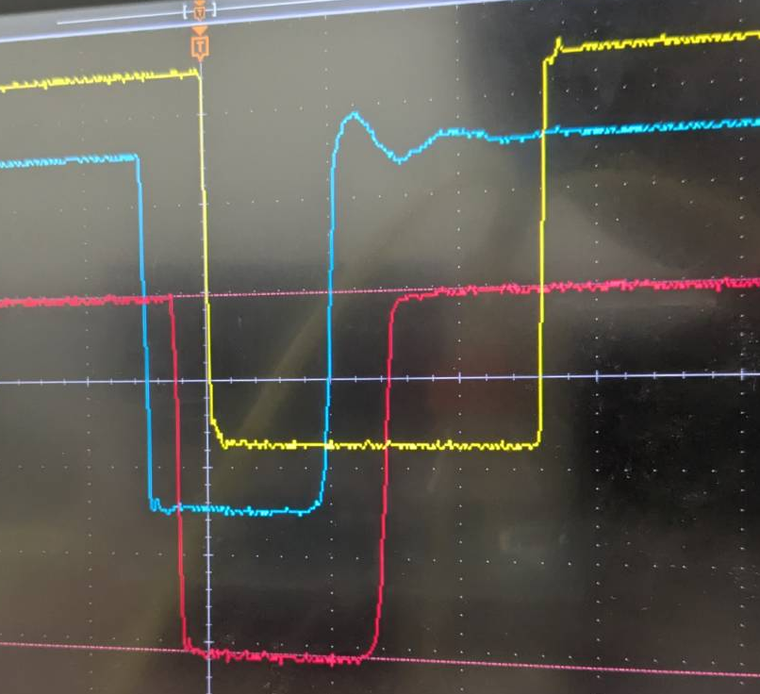
NIM System Module
Phillips Scientific Model 755 (Quad Four-Fold Logic Unit)
The setting of the coincidence level switch then determines whether a logic OR, AND, or Majority logic function will produce an output.
Signal 1
Signal 1
Signal 2
AND
Signal 2

Slide 6
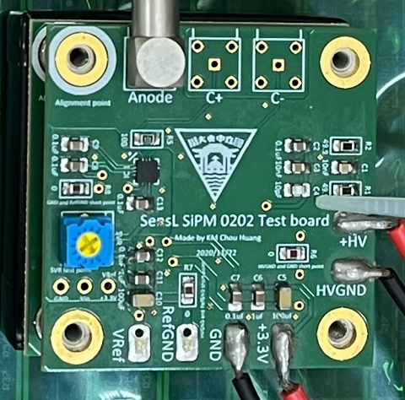
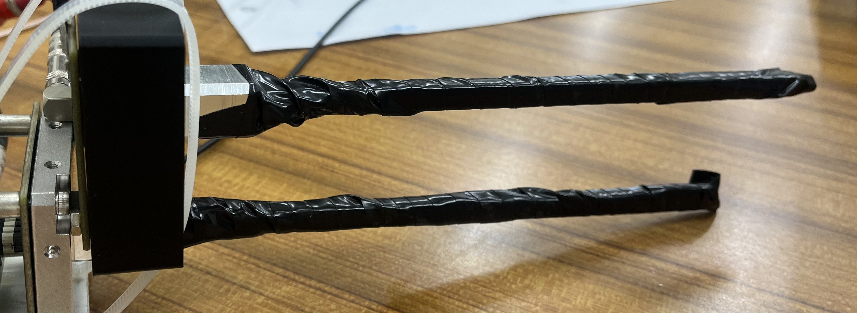
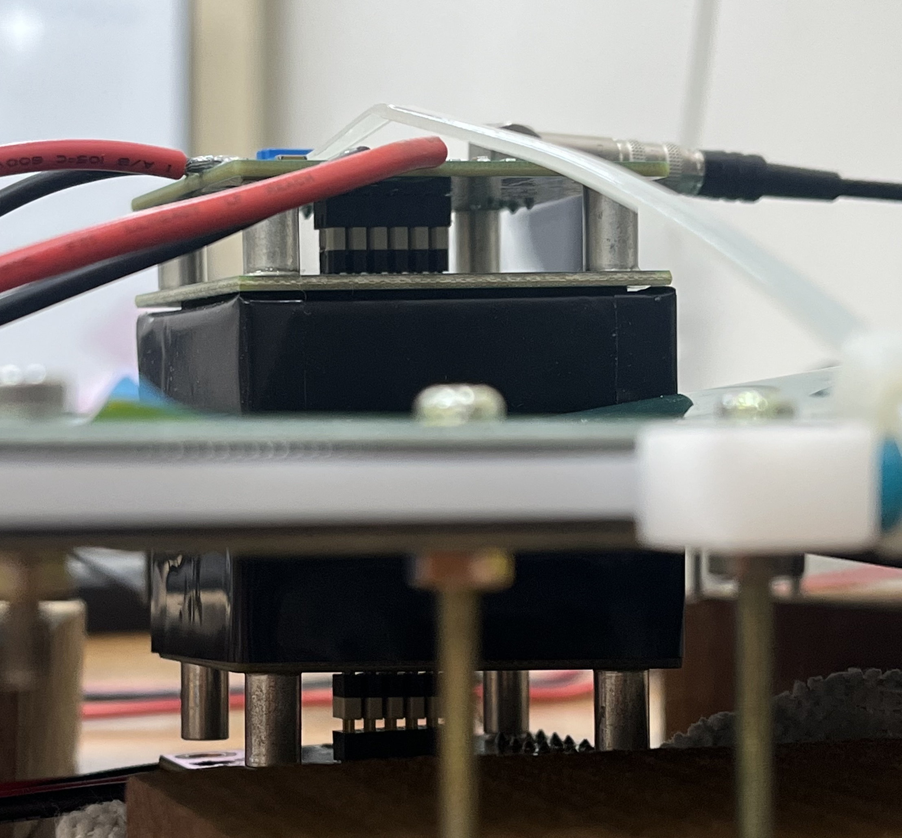
Scintillator cosmic ray trigger
Setup:
50mm
Thin bar
Square bar
50mm
8mm
30V
Scintillator1
32mm
30V
8mm
162mm
RPC
Scintillator2
scintillator | Thin bar | Square bar
Obtain signals | 500 | 1000
Average time per signal | 195.611 s | 10.052s
Standard deviation | 186.835 s | 410.618s
(theoretical by家城)

Slide 7
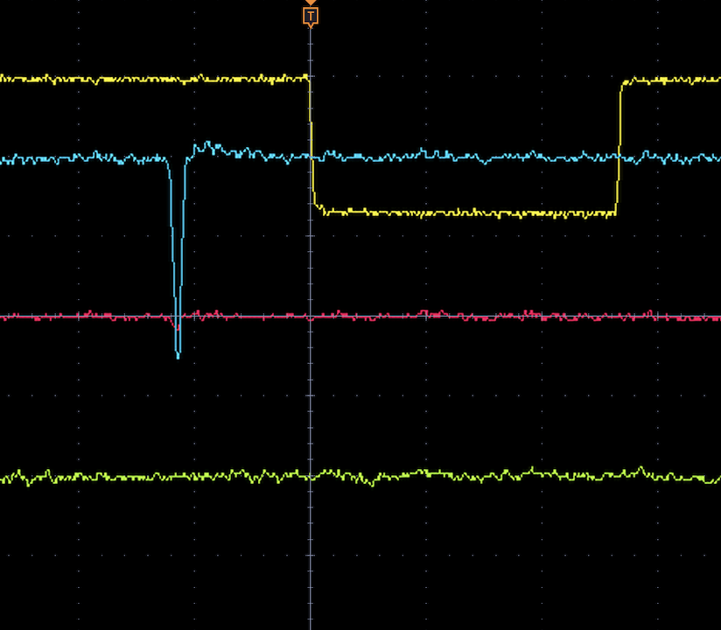
Setup
Cosmic ray trigger
RPC 1
RPC 2
LV +30V
LV +5V
RPC 3
Scin_top
signal
AND
RPC
Amp
oscilloscope
Scin_bottom
HV = +7kV
+HV = -7kV
LV +30V

Slide 8
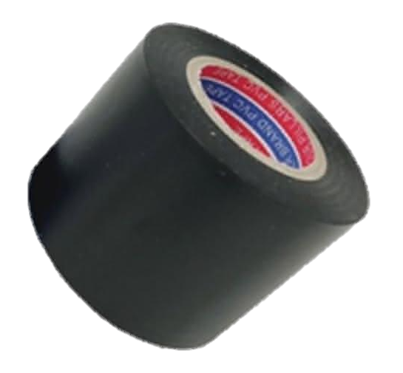

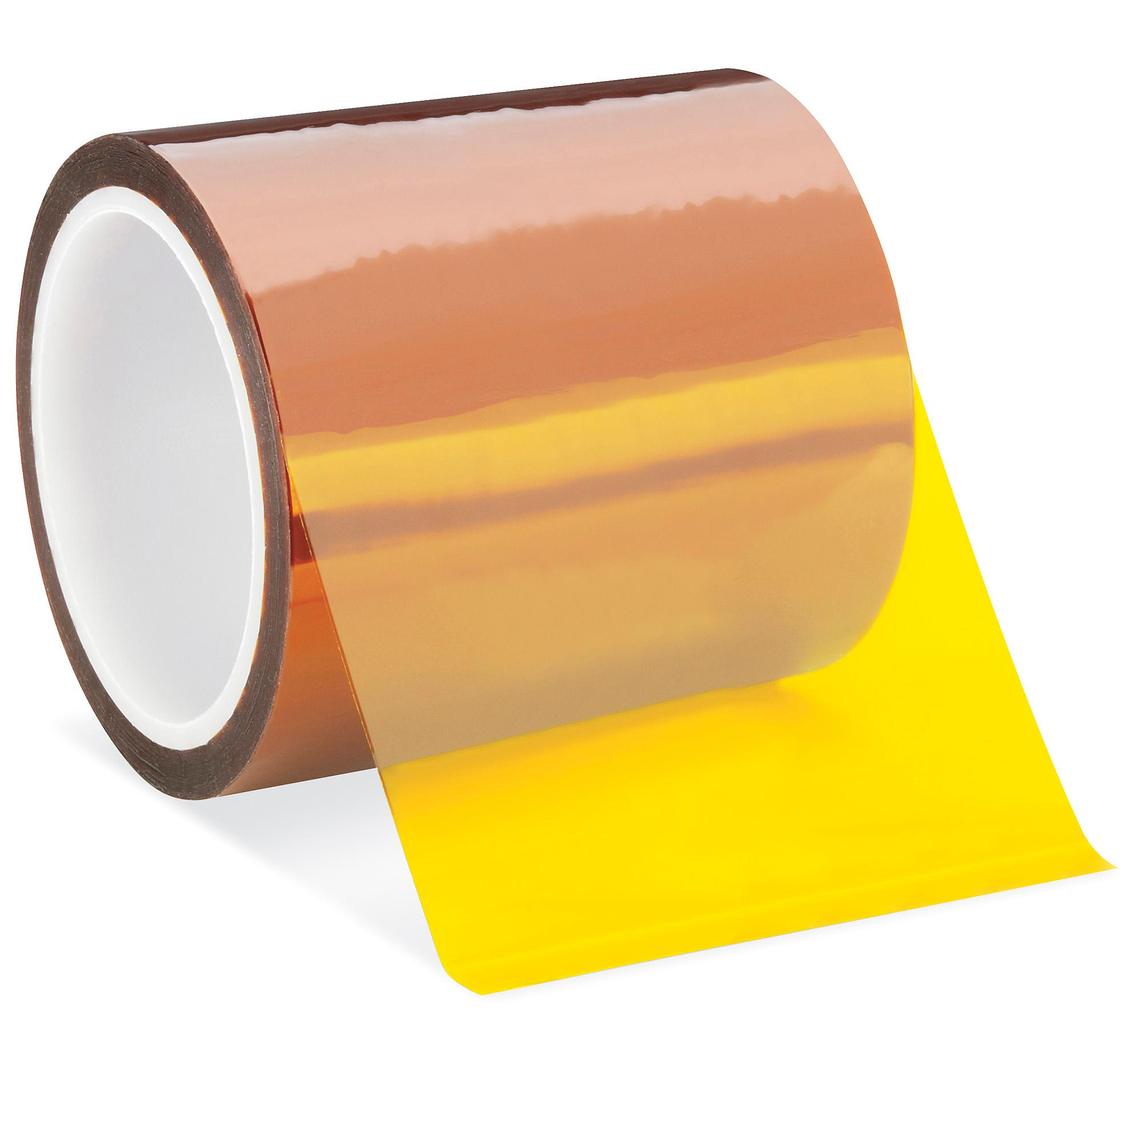

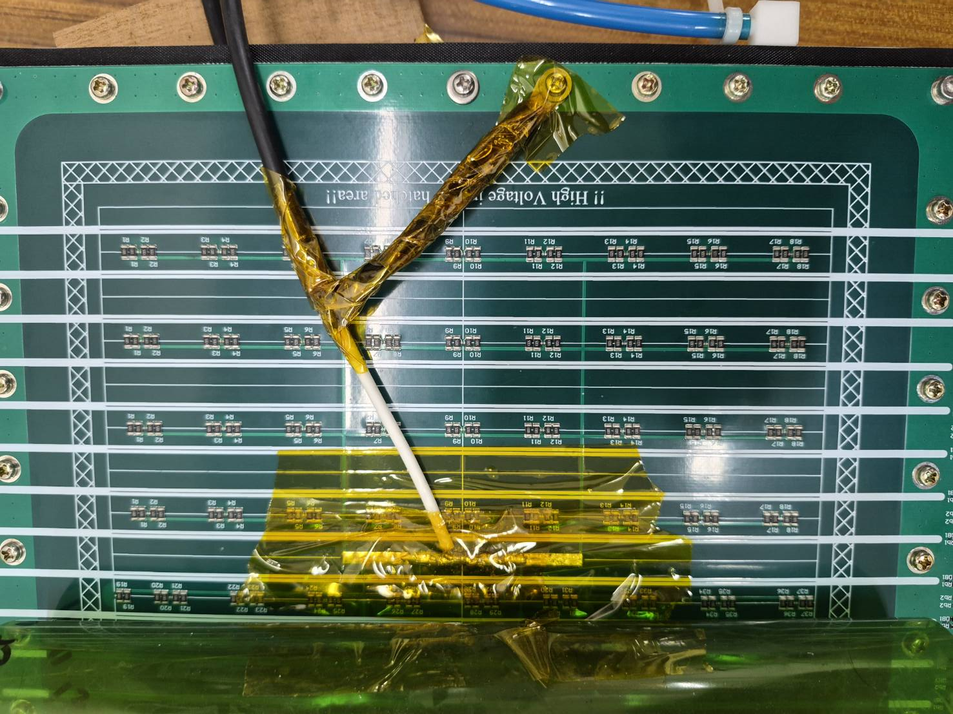
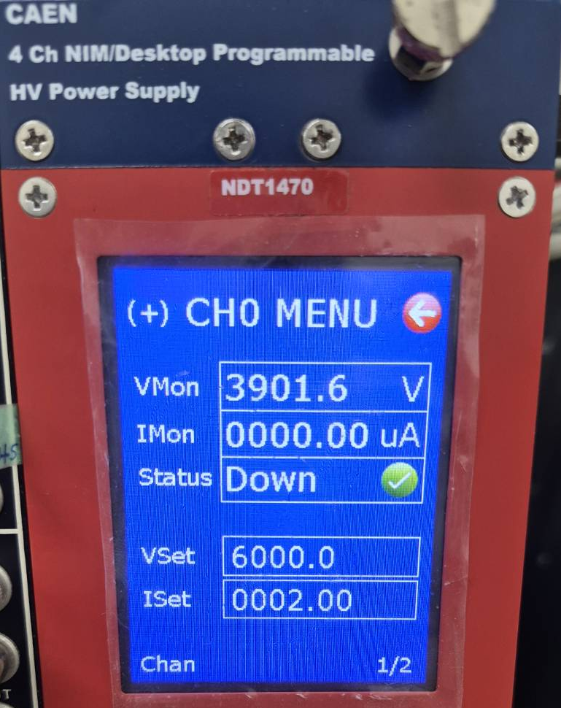
Problems
HV & Ground Connection
Problem:
Sparks occurred when applying high voltage.
Cause and solution
Electrical tape
HV Trip / OvC Warning
Problem:
The HV tripped and an OvC warning appeared.
Cause and solution
The Iset was set too low (0.3 mA).
Increased ISet from 1 mA to 2 mA.
Kapton tape
Ground
HV

Slide 9
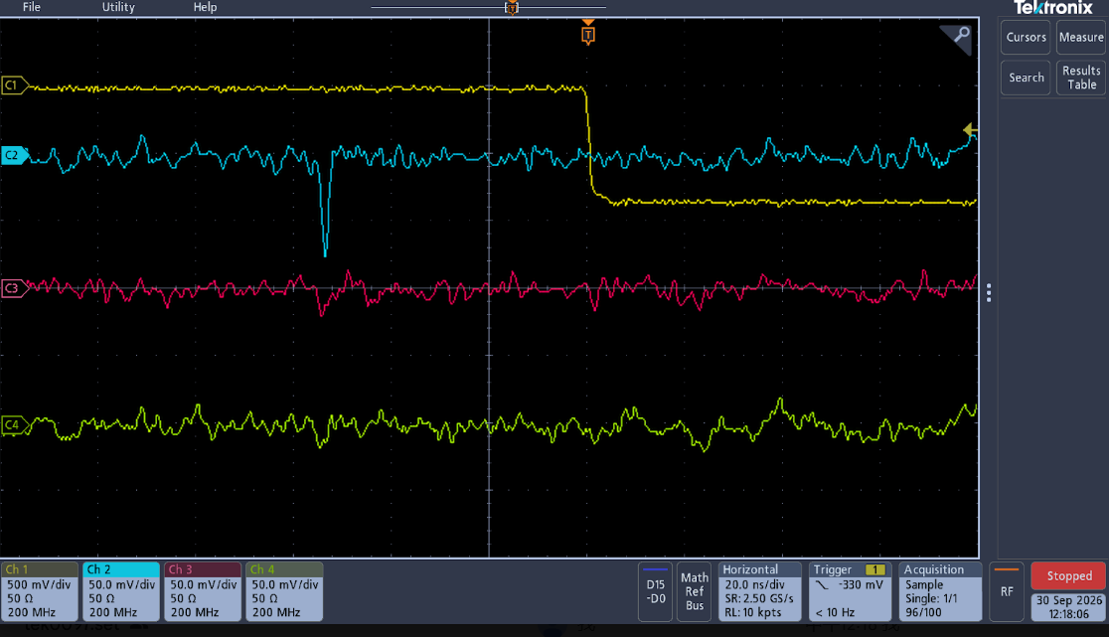
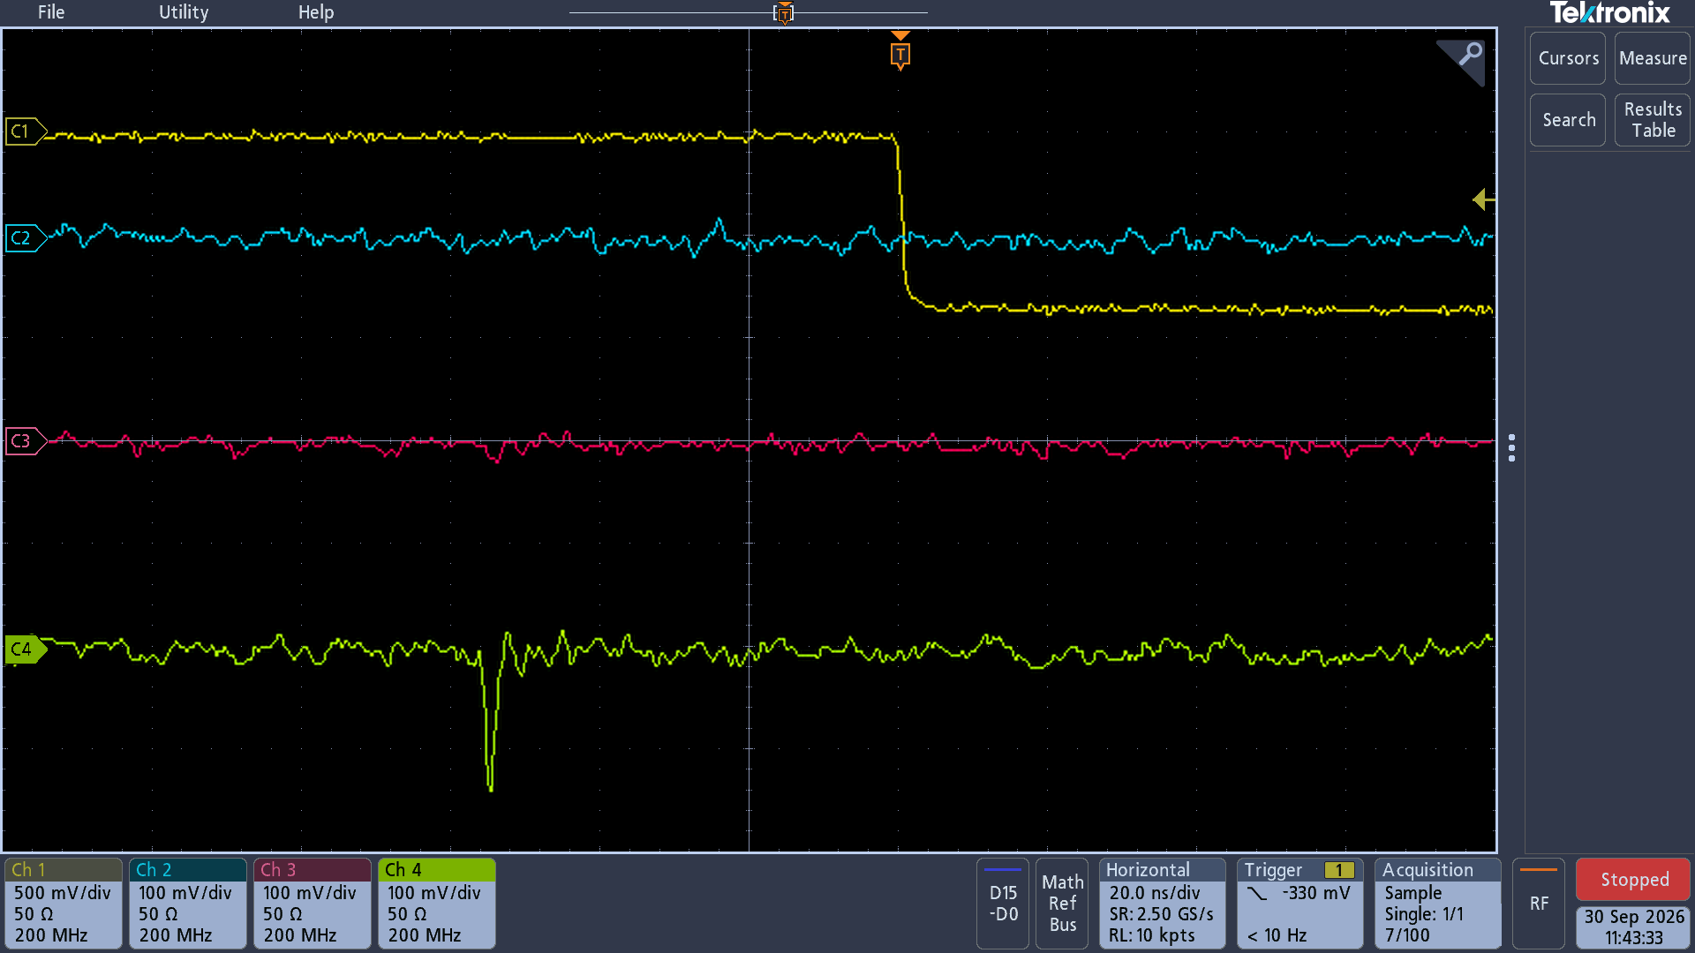
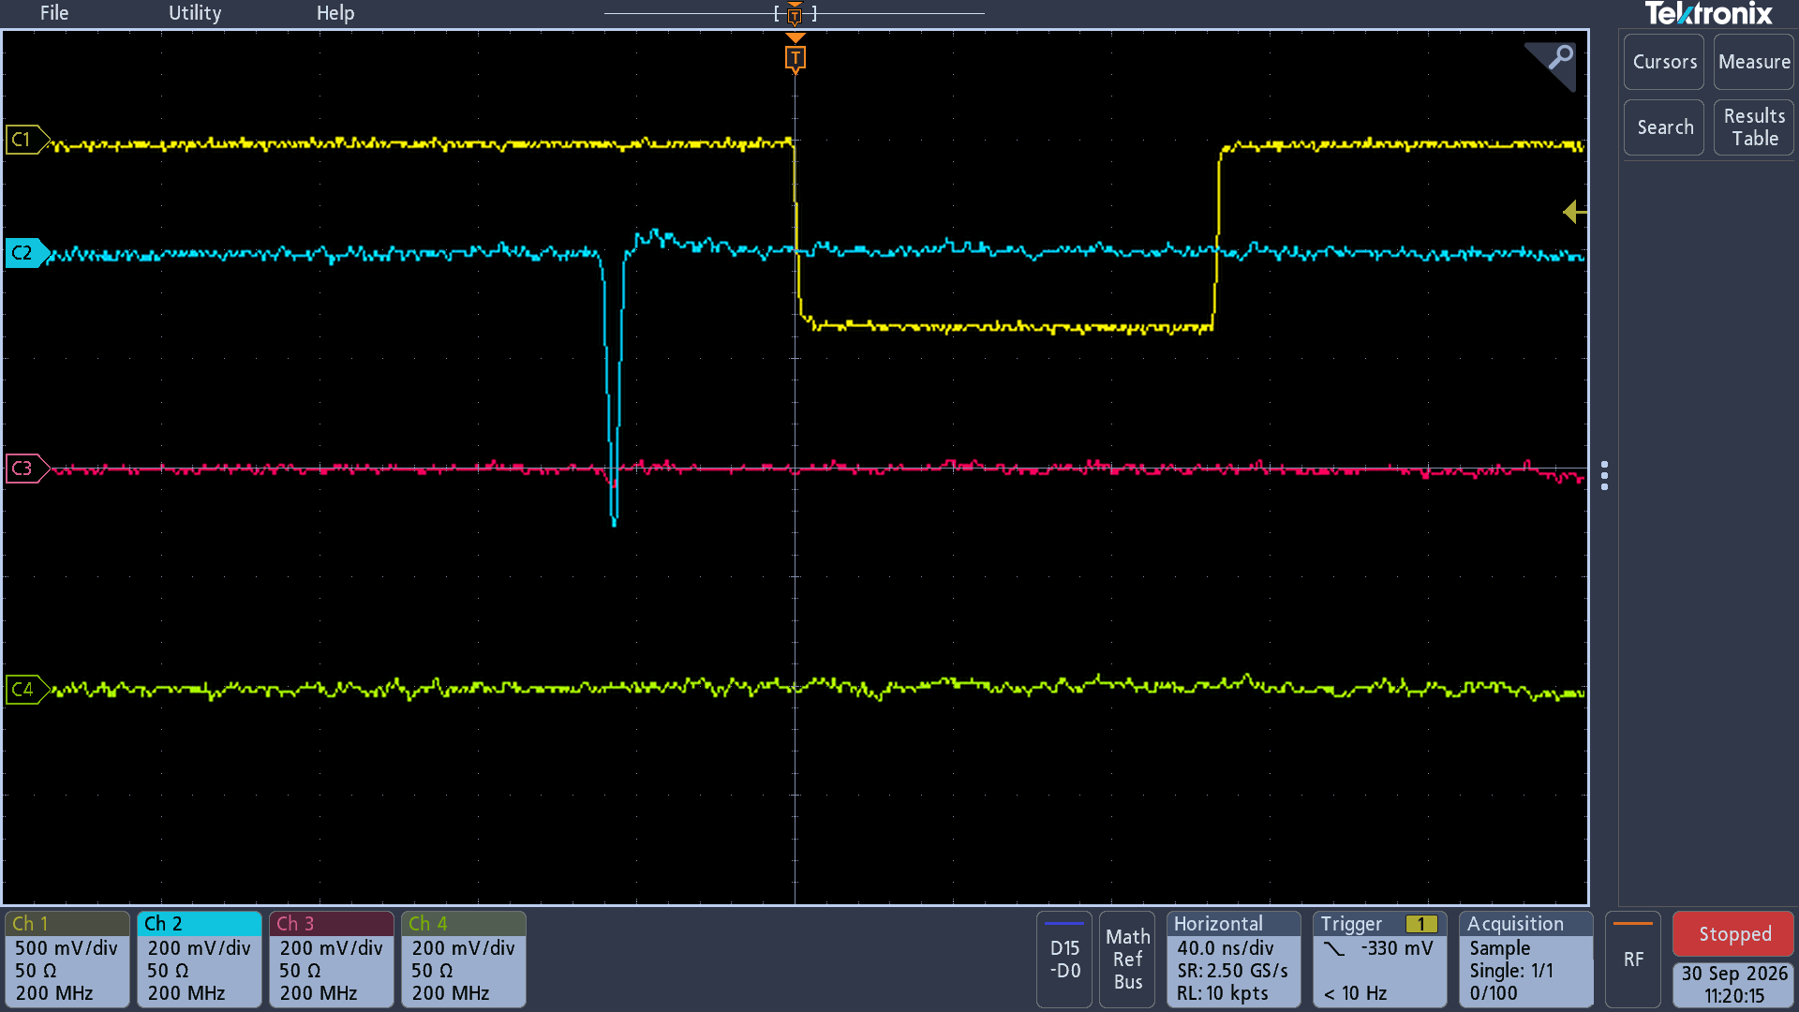
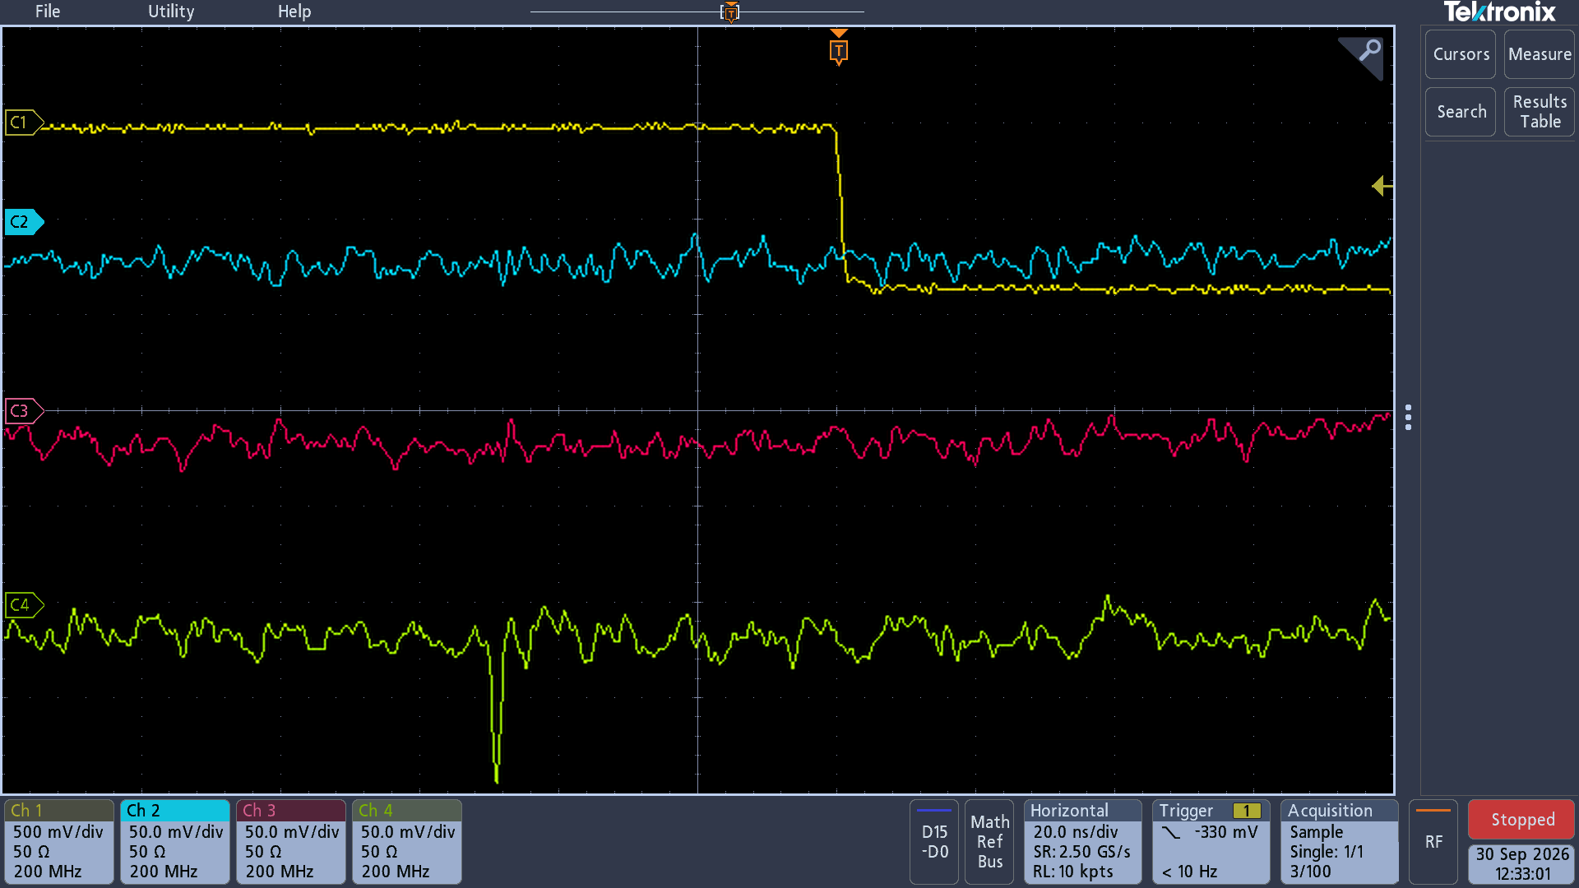
HV Scan
12kV
13kV
Cosmic ray trigger
Cosmic ray trigger
RPC ch8
RPC ch8
RPC ch9
RPC ch9
RPC ch10
RPC ch10
14kV
15kV
Cosmic ray trigger
Cosmic ray trigger
RPC ch8
RPC ch8
RPC ch9
RPC ch9
RPC ch10
RPC ch10

Slide 10
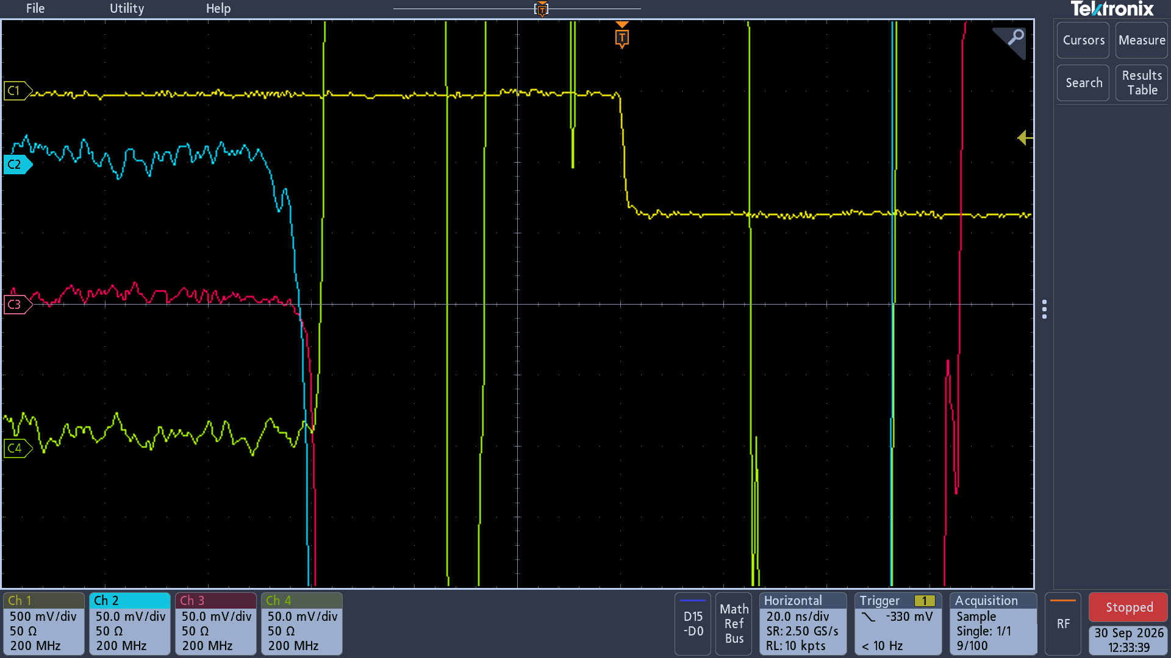
HV Scan
16kV
Cosmic ray trigger
RPC ch8
RPC ch9
RPC ch10
50mV
20ns
A lot of noise

Slide 11
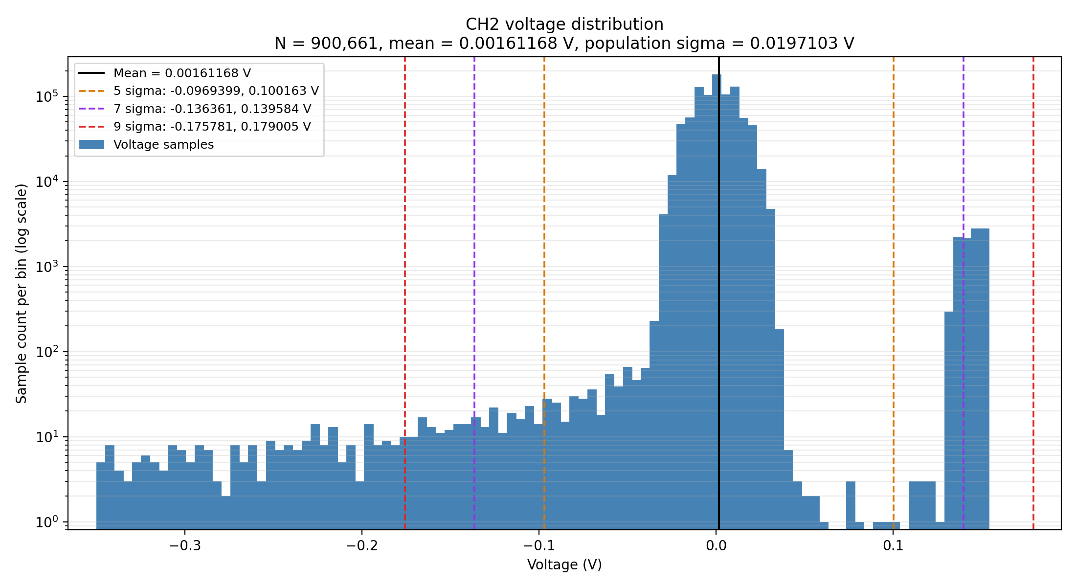
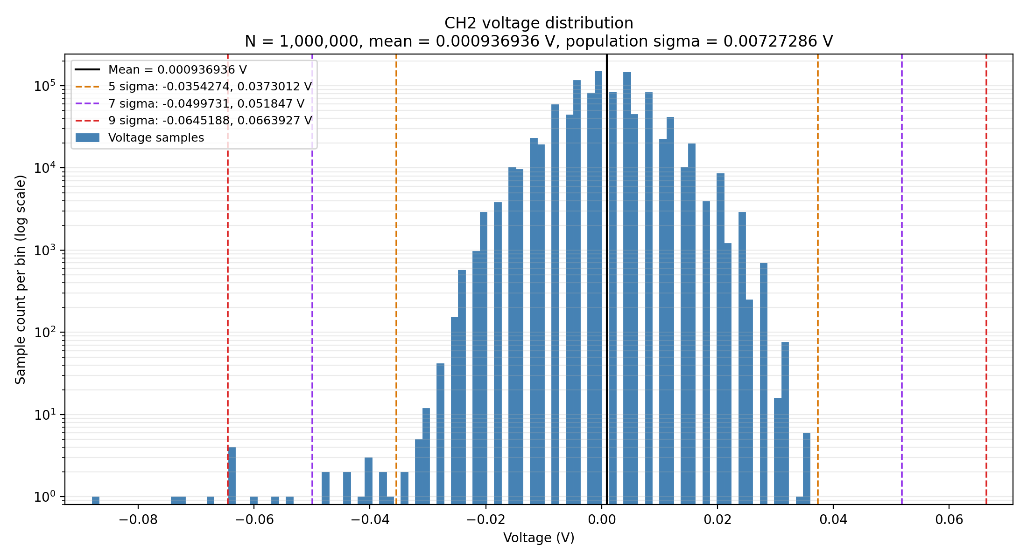
Voltage distribution
Unable to find the common threshold of different high voltage.
Planning to observe different threshold of different voltage.
15kV
12kV

Slide 12
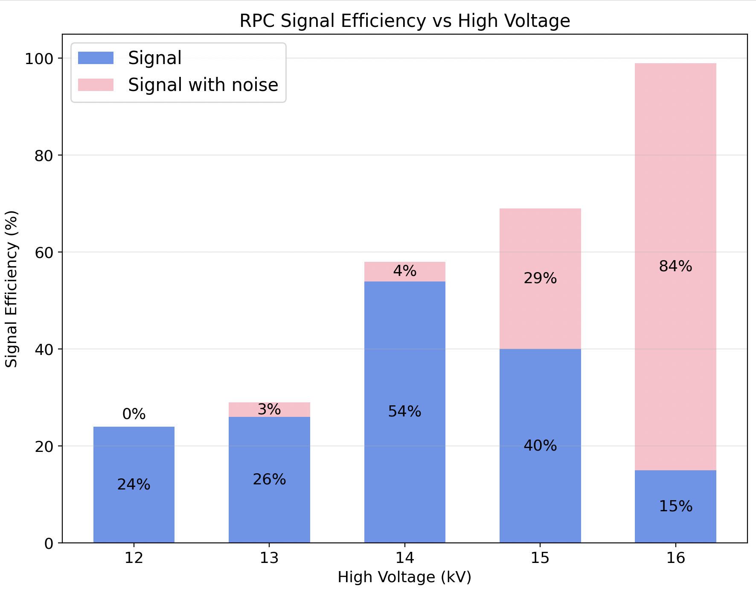
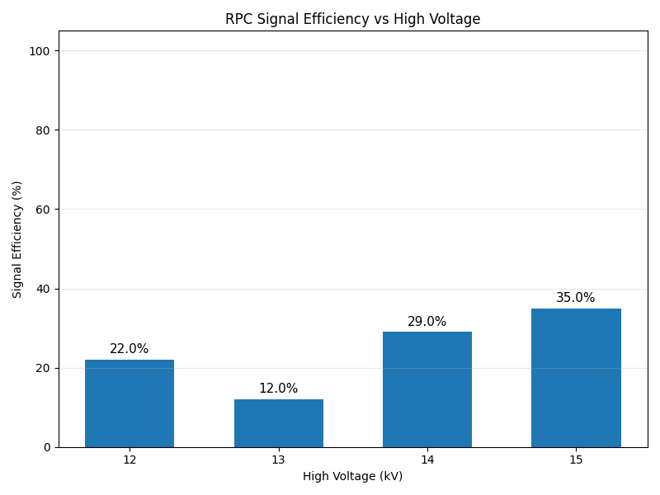
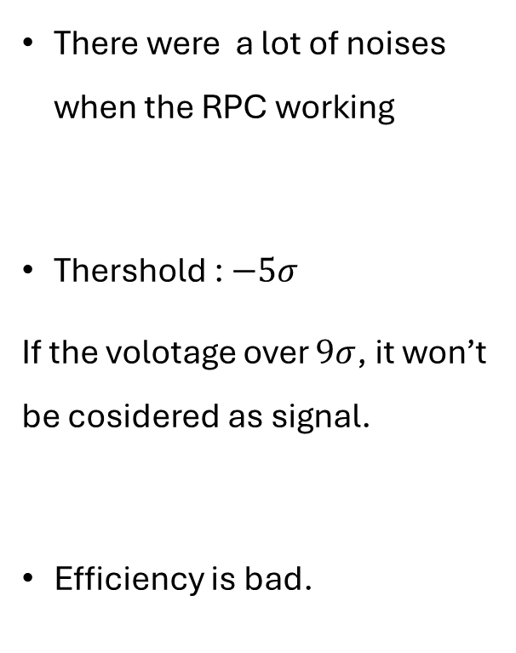
Efficiency
There were a lot of noises when the RPC working
Thershold : $−5σ$
If the volotage over $9σ$, it won’t be cosidered as signal.
Efficiency is bad.
Manual check
Threshold

Slide 13
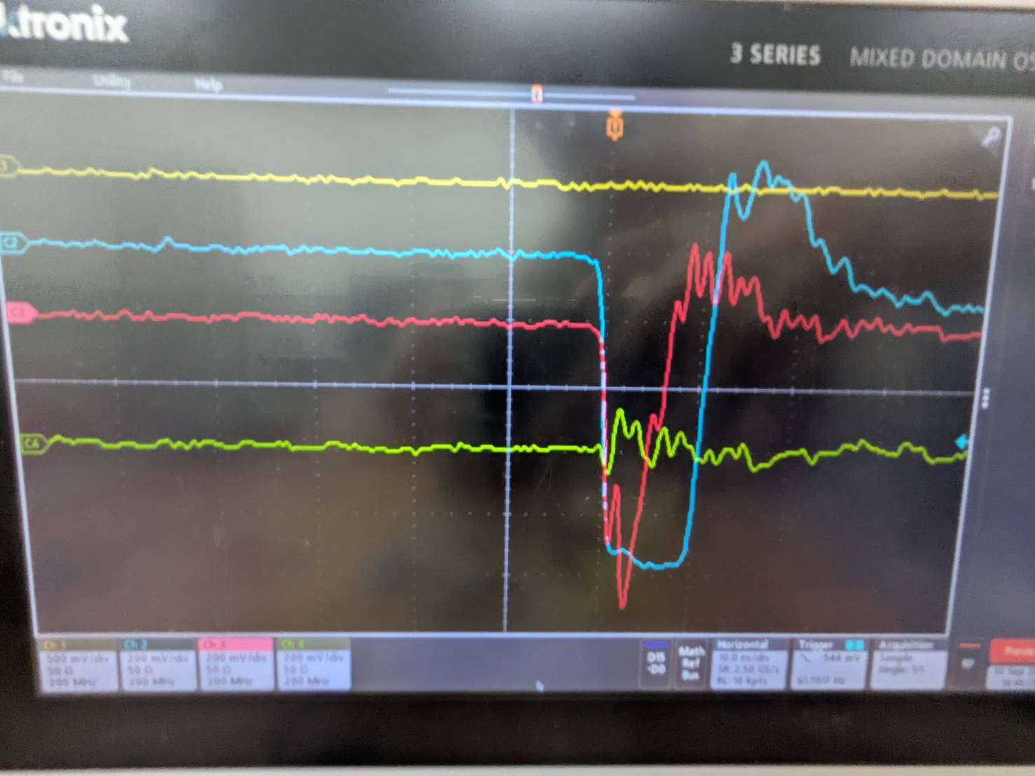
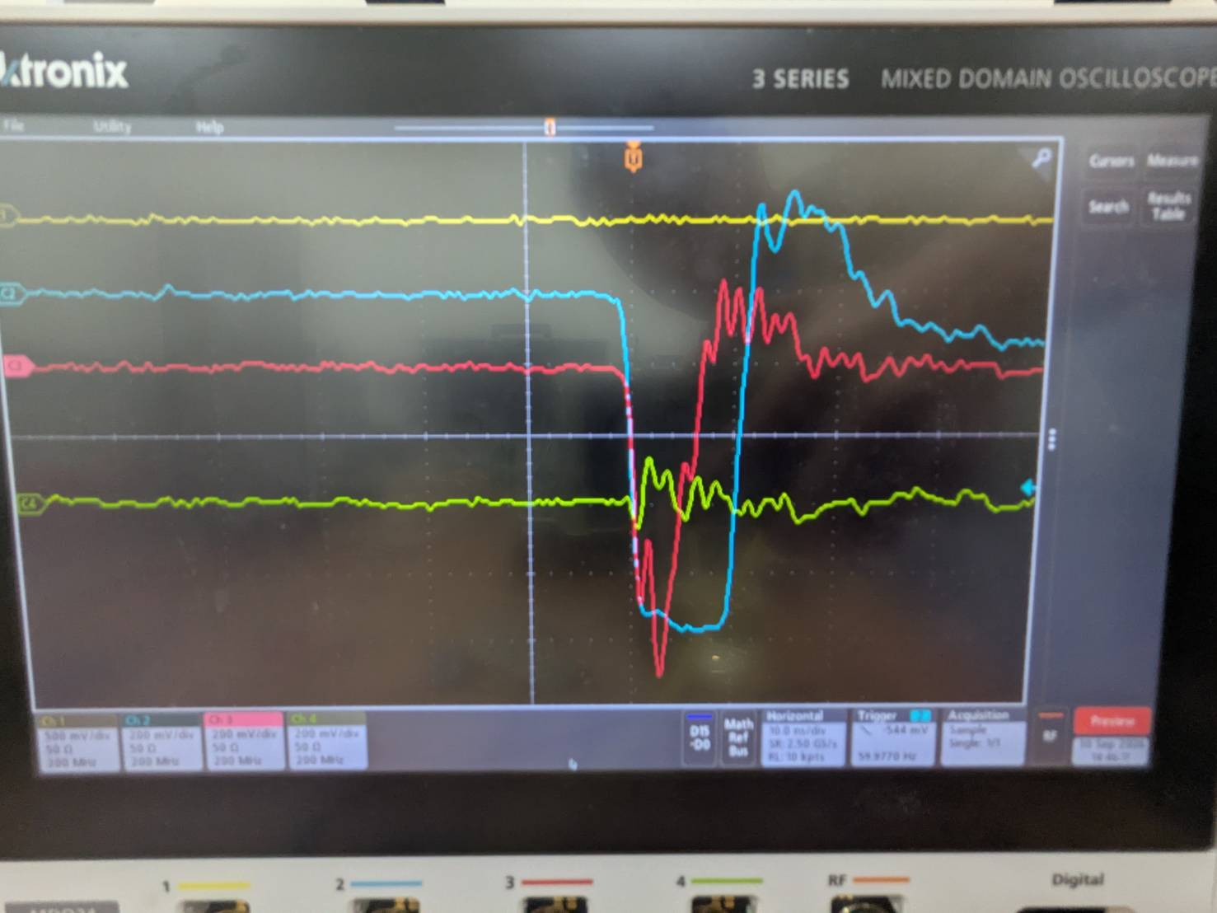
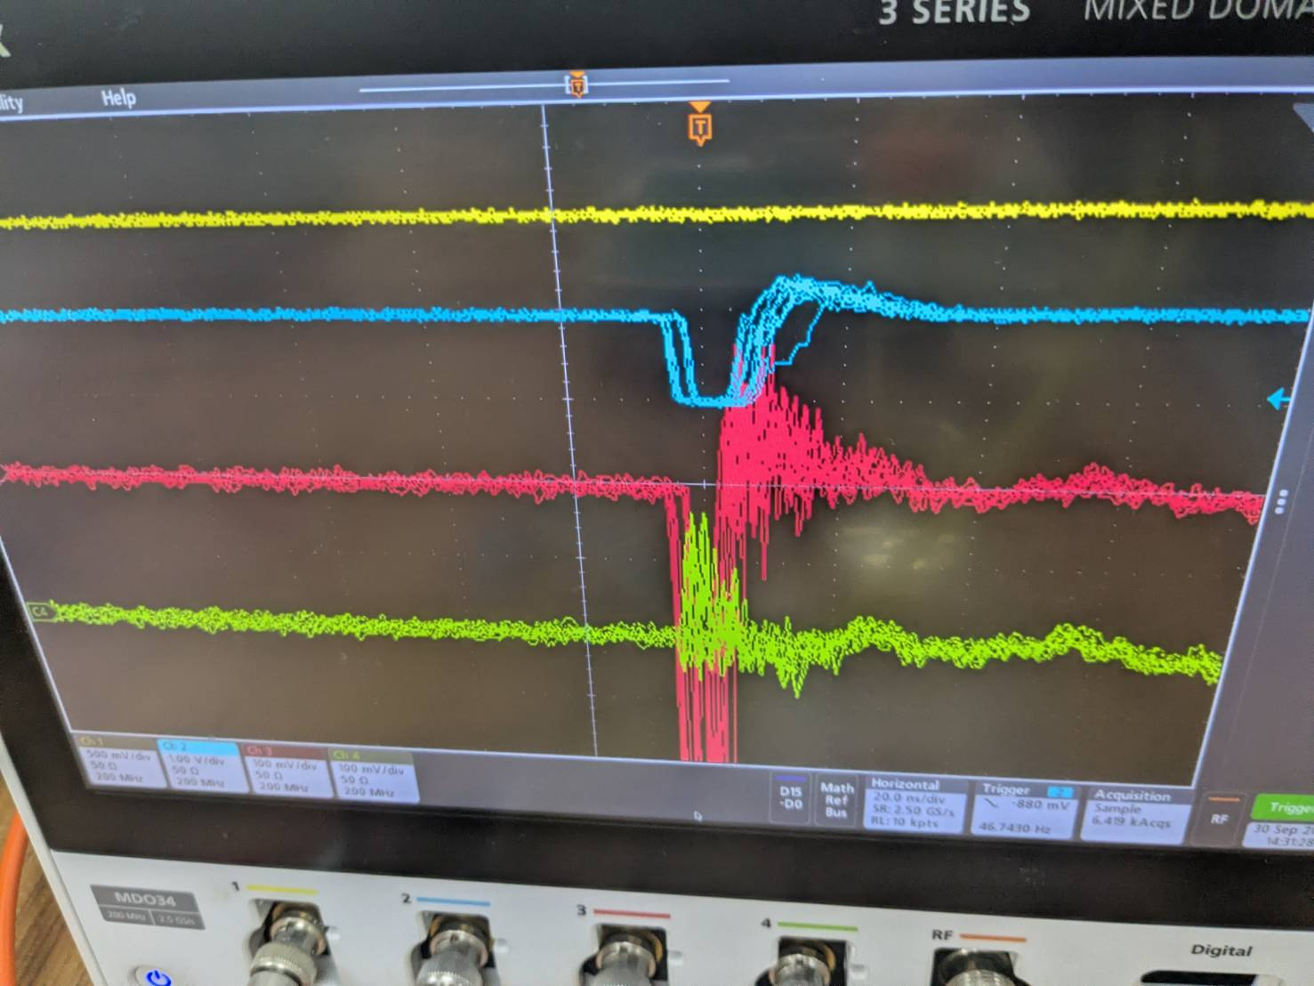
Abnormal channel
After HV scan channel 10 has abnormal cutoff
We change its Amp channel
->nothing improve
We change to channel 7 on RPC, signal becomes normal.
RPC channal 10 seems to have some problem
Cosmic ray trigger
RPC ch10
RPC ch8
RPC ch9

Slide 14
Summary
Finish the bar and square scintillator trigger test
Apply HV on RPC (12,13,14,15,16kV)

