Slide 1
ECal 3rd Prototype
Beam Test Analysis
Yen-Chen Wu
Dept. Physics, National Central University
2026/10/14

Slide 2
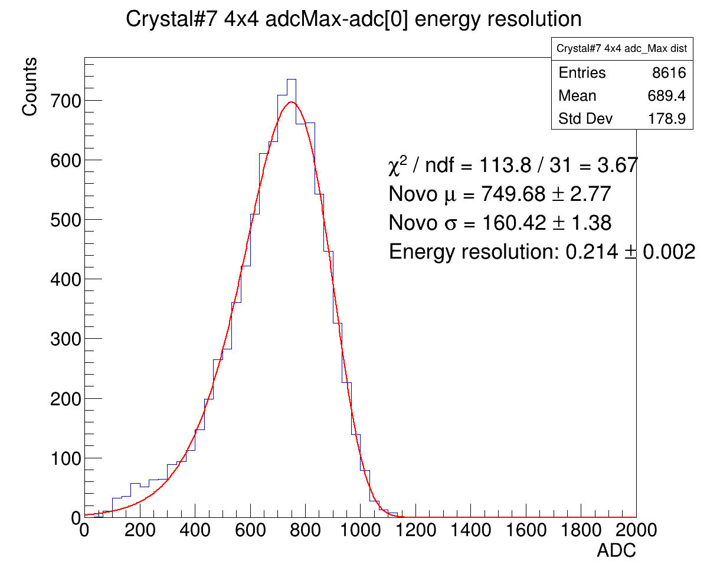
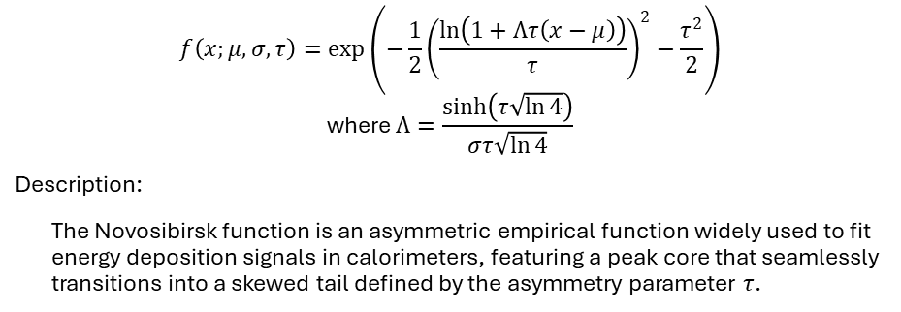


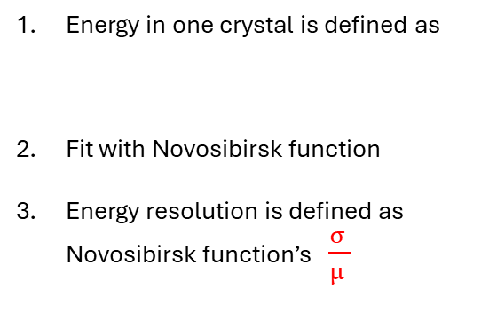

Novosibirsk function
$$f\left(x;μ,σ,τ\right)=\exp\left(−\frac{1}{2}{\left(\frac{\ln\left(1+Λτ\left(x−μ\right)\right)}{τ}\right)}^{2}−\frac{τ^{2}}{2}\right)$$
$$\text{where} Λ=\frac{\sinh\left(τ\sqrt{\ln{4}}\right)}{στ\sqrt{\ln{4}}}$$
Description:
The Novosibirsk function is an asymmetric empirical function widely used to fit energy deposition signals in calorimeters, featuring a peak core that seamlessly transitions into a skewed tail defined by the asymmetry parameter $τ$.
Resolution definition: $\frac{σ }{μ }$
Energy in one crystal is defined as
Fit with Novosibirsk function
Energy resolution is defined as Novosibirsk function’s $\frac{σ }{μ }$
(raw ADCmax – ADC[0]) / (number of good channel)
Novosibirsk function
$$μ$$
$$σ$$
Novosibirsk function improves the fitting chi-square in all 1x1, 3x3 & 4x4 clustering cases.

Slide 3
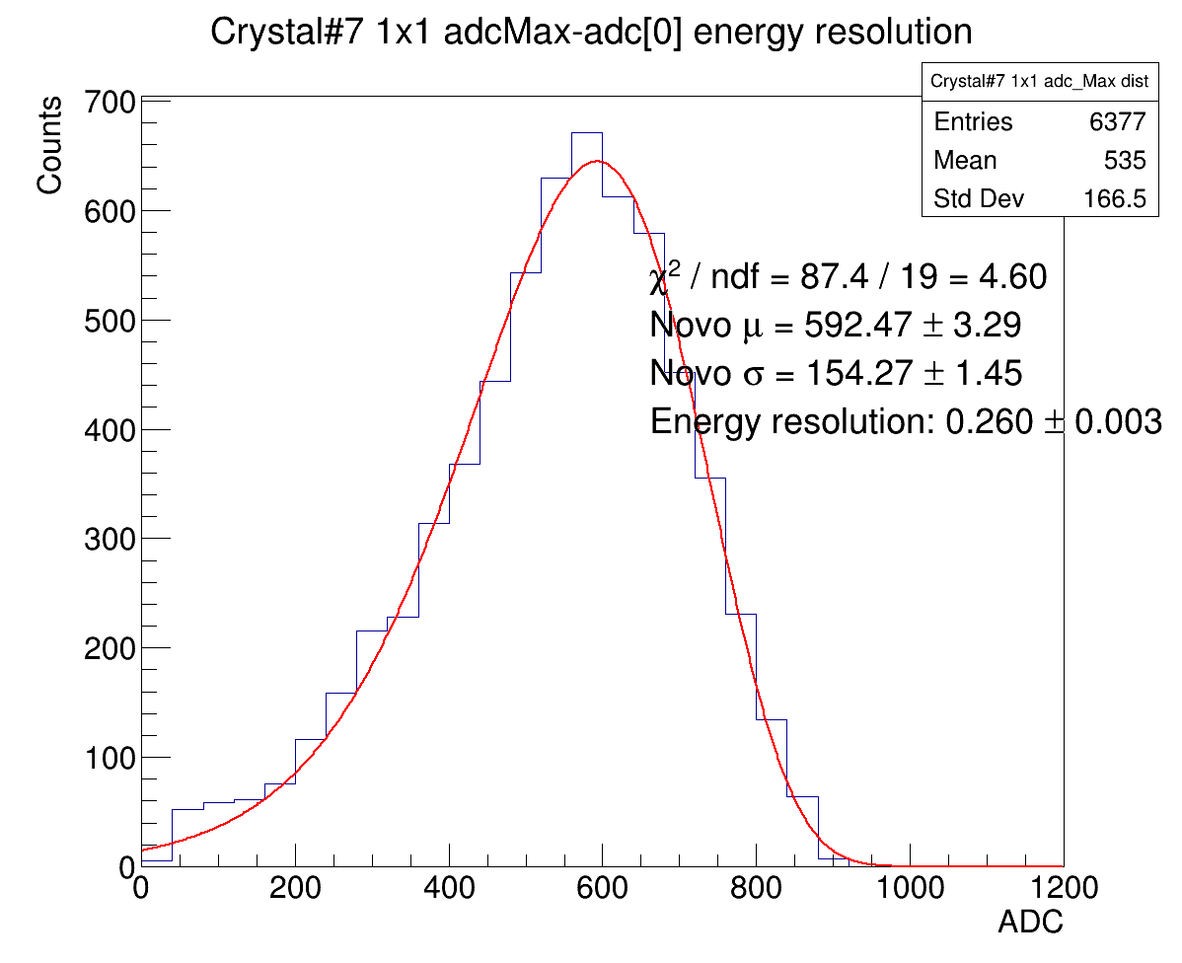
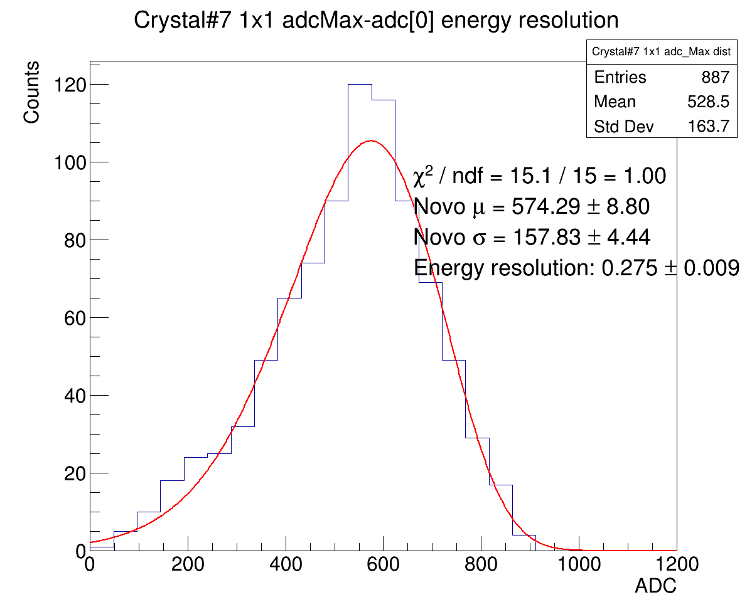
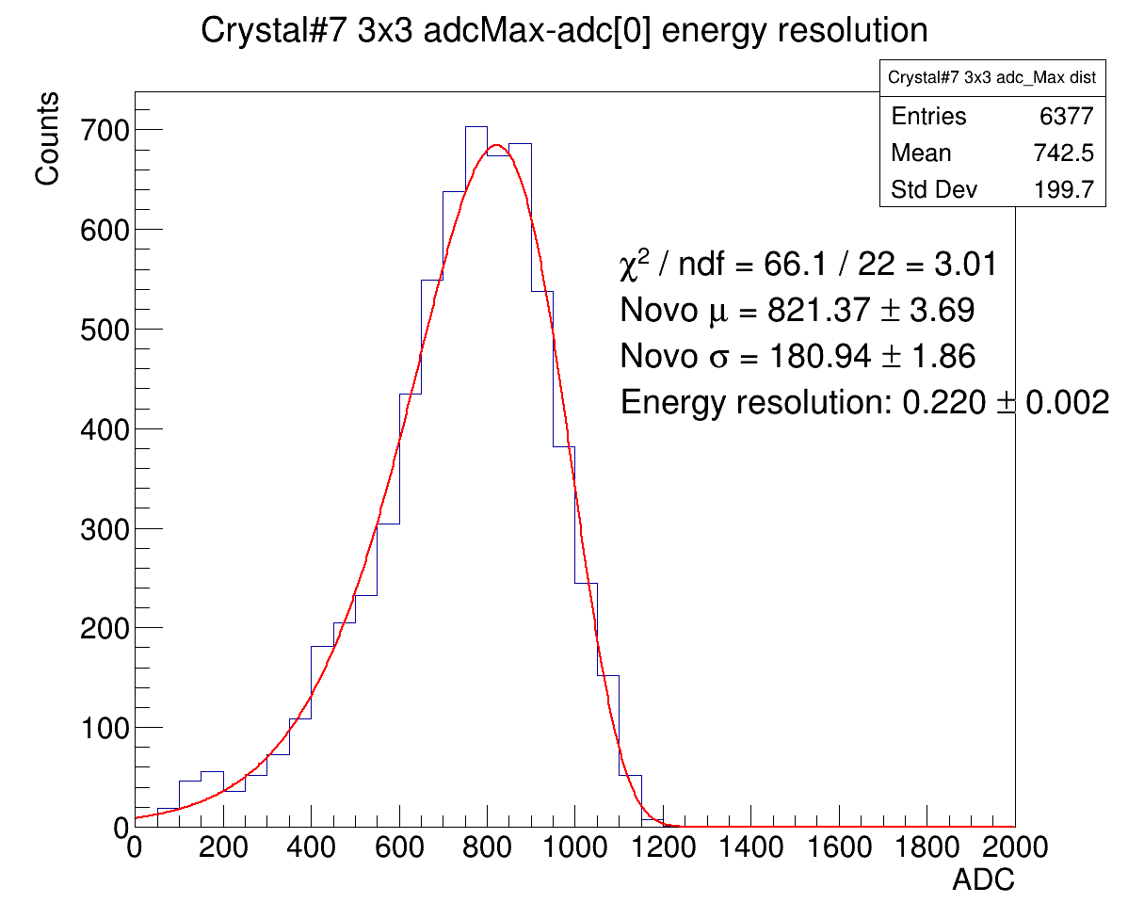
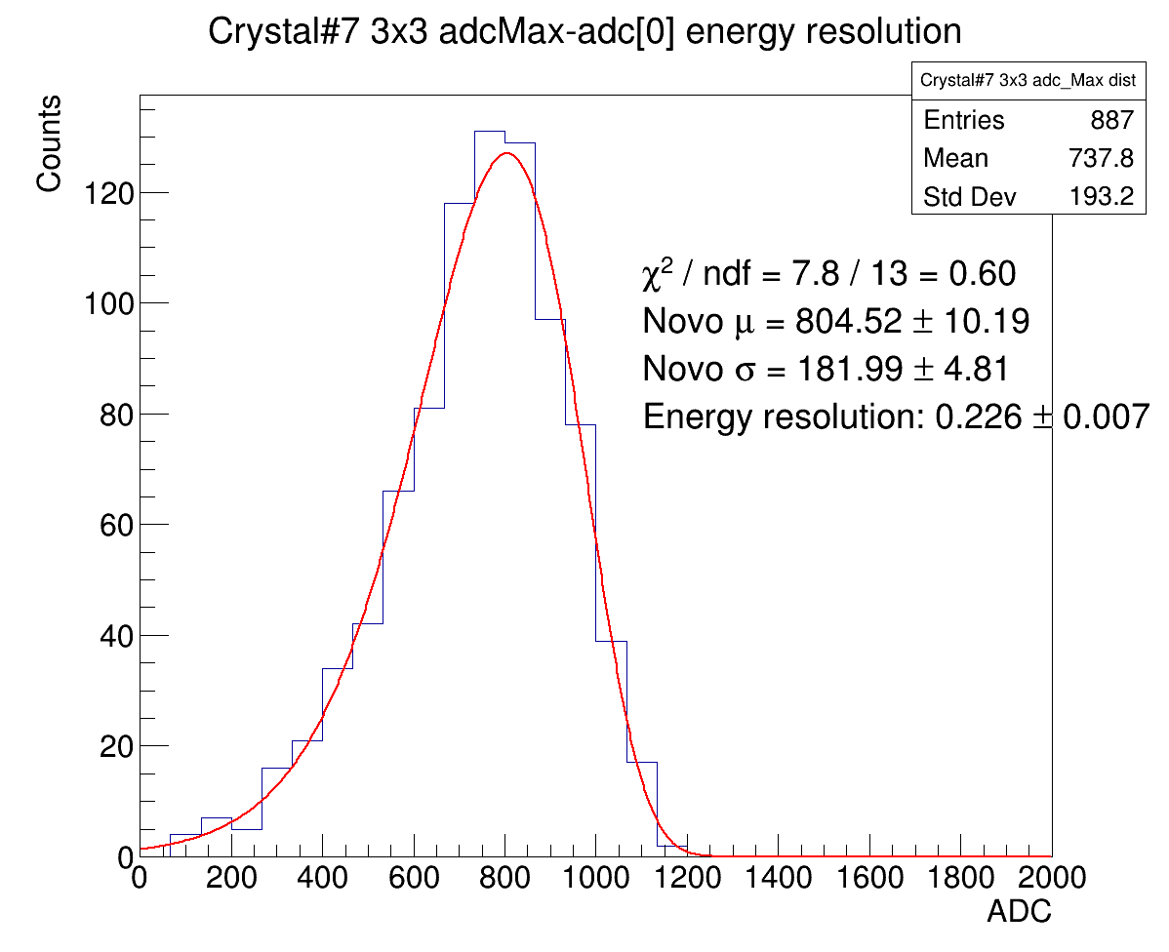
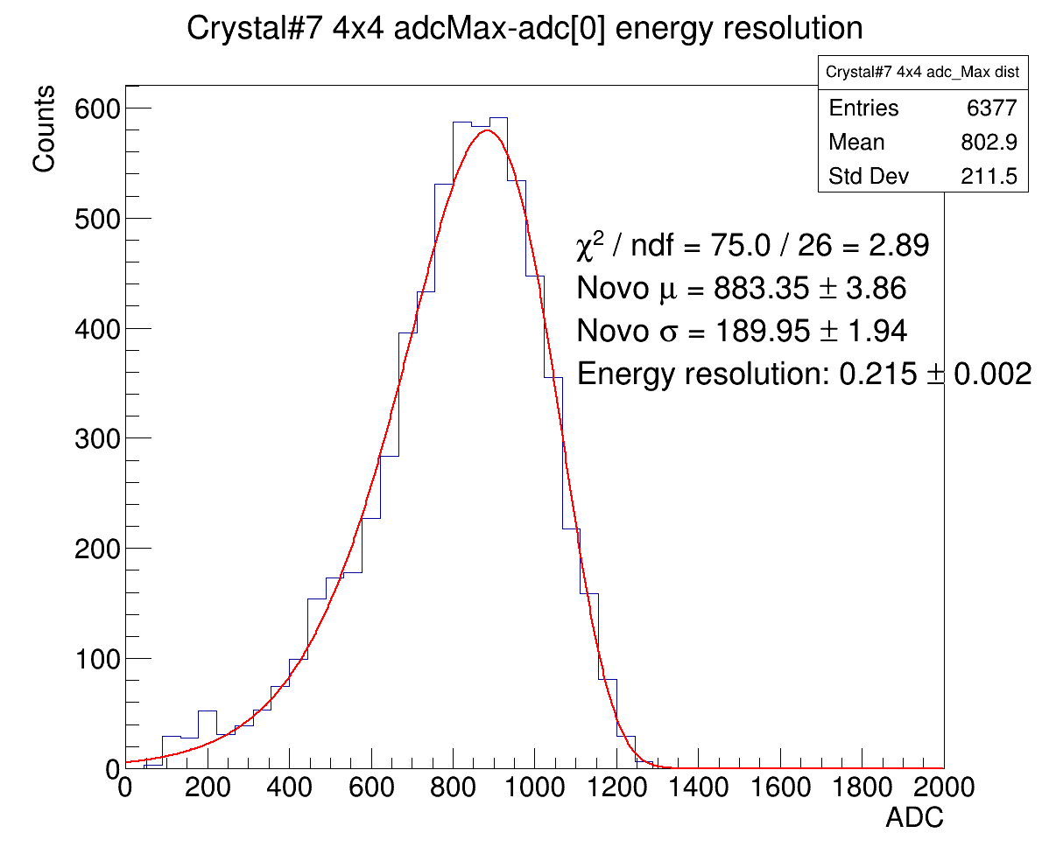
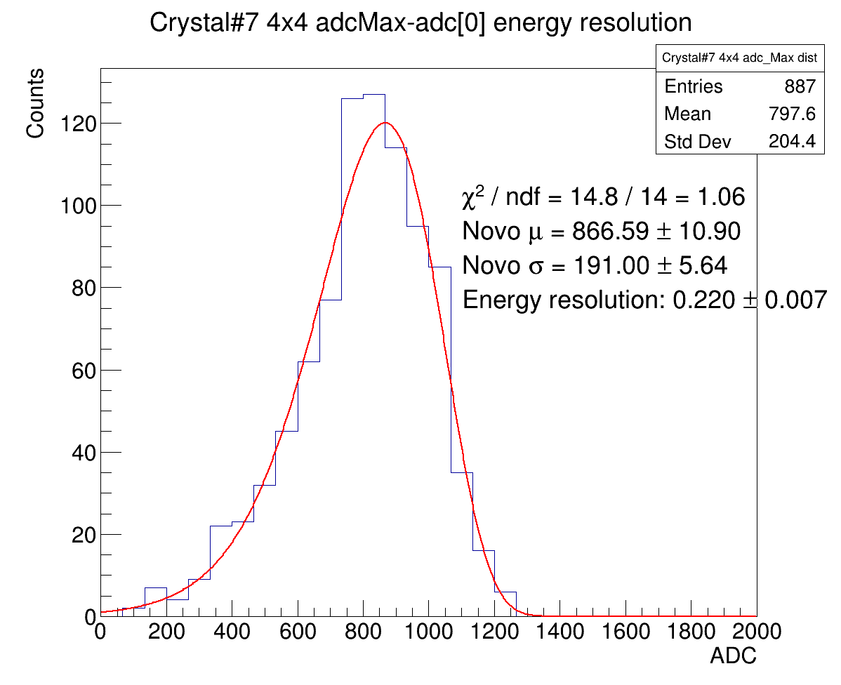
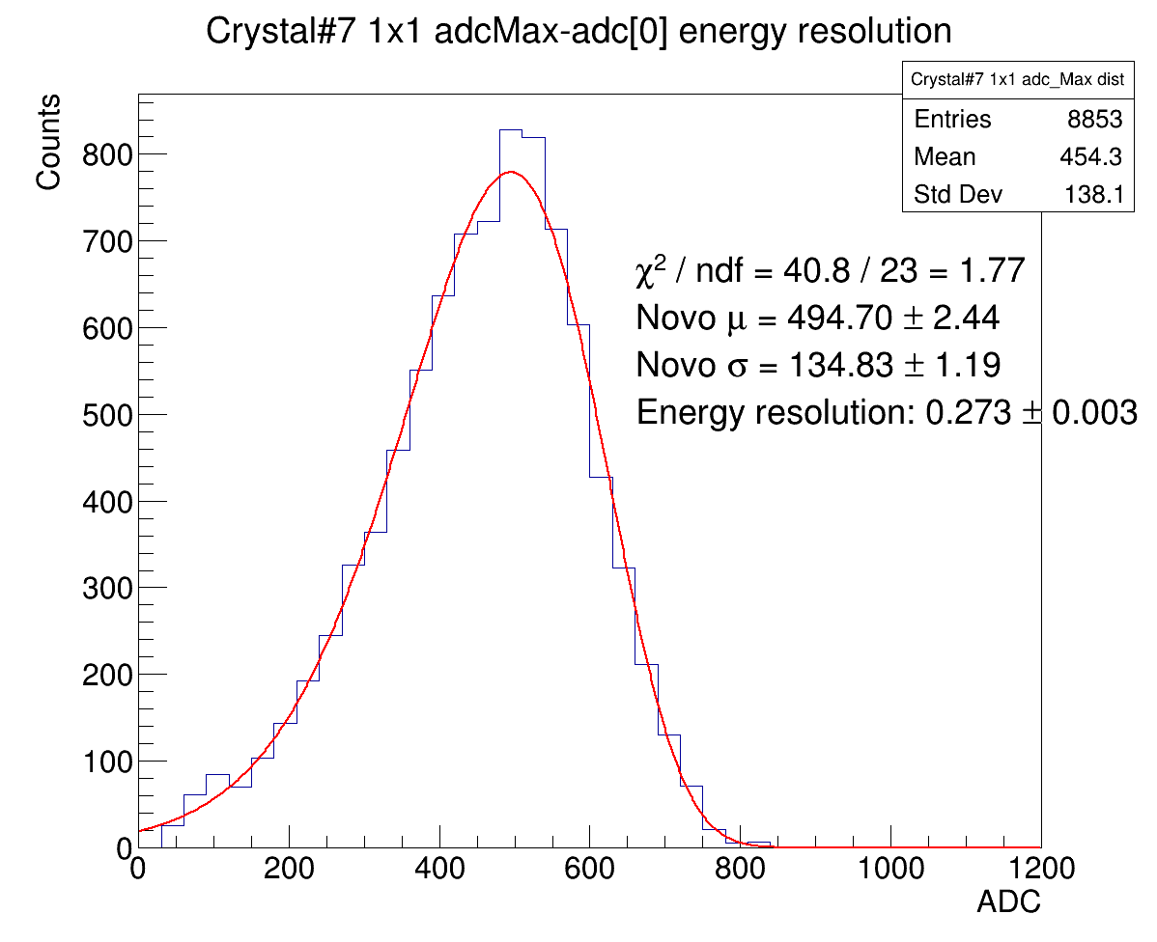
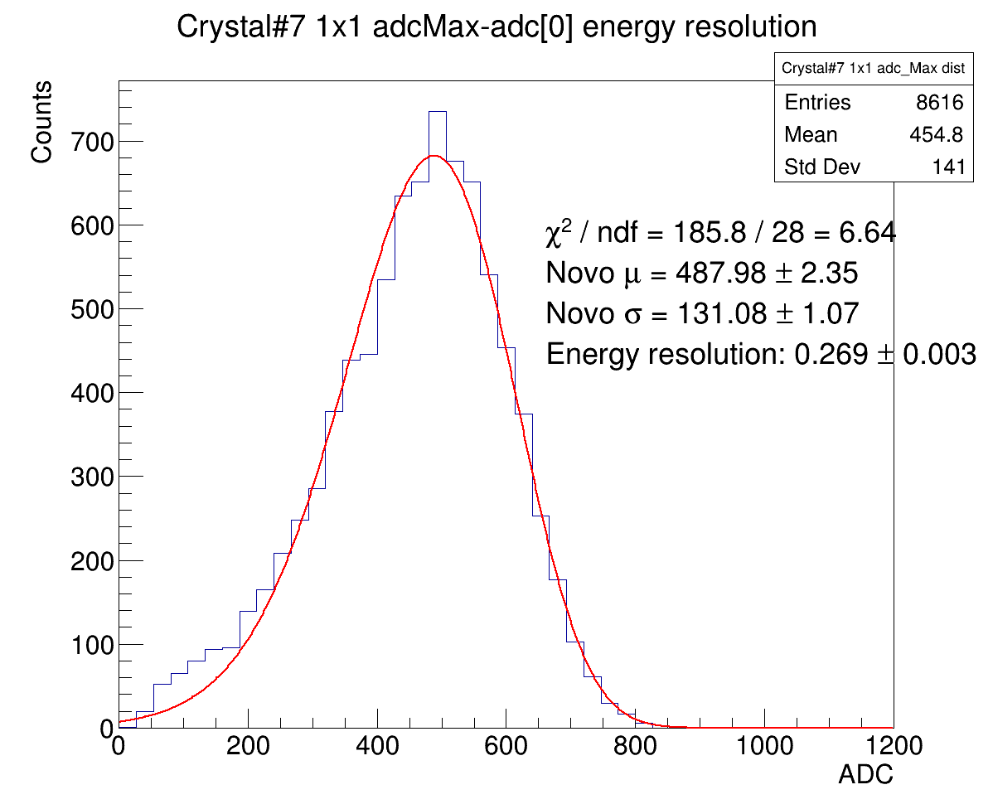
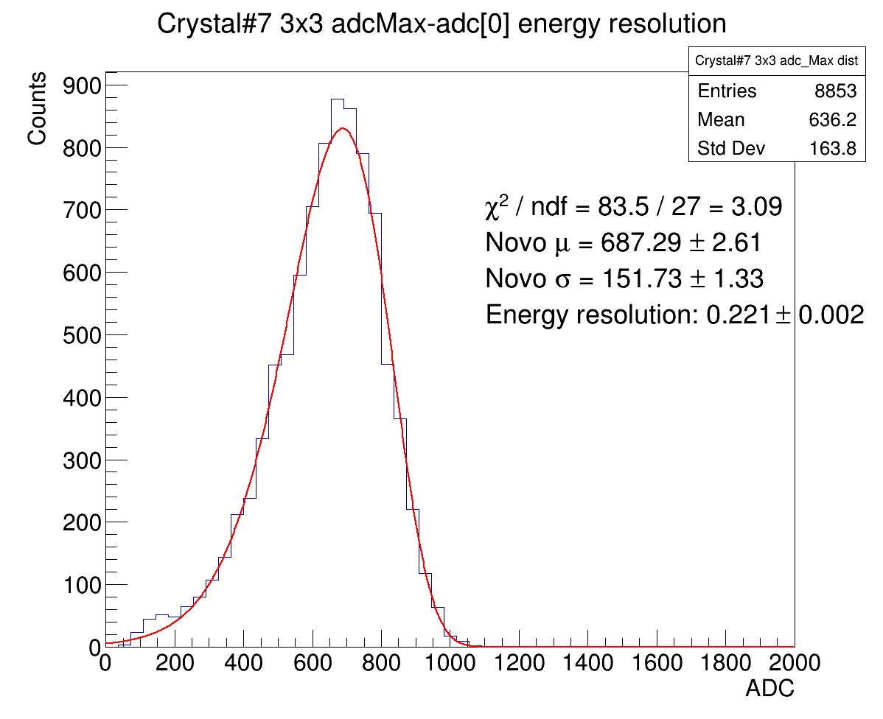

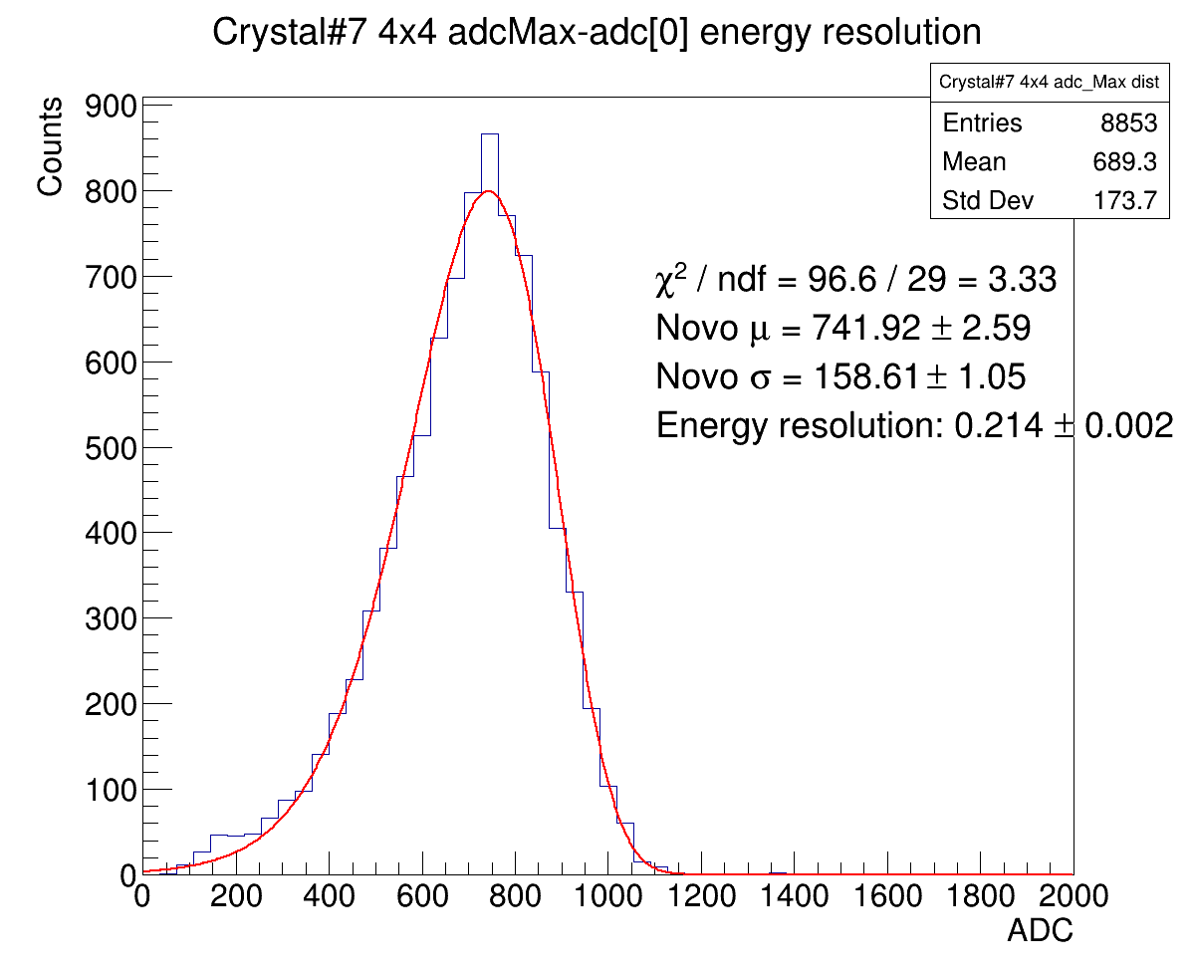
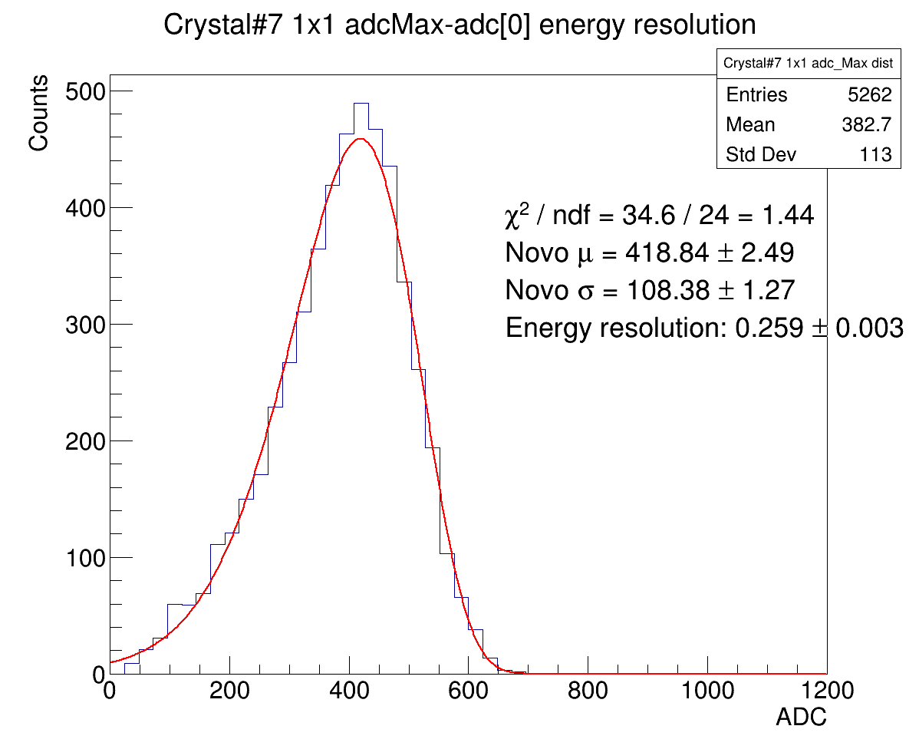
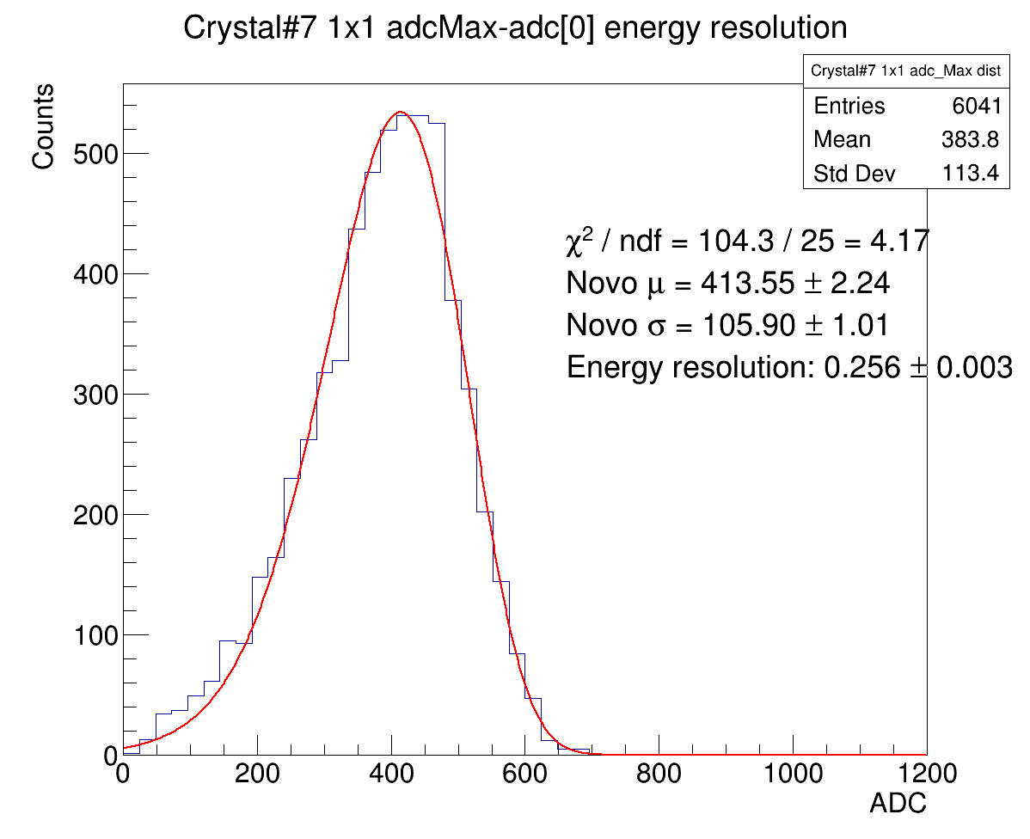
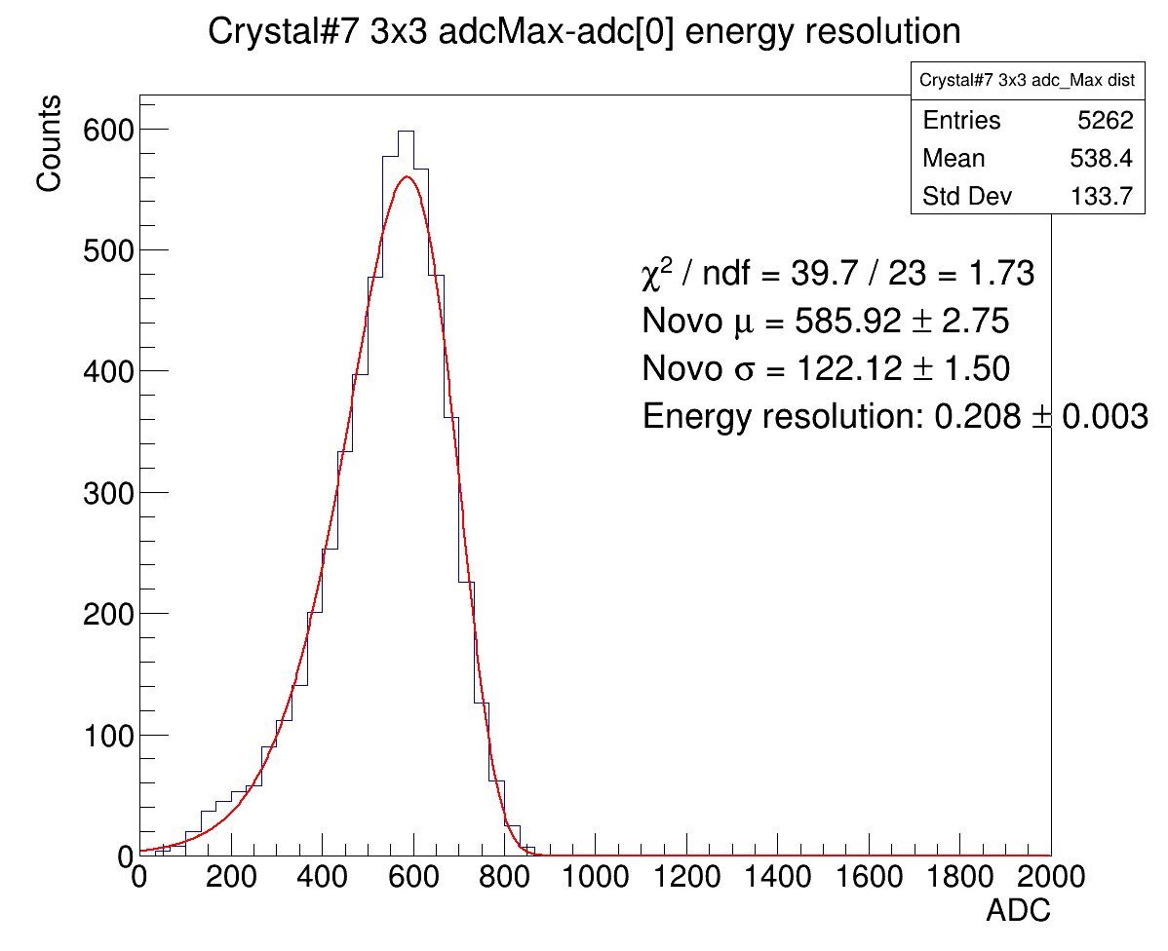
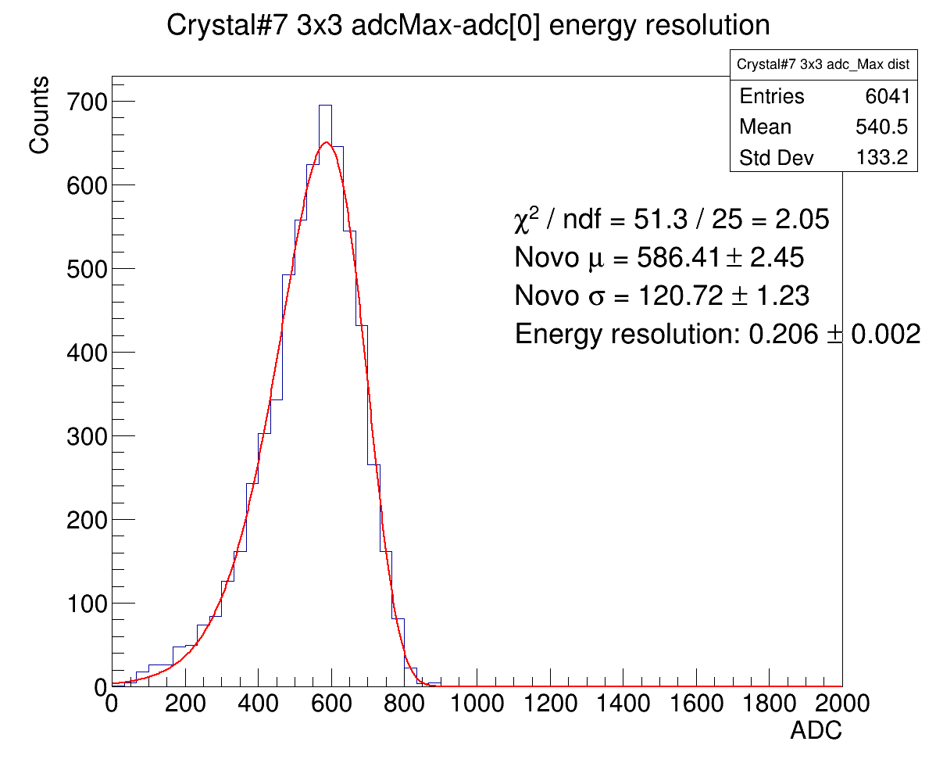
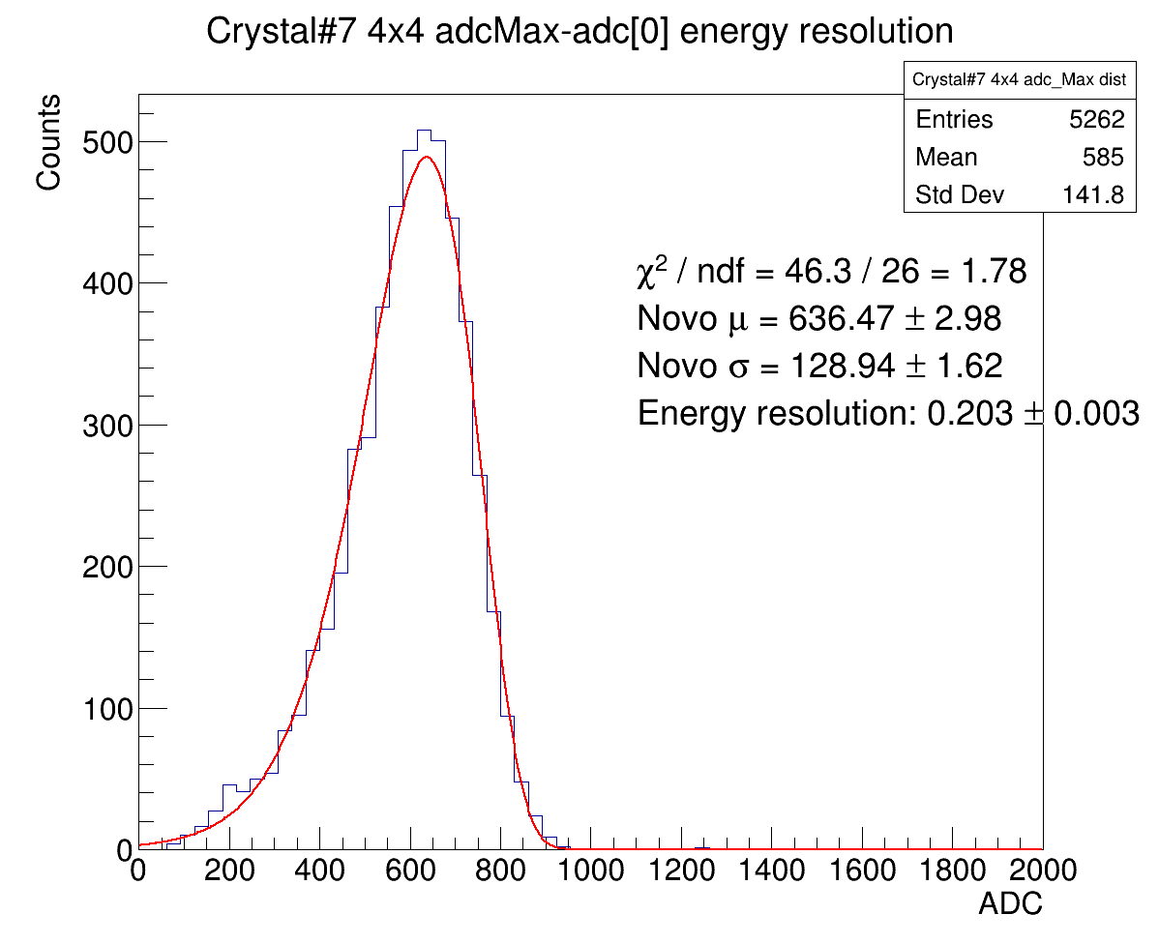
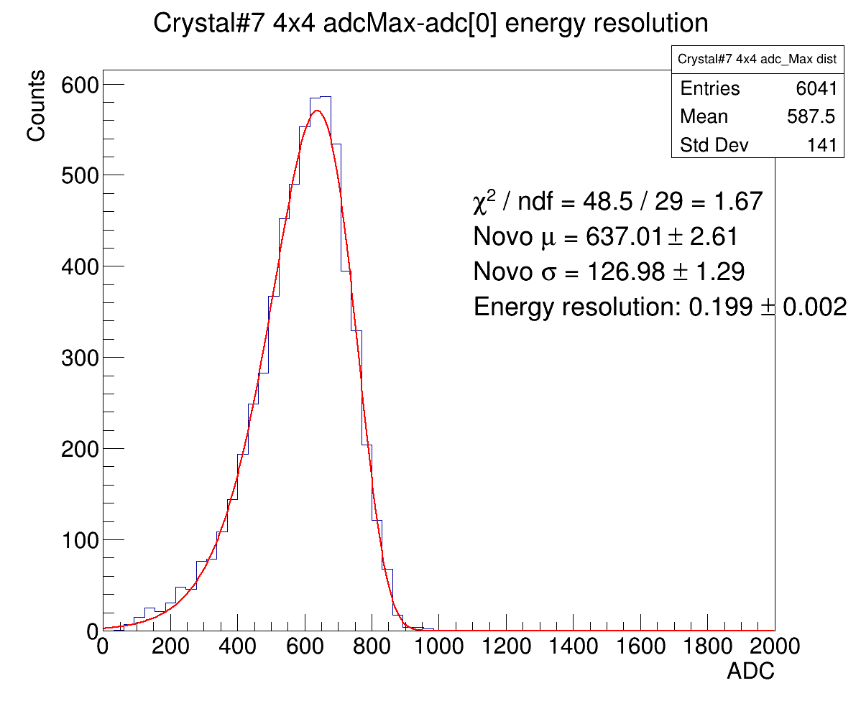
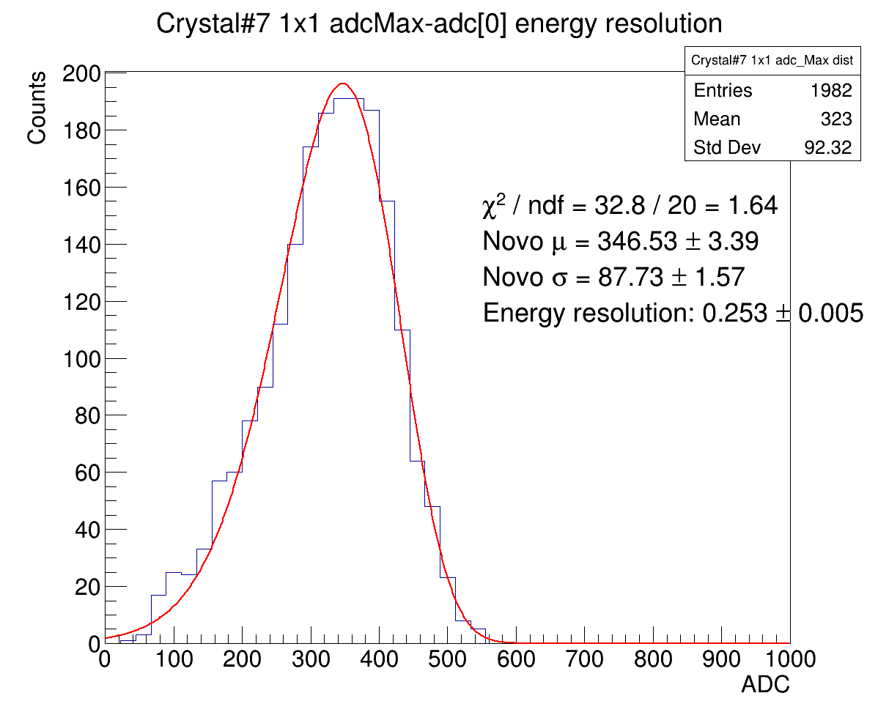
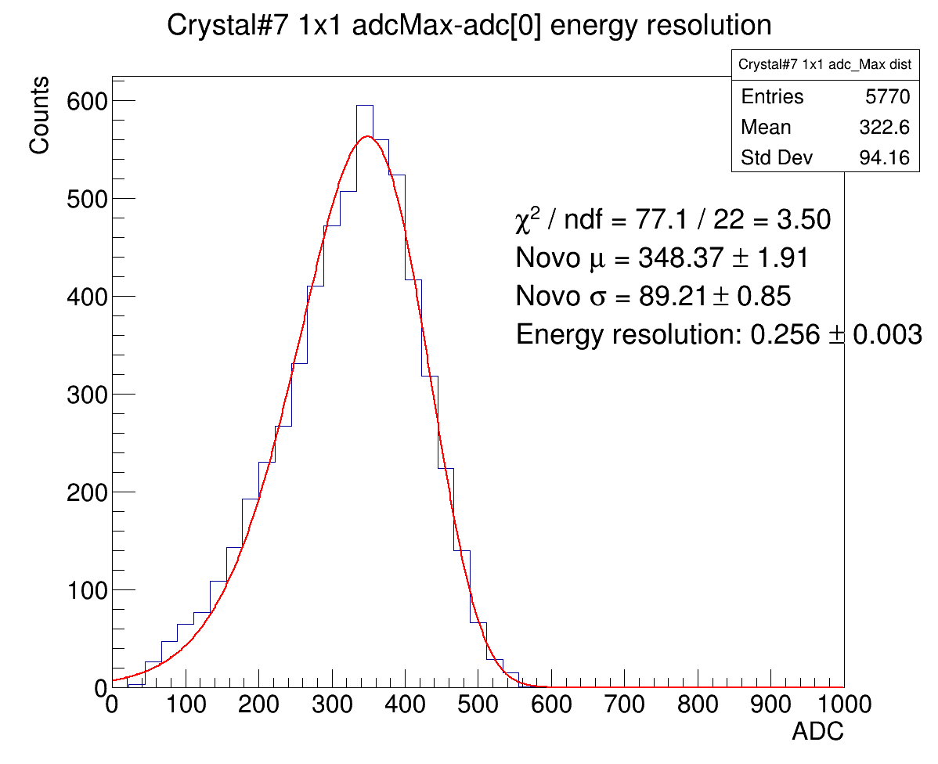
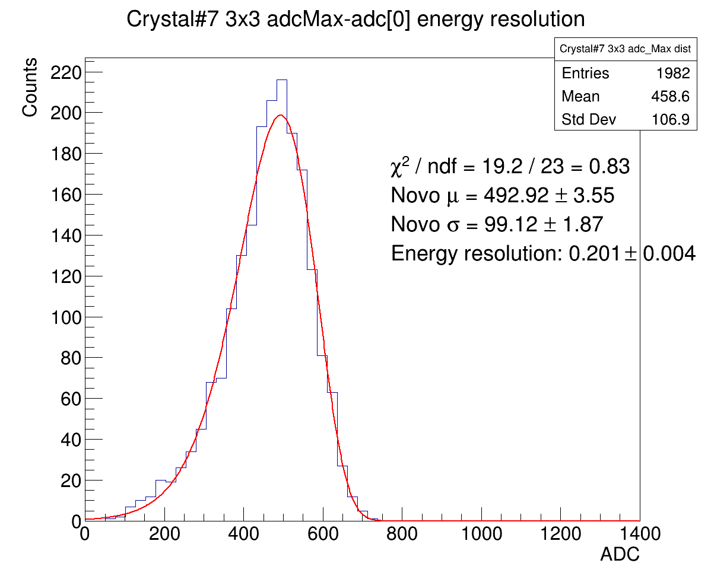
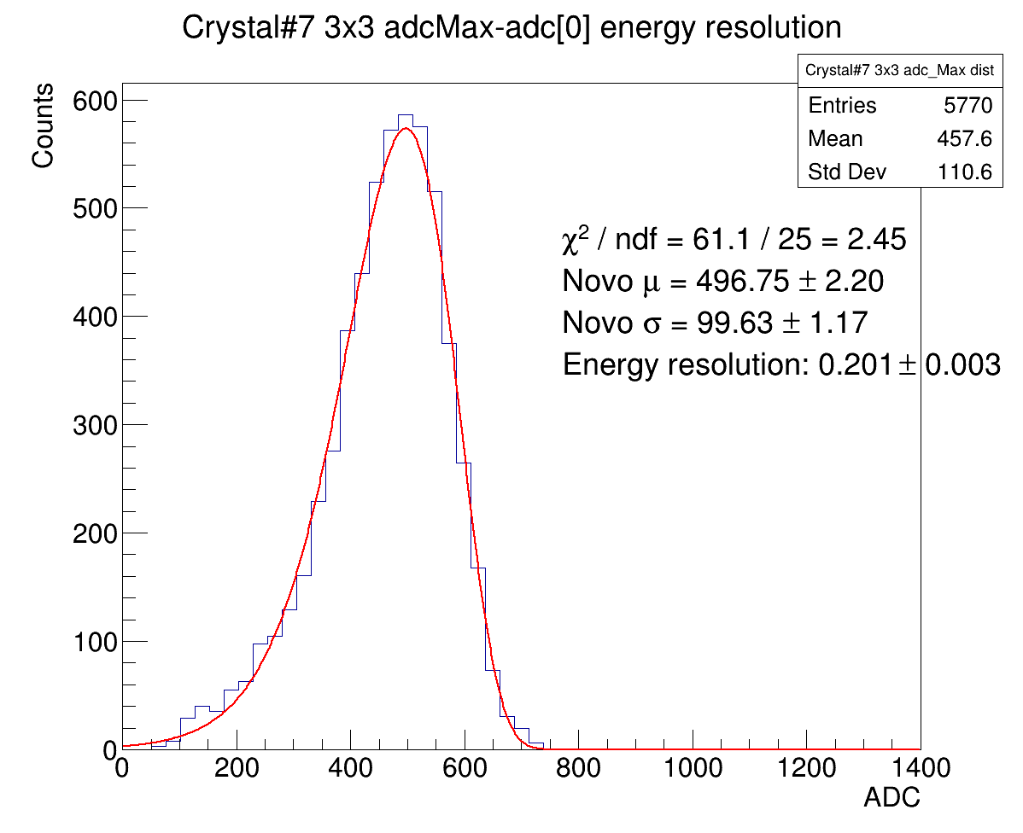

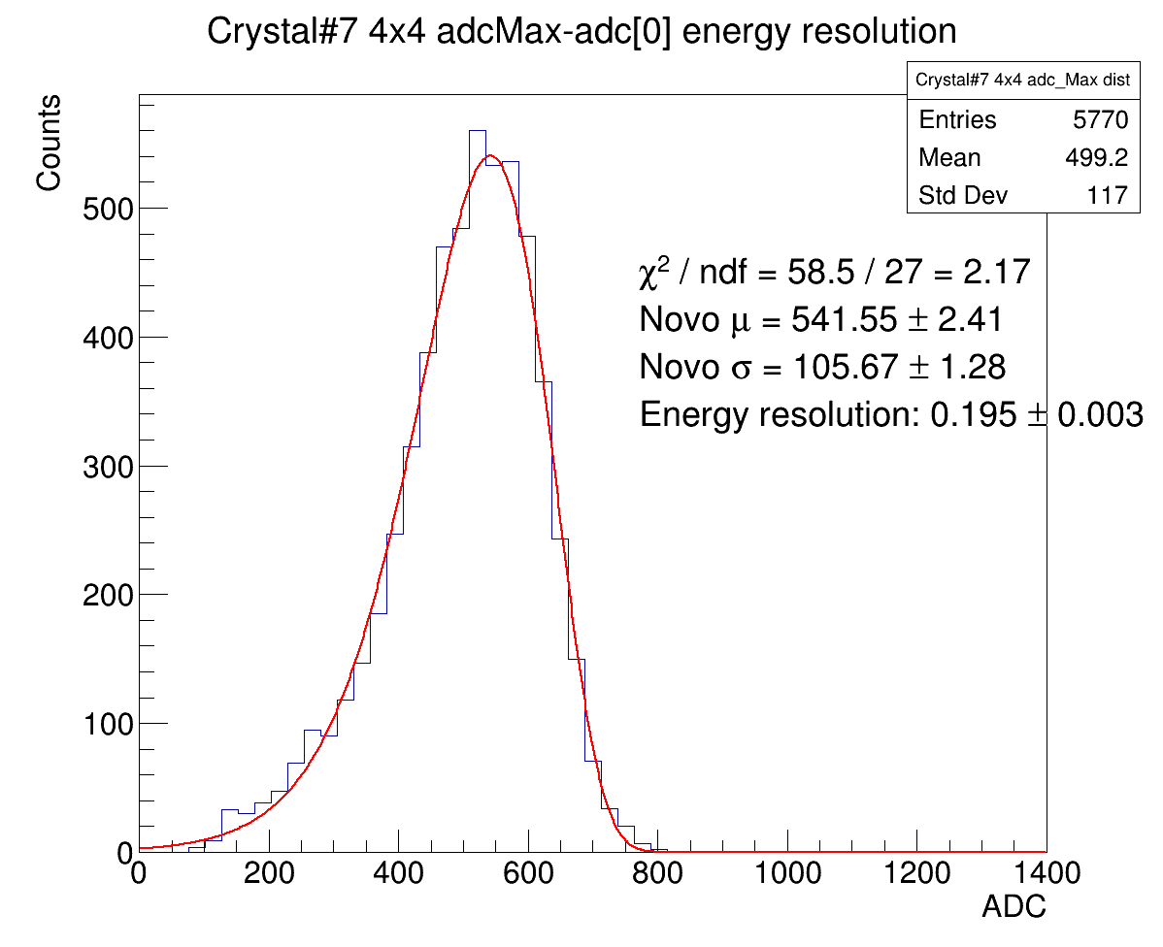
Resolution with Novo fit
1x1 clustering
3x3 clustering
4x4 clustering
823MeV
705MeV
584MeV
492MeV

Slide 4
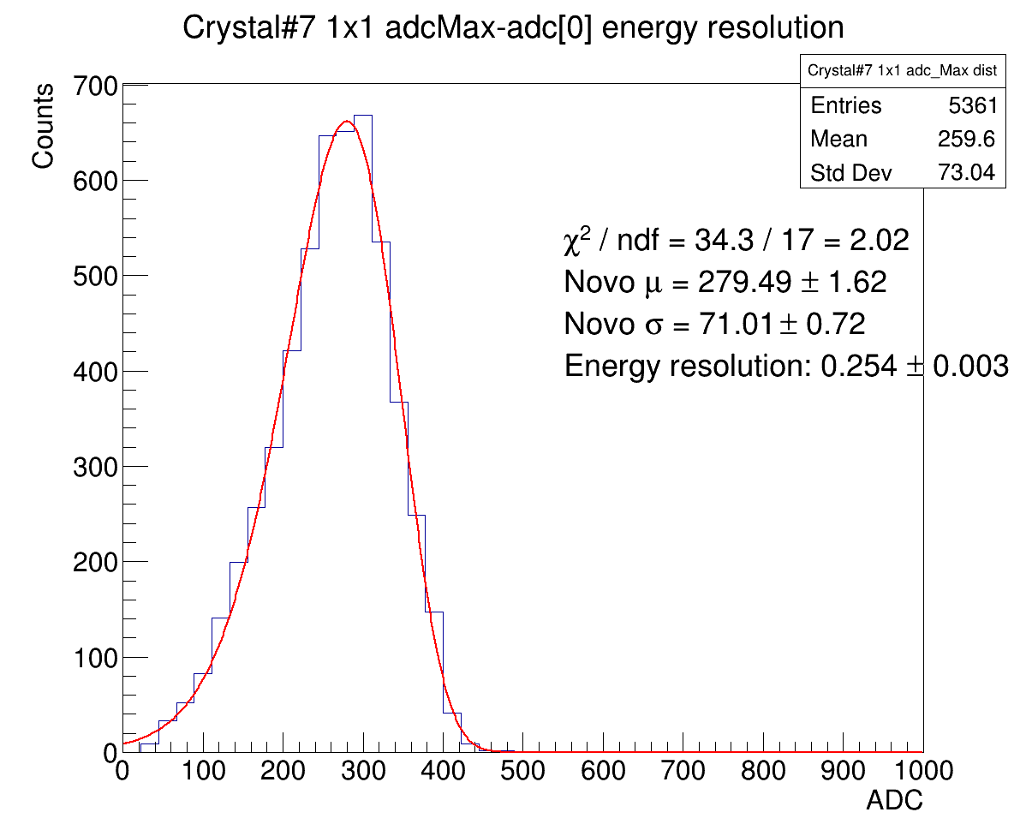
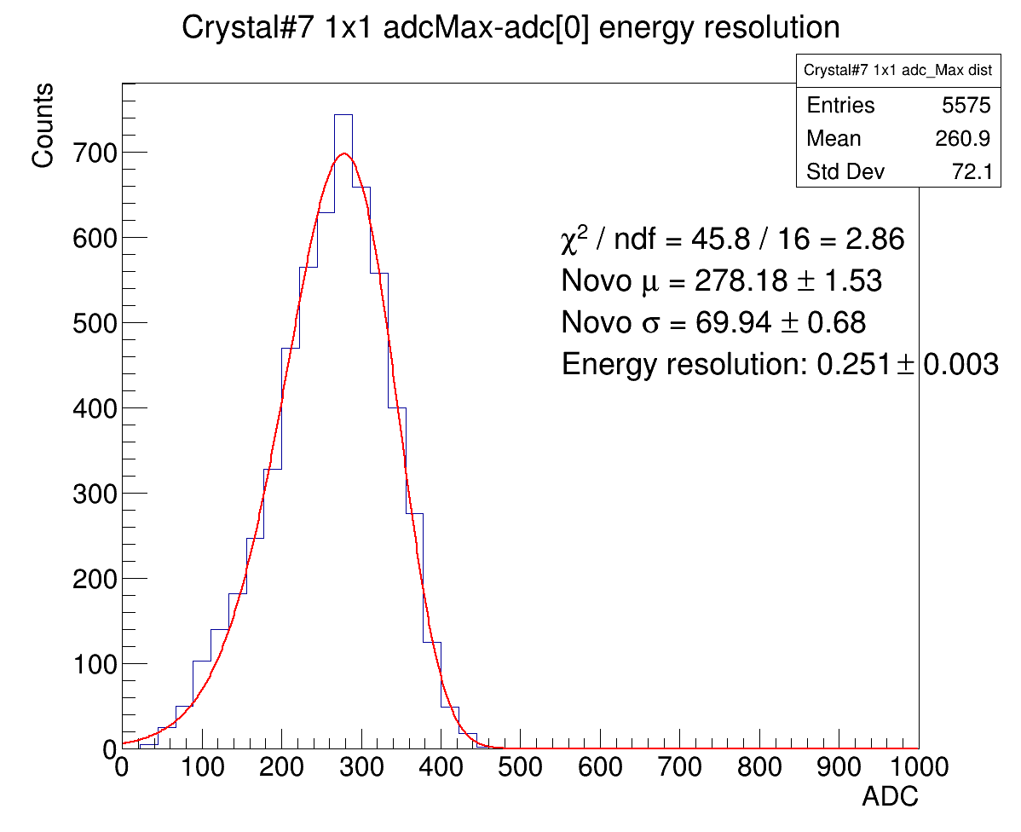
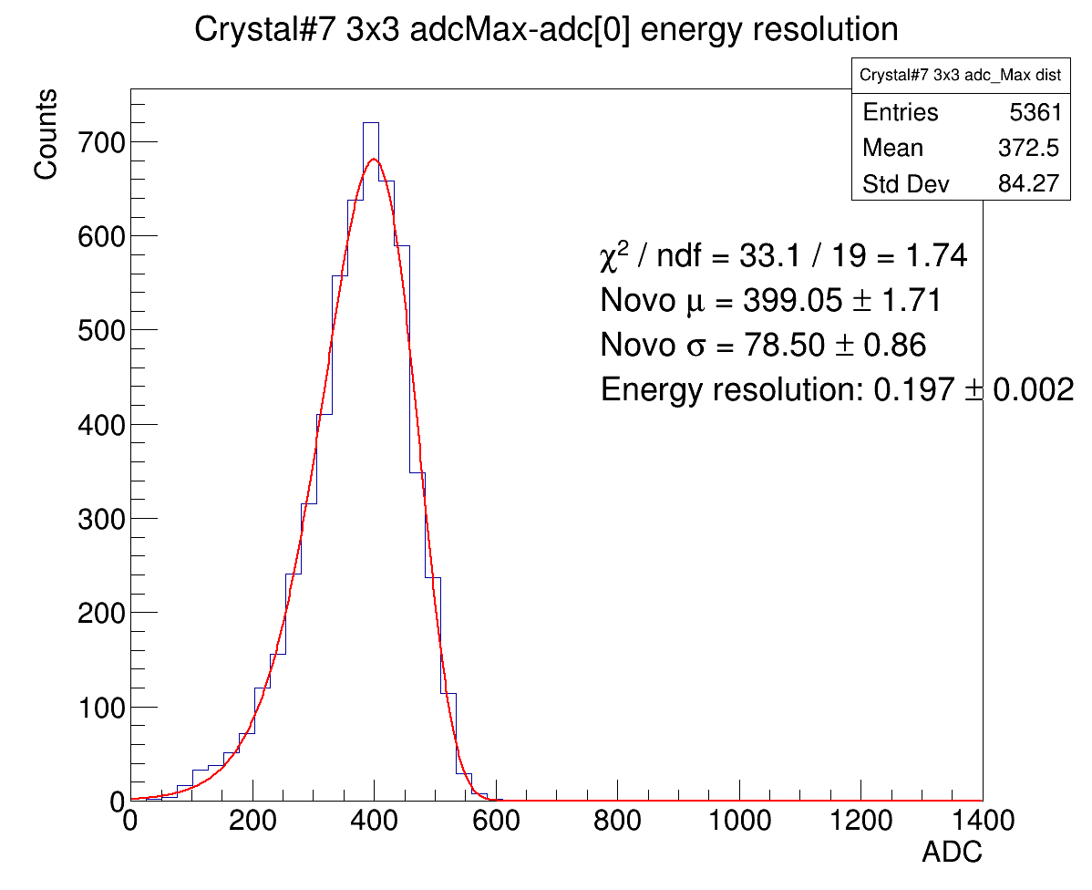
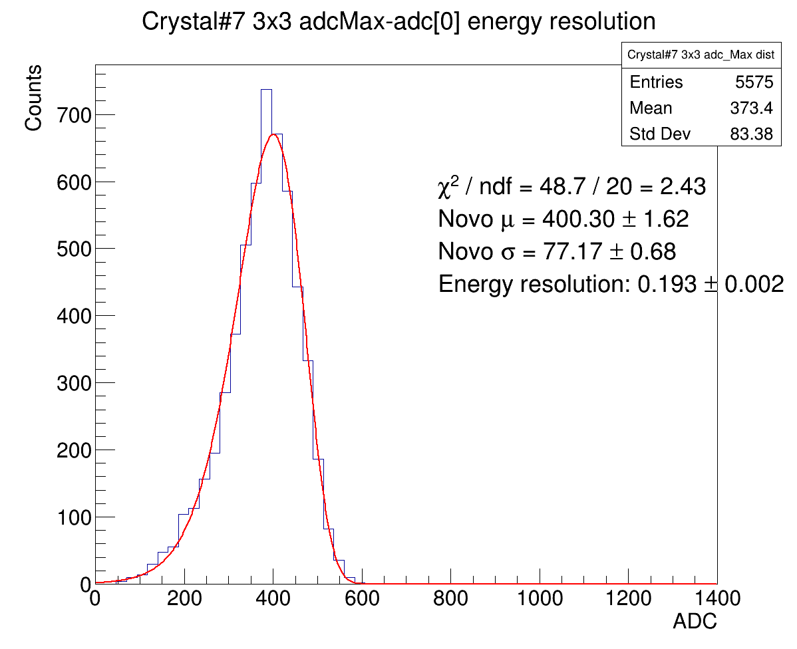

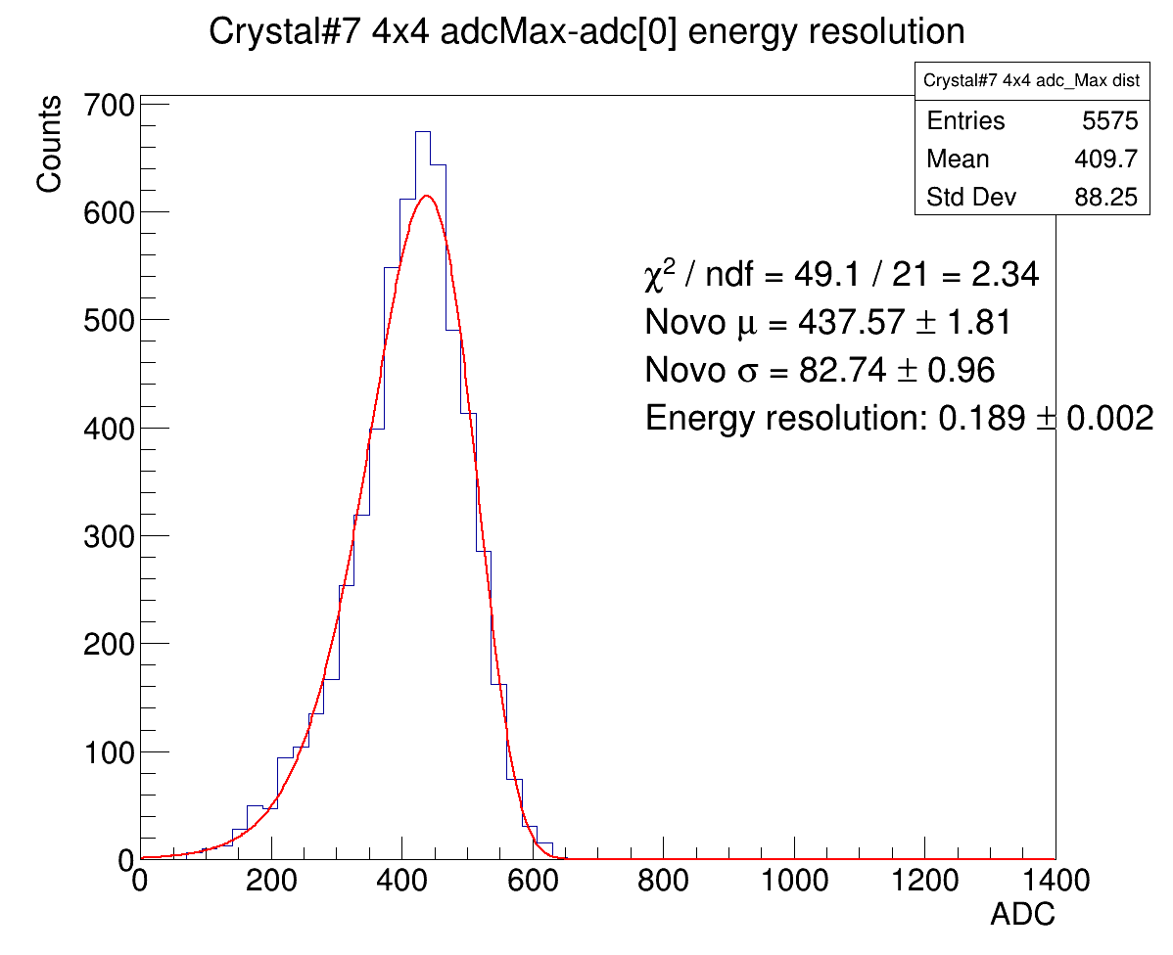
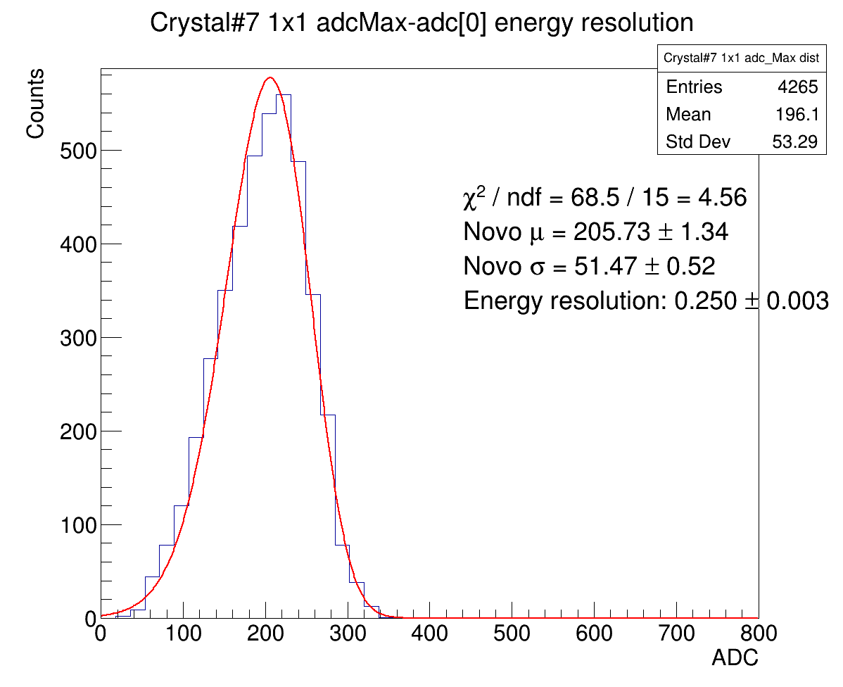

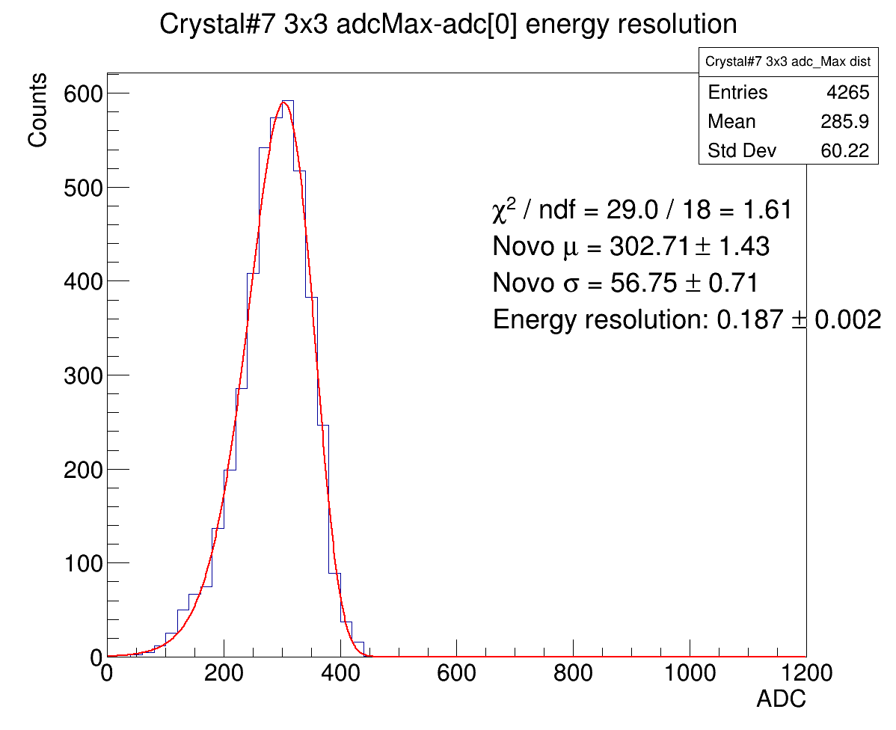

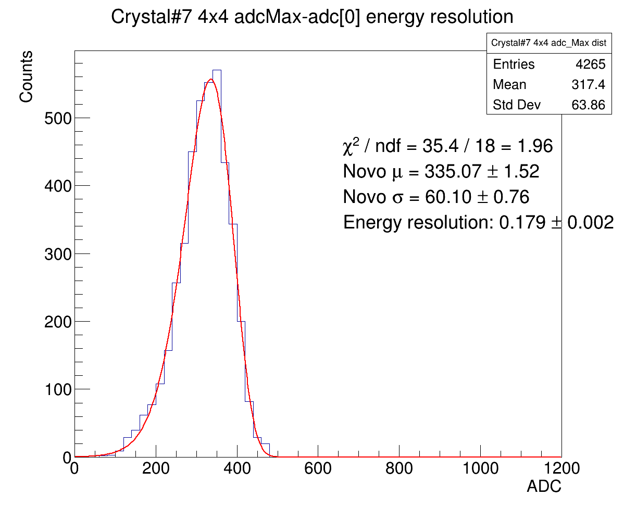

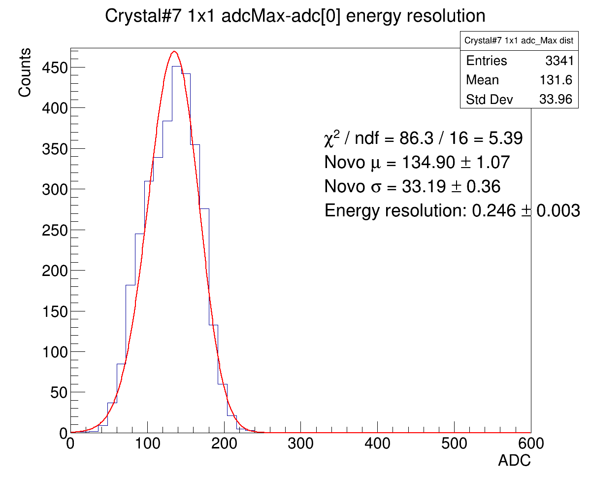
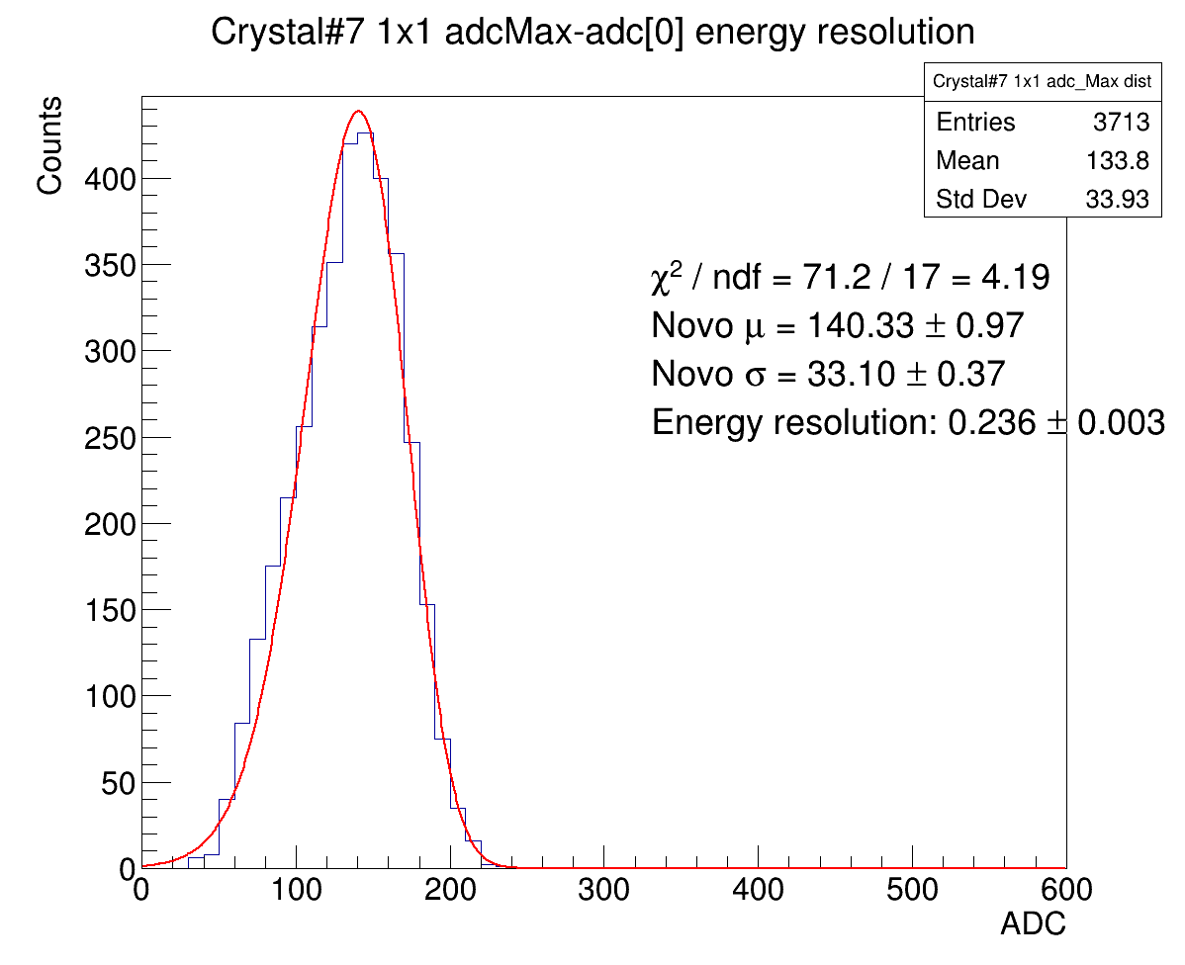
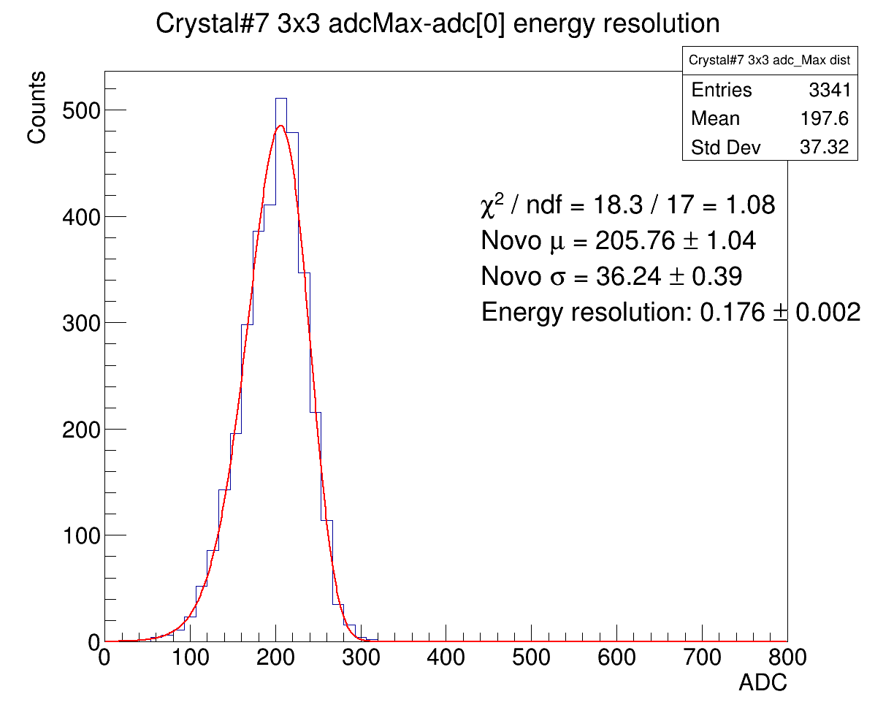

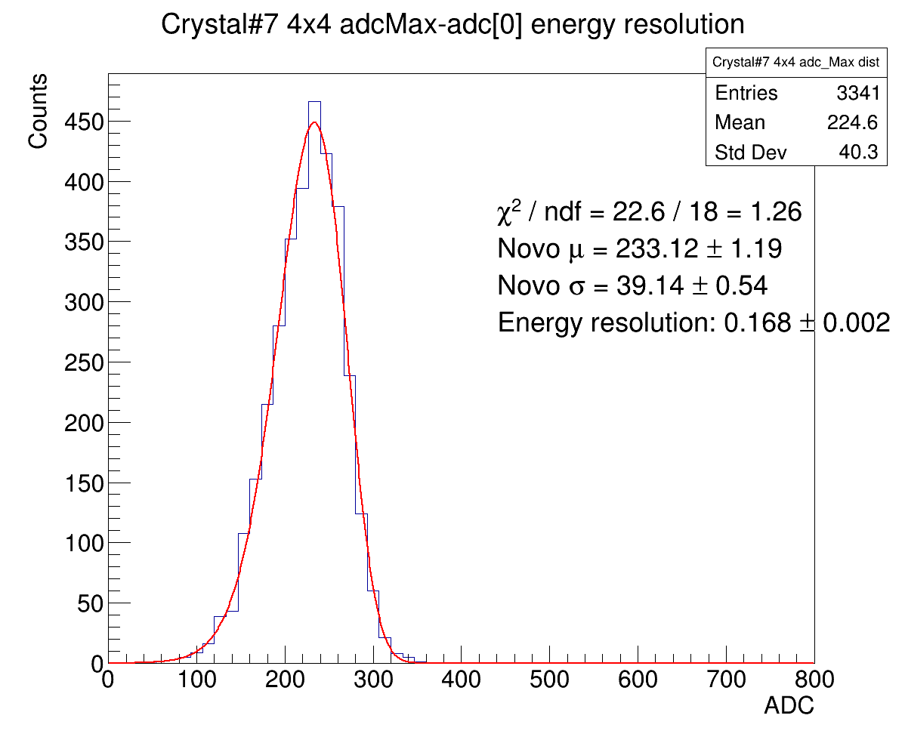
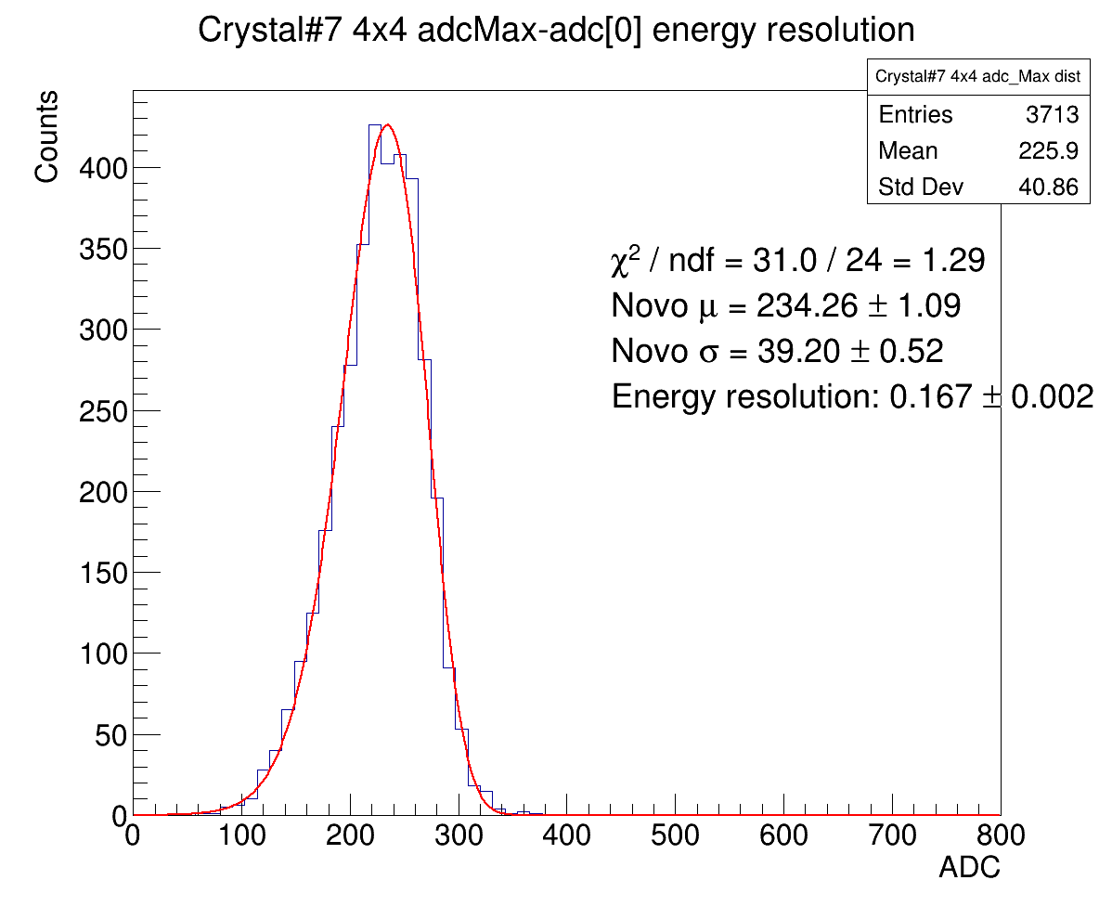
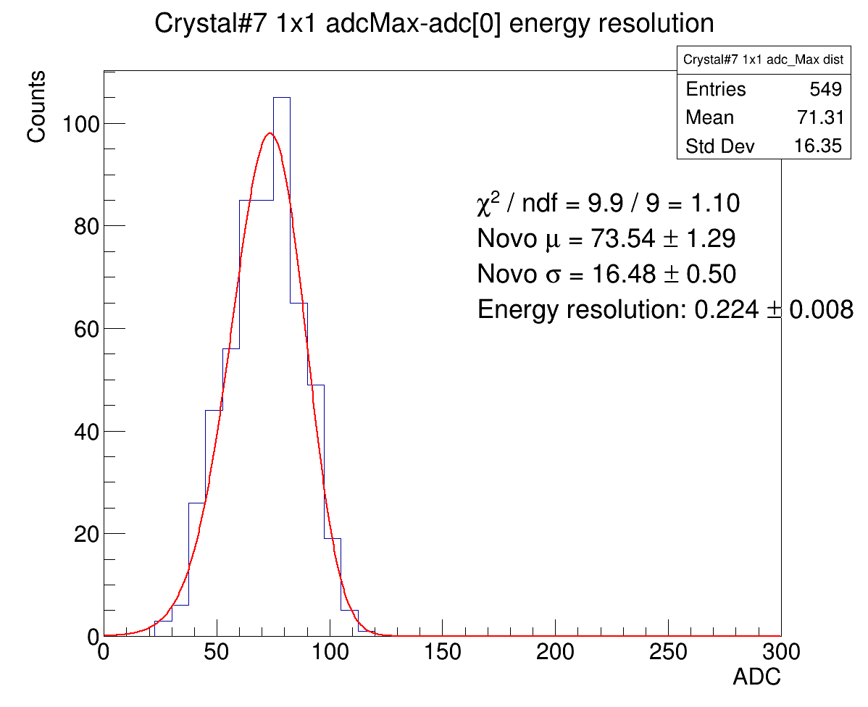
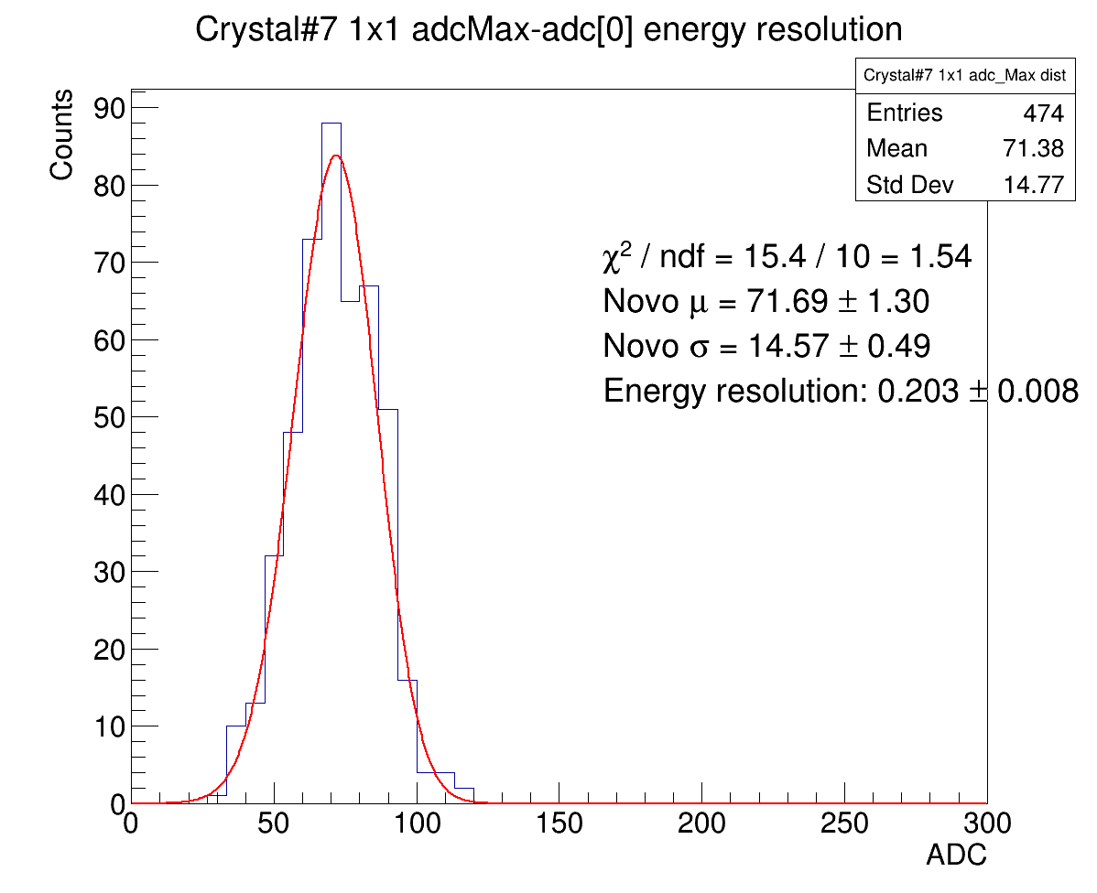
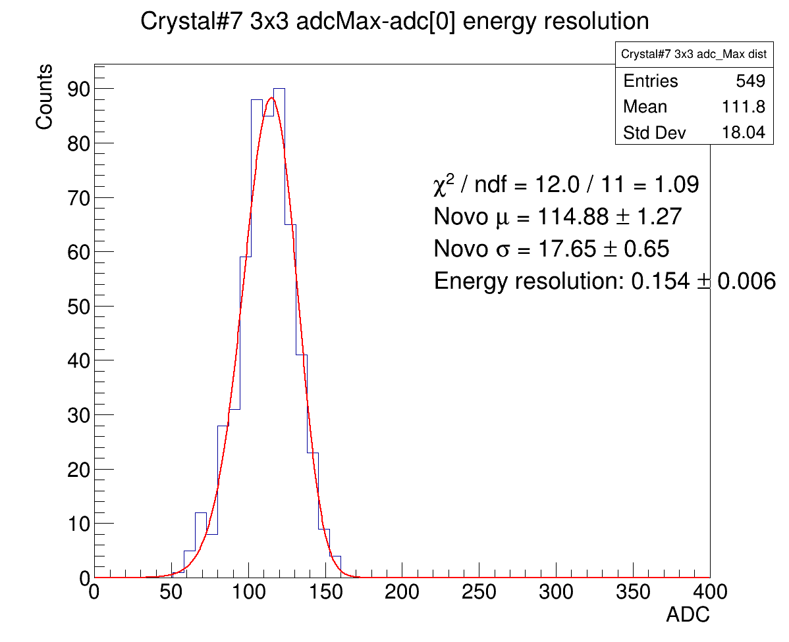
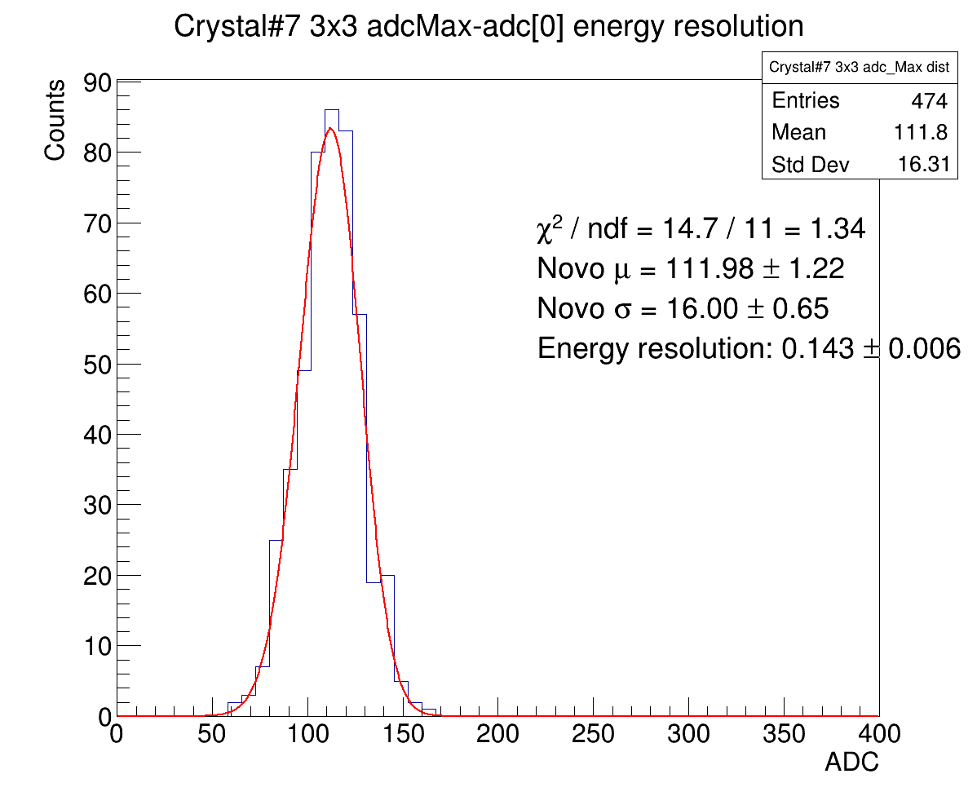
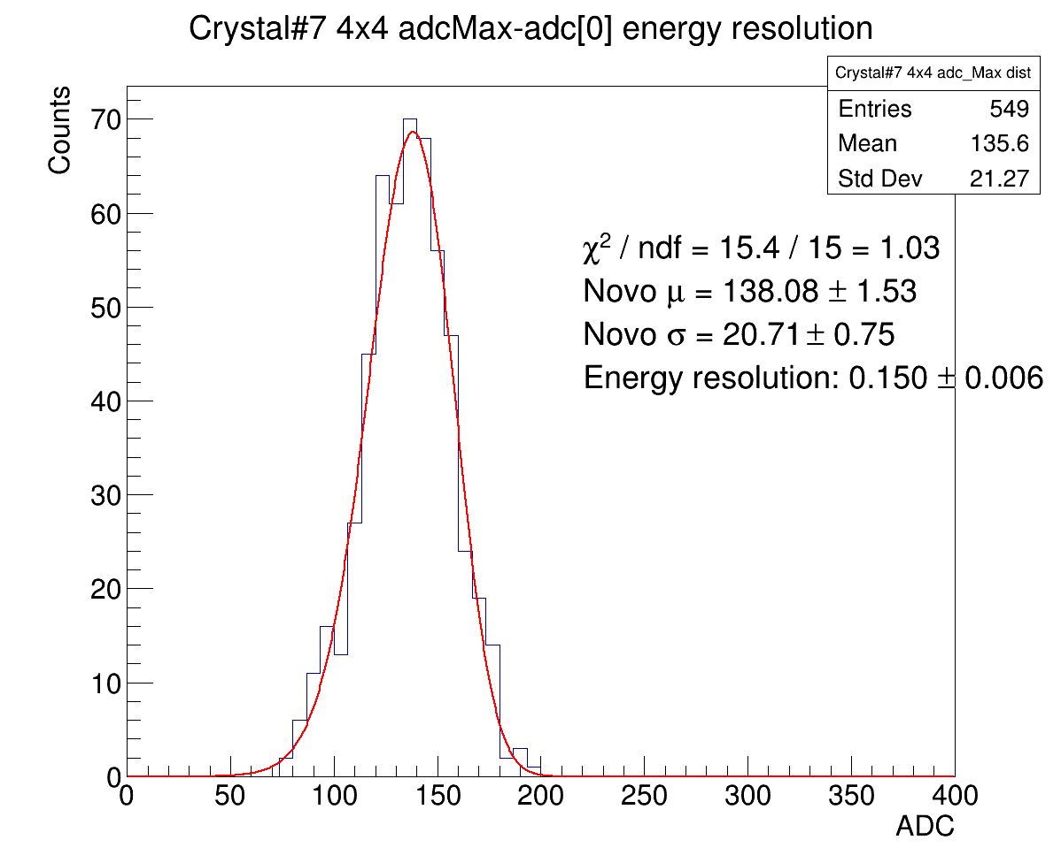
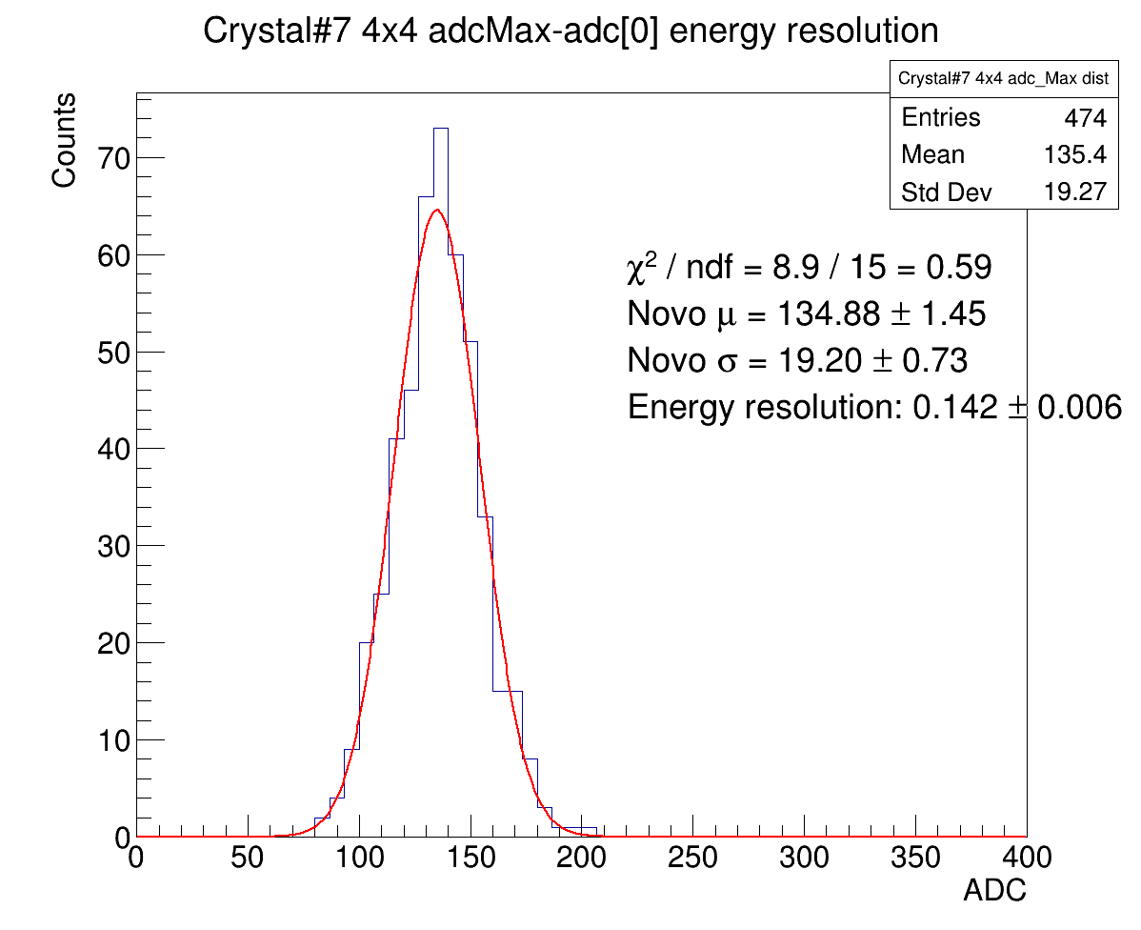
Resolution with Novo fit
1x1 clustering
3x3 clustering
4x4 clustering
395MeV
297MeV
197MeV
100MeV

Slide 5
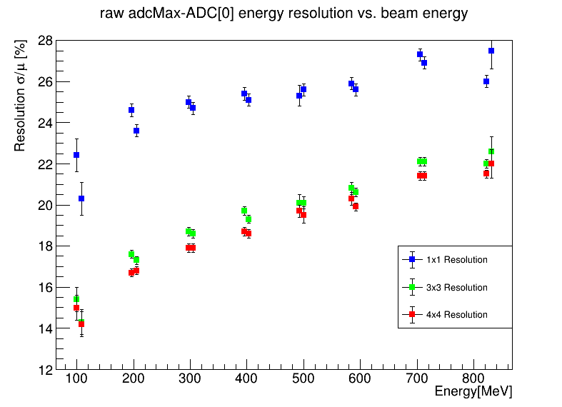
Resolution with Novo fit

Slide 6
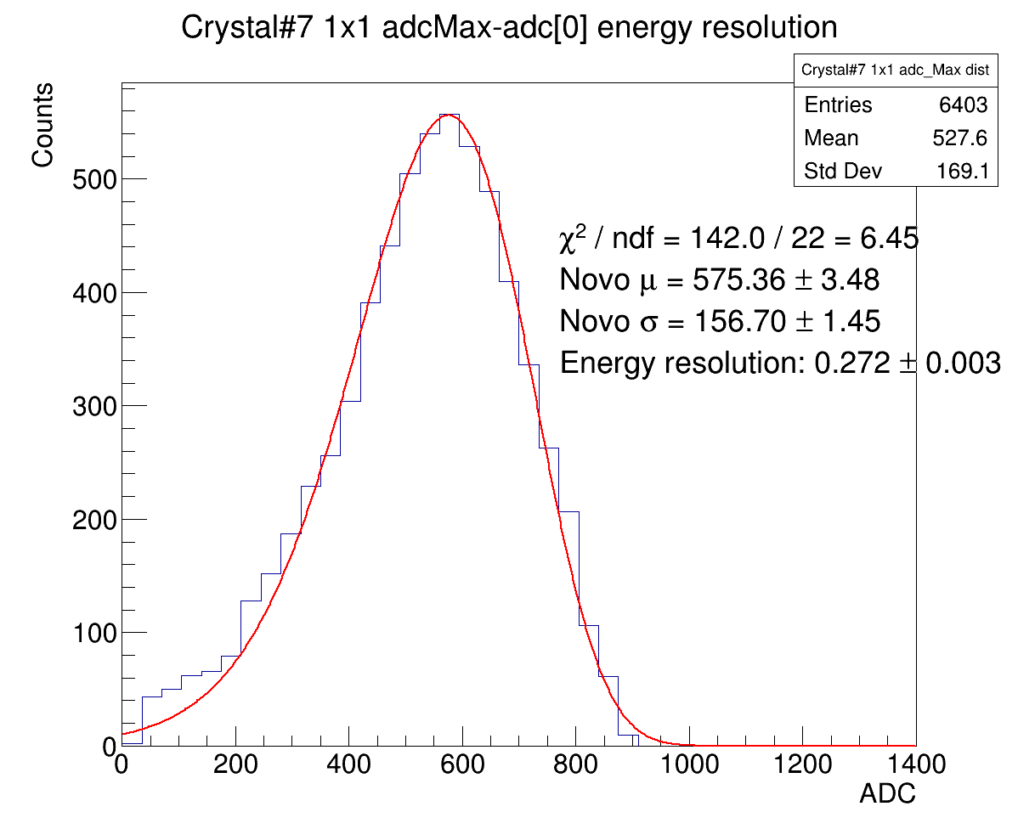
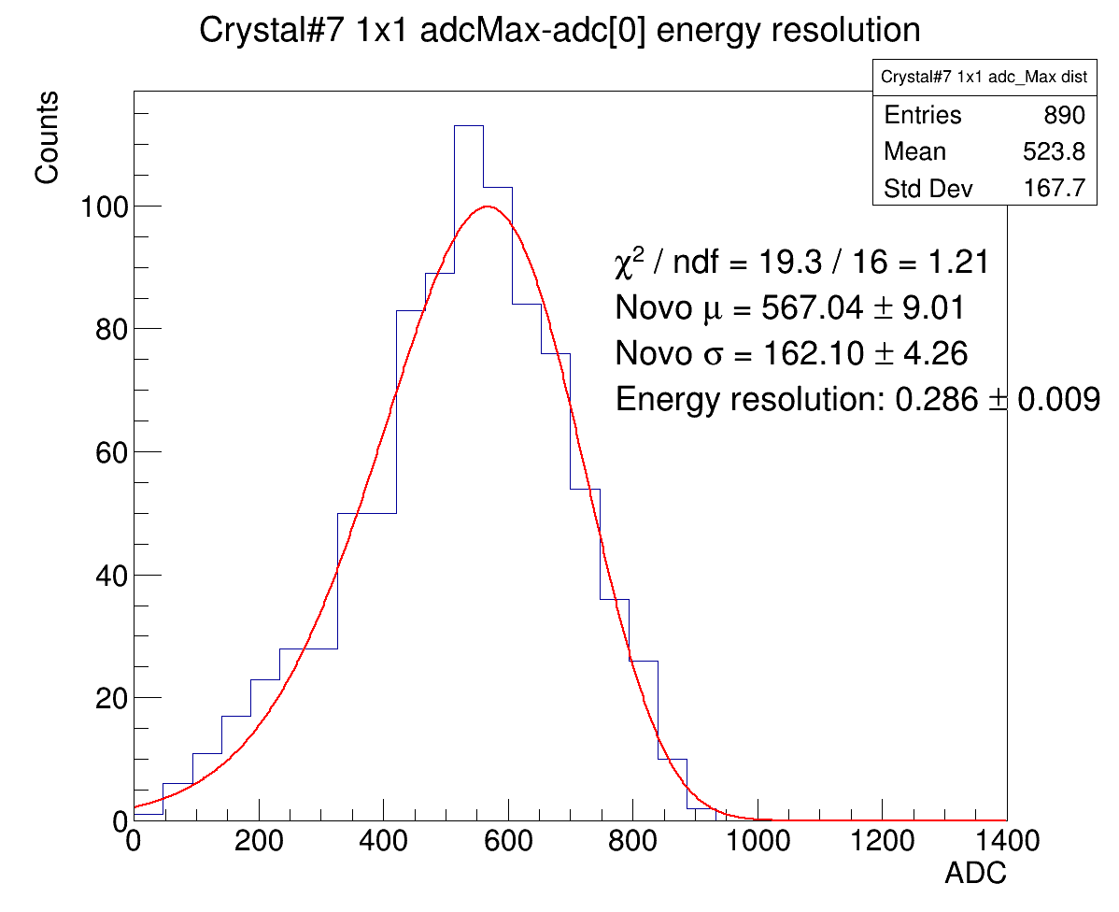
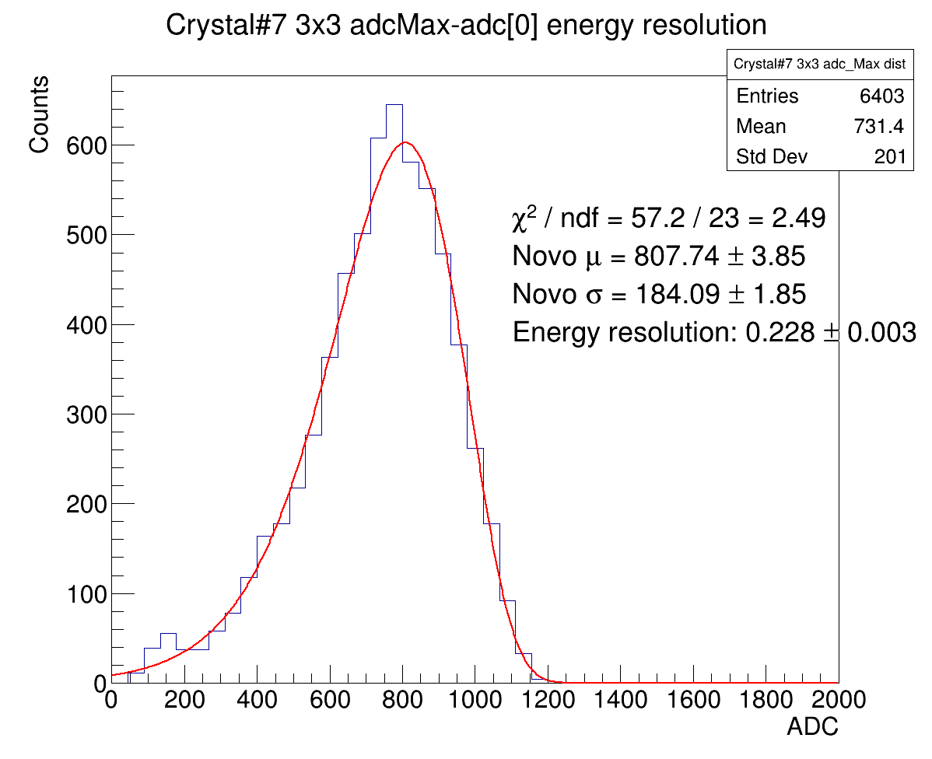
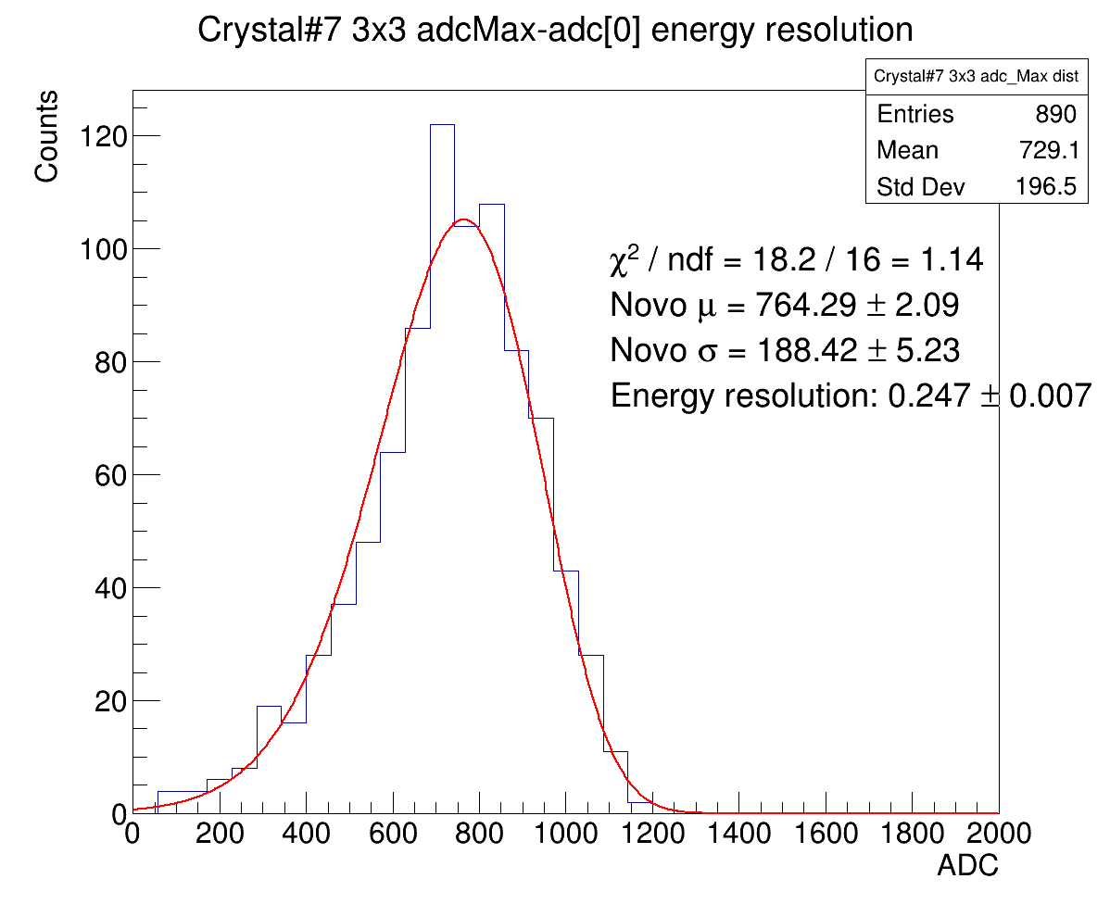



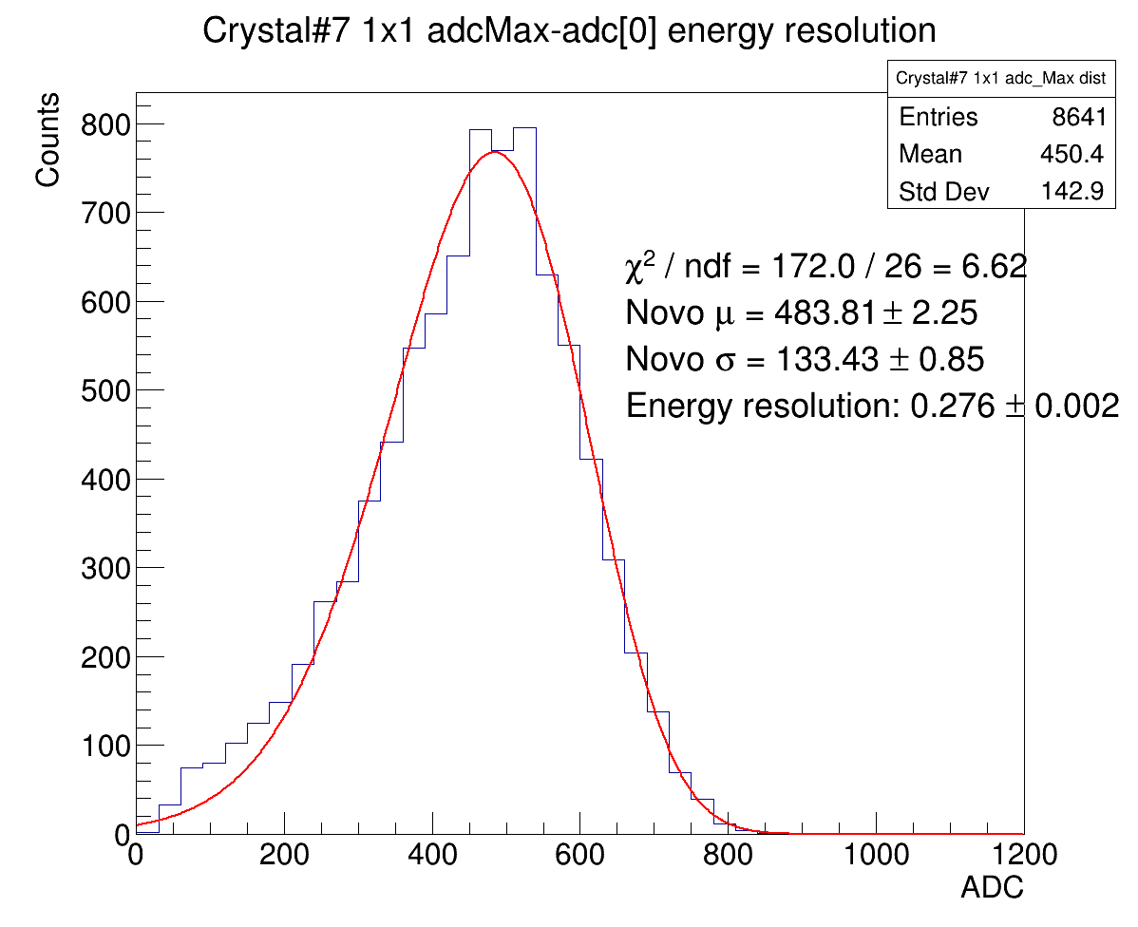


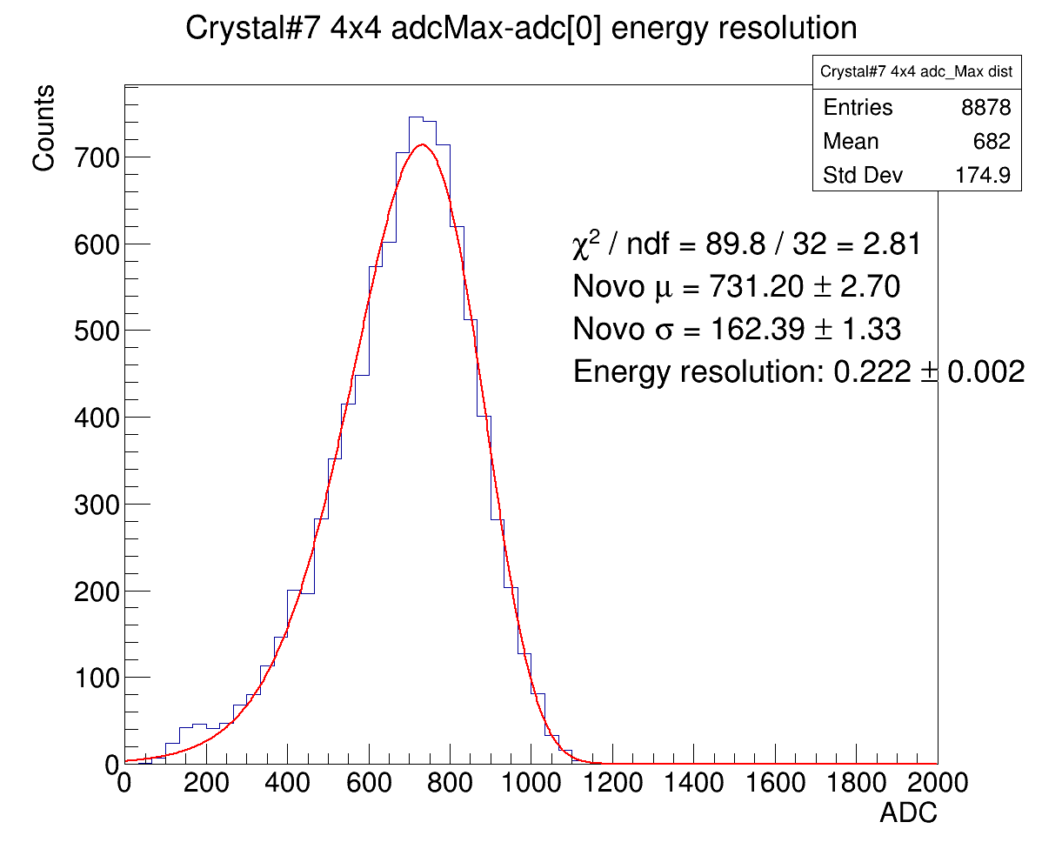













Half channel
1x1 clustering
3x3 clustering
4x4 clustering
823MeV
705MeV
584MeV
492MeV

Slide 7
























Half channel
1x1 clustering
3x3 clustering
4x4 clustering
395MeV
297MeV
197MeV
100MeV

Slide 8

Half channel

Slide 9

All channels vs. half of all channels’ resolution
Both 3x3 & 4x4 clustering yield better resolution when using all available good channels compared to only half.
Energy Resolution:
all channels < half channels
4x4 < 3x3

