Slide 1
EPIC ZERO DEGREE CALORIMETER (ZDC) GROUP MEETING
Two-Step Decoupled Multivariate Energy Regression for the X0 PbWO4 Calorimeter Prototype
Weekly Meeting Report — Workflow, Validation, and Intrinsic Resolution
Author: Yu-Siang Xiao (蕭宇翔) | NCUHEP, Taiwan
Department of Physics, National Central University & ePIC Collaboration
RARiS Positron Beam Test Analysis & Digital Twin Modeling | 21 October 2026

Slide 2

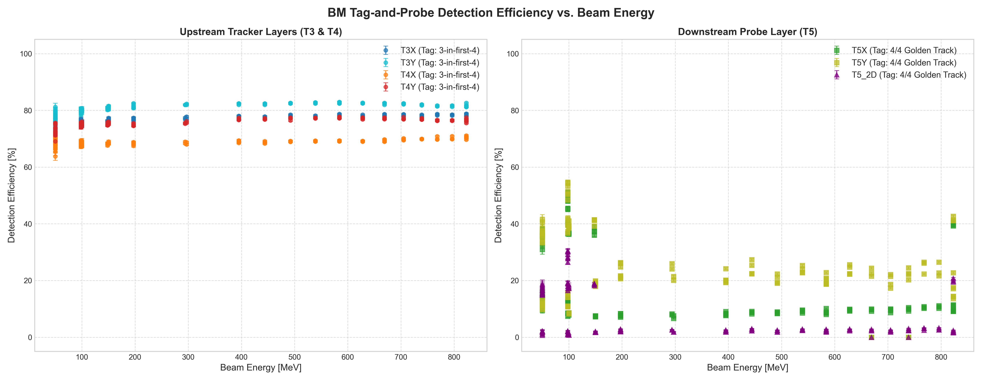
Beam Monitor (BM) Efficiency & Tracking(BT July26)
Eff.T3/T4
O
Upstream Trackers (T3 & T4): Stable detection efficiency (70%–83%) maintained across full 50–800 MeV range.
Downstream Probe (T5): Lower efficiency due to the “low trigger rate requriment”.
Definition:
Filter: Low statistics/problem Run & the outliers.
O
Probe
O
X
O
Eff.T5
O
O
O
O
Probe
O
X

Slide 3
THIS IS bt Feb 2025 MC / data regression result

Slide 4
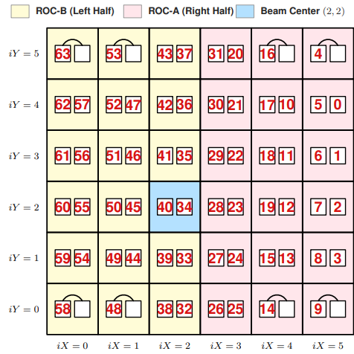
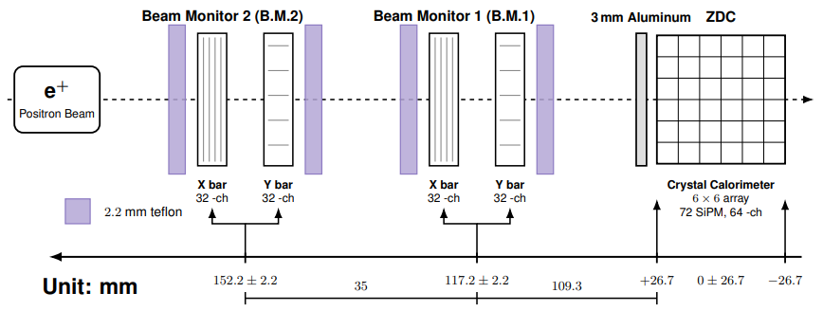
Step 1 — Golden Event Selection Criteria in MC&Data
1. Central Seed Isolation: E_{max} strictly at central crystal (2,2) to ensure intact 3x3 and 5x5 containment rings.
2. Collimated Incidence: Upstream track angle θ_{BM} < 1.0 deg (suppresses Multiple Coulomb Scattering tails).
3. Tracking Quality: Complete 4-layer hits with bounded transverse beam dispersion across trajectory.
4. Threshold & Coincidence: Seed E_{max} > 20 MeV with simultaneous dual-SiPM trigger consistency.
θ_{BM} < 1.0 deg
E_{max} ch is 40/34
E_{max} > 20 MeV
Ch34/40 both hit
O
O
O
O
O
O

Slide 5
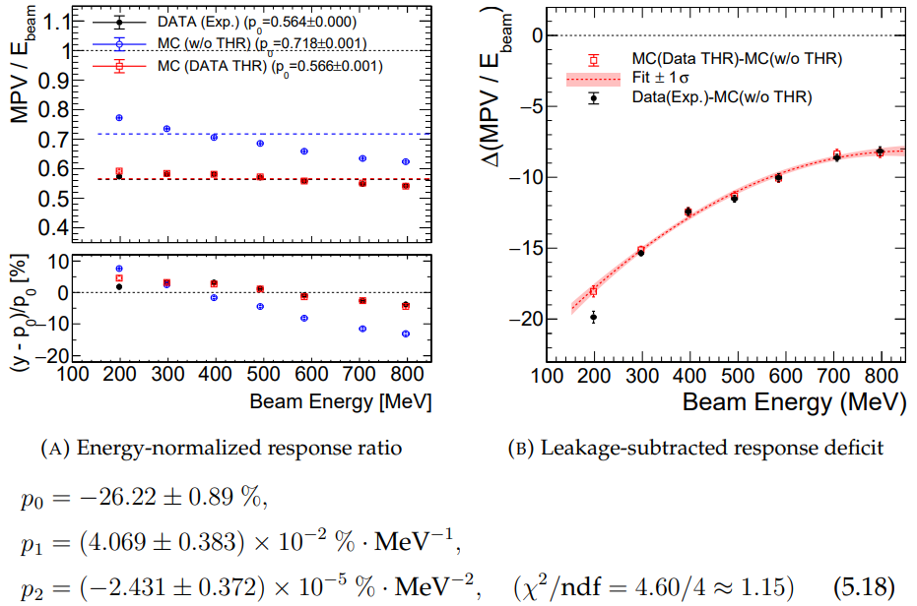
Step 2 — Problem Diagnosis (1): Energy Deficit & Non-Linearity
MEASURED DEFICIT PARAMETERS
<E_{3x3}> / E_{beam} = 56.4% (Data) vs. 56.6% (MC-THR)
Low-E Truncation Offset: p0 = -26.22% (chi2/ndf = 4.31)
Severe Containment Loss: Uncalibrated E_{3x3} collects only ~56.4% of E_{beam} (closely matches DAQ-THR MC at 56.6%).
Low-Energy Deficit: Hardware DAQ threshold (VF/THR) causes up to ~20% response drop at 200 MeV (p₀ = -26.22%).
High-Energy Roll-Off: Rear longitudinal shower punch-through in the compact 6 X₀ (5.34 cm) crystal array.
Figure: E_3x3 peak response ratio and DAQ-THR energy deficit curves.

Slide 6
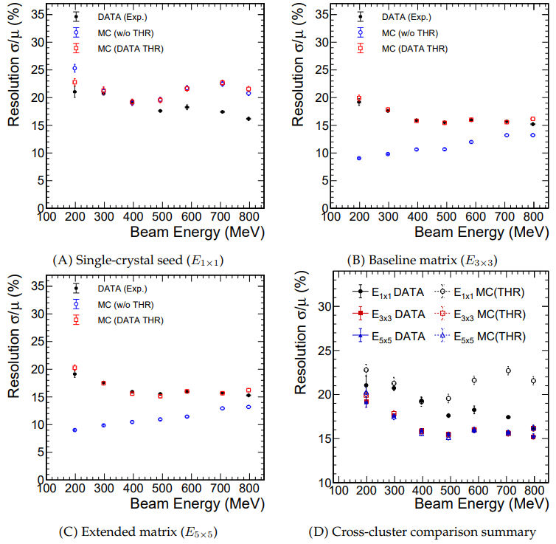
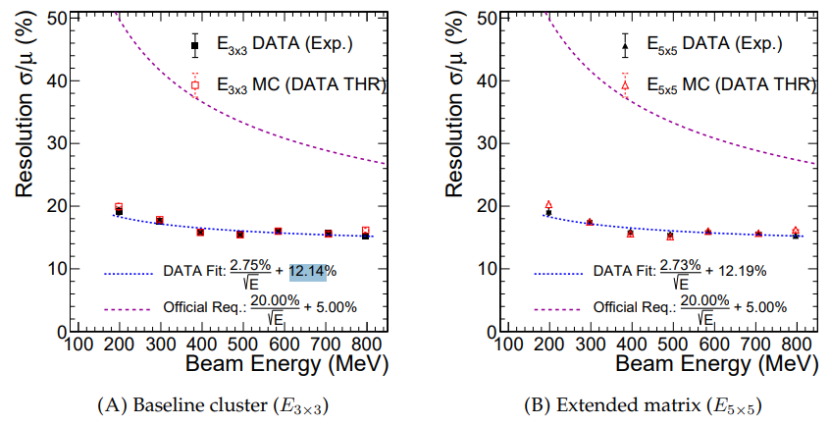
Step 2 — Problem Diagnosis (2): Pre-Regression Resolution
Clustering Limit: Expanding E_3x3 to E_5x5 yields no resolution gain due to outer-ring hardware threshold truncation.
Dominant Constant Term: Fit exhibits stochastic a = 2.75%/sqrt{E} but a massive constant term c = 12.14%.
Core Objective: Design a physics-informed regression to restore linearity (-> 1.0) and suppress punch-through variance (c).
PRE-REGRESSION RESOLUTION
Uncalibrated E_3x3 Fit: sigma/E = (2.75% / sqrt{E}) + 12.14%
Reduced Chi2: chi2 / ndf = 34.50 / 5 = 6.90
Figure: Pre-regression resolution (E_1x1, E_3x3, E_5x5) vs. beam energy.

Slide 7
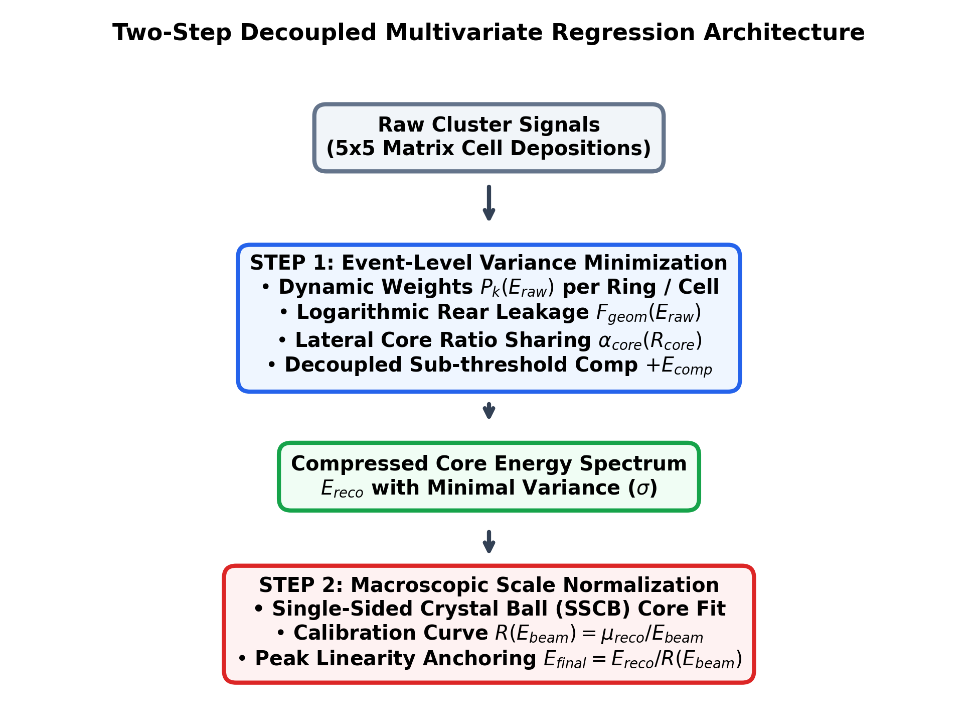
Step 3 — Why Two-Step Decoupled Regression Architecture?
[ TWO-STEP REGRESSION ARCHITECTURE ]
Single-Step Dilemma: Forcing scale (mu -> E_{beam}) and variance (sigma) in one step distorts asymmetric shower leakage tails.
Step 1 (Variance Minimization): Event-level optimization of spatial weights and leakage terms compresses Gaussian core width (sigma).
Step 2 (Scale Normalization): Fit Step-1 spectra with Single-Sided Crystal Ball (SSCB) and align peak MPV (muSS_{CB} / E_{beam} -> 1.0).
Blind Deployment: Trained strictly on DAQ-MC digital twin; blindly deployed onto RARiS experimental data.
Figure: Two-step decoupled multivariate regression architecture workflow.

Slide 8
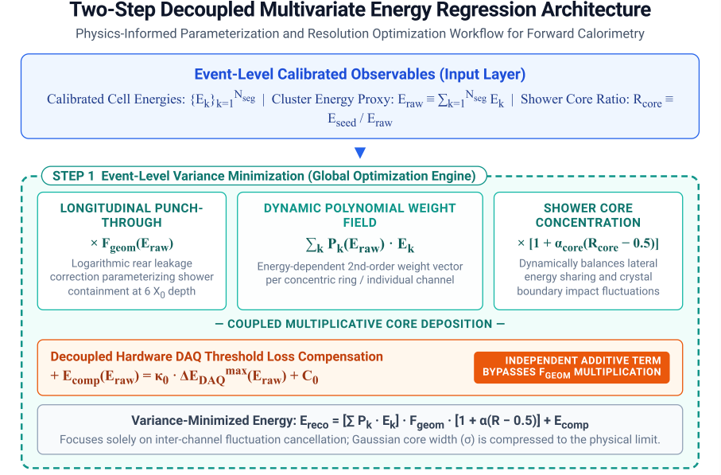
Step 3A — Event-Level Variance Minimization (Step 1)
STEP 1 REGRESSION FORMULA
E_{reco} = Σ_{k} (P_{k}(E_{raw}) E_{k} ) x F_{geom}(E_{raw})
x [ 1 + alpha_{core} (R_{core} - 0.5) ] + E_{comp}(E_{raw})
[ STEP 1 GLOBAL OPTIMIZATION ENGINE ]
P_{k}(E_{raw}) Cell Weights: Dynamic pol2 weights per concentric ring (E_{clus}, 3 pars) or crystal cell (E_3x3, 9 pars).
F_{geom}(E_{raw}) Rear Leakage: Logarithmic rear longitudinal leakage correction tailored for 6 X₀ compact depth.
R_{core} Lateral Sharing: R_{core} = E_{seed} / E_{raw} balances lateral energy sharing and impact fluctuations.
+E_{comp} Decoupled Offset: Independently compensates sub-threshold DAQ loss without inflating high-energy leakage.
Figure: Step 1 event-level regression parameterization and optimization framework.

Slide 9
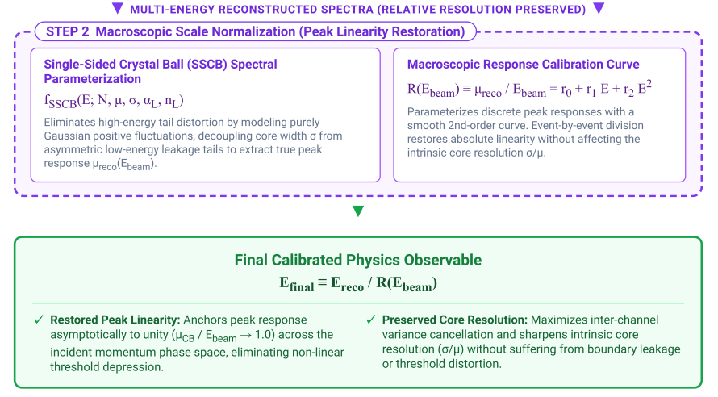
Step 3B — Macroscopic Peak Linearity Restoration (Step 2)
MC
STEP 2 SCALING FORMULATION
Calibration Curve:
R(E_{beam}) = μ_{reco} / E_{beam} = r₀ + r₁ E + r₂ E²
Final Observable: E_{final} = E_{reco} / R(E_{beam}) [Linearity -> 1.0]
[ STEP 2 SSCB & SCALE NORMALIZATION ]
SSCB Spectral Fit: Single-Sided Crystal Ball decouples Gaussian core (μ_{reco}, sigma) from low-energy leakage tails.
Smooth Calibration Curve: 2nd-order polynomial R(E_{beam}) models macroscopic peak response across discrete beam energies.
Variance Invariance: Dividing by R(E_{beam}) anchors peak linearity strictly to 1.0 while exactly preserving relative resolution (sigma/mu).
Figure: Step 2 macroscopic scale normalization and SSCB fitting framework.

Slide 10
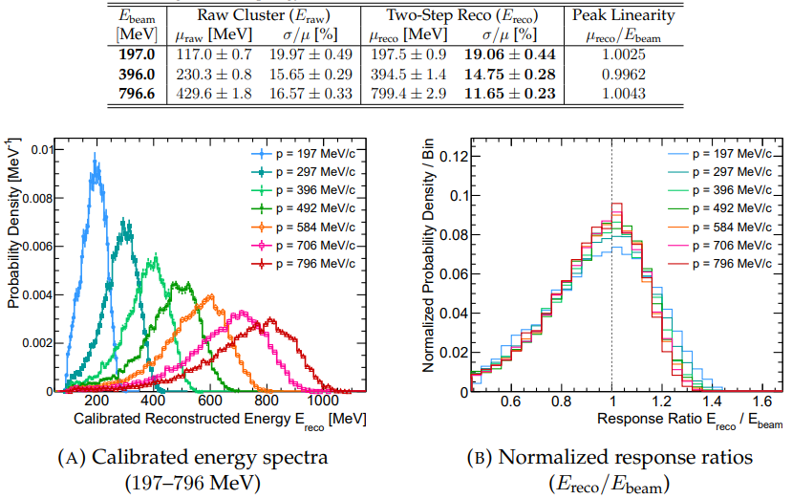
Step 4 — Reconstructed Spectra & Scale Restoration
MC
[ RECONSTRUCTED SPECTRA & DATA TABLE ]
Deficit Fully Eliminated: Raw cluster peaks (117–430 MeV) are successfully restored to true beam energies (197.5–799.4 MeV).
Unified Linearity Profile: Normalized response ratios (E_{reco} / E_{beam}) across all 7 energies (197–796 MeV) collapse precisely onto 1.0.
Substantial Resolution Gain: At 796.6 MeV, sigma/mu improves from 16.57% (Raw) down to 11.65% (Two-Step Reco).
Figure: Calibrated energy spectra (197–796 MeV) and performance summary table.

Slide 11
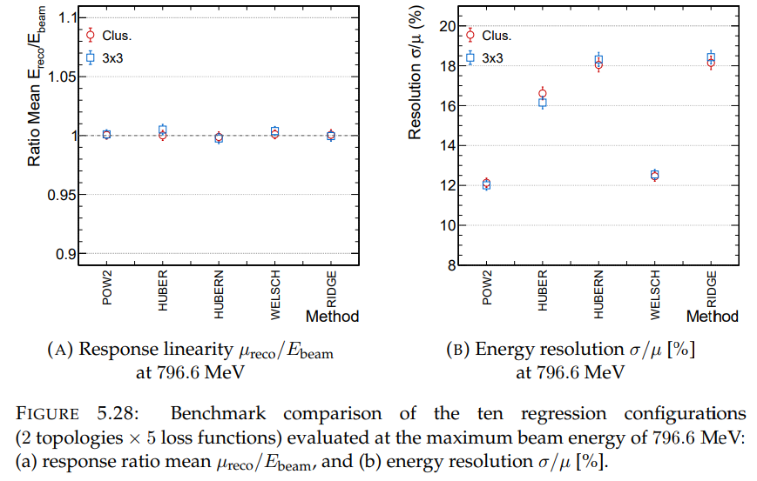
Step 5 — Screening 2 Topologies x 5 Objective Loss Functions
MC
[ FIG 5.28: 796.6 MEV BENCHMARK COMPARISON ]
2 Spatial Topologies: Concentric rings (E_clus, 4 weights) vs. Full 3x3 matrix (E_3x3, 9 independent weights).
5 Objective Losses: Evaluated POW2 (LSM), HUBER, HUBERN, WELSCH (robust outlier-downweighting), and RIDGE (L2 penalty).
796.6 MeV Benchmark: All 10 configurations restore linearity to 1.000 +- 0.005; POW2 achieves best energy resolution (~12.0%).
Figure: Benchmark comparison of 10 configurations (2 topologies x 5 losses) at 796.6 MeV.

Slide 12
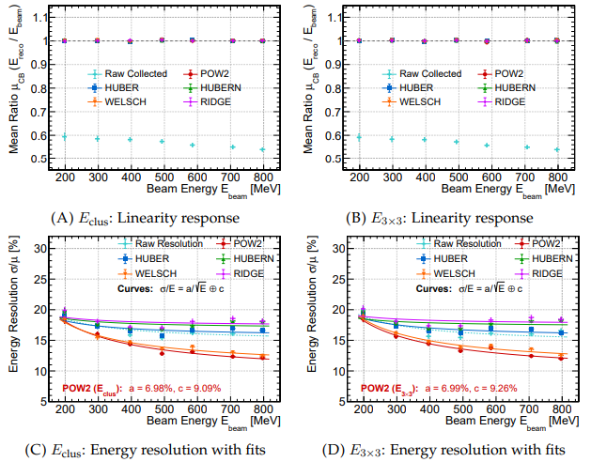
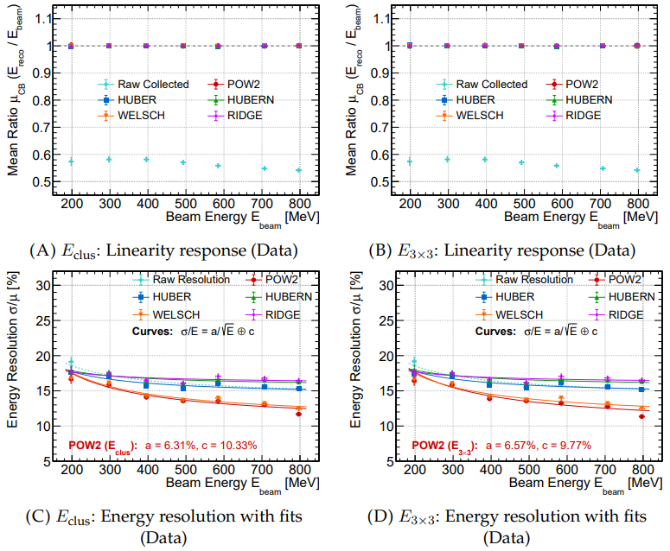
Step 5 — Full-Range Evaluation (DAQ-MC & Blind Test Data)
MC
DATA
Precision Linearity: Response bounded strictly within +- 0.1% of unity across 197.94–796.60 MeV in both MC and Data.
Why POW2 Wins: Golden Cuts already isolate clean Gaussian cores; robust loss functions under-penalize genuine shower leakage.
Zero-Shot Generalization: Blind test on RARiS experimental test beam data reproduces the exact same estimator hierarchy.
Blind Test: Apply the regression function on data, its is also well.
MC
DATA

Slide 13
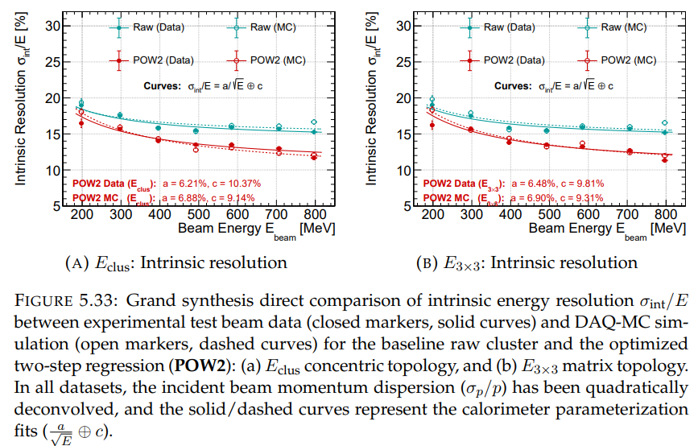
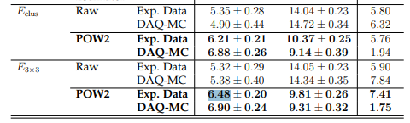
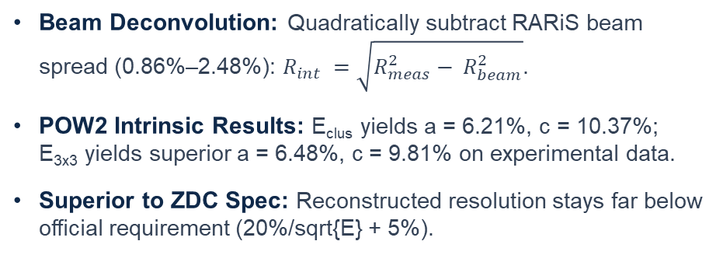
Step 6 — Grand Synthesis: Intrinsic Resolution vs. Official Spec
MC
DATA
[ FIG 5.33: GRAND SYNTHESIS RESOLUTION ]
Beam Deconvolution: Quadratically subtract RARiS beam spread (0.86%–2.48%): $R_{int} =\sqrt{R_{meas}^{2}− R_{beam}^{2}}$.
POW2 Intrinsic Results: E_{clus} yields a = 6.21%, c = 10.37%; E_{3x3} yields superior a = 6.48%, c = 9.81% on experimental data.
Superior to ZDC Spec: Reconstructed resolution stays far below official requirement (20%/sqrt{E} + 5%).
Figure: Fig 5.33 Grand Synthesis intrinsic resolution 2x2 plot with official spec curve.

Slide 14
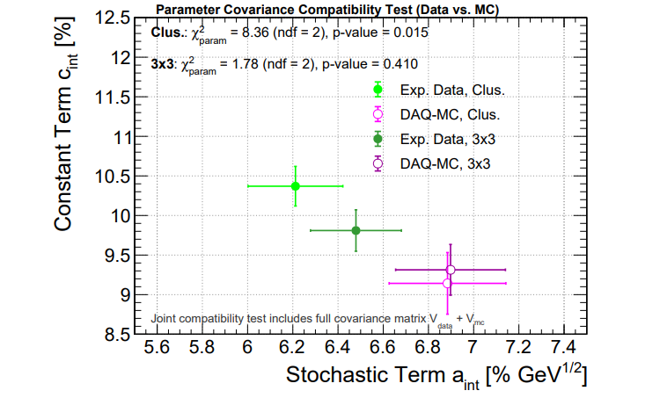
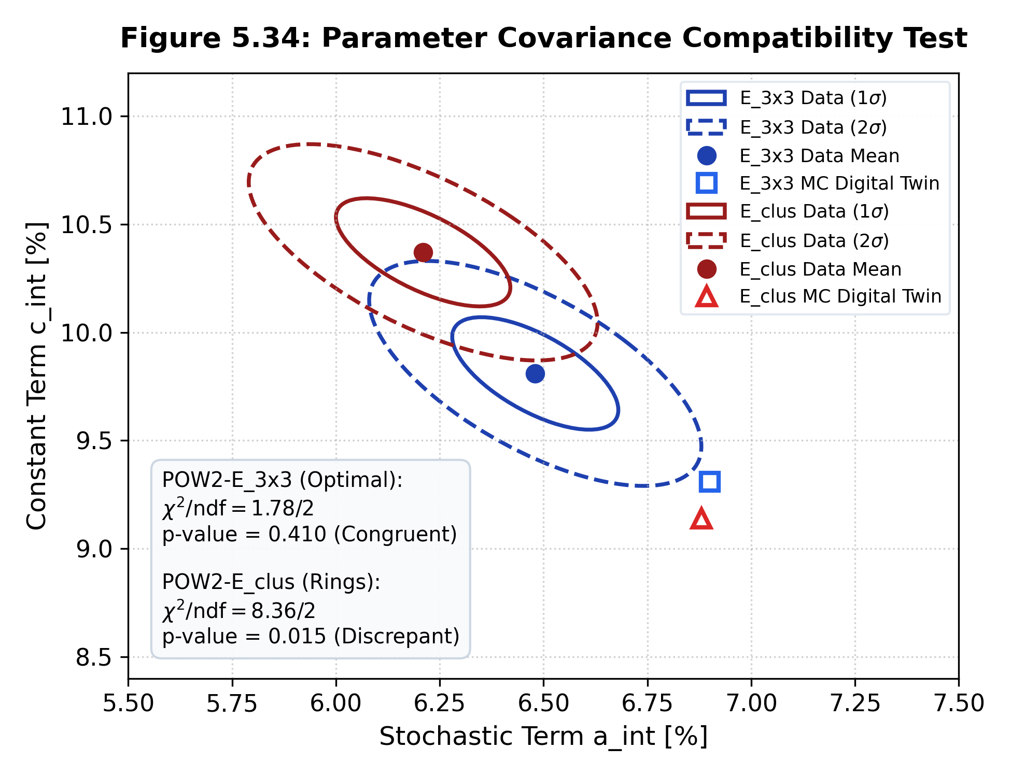
Step 7 — Parameter Covariance Compatibility Test
MC
DATA
Criterion 1: Lowest Constant Term: c_int = 9.81% (E_3x3) vs. 10.37% (E_clus) on experimental beam data.
Criterion 2: Fit Stability: Lowest reduced chi2/ndf = 1.75 in controlled MC digital twin simulation.
Criterion 3: Data-MC Congruence: E_3x3 achieves p-value = 0.410 (chi2 = 1.78), far outperforming E_clus (p = 0.015, chi2 = 8.36).
[ FIG 5.34: PARAMETER COVARIANCE TEST ]
Figure: Fig 5.34 parameter covariance compatibility test in (a_int, c_int) space.

Slide 15
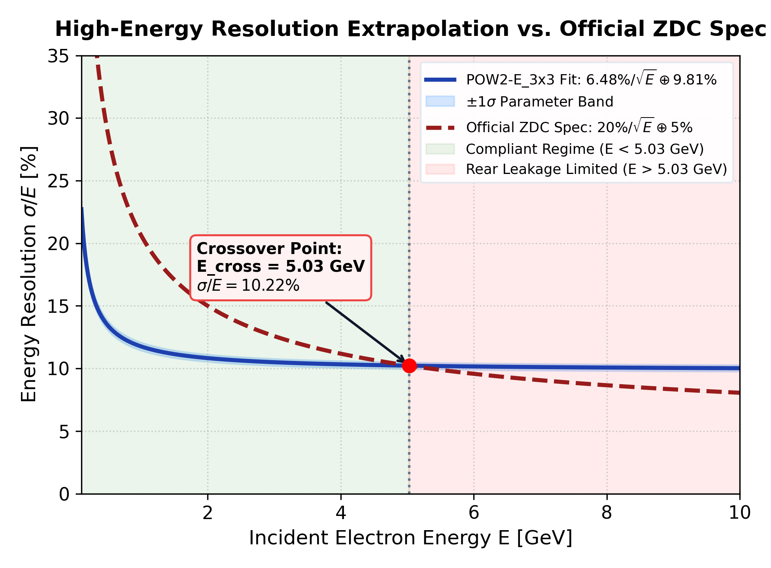
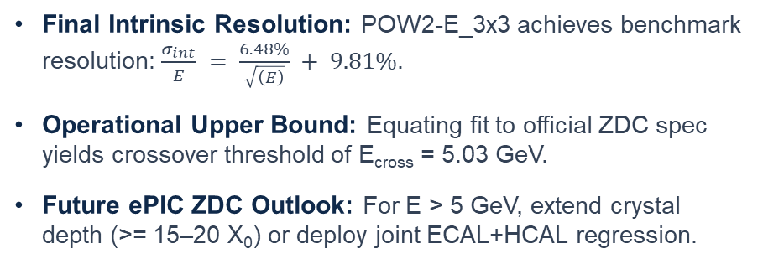
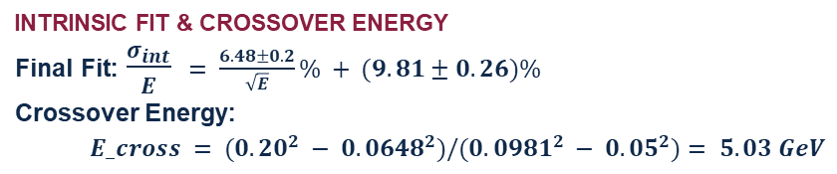
Step 8 — High-Energy Extrapolation & Final Conclusions
DATA
[ HIGH-ENERGY EXTRAPOLATION & CROSSOVER ]
INTRINSIC FIT & CROSSOVER ENERGY
Final Fit: $\frac{σ_{int}}{E}$ $= \frac{6.48±0. 2}{\sqrt{E}}\% + (9.81±0.26)\%$
Crossover Energy:
$E_cross = (0.20^{2} − 0.0648^{2})/(0.0981^{2} − 0.05^{2})= 5.03 GeV$
Final Intrinsic Resolution: POW2-E_3x3 achieves benchmark resolution: $\frac{σ_{int}}{E} = \frac{6.48\%}{\sqrt{\left(E\right)}} + 9.81\%$.
Operational Upper Bound: Equating fit to official ZDC spec yields crossover threshold of E_{cross} = 5.03 GeV.
Future ePIC ZDC Outlook: For E > 5 GeV, extend crystal depth (>= 15–20 X₀) or deploy joint ECAL+HCAL regression.
Figure: High-energy extrapolation of intrinsic resolution and operational crossover boundary.

Slide 16
END

Slide 17
Backup

Slide 18
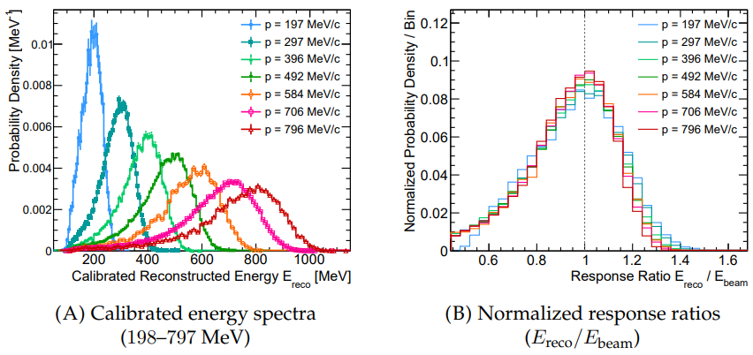
STEP 4 — SPECTRAL CALIBRATION RESULTS
Step 4 — Reconstructed Spectra & Scale Restoration
DATA
[ RECONSTRUCTED SPECTRA & DATA TABLE ]
Deficit Fully Eliminated: Raw cluster peaks (117–430 MeV) are successfully restored to true beam energies (197.5–799.4 MeV).
Unified Linearity Profile: Normalized response ratios (E_{reco} / E_{beam}) across all 7 energies (197–796 MeV) collapse precisely onto 1.0.
Substantial Resolution Gain: At 796.6 MeV, sigma/mu improves from 16.57% (Raw) down to 11.65% (Two-Step Reco).
DATA
Figure: Calibrated energy spectra (197–796 MeV) and performance summary table.

