Slide 1
EPIC ZERO DEGREE CALORIMETER (ZDC) GROUP MEETING
Two-Step Decoupled Multivariate Energy Regression for the Compact 6 X₀ PbWO₄ Calorimeter Prototype
Weekly Meeting Report — Workflow, Validation, and Intrinsic Resolution
Author: Yu-Siang Xiao (蕭宇翔) | NCUHEP, Taiwan
Department of Physics, National Central University & ePIC Collaboration
RARiS Positron Beam Test Analysis & Digital Twin Modeling | 3 November 2026

Slide 2
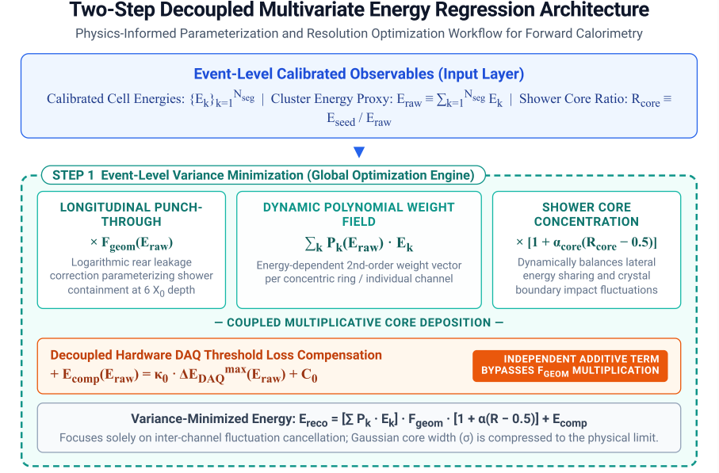
Step 3A — Event-Level Variance Minimization (Step 1)
Correcting and supplementing the issues from the previous slides.
STEP 1 REGRESSION FORMULA
E_{reco} = [ Σ_{k} P_{k}(E_{raw}) E_{k} ] × F_{geom}(E_{raw})
× [ 1 + α_{core} (R_{core} − 0.5) ] + E_{comp}(E_{raw})
[ STEP 1 GLOBAL OPTIMIZATION ENGINE ]
P_{k}(E_{raw}) Cell Weights: Dynamic 2nd-order polynomial weights per concentric ring (E_{clus}, 3 pars) or crystal cell (E_{3×3}, 9 pars).
F_{geom}(E_{raw}) Rear Leakage: Logarithmic rear longitudinal leakage correction tailored for 6 X₀ compact depth.
R_{core} Lateral Sharing: R_{core} = E_{seed} / E_{raw} balances lateral energy sharing and impact fluctuations.
+E_{comp} Decoupled Offset: Independently compensates sub-threshold DAQ loss without inflating high-energy leakage.
Ex: α_{core} =0.375946
@ POW2-E3x3
Figure: Step 1 event-level regression parameterization and optimization framework.

Slide 3
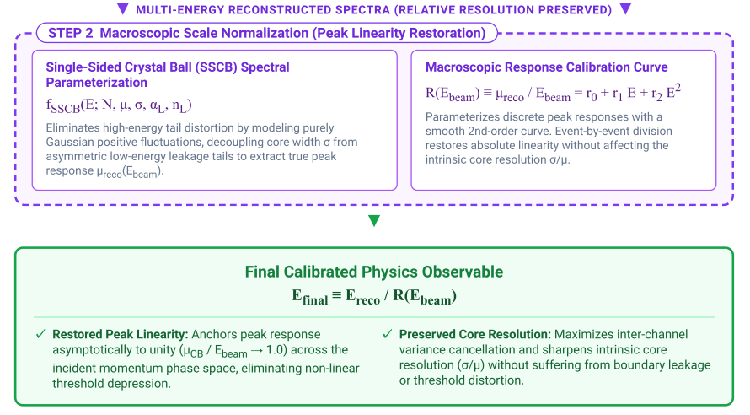
Step 3B — Macroscopic Peak Linearity Restoration (Step 2)
MC
The last study didn’t apply…
STEP 2 SCALING FORMULATION
Calibration Curve: R(E_{beam}) = μ_{reco} / E_{beam} = r₀ + r₁ E + r₂ E²
Final Observable: E_{final} = E_{reco} / R(E_{beam}) [Linearity → 1.0]
[ STEP 2 SSCB & SCALE NORMALIZATION ]
SSCB Spectral Fit: Single-Sided Crystal Ball decouples Gaussian core (μ_{reco}, σ) from low-energy leakage tails.
Smooth Calibration Curve: 2nd-order polynomial R(E_{beam}) models macroscopic peak response across discrete beam energies.
Variance Invariance: Dividing by R(E_{beam}) anchors peak linearity strictly to 1.0 while preserving relative resolution (σ/μ).
Figure: Step 2 macroscopic scale normalization and SSCB fitting framework.

Slide 4
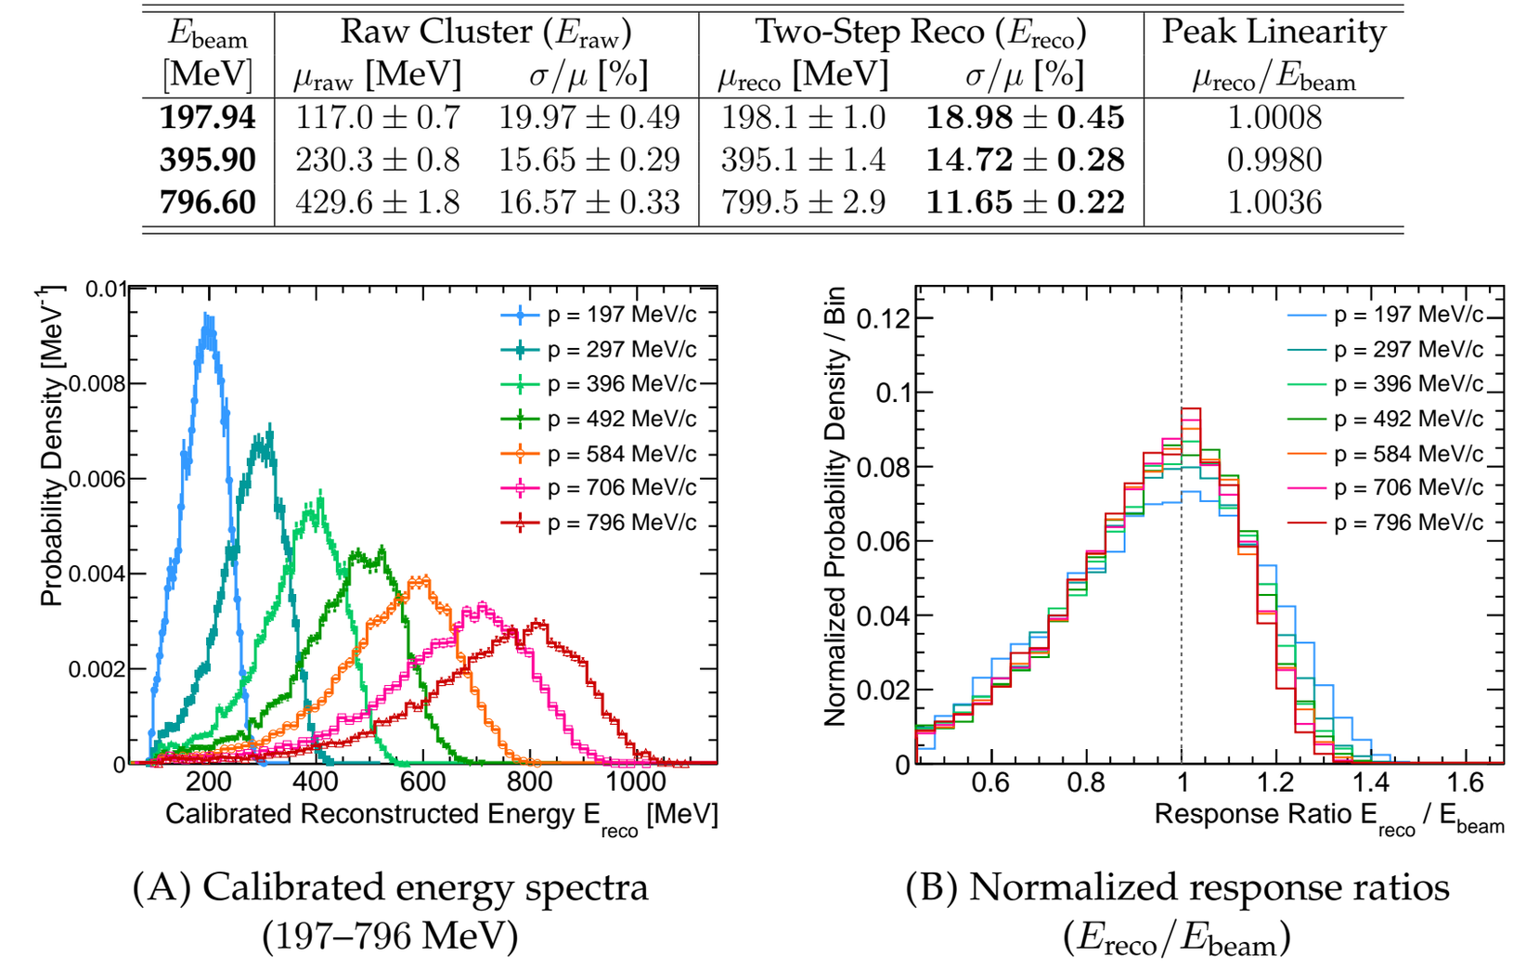
Step 4 — Reconstructed Spectra & Scale Restoration
MC
[ RECONSTRUCTED SPECTRA & DATA TABLE ]
Deficit Fully Eliminated: Raw cluster peaks (117.0–429.6 MeV) are restored to true beam energies (198.1–799.5 MeV).
Unified Linearity Profile: Normalized response ratios (E_{reco} / E_{beam}) across all 7 energies (197.94–796.60 MeV) collapse onto 1.0 (within ±0.36%).
Substantial Resolution Gain: At 796.60 MeV, σ/μ improves from 16.57 ± 0.33% (Raw) down to 11.65 ± 0.22% (Two-Step Reco).
Figure: Calibrated energy spectra (197–796 MeV) and performance summary table.

Slide 5
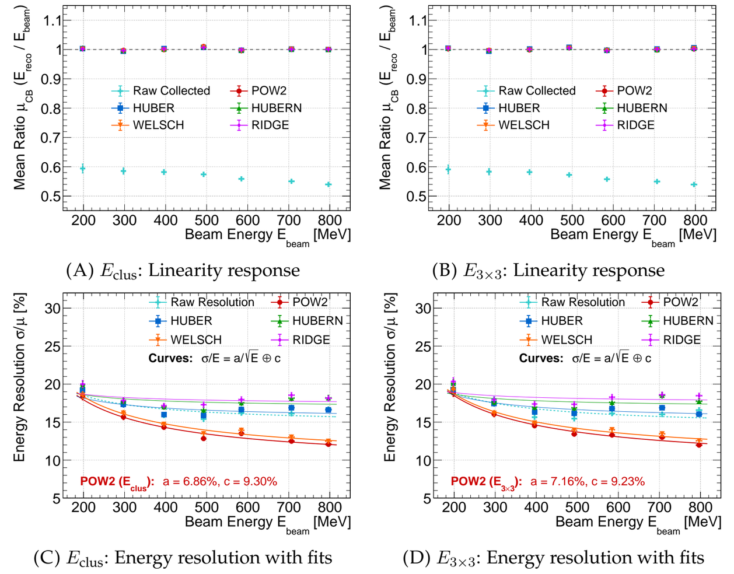
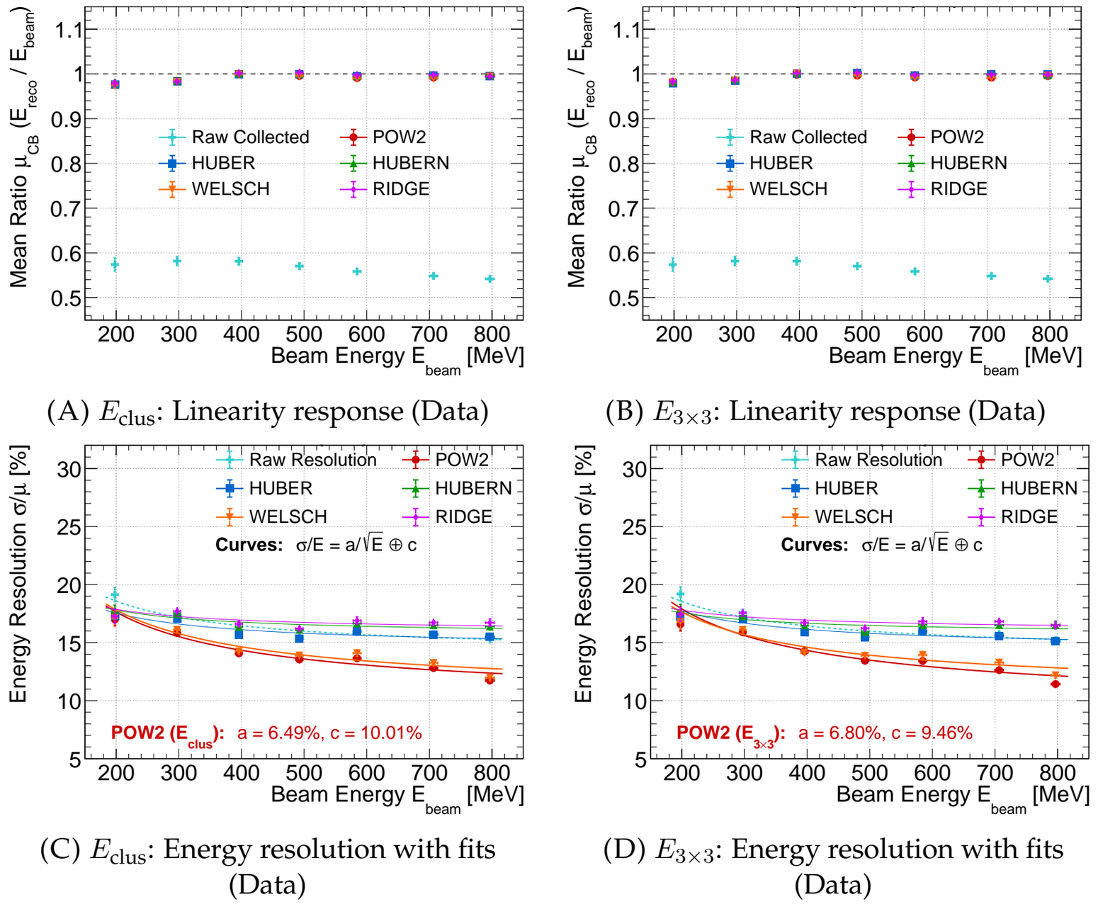
Step 5 — Full-Range Evaluation (DAQ-MC & Blind Test Data)
MC
Precision Linearity: Ensemble ⟨μ_{reco}/E_{beam}⟩ = 1.0001 ± 0.0014 (MC) & 0.9919 ± 0.0008 (Data), within ±0.8%.
Why POW2 Wins: Golden Cuts isolate clean Gaussian cores; compresses c from ~14.02% to 9.23% (MC) & 9.46% (Data).
Zero-Shot Generalization: Blind test on RARiS beam data reproduces the exact same estimator hierarchy without retuning.
Pre-Deconvolution Fit (POW2-E_{3×3}): MC: a = 7.16 ± 0.26%, c = 9.23 ± 0.41%; Exp. Data: a = 6.80 ± 0.19%, c = 9.46 ± 0.27%.
DATA
MC
DATA

Slide 6
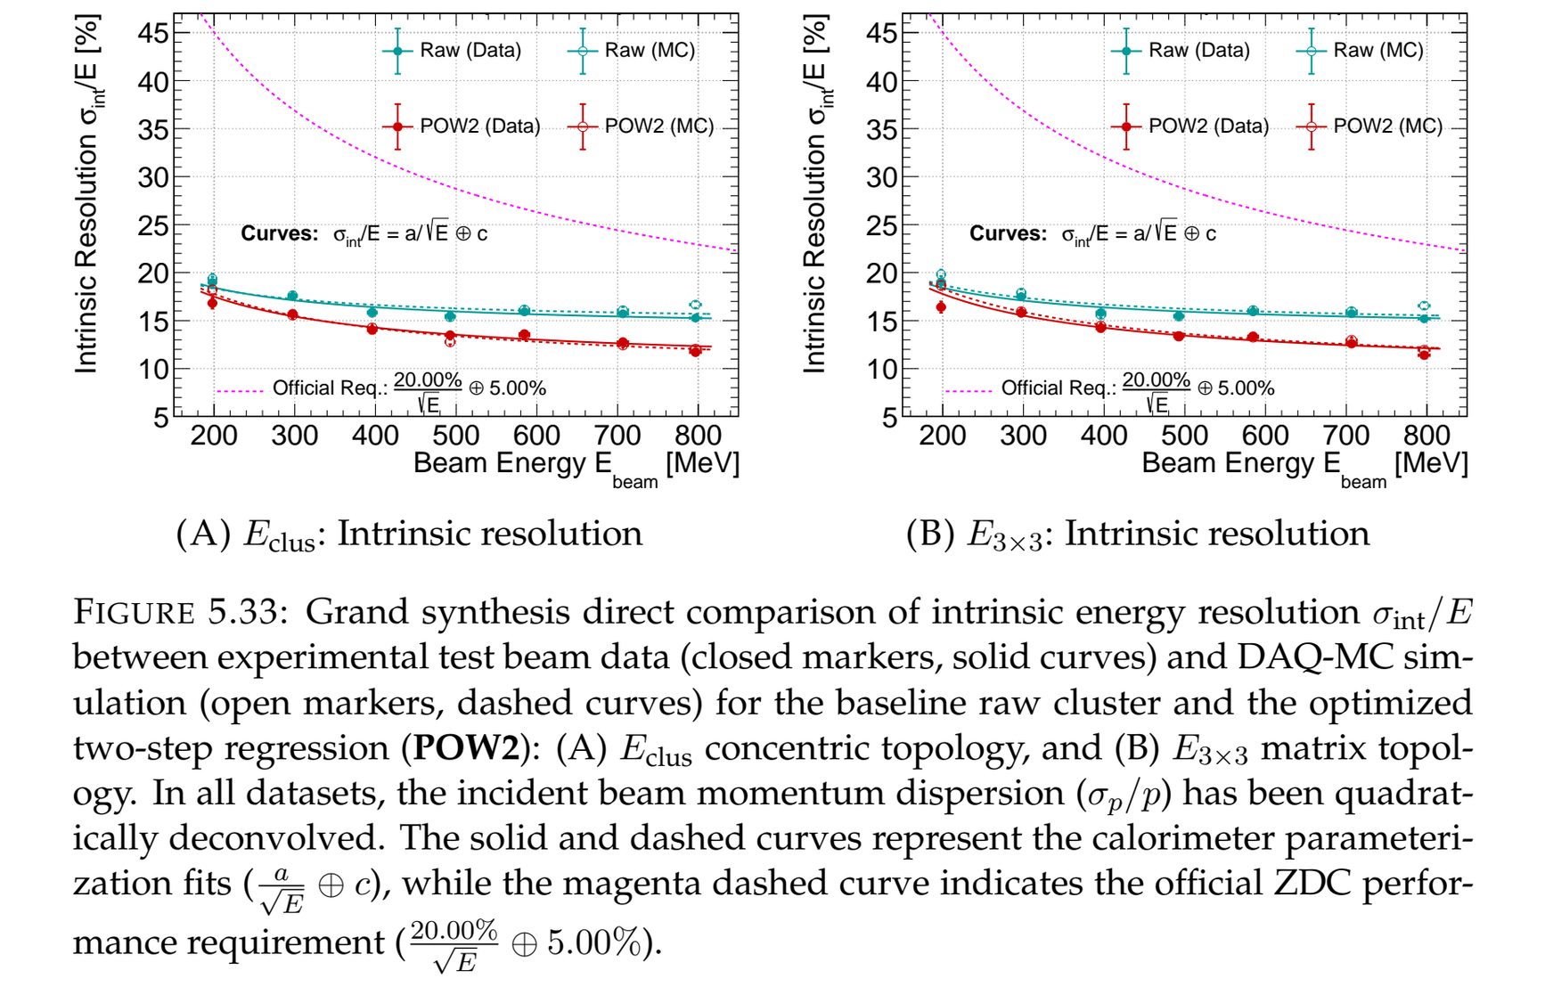
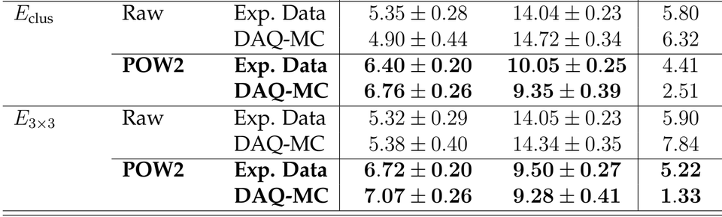
Step 6 — Grand Synthesis: Intrinsic Resolution vs. Official Spec
MC
DATA
[ FIG 5.33: GRAND SYNTHESIS RESOLUTION ]
Beam Deconvolution: Quadratically subtract RARiS beam spread (σ_{p}/p = 0.86%–2.48%): R_{int} = √(R_{meas}² − (σ_{beam}/μ_{beam})²).
POW2 Intrinsic Results (Data): E_{clus} yields a_{int} = 6.40 ± 0.20%, c_{int} = 10.05 ± 0.25%; E_{3×3} achieves superior a_{int} = 6.72 ± 0.20%, c_{int} = 9.50 ± 0.27%.
Superior to ZDC Spec: Calibrated trajectory (17.8% → 12.1%) stays far below official requirement (20.00% / √E ⊕ 5.00%).
Figure: Fig 5.33 Grand Synthesis intrinsic resolution 2x2 plot with official spec curve.

Slide 7
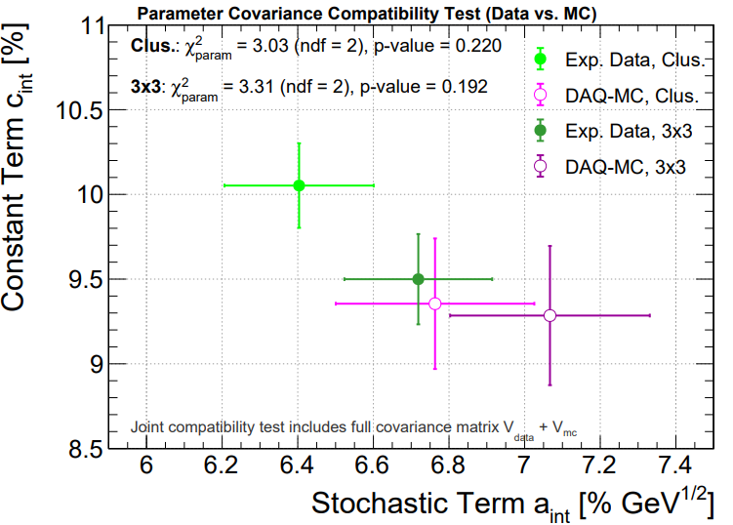
Step 7 — Parameter Covariance Compatibility Test
MC
DATA
Criterion 1 — Superior Leakage Suppression: c_{int} = 9.50 ± 0.27% (E_{3×3}) vs. 10.05 ± 0.25% (E_{clus}) on experimental beam data.
Criterion 2 — Optimal Baseline Fit Stability: Lowest reduced χ²/ndf = 1.33 (E_{3×3}) vs. 2.51 (E_{clus}) in controlled DAQ-MC simulation.
Criterion 3 — High Data–MC Congruence: Both schemes show strong consistency:
  p = 0.192 (χ²_{param} /ndf = 3.31/2) for E_{3×3} and p = 0.220 (χ²_{param} /ndf = 3.03/2).
[ FIG AppF.1: PARAMETER COVARIANCE TEST ]
Figure: Fig. 5.34 parameter covariance compatibility test in (a_{int}, c_{int}) space.

Slide 8
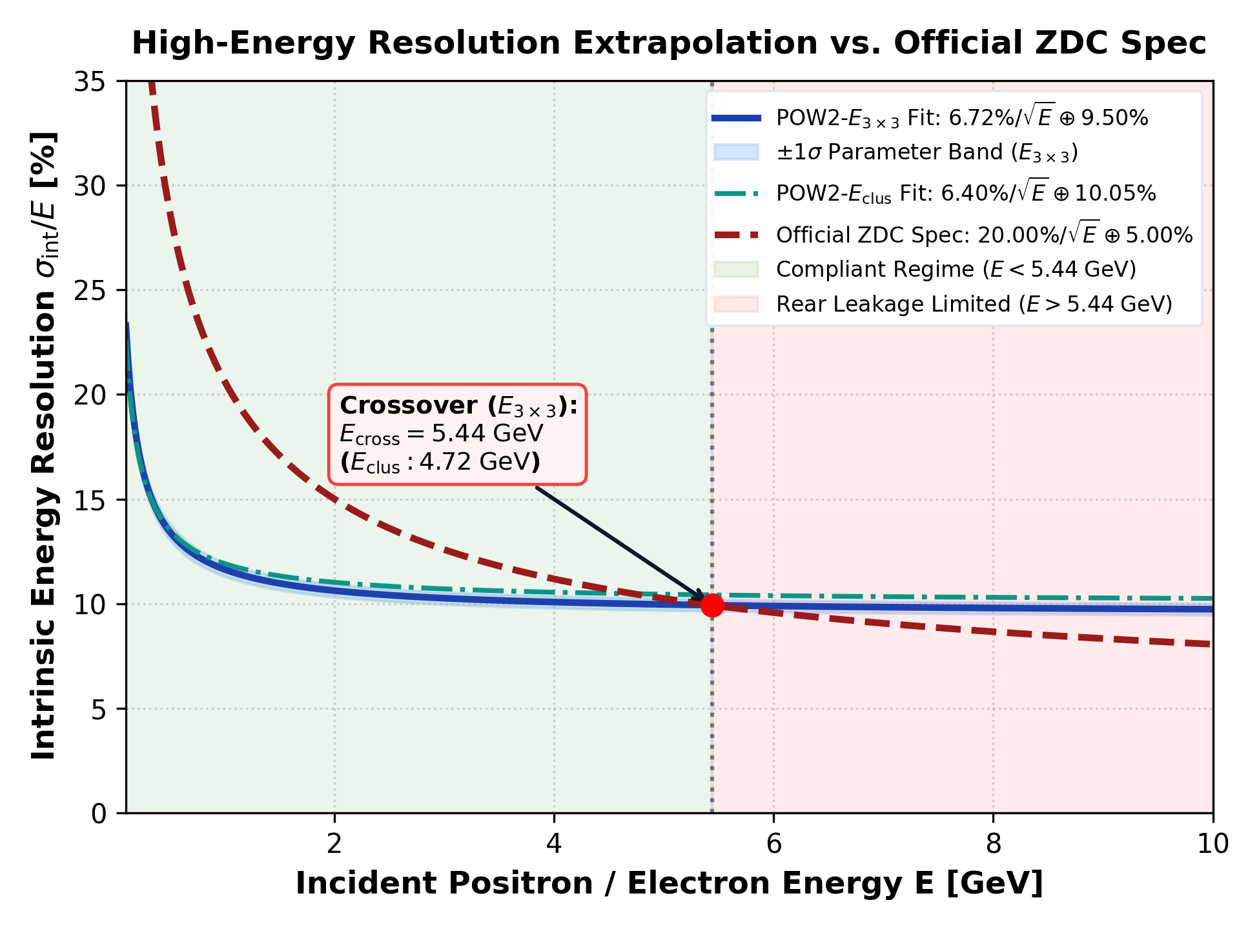
Step 8 — High-Energy Extrapolation & Final Conclusions
DATA
[ HIGH-ENERGY EXTRAPOLATION & CROSSOVER ]
INTRINSIC FIT & CROSSOVER ENERGY (POW2-E_{3×3})
Final Fit: σ_{int} / E = (6.72 ± 0.20)% / √E ⊕ (9.50 ± 0.27)%
Crossover: E_{cross} = (0.2000² − 0.0672²) / (0.0950² − 0.0500²) ≈ 5.44 GeV
Final Intrinsic Resolution: POW2-E_{3×3} achieves σ_{int} / E = (6.72 ± 0.20)% / √E ⊕ (9.50 ± 0.27)% on test beam data.
Operational Upper Bound: Equating to ZDC spec (20%/√E ⊕ 5%) yields E_{cross} ≈ 5.44 GeV (E_{3×3}) and 4.72 GeV (E_{clus}).
Future ePIC ZDC Outlook: For E > 5.4 GeV, extend crystal depth (≥ 15–20 X₀) or deploy joint ECAL+HCAL regression.
Figure: High-energy extrapolation of intrinsic resolution and operational crossover boundary.
Yu-Siang Xiao (NCUHEP, Taiwan) | ePIC ZDC EMCal Prototype Analysis

Slide 9
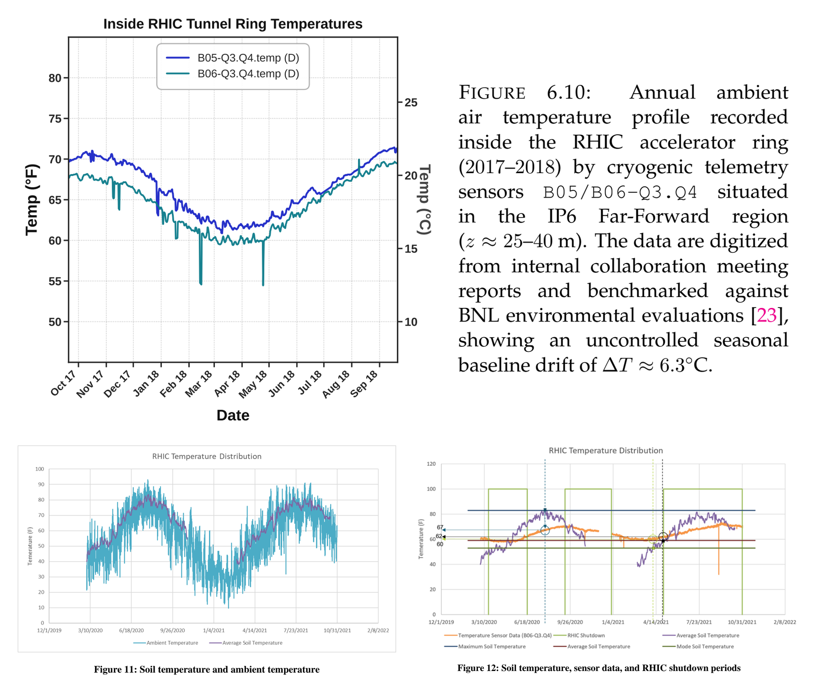
Baseline Seasonal Drift in RHIC Tunnel
PRIMARY REFERENCE — BNL TUNNEL CFD REPORT
Authors: Emma Letourneau & Ram Srinivasan (BNL, Aug. 2022)
Title: A numerical evaluation of the ambient air temperature in the EIC tunnel
Report ID: BNL-224169-2023-TECH / EIC-ADD-TN-043
OSTI / DOI: osti.gov/biblio/1964074 (DOI: 10.2172/1964074)
[ THESIS FIG. 6.10 & BNL REPORT FIG. 11 / FIG. 12 ]
IP6 Telemetry (z ≈ 25–40 m): Cryogenic sensors B05-Q3.Q4 & B06-Q3.Q4 in Far-Forward zone.
Seasonal Swing: Winter 15.6°C (60°F) ↔ Summer 21.9°C (71.5°F) → Uncontrolled drift ΔT ≈ 6.3°C.
Driving Mechanism: 6-inch soil boundary temperature tracks & lags outdoor seasonal cycle (BNL Fig. 11 & Fig. 12).
Diurnal Invariance: Daily outdoor swings damped by soil mass; seasonal soil drift dominates.
Top: Thesis Fig. 6.10 (IP6 B05/B06 annual drift). Bottom: BNL Fig. 11 & Fig. 12 (soil-tunnel seasonal lag).

Slide 10
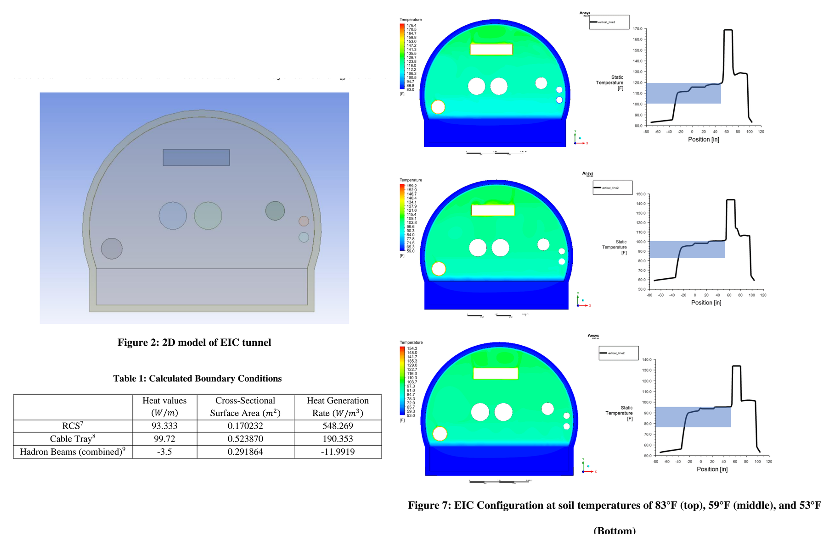
Future EIC Era: New Heat Loads & Thermal Stratification
NEW EIC HEAT SOURCES IN TUNNEL CROWN (BNL TABLE 1)
RCS Synchrotron: 93.3 W/m (548.3 W/m³ volumetric)
DC Cable Trays: 99.7 W/m (190.4 W/m³ lumped load)
ESR & Water Pipes: Upper pipe 96°F (35.6°C) / Lower 86°F (30.0°C)
[ BNL FIG. 2 GEOMETRY, TABLE 1 & FIG. 7 UNCOOLED CFD ]
2D Ansys Fluent CFD: 16-ft corrugated steel tunnel + 6-in soil boundary (T_soil = 83°F, 59°F, 53°F).
Buoyancy Stratification: Unventilated natural convection traps intense heat in upper tunnel crown (BNL Fig. 7 & Fig. 14).
Detector Envelope: Height -30 to +50 in relative to beam center.
Summer Peak Crisis: Unconditioned EIC air reaches 37.8–48.9°C (100–120°F) in summer!
Left: BNL Fig. 2 (2D EIC cross-section) & Table 1. Right: BNL Fig. 7 (uncooled EIC CFD profiles).

Slide 11
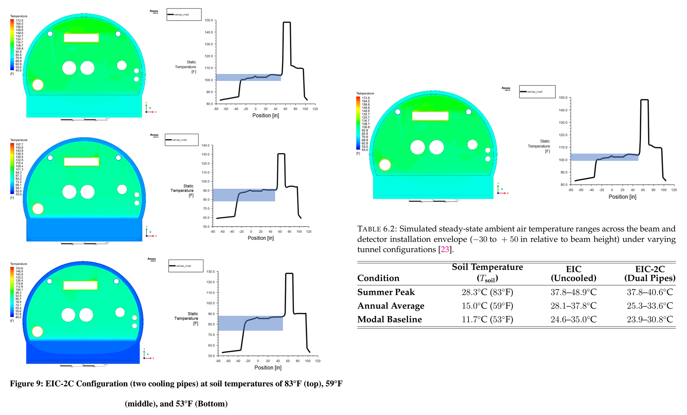
Upgraded EIC-2C Cooling vs. Residual Bottleneck
EQUILIBRIUM TEMP IN DETECTOR ENVELOPE (TABLE 6.2)
Summer Peak (28.3°C): Uncooled 37.8–48.9°C
→ EIC-2C 37.8–40.6°C (100–105°F)
Annual Avg (15.0°C): Uncooled 28.1–37.8°C
→ EIC-2C 25.3–33.6°C (77.5–92.5°F)
Modal Base (11.7°C): Uncooled 24.6–35.0°C
→ EIC-2C 23.9–30.8°C (75.0–87.5°F)
[ BNL FIG. 9 (EIC-2C DUAL PIPES) & THESIS TABLE 6.2 ]
Cooling pipe
EIC-2C Upgrade (BNL Fig. 9): Dual 8-inch chilled-water pipes at 7.2°C (45°F) installed in upper tunnel corners.
Persistent High Temp: Summer equilibrium stays at 37.8–40.6°C; modal periods remain 23.9–33.6°C.
Key Takeaway: Tunnel-level cooling pipes alone CANNOT cool the detector zone below 35–40°C in summer.
Left: BNL Fig. 9 (EIC-2C dual cooling pipes CFD). Right: Summer peak zoom & Thesis Table 6.2.

Slide 12
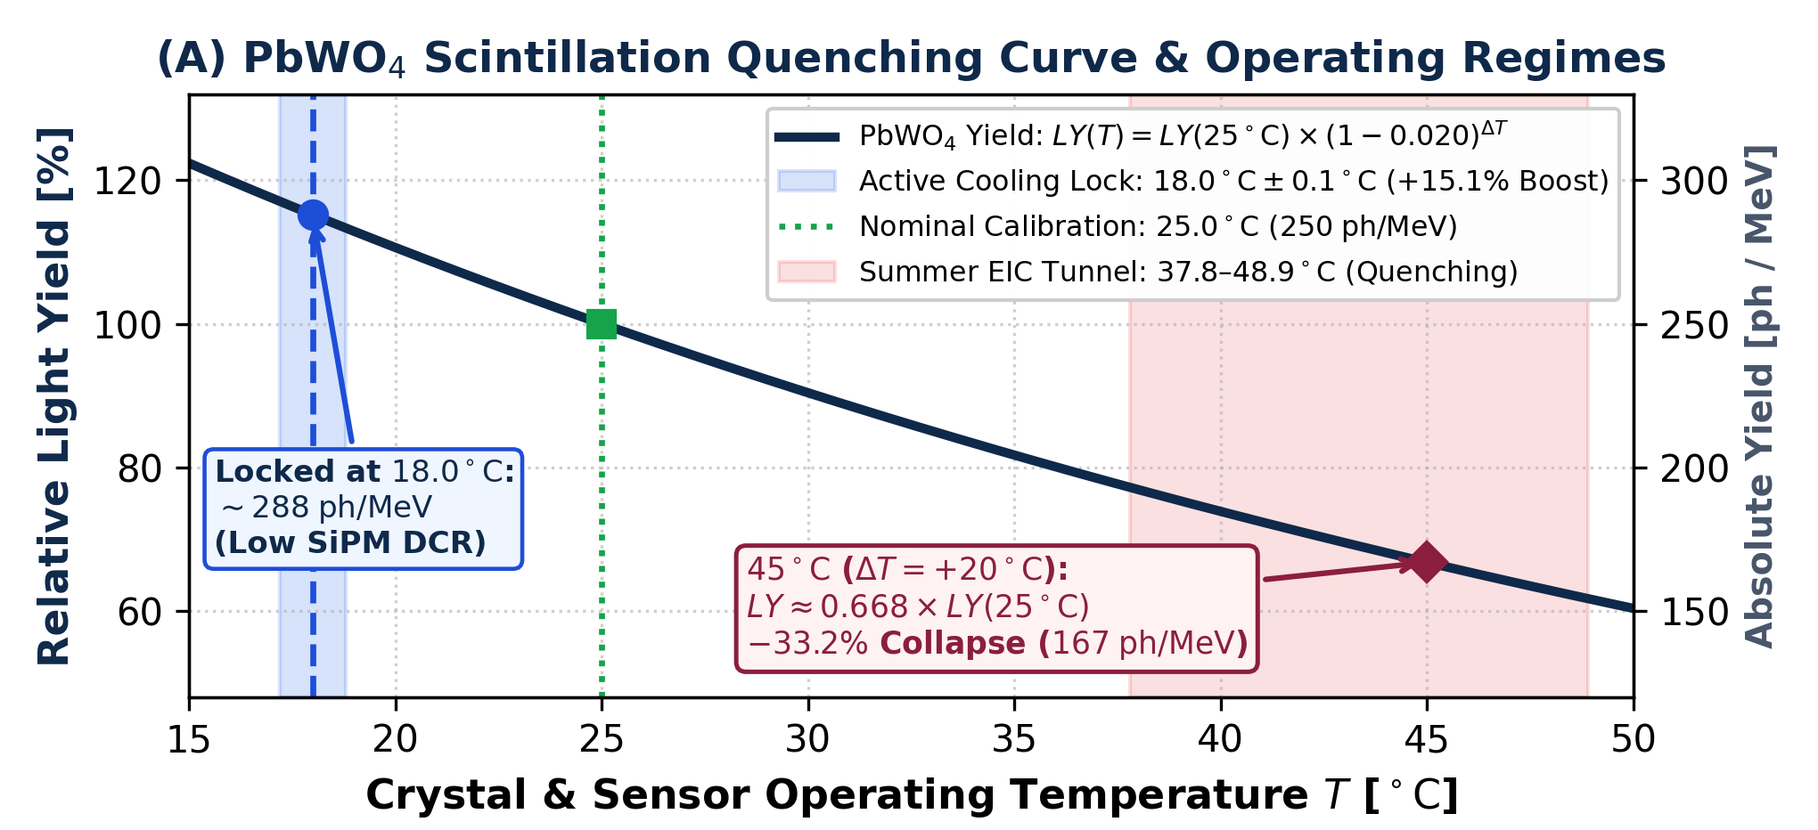
Impact on PbWO4 + SiPM & Active Cooling Mandate
PBWO4 SCINTILLATION QUENCHING AT 45°C (ΔT = +20°C)
Thermal Quenching (Eq. 6.6): LY(45°C) ≈ LY(25°C) × (1 − 0.020)^20 ≈ 0.668 × LY(25°C)
Acute Light Yield Collapse: −33.2% reduction (250 ph/MeV → 167 ph/MeV at 45°C)
[ PBWO4 QUENCHING CURVE & 18.0°C ACTIVE COOLING LOOP ]
Compounded Sensor Drift: Exponential SiPM DCR surge + overall gain drift −3.1% to −3.7% / °C (shifts g_ADC/MeV).
Operational Prohibition: Passive thermodynamic equilibration with tunnel air is strictly prohibited!
Engineering Mandate (c ≤ 5.00%): Complete atmospheric isolation of full 27 × 27 EMCal matrix:
Thermal Enclosure: Airtight Thermal Insulation Shell blocking ambient convective heat.
Active Chilled Loop: Active Liquid-Cooling Loop locked at 18.0°C ± 0.1°C.
Top: PbWO4 light yield quenching curve (Eq. 6.6). Bottom: 27x27 EMCal active cooling architecture.

Slide 13
Summary of Key Parameters & Q&A
1. RHIC BASELINE DRIFT
IP6 Sensors: B05 / B06 (z ≈ 25–40 m)
Seasonal Range: 15.6°C ↔ 21.9°C
Uncontrolled Drift: ΔT ≈ 6.3°C (Soil lag)
2. EIC CROWN HEAT LOADS
RCS + Cable Tray: 93.3 + 99.7 W/m
Detector Zone: -30 to +50 in height
Uncooled Summer: 37.8–48.9°C (100–120°F)
3. EIC-2C BOTTLENECK
Dual Cooling Pipes: 8-in loops at 7.2°C (45°F)
Summer EIC-2C: Still 37.8–40.6°C!
Modal Operating: Persists at 23.9–33.6°C
4. ZDC EMCAL MANDATE
45°C Quenching: −33.2% LY (250→167 ph/MeV)
System Gain Drift: −3.1% to −3.7% / °C
Active Cooling Lock: 18.0°C ± 0.1°C + Shell
Reference: E. Letourneau & R. Srinivasan, BNL-224169-2023-TECH / EIC-ADD-TN-043 (DOI: 10.2172/1964074) | Thesis Sec. 6.4.2

Slide 14
END

Slide 15
Backup

Slide 16
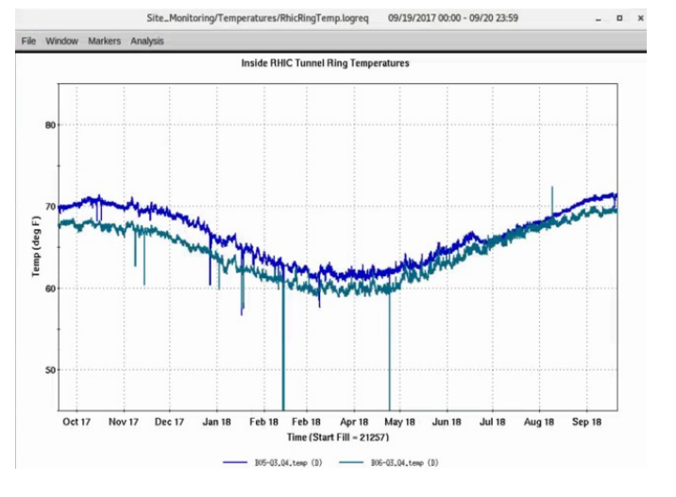
SLIDE 1 — MOTIVATION & EMPIRICAL RHIC TELEMETRY
Baseline Seasonal Drift in RHIC Tunnel
PRIMARY REFERENCE — BNL TUNNEL CFD REPORT
Authors: Emma Letourneau & Ram Srinivasan (BNL, Aug. 2022)
Title: A numerical evaluation of the ambient air temperature in the EIC tunnel
Report ID: BNL-224169-2023-TECH / EIC-ADD-TN-043
OSTI / DOI: osti.gov/biblio/1964074 (DOI: 10.2172/1964074)
[ THESIS FIG. 6.10 & BNL REPORT FIG. 11 / FIG. 12 ]
IP6 Telemetry (z ≈ 25–40 m): Cryogenic sensors B05-Q3.Q4 & B06-Q3.Q4 in Far-Forward zone.
Seasonal Swing: Winter 15.6°C (60°F) ↔ Summer 21.9°C (71.5°F) → Uncontrolled drift ΔT ≈ 6.3°C.
Driving Mechanism: 6-inch soil boundary temperature tracks & lags outdoor seasonal cycle (BNL Fig. 11 & Fig. 12).
Diurnal Invariance: Daily outdoor swings damped by soil mass; seasonal soil drift dominates.
Top: Thesis Fig. 6.10 (IP6 B05/B06 annual drift). Bottom: BNL Fig. 11 & Fig. 12 (soil-tunnel seasonal lag).
Siang Xiao (NCUHEP, Taiwan) | EIC Tunnel Thermal Environment & ZDC EMCal Cooling Mandate | 2026/10/21 Slide 2 / 6

