Slide 1
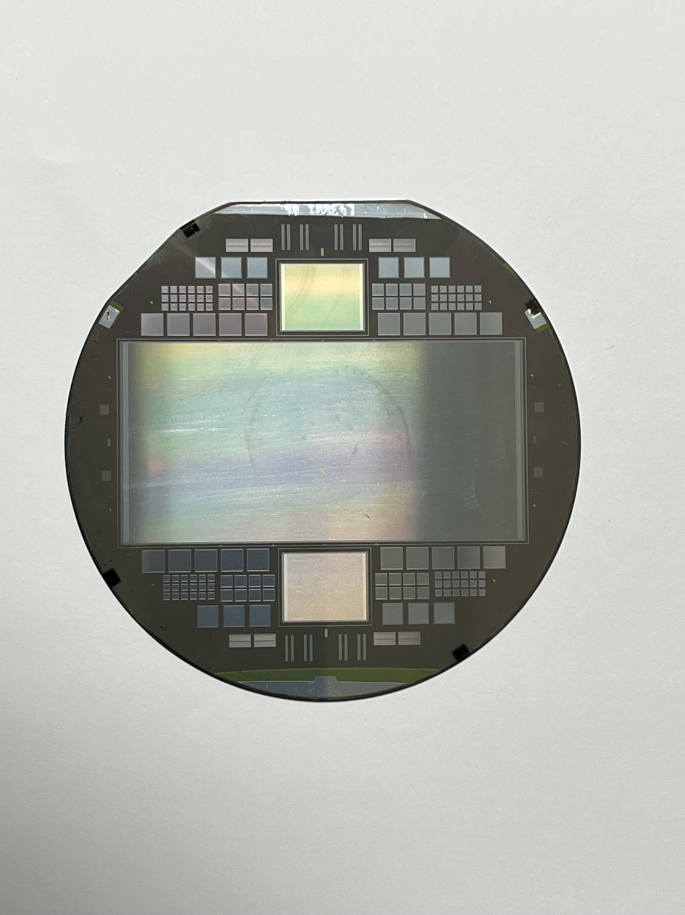
Introduction to Silicon Detectors
Working principle.
Detector structure and readout
Large scale applications
Yuan-Hann Chang
May 25, 2023
PIRE GEMADARC summer school

Slide 2
What is a Silicon detector in HEP?
Many particle (photon) detectors are based on silicon technology (e.g. CCD, photo diode, …).
For HEP, ”Silicon Detector” often refers to a specific type of detector:
  Similar to a PN junction (diode).
  Bulk of silicon is active, charge signals generated there.
  Surface patter are built to obtain position information.

Slide 3
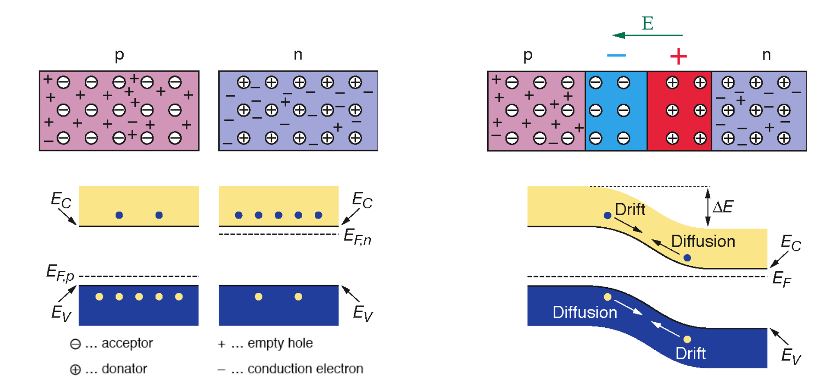
Depletion zone (no excess charge carrier)
PN junction:
Figures taken from “Silicon Detectors”
Presentation by Manfred Krammer and Frank Hartmann

Slide 4
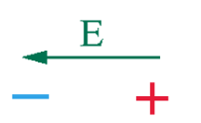
PN junction with forward bias: Adding an external electric field, opposite to the internal field, will reduces the depletion zone. Eventually allows large current to cross the boundary (~ V=0.6V).
External E field
I
V

Slide 5
Reverse Bias: External field in the same direction as internal field. This will extend the depletion zone. No current flow until external voltage is high enough to break the band gap.
External E field
I=0

Slide 6

Absorbing a photon when the PN junction is reverse biased:
Excite an electron, create an electron-hole pair
The electron will drift to opposite directions due to the electric field.
Induced a current
This is a the working principle of a photo diode.
External E field
I=0

Slide 7
Charged particle:
Creates electron-hole pairs by the particle’s electric field
Particle lose ~2 eV to create 1 e-h pair.
Generate a pulsed current.
Charged particle
External E field

Slide 8
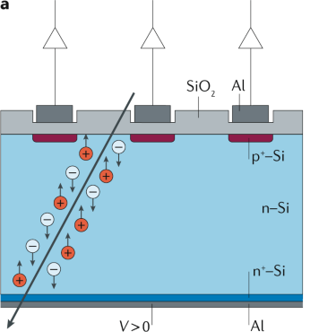
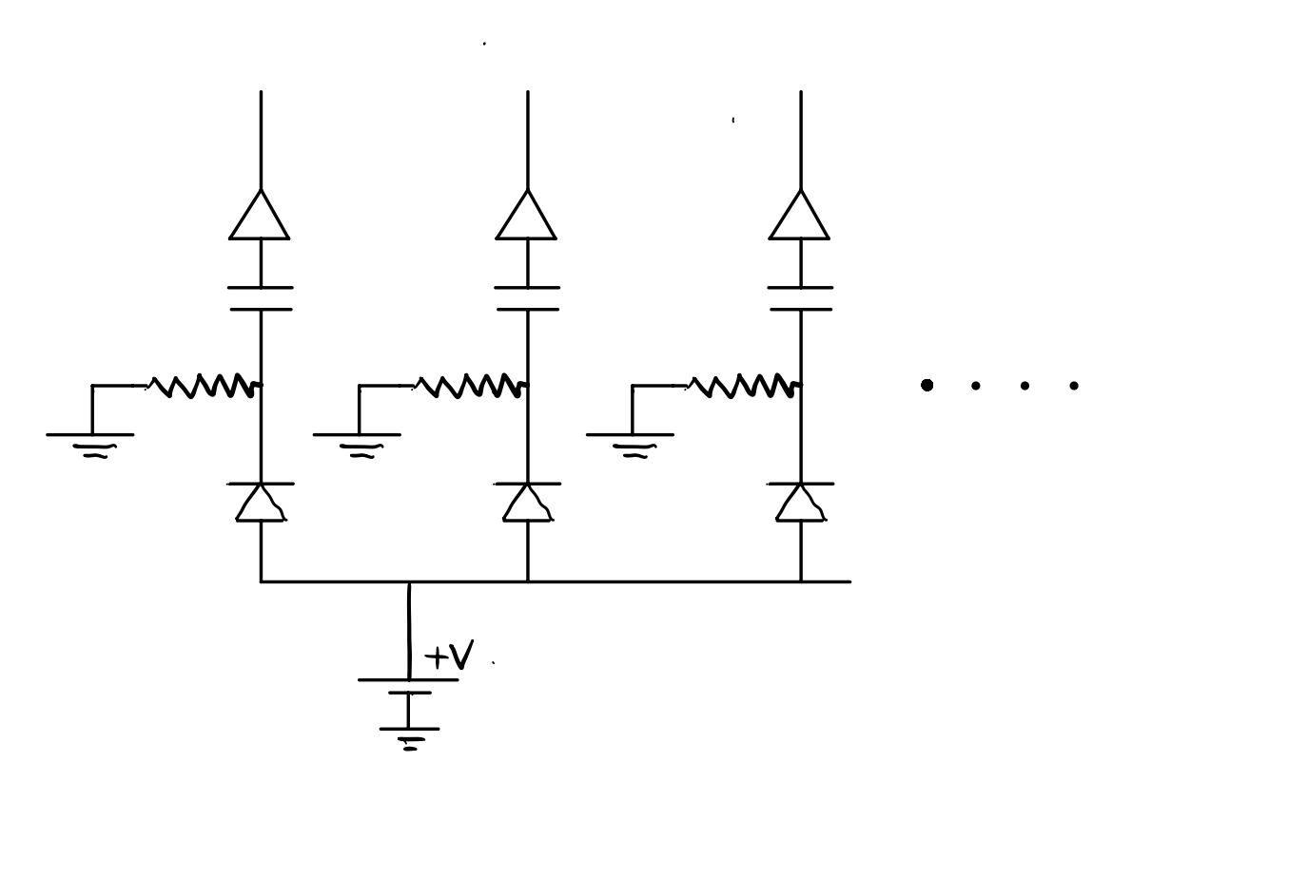

Silicon detector in HEP is a large area diode, with thick (~300 μm) depletion zone
The e-h pairs are created within ~25μm of the passing particle.
Uniform drift field (because thickness is much smaller than the horizontal size), and electron/hole drift along the E field.
P+ and Metal pattern on the surface pick up
the drift charge carriers, and determines
the location of the particle.
Polysilicon
Resistor (Mohm)
Silicon Detector
$$\overset{⃑}{E}$$

Slide 9
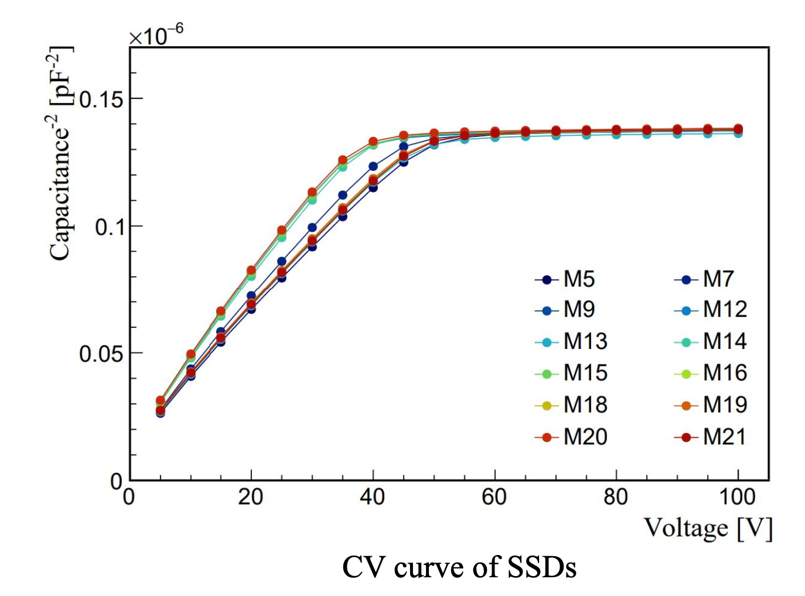

How do we know that the depletion zone is formed?
-- Measure the capacitance of the diode as a function of the bias voltage.
  Higher reverse bias ➔ larger depletion zone ➔ smaller capacitance
  When full depletion is achieved, capacitance become constant.
$$\frac{1}{C^{2}}$$

Slide 10
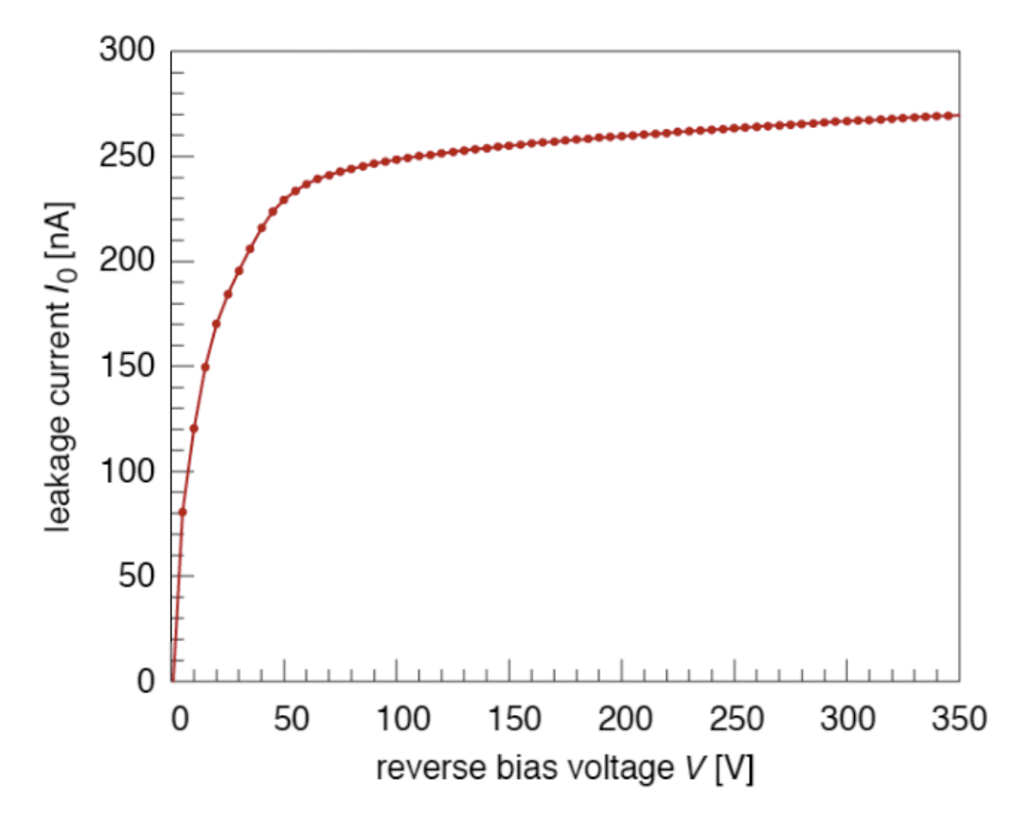
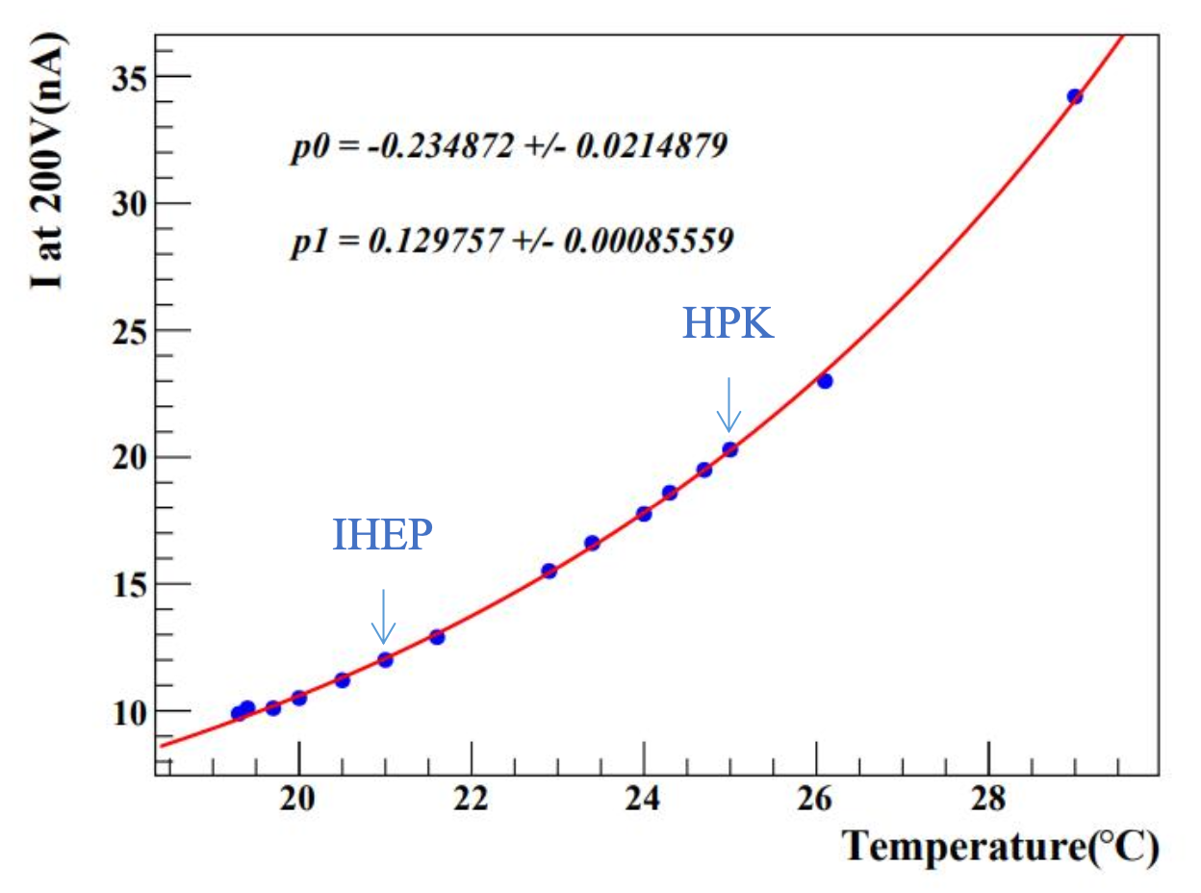
How do we know that the depletion zone is formed?
-- Measure the leakage current of the diode as a function of the bias voltage.
  Small current in the depletion zone is allowed, due to thermal fluctuation.
  Higher voltage ➔ larger depletion zone ➔ more e-h pair thermal excitation.
  When full depletion achieved, leakage current become ~constant.
C-V and I-V measurement are the basic acceptance tests performed on silicon detector

Slide 11

Position measurement by the silicon detector:
The electrons and holes created by particle passage drift in the direction of the electric field.
The location of the particle passage can be determined by which metal pad picks up the charge.
The semiconductor technology allows very
fine structure (few nm). → high resolution.
However, the intrinsic resolution is limited by:
e-h pair can be created within ~25 μm of the passing particle.
Electrons and holes also diffuse during the drift.
Realistic best position resolution: ~5 μm.
➔ Typical structure > 25 μm
Polysilicon
Resistor (Mohm)
$$\overset{⃑}{E}$$

Slide 12
Typical Silicon detectors are made of 300 μm thick, 4-6 inch silicon wafers, area as large as 10cm x 10cm
Full depletion happens at ~50V – 80V.
Roughly 20000 e-h pairs created when relativistic charge-1 particle passes.
Typical noise is ~1000 electrons ➔ S/N ~ 20 or better.
P+ /metal pattern can be designed according to the experimental requirements:
  Position resolution and pileup probability
  Number of channels (readout speed, complexity, cost…)

Slide 13
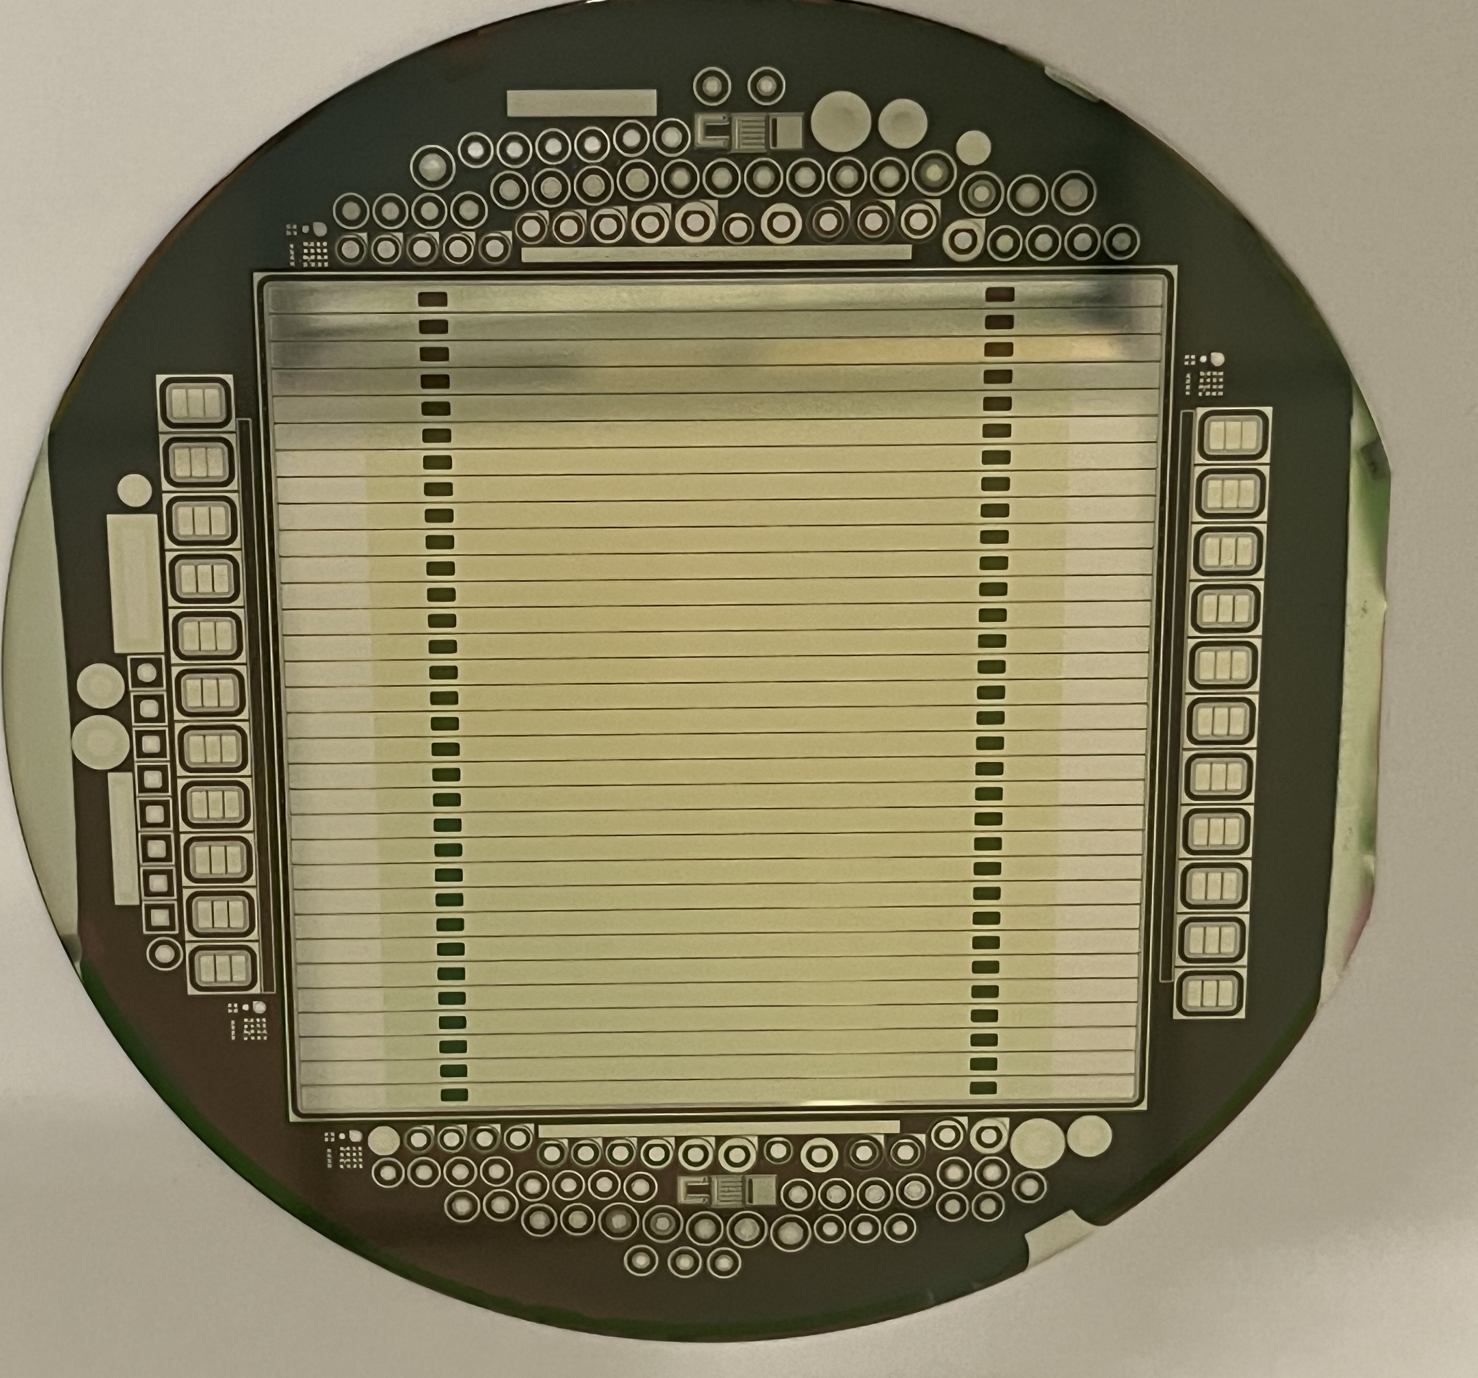
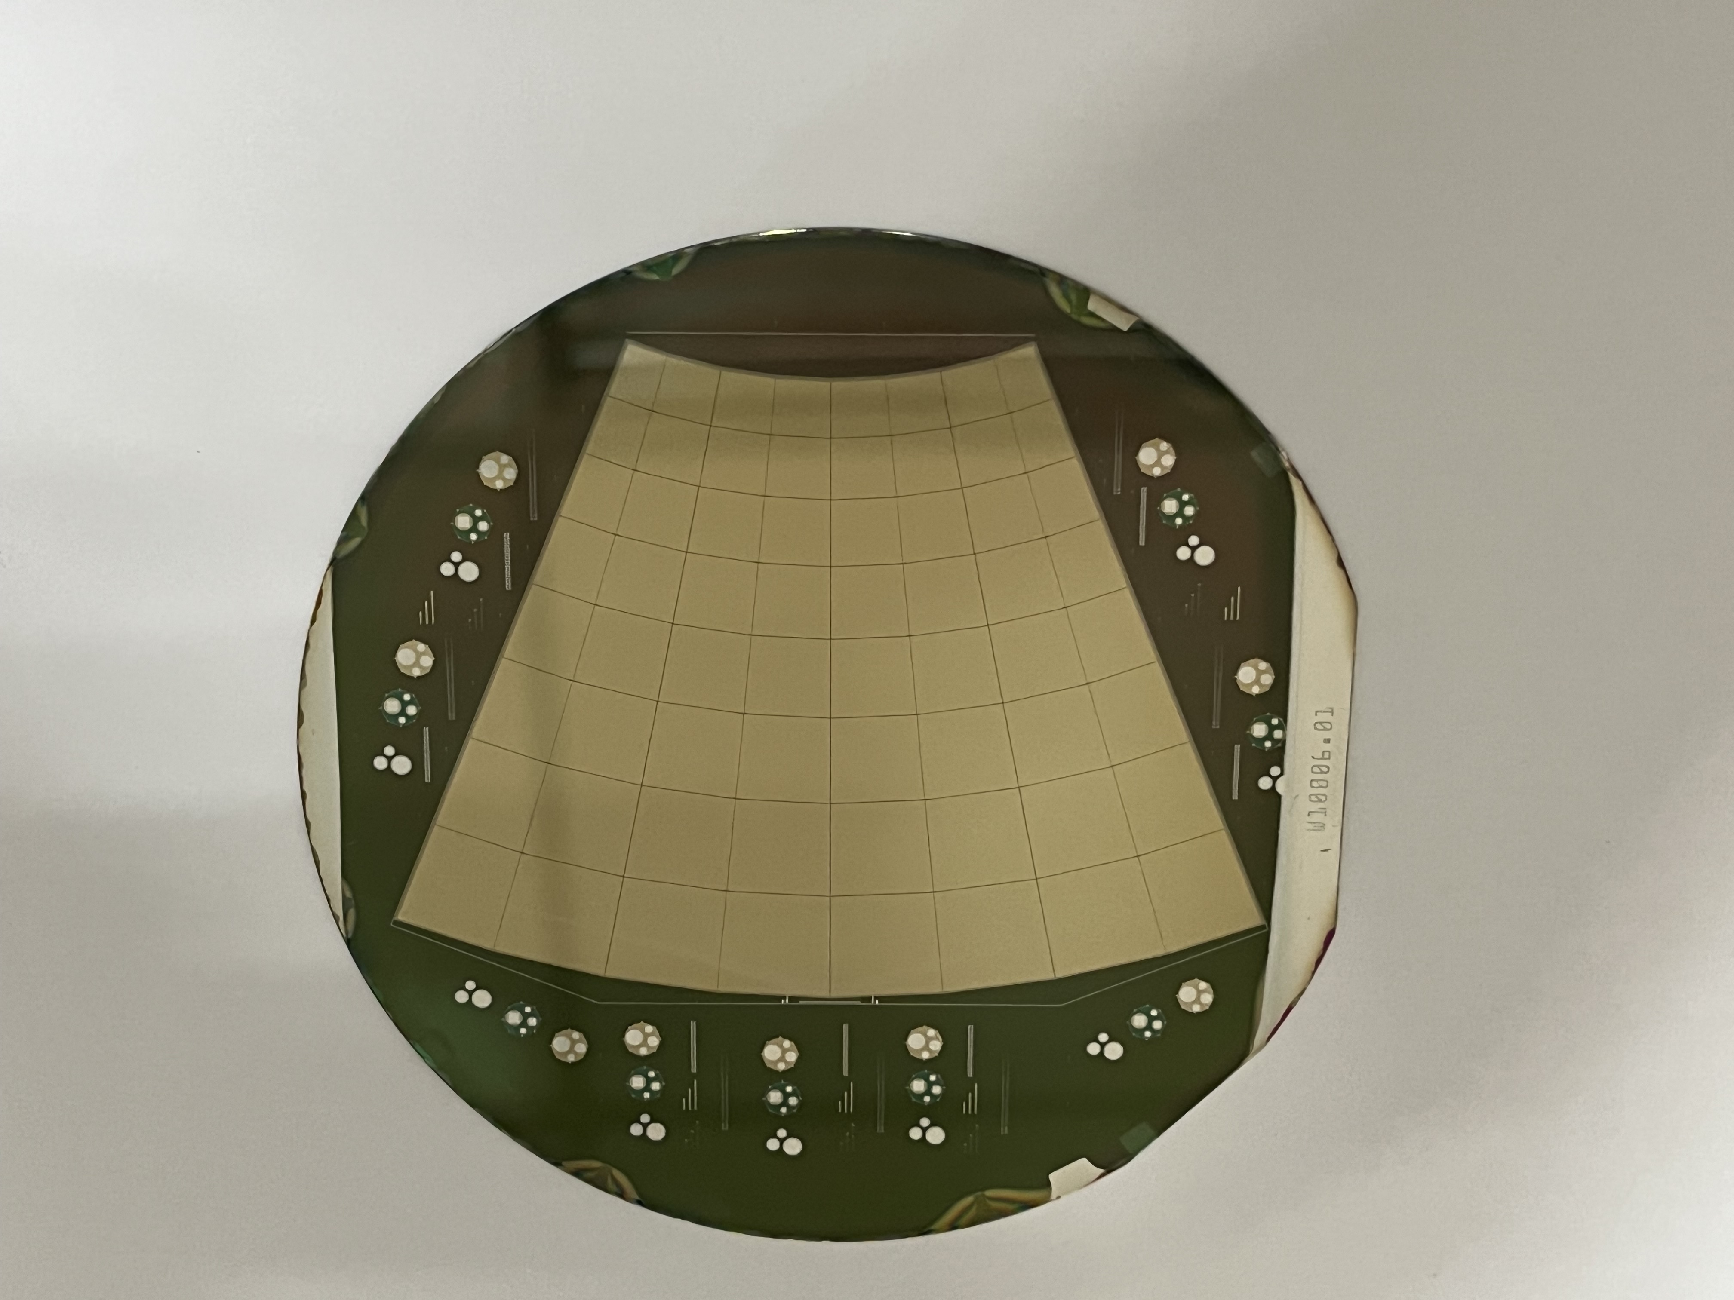
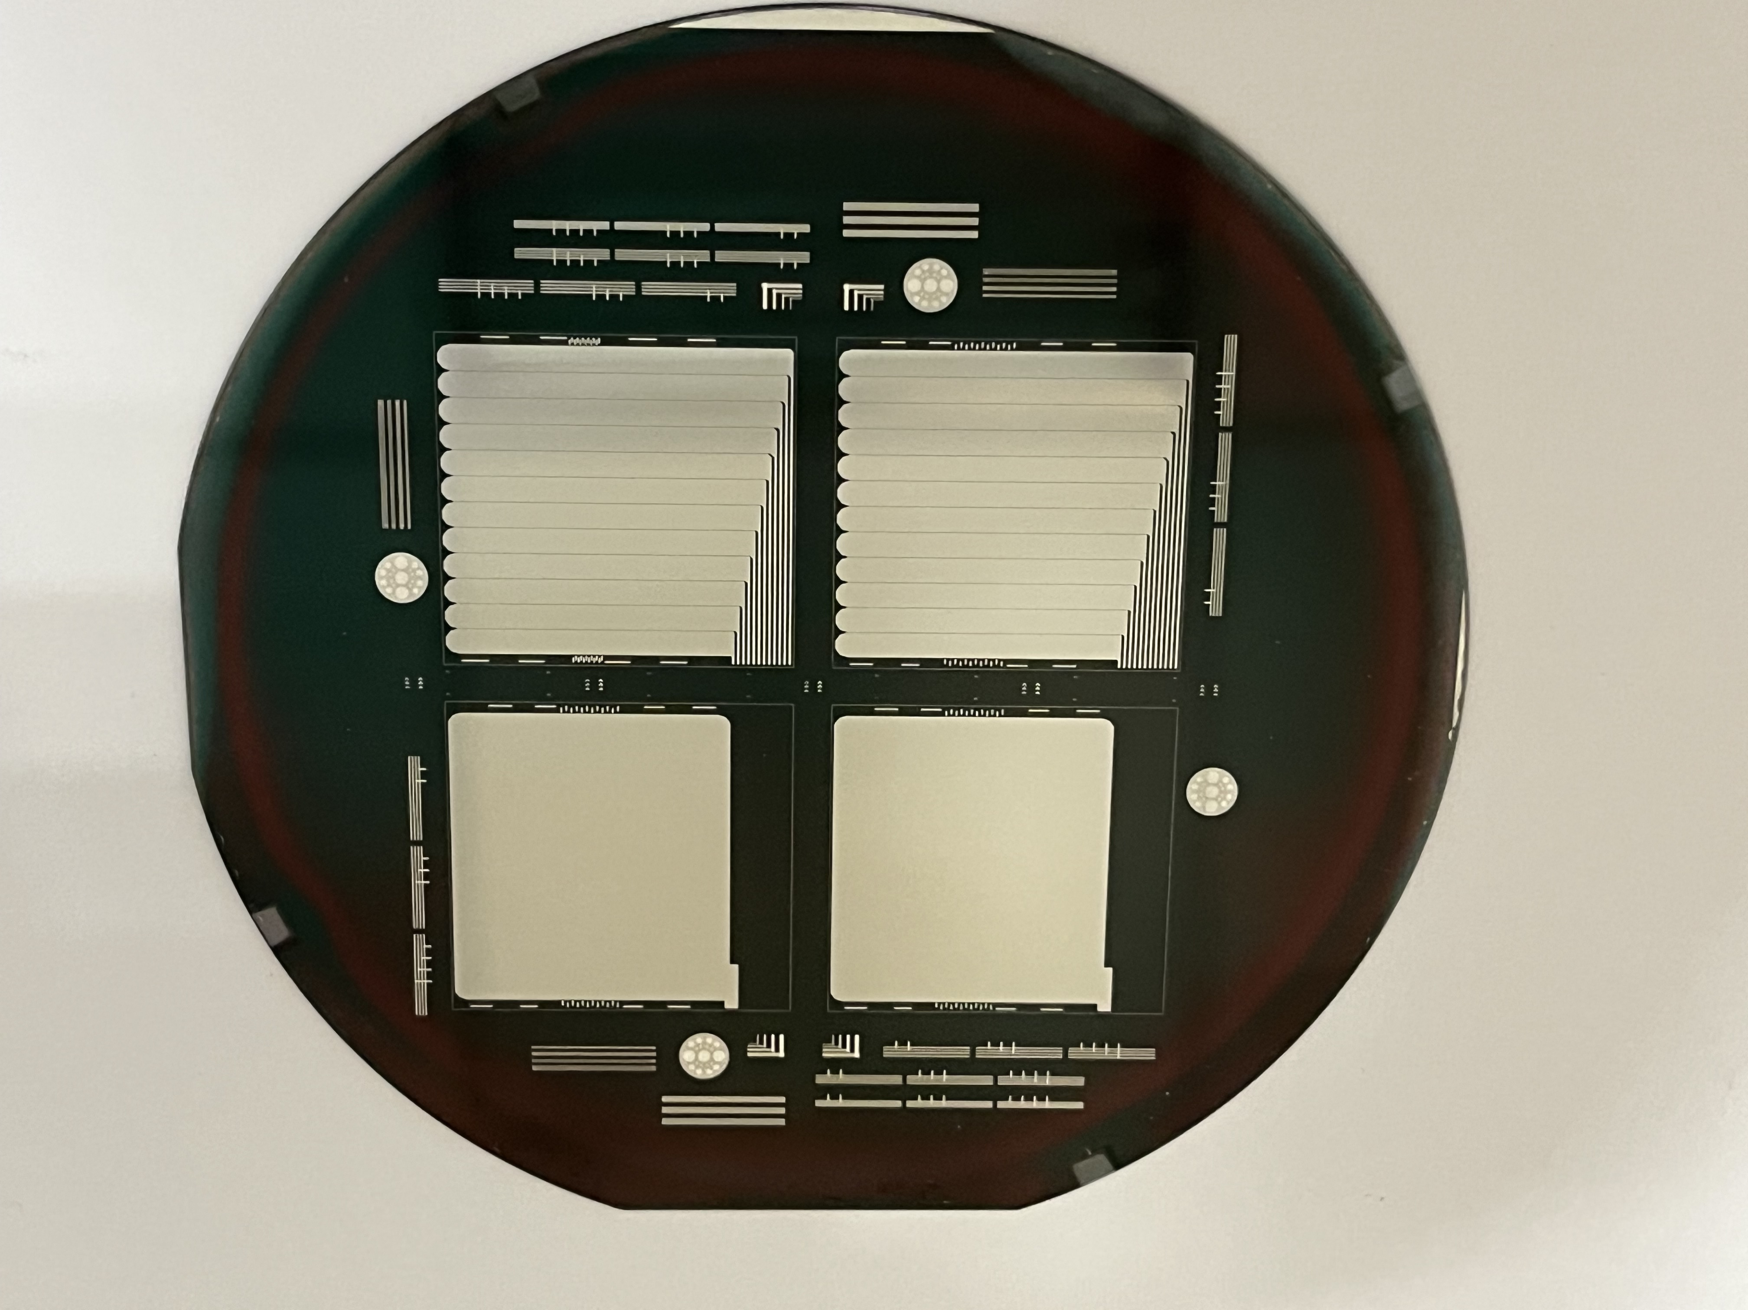
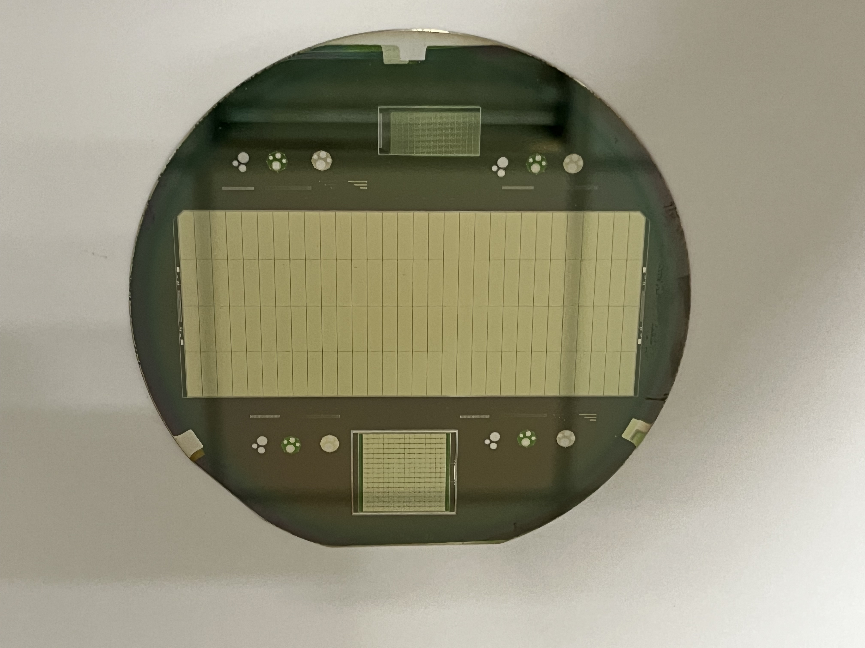
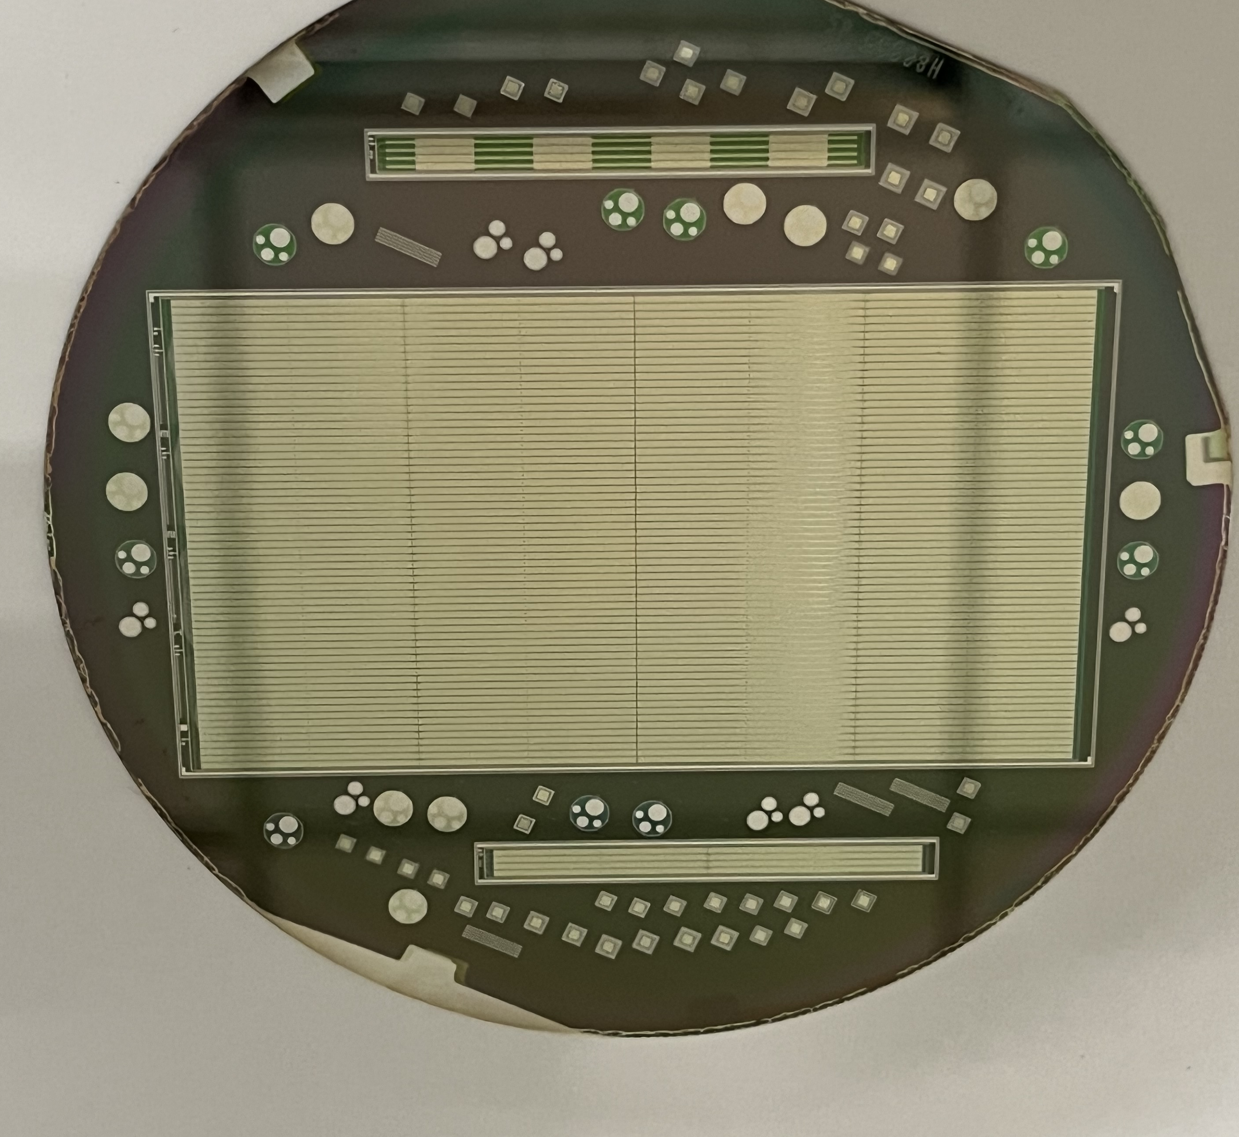
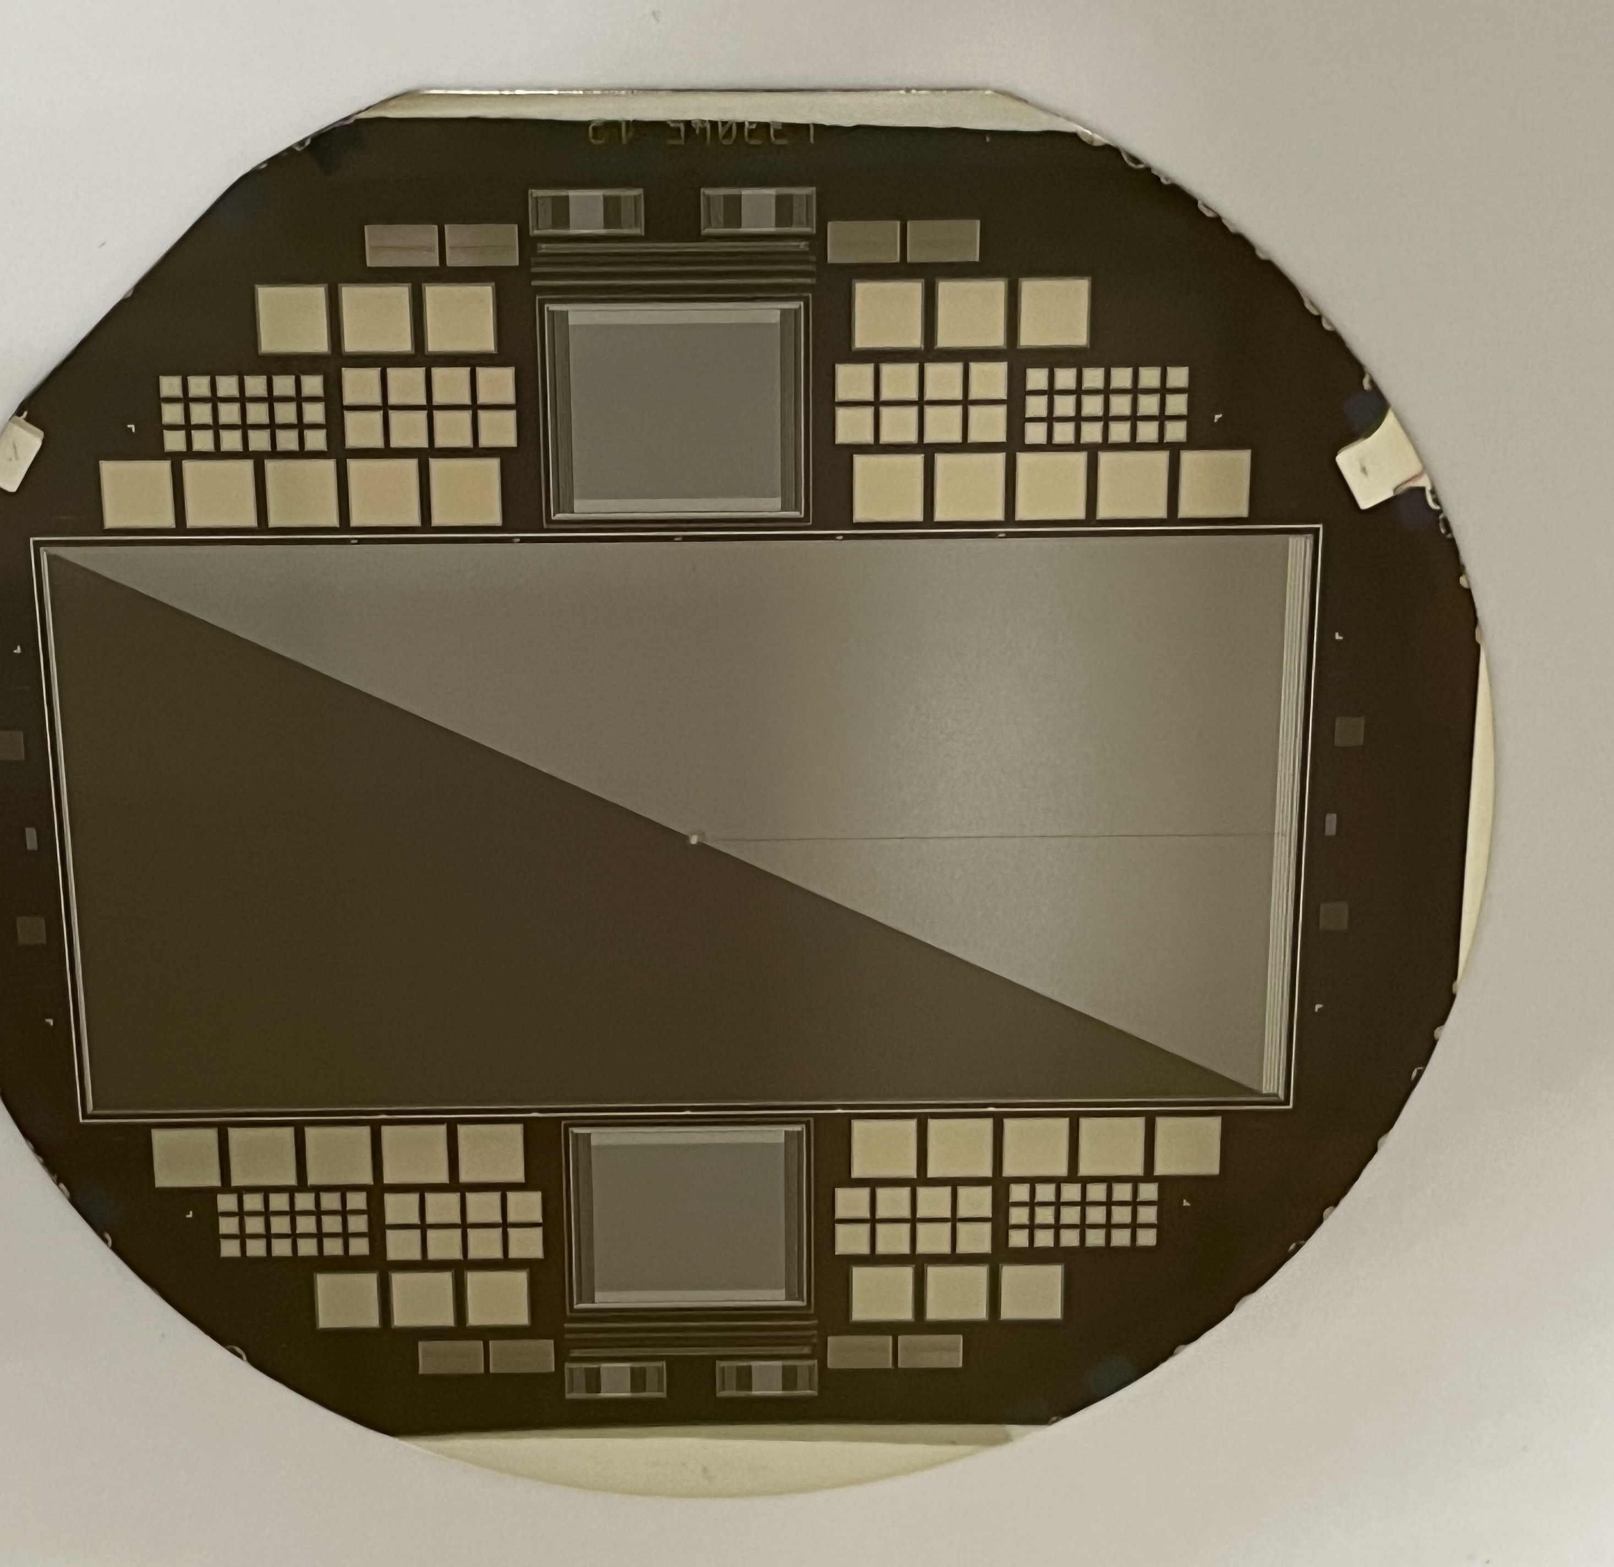
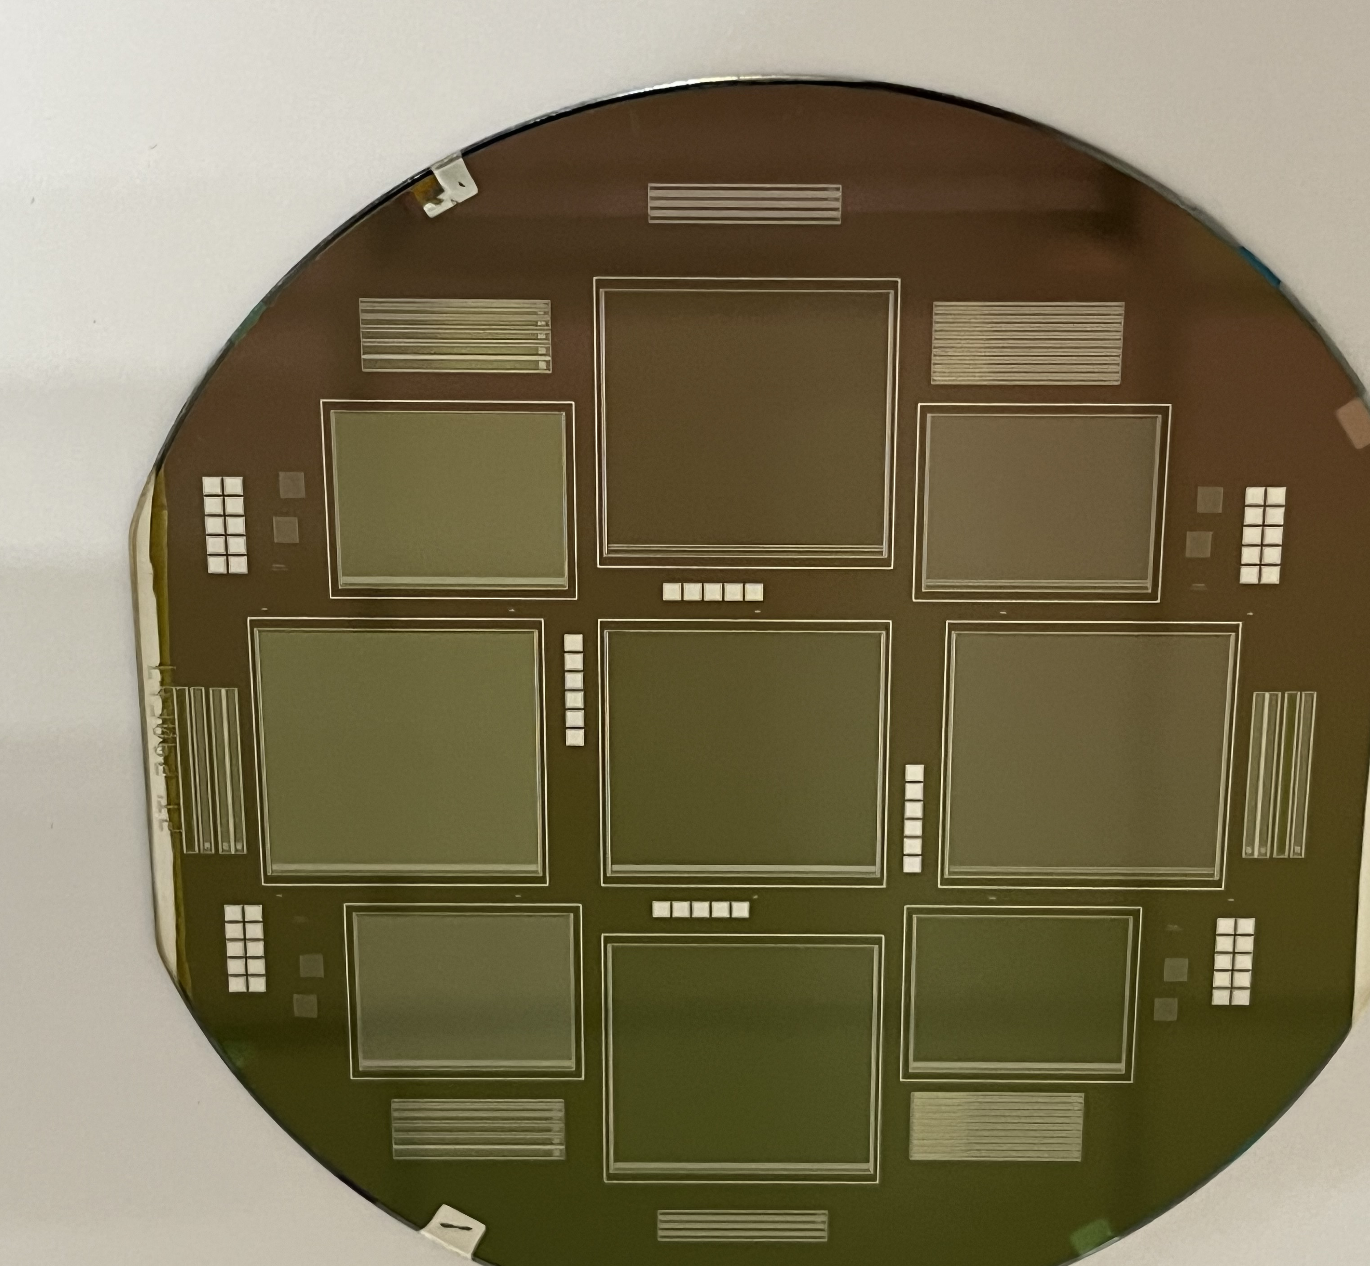

Slide 14
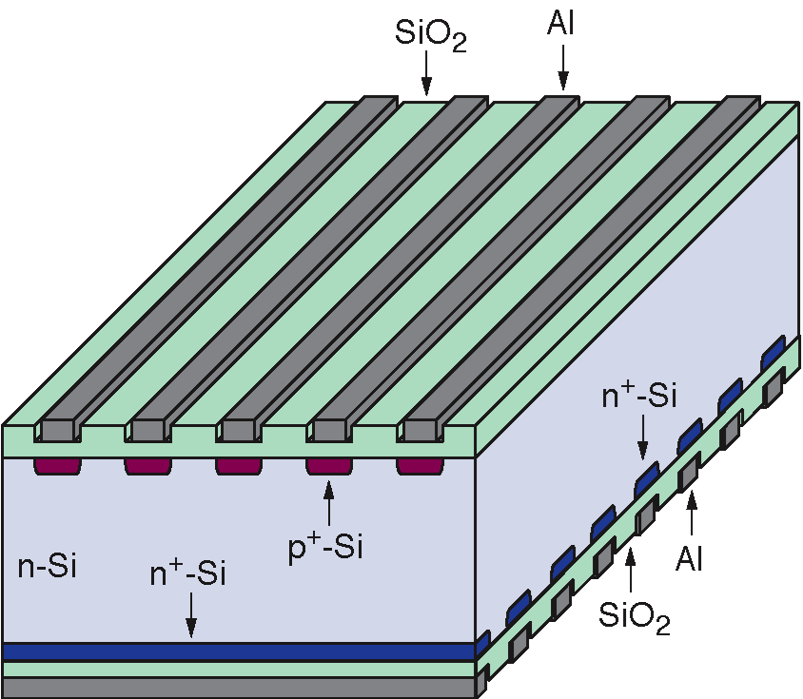
Most common silicon detector: Silicon microstrip detector
P+ and metal layer form parallel strips
Can be single sided or double sided.
Register particle’s position in the direction perpendicular to the strip direction.
For precise tracking (example):
Pitch between strips: ~25 μm.
Readout every 2 or 4 strips
Total width of 1000 readout strips ~ 5-10 cm
Often join several detectors by “wire bonding” to form long “ladders”.

Slide 15
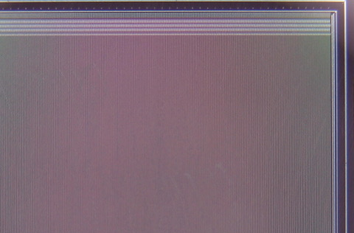
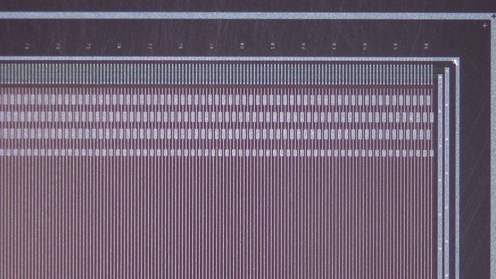
A silicon microstrip detector with 50 μm readout pitch

Slide 16
Charge sharing:
Center of mass position
+
−
+
−
+
25μm
300μm
−
−
+
+
−
~20000 e/hole pairs, typical signal/noise ~ 20 for charge 1 particle

Slide 17
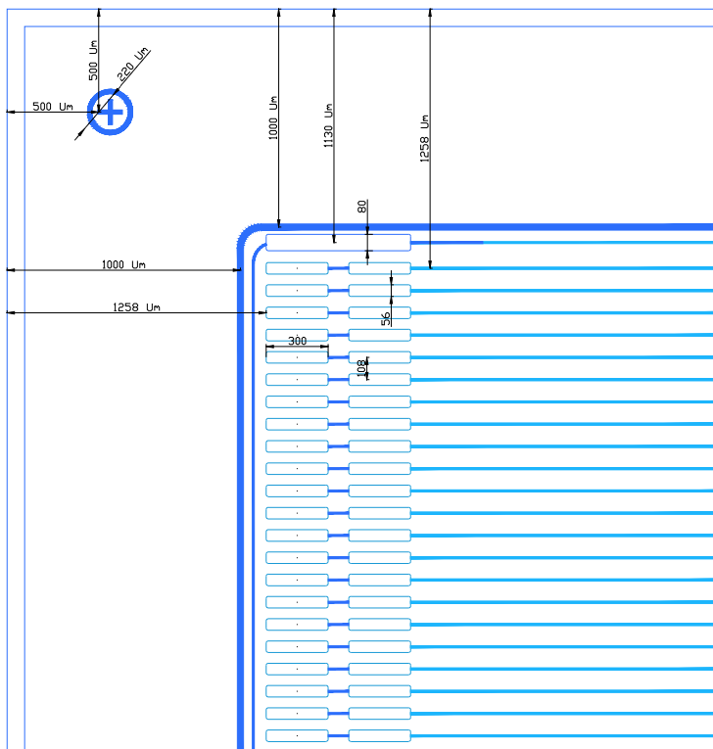
SSD for AMS experiment
Chip size [mm²] | 113×80
Active size [mm²] | 110.48 x 78
Chip thickness [μm] | 320
Guard ring center to chip edge [μm] | ¹⁰⁰⁰
Guard ring width [μm] | 50
Bias ring center to chip edge [μm] | ¹¹³⁰
Bias ring width [μm] | 50
Bias ring pad size [μm²] | 80x700
Strip width [μm] | 10-12
strip pitch [μm] | 27.5
Readout strip pitch [μm] | 108
Readout pad size [μm²] | 60x300
Number of readout strips | 1024

Slide 18
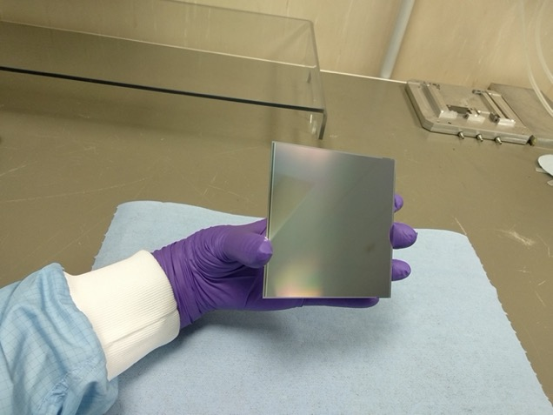

Slide 19
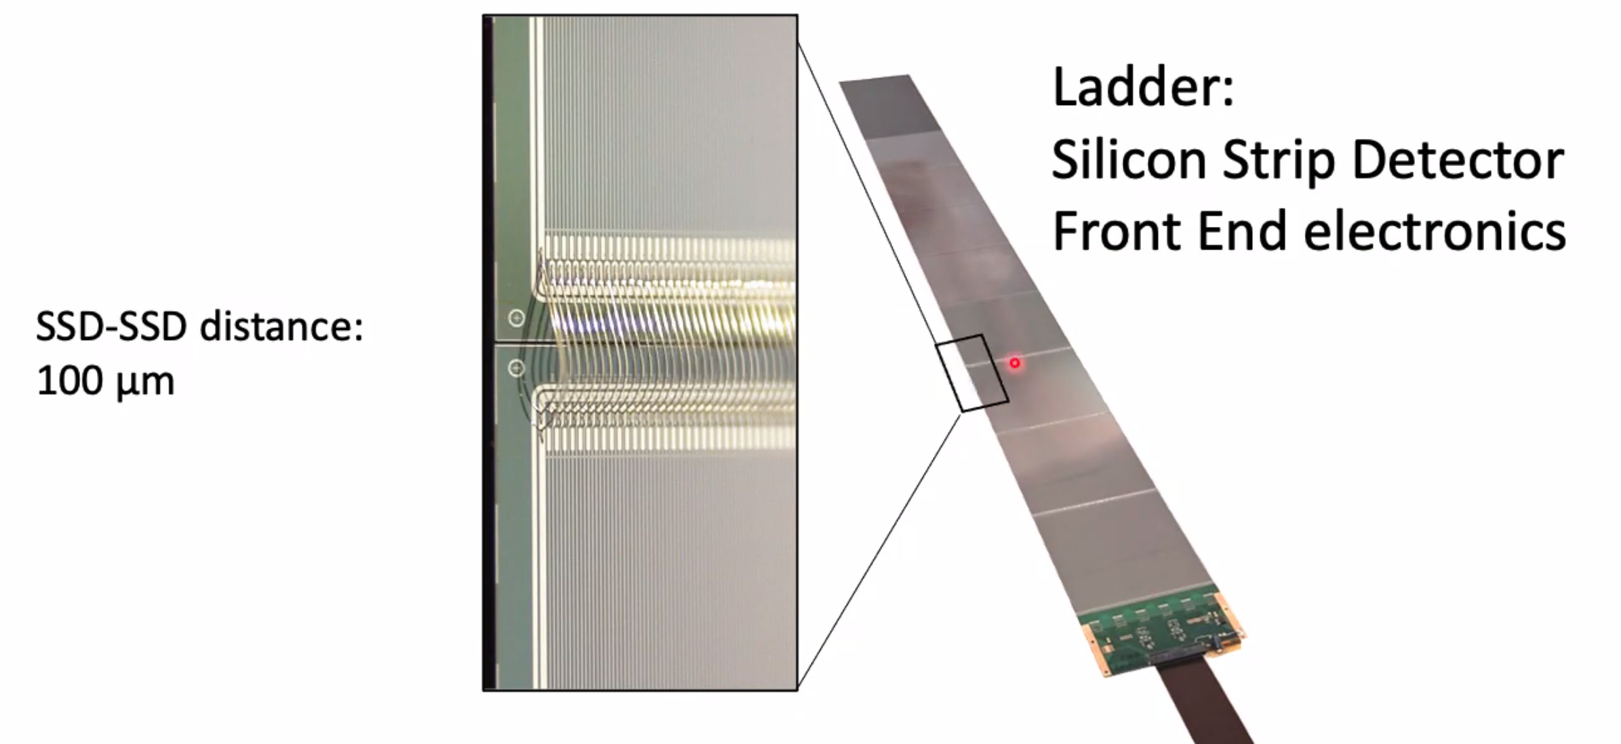
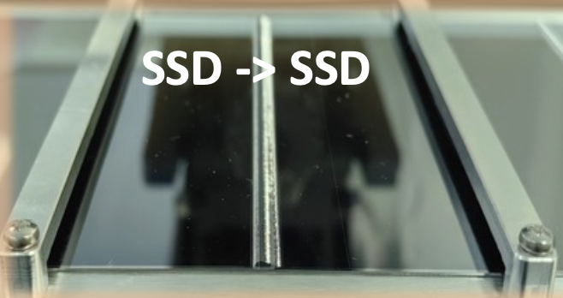
Wire bonding: a standard silicon industry technique
Join the metal layers of different components by thin (1 mil) Al wires
Apply ultrasonic power to bond the wire to the metal pad.
1000 bonds in 10cm
Effectively: 1024 strips of 1 meter in length. Covers an area of 1m x 10cm with 1024 channel, which are readout in series.

Slide 20
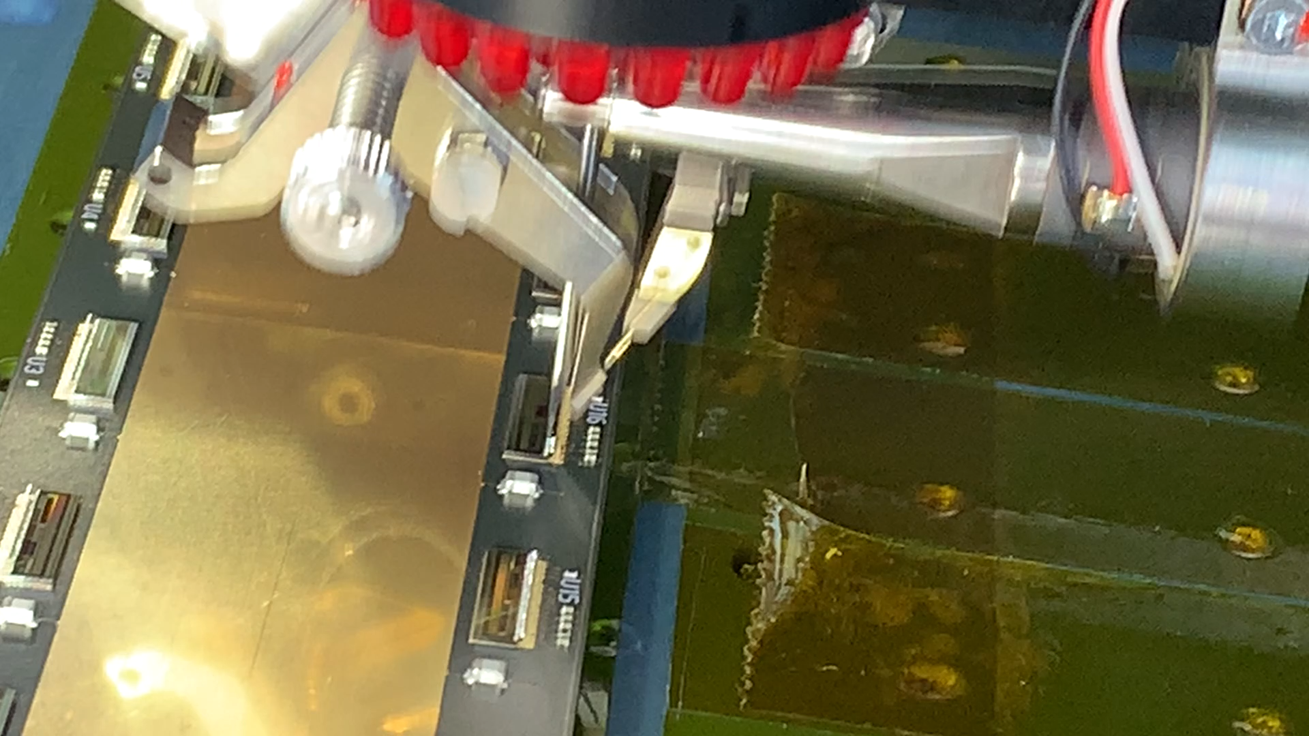

Slide 21
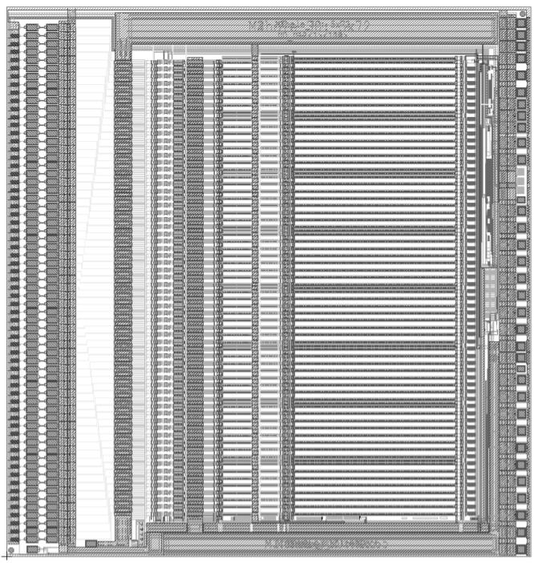
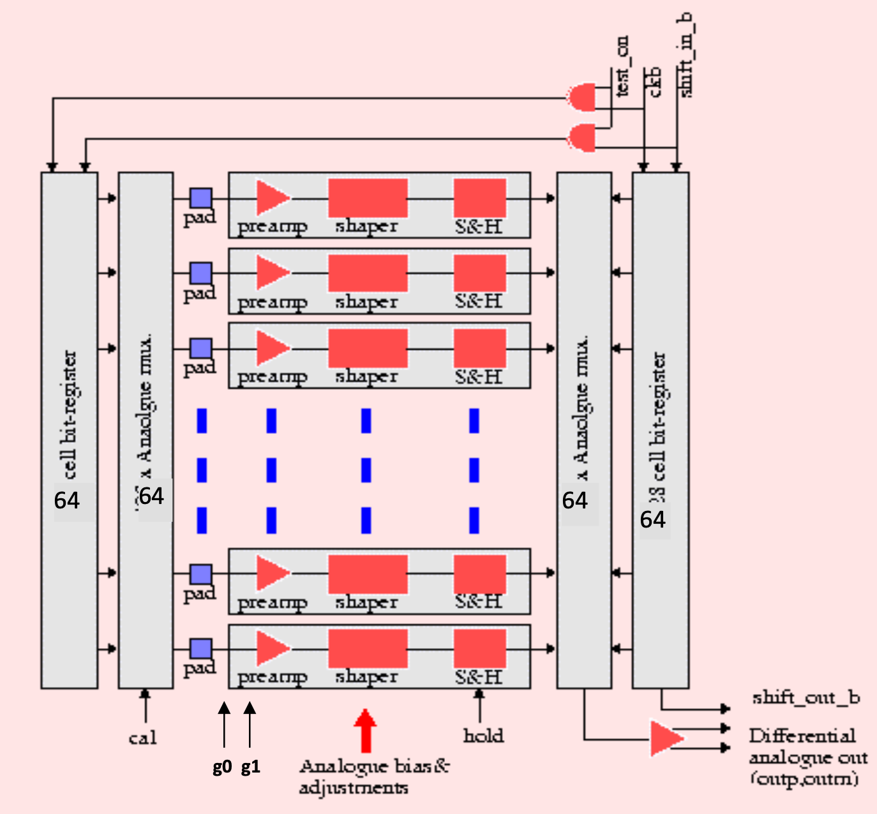
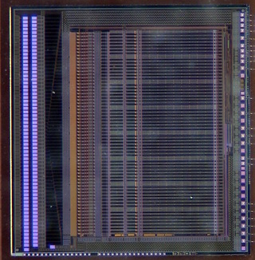
Readout electronics:
High density multichannel ASIC
Amplifier & shaper
Sample & hold
Serialization
(Digitization)
6mm
64 channels

Slide 22
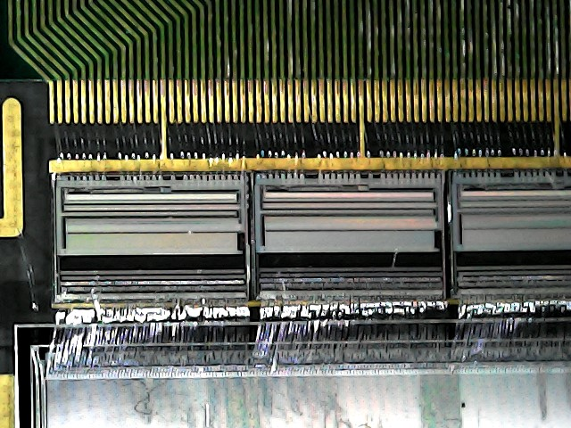
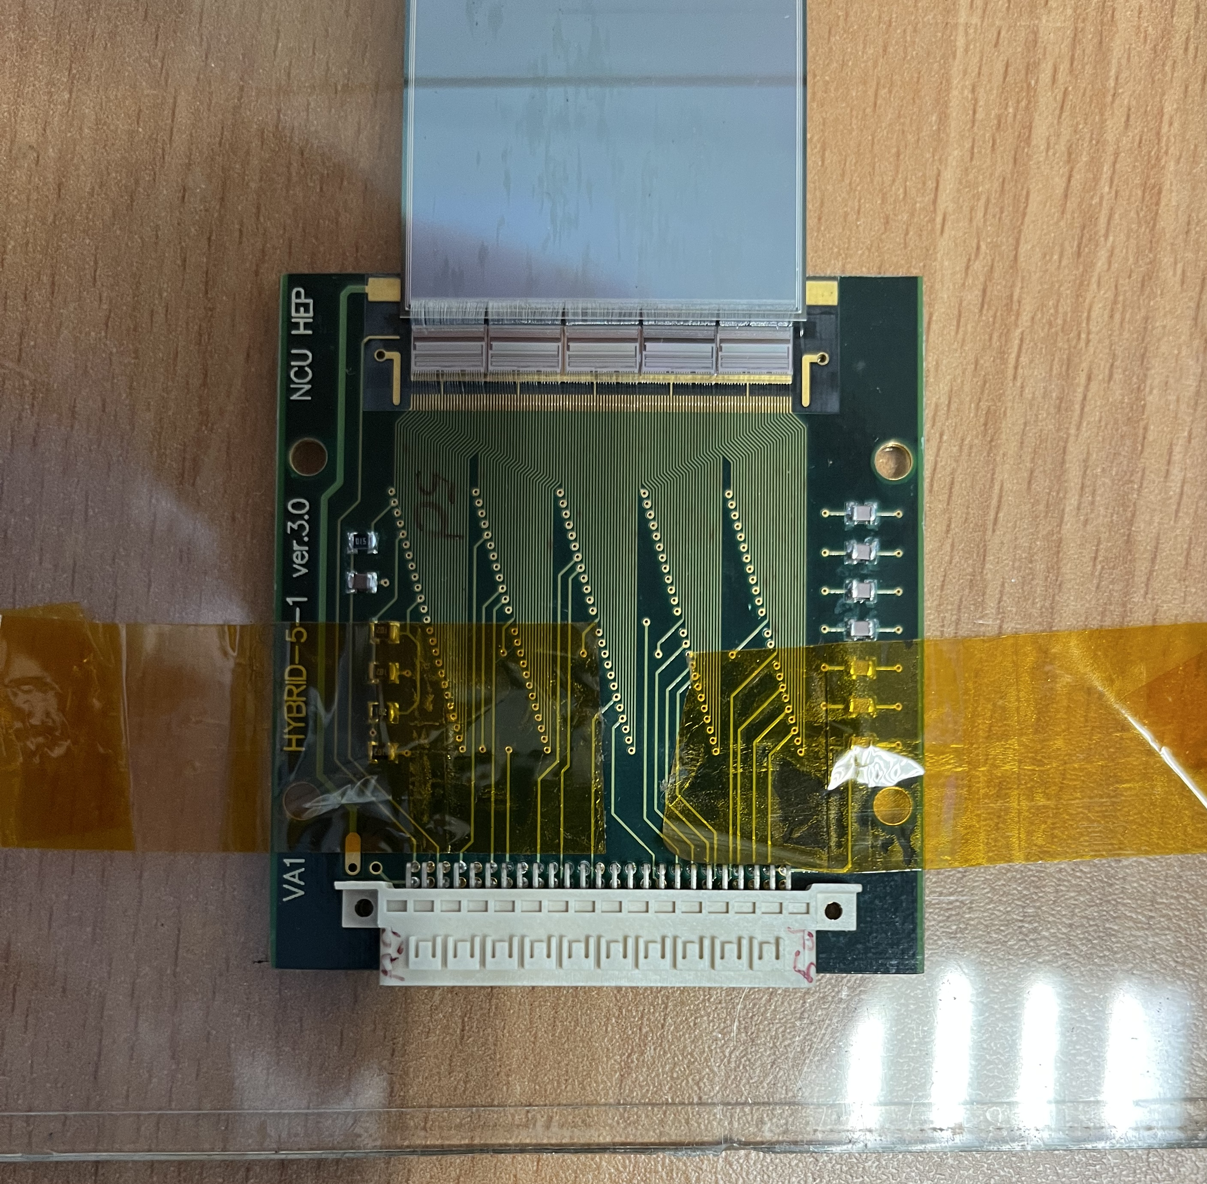
ASIC
Silicon detector
Bonding between Silicon detector and ASIC
Bonding between ASIC and PC board
Most of the channels have no signal.
➔ Perform ”zero suppression” in the frontend electronics. Only a few signals are actually sent out in each event.

Slide 23
Very large tracking system can be constructed by putting together many layers of such ladders.
Advantage:
High resolution.
Flexible strip pitch and ladder length.
Can adapt to different arrangements for specific requirement of experiment.
Thanks for the semiconductor industry, very large area silicon tracker can be constructed.
Disadvantage:
High cost. 1 sensor (10cm x 10cm) ~1000 $
Thick material compared to gas detector ➔ not good for low energy applications.
Serial readout ➔ Require complicated readout scheme if event rate is high.
Radiation damage.

Slide 24
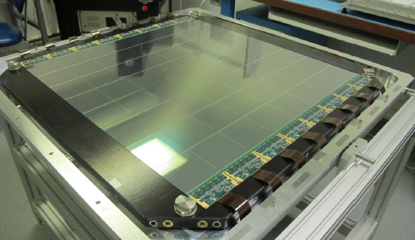
8 ladders put together to form a tracking plane. This plan determines the position of a passing charged particle in y-direction, with a precision of ~10 μm.
x
y
For 2D position determination, add another plane orthogonal to this plane.

Slide 25
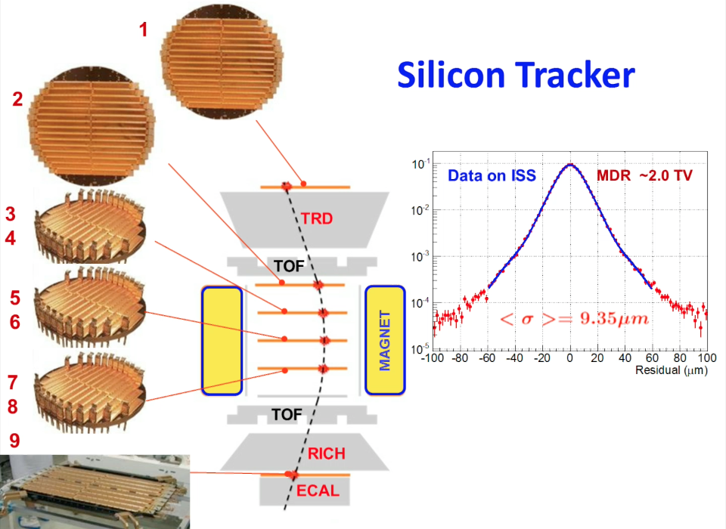
Example: AMS Tracker
200 ladders in 9 planes. 8 m² in total area, ~200k readout channels
In a 1.4 kG magnetic field, measure particle momentum with ~10% resolution up to ~100 GeV/c
Single layer resolution ~10 μm
Alignment by cosmic rays in space

Slide 26
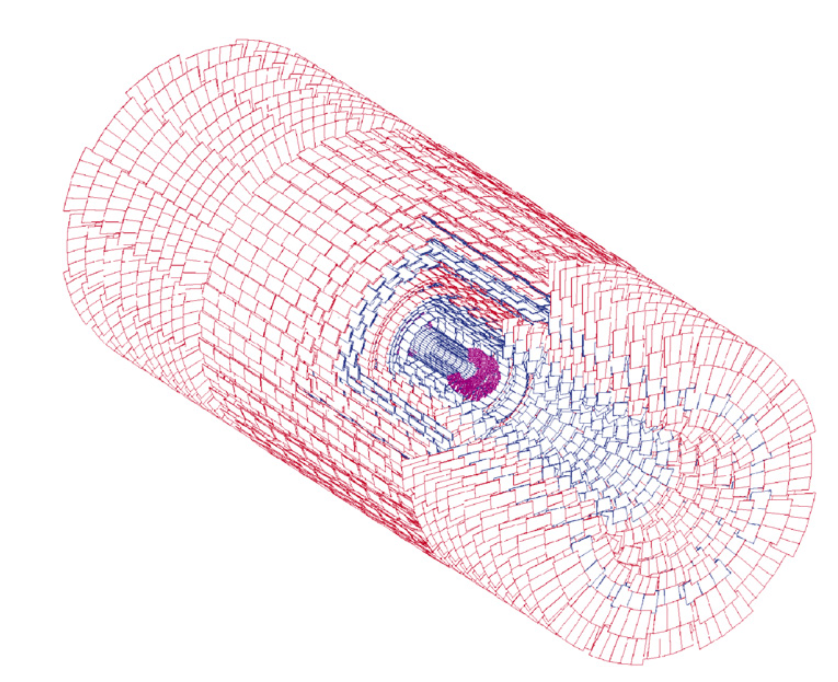
Example: CMS Tracker
Acceptance |η|<2.5, 200 m² silicon area, 1440 pixel and 15148 strip modules.
pixel: 100x150 μm²; Inner silicon: 10cm x 80μm; outer silicon: 25cm x 180 μm

Slide 27
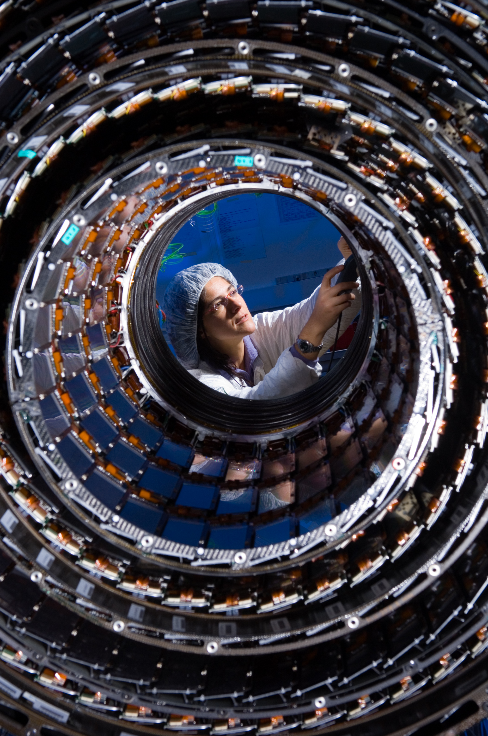
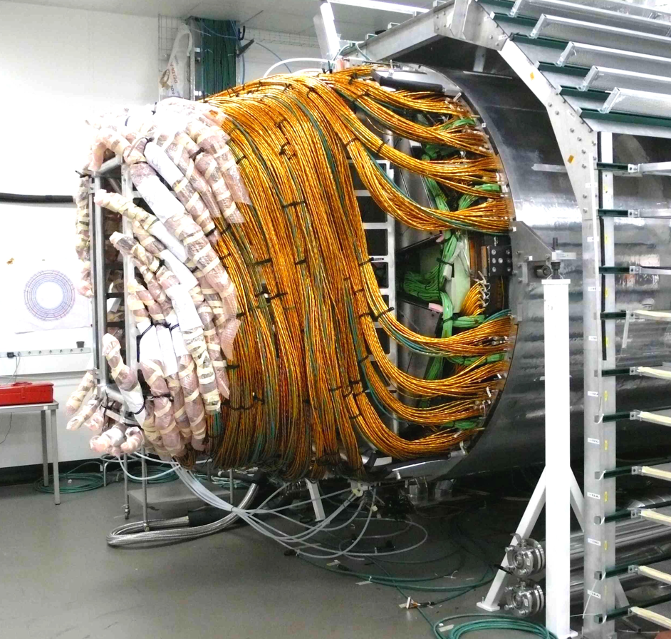

Slide 28
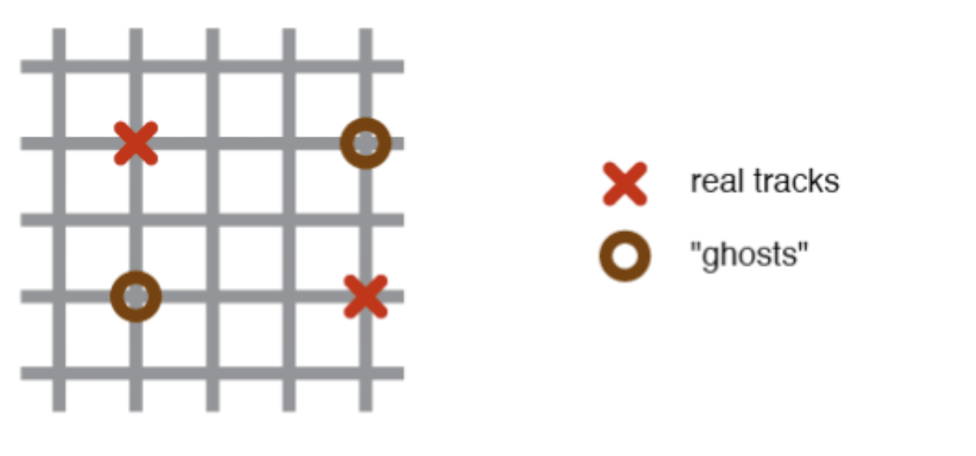
Microstrip detector is good for 1D coordinate measurement. For 2D measurement, 2 layers (or one double layer) is needed.
There are N² possible particle position when N particles hit a single detector.
OK for low particle flux
Not good when flux is high, e.g., vertex detector for LHC experiment
Solution: pad (pixel) detector.

Slide 29
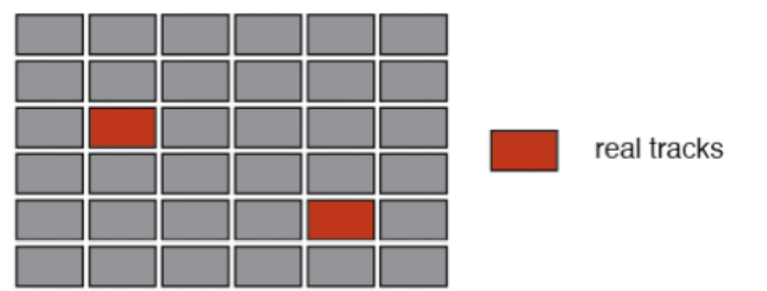
Silicon pad (pixel) detector:
Instead of strips, the p+ electrodes and metal contact are pad with size as small as 30μm x 30μm
True 2D position determination.
Problem: Very high number of readout channels. Order of 100k channels per detector of ~ 10mm x 10mm in size.
How to guide the signals out?
How to build and operate electronics with such high number of channels.
Solution: Build amplifier of matching size, and bond the detector with the amplifiers directly with “bump bonding”.

Slide 30
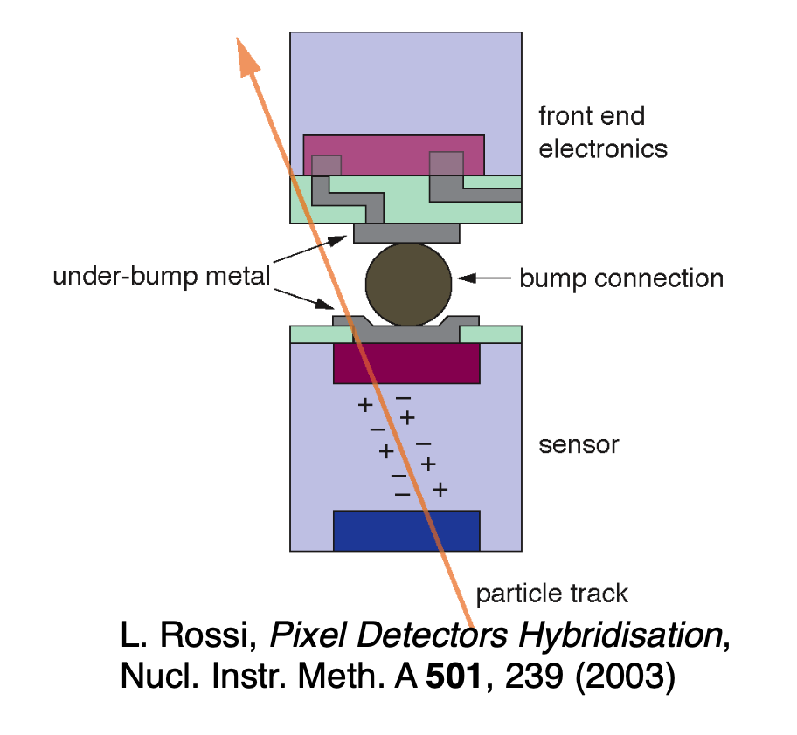
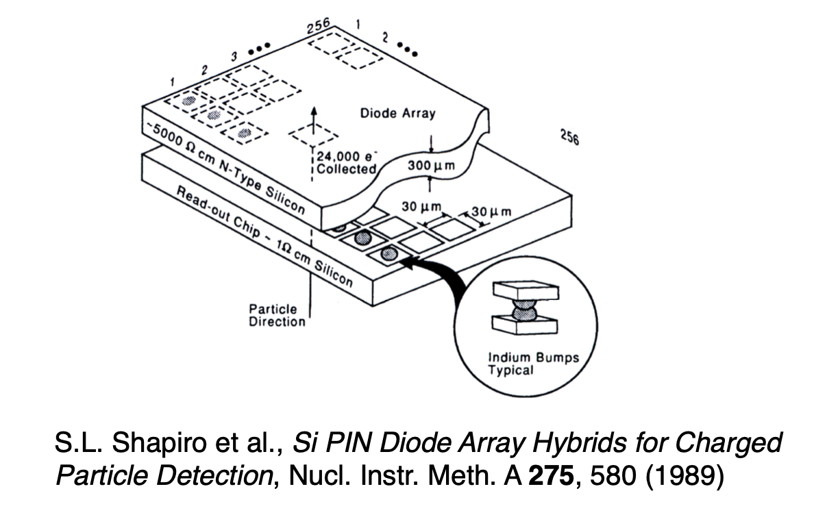

Slide 31
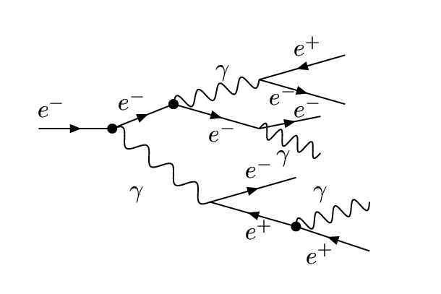
Calorimetric application of silicon detector
Less requirement for position resolution.
Measure the energy deposition of passing particles by counting the total number of particles in a shower.
Detector material
EM shower: electron, positron and photon
e/g has quite uniform response in detector
Shower is concentrated in a narrow region of ~25X₀
Silicon Detector
The process terminates when e⁺/e⁻ energy is below ~1 MeV
Number of e⁺e⁻ pairs in the shower reflects the energy of the initial particle
Insert silicon pad detector in the detector material to count number of passing particles ➔ measure the energy of the initial particle.
(Note: each passing particle create roughly the same amount of e-h pairs.)

Slide 32
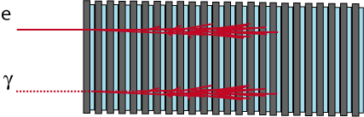
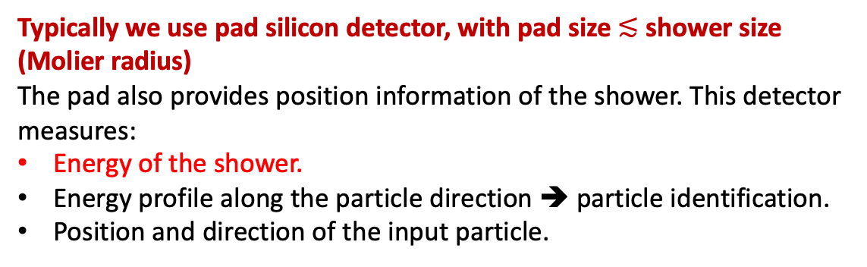
Silicon pad detector
…
…
Passive absorber (e.g. Tungsten, lead, copper, Uranian, …)
Typically we use pad silicon detector, with pad size $≲$ shower size (Molier radius)
The pad also provides position information of the shower. This detector measures:
Energy of the shower.
Energy profile along the particle direction ➔ particle identification.
Position and direction of the input particle.

Slide 33
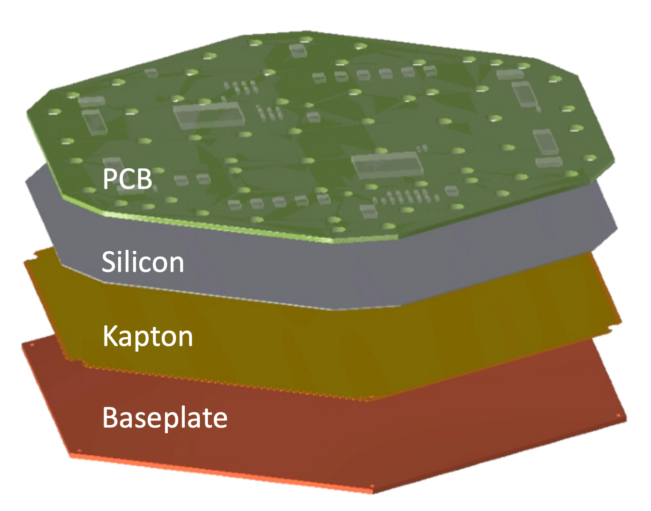
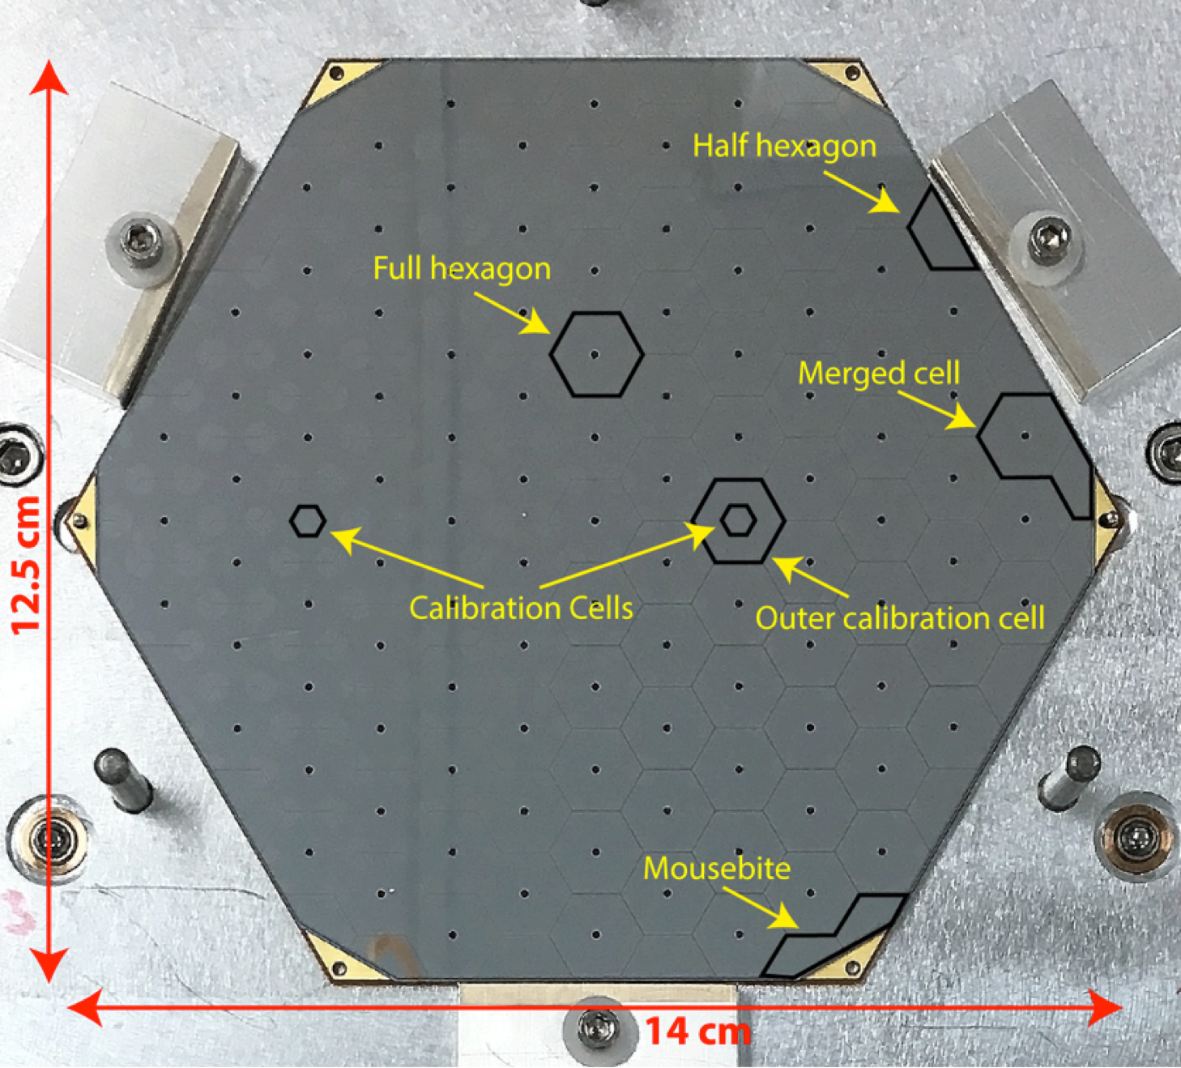
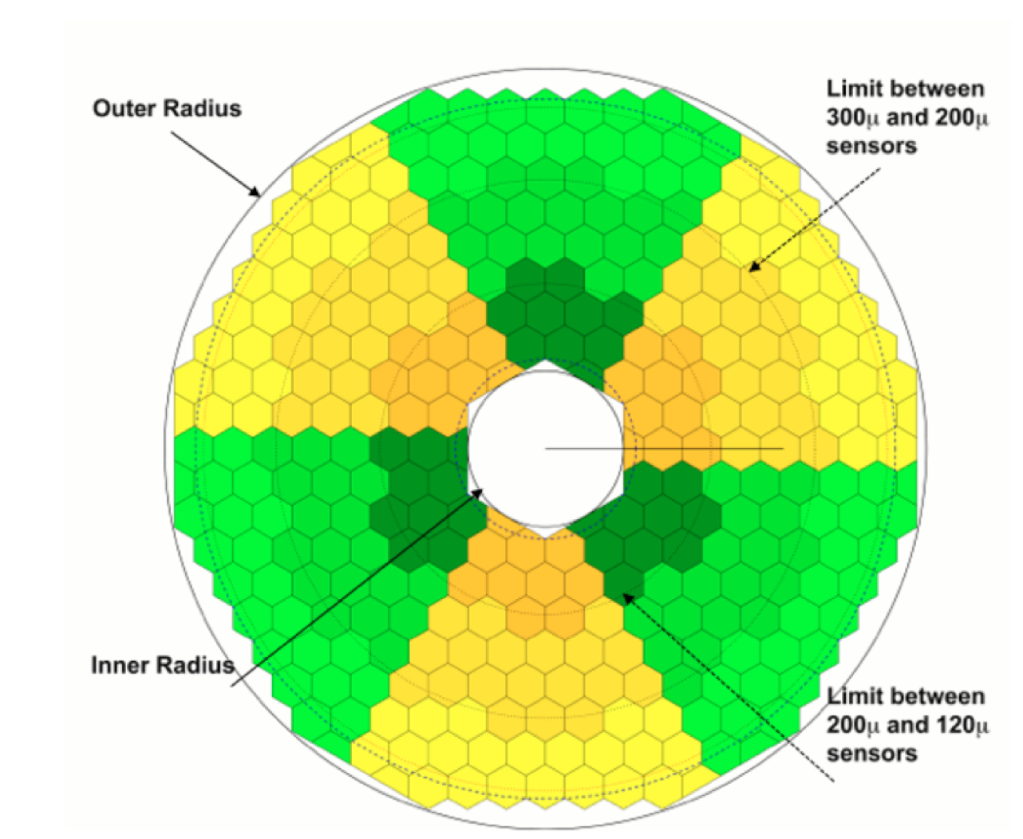
Example: CMS HGCAL
Detector module
Silicon pad detector
Detector plane

Slide 34
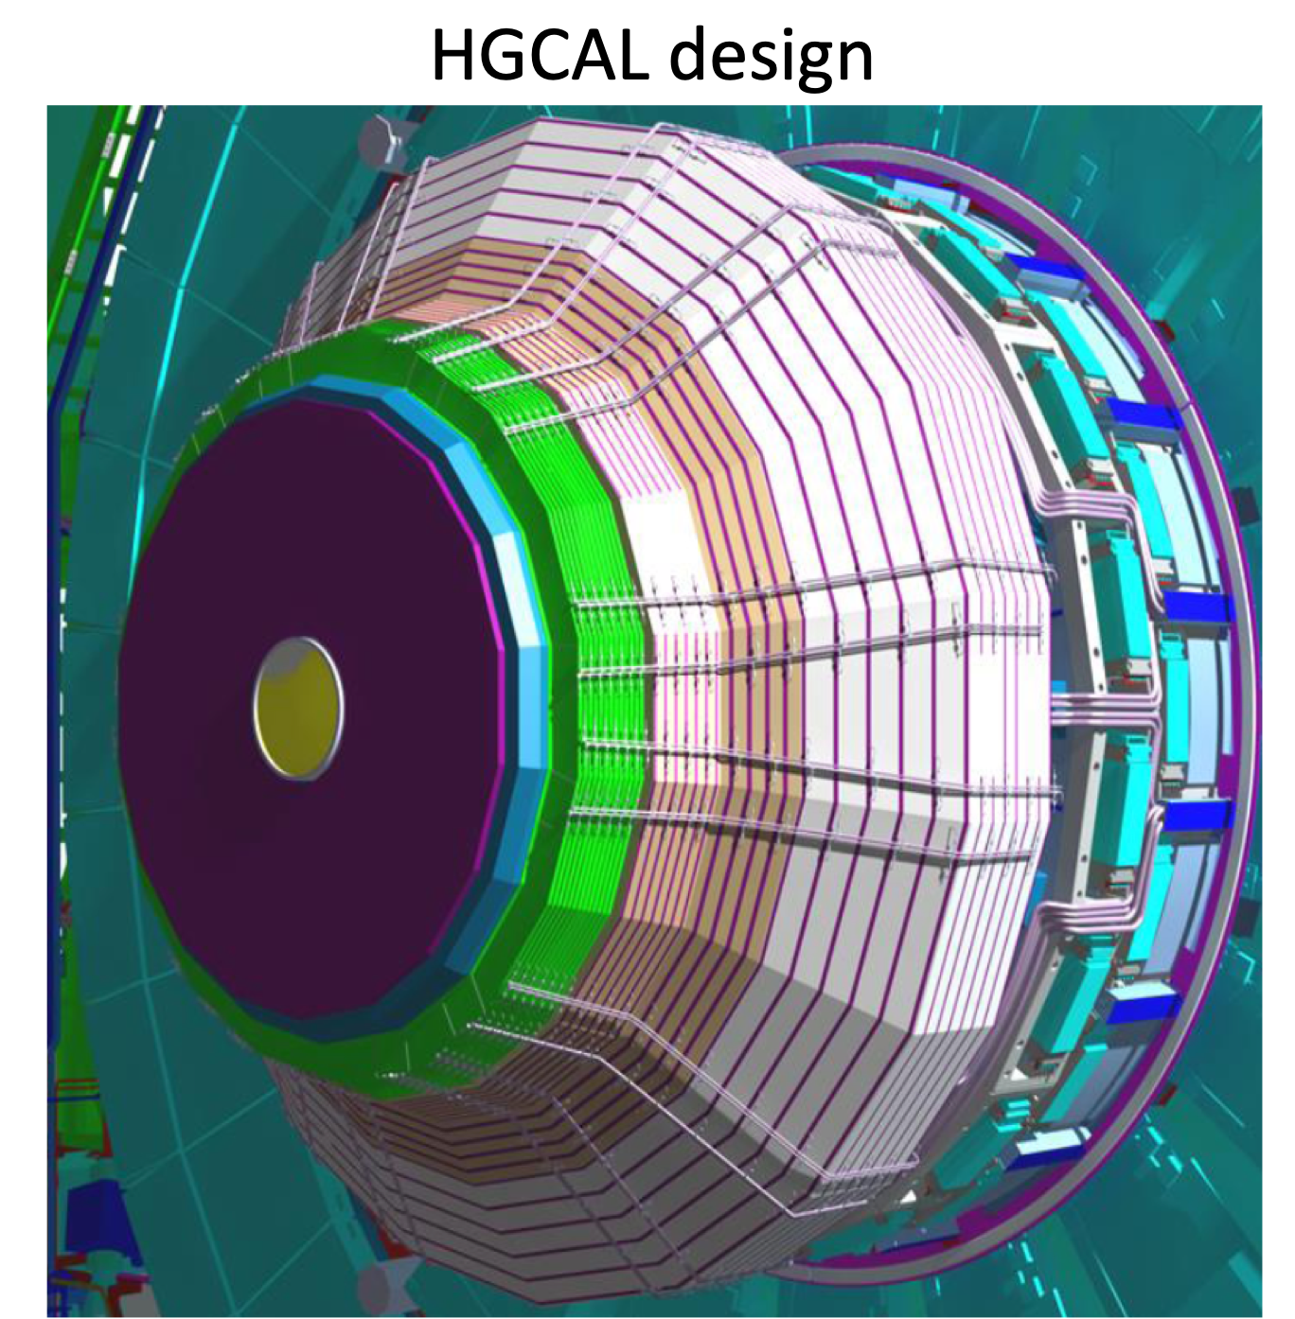
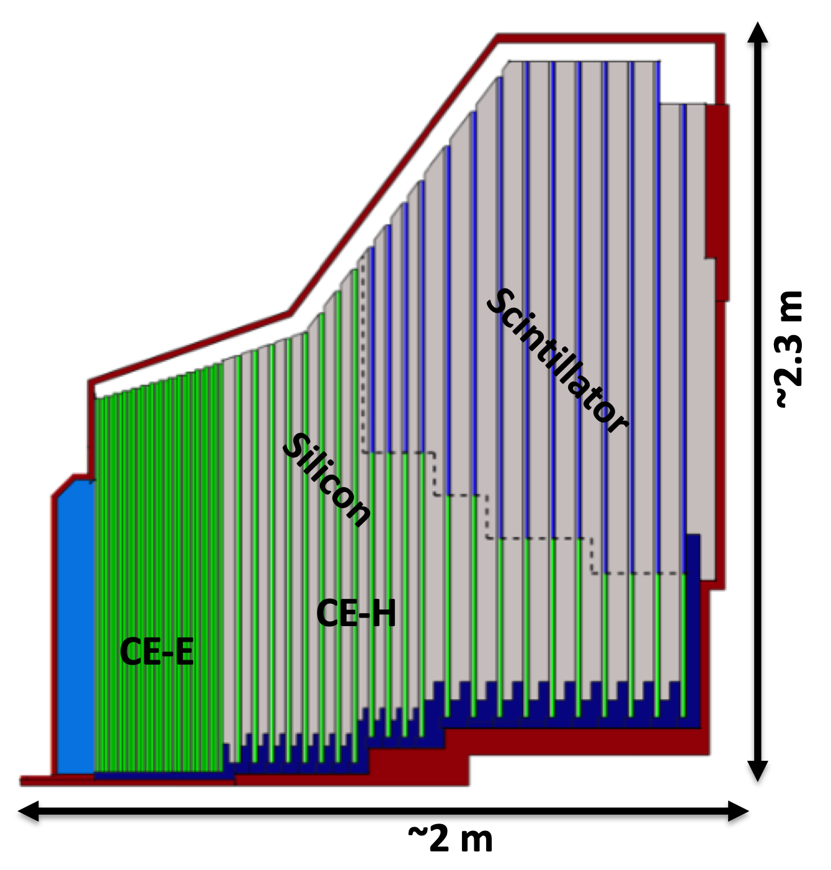

Slide 35
Summary:
Silicon detector is a versatile detector based on the mature semi-conductor technology.
Strip detectors provide 1D position resolution at 5 μm resolution.
Pixel detector provide 2D position resolution at 5 μm resolution.
Pad detector can be adapted to many different tracking or calorimetric applications.
Industrial production capacity is available, we can build very large detector system with very high resolution.

