Slide 1
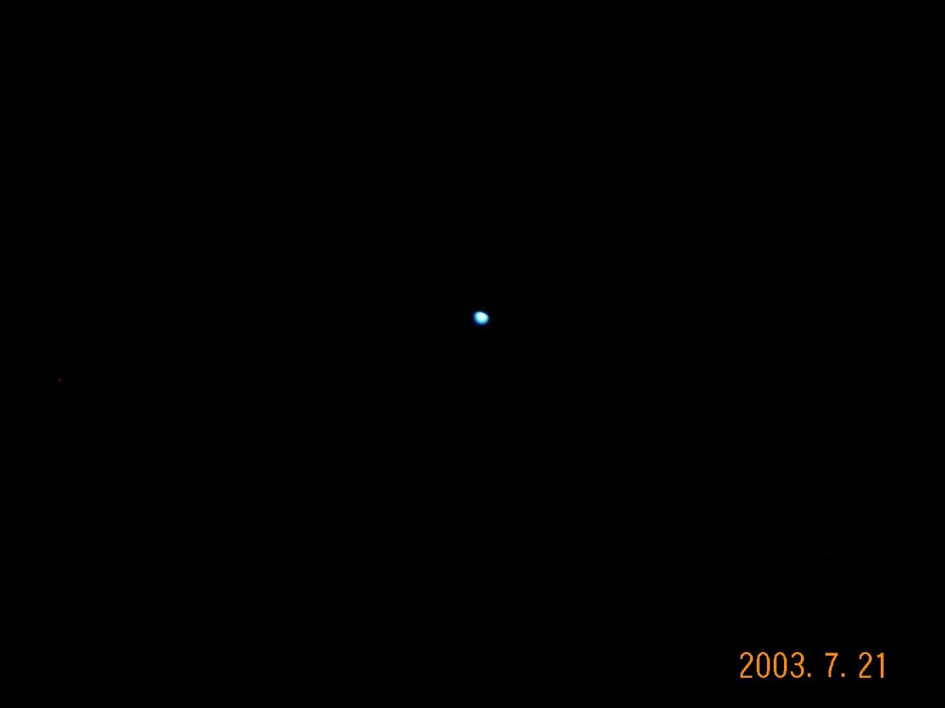




Dark Matter Detection – Lecture I
Grand Landscape [Public Talk] – Particle Physics & Cosmology
Evidence of Dark Matter Problems
Candidates of Dark Matter
Experimental Searches of WIMPs
Basics of Direct Searches [themes of Lecture II (Mirabolfathi)]
[ SKIP: TEXONO & CDEX Program on Dark Matter ]
Historical Perspectives & Future Prospects [Public Talk]
Henry T. Wong / 王子敬
Academia Sinica / 中央研究院
May 2023
@

Slide 2
Evolution of Events:
Original Plans since many months: Prof. Nader Mirabolfathi (TAMU) would give three lectures in-person 1.5h+1.5h+1h
NM was advised not to travel on long-flights by doctor one week before PG2023.
Last minute Maneuvers & Fixes:
  H.T. Wong will give Lecture I on “Landscape” in person, based on existing materials (public talks, colloquia ….) in hand:
    Theme was “Dark Matter Problem in the Context of Science and Basic Research”
    Not customized for THIS purpose, technically ill-prepared, information not updated, meant to be provoke(thoughts) and to inspire(interest) rather than to teach …..
    BUT …. perhaps offer new insights to the fresh minds
  NM will give Lecture II in remote-mode (Friday May 26) with themes on “Direct Experimental Searches, cryo-phonon detectors, CDMS”
  Leave it open how to optimally use Lecture III (Tues. May 30) slot: Thematic Forum, Q&As, Free-Style discussions, … or Hands-On Projects ….

Slide 3
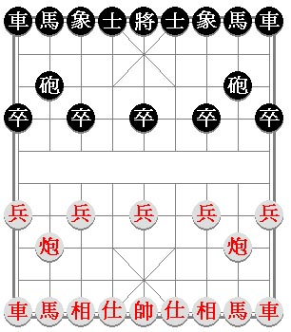
自然科學最基礎的問題 – 『學問』：
宇宙物質的最基本成分是甚麼？
※棋盤裡的棋子
這些基本成分的本然性質是甚麼？
※棋子的定位功能
這些基本成分的交互作用是甚麼？
※棋子間互動的規則
時間與空間的性質是甚麼？
※棋盤
宇宙起源和那時的狀態是甚麼？
※棋子在棋局開始時的佈局
粒子物理
How the Public Talk Starts …..
宇宙學

Slide 4
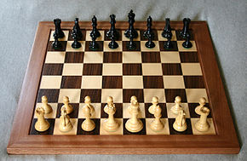
Chinese --
  Knowledge is 『學問』 { Learn – ASK (Questions) }
Fundamental Natural Science Research is the Pursuit to Understand the Alphabet and Grammar of the Universe (Nature).
Beyond – Use this “Knowledge” to build Civilization……
e.g. Fundamental Questions for Chess game
  What are the pieces ?
  What are the rules ?
  What are the intrinsic properties of the Chess pieces ?
  How do they interact ?
  What is the Chess Board, and their properties?
  What is the Initial Configurations?

Slide 5
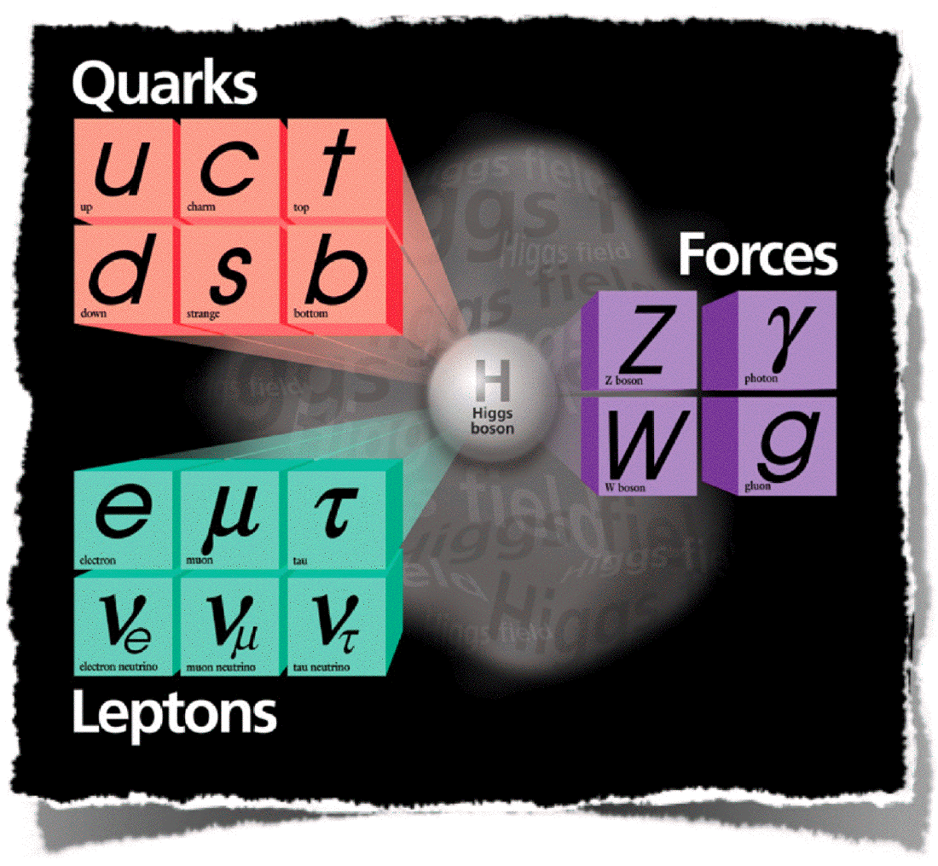


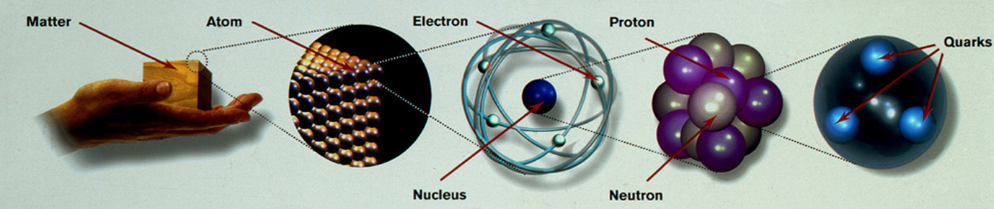
Composition of Our “Understood” Universe
Standard Model of Elementary Particles
媒介粒子
基本粒子
+
Higgs
[2012-CERN ; 2013-Nobel]
+ Anti-Matter (反物質)
「已瞭解」的萬物
原分子
原子核

Slide 6
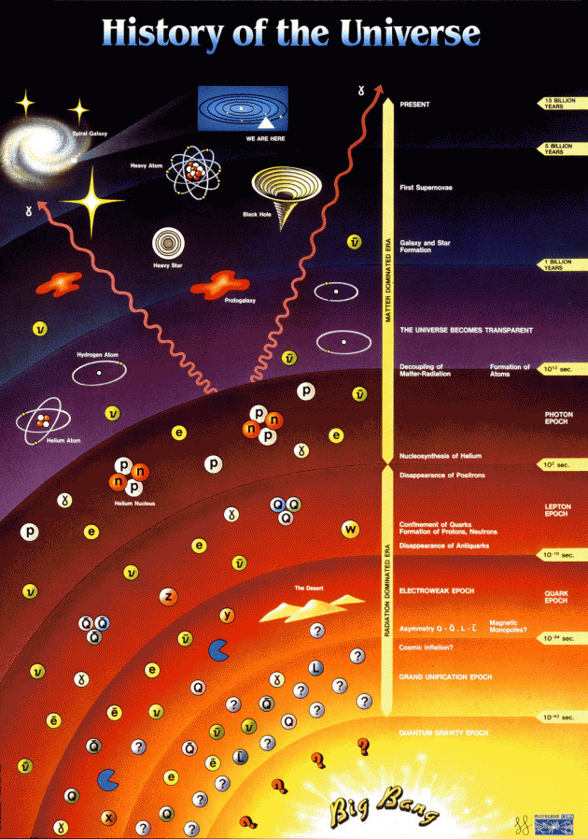
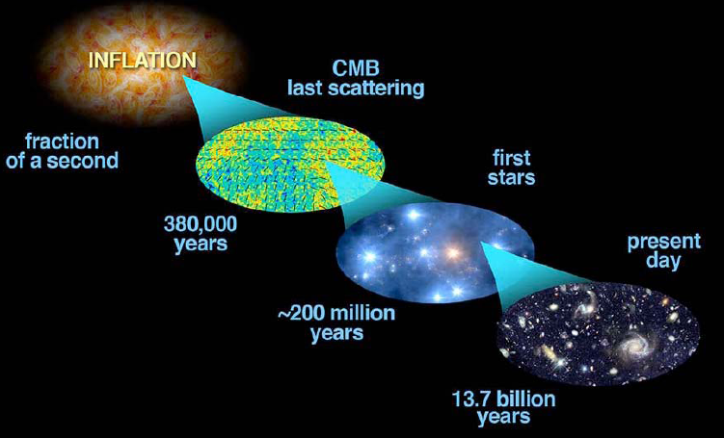
Particle Physics
Time
Energy /Tº
⇒
Structures Form
Physics at the Biggest and Smallest Scales are the SAME!
Evolution of the Universe
？？

Slide 7

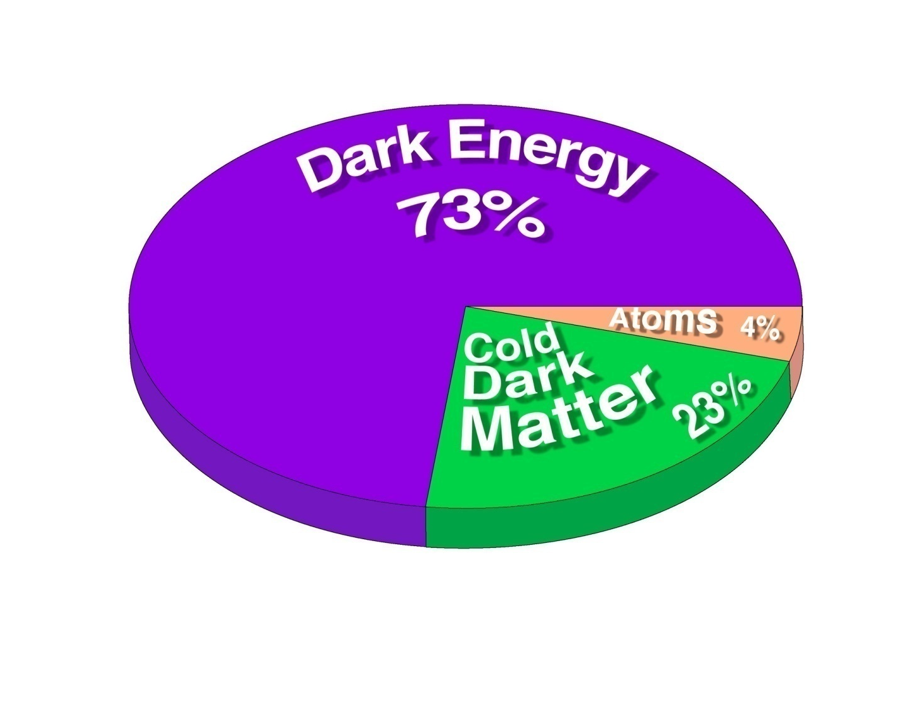
Compositions of the Universe : We only Understand ~4% !!!????
Or …. The Ultimate Copernicus Principle !!
Dark Energy：”We know less than Nothing !”
 Standard Model Matter：Understood
Dark Matter：”We know Nothing !” (but perhaps have reasonable guesses)
Dark Matter: Obey Known Laws of Gravitation.
Dark Energy: Does NOT.

Slide 8


The Grand Landscape [大視野]
Fundamental Conflict between the Universe comprehended via
Gravitation [General Relativity – Macroscopic] Vs
Particle Physics [Standard Model – Microscopic]
微觀(粒子作用) 與 宏觀(重力現象) 在
實驗數據 與 理論基礎 的 矛盾
      Experimental Data (Observations)
      Theoretical Formulation
  Mainstream Interpretation:
  ~95% of the Energy Density of the Universe is not understood ??

Slide 9
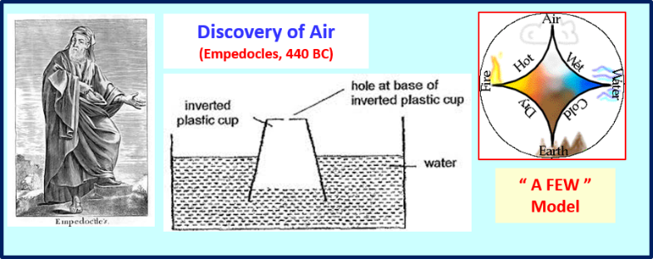
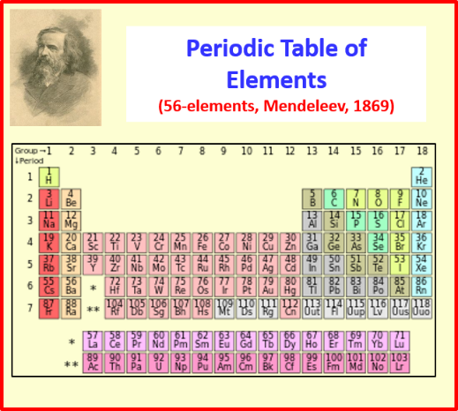
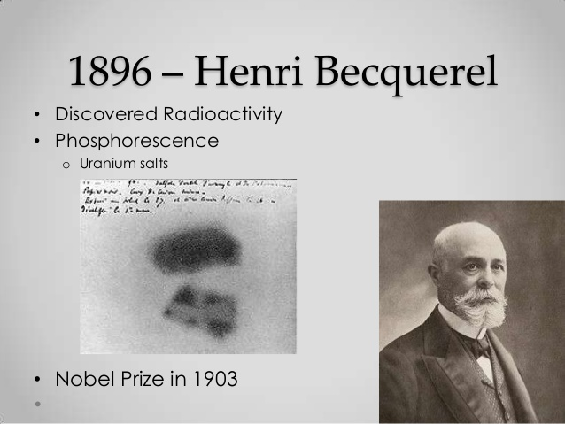
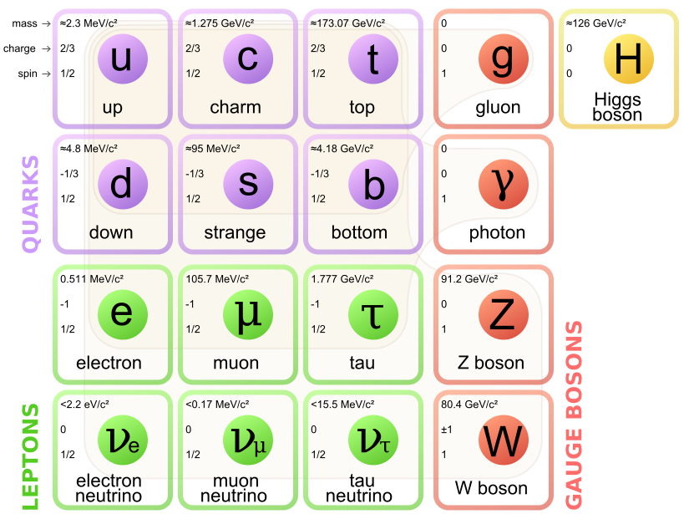
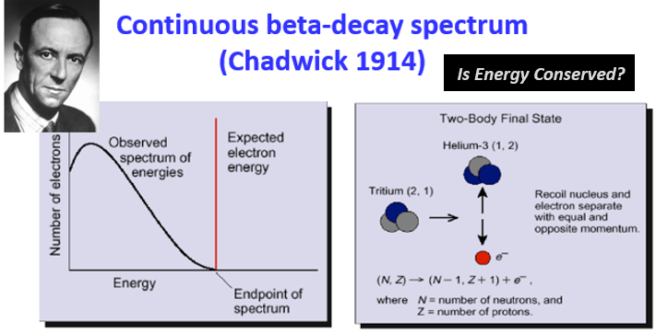
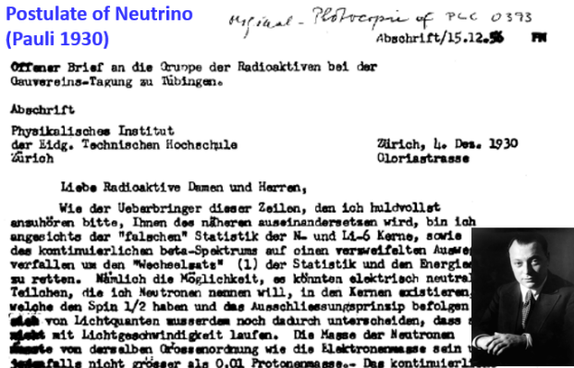
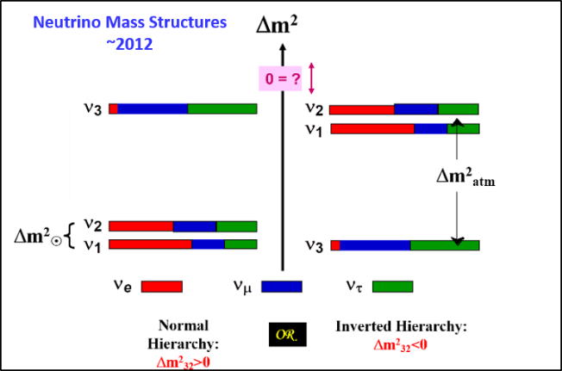
Dark Matter ProblemS are not NEW !!
Standard Model of Elementary Particles (2012)

Slide 10
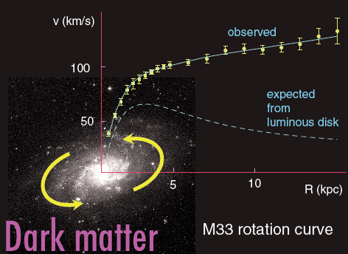
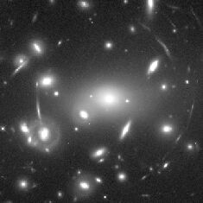
Evidence for Dark Matter
Length Scale
Spiral galaxies
  Rotation Curve
    Missing Ω (Galactic)
Clusters & Superclusters
  Gravitational Lensing
    Missing Ω (Cluster)
Large Scale Structures
  Cold Dark Matter
CMB Anisotropy
  Ω_{total} ; Ω_{baryon} (cosmological)
Big Bang Nucleosynthesis
  Constrain Baryon density

Slide 11
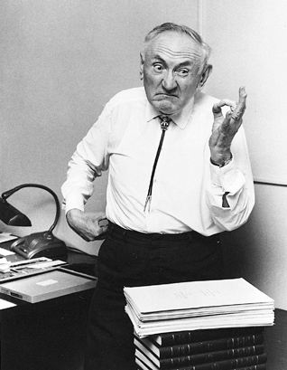
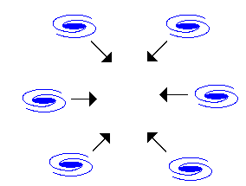
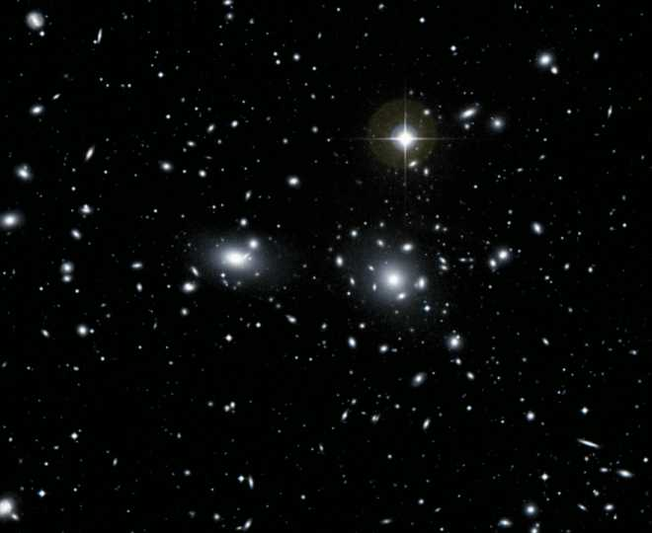
Dark matter in clusters
Zwicky, 1933
Zwicky
Mass of luminous matter
=
10%
Gravitational mass
Amas de Coma

Slide 12
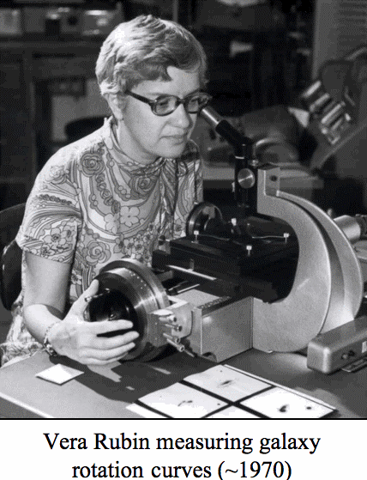
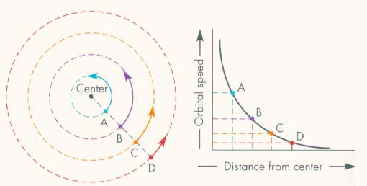
Evidence for Dark Matter
1 parsec = 3.26 light years
Spiral Galaxies Rotation Curve
    Gravitational Mass Ω_{mass}
        > Luminous Mass Ω_{lum.}
    Missing Ω (Galactic-kpc)

Slide 13
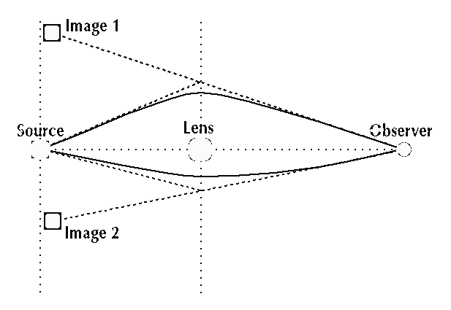


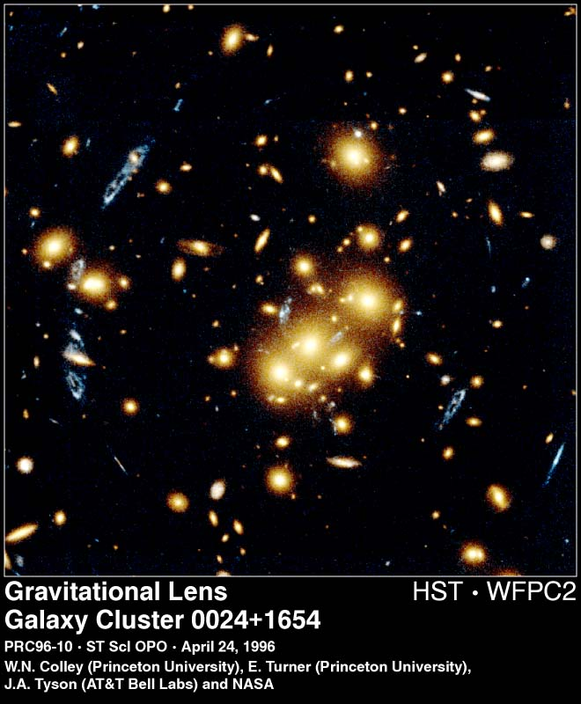
Clusters & Superclusters
  Gravitational Lensing
    Grav. Mass > Lum. Mass
        ！ Ω_{mass} > Ω_{lum.}
    Missing Ω (Cluster-Mpc)

Slide 14
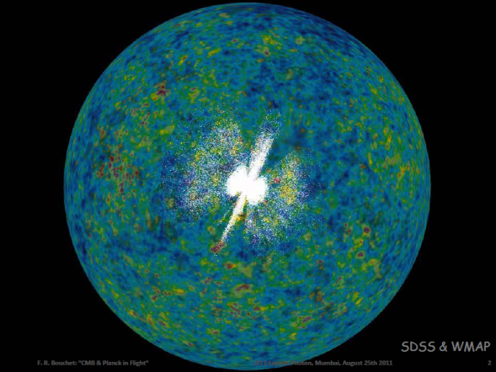
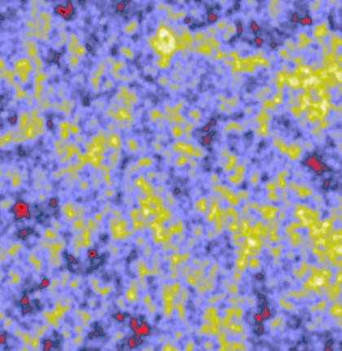
Large-Scale Structures & Cosmic Microwave Background sensitive to initial fluctuations & their evolution - which depends on nature of DM @ cosmological scale.
t = 10⁻³⁵ s
Density perturbations (inflation?)
t ~ 1 mn
Nucleosynthesis
observable
t ~ 300000 yrs
Recombination: p+e⁻ → H+γ
Matter:
Gravitational collapse
Photons:
Free propagation
observable
observable
CMB : “background” @
T₀ = 2.7 K NOW
Galaxies, clusters

Slide 15
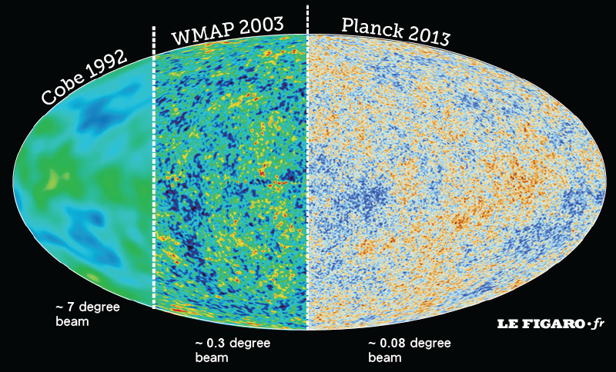

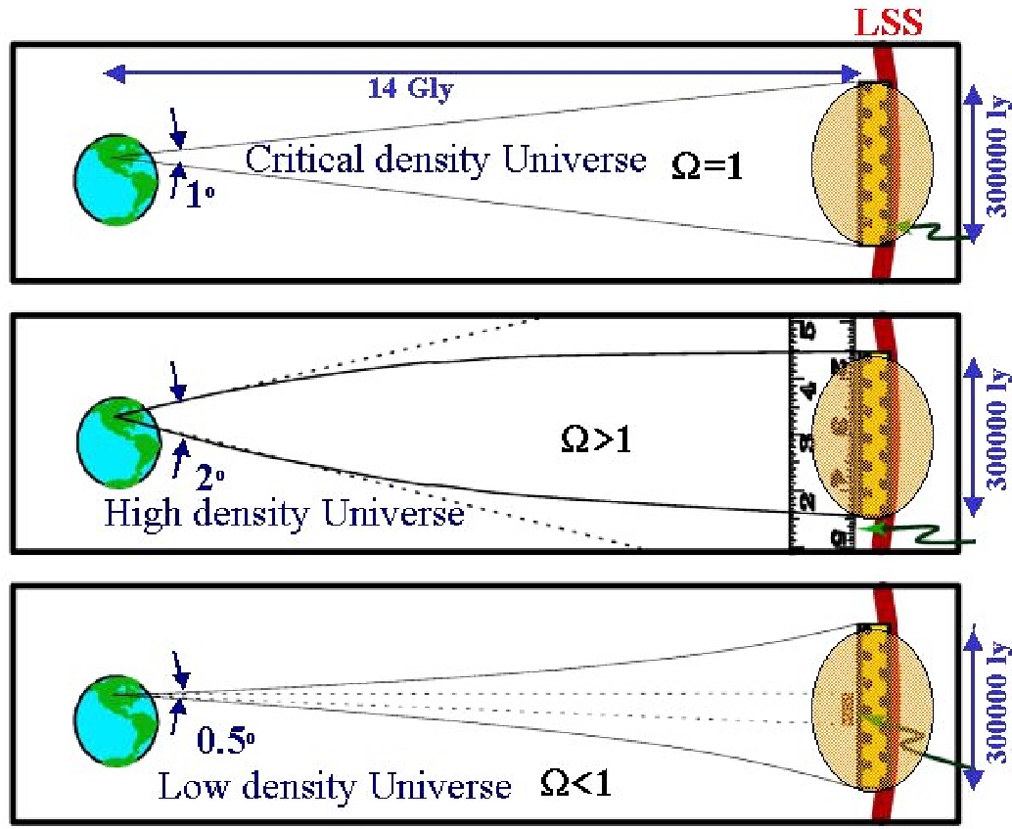
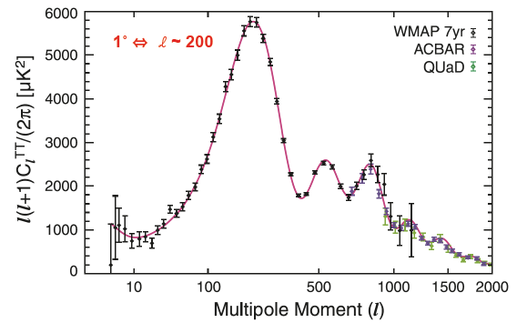
CMB Power Spectrum: Ω_{total} > Ω_{mass} > Ω_{baryon}
⇒ Exotic Dark Matter
Ω_{mass}
Ω_{bary}
Ω_{total}

Slide 16
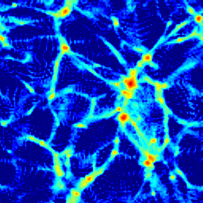
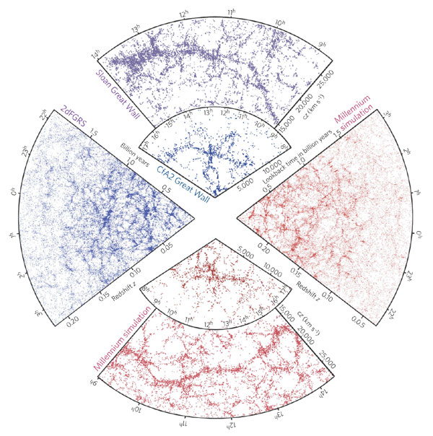
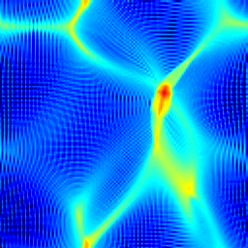
Structure Formation of the Universe
  ⇨ Distribution of Density Fluctuations (Power Spectrum)
CDM Universe
HDM Universe

Slide 17
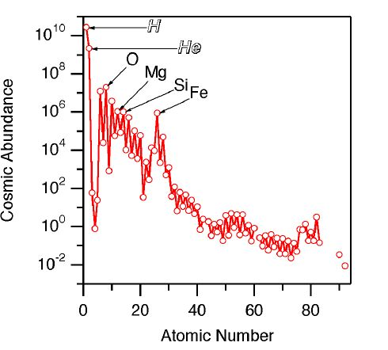
Origin of elements
Big Bang Nucleosynthesis
Big Bang Nucleosynthesis
Hot Stars
Supernova Explosions
Cosmic Ray Interactions

Slide 18
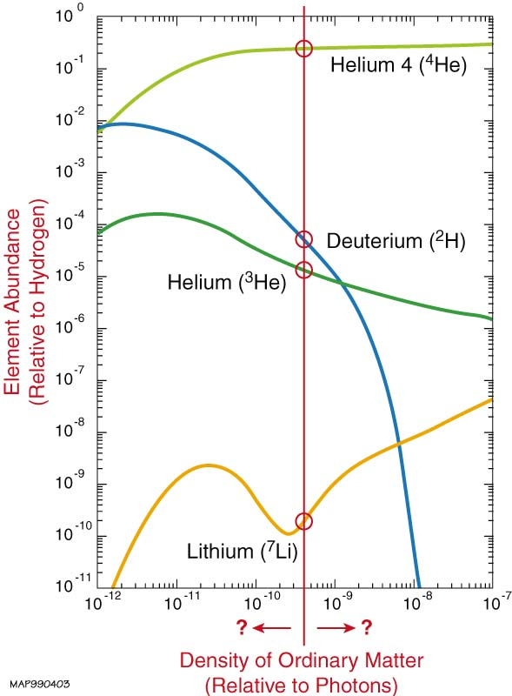
Primordial Abundances Constrain Baryon Density
Observational concordance
Agreement of abundances
over 10 orders of magnitude
⇓
Major success of Big-Bang
CMB: n_{γ} = 411 cm⁻³
η = n_{B}/n_{γ} = (4±1).10⁻¹⁰
ρ_{B}
n_{B}m_{B}
Ω_{B} = =
ρ_{c}
3H²/8πG
η
  Ω_{B} < Ω_{Mass} ⇒Exotic Dark Matter

Slide 19
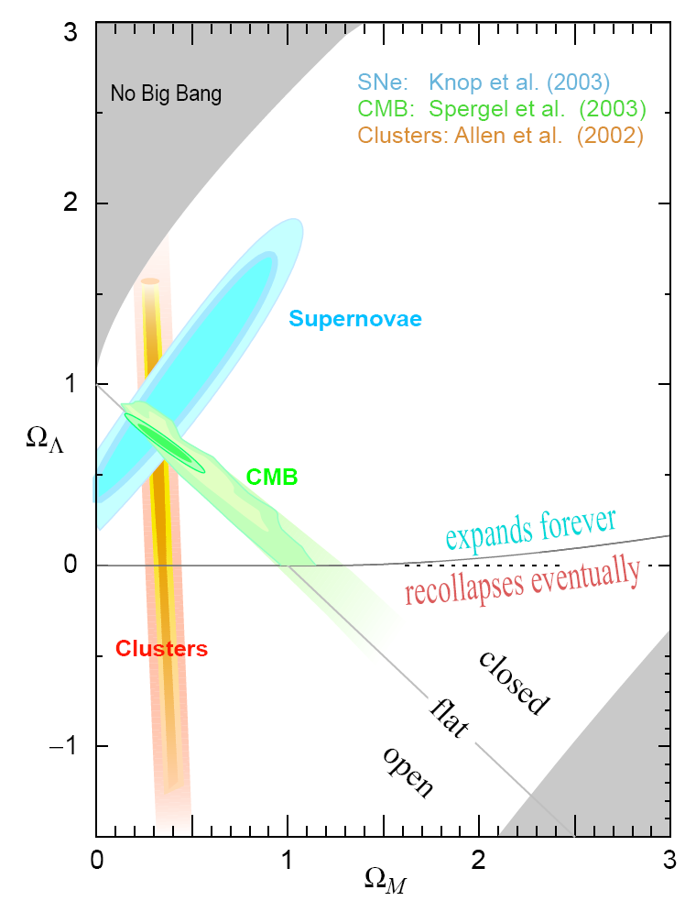

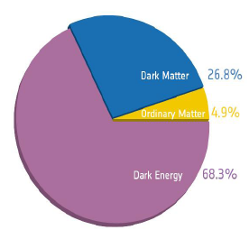

Crisis/Opportunities of Basic Science
  Ω_{total} ≅ 1 > Ω_{mass} > Ω_{baryon} > Ω_{luminous}
Dark Energy
Dark Matter

Slide 20

Identification of Dark Matter
『暗物質是甚麼、其特性如何』仍有很多猜想、距離答案還遙遠
Still far from having the “Periodic Table”, even the definite direction

Slide 21
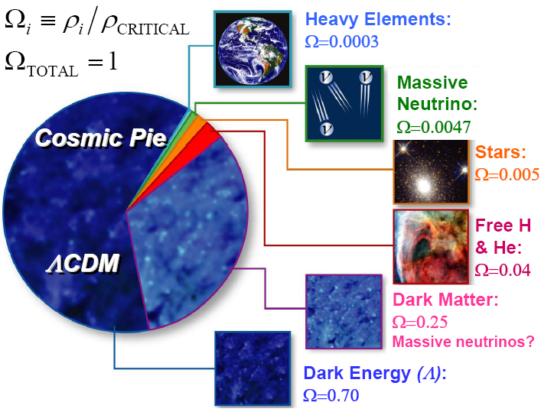
at least as much neutrinos by mass as visible matter !

Slide 22
Dark Matter Current Wisdom:
Gravitationally bounded in galactic halo
Velocity distribution being Maxwellian
Properties of a Good Cold Dark Matter Candidates:
stable (protected by a conserved quantum number)
no charge, no colour (weakly interacting)
cold, non-relativistic (mass >> kinetic energy)
relic abundance compatible to observation
motivated by theory (vs. “ad hoc”)

Slide 23
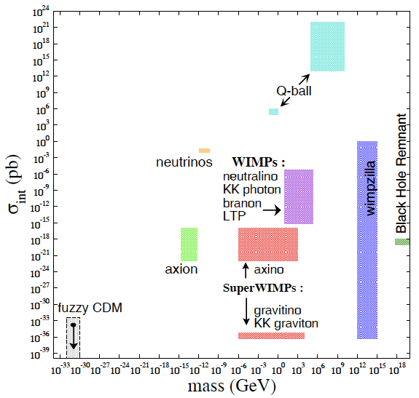
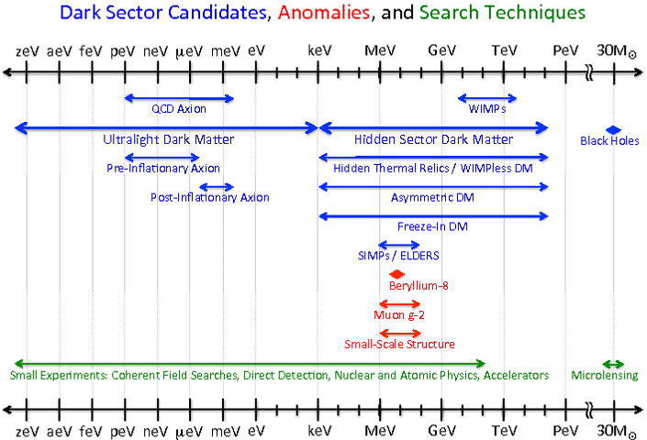
(Incomplete) List of CDM candidates [按牌理的理論猜想]
CDM Candidates
Most Experimental Programs focus on the Search of WIMPs [λCDM]
ASSUMING!!
Key Variables [參數/指標] :
  Mass [質量] & cross-sections [作用機率]
WHY this is mainstream ?
(Benefits or Burden) of Success of SM [成功的擔子]
Look where we are able to [舒適圈]
⇨ Natural (and Human!)

Slide 24
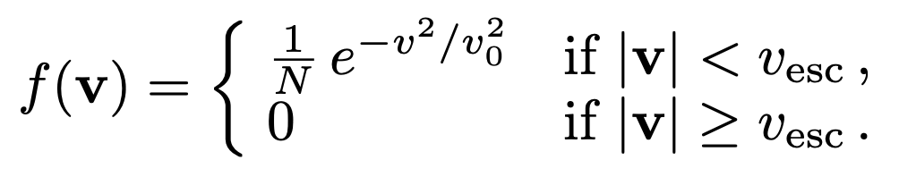
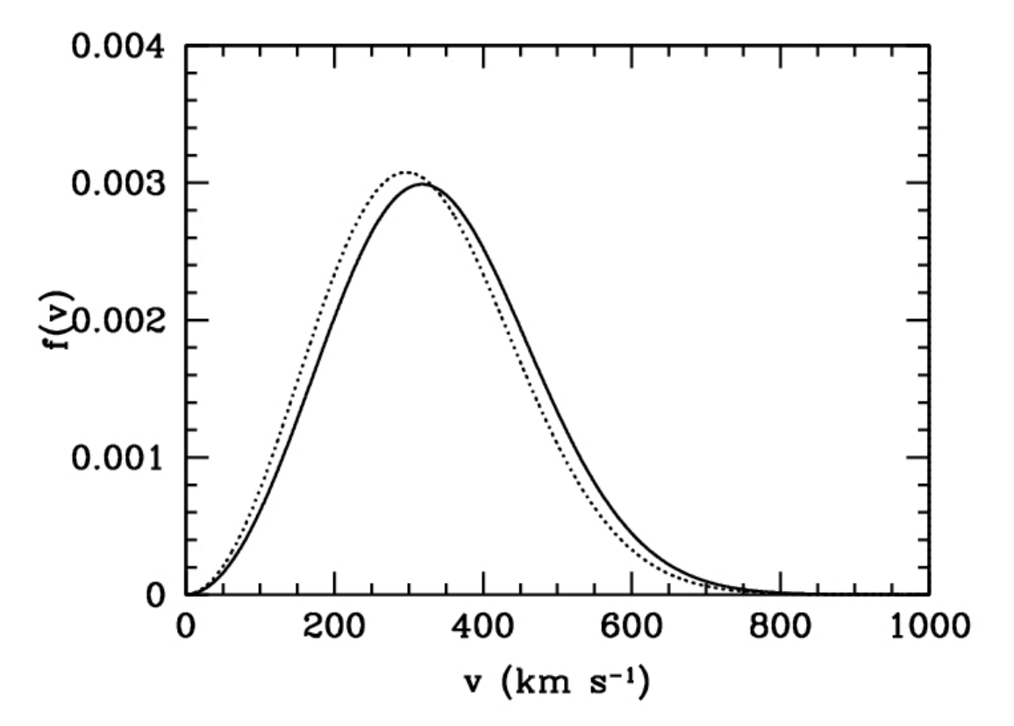
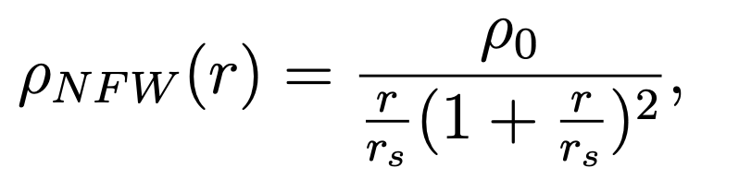
Standard Halo Model
Dark Halo Density & velocity distributions, connected via gravitational effects
Assume isotropic, isothermal sphere of collisionless particles with
    density profile ρ(r) ∝ 1 / r²
    Velocity profile:
e.g. Navarro-Frenk-White (NFW) profile predicts the density distribution with N-body simulations:
i.e. [300,000 / X ] WIMPs / m³ at m_{χ}=X GeV
v_{esc} -- escape velocity 650 km/s
v₀ -- circular rotation speed 220 km/s
winter
summer
ρ₀ -- 0.3 GeV/cm³
r_{s} -- radius scale

Slide 25
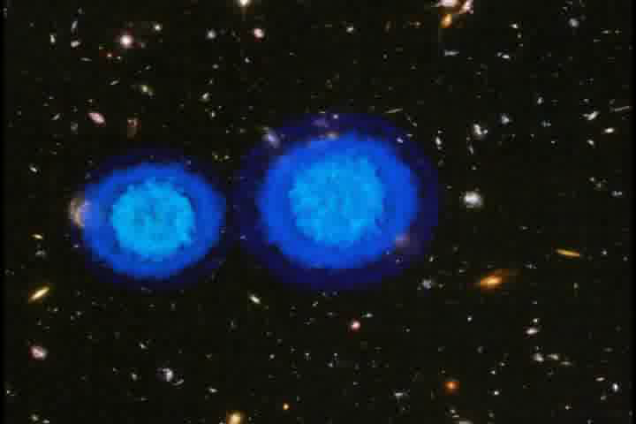
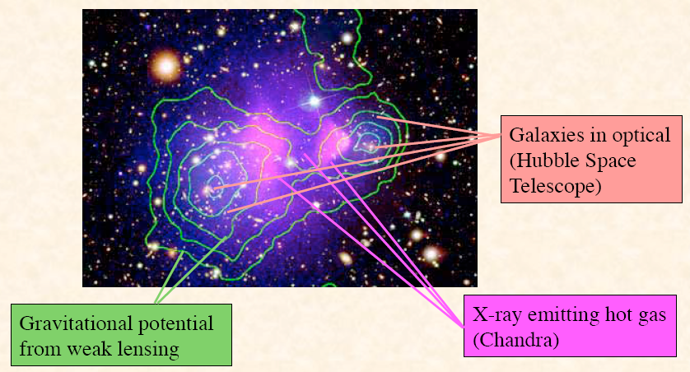
Dark Matter is DARK (not interacting electromagnetically) And NOT Modified Gravity (at present sophistication) …….
Is Gravity Reeeally Ruled Out …..??

Slide 26
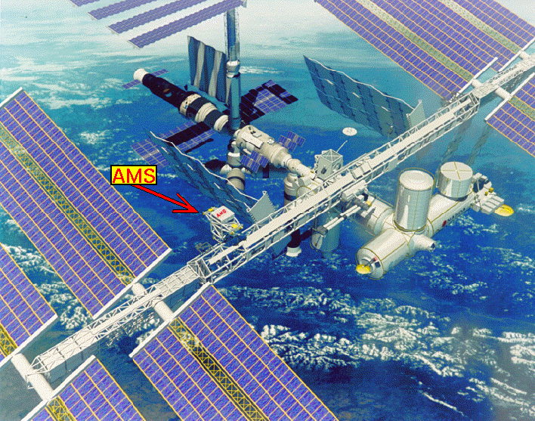
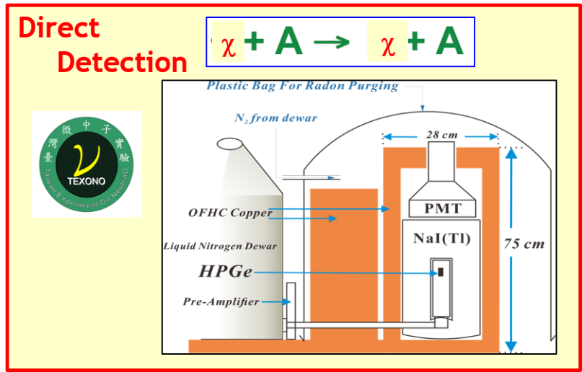
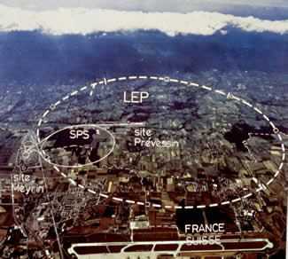
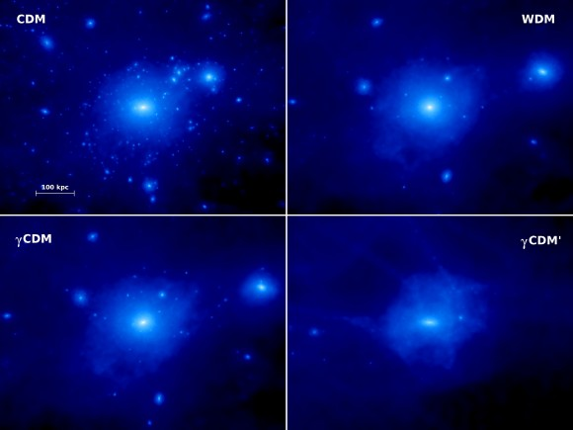
WIMP Dark Matter Detection
Indirect Detection
DM
SM
New Physics?
Direct Detection
Production
DM
SM
+ Emerging : Probing DM Particle Physics Interactions with Astro/Cosmo/GW Data

Slide 27
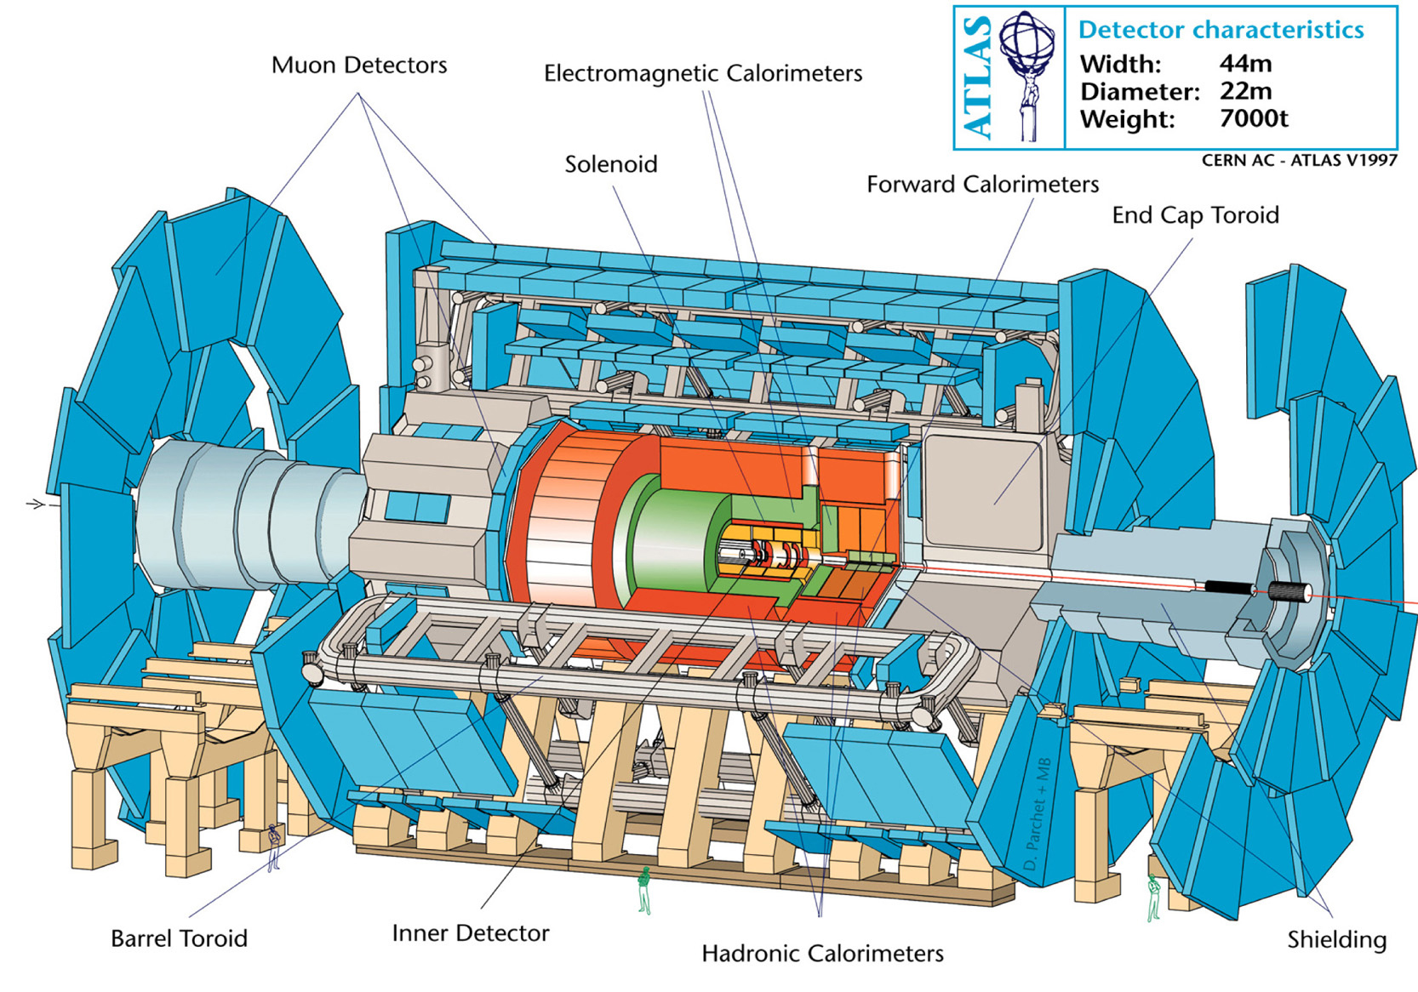
歐洲粒子物理研究中心(CERN)ATLAS實驗
Idea of Particle Search at Accelerator Experiments
本所參加

Slide 28
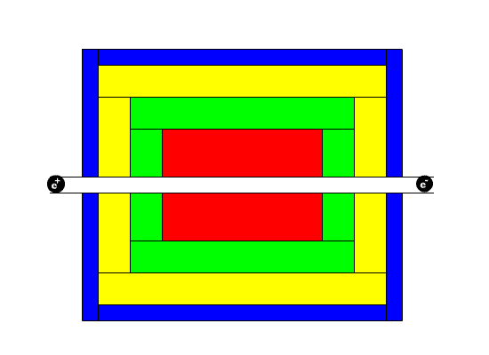

e⁺e⁻ ➔τ⁺τ⁻
e⁺e⁻➔μ⁺μ⁻
e⁺e⁻ ➔ qq
e⁺e⁻ ➔e⁺e⁻

Slide 29




Control Room
Event Display
Top View

Slide 30


Indirect Detection of WIMP
through their annihilation products
Signals ⇨ high-energy neutrinos, anti-protons, positrons & photons
Sources ⇨ Sun, Earth, Galactic Center, Milky Way Halo, Stars, External Galaxies
HE neutrinos from Sun/Earth or anomalous γ-rays peaks (E,θ) ⇨ smoking gun signatures
Anomalous spectral distributions of e⁺, p-bar, γ etc. ⇨ dependent on background models

Slide 31


May 16, 2011

Slide 32




Anomalous Cosmic Positron Spectrum
！ Consolidated by latest results from PAMELA, Fermi , AMS-02
Fermi
PAMELA
Background
Astrophysical Primary sources or WIMP-induced ??

Slide 33



Super-Kamionkande
※ Water Cerenkov detector: 50k tons, viewed by 11,000⁺ Φ=50 cm PMTs in 1000 m underground site in central Japan
※ Physics: solar n, atmospheric ν , long baseline accelerator ν, proton decays ..

Slide 34



SK sub-GeV events from atmospheric ν interactions
e-ring from ν_{e}N
μ-ring from ν_{μ}N
NC events with π⁰ → 2γ
WIMP Search : Look for ν→μ events from the Sun’s (or Earth’s) direction

Slide 35



WIMP Direct Detection
December
60°
30 km/s
June
~ 232 km/s
30 km/s
Elastic recoil of non relativistic halo WIMPs off the nuclei
Both Spin-Independent (~A²) and Spin-Dependent [~(J+1/J) ] Couplings
Recoil energy of the nucleus in the keV range
Annual modulation effect due to the rotation of the Earth around the Sun
Directional Recoils, experimentally challenging

Slide 36
Detector Techniques - Present Focus : Nuclear Vs Electron recoils
WIMP
Background
E_{ionization}
HPGe expts: TEXONO, CDEX, CoGeNT
CDMS II, EDELWEISS I
Signal
CDMS II, EDELWEISS II
E_{phonons}
Ionization
10% energy
ZEPLIN II/III/Max, XENON, LUX, WARP, ArDM
Picasso, Simple, Coupp
(superheated)
Target
Phonons/heat
100% energy
slowest
cryogenics
Light
Background
E_{light}
DAMA/LIBRA
KIMS
ZEPLIN-I,
DEAP, CLEAN, XMASS
1% energy
fastest
no surface effects
CRESST II
Signal
WIMP
E_{phonons}
◎ Future : Lower Threshold ; Direction Sensitive

Slide 37
Nuclear Recoils : Kinematics and Rates …
Reduced mass
Maximal E_{R} ∼ ½ m_{χ} v_{χ}²
@ m_{N}∼m_{χ}

Slide 38
Different Target
Different WIMP mass
Different Threshold

Slide 39
Electron “Recoils”
χ + A → χ + A⁺ + e⁻
Experimental signature: electron “recoils”
Observable Energy too low for elastic scattering with free electrons
Atomic physics inelastic processes provide larger signals ∼ ½ m_{χ} v_{χ}²
To probe m_{χ}<0.1 GeV, require new detector techniques <100 eVee

Slide 42
Twists/Complications in Reality:
Different possible Particle Physics Interactions (“Effective Theory”); Benchmark is “Spin-Independent” with A² dependence due to QM coherency.
Nuclear many body response “Nuclear Form Factors“, incomplete coherency at large energy transfer
Atomic physics response: esp. in WIMP-electron scattering.
  ⇨ Inelastic processes: absorption, ionization, excitation, dissociation ….
Detector response,
  different for electron and nuclear recoils as they move through the detector media, e.g. as “NR Quenching Factor”, “channeling” in crystal scintillators, complications in semiconductors, superconductors, superfluids …
  different in ionization (electron-holes), phonon and photons, & their inter-relations.
Background severe at the expected low event rate.

Slide 43
Quenching Factor: Detector (Ge) response to nuclear recoil relative to electron recoils at the same energy deposition

Slide 44
Migdal (& Bremsstrahlung) Effects – Higher Order Inelastic Scattering in Nuclear Recoil
Ge Ionization
Atomic electrons do not follow instantaneously the motion of recoiling nucleus in DM+N scattering
Finite time necessary for electrons to “catch up”, resulting in possible ionization and excitation in that atom ⇒ inelastic processes
Energy loss E_{EM} with electromagnetic signatures, in addition to E_{NR} for nuclear recoil.
Small probability but enhance total energy loss to above detector threshold for light DM
Energy boost esp. significant for E_{ER} with quenched signals.

Slide 45
Up-scattering by Cosmic-Rays
Cosmic-Ray DM scattering boosting DM-kinetic energy
DM-Detector interactions provide (much) larger deposited energy
Large target mass neutrino detectors can place constraints
Can probe very low mass
m_{DM} < keV
MiniBooNE
XENON-1T

Slide 46
χN-Spin-Independent Constraints – Future [ Schumann, TAUP-2021 ]
quality
Detector requirements
mass
Semiconductor Experiments
Low Detector Threshold (→ 10-100 eV)
  … and Beyond for Future!!
Liquid Noble Gas Experiments
⇨ Large target mass (→ ton) with low (→ 0) Background

Slide 47



Brief Touch on Selected Experiments: Themes of Lecture II
DAMA/LIBRA
NaI(Tl) Scintillator at Gran Sasso : total 0.29+0.87 ton-year data
Observe annual modulation in the 2-6 keV single-hit signal band, total 11 cycles, > 8σ
No modulations at higher energy & for multiple-hits

Slide 48






Slide 49





Measure: photons & ionization

Slide 50








Advancing sub-keV Ge ionization detectors; Opened windows of Light DM Searches
CDEX-1
As Ge-Array -- important stage towards large-scale Ge experiment
Novel -- Directly immersed into liquid nitrogen for cooling;

Slide 51


Recall Lessons from History
[十九世紀數據偏離標準模型的故事]
Anomalies in “Precision Measurements” in Planetary Orbits Vs Newton’s “Standard Model” Theory of Gravitation in the 19th Century
  Irregularities of Uranus’s Orbit
  Solution [Alphabet]
    Prediction [1845, Verrier, Adams] AND THEN
      Observation [1846, Galle ….] of Neptune
  Anomalous Perihelion Precession of Mercury [1859, Verrier]
  Solution [Grammar]
      General Relativity [1915, Einstein]
  BUT …. History was …..
  “Vulcan (Hypothetical Inner Planet) Theory” [~1860, Verrier]
  and …... World-Wide Searches …
  + Multi Observation Claims & Refutations [1859-1908 ]
[ Sooooo…. Natural & Human !!! ]
天皇星的軌跡
海皇星的發現
水星的軌跡
不按牌理
相對論的發現
按牌理

Slide 52




From Science History to
Popular Culture ……

Slide 53




TEXONO-CDEX Collaboration
TEXONO [since 1997] :
◉ Neutrino Physics at Kuo-Sheng Reactor Neutrino Laboratory (KSNL)
  Taiwan (AS,NCU,NDHU,INER,KSNPS)
  Turkey (METU,DEU)
  India (BHU,CUSB,GLAU,)
CDEX [birth 2009] :
  Dark Matter Searches at China Jin-Ping Underground Laboratory (CJPL)
    China (THU,CIAE,SCU,BNU,NKU,EHDC)
Taiwan EXperiment On NeutrinO
TEXONO 2019
China Dark Matter EXperiment
CDEX 2018
Research Program: Low Energy Neutrino and Dark Matter Physics

Slide 54





Kuo Sheng Reactor Neutrino Laboratory [KSNL]
28 m from core#1 @ 2.9 GW
Shallow site : ~30 mwe overburden
~10 m below ground level

Slide 55



Front View (cosmic vetos, shieldings, control room …..)
Configuration: Modest yet Unique
Flexible Design: Allows different detectors conf. for different physics
Inner Target Volume

Slide 56






Baseline Hardware Design [Both TEXONO@KSNL & CDEX-1@CJPL]
4x5g ULEGe
p- PCGe
[500g – 1 kg]
p⁺
n⁺(~1mm Li diffused)
n- PCGe
[500 g]
n⁺
p⁺(~0.5 μm Boron implanted)
500 g
Electro-Cooled p-PCGe [1430 g]

Slide 57

Neutrino Properties & Interactions at Reactor
quality
Detector requirements
mass
Observable Spectra with Reactor Neutrino “Beam”
ν-e Scattering SM [PRD10] & NSI/BSM [PRD10,PRD12,PRD15,PRD17]
⇨ 200 kg CsI(Tl)
Magnetic Moments
  [PRL03,PRD05,PRD07]
⇨ 1 kg HPGe
Reactor Neutrino Spectrum
Threshold ~ 100 eV
Neutrino Milli-charge [PRD14]
⇨ sub-keV O(kg) PCGe
νN Coherent Scattering [Current Theme;PRD16,PRD21]
Pioneered sub-keV O(kg) ULEGe / PCGe [MPLA08, NIMA16]
  Light Dark Matter Searches @ KSNL [PRD09,PRL13,AP14,PRD19]
  CDEX DM Program@CJPL [PRD13………]
  Theory Program [PLB14………]
sub-keV PCGe

Slide 58
TEXONO Theory Program [AS, NTU, NDHU, UCSB, DEU, SCU …… ]
Connecting the Dots:
  TEXONO & CDEX detector frontiers in low (sub-keV) energy
    ➔ atomic physics range
  Studies of EW/BSM physics
    understanding of the detection many-body physics
    state-of-the-art techniques in atomic, nuclear & QCD physics.
  i.e. ν(χ,α) A instead of ν(χ,α) N or ν(χ,α) e
Selected Highlights:
Identified Pole structures, Cross-section enhancement, Smoking-gun signatures in:
  milli-charged ν interactions: ν (δ_{Q}) + A [PRD 14]
  DM-_{n} (NR) transitive-μ_{ν} interactions: ν_{DM} + A → ν_{SM} + A⁺ + e⁻ [PRD15]
  DM-ALP (NR) Inverse Primikoff scattering: a_{DM} + A → γ + A⁺ + e⁻ [arXiv:2206.07878]
Identified universal parameter to quantify QM-coherency in νN_{el} [PRD16,PRD21]

Slide 59





Merits: 2400+ m rock overburden ; drive-in road tunnel access ; superb supporting infrastructures
CJPL-I (2010): 6X6X40 m cavern
CJPL-II (2018+) : [ 4X(14X14X130 m) Halls ] + Pits
CDEX Dark Matter Program
  Based on sub-keV Ge detectors
  May well evolve back into neutrino physics
CJPL-I

Slide 60


CDEX-1
CDEX-10
As Ge-Array -- important stage towards large-scale Ge experiment
Novel -- Directly immersed into liquid nitrogen for cooling;

Slide 61

Selected Recent Results ……

Slide 62
CDEX Exotic BSM Analysis Results:
σ_{χN} SI [ Migdal & AM ] [PRL19]
Dark Photon Searches [PRL20]
Axion-Like-Particles (ALP) & Bosonic Vector DM [PRD17,PRD20]
χ-N Effective Field Theory Constraints [SCPMA21]
Earth Shielding Effects [PRD22]
Boosted Dark Matter by Cosmic-Rays [PRD22]
χ-e scattering [PRL22]

Slide 63


CJPL-II
~500m west to CJPL-I
Construction started 2014
Rock Excavation completed May 2016
To be Commissioned Soon…
Four 14m*14m*130m Main Halls
Two Pits: (1) 18(φ)X18(H)m ;
(2) 27(L)X16(w)X14(D)m
Total space: ~300K m³

Slide 64




Prospects of CDEX @ CJPL-II : Ge1T Project
Next: 300-kg 0νββ (towards IH) ; 50-kg DM (@ 0νββ bkg spec) (2028)]
Visions: Ge-1T (2033) → Ge-10T (2040) 0νββ (towards NH)
CJPL-II Hall-C (Half) + Pit
14m(H) X 14m(W) X 65m(L)
Pit & Cryostat 2020
Pit Construction 2016
Artist’s Conception

Slide 65







Mastering Key Technologies towards Ge-1T
⁷⁶Ge enrichment (acquired: 200 kg @ CJPL)
Ge purification and crystal growth;
HPGe detector fabrication;
Ultra-low background VFE-ASIC and FADC;
Ultra-pure Cu for structure and cables;
Large-volume cooling tank “cryostat”

Slide 66

Prospects & Outlook
Missing Energy Density [Ω_{SM}<Ω_{Total}] Problem is compelling.
Solution…s are natural (best-efforts/intentions/comfort zones) extensions of our tools & expertise.
Intense (+ intellectually captivating & engaging) world-wide activities on Dark Matter searches.
Surprising development likely – Science & Appl. Tools
Stay Tuned & Get Prepared

Slide 67



How Science Makes Progresses …
To Ponder : Which is the Most Important Ingredient of the Scientific Enterprise ?
Have Faith in the Power of Scientific Investigations
and the Prowess of Scientific Investigators !

Slide 68



期待：依然精彩
High on My Bucket List !
朝聞道 ……
!?!
“ ……The Powerful Play Goes On,
and You May Contribute a Verse .” [Whitman]
  『…這撼人的戲劇持續上演，你可寫上其一詩句。』
Search & Enjoy .…. “ ipad your verse 2014 TV ad ” (1:31m)

