Slide 1
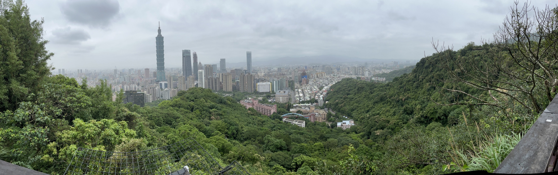




Double Beta Decay in Germanium
Ian Guinn
May 24, 2023
PIRE-GEMADARC Summer School
Taipei, Taiwan

Slide 2
Outline
What is neutrinoless double-beta decay? Why is it interesting?
How do we search for neutrinoless double beta decay?
Searching for 0νββ in Germanium: the current experimental landscape
A brief survey of low background experimental techniques

Slide 3
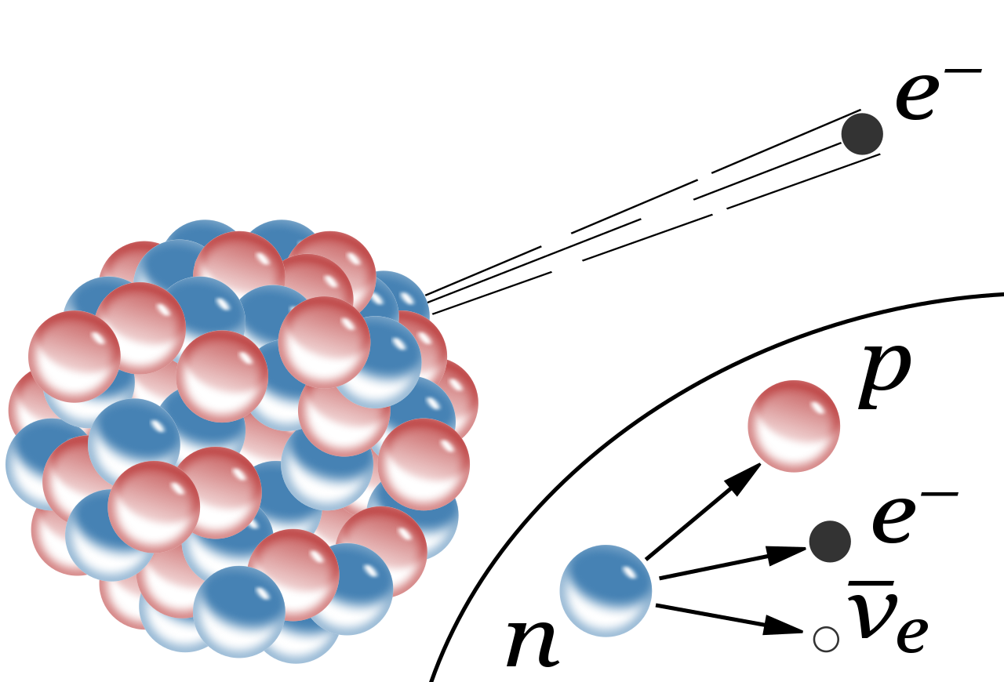
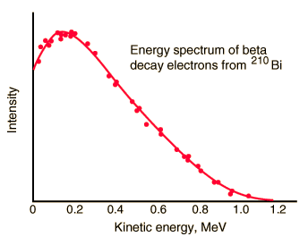
What is Double-Beta Decay?
Reminder: β⁻-decay
Neutron decays into a proton, electron and anti-neutrino
Broad energy spectrum because of “missing” energy in neutrino
Conserves
Energy+momentum
Angular Momentum
Charge
Lepton Number
From G. J. Neary, Proc. Phys. Soc. (London), A175, 71 (1940).

Slide 4
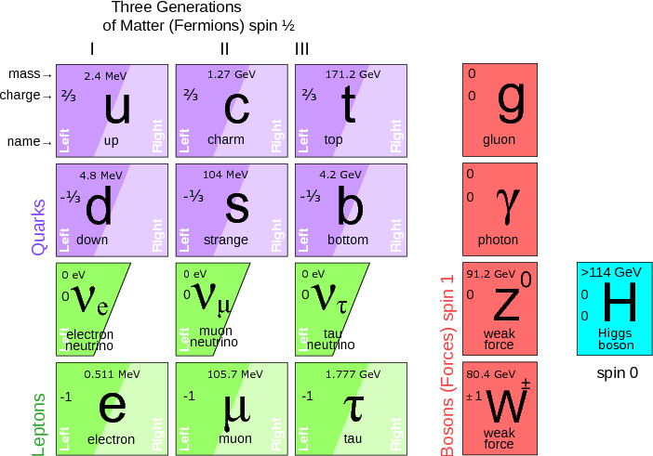
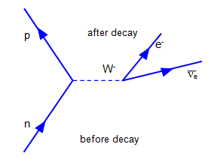
β-decay in the Standard Model
β-decay is moderated by the W-Boson:
Charged-Current Interaction
Conserved Lepton-number
and Baryon-number
Maximally parity violating
  We have never observed
  a right-handed neutrino!
M. Shaposhnikov, Neutrino physics within and beyond the three flavour oscillation, J.Phys.Conf.Ser. 408 (2013) 012015.

Slide 5
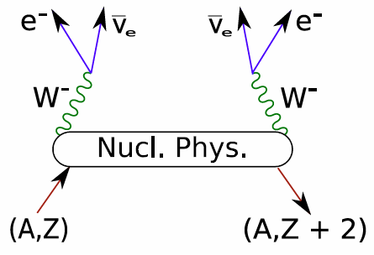
What is Double-Beta Decay?
ββ-decay:
2 neutrons decay into 2 protons,
2 electrons and 2 anti-neutrinos
Broad energy spectrum
Conserves
Energy+momentum
Angular Momentum
Charge
Lepton Number

Slide 6
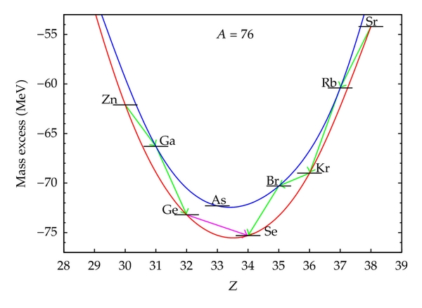
What is Double-Beta Decay?
ββ-decay is seen in even-even nuclei when single β-decay is energetically forbidden
Predicted by Maria Goeppert-Mayer in 1935
First evidence in 1950 from geochemical measurements; not directly observed until 1987
Typical half-lives are 10¹⁸ - 10²⁴ yrs
Related process of double-electron capture first directly observed in 2019
J. Menendez, (http://www.hindawi.com/journals/ahep/2012/857016/)
Proton Number

Slide 7
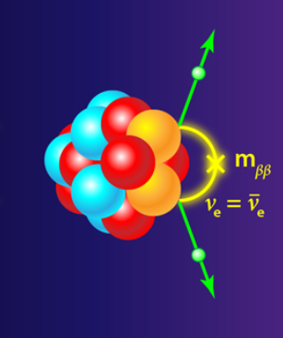
Neutrinoless Double-Beta Decay
0νββ-decay:
2 neutrons decay into 2 protons,
2 electrons and 2 anti-neutrinos
Broad energy spectrum
Predicted by Furrie in 1937, if
the neutrino is a Majorana fermion
Conserves
Energy+momentum
Angular Momentum
Charge
Lepton Number

Slide 8
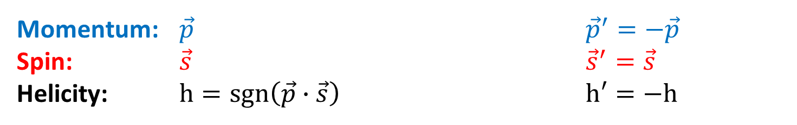
What’s a Majorana Fermion?
First: a thought experiment to demonstrate the relationship between mass and helicity for spin-1/2 particles:
In particle physics terms, this means that massive spin-1/2 particles must have a coupling between their left-handed and right-handed components
Lorentz Boost
Momentum: $\vec{p}$ ${\vec{p}}^{′}=−\vec{p}$
Spin: $\vec{s}$ ${\vec{s}}^{′}=\vec{s}$
Helicity: $h=sgn\left(\vec{p}∙\vec{s}\right)$ $h′=−h$

Slide 9
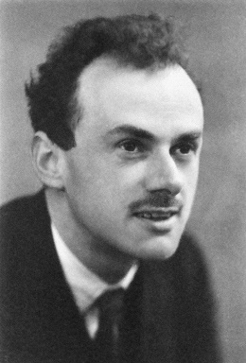
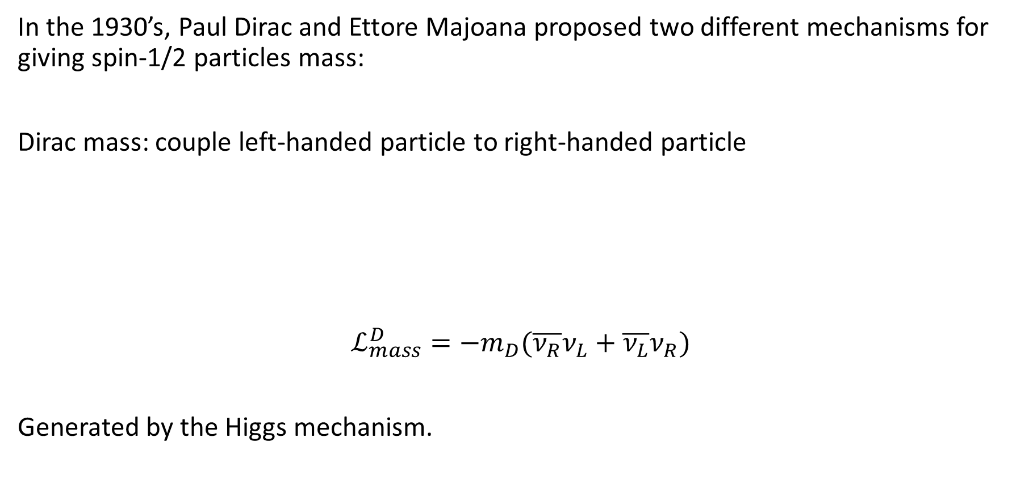



Where does neutrino mass come from?
In the 1930’s, Paul Dirac and Ettore Majoana proposed two different mechanisms for giving spin-1/2 particles mass:
Dirac mass: couple left-handed particle to right-handed particle
$$ℒ_{mass}^{D}=−m_{D}(\overline{ν_{R}}ν_{L}+\overline{ν_{L}}ν_{R})$$
Generated by the Higgs mechanism.
$$ν_{L}$$
$$m_{D}$$
$$ν_{R}$$
H (Higgs Boson)

Slide 10
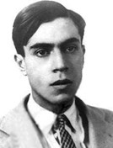

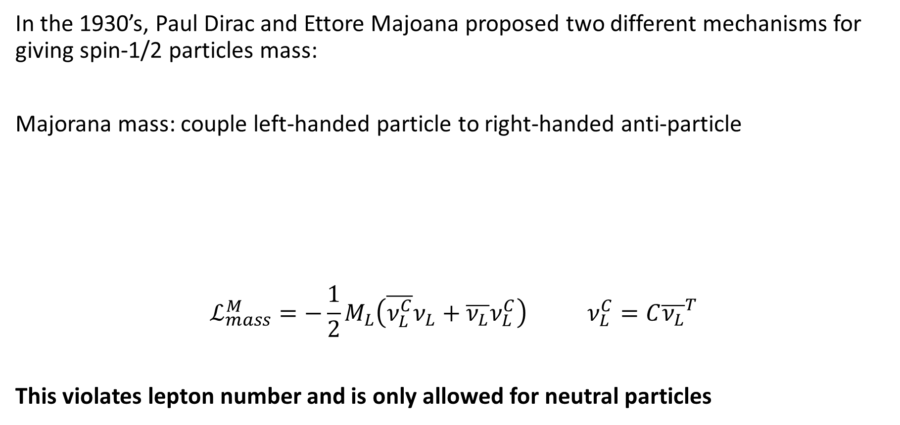


Where does neutrino mass come from?
In the 1930’s, Paul Dirac and Ettore Majoana proposed two different mechanisms for giving spin-1/2 particles mass:
Majorana mass: couple left-handed particle to right-handed anti-particle
$$ℒ_{mass}^{M}=−\frac{1}{2}M_{L}\left(\overline{ν_{L}^{C}}ν_{L}+\overline{ν_{L}}ν_{L}^{C}\right) ν_{L}^{C}=C{\overline{ν_{L}}}^{T}$$
This violates lepton number and is only allowed for neutral particles
$$ν_{L}$$
$$M_{L}$$
$$ν_{L}^{C}$$

Slide 11
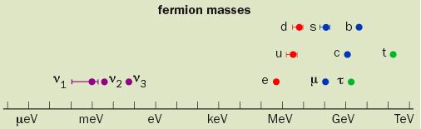
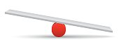

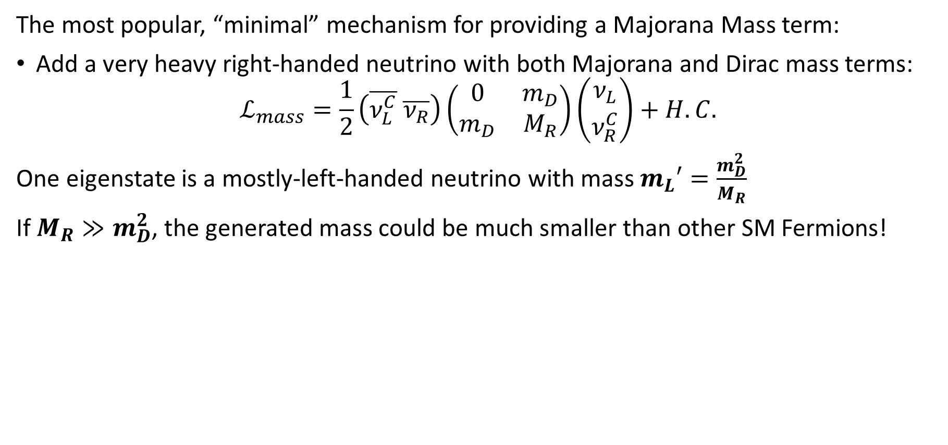
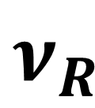
See-Saw Mechanism
The most popular, “minimal” mechanism for providing a Majorana Mass term:
Add a very heavy right-handed neutrino with both Majorana and Dirac mass terms:
$$ℒ_{mass}=\frac{1}{2}\left(\overline{ν_{L}^{C}} \overline{ν_{R}}\right)\left(\begin{matrix}0 & m_{D} \\ m_{D} & M_{R}\end{matrix}\right)\left({ν_{L} \atop ν_{R}^{C}}\right)+H.C.$$
One eigenstate is a mostly-left-handed neutrino with mass $m_{L}′=\frac{m_{D}^{2}}{M_{R}}$
If $M_{R}≫m_{D}^{2}$, the generated mass could be much smaller than other SM Fermions!
$$ν_{L}$$
$$ν_{R}$$
H. Murayama, Physics World (May 2002).

Slide 12
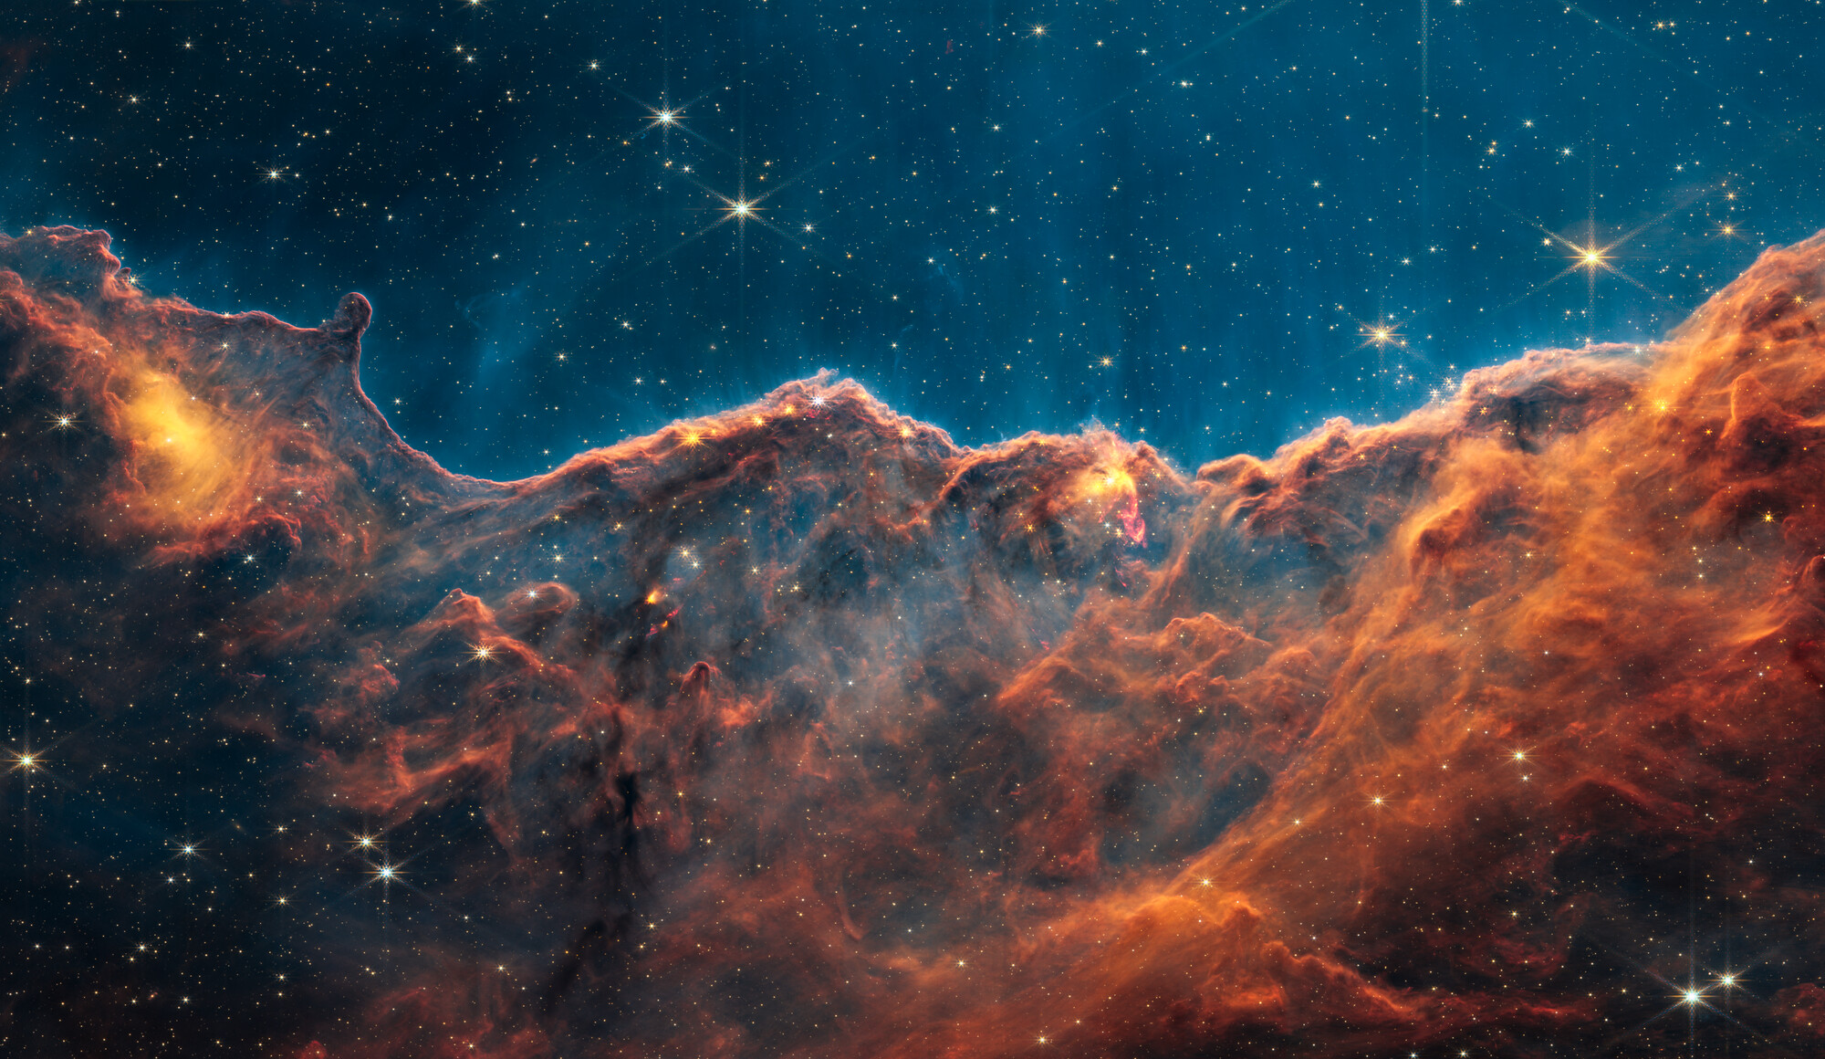
The Origin of Matter: Leptogenesis?
Why is there an asymmetry between matter and anti-matter in the universe?
To do this, we need to fulfill
the Sakharov conditions:
Violation of lepton/baryon number
C and CP violation
Thermodynamic disequilibrium
The Standard Model is insufficient!
Not enough CP violation to do this
with quarks
Could produce this via Leptogenesis
A Majorana mass generating mechanism at high energy scales could cause leptogenesis!
NASA, James Webb Telescope

Slide 13
Outline
What is neutrinoless double-beta decay? Why is it interesting?
How do we search for neutrinoless double beta decay?
Searching for 0νββ in Germanium: the current experimental landscape
A brief survey of low background experimental techniques

Slide 14
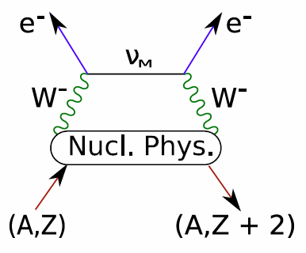
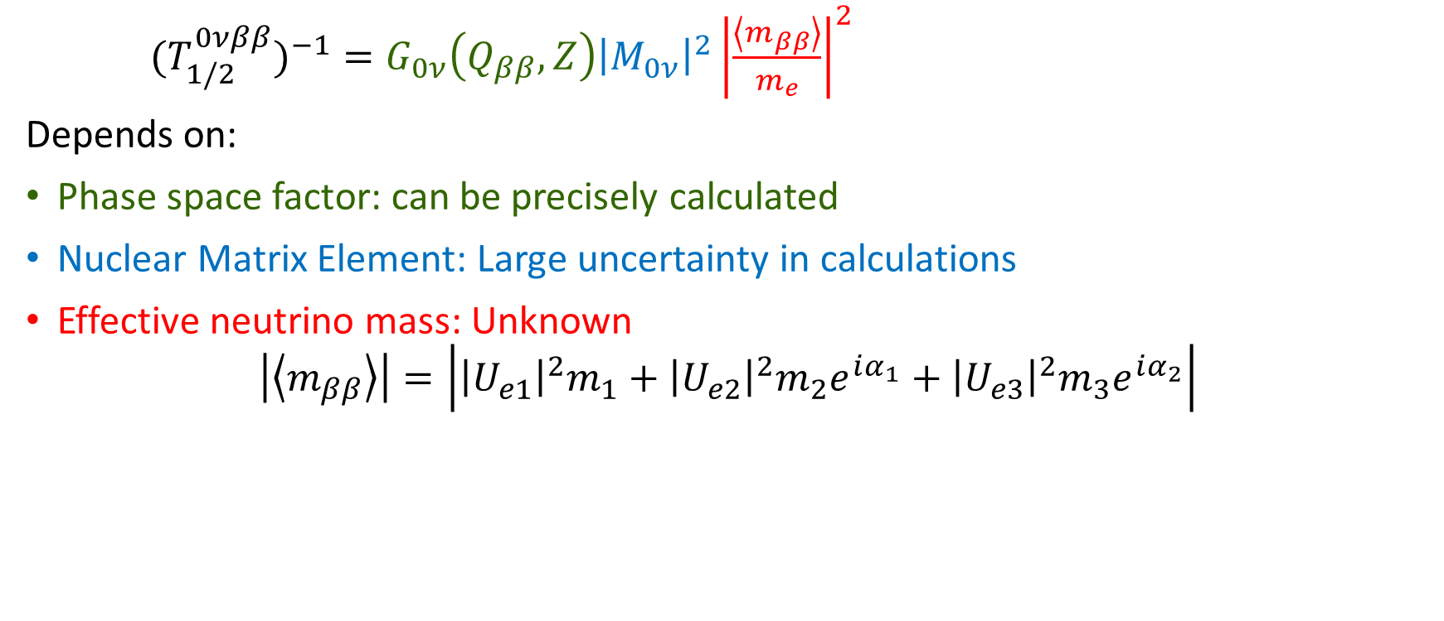
The half-life of 0νββ
$(T_{1/2}^{0νββ})^{−1}=G_{0ν}\left(Q_{ββ},Z\right){\left|M_{0ν}\right|}^{2}{\left|\frac{\left\langle m_{ββ}\right\rangle }{m_{e}}\right|}^{2}$
Depends on:
Phase space factor: can be precisely calculated
Nuclear Matrix Element: Large uncertainty in calculations
Effective neutrino mass: Unknown
$$\left|\left\langle m_{ββ}\right\rangle \right|=\left|{\left|U_{e1}\right|}^{2}m_{1}+{\left|U_{e2}\right|}^{2}m_{2}e^{iα_{1}}+{\left|U_{e3}\right|}^{2}m_{3}e^{iα_{2}}\right|$$
Mixing Angles: measured
Neutrino masses: scale and hierarchy unknown

Slide 15
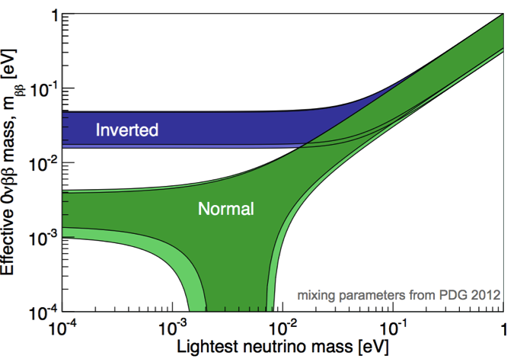
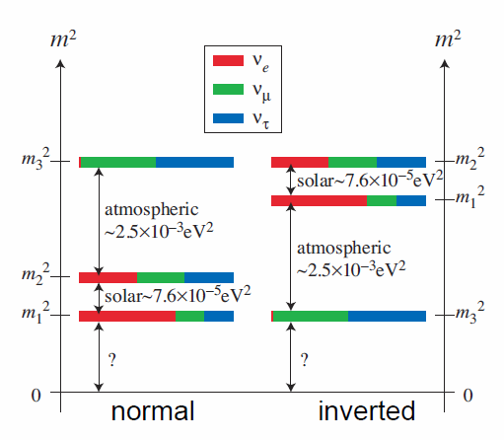

The Lobster Plot
The allowed values of $\left|\left\langle m_{ββ}\right\rangle \right|=\left|{\left|U_{e1}\right|}^{2}m_{1}+{\left|U_{e2}\right|}^{2}m_{2}e^{iα_{1}}+{\left|U_{e3}\right|}^{2}m_{3}e^{iα_{2}}\right|$
Exercise: Where do these shapes come from?
Figure courtesy of A. Schubert
Recall: there are two “mass orderings” that are consistent with current experiments

Slide 16






The Lobster Plot
The allowed values of $\left|\left\langle m_{ββ}\right\rangle \right|=\left|{\left|U_{e1}\right|}^{2}m_{1}+{\left|U_{e2}\right|}^{2}m_{2}e^{iα_{1}}+{\left|U_{e3}\right|}^{2}m_{3}e^{iα_{2}}\right|$
$${\left|U_{e3}\right|}^{2}m_{3}$$
$$\left|\left\langle m_{ββ}\right\rangle \right|$$
$$α_{2}$$
$${\left|U_{e2}\right|}^{2}m_{2}$$
$$α_{1}$$
$${\left|U_{e1}\right|}^{2}m_{1}$$
Figure courtesy of A. Schubert
Trick: add these together in complex-polar coordinates to deduce properties

Slide 17
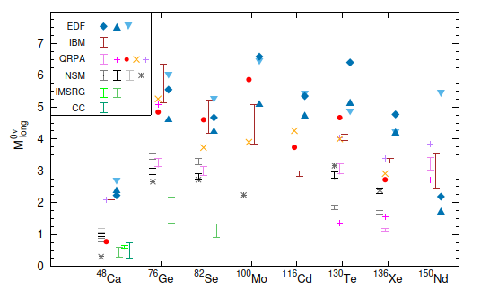
Nuclear Matrix Elements
Great uncertainty in theory estimation of half-life from nuclear matrix elements

Slide 18
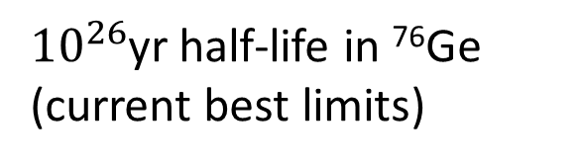
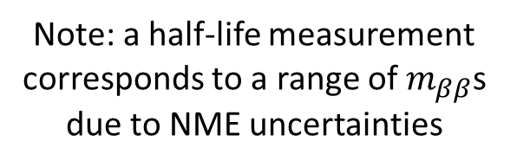
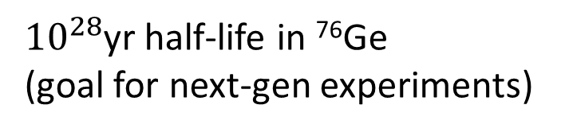
What Half-lifes are we looking at?
${10}^{26}$yr half-life in ⁷⁶Ge (current best limits)
${10}^{28}$yr half-life in ⁷⁶Ge
(goal for next-gen experiments)
Figure courtesy of A. Schubert
Note: a half-life measurement corresponds to a range of $m_{ββ}$s due to NME uncertainties

Slide 19
How do we measure a half-life?

Slide 20
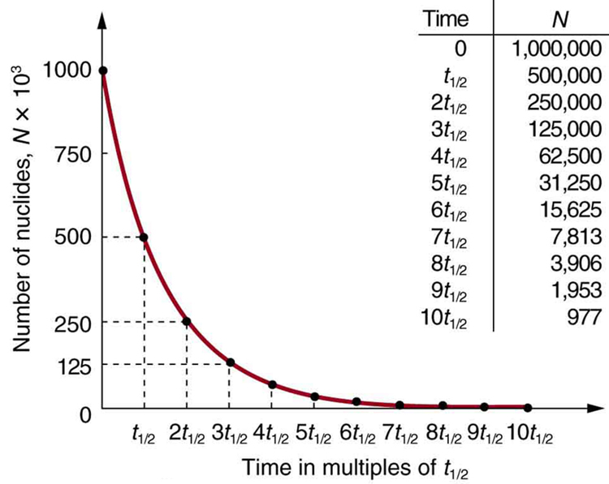
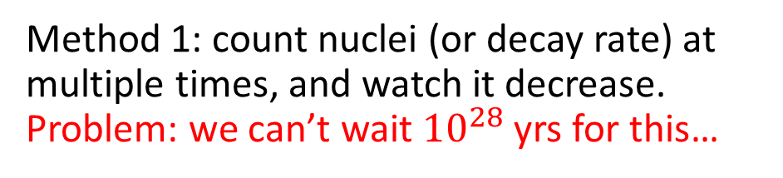
How do we measure a half-life?
Method 1: count nuclei (or decay rate) at multiple times, and watch it decrease.
Problem: we can’t wait ${10}^{28}$ yrs for this…

Slide 21
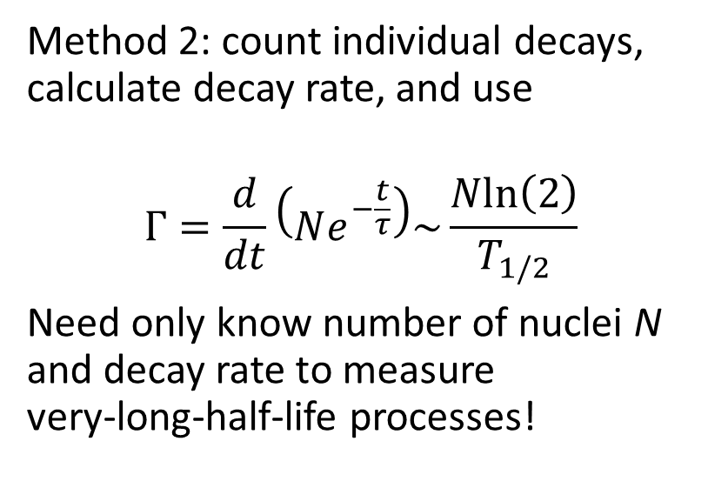
How do we measure a half-life?
Time
Method 2: count individual decays, calculate decay rate, and use
$$Γ=\frac{d}{dt}\left(Ne^{−\frac{t}{τ}}\right)\sim \frac{Nln\left(2\right)}{T_{1/2}}$$
Need only know number of nuclei N and decay rate to measure
very-long-half-life processes!
Method 1: count nuclei (or decay rate) at multiple times, and watch it decrease.
Problem: we can’t wait ${10}^{28}$ yrs for this…

Slide 22

How many events do we expect to see?
If we have a Ge detector with 25 kg of 76Ge, how many counts would we see on average in 1 year if the half-life were ${10}^{26}$ yr (assume perfect detection efficiency)?

Slide 23
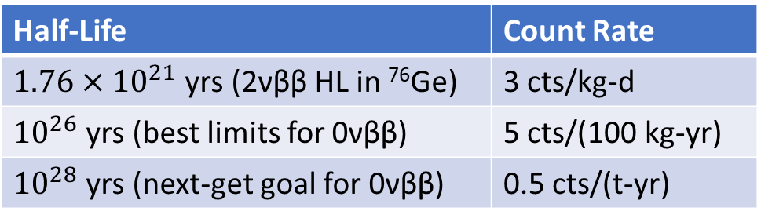
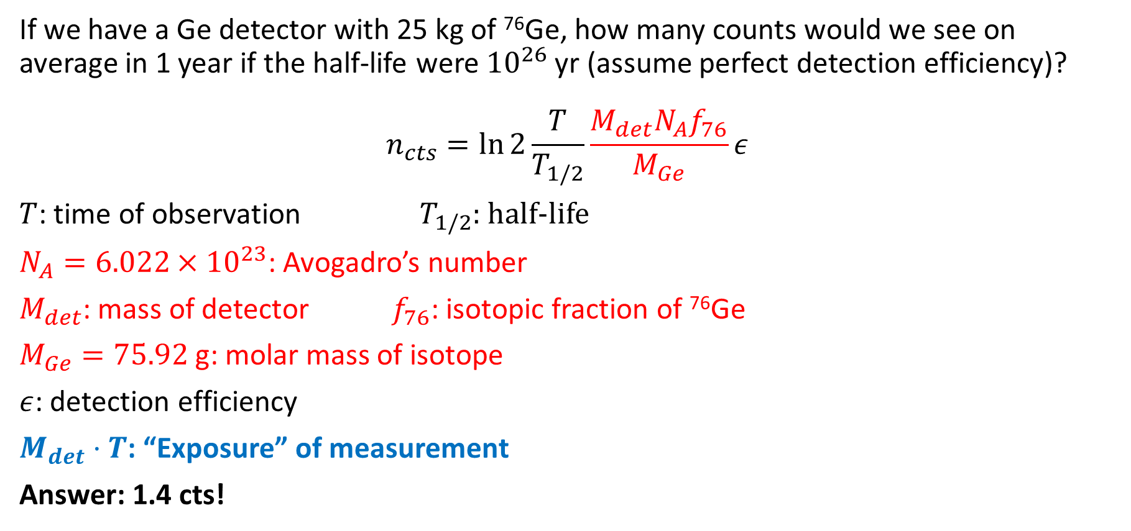
How many events do we expect to see?
If we have a Ge detector with 25 kg of ⁷⁶Ge, how many counts would we see on average in 1 year if the half-life were ${10}^{26}$ yr (assume perfect detection efficiency)?
$$n_{cts}=\ln{2}\frac{T}{T_{1/2}}\frac{M_{det}N_{A}f_{76}}{M_{Ge}}ε$$
$T$: time of observation $T_{1/2}$: half-life
$N_{A}=6.022×{10}^{23}$: Avogadro’s number
$M_{det}$: mass of detector $f_{76}$: isotopic fraction of ⁷⁶Ge
$M_{Ge}=75.92$ g: molar mass of isotope
$ε$: detection efficiency
$M_{det}⋅T$: “Exposure” of measurement
Answer: 1.4 cts!
Number of nuclei
Half-Life | Count Rate
$1.76×{10}^{21}$ yrs (2νββ HL in ⁷⁶Ge) | 3 cts/kg-d
${10}^{26}$ yrs (best limits for 0νββ) | 5 cts/(100 kg-yr)
${10}^{28}$ yrs (next-get goal for 0νββ) | 0.5 cts/(t-yr)

Slide 24
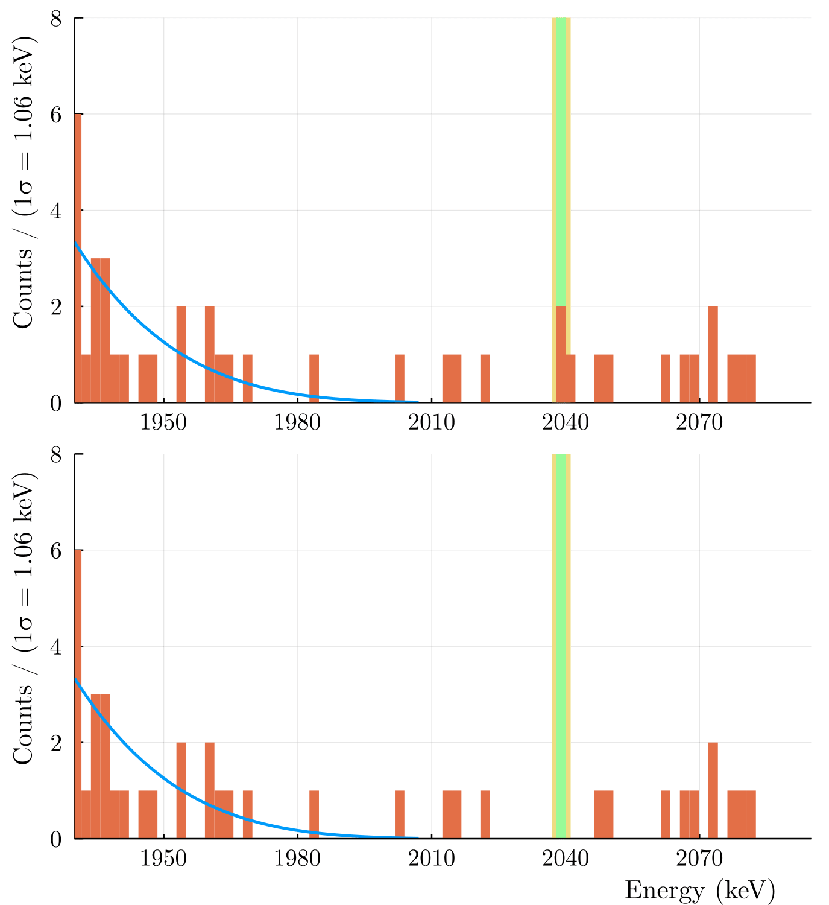
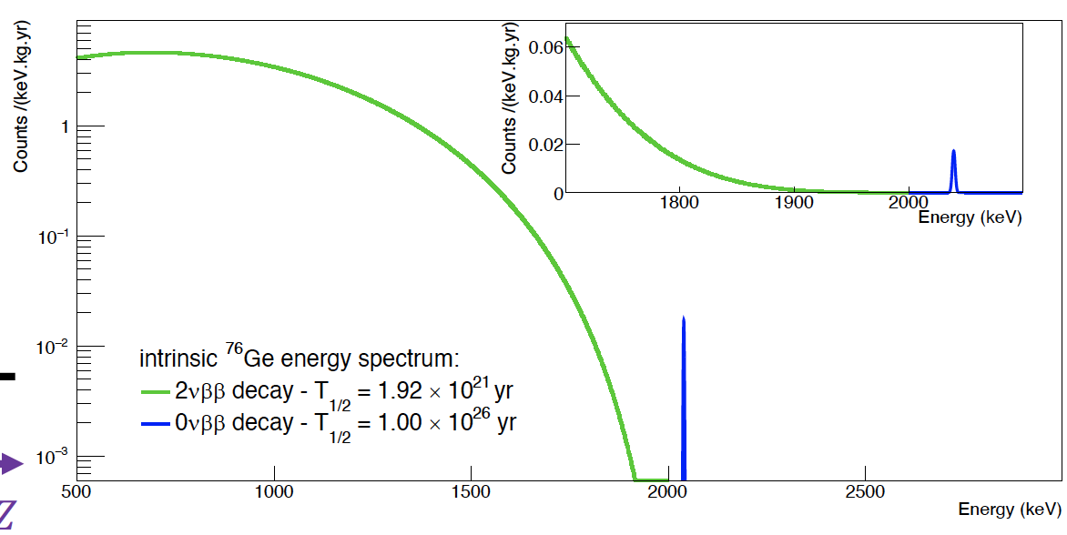
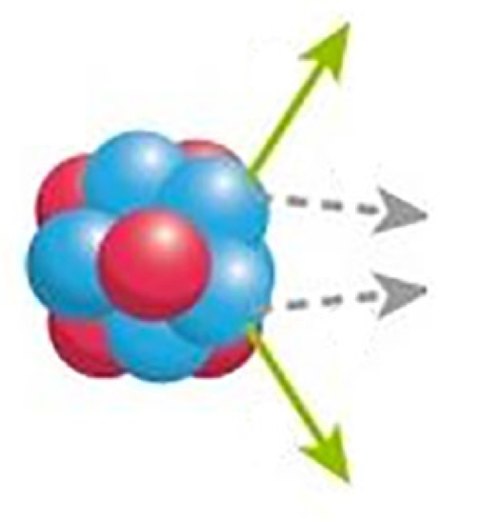
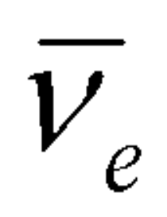
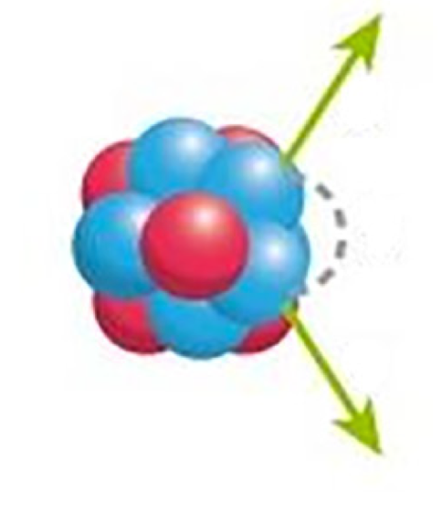
How do we detect 0νββ events
Backgrounds plus peak with HL 10²⁸ yrs
2νββ
e
e
e
x
0νββ
e
Backgrounds only
Above: Idealized 2νββ and 0νββ spectrum
Right: Simulation of 0νββ peak in one ton of ⁷⁶Ge in the presence of backgrounds

Slide 25
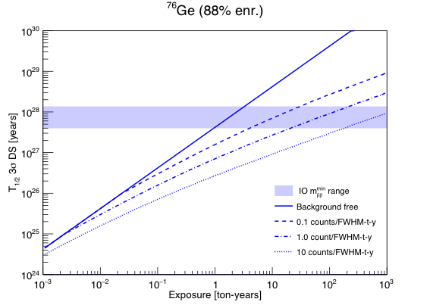
Discovery Sensitivity vs Exposure
To discover double-beta decay, we need:
Large exposure
  Large mass
  High detection efficiency
Nearly background free
  Reduce backgrounds from environment
  Distinguish signal from backgrounds with analysis

Slide 26
Outline
What is neutrinoless double-beta decay? Why is it interesting?
How do we search for neutrinoless double beta decay?
Searching for 0νββ in Germanium: the current experimental landscape
A brief survey of low background experimental techniques

Slide 27
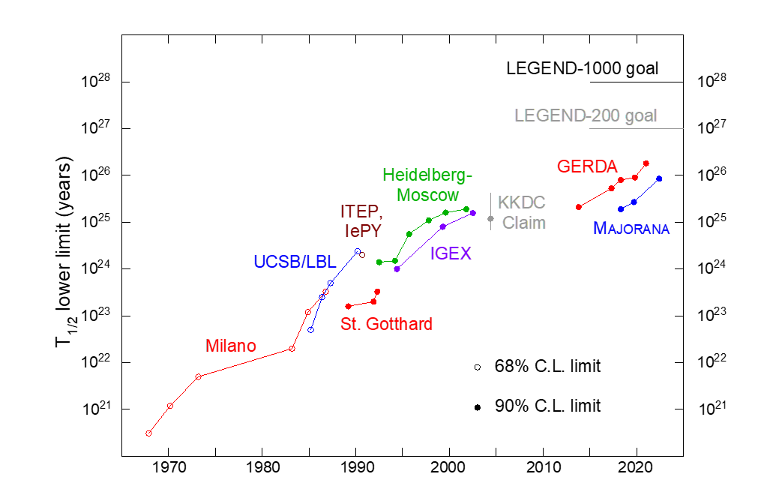
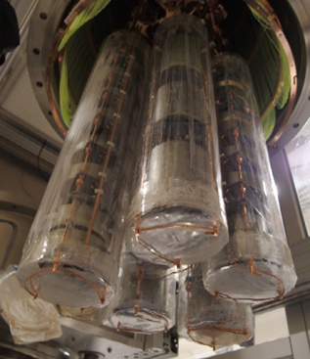
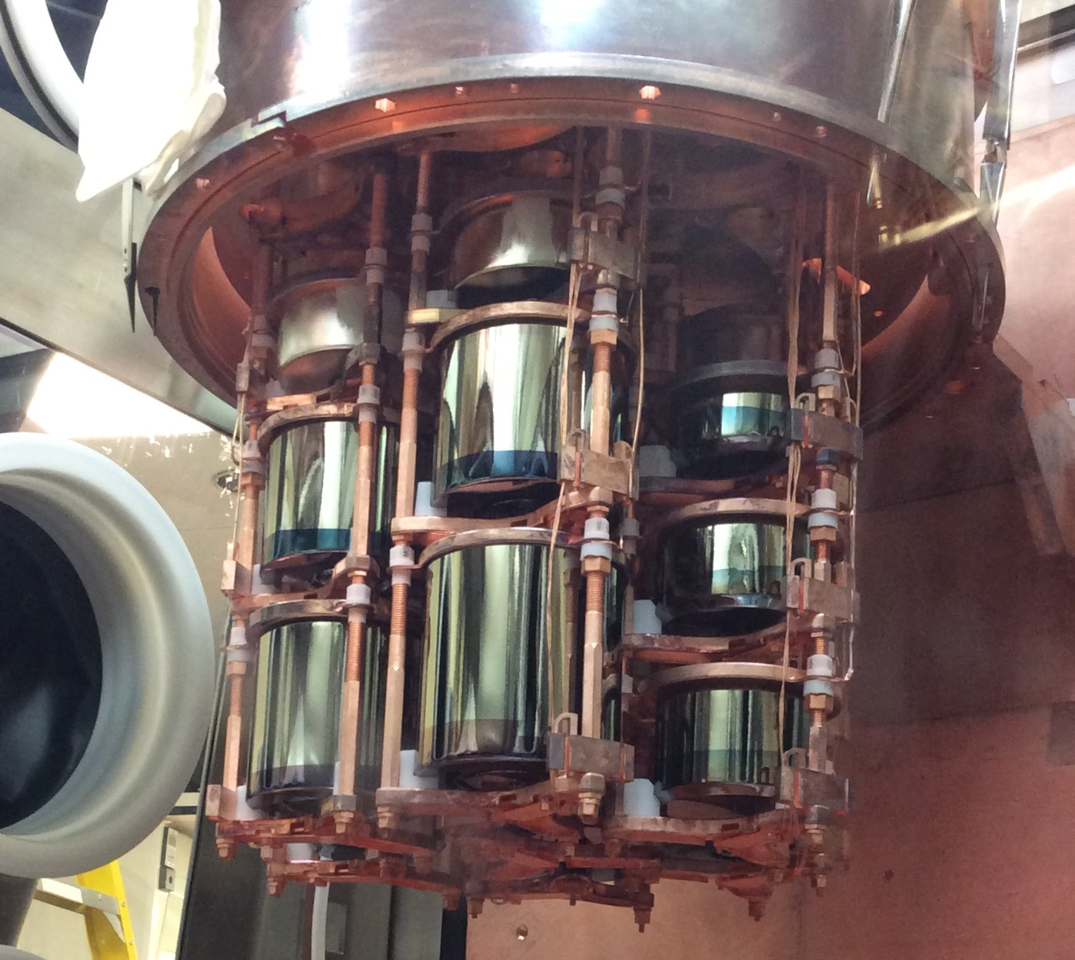
Searching for 0νββ in Germanium Detectors
High Purity Germanium (HPGe) detectors have a long history of use in searching for 0νββ in ⁷⁶Ge
HPGe detector acts as source and detector
Detectors can be isotopically enriched to >90% in 76Ge
Well understood technology with excellent energy resolution and low intrinsic backgrounds
Heidelberg-Moscow Experiment
(Prog. Part. Nucl. Phys. 32, 261 (1994))
IGEX Experiment
(Front. Phys. 7, 6 (2019))
GERDA
The Majorana Demonstrator
LEGEND-200

Slide 28
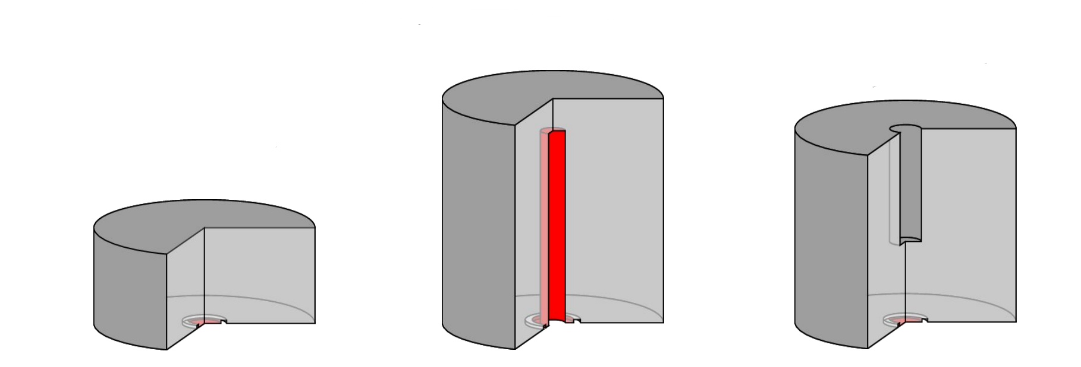
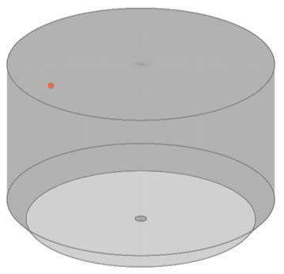
P-Type Point Contact Detectors
Advantages of P-type Point-Contact detector geometries
Low capacitance for improved energy resolution and low thresholds
Pulse shape highly dependent on position of charge deposition
PPC
IEEE Trans. on Nuc. Sci., 36, 1, 926-930 (1989)
Inverted-Coaxial
NIMA ,891, 106-110, (2018)
Small mass (< 1 kg)
Excellent background rejection
Newly developed for LEGEND
Large mass (up to 4 kg)
Excellent background rejection
BeGe
Eur. Phys. J. C 79, 978 (2019)

Slide 29
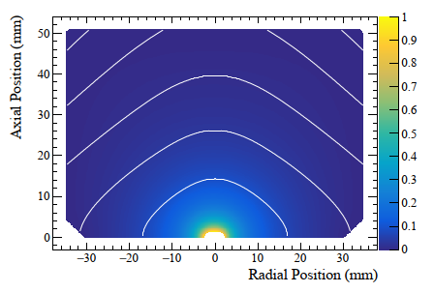
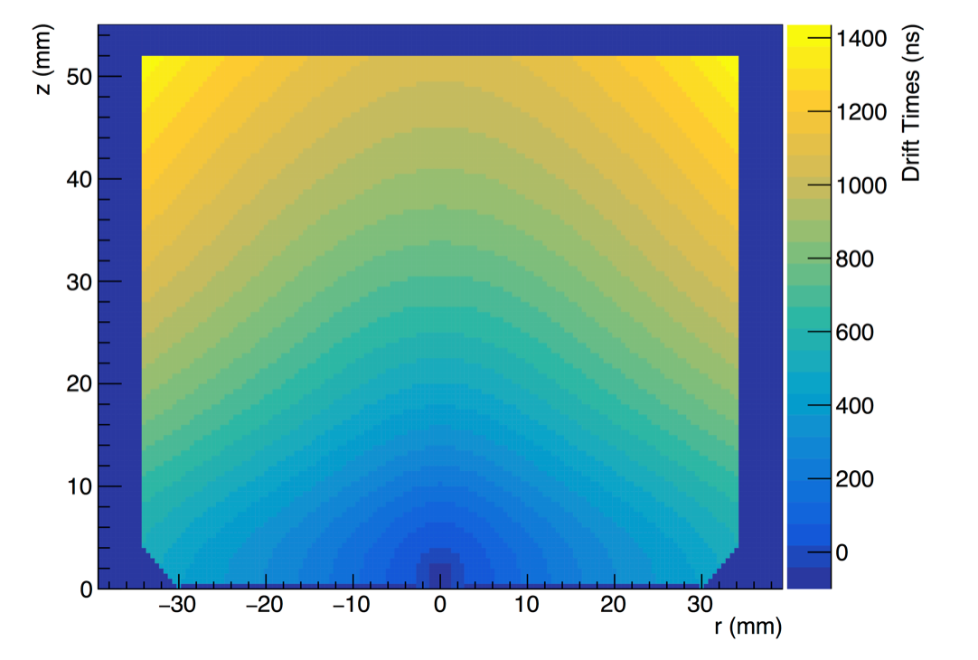
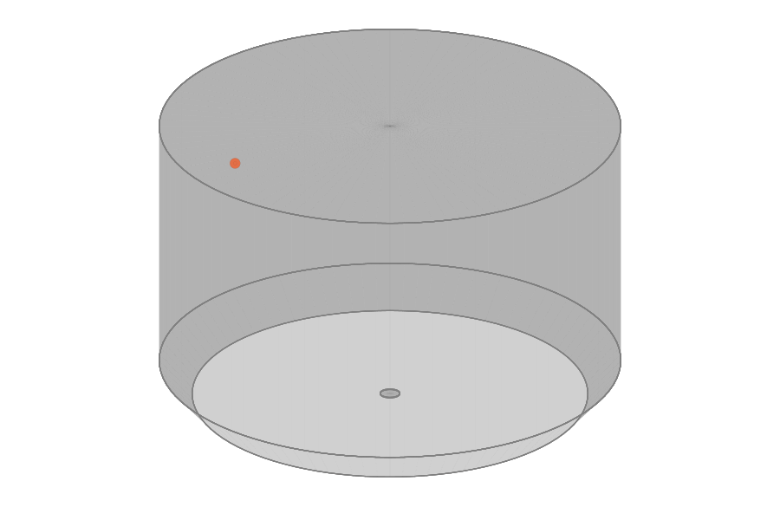
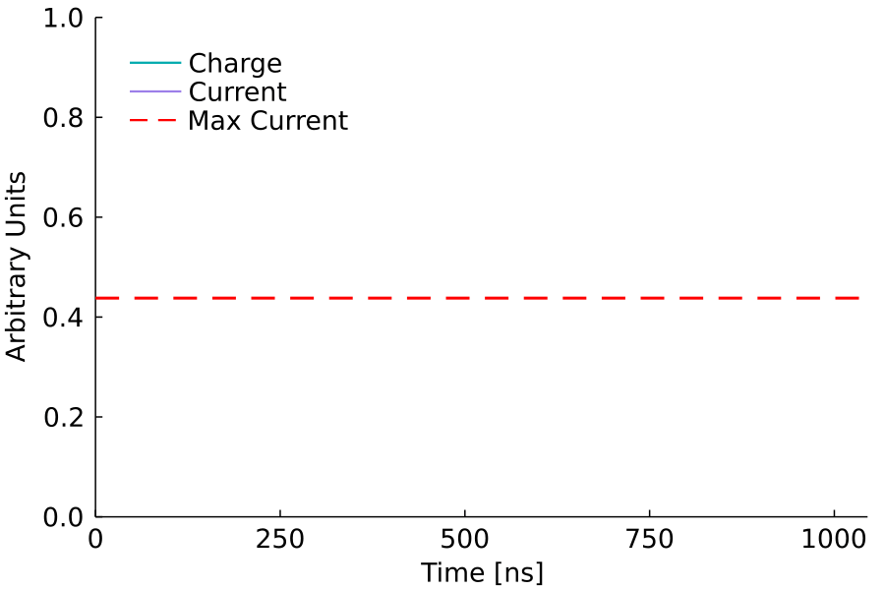
P-Type Point Contact Detectors
How do they work?
Weighting Potential
Drift Time (ns)
Weighting potential is localized around point contact, producing a sharp rising edge
Low electric field in bulk produces long drift times that can be distinguished in time

Slide 30
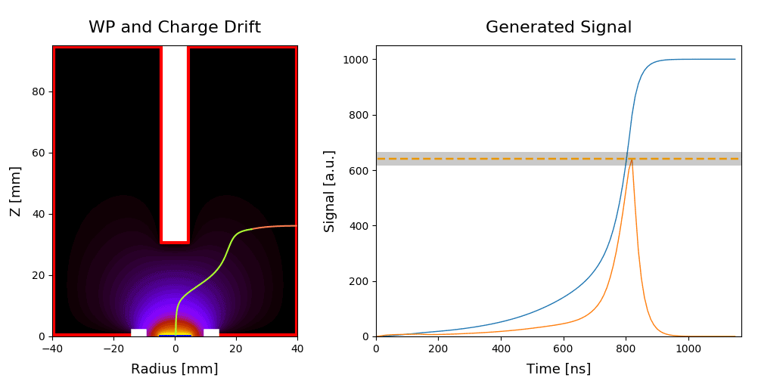




P-Type Point Contact Detectors
0νββ signal candidate (single-site)
Weighting Potential and Charge Drift
Weighting Potential and Charge Drift
Acceptance Window
Charge signal
Acceptance Window
Charge signal
External α, β, and γ backgrounds all create distinctive pulse shapes, allowing for highly efficient ββ decay event selection
accepted
Current signal
rejected
Current signal
Surface background on n+ contact
Surface background on p+ contact
Weighting Potential and Charge Drift
Acceptance Window
Weighting Potential and Charge Drift
Charge signal
Charge signal
Acceptance Window
rejected
Current signal
rejected
Current signal
Courtesy of the LEGEND Collaboration

Slide 31






The Majorana Demonstrator
Searching for neutrinoless double-beta decay of ⁷⁶Ge in HPGe detectors, probing additional physics beyond the standard model, and informing the design of the next-generation LEGEND experiment
Source & Detector: Array of p-type, point contact detectors
  30 kg of 88% enriched ⁷⁶Ge crystals - 14 kg of natural Ge crystals
    Included 6.7 kg of ⁷⁶Ge inverted coaxial, point contact detectors in final run
Excellent Energy Resolution: 2.5 keV FWHM @ 2039 keV
          and Analysis Threshold: 1 keV
Low Background: 2 modules within a compact graded shield and active muon veto using ultra-clean materials
Reached an exposure of ~65 kg-yr before removal of the enriched detectors for the LEGEND-200 experiment at LNGS
Continuing to operate at the Sanford Underground Research Facility with natural detectors to search for decay of ^{180m}Ta

Slide 32


Majorana Demonstrator Final Result
Operating in a low background regime and benefiting from excellent energy resolution
Final enriched detector active exposure: 64.5 ± 0.9 kg-yr
Background index at 2039 keV in lowest background configuration
15.7 ± 1.4 cts/(FWHM t yr)
Expect 1.5 background counts in ROI; measured 1 count
Second lowest background index by any 0νββ search to date!
PRL 130 062501 (2022)
  65 kg-yr Exposure Limit: T_{1/2} > 8.3 × 10²⁵ yr (90% C.I.)
m_{ββ} < 113 - 269 meV

Slide 33







GERDA
64 m³ LAr cryostat
Fibershroud
HPGe detector array
590 m³ instrumented water tank
7x PMT
Courtesy of the GERDA Collaboration

Slide 34


Final GERDA Result
PRL 125, 252502 (2020)
Background free!
Lowest background index of any experiment to date!
Background index: 5.2^{+1.6} ⋅10⁻⁴ cts/(keV kg yr),
Energy resolution ~3 keV (FWHM)
Frequentist: N^{0v} = 0 best fit, T_{1/2} > 1.8⋅10²⁶ yr at 90% C.L.
Bayesian: flat prior on rate, T_{1/2} > 1.4⋅10²⁶ yr at 90% C.I.

Slide 35



The LEGEND Experiment
Select best technologies, based on what has been learned from GERDA and the Majorana Demonstrator, as well as contributions from other groups and experiments.
MAJORANA
GERDA
Both
- Radiopurity of nearby parts (FETs, cables, Cu
mounts, etc.)
- Low noise electronics improves PSD
- Low energy threshold (helps reject cosmogenic
background)
- LAr veto
- Low-A shield, no Pb
Clean fabrication techniques
Control of surface exposure
Inherited point-contact detectors and production of new point-contact detectors
Lowest background and best resolution of 0nbb experiments
LEGEND
Subsequent stages:
1000 kg, staged via individual payloads
Timeline connected to review process
Background goal <0.025 cts/(FWHM t yr)
Location to be selected
First phase:
(up to) 200 kg in upgrade of existing infrastructure at LNGS
BG goal: <0.5 c /(FWMH t y)
Discovery sensitivity at a half-life of 10²⁷ years
Currently taking physics data

Slide 36
LEGEND: Current Status
LEGEND-200 is currently taking data with 140 kg of HPGe detectors!
²²⁸Th Calibration Data

Slide 37





Future Prospects of CDEX @ CJPL-II : Ge1T Project
Next: 300-kg 0νββ (towards IH) ; 50-kg DM (@ 0νββ bkg spec) (2028)]
Visions: Ge-1T (2033) → Ge-10T (2040) 0νββ (towards NH)
CJPL-II Hall-C Pit (Foreseen)
2019-11
Artist’s Conception

Slide 38






Mastering Key Technologies towards Ge-1T
⁷⁶Ge enrichment
Ge purification and crystal growth;
HPGe detector fabrication;
Ultra-low background VFE and FADC;
Ultra-pure Cu for structure and cables;
Large-volume cooling tank “cryostat”

Slide 39


The Broader Experimental Landscape
GERDA is the leading limit in $m_{ββ}$for ⁷⁶Ge
$$m_{ββ}<\text{(}\text{93}\text{ – }\text{222}\text{) }\text{meV}$$
KamLAND-Zen 800 has the leading overall limit using ¹³⁶Xe:
$$m_{ββ}<\text{(36 – 156) }\text{meV}$$
PRL 125, 252502 (2020)
PRL 130, 051801 (2023)

Slide 40
Outline
What is neutrinoless double-beta decay? Why is it interesting?
How do we search for neutrinoless double beta decay?
Searching for 0νββ in Germanium: the current experimental landscape
A brief survey of low background experimental techniques

Slide 41
Sources of Backgrounds
μ
Cosmic ray muons, and particles produced as they pass through matter
Radioactive decays in the environment produce gammas that penetrate into the detector
γ
n
β
β⁺
Radon daughters can plate out on surfaces, later depositing alpha and beta particles into surfaces
Decays of isotopes produced cosmogenically in detectors and surrounding components
α
We have strategies to reduce and discriminate each of these!

Slide 42



Reducing Environmental Gammas
Use ultra-clean materials:
Underground electroformed copper
Low-mass, low-background electronic components
Courtesy of the Majorana Collaboration

Slide 43


Discriminating Environmental Gammas
0νββ is localized within ~1 mm (i.e. single-site). Many backgrounds are multi-site
Reject by comparing current amplitude
to pulse height (AvsE)
Tuned on ²²⁸Th calibration data to accept 90% of
single-site DEP events. Rejects >50% of the
Compton continuum near Q_{ββ}
Multi-site events in active volume: AvsE cut
γ
e
~1mm
e
Current Amplitude (A)
Single-Site (0νββ-like)
accepted
Current Amplitude (A)
Multi-Site (γ-like)
rejected
Courtesy of the Majorana Collaboration

Slide 44



Active Shielding for Environmental Gammas
Submerge detectors in liquid Argon and use scintillation light to veto events
Compton events with energy deposition in the LAr
Pure 2νββ spectrum after LAr signal suppression
Courtesy of the GERDA Collaboration

Slide 45

Reducing Surface Particles
To prevent contamination of detector surfaces, we keep them in Nitrogen purged environments
Right: a LEGEND scientist is building a string of detectors in a glove box
Courtesy of the LEGEND Collaboration

Slide 46

Discriminating Surface Particles
Events at the surfaces of detectors can be distinguished by their pulse-shapes
Bulk event
Surface α event
Fast drift time
Delayed Charge Collection
Slow Component
Courtesy of the Majorana Collaboration

Slide 47


Reducing Muon Events
Build experiments in underground labs
  Top right: Sanford Underground Research Facility
  Bottom left: Gran Sasso National Laboratory
  Bottom right: China Jinping Underground Laboratory
Gran Sasso Mountain
LEGEND
LNGS
Highway Tunnel

Slide 48
Vetoing Muon Events
Muon associated events can be vetoed by surrounding our experiments with muon detectors
590 m³ instrumented water tank

Slide 49
Conclusion
Discovery of Neutrinoless Double-Beta Decay would revolutionize our understanding of physics
To do so will require a background free measurement of ~1 ton of material for ~10 years
Germanium detectors can search for 0νββ using many demonstrated techniques for achieving ultra-low backgrounds
Thanks for listening!

