Slide 1
Compton Imaging with
Germanium Cross-strip Detectors
in Astronomical Observations
Hsiang-Kuang Chang
Institute of Astronomy
National Tsing Hua University
The PG2023 summer school, Institute of Physics, Academia Sinica, May 24-31, 2023

Slide 2
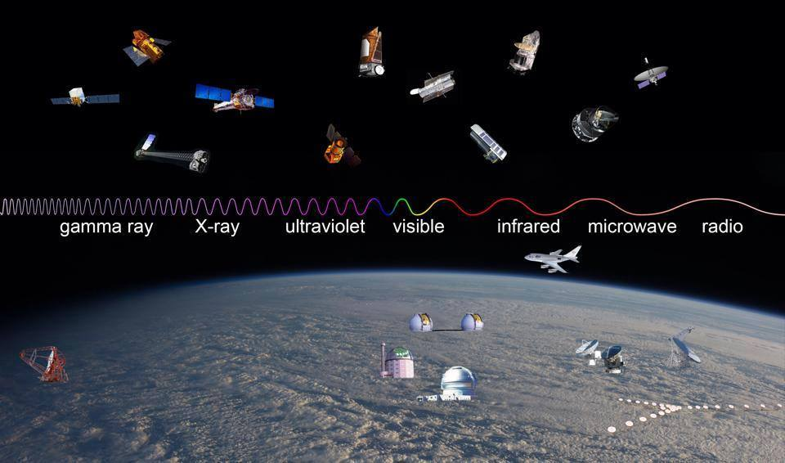
Observatories throughout the Electromagnetic Spectrum
(Credit: NASA)

Slide 3
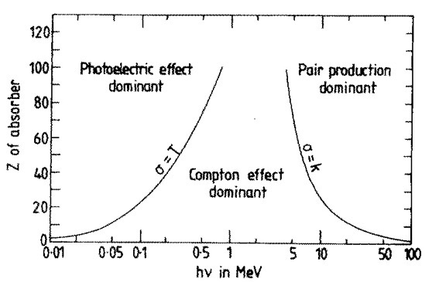
Detection of MeV Photons
(Evans 1955)
(Bandstra 2010, PhD thesis, UC Berkeley)

Slide 4
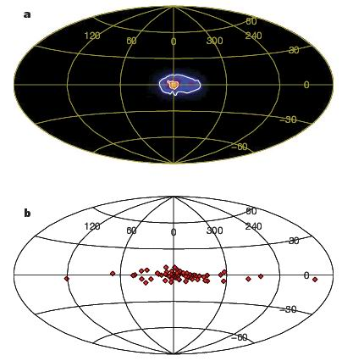
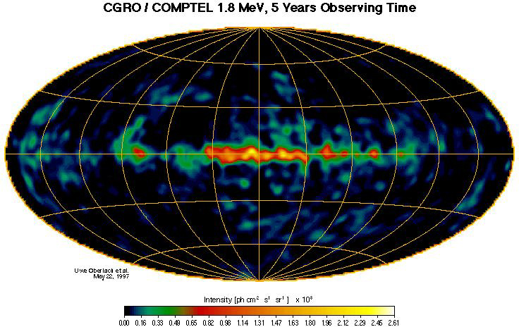
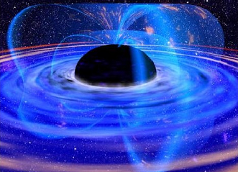
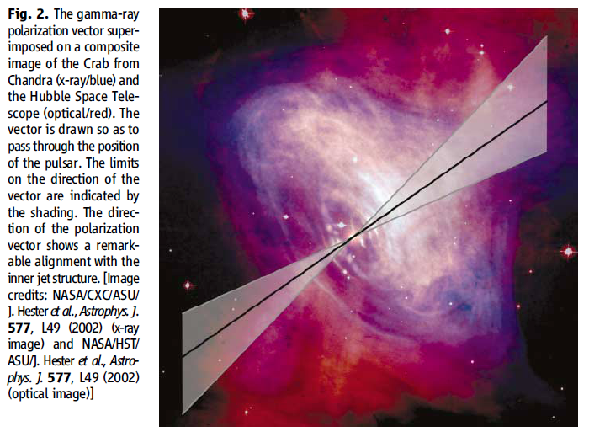
The MeV Universe:
Line emission
positron astrophysics:
the 511 keV line from the galactic center
nucleosynthesis gamma-ray lines:
²⁶Al (1809 keV), ⁵⁶Co (847,1238 keV), ⁴⁴Ti (1157 keV)
Continuum emission
neutron stars, BH binaries, AGN
Gamma Ray Bursts (GRBs)
Polarization measurements
pulsars and PWNe, BH binaries, GRBs
Implications on SN Ia and cosmology
COMPTEL ²⁶Al all-sky map
EM counterparts to GW sources
Notes:
Pulsars: location of emission sites
The rate for detecting GRB with polarized signal is ~0.04 bursts/day.
The 3σ MDP of 2009 balloon flight was estimated as 124% for a 28 ksec observation.
GRB: The nature of the jets and the role of magnetic fields in gamma-ray bursts (GRBs) remains unclear
How does the inner engine work and what are the γ-ray emission processes : Synchrotron / Inverse Compton
→ hadron related emission via pion production and decay

Slide 5
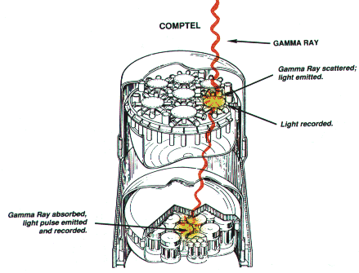
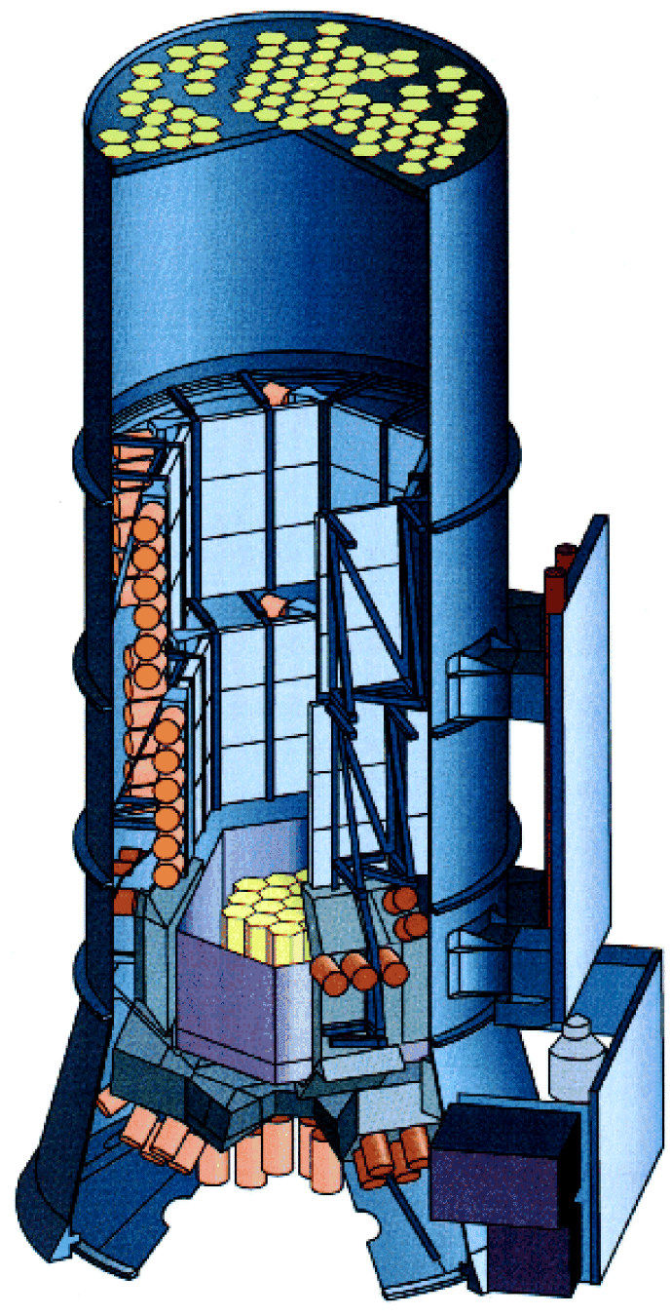
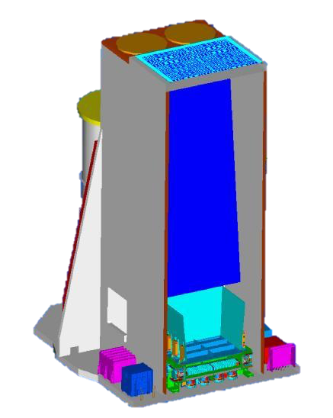
In the past and currently …
(Credit: COMPTEL Collaboration)
(Credit: ESA)
(Credit: ESA)
COMPTEL of CGRO
(1991-2000)
SPI of INTEGRAL
(2002 - )
IBIS of INTEGRAL
(2002 - )
Coded mask & Compton telescope
These are all huge and heavy.

Slide 6
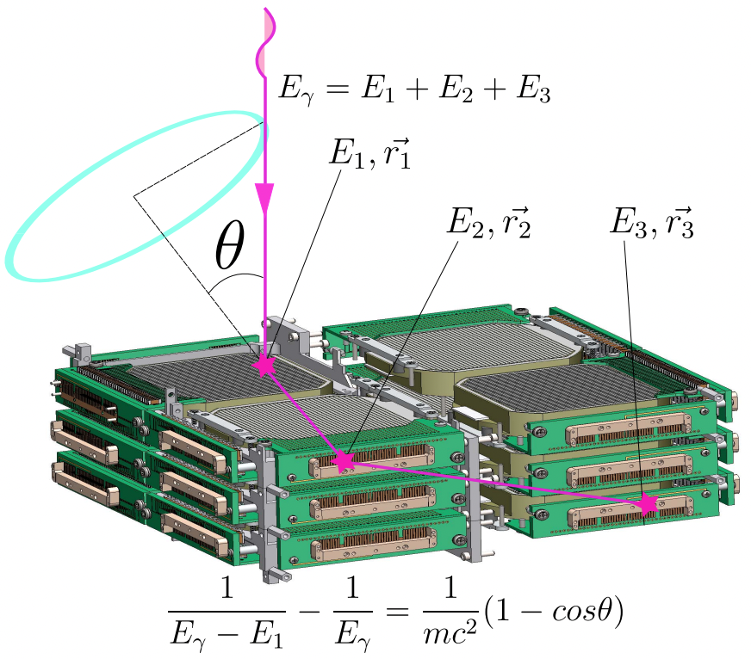
The Compton Spectrometer and Imager (COSI)
An array of 3-D-tracking cross-strip HPGeD
(Beechert et. al. 2022)

Slide 7
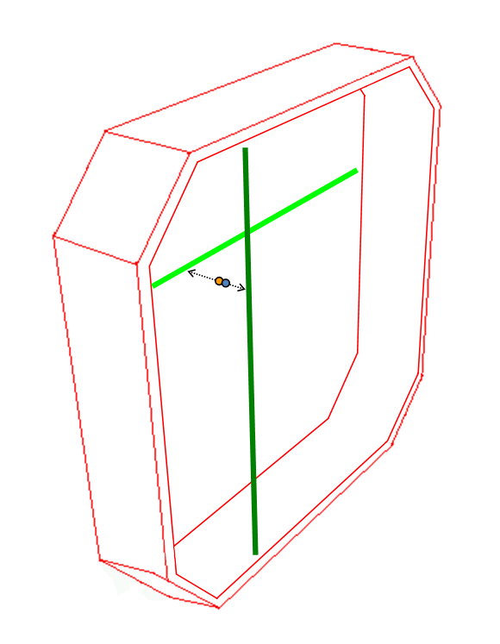
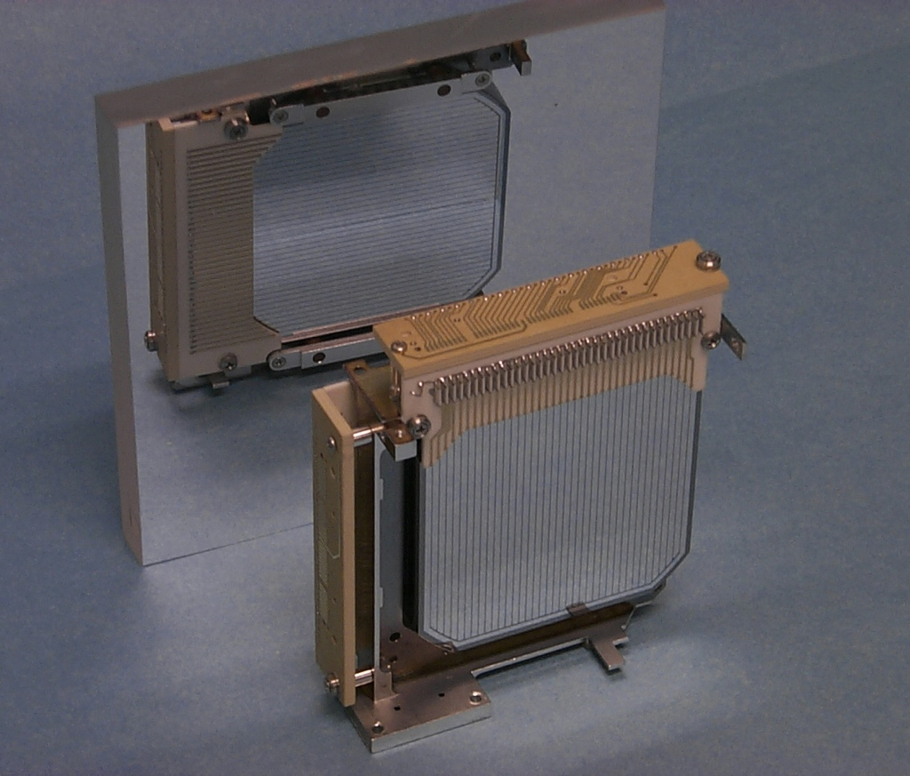
COSI scattering position measurement
X and Y positions: determined by orthogonal strips
→ Strip pitch: 2 mm (0.25 mm gap)
Z position: calculated by time difference between X & Y strips
→ Depth resolution: 0.5 mm
Edge-On View
mirror
-
h
e
+
Depth
Z
X
Y
Notes:
1. X and Y positions: determined by the orthogonal strips
2. Z positions: obtained by using the Collection Time Difference (CTD)

Slide 9
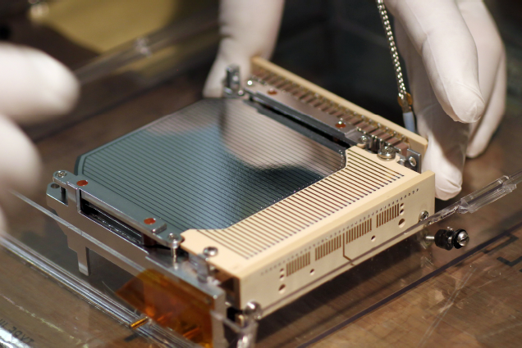

Slide 10
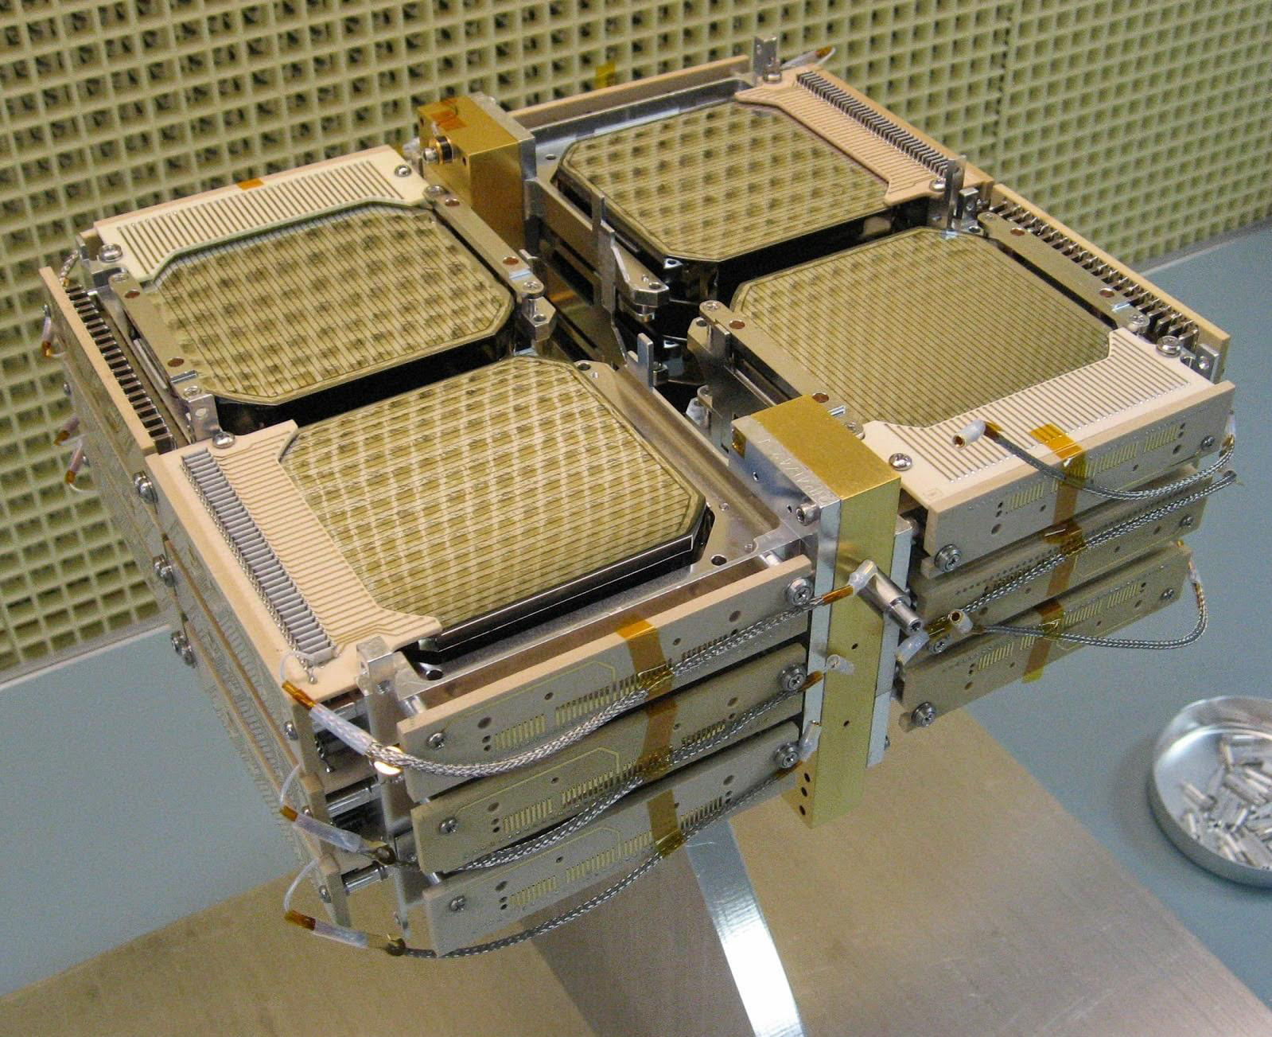
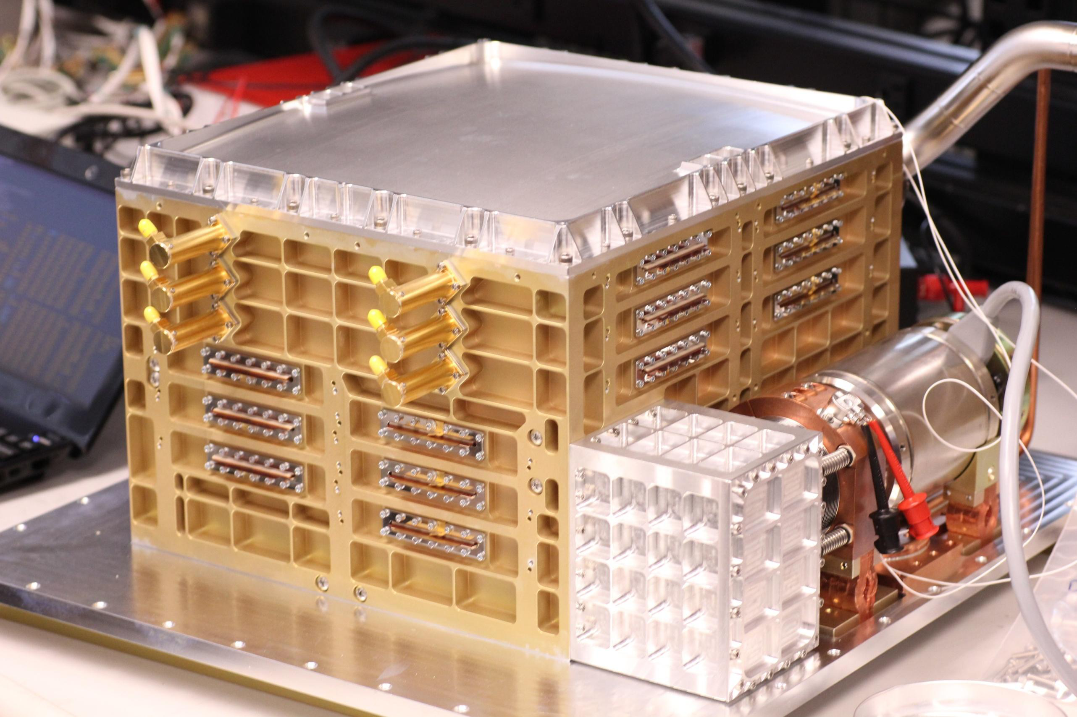
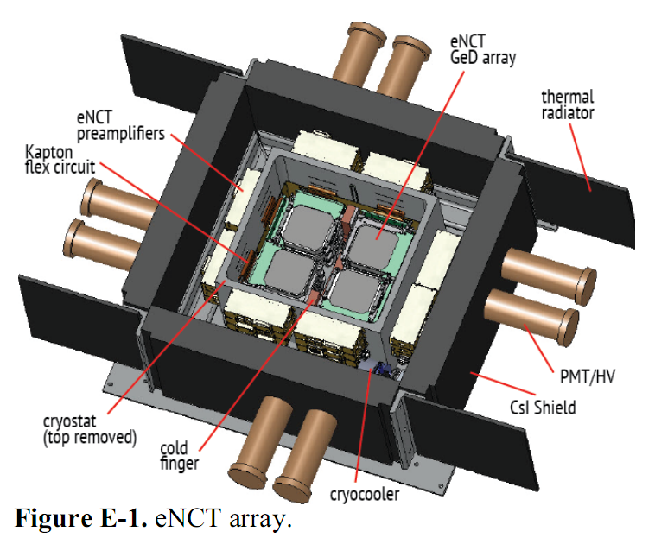
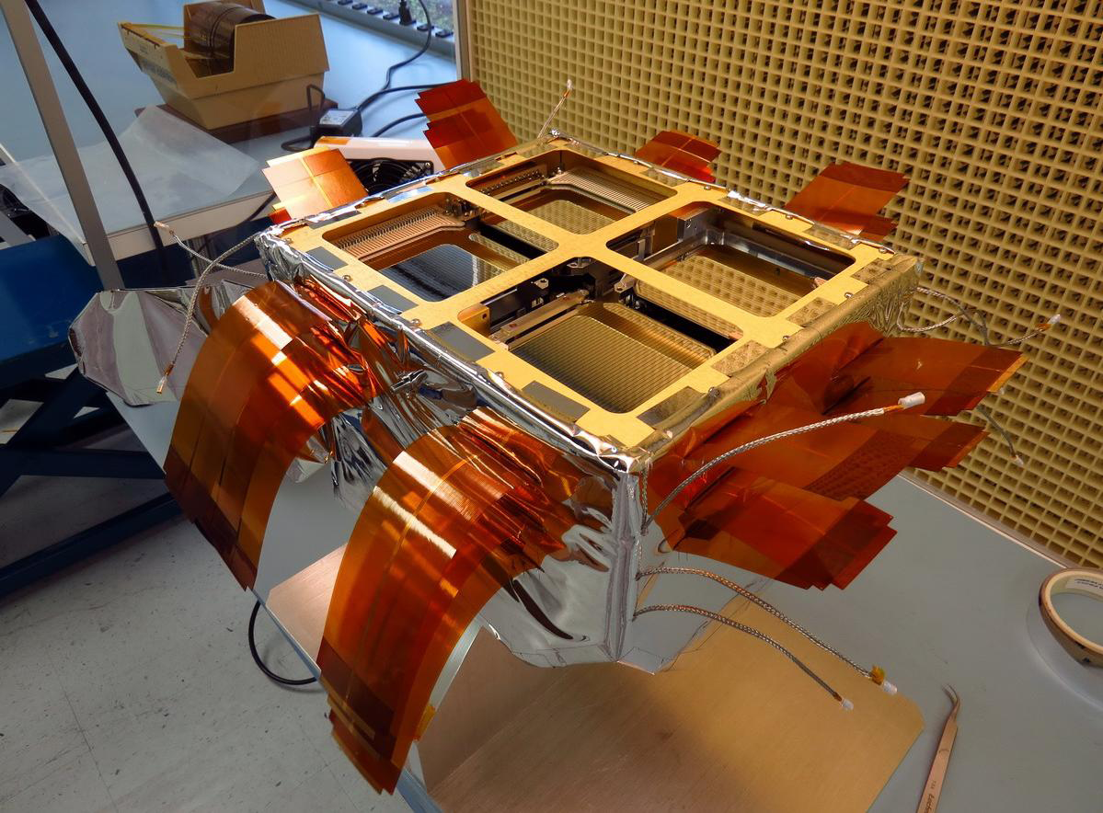
The COSI GeD array

Slide 11
COSI stratospheric balloon flights
Launch date | Launch location | Primary target | Duration | # of GeDs
June 1, 2005 | Ft. Sumner, NM, USA | background | 8.5 hours | 2
May 17, 2009 | Ft. Sumner, NM, USA | Crab | 38.5 hours | 10
April 29, 2010 | Alice Springs, Australia | Galactic center | crashed | 10
Dec. 29, 2014 | McMurdo, Antarctica | GRB | 44 hours | 12
May 17, 2016 | Wanaka, New Zealand | Galactic center | 47 days | 12
Spring 2020 | Wanaka, New Zealand | Galactic center | cancelled | 12
Selected in 2021 as NASA’s next SMEX to launch in 2027!

Slide 12
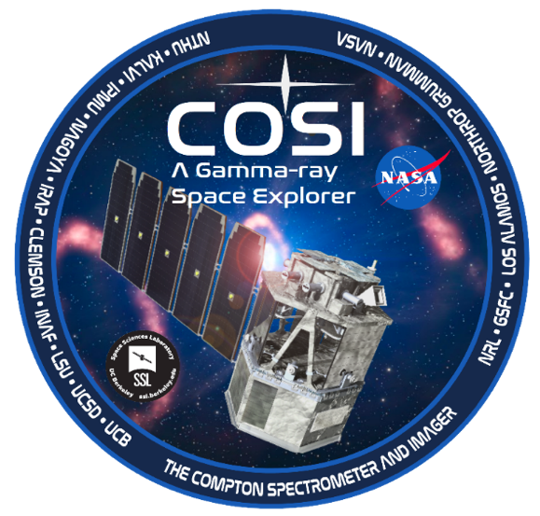
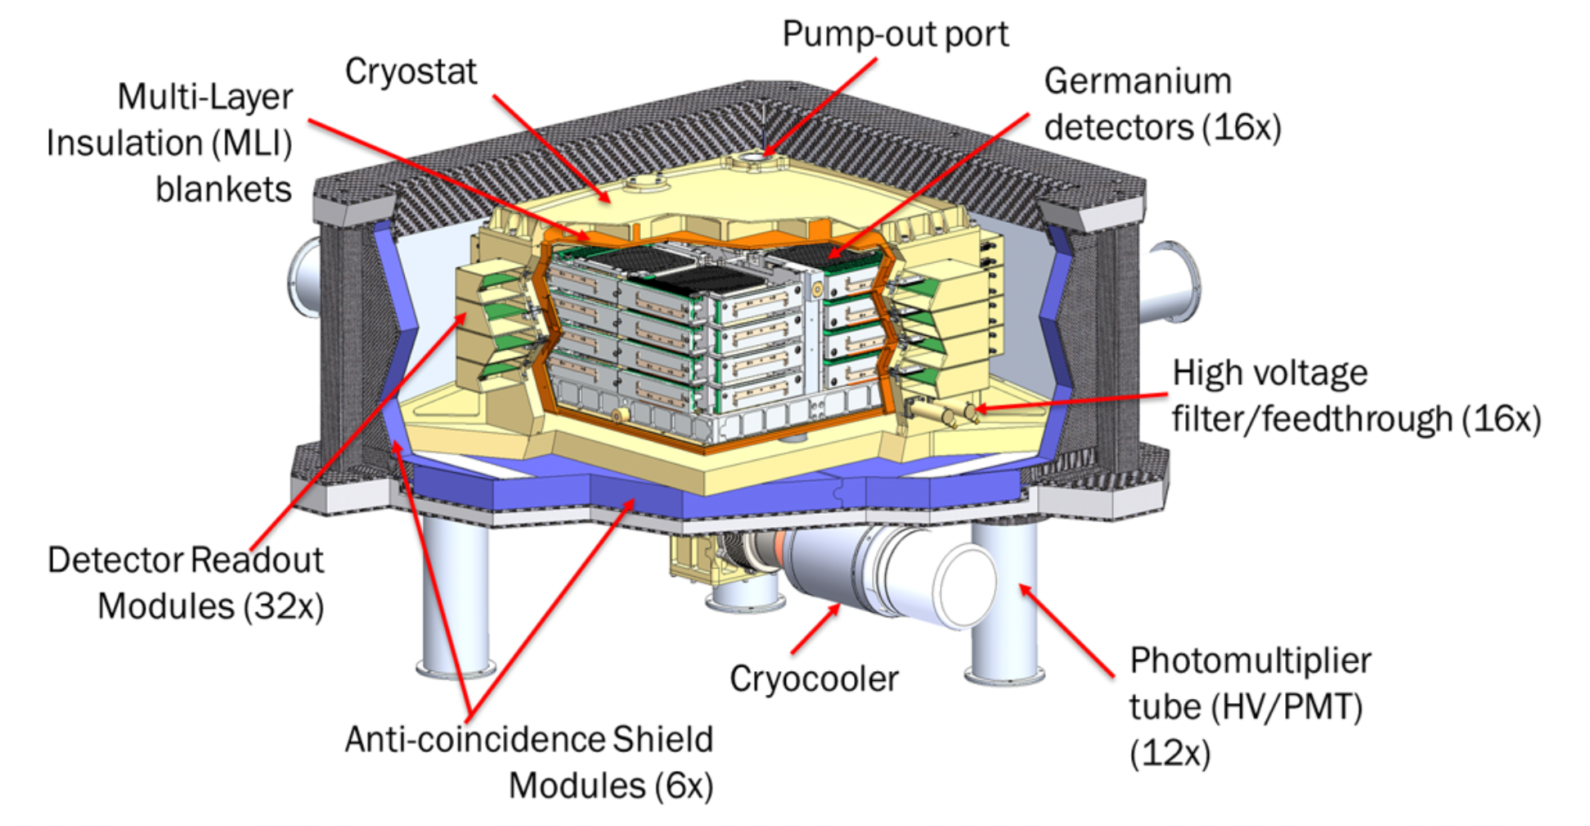
The Compton Spectrometer and Imager (COSI)
COSI was selected as NASA’s next SMEX to launch in 2027!
This is a next-generation Compton telescope in MeV (0.2-5 MeV) gamma-ray astronomy, led by UC Berkeley (PI: John Tomsick). NTHU has been a member of the COSI team since 2006.
(Tomsick et al. 2021)
(Credit: COSI)

Slide 13
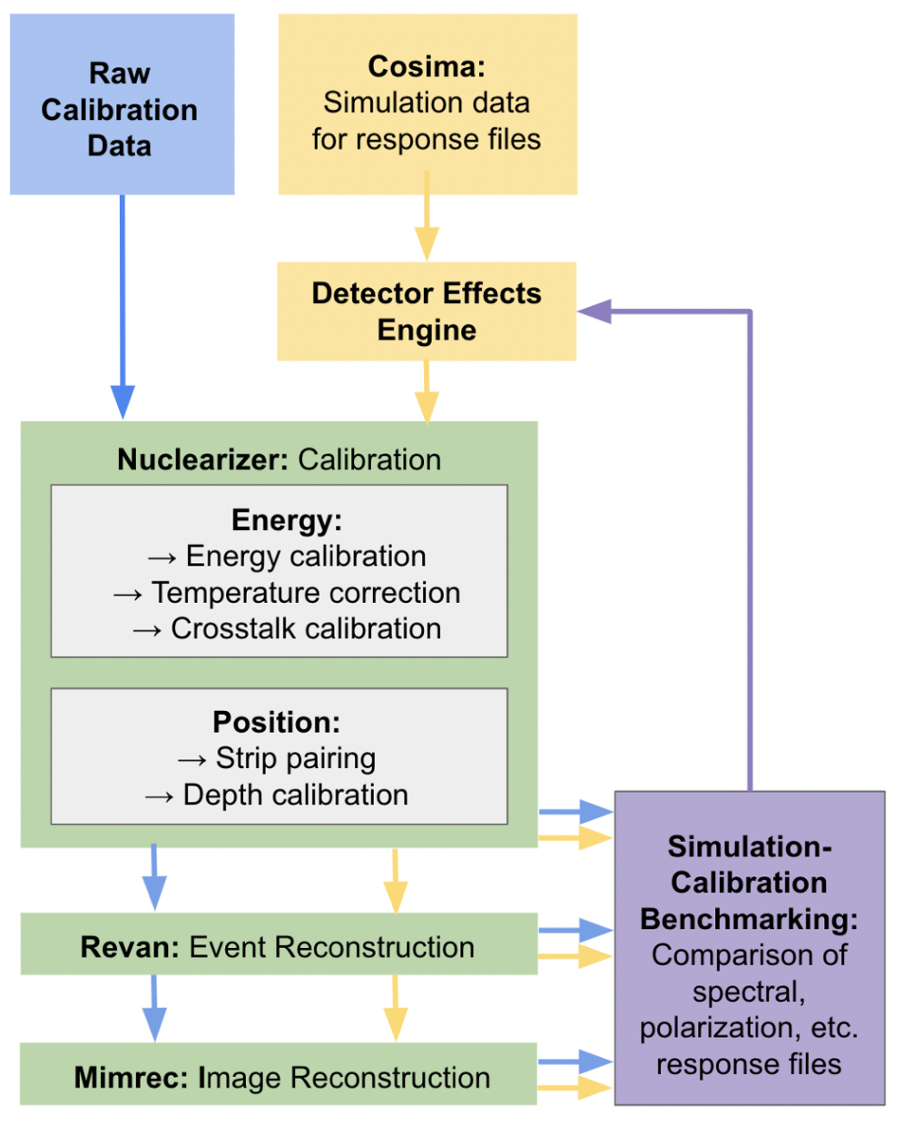
* COSI data analysis pipeline was structured in MEGAlib (Zoglauer et al. 2006), a Geant4-based toolkit for MeV astronomy.
(https://github.com/zoglauer/megalib)
* Now, a huge effort is going on to create more user-friendly tools for analyzing COSI-SMEX data.
(https://github.com/cositools)
* Most of the issues are common to different Compton telescopes (cameras). More specific to strip detectors are crosstalk and strip-pairing.

Slide 14
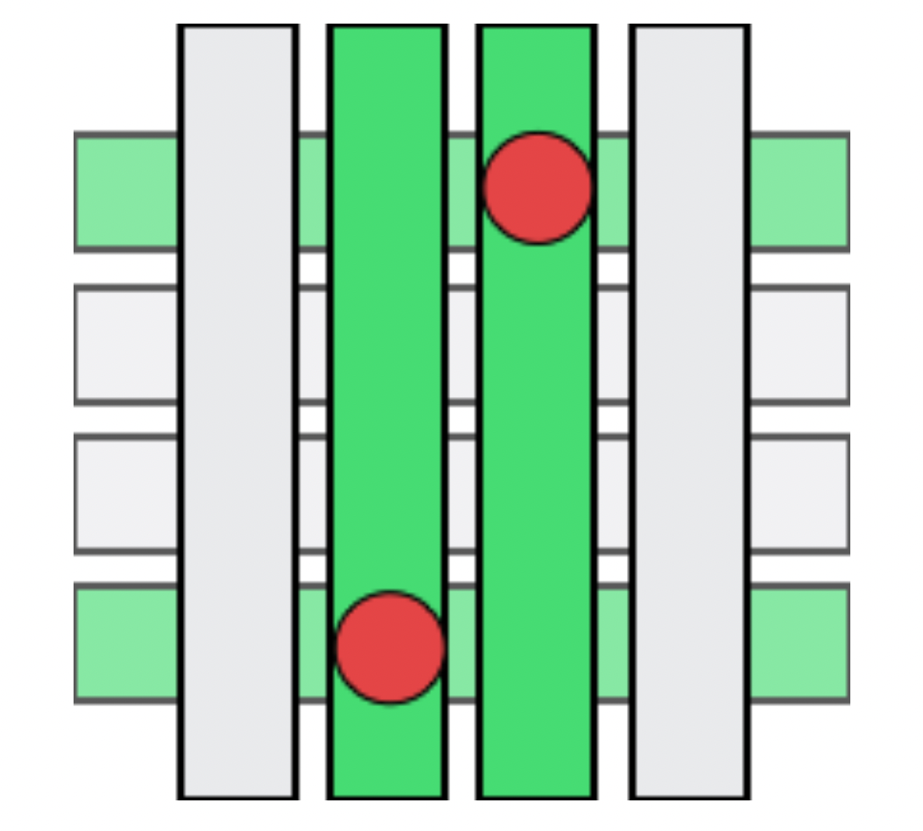
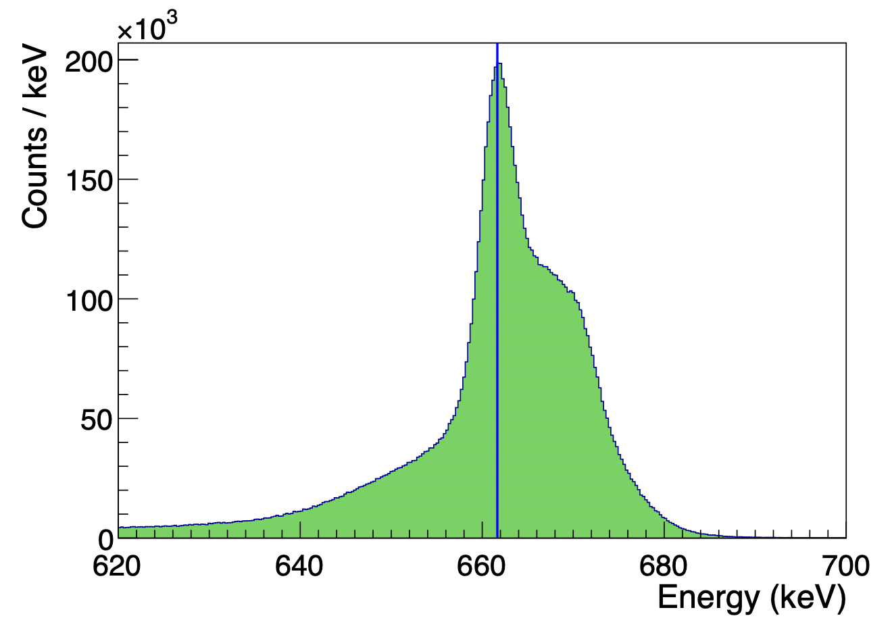
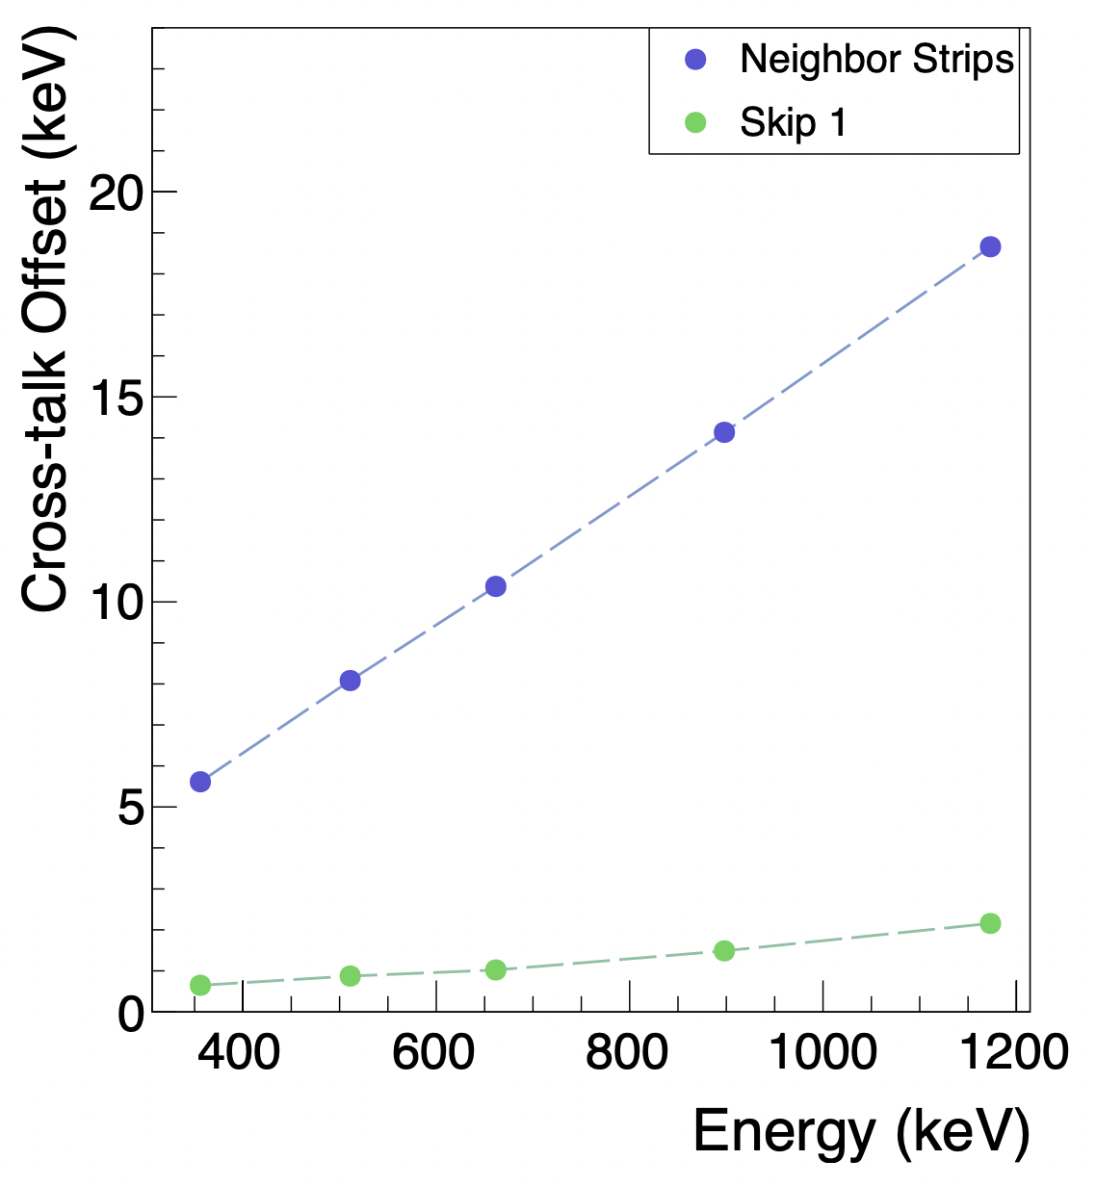
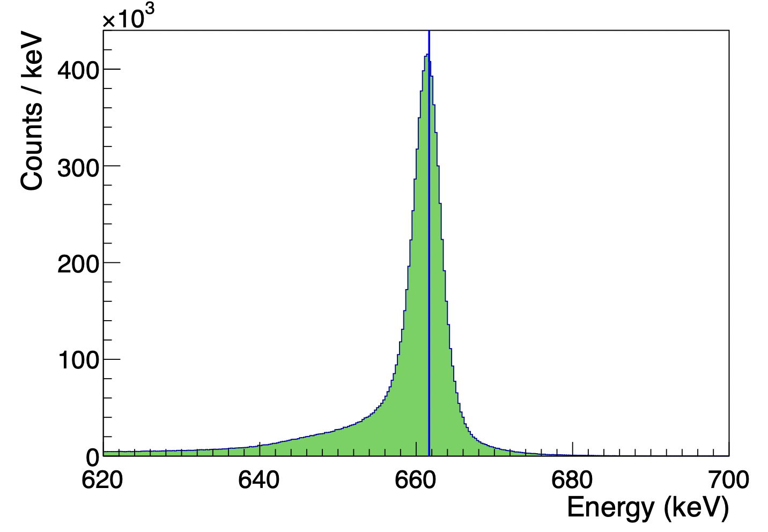
The cross-talk effect: The energy recorded by a strip electrode in close proximity to another triggered strip is enhanced by the charge deposited on the neighboring strip.
(Beechert et. al. 2022)

Slide 15
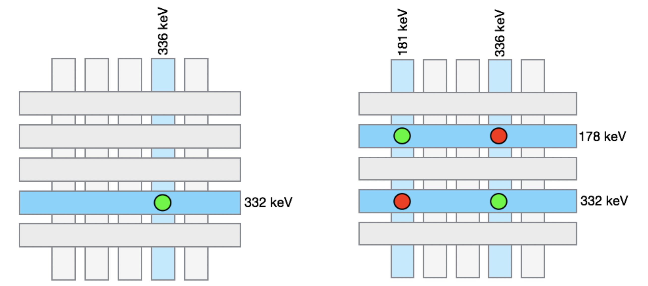
Strip-pairing is based on the measured energies. More hits in the same layer will make the decision more unreliable.
(Beechert et. al. 2022)

Slide 16
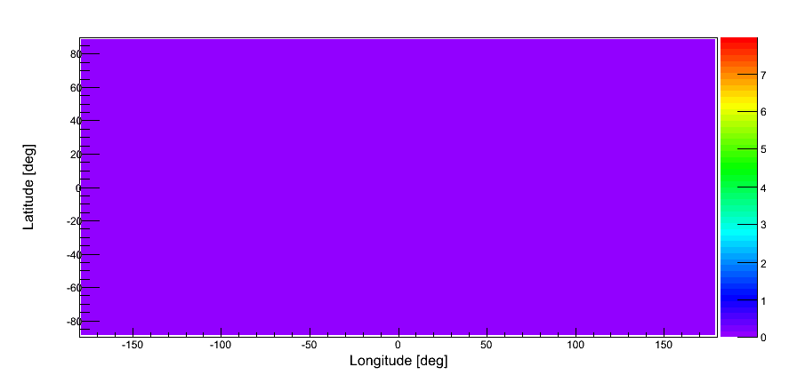
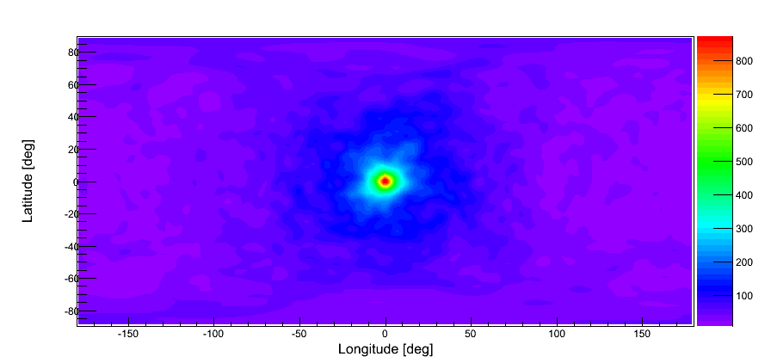
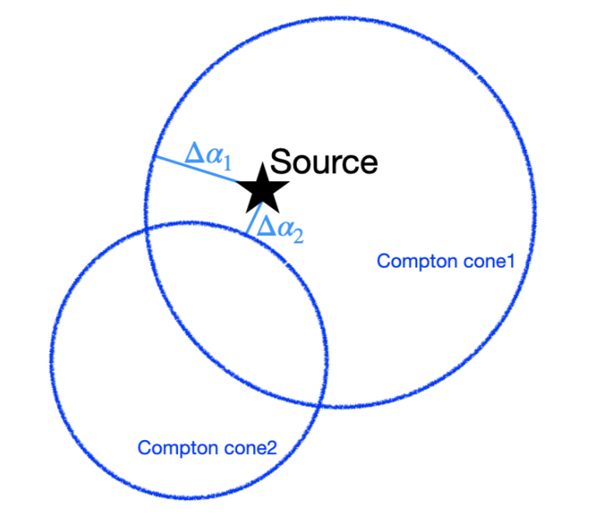
With data in physical units, one can do Compton event reconstruction
(e.g., Boggs & Jean (2000)) and
event selection to reduce background, increase signal, and optimize imaging, spectral, or polarization performance.
Selection criteria may include:
Photon energy
Number of interactions
Scattering angle
ARM (angular resolution measure)
Minimum distance between the first two hits
Minimum distances between any two hits
For imaging, further processing is needed.

Slide 17
Maximum Likelihood Expectation Maximization (MLEM)
$\vec{y}=\overset{⃡}{t}$ x $\vec{λ}$ + $\vec{b}$
$$y_{i}$$
: the measured value in data space bin i
$$t_{ij}$$
: the probability that a photon from image space bin j
to be measured in data space bin i (transition matrix, response)
$$λ_{j}$$
: the content in image space bin j
$$b_{i}$$
: the ‘background’ contribution in data space bin i, usually small
The likelihood (probability) that a measured $\vec{y}$ is generated by an image $\vec{λ}:$ (assuming a very small ‘background’)
$$ℒ\left(\vec{y}; \vec{λ}\right)= \prod_{i}{p\left(y_{i}, \vec{λ}\right)= \prod_{i}{\frac{{μ_{i}}^{y_{i}}e^{−μ_{i}}}{y_{i}!}}}$$
$${(μ}_{i}=\sum_{k}{t_{ik}λ_{k})}$$

Slide 18
To maximize the likelihood, one may consider:
$$\ln{ℒ\left(\vec{y}; \vec{λ}\right)}= \sum_{i}{(y_{i}\ln{μ_{i}−μ_{i}−\ln{y_{i}!}})}$$
$${(μ}_{i}=\sum_{k}{t_{ik}λ_{k})}$$
$$\frac{∂\ln{ℒ}}{∂λ_{j}}=0$$
$$\sum_{i}{\left(\frac{y_{i}t_{ij}}{μ_{i}}−t_{ij}\right)=0}$$
Defining:
$$Y_{ij}=\frac{y_{i}t_{ij}}{μ_{i}}λ_{j}$$
$$s_{j}=\sum_{i}{t_{ij}}$$
$$λ_{j}=\frac{\sum_{i}{Y_{ij}}}{s_{j}}$$
$\frac{1}{λ_{j}}$ $\sum_{i}{Y_{ij}}−s_{j}=0$
# The detector response
$t_{ij}$ is the key issue.
# A list-mode (LM) MLEM can be implemented.
$$λ_{j}^{(n+1)}=\frac{λ_{j}^{(n)}}{s_{j}}\sum_{i}{\left(\frac{y_{i}t_{ij}}{\sum_{k}{t_{ik}}λ_{k}^{(n)}}\right)}$$
(See, e.g., Wilderman et al. 1998; Lowell et al. 2017)

Slide 19
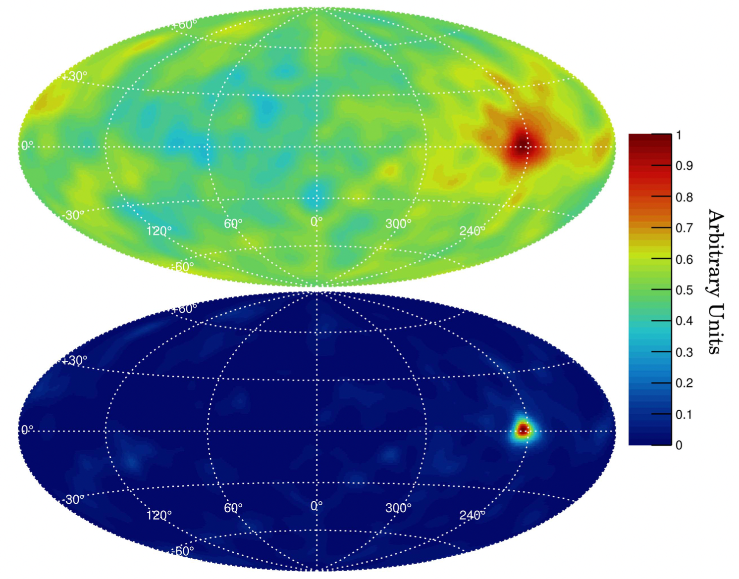
COSI image of GRB 160530A in Galactic coordinates using 0 iterations (top) and 10 iterations (bottom) of the LM-MLEM image deconvolution algorithm. (Lowell et al. 2017)

Slide 20
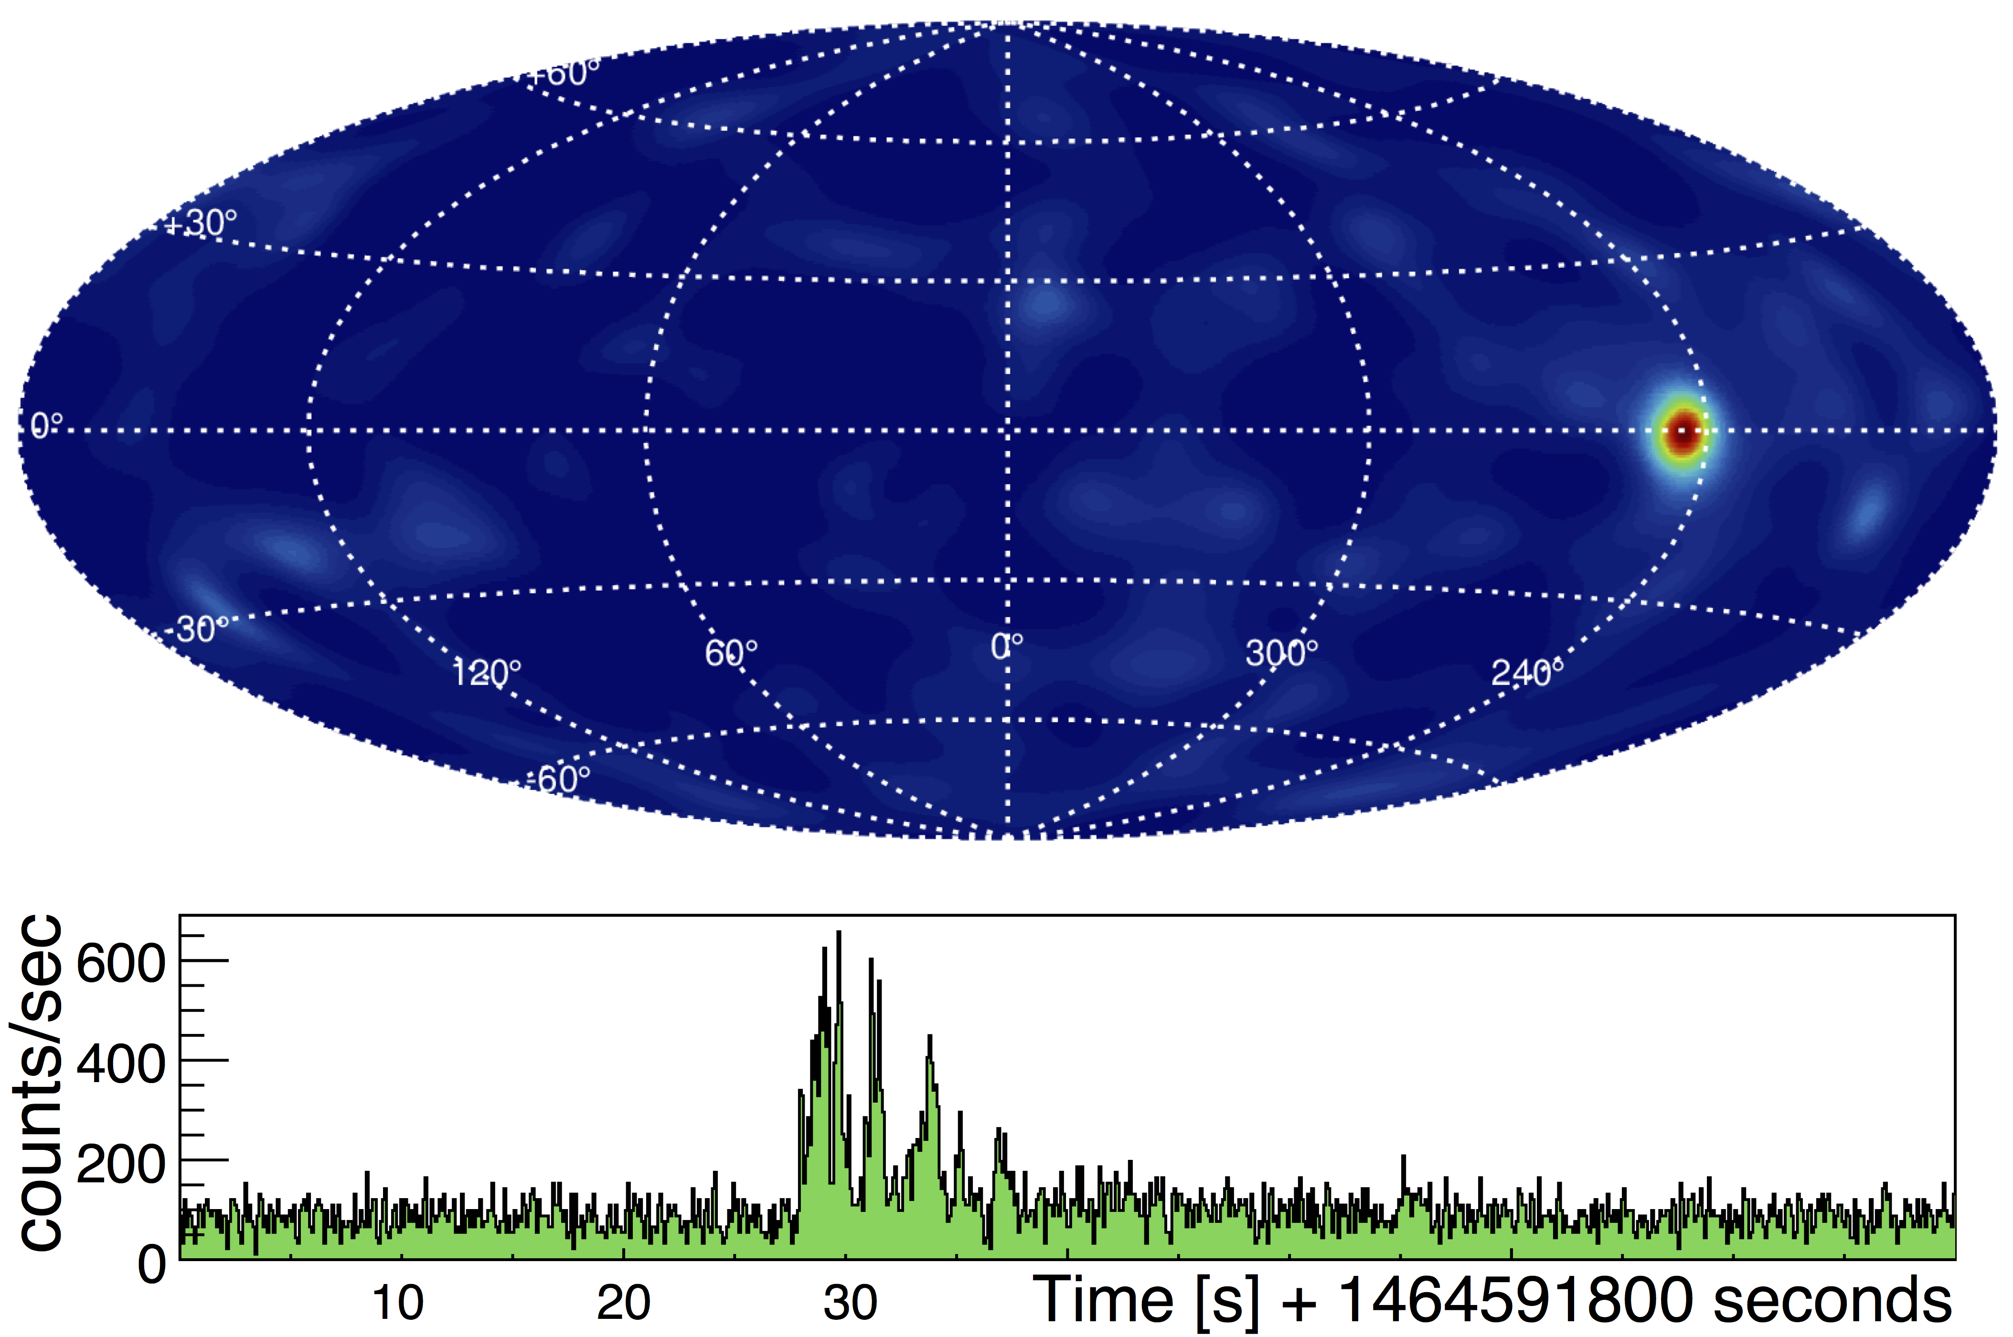
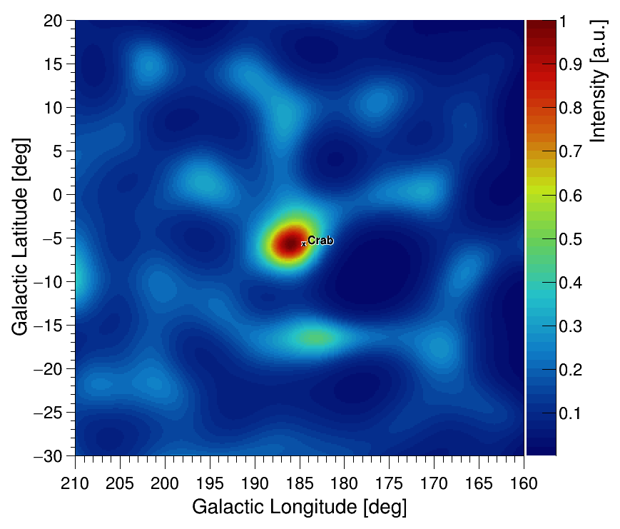
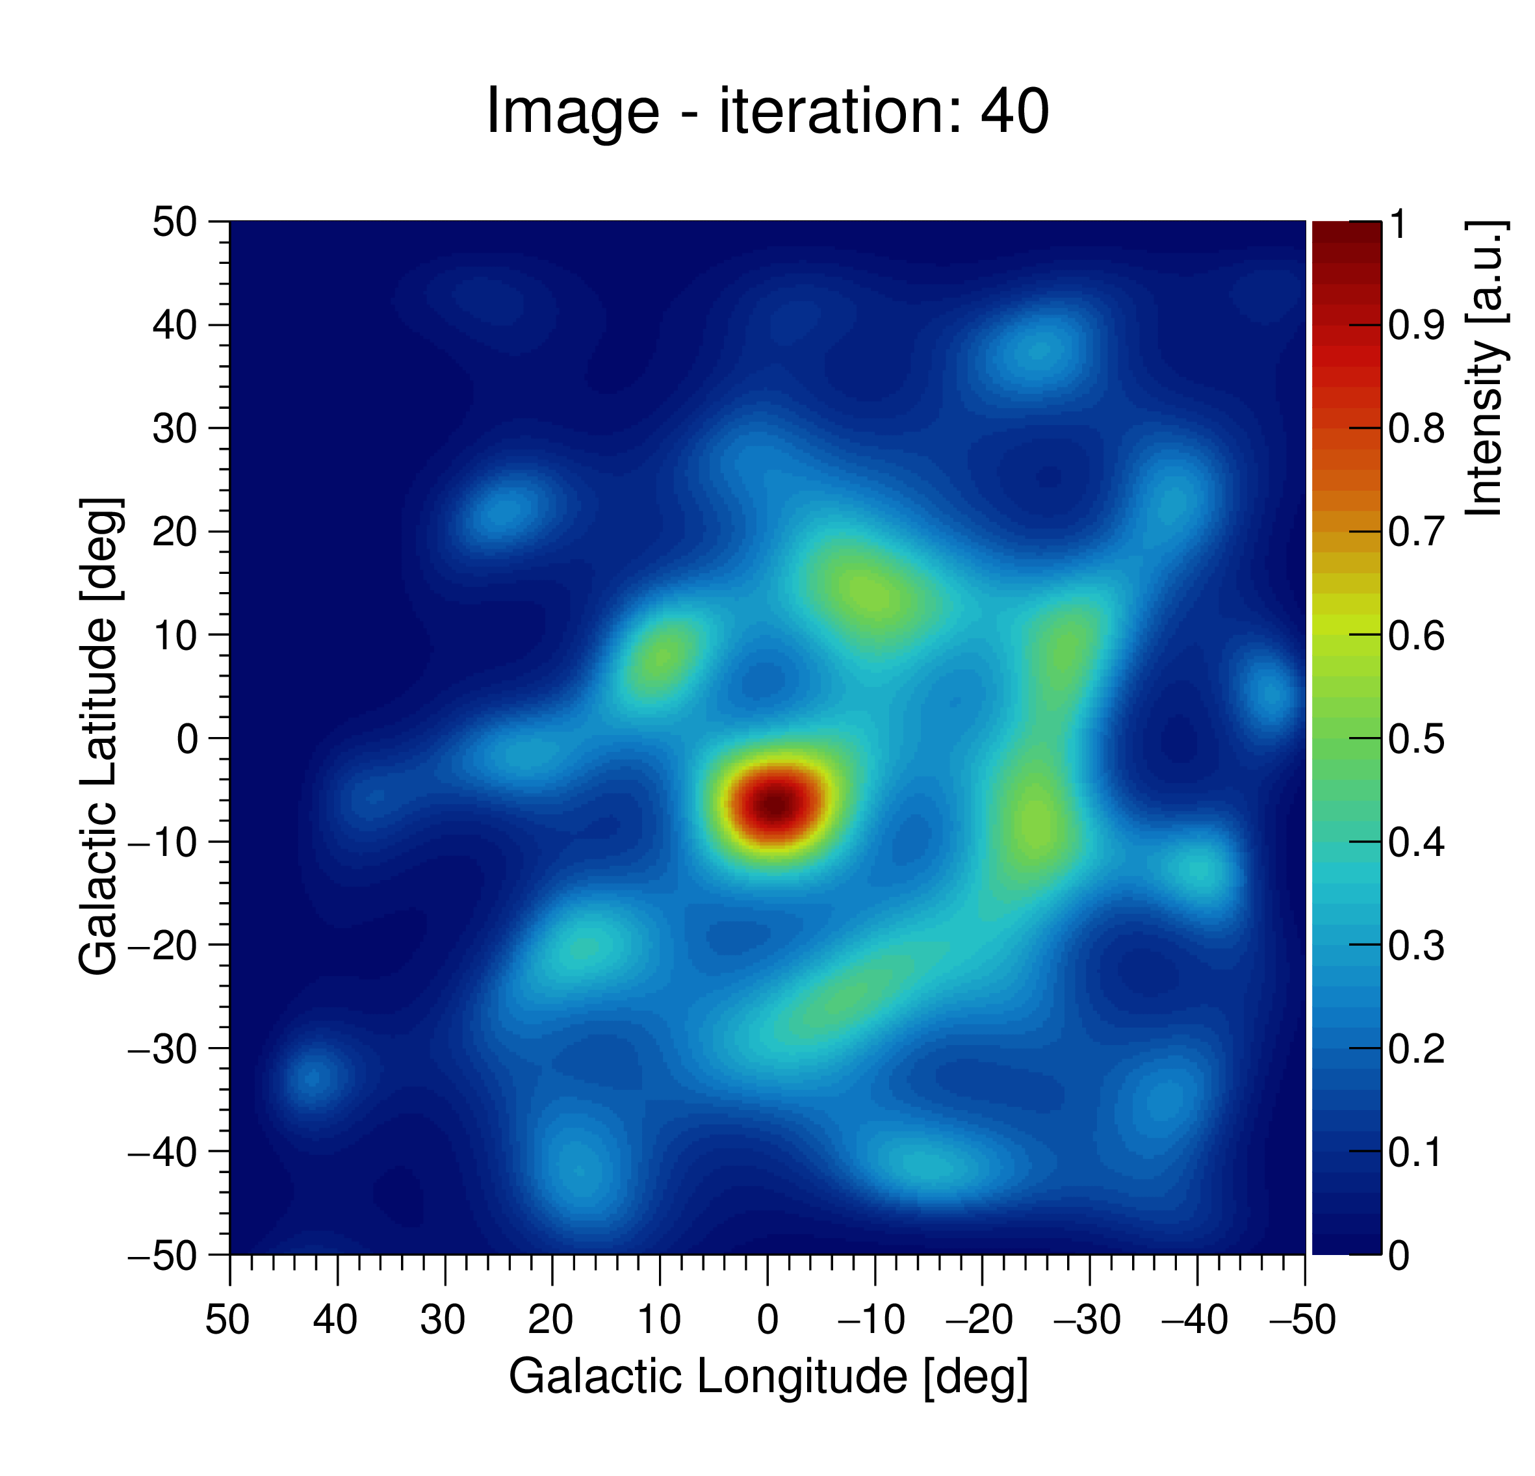
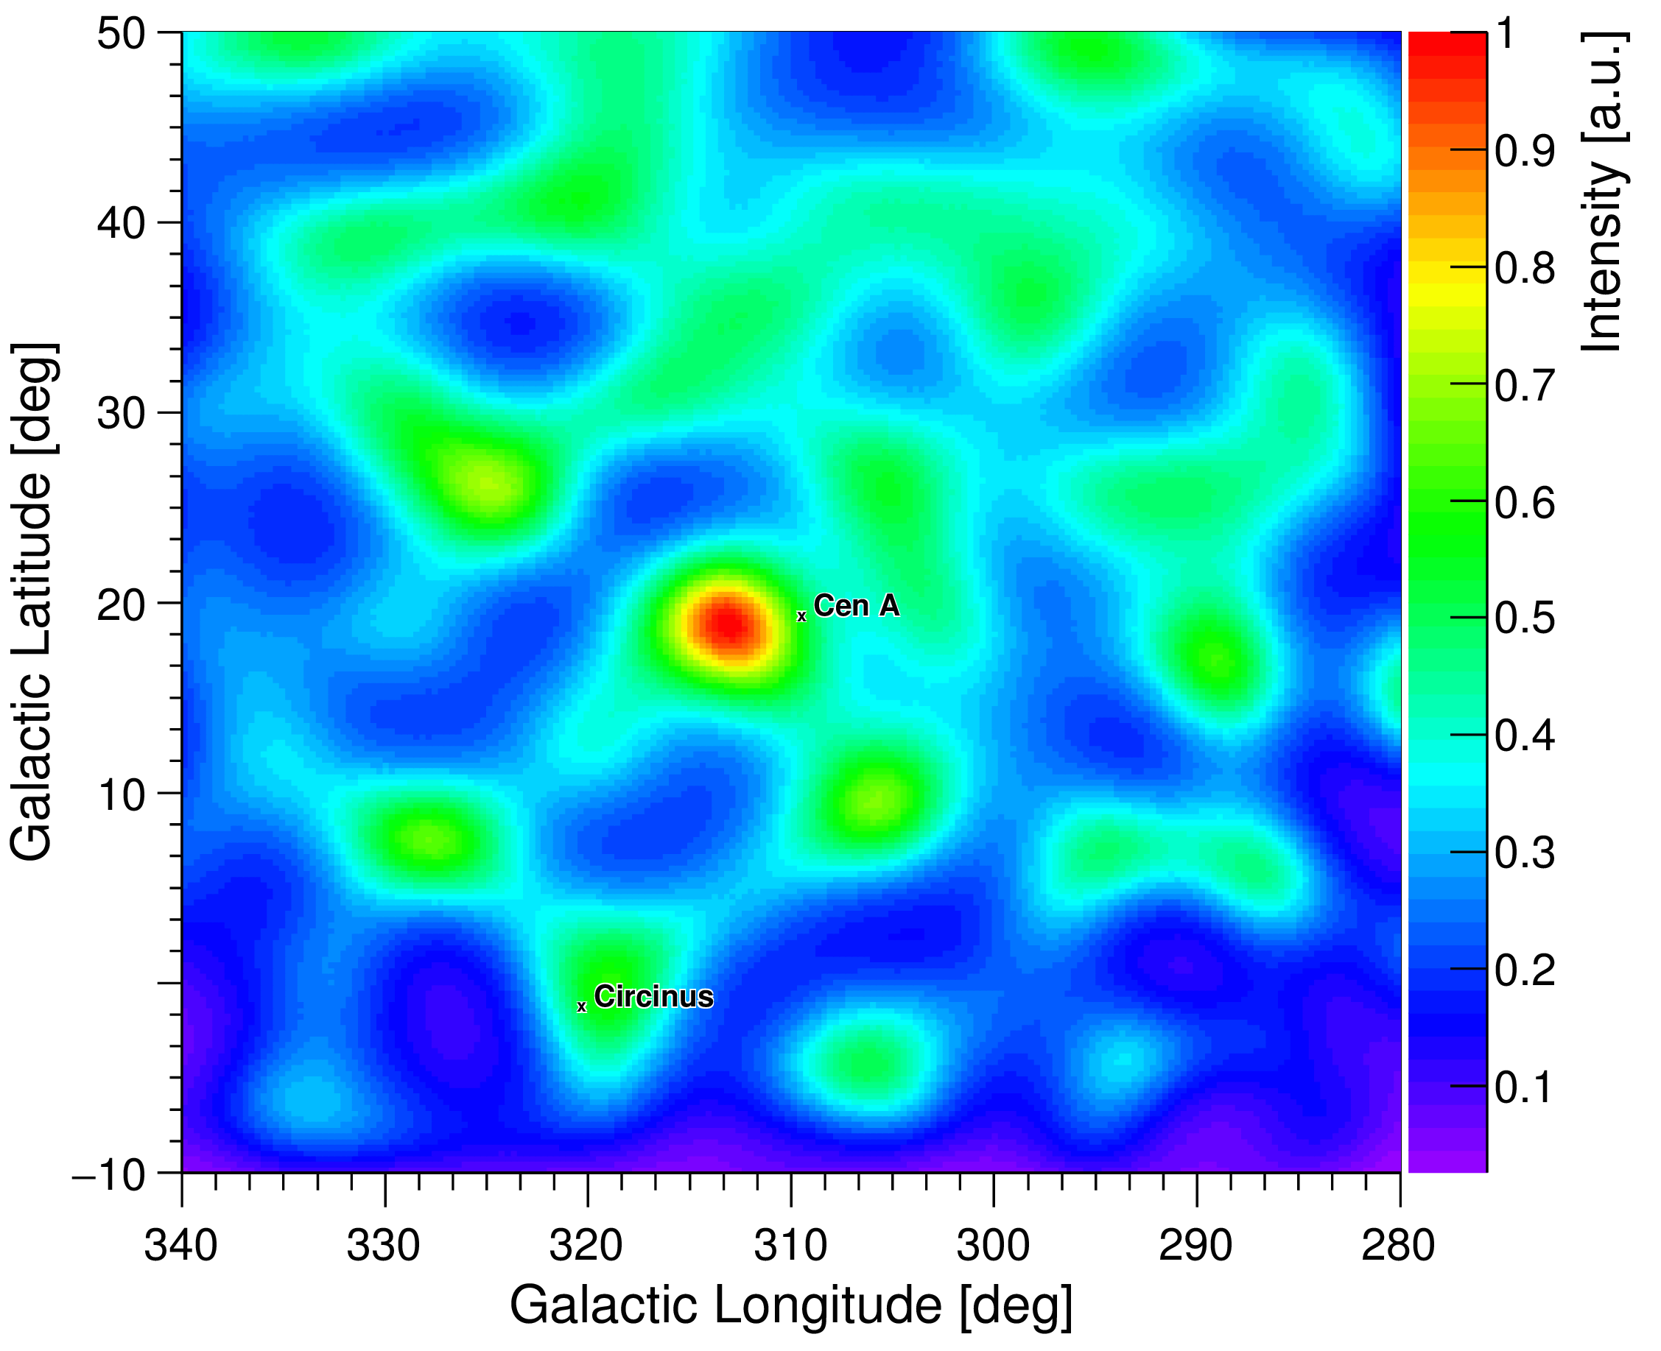
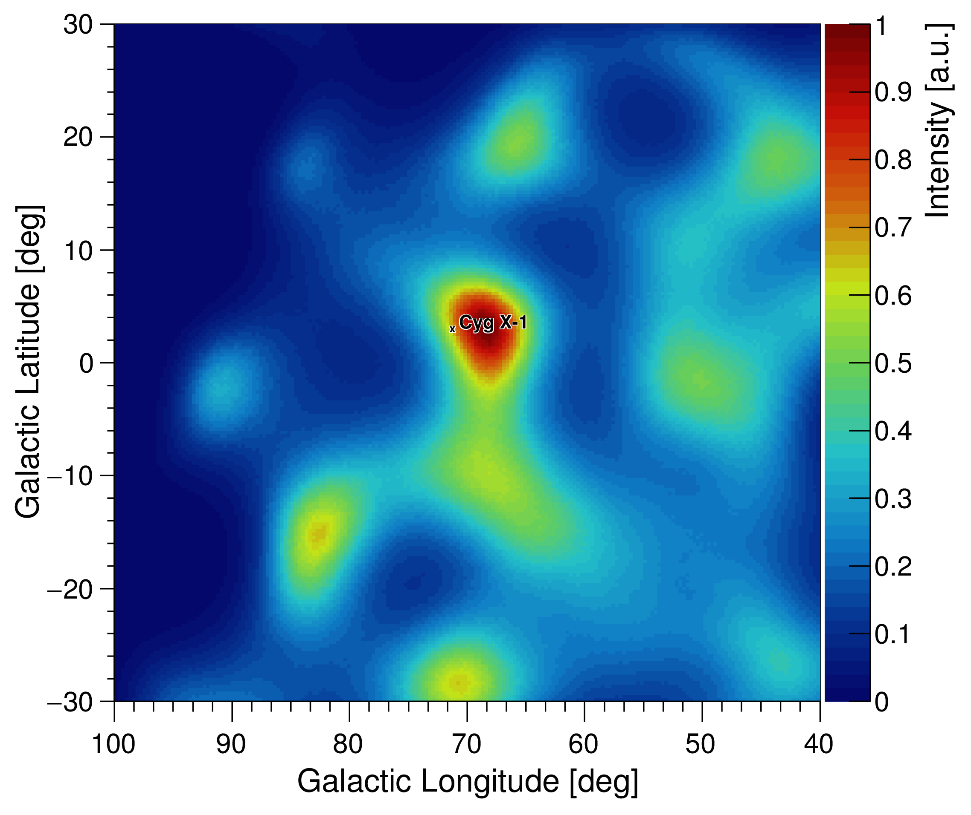
COSI 2016 flight results
Upper limit to the polarization degree
~ 46% (90% c. l.)
(Lowell et al. 2017, ApJ 848, 119)
GRB 160530A

Slide 21
Some remarks:
# The Compton Spectrometer and Imager (COSI), a NASA-SMEX mission to launch in 2027, is a next-generation Compton telescope using an array of 3D-tracking cross-strip HPGeDs.
# There are a lot of Compton imaging processing methods. The (LM)MLEM is a basic one.
# The angular resolution of Compton telescopes is ultimately restricted to about degrees or so, because of Doppler broadening due to the intrinsic motion of electrons in the detector material (Zoglauer & Kanbach 2003).

Slide 22
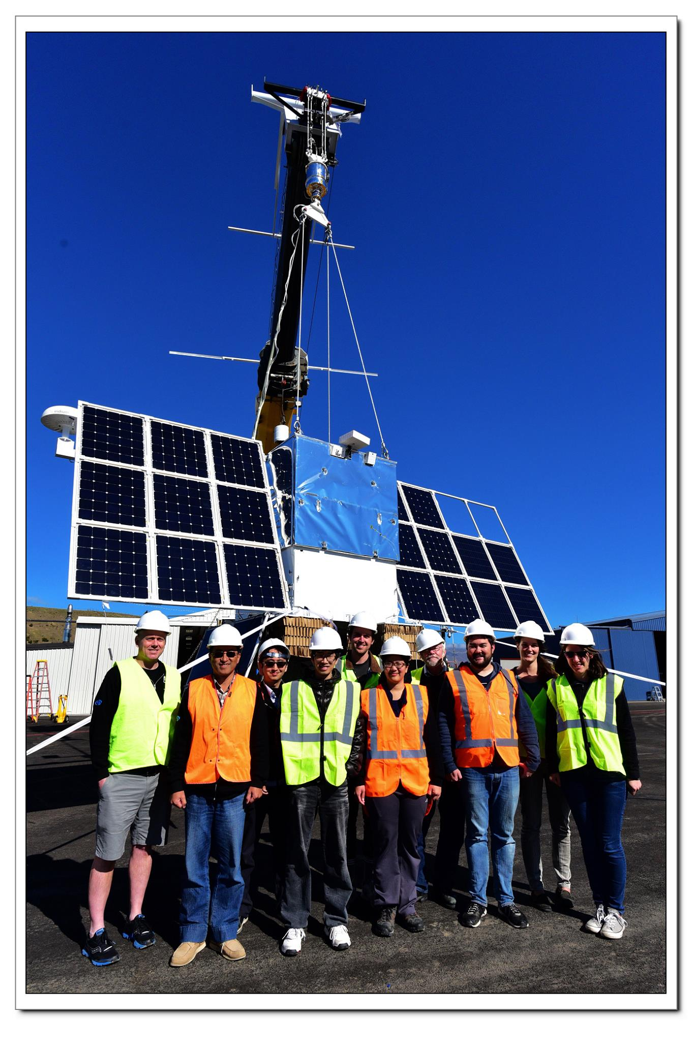
Thanks for listening!
References:
Bandstra, M. S., Bellm, E. C., Boggs, S. E., et al. 2011, ApJ, 738, 8
Beechert J., et al., 2022, NIMA 1031, 166510
Boggs S. E., Jean P., 2000, A&AS, 145, 311
Lowell A. W., et al, 2017, ApJ 848: 119
Wilderman S. J., et al., 1998, Nuclear Science Symp. Conf. Record. 1998 IEEE, 3, 1716
Zoglauer A., Andritschke R., Schopper F., 2006, New Astronomy Reviews 50, 629–632
Zoglauer A., Kanbach G., 2003, Proc. SPIE, 4851, 1302

