Slide 1
Particle Detectors for Medical Applications
Chih-hsun Lin
Institute of Physics, Academia Sinica

Slide 2
Radiation
is
transmission of energy through space or materials.
Electromagnetic waves
Charge or neutral particles
*https://en.wikipedia.org/wiki/Radiation

Slide 3
Particle Physics is the study
of
fundamental particles and forces.
Detectors developed in particle experiments could be useful in radiation applications.
*https://en.wikipedia.org/wiki/Particle_physics

Slide 4
Discovery of Radiation
In 1895, Wilhelm Röntgen discovered X-ray by experiments with Crookes tubes.
In 1896, Henri Becquerel discovered that uranium salts emitted rays with penetrating power.
In 1898, Pierre and Marie Curie discovered Polonium (²¹⁰Po) and Radium (²²⁶Ra).
The term “Radioactivity” was coined by Marie Curie。
Notes:
H->ZZ->eeuu

Slide 5
Application of Radiation
First X-ray image of Wilhelm Röntgen's wife's hand.
Great tool in the medical examination.
Notes:
H->ZZ->eeuu

Slide 6
Taking an X-ray image with early Crookes tube

Slide 7
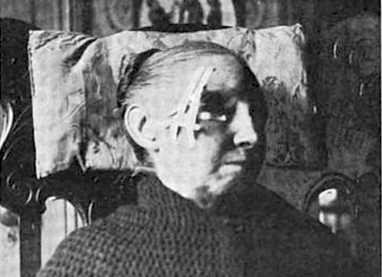
Radiotherapy – Early Stage
X-ray
1896- treated a local relapse of breast carcinoma (Emil Grubbe in Chicago)
1896 - treated stomach cancer (Victor Despeignes in Lyon, France)
1896- treated a skin tumor (Léopold Freund in Vienna, Austria)
Radium
Skin, prostate, and gynecologic cancers.
Notes:
H->ZZ->eeuu

Slide 8
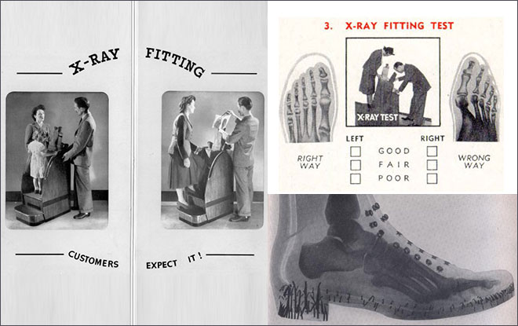
Wrong Application – X-ray Fitting
Notes:
1970才正式禁止

Slide 9
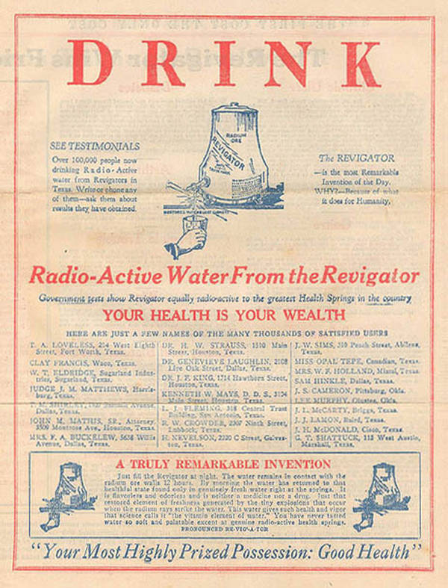

Slide 10
Radiosensitivity
Radiation affects both normal cells and cancel cells.
Different types of cells have different radiosensitivity. They are more sensitive if
Cells are highly proliferative with rapid cell divisions.
Less differentiated like stem cells
Cancel cell is usually more sensitive to radiation.
In general, radiotherapy must
Deliver less radiation to normal tissues.
Deliver sufficient radiation to cancel cells.
Precision radiation delivery and verification are important.
Good Radiation Detector is required.

Slide 11
Radiation Delivery
Body surface:
Electrons from Linac
Inside body:
X-ray from Co60 or Linac
Protons from cyclotron or Synchrotron
Dose depth in water

Slide 12
Bragg curve, discovered by Sir William Henry Bragg in 1903.
Particle therapy was proposed by Robert R. Wilson in 1946.
Notes:
Ra226 decay mode Ra226-> Alpha + Rn222
Bragg 1915 Nobel Prize in Physics: "for their services in the analysis of crystal structure by means of X-rays".

Slide 13
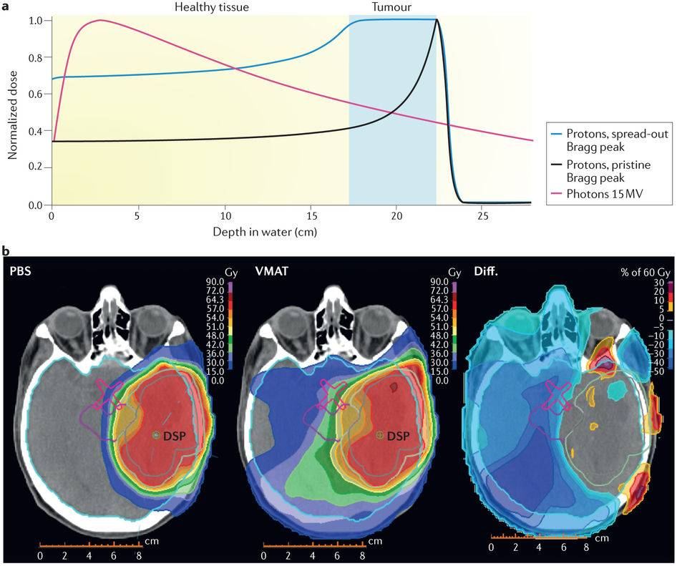
Proton
X-ray
Notes:
Tricho sales corporation established in 1924

Slide 14
Cyclotron Machine
Harvard Cyclotron Lab: 165 MeV (1956), ~ 1000 tons
Notes:
治療到2002

Slide 15
Particle Therapy Center in US
1990, First hospital-based facility at
the Loma Linda University Medical Center in California

Slide 16
IBA cyclotron for proton therapy
There are more than 100 particle therapy centers in the world.
More than 30,000 patients treated per year.

Slide 17
Proton Beam Delivery – Passive
Broad Proton Beam ➔ Dose distribution in various conditions
Ionization detector

Slide 18
Gaseous Ionization Detector
Many particles or X-rays
Bigger signal
Stability
Ionization charges depend on
Chamber volume
Particle Energy
Particle type
Precision dose measurement
Proportional
chamber
R.T.
Geiger counter
Spark
chamber
*https://www.radiation-dosimetry.org/what-is-proportional-region-ionization-detector-definition/

Slide 19
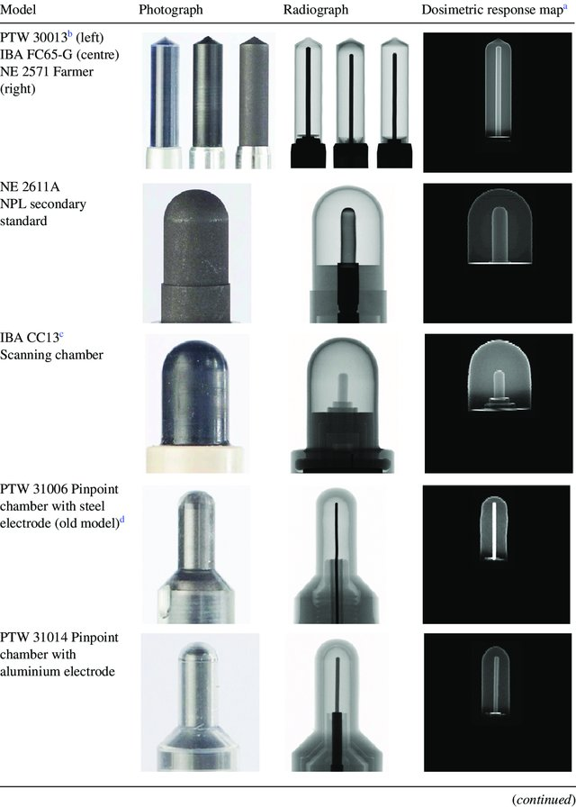
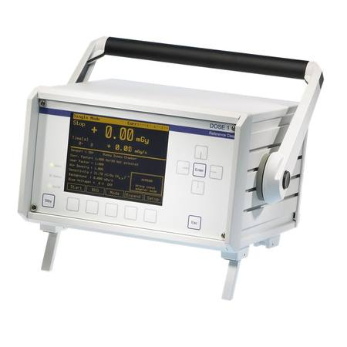
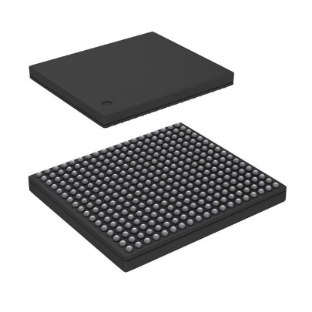
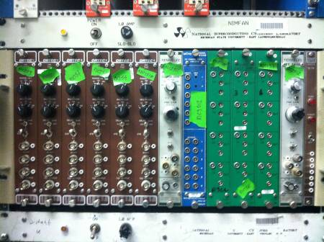
Gaseous Ionization Detector
*AEC Radiation Measuring Instruments
*Physics in Medicine and Biology 60(22):8625-8641

Slide 20
2D Gaseous Ionization Detector
200 MeV Proton Beam and Collimator Diameter = 10 cm

Slide 21
100 MeV Proton Beam in Water
100 MeV Proton Beam in water

Slide 22
Pencil Beam Scanning
Active Scanning

Slide 23
Pencil Beam Scanning

Slide 24
Characteristics of Pencil Beam Scanning
High precision
Small beam size (σ ~ few mm)
Fast scanning (Max speed = 20 m/sec)
High flexibility
Use full beam energy = Maximum treatment depth.
Adjustable scanning speed and beam current
Bring new requirements to the radiation detector

Slide 25
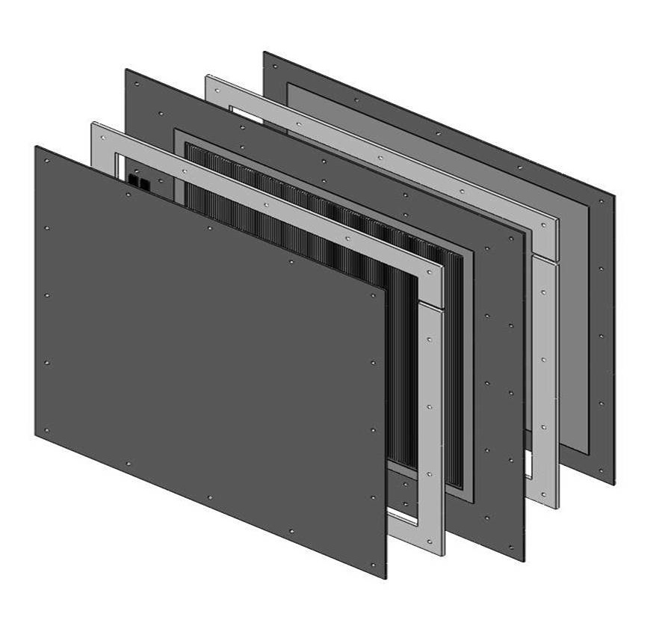
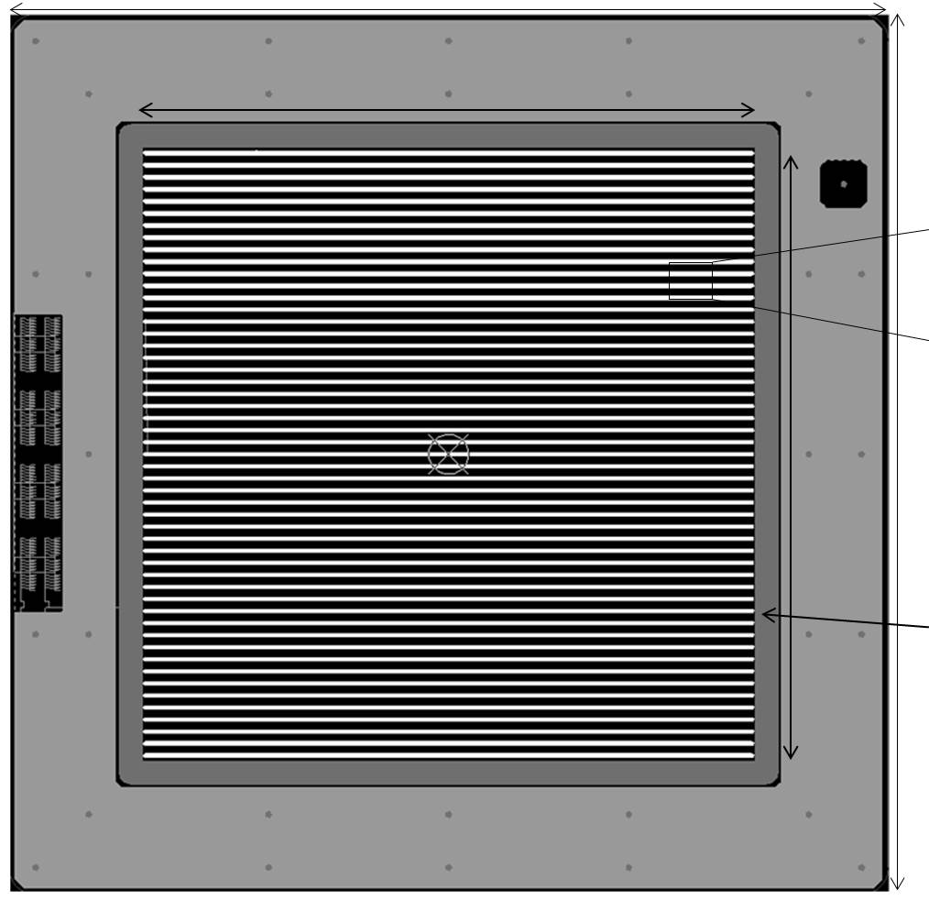
Quality Assurance Requirements
Position
Profile
Intensity
Scanning speed
Energy
Large area
One detector
Short QA time
1 : HV board
2 : Spacer
3 : Strip detector
4 : Spacer
5 : HV board
3
4
5
2
1
1.88 mm
0.12 mm
Fine Strip X&Y Strip ion detector
Fine pitch but large area.
Less channel numbers to reach high rates in measurement.
Wedge phantom for energy measurment

Slide 26
CROSS Detector
Type: Strip of Parallel Plate Ionization Chambers
Active area: 330 x 330 mm².
Maximum sampling rate: 20 kHz One measurement per 50 μsec
Single interface: USB 2.0

Slide 27
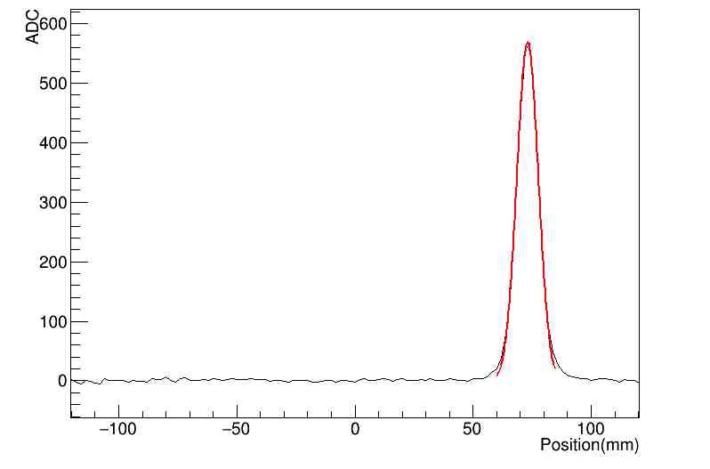
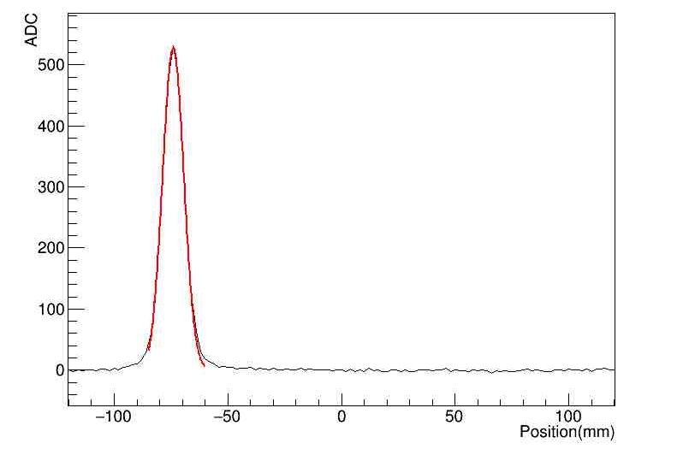
Beam position and spot size measurement (single event)
Beam Energy = 150MeV
X
Y
Peak position = -74.0 mm
σ = 4.64 mm
Peak position = 73.1 mm
σ = 4.52 mm

Slide 28
Position measurement uncertainty
Histogram of position measurement
Position vs time(ms)
σ _{x}~ 0.09 mm

Slide 29
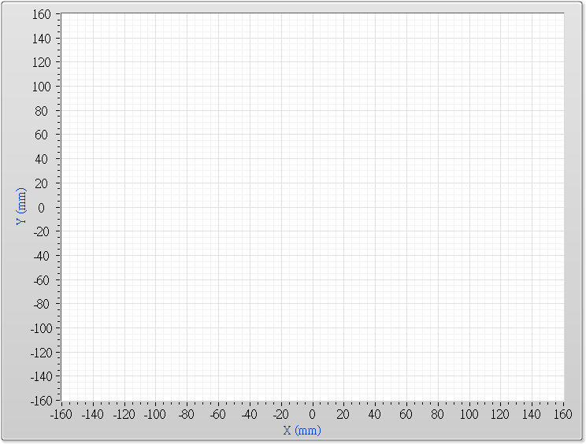
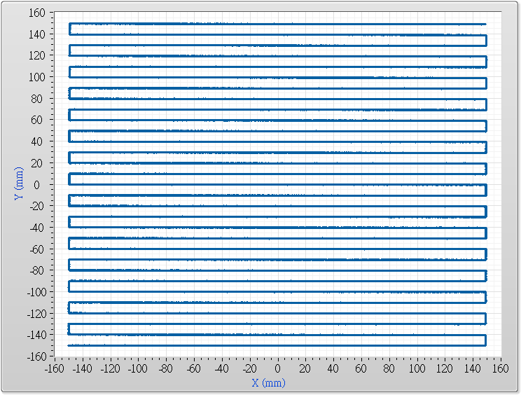
Proton Beam Trajectory (30x30 cm)
Scanning Plan
Measurement

Slide 30
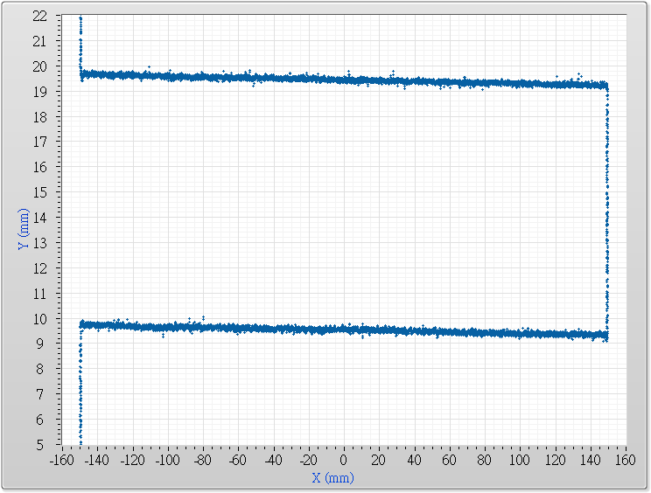
Proton Beam Trajectory (30x30 cm)

Slide 31
Scanning Speed

Slide 32
Scanning Speed
V = 19.83±0.09 mm/msec

Slide 33
Beam Energy Verify (with Wedge)
Thin
PBS Scan direction
Thick

Slide 34
Beam Energy Verify ( 70MeV – 220MeV )

Slide 37
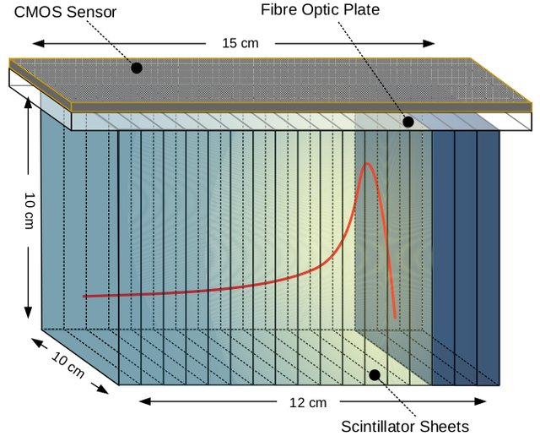
Summary
Ionization detector is an important QA tool of radiotherapy.
Scintillating detector is also a tool by taking an advantage of CMOS imaging sensor.
Notes:
H->ZZ->eeuu

