Slide 1
Boosted dark matter searches with the CDEX-10 Experiment
XU Rui Tsinghua University
2023/06/01

Slide 2
Content
Introduction
Cosmic ray inputs
CRDM flux in space
Earth shielding and recoil spectrum
Results and discussion

Slide 3
Introduction

Slide 4
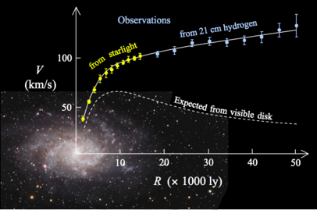
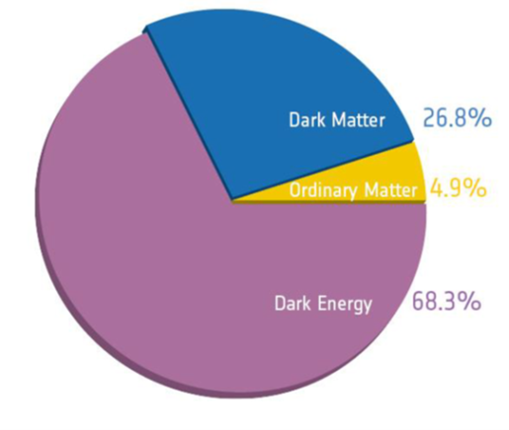
Introduction: Evidence of the existence of DM
Various astronomical observations support the existence of DM;
Including the Galactic rotation curve, gravitational lensing, the collision of the Bullet Cluster etc.
The DM accounts for 26.8% of the total mass of the Universe, while the ordinary matter only takes up 4.9%
The composition of the Universe detected by the Planck telescope
The Galactic rotation curve

Slide 5
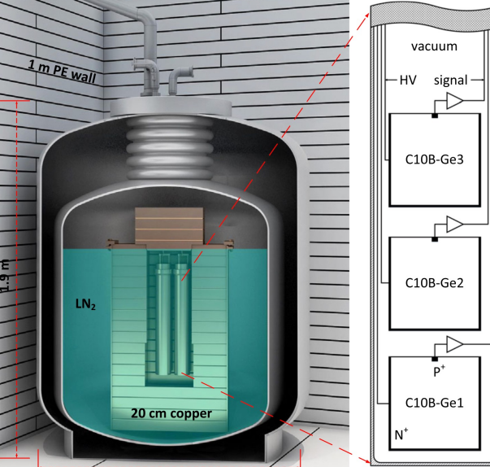
Introduction: CJPL laboratory and CDEX experiment
The China Jinping Laboratory (CJPL) locates in Liangshan, Sichuan province with a rock overburden of 2400m;
The China Dark Matter Experiment (CDEX) runs high-purity germanium detectors in the CJPL;

Slide 6
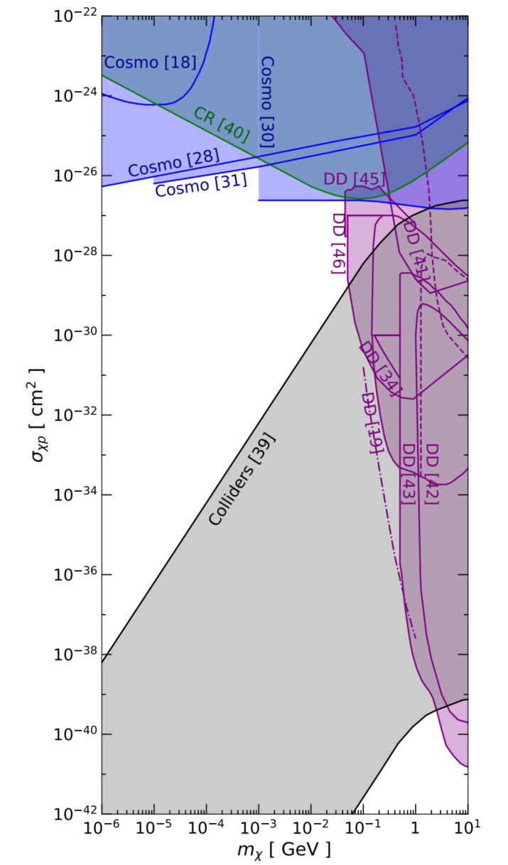
Introduction: current status of DD experiments
None results from DM direct detection (DD) experiments;
Large unexplored region in sub-GeV range;
Right: Exclusion regions for DM-proton scattering from cosmology, colliders, CRs, and various direct detection experiments. (From PRD 99, 063004 (2019))

Slide 7
Introduction: mechanism of boosting DM
In the Standard Halo Model (SHM), low mass (<1 GeV) DM particles cannot transfer sufficient energy to the detectors;
DM can be boosted to relativistic momenta via elastic scattering by cosmic ray particles;
A sketch for the boosted DM scenario. From Chin.Phys.C 46 (2022) 8, 085103

Slide 8
Cosmic ray inputs

Slide 9
Cosmic ray inputs: Fitting Formula
CR spectra near Earth were measured by space-based experiments (AMS, PAMELA etc.), which peaks at ~1GeV due to solar modulation;
Proton and helium flux can be described by the fitting formula; (Used in previous CRDM studies)
$R$: rigidity (p/q) $I$: intensity.
$a−g$ are fitting parameters from M. J. Boschini et al., Astrophys. J. 840, 115 (2017).

Slide 10
Cosmic ray inputs: GALPROP
Voyager I measured CR spectra away from the Earth down to a few MeV, which is not affected by solar modulation;
The GALPROP simulation package can model the CR propagation in the Galaxy, which was adopted to generate required CR data in this analysis.
CR electron intensity measured by AMS, PAMELA and Voyager and fitted by GALPROP; from M. J. Boschini et al., Astrophys. J. 858, 61 (2018)

Slide 11
Cosmic ray inputs: Comparation
The local differential intensities of (a) proton and (b) helium, generated by GALPROP, are shown as red lines. The intensities calculated using the fitting formula are shown as blue lines. The dashed line represents the extrapolation in form CRDM study (PRL 122, 171801 (2019)).

Slide 12
Cosmic ray inputs: Spatial Distribution
Left: A heat map of the proton intensity in the Galaxy;
Right: The helium intensity at different distances from the Galactic center;

Slide 13
Cosmic ray inputs: CR species
CR nuclear species from H to Ni are considered, while former studies only considered proton and helium;
CR electrons is not considered here and left for future analysis;

Slide 14
CRDM flux in space

Slide 15
CRDM flux in space: Formula
The CR-induced DM flux is obtained by integrating over all CR nucleus species $i$ and energies $Ti$ along the line of sight (LOS):
$T$: kinetic energy $μ$: reduced mass $A$: atomic number
$σ_{χi}$: the zero-momentum transfer DM-nucleus elastic scattering cross section
$G(Q^{2})$: form factor of the momentum transfer $Q=\sqrt{2mT}$

Slide 16
CRDM flux in space: Results
The CRDM fluxes scaled by $Tχ$ for different DM masses.
Solid: all species; dashed: only proton and helium.
Blue: SHM for DM mass 1 GeV, scaled by 10⁻¹⁰

Slide 17
CRDM flux in space: Discussion on $D_{eff}$
The CRDM flux can be rewritten as:
where the spatial integration are represented by $D_{eff}$
$D_{eff}$ can be calculated by:
Homogeneous assumption:
(Depends on the Galactic model)
$D_{eff}$ varies from 1-10 kpc, becomes a major source of uncertainty.

Slide 18
CRDM flux in space: Discussion on $D_{eff}$
$D_{eff}$ as a function of kinetic energy for different DM masses from 1 MeV to 1 GeV.

Slide 19
Earth shielding and recoil spectrum

Slide 20
Earth shielding effect
DM particles lose energy and change direction while go through the rock overburden before reach the laboratory.
Monte-Carlo simulation package CJPL_ESS is adopted to evaluate the Earth shielding effect.
CJPL_ESS includes: mountain topology & form factor effect
The topographic map of Jinping mountain used in CJPL_ESS.

Slide 21
Earth shielding effect: CDEX10 data
The 205.4 kg day CDEX10 data was used in this analysis.
The spectrum went through a series of physics event selections and efficiency corrections.
The characteristic X-ray peaks from internal cosmogenetic radionuclides are identified and subtracted.
Right:
The CDEX10 data with error bars; the fitted K-shell X-ray peaks with a flat background; Inset shows the K-X and M-X peaks.

Slide 22
Earth shielding effect: CDEX10 data
Residual spectrum from 0.16-2.56 keV, together with the expected CRDM spectrum.
Solid: with the energy resolution $σ=35.8+16.6\sqrt{E} (eV)$; dashed: without resolution.

Slide 23
Results and discussion

Slide 24
The exclusion region
Red contour: the exclusion region adopting the CRDM scenario using CDEX10 data.
The CRDM analysis from PROSPECT, KamLAND, XENON1T and PandaX are shown, together with the CDEX Migdal analysis, other DD experiments results and the cosmology and CMB constraints.

Slide 25
Summary and future works
Features
Considered: more CR species & CR spatial distribution.
Discussed: the effective distance $D_{eff}$.
Earth shielding effects evaluated with the CJPL_ESS.
The newest 205.4 kg day CDEX10 dataset is used
Future works
CR electrons;
Inelastic scattering process and model dependent analysis;
Modulation of the spectrum;
Other boosting sources, e.g. blazar
……

Slide 26
Thanks for listening!
Q & A

