Slide 1


Surface Event Pulse Shape Simulations for the LEGEND Experiment
Kevin H. Bhimani
June 1, 2023
PIRE GEMADARC Collaboration Meeting

Slide 2
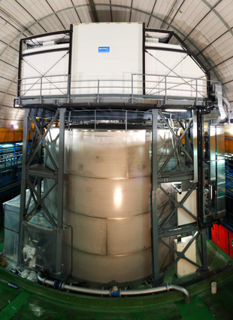
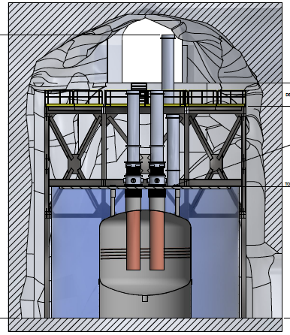
LEGEND (arXiv:1709.01980)
Mission: “The collaboration aims to develop a phased, Ge-76 based double-beta decay experimental program with discovery potential at a half-life beyond 10²⁸ years, using existing resources as appropriate to expedite physics results.”
Select best technologies, based on what has been learned from GERDA and the Majorana Demonstrator, as well as contributions from other groups and experiments.
MAJORANA
GERDA
Both
- Radiopure nearby parts
- Low noise / low threshold electronics
- LAr veto
- Low-A shield, no Pb
- Clean fabrication techniques surface exposure
- Control Development of large point-contact detectors
First phase:
200 kg in upgraded infrastructure at LNGS
Currently taking data with 140 kg source
BG goal: <0.6 c /(FWMH t y)
Discovery sensitivity at a half-life of 10²⁷ years
Subsequent stages:
1000 kg, staged via individual payloads
Background goal <0.03 cts/(FWHM t yr)
Discovery sensitivity at a half-life > 10²⁸ years
Will probe the entire inverted hierarchy

Slide 3
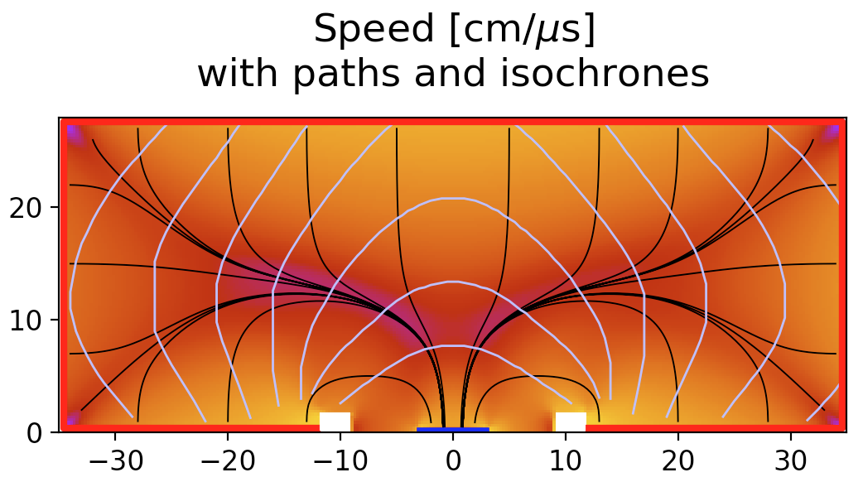
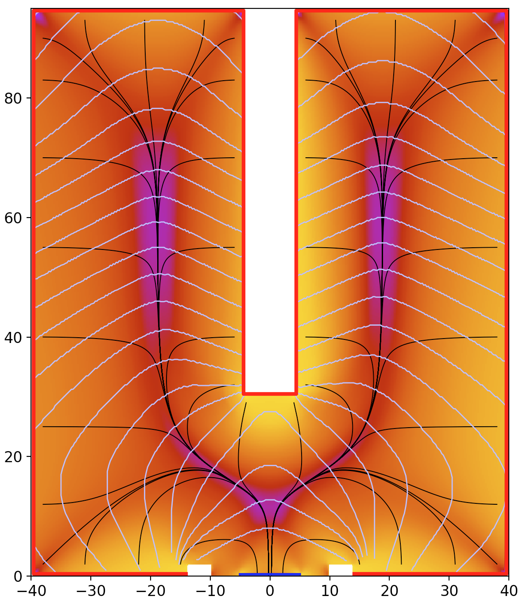
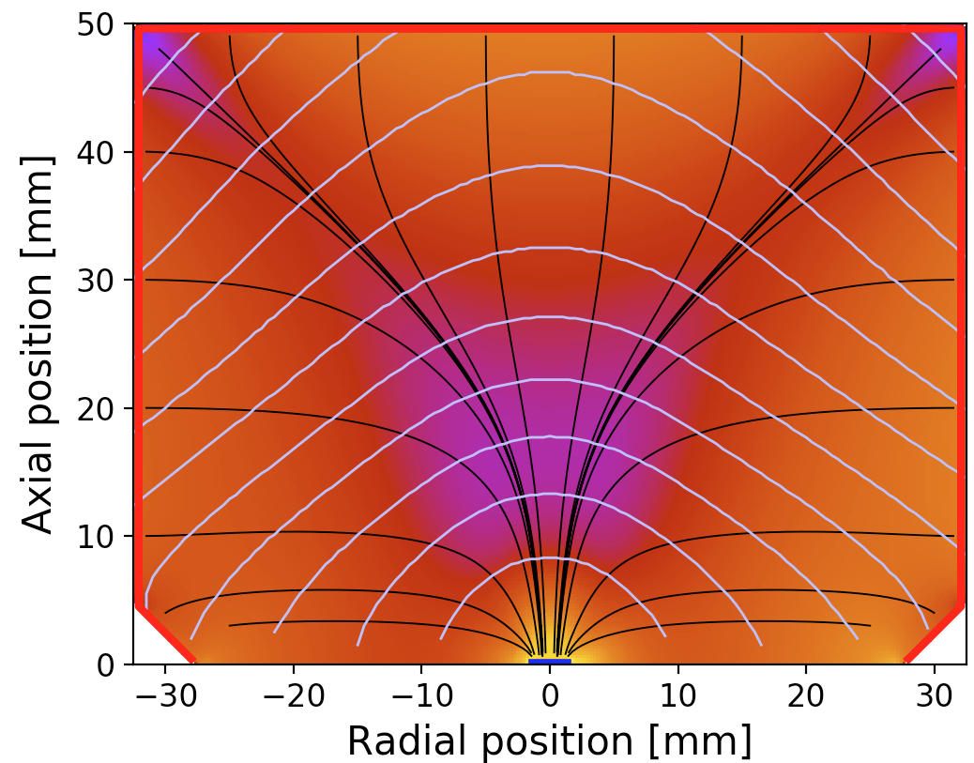
Point Contact Ge Detectors for LEGEND-200
Three detector geometries used in LEGEND-200:
  GERDA BEGes
  Majorana PPCs
  New Inverted-Coaxial Point Contact detectors (ICPC)
n⁺ contact: Lithium atoms diffusion into the outer crystal surface
p⁺ contact: Boron implantation onto the surface
Contacts isolated using passivation region in between
BEGe
ICPC
PPC

Slide 4
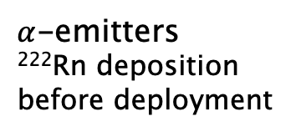
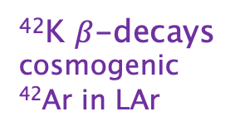
LEGEND 200 background model
Grey bands indicate uncertainties in assays and background rejection
²³⁸U, ²³²Th: Internal contamination in the array
⁶⁰Co and ⁶⁸Ge: Cosmogenic activation
Muon-Induced Background
⁴²K $β$-decays
cosmogenic ⁴²Ar in LAr
$α$-emitters
²²²Rn deposition before deployment
LEGEND-200 background Goal

Slide 5
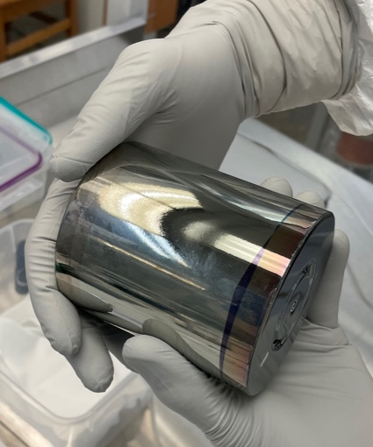
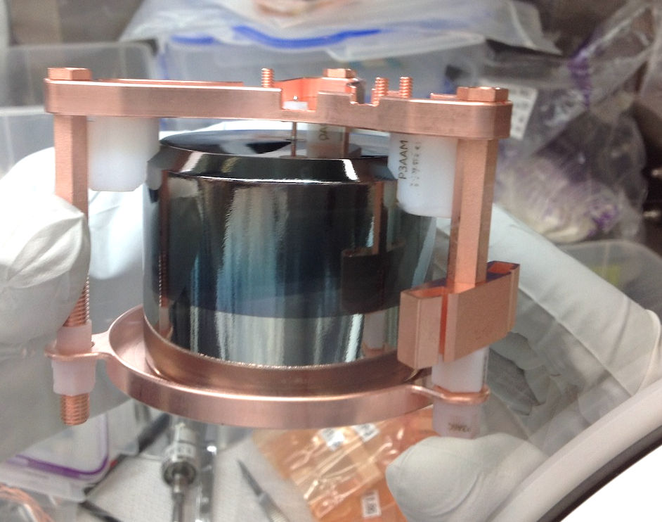
Surface background
Passivated surface is particularly susceptible to alpha and beta backgrounds
  n⁺ contact is too thick for alphas to penetrate
  p+ backgrounds possible, but easy to understand and reject using pulse shape
Background model uncertainty driven by uncertainty in pulse shape rejection
  Surface event pulse shape discrimination is determined from data
Passivated surface
ICPC detector
PPC detector

Slide 6
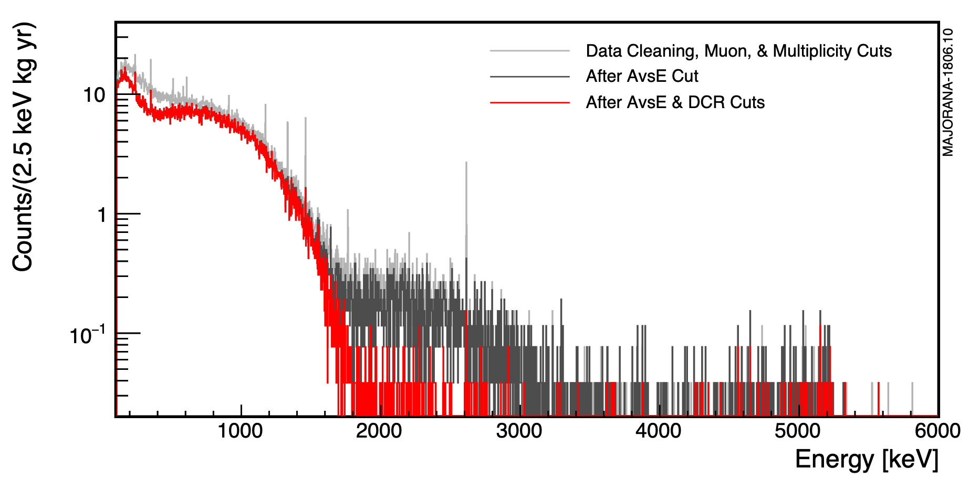
Charge collection on Passivated surface
Slow charge collection on the passivated surface
Charges experience trapping and slow re-release and/or reduced drift speed
  Degrades alpha events energies into ROI
MJD - Cut with a parameter related to slope of tail
GERDA - Cut using a risetime parameter
Surface Alpha Event
Bulk Event
Surface alphas
Known alpha waveform in a PPC detector
MAJORANA spectrum before and after alpha cuts

Slide 7
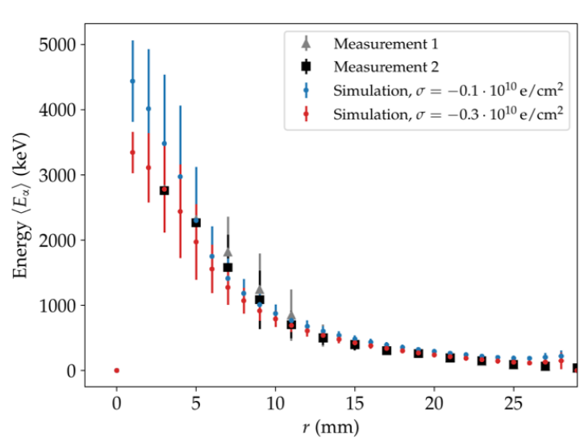
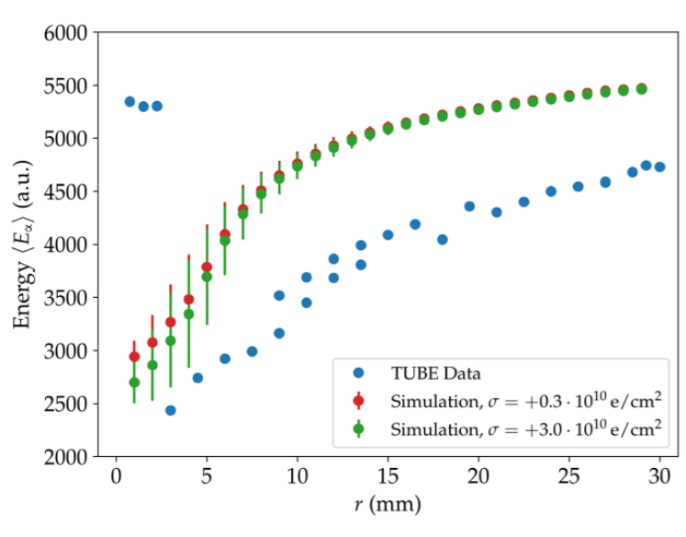
Surface Charge Effects
Surface charges on passivated surfaces impact fraction of charge collected and drift times
Dedicated alpha scans gave conflicting results
Simulations can help model the passivated surface and reduce uncertainty

Slide 8
Beyond standard model (BSM) searches with L1000
Enriched detectors with limited cosmogenic exposure enable BSM searches
LEGEND 1000 with its use of UGLA will have a robust BSM program
The physics will encompass a wide range of energies from keV scale to 10’s of MeV
External backgrounds at low-energy are primarily surface events
BSM searches require an accurate model of the passivated surface and n⁺ dead layer
Preliminary
J. Waters Masters thesis

Slide 9
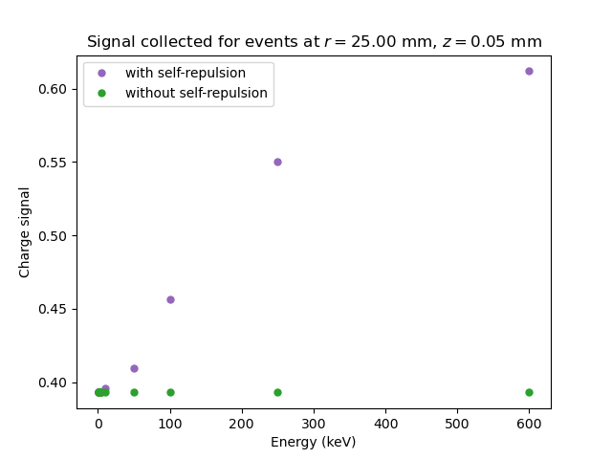
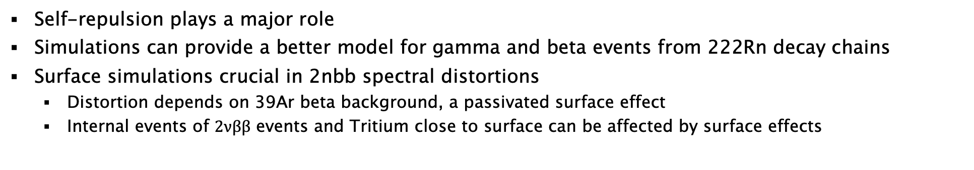
Beyond standard model searches with L1000
Self-repulsion plays a major role
Simulations can provide a better model for gamma and beta events from 222Rn decay chains
Surface simulations crucial in 2nbb spectral distortions
  Distortion depends on 39Ar beta background, a passivated surface effect
  Internal events of $2νββ$ events and Tritium close to surface can be affected by surface effects
Energy collected for a Majorana PPC detector
Notes:
Spectral distortion plot: amplitude of the different processes would not be same, the 2vbb would dominate the spectrum, but the plot illustrates how different processes would change the spectrum

Slide 10
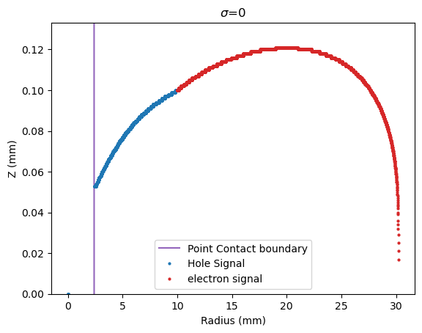
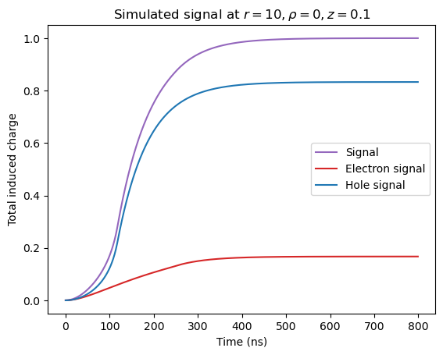
Waveform Simulations
Pulse shape simulations so far have used point charges
Diffusion can be approximated with a Gaussian convolution
Charge trapping and rerelease effect is not accurately modeled in current simulations
Alpha interactions produce a large and dense charge cloud, where diffusion and self-repulsion effects are significant
Self repulsion could also push the charge onto the passivated surface, leading to delayed charge component
Notes:
Current simulations cannot predict what events are getting through the analysis cuts
Having the right simulations will:
Help develop future generation detectors
Make models to simulate Beta and Gamma event

Slide 11
EH Drift simulations
Incorporates diffusion and self repulsion:
Initially developed by David Radford
Keeps track of charge density at each point
Electric potential is recalculated at each time step
Siggen
Initial setup
Calculate Electric potential using relaxation algorithm
Calculate the signal using Shockley–Ramo theorem
Calculate the weighting potential and the capacitance
EH Drift
Initial setup
Calculate Electric potential using relaxation algorithm
Calculate the weighting potential and the capacitance
Save snapshots of charge densities
Calculate the signal using Shockley–Ramo theorem
Step over time steps
Update charge densities
Recalculate the electric potential
Track charge diffusion and drift in the field

Slide 12
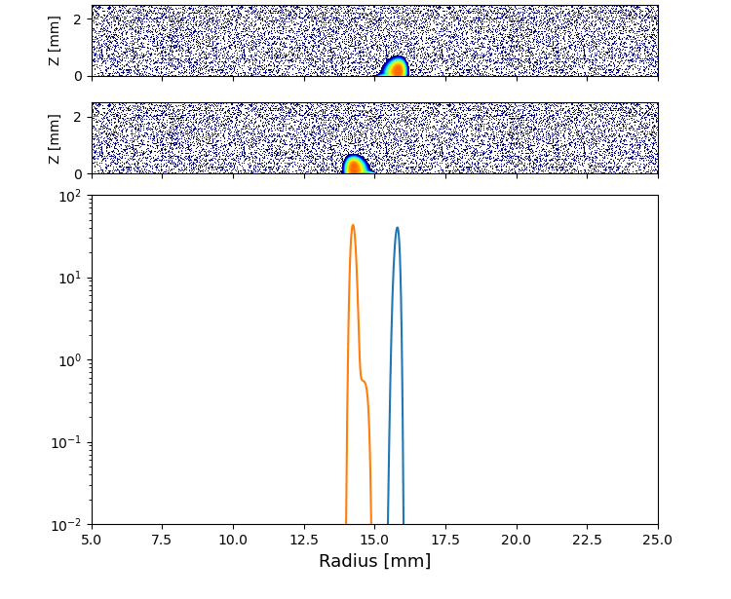
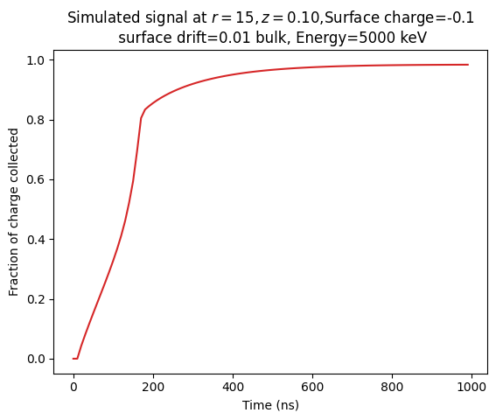

EH Drift simulation results
Self repulsion pushes charges onto the surface
Produces waveform that better models the data
Electron
Hole
Projected Density

Slide 13
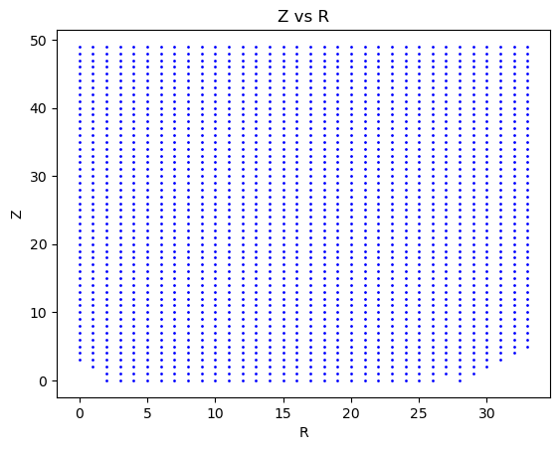
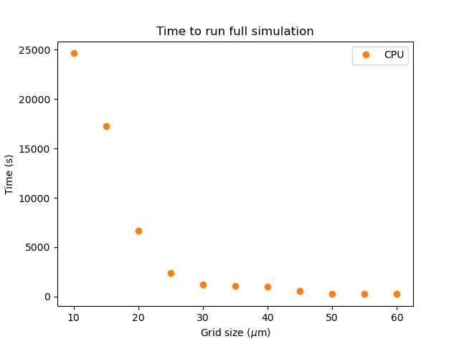
Parallel calculations on GPU
On CPU, O(n²) calculations must be completed for each time step
Expected range of alpha in Ge is 17.6- 20.0 micron
A single waveform takes about an hour to produce
GPU-based calculation dramatically speeds up intrinsically parallel calculations: identical calculations are performed at each position in the detector
Different approach to numerical relaxation was needed
Used supercomputing cluster at UNC to run on Tesla V100-SXM2 GPUs

Slide 14
EH Drift simulations
Incorporates diffusion and self repulsion:
Initially developed by David Radford
Keeps track of charge density at each point
Electric potential is recalculated at each time step
Siggen
Initial setup
Calculate Electric potential using relaxation algorithm
Calculate the signal using Shockley–Ramo theorem
Calculate the weighting potential and the capacitance
EH Drift
Initial setup
Calculate Electric potential using relaxation algorithm
Calculate the weighting potential and the capacitance
Calculations on GPUs
Save snapshots of charge densities
Calculate the signal using Shockley–Ramo theorem
Step over time steps
Update charge densities
Recalculate the electric potential
Track charge diffusion and drift in the field

Slide 15
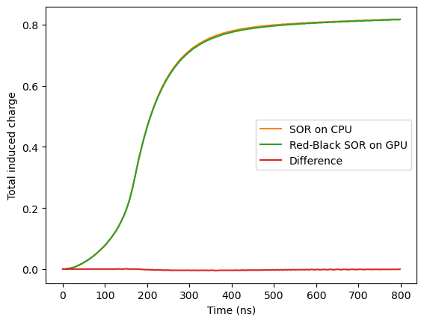
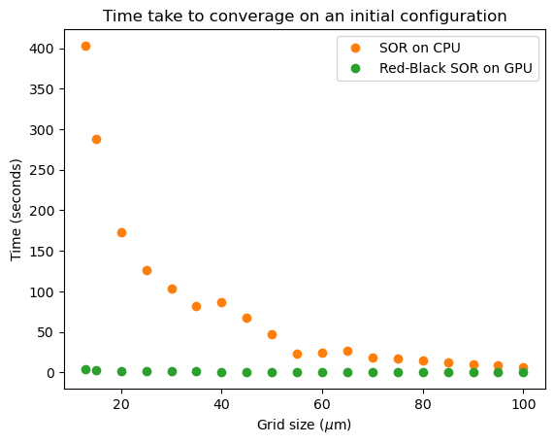
GPU performance
GPU accurately reproduces CPU results: < 0.69% difference in waveforms
GPU approach speeds up waveform simulations:
  GPU and CPU algorithms converge in approximately the same number of iterations
  GPU calculation time does not depend on grid size
  100x speed up for a 13-micron grid
GPU approach allows us to use EH drift for alphas simulations

Slide 16
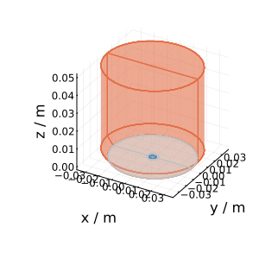
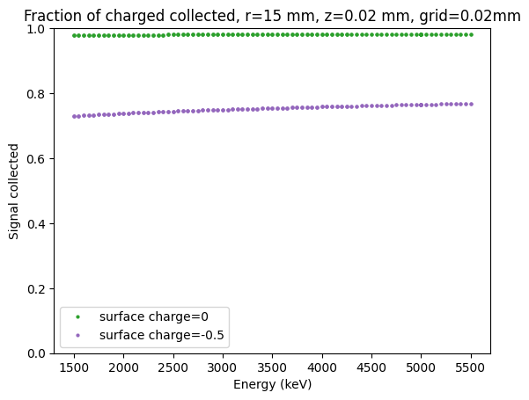
Preliminary results
Built a test library for a Majorana PPC detector
6000 ns run time
Charge collection measured at 6000ns
Demonstrates the effect of surface charge and surface drift on the surface effects

Slide 17
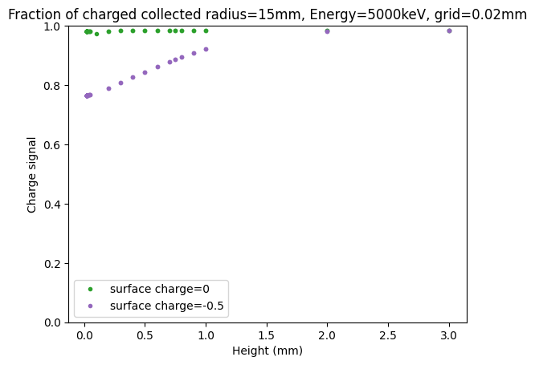
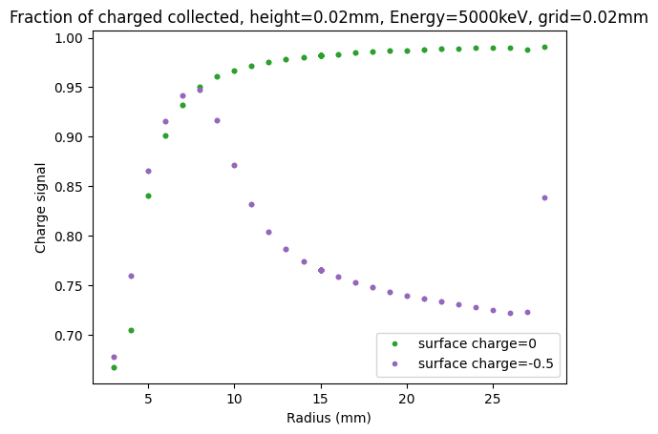

Slide 18
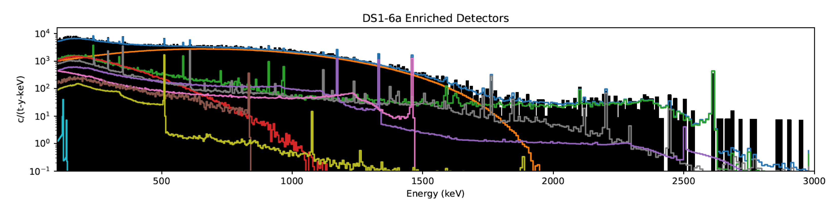
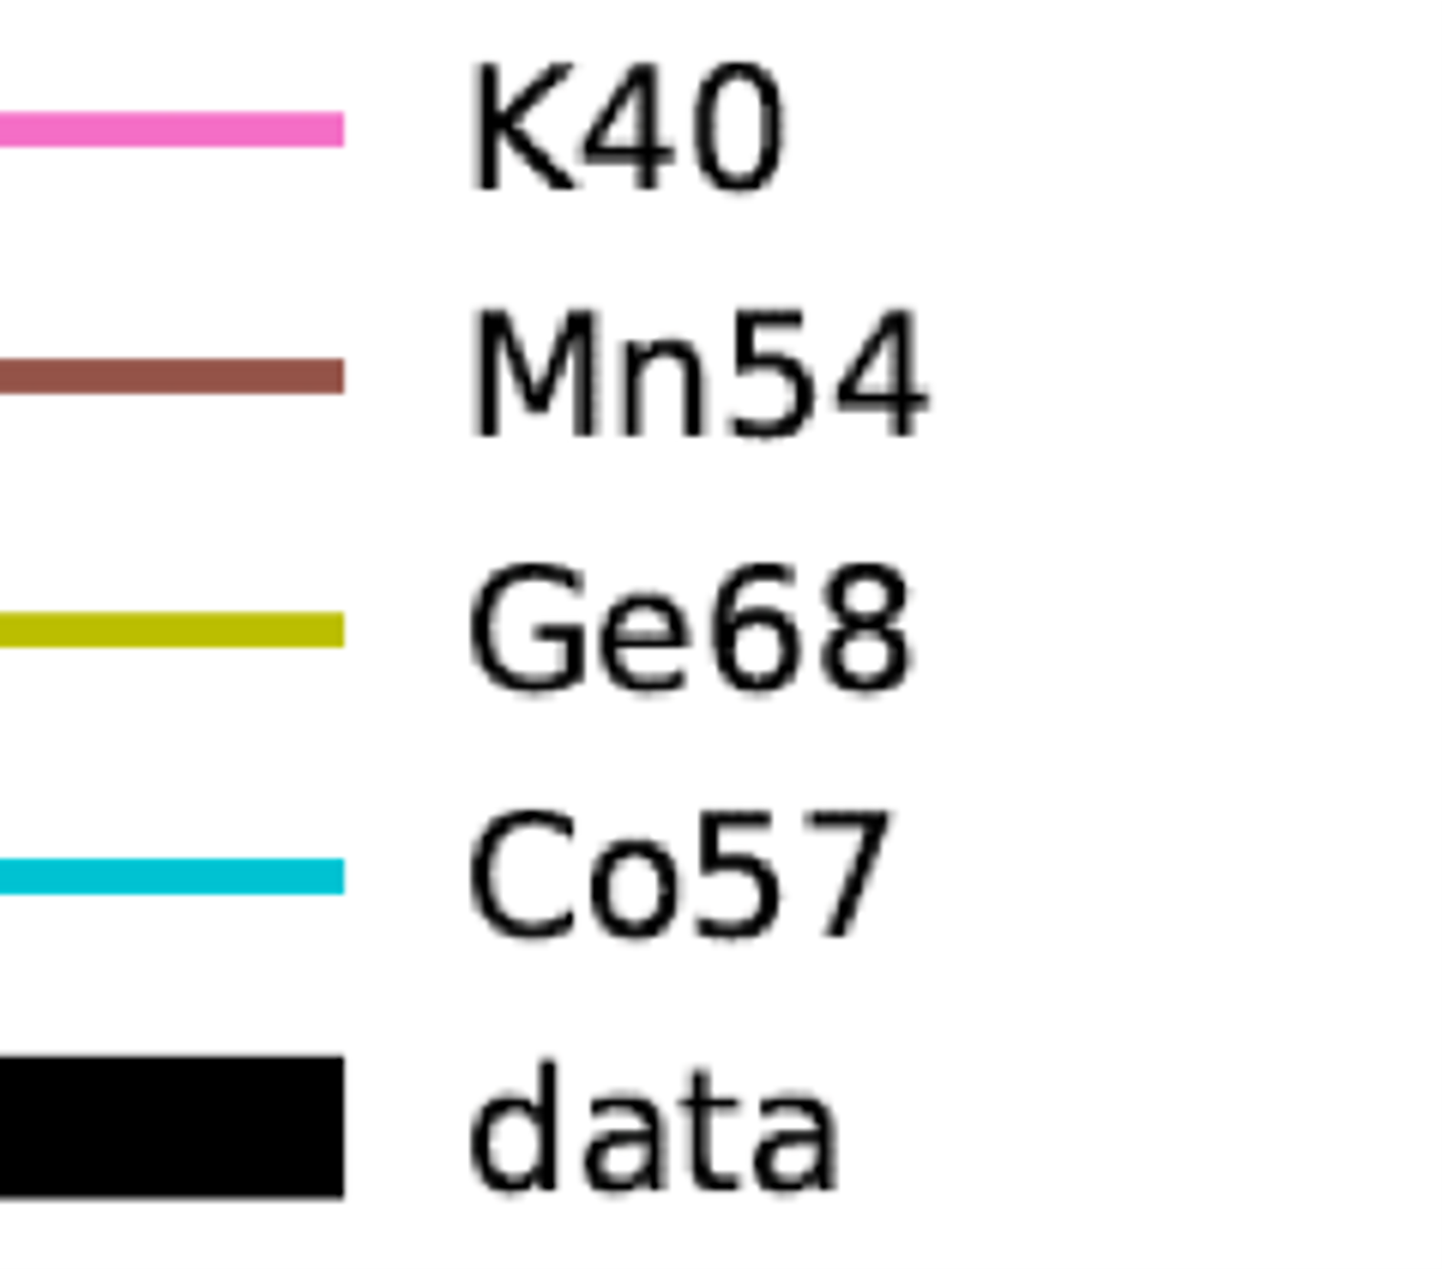
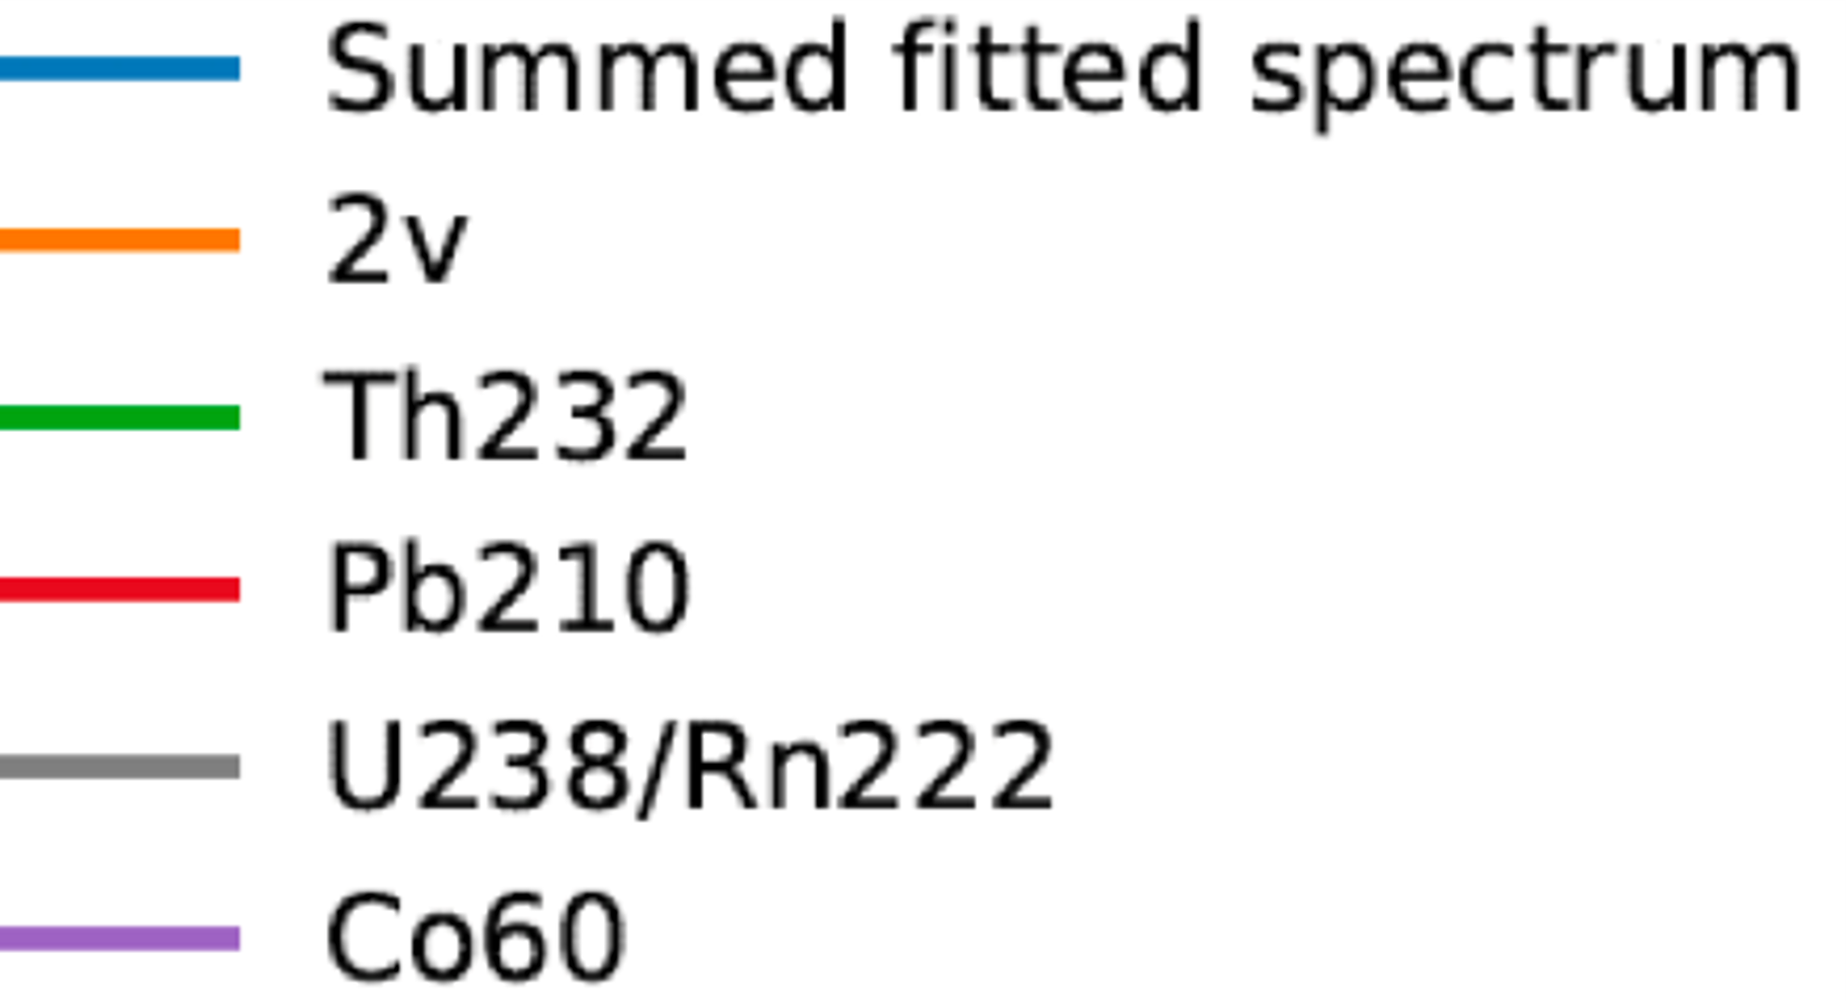
Next steps: Build a background spectrum
Build a library of waveforms using GPU powered simulations
Integrate into LEGEND simulations workflow
  Location and impact energy from GEANT4 simulations
  MaGe-post-proc pulls waveforms from library
  Build a background model for Alphas based on the library
Calculate the pulse-shape background rejection efficiency using simulations
  Apply cuts to simulated waveforms
MJD background model

Slide 19
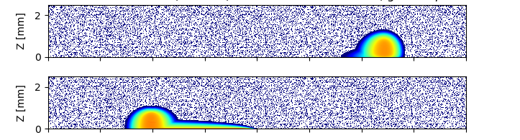
Conclusion and future directions
LEGEND collaboration build upon best techniques from current generation experiments
Surface events are the largest contributor to LEGEND-200 backgrounds, and a source of uncertainty
Modeling alpha events requires an accurate model of surface charge collection
New waveform simulation technique that models the entire charge cloud more accurately reproduces observed behavior of alphas, but is computationally intensive
GPU-based simulations show significant speed-up, and can reach needed level of detail
GPU-powered simulations will be used to create a background model component for Alphas

Slide 20
Thank you!

