Slide 1

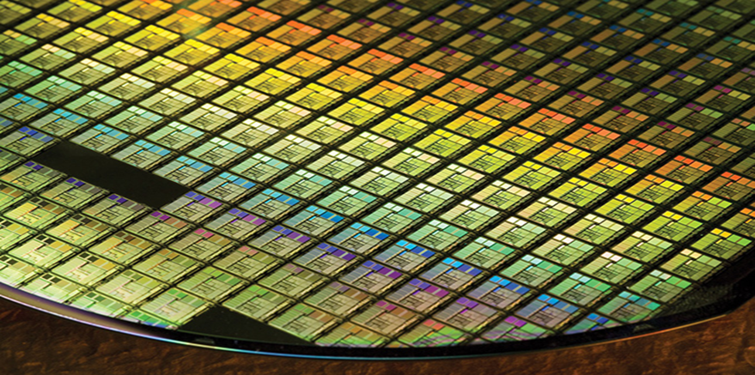
From Neutrino to Semiconductor
A journey of Learning and Research that Started from Physics
KC Wang (王克中)
Macronix (旺宏電子)
Joint AS IOP Colloquium and PG2023 General Talk on 6/1/2023

Slide 2
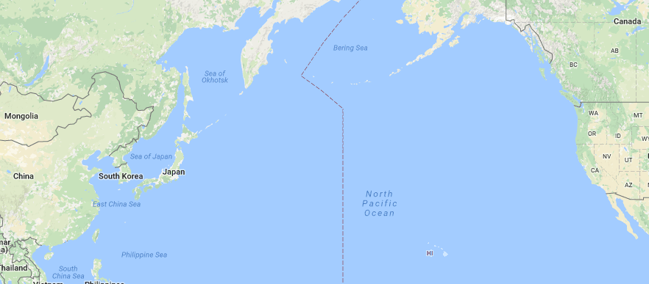
A Fulfilling Journey
1974
2015
HK
1951
2009
2

Slide 3
Outline
Introduction
Experience Sharing
  Some Stories of Neutrino
  GaAs Heterojunction Bipolar Transistor (HBT) and ICs
  Semiconductor Memories
Conclusion Remarks
3

Slide 4
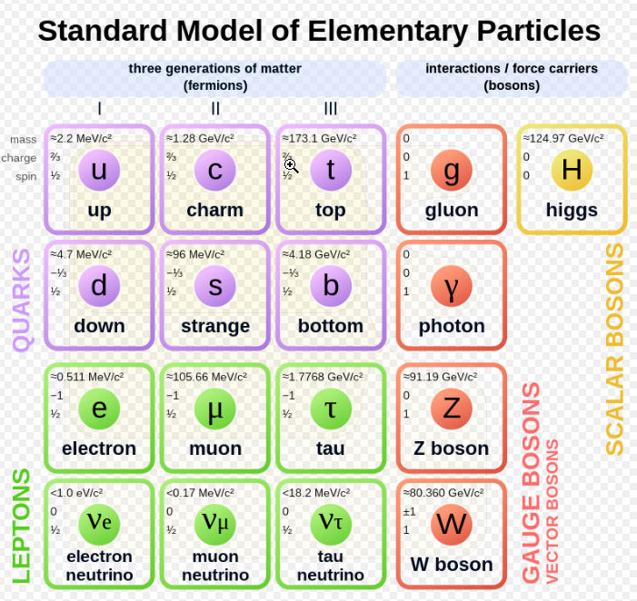
Elementary Particles of Standard Model
There are 3 flavors of neutrinos and their anti-particles
4
Source: https://en.wikipedia.org/wiki/Fundamental_interaction#/media/File:Standard_Model_of_Elementary_Particles.svg

Slide 5
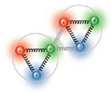

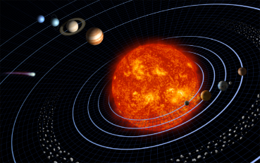
Fundamental Interactions
1. Strong
2. Electromagnetic
3. Weak
4. Gravitation
Interaction | Current theory | Mediators | Approximate relative strength | Long distance behavior (potential) | Range (m)
Strong | QCD | gluons | 1 | ~r | 10⁻¹⁵
EM | QED | photons | 10⁻² | 1/r | infinite
Weak | Elecroweak theory | W and Z bosons | 10⁻⁶ to 10⁻⁷ | 1/r e^{-m}_{W,Z} ^{r} | 10⁻¹⁸
Gravity | General relativity | gravitons | 10⁻³⁹ | 1/r | infinite
https://en.wikipedia.org/wiki/Fundamental_interaction
http://hyperphysics.phy-astr.gsu.edu/hbase/Forces/couple.html
5

Slide 6
Outline
Introduction
Experience Sharing
  Some Stories of Neutrino
  GaAs Heterojunction Bipolar Transistor (HBT) and ICs
  Semiconductor Memories
Conclusion Remarks
6

Slide 7
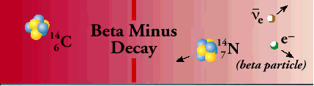
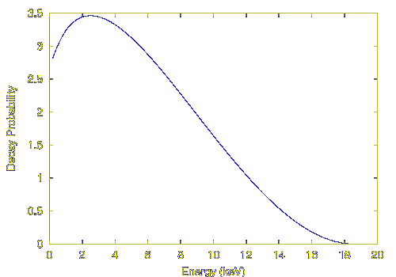
The Origin of Neutrino Concept
Puzzle of Beta Decay
When a neutron converts to a proton and electron,
The electron should have single energy
However, the observed spectrum of
electron was continuous.
N1 → N2 + e⁻
E_{e-} = E_{N1} – E_{N2}
In 1930, Wolfgang Pauli proposed an idea of neutrino to save the law of conservation of energy
7
Notes:
7

Slide 8
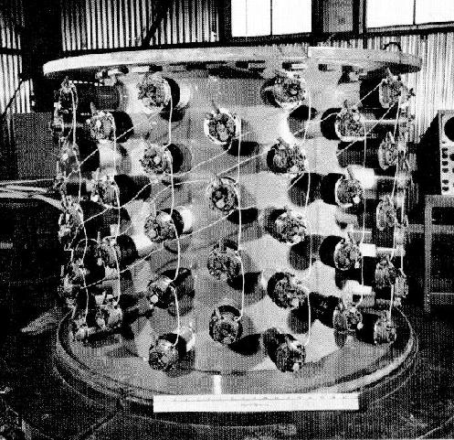
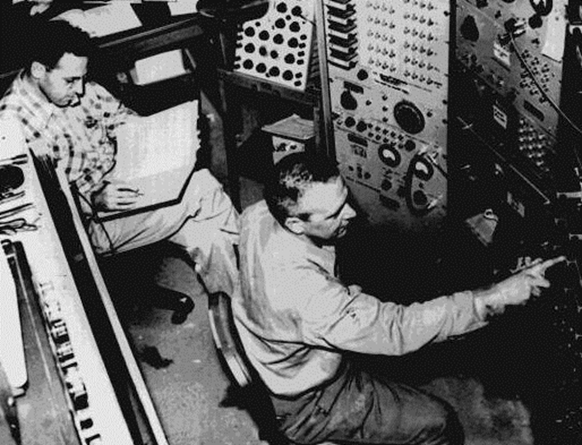
Discovery of Neutrino
Energy >1.8 MeV
8 MeV
0.5MeV
300-liter liquid scintillator with Cadmium salt using 90 PMTs
Signal 2γ, then several γ ~few μs later
Reines
antineutrino
γ
Cowan
Experiment attempted at Hanford in 1953,
too much background. Repeated at Savannah
River in 1956. [Flux: 1.2 x 10¹² neutrinos/(cm² s)]
Cd
e⁺
H₂O +
CdCl₂
n
p⁺
γ
8

Slide 9
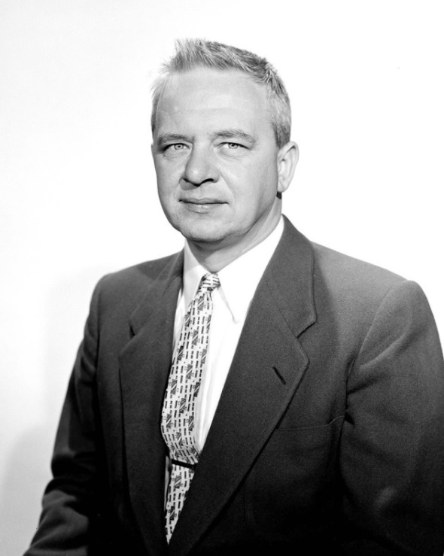
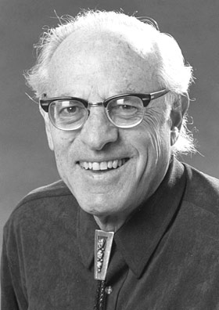
Cowan passed away in 1974
In 1995, Reines was awarded the Nobel Prize in Physics
Clyde Cowan
Fred Reines
9

Slide 10
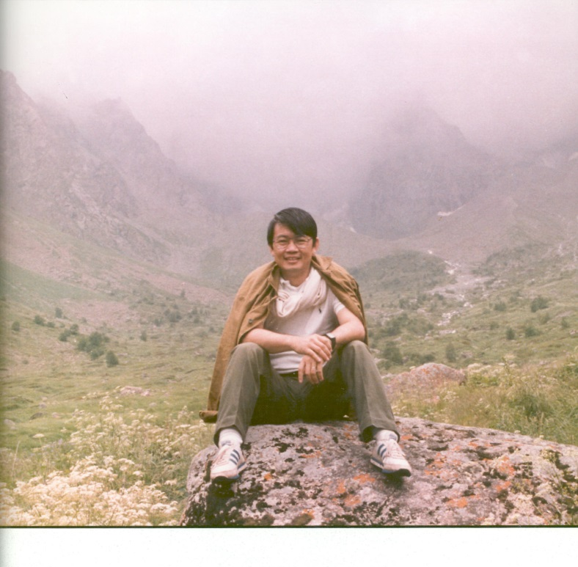
Herbert H. Chen (陳華生) – An Exceptional Neutrino Physicist
Born in Chunking, China in 1942 and immigrated to US in 1955
B.S. from Caltech and Ph.D. from Princeton U.
Joined UC Irvine in 1968, Associate Prof. in 1974, Prof. in 1980
Led UCI-LANL ν_{e} - e elastic scattering experiment
Designed and initiated Sudbury Neutrino Observatory (SNO) experiment
Pioneered development of Liquid Argon TPC
Chaired an NSF committee on “Computing for Particle Physics by Network” which led to NSFNET that soon merged with ARPANET which eventually became Internet
Passed away in 1988
https://en.wikipedia.org/wiki/Herbert_H._Chen
10

Slide 11
ν_{e} - e Elastic Scattering Experiment
11

Slide 12
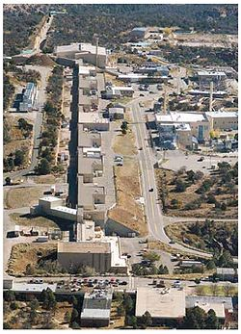
Los Alamos Meson Physics Facility (LAMPF)
Opened in 1972
Has an 800-m long, 800 MeV, 1mA proton linear accelerator
Now, it is Los Alamos Neutron Science Center (LANSCE)_
12
https://lansce.lanl.gov/facilities/index.php

Slide 13
LAMPF Beam-Stop Neutrino Source and Experimental Area
Source: LAMPF
13

Slide 14
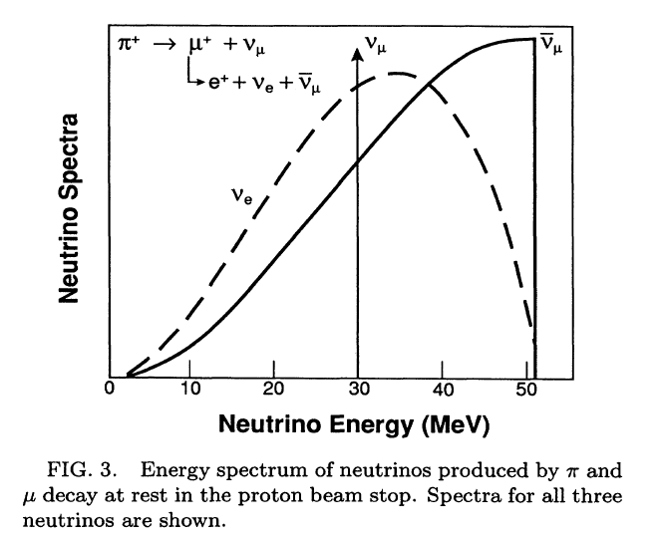
Energy Spectrum of Neutrinos at LAMPF
14
R.C. Allen, et al., Physical Review D, Vol. 47, No. 1, 1993

Slide 15
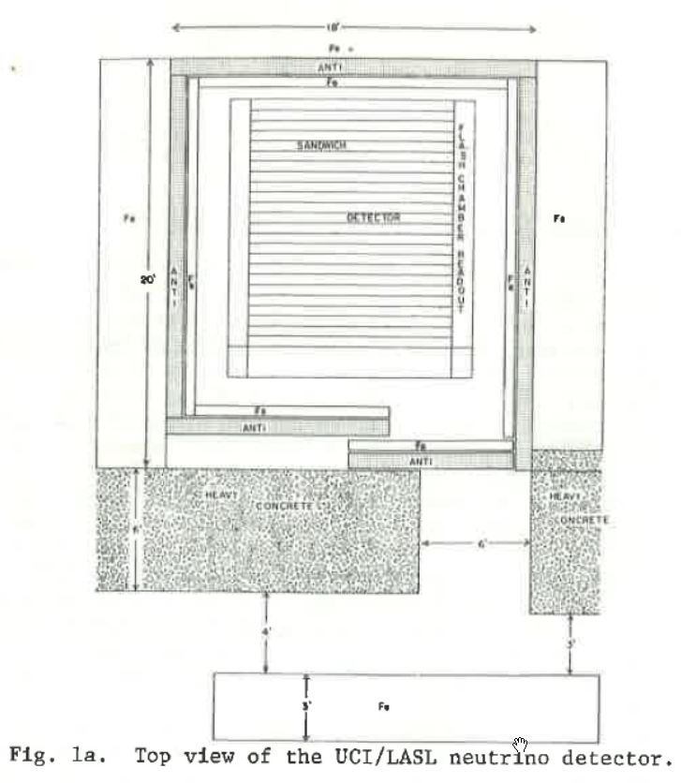
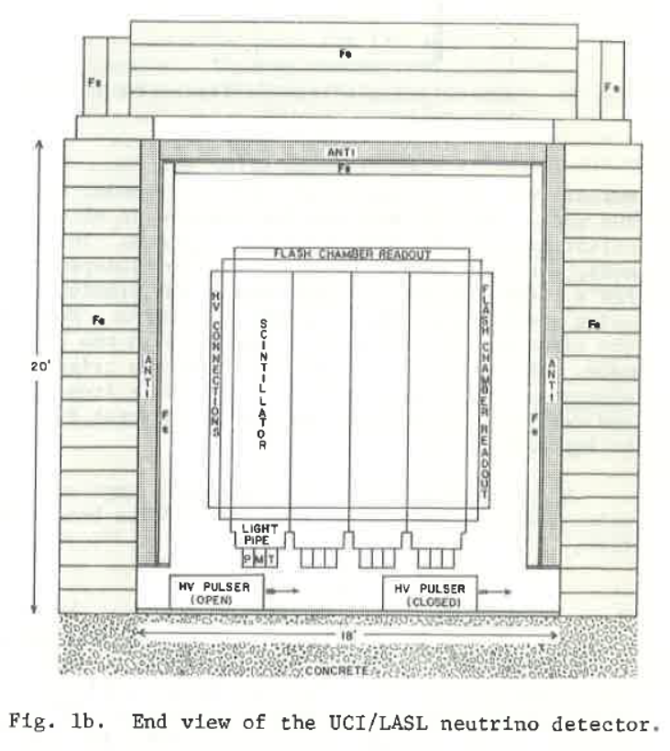
Neutrino-Electron Elastic Scattering Detector
End View
Top View
15
Source: UCI-LANL Neutrino Collaboration
K. C. Wang and H. H. Chen, IEEE Tran. on Nuclear Science, Vol. NS-28, No. 1, 1981

Slide 16
Key υ_{e} e → υ_{e} e Results
Observed 236 ± 35 υ_{e} e → υ_{e} e events
Determined total elastic scattering cross-section to be 10.0±1.5(stat)±0.9(syst)×10⁻⁴⁵ cm²×[E_{υ} (MeV)]
The results showed that the interference of weak charged and neutral currents was destructive with a strength of I=−1.07±0.21
It agreed well with the standard model (SM) prediction of I=−1.08
Ref: Physical Review D, Vol. 47, No. 1, pp. 11-28, 1993.
16

Slide 17
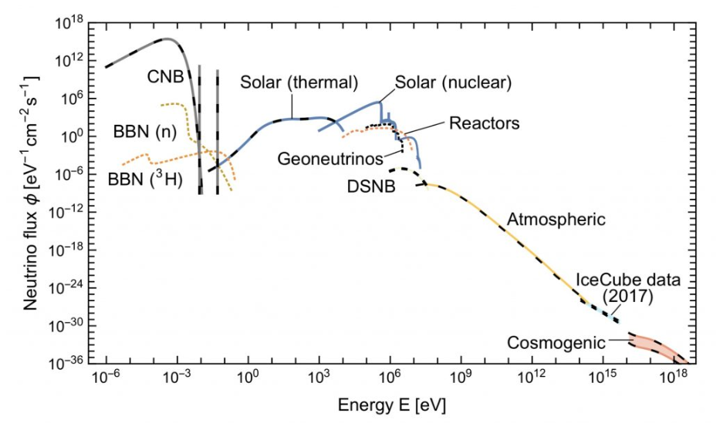
Neurtino Sources and Flux on Earth
- Grand Unified Neutrino Spectrum
E. Vitagliano, I. Tamborra, G. Raffelt, Rev. Mod. Phys. 92 (2020) 45006; arXiv:1910.11878
https://neutrino-history.in2p3.fr/introduction-to-neutrino-sources/
17
Notes:
In [Vit19] G. Raffelt and collaborators revisited in great detail the different components in the light of the new discoveries and published this new version of the Grand Unified Neutrino Spectrum, much more precise quantitatively. CNB is for cosmic neutrino background, BBN for big bang nucleosynthesis, DSNB for diffuse supernova neutrino background, cosmogenic for neutrinos coming from the interaction of ultra high-energy cosmic-rays with the cosmic microwave background CMB.

Slide 18
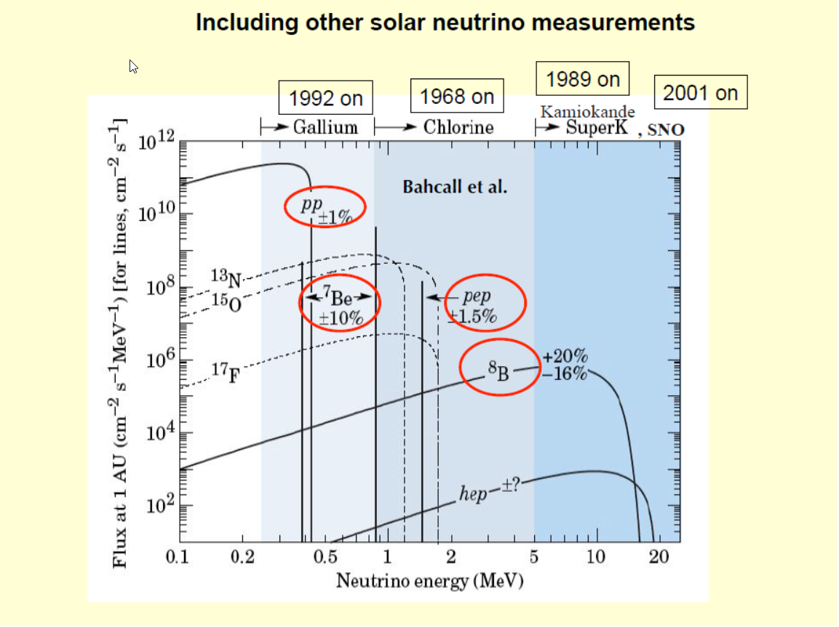
18
Source: Art McDonald, Queen’s University, for SNO Collaboration

Slide 19
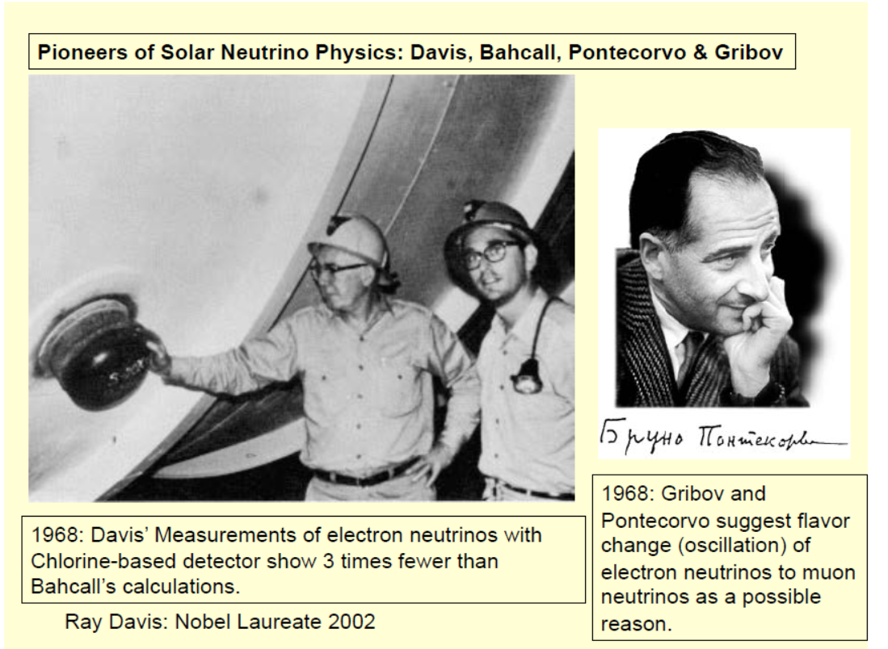
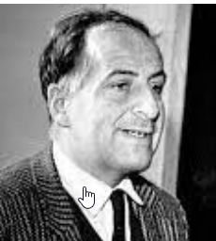
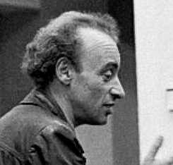
1969:
19
Source: Art McDonald, Queen’s University, for SNO Collaboration
Notes:
Raymond Davis Jr. (October 14, 1914 – May 31, 2006) was an American chemist and physicist. He is best known as the leader of the Homestake experiment in the 1960s-1980s, which was the first experiment to detect neutrinos emitted from the Sun; for this he shared the 2002 Nobel Prize in Physics.
John Norris Bahcall (December 30, 1934 – August 17, 2005) was an American astrophysicist and the Richard Black Professor for Astrophysics at the Institute for Advanced Study. He was known for a wide range of contributions to solar, galactic and extragalactic astrophysics, including the solar neutrino problem, the development of the Hubble Space Telescope and for his leadership and development of the Institute for Advanced Study in Princeton.
Bruno Pontecorvo, (born August 22, 1913, Marina di Pisa, Italy—died September 25, 1993, Dubna, Russia), Italian-born nuclear physicist who defected to the Soviet Union after having done atomic research in the United States, Canada, and the United Kingdom from 1943 to 1950.
Vladimir Naumovich Gribov (Russian Влади́мир Нау́мович Гри́бов; March 25, 1930, Leningrad – August 13, 1997, Budapest) was a prominent Russian theoretical physicist, who worked on high-energy physics, quantum field theory and the Regge theory of the strong interactions.[1]
His best known contributions are the pomeron,[2] the DGLAP equations, and the Gribov copies.

Slide 20
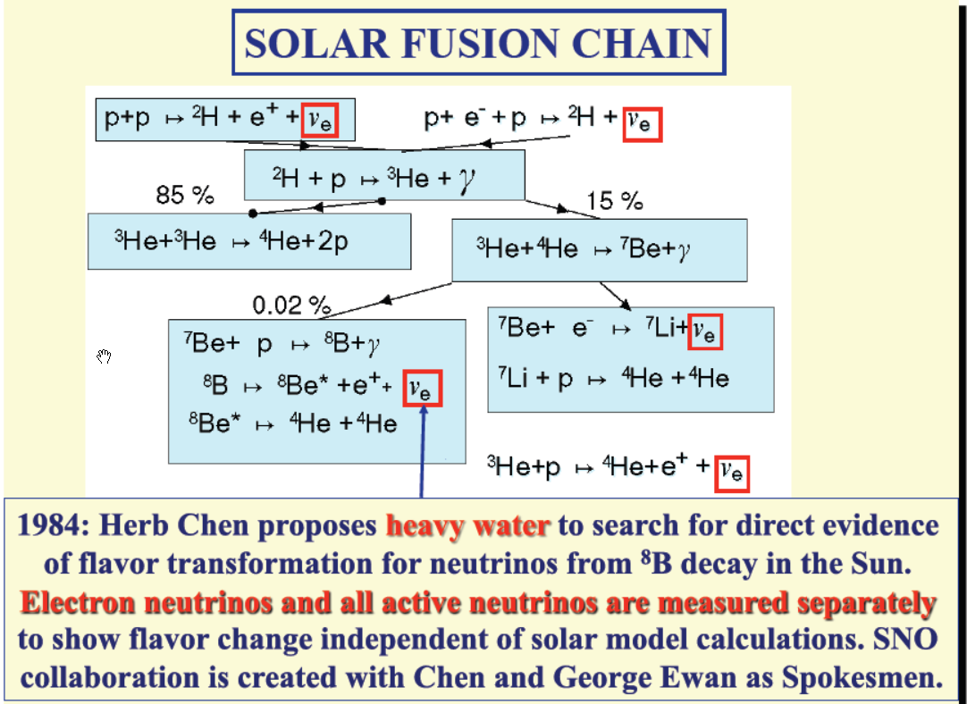
20
Source: Art McDonald, Queen’s University, for SNO Collaboration

Slide 21
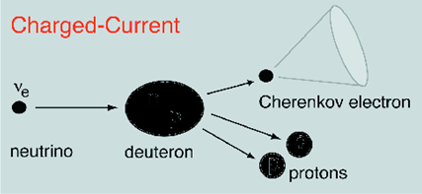
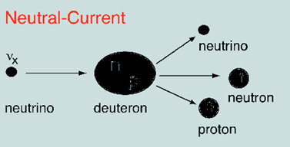
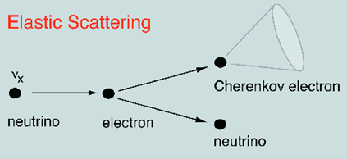
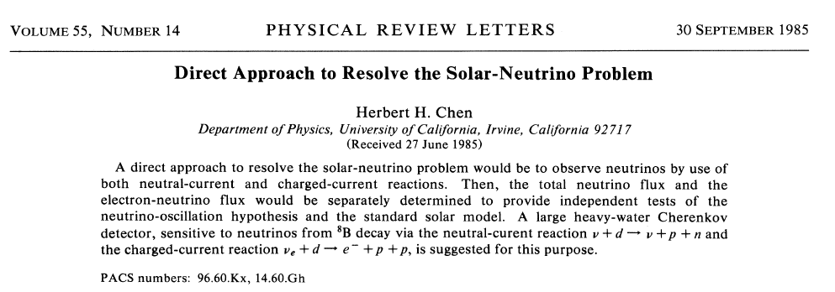
Herb Chen’s Idea (1984): Using Heavy Water
21

Slide 22
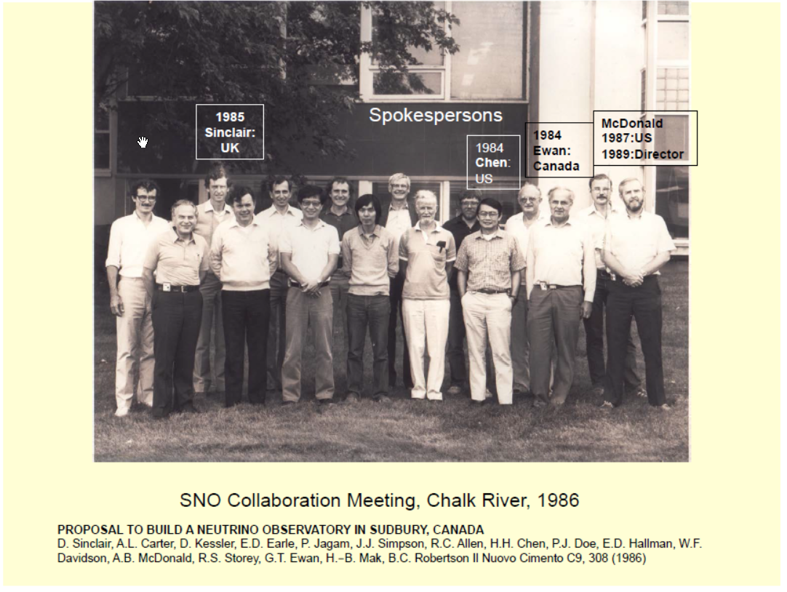
22
Source: Art McDonald, Queen’s University, for SNO Collaboration

Slide 23
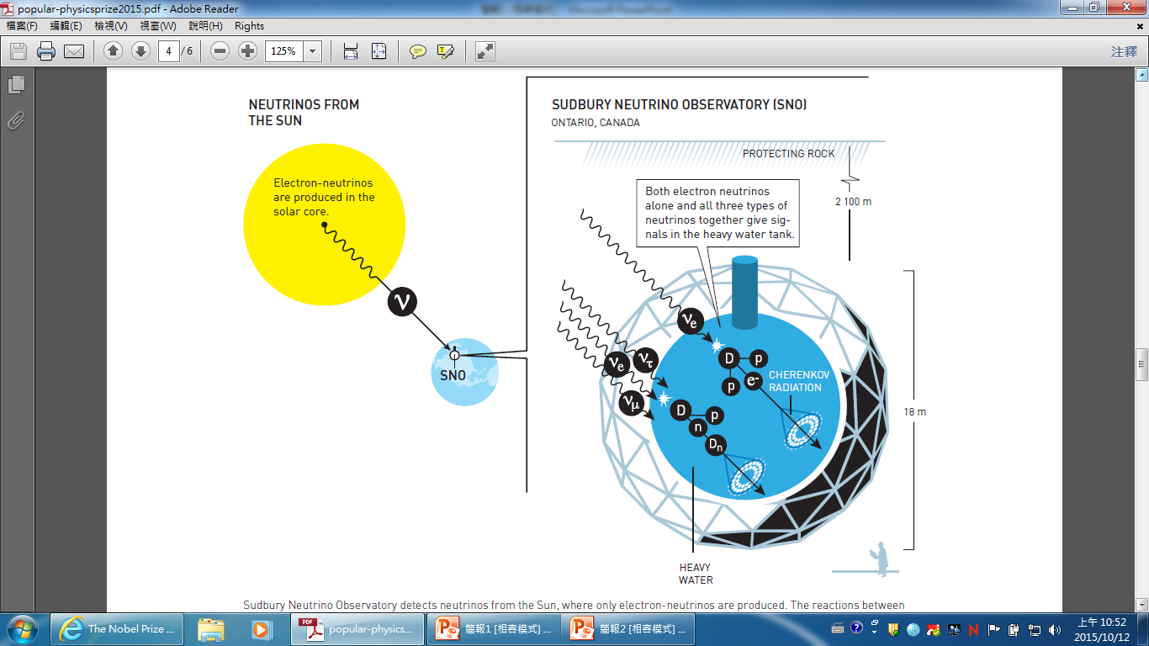
Sudbury Neutrino Observatory
https://www.nobelprize.org/uploads/2018/06/fig_fy_en_15_sudburyneutrinoobservatory.pdf
23
Notes:
23

Slide 24
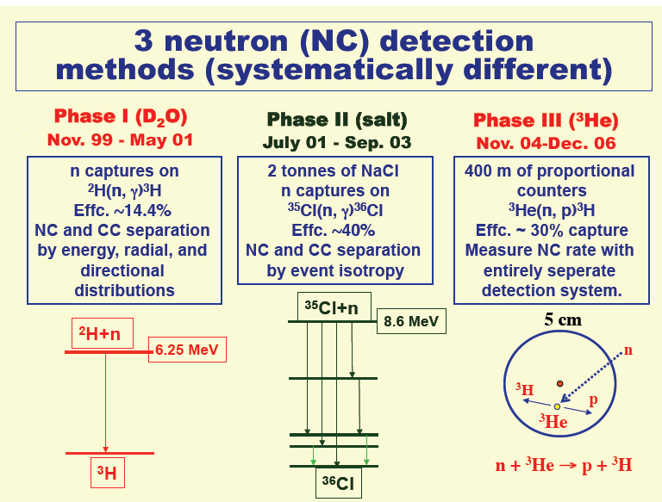
24
Source: Art McDonald, Queen’s University, for SNO Collaboration

Slide 25
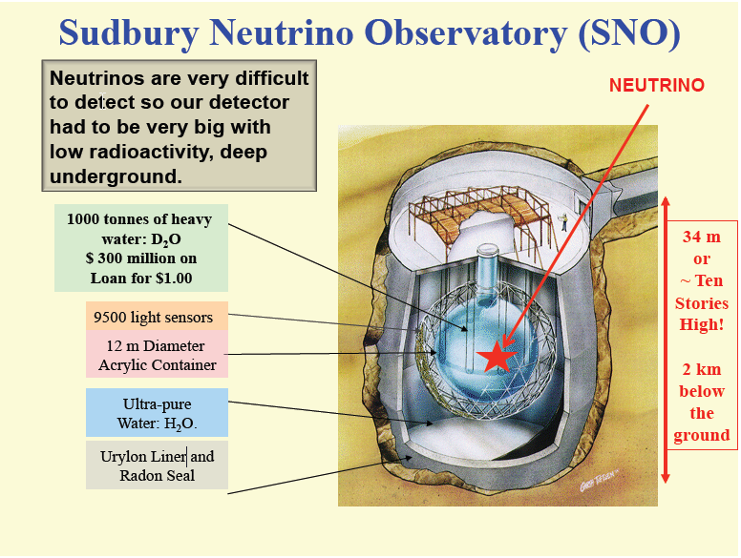
25
Source: Art McDonald, Queen’s University, for SNO Collaboration

Slide 26
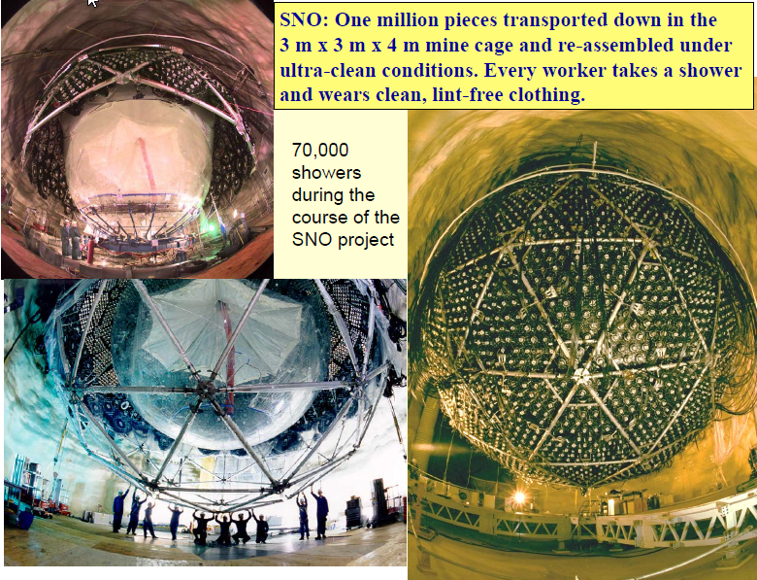
26
Source: Art McDonald, Queen’s University, for SNO Collaboration

Slide 27
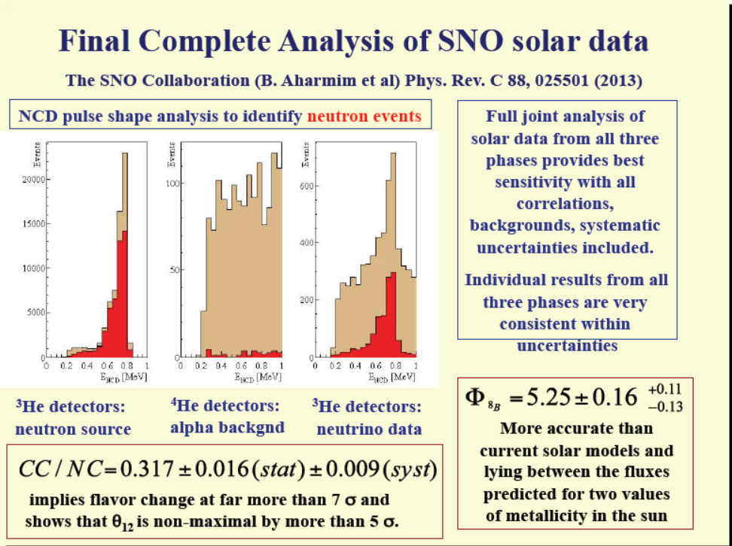
27
Source: Art McDonald, Queen’s University, for SNO Collaboration

Slide 28
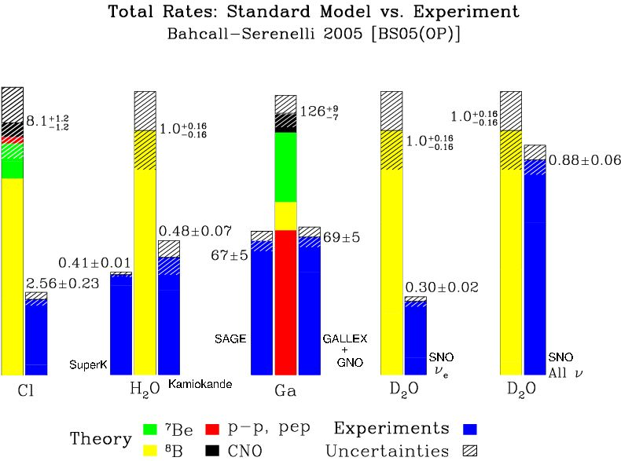
Experimental Results of Solar ν Experiments
+
-
+ 0.11
- 0.12
Final SNO results (2013): Total ν flux = 5.25 0.16 (stat) (sys) x10⁶cm⁻² s⁻¹
In very good agreement with theory
28

Slide 29
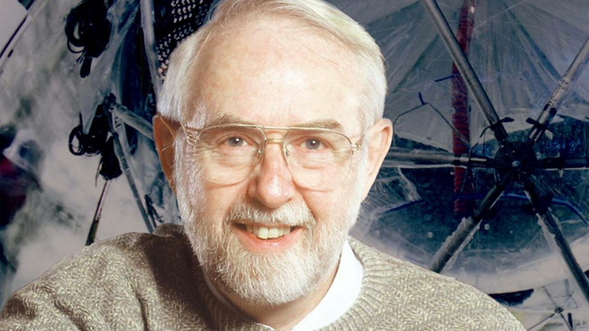
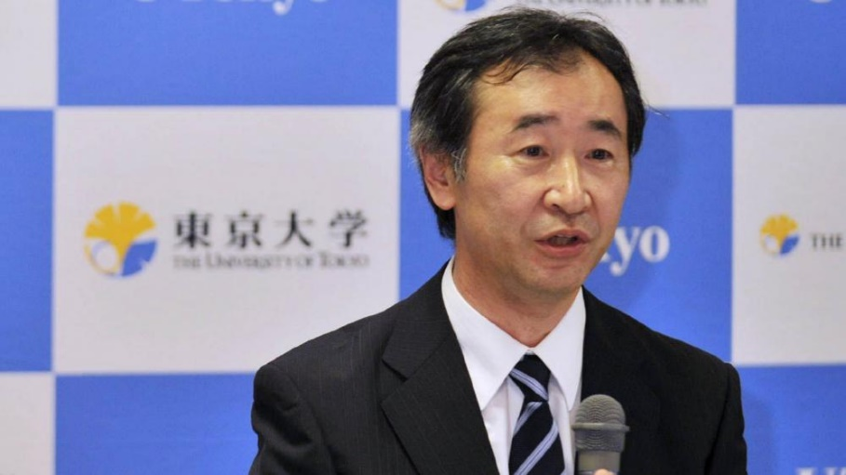
Arthur B. McDonald and Takaaki Kajita were awarded Nobel Prize in Physics in 2015 for "for the discovery of neutrino oscillations, which shows that neutrinos have mass"
Takaaki Kajita
Arthur B. McDonald
29

Slide 30
6 Neutrino Experiments Won Nobel Prizes
  1988 Leon Lederman, Melvin Schwartz, and Jack Steinberger (at Brookhaven National Lab., USA)
  1995 Frederick Reines (at Savannah River Nuclear Reactor, USA)
  2002 Raymond Davis, Jr. (at Homestake Gold Mine, USA)
  2002 Masatoshi Koshiba (at Kamioka Observatory, Japan)
  2015 Takaaki Kajita (at Super Kamiokande, Japan)
  2015 Arthur B. McDonald (at Sudbury Neutrino Observatory, Canada)
And more are coming…
30

