Slide 1
Outline
Introduction
Experience Sharing
  Some Stories of Neutrino
  GaAs Heterojunction Bipolar Transistor (HBT) and ICs
  Semiconductor Memories
Conclusion Remarks
1

Slide 2
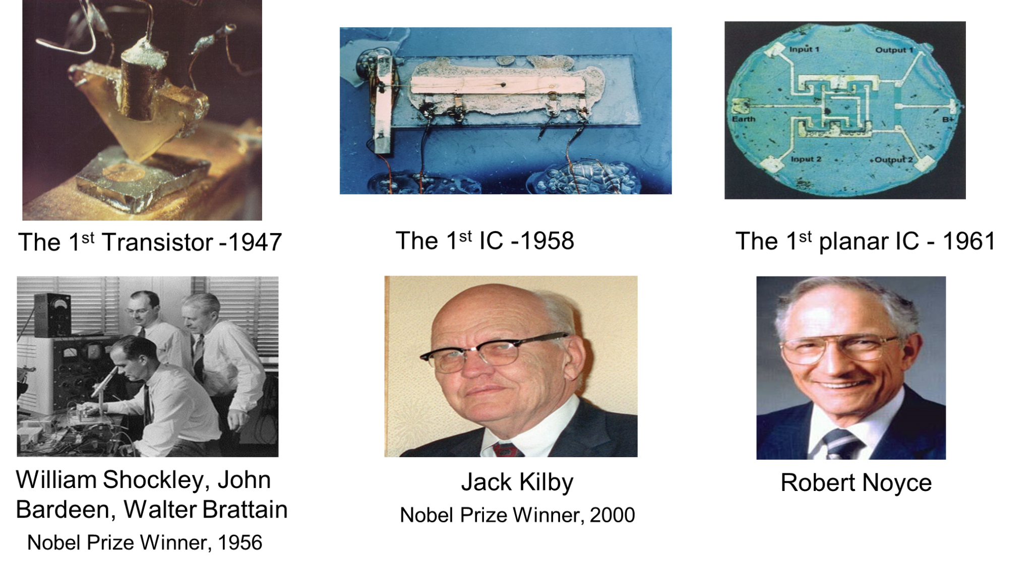
First Transistor and ICs
1960
2
Images from Wikipedia

Slide 3


Moore’s Law
The number of transistors per chip doubles each 18~24 months *
V-NAND 1.33Tb (QLC)
Gordon Moore
Co-founder of Intel 1968
V-NAND 512 Gb (TLC)
M1 Ultra
NAND 256 Gb (TLC)
NVIDIA's H100 GPU
NAND 16 Gb
DRAM 16 Gb
DRAM 24 Gb
NAND 8 Gb
DRAM 8 Gb
Apple A10X Fusion
DRAM 4Gb
NAND 2 Gb
NOR 2 Gb (MLC)
memory
DRAM 1Gb
NOR 1Gb (MLC)
DRAM 256 Mb
NAND 256 Mb
NOR 512Mb
NAND 128 Mb
DRAM 64 Mb
NAND 32 Mb
P 4
NOR 16Mb
NAND 4 Mb
PIII
Number of Transistors(millions)
DRAM 1Mb
486
PII
DRAM 256Kb
NOR 256Kb
DRAM
DRAM 64Kb
286
386
DRAM 16Kb
NOR
DRAM 4Kb
8080
NAND
DRAM 1Kb
4004
8008
DRAM 256b
logic
1st IC
Year
Note: MLC – 2 bits per cell
TLC – 3 bits per cell
QLC – 4 bits per cell
Data source: https://en.wikipedia.org/wiki/Transistor_count
https://en.wikipedia.org/wiki/Random-access_memory
https://en.wikipedia.org/wiki/Flash_memory#NAND_flash
* https://en.wikipedia.org/wiki/Moore%27s_law#cite_note-26
3

Slide 4
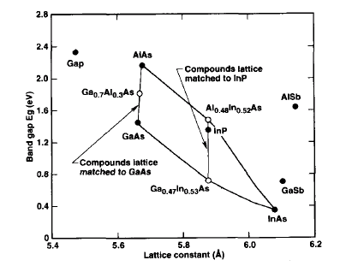
III-V Compound Semiconductors for High-speed Electronics
4

Slide 5
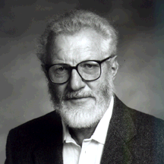
An Enthusiastic HBT Promoter
Herb Kroemer
2000 Nobel Laureate in Physics
5

Slide 6
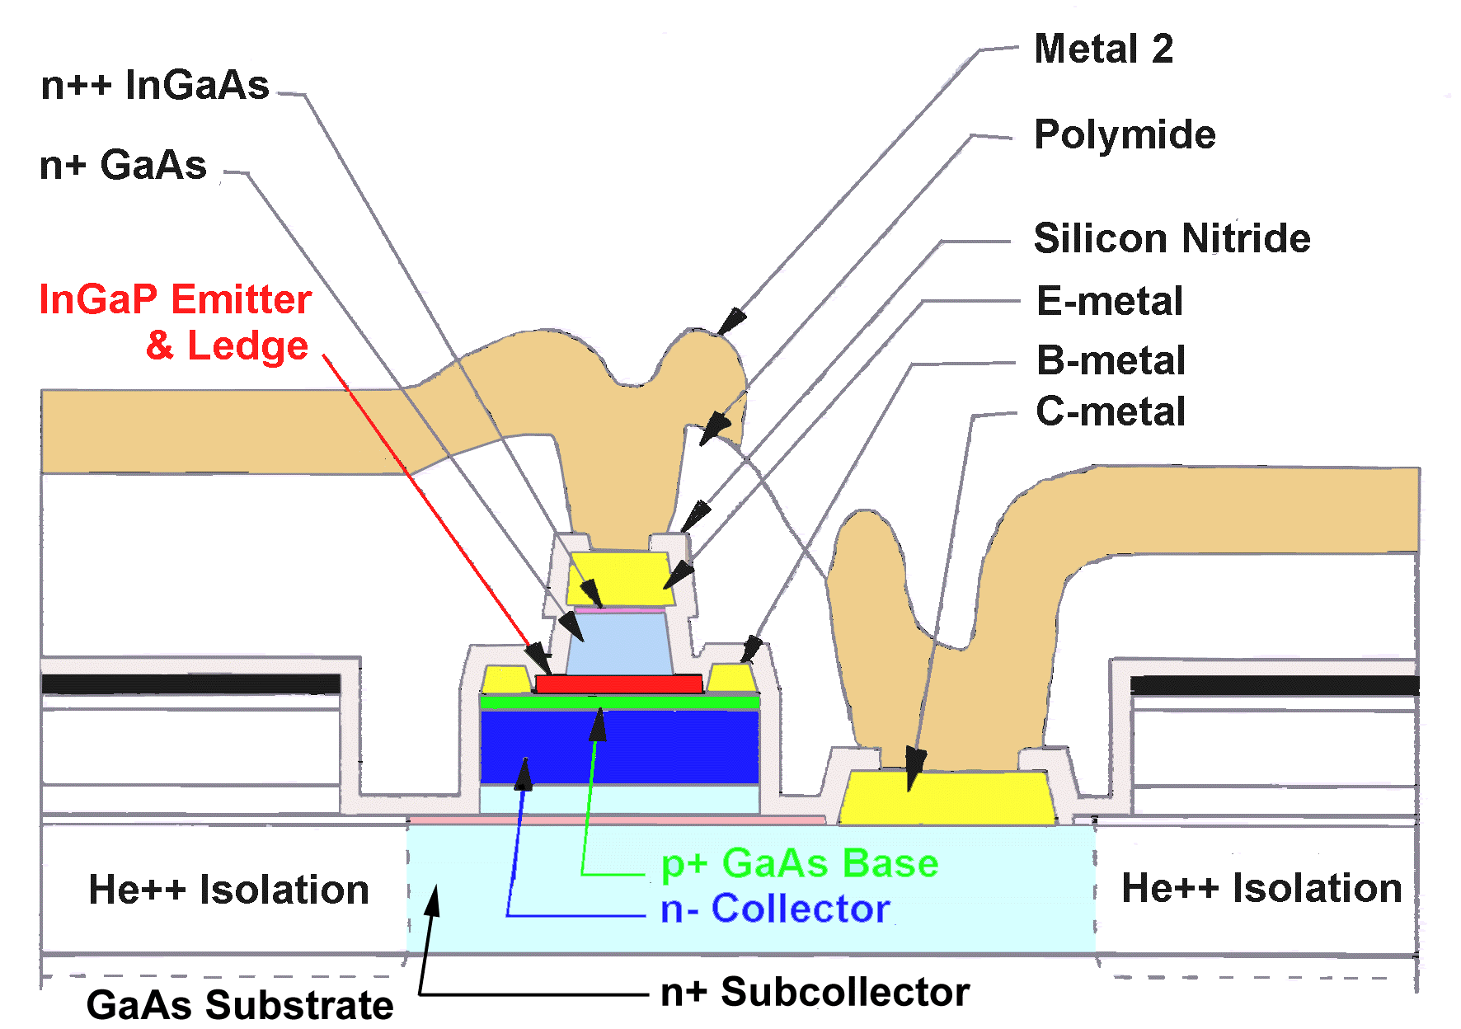
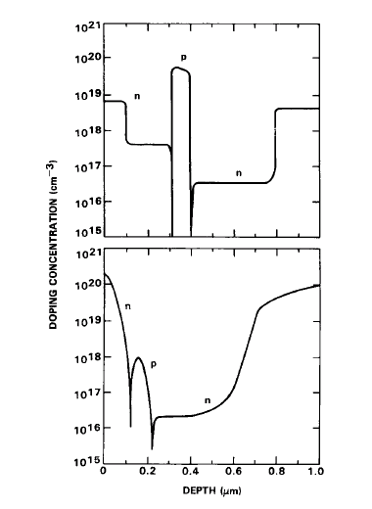
InGaP/GaAs HBT
DOPING
GaAs HBT
Si BJT
Source: Peter Asbeck, UCSD
6

Slide 7

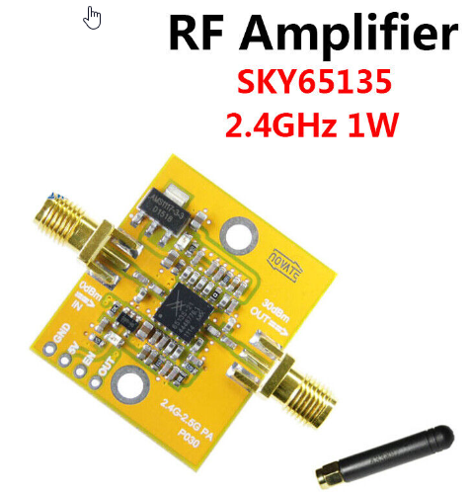

HBT Power Amplifiers Enhanced Mobile Communications
7
https://www.skyworksinc.com/About/-/media/SkyWorks/Documents/Downloads/skyworks_overview.pdf

Slide 8
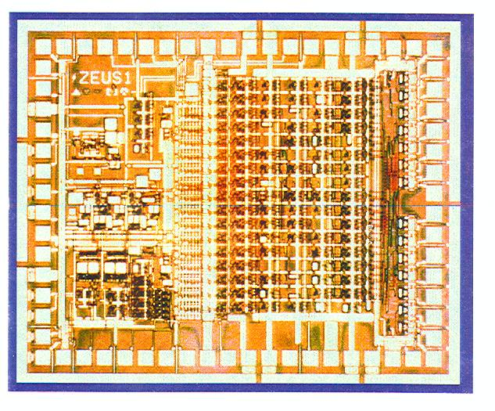
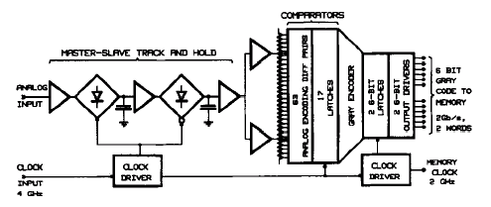

6-Bit 4 GS/s ADC with AlGaAs/GaAs HBTs
Supported by AFWL
6-Bit ADC with on-chip 1:2 demux
1.8 GHz analog BW at 4GS/s
6 W power
Source: Rockwell & Agilent
8

Slide 9
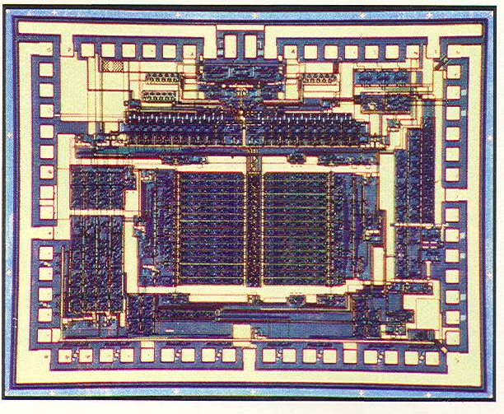
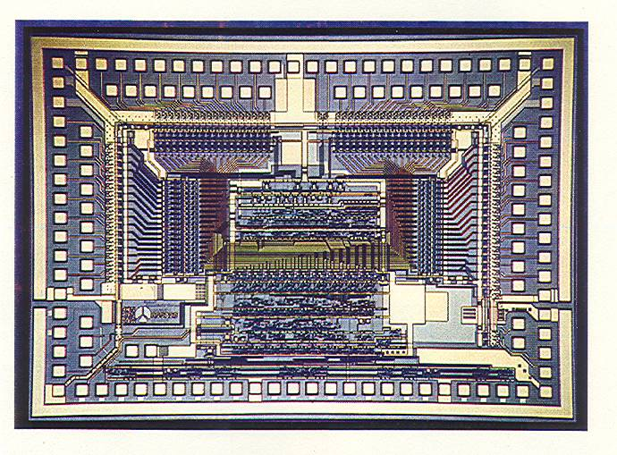
8-Bit 2-Gs/s ADC and 8:64 DEMUX
2.5GS/s sampling rate
3 GHz analog input BW
IQ Folding and Interpolation architecture
5 W power
Gray to Binary converter
3 GB/s
BIST PRN generator
3 W power
9

Slide 10
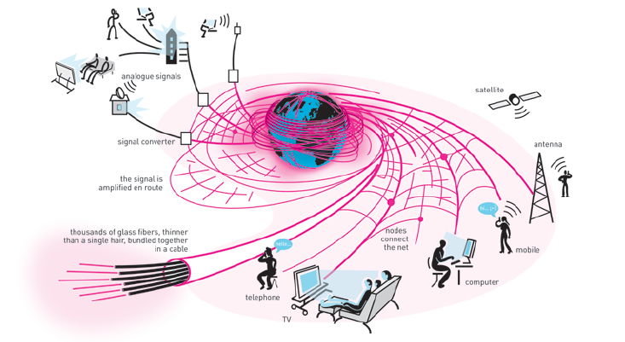
Artistic View of Global Communication
Sources: The Royal Swedish Academy of Sciences.
10

Slide 11
WDM with Electronic Switch Technology (WEST)
WEST Optoelectronic 3 x 3 WDM Switch
• Low risk
• Fast reconfiguration
• Clock and data
regeneration
• Minimum crosstalk
• Flexible switching
(Wavelength translation)
• Low cost
WDM: Wavelength Division Multiplexing
WEST Consortium: DAARPA, Rockwell, Ortel, Caltech/JPL, UCSB, UCSD
Source: Rockwell Science Center
11

Slide 12
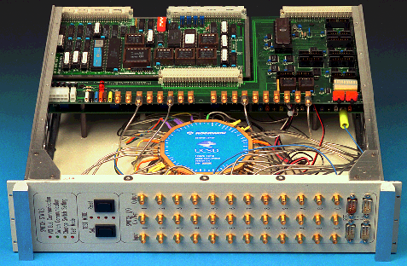
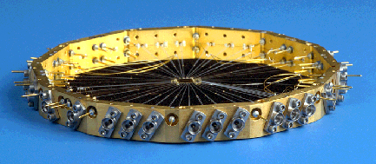
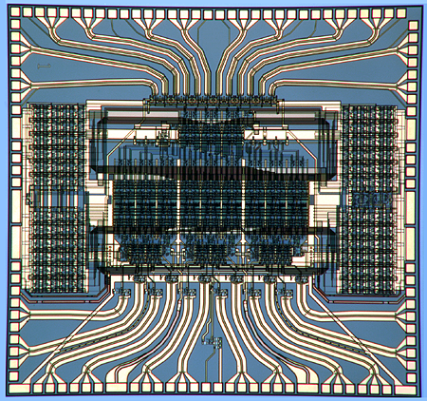
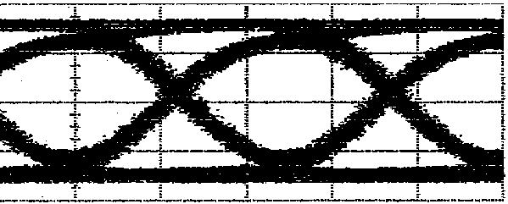
12x12 VXI Switch Module
Feature Highlights
Switch Module Features:
  120 Gb/s data throughput
  Twelve 10 Gb/s channels
  VXI Management and Control
High Speed Package Features:
  Clean high speed interface
  High Isolation
  Thermal management
Switch Chip Highlights:
  Suitable for larger switching fabrics
  GaAsAlGaAs HBT
  Low crosstalk & jitter generation
  Die size: 4.8 x 5.1 mm²
  4600 transistors
  P_{diss}: 7.4 W
10Gb/s
Source: Rockwell Science Center
12

Slide 13
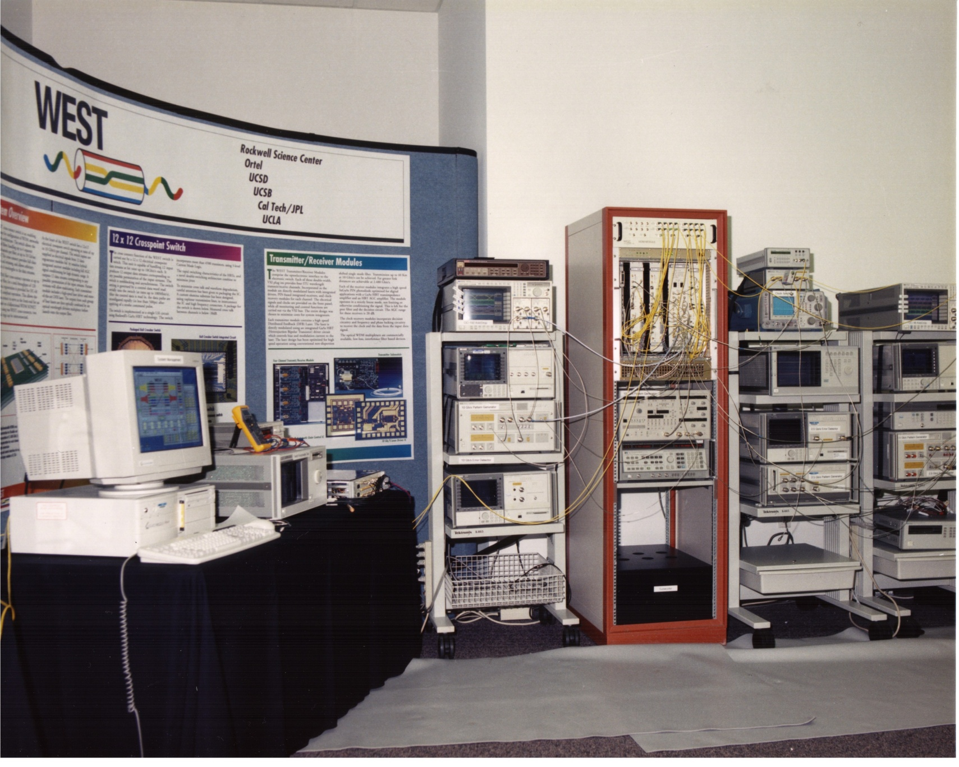
WEST Demonstration
Source: Rockwell Science Center
13

Slide 14
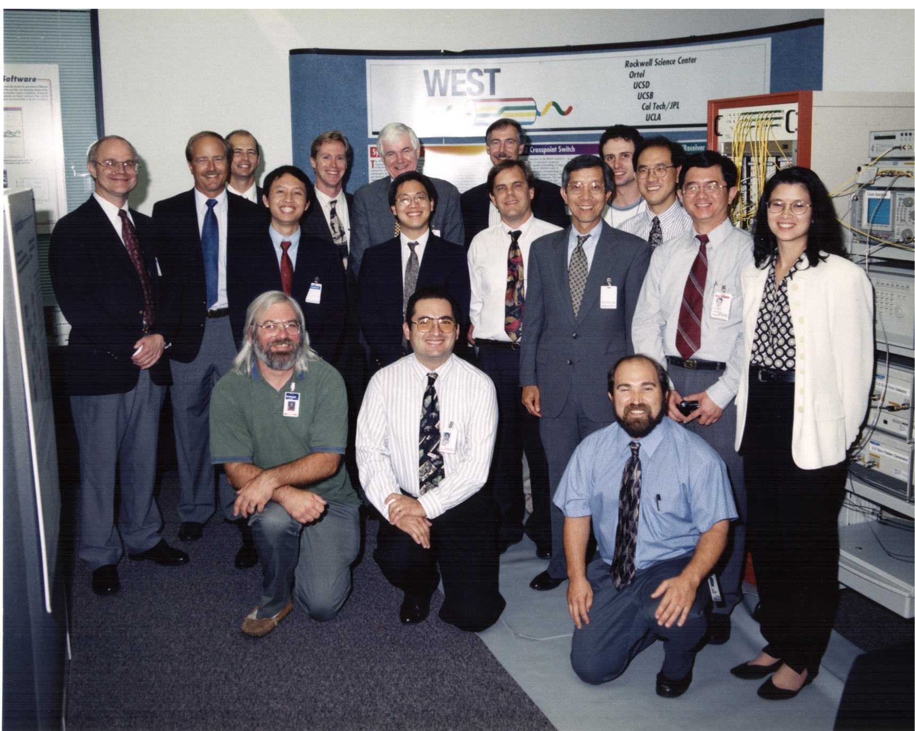
WEST Team
14
Source: Rockwell Science Center

