Slide 1
Outline
Introduction
Experience Sharing
  Some Stories of Neutrino
  GaAs Heterojunction Bipolar Transistor (HBT) and ICs
  Semiconductor Memories
Conclusion Remarks
1

Slide 2
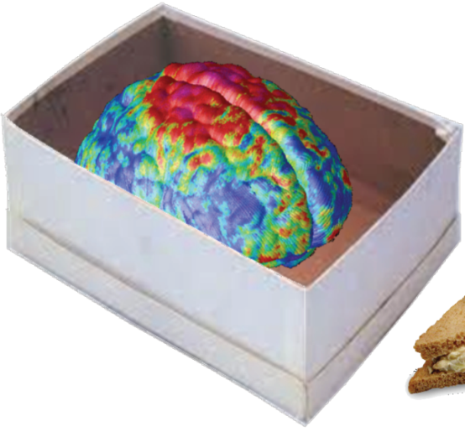
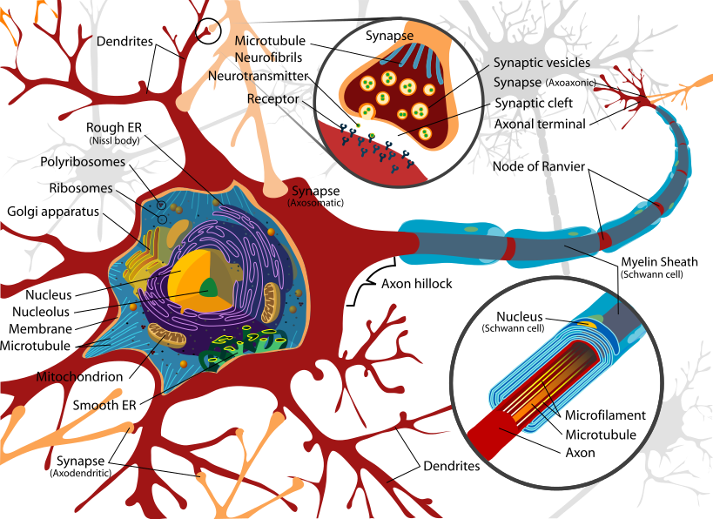
An Amazing Nature Memory
Fits in a shoe box
Runs on a tuna sandwich and a cup of water
Ultra-low power and always on
86B neurons, 16B in cerebral cortex, Most of
the 16 B neurons have ~10K synapses each
1.5Kg (1.2Kg in cerebral cortex)
A brain keeps information and processes it
2

Slide 3
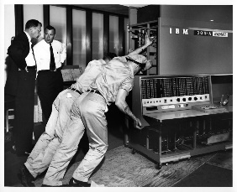
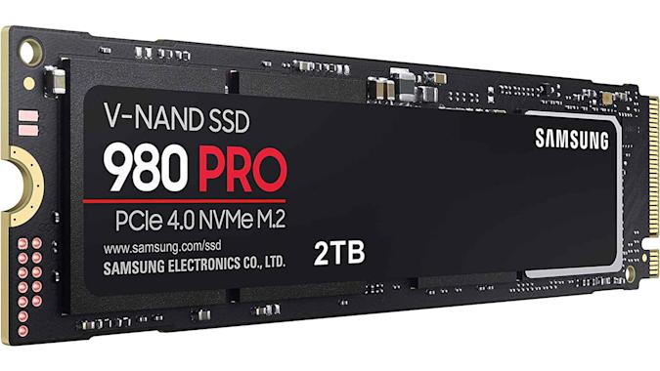
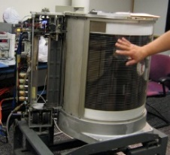
The Power of Semiconductor Technology
1956
2022
2 TB Solid State Drive
IBM 350 Disk Storage Unit
Storage Capacity: 5 million characters (3.75 MB)
Weight: over 1 ton
Leased: $750 per month
Solid State Drive
Storage Capacity: 2 TB
Weight:~ 80 g
Price: $250 ( ~ per GB costs $ 0.125 )
One GB capacity needs more than 308 sets IBM 350.
The total rent for one GB storage memory per month is $ 231,000.
The price drops to 6 order magnitudes
https://www.computerhistory.org/storageengine/first-commercial-hard-disk-drive-shipped/
3
https://www.engadget.com/samsungs-2tb-980-pro-ssd-drops-to-a-new-low-of-250-132013127.html

Slide 4
Semiconductor Memory Family
Semiconductor Memory
RAM (Volatile)
(Random Access Memory)
Non Volatile Memories (NVM)
DRAM
SRAM
Standard NVM
Emerging NVM
EEPROM
FeRAM
FLASH
PCM
MRAM
NOR
NAND
RRAM CBRAM
4

Slide 5
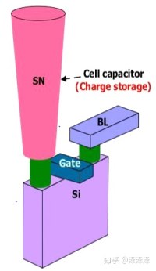
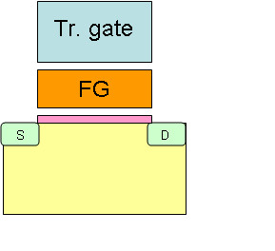
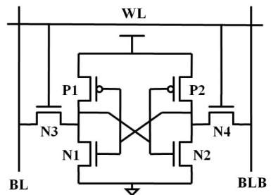
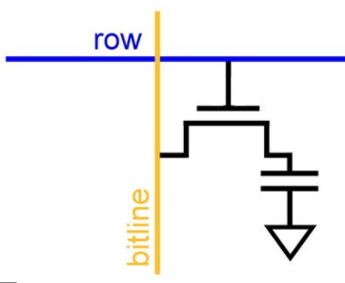

Mature Semiconductor Memory Devices
Features | SRAM | DRAM | FLASH
Density | Low | High | High
Speed | Very Fast | Fast | Slow
Leak Power | Low | Medium | Low
Non-volatile | No | No | Yes
Device | 6T | 1T1C | 1T
Cell Structure
5

Slide 6
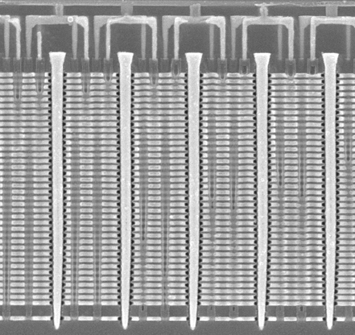
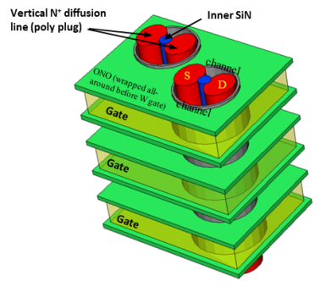
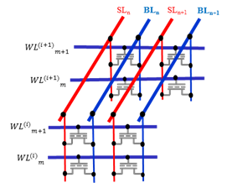
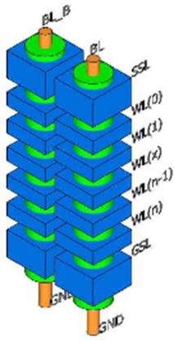
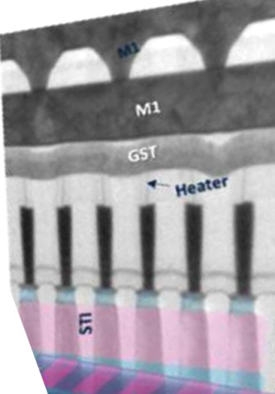
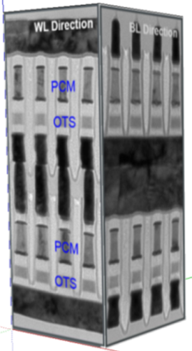
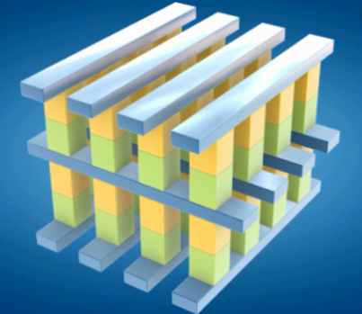
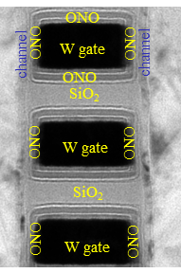
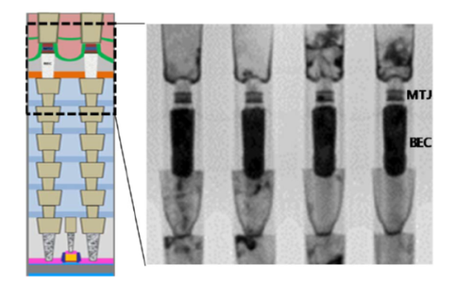
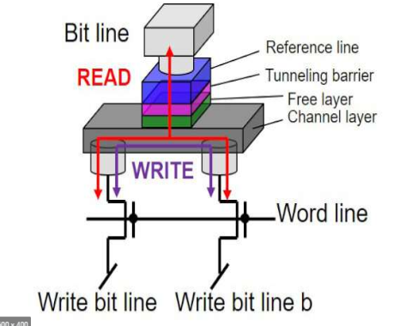
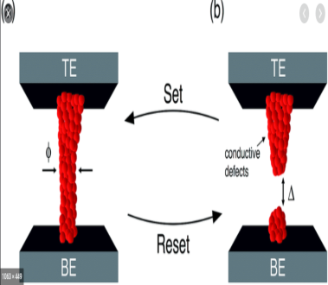
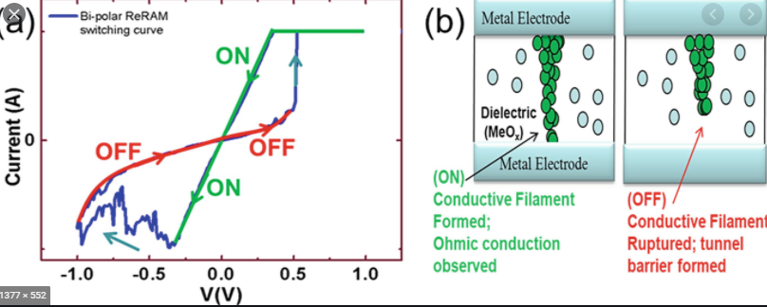
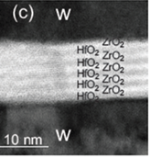
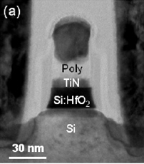
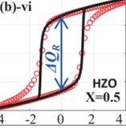
Landscape of Non-Volatile Memories
3D NAND Flash
3D NOR Flash (in R&D)
Phase-Change Memory and 3DXP
1T1R
3D Cross-Point with selector
MRAM
ReRAM
Ferroelectric RAM
STT
SOT
Metal Oxide
Conductive-Bridge
1T1C or 2T2C
1T FeFET
6
Notes:
In addition to the fast and volatile SRAM and DRAM, there are many non-volatile memories being used or developed, as shown in this chart.
NAND Flash and NOR Flash memories are the main engine of storing data and computer codes. Global market of NAND Flash in 2020 was about $46.6B US dollars and that of NOR was $3.2B.
3-Dimentional NAND Flash memories are in mass production for years. 3D NOR technologies are emerging.
Other non-volatile memories include phase-change memory, magnetic RAM, resistive RAM, and ferroelectric RAM. All these memories are under very active research.
In this talk, we will focus on the Flash memories.

Slide 7
Memory Hierarchy
1ns
1ns
Register
Register
Memory
REG
REG
10ns
10ns
Cache
Cache
SRAM
SRAM
100ns
Fast,
Byte-Addressable,
High Endurance,
Volatile,
Expensive
100ns
Main
Memory
Main
Memory
DRAM
DRAM
Access Latency
Access Latency
1us
1us
(performance gap)
(performance gap)
Performance
Gap
Memory Wall
Performance
Gap
10us
10us
Slower,
Block-Access,
High-Density,
Low-Cost,
Non-Volatile
100us
100us
Mass storage
Mass storage
Flash
Flash
>ms
>ms
Mass storage, archive
Mass storage, archive
HDD
HDD
Memory Density
Storage
7
Notes:
在計算機系統中, 從記憶體到儲存裝置, 從速度快到速度慢, 從容量小到容量大, 從高成本到低成本, 從高能耗到低能耗, 都有不同的裝置配合,
但是在現有的裝置中, 仍有一段空缺, 使得整個記憶體階層造成瓶頸, 仍有待新元件或新架構來彌補這個缺口.

Slide 8
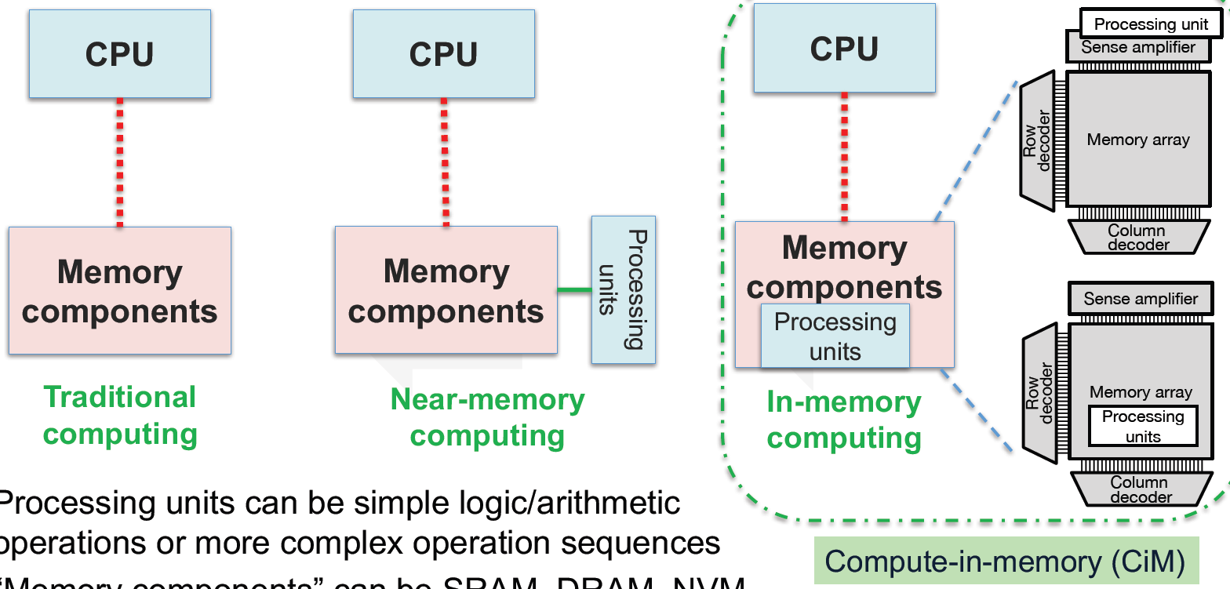

Memory-Centric Computing is Emerging to Complement Process-Centric Computing
Processing units can be simple logic/arithmetic operations or more complex operation sequences
“Memory components” can be SRAM, DRAM, NAND, NOR, PCM, ReRAM, MRAM, FeRAM, HDD, etc. depending on applications
X. Sharon Hu, U. of Norte Dame, NVMSA 2019
8
Notes:
Memory-centric computing is emerging to complement process-centric computing.
The traditional process-centric computing spends too much time and energy in data movement between memory components and CPU.
We can move some processing units near the memory components to facilitate near-memory computing.
Or, we can move the processing units inside the memory components for in-memory computing.
The processing units can be simple logic/arithmetic operations or more complex operation sequences such as multiply and accumulate (MAC) operation in Deep Neural Network (DNN).
“Memory components” can be SRAM, DRAM, NAND, NOR, PCM, ReRAM, MRAM, FeRAM, HDD, etc. depending on applications.
Depending on applications, many memories can be used for memory-centric computing. Flash memories are among the most promising ones for memory centric computing in applications of AI inference.

Slide 9
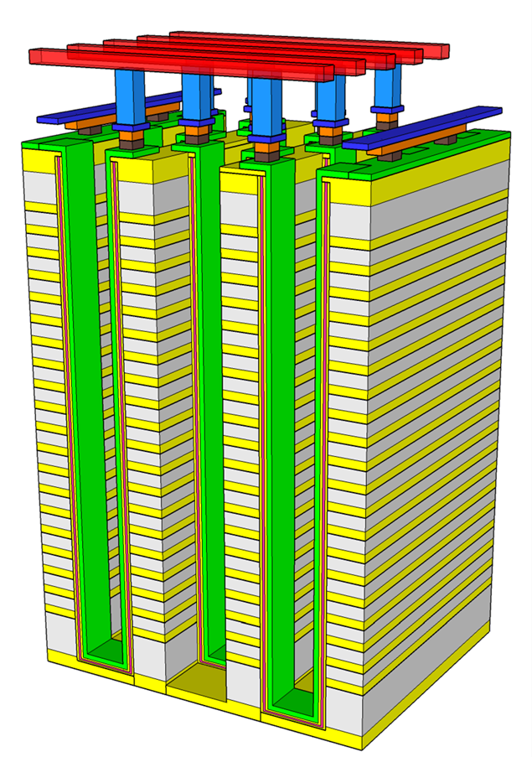
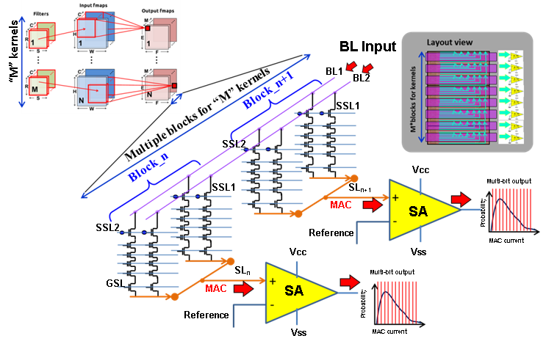
In-Memory Computing Using 3D NAND
Key features:
High capacity (>64Gb) for large NNs
SLC storage for best reliability, but still can provide multi-bit MAC operation
The large ON/OFF ratio >4 orders of transistor Icell
Low Icell ~nA
Tight Vt distributions
Enable large and parallel summation (up to ~10,000) to enhance the MAC operation bandwidth
Hang-Ting Lue, et al., Macronix, IEDM 2019 38.1
9
Notes:
This slide shows an example design of AI-MAC in-memory computing with 3D NAND for inference. Each layer of a DNN contains input neurons, output neurons, and weight parameters. Each weight parameter represents strength of connection between a pair of input and output neurons. We can store each of the multi-bit weight on multiple NAND cells in binary format.
A 3D NAND chip contains thousands of blocks, each block has a large number of vertical strings of NAND cells. To carry out the MAC computing, we put the inputs on BLs, select one word-line, sum the current from each block. Then we digitize it and do activation function digitally.
The key features are high-capacity, robust, multi-bit, accumulating large number of cell currents once, massively parallel computing, and minimum data movement, as listed on the chart.
This kind of “analog” in-memory computing technologies has high potential for AI-MAC computing. However, there are challenges before good products appear: (1) proper ADC/DAC, (2) data routing for reconfigurable neural networks, (3) System level design.

Slide 10

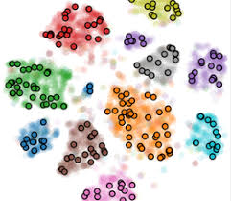
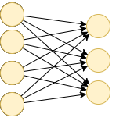

In-Memory Search Technology
Feature Vector Extraction
Similarity Computation
Offline create data base
Query Vector data base
Trained neural network encoder
Online query
Euclidean space
Query Vector
An in-memory search engine can be embedded in a data search system as a memory module (device)
nvTCAM: Non-volatile Ternary Content-Addressable Memory
Similarity search with Cosine Similarity or Hamming Distance sorter
Source: Macronix
10
Notes:
Facenet: 2015 by researchers at Google.

Slide 11
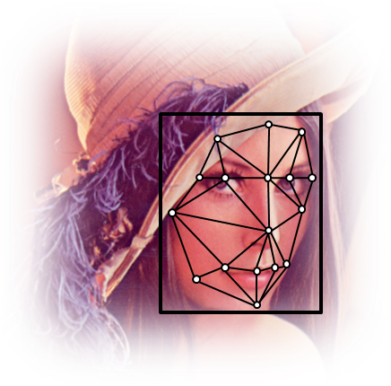

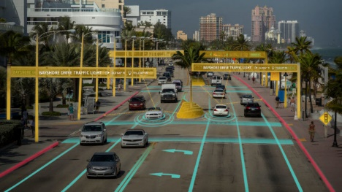
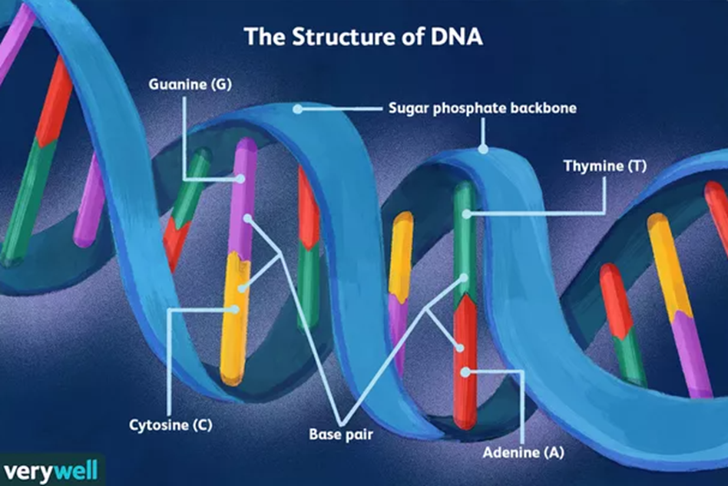

In-Memory Search with Flash Memories
Key Advantages
  High capacity 512Gb per NAND, 4Gb per NOR
  Non-volatility, Low cost, Low power (a few 100mW),
  low read disturbance (> 1G) + refresh
Key Dis-advantages
  Slow read for NAND (~50us), NOR (~120ns)
  Limited endurance for NAND (~1e4), NOR (~1e5)
Some Example Applications
Face Recognition
Large Language
Model
Car Localization
DNA Mapping
Recommendation
Source: Macronix
11
Notes:
Voice recognition & NLP- HK student 5G cell phone peer-to-peer 3m , UN languages, real-time 100-200 translators. US$100/hr. HK-JPN-English

Slide 12
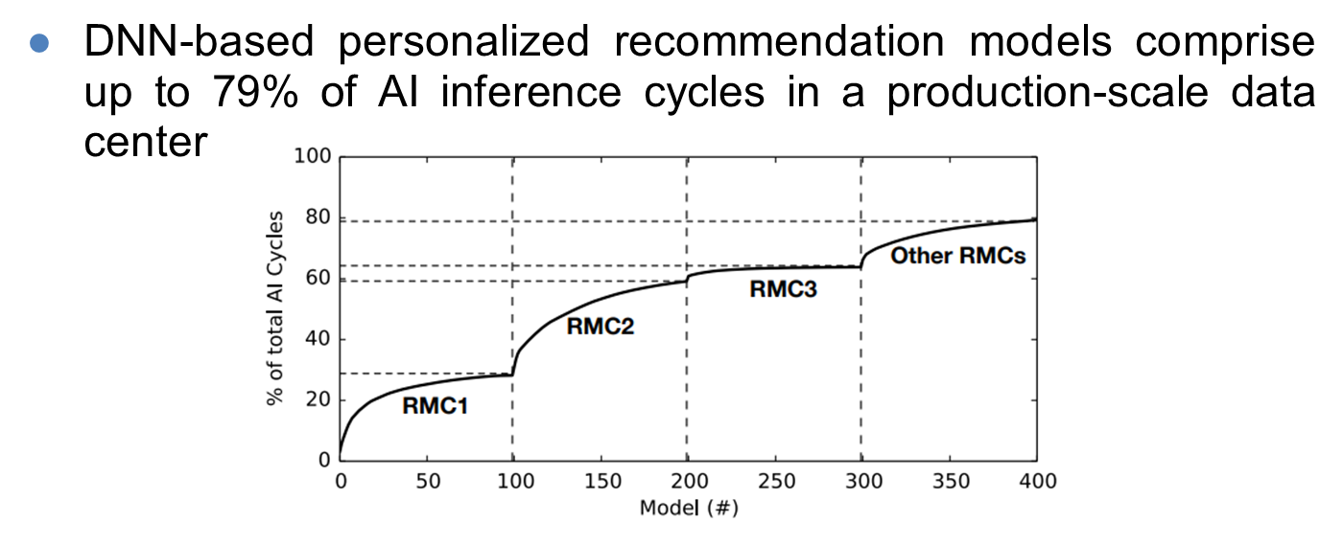
Recommendation (1)
U. Gupta, et al. “The Architectural Implications of Facebook’s DNN-based Personalized Recommendation” (HPCA2020)
12

Slide 13
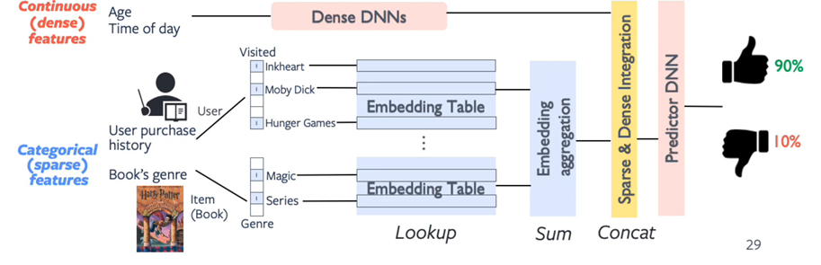
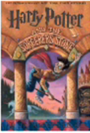
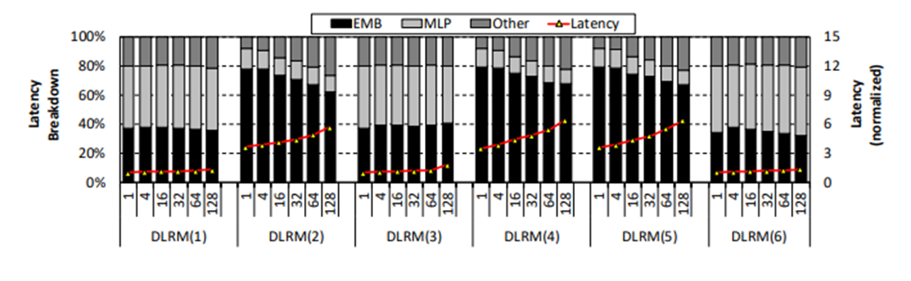
Recommendation (2)
EMB
MLP
R. Hwang et al. "Centaur: A Chiplet-based, Hybrid Sparse-Dense Accelerator for Personalized Recommendations," (ISCA2020)
13

Slide 14
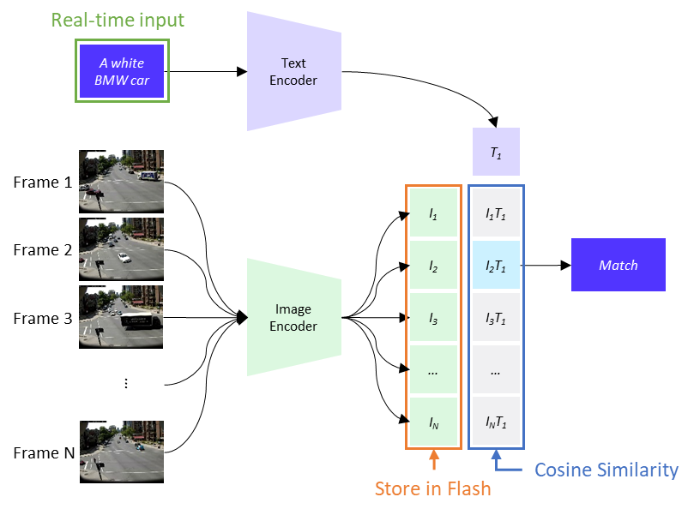
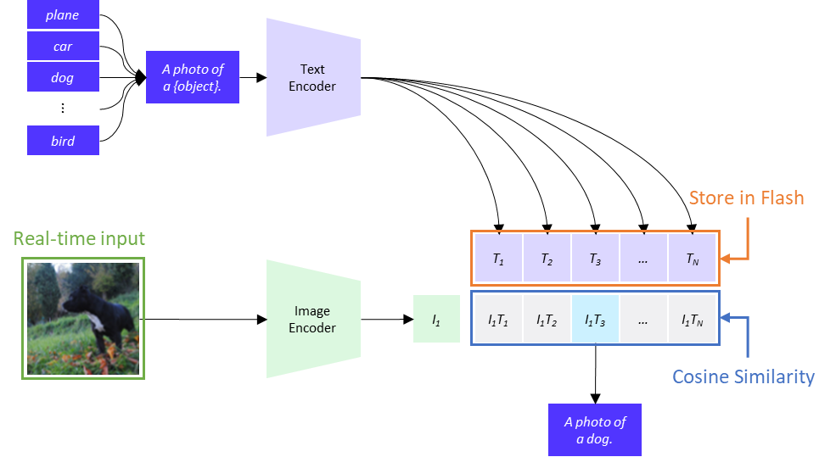
Surveillance (1)
CLIP (Contrastive Language-Image Pre-Training)
CLIP is trained to match images with the corresponding captions and vice versa. Therefore, there are two ways to use CLIP
  A bunch of categories are given and encoded as features. The input image is encoded and searched against the features of the categories in real time.
  Given a bunch of images, encode them into features. The text you want to find is encoded and searched against the features of the category in real time.
  ①
  ②
CLIP is a really powerful neural network proposed by OpenAI. It is trained with 400 million (image, text) pairs collected from the internet.
14
https://openai.com/blog/clip/
https://arxiv.org/abs/2103.00020\

Slide 15
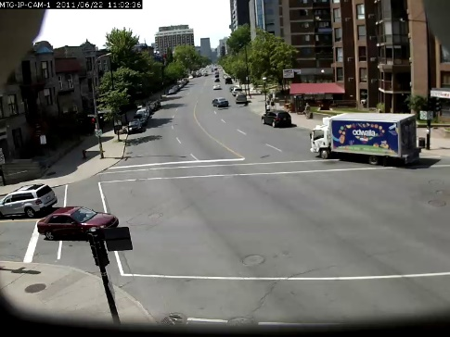
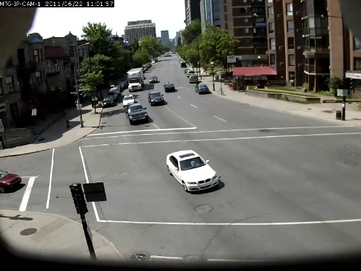
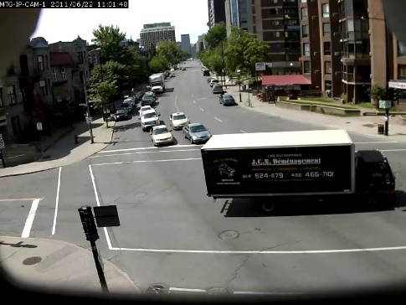
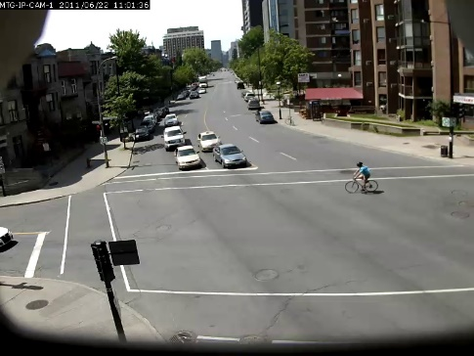
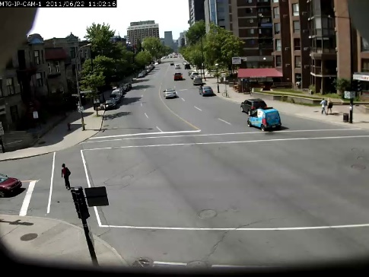
Surveillance (2)
CLIFS: Contrastive Language-Image Forensic Search
CLIFS is a proof-of-concept for free text searching through videos for video frames with matching contents.
The searching is done by first extracting features from video frames using the CLIP image encoder and then getting the features for the search query through the CLIP text encoder.
The features are then matched by cosine similarity and the top results are returned, if above a set threshold.
A truck with the text "odwalla"
A white BMW car
A truck with the text "JCN"
A bicyclist with a blue shirt
A blue SMART car
Scenario: There are about 15,000 surveillance camera in Taipei City. Each video will be saved for 1 month.
  Each frame is embedded to a 512 dimension FP32 feature: 2KB/feature
  For each second, suppose that one frame is encoded and stored. Then 2,592,000 features will be stored for one month of video.
  Total storage requirement: 2KB/feature * 2,592,000 features/month * 15,000 surveillance camera = 72.4 TB
https://github.com/johanmodin/clifs
https://news.ltn.com.tw/news/society/paper/1510190
15

Slide 16
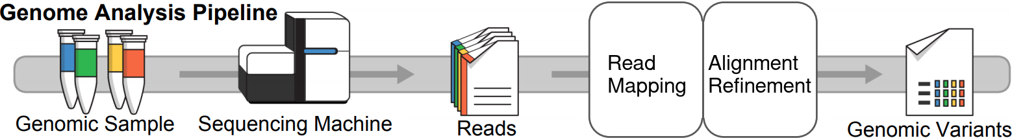


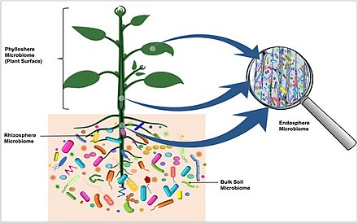
Genomic Analysis
Metagenome Analysis
K-mer matching (Data base searching)
Functional,
Taxonomic,
Sequence analysis
K-mer
(Reads)
Remediation
Agriculture
Wu, Lingxi, et al. "Sieve: Scalable in-situ dram-based accelerator designs for massively parallel k-mer matching." (ISCA 2021)
16
Notes:
NYCU –Dr. Tung, Alex Su of past ARM FPGA accelerator of AI (face detection, etc.)
NTU – Chia-Hsiang Yang
ARM AI – Audin-san persues PhD from Prof. Chia-Hsiang Yang.

Slide 17
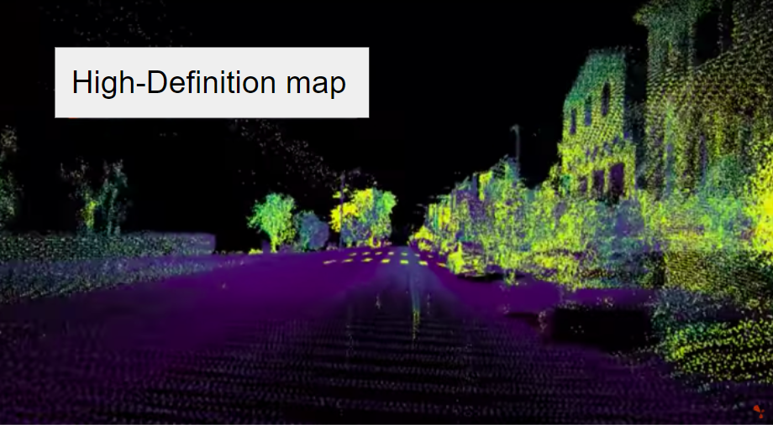
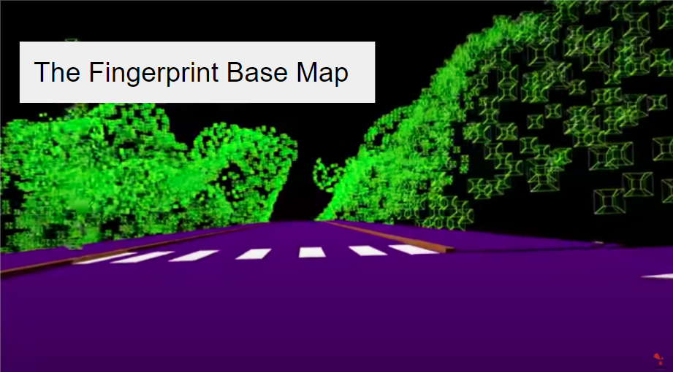
Car Localization
Civil Maps’ The Fingerprint Base Map™
A high-definition map (HD map) is a highly accurate map used in localization for autonomous driving.
Civil Maps’ The Fingerprint Base Map™ is an edge-based map for real-time localization
  Each voxel contains its unique fingerprint.
  It allows a dictionary lookup of the location in 0.1 second and achieves 15 cm – 20 cm accuracy at high speed.
  A HD map of San Francisco, which is about 4,000 kilometers, can take up to 4 terabytes, and Base Map of only ~400 megabytes for that same region (compress 10,000x)
High density points
Sparse voxels
Source: www.civilmaps.com
17
Notes:
NTU Professors: Kan Lee, Chih-Kan Yang,
Civil Maps is being acquired by a public lidar company that collaborates with Meceed Benz. (Level 3) also Honda.

Slide 18
Outline
Introduction
Experience Sharing
  Some Stories of Neutrino
  GaAs Heterojunction Bipolar Transistor (HBT) and ICs
  Semiconductor Memories
Conclusion Remarks
18

Slide 19
It is a Privilege Being a Physicist
(Victor F. Weisskopf)
Studying physics is a lucky, interesting, and practical journey. It trains us to learn new things fast and be leaders of many fields of research and work
Semiconductor industry has been advancing exponentially following Moore’s Law since 1960’s
  It enabled many electronic products that enriched our lives
  It accelerates developments of AI, IoT, communication, sensing, biomedicine, etc.
  Memory-centric computing is emerging to complement process-centric computing
Neutrino physics research continues to be exciting and important for exploring frontier knowledge of Nature
Competitions in both fields are severe. The keys to success are passion, innovation, and persistence
19

Slide 20
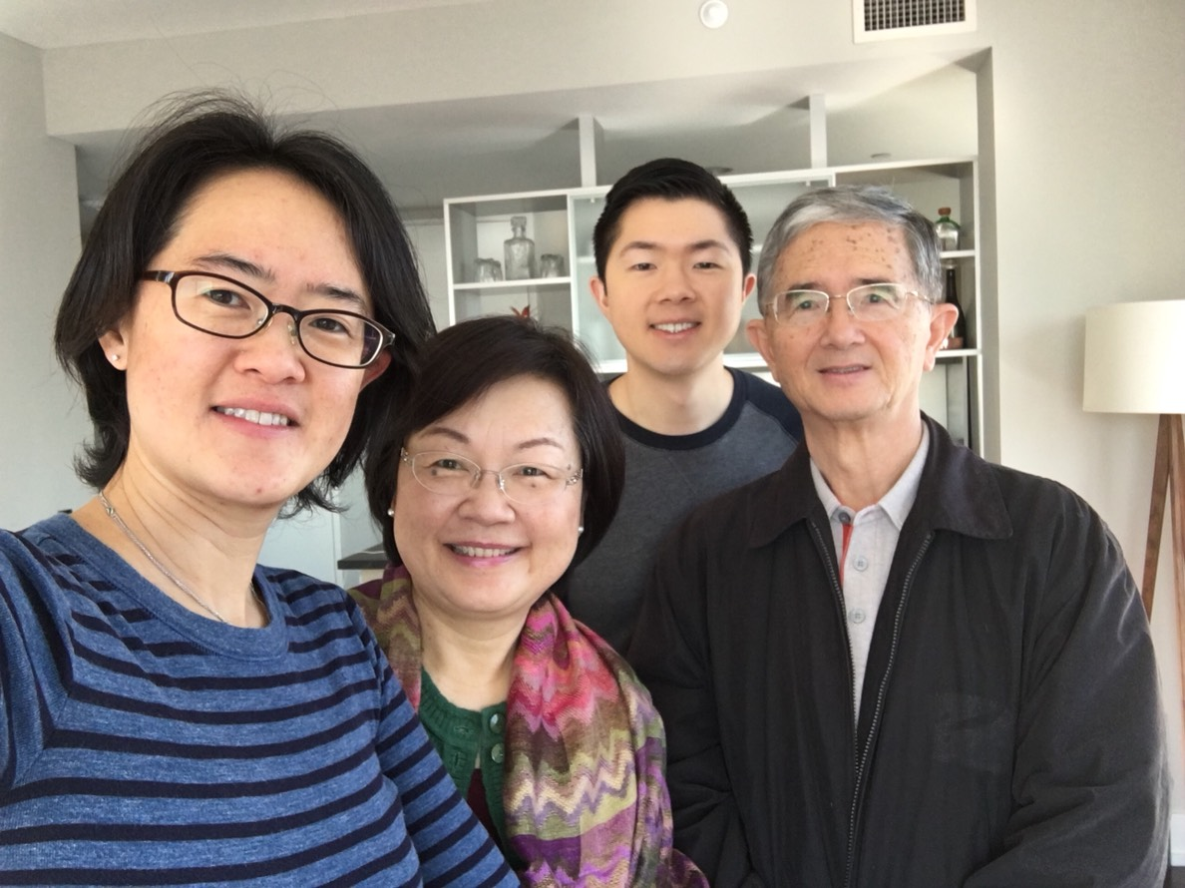
Acknowledgement
夏期岳先生夫人
Felix Boehm
Herb Chen
Peter Asbeck
Frank Chang
Derek Cheung
Jackson Hu
Nim Cheung
C. Y. Lu
Rich Liu
Teachers
Classmates
Colleagues
Sponsors
Customers
Collaborators
Friends
Father
Wife, Children, Relatives
…
20

Slide 21
Thank You!
kcwang@mxic.com.tw
21

