Slide 1
Study of Time-Dependent Impact Ionization in a Large-Size Low Energy Threshold Ge Detector
Pramod Acharya
University of South Dakota

Slide 2
Motivation
Test USD grown crystals if suitable for detector use
Crystal is intended for cryogenic detectors, specifically Super-CDMS-style dark matter detectors.
Test the charge performance:
Charge collection efficiency (as function of bias)
Time dependent impact ionization
Impact ionization scattering cross-section
Binding Energy of charged state
Maximum bias
1

Slide 3
USD detector “USD1”
Ge crystal (2014) used in USD1 fabricated by Dongming Mei's group at USD
Net Impurity
$$N_{A}−N_{D}≈{4×10}^{11} cm^{−3}$$
$$N_{D}+N_{A}=\left(5−7.5\right)×{10}^{11} cm^{−3}$$
$$N_{D}=\left(1−3.5\right)×{10}^{11} cm^{−3}$$
$$N_{A}≈6×{10}^{11} cm^{−3}$$
USD1: 100 mm diameter, 33.8 mm thickness (SNOLAB size)
• 4 concentric charge channels on one side, and bias electrode on opposite side
2

Slide 4
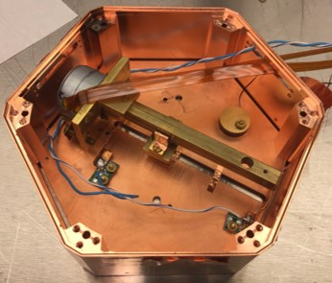
Testing at UMN- Run 67 & Run 74
Four Am-241 sources, one over each channel (Run 67). Movable Am-241 source top of the detector (Run 74).
A lead collimator allows 60keV gammas through the detectors.
Alphas from the sources are blocked by the source encapsulation.
Base temperature around 50 mK in dilution refrigerator
Ground side of the detector- Uniform Al electrode rather than a grid. This may have impacted the ability to neutralize the detector with LEDs.
Purpose: characterize charge performance for this crystal
Figure: Shows the orientation of the Am-241 source mover before it was installed on the detector
3

Slide 5
Impact Ionization
Free charge carriers gain enough energy to produce additional free carriers through interactions with either impurity atoms or the crystal lattice itself.
Evidence of impact ionization must involve impurity states, namely charged state and neutral states
$$D^{+}/A^{−}$$
$${ D}^{0}/{ A}^{0}$$
At t=0: Equilibrium State
$$p−n+N_{D}^{+}−N_{A}^{−}=0→charge neutralization$$
$$p\left(free holes\right)+p_{d}\left(holes bound to the atom\right)=N_{A}(Densities of acceptor impurities)$$
$$similarly, n+n_{d}(unionized \text{donor} electron)=N_{D}$$
$$p=N_{A}−p_{d} \& n=N_{D}−n_{d}$$
$$N_{A}−N_{D}=N_{A}^{−}−N_{D}^{+}+p_{d}−n_{d}$$
0
$$N_{A}−N_{D}=p_{d}−n_{d}===(bound h^{+} \&{ e}^{−}, This represents dipole densities at low temp.$$
Density of detector state= $N_{A}−N_{D}=p_{d}−n_{d}=4×{10}^{11} cm^{−3}$
4

Slide 6
At $t≠0$ : Prolong ionization, i.e. at Operational mode
$$e^{−}+A^{0∗}→A^{−∗} (e^{−} from background)$$
+ve ion state
For p-type
$$h^{+}+A^{−∗}→2h^{+}+e^{−}+A^{−} (Impact ionization)$$
-ve ion state
Can be seen growth of $A^{−∗}$ as a function of time
Onsager radius
$$h^{+}+A^{−}→A^{0∗} \left(Loss of neutralization\right), trapping of h^{+}$$
Fig. Formation of cluster dipole states in an n-type (upper) and a p-type (lower) Ge detector operated at low temperatures, where ⃗p and ⃗q are the corresponding dipole moments.
https://arxiv.org/pdf/2203.15904.pdf
5

Slide 7
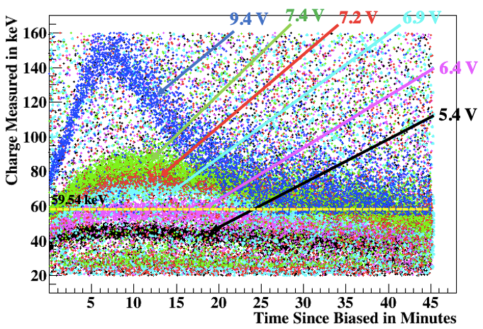
Experimental Results – Run 67 & Run 74
Fig: Shows the time-dependent impact ionization for Am-241, 60 keV. At certain biases charge collection efficiency starts near 100% then rises steadily above 100%, apparently due to impact ionization.
Impact ionization is only seen when the side with the Am-241 source has positive bias, thus it's a hole-drift phenomenon.
Charge collection efficiency (CCE) starts to fall off at some point. This is attributed to loss of neutralization. Space charge builds up in the detector producing new trapping centers, which eventually degrade CCE
Detector neutralization can be restored by removing bias and LED flashing
6

Slide 8
A Model to explain Impact Ionization
$$E\left(t\right)=E_{γ}\{p_{0}+p_{1}exp[\frac{p_{2}}{p_{3}}\left(1−exp\left(−p_{3}t\right))\right]\}exp⁡(−p_{4}t)$$
$$E_{γ}=60 keV$$
$p_{0}$represents the charge observed at t = 0, $p_{0}=ε_{0}M_{0}$
$$ε_{0}=Average Charge collection efficiency at t=0$$
$$M_{0}=Multification factor for the charge created by the impact ionization at t=0$$
$$p_{1}=ε_{t}M_{t}$$
$$M_{t}→fraction of charge carriers that undergo impact ionization under dipole cluster$$
$$p_{2} represents the rate creating A^{−∗} states, p_{2}=R_{A}^{−∗}×σ_{1}×v_{d} α E$$
$$p_{3}=λ→Decreasing rate of A^{−∗}$$
$$p_{4}=λ_{d}→represents loss of neutralization$$
7

Slide 9
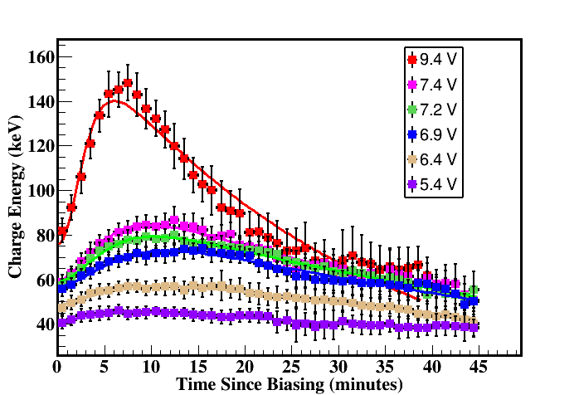
Fitting
Fitting the Model: Run-67
Fitting the Model: Run-74
8

Slide 10
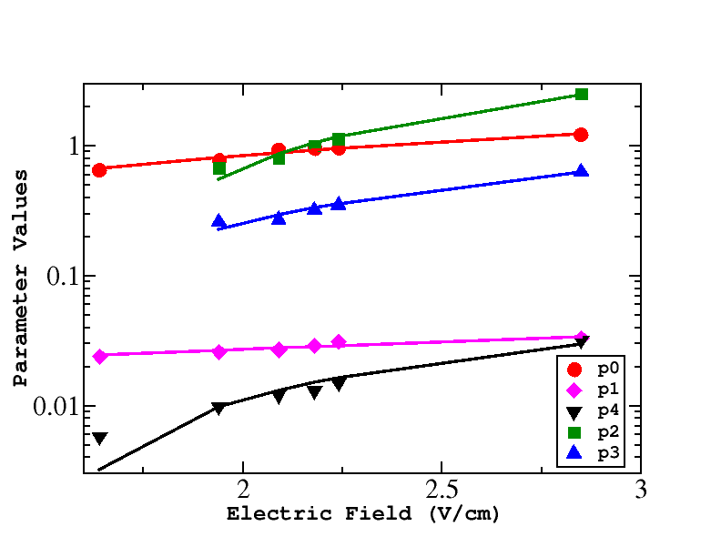
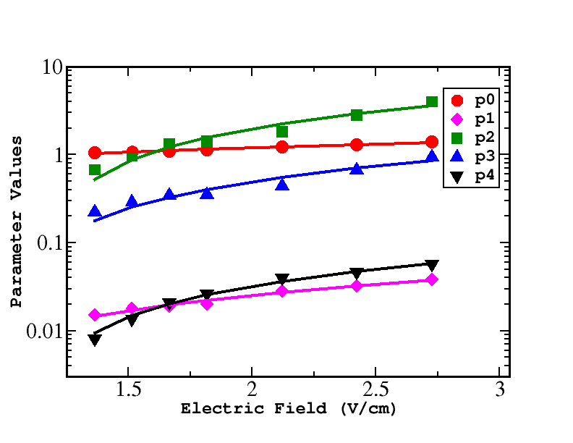
Fitting Parameters Correlation
Run -67
Run -74
$$p0=0.25E+0.69$$
$$p1=0.017E−0.0087$$
$$p2=2.27E−2.57$$
$$p3=0.49E−0.49$$
$$p4=0.036E−0.039$$
$$p0=0.47E−0.11$$
$$p1=0.0078E+0.011$$
$$p2=2.1E−3.5$$
$$p3=0.43E−0.61$$
$$p4=0.022E−0.033$$
DOI:10.1140/epjc/s10052-023-11432-y
9

Slide 11
Binding Energy
Series | Bias (V) | Tower Temp (K) | Amp rate(keV/min) | Slope error (keV/min)
07210921_1501 | 10 | 0.85 | 7.32 | 1.36
07210921_2153 | 10 | 1.28 | 8.39 | 1.837
07210914_1545 | 10 | 1.52 | 11.9994 | 3.41301
07210922_1454 | 10 | 2.28 K | 12.6555 | 2.74246
07210922_1634 | 10 | 2.69 K | 13.3850 | 3.53605
RUN-74
$$\frac{R_{t}}{E_{B}}=σ_{n}v_{th}N_{v}e^{− \frac{E_{B}}{K_{B}T}}$$
DOI 10.1007/s10909-012-0547-1
$E_{B} \text{is} \text{the} \text{binding} \text{energy} \text{of} \text{charged} \text{state} A^{−∗}\text{, }\text{and} σ_{n} \text{is} \text{the} \text{scattering} \text{cross}\text{−}\text{section}$ for impact ionization
10

Slide 12
$$\frac{R_{t}}{E_{B}}=σ_{n}v_{th}N_{v}e^{− \frac{E_{B}}{K_{B}T}}$$
$$\frac{R_{t}}{σ_{n}v_{th}N_{v}}={E_{B}e}^{− \frac{E_{B}}{K_{B}T}}$$
N_{ν} = 9.6*10¹⁴ T^{3/2} cm⁻³
$$v_{th}=\sqrt{\frac{3K_{B}T}{m_{h}^{∗}}}$$
This was from our calculation and approx. equal to the Super-CDMS calculation
$$m_{h}^{∗}=0.29m_{e}$$
$$σ_{n}=7.4×{10}^{−13} cm^{2}$$
$$Ground state Energy,E_{B}^{0}=0.01 eV=10 meV$$
11

Slide 13
Impact ionization Charge Collection Efficiency
$$σ=\frac{v_{d}}{v_{tot}N_{dip}λ_{t}}$$
$$λ_{i}=trapping length for impact ionization$$
$$\frac{1}{λ}=\frac{1}{λ_{t}}−\frac{1}{λ_{i}}$$
$$λ_{t}=trapping length for trapping cross section$$
$$λ_{i}=\frac{1}{R×σ_{0}}$$
L=3.3;
R=4E11;
s0=7E-13;
$$R=4E11 cm^{−3}$$
$$σ_{0}=7.4E−13 cm^{2}$$
The trapping length, we observed is due to the impact ionization due to cluster dipole states, and the trapping of holes
12

Slide 14
Trapping Cross-section
Run-67
Series | Bias (V) | CCE | Trapping Length (cm) | Amp Rate (keV/min)
07180325_1634 | 4.5 | 1 | 3.6 | 0.65
07180326_1709 | 5 | 1.08 | 4.3 | 1.84
07180325_1734 | 5.5 | 1.11 | 4.6 | 3.63
07180326_1840 | 6 | 1.15 | 5.1 | 4.66
07180326_2011 | 7 | 1.25 | 6.7 | 8.66
07180323_2043 | 8 | 1.41 | 12.2 | 14.47
$$σ=\frac{v_{d}}{v_{tot}N_{dip}λ_{t}}$$
At Low temp. mK
$$N=4E11 cm^{−3}$$
13

Slide 15
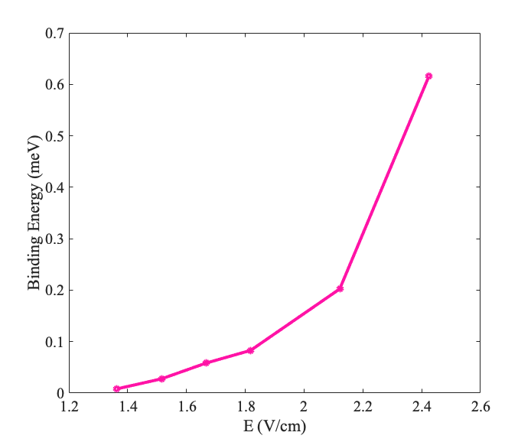
Binding Energy
$$\frac{R_{t}}{σ_{n}v_{th}N_{v}}={E_{B}e}^{− \frac{E_{B}}{K_{B}T}}$$
Imply the Fermi-Dirac distribution
$$f\left(ϵ\right)=\frac{1}{1+exp\left(\frac{E_{B}−E_{f}}{K_{B}T}\right)}$$
$$\frac{R_{t}}{σ_{n}v_{th}N_{v}}=E_{B}f(ϵ)$$
$$\frac{R_{t}}{σ_{n}v_{th}N_{v}}=\frac{E_{B}}{1+exp\left(\frac{E_{B}−E_{f}}{K_{B}T}\right)}$$
The Fermi energy of germanium at low temperature can be estimated using the following formula:
$$E_{f}=\frac{3}{4}×E_{G}$$
where $E_{f}$ is the Fermi energy and $E_{G}$ is the bandgap energy of germanium.
The bandgap energy of germanium is approximately 0.74 eV at low temperature.
$$E_{f}≈0. 55 eV$$
14

Slide 16
Conclusion
We determined that electrons are more trapped in a p-type detector
We observed impact ionization in both run-67 and run-74. This unique phenomenon can be utilized to understand the detector’s performance for dark matter search.
For higher binding energy, a higher electric field is required in order to accelerate the charge carriers being trapped.
The meV level binding energy will be useful in understanding the MeV scale or even lower mass DM
Study will be carried out in details: Charge breakdown, Charge collection efficiency, Energy resolution, Charge trapping length, and binding energy of charged state.
15

Slide 17
Thank You!
Questions ?
This work is supported by NSF OISE -1743790 and the PIRE-GEMADARC collaboration
Thankful to the UMN K100 lab for the facilities

Slide 18
BACK-UP
10

Slide 19
Impact Ionization Rate
$$γ\left(a,x\right) is the incomplete gamma function$$
Electronic temp.
$$s={5.39×10}^{5}\frac{cm}{s}, m^{∗}=0.12m_{0} for donors, α=31.1$$
$$s={5.39×10}^{5}\frac{cm}{s}, m^{∗}=0.29m_{0} for acceptors, α=26.08$$

Slide 20
$$A_{i}=\frac{σ_{i}}{γ\left(\frac{3}{5}\right)}×{\left(\frac{2k}{m^{∗}}\right)}^{\frac{1}{2}}×{\left(αE^{\frac{4}{5}}\right)}^{\frac{1}{2}}$$
$$A_{i}=\frac{σ_{i}}{γ\left(\frac{3}{5}\right)}×{\left(\frac{2k}{m^{∗}}\right)}^{\frac{1}{2}}×sqrt\left(α\right)×E^{\frac{2}{5}}$$
$$A_{i}=6.87×{10}^{5}×σ_{i}×sqrt\left(α\right)×E^{\frac{2}{5}}$$
$$A_{i}=6.87×{10}^{5}×p_{0}×sqrt\left(p_{1}\right)×E^{\frac{2}{5}}$$
$$Impact ionization scattering cross−section is 7.39E−13 cm^{2}$$

Slide 21
Rate of Energy Loss due to Impact Ionization
$$ϵ_{i}=Binding energy of A^{−} State$$
https://doi.org/10.1103/PhysRev.127.744
$$ε_{i}=\frac{\frac{dε}{dt}}{\left(N_{A}−N_{D}\right){\left(\frac{2ε}{m^{∗}}\right)}^{\frac{1}{2}}σ_{i}\left(ε\right)}$$
$$\frac{dε}{dt}=\left(N_{A}−N_{D}\right){\left(\frac{2ε}{m^{∗}}\right)}^{\frac{1}{2}}σ_{i}\left(ε\right)ε_{i}$$
$$ϵ_{i}=\frac{\frac{dϵ}{dt}}{\left(N_{A}−N_{D}\right){\left(\frac{2K_{B}T}{m^{∗}}\right)}^{\frac{1}{2}}σ_{i}\left(ϵ\right)}$$
Where, $ε_{i}$ is the binding energy of charged state.
where $σ_{i}(ε)$ is the cross section for impact ionization, $m^{∗}$ is effective mass of holes

Slide 22
$$σ_{i}=7.4E−13 cm^{2}$$
$$total velocity \left(v\right)= {√(v}_{d}^{2}+v_{th}^{2}) at mK temperature$$
$$ϵ_{i}=\frac{\frac{dϵ}{dt}}{\left(N_{A}−N_{D}\right){\left(\frac{2K_{B}T}{m^{∗}}\right)}^{\frac{1}{2}}σ_{i}\left(ϵ\right)}$$
$$ϵ_{i}=\frac{\frac{dϵ}{dt}}{\left(N_{A}−N_{D}\right)vσ_{i}\left(ϵ\right)}$$
$$ϵ_{i}=\frac{\frac{dϵ}{dt}}{\left(N_{A}−N_{D}\right){√(v}_{d}^{2}+v_{th}^{2})×σ_{i}\left(ϵ\right)}$$
Drift velocity is inversely proportional to temp.

