Slide 1


Ring Contact Technology and Sputtering Technology
Kunming Dong
PIRE GEMADARC Collaboration Meeting 2023
June 2nd, 2023

Slide 2
Outline
Ring Contact Technology
Background and Motivation
Current Experimental Progress
Future Plan
Sputtering Technology with Thin contacts
Background and Motivation
Current Experimental Progress
Future Plan
Summary

Slide 3
Objective
Project Goal: To advance novel GeRC detector technology to study the feasibility of using large-size Ge detectors for LEGEND-1000. To achieve this goal, the following three objectives are determined:
  Fabricate the first GeRC detector with a mass of ~2 kg from an existing USD-grown crystal. The fabrication will be conducted at TAMU in collaboration with Prof. Rusty Harris and William Baker.
  If the detector is successful, we will investigate the energy resolution and pulse shape properties of this detector. The characterization will be conducted at UNC in collaboration with Prof. John Wilkerson.
  Grow a new crystal with a mass of >3 kg at USD for fabrication and characterization of the second GeRC detector.
n+ contact
P+ contact
Cross section of GeRC Detector as proposed by David Radford, ORNL

Slide 4
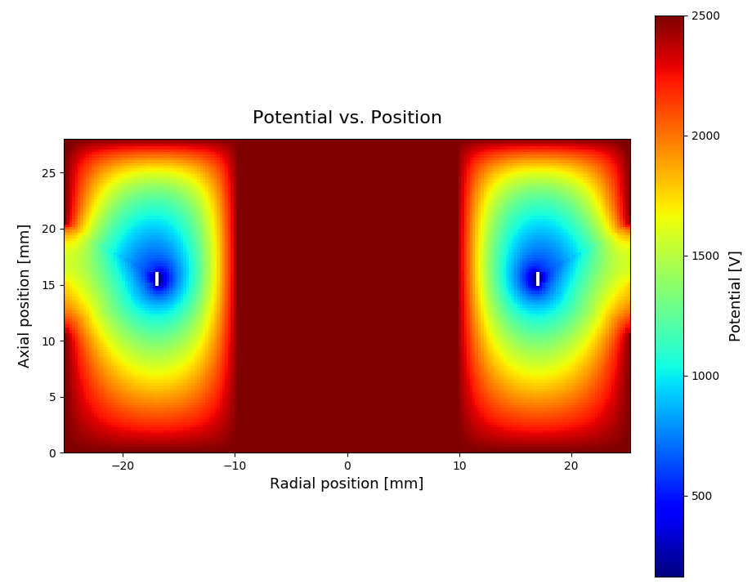
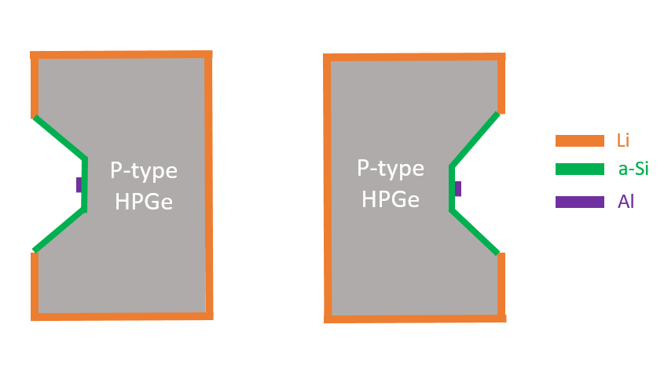
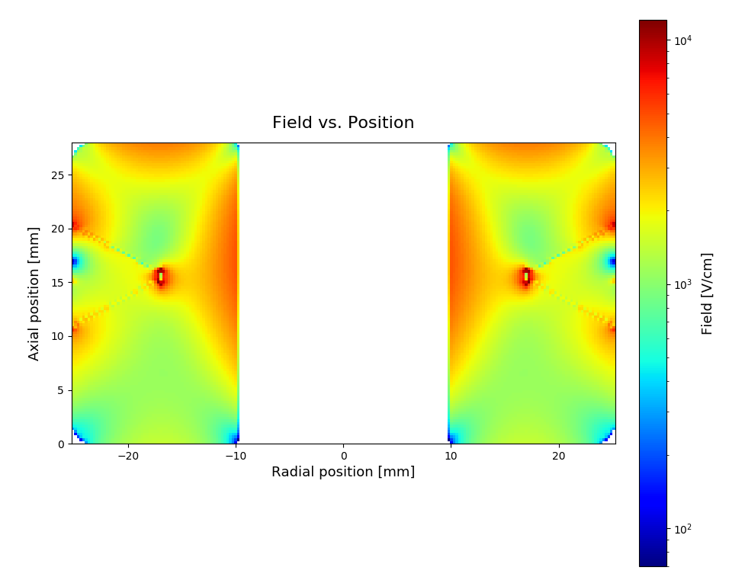
Design based on Simulation
Detector Capacitance Prediction
Cross-section view of the detector.
Ring Contact Length (mm) | Predicted Capacitance by Siggen (pF) | Depletion Voltage (V)
4 | 25.0 | 1347
3 | 22.7 | 1370
2 | 20.2 | 1381
1 | 16.9 | 1374
0.5 | 14.5 | 1352
Ring Contact Width: 1 mm
Depletion Voltage: 1374 V
Applied Voltage: 2500 V
Predicted detector capacitance with different ring sizes by Siggen.

Slide 5
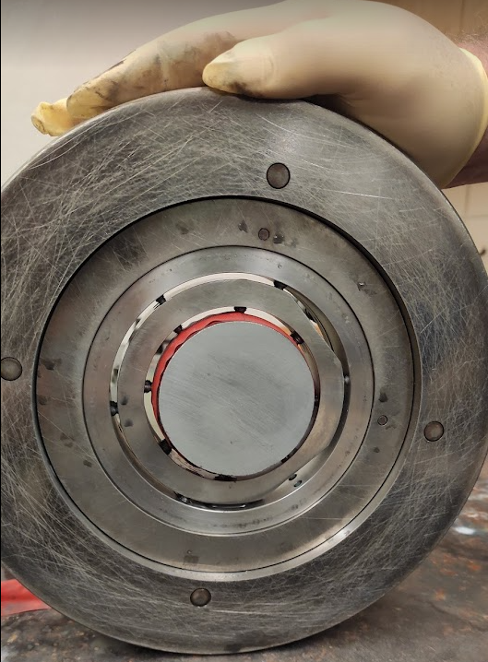
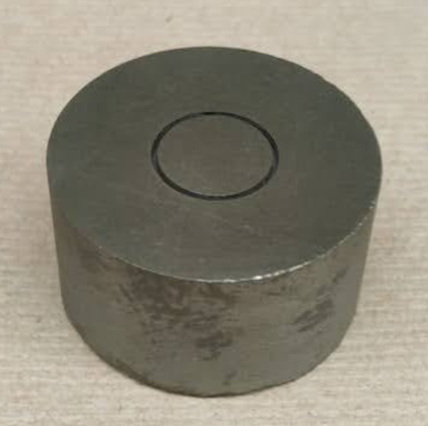
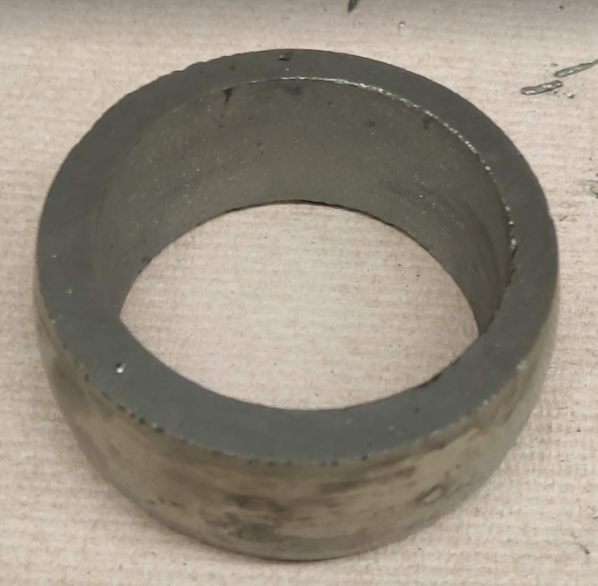
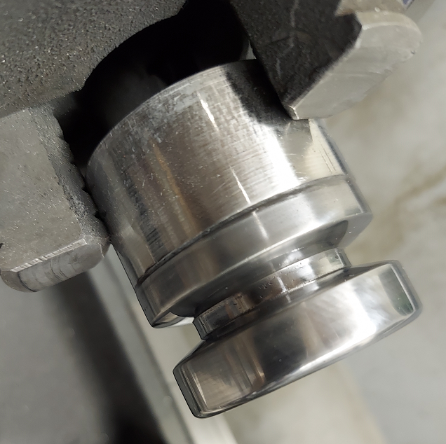
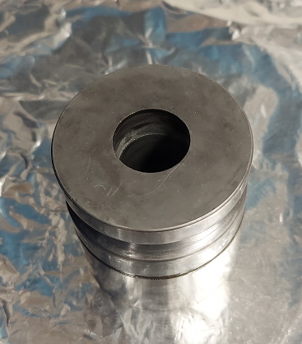
Mechanical Processing
Grinding
Thickness: 28.1mm
Δ thickness: <0.3mm
Core Drilling (Cylinder)
Radius: 25.3 mm
Cutting Groove
Groove:
Bottom Depth: 8.4 mm
Bottom Radius: 16.9 mm
Bottom Length: 4.1 mm
Gap at Outer Radius: 10 mm
Core Drilling (Hole)
Radius: 9.8 mm

Slide 6
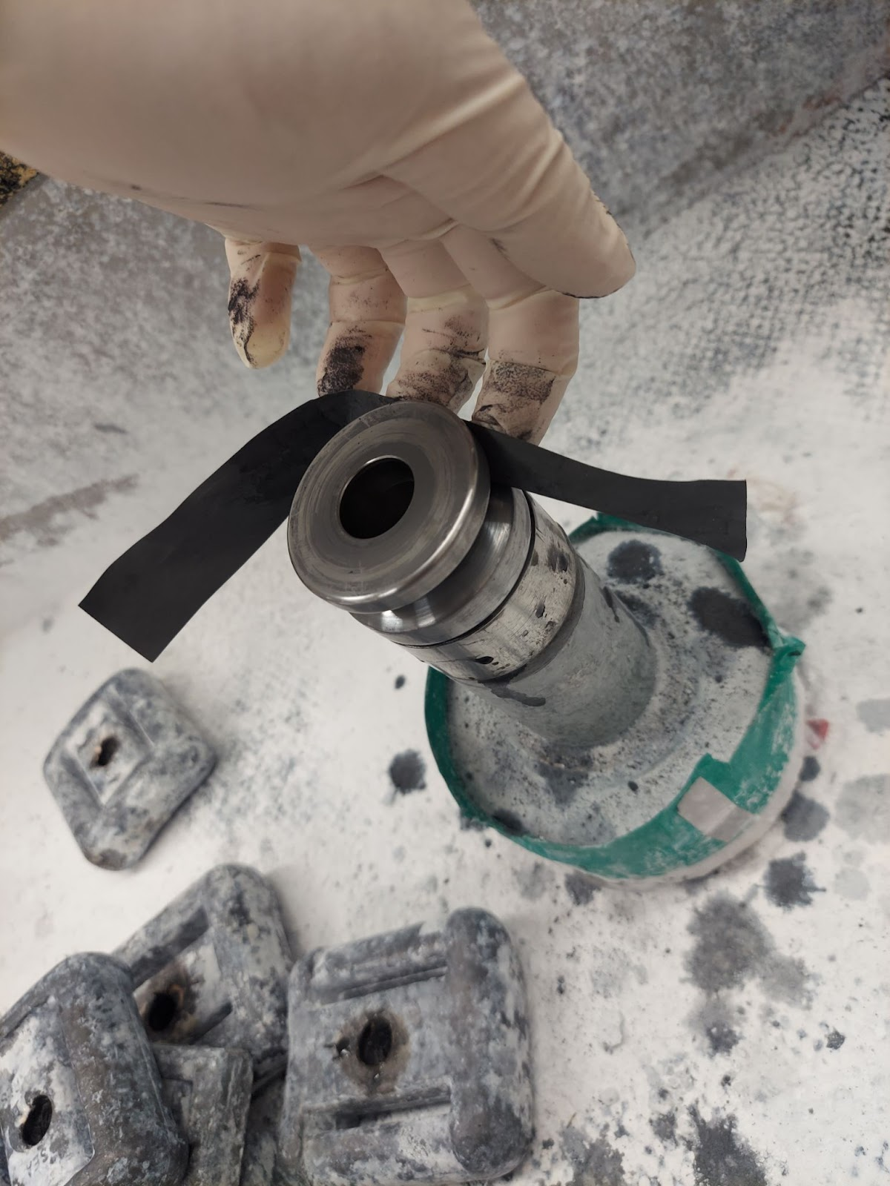
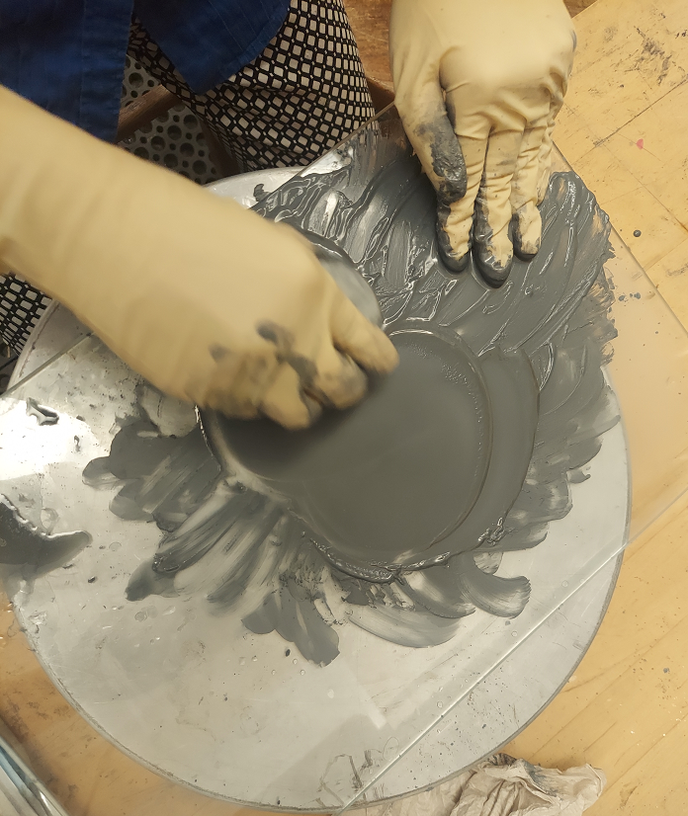
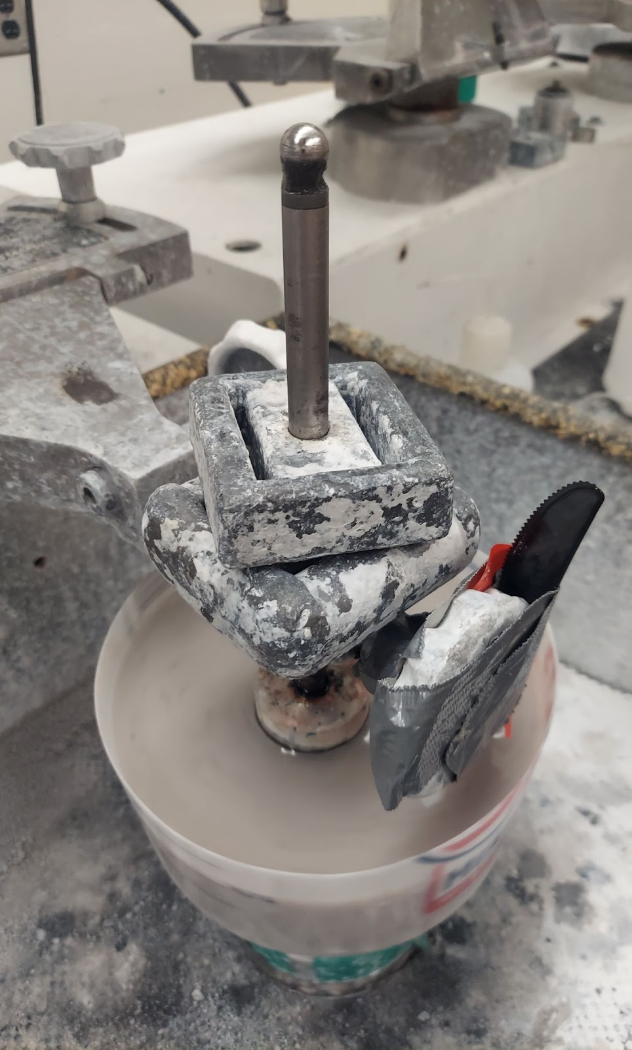
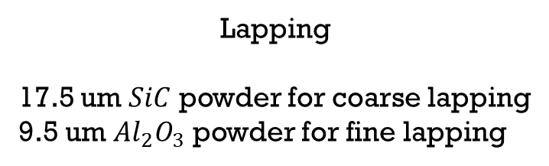
Surface Treatment
Sanding
With graduated fineness of grinding media (sandpaper)
Lapping
17.5 um $SiC$ powder for coarse lapping
9.5 um ${Al}_{2}O_{3}$ powder for fine lapping
Polishing
1 um and 0.3 um polishing powder

Slide 7
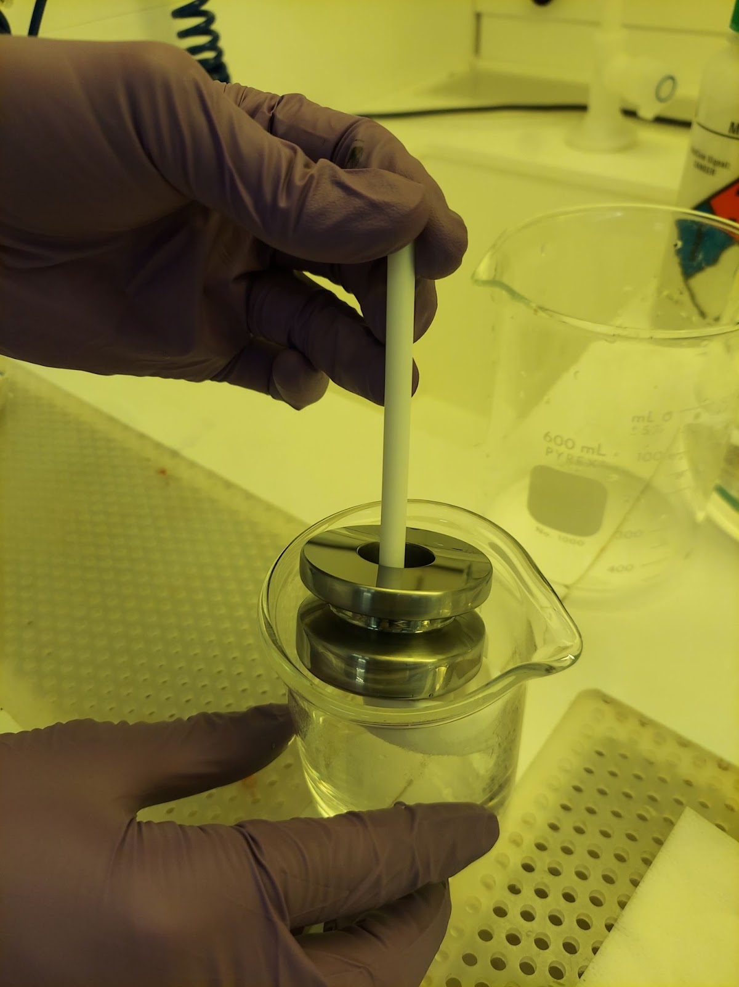
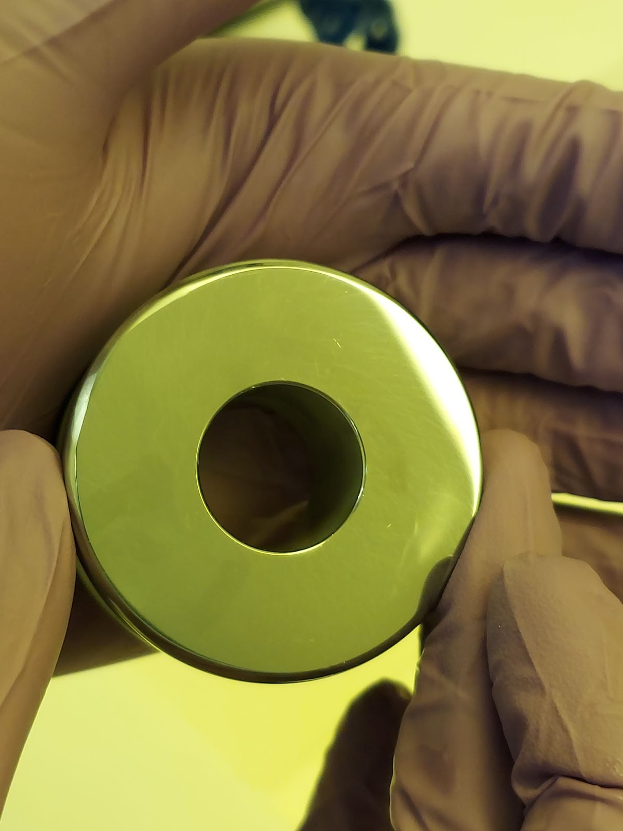
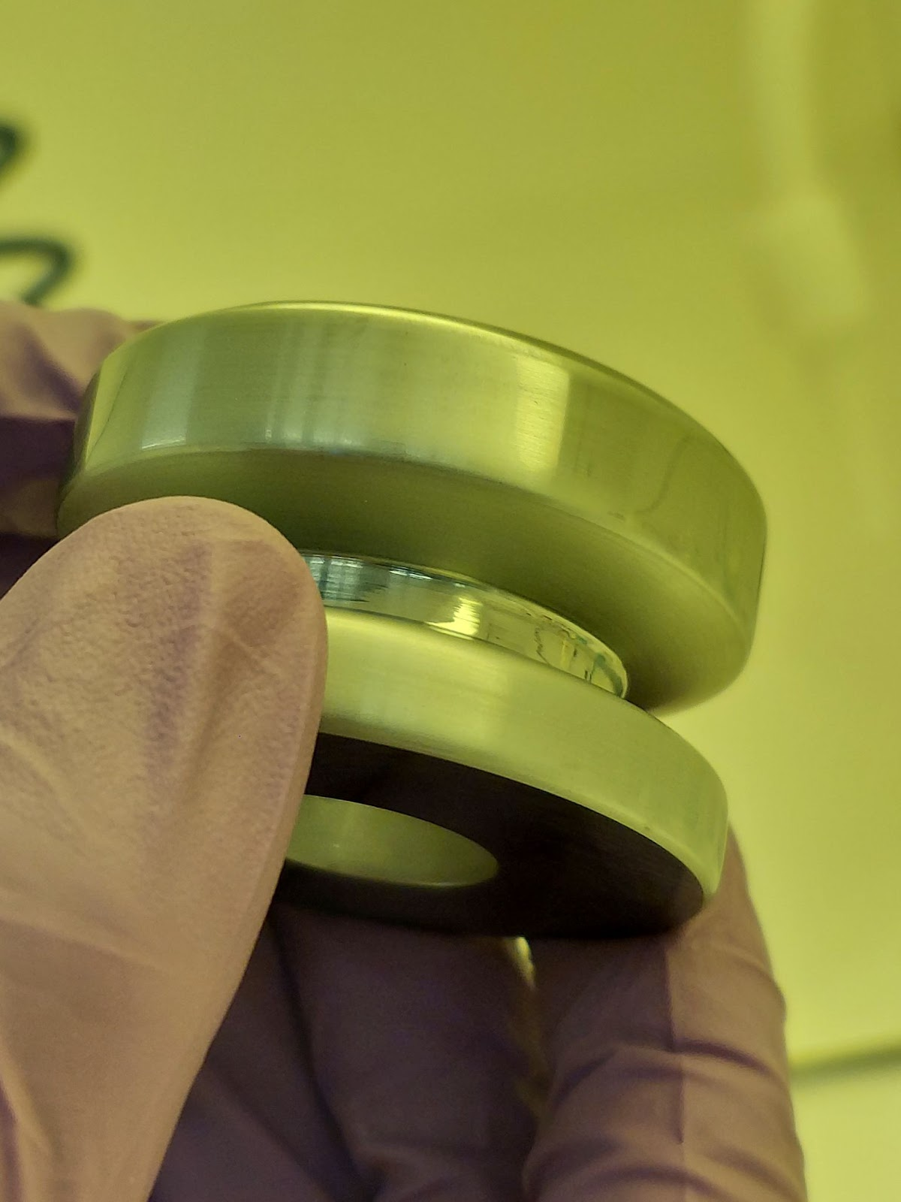
Cleaning and Etching
RCA Cleaning
Heavy Etching
Acetone- 2 mins
Isopropyl Alcohol- 2 mins
Methanol- 2 mins
4. Trichloroethylene- 2mins
5. Acetone- 2 mins
6. DI water- 2 mins
5% HF and 95% HNO3
30 seconds

Slide 8
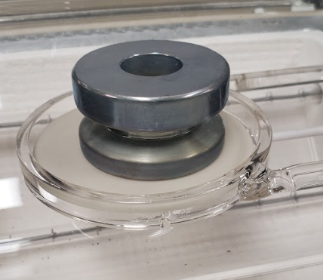
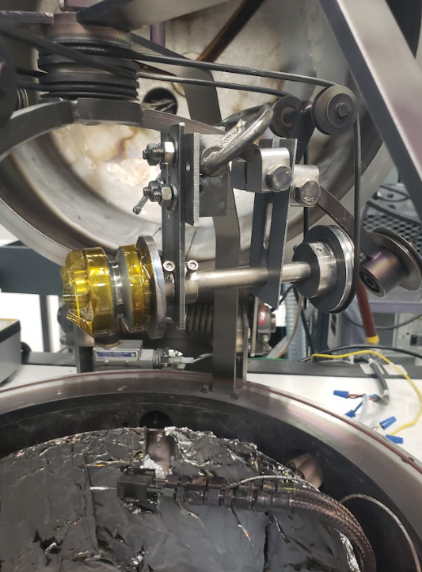
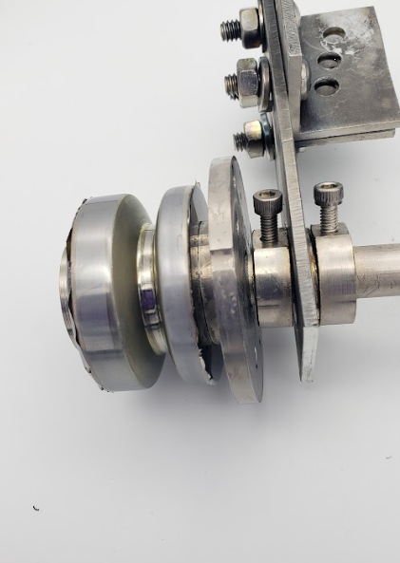

Contacts Fabrication
Lithium Diffusion
${SiO}_{2}$ Deposition
Al Deposition

Slide 9
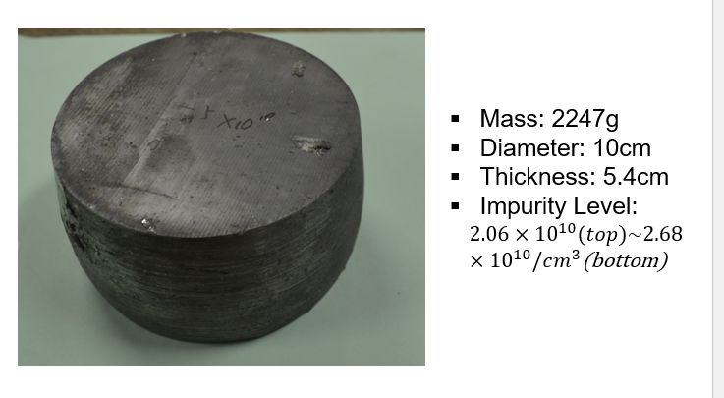
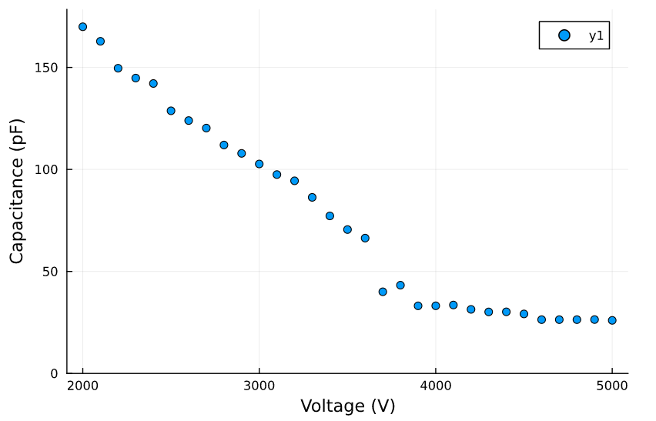
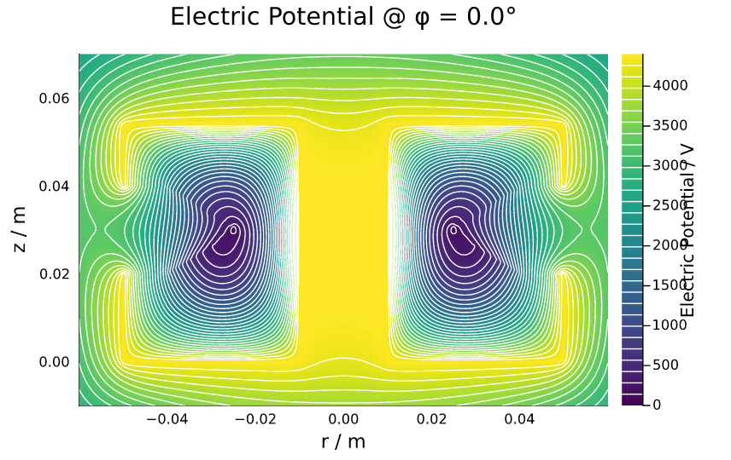
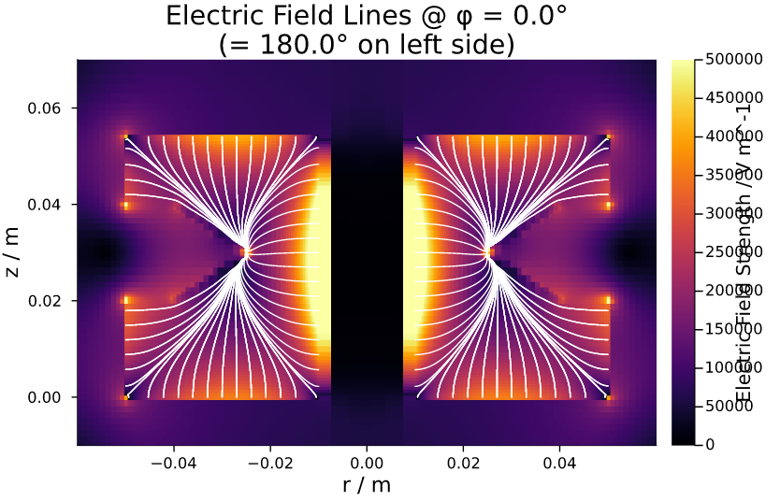
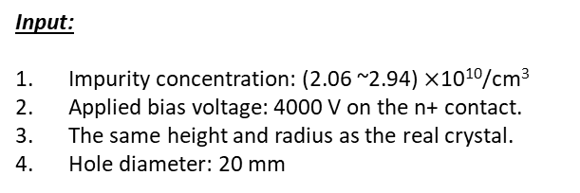
Future Plan
  Refabricate GeRC detector #0.
  Fabricate the GeRC detector with a mass of ~2 kg from an existing USD-grown crystal. The fabrication will be conducted at TAMU in collaboration with Prof. Rusty Harris and William Baker.
  If the detector is successful, we will investigate the energy resolution and pulse shape properties of this detector. The characterization will be conducted at UNC in collaboration with Prof. John Wilkerson.
  Grow a new crystal with a mass of >3 kg at USD for fabrication and characterization of the second GeRC detector.
Input:
Impurity concentration: (2.06 ~2.94) $×$10¹⁰/cm³
Applied bias voltage: 4000 V on the n+ contact.
The same height and radius as the real crystal.
Hole diameter: 20 mm
Output from Julia:
Calculated capacitance at 5000 V: 23.3 pF
Depletion voltage: ~4400 V

Slide 10
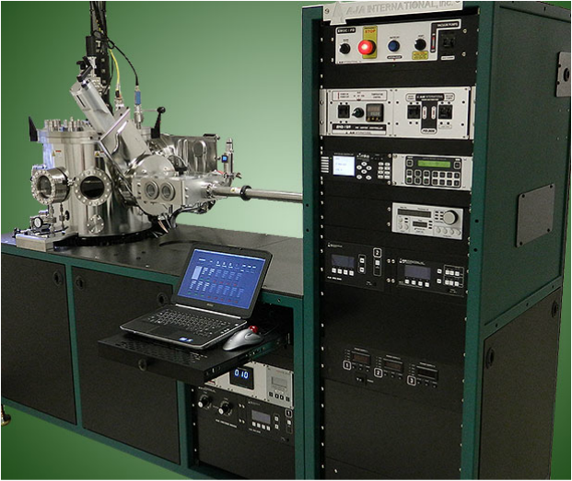
Project Goal
Project Goal: To advance contact technology for studying the feasibility of using large-size Ge detectors for rare-event physics searches. To achieve this goal, the following four objectives are determined:
Purchase a larger and more advanced automated sputtering system
Find out the impact of different parameters on contact through many tests. Then find recipes for different types of detectors
Fabricate small detectors to characterize the contact performance produced by the new sputtering system
Design and fabricate large-size detectors

Slide 11
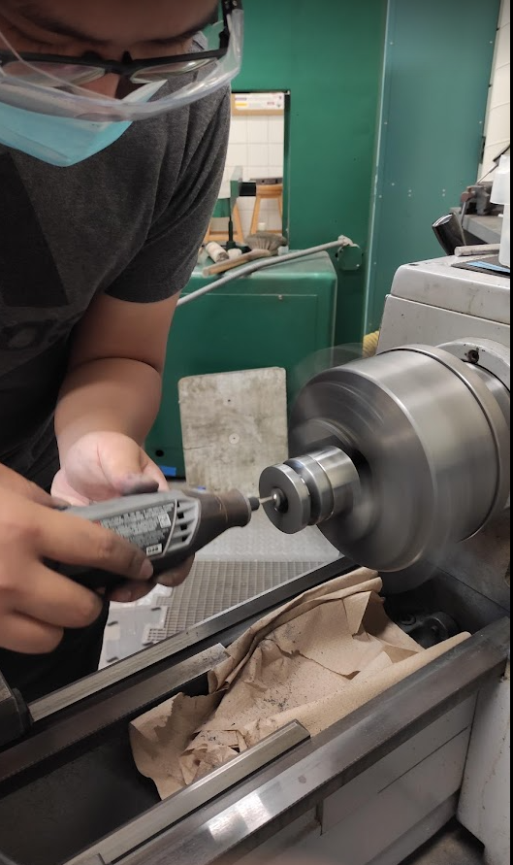
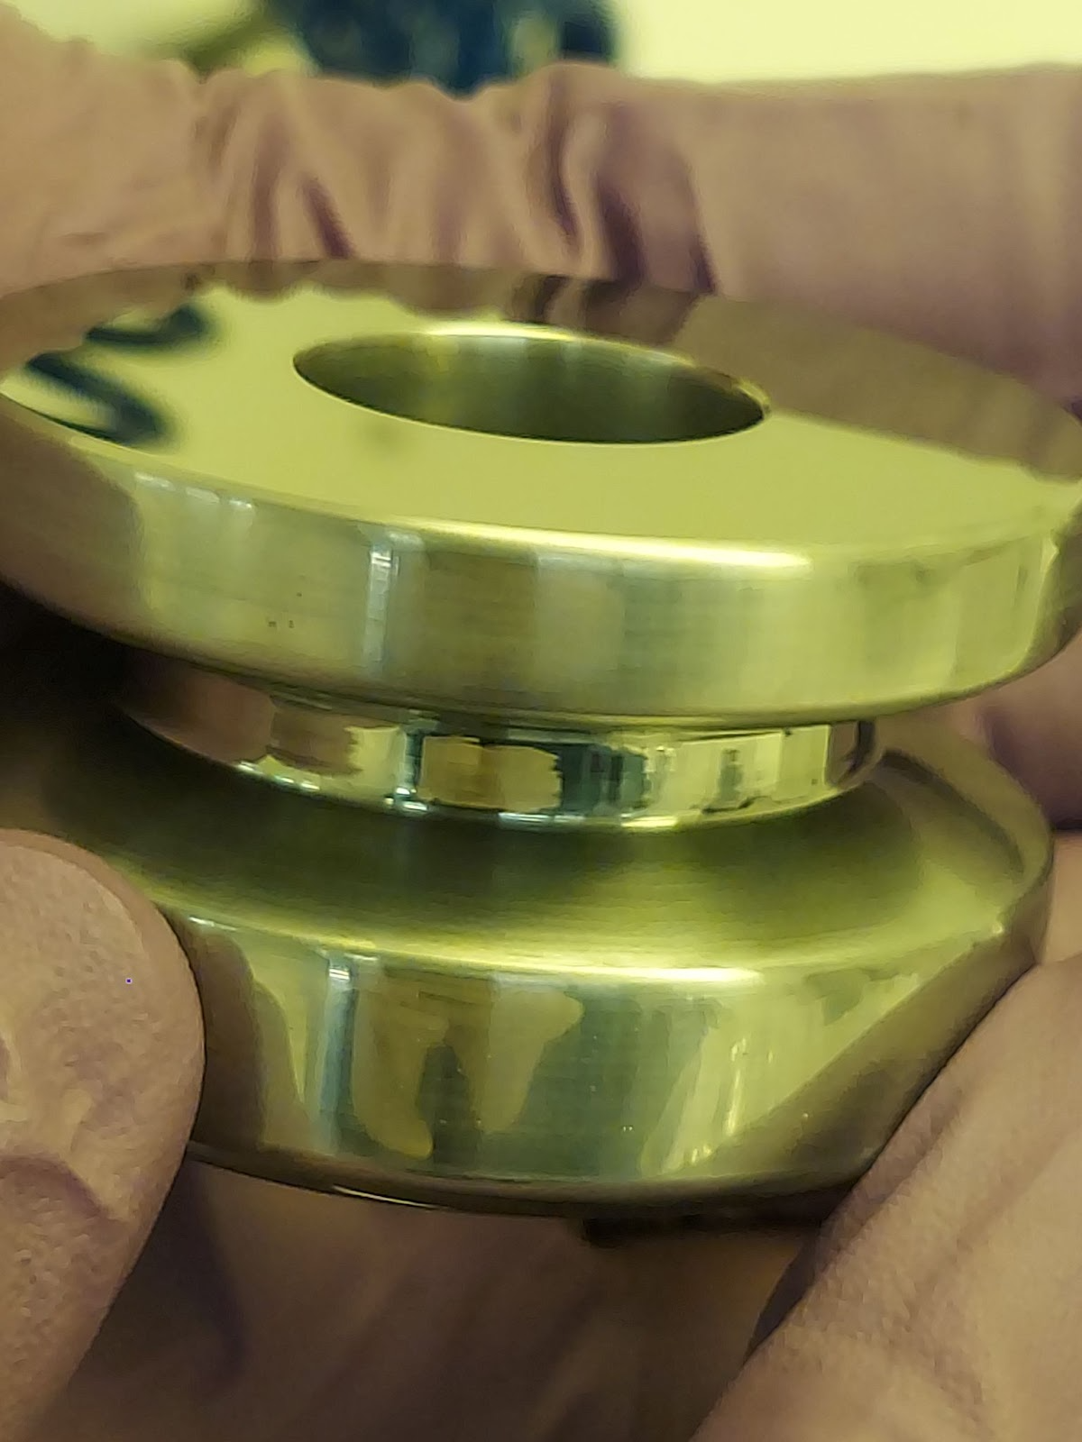
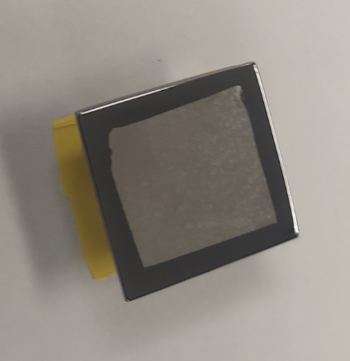
HPGe Detector Fabrication Introduction
Desired electrical contact characteristics:
A n+ contact blocks hole injection
A p+ contact blocks electron injection
Withstand high fields ~ few kV/cm
Mechanically robust
Thin dead layer
Stable characteristics with time, T cycling, and environmental exposure
Desired surface passivation characteristics:
Low surface leakage
Charge neutral
Withstand high fields ~ few kV/cm
Mechanically robust
Thin dead layer
Stable characteristics with time, T cycling, and environmental exposure

Slide 12
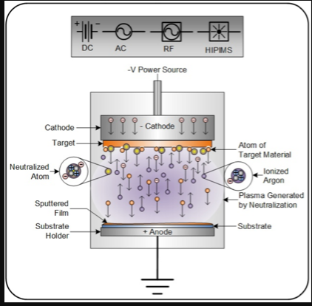
Sputter Deposition Technology
What is sputtering?
  Sputter deposition is a physical vapour deposition (PVD) method of depositing thin films by sputtering material from a ‘target’, then depositing it onto a ‘substrate’.
Process of sputtering
  The principle of sputtering is to use the energy of a plasma (partially ionized gas) on the surface of a target (cathode), to pull the atoms of the material one by one and deposit them on the substrate.

Slide 13
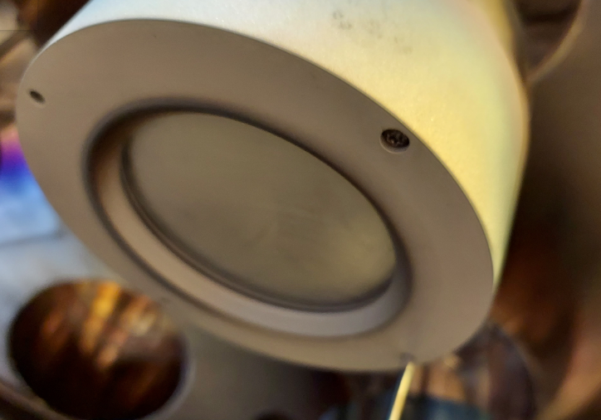
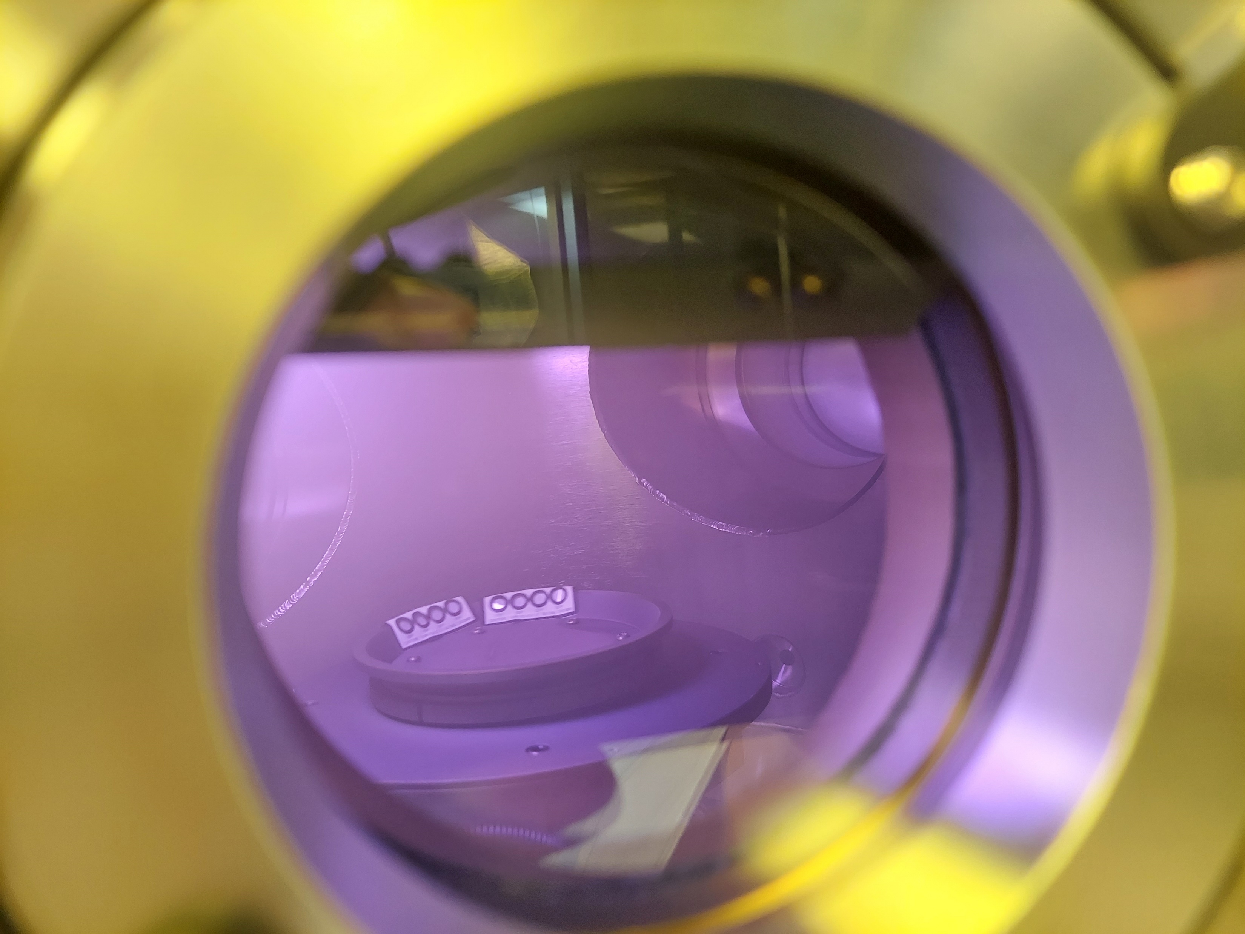
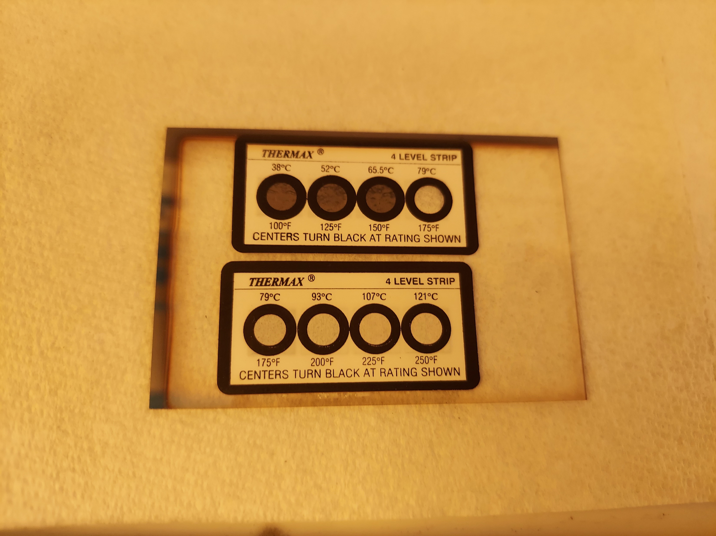
Temperature variation during sputtering
Temp Measurements
Power | Time (min) | Temp(℃)
RF-150W | 30 | Less than 38
DC-400W | 7 | Less than 38
RF-480W | 5 | <38
RF-480W | 10 | 52-65.5
RF-480W | 15 | 65.5-79
RF-480W | 30 | 65.5-79

Slide 14
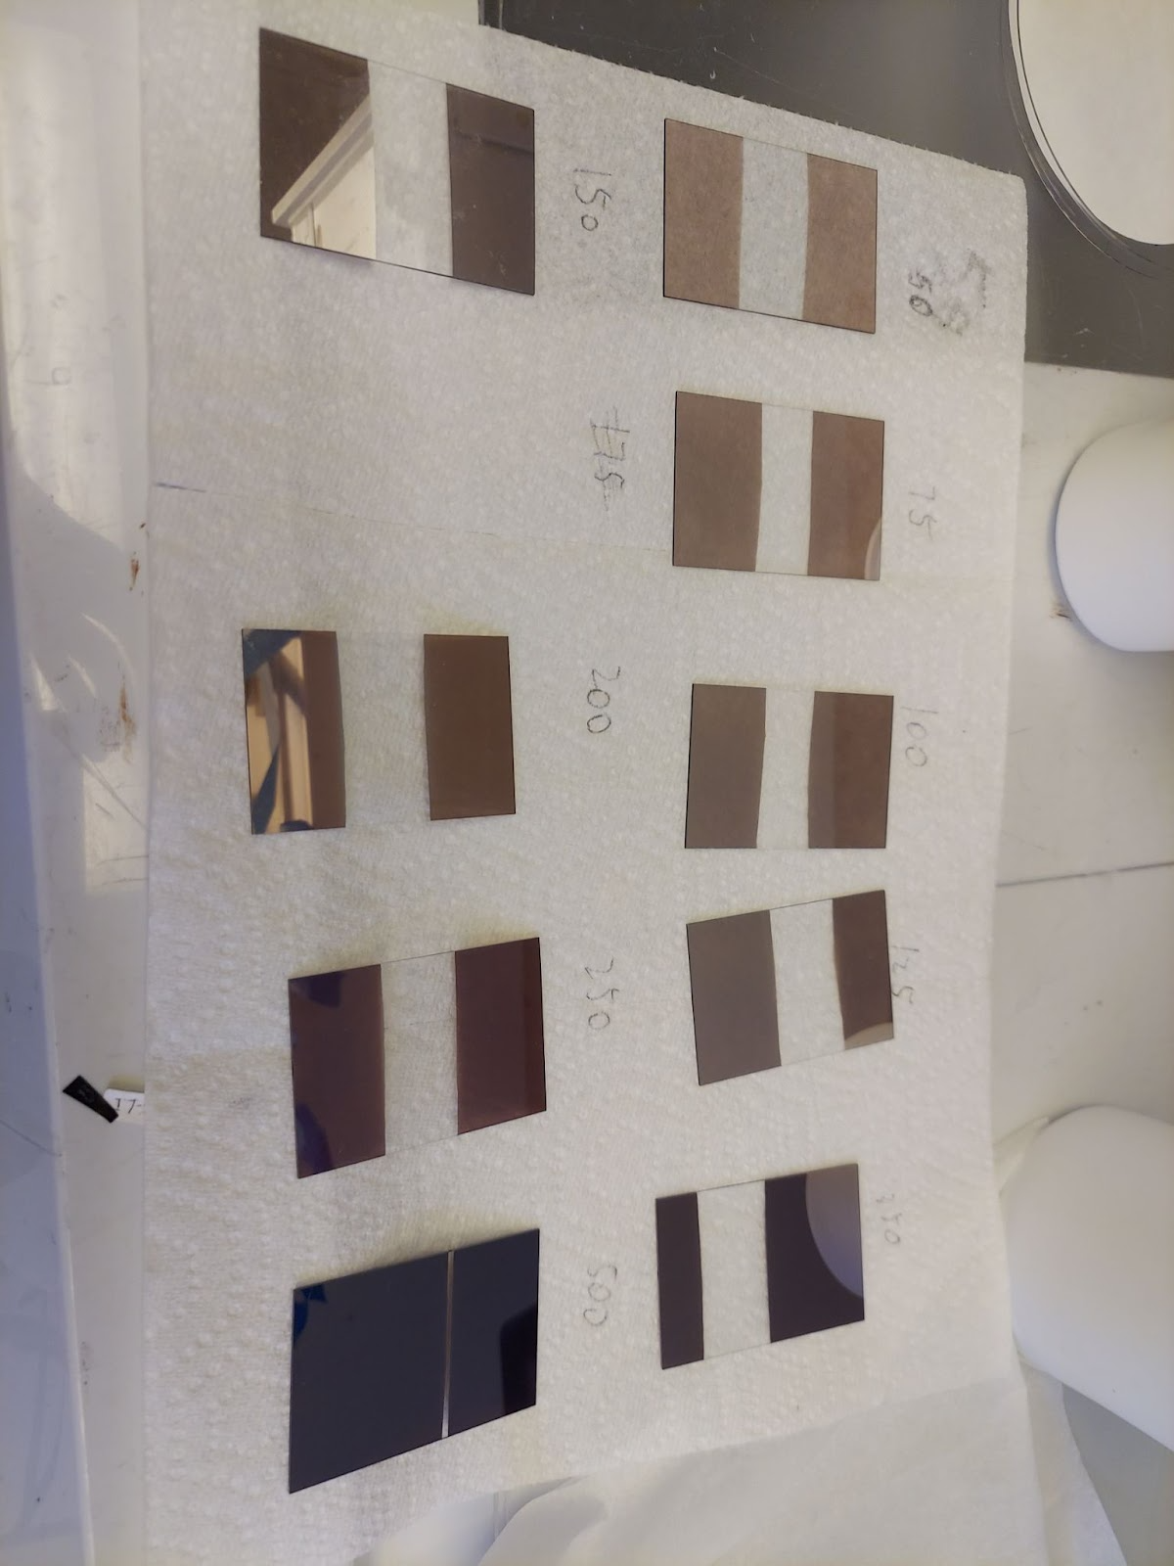
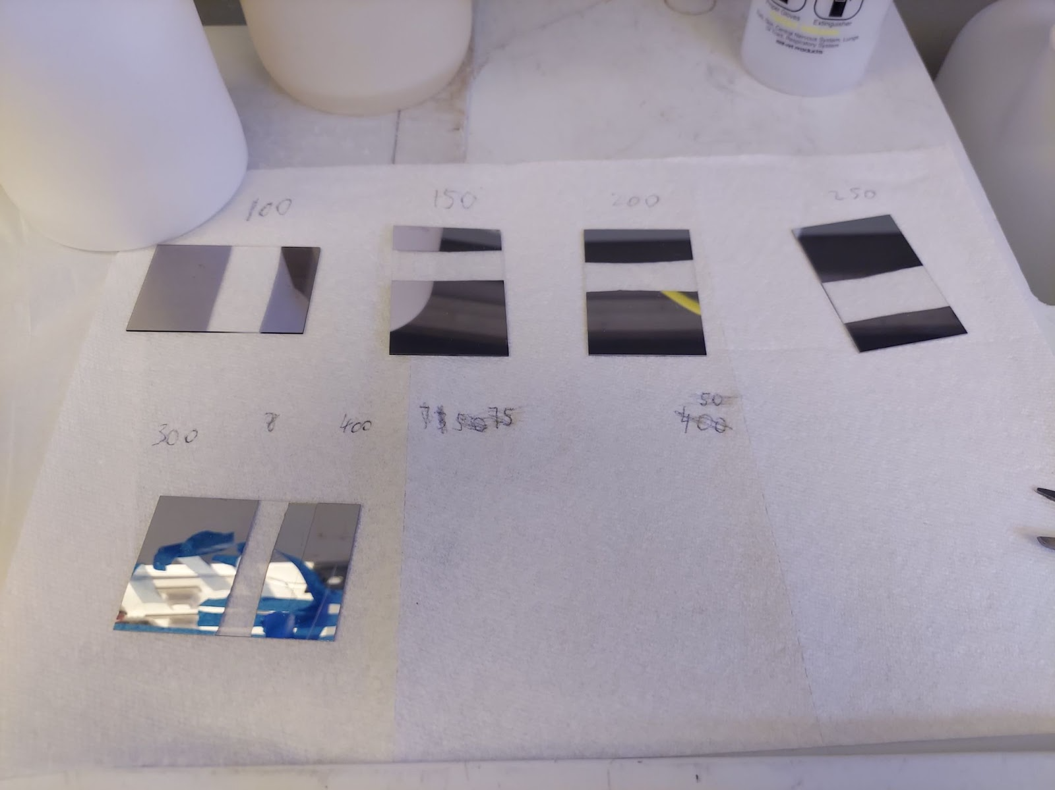
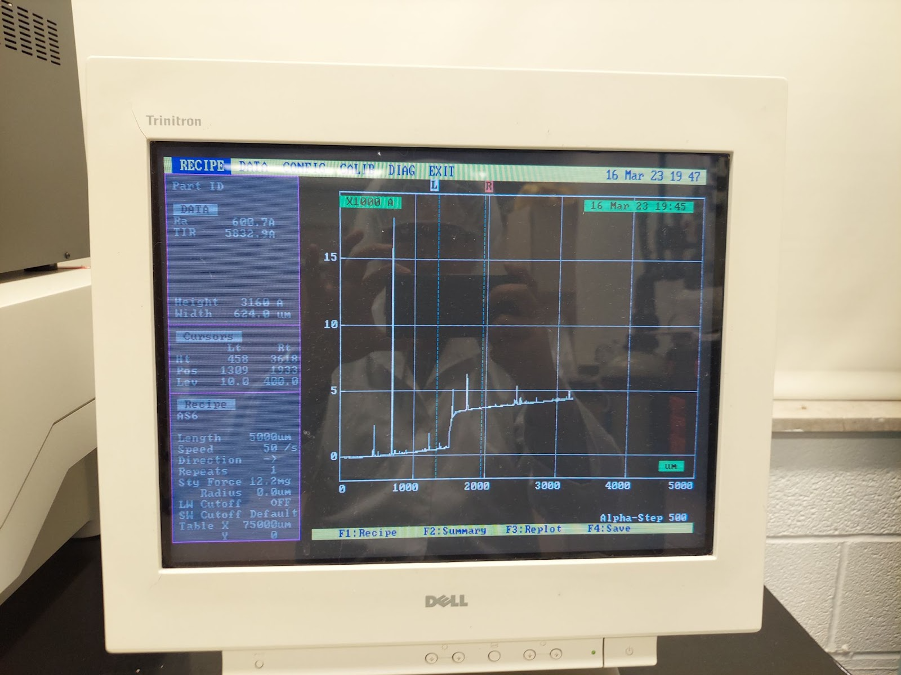
Sputtering Rate
RF power, 15 mins, 30mTorr(7% H_2)
DC power, 5 mins, 3mTorr(Ar)
Power | Thickness(nm)
75 | <50
100 | <50
125 | <50
150 | 41
200 | 55
250 | 111
350 | 125
500 | 301
Power | Thickness(nm)
100 | <50
150 | <50
200 | <50
250 | 66
300 | 81
400 | 86
Alpha-Step Profiler

Slide 15
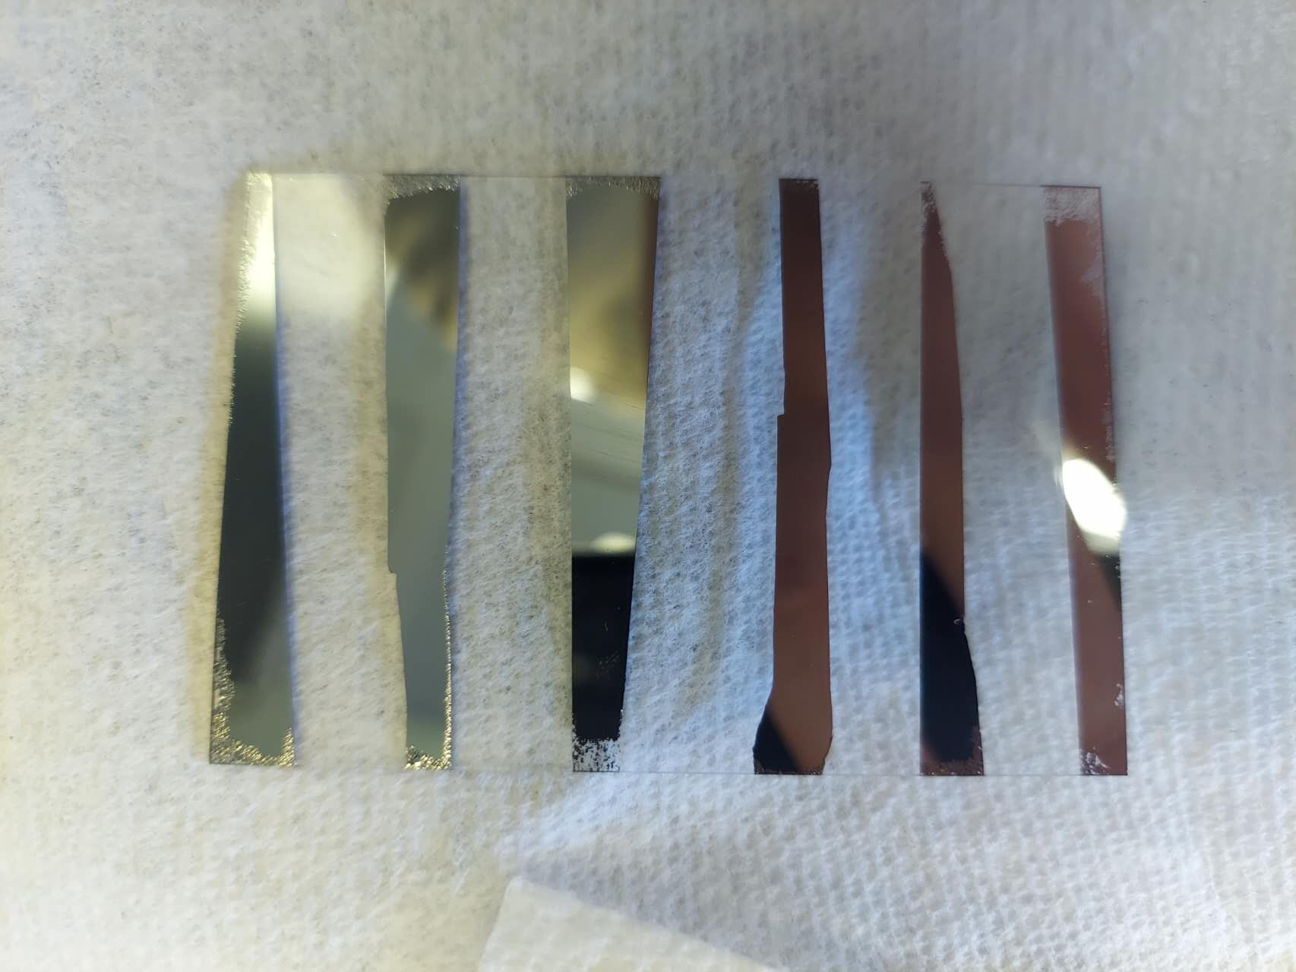
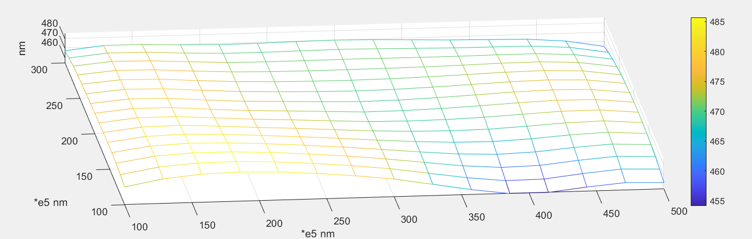
Thickness Map
200W RF power, 30 mins
Target material: Ge
Pressure: 3mTorr(7% H_2)
Tilt angle: 10 mm
Substrate height: 2.7 inch
z=[ 473 485 473 453 461
476 475 469 473 471
467 469 470 466 455]; #nm
Film Uniformity: 3%

Slide 16
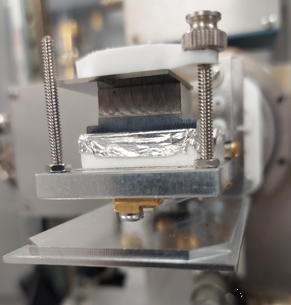
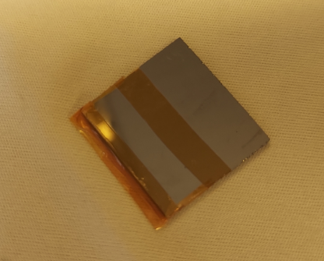
Amorphous-Ge Film Resistivity
3 mTorr (7% H_2)
Al
A
Ωcm
K
a-Ge
30 mTorr (7% H_2)
Temp (K) | Resistivity (Ωcm)
300 | 16000
+V

Slide 17
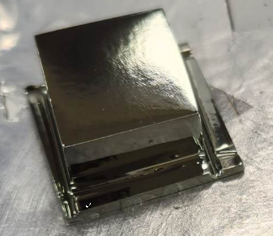
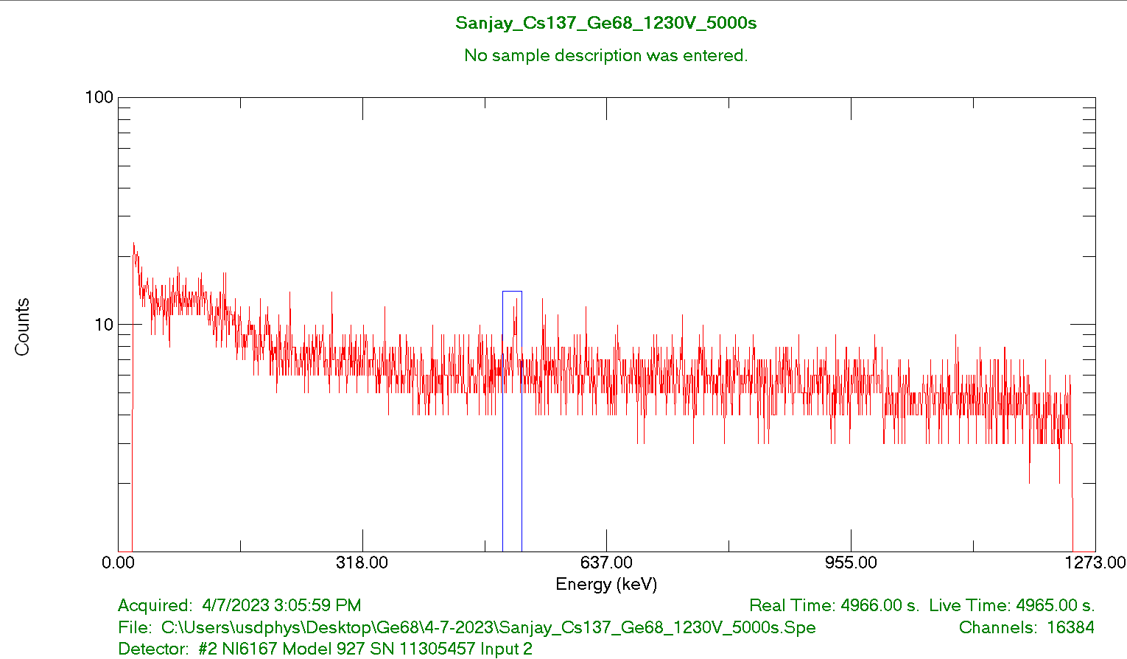
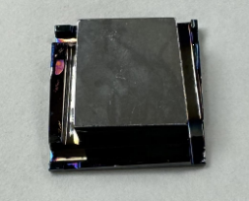
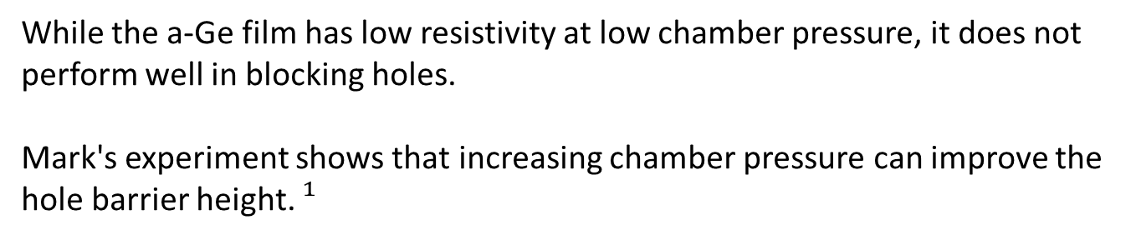
High Purity Ge-68 Planar Detector
pA
The HP-Ge68 detector made by Sanjay Bhattarai
V
While the a-Ge film has low resistivity at low chamber pressure, it does not perform well in blocking holes.
Mark's experiment shows that increasing chamber pressure can improve the hole barrier height. $¹$
The HP-Ge68 detector made by Mathbar Singh Raut
$¹$Amman, Mark. (2018). Optimization of Amorphous Germanium Electrical Contacts and Surface Coatings on High Purity Germanium Radiation Detectors. 10.13140/RG.2.2.34748.08327/1.

Slide 18
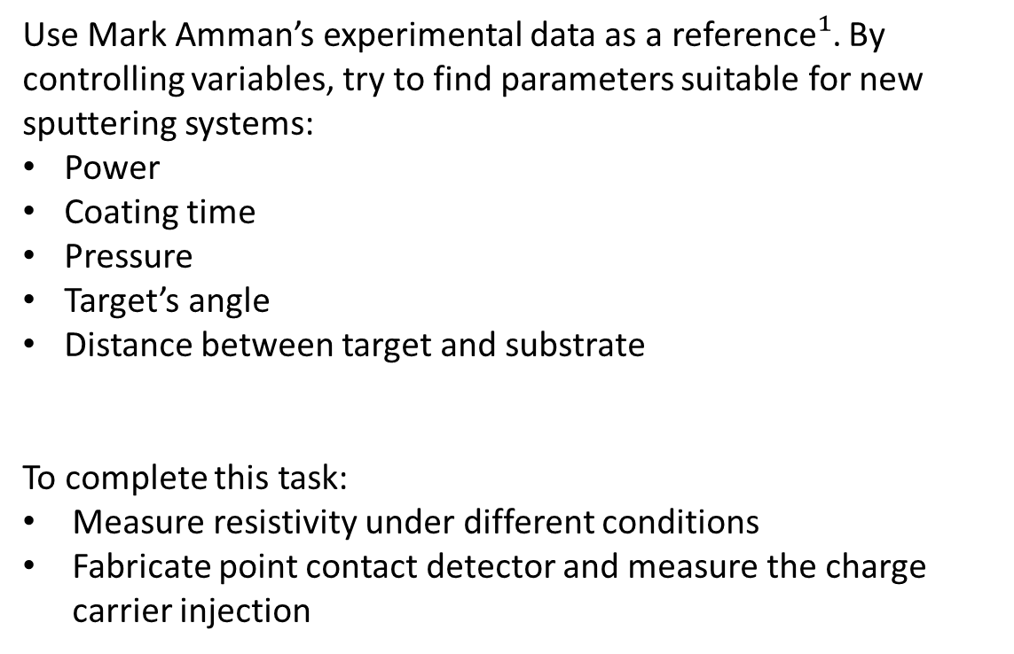
Research Plan
Use Mark Amman’s experimental data as a reference$¹$. By controlling variables, try to find parameters suitable for new sputtering systems:
Power
Coating time
Pressure
Target’s angle
Distance between target and substrate
To complete this task:
Measure resistivity under different conditions
Fabricate point contact detector and measure the charge carrier injection
$¹$Amman, Mark. (2018). Optimization of Amorphous Germanium Electrical Contacts and Surface Coatings on High Purity Germanium Radiation Detectors. 10.13140/RG.2.2.34748.08327/1.

Slide 19
Summary
Project Goal: To advance contact technology to study the feasibility of using large-size Ge detectors for neutrinoless double-beta decay and dark matter experiments.
Done:
  The AJA sputtering system was assembled and operated successfully
  On-site training
  Temperature measurement
  Sputtering rate measurement
  Partially resistivity measurement
Chamber pressure has a great effect on the resistivity of a-Ge film
It takes a lot of experimentation to find the right recipe

Slide 20
End
Thank you!

