Slide 1
中央研究院物理研究所 暑期大學生研習計畫
Summer Student Program, ASIoP, 2023
Duration: July 1st – August 31st, 2023 Participant: 48 (34 of IoP-Summer-Student-Awardees, 13 of lab summer
students, 1 of M.O.E internship summer students)
Supervisor: 15
ASIoP-SSP2023 Jul, 1st-Aug. 31st, 2023

Slide 2
中央研究院物理研究所 暑期大學生研習計畫
Compulsory
7/5: IoP Lectures, Lab Tours
7/7: AS Laboratory Safety Training Course
8/30: IoP End-of-Term Presentation
Elective
July-August: IoP Weekly Lunch Gathering (7 sessions in total, 1.5hrs per session) ※ IoP-Summer-Student-Awardees: Compulsory and Elective courses. ※ Lab summer students, M.O.E internship summer students: Please follow the instructions of your supervisor regarding participation in the courses.
indico Timetable
ASIoP-SSP2023 Jul, 1st-Aug. 31st, 2023

Slide 3
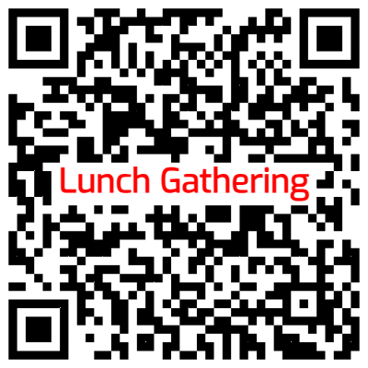
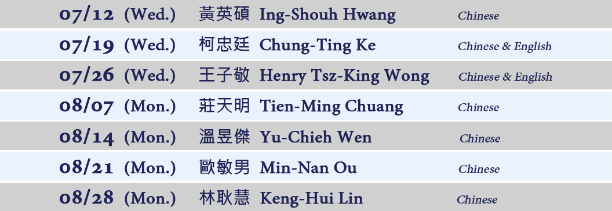
中央研究院物理研究所 暑期大學生研習計畫
IoP Weekly Lunch Gathering
12:30 ~ 14:00
Online Registration
ASIoP-SSP2023 Jul, 1st-Aug. 31st, 2023

Slide 4
中央研究院物理研究所 暑期大學生研習計畫
Summer Student Activities during July-August 2023
please visit https://indico.phys.sinica.edu.tw/e/ASIoP-SSP2023
(up-to-date)
Q1: How can I find the overview of activities during July-August?
A: Go to link “Summer Student activities of ASIoP-SSP2023” → click on the “Activities List” on the left sidebar. Q2: Where can I find timetable for designated activities? A: go to the link “Summer Student activities of ASIoP-SSP2023” → click on the “Summer Student activities Timetable”→Detailed information can be found by clicking on the or referring to the attached document.
indico SSP Activities
ASIoP-SSP2023 Jul, 1st-Aug. 31st, 2023

Slide 5
中央研究院物理研究所 暑期大學生研習計畫
All summer student activities will be notified
via EMAILS. Please make sure to check your inbox regularly, especially your JUNK/SPAM FOLDER, to AVOID MISSING IMPORTANT MESSAGES.
☛ Main Senders of SSP activities 蘇靖琁/Ms. Jing、林汝蓮/Ms. Elina & Your Lab Secretary
ASIoP-SSP2023 Jul, 1st-Aug. 31st, 2023

Slide 6
中央研究院物理研究所 暑期大學生研習計畫
PLEASE ATTEND
Check your NAME (CHINESE and ENGLISH) displayed on cardboard. KEEP US INFORMED on any UPDATE.
Refer to the back of the cardboard for the LAB TOUR TIME & GROUP INFORMATION.
Please KEEP YOUR CARDBOARD for identity verification on AS campus (get a employee discount at convenience store, gymnasium, etc.) and RETURN YOUR BADGE HOLDER & LANYARD for recycling after event.
We go GREEN!
ASIoP-SSP2023 Jul, 1st-Aug. 31st, 2023

Slide 7
預祝大家有個愉快&充實暑期研習！
中央研究院物理研究所 暑期大學生研習計畫
（圖為 ASIoP-SSP2022）

Slide 8
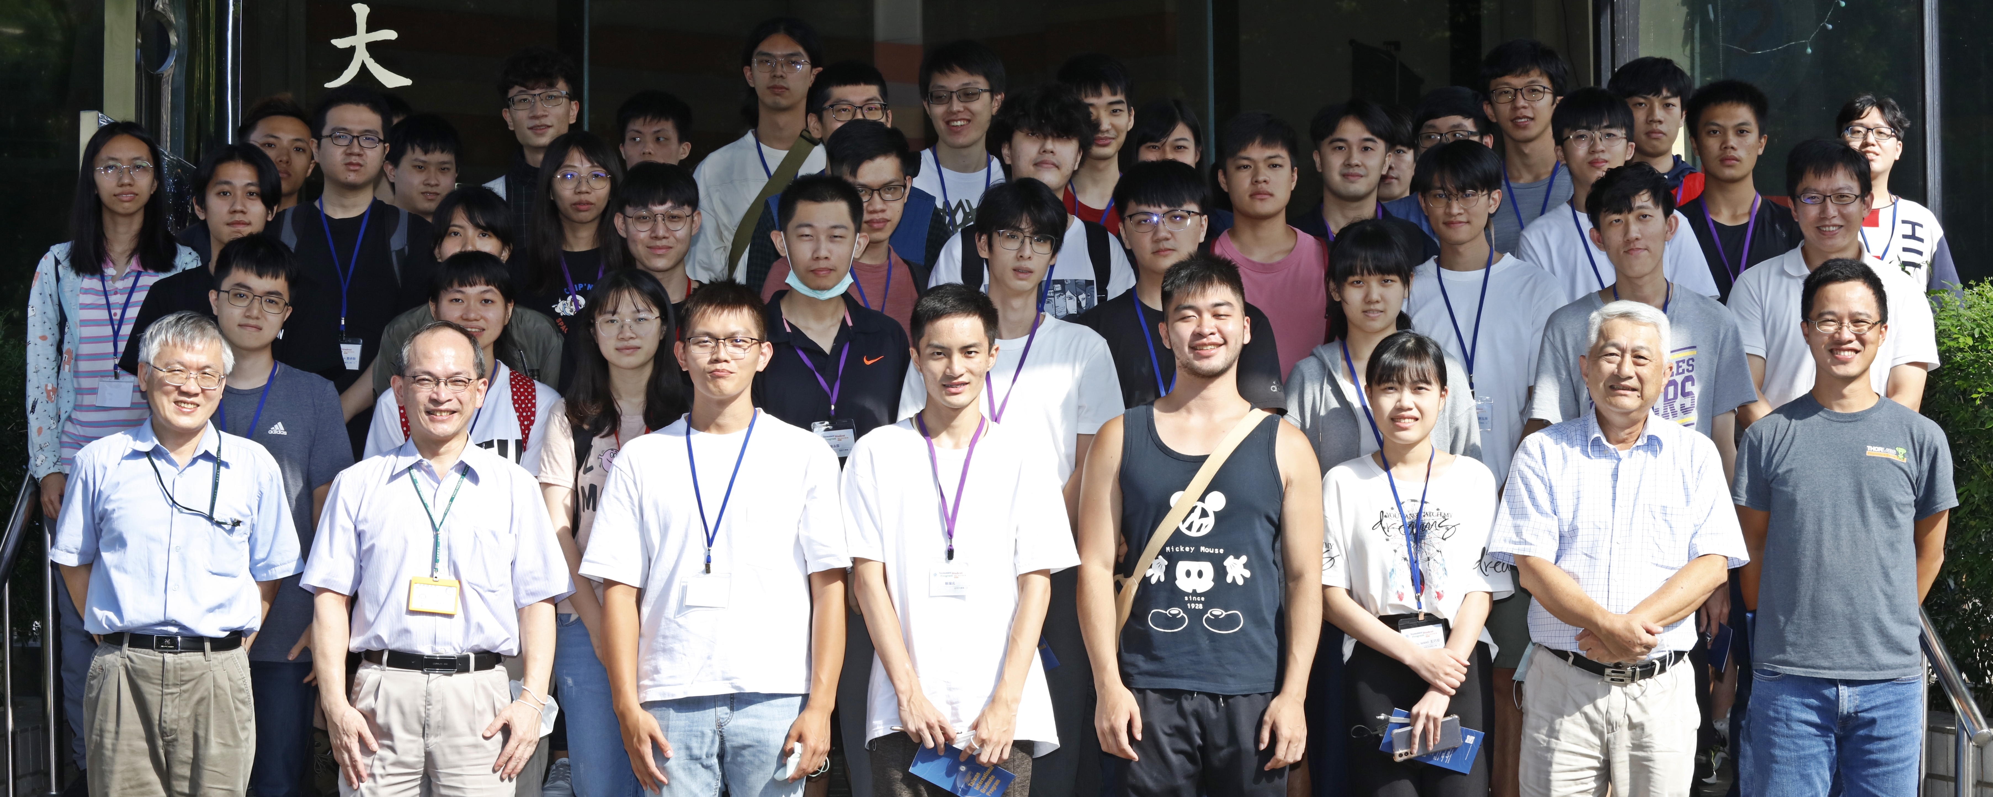
Wishing you a happy and fulfilling summer research program!
Summer Student Program,
Institute of Physics, Academia Sinica
* Image source: ASIoP-SSP2022

