Slide 1
Towards a New Science Frontier: The Electron Ion Collider – Science, Detector and Status
Rolf Ent (Jefferson Lab)
TIDC Autumn School on Electron-Ion Collider
August 28-30, 2023

Slide 2
Four Lectures
Lecture 1 Introduction and Electron Scattering Basics
Lecture 2 EIC Science
Lecture 3 EIC Detector
Lecture 4 EIC Project Status

Slide 3
Outline of This Lecture
What Is EIC?
Cool Facts about QCD and Nuclei
Introduction to QED and QCD
The Quest to Understand the Fundamental Structure of Matter
Why Electron Scattering?
Electron Scattering Formalism and History
A Few QCD Surprises
A Bright Future

Slide 4

What is the EIC?
A high luminosity (10³³ – 10³⁴ cm⁻²s⁻¹) polarized electron proton / ion collider with √s_{ep} = 28 – 140 GeV
What is special:
EIC is the ONLY new collider in foreseeable future. Allows to remain at frontier of Accelerator S&T.
Uniqueness:
factor 100 to 1000 higher luminosity as HERA
both electrons and protons / light nuclei polarized,
nuclear beams: d to U
at minimum > 2 decades increase in kinematic coverage in x and Q² as Fixed Target Facilities
Science Program: An EIC can uniquely address three profound questions about nucleons — neutrons and protons — and how they are assembled to form the nuclei of atoms:
How does the mass of the nucleon arise?
How does the spin of the nucleon arise?
What are the emergent properties of dense systems of gluons?
Detector: State of the art general purpose collider detector
Possible
2nd Detector
Location
Project
Detector
Location
ePIC

Slide 5
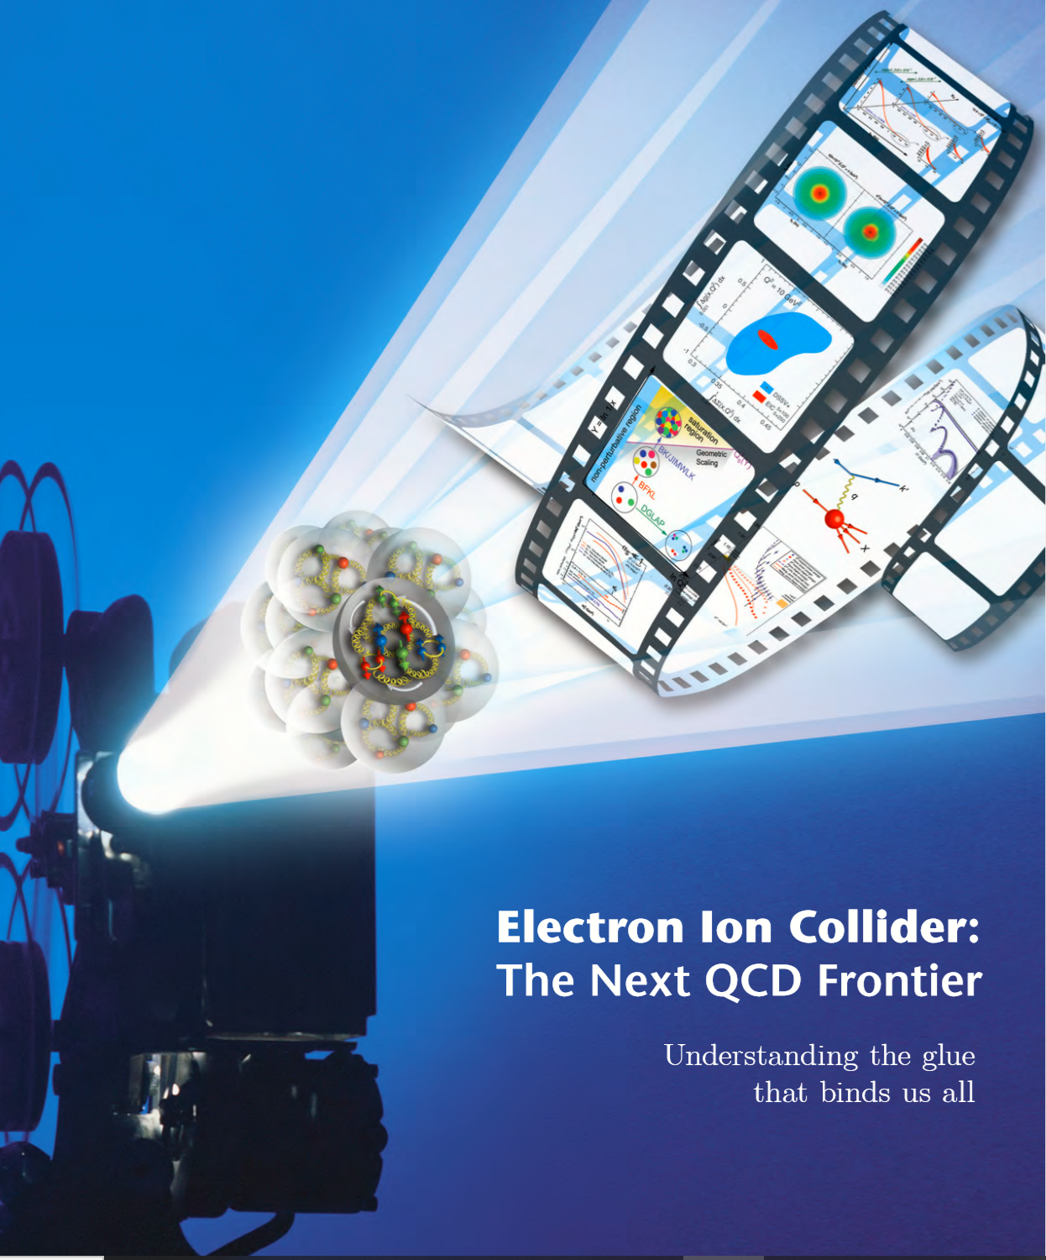

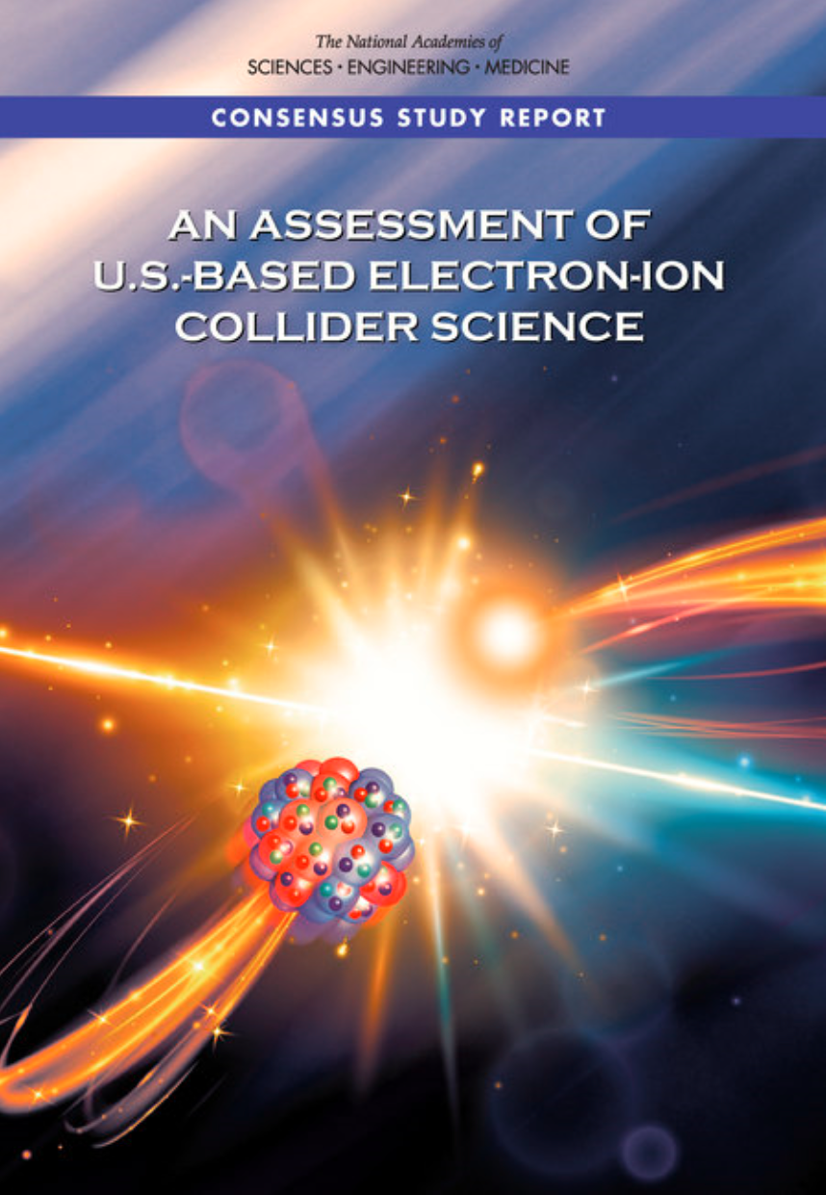
EIC Scope
Project Design Goals
High Luminosity: L= 10³³ – 10³⁴cm⁻²sec⁻¹, 10 – 100 fb⁻¹/year
Highly Polarized Beams: 70%
Large Center of Mass Energy Range: E_{cm} = 29 – 140 GeV
Large Ion Species Range: protons – Uranium
Large Detector Acceptance and Good Background Conditions
Accommodate a Second Interaction Region (IR)
IR-8
IR-6, ePIC Detector
IR-8
p/A beam
e beam
p: 41 GeV, 100 to 275 GeV
e: 5 GeV to 18 GeV

Slide 6
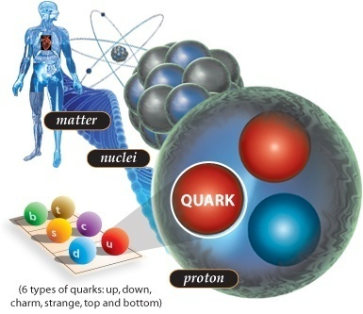
Cool Facts About QCD and Nuclei
If an atom was the size of a football field, the (atomic) nucleus would be about the size of the ball inside it.
Despite its tiny size, the nucleus accounts for 99.9% of an atom’s mass.
Protons and neutrons swirl in a heavy atomic nucleus with speeds of up to some ¾ of c. More commonly, their speed is some ¼ the speed of light. The reason is because they are “strong-forced” to reside in a small space.
Quarks (and gluons) are “confined” to the even smaller space inside protons and neutrons. Because of this, they swirl around with the speed of light.

Slide 7
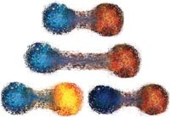
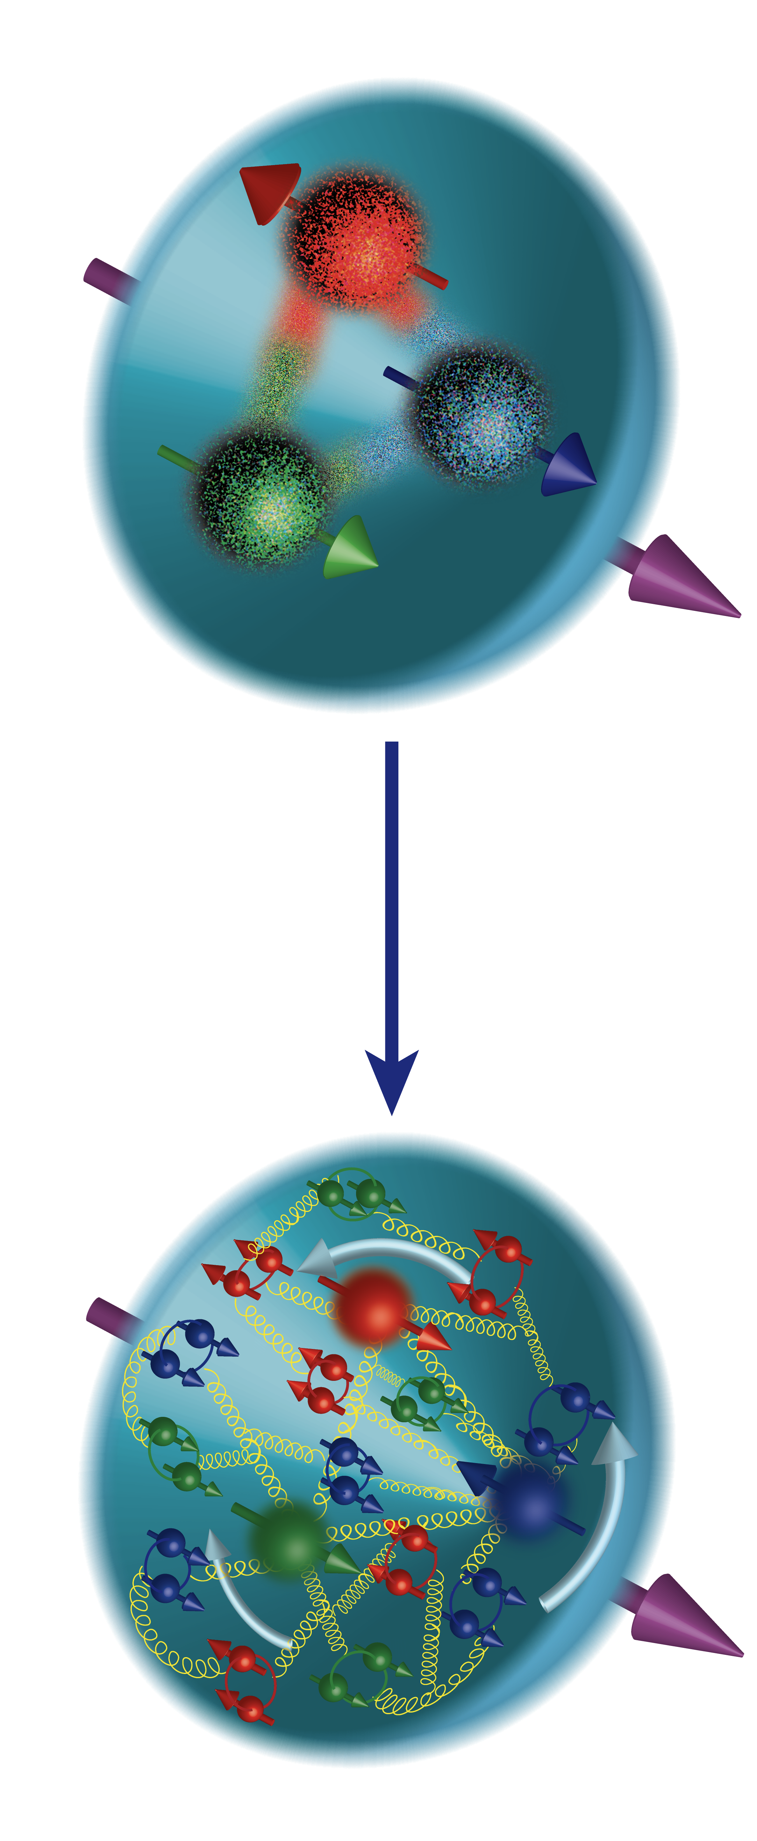
Cool Facts About QCD and Nuclei
The strong force is so strong, that you can never find one quark alone (this is called “confinement”).
When pried even a little apart, quarks experience ten tons of force pulling them together again.
Quarks and gluons jiggle around at nearly light-speed, and extra gluons and quark/anti-quark pairs pop into existence one moment to disappear the next.
This flurry of activity, fueled by the energy of the gluons, generates nearly all the mass of protons and neutrons, and thus ultimately of all the matter we see.
Even the QCD “vacuum” is not truly empty. Long-distance gluonic fluctuations are an integral part. Quarks have small mass themselves but attain an effective larger mass due to the fact that they attract these gluonic fluctuations around them.
Nuclear physicists are trying to answer how basic properties like mass, shape, and spin come about from the flood of gluons, quark/anti-quark pairs (the “sea”), and a few ever-present quarks.

Slide 8
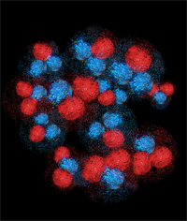
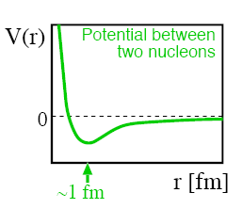
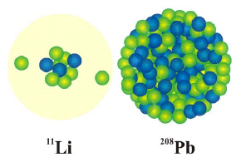
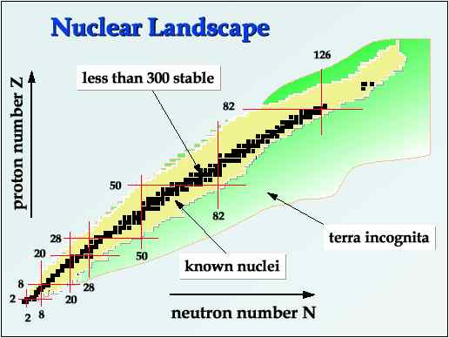
Cool Facts About QCD and Nuclei
A small fraction of the force between quarks and gluons “leaks out” of protons and neutrons and binds them together to form tiny nuclei. The long-range part of this process can be well described as if protons and neutrons exchange pions.
Nuclear physicists are only now starting to understand how this “leakage” occurs, and how it results in the impressive variety of nuclei found in nature.
A nucleus consisting of some 100 protons and 150 neutrons can be the same size as one with 3 protons and 8 neutrons.
Despite the variety of nuclei found in nature, we believe we miss quite some more. These are necessary to explain the origin of nuclei and the abundance of elements found in the cosmos.

Slide 9
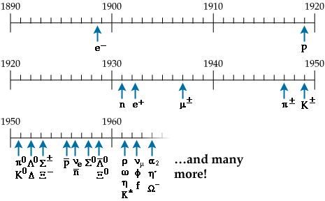
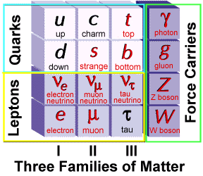
Elementary Particles
Protons, neutrons and electrons (p, n, e) build all the atoms.
Proton and neutrons make up 99.9% of the visible mass in the universe.
Dozens of new particles were discovered in the past century.
Strong interaction: strength can be 100 times the electromagnetic one
leptons (e, μ, ν,..): not involved in strong interaction
hadrons [mesons(π, K,…) and baryons (p, n,…)]: involved in strong interaction
Electron Scattering
Quarks & Gluons: QCD

Slide 10

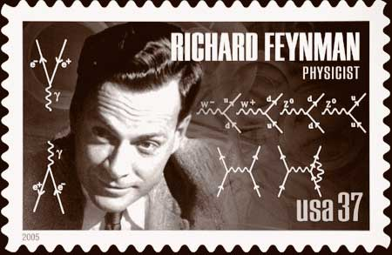

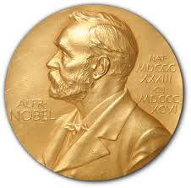
Quantum ElectroDynamics (QED)
At the beginning of the 1960s, field theories became well developed in which the objects of study are not particles and forces, but quantum fields and their symmetries. One huge problem was that some such theories seemed to suggest massless particles which did not correspond to anything observed.
Dirac structure!
Interaction terms
Kinetic energy with rest mass m
with field
self interaction
where
• unchanged under U(1) local gauge transformation
is interaction between
electron and photon
1965

Slide 11
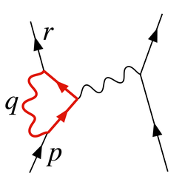

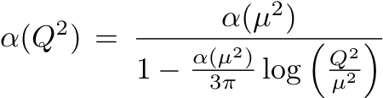
Quantum ElectroDynamics (QED)
Gauge theories are plagued by infinities
These can be absorbed in a well-defined way
into the “renormalized” (measurable) couplings and masses
• renormalization -> “running couplings”
e.g.
Running
QED
coupling

Slide 12
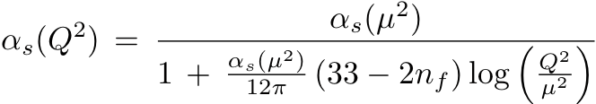
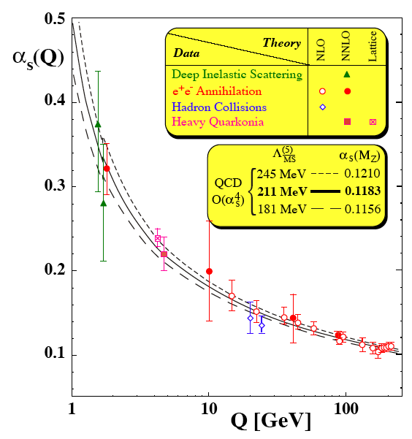


A Famous Example of a Running Coupling
QCD
“Confinement”
“Asymptotic
Freedom”
Gross, Wilczek; Politzer

Slide 13
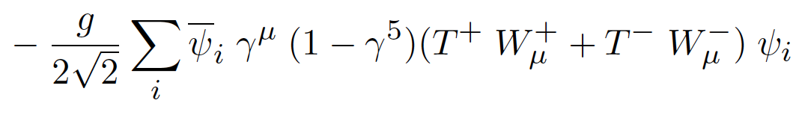

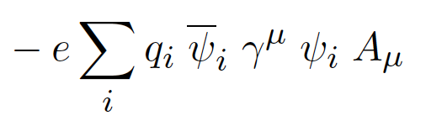

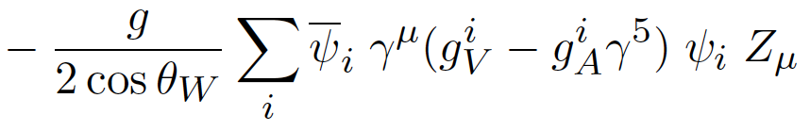
Electroweak Theory
At the beginning of the 1960s, field theories became well developed in which the objects of study are not particles and forces, but quantum fields and their symmetries. One huge problem was that some such theories seemed to suggest massless particles which did not correspond to anything observed.
• one of the biggest achievements in the 20th century:
electromagnetic and weak interactions
unified based on gauge group SU(2) x U(1)
(Glashow, Salam, Weinberg)
1979
• cornerstone of the Standard Model
W^{+/-}
charged currents
electromagnetic interaction
γ
Z⁰
weak neutral current

Slide 14
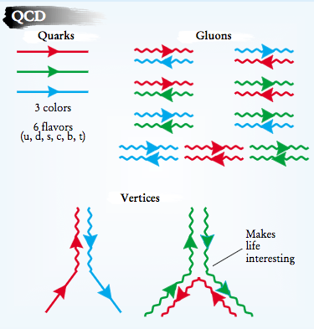
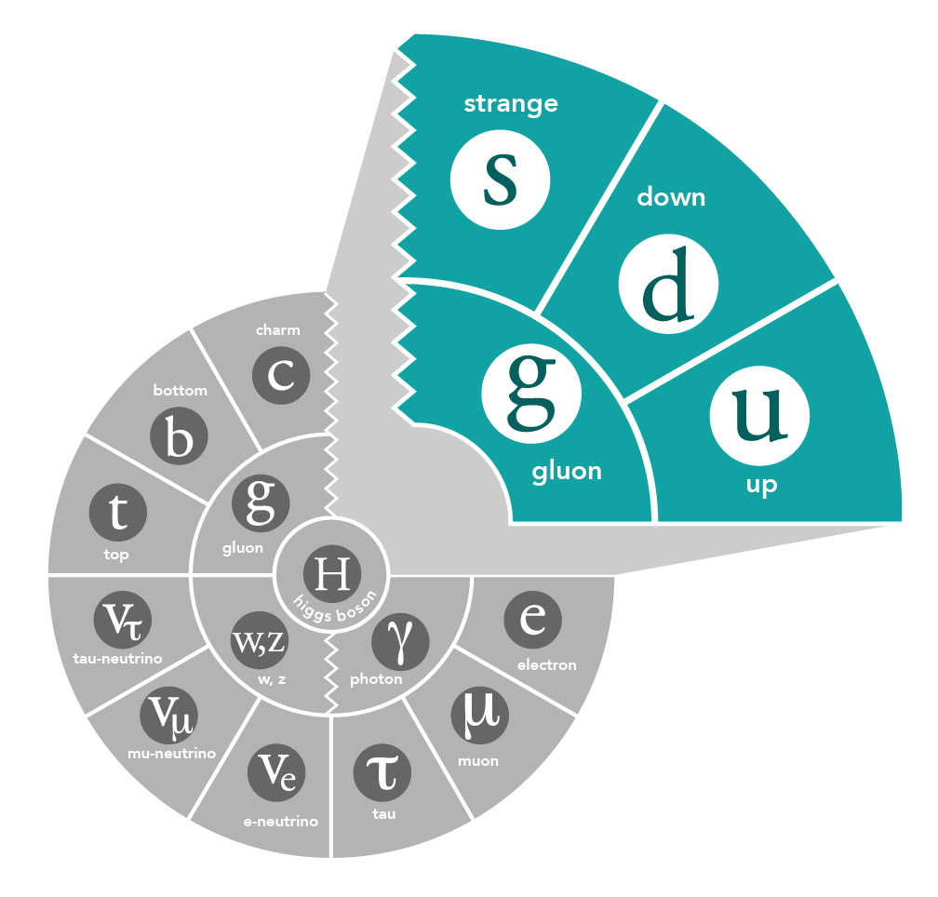
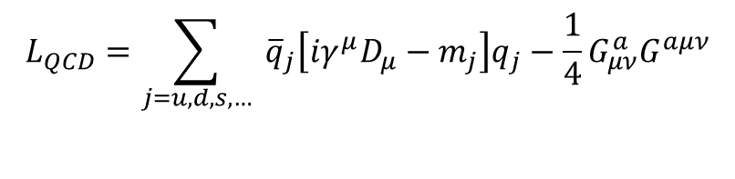
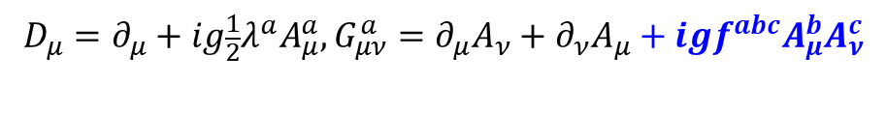
Gluons and QCD
2004
QCD is the fundamental theory that describes structure and interactions in nuclear matter.
Without gluons binding quarks there are no protons, no neutrons, and no atomic nuclei
Gluons dominate the structure of the QCD vacuum
$$L_{QCD}=\sum_{j=u,d,s,…}{ {\overline{q}}_{j}\left[iγ^{μ}D_{μ}−m_{j}\right]q_{j}−\frac{1}{4}G_{μν}^{a}G^{aμν}}$$
$$D_{μ}=∂_{μ}+ig\frac{1}{2}λ^{a}A_{μ}^{a}, G_{μν}^{a}=∂_{μ}A_{ν}+∂_{ν}A_{μ}+igf^{abc}A_{μ}^{b}A_{ν}^{c}$$
Facts:
  Unique aspect of QCD is the self interaction of the gluons
  The essential features of QCD - asymptotic freedom and (the emergent features) dynamical chiral symmetry breaking and color confinement - are all driven by gluons!
  Mass from massless gluons and nearly massless quarks
    Most of the mass of the visible universe emerges from quark-gluon interactions
    The Higgs mechanism has almost no role here
Emergent mass of the visible universe

Slide 15
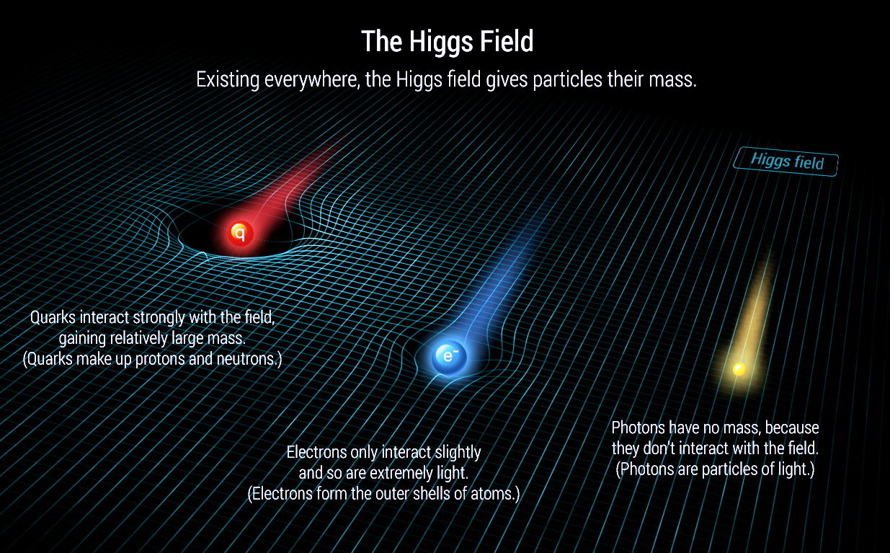
The Higgs Solves One Mass Problem, But One Remains…
Problem 1: What caused the rest masses of particles, such that the world we know is classical and everything does not move at the speed of light? → the interactions with the Higgs Fields
Problem 2: What made the proton so massive? Or, in other words, what caused this 1 GeV mass gap? (also known as the confinement or mass gap problem)
2013

Slide 16
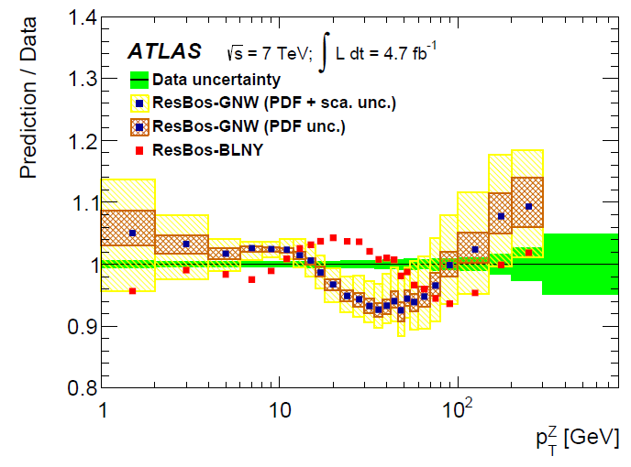
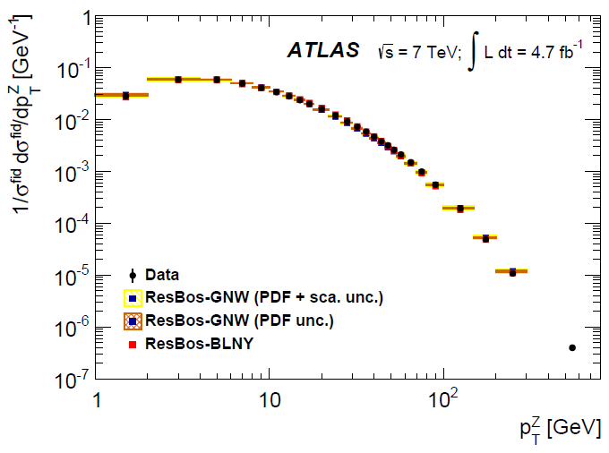
QCD – impressive tool at high energies
Z production at the LHC

Slide 17
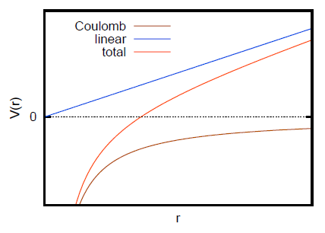
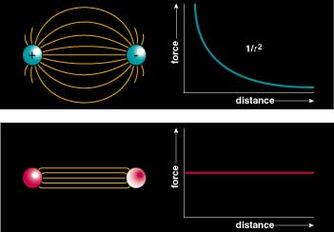
QCD - Continued
At small distance scales we have a Coulomb-like asymptotically free theory.
At larger distances we have a linear confining potential ~ 1GeV/fm.
Color Field: the field lines are compressed to vortex lines like the magnetic field in a superconductor

Slide 18
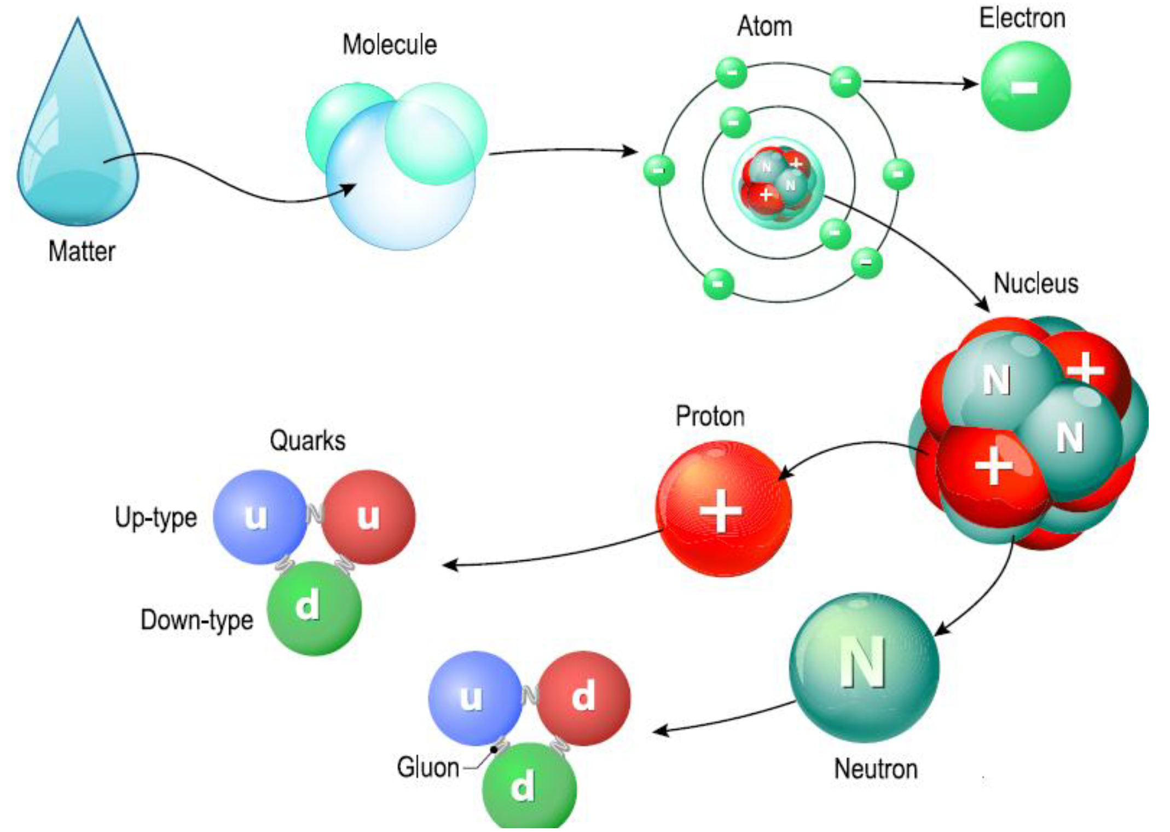
The Quest to Understand the Fundamental Structure of Matter
1808
1874
1911
1913
1968
1932
1978

Slide 19
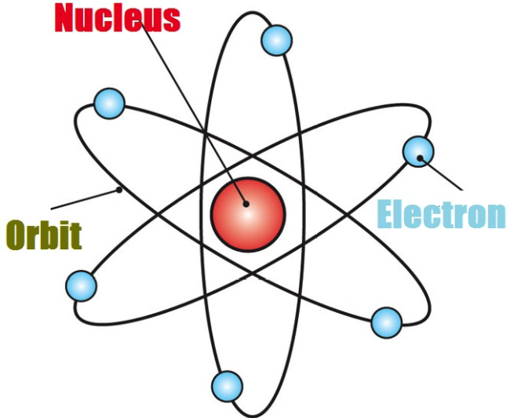
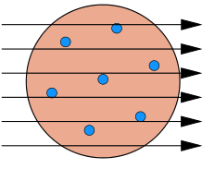
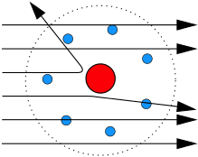
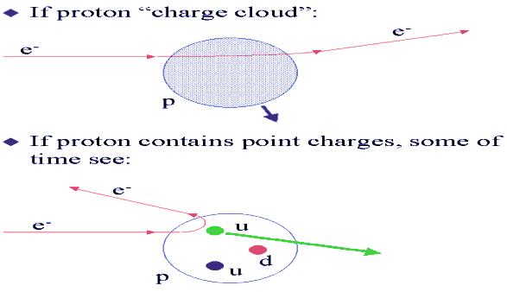
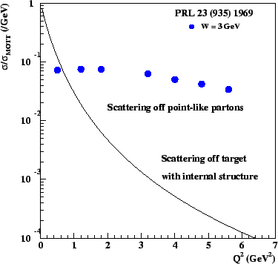
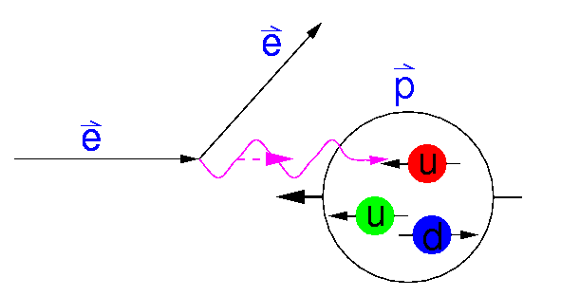
From 3D atomic structure to the quantum world
Atomic structure: dating back to Rutherford’s experiment :
α + Au ➔ α + X
Over 100 years ago
Experiment
Theory
Atom:
J.J. Thomson’s
plum-pudding model
Rutherford’s
Experiment - Data
Quantum orbitals
Discovery:
Tiny nucleus - less than 1 trillionth in volume of an atom
Quantum probability - the Quantum World!
A modern “Rutherford” experiment (about 50 years ago):
Nucleon:
The building unit of all atomic nuclei
Prediction
Discovery
e + p ➔ e + X
1968
Quark
model
Discovery of quarks!

Slide 20
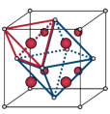
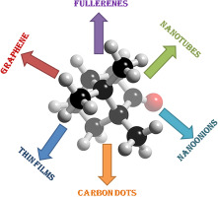
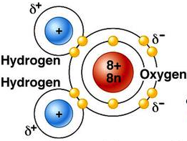
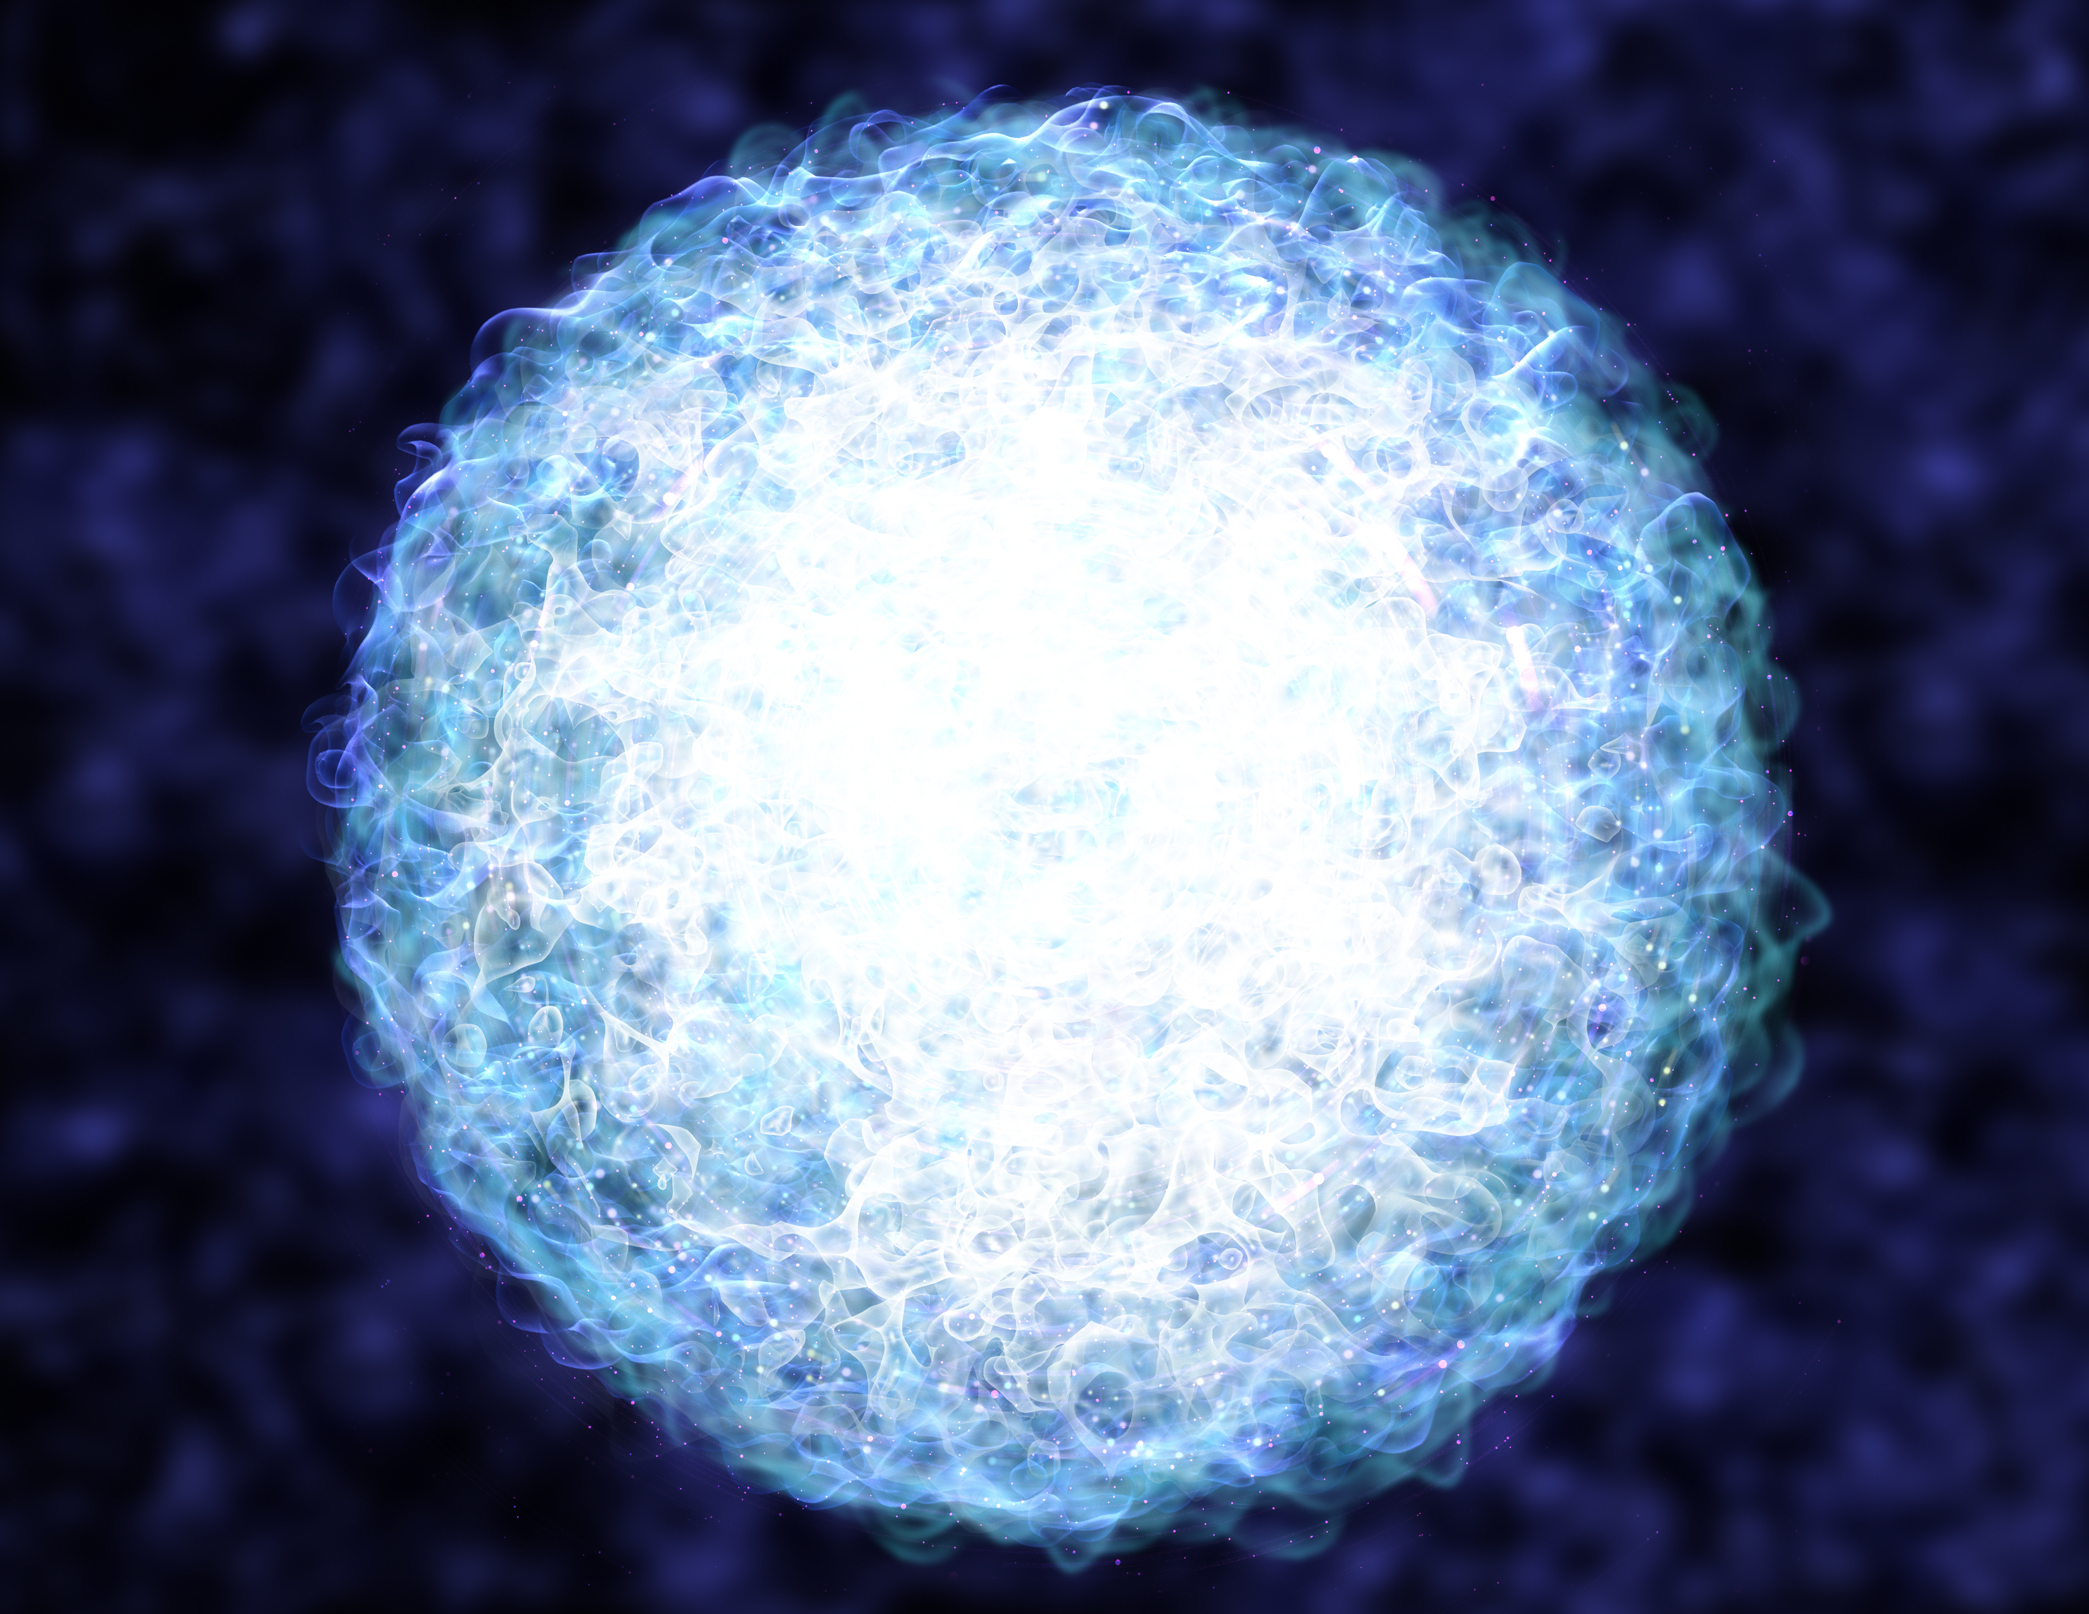
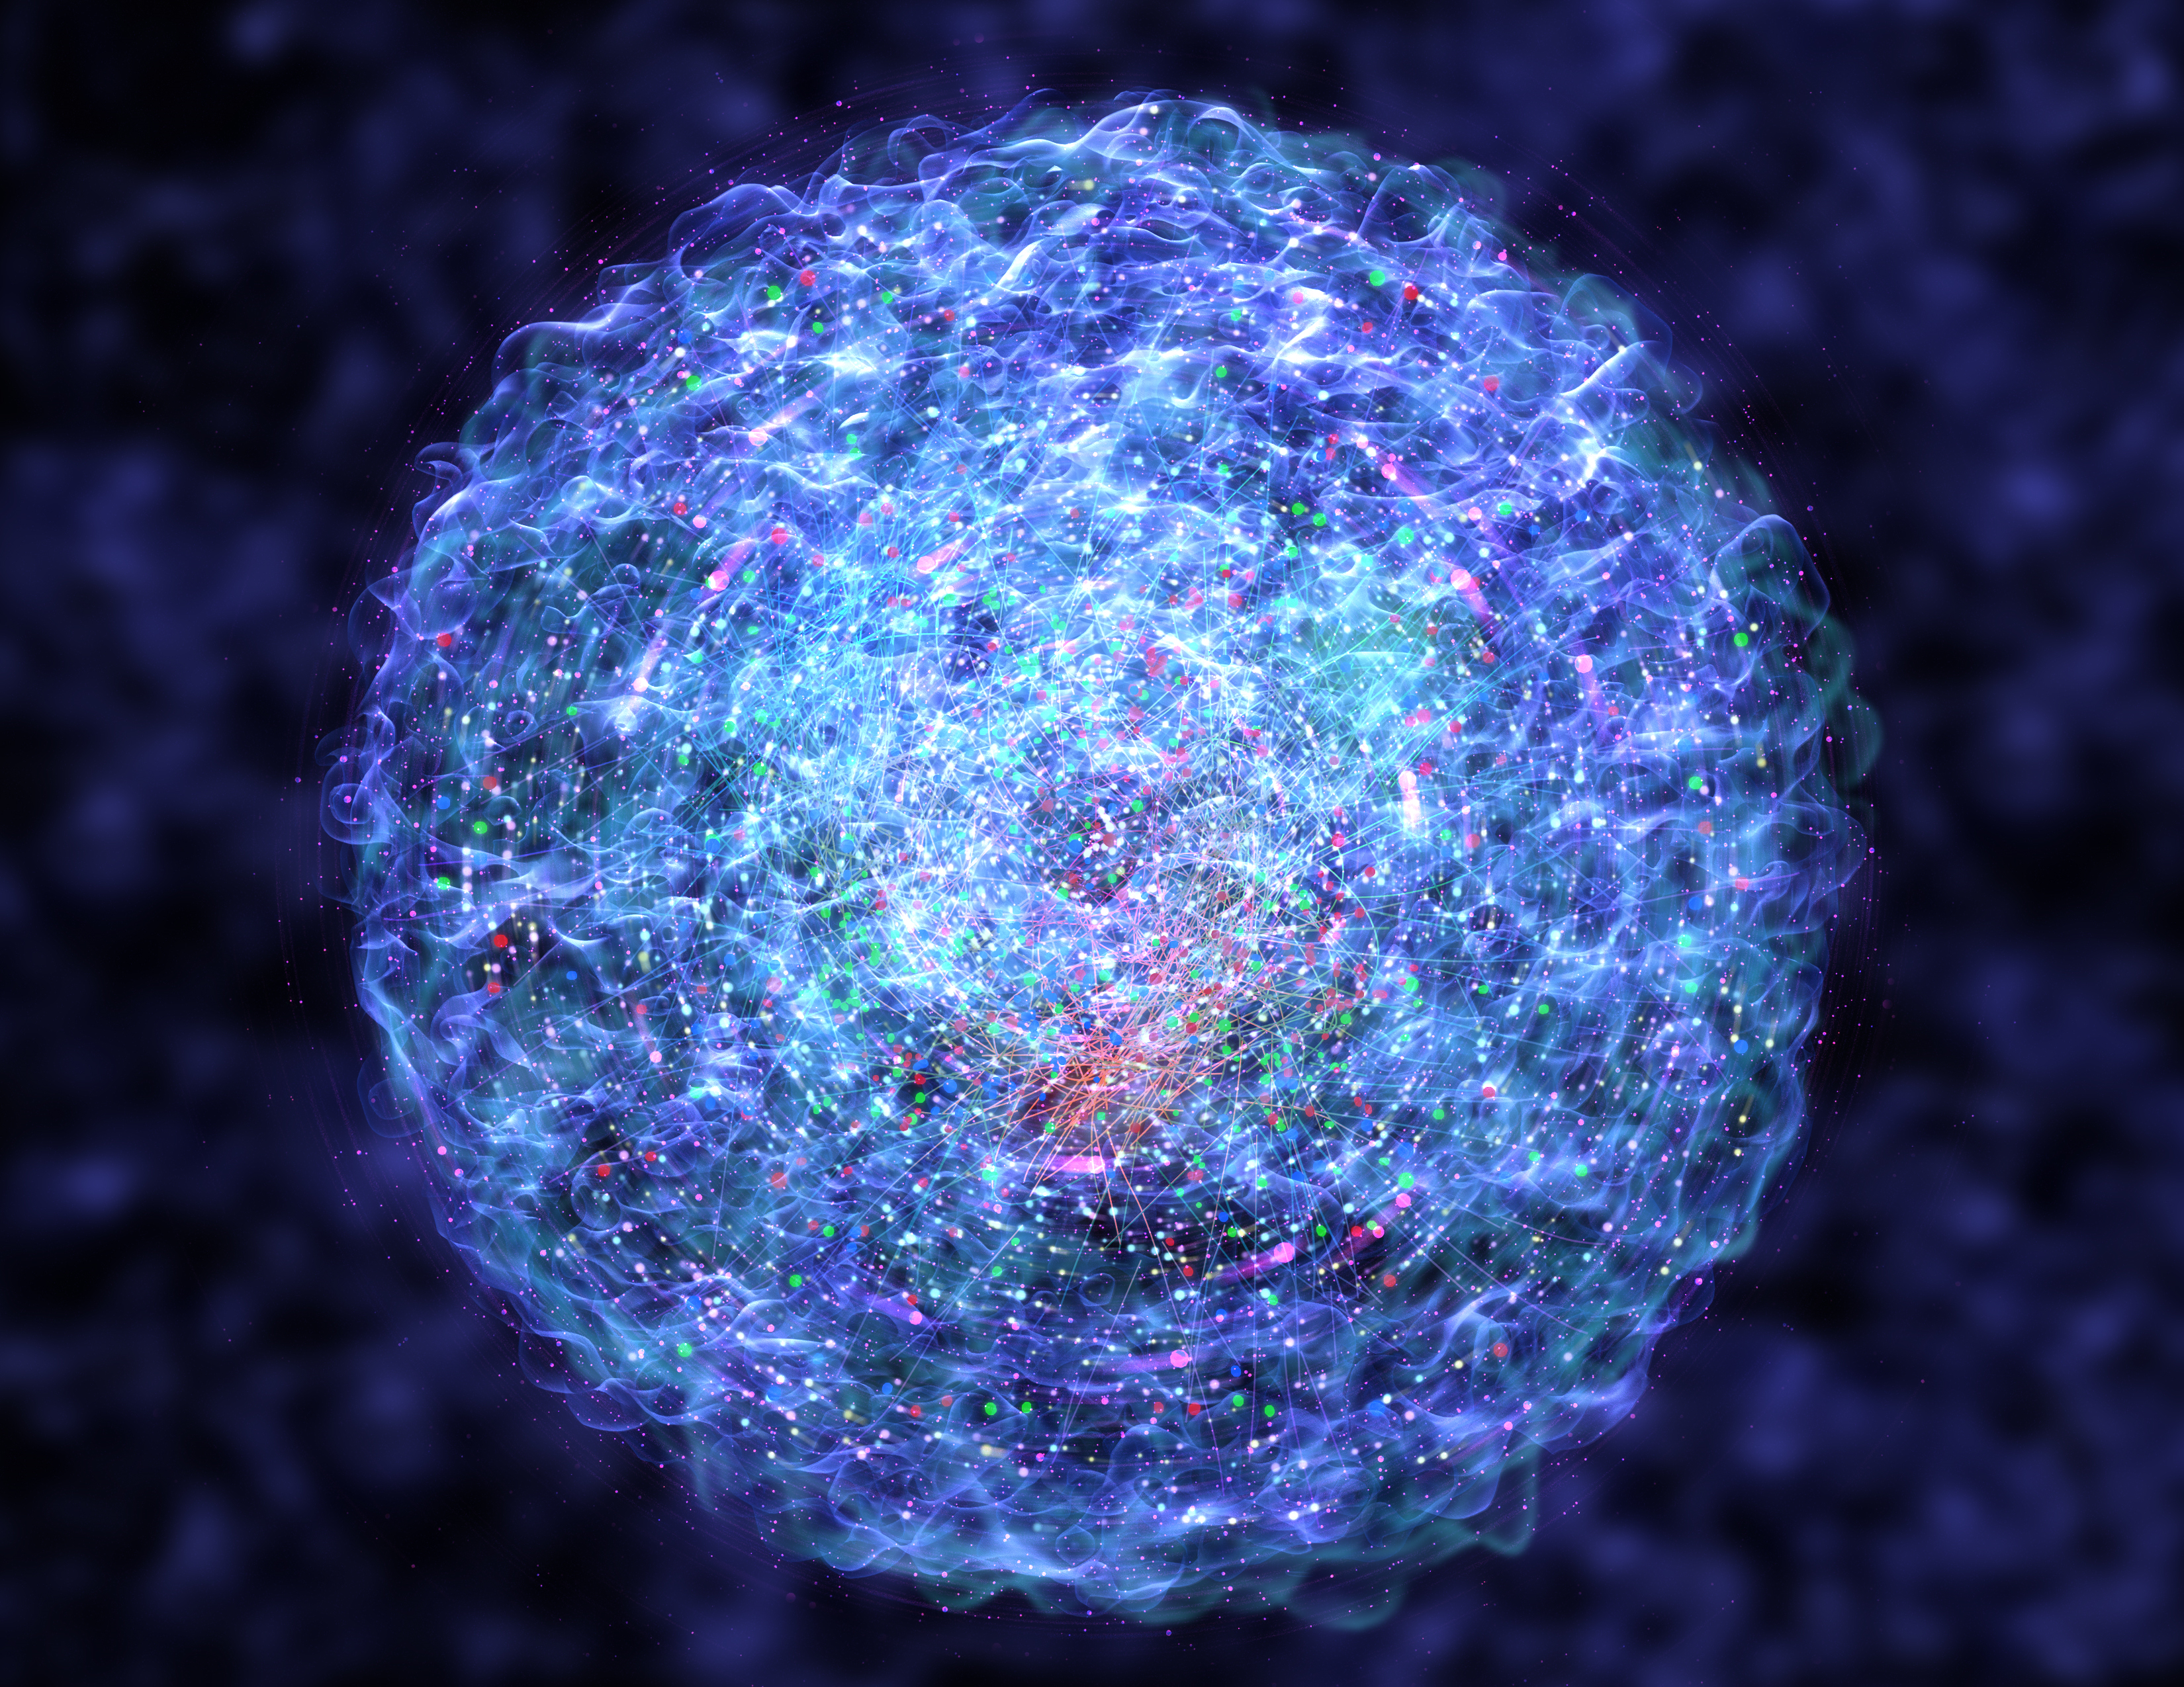
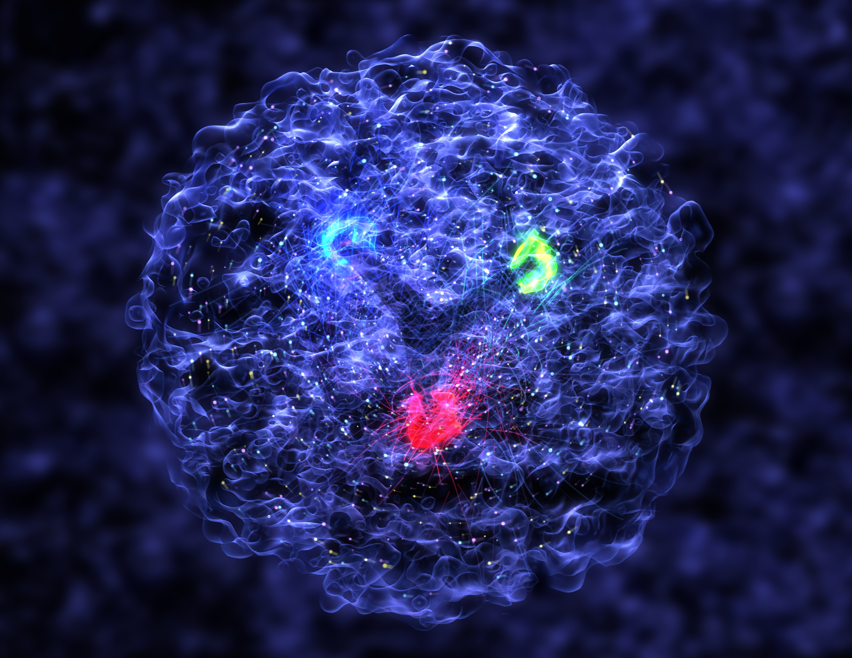
Nuclear Femtography – Subatomic Matter is Unique
Most known matter has localized mass and charge centers – vast “open” space
Molecule:
Crystal:
Nanomaterial:
“Water”
Rare-Earth metal
Carbon-based
Not so in nuclear matter! – unlike the more familiar molecular and atomic matter, the interactions and structures are inextricably mixed up in protons and other forms of nuclear matter, and the observed properties of nucleons and nuclei, such as mass & spin, emerge out of this complex system.
Proton (low-x):
Proton (medium-x):
Proton (high-x):
https://www.youtube.com/watch?v=G-9I0buDi4s

Slide 21
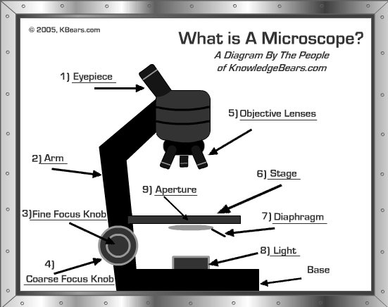

Slide 22
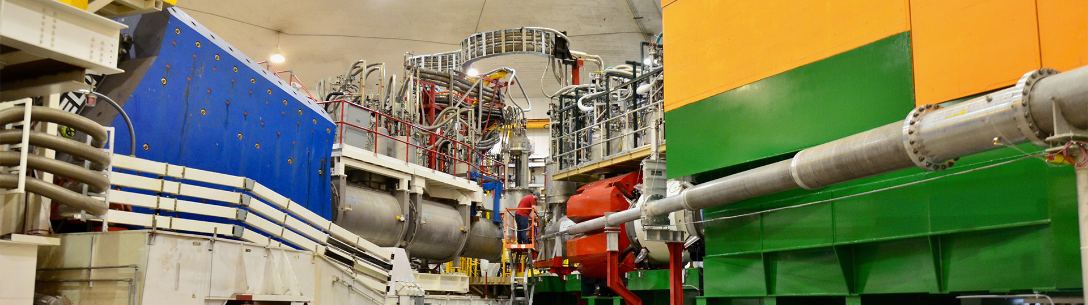
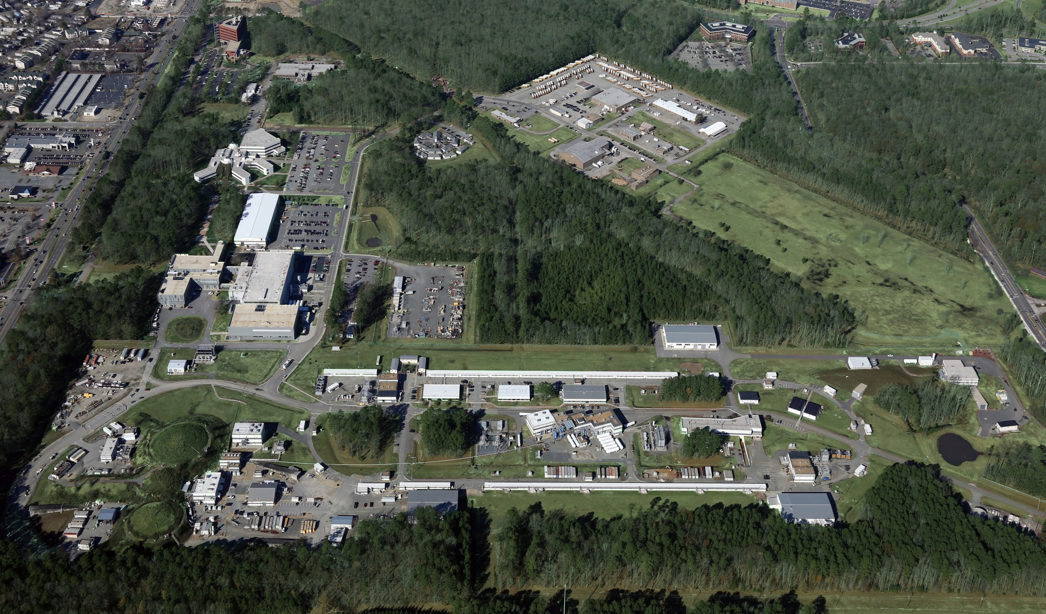
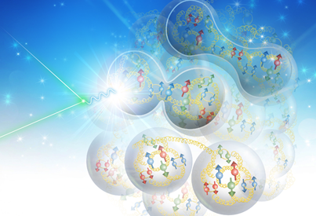
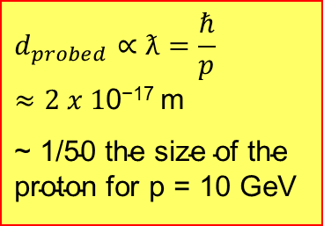
Overview of Jefferson Lab – An Electron Microscope to Image Protons and Nuclei
Created to build and operate the Continuous Electron Beam Accelerator Facility (CEBAF), world-unique user facility for Nuclear Physics
$$d_{probed}∝ƛ=\frac{ℏ}{p}≈2 x 1\text{0}\text{−17} \text{m}$$
$\text{\sim 1/50 }\text{the} \text{size} \text{of} \text{the} \text{proton}$ for p = 10 GeV
Inside Hall C
Computer
Hall D
Hall A
Spectrometer
Detector
Data
acquisition
Hall B
Hall C
~0.5 kilometer
Jefferson Lab Stats: Located in Newport News, VA 169-acre site In operation since 1995 ~800 employees 1,889 Active Users (FY22) 1/3 of Users are from non-US Institutions, from 37 countries >700 PhDs granted to-date On average 30% of US PhDs in nuclear physics FY2022 Costs: ~$200M (~2/3 operations, ~1/3 new construction)
proton
Source of Photons
Electron accelerator
Electron scattering experiments employ the high momentum point-like electrons, and electromagnetic interactions, which are well understood, to probe nuclear structure (which isn’t).
nucleus
E_{CM} ~ 3.3 (@6 GeV), 4.5 (@12 GeV)
(EIC has E_{CM} in 29 GeV to 140 GeV range and will be a much larger electron microscope to peer into the realms of gluons and the quark sea).
22

Slide 23
Electron Scattering
Electrons as probe of nuclear structure have some distinct advantages over other probes like hadrons or γ-rays:
  The interaction between the electron and the nucleus is known; it is the electromagnetic interaction with the charge ρ and the current J of the nucleus: V_{int} = ρφ + J.A, where φ and A are the scalar and vector potentials generated by the electron.
  The interaction is weak, so that in almost all cases it can be treated in the “one-photon exchange approximation” (OPEA), i.e., two-step processes (two-photon exchange) are small. One exception is charge elastic scattering of the Coulomb field of a heavy-Z nucleus.
  The energy (ω) and linear momentum (q) transferred to the nucleus in the scattering process can be varied independently from each other. This is very important, as for a certain |q| one effectively measures a Fourier component of ρ or J. By varying |q| all Fourier components can be determined and from these the radial dependence of ρ and J can be reconstructed.
  Because the photon has no charge, only the J.A interaction plays a role, leading to magnetic M_{λ} and electric E_{λ} transitions. In electron scattering, one can also have charge C_{λ} transitions.

Slide 24
Electron Scattering (Cont.)
Electron scattering has also some disadvantages:
  The interaction is weak, so cross sections are small, but one can use high electron beam currents and thick targets.
      At Jefferson Lab, we can measure neutrino-like cross sections in a day or so.
  Neutrons are less accessible than protons, since they do not have a net electric charge.
      Weak interaction can come to the rescue through parity-violating electron scattering.
  Because electrons are very light particles, they easily emit radiation (so-called Bremsstrahlung). This gives rise to radiative tails, with often large corrections for these processes.
      This can pose limits for kinematics, if the radiative correction factor would become too large.

Slide 25
Electron Scattering Kinematics
k’ = (Ε’,k’)
Virtual photon → off-mass shell
q_{μ}q^{μ} = ν² – q² ≠ 0
k = (Ε,k)
Θ
Define two invariants:
Q² = -q_{μ}q^{μ} = -(k_{μ} – k_{μ}’)(k^{μ}-k’^{μ})
= -2m_{e}² + 2k_{μ}k’^{μ}
(m_{e} ~ 0) = 2k_{μ}k’^{μ}
(LAB) = 2(EE’ – k.k’)
= 2EE’(1-cos(Θ))
= 4EE’sin²(Θ/2)
only assumption: neglecting m_{e}²!!
2) 2Mν = 2p_{μ}q^{μ} = Q² + W² – M²
q = (ν,q)
Undetected final state X
p = (Μ,0)
p’ = (sqrt(p’² + M’²),p’)
Elastic scattering
→ W² = M² → Q² = 2M(E-E’)
(→ p’² = M’² = W²) !!

Slide 26
Use electron scattering as high-resolution microscope to peer into matter
Extracting the (e,e’) cross section
N_{N} (cm⁻²)
e'
N_{e}
e
(ΔΩ_{e}, Δp_{e})
Rutherford’s
Experiment - Data
Scattering probability or cross section
Cross section or scattering probability corresponds to the geometric area that is responsible for scattering, appropriately expressed in units of area or “barns”.

Slide 27
Electron Scattering at Fixed Q²
Quark (fictitious)
Elastic
ν
Proton
Elastic
Δ
Deep Inelastic
N*
ν

Slide 28
Electron Scattering at Fixed Q²
Elastic
Nucleus
Deep Inelastic
Δ
Quasielastic
N*
ν
Proton
Elastic
Δ
Deep Inelastic
N*
ν

Slide 29
Electron Scattering Off Point Particles
k = (Ε,k)
k’ = (Ε’,k’)
1
3
2
4
p = (Μ,0)
p’
Working out will render the so-called Mott cross section

Slide 30
Electron Scattering Off Composite Target
k’ = (Ε’,k’)
Recall: matrix element = <Ψ∗|O|Ψ>
Define transition matrix element T_{fi}:
k = (Ε,k)
Θ
T_{fi} = < f | T | i >
which separates into two integrals and gives the well-known result:
where F(q) is the form factor:

Slide 31
Form Factor
r
Phase difference:
k
k'
Amplitude at q:

Slide 32
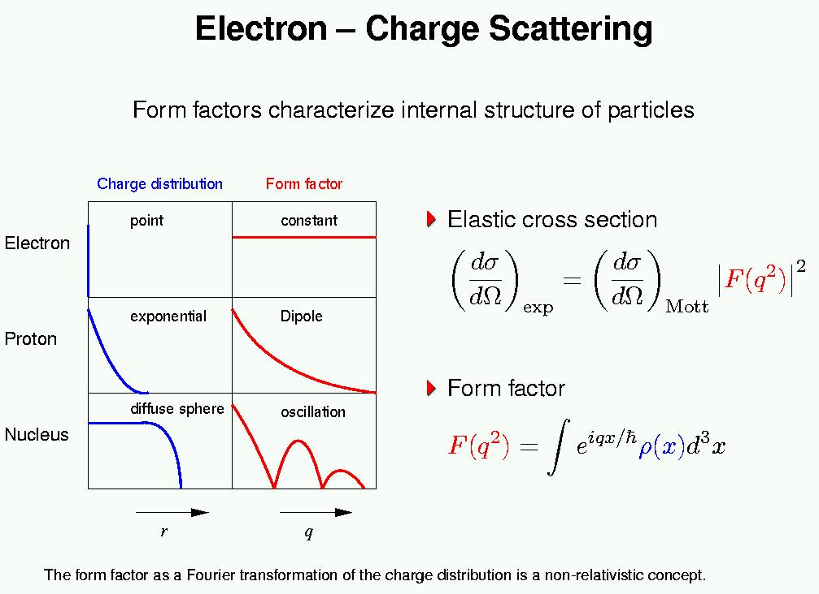
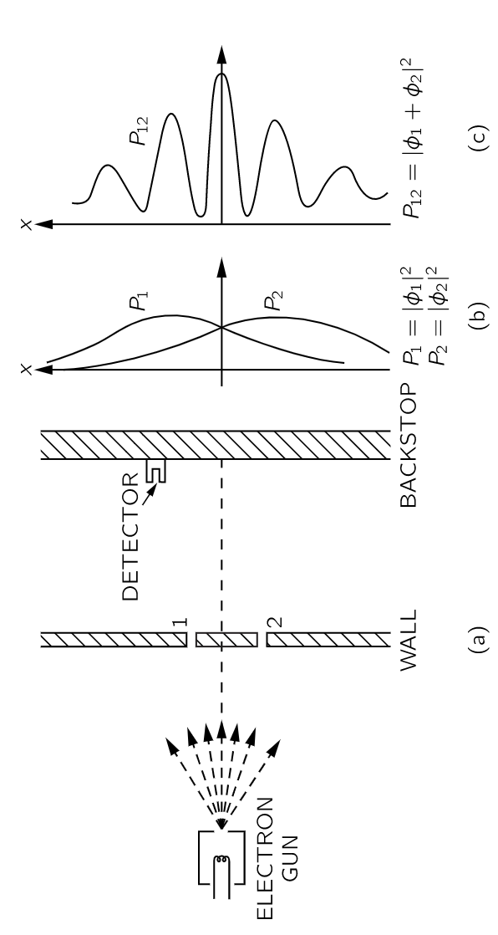
Electron-Charge Scattering
Form Factors characterize internal structure of particles
1961
Note analogy with light

Slide 33
Form Factors of Nuclei at Low Energies
Elastic scattering → W² = M² → Q² = 2M(E-E’) → Q² and ν are correlated
dσ/dΩ (and not dσ/dΩdE) = σ_{M}F₀²(q)
For a point charge with charge Z one has F₀(q) = Z.
For a charge with a finite size F₀(q) will be smaller than Z, because different parts of ρ(r) will give destructive contributions in the integral that constitutes F₀(q).
Often one includes the factor Z in σ_{M} and not in F₀, such that F₀(0) = 1.
Scatter from uniform sphere with radius R at low q: sin(qr) = qr – (1/6)(qr)³
1st term disappears (charge normalization)
2nd term gives direct R_{RMS} measurement (for q low enough)
At higher q pattern looks like slit scattering with radius R

Slide 34
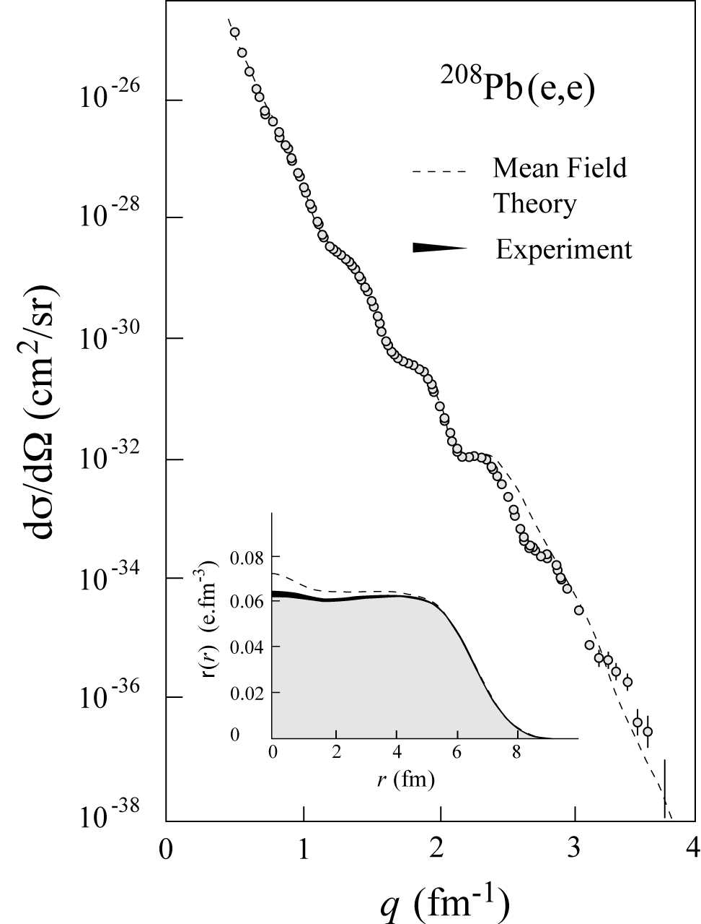

History: Charge Distributions
In ‘70s large data set was acquired on elastic electron scattering (mainly from Saclay) over large Q²-range and for variety of nuclei
“Model-independent” analysis provided accurate results on charge distribution well described by mean-field Density-Dependent Hartree-Fock calculations
34

Slide 35
History: Knock a Proton out of a Nucleus
A(e,e'p)B
p
scattering plane
e'
θ_{pq}
reaction plane
e
(ω,q)
p_{A–1}
φ_{x}
“out-of-plane” angle
Neglecting m_{e}: Q² ≡ – q_{μ}q ^{μ} = q² –ω ² = 4ee' sin²θ/2
Known: e and A + Detect: e’ and p → Infer:
Missing momentum: p_{m} = q – p = p_{A–1}
Missing mass: ε_{m} = ω –T_{p} – T_{A–1}

Slide 36



History: Visualizing the Shell Model
ν
in binding
in momentum
Missing 20+% in the integral??

Slide 37
Where Does the “Missing” Strength Go?
One possibility:
Detected
populates high ε_{m}
recoils

Slide 38



Proton Momenta in the Nucleus
Similar shapes for few-body nuclei and nuclear matter at high k (=p_{m}).
Nuclear Matter
Short-range repulsive core gives rise to high proton momenta
β = 0.75
p
n
²H
³He
⁴He
0 200 400 600 800 1000
p (MeV/c)

Slide 39

Deep-Inelastic Scattering
➔ Precision microscope with superfine control
Q² → Measure of resolution
y → Measure of inelasticity
x → Measure of momentum fraction
of the struck quark in a proton
Q² = S x y
Inclusive events: e+p/A → e’+X
Detect only the scattered lepton in the detector
Semi-Inclusive events: e+p/A → e’+h(π,K,p,jet)+X
Detect the scattered lepton in coincidence with identified hadrons/jets in the detector
Exclusive events: e+p/A → e’+ p’/A’+ h(π,K,p,jet)
Detect every things including scattered proton/nucleus (or its fragments)

Slide 40













History: Deep Inelastic Scattering (DIS) and the Parton Model
(Infinite Momentum Frame)
Parton Model : Feynman; Bjorken, Paschos
(x = momentum
fraction)
→ access through Structure Functions F₂ to Parton Distribution Functions
Empirically, DIS region is where logarithmic scaling is observed
Q² > 1 GeV², W² > 4 GeV²
40

Slide 41



Parton Distribution Functions (PDFs)
PDF q(x): probability that a quark (or gluon) has fraction x of proton’s momentum
proton: uud + uū + dđ + …

Slide 42


History: Structure Function by Different DIS Probes
F₂^{μD}
μ DIS
ν DIS
(-)
x $\frac{5}{18}$
F₂^{νN}
F₂(x,Q²) + c(x)
1990
The Classic Example
Extending the scaling found by the venerable SLAC (electron scattering) experiment.
Confirming the basis of the Quark-Parton Model: the expected 5/18 charge weighting works well.
Logarithmic Scaling Violations as anticipated from a renormalizable field theory (QCD) are clearly shown, with both muon and neutrino probes.
Q² (GeV²)

Slide 43



Proton Viewed in High Energy Electron Scattering: 1 Longitudinal Dimension
Viewed from boosted frame,
length contracted by
Internal motion of the proton’s constituents is slowed down by time dilation – the instantaneous charge distribution of the proton is seen.
In boosted frame x is understood as the longitudinal momentum fraction
valence quarks: 0.1 < x < 1
sea quarks: x < 0.1
Lorentz Invariants
E²_{CM} = (p+k)²
Q² = -(k-k’)²
x = Q²/(2p•q)
J. Bjorken, SLAC-PUB-0571
March 1969

Slide 44

Learn From Past: 1D Longitudinal Momentum Distributions
g – gluons
S – quark sea
u, d – up, down
valence quarks
1/Q ~ spatial resolution
R. Yoshida
C. Gwenlan

Slide 45

A Gluon PDF Surprise ~ 1990-2007
HERA collider at DESY (Germany)
Gives tremendous reach in measurements of F₂ structure functions. Result: the gluons start running wild…

Slide 46



A Sea Quark PDFs Surprise ~ 1995
High energy lore: gluon splits in quark and antiquark pair & m_{u} ~ m_{d}: d = u
Low energy: Neutron has no charge,
but does have a charge distribution:
n = p + π⁻, n = ddu, duudu
-
-
-
q
g
-
q
FNAL Drell-Yan
σ_{pd}/2σ_{pp}
→ d(x) ≠ u(x)
Even at high energies …
The low-energy signatures persist

Slide 47
Nuclear Femtography - Imaging
In other sciences, imaging the physical systems under study
has been key
to gaining new
understanding.
Structure mapped
in terms of
b_{T} = transverse position
k_{T} = transverse momentum
Also information on orbital angular momentum: r x p

Slide 48
Exploring the 3D Nucleon Structure
After decades of study of the partonic structure of the nucleon we finally have the experimental and theoretical tools to systematically move beyond a 1D momentum fraction (x_{Bj}) picture of the nucleon.
    High luminosity, large acceptance experiments with polarized beams and targets.
    Theoretical description of the nucleon in terms of a 5D Wigner distribution that can be used to encode both 3D momentum and transverse spatial distributions.
Deep Exclusive Scattering (DES) cross sections give sensitivity to electron-quark scattering off quarks with longitudinal momentum fraction (Bjorken) x at a transverse location b_{T}.
Semi-Inclusive Deep Inelastic Scattering (SIDIS) cross sections depend on transverse momentum of hadron, P_{h⊥}, but this arises from both intrinsic transverse momentum (k_{T}) of a parton and transverse momentum (p_{T}) created during the [parton → hadron] fragmentation process.
PDFs
Nuclear Femtography

Slide 49

Jefferson Lab 6-GeV – A Surprise Enabled by 3D Imaging
First determination using 3D spatial imaging data (DVCS - Deeply Virtual Compton Scattering)
Interior pressure in proton is > pressure inside a neutron star! Who knew that!

Slide 50


The low- and high-energy side of nuclei
The Low Energy View of Nuclear Matter
  nucleus = protons + neutrons
  nucleon ↔ quark model
  (valence) quark model ↔ QCD
The High Energy View of Nuclear Matter
The visible Universe is generated by quarks but dominated by gluons!
But what influence does this have on hadron structure?
Remove
factor 20
quark model
50

Slide 51
21st Century View of the
Fundamental Structure of the Proton
Elastic electron scattering determines charge and magnetism of nucleon
Approx. sphere with <r> ≈ 0.85 Fermi
The proton contains quarks,
as well as dynamically
generated
quark-antiquark pairs
and gluons.
Quark and gluon
momentum fractions
(in specific Infinite
Momentum Frame)
are well mapped out.
The proton spin
and mass have large
contributions from
the quark-gluon
dynamics.
1961
In fact, mass and structure emerge from the quark-gluon dynamics

Slide 52


Proton Structure
Naïve Quark Model: proton = uud (valence quarks)
QCD: proton = uud + uu + dd + ss + …
The proton sea has a non-trivial structure: u ≠ d
(90s)
(late 80s)
& gluons are abundant
(early 2000s)
gluon dynamics
Non-trivial sea structure
The proton is far more than just its up + up + down (valence) structure
Gluon photon:
Radiates
and recombines:

Slide 53
Early Thinking on the Need for an Electron-Ion Collider Emerged in the Late 90s to early 2000s
Two roads led to the community thinking about an EIC:
The success of the HERA electron-proton collider.
  People speculated about the need for an eA collider (and some thinking also about a polarized ep collider).
  Only existing nuclear effect pointing unambiguously to the role of quarks in nuclear physics: the venerable “nuclear” EMC effect: quarks in nuclei behave differently than quarks in a nucleon, and we had no satisfactory explanation.
  Theorists started thinking about the growth of gluons that could not be untamed and the concepts of the “Color Glass Condensate”.
  This naturally led to the need for a high energy EIC as HERA follow-up.
The success of the HERMES experiment.
  This showed among others, together with other efforts worldwide, the power of a flavor decomposition of spin-dependent scattering in PDFs, supported the sea quark pdf surprise, started thinking about 3D imaging through deep exclusive measurements.
  Theorists developed the frameworks towards 3D imaging in terms of “TMDs” and “GPDs”.
  This naturally led to the need for a medium energy EIC as “super-HERMES”.

Slide 54





The Scientific Foundation for an EIC was Built Over Two Decades
Electron-Ion Collider..absolutely central to the nuclear science program of the next decade.
2002
“a high-energy high-luminosity polarized EIC [is] the highest priority for new facility construction following the completion of FRIB.”
2007
The science questions that an EIC will answer are central to completing an understanding of atoms as well as being integral to the agenda of nuclear physics today.”
2009
2010
Gluons and the Quark Sea at High Energies
2012
2013
2015
Major Nuclear Physics Facilities for the Next Decade
2018
NSAC
2021
“…essential accelerator and detector R&D [for EIC] should be given very high priority
in the short term.”
“We recommend the allocation of resources …to lay the foundation for a polarized Electron-Ion Collider…”
March 14, 2013
“..a new dedicated facility will be essential for answering some of the most central questions.”
“The quantitative study of matter in this new regime [where abundant gluons dominate] requires a new experimental facility: an Electron Ion Collider..”

Slide 55
EIC Scope
Project Design Goals
High Luminosity: L= 10³³ – 10³⁴cm⁻²sec⁻¹, 10 – 100 fb⁻¹/year
Highly Polarized Beams: 70%
Large Center of Mass Energy Range: E_{cm} = 29 – 140 GeV
Large Ion Species Range: protons – Uranium
Large Detector Acceptance and Good Background Conditions
Accommodate a Second Interaction Region (IR)
IR-8
IR-6, ePIC Detector
IR-8
p/A beam
e beam
p: 41 GeV, 100 to 275 GeV
e: 5 GeV to 18 GeV

Slide 56

Subatomic Matter is Unique
Interactions and Structure are entangled
because of gluon self-interaction.
Observed properties such as mass and spin emerge from this complex system.
EIC needed to explore the gluon dominated region
JLAB 12 to explore the valence quark region
Longitudinal (1D) Momentum Fraction x
56

Slide 57
Jefferson Lab and EIC – an exciting future lies ahead
Hall D
Hall A
Hall B
Hall C
~0.5 kilometer
Electron accelerator on fixed-targets
1995 start of 4 GeV science program
2000s evolutionary upgrade to 6 GeV
2017 formal start of 12-GeV program
2023 continue 12-GeV operations, decade-long science program on books
Studying options to upgrade to 22 GeV
~1900 scientific users
Electron-proton/ion collider
Science operations phase in 2030s
~1400 members of EICUG

Slide 58


Slide 59

EIC High Level Project Schedule
Construction Phase
Science Phase
Conclusion of RHIC Operations
The thinner bars indicate that R&D and design
can continue at a small level beyond CD-2 and CD-3
for LLP construction
starts at CD-3A
Recent change replaced CD-4A with project internal milestones
The logic remains the same though, we start accelerator commissioning with an instrumented beam pipe and the detector in the Assembly Hall. The detector only rolls in later.

Slide 60
From 3D atomic structure to the quantum world
Atomic structure: dating back to Rutherford’s experiment :
α + Au ➔ α + X
Over 100 years ago
Experiment
Theory
Atom:
J.J. Thomson’s
plum-pudding model
Rutherford’s
Experiment - Data
Quantum orbitals
Discovery:
Tiny nucleus - less than 1 trillionth in volume of an atom
Quantum probability - the Quantum World!
Localized mass and charge centers – vast “open” space:
Molecule:
Crystal:
Nanomaterial:
“Water”
Rare-Earth metal
Carbon-based
Not so in proton structure!

Slide 61

From 3D hadron structure to QCD
A modern “Rutherford” experiment (about 50 years ago):
Nucleon:
The building unit of all atomic nuclei
Prediction
Discovery
e + p ➔ e + X
1968
Quark
model
Discovery of quarks!
Discovery of Quantum Chromodynamics (QCD):
Gluons
No still picture!
No fixed structure!
Nanometer
Femtometer
Quantum Probability

Slide 62


The Revolution in Hadron and Nuclear Structure
Nuclear Physics in terms of protons, neutrons and pion exchange is a very good effective model. Resolution or Momentum transfer Q is negligible
Protons and Neutrons in terms of constituent (valence) quarks is a very decent effective model:
the Constituent Quark Model works surprisingly well.
Resolution or Momentum transfer Q is small
Looking deep inside protons and neutrons:
Quantum fluctuations + special relativity + M = E/c² gives rise to quark-gluon dynamics (structure and interactions).
Resolution or Momentum transfer Q is “large”
E866 result
The QCD vacuum is not empty, but full of gluon fluctuations: deep in the proton is a wall of gluons
The proton is complex, mass and spin are emergent phenomena
Quantum fluctuations play a role in nucleon structure:
d(x) ≠ u(x)
-
-

Slide 63

Nuclear Femtography: 2 New Dimensions Transverse to Longitudinal Momentum
Structure mapped in terms of
b_{T} = transverse position
k_{T} = transverse momentum
Spin!
Nuclei!
Goal:
Unprecedented
21st Century Imaging
of Hadronic Matter
Direction of longitudinal
momentum normal to
plane of slide
Valence Quarks: JLab 12 GeV
Sea Quarks and Gluons: EIC

Slide 64
Extra

