Slide 1
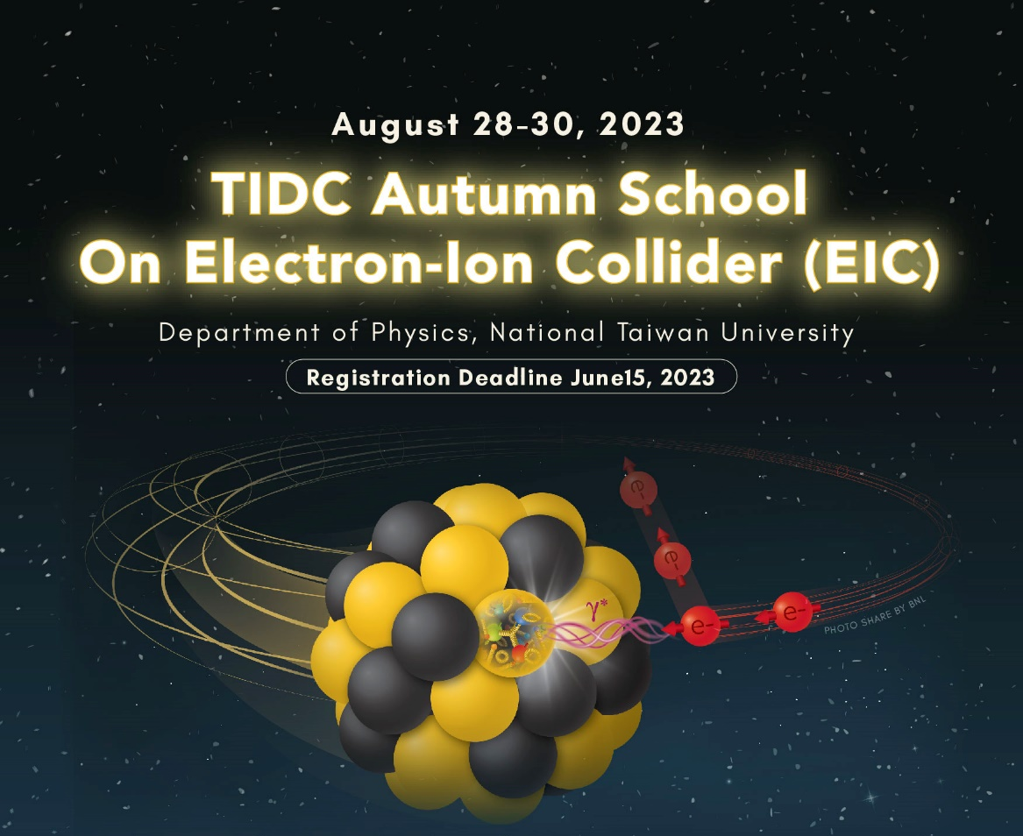
Experimental overview of the nucleon (spin) structure leading up to the EIC
TIDC Autumn School on the EIC,
NTU, Taipei, August 28-30
Ralf Seidl (RIKEN)

Slide 2
Outline
QCD and unpolarized nucleon structure
Spin sum rule and helicity structure
  Inclusive DIS
  Gluon Spin from p+p
  Interlude: Fragmentation functions
  (anti)quark helicities from SIDIS, EW pp
Transverse spin and momentum structure and effects
  Transversity and tensor charge
  Sivers function and other TMDs
3-dimensional structure in position space
  GPDs and DVCS
  Energy momentum tensor and related topics
Low-x physics

Slide 3
Interaction | Energy scale | System size | Main topics | (quasi) participants
Electro-magnetic | eV-keV | >10⁻¹⁰ m | Atoms, molecules, condensed matter | Nuclei + chg. leptons
QCD (effective theories) | MeV | <10⁻¹⁴ m | Nuclear structure | Protons, neutrons
QCD (non-perturbative) | ~1GeV | 10⁻¹⁵ m | Parton distribution and fragmentation functions | Quarks, Gluons
QCD (perturbative) | >1GeV | <10⁻¹⁵ m | Partonic hard scattering | Quarks, Gluons
Electroweak | ~100GeV | 10⁻¹⁸ m | Higgs, parity violation, sea quark access | Quarks, leptons, W/Z/Higgs Bosons
Gravity | 10¹⁹ GeV | 10⁻³² m | Extra dimensions, black holes… | Strings, any massive particle
Nearly all the mass of the visible universe from proton/neutron masses
Proton: |up,up,down> valence quarks, sea quarks, gluons
Nucleon mass (1Gev/c²)not from Higgs mechanism ( only 2-3 MeV/c² from Higgs), but from quantum chromo(color) dynamics,QCD

Slide 4
Strength of the QCD interation
Electromagnetic interaction
Electric charge e
Mediator: Photons
Coupling strength：1/137
Strong interaction (QCD)
Color charge (quarks and gluons)
Mediator: Gluons
Coupling strength: depends on the energy
Asymptotic freedom (high scale): perturbative treatment, calculable
Color confinement (low scale): only color-neutral (white) objects allowed

Slide 5
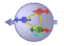
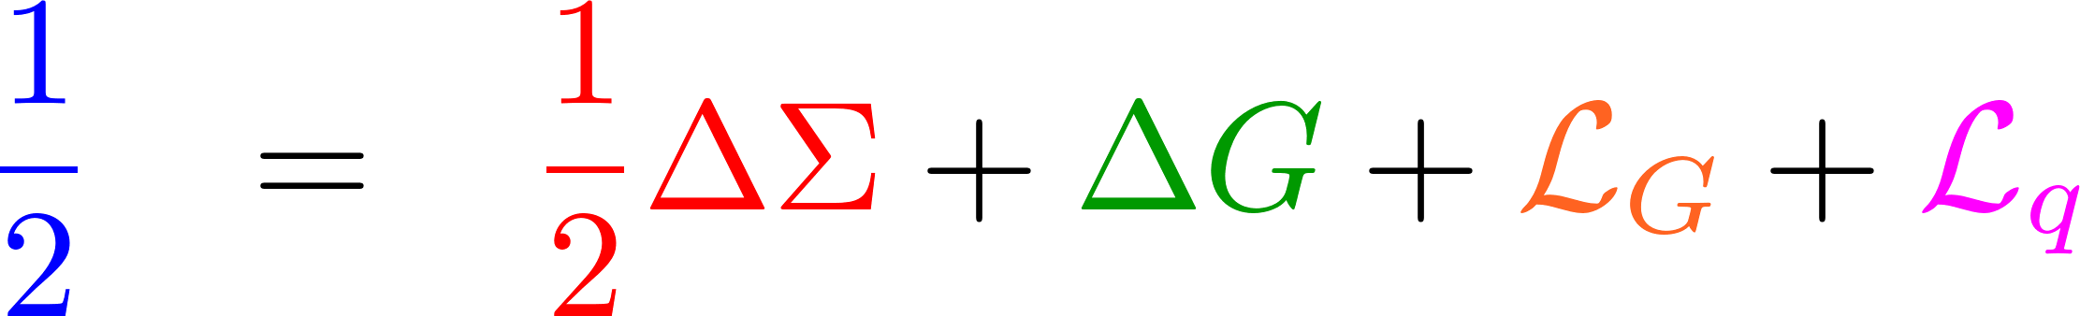
Main QCD Questions
DIS, SIDIS, RHIC (sea quarks)
How are partons distributed in confined objects?
How is the spin of the proton distributed? What is the role of gluons and sea quarks and orbital angular momenta? Correlations, Dynamics
How does QCD create 99% of the visible mass of the universe?
How does confinement work?
Cross section measurements in DIS/p+p collisions
Spin asymmetries in polarized DIS/pp (longitudinal/transverse)
Formation of particles at threshold/pion structure
Fragmentation functions and their spin, flavor, type, long. and transverse momentum dependence
RHIC

Slide 6
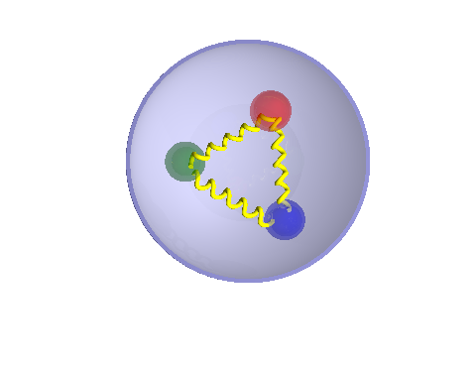
Unpolarized PDFs at intermediate to high x

Slide 7
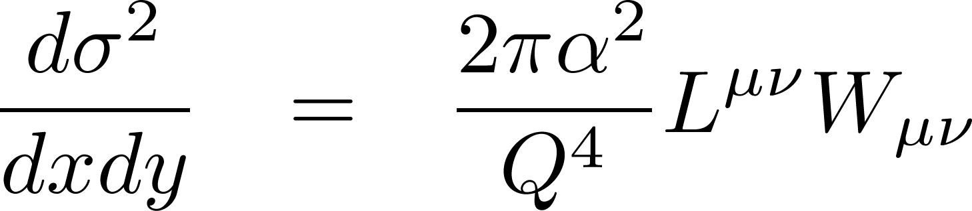
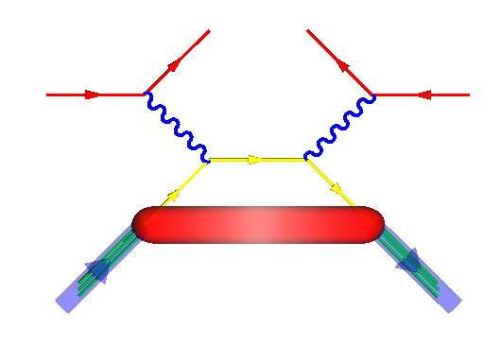
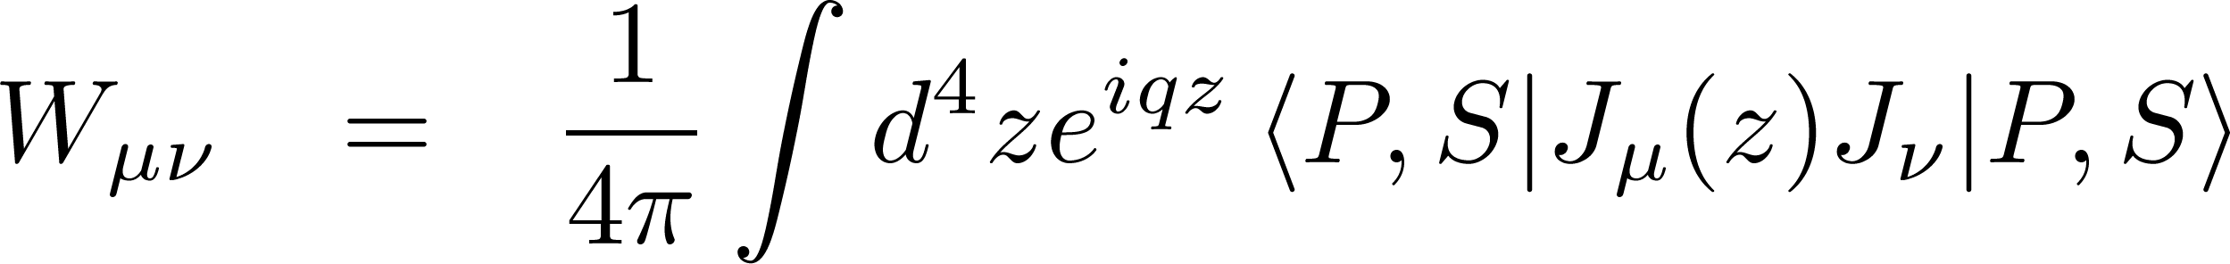
DIS cross section
DIS
l’
Lepton l
Hadron h
q
Parton xP
Cross section:
Leptonic Tensor straightforward
Hadronic tensor related via optical theorem to forward scattering amplitude:
Nucleon P,s

Slide 8
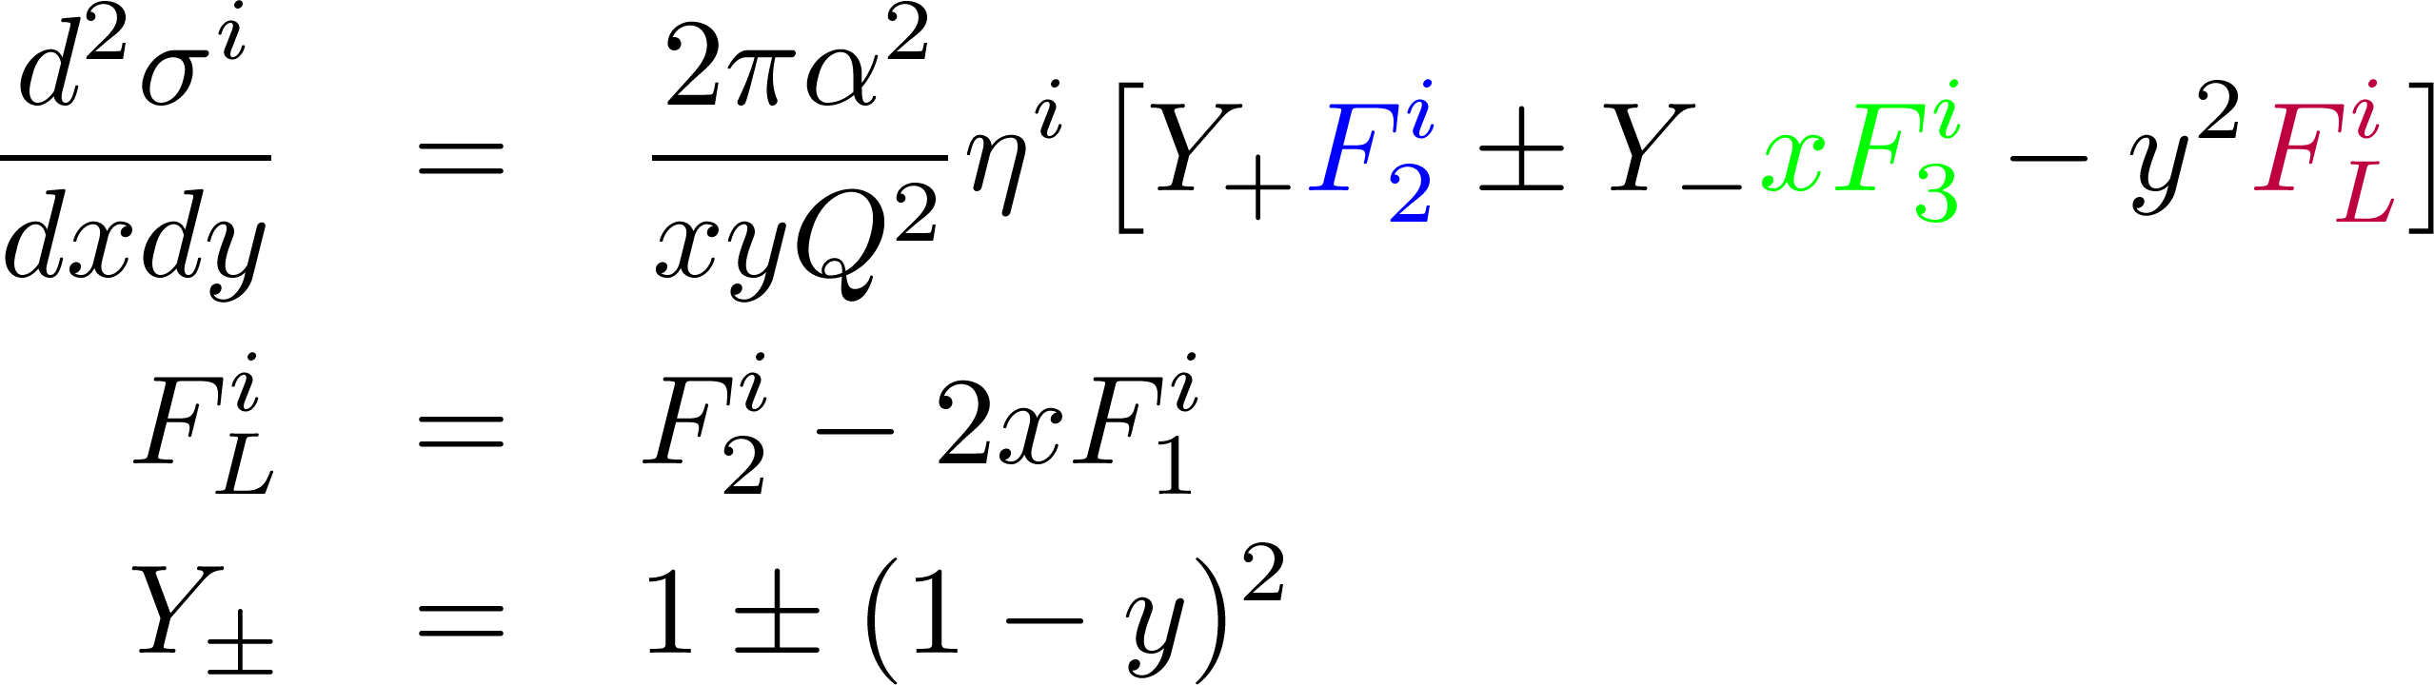
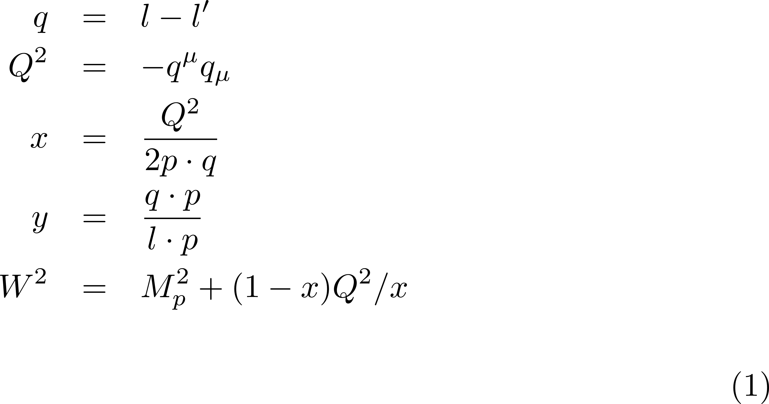
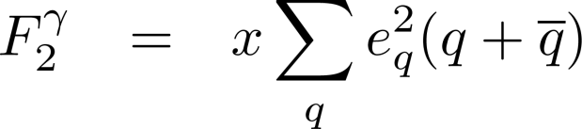
Unpolarized proton structure
DIS
l’
Lepton l
Hadron h
q
Parton xP
Nucleon P,s
Momentum transfer
Neutral current
Parton momentum fraction*
Inelasticity
F₂ (and F₁) measure the sum of quark and antiquark distributions in the nucleon or nucleii
The majority of our knowledge on the unpolarized PDFs is coming from F₂ measurements
Mass of had final state

Slide 9
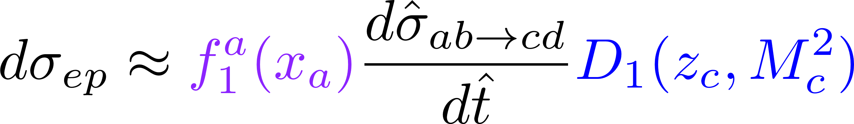
Factorization and Universality
Physics processes can be factorized into small distance and large distance behavior:
  Small distance: asymptotic freedom →perturbative QCD calculation
  Large distance: confinement, needs to be measured!
Non-perturbative functions
(PDFs, FFs) universal (same in
ep, p+p or e⁺e⁻), momentum
fractions x, z
Parton Distribution
Functions: measured in (SI)DIS and p+p
Fragmentation Functions
measured in e⁺e⁻ , SIDIS and p+p
Hard scattering
cross section
from pQCD or EM/EW calc.
a,b,c,d participating parton flavors

Slide 10
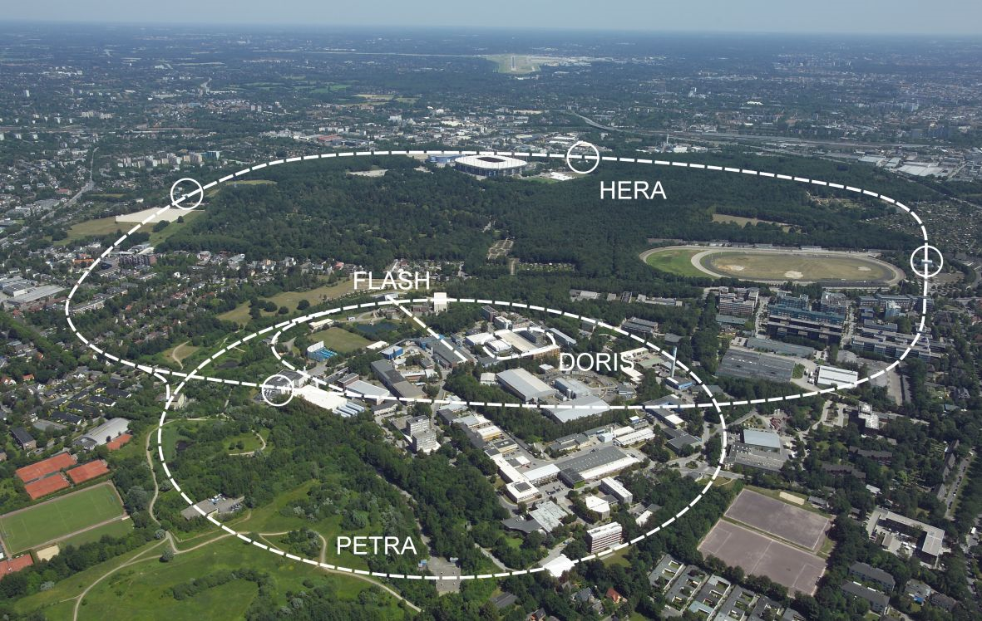



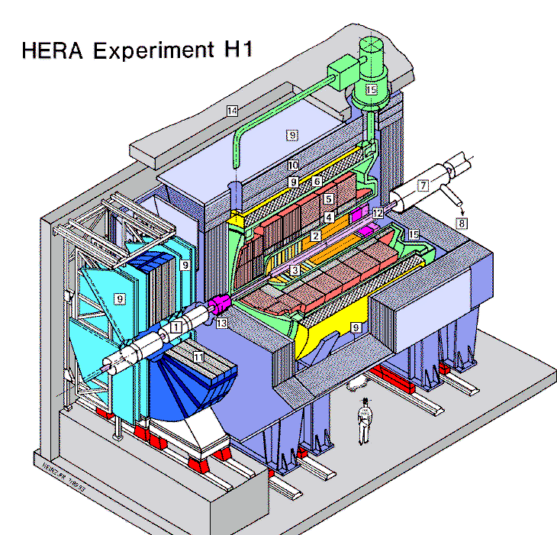
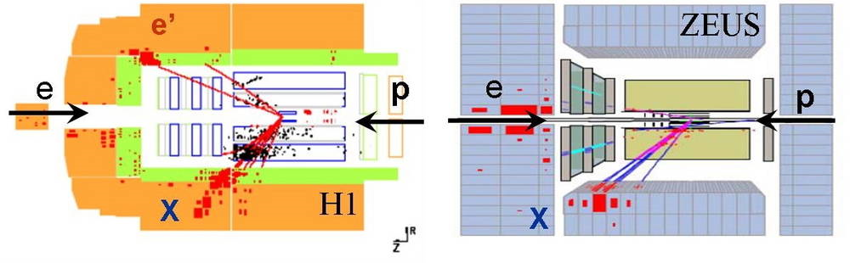
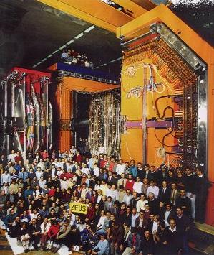
Modern day DIS
At Slac Fixed target with electron energies of up to ~20 GeV
HERA @DESY in Hamburg Germany:
  First e-proton collider with 920 GeV Protons on 27 GeV (polarized) electons
  About 2 orders of magnitude better resolution: 10⁻¹⁷m
  …and partons at very low momentum fraction

Slide 11
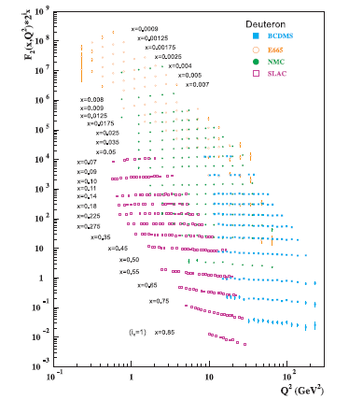
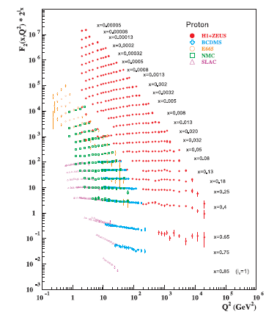
F₂ world data
Initial fixed target data:
  Bjorken scaling (little Q2 dependence as indication for nucleon substructure)
At higher energies: scaling breaking as indication of higher order/gluon effects

Slide 12
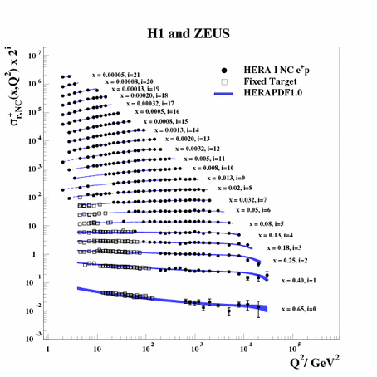
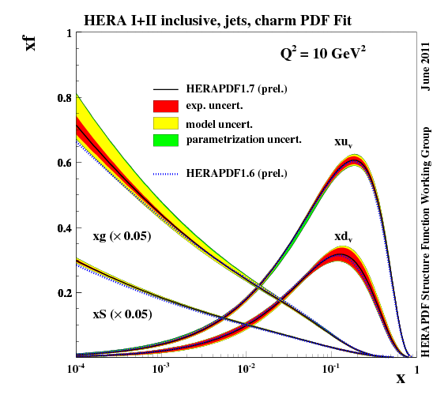
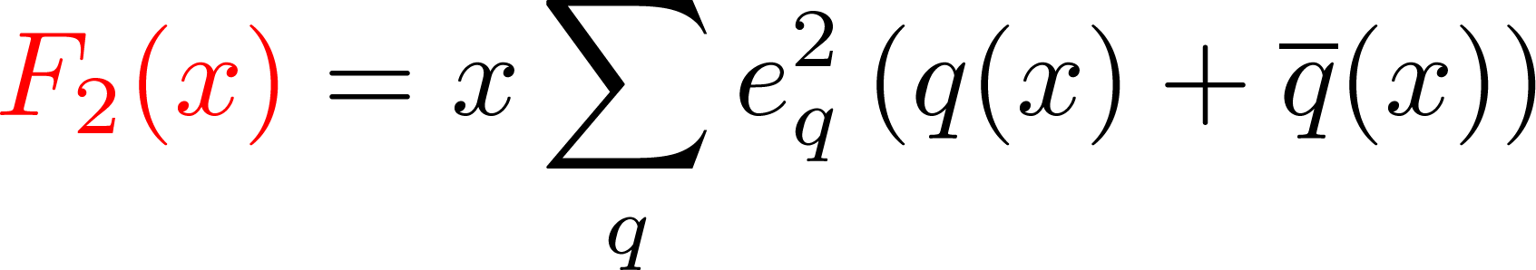
Current unpolarized structure and distribution functions from DIS
Large lever arm of data+DGLAP evolution allows for a good determination of pdfs, including gluons
Structure function

Slide 13
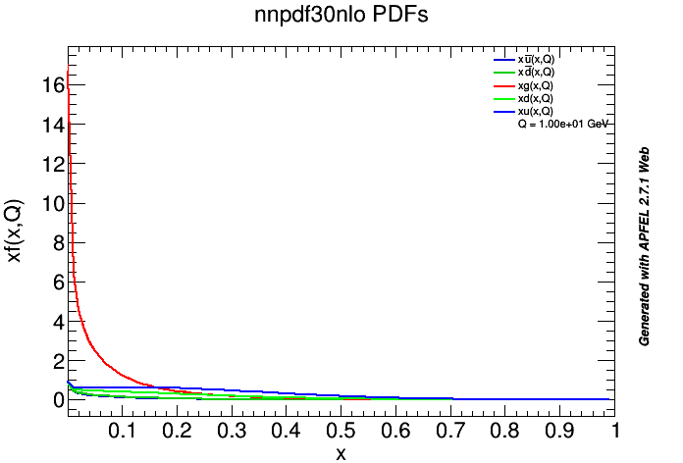
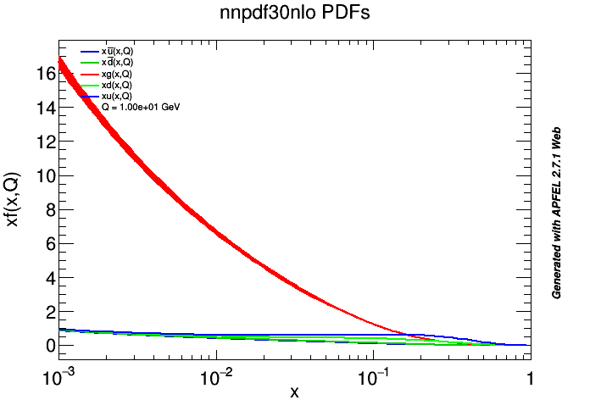
NNPDF 3.0 at scale 10 GeV
The gluons are huge – even at not so low x!

Slide 14
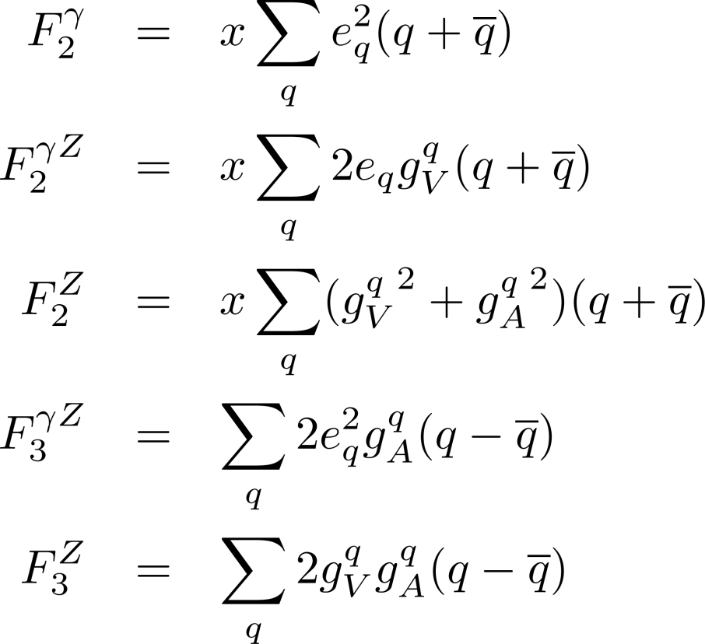
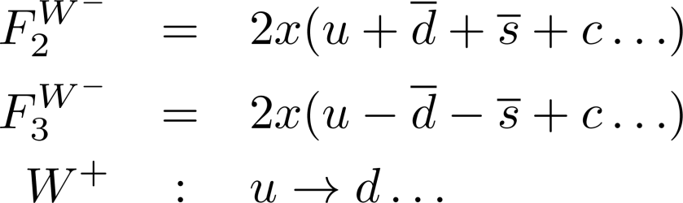
Unpolarized proton structure
(polarized lepton beams included)
F_{L} measures the violation of the Callen-Gross relation
Flavor information from γZ interference, Z exchange and in particular charged curent (W exchange) interactions
Z and W parts of F₃ depend on lepton helicity)
Neutral current
Charged current

Slide 15
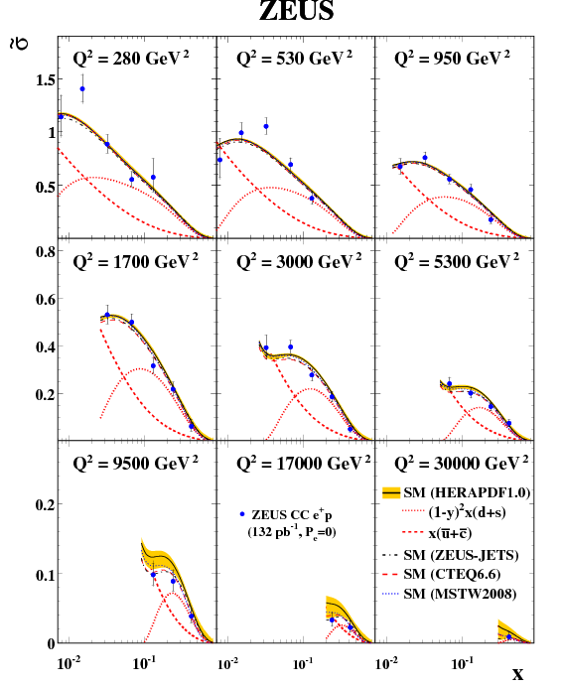
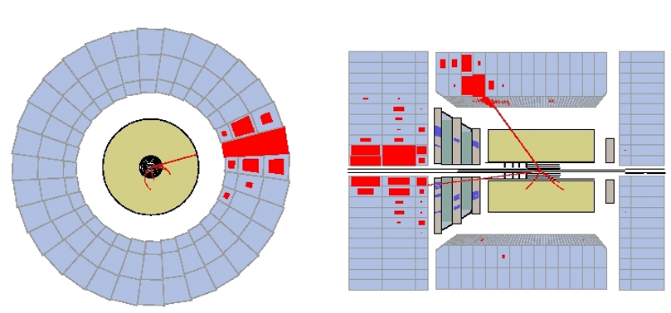
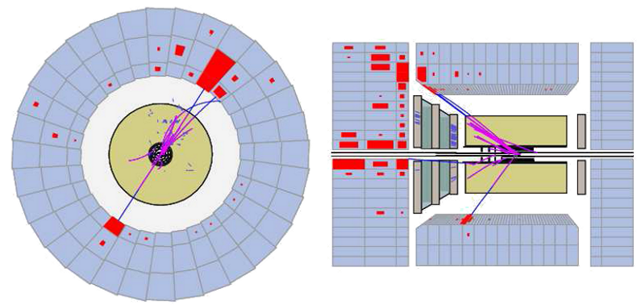
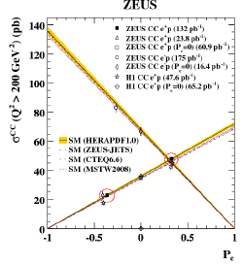
Weak interaction and F₃
Clear Polarization and lepton charge dependence of cross sections seen

Slide 16
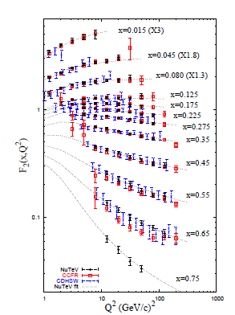
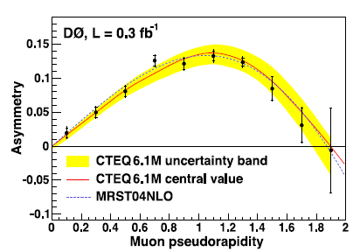
Electroweak information
Neutrino CC DIS
Hadron collider W production asymmetries

Slide 17
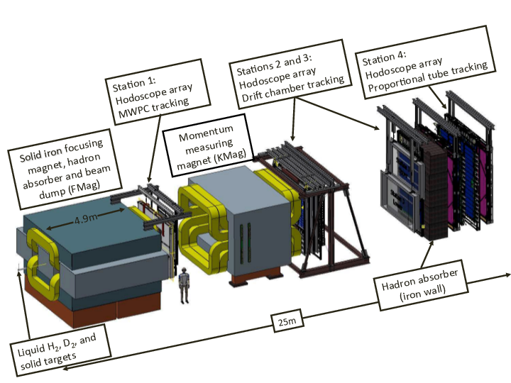
Sea quark asymmetries in DrellYan process
q
Drell Yan is rotated DIS process: p+p → γ* →μ⁺μ⁻
E866/E906/E1039 at FermiLab: 800/125 GeV proton beams on fixed p/d/A target
Ratio of p+p vs p+d cross sections can be related to the light anti-quark ratio

Slide 18
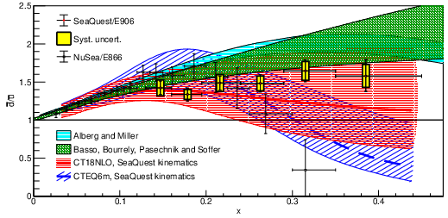
Sea quark asymmetries in DrellYan process + W/Z production
Asymmetric light see seen
anti-d quarks larger than anti-u quarks
no indication of inversion of ratio at higher x
Nature 604 (2022) 7907, E26 (erratum), Nature 590 (2021) 7847
STAR: Phys.Rev.D 103 (2021) 012001
JAM: Phys.Rev.D 104 (2021) 7, 074031

Slide 19
LHC
Many contributions fro LHC experiments via Jet cross sections, W and Z measurements from ATLAS, CMS and LHCb

Slide 20
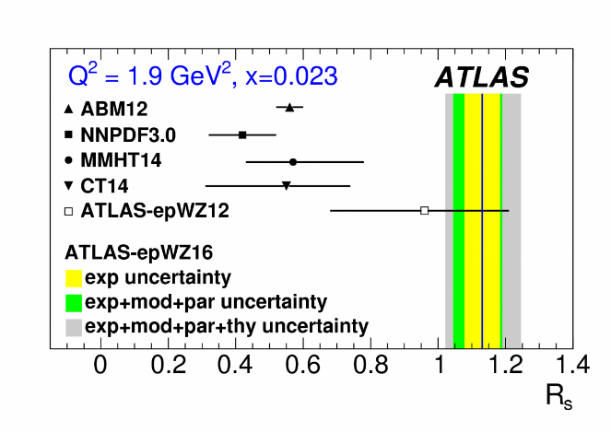
Strange ratio
Taken from Gao @DIS2022
Initially discrepancy between ATLAS and global fits/CMS measurements for Rs = (s+sbar)/(ubar +dbar)
Inclusive W measurements pulled toward higher Rs
V+Jet addition more consistent with other global fits/CMS results
Taken from Cridge @DIS2023

Slide 21
Open questions for unpolarized nucleon structure/PDFs
Strange quark PDFs at intermediate to high x
High-x PDF uncertainties impact LHC searches
Low-x PDFs and color-glass condensate →later
Is there intrinsic charm?

Slide 22

Helicity PDFs, longitudinal spin

Slide 23
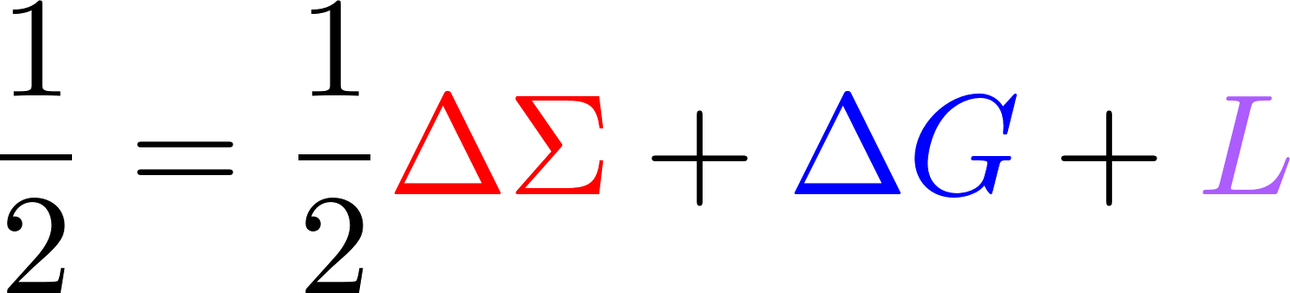
The Spin sum rule
Naïve Quark Model picture: 3 valence quarks make up the spin of the nucleon:
= + +
Spin Crisis (1980s): Quark spin contributes only little
ΔΣ and ΔG can be accessed in longitudinally polarized (SI)DIS and pp collisions (currently for x>0.01)
Where is the rest of the spin? Gluons? Lower momentum fractions? Orbital angular momentum?
Jaffe, Manohar
Quark spin
Gluon spin
Orbital angular momentum

Slide 24
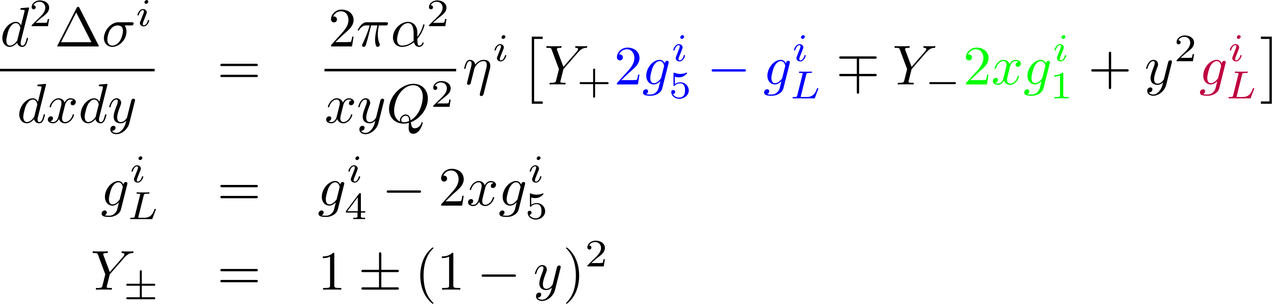
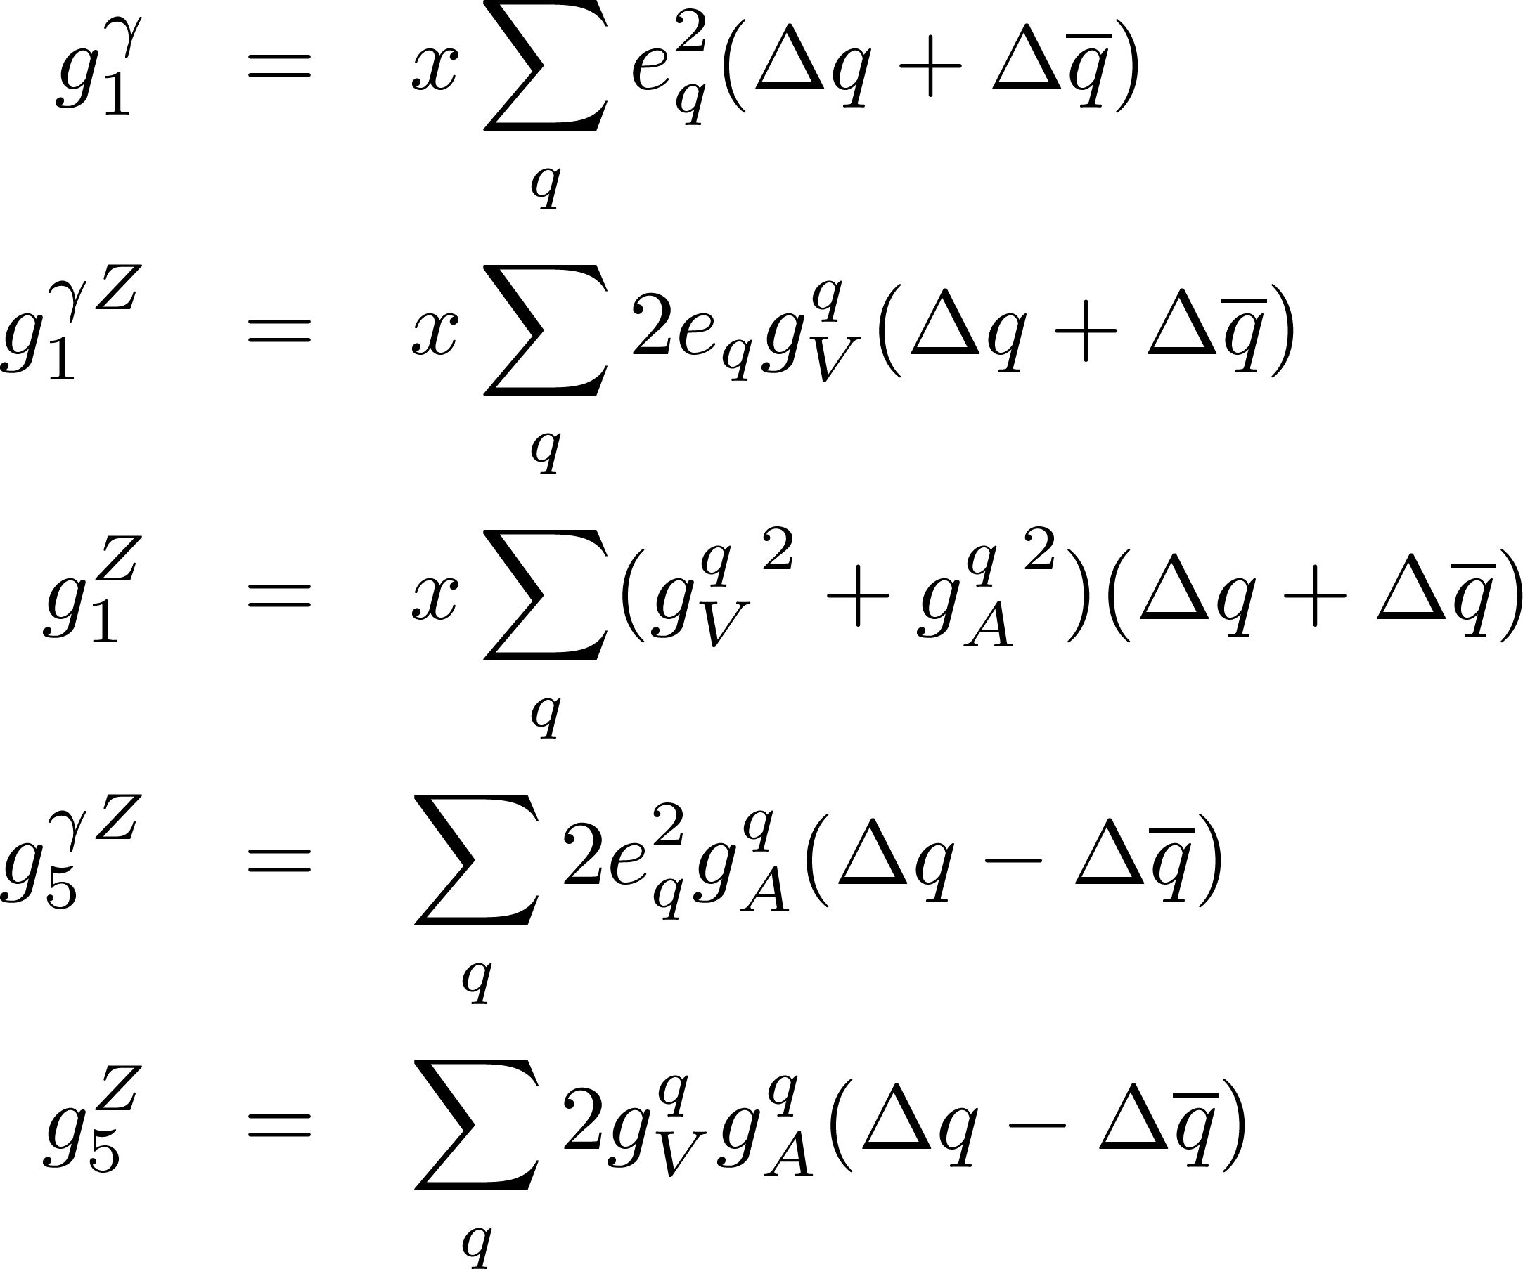
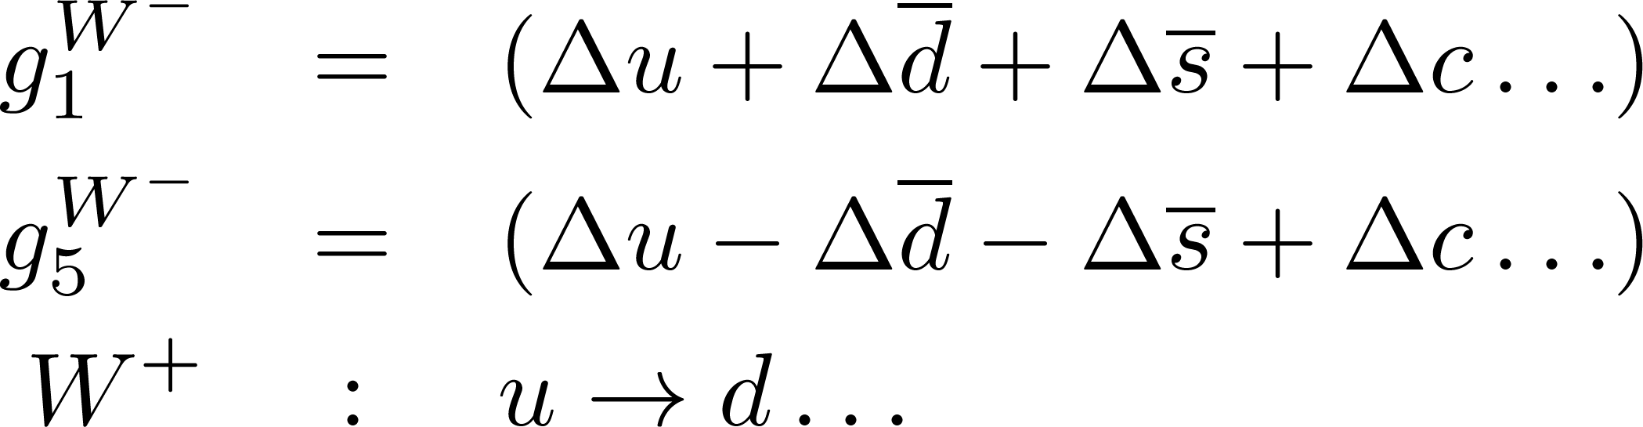
polarized proton structure
g₁ measures charge square weighted total quark spin contribution to the nucleon
Flavor information from gZ interference, Z exchange and in particular charged curent (W exchange) interactions
Neutral current
Charged current

Slide 25
Quark distributions
Sum of quarks with parallel and antiparallel polarization relative to proton spin
(well known from Collider DIS experiments)
q(x),G(x)
Unpolarized distribution function q(x)
Difference of quarks with parallel and antiparallel polarization relative to longitudinally polarized proton
(known from fixed target (SI)DIS experiments)
Δq(x), ΔG(x)
Helicity distribution function Δq(x)
δq(x)
Transversity distribution function δq(x)

Slide 26
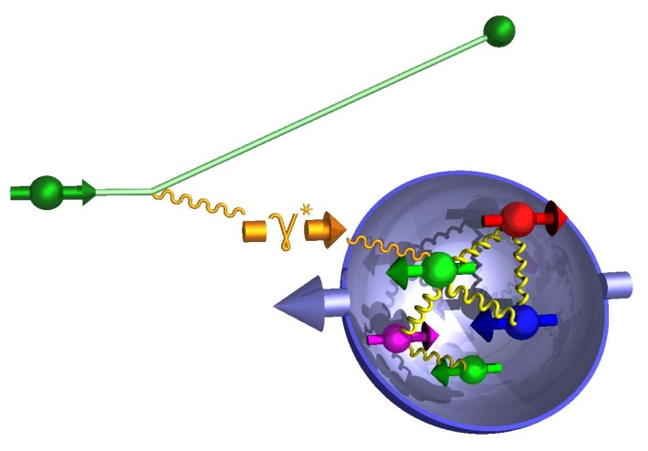
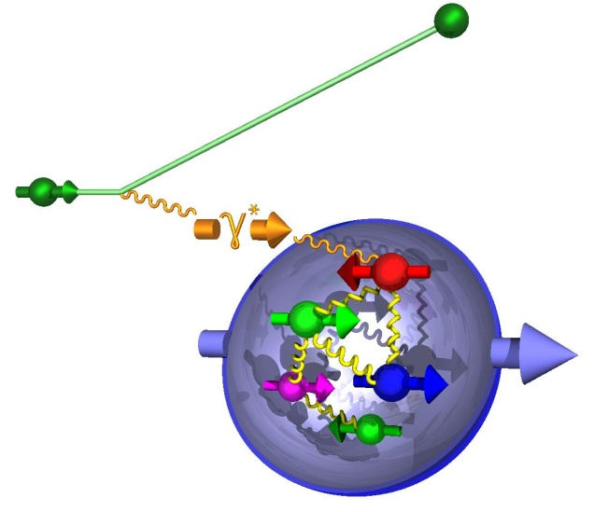
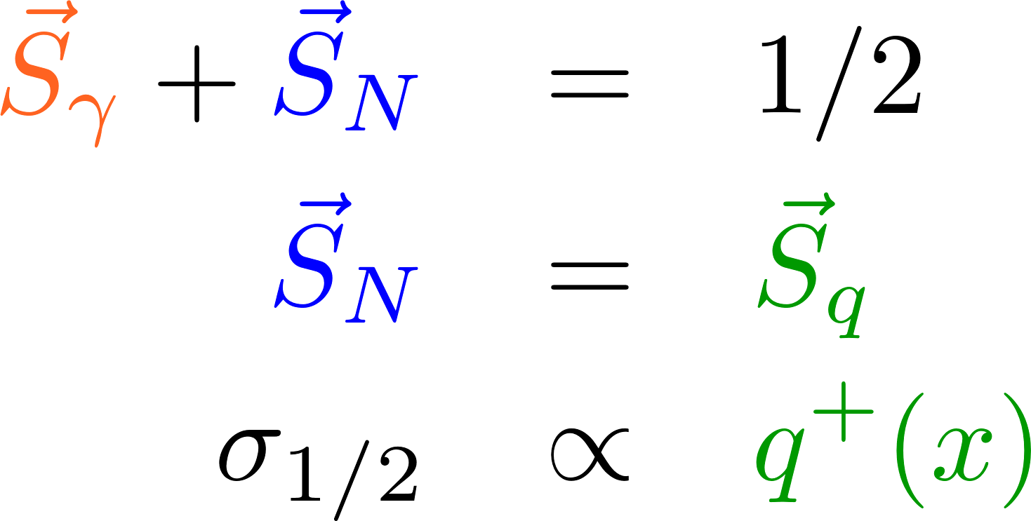
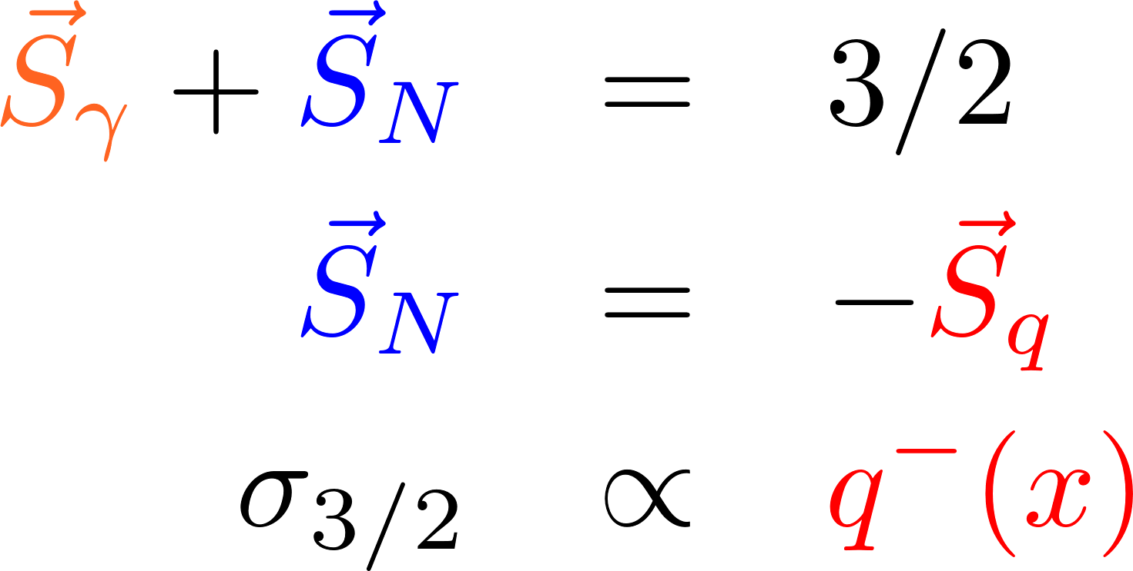
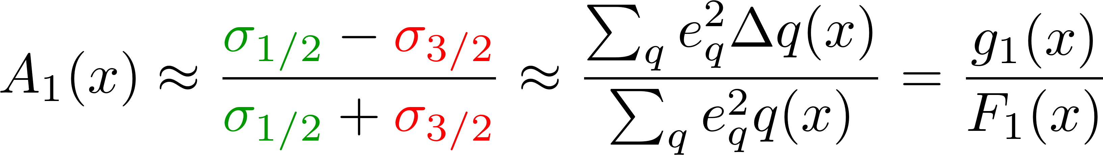
Polarized inclusive DIS
Virtual photon γ* can only couple to quarks of opposite helicity
Select q⁺(x) or q⁻(x) by changing the orientation of target nucleon spin or helicity of incident lepton beam
Δq(x) = q⁺(x) – q⁻(x)
Asymmetry definition:
L.O.
inclusive DIS: only e’ info used

Slide 27
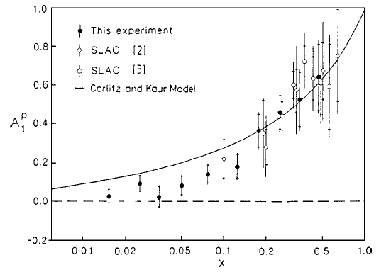
First polarized DIS measurements and spin crisis
First SLAC measurements consistent with naïve quark model (valence quarks make up proton spin)
EMC finds quark contribution of only ~12%
  Anomaly?: huge gluon
  and orbital angular momentum contribution?
20 years later ΔΣ around 0.3

