Slide 1
Towards a New Science Frontier: The Electron Ion Collider – Science, Detector and Status
Rolf Ent (Jefferson Lab)
TIDC Autumn School on Electron-Ion Collider
August 28-30, 2023

Slide 2
Outline
Lecture 1 Introduction and Electron Scattering Basics
Lecture 2 EIC Science
Lecture 3 EIC Detector
Lecture 4 EIC Project Status

Slide 3

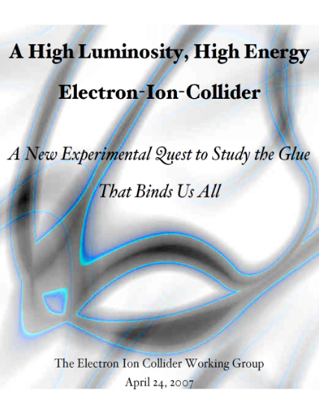


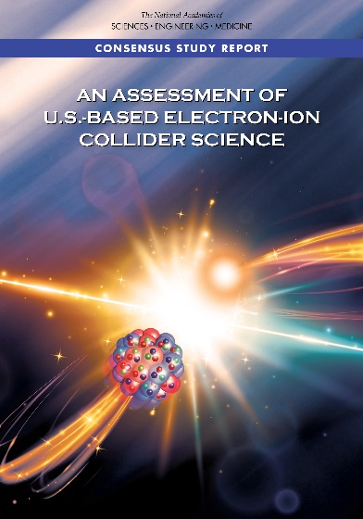
The Scientific Foundation for an EIC was Built Over Two Decades
Electron-Ion Collider..absolutely central to the nuclear science program of the next decade.
2002
“a high-energy high-luminosity polarized EIC [is] the highest priority for new facility construction following the completion of FRIB.”
2007
The science questions that an EIC will answer are central to completing an understanding of atoms as well as being integral to the agenda of nuclear physics today.”
2009
2010
Gluons and the Quark Sea at High Energies
2012
2013
2015
Major Nuclear Physics Facilities for the Next Decade
2018
NSAC
2021
“…essential accelerator and detector R&D [for EIC] should be given very high priority
in the short term.”
“We recommend the allocation of resources …to lay the foundation for a polarized Electron-Ion Collider…”
March 14, 2013
“..a new dedicated facility will be essential for answering some of the most central questions.”
“The quantitative study of matter in this new regime [where abundant gluons dominate] requires a new experimental facility: an Electron Ion Collider..”

Slide 4
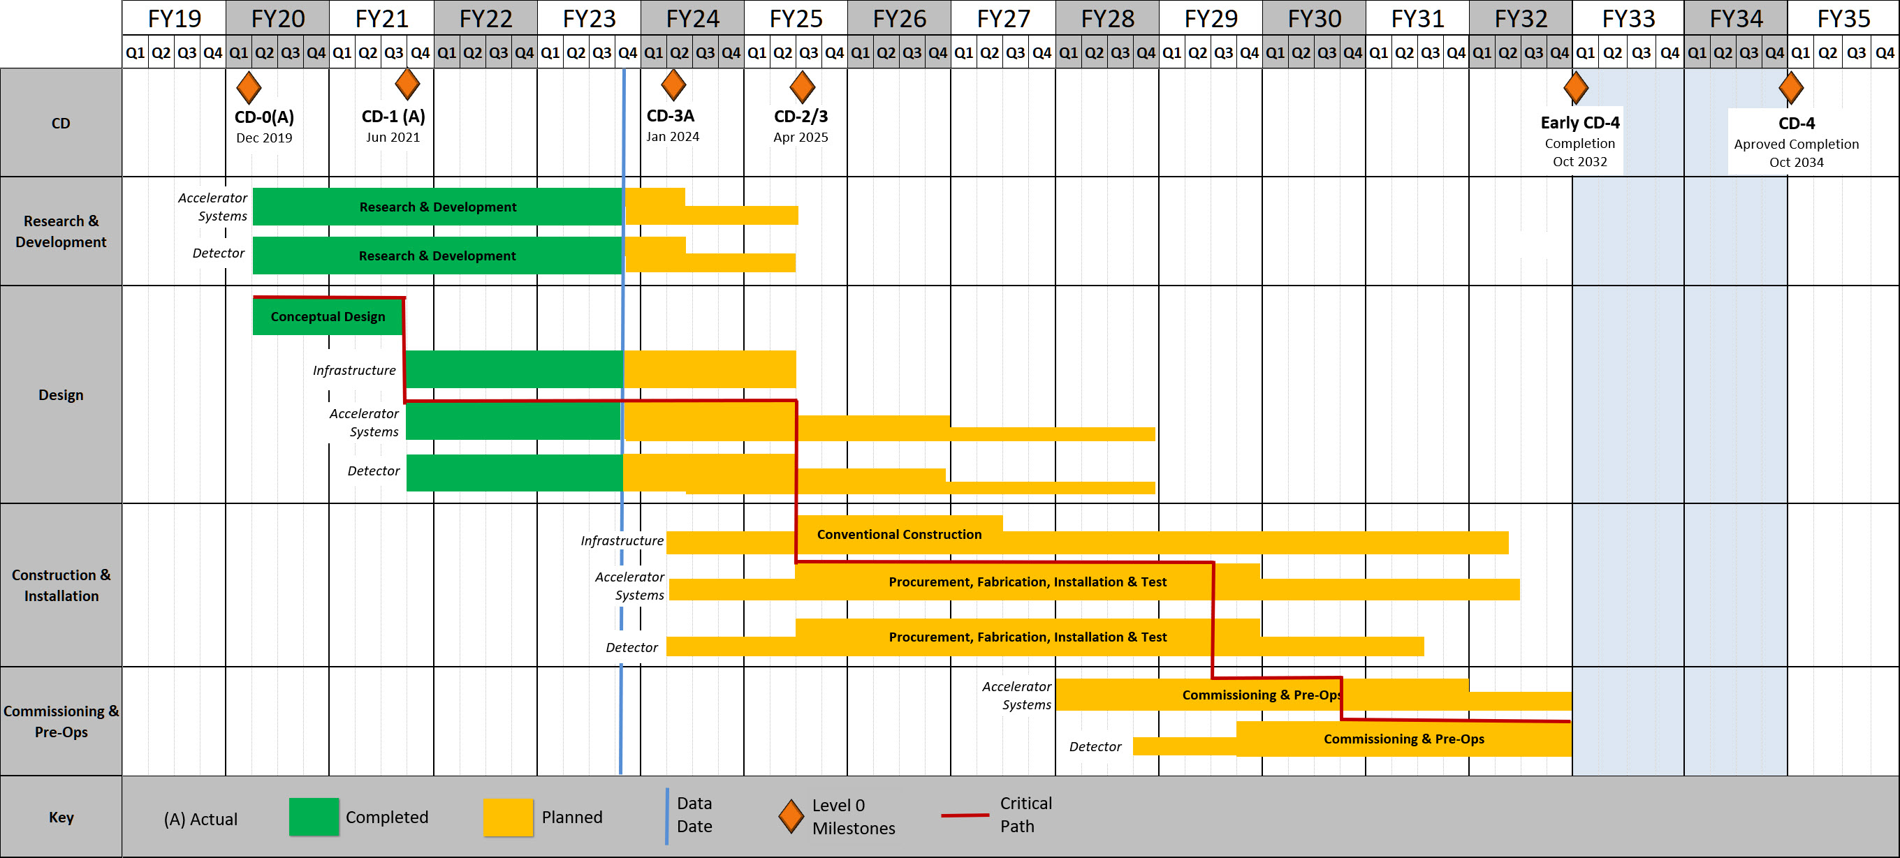
EIC High Level Project Schedule
Construction Phase
Science Phase
Conclusion of RHIC Operations
The thinner bars indicate that R&D and design
can continue at a small level beyond CD-2 and CD-3
for LLP construction
starts at CD-3A
Recent change replaced CD-4A with project internal milestones
The logic remains the same though, we start accelerator commissioning with an instrumented beam pipe and the detector in the Assembly Hall. The detector only rolls in later.

Slide 5
EIC Science Landscape
EIC: Understanding the Glue that Binds Us All - Without gluons binding the quarks, there would be no nucleons, no atomic nuclei… no visible world!
A huge leap in accessible kinematics landscape (into the land of gluons and the quark sea) for polarized e-N and unpolarized e-A reactions!

Slide 6

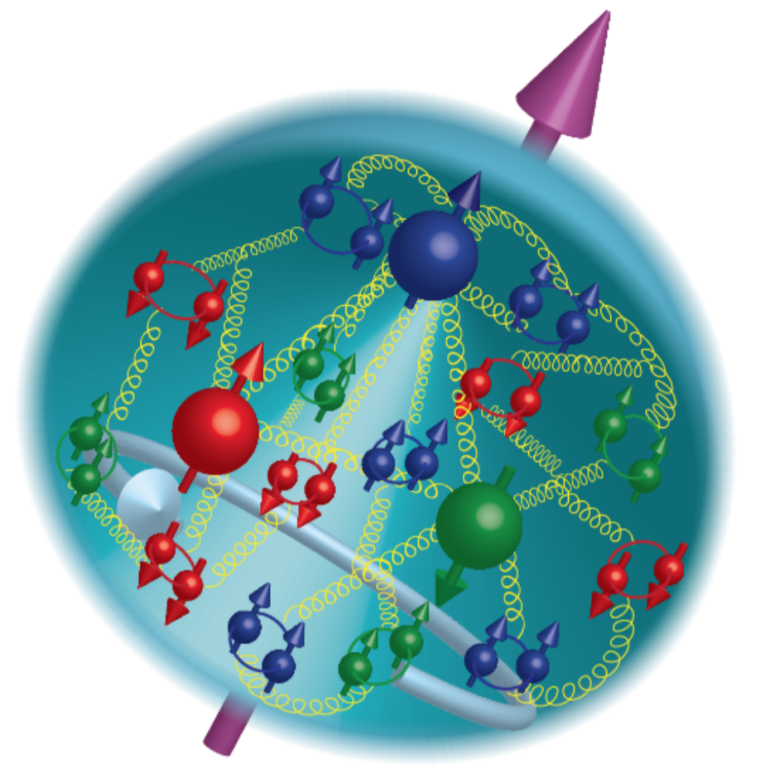
21st Century View of the
Fundamental Structure of the Proton
Elastic electron scattering determines charge and magnetism of nucleon
Approx. sphere with <r> ≈ 0.85 Fermi
The proton contains quarks,
as well as dynamically
generated
quark-antiquark pairs
and gluons.
Quark and gluon
momentum fractions
(in specific Infinite
Momentum Frame)
are well mapped out.
The proton spin
and mass have large
contributions from
the quark-gluon
dynamics.
1961
In fact, mass and structure emerge from the quark-gluon dynamics

Slide 7
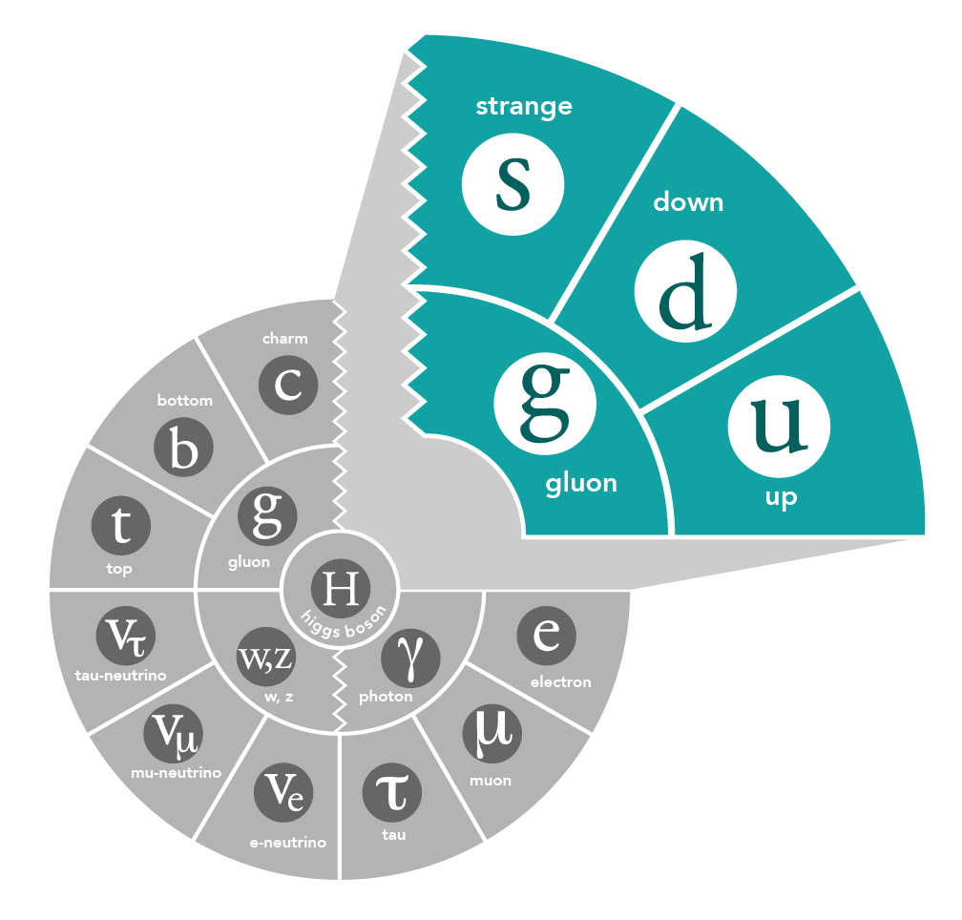

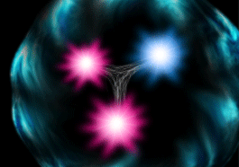
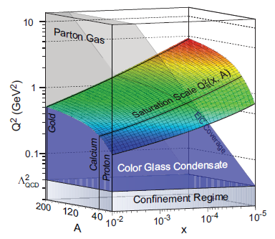
Proton Structure
Naïve Quark Model: proton = uud (valence quarks)
QCD: proton = uud + uu + dd + ss + …
The proton sea has a non-trivial structure: u ≠ d
(90s)
(late 80s)
& gluons are abundant
(early 2000s)
gluon dynamics
Non-trivial sea structure
The proton is far more than just its up + up + down (valence) structure
Gluon photon:
Radiates
and recombines:

Slide 8
Nuclear Femtography - Imaging
In other sciences, imaging the physical systems under study
has been key
to gaining new
understanding.
Structure mapped
in terms of
b_{T} = transverse position
k_{T} = transverse momentum
Also information on orbital angular momentum: r x p

Slide 9
Exploring the 3D Nucleon Structure
After decades of study of the partonic structure of the nucleon we finally have the experimental and theoretical tools to systematically move beyond a 1D momentum fraction (x_{Bj}) picture of the nucleon.
    High luminosity, large acceptance experiments with polarized beams and targets.
    Theoretical description of the nucleon in terms of a 5D Wigner distribution that can be used to encode both 3D momentum and transverse spatial distributions.
Deep Exclusive Scattering (DES) cross sections give sensitivity to electron-quark scattering off quarks with longitudinal momentum fraction (Bjorken) x at a transverse location b_{T}.
Semi-Inclusive Deep Inelastic Scattering (SIDIS) cross sections depend on transverse momentum of hadron, P_{h⊥}, but this arises from both intrinsic transverse momentum (k_{T}) of a parton and transverse momentum (p_{T}) created during the [parton → hadron] fragmentation process.
PDFs
Nuclear Femtography

Slide 10


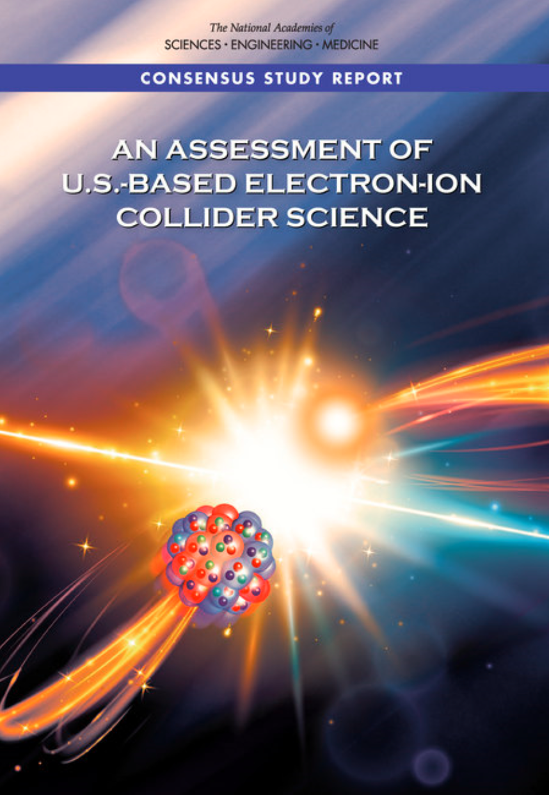

EIC Scope
Project Design Goals
High Luminosity: L= 10³³ – 10³⁴cm⁻²sec⁻¹, 10 – 100 fb⁻¹/year
Highly Polarized Beams: 70%
Large Center of Mass Energy Range: E_{cm} = 29 – 140 GeV
Large Ion Species Range: protons – Uranium
Large Detector Acceptance and Good Background Conditions
Accommodate a Second Interaction Region (IR)
IR-8
IR-6, ePIC Detector
IR-8
p/A beam
e beam
p: 41 GeV, 100 to 275 GeV
e: 5 GeV to 18 GeV

Slide 11
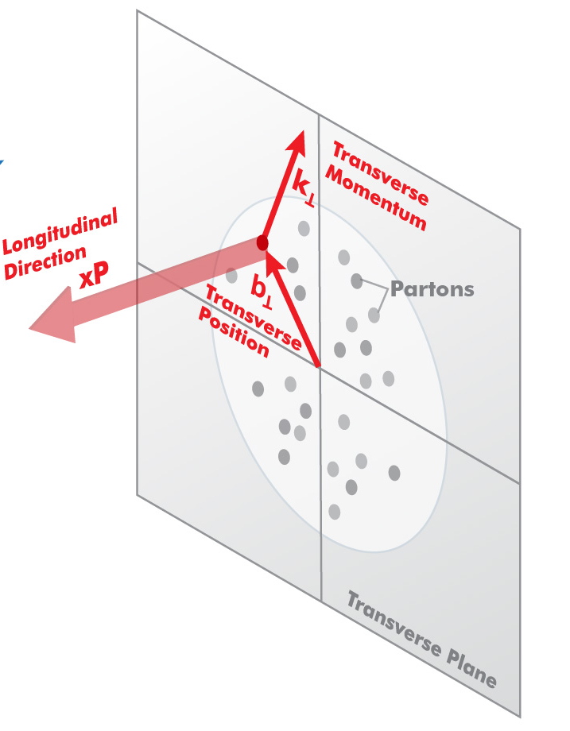
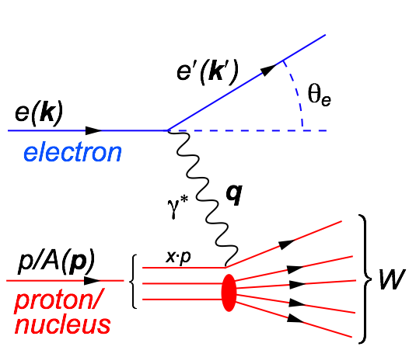
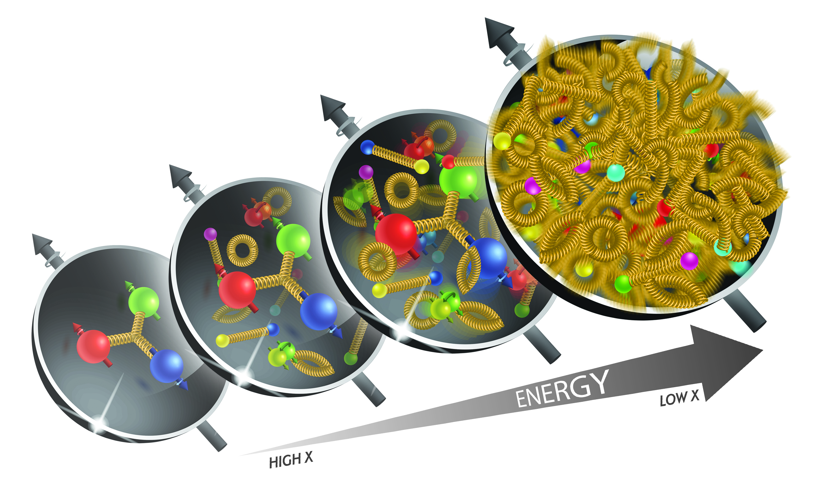
3D Structure of Nucleons and Nuclei
s=xyQ², s=4E_{e}E_{p}
s: center-of-mass energy squared
x: the fraction of the nucleon’s momentum carried by the struck quark (0 < x < 1)
Q²: resolution power
y: inelasticity
need energy range to unambiguously resolve partons over wide range in x and Q² → versatile center-of-mass energy energy √s: 20 – 140 GeV
need to resolve parton quantities (k_{t}, b_{t}) of order a few hundred MeV in the proton → high luminosity needed: 10³³-10³⁴ (and high polarization needed)
k_{T}, b_{T} (~100 MeV)
Proton and Ion Beam ~100 GeV

Slide 12

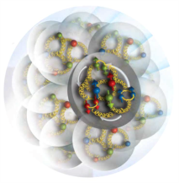
EIC Science Questions
How are the sea quarks and gluons, and their spins, distributed in space and momentum inside the nucleon?
How do the nucleon properties emerge from them and their interactions?
How do color-charged quarks and gluons, and colorless jets, interact with a nuclear medium?
How do the confined hadronic states emerge from these quarks and gluons?
How do the quark-gluon interactions create nuclear binding?
How does a dense nuclear environment affect the quarks and gluons, their correlations, and their interactions?
What happens to the gluon density in nuclei? Does it saturate at high energy, giving rise to a gluonic matter with universal properties in all nuclei, even the proton?
gluon
emission
gluon recombination
?
=

Slide 13
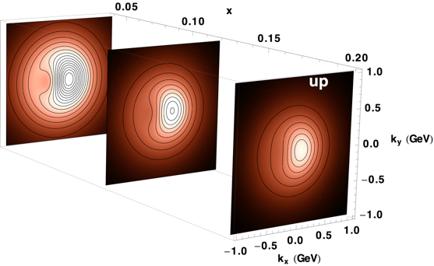
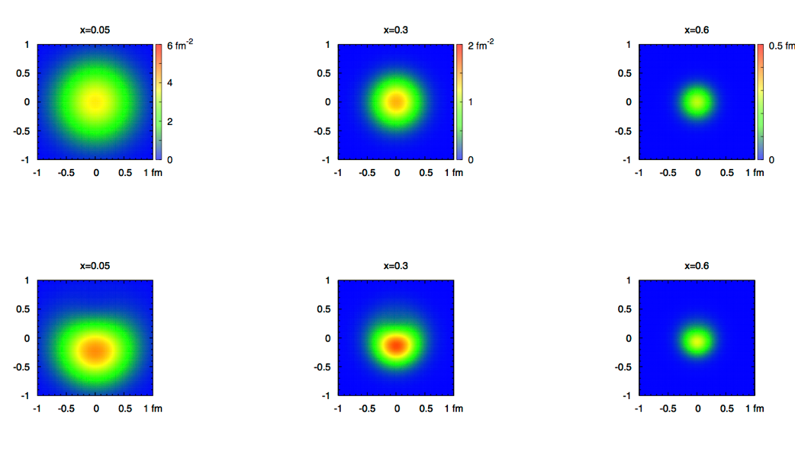
2+1 Dimensional Imaging of Quarks & Gluons
Wigner function
W(x,b_{T},k_{T})
→ QCD genetic map
Momentum
space
Coordinate
space
∫d²b_{T}
∫ d²k_{T}
f(x,k_{T})
f(x,b_{T})
Quarks
Quarks
down quark
x
Spin-dependent 3D momentum space
images from semi-inclusive scattering
Spin-dependent 2+1D coordinate space images from exclusive scattering

Slide 14
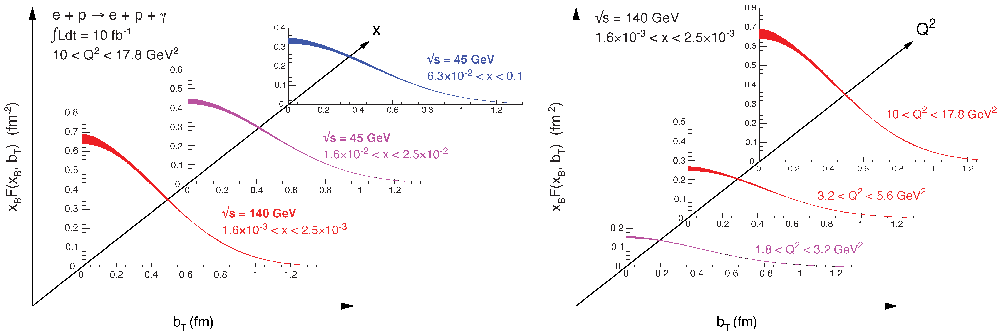
2+1 Dimensional Imaging in Coordinate Space
High precision
imaging at EIC
at low and high x
Golden channel:
DVCS
e’
e
γ_{L}*
γ
(Q²)
x+ξ
~
x-ξ
~
p
H, H, E, E (x,ξ,t)
p’
t
(access mainly to quarks)

Slide 15
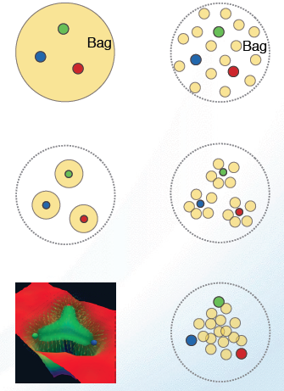
What Does a Proton (or a Nucleus) Look Like?
Static Boosted
Bag Model: Gluon field distribution is wider than the fast moving quarks. Gluon radius > Charge Radius
Constituent Quark Model: Gluons and sea quarks hide inside massive quarks. Gluon radius ~ Charge Radius
Lattice Gauge theory (with slow moving quarks), gluons more concentrated inside the quarks: Gluon radius < Charge Radius
Need transverse images of the quarks and gluons in protons and nuclei

Slide 16
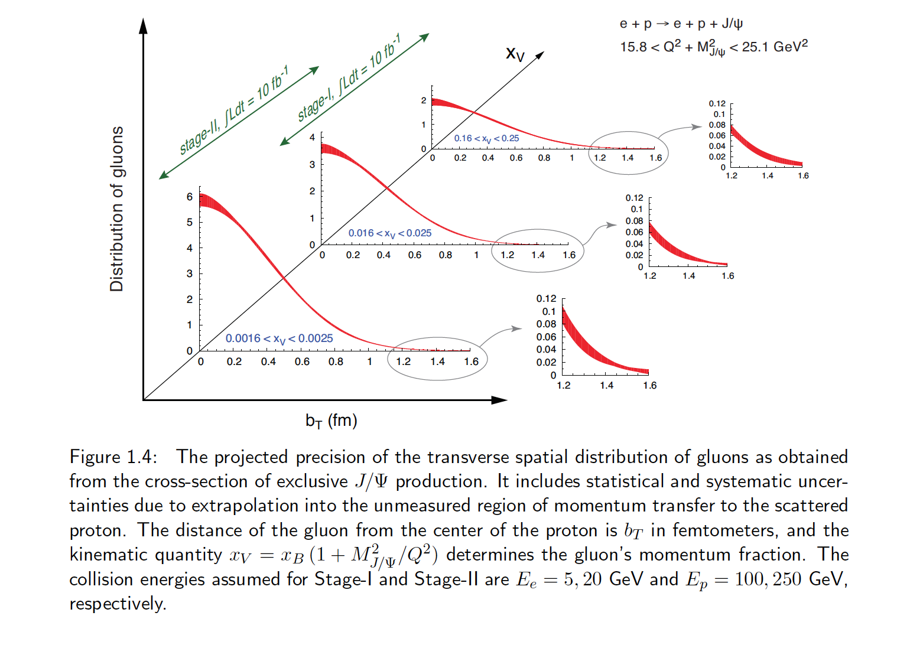
Confined Spatial Correlations: Transverse Spatial Distribution of Gluons
How are gluons spatially distributed in a proton or a nucleus?
Is the distribution smooth?
How does it differ from the charge distribution?
First ever tomographic images of ocean of gluons within matter !

Slide 17
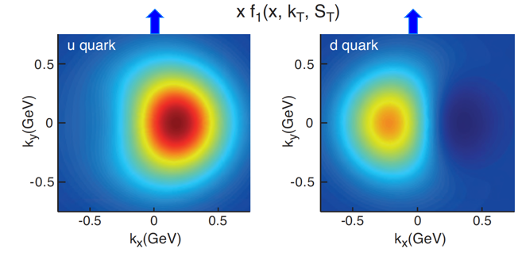
Confined Motion: Transverse Momentum Distributions of Quarks & Gluons
Down quark
Sivers function
(at a scale of 2 GeV)
Quark transverse momentum (GeV)
The green-shaded areas represent the current uncertainty, while the blue-shaded areas are the uncertainties when including the EIC pseudodata.
Spin and the ability to look at transverse momentum together give a powerful new window into QCD
Transverse Momentum Distributions directly related to orbital motion
For example, we can explore for the first time interference in quantum phases due to the color force – impossible with previous purely 1D/longitudinal experiments

Slide 18
The EIC Will Deliver
EXAMPLE 1 – 3D Imaging
Coordinate space
Momentum space
Down quark
Sivers function
(at a scale of 2 GeV)
Quark transverse momentum (GeV)
The green-shaded areas represent the current uncertainty, while the blue-shaded areas are the uncertainties when including the EIC pseudodata.
How are gluons spatially distributed in a proton? Is the distribution smooth?
How does it differ from the charge distribution?
We can measure first-ever tomographic images of ocean of gluons within matter !
Spin and the ability to look at transverse momentum together give a powerful new window into QCD
Distributions directly related to orbital motion
We can explore for the first-time interference in quantum phases due to the color force – impossible with 1D/longitudinal experiments !

Slide 19
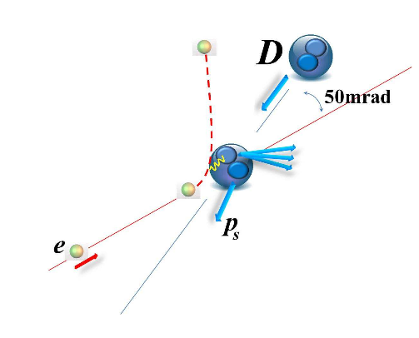
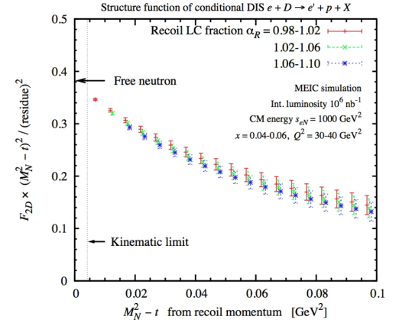
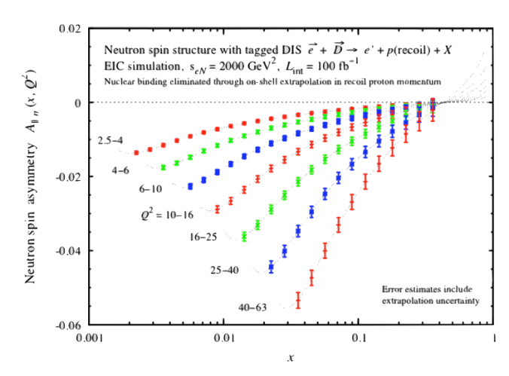

EIC Science: Deuterons and neutron targets
Studies ongoing to enable polarized (vector and tensor) deuteron beams (>80% polarization).
Collider → allows a precision measurement of the spectator nucleon.
First precision measurement of polarized (and unpolarized) neutron is possible at EIC
Extrapolation
from bound to
free neutron
under control
Polarized
Neutron
Structure
F₂^{n} can be extracted at % level accuracy
Investigate nuclear effects at the level of partons with Tensor Polarization Observables
Polarized Deuteron Structure Function b₁
Are quarks sensitive to the shape of the nucleus?
-
Similar studies to map out polarized 3He nuclear structure in detail, from both nucleon-meson and parton level point of view

Slide 20
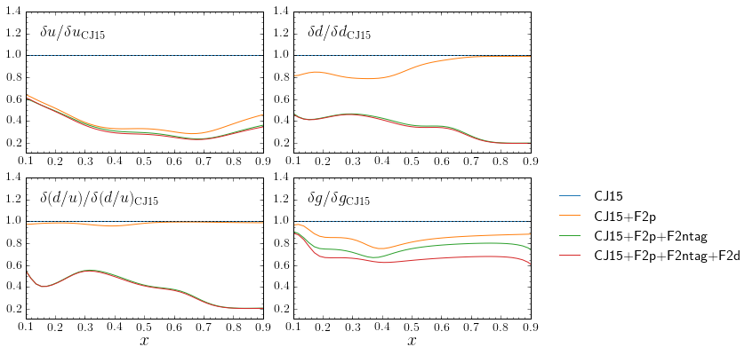
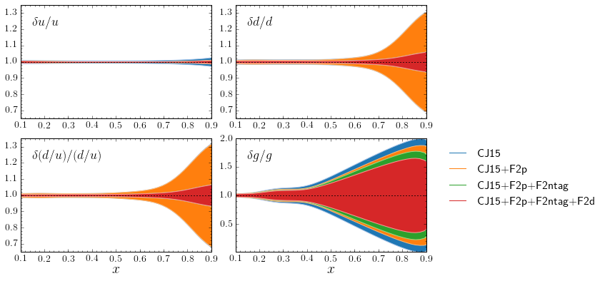
EIC e-d (with ntag) projection with 100/fb luminosity
d quark precision will become comparable to current u!!
(becomes ~5% at x = 0.9)
similar improvement in g(x)
The u quark uncertainty becomes less than ~1%; may be important for large mass BSM new particles.
With d quark nailed by F₂^{n}, fitting F₂^{d} data will explore details of nuclear effects
(somewhat older plots, see Yellow Report for later studies)

Slide 21
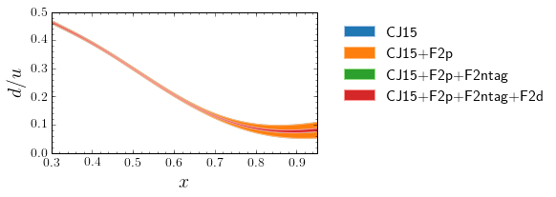
Improved d(x) Precision of EIC is Good News
(somewhat older plots, see Yellow Report for later studies)
The d-quark goes from a few 10% to ~few% percent level
Resolve long-standing mystery of d/u at large x, bell-weather for fundamental models of nucleon structure
D/(p+n) in one experiment for the first time – unprecedented handle on nuclear medium modifications
Facilitate accurate neutron excess/isoscalar corrections
  Important also for neutrino physics and nuclear PDFs

Slide 22
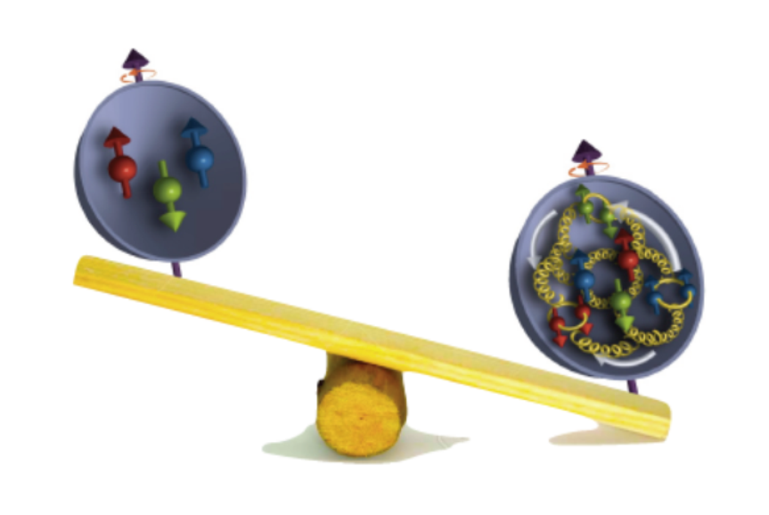




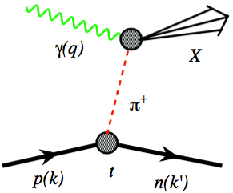
What Do We Know: Mass of the Proton, Pion, Kaon
Visible world: mainly made of light quarks – its mass emerges from quark-gluon interactions.
gluon ocean
quark sea
MeV
Proton
Quark structure: uud
Mass ~ 940 MeV (~1 GeV)
Most of mass generated by dynamics.
Gluon rise discovered by HERA e-p
Quark, Gluon Density
GeV
Fraction of overall proton momentum carried by quark or gluons
Pion
Kaon
Quark structure: ud
Mass ~ 140 MeV
Exists only if mass is dynamically
generated.
Empty or full of gluons?
Quark structure: us
Mass ~ 490 MeV
Boundary between emergent-
and Higgs-mass mechanisms.
More or less gluons than in pion?
For the proton the EIC will allow determination of an important term contributing to the proton mass, the so-called “QCD trace anomaly”
For the pion and the kaon the EIC will allow determination of the quark and gluon contributions with the Sullivan process.
A.C. Aguilar et al., Pion and Kaon structure at the EIC, arXiv:1907.08218, EPJA 55 (2019) 190.
J. Arrington et al., Revealing the structure of light pseudoscalar mesons at the EIC, arXiv:2102.11788, J. Phys. G 48 (2021) 7, 075106.

Slide 23
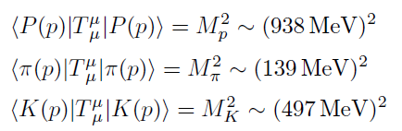
Mass of the Proton, Pion, Kaon – the Chiral Limit
The chiral limit gives us understanding and can act as consistency check
But the pion mass is not zero, it is 140 MeV
[Jianwei Qiu:]
Good mass decomposition should work for the proton, pion, (the kaon), …
A decomposition is valuable iff individual terms can be measured or calculated independently with controllable approximations

Slide 24
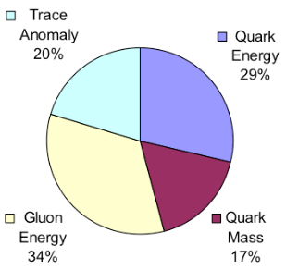
The Incomplete Proton: Mass Puzzle
“… The vast majority of the nucleon’s mass is due to quantum fluctuations of quark-antiquark pairs, the gluons, and the energy associated with quarks moving around at close to the speed of light. …”
Proton mass:
Relativistic motion
Quantum fluctuation
MeV
Ji PRL 1995
Quark Energy
Gluon Energy
Quark Mass
Trace Anomaly
GeV
Ji 1995 (proton): c_{mq} = small, E_{q} = ¾M <xq> (m), E_{g} = ¾ M <xg> (m), T_{g} = ¼ M
Early Lattice:
(Keh-Fei Liu)
Present Lattice:
(C. Alexandrou)
c_{mq} ~ 20%
E_{q} ~ 30% (MSbar, at 2 GeV)
E_{g} ~ 32% (MSbar), at 2 GeV)
T_{g} ~ 20%

Slide 25
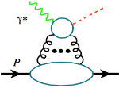
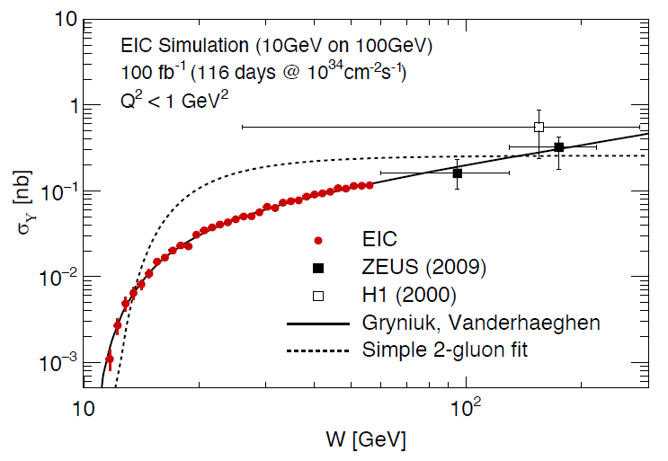
Elastic Y production near threshold at an EIC
At an EIC a study of the Q² dependence in the threshold region is possible (J/Ψ also)
Y
S. Joosten, Z-E. Meziani
t distribution
Low W → trace anomaly
Large W → Gluon GPDs
(see arXiv:1802.02616)

Slide 26
JLab12 and EIC: Constraining the Vacuum Contribution to the Proton Mass

Slide 27
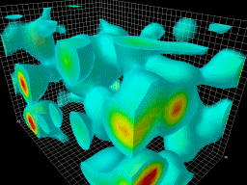
The Incomplete Hadron: Mass Puzzle
Pion mass:
Relativistic motion
Quantum fluctuation
MeV
Quark Energy
Gluon Energy
Quark Mass
Trace Anomaly
0.1 GeV
Ji 2021 (pion): c_{mq} ~ 1/2 M, E_{q} = 3/8 M <xq> (m), E_{g} = 3/8 M <xg> (m), T_{g} = 1/8 M
Ji 1995
Yang et al, Phys. Rev. D91, 074516
Yu Jia et al., Phys. Rev. D98, 074024
In chiral limit, all terms vanish, and pion’s gluon structure becomes like vacuum
In 2D QCD the quark and gluon contributions diverge and bear opposite sign, upon summing the GOR relation holds
The combined quark/glue energy contribution to the PS/V meson mass

Slide 28
EIC – Versatility and Luminosity is Key
Why would pion and kaon structure functions, and even measurements of pion structure beyond (pion GPDs and TMDs) be feasible at an EIC?
L_{EIC} = 10³⁴ = 1000 x L_{HERA}
Detection fraction @ EIC in general much higher than at HERA
Fraction of proton wave function related to pion Sullivan process is roughly 10⁻³ for a small –t bin (0.02).
Hence, pion data @ EIC should be comparable or better than the proton data @ HERA, or the 3D nucleon structure data @ COMPASS
If we can convince ourselves we can map pion (kaon) structure for –t < 0.6 (0.9) GeV², we gain at least a decade as compared to HERA/COMPASS.
Ratio of the F₂ structure function related to the pion Sullivan process as compared to the proton F₂ structure function in the low-t vicinity of the pion pole, as a function of Bjorken-x (Jefferson Lab TDIS Collaboration, JLab Experiment C12-15-005)

Slide 29
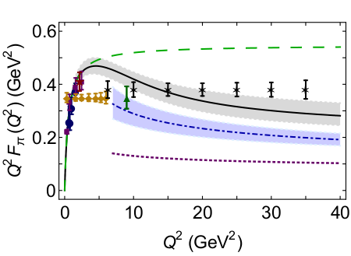
Reduction of Pion 1-D Structure Information by EIC
From EIC Yellow Report,
P. Barry, W. Melnitchouk, N. Sato et al.
Pion form factor measurement projections at EIC
Assumed 5 GeV(e⁻) x 100 GeV(p) with an integrated luminosity of 20 fb⁻¹/year, and similar luminosities for d beam data
From A.C. Aguilar et al., EPJ A 55 (2019) 10, 190

Slide 30
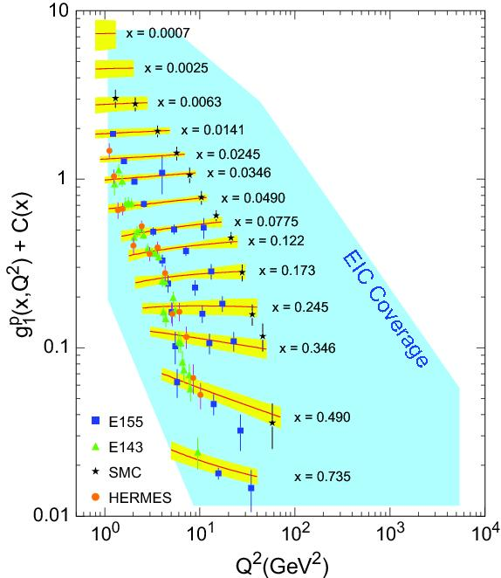
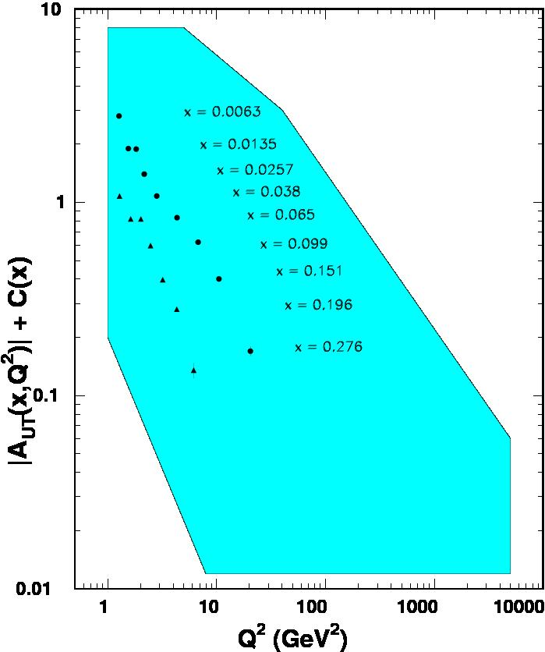
World Data on F₂^{p} World Data on g₁^{p} World Data on h₁^{p}
Similar for F₂^{n}
Similar for g₁^{n}, g₂^{p}, g₂^{n}
(and b₁^{d})
Similar for h₁^{n}
F_{UT}^{sin(fh+fs)}(x,Q²) + C(x) $∝h1$
Note: need to update plots for COMPASS data
An EIC makes it possible!
EIC coverage
COMPASS
HERMES
transverse spin ~ angular momentum
momentum
spin
EIC will be a real game changer

Slide 31
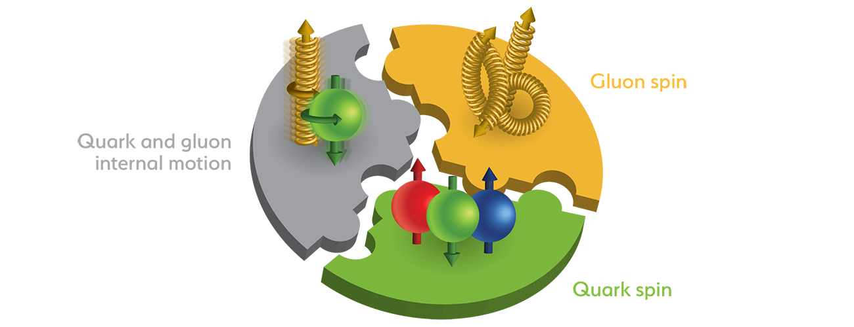
The Spin of the Proton
SPIN is one of the fundamental properties of matter
all elementary particles, but the Higgs carry spin
Spin cannot be explained by a static picture of the proton
It is more than the number ½ ! It is the interplay between
the intrinsic properties and interactions of quarks and gluons
What do we know:
total
quark spin
gluon
spin
angular
momentum

Slide 32
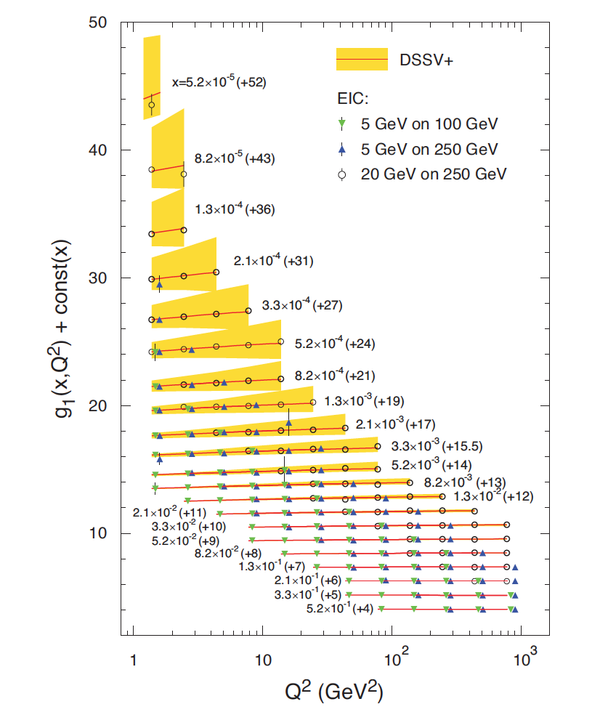
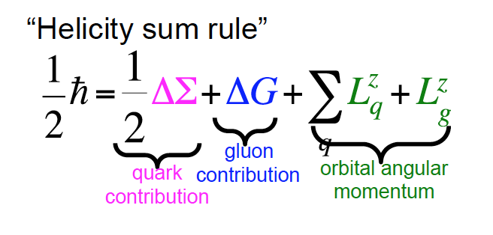
The Incomplete Hadron – the Spin Puzzle
EIC projected measurements:
Precise determination of polarized PDFs of
quark sea and gluons ➔ precision ΔG and ΔΣ
➔ Determination of L_{q} + L_{g}

Slide 33
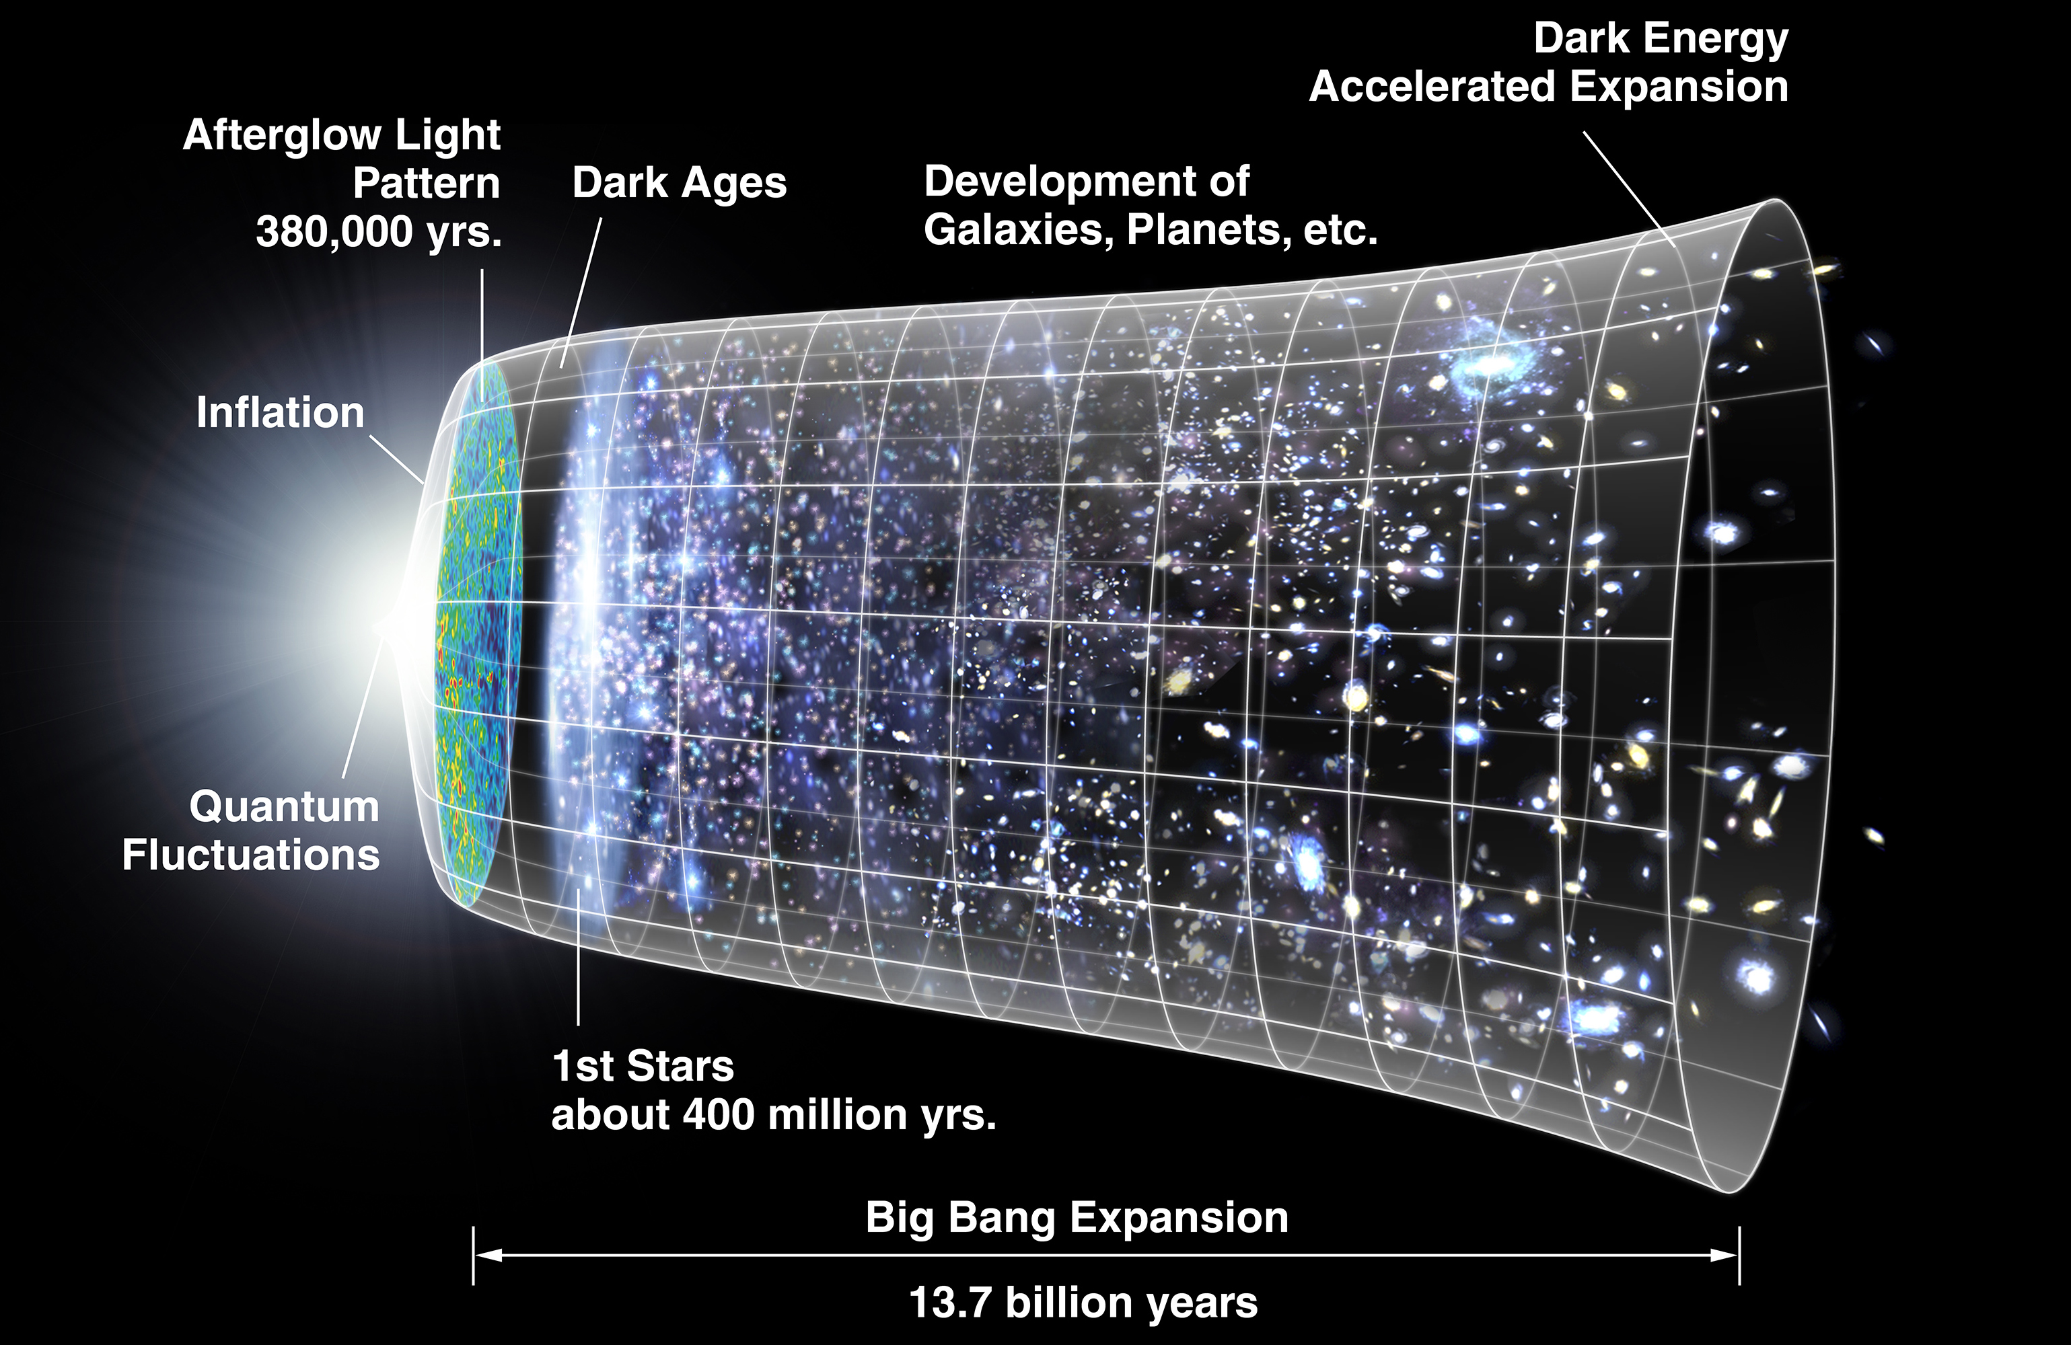
Timeline of the Universe
In Steven Weinberg’s seminal treaty on The First Three Minutes, a modern view of the origin of the universe, he conveniently starts with a ‘first frame” when the cosmic temperature has already cooled to 100,000 million degrees Kelvin, carefully chosen to be below the threshold temperature for all hadrons. Two reasons underlie this choice, the first that the quark-gluon description of hadrons was not universally accepted yet at that time, the second that the choice evades questions on the emergence of hadrons from quarks and gluons.

Slide 34
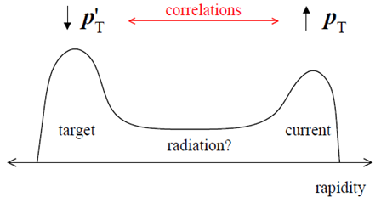
Towards a QM Description of the Final State
Balancing the transverse momentum (and spin) – candles of space-time
D_{a}^{h}(z, p_{t}²; Q²)
From 1D to 3D fragmentation:
Many more variables,
  Many more angles
Multi-dimensional data
Fine binnings
Many spin correlations
Understanding of the 3D structure of fragmentation into a hadron requires studies of transverse momentum, spin and hadron species dependence

Slide 35
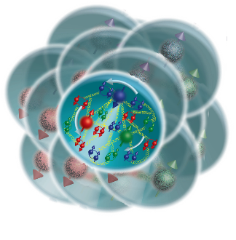

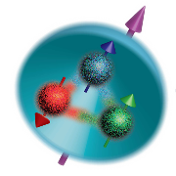
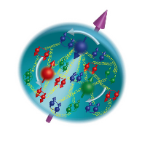
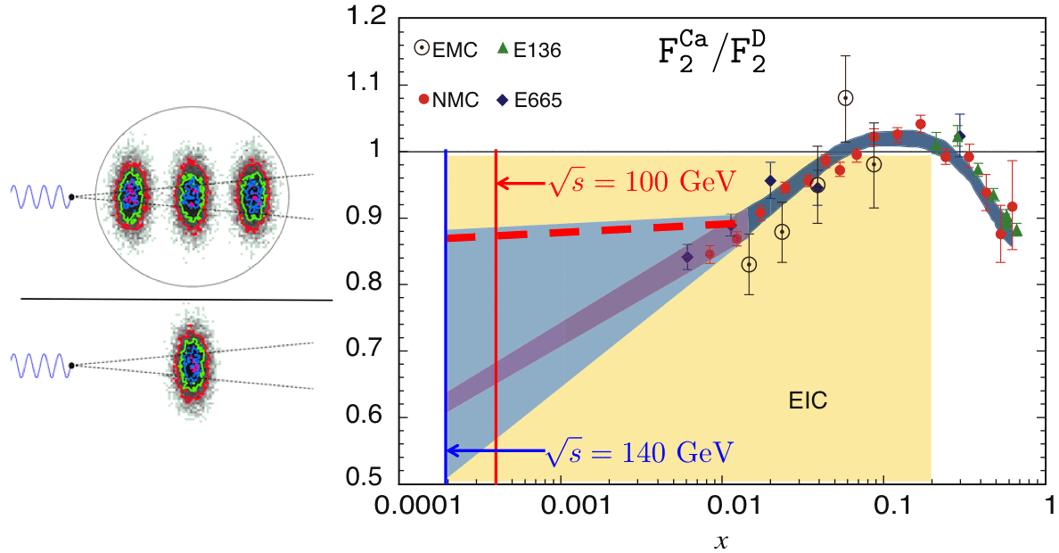
What Do We Know of Gluons in Nuclei? Not Much!
The EIC will, for the first time, provide a complete view of the nucleus:
The Proton
(1975)
The Proton (2015)
The Proton
in a nucleus
And much more QCD dynamics that can affect the identity of the protons and neutrons
How does a dense nuclear environment affect the quarks and gluons, their correlations, and their interactions?
What happens to the gluon density in nuclei? Does it saturate at high energy, giving rise to a gluonic matter with universal properties in all nuclear matter?
gluon
emission
gluon recombination
=
At Q_{S}

Slide 36
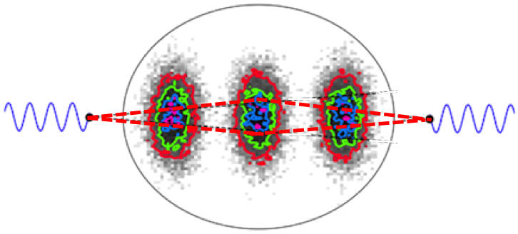
EIC: impact on the knowledge of 1D Nuclear PDFs
EIC-WP
Fig. 3.25
Without EIC, large uncertainties in nuclear sea quarks and gluons
Complementary to RHIC and LHC pA data.
➔ Provides information on initial state for heavy ion collisions
Does the nucleus behave like a proton at low-x?
➔ relevant to the understanding of astronomical objects

Slide 37
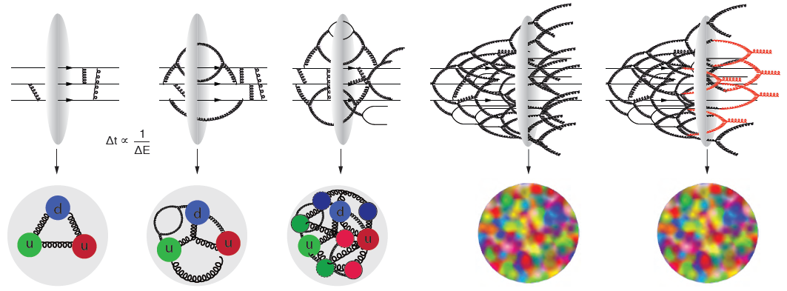
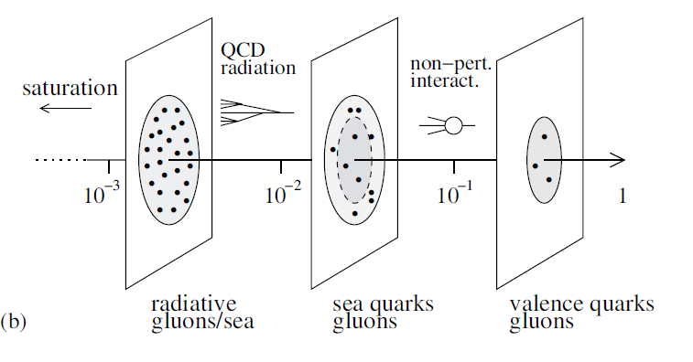
The Evolution of a Proton – Deep Into the Sea
Resolution
=
>
Saturation

Slide 38
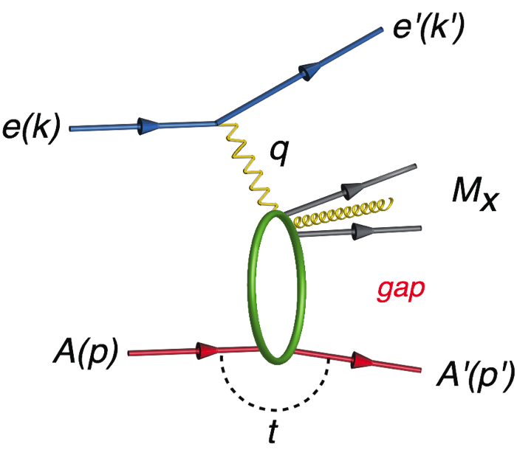
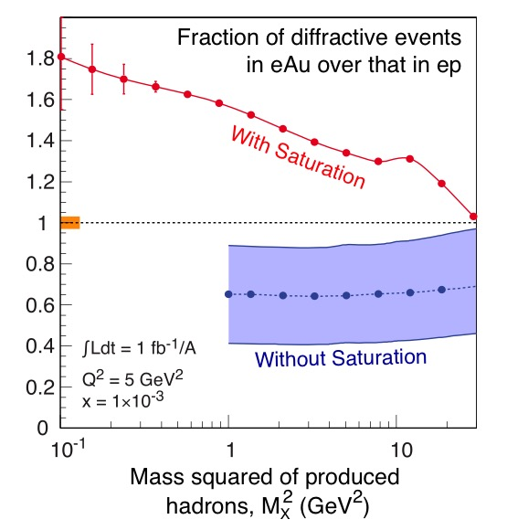
Gluon Saturation: What To Measure?
Many ways to get to gluon distribution in nuclei, but diffraction most sensitive:
Diffractive event
No activity in proton direction
A 7 TeV equivalent electron bombarding the proton … but nothing happens to the proton in 10-15% of cases
Predictions for eA for such hard diffractive events range up to: 25-30%... given saturation models
(EIC: utilize g ~ A^{1/3} x s^{0.3} to hunt for c.q. map onset of saturation)

Slide 39
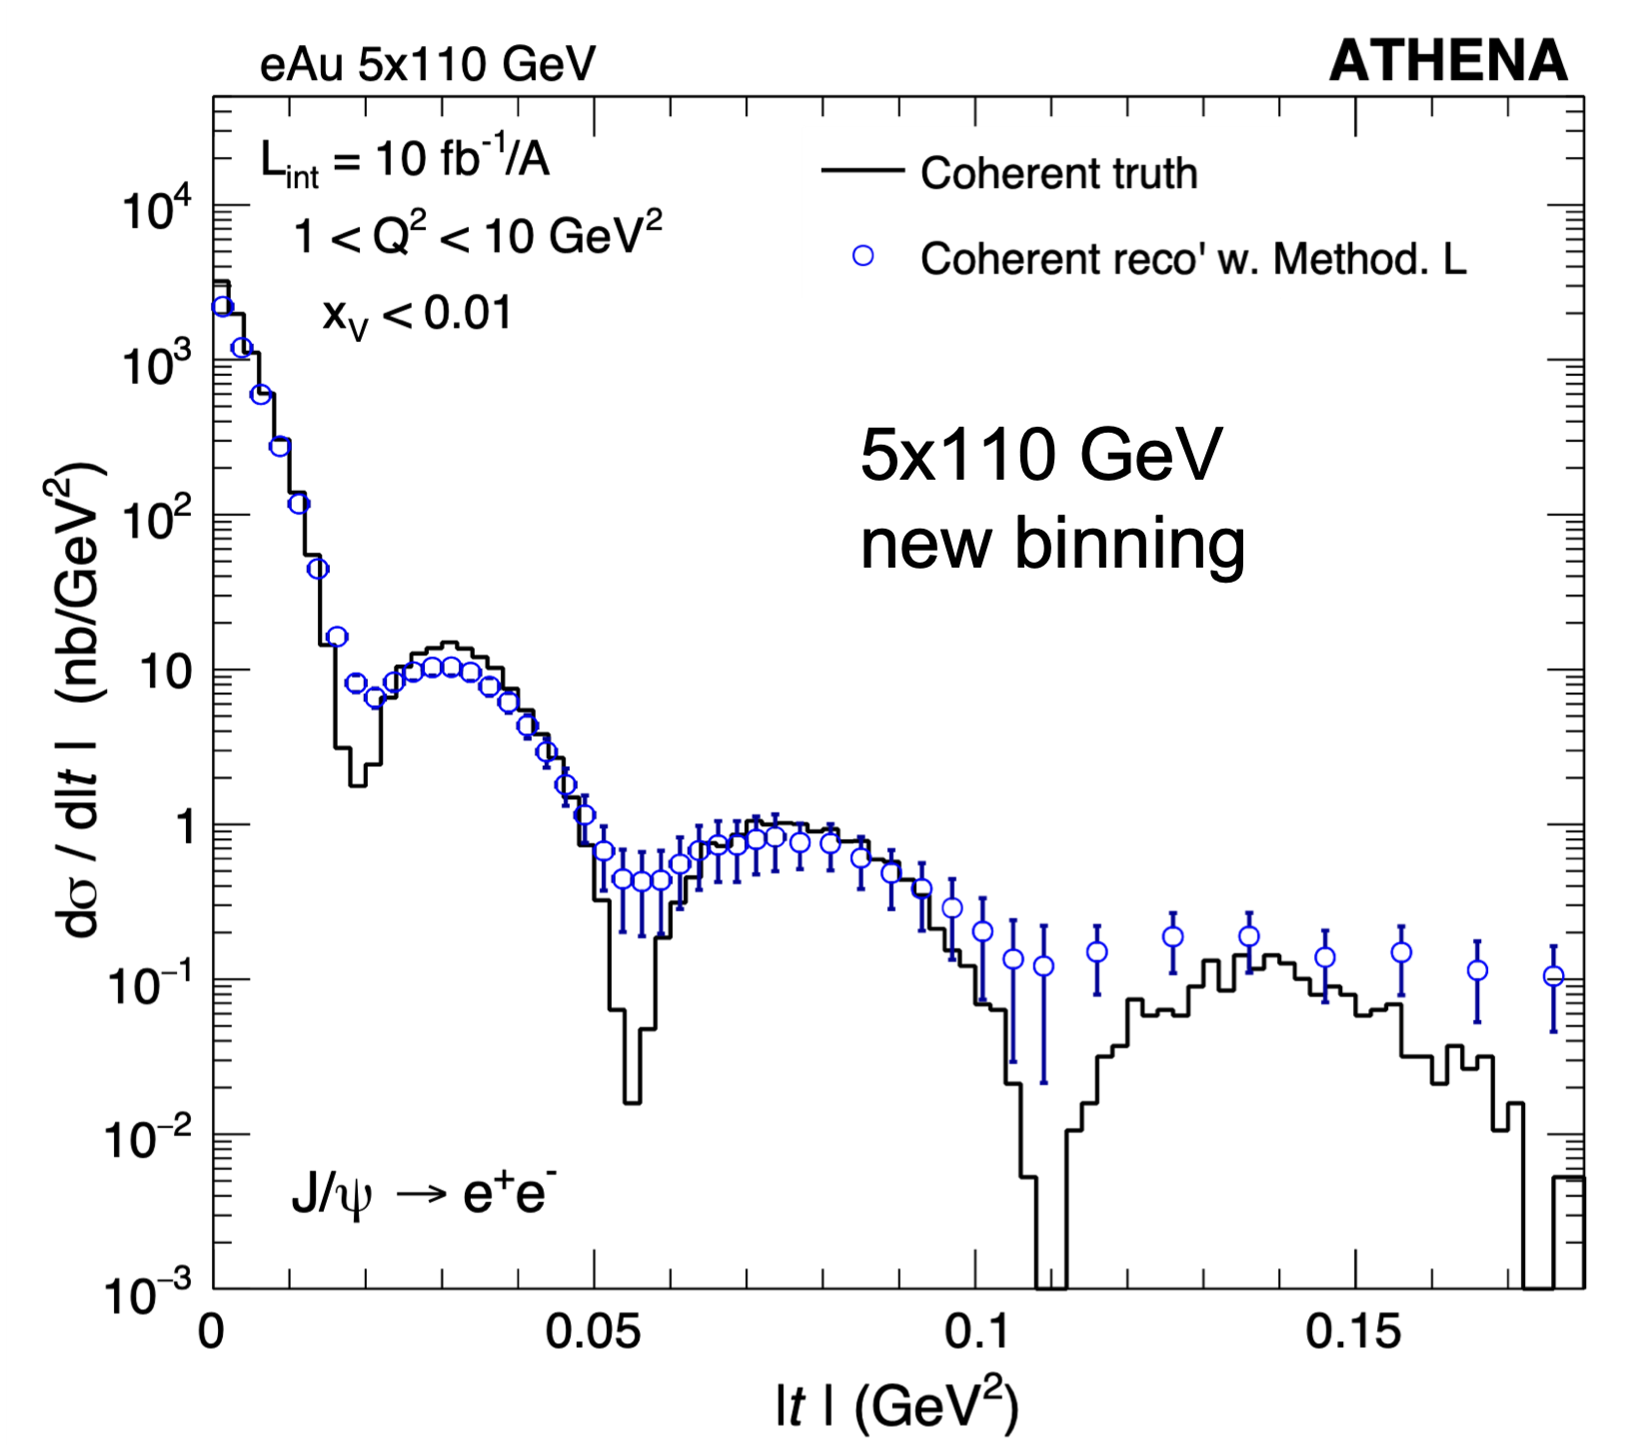
The EIC Will Deliver
EXAMPLE 2 – Dense Gluon Systems
3D imaging of nuclei
Hadron-Hadron Correlation functions
How are gluons spatially distributed in a nucleus? Is the distribution smooth?
How does it differ from the charge distribution?
We can explore the onset of gluon saturation in the form factor pattern !
The angle between the two hadrons h1 and h2 in the azimuthal plane, Δϕ, is sensitive to the transverse momentum of gluons to and their self-interaction — the mechanism that leads to saturation.
We can explore for the first-time in a controlled way the effects of these mechanisms – does the ridge disappear or not in nuclei at small x ?

Slide 40
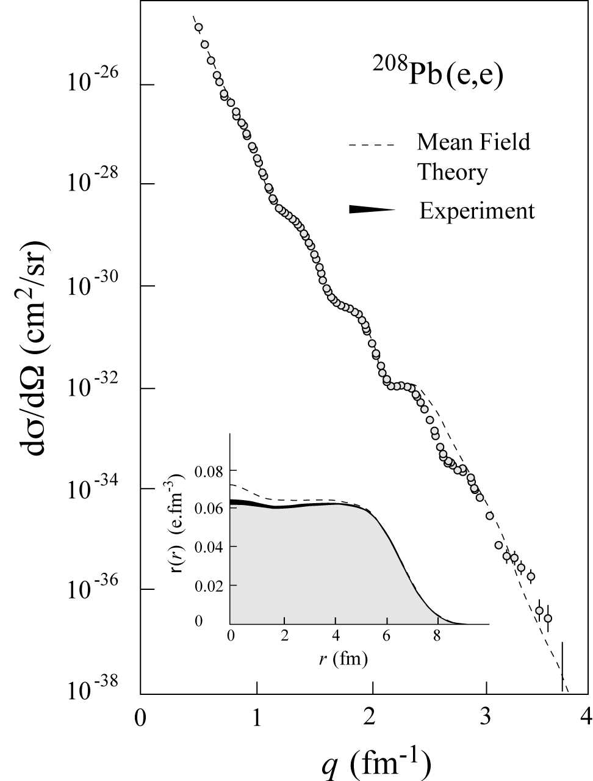



Exposing Different Layers of the Nuclear Landscape with Electron Scattering
History:
Electromagnetic
Elastic electron-nucleus scattering → charge distribution of nuclei
Present/Near-future:
Electroweak
Parity-violating elastic electron-nucleus scattering (or hadronic reactions e.g. at FRIB) → neutron skin
Future/EIC:
Color dipole
φ Production in coherent electron-nucleus scattering → gluon spatial distribution of nuclei
Fourier transform gives unprecedented info on gluon spatial distribution, including impact of gluon saturation

Slide 41

Diffraction for the 21st Century
Many ways to get to gluon distribution in nuclei, but diffraction most sensitive
HERA surprise: A 7 TeV equivalent electron bombarding the proton … but nothing happens to the proton in 10-15% of cases
Extracting the gluon distribution ρ(bT) of nuclei via Fourier transformation of dσ/dt in diffractive J/ψ production
Diffractive event
Diffraction cross-sections have strong discovery potential due to their high sensitivity to gluon density: σ~[g(x,Q²)]²
Probing the onset of gluon saturation through measuring σdiff/σtot
Predictions for eA for such hard diffractive events range up to: 25-30%... given saturation models
gluon
emission
gluon recombination
=
At Q_{S}

Slide 42





Interaction Region Layout
Central Detector
ESR Forward side
Detectors in B0 magnet
Roman Pots
Forward Side
SC Magnet Cryostat
HSR Injection Line
Central Detector
Rear Side
SC Magnet Cryostat
HSR Forward Side
HSR: Hadron Storage Ring
ESR: Electron Storage Ring
RCS: Rapid Cycling Synchrotron
SC: Superconducting
HSR
Rear Side
RCS
With Detector Bypass
Low-Q2 Detectors
ESR Rear side
every cm counts… → integration and communication with accelerator team is crucial

Slide 43





Far-forward physics at EIC
e+d incoherent J/Psi events with proton or neutron tagging
e+p DVCS events with proton tagging.
Diffraction
Rapidity
gap
Saturation (coherent/incoherent J/$ψ$production)
Meson structure:
with neutron tagging (ep$→\left(π\right)→$e’ n X)
Lambda decays ($Λ→$p$π−$ and $Λ→nπ0$)
e+He3 with spectator proton tagging.
Tagging of coherent light ions (d, He3, He4) from coherent scattering.
e+Au events with neutron tagging to veto breakup and photon acceptance.
….

Slide 44


New Avenues
Nature, 557, May 17, 2018
Pressure in the Proton
  First determination using DVCS (Deeply Virtual Compton Scattering) data
  Interior pressure in proton is > pressure inside a neutron star! Who knew that!
  Lattice calculation motivates determination of gluon GPDs at EIC
Polarized Deuteron Structure
  Inclusive Deep Inelastic Scattering on a Tensor-Polarized Deuteron Beam
  Map the Structure Function b1
  Are quarks sensitive to the doughnut or dumbbell shape of the nucleus?
Hot Spots in the Nucleus
  Simulated proton density fluctuations x = 10⁻³
  Accessible with 3D tomography
  Responsible for ridge behavior found in Heavy-Ion reactions at high energies?
-

Slide 45

Exotic Glue in Nuclei
(Would need upgrade to allow polarized spin-1 beams)
Exotic Glue in Nuclei =
gluons not associated with individual nucleons in nucleus
operator in nucleon = 0 & operator in nuclei ≠ 0
Targets with J ≥ 1 have leading twist gluon contribution
Δ(x,Q²): double helicity flip (Jaffe and Manohar, 1989)
Changes both photon and target helicity by two units…
Measurable in unpolarized Deep Inelastic Scattering with a transversely polarized J ≥ 1 target like the deuteron as azimuthal variation.
Parton model interpretation:
Δ(x,Q²) informs how much more momentum of a transversely polarized particle is carried by a gluon with spin aligned rather than perpendicular to it in the transverse plane.
Shanahan, Detmold, et al.
LQCD calculation: gluon transversity distribution in the deuteron, m_{π} = 800 MeV → First evidence for non-nucleonic gluon contributions to nuclear structure
(Also results at m_{π} = 300 MeV)

Slide 46
QCD Landscape Explored by EIC
Strong QCD dynamics creates many-body correlations between quarks and gluons → structure of nuclear matter emerges
Longitudinal (1D) Momentum Fraction x
Explore QCD landscape over large range of resolution (Q²) and quark/gluon density (1/x)
EIC needed as microscope to explore the region from where a proton is (mostly) an up-up-down quark system to the gluon dominated region.
Heavy nuclei critical to explore high-density gluon matter.

Slide 47




EIC Physics vs. Luminosity & Energy
?

Slide 48


The EIC Will Deliver
Some highlight plots from the submitted 2023 EIC White Paper
Mass
Spin
Pion PDF uncertainty ratio
Imaging
Nuclei

Slide 49
Uniqueness of EIC
EIC will be unique facility worldwide: there is no equivalent of the EIC science capabilities due to its versatility in energies, polarization, and ion species.
Global competition can exist in subsets of the EIC science, e.g.:
  Ideas for an Electron-Ion Collider in China (EicC) which would operate at center-of-mass energies similar as COMPASS@CERN.
  Annual ongoing workshops related to adding a high-energy electron beam to interact with LHC beams at CERN (LHeC).
In addition, several programs have natural complementarity:
  Consideration to add a fixed-target spin program at the LHC – LHCspin (@LHCb).
  The AMBER experiment at CERN mainly emphasizing the valence and sea quark regions with pion and kaon beams.
  Ultraperipheral and heavy-ion reactions at CERN/LHC to constrain low-x behavior.
  (within the US) The polarized RHIC pp and pA program, addressing universality questions in QCD.
  (within the US) The Jefferson Lab fixed-target program at high luminosity (12 GeV and energy extension), adding crucial data in the strongly-interacting valence quark region.
\

Slide 50

EIC Science is Well Known and Highly Cited
EIC White Paper that guided the EIC science written following a 10-week program at the Institute for Nuclear Theory
  Electron-Ion Collider: The Next QCD Frontier: understanding the glue that binds us all
  arXiV:1212.1701 & Eur. Phys. J. A 52 (2016) 9, 268 – 1459 citations (08/20/2023)
Year-long EIC User Group driven EIC Yellow Report activity (December 2019 – February 2021)
  Science Requirements and Detector Concepts for the EIC
  arXiv:2103.05419 & Nucl. Phys. A 1026 (2022) 122447 – 595 citations (08/20/2023)
The EIC is a facility for the world

Slide 51

EIC: 21st Century Laboratory of Emergent Dynamics in QCD
Massless gluons & almost massless quarks, through their interactions, generate most of the mass of the nucleons
Gluons carry ~50% of the proton’s momentum, a significant fraction of the nucleon’s spin, and are essential for the dynamics of confinement
Properties of hadrons – composite systems of quarks and gluons – are emergent phenomena and inextricably tied to the properties of the QCD vacuum. Striking examples besides confinement are spontaneous symmetry breaking and anomalies
The nucleon-nucleon forces emerge from quark-gluon interactions: how this happens remains a mystery
The goal is to provide us with an understanding of the internal structure of the proton and more complex atomic nuclei that is comparable to our knowledge of the electronic structure of atoms, which lies at the heart of modern technologies

Slide 52

Jefferson Lab and EIC – an exciting future lies ahead
Hall D
Hall A
Hall B
Hall C
~0.5 kilometer
Electron accelerator on fixed-targets
1995 start of 4 GeV science program
2000s evolutionary upgrade to 6 GeV
2017 formal start of 12-GeV program
2023 continue 12-GeV operations, decade-long science program on books
Studying options to upgrade to 22 GeV
~1900 scientific users
Electron-proton/ion collider
Science operations phase in 2030s
~1400 members of EICUG

Slide 53


Slide 54

EIC Science – Findings of the NAS Committee
2018
Finding 1: An EIC can uniquely address three profound questions about nucleons — neutrons and protons — and how they are assembled to form the nuclei of atoms:
  How does the mass of the nucleon arise?
  How does the spin of the nucleon arise?
  What are the emergent properties of dense systems of gluons?
Finding 2: These three high-priority science questions can be answered by an EIC with highly polarized beams of electrons and ions, with sufficiently high luminosity and sufficient, and variable, center-of-mass energy.
EIC science is compelling,
timely and fundamental
Developed by NAS committee with broad science perspective

Slide 55



NAS Report on EIC Requirements
The EIC requirements have remained consistent, see e.g., the 2012 white paper and 2015 NSAC Long Range Plan

Slide 56






















Imaging Physical Systems is Key to New Understanding
Dynamical System | Fundamental Knowns | Unknowns | Breakthrough Structure Probes | New Sciences, New Frontiers
Solids
Electromagnetism
Atoms
Structure
X-ray Diffraction
(~1920)
Solid state physics
Molecular biology
1801
DNA
Universe
General Relativity
Standard Model
Quantum Gravity,
Dark matter, Dark
energy. Structure
Large Scale Surveys
CMB Probes
(~2000)
Precision
Observational
Cosmology
CMB 1965
Nuclei
and Nucleons
Perturbative QCD
Quarks and Gluons
Non-perturbative QCD. Structure
Electron-Ion Collider
(~2030)
Structure & Dynamics in QCD
2017

