Slide 1
Towards a New Science Frontier: The Electron Ion Collider – Science, Detector and Status
Rolf Ent (Jefferson Lab)
TIDC Autumn School on Electron-Ion Collider
August 28-30, 2023

Slide 2
Outline
Lecture 1 Introduction and Electron Scattering Basics
Lecture 2 EIC Science
Lecture 3 EIC Detector
Lecture 4 EIC Project Status

Slide 3
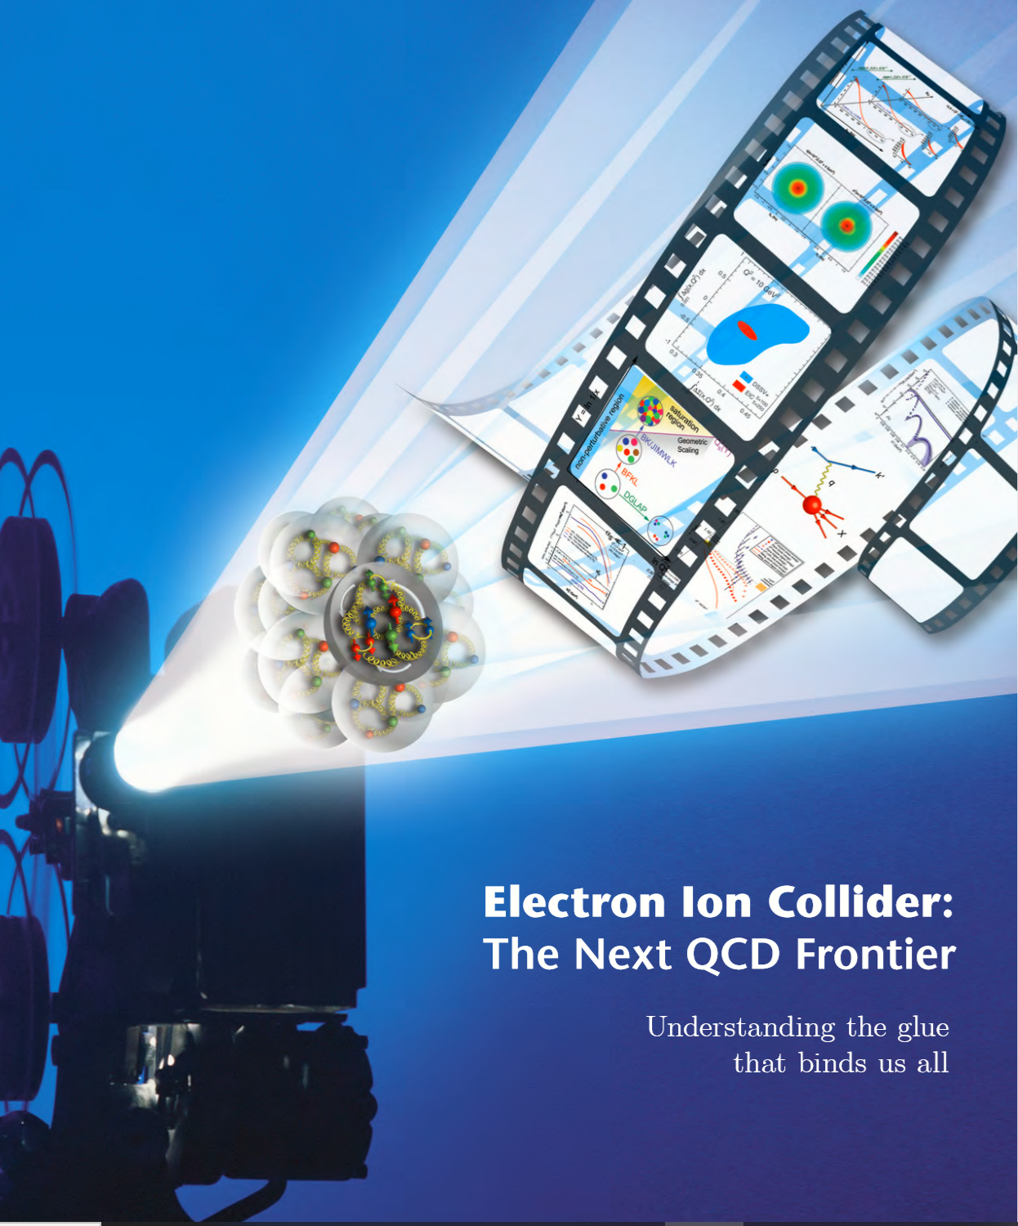

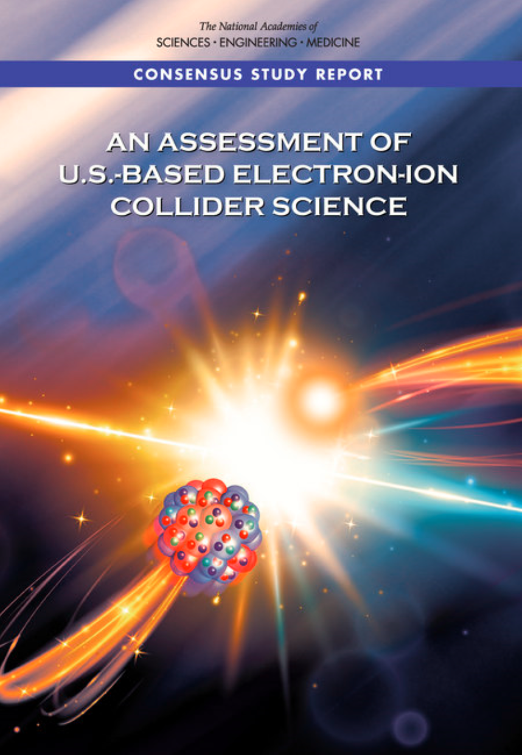

EIC Scope
Project Design Goals
High Luminosity: L= 10³³ – 10³⁴cm⁻²sec⁻¹, 10 – 100 fb⁻¹/year
Highly Polarized Beams: 70%
Large Center of Mass Energy Range: E_{cm} = 29 – 140 GeV
Large Ion Species Range: protons – Uranium
Large Detector Acceptance and Good Background Conditions
Accommodate a Second Interaction Region (IR)
IR-8
IR-6, ePIC Detector
IR-8
p/A beam
e beam
p: 41 GeV, 100 to 275 GeV
e: 5 GeV to 18 GeV

Slide 4
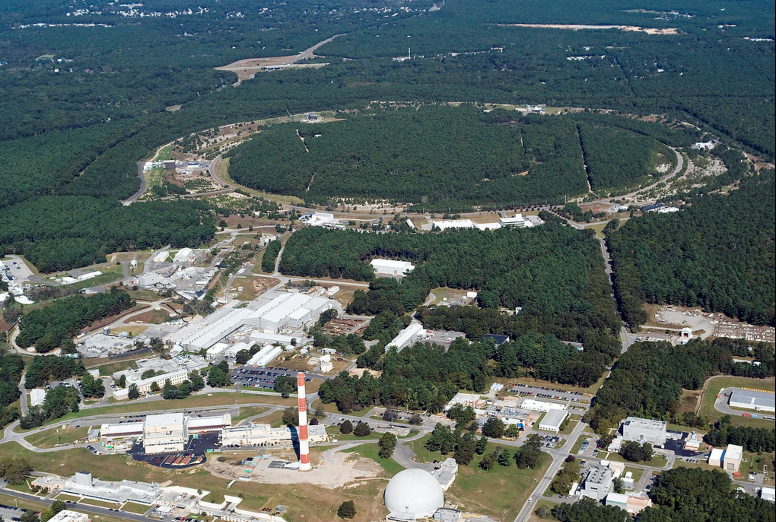

EIC Accelerator Design Overview
Hadron storage ring (HSR): 40-275 GeV (existing)
  up to 1160 bunches, 1A beam current (3x RHIC)
  bright vertical beam emittance (1.5 nm)
  strong cooling (coherent electron cooling, ERL)
Electron storage ring (ESR): 2.5–18 GeV (new)
  up to 1160 polarized bunches
    high polarization by continual reinjection from RCS
  large beam current (2.5 A) ➔ 9 MW SR power
  superconducting RF cavities
Rapid cycling synchrotron (RCS): 0.4-18 GeV (new)
  2 bunches at 1 Hz; spin transparent due to high periodicity
High luminosity interaction region(s) (new)
  L = 10³⁴ cm⁻²s⁻¹
  superconducting magnets
  25 mrad crossing angle with crab cavities
  spin rotators (produce longitudinal spin at IP)
EIC

Slide 5
The EIC – A Unique Collider
EIC
LHC /RHIC
collide different beam species: ep & eA
consequences for beam backgrounds
  hadron beam backgrounds,
  i.e. beam gas events
  → synchrotron radiation
asymmetric beam energies
boosted kinematics
  high activity at high |η|
Small bunch spacing: 10 ns
crossing angle: 25 mrad
wide range in center of mass energies
factor 6
both beams are polarized
→ stat uncertainty: ~ 1/(P₁P₂ (∫L dt )^{1/2})
collide the same beam species: pp, pA, AA
→ beam backgrounds
  hadron beam backgrounds,
  i.e. beam gas events, high pile up
symmetric beam energies
kinematics is not boosted
  most activity at midrapidity
moderate bunch spacing: 25 ns
no significant crossing angle yet (150 μrad now)
LHC limited range in center of mass energies
factor 2
RHIC wide range in center of mass energies :
→ factor 26 in AA and 8 in pp
no beam polarization
→ stat uncertainty: ~1/(∫L dt )^{1/2}
Differences impact detector acceptance and possible detector technologies

Slide 6
EIC Experimental program preparation
Year-long EIC User Group driven EIC Yellow Report activity (December 2019 – February 2021)
  Science Requirements and Detector Concepts for the EIC
  arXiv:2103.05419 & Nucl. Phys. A 1026 (2022) 122447 – 595 citations (08/20/2023)
BNL and TJNAF Jointly Leading Efforts Towards Experimental Program | BNL and TJNAF Jointly Leading Process to Select Project Detector
2020 | Call for Expressions of Interest (EOI) https://www.bnl.gov/eic/EOI.php | May 2020
 | EOI Responses Submitted | November 2020
 | Assessment of EOI Responses | On-going&
2021 | Call for Collaboration Proposals for Detectors https://www.bnl.gov/eic/CFC.php | March 2021
 | BNL/TJNAF Proposal Evaluation Committee | Spring 2021
 | Collaboration Proposals for Detectors Submitted | December 2021
2022 | Decision on Project Detector – baseline “ECCE” | March 2022
 | Process to consolidate ECCE & ATHENA to the EIC Project Detector | Spring 2022
 | ePIC Collaboration* Formed – 160 institutions | July 2022
2023 | ePIC Charter ratified & elected Leadership Team | February 2023
 | 1st Resources Review Board Meeting | April 2023
 | ePIC Detector remaining technology choices made | April 2023
&Remains ongoing until formal agreements are in place – it originally led to confirmation that in-kind level assumed for the EIC detector was in range.
6
*Merger of two large ATHENA and ECCE proposals

Slide 7

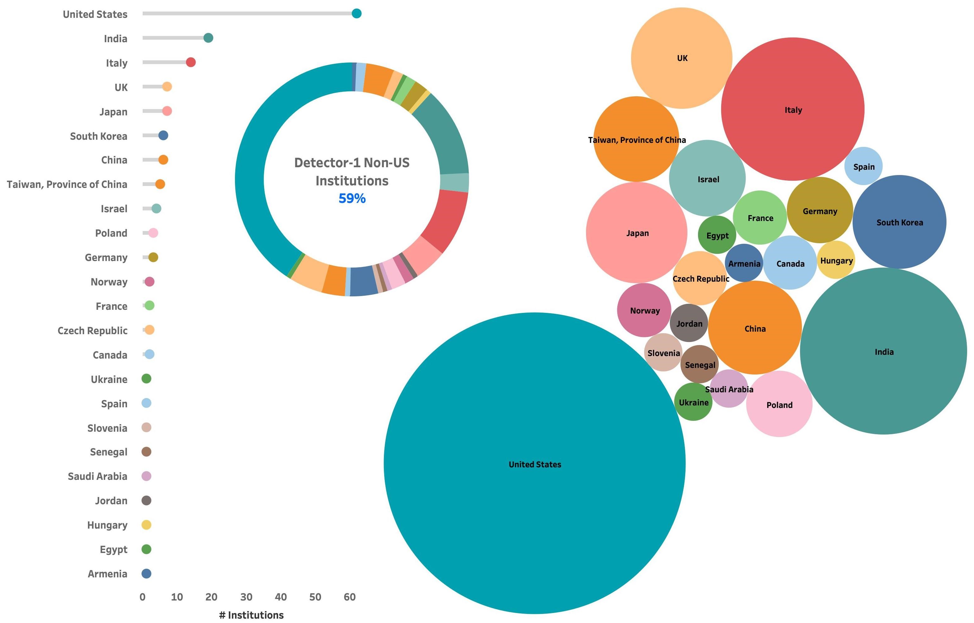
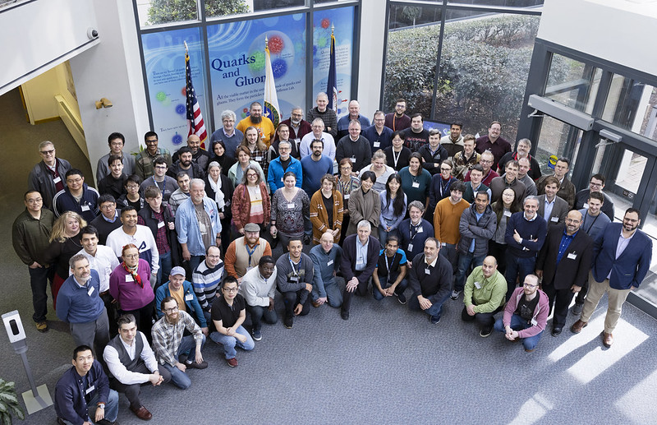
The ePIC Collaboration
ePIC formed a year ago.
ePIC is now 171 institutions including 11 new institutions that joined this July 2023.
Representing 24 countries
500+ participants
A truly global pursuit for a new experiment at the EIC!
ePIC non-US
Institutions
59%
ePIC Spokesperson:
John Lajoie (Iowa State)
ePIC Deputy Spokesperson:
Silvia Dalla Torre (INFN Trieste)

Slide 8
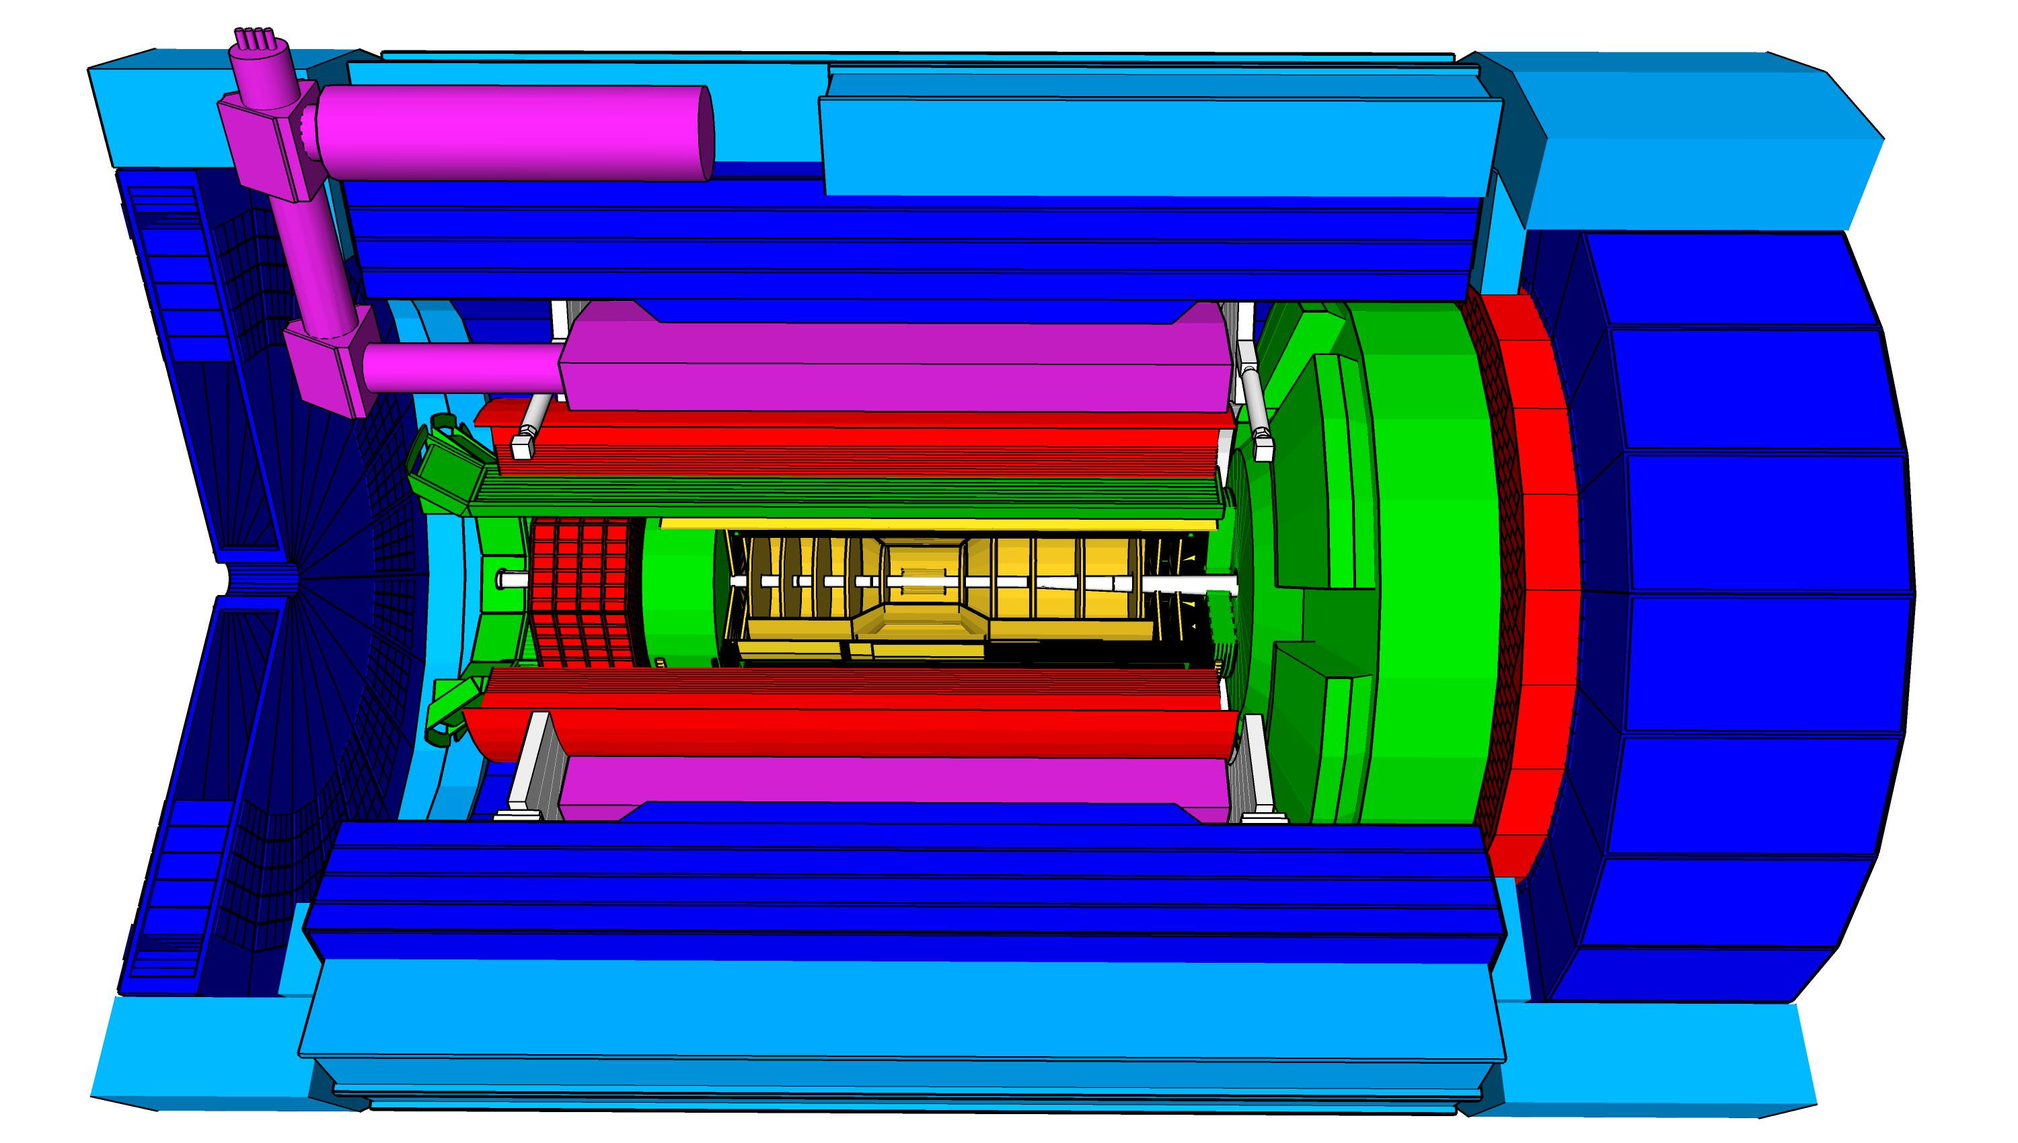
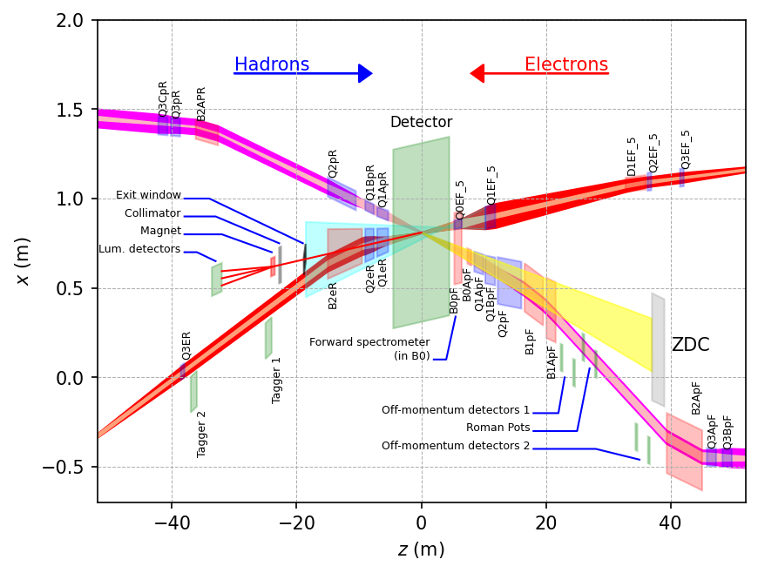
ePIC Detector
hadronic calorimeters (HCAL)
Asymmetric beam energies
→ require an asymmetric detector Barrel
with electron and hadron endcap
→ 9.5 m
→ Tracking, particle identification, EM
calorimetry and hadronic calorimetry
functionality in all directions
→ very compact Detector Integration
will be key
Imaging science program with protons and nuclei
→ requires specialized detectors
integrated in the Interaction Region
over 80 m
Science program required momentum resolution
→ requires a large bore 2T magnet
(1.7 T magnet operation point, stretch goal 2T)
that has same geometry as the BaBAR magnet.
Streaming readout electronics model
→ highest scientific flexibility
Solenoidal Magnet
e/m calorimeters (ECal)
Time.of.Flight (ToF), DIRC,
RICH detectors
MPGD trackers
MAPS tracker
23 Subdetectors
incl. Polarimeters
+ Data Acquisition
9.5 m

Slide 9
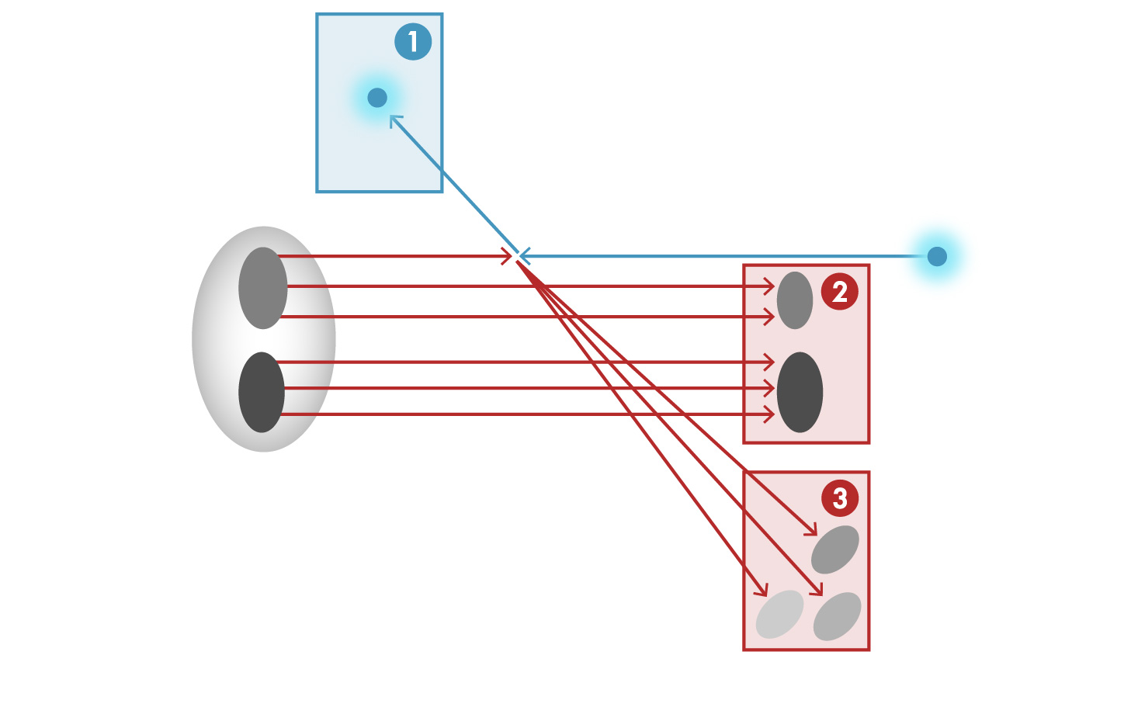


Detector Integration Challenge of the EIC
e’, $ν$
Aim of EIC is 3D nucleon and nuclear structure beyond the longitudinal description.
This makes the requirements for the machine and detector different from all previous colliders.
e
$γ,$Z,W
p/A
q
p remnant
“Statistics”=Luminosity × Acceptance
EIC Physics demands ~100% acceptance for all final state particles (including particles associated with initial ion)
e’
e
p/A
Ion remnant is particularly challenging
not a usual concern at colliders
at EIC integrated from the start with a highly integrated (and complex) detector and interaction region scheme.
Scattered electron
Particle associated with initial Ion
Particle associated with struck quark (or associated gluon)
9

Slide 10


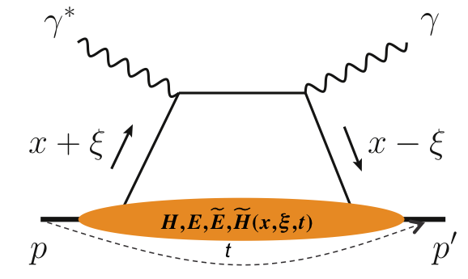
What is Needed Experimentally?
experimental measurements categories to address EIC physics:
Parton Distributions in nucleons and nuclei
Spin and
Flavor structure of nucleons and nuclei
Tomography Transverse Momentum Dist.
QCD at Extreme Parton Densities - Saturation
Tomography
Spatial Imaging
inclusive DIS
semi-inclusive DIS
exclusive processes
measure scattered lepton
multi-dimensional binning: x, Q²
reach to lowest x, Q² impacts
Interaction Region design
measure scattered lepton
and hadrons in coincidence
multi-dimensional binning:
x, Q², z, p_{T}, Θ
particle identification over entire region is critical
measure all particles in event
multi-dimensional binning:
x, Q², t, Θ
proton p_{t}: 0.2 - 1.3 GeV
  cannot be detected in main detector
  strong impact on Interaction Region design
∫Ldt:
1 fb⁻¹
10 fb⁻¹
10 - 100 fb⁻¹
machine & detector requirements

Slide 11
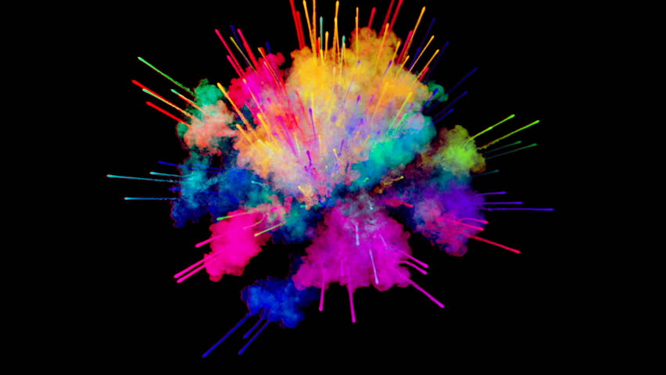
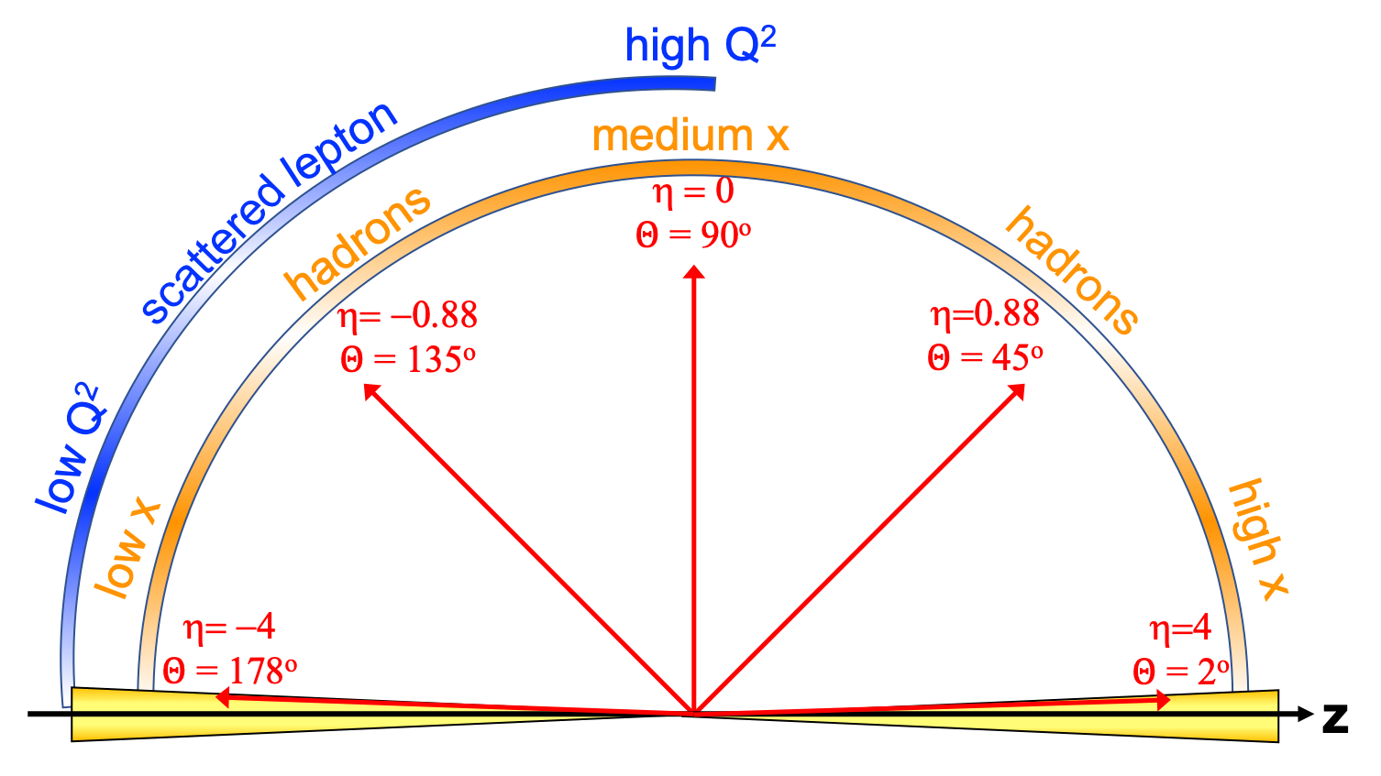
EIC General Purpose Detector: Concept
p/A beam
electron beam
inclusive DIS:
semi-inclusive DIS
Backward-η
Forward-η
hadronic calorimeters
solenoid magnet
ToF, DIRC,
RICH detectors
e/m calorimeters
MPG & MAPS trackers
Central
Detector
HCAL
Lepton
Endcap
Magnet
Hadron
Endcap
HCAL
ECAL
HCAL
ECAL
ECAL
Tracking
PID
PID
PID
Tracking
very low Q²
scattered lepton
Bethe-Heitler photons
for luminosity
Tracking
particles from nuclear
breakup and
from diffractive reactions
exclusive DIS
ZDC
Luminosity Detector
Forward Tracking
Low Q²-Tagger

Slide 12
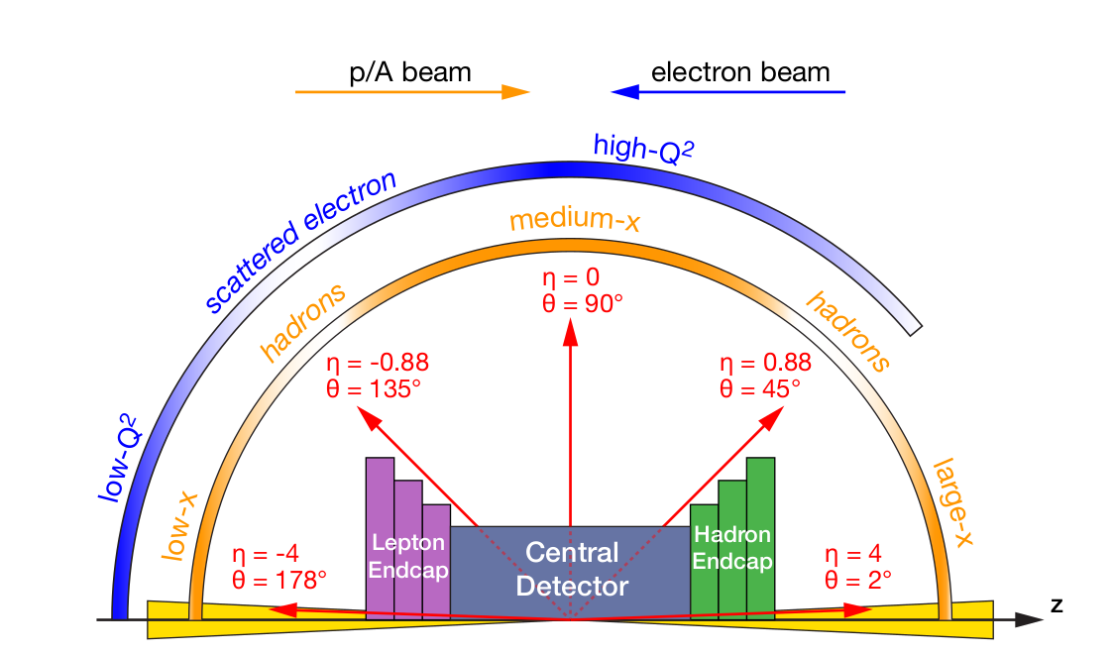
EIC General-Purpose Detector Requirements
Vertex detector → Identify primary and secondary vertices,
  Low material budget: 0.05% X/X₀ per layer;
  High spatial resolution: 10 μm pitch CMOS Monolithic Active Pixel Sensor
Central and Endcap tracker → High precision low mass tracking
  MAPS – tracking layers in combination with micro pattern gas detectors
Particle Identification → High performance single track PID for π, K, p separation
  RICH detectors (proximity focusing and dual radiator RICH, DIRC)
  Time-of-Flight high resolution timing detectors (HRPPDs, LGAD)
  Novel photon sensors: MCP-PMT / HRPPD
Electromagnetic calorimeter → Measure photons (E, angle), identify electrons
  PbWO₄ Crystals (backward), W/SciFi (forward)
  Barrel Imaging Calormieter: (Si + Pb/SciFi)
Hadron calorimeter → Measure charged hadrons, neutrons and K_{L}⁰
  Stretch goal ~50%/√E + 10% for low E hadrons (~ 20 GeV)
  Fe/Sc sandwich with longitudinal segmentation
DAQ & Readout Electronics: trigger-less / streaming DAQ
  Integrate AI into DAQ → cognizant Detector
Very forward and backward detectors → Large acceptance for diffraction, tagging, neutrons from nuclear breakup
  Silicon tracking layers in lepton and hadron beam vacuum
  Zero–degree high resolution electromagnetic and hadronic calorimeters
Polarimetry
  Lepton: integrated transverse and longitudinal Compton polarimeter
  Hadron: absolute and relative hadron polarimetry in the CNI region
Radius/Distance from IP

Slide 13
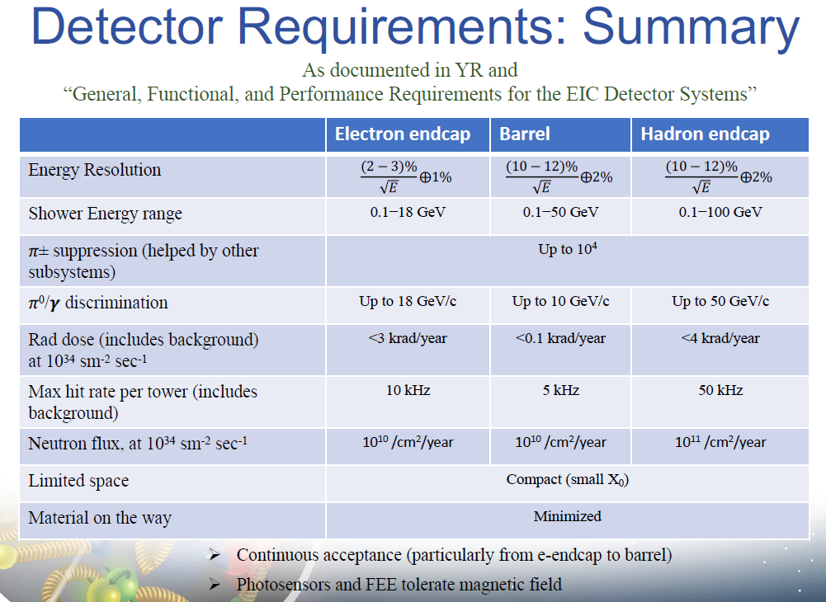
Subdetector Requirements
Example below for EM calorimetry. You can find all requirements online:
https://eic.jlab.org/Requirements/index.html (sometimes we run behind...)

Slide 14
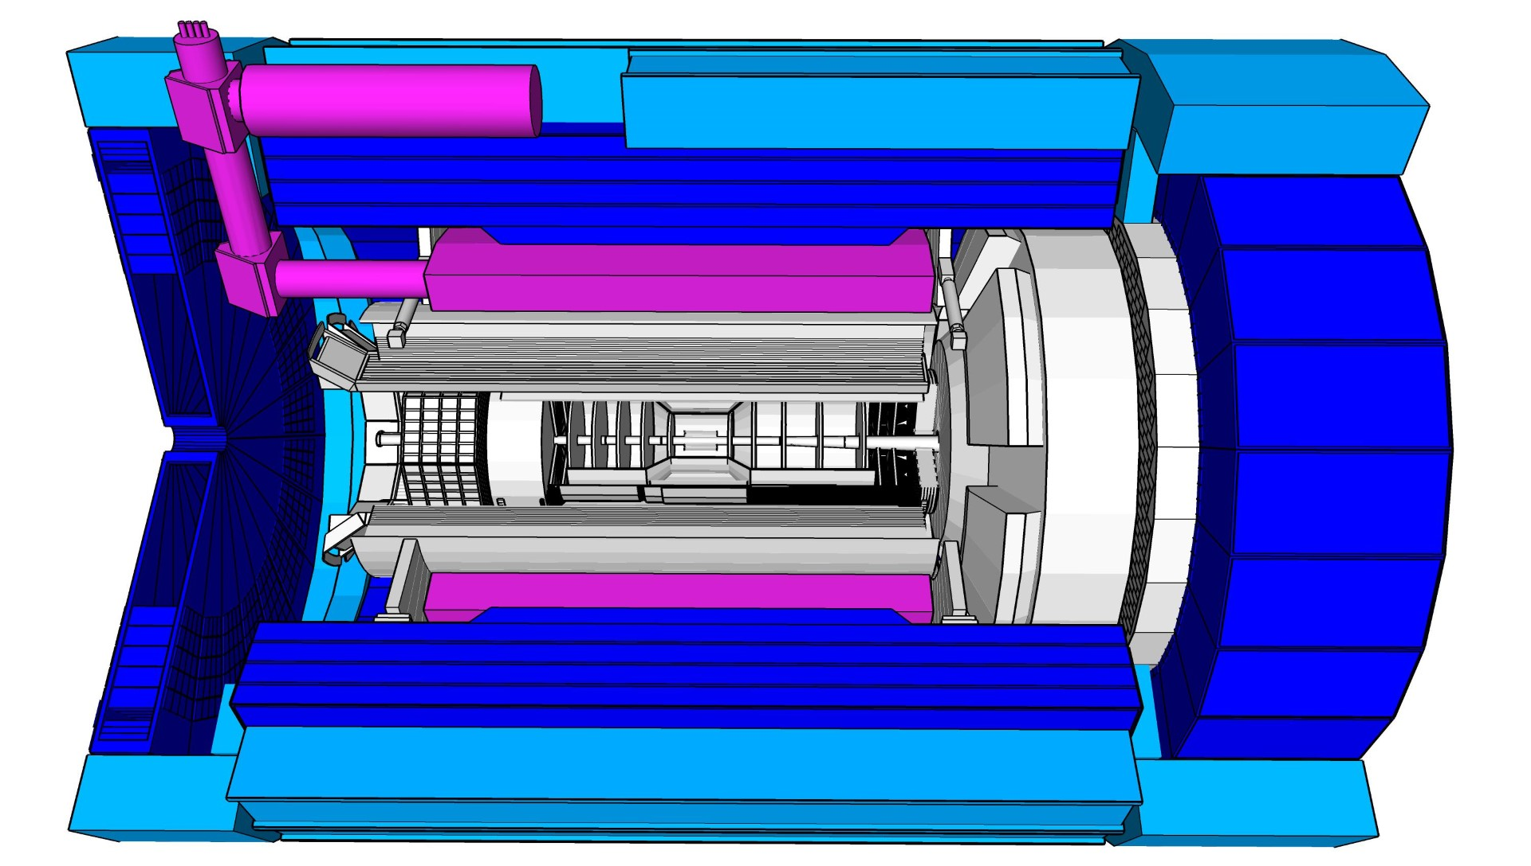
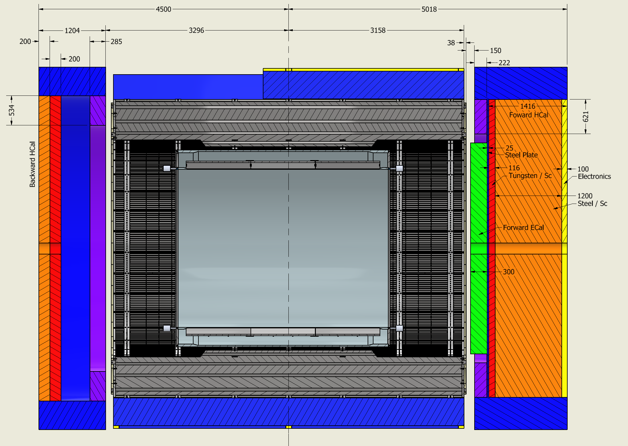
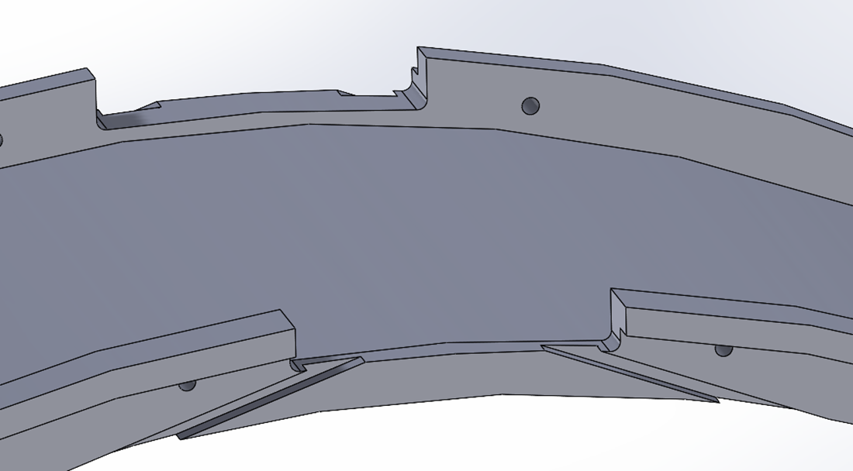
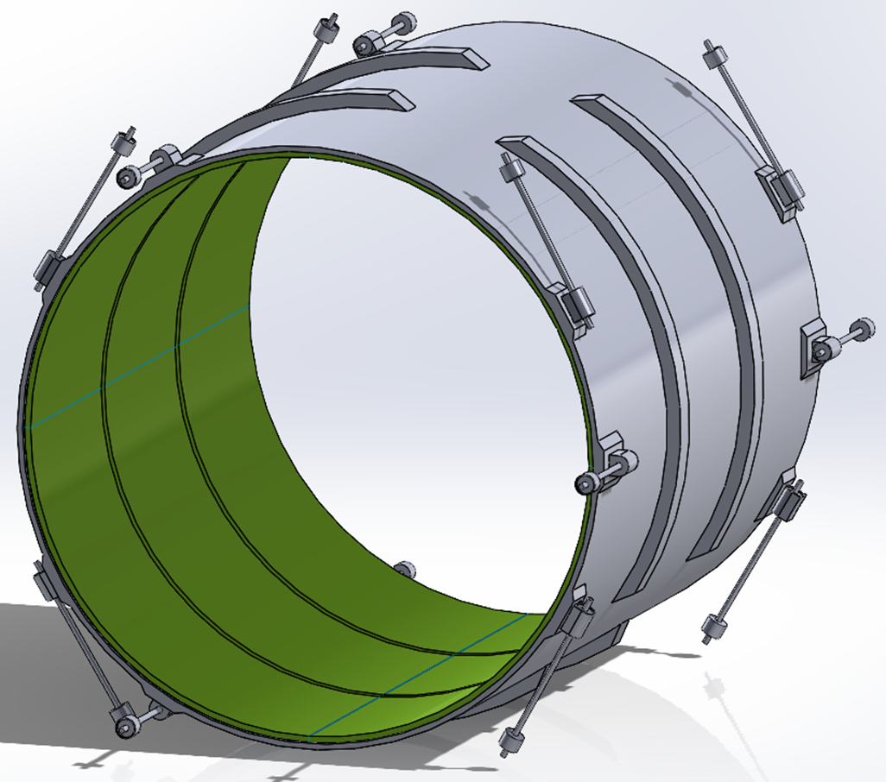
MARCO Magnet Design Details
Conductor is based on CEA-Saclay experience as used for previous magnets.
Contract for conductor test samples in place with viable vendor.
Steel
Coil is divided in 3 modules with 557 Turns each. This is done mainly to accommodate possible conductor length.
Flux return steel layout fully defined to minimize forces and fringe fields (~10G)
The two most important design parameters are conservative: large temperature margin and large critical current margin
Conductor exits
Mechanical analysis undergoing final checks

Slide 15
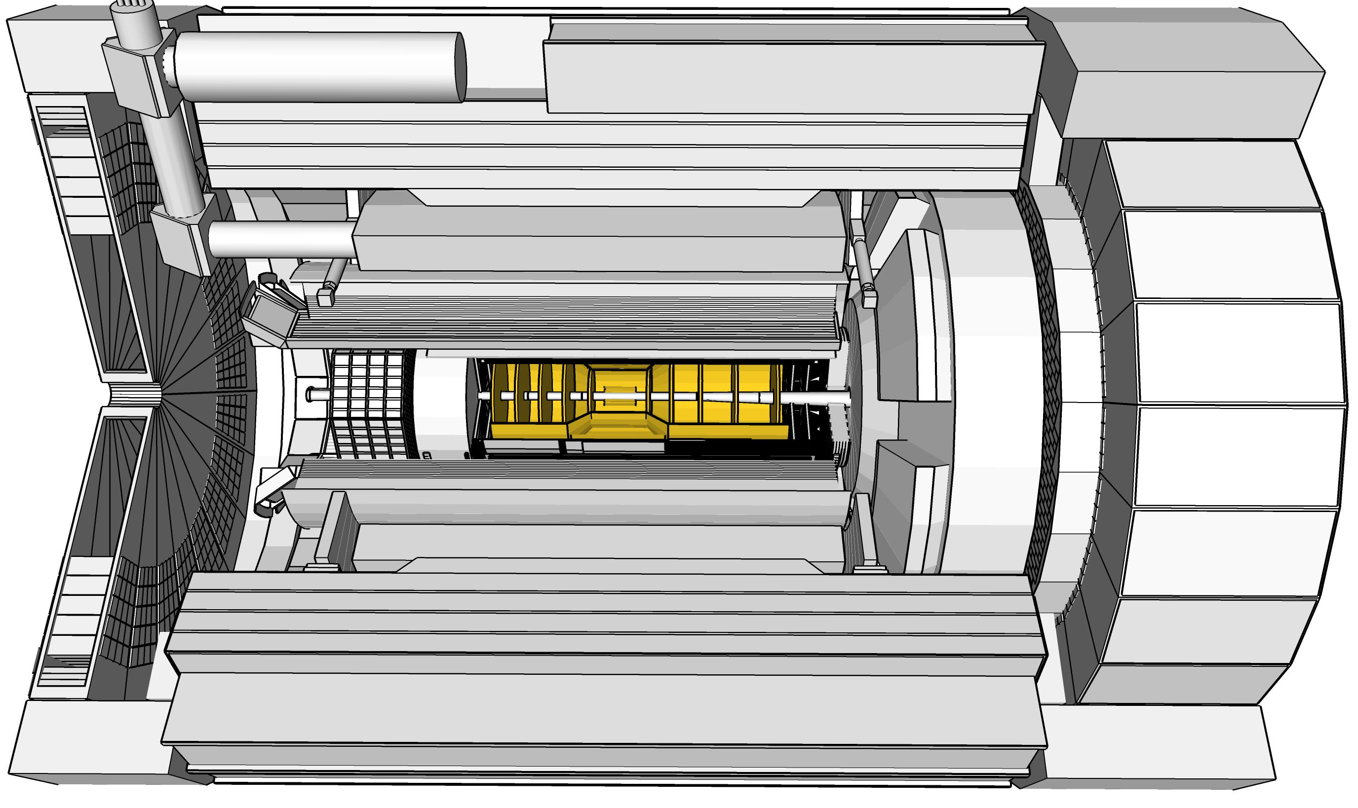

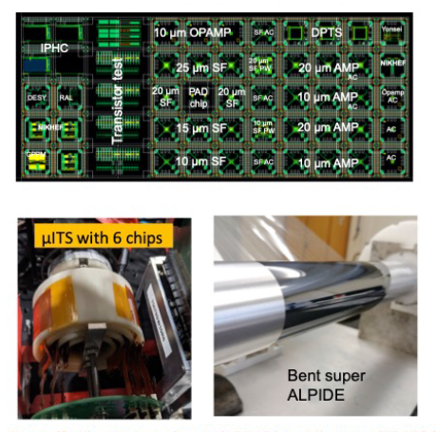
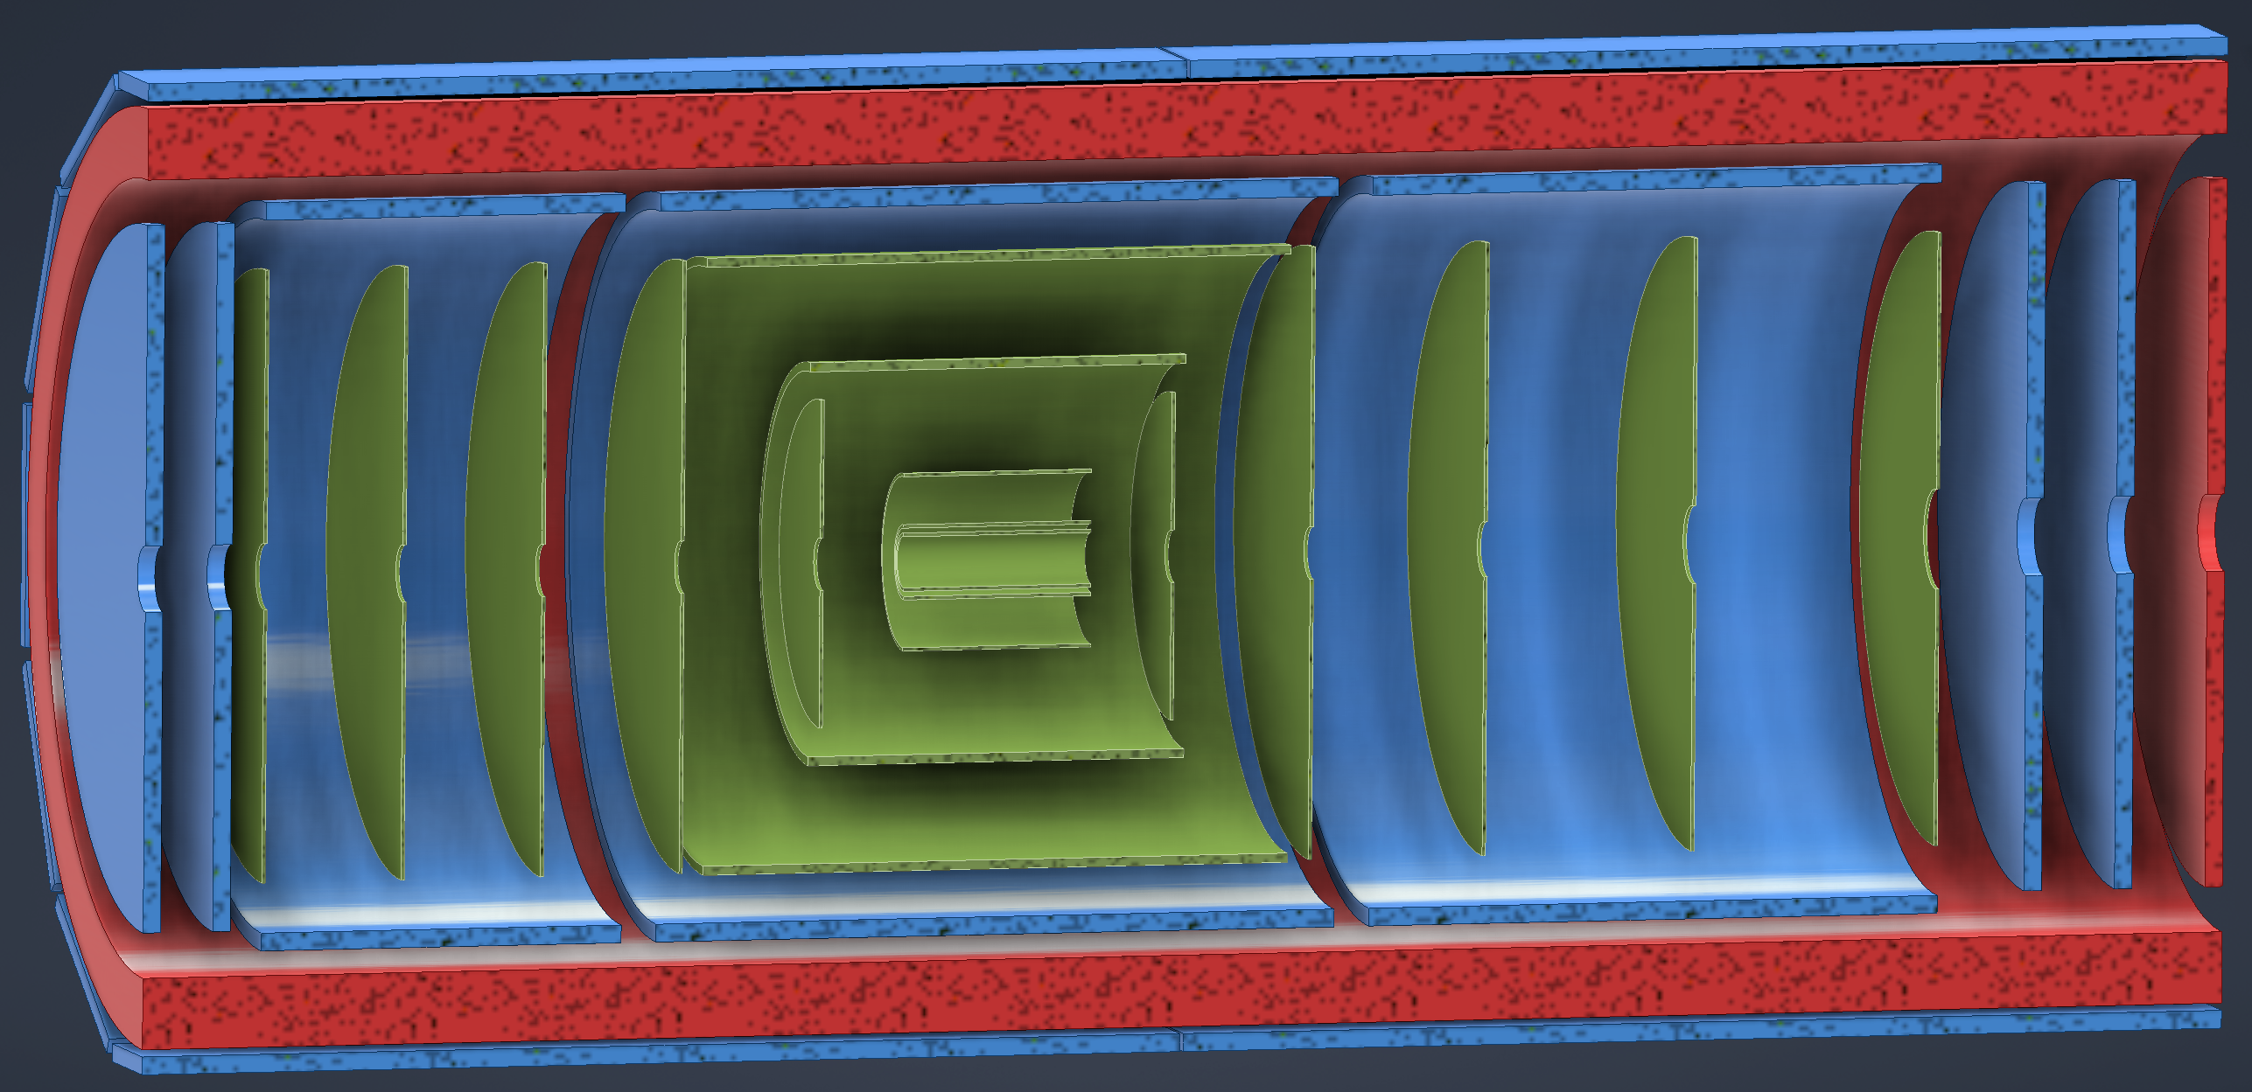
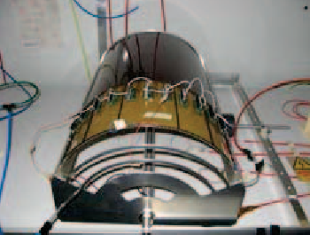
ePIC Tracking Detectors
Monolithic Active Pixel Silicon Tracker:
1 single technology: 65-nm MAPS
  small pixels (10 μm) and power
  consumption (<20 mW/cm²)
  low material budget
  (0.05% to 0.55% X/X₀ / layer)
  based on ALICE ITS3
  development
  MAPS Vertex layers
  MAPS Barrel, forward and
  backward disks
Multi Pattern Gas Detectors:
additional space points at large radii
Cylindrical microMEGAS
→ Additional space point for
pattern recognition / redundancy
→ Ongoing geometry
optimization
μRWELL planar layer
just before hpDIRC
→ Impact point and direction for the
ring seeding of hpDIRC
→ Additional space point for pattern
recognition / redundancy
Two MPGD disks each beyond Si disks in forward and backward direction
→ To provide sufficient hits under
large backgrounds to compensate
for large Si time integration frame
world’s first
at
world’s first
at
MAPS Barrel + Disks
MPGD Barrels + Disks
AC-LGAD based ToF

Slide 16
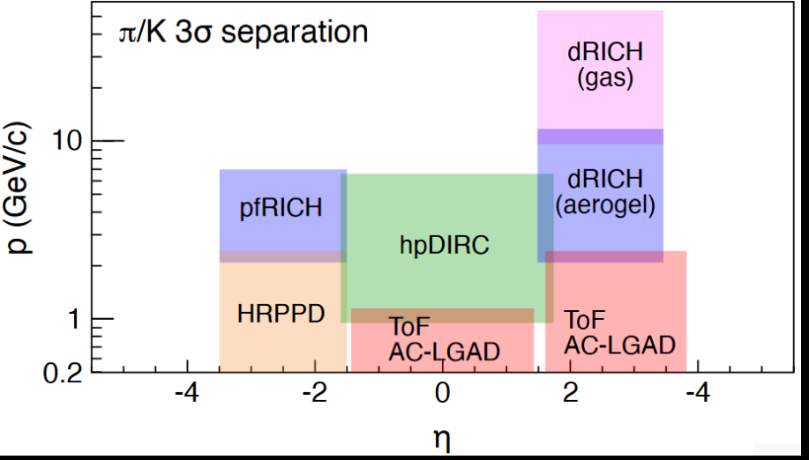
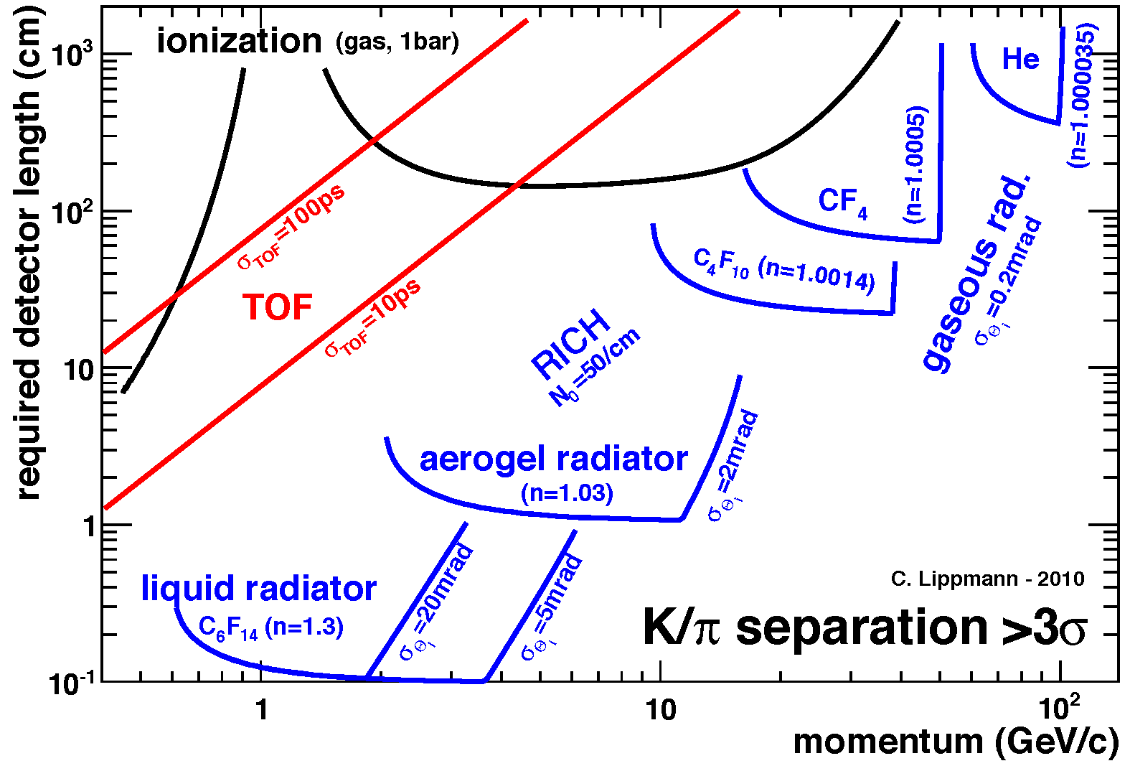
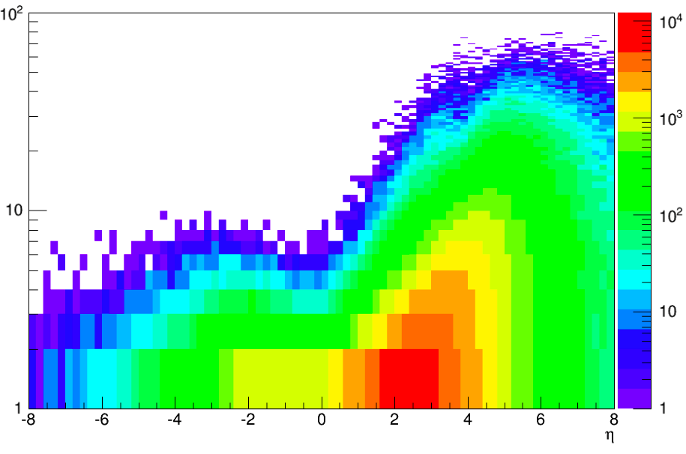


Particle ID
In general, need to separate:
Electrons from photons → 4π coverage in tracking
Electrons from charged hadrons → mostly provided by calorimetry
Charged pions, kaons and protons from each other → Cherenkov detectors
  Cherenkov detectors, complemented by other technologies at lower momenta
  Time-of-flight or dE/dx
Illustration of PID detectors achievements:
Pythia MC
P [GeV]
$$π/K±$$
$$η$$
Physics requirements:
Need more than one technology to cover the entire momentum ranges at different rapidities
Rapidity | π/K/p and π0/γ | e/h | Min pT (E)
-3.5 − -1.0 | 7 GeV/c | 18 GeV/c | 100 MeV/c
-1.0 − 1.0 | 8-10 GeV/c | 8 GeV/c | 100 MeV/c
1.0 − 3.5 | 50 GeV/c | 20 GeV/c | 100 MeV/c

Slide 17
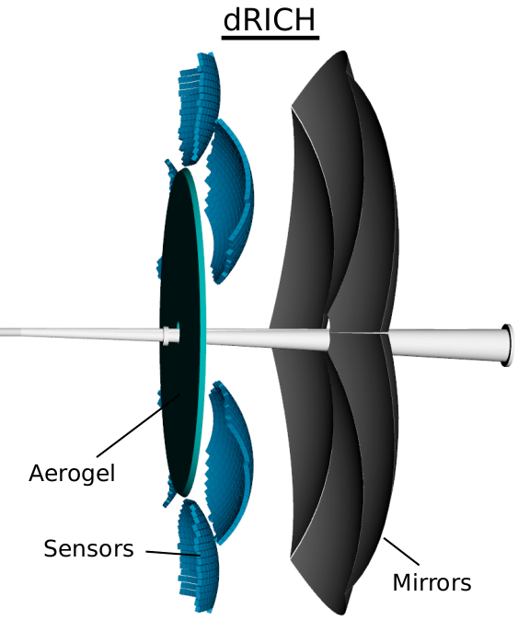
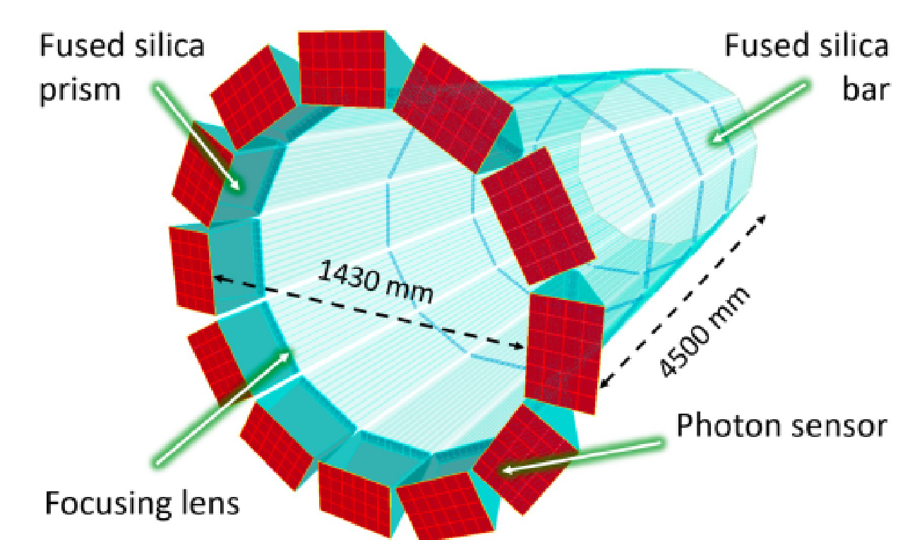
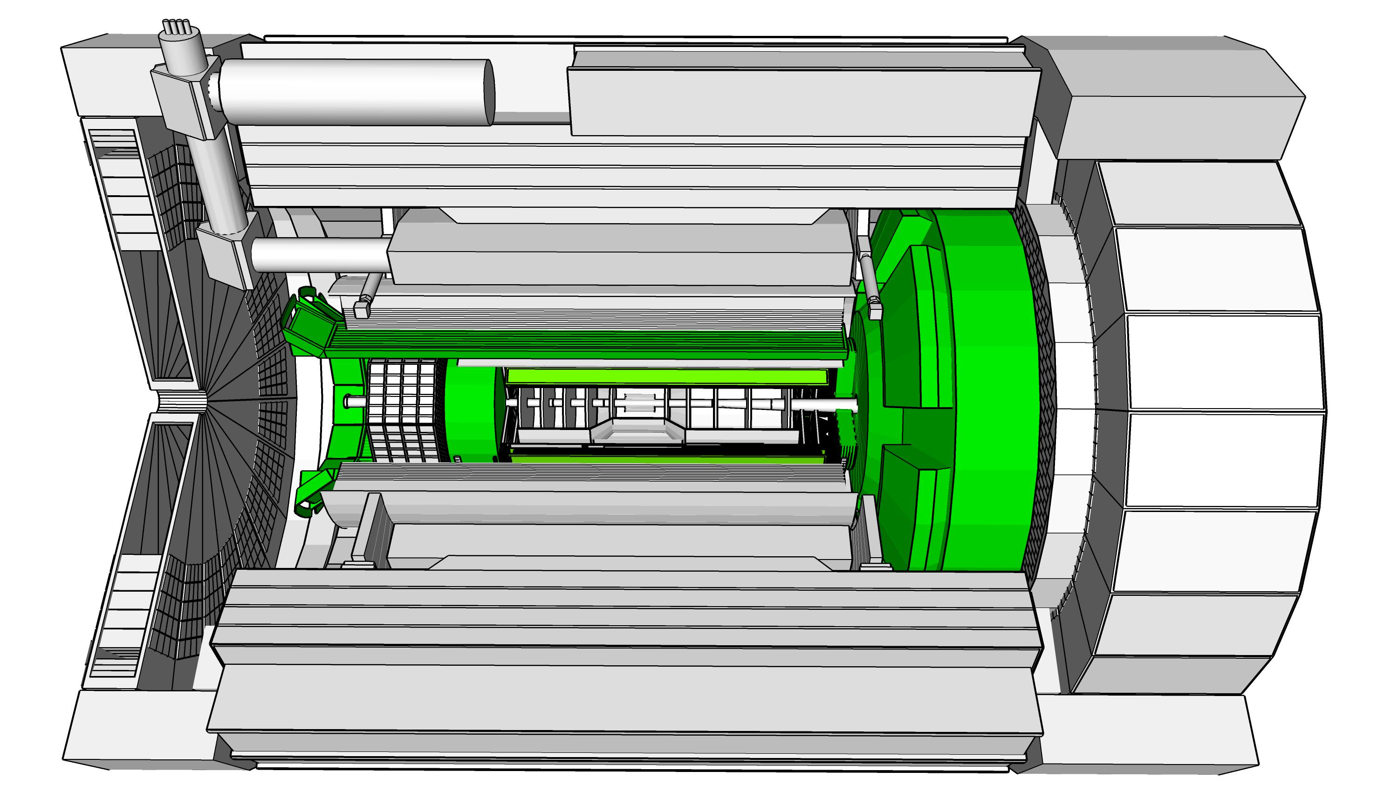
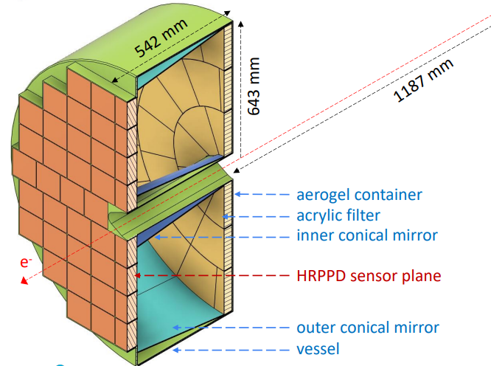
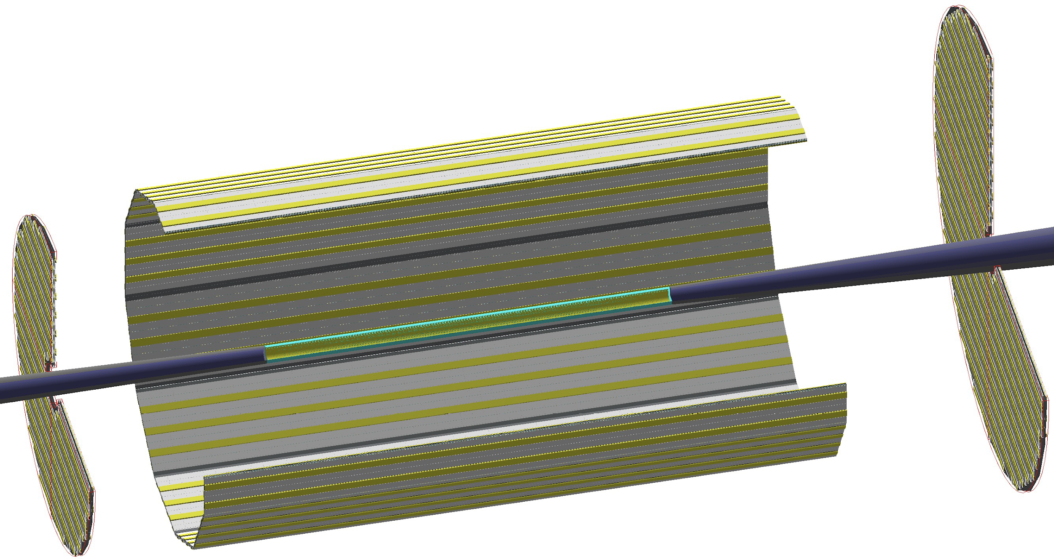
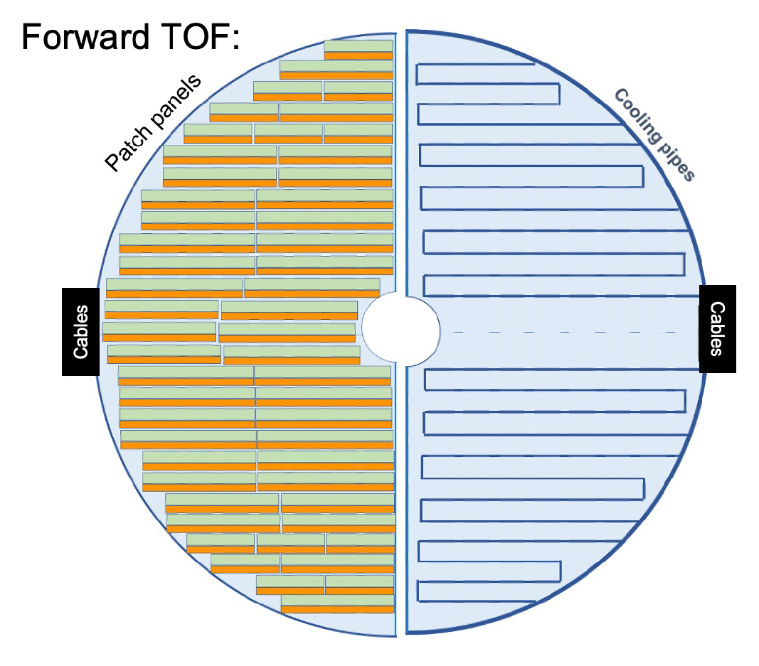
ePIC Particle Identification Detectors
Dual-Radiator RICH(dRICH)
High-Performance DIRC
Quartz bar radiator (BaBAR bars)
light detection with MCP-PMTs (or HRPPDs)
Fully focused
π/K 3σ separation at 6 GeV/c
world’s first
at
C₂F₆ Gas Volume and Aerogel
Sensors tiled on spheres (SiPMs)
π/K 3σ sep. at 50 GeV/c
Proximity Focused (pfRICH)
Long proximity gap (~40 cm)
Sensor: HRPPDs/LAPPDs
up to 9 GeV/c 3σ π/K sep.
AC-LGAD
(Low-Gain Avalanche Detector)
world’s first
at
Main purpose TOF: 25-30 ps
Accurate space point for tracking
forward disk (0.5 mm x 0.5 mm pixels) and central barrel (0.5 x 10 mm² strips)
world’s first
at

Slide 18
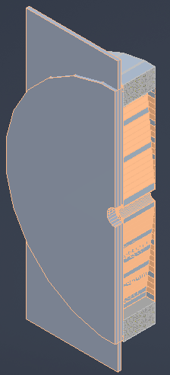
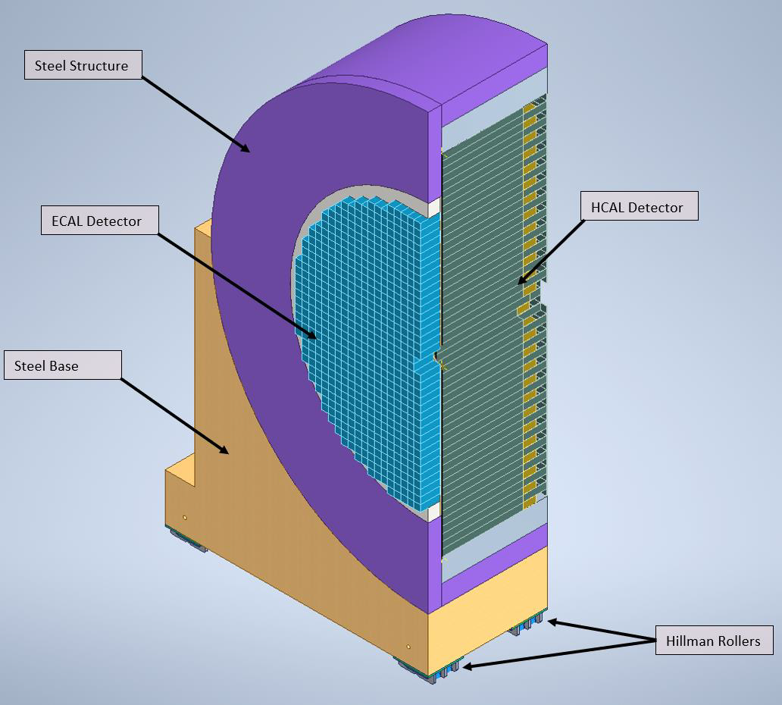
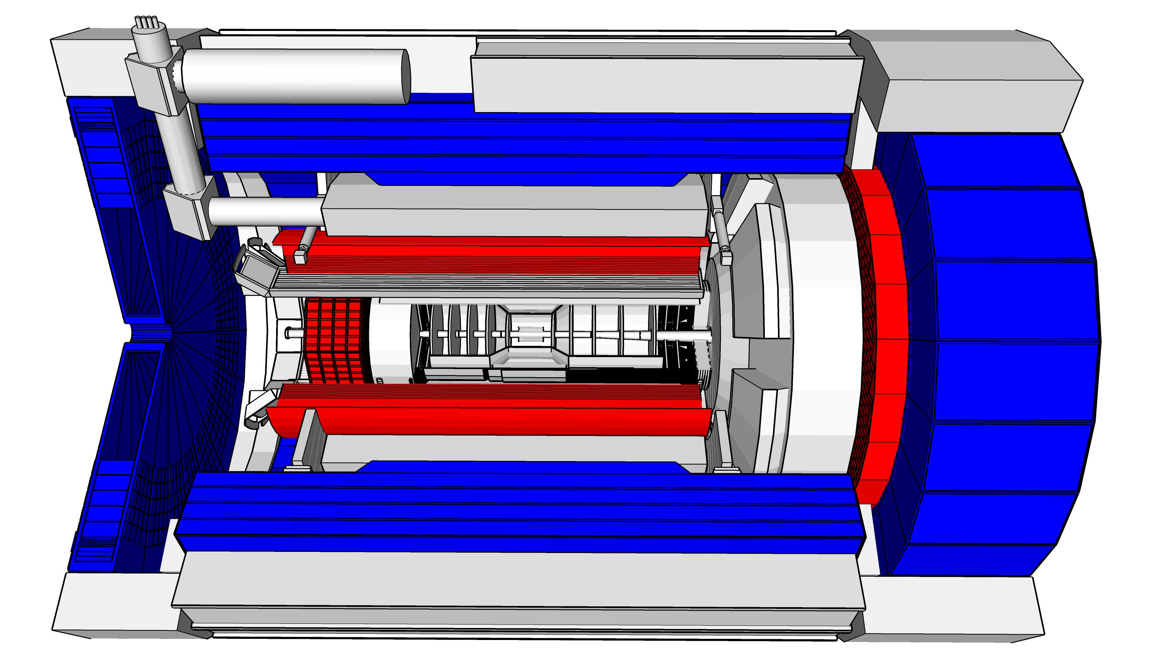
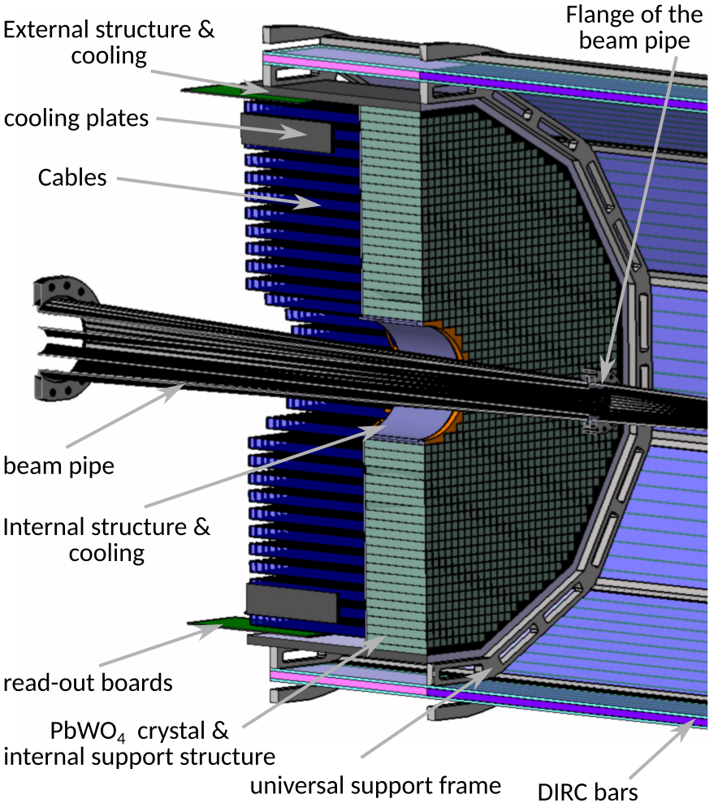
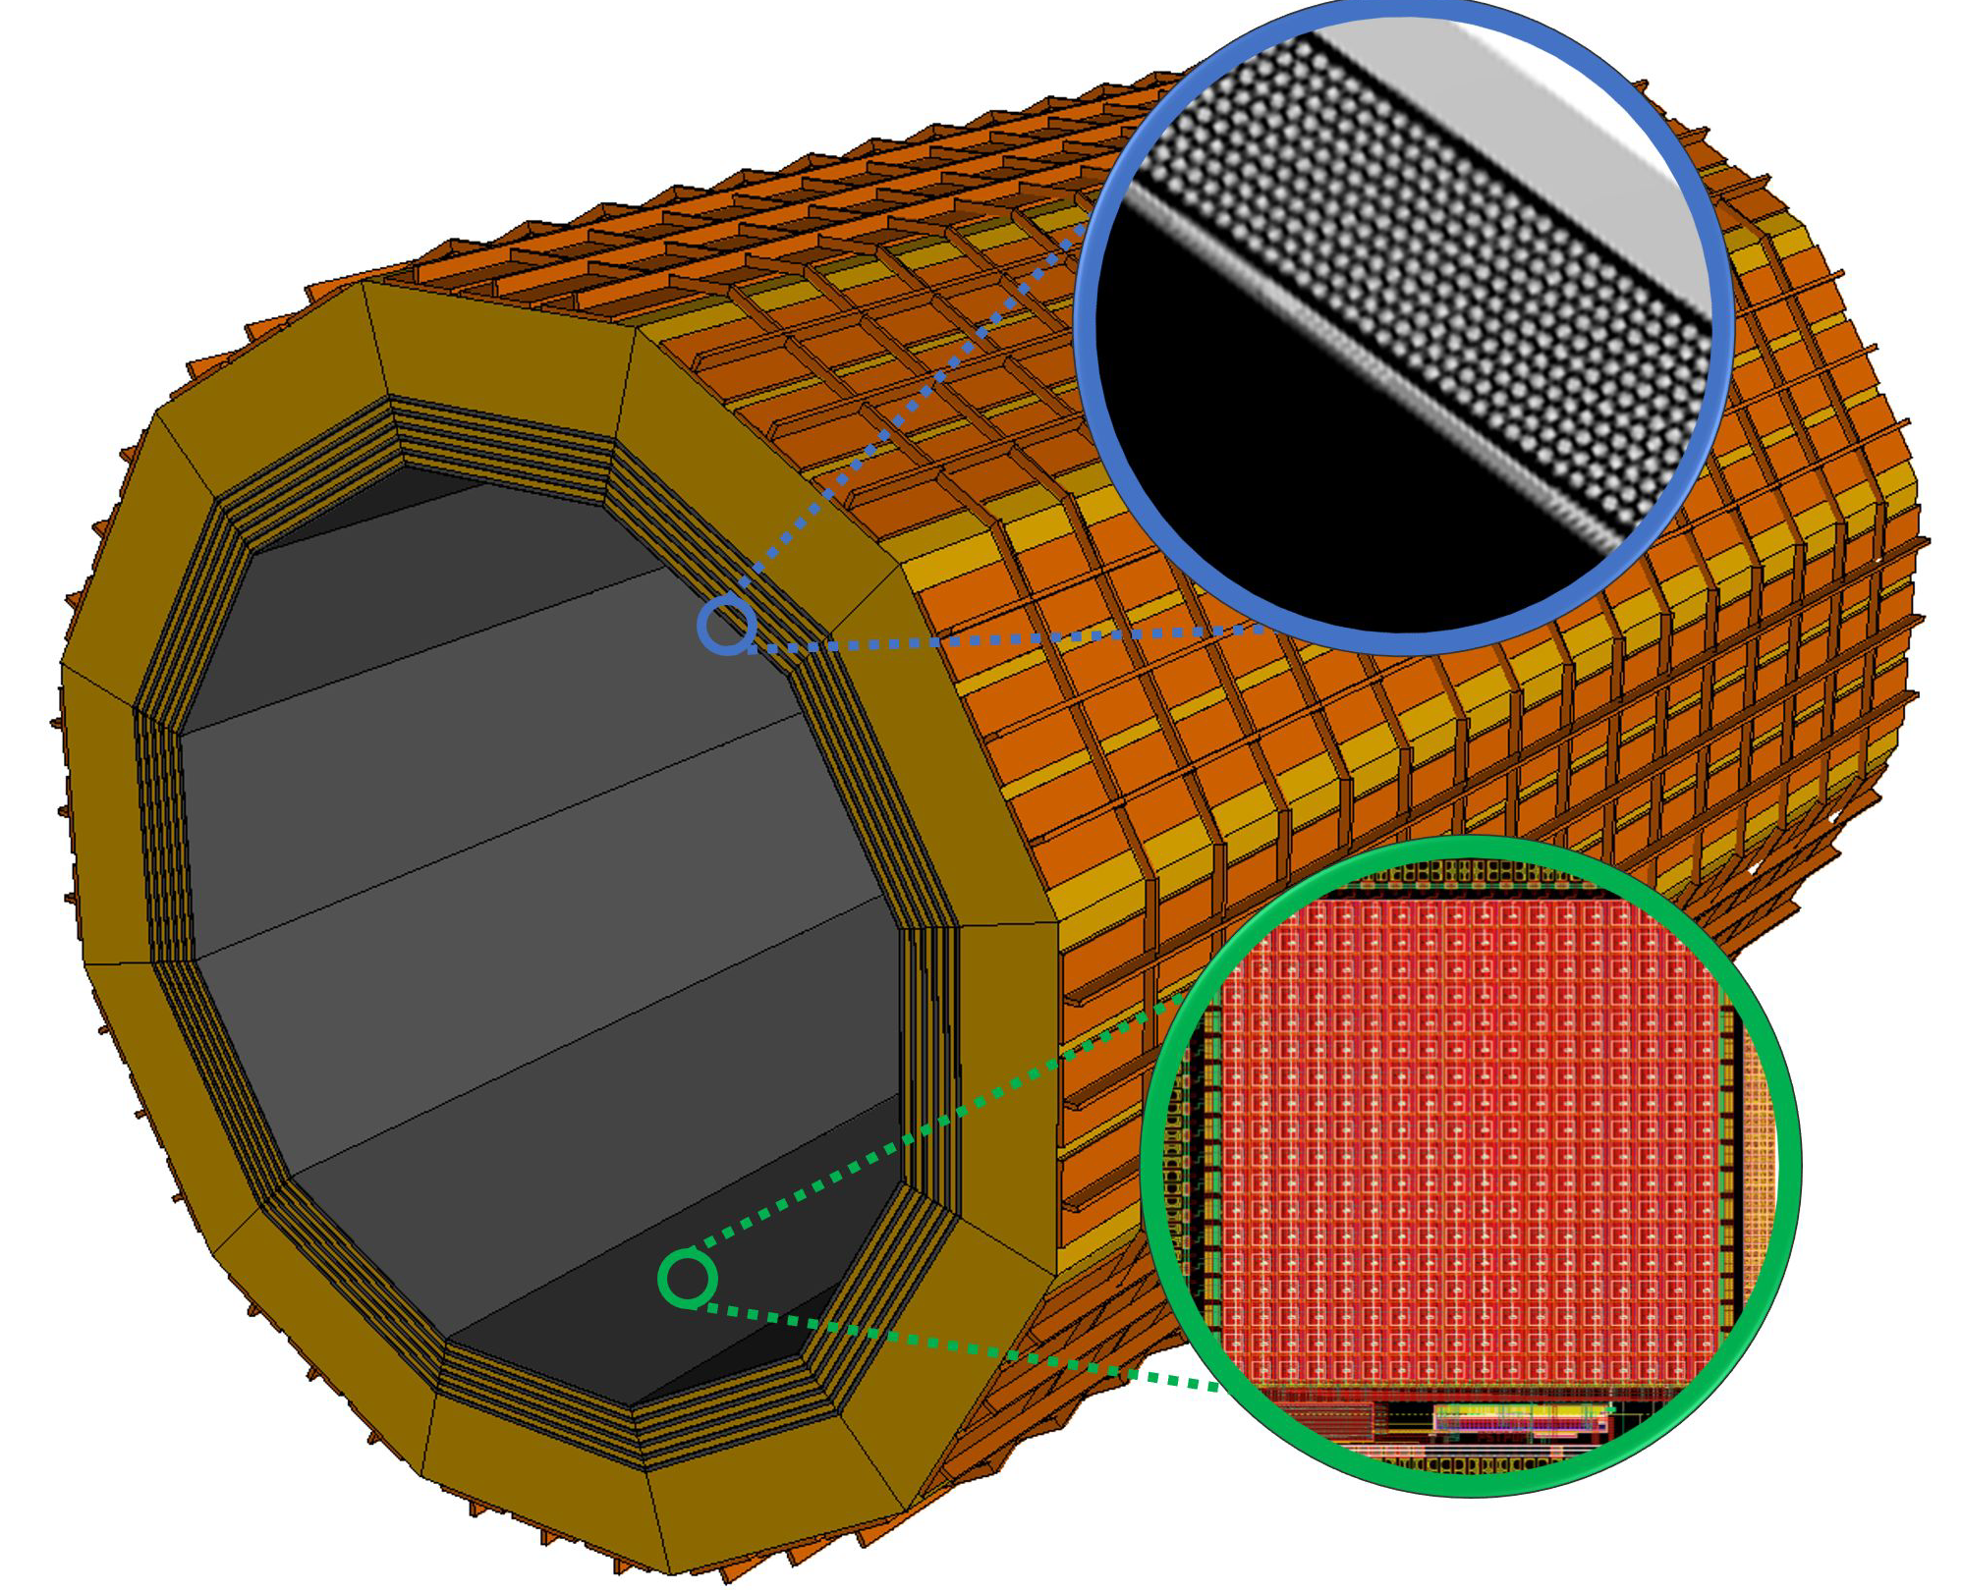
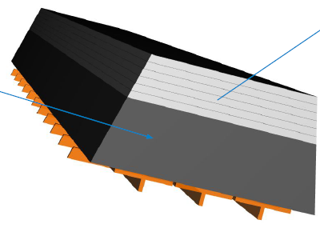
ePIC Calorimetry
Backwards HCal
Steel/Sc Sandwich
tail catcher
Barrel HCAL
(re-used from sPHENIX)
Forward ECal
High granularity
Tungsten/SciFi matrix
SiPMs as photonsensors
ForwardHCAL
Longitudinally separated Steel/Sc & W/Sc sandwich
with SiPMs embedded in Scintillator
world’s first
at
world’s first
at
Backward Ecal
High-precision, PbWO4
SiPMs as photonsensor
Pb/SciFi
world’s first
at
Barrel ECal: Pb/SciFi with a
hybrid imaging part (using 6 layers of ASTROPIX)
Recent Technology Choice
Review 03/14/23, ePIC Decision 04/21/23

Slide 19
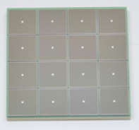
Electronics
We have 23 different detector technologies in the ePIC detector
It would be intractable if all have different readout electronics
→ the goal is to minimize the number of different ASICs and use common readout solutions
Global Timing Unit (GTU)
-Interfaces to
Collider Run Control & DAM
-Config & Control
-Clock & Timing
Electronics Readout Chain
On Detector
SMT BGA
Sensor
Adapter
Front End Board (FEB)
Readout Board (RDO)
Data Aggregation Module (DAM)
Computing
Detector Group | Channels | AC-LGAD | SiPM/PMT | MPGD
 | MAPS | AC-LGAD, HRPPD | SiPM/PMT | MPGD
Tracking | 36 B |  |  | 202 k
Calorimeters | 88 M |  | 123 k
Far Forward | 300 M | 2.3 M | 170 k
Far Backward | 146 M |  | 2 k
PID |  | 7.8 M + 140k | 320 k
TOTAL | 36.5 B | 10.24 M | 615 k | 202 k
ASIC | ITS-3 | EICROC FCFD | Discrete/COTS HGCROC3 ALCOR | SALSA
We expect to need ITS-3, Astropix, Timepix, and 4 different ASICs
Based on existing ASICs → reduce cost & time
Much synergy with international efforts

Slide 20
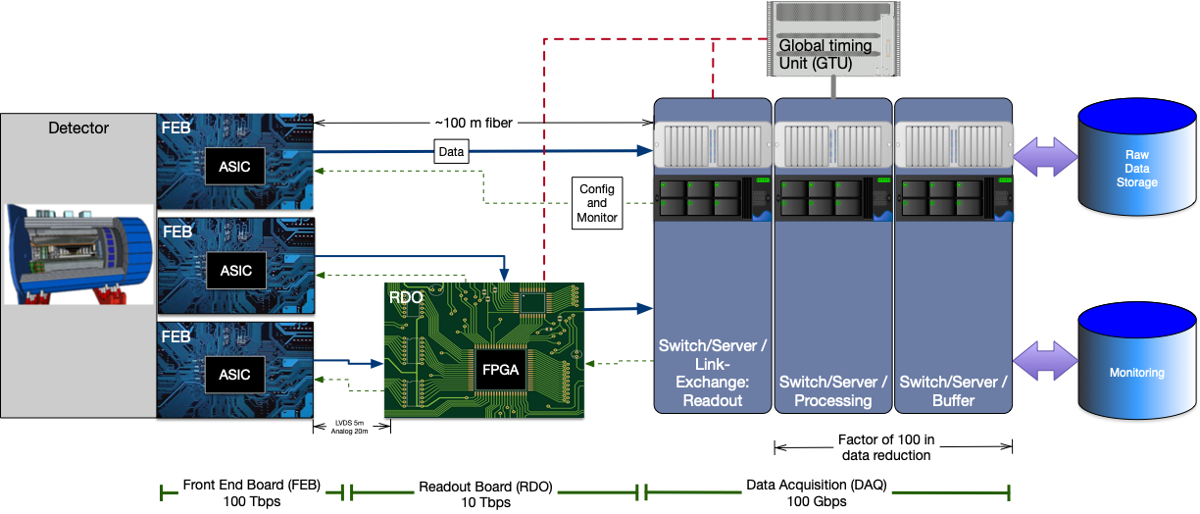
Streaming Readout Architecture
Triggerless streaming architecture gives much more flexibility to do physics
Rates quoted are at output of each stage
Integrate AI/ML as close as possible to subdetectors → cognizant Detector

Slide 21
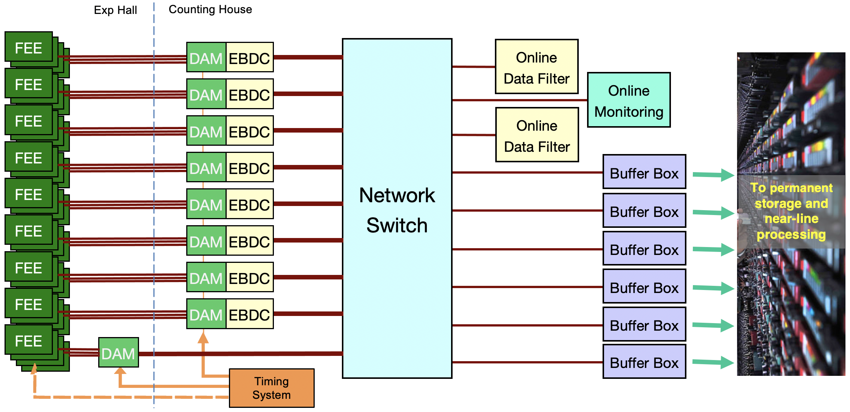
ePIC Streaming DAQ/Computing Architecture
Bunch Crossing ~ 10.2 ns/98.5 MHz
Interaction Rate ~ 2 us/500 kHz
Low occupancy.
BW O(100Tbps)
RDO
RDO
RDO
RDO
RDO
BW O(10Tbps)
ePIC DETECTOR
RDO
RDO
BW O(100Gbps)
RDO
RDO
Distributed clock
jitter ~5ps

Slide 22
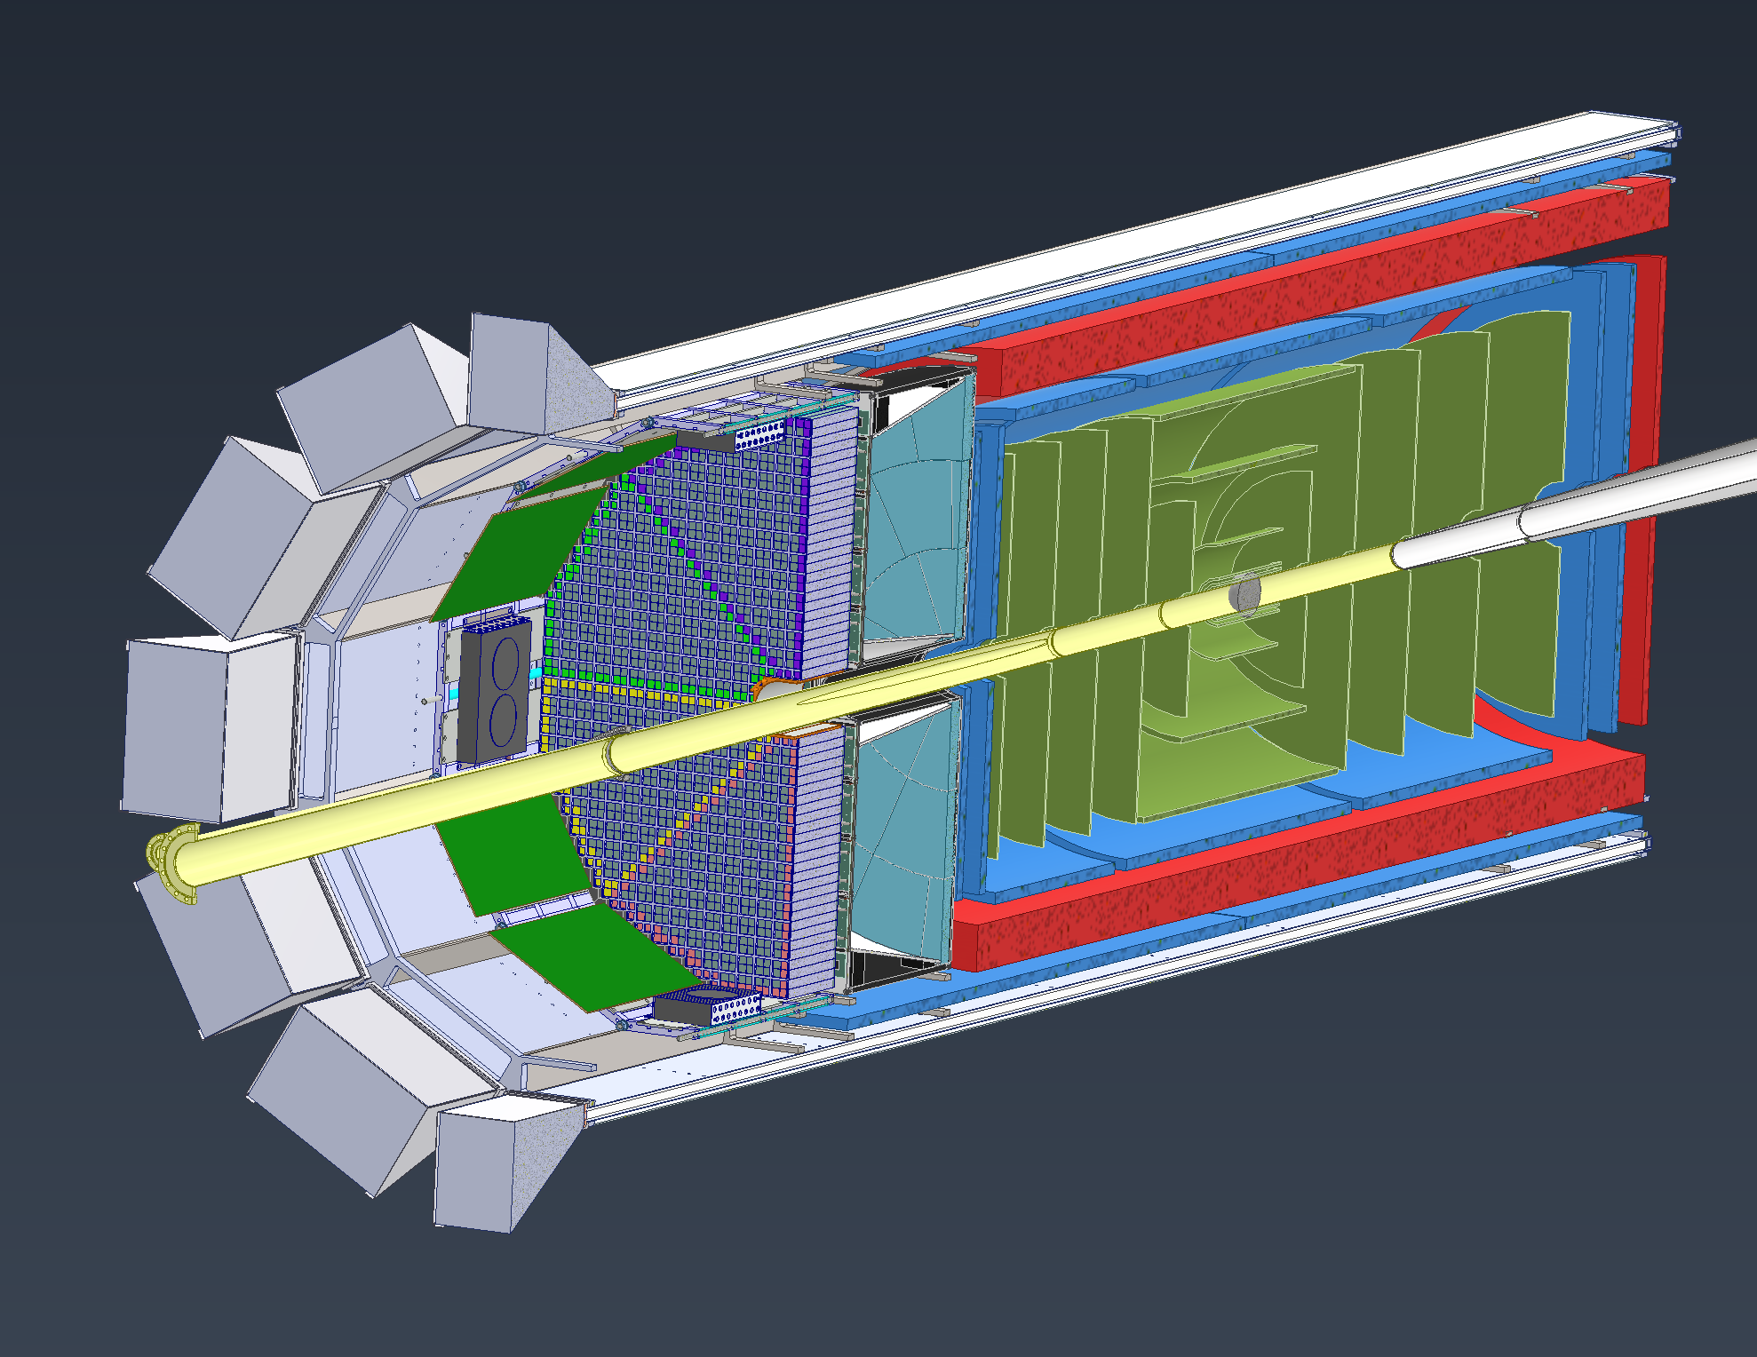
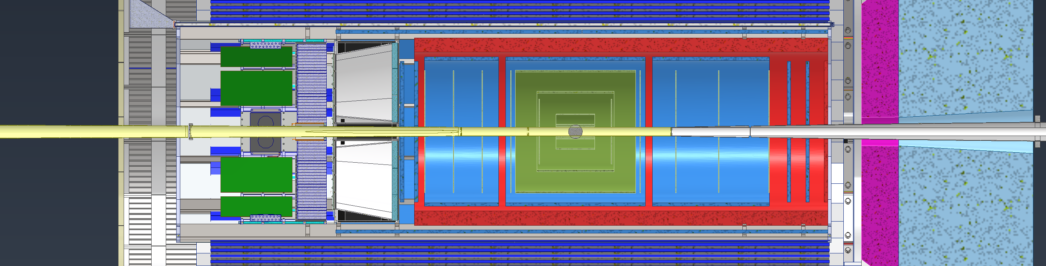
Integration Model Overview – Inner Detector
EEEMCAL: Will be slid in on rails at 3 & 9 O’clock positions
pfRICH: Will most likely use the same rail structure that the EEEMCAL uses
AC-LGAD: Cylinder and disk models are placeholders. A support structure is being developed that will house the AC-LGAD, Inner MPGDs & disks and all the Silicon Trackers
MPGDs: Consists of outer and inner barrel layers along with 4 disks, 2 on each end. Outer layer will be supported with the DIRC
Silicon Vertex & Sagitta Silicon: Will use same support structure as other inner detectors
Si Disks: 10 Disks total, 5 each side, using same support structure as other inner detectors
MPGDs
Silicon Trackers
AC-LGAD
pfRICH
EEEMCAL
Beampipe
Si Disks

Slide 23
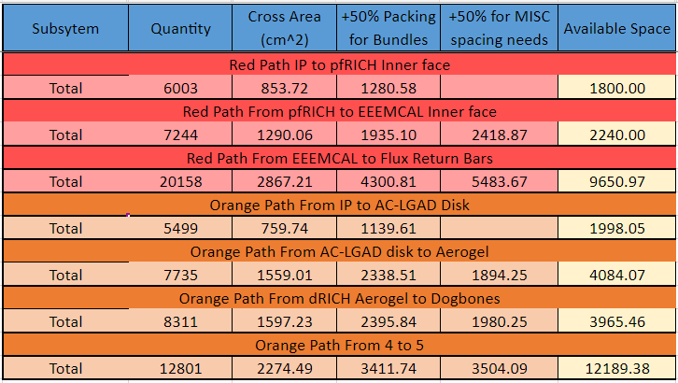
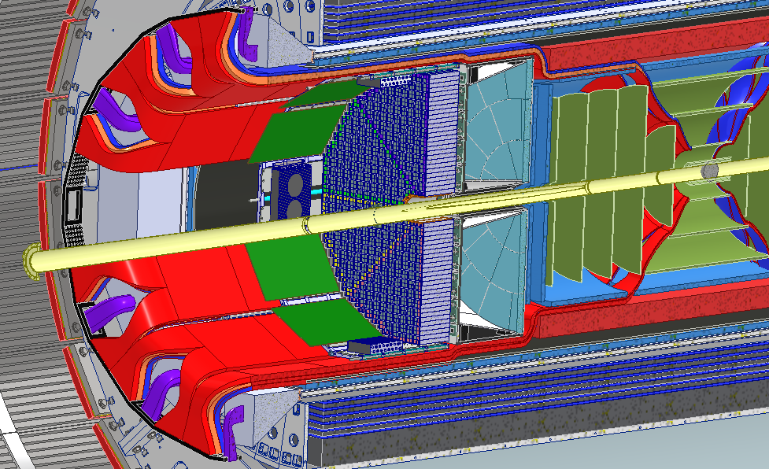
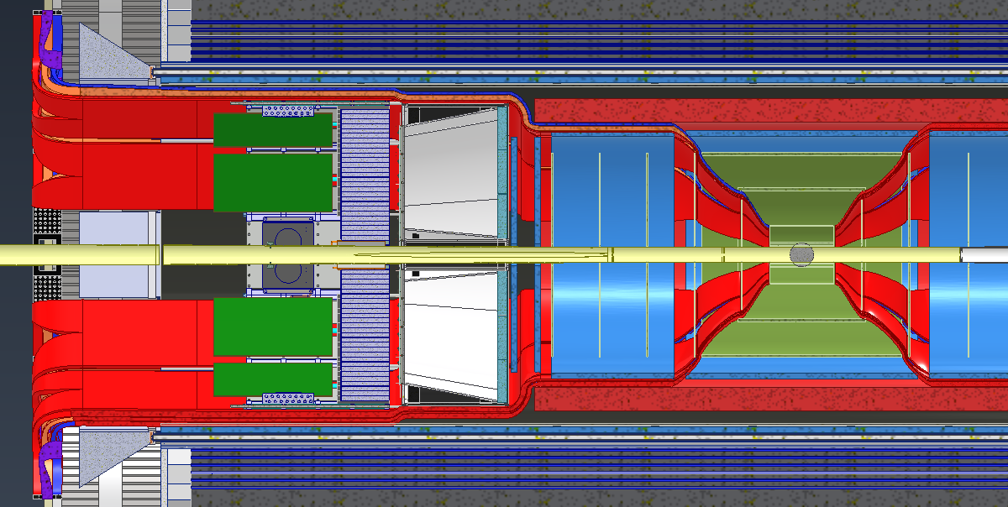
Integration – Services Layout
Services (Cable and Cooling Line Estimates) were collected from various subgroups.
Services Layout is shown in snapshots below:

Slide 24
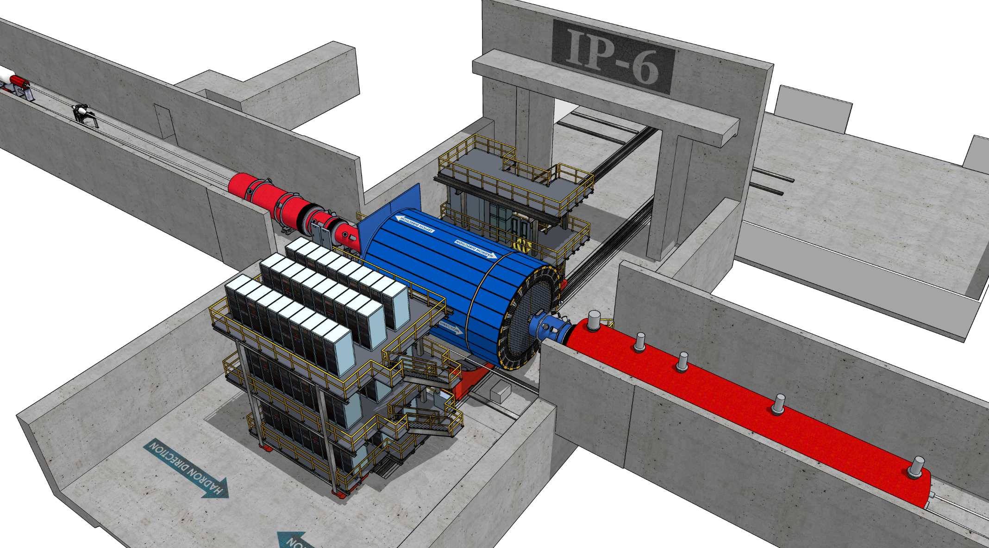
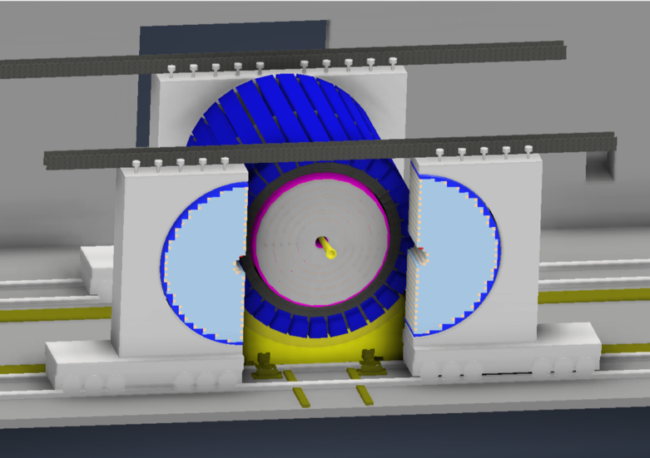
IR-Integration and Interfaces
Space Constraints:
-4.5 m – IP – +5m not negotiable
50 cm space to 1st IR-magnet occupied by vacuum pumps, valves, …..
IP moved 81 cm towards ring inside compared to RHIC; y: 432 cm above floor
limited installation possible in Collider Hall
  endcap hadron calorimeters need to be split transverse to beam pipe
  RCS vacuum needs to be broken
Electrons
Hadrons
RCS
9.5 long detector does not fit through the door
  Door-Size: 823 cm x 823 cm
  endcap hadron calorimeters need to stay in collider hall, if detector rolls in assembly hall
RCS to IP: radial distance 335.2 cm at a height of 372 cm from floor
  Maximum outer radius ~ 3.2 m

Slide 25
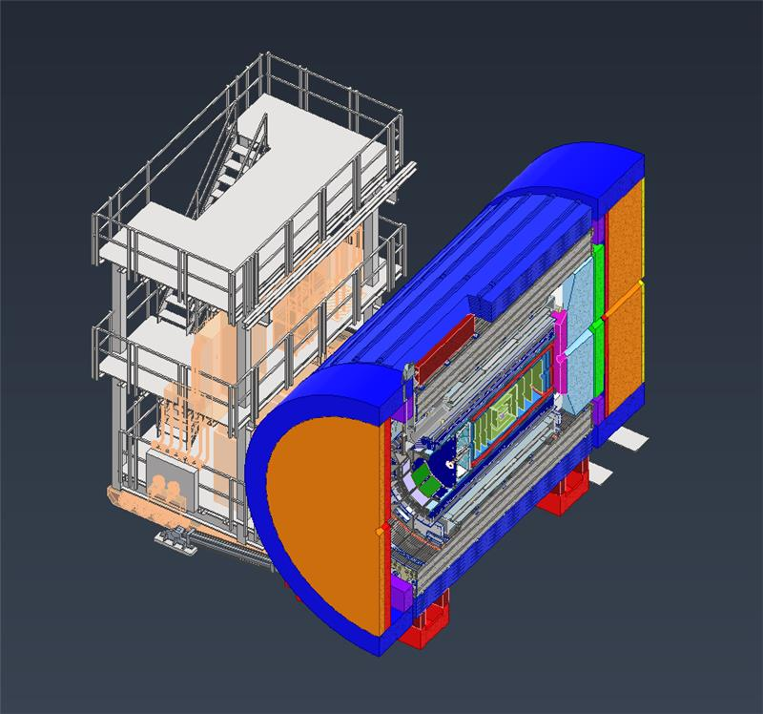
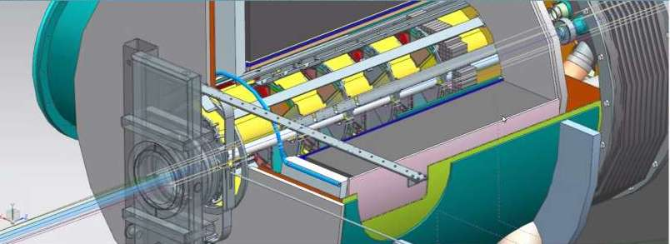
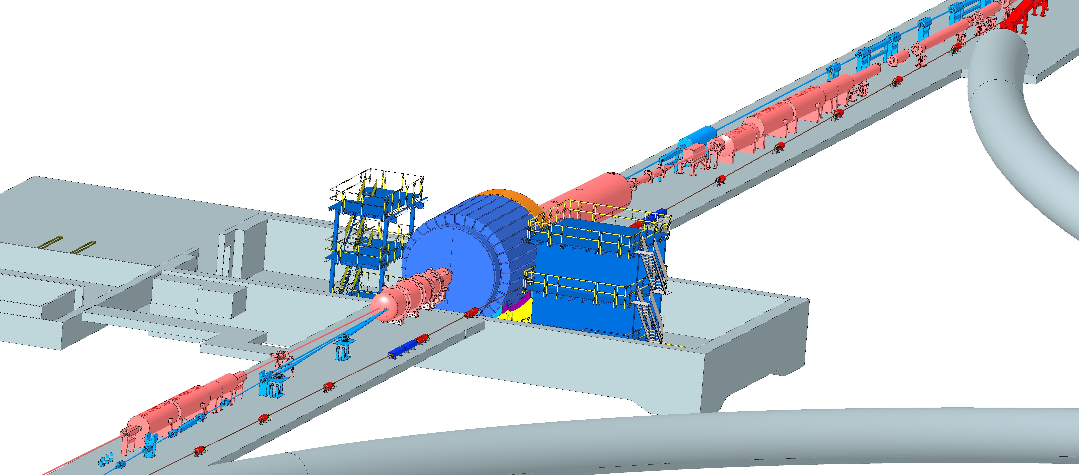
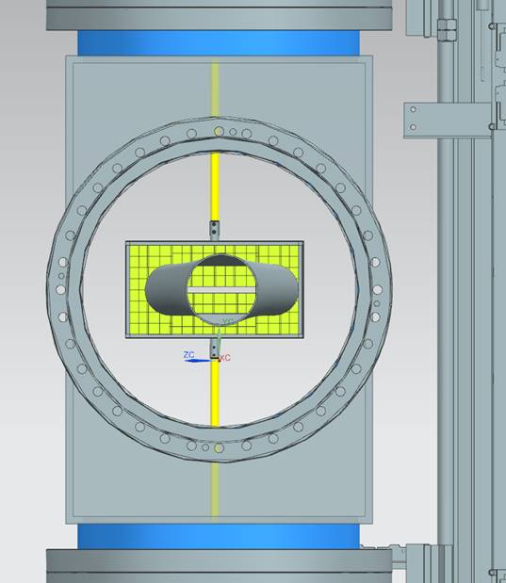

Interaction Region Layout
Central Detector
ESR Forward side
Detectors in B0 magnet
Roman Pots
Forward Side
SC Magnet Cryostat
HSR Injection Line
Central Detector
Rear Side
SC Magnet Cryostat
HSR Forward Side
HSR: Hadron Storage Ring
ESR: Electron Storage Ring
RCS: Rapid Cycling Synchrotron
SC: Superconducting
HSR
Rear Side
RCS
With Detector Bypass
Low-Q2 Detectors
ESR Rear side
every cm counts… → integration and communication with accelerator team is crucial

Slide 26





Far-forward physics at EIC
e+d incoherent J/Psi events with proton or neutron tagging
e+p DVCS events with proton tagging.
Diffraction
Rapidity
gap
Saturation (coherent/incoherent J/$ψ$production)
Meson structure:
with neutron tagging (ep$→\left(π\right)→$e’ n X)
Lambda decays ($Λ→$p$π−$ and $Λ→nπ0$)
e+He3 with spectator proton tagging.
Tagging of coherent light ions (d, He3, He4) from coherent scattering.
e+Au events with neutron tagging to veto breakup and photon acceptance.
….

Slide 27





Far-Forward Ancillary Detector Integration
Roman Pots integration
Roman Pots
Off-momentum
detectors
IP magnets & ancillary detectors fully simulated in GEANT including all beam effects
Technologies defined
Silicon: AC-LGAD & MAPS
Zero Degree Calorimeter:
  ECAL (PbWO4)
  HCAL (PbSi + PbScint)
Detector | Angular accept. [mrad] | p_{T} coverage
ZDC @ ~30m | $θ$<5.5 ( $η>6)$ | p_{T}<1.3 GeV
Roman Pots | 0*<$θ$<5.0 ( $η>6)$ | *Low p_{T}(t) cutoff (beam optics)
Off-Momentum Detectors | 0.< $θ$ < 5.0 ( $η>6)$ | Low-rigidity particles from nuclear breakups
B0 forward spectrometer | $$5.5<θ<20.0$$ (4.6< $η<5.9)$ | High p_{T}(t)
ECAL
PbW0₄
PbSi PbSc

Slide 28



Far-Backward Detectors
Luminosity Detector and Low Q² Tagger
local hadron
polarimeter
luminosity detector
low Q²-tagger
Luminosity Detector Concept:
Use Bremsstrahlung ep → epγ as reference cross section
Goals for Luminosity Measurement:
Integrated luminosity with precision δL/L< 1%
Measurement of relative luminosity:
physics-asymmetry/10 → ~10⁻⁴ – 10⁻⁵
IP magnets, Lumi & low-Q² detectors fully simulated in GEANT including all beam effects and CAD layout
Low Q²⁻Tagger:
Purpose:
Detection of scatter electron for Q² < 0.1 GeV²
Critical for calibration of Lumi-detector
Beam divergence and energy spread impact performance
Technology:
Electromagnetic calorimetry with Si-tracking
→ strong synergy with luminosity detector
Combine
pair spectrometer → high precision
with
zero degree photon calorimeter
→ fast feedback for collider
Technology:
Electromagnetic calorimetry with Si-tracking

Slide 29

Far-forward/far-backward integration
Integration with accelerator/RF / impedance calculations
  hadron line : Roman Pots/Off-Momentum detectors
  electron line: exit window for low-Q2 taggers
B0-detectors support and installation (only 13cm in front!)
Detector placement (accelerator design is still a bit in flux): ZDC
Off-Momentum detectors (OMD) and the neutron cone
OMD
OMD
B0 installation
p
n
Only 13 cm (!) space for installation
Negative side of OMD
Roman Pots integration

Slide 30



Electron and Hadron Polarimetry
Electron Storage Ring
Compton polarimeter
Rapid Cycling Synchrotron
Compton polarimeter
(for machine setup)
IR-6 / ePIC
Local polarimetry
Inside spin rotators
Fiber target for hadron polarization orientation
Compton backscattering for electron polarization
IR-4
Hadron polarimetry
HJET for absolute polarization
Fiber target for time dependence and bunch profile
$$10 \text{ns}$$
transverse
longitudinal
Electron bunches are replaced every few seconds.
Hadron bunches are stored for many hours.

Slide 31

EIC Project Detector R&D Program & In-Kind
https://wiki.bnl.gov/conferences/index.php/ProjectRandDFY23
INFN-Ferrara, Glasgow
INFN-Roma1, INFN-Ferrara
GSI
IJCLab-Orsay, INFN-Genova, AANL/Armenia
Valparaiso
IJCLab-Orsay, CEA Saclay, INFN-Torino
IJCLAB/Omega/
Saclay/NCKU
International
Partners
Birmingham, Brunel, RAL, INFN-Bari, INFN-Trieste, IMP, CCNU
Nurnberg, GSI, INFN-Bologna, Cosenza, Ferrara, Genova, Trieste
Birmingham, Brunel, RAL, INFN-Bari, INFN-Trieste, IMP, CCNU
Chinese EMCal
Consortium
CEA Saclay
Strong synergies with CERN
CERN – EIC R&D Day November 2021 https://indico.cern.ch/event/1063927/
MAPS: ALICE-3 – ITS-3 development
PID: LHC-b and ALICE-3
Photon-sensors: LAPPDs with LHC-b
MPGD: long-term CERN R&D program RD51
DAQ: strong developments on streaming DAQs for all LHC experiments
AI/ML and high-performance distributed computing

Slide 32

EIC Project Detector R&D
Photon-Sensors:
WBS 6.10.04 & 05 & 06
Assess current state of LAPPD performance. Improve design through iterations to fulfill EIC specifications
  Spatial resolution for Cherenkov imaging applications
  Timing resolution in a single photon mode
  Timing resolution for Time-of-Flight purposes
  Performance in a strong (inhomogeneous) magnetic field
  QE & PDE spectrum optimization
  Geometric form factor optimization
MAPS-Tracker:
Development of a full tracking detector solution composed of 65 nm MAPS sensors Modules from stitched sensors, barrel & discs, mechanics, integration & cooling
reduce the services material load
→ Improved powering and readout system
Development of the EIC sensor: design & characterization
MPGDs:
Development of prototypes of cylindrical MPGDs & planar thin gap MPGDs
AC-LGAD:
Develop system including sensors, ASIC & services for auxiliary detectors and ToF
Electronics & DAQ/Computing
Development of readout solutions for
calorimeters with SiPMs, ASIC based & ADC based
dRICH with SIPMs based on ALCOR
AC-LGAD readout chain with EICROC & FCFD
MPGD readout based on SALSA-ASIC
PID-Detectors:
DIRC: focus on Cosmic ray telescope (CRT), validation of BaBar bars reuse option, and completion of cost optimized hpDIRC design
mRICH: optimize photonsensors + electronics; testbeam of improved prototype
dRICH: Characterize mirror & aerogel; Assessment of dRICH prototype performance with the EIC detection plane
HCals:
Prototype SC-tile production using machining & injection molding & detailed characterization
Sensor board development
first prototype of one full segment
ECals:
bECAL: Full characterization of full SciGlass block designed for EIC by beam test
fECAL: construct 64 channel prototype to optimize light uniformity, light guides, verify performance by test beam
Hadron Polarimetry:
R&D through Accelerator
validate concepts to veto breakup of He-3
new targets for pC-polarimeters

Slide 33

Some EIC Detector R&D Highlights
dRICH (and GEM) test at CERN beam
Synergy with CERN/ALICE R&D, submission of Si ITS3/MAPS TowerJazz 65 nm. EIC contribution through RAL group is high-speed data transmission IP blocks (LVDS receiver, CML transmitter). Further EIC R&D is ongoing ITS3 stitched sensor design.
Scale-up of scintillating glass, in synergy with DOE SBIR/STTR (EIC R&D is beam prototype tests)
Two radiators with 180 hadron beam with reference readout
40 cm long SciGlass

Slide 34


Detector PED Progress – In-Kind User Contributions
Much PED progress was made courtesy in-kind contributions!
Example I: Backward EM Calorimeter: France/IJCLab
Example II: Barrel EM Calorimeter: Canada & Korea Universities
Example III: dRICH: INFN institutions
Example IV: Magnet PED contribution: France/CEA-Saclay
Example V: Si vertex tracker design: UK/STFC (supported by $3M UKRI grant, as part of the Si-Consortium)
Photo sensor module with integrated cooling and annealing:
256 channels/module (4 ASICs)
832 modules/sector
6 sectors
319488 channels overall
dRICH design
Backward EM Calorimeter design
Pre-CD-2 baseline contributions to the detector PED from in-kind are around $5M

Slide 35




Detector PED Progress – In-Kind User Contributions
Much PED progress was made courtesy in-kind contributions!
Example VI: Detector engineering design evaluation of AC-LGAD TOF stave and support structure (Purdue & NCKU)
Detector engineering design evaluation under way:
Construction of ¼ barrel full length (carbon fiber composite)
Evaluate the integration of cooling into the structure
End-cap low mass support structure engineering test
FEA of the support structure and tolerances
Thermal property studies and analysis of barrel and endcap
AC-LGAD stave and support structure design

Slide 36
Requirements: Beam Background at IR
electron beam:
Synchrotron radiation
  Backscattering
  Photo desorption
  → degradation of vacuum
Beam gas interactions
  Off momentum electrons
Higher order mode losses
  Local heating at injection and ramp (short bunches)
  degradation of vacuum
background due to de-excitation of beam if bunches are replaced
proton beam:
Low beam lifetime during
injection and ramping
Beam gas interactions, large
hadronic cross section
  Secondary interactions with
  aperture limitations, i.e. with
  magnets, beam pipe, masks
Requirement:
Keep beam backgrounds as low as possible
→ Careful design of interaction region, beam-pipe masks and photon beam dump
→ Excellent vacuum system
Important to note:
low multiplicity per event: < 10 tracks
No pileup from collisions 500 kHz @10³⁴ cm⁻²s⁻¹ → DIS event every 200 bunches
radiation environment much less harsh than LHC → factor 100 less

Slide 37






Background/Radiation Simulations
Details: https://wiki.bnl.gov/EPIC/index.php?title=Background
Synchrotron Radiation:
1 MeV Neutron fluence at top luminosity (500 kHz) for
18 GeV x 275 GeV
Electron Beam Gas:
Neutron & proton flux E_{kin}>250 MeV to determine single event upsets
top luminosity & 18 GeV x 275 GeV
Hadron Beam Gas:
Radiation doses at 18 GeV x 275 GeV for top luminosity 500 kHz

Slide 38


Background/Radiation
Primary collisions contribute a substantial fraction of the ionizing radiation and low energy neutron fluence in the experimental hall
→forward EmCal: up to ~5*10⁹ n/cm² per fb⁻¹ (inside the towers); perhaps ~5 less at the SiPM location
→ backward EmCal: ~250 rad/year
(at “nominal” luminosity ~10³³ cm⁻² s⁻¹)
Beam-gas interactions are one of the main sources of neutrons that thermalize within the detector hall and cause the damage.
The current FLUKA simulations show that the EIC detector will obtain annual dose of 6*10¹⁰ n/cm² (1 MeV equivalent)
→ Impact on SiPMs and Silicon Vertex Tracker → suggested tolerance of 10¹⁴ n/cm²

Slide 39

EIC High Level Project Schedule
Construction Phase
Science Phase
Conclusion of RHIC Operations
The thinner bars indicate that R&D and design
can continue at a small level beyond CD-2 and CD-3
for LLP construction
starts at CD-3A
Recent change replaced CD-4A with project internal milestones
The logic remains the same though, we start accelerator commissioning with an instrumented beam pipe and the detector in the Assembly Hall. The detector only rolls in later.

Slide 40








Installation Sequence (Barrel)
40

Slide 41

High Level Installation Schedule
Oct 2028
Jan 2029
CD-3
04/2025
April 2029
Milestone
P0_0305_0900
CD-4
09/2034
Dec 2029
early CD-4
09/2032
June 2030
Oct 2030
Jan 2031
Construction
Pre-OPS
IR-6 ready
for installation
Transition into
Operations
Early start of
Operations
&
Science
Start of
Operations
&
Science
lower half
barrel Hcal
installed
Solenoid
delivered
Endcap HCals
completed
Solenoid
Field mapping
done in beam position
Hadron Endcap
Detectors
installed
Trackers, dRICH
ECal
done in IP-6 Assembly Hall
Barrel Ecal
ready
for installation
Barrel Hcal
& Solenoid
installed
followed by low
power test
Lepton Endcap
Detectors
installed
Trackers, bRICH
ECal
Barrel Detectors
installed
ECal, DIRC,
ToF, Trackers
Take Away:
Solenoid and Barrel HCal need to be ready by Jan 2029
all other subdetectors need to be ready between 06/29 to 06/30 depending on their location in the detector

Slide 42
Detector #2

Slide 43
EIC User Group 2nd Detector/IR Brochure
Electron-Ion Collider User Group Steering Committee
The Electron-Ion Collider – The Benefits of Two Detectors
The Electron-Ion Collider's Golden Opportunity for Two Detectors
  Taking Advantage of the RHIC/EIC Collider Layout
  Detector Redundancy and Complementarity
  Lessons from History
  Sidebar on Science Discovery Relies on Independent
  Experimental Confirmation
A Gateway to Innovation and International Collaboration
  Two Detectors are More than 1+1
  The Path to New Ideas
  Sidebar on Radiation Therapy – Pushing the Envelope of Nuclear Physics Technology
  A Long-Term Investment in a Country’s Vitality
Brochure is eight pages, folds in input from 10 external readers from around the globe, Sent out to various international agency representatives late Spring 2022.

Slide 44

High Level EIC Reference Schedule
Construction Phase
Science Phase
The thinner bars indicate that R&D and design
can continue at a small level beyond CD-2 and CD-3
for LLP construction
starts at CD-3A
Generic Detector R&D
Schedule

Slide 45

Detector – Location
Two possible locations – IP6 and IP8 – for detectors and Interaction Regions.
IP6 - planned EIC project detector location
hadrons “going from inner to outer arc”
IP8 - viable location for complementary detector/IR
hadrons “going from outer to inner arc”
→ IR designs are NOT interchangeable with each other
IP8
IP6
Hadron Storage Ring
Electron Storage Ring
Electron Injector Synchrotron
Possible on-energy Hadron
injector ring
Hadron injector complex

Slide 46
Complementarity for 1st IR and 2nd IR
Following CD-1 progress on the design for the 2nd IR with a focus on complementarity
1st IR (IP-6)
2nd IR (IP-8)
Geometry:
ring inside to outside
ring outside to inside
tunnel and assembly hall
are larger
Tunnel: ⦰ 7m +/- 140m
tunnel and assembly hall are smaller
Tunnel: ⦰ 6.3m to 60m then 5.3m
Crossing Angle:
25 mrad
35 mrad
secondary focus
different physics emphasis and blind spots
different forward detectors and acceptances
different acceptance of central detector
Luminosity:
more luminosity at lower E_{CM}
optimize doublet focusing DF vs. triplet FDF
→ impact of far forward p_{T} acceptance
Experiment:
1.5 Tesla or 3 Tesla
different subdetector technologies

Slide 47



2nd Detector – Complementarity is Key
What do we want from “Complementary”
Cross-checking important results (obvious!)
  Many examples of wrong turns in history of nuclear and particle physics.
  Independent cross checks (detector, community, analysis tools) are essential for timely verifications and corrections
Cross Calibration
  Combining data gave well beyond the √2 statistical
  improvement …
  Different dominating H1, ZEUS systematics…
  Effectively use H1 electrons with ZEUS hadrons
  … not all optimal solutions have to be in one detector…
Technology Redundancy
... by applying different detector technologies and philosophies
to similar physics aims
  mitigates technology risk vs. unforeseen backgrounds
  differently optimizes precision and systematics
Different primary physics focuses
... EIC has unusually broad physics program
(from exclusive single particle production to high multiplicity
eA or γA with complex nuclear fragmentation)
→ Impossible to optimize for the full program in a single detector.
→ Impact on IR design
ATLAS
CMS

Slide 48

Progress – Interaction Region
1st IR (IP-6)
2nd IR (IP-8)
IR Highlights and Challenges
High Luminosity → High current (~ 2.5 A)
High number of bunches (1160, ~10 ns separation)
  Avoid parasitic collisions at IR
    Crossing angle
    Both focusing elements close to IP
Small $β$* values (h: 80/7.2 cm, e:45/5.6 cm)
  Strong final focus magnets close to IR
  Aperture: challenging magnet designs
Polarization
  Lattice constraints to enable polarized beams
  Polarized hadrons / electons
    Polarimetry (local and global)
    Spin rotators & Snakes
  electrons: Frequent on-energy bunch replacements
Experimental detector
  Forward detectors
  Experimental solenoid & compensation
The same highlights and challenges as IP-6
Different: pre-conceptual design with 35mr crossing angle and secondary focus for science complementary checks.
Further study needed for the feasibility of the IR magnets → Nb3Sn magnets are being evaluated as an option.
2nd focus enables:
enhanced low P_{T} acceptance, DVCS on nuclei, Light ion tagging, Diffraction, improved Gluon imaging by detection of (A-1) nuclei

Slide 49
IR Requirements and Parameters
(from talk of Angelika Drees and Randy Gamage at DPAP meeting December 13-15, 2021)
 | 1st IR |  | 2nd IR
 | proton | electron | proton | electron
Detector occupied region | -4.5 m +5.0 m Beam elements < 1.5º in main detector |  | -4.5 m +5.0 m Beam elements < 1.5º in main detector
Polarimetry | Yes (IR4) | local | Yes (IR4) | local
2nd focus | No |  | Yes
$β$* @ 275 GeV (h), 10 GeV (e) | $β$*_{x} = 80 cm $β$*_{y} = 7.2 cm | $β$*_{x} = 45 cm $β$*_{y} = 5.6 cm | $β$*_{x} = 80 cm $β$*_{y} = 7.2 cm | $β$*_{x} = 45 cm $β$*_{y} = 5.6 cm
ZDC | 0.6m x 0.6m x 2m @ s$≅$30m $n: ±$ 4 mrad |  | 0.6m x 0.6m x 2m @ s$≅4$0m $n: ±$ 4 mrad
Roman Pots | 1-5 mrad, @s$≅$30m |  | 0-5 mrad, @s$≅$30-45m
Scattered particle acceptance | p: 0.18 GeV/c < p_{T} < 1.3 GeV/c |  | p: 0 GeV/c < p_{T} < 1.3 GeV/c
Q² tagger |  | Q²< 0.1 GeV
Crossing angle | 25 mrad |  | 35 mrad

Slide 50

Science Slide
Interaction Region design that includes a secondary focus provides a distinct advantage for tagging experiments off heavy ion beams
2nd focus enables:
enhanced low P_{T} acceptance
DVCS on nuclei
Light ion tagging
Diffraction
improved Gluon imaging by detection of (A-1) nuclei

Slide 51


Summary
a modern forward looking general purpose detector
  several novel technologies that will advance the state of the art
  scope well defined → last two technology choices finalized by 04/21/2023
    Long Lead Procurements identified and corresponding design prioritized
  construction and installation timelines understood
collaboration will be fully integrated in project structure
  Detector subsystem technical leads will be technical contact of subsystem on Level-4
  L5 Work Package leaders as defined in the detector subsystem - structures
Progress in R&D and PED has already now large intellectual and in-kind contributions from the international community -- THANK YOU
Collaboration on all subsystems with and without in-kind contribution is extremely welcome
  the EIC project is planning on in-kind at a level that corresponds to the expressions of interest → 1/3 of total detector cost

Slide 52


Slide 53

Accelerator Science and Technology – Ongoing EIC R&D
ESR = Electron Storage Ring
HSR = Hadron Storage Ring
IR = Interaction Region
HOM = Higher-Order Modes
Cooler Electron Source
ESR
Vacuum R&D
Electron Injection
Fast Kicker
Strong Cooling
Polarized e⁻ Source
ESR Cavity
Prototype
HSR Vacuum Upgrade
ESR RF 500kW FPC
2nd IR
ePIC
Hadron Polarimetry
ESR RF HOM Damper
Crab Cavity
Prototype
Proton Injection
Fast Kicker
IR Design and Magnet Prototyping
IR Vacuum Chamber
Existing tunnel and
experiment halls
EIC is the ONLY new collider in the next decade! Allows to remain at frontier of Accelerator S&T

Slide 54

Far-Forward Detectors: Roman Pots
need two configurations:
high acceptance:
measure the low-t region
lowest t impacted by beam optics
high divergence
measure high-t tail
highest t reach driven by IR magnet
design → bore size
t= p_{T}²
HA
HD
$$\boxed{σ(z)=\sqrt{ε∙β(z))}}$$
Note:
→ high luminosity and low p_{T} acceptance for forward scattered particles are anticorrelated
Luminosity increases if β* ↓ &divergence $σ^{′∗}$↑
Highest luminosity → smallest low p_{T} acceptance at RPs

Slide 55


Electron and Hadron Polarimetry
Electron Polarimeter:
Method: Compton Backscattering
longitudinal polarization → Energy Asymmetry
transverse polarization → Energy dependent position asymmetry
Requirement:
Need to measure both polarization components
beam is only at IP fully longitudinal polarized
Beamline integration
Backscattered photon cone clearance through quads
Electron detector will need to be ~5 mm from electron beam
  Investigating a Si in vacuum ala off-momentum
  detectors can be used?
In close contact with Accelerator group for SR simulations
and beam backgrounds
Hadron Polarimeter:
Method: RHIC H-Jet and pC Polarimeters
measure polarization through left-right asymmetries in CNI region
Requirement:
Need to measure
absolute polarization → H-jet (slow)
need to measure polarization lifetime, profile and fast feedback to collider
Beamline integration
new location at IP-4
H-Jet and pC fully integrated in lattice, including taggers for He-3 polarimetry
Challenge
make RHIC polarimeters work for the different EIC beam conditions

