Slide 1
Lecture 3: TMD factorization
TMD factorization, evolution, resummation

Slide 2
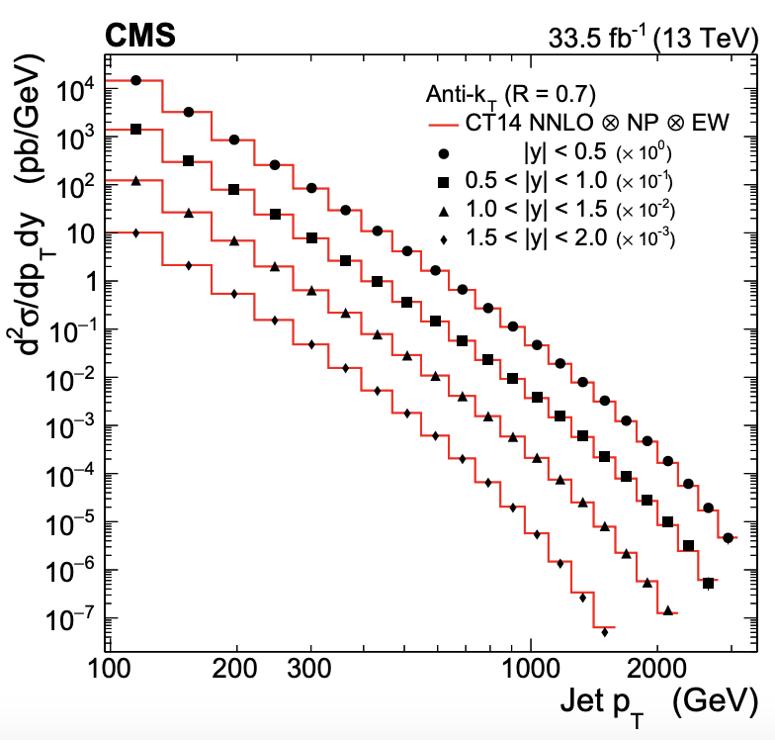
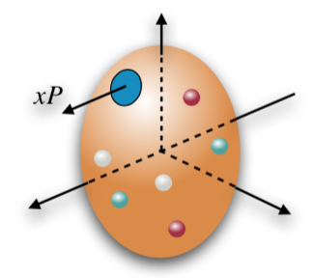
Two kinds of QCD factorization
There are different types of QCD factorization, one should use them accordingly to describe data in different processes
  Collinear factorization: process with ONE single hard scale
    Single-inclusive hadron/jet in p+p collisions: pT is the hard scale
    Inclusive deep inelastic scattering (DIS): Q is the hard scale
2111.10431

Slide 3
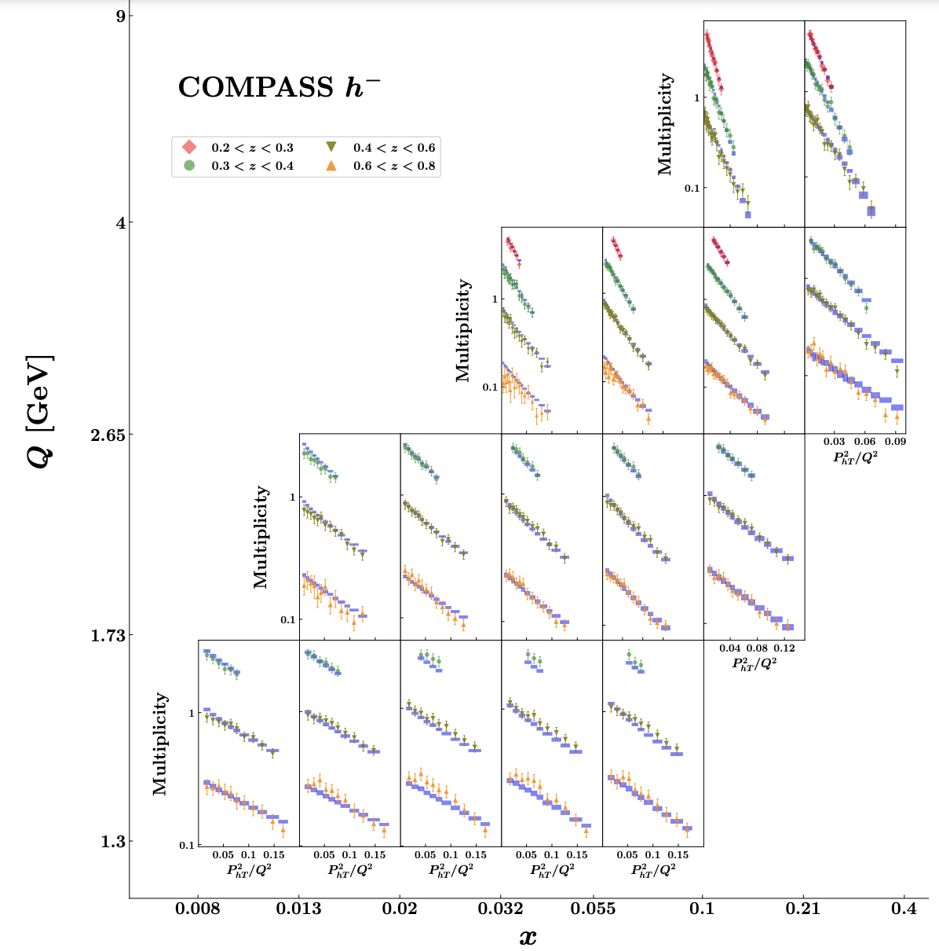

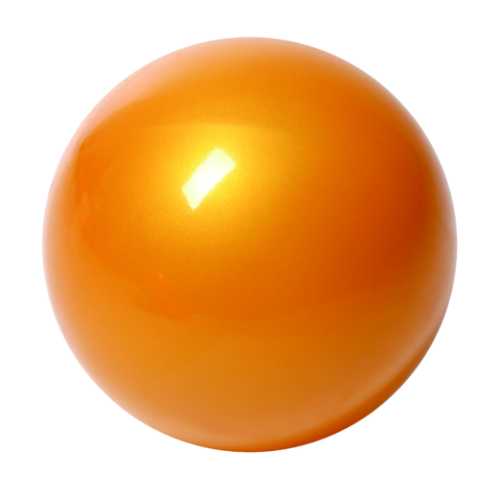

Another type: TMD factorization
TMD factorization, used for more differential processes
  TMD factorization: process with TWO momentum scales (Q, qT) with qT << Q
    Semi-inclusive hadron production in e+p collisions (SIDIS): qT, Q
    Drell-Yan production in p+p collisions: qT, Q
electron
p
h
p
p

Slide 4
TMD factorization in a nut-shell
Drell-Yan:
Factorized form and mimic “parton model”
Factorization of regions:
(1) k//P₁, (2) k//P₂, (3) k soft, (4) k hard
mimic “parton model”

Slide 5
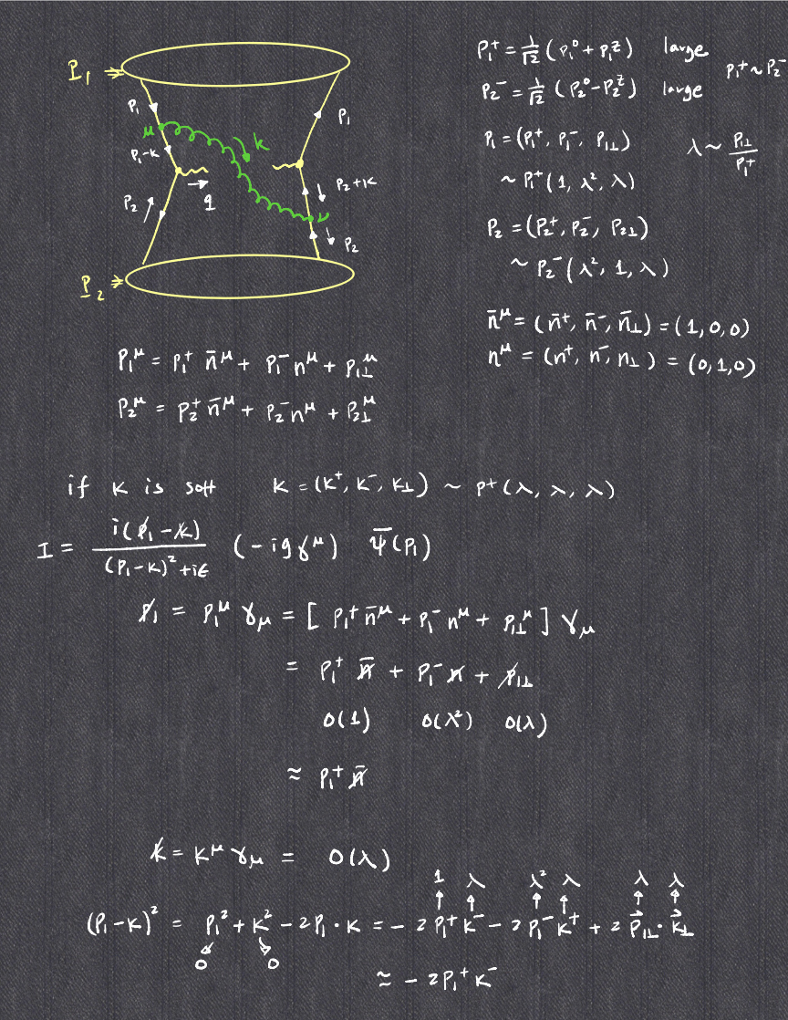
Illustration I

Slide 6
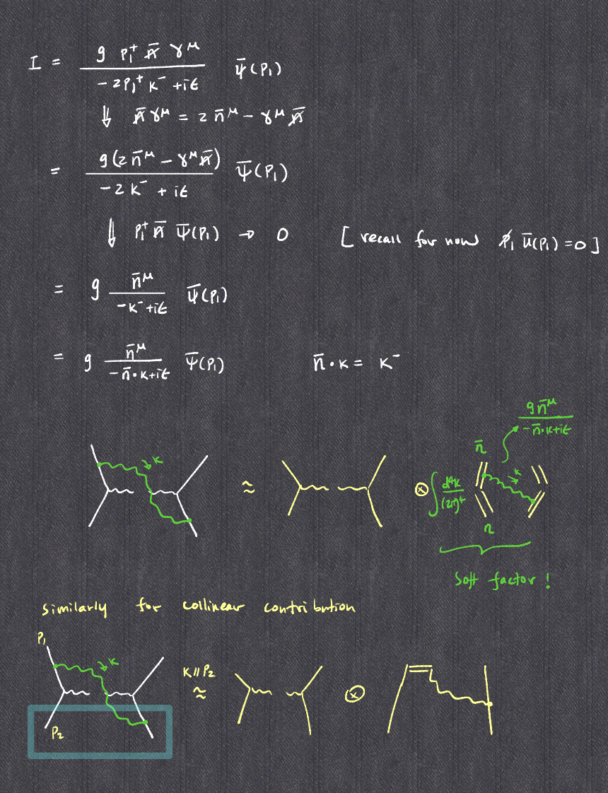
Illustration II

Slide 7
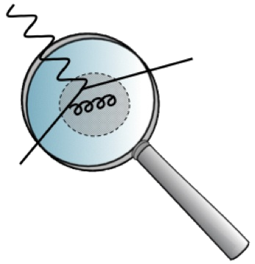
TMD evolves
Just like collinear PDFs, TMDs also depend on the scale of the probe = evolution
Collinear PDFs
TMDs
DGLAP evolution
Resum
Kernel: purely perturbative
Collins-Soper/rapidity evolution equation
Resum
Kernel: can be non-perturbative when

Slide 8
QCD evolution: meaning
Evolution = include important perturbative corrections
  DGLAP evolution of collinear PDFs: what it does is to resum the so-called single logarithms in the higher order perturbative calculations
TMD factorization works in the situation where there are two observed momenta in the process, Q>>q_{T}: what it does is to resum the so-called double logarithms in the higher order perturbative corrections

Slide 9
TMD evolution in a nutshell
longitudinal/collinear part
transverse part
Non-perturbative: fitted from data
The key ingredient – ln(Q) piece is spin-independent
The presence of non-perturbative evolution kernel makes TMD global analysis much more involved

Slide 10
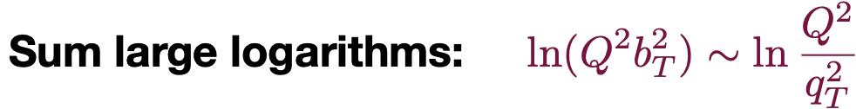
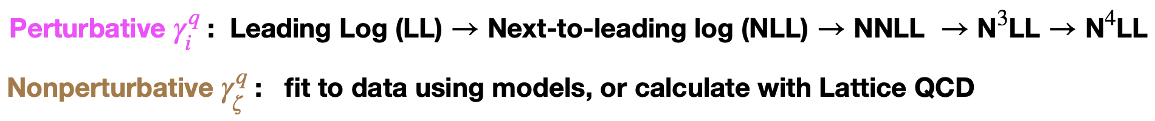
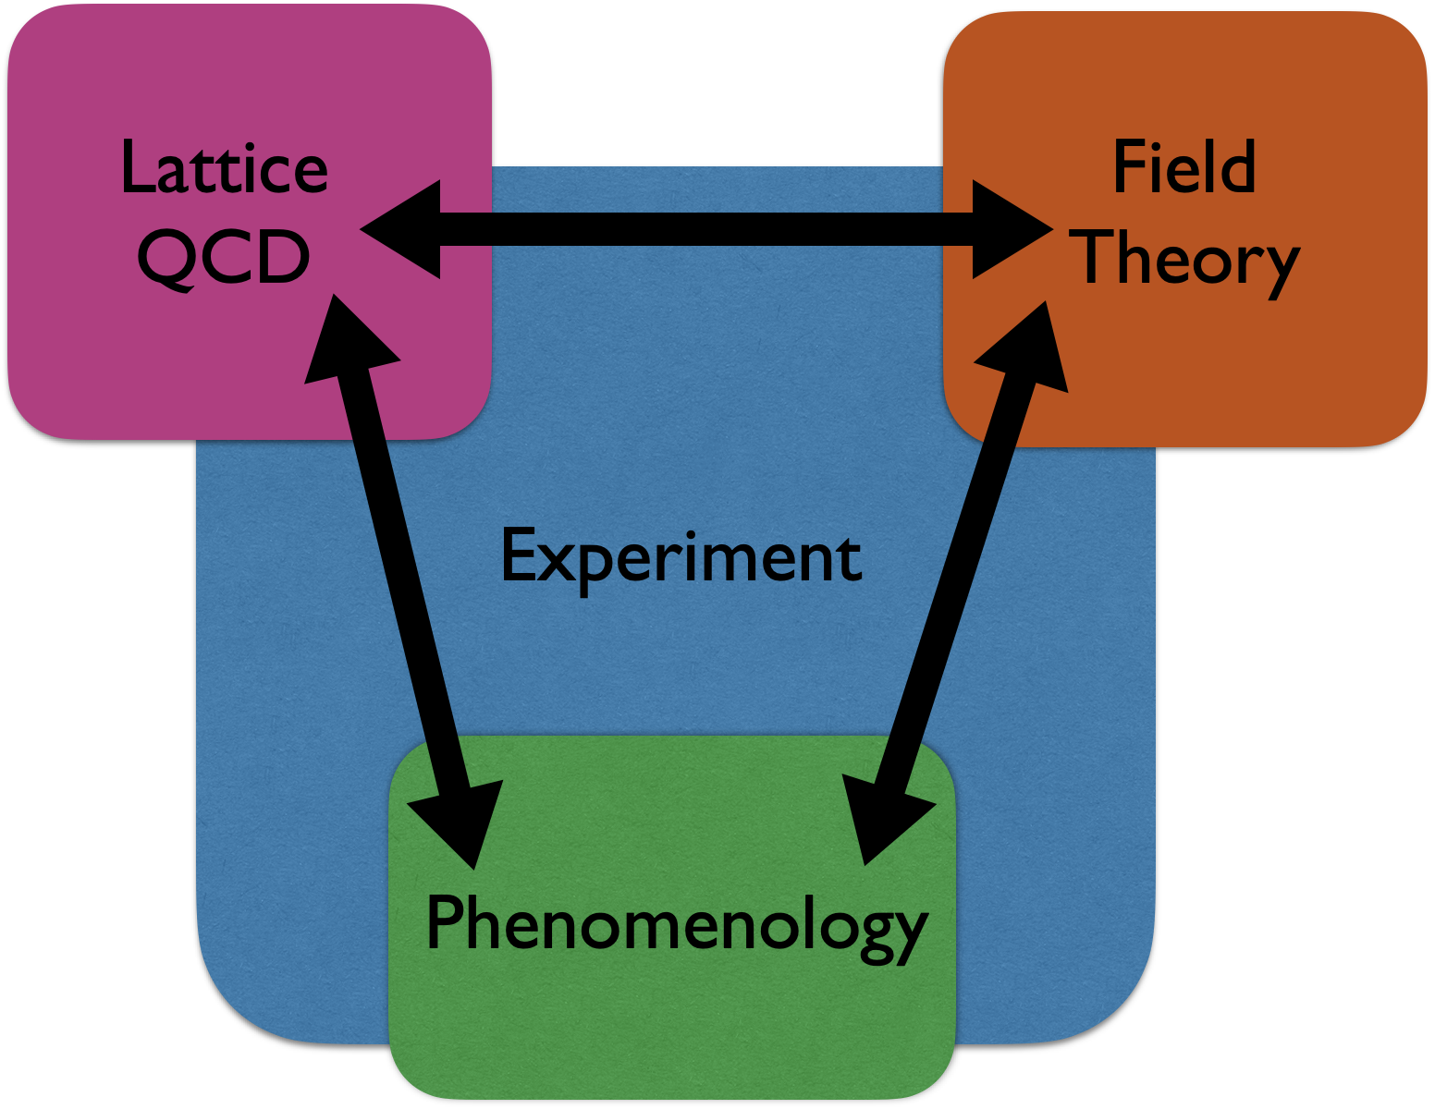
TMD evolution
TMD evolution
  Usual renormalization scale + a rapidity scale
Collins-Soper kernel
Courtesy of I. Stewart

Slide 11
TMD global analysis
Outline of a TMD global analysis [lattice input on initial TMD and CS kernel]
Ansatz for TMDs at initial scale
Model ansatz for
non-perturbative
Collins-Soper kernel
Evolve TMDs to relevant scale with TMD evolution
Fourier transform back to momentum space
adjust parameters
all data points
calculate the cross section/asymmetry as well as χ²
Fourier transform numerical heavy
Kang, Prokudin, Sato, Terry, 1906.05949
Implemented by ResBos
[Joshua Isaacson, 2022]
χ² minimum?
no
yes

Slide 12
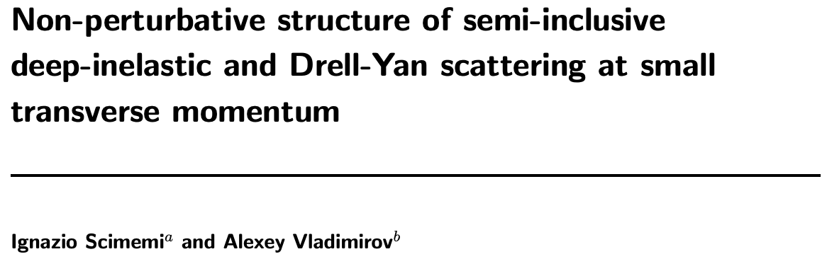
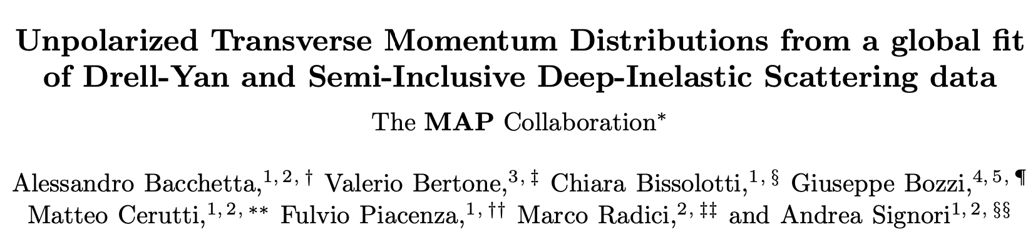
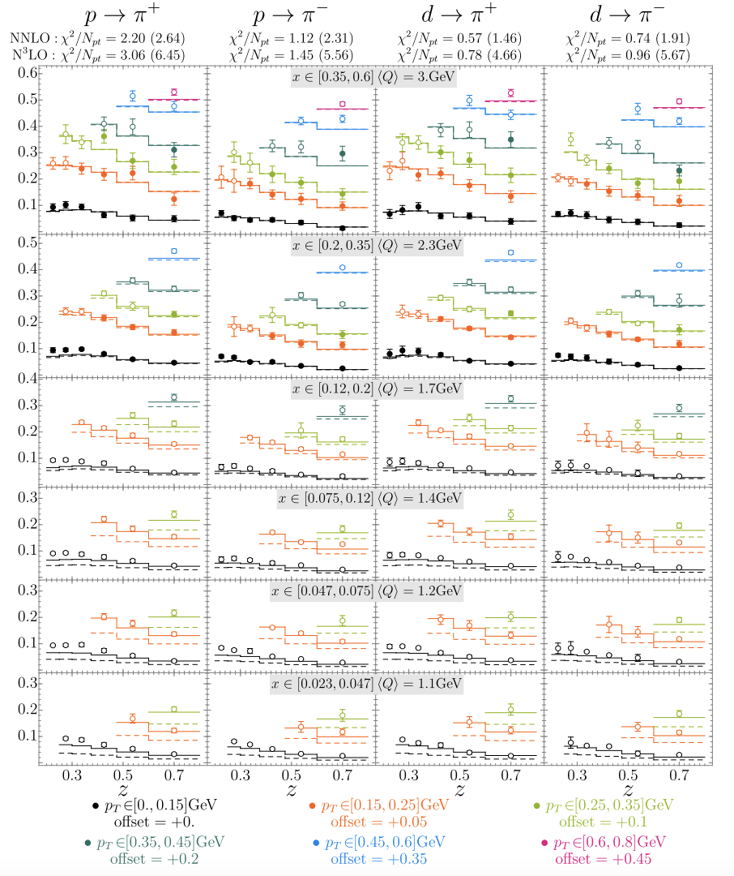
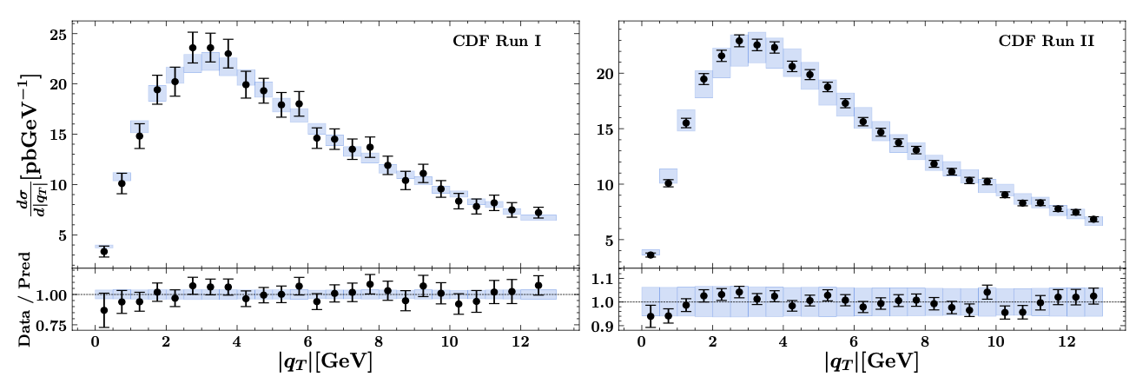
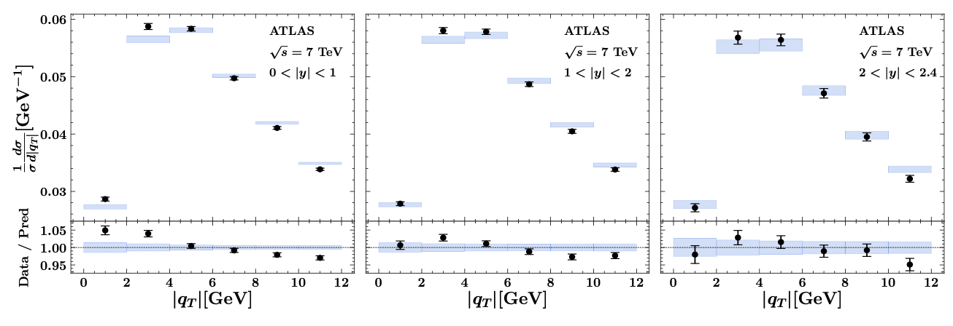
Unpolarized cross sections
Good fit achieved in the “TMD region” (N³LL)
JHEP (2020)
2206.07598
SIDIS
Drell-Yan

Slide 13
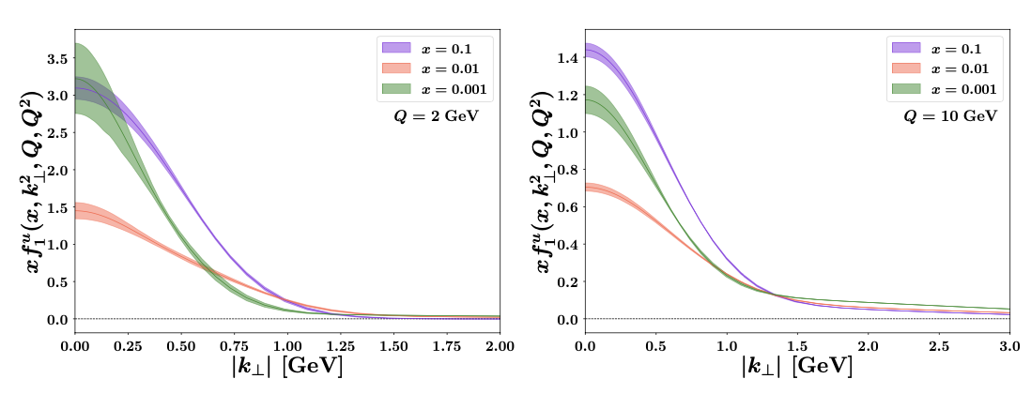

Unpolarized TMDs
Extracted unpolarized TMD PDFs and FFs
Useful tools
2206.07598
2103.09741

Slide 14
Effect of TMD evolution
What evolution does
  Spread out the distribution to much larger kt
  At low kt, the distribution decreases due to this spread
Based on Echevarria, Idilbi, Kang, Vitev, 14

Slide 15
Sivers function: non-universal
Sivers function: unpolarized quark distribution inside a transversely polarized proton
Spin-independent
Spin-dependent
1990: introduced by D. Sivers, to describe the large single spin asymmetry measured in inclusive hadron production in p+p collisions at Fermilab
1993: J. Collins shows Sivers function has to vanish due to time-reversal invariance
2002: Brodsky, Hwang, Schmidt performed an explicit model calculation, showed the existence of the Sivers function
2002: Original proof missed the gauge link (needed to properly define gauge invariant distribution), once added, found Sivers function in SIDIS is opposite to that in Drell-Yan
Collins 02, Boer-Mulders-Pijlman 03, Kang-Qiu, 09 …

Slide 16

Fundamental feature of Sivers function
Sivers function: check its definition
Sivers function
Look closer
Naïve time-reversal-odd: recall momentum and spin change sign under T
Forbidden?: such a correlation is forbidden in QCD, unless there is a phase
Sivers effect
left-right asymmetry
Recall:

Slide 17
Quantum mechanical phase
Quark passes through a color gauge field, generated by the remnant of the proton, it will accumulate a phase
electron
proton
anti-quark
quark
quark
quark
remnant
remnant
DIS: after the interaction
final state
Drell-Yan: before the interaction
initial state
Collins 02, Boer-Mulders-Pijlman 03, Collins-Metz 04, Kang, Qiu, PRL 09, …

Slide 18
Sivers effect: QCD version of Aharonov-Bohm effect
Pure quantum effect: different paths lead to interference
Physics today, September 2009

Slide 19
Gauge link: where does it come from?
Existence of the Sivers function relies on the interaction between the active parton and the remnant of the hadron
  SIDIS: final-state interaction
  Drell-Yan: initial-state interaction

Slide 20
Non-universality of the Sivers function
Different gauge link for gauge invariant TMDs in SIDIS and DY
Sivers function and its sign change
  See a derivation here Sivers function vanishes without gauge link

Slide 21
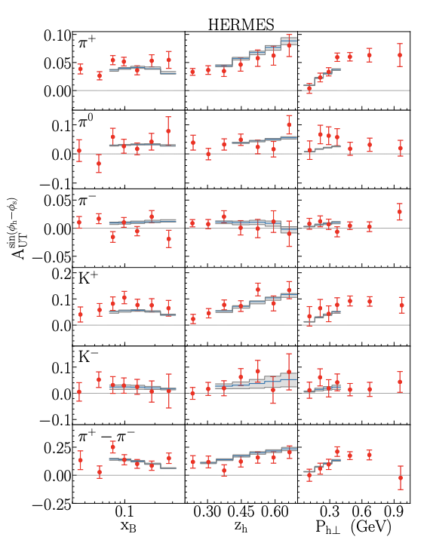
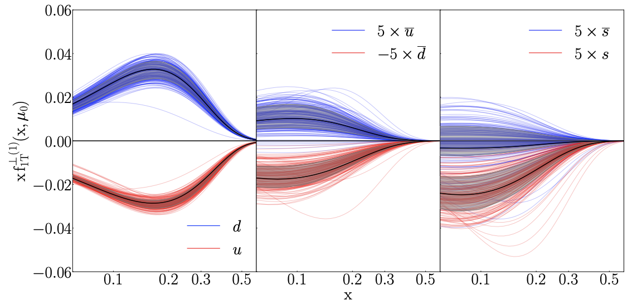
Progress from standard processes
Take an example: Sivers function
  Data: Jlab 12, HERMES, COMPASS, RHIC W boson
Echevarria, Kang, Terry, JHEP (2021)

Slide 22
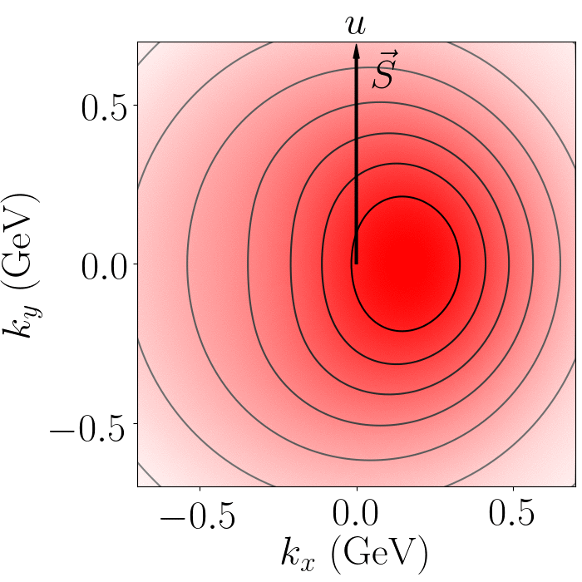
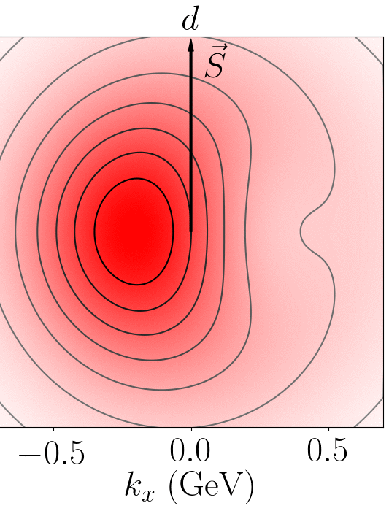
Distorted distribution
Sivers correlation leads to a distortion in u/d quark distribution
  Left or right shift
  Positive = more quark moves to the left

Slide 23
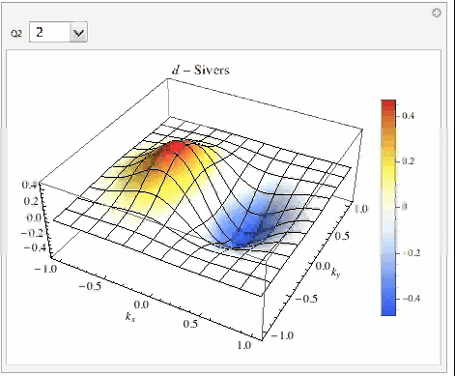
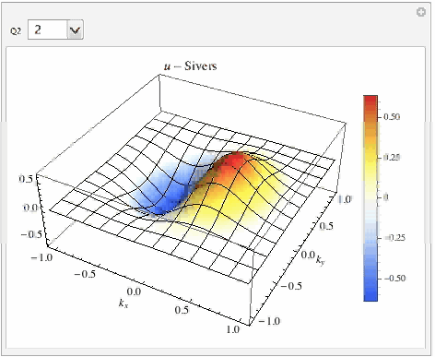
Extracted Sivers function and evolution
  3D visualization
D
U

Slide 24
Sign change between SIDIS and DY/W
Story about you need a persistent student
  Earlier predictions for W Sivers asymmetry is done in TMD parton model, i.e. no TMD evolution: works well
  Predictions for COMPASS DY Sivers asymmetry is done with TMD evolution: works well
  However, once taking into account TMD evolution for W Sivers asymmetry, the prediction is much smaller than data
Predictions comparison with DY/W
Echevarria, Kang, et.al., 2014
COMPASS, PRL, 2017
KQ = Kang, Qiu
STAR, PRL, 2016

Slide 25
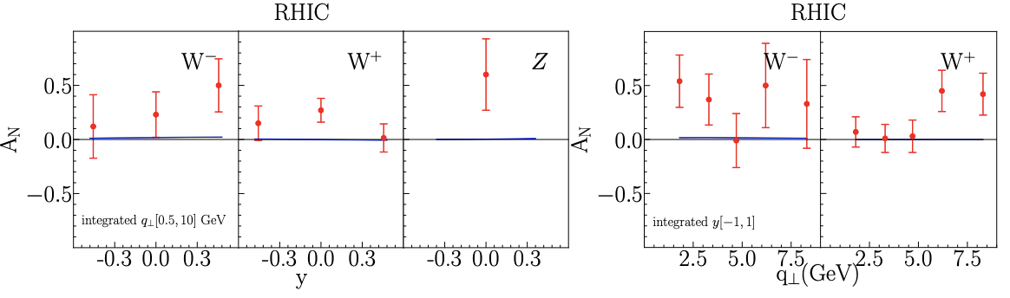
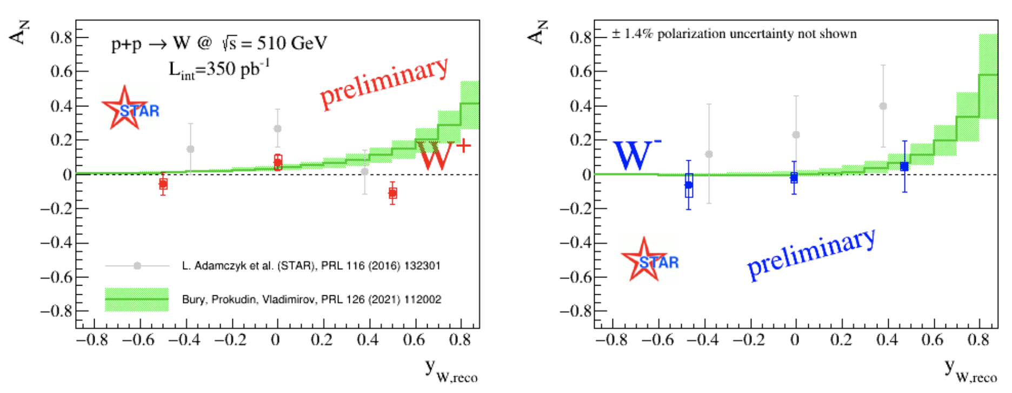
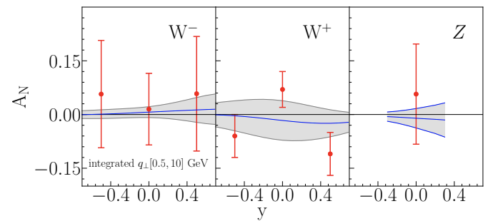
RHIC data: update
With TMD evolution, tension in fitting (2016) RHIC W/Z data (very large asymmetry), but consistent with 2021 preliminary data
  Emphasizing the importance of the precision measurement
OLD data
NEW data
Bury, Vladimirov, Prokudin
Echevarria, Kang, Terry

Slide 26
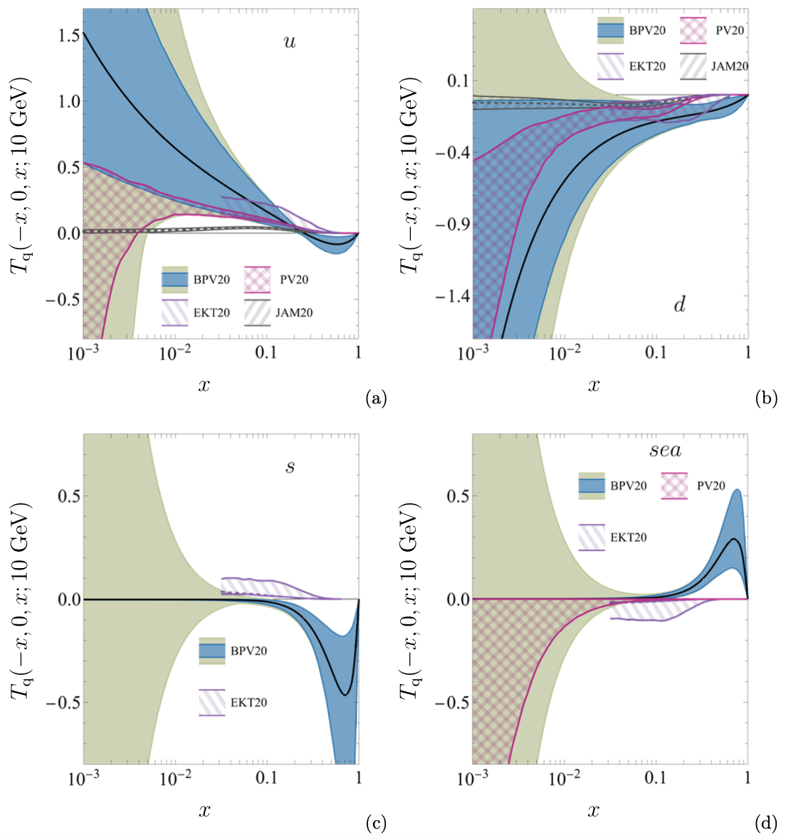

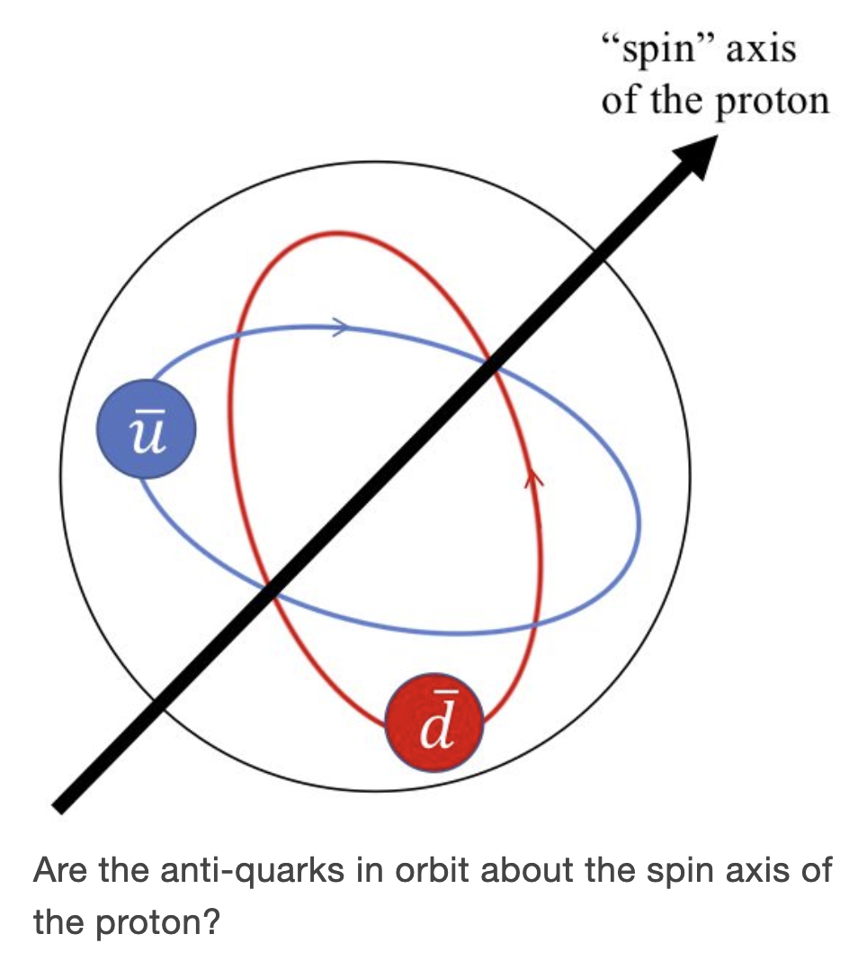
RHIC data: update
Major difference: sea quark in relatively large x region
This is precisely the main goal of SpinQuest/E1039 Drell-Yan experiment at Fermilab is to determine sea quark Sivers functions
Courtesy of A. Prokudin

Slide 27
Collins asymmetry from SIDIS and e+e-
SIDIS and e+e-: combined global analysis
transversity
Collins function
Collins function

Slide 28
Collins asymmetry in SIDIS
Fitting of SIDIS data
Kang, Prokudin, Sun, Yuan, PRD 15 & 16
HERMES
COMPASS
JLab

Slide 29
Collins asymmetry in e+e-
Fitting of e+e- data from BaBar and Belle
BaBar
Belle

Slide 30
Fitted TMDs
Fitted quark transversity and Collins function: x (z) -dependence
Collins function: pt-dependence

Slide 31
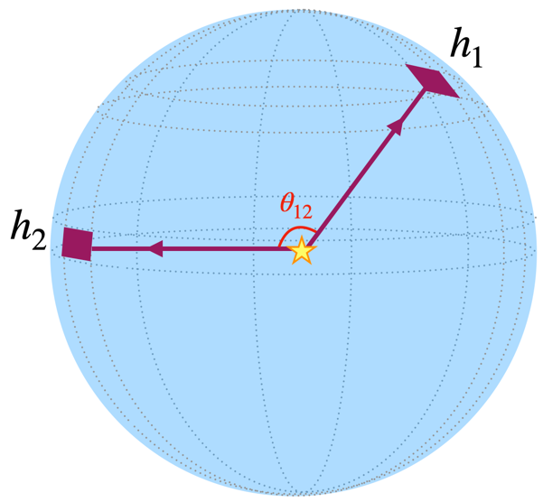
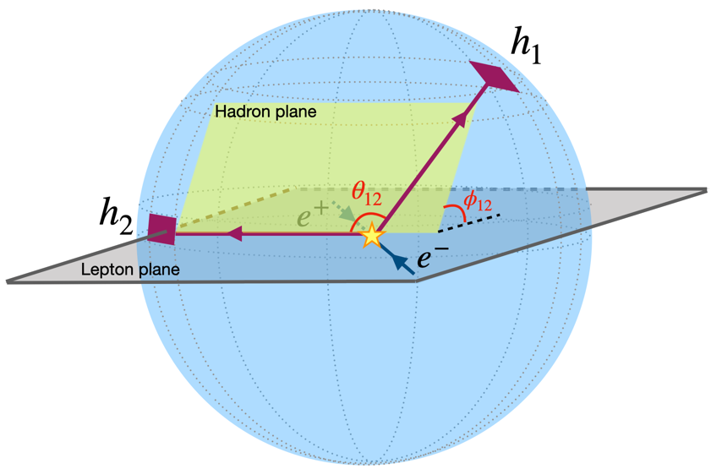
Energy-Energy Correlator
If you have ever heard about energy energy correlator
If including the azimuthal angle, this is so very similar to Collins effect studied at BELLE
Kang, Lee, Shao, Zhao, to appear, 2023.09xxx

Slide 32
Summary
TMD factorization and evolution
Global analysis
Modified universality of TMDs

