Slide 1

Experimental overview of the nucleon (spin) structure leading up to the EIC
TIDC Autumn School on the EIC,
NTU, Taipei, August 28-30
Ralf Seidl (RIKEN)

Slide 2
Outline
QCD and unpolarized nucleon structure
Spin sum rule and helicity structure
  Inclusive DIS
  Gluon Spin from p+p
  Interlude: Fragmentation functions
  (anti)quark helicities from SIDIS, EW pp
Transverse spin and momentum structure and effects
  Transversity and tensor charge
  Sivers function and other TMDs
3-dimensional structure in position space
  GPDs and DVCS
  Energy momentum tensor and related topics
Low-x physics

Slide 3
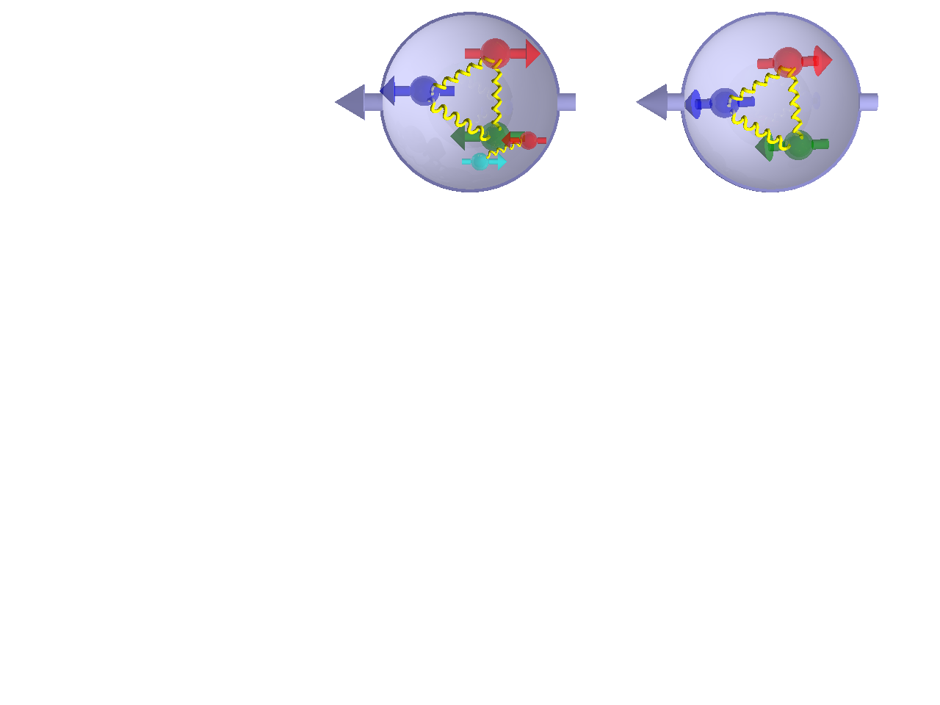
Helicity PDFs, longitudinal spin

Slide 4
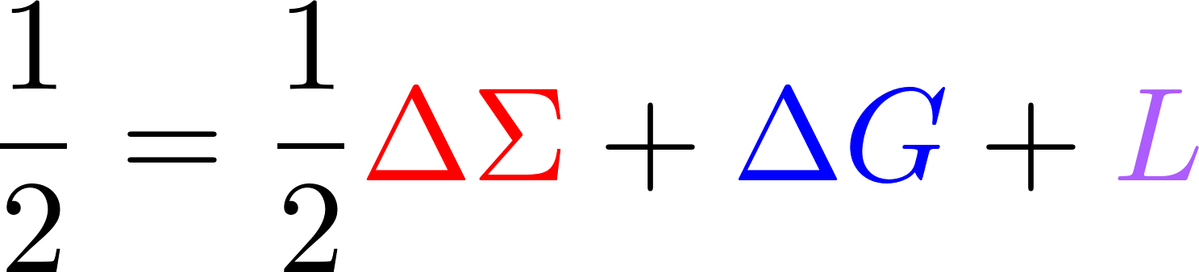
The Spin sum rule
Naïve Quark Model picture: 3 valence quarks make up the spin of the nucleon:
= + +
Spin Crisis (1980s): Quark spin contributes only little
ΔΣ and ΔG can be accessed in longitudinally polarized (SI)DIS and pp collisions (currently for x>0.01)
Where is the rest of the spin? Gluons? Lower momentum fractions? Orbital angular momentum?
Jaffe, Manohar
Quark spin
Gluon spin
Orbital angular momentum

Slide 5
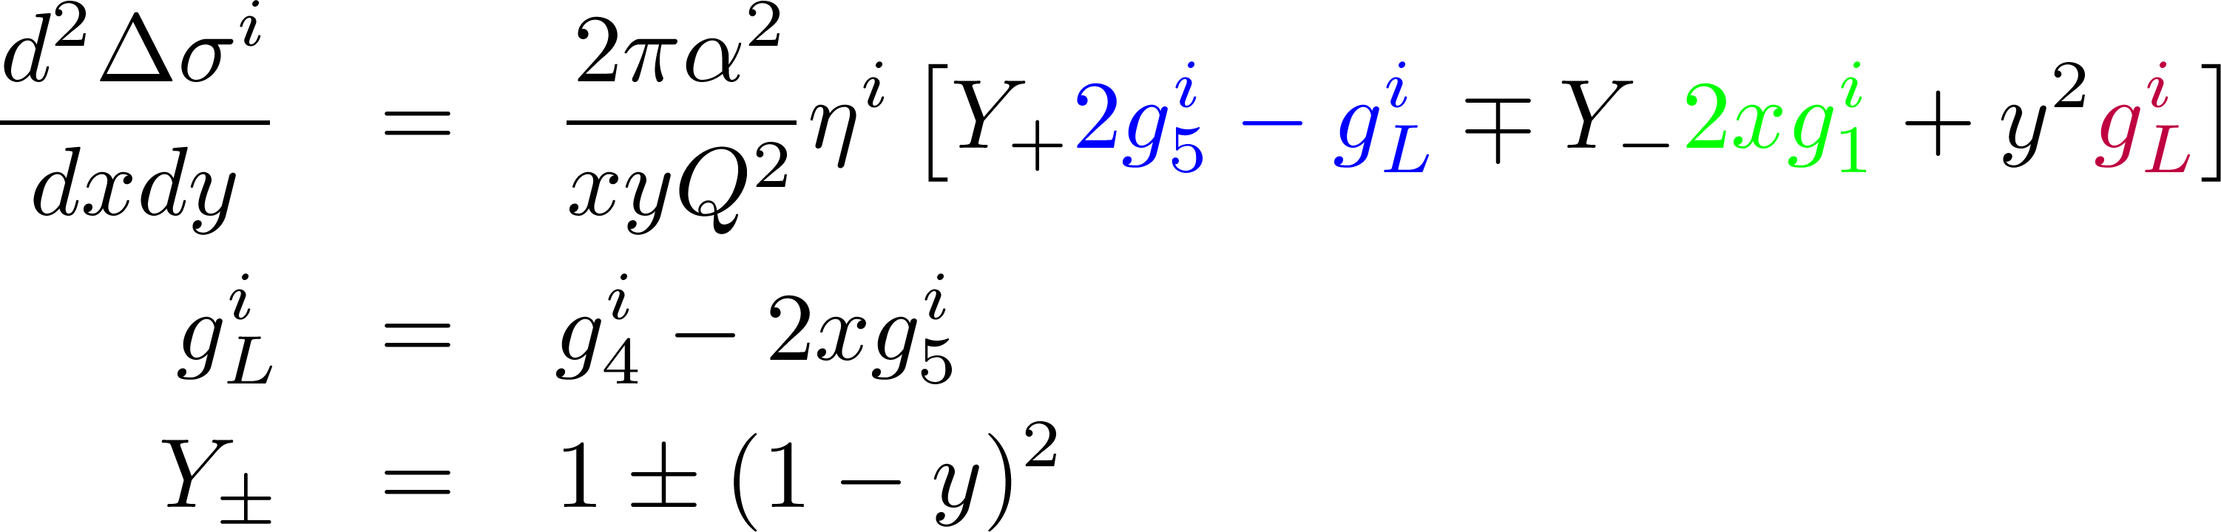
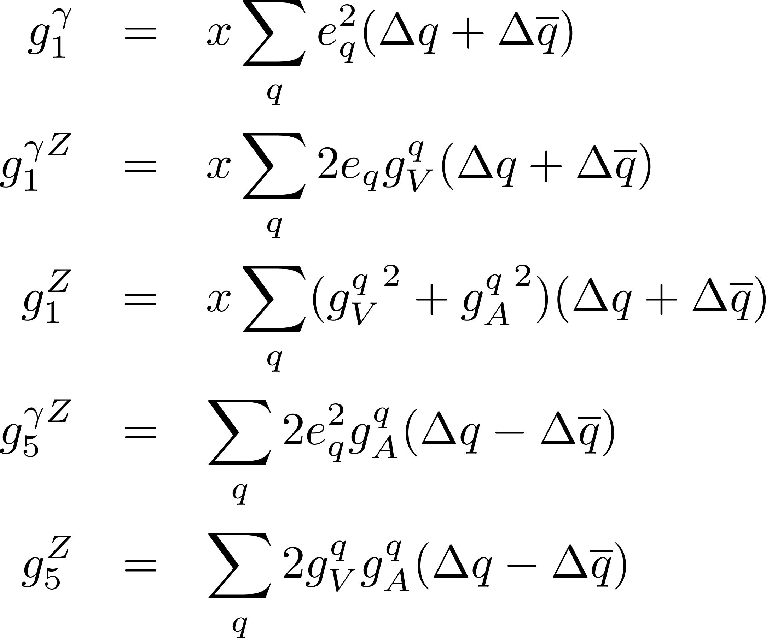
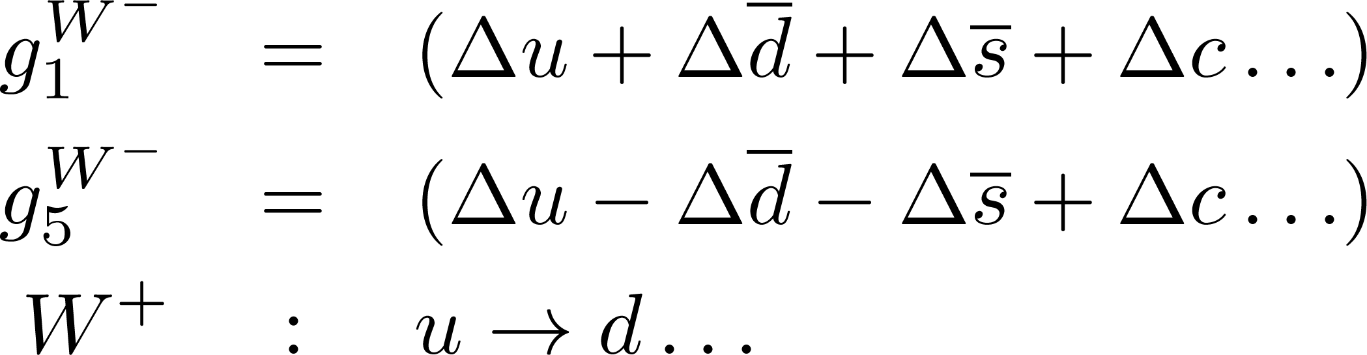
polarized proton structure
g₁ measures charge square weighted total quark spin contribution to the nucleon
Flavor information from gZ interference, Z exchange and in particular charged curent (W exchange) interactions
Neutral current
Charged current

Slide 6
Quark distributions
Sum of quarks with parallel and antiparallel polarization relative to proton spin
(well known from Collider DIS experiments)
q(x),G(x)
Unpolarized distribution function q(x)
Difference of quarks with parallel and antiparallel polarization relative to longitudinally polarized proton
(known from fixed target (SI)DIS experiments)
Δq(x), ΔG(x)
Helicity distribution function Δq(x)
δq(x)
Transversity distribution function δq(x)

Slide 7
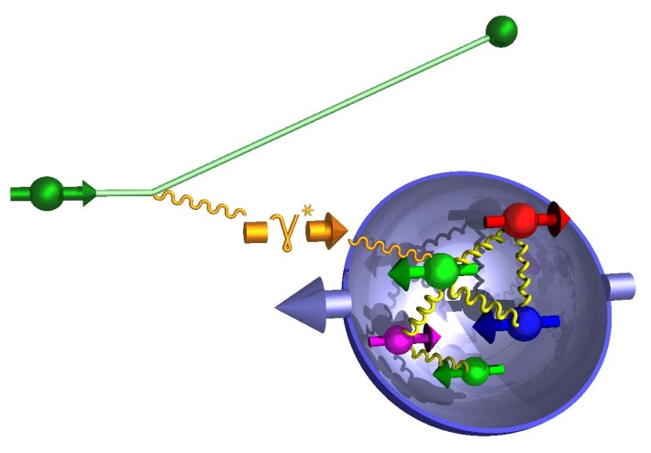
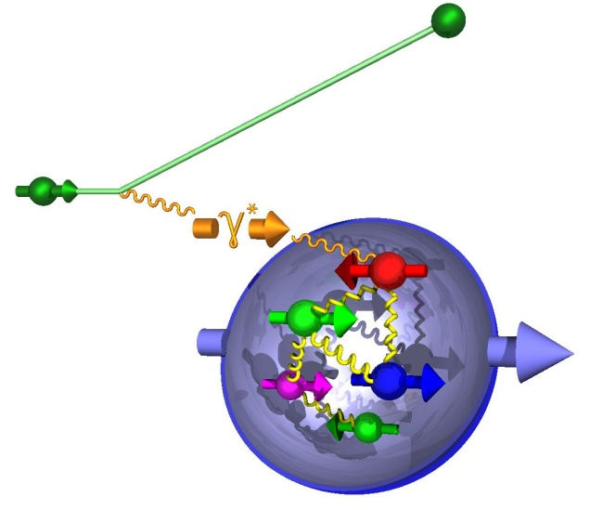
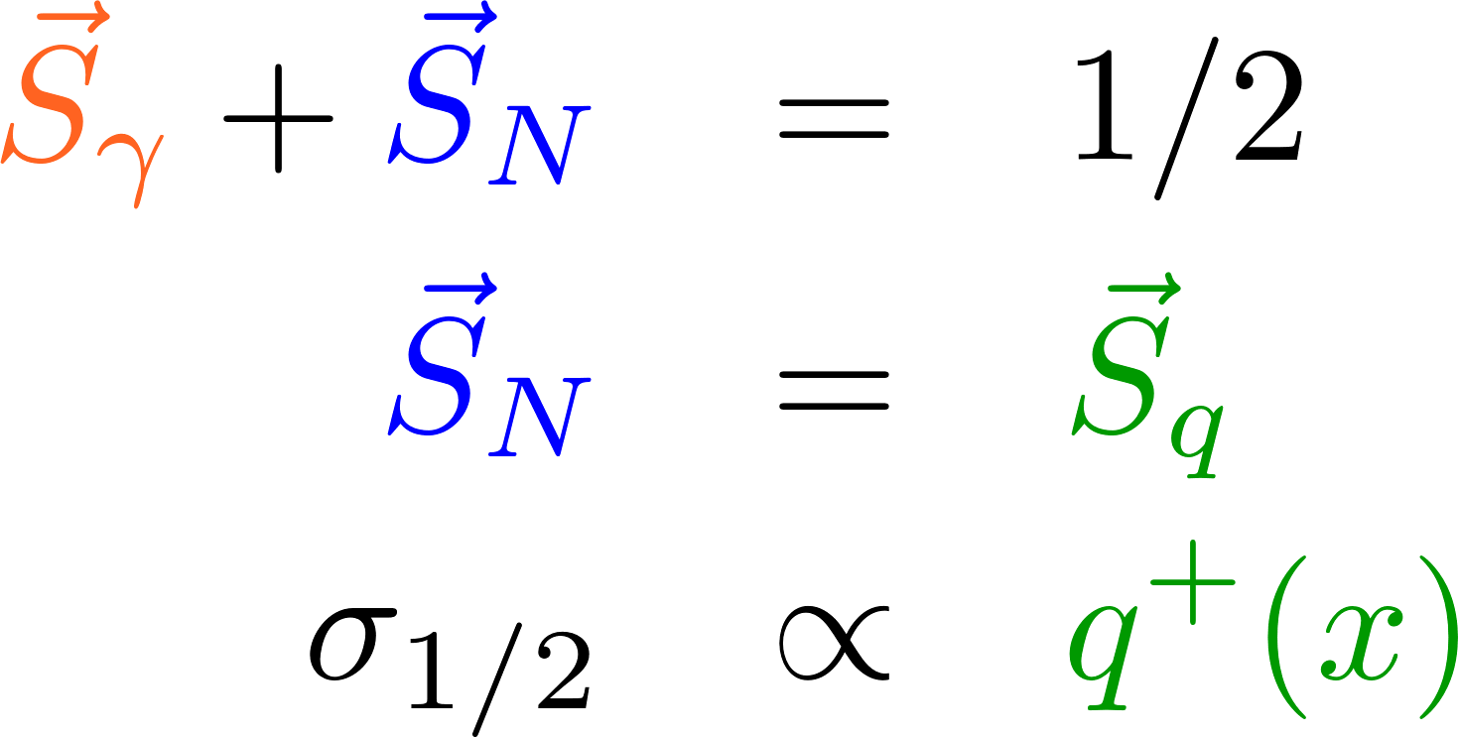
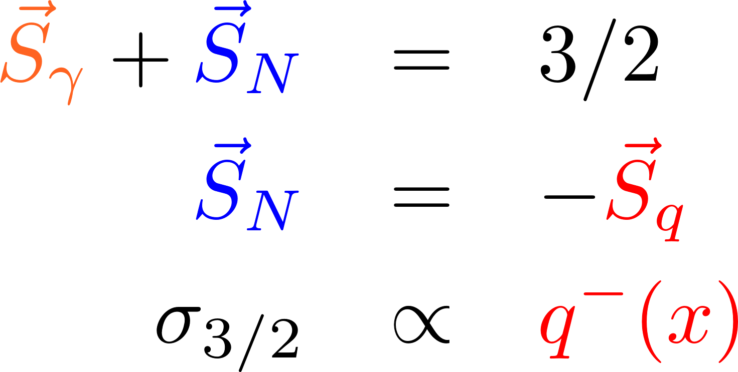
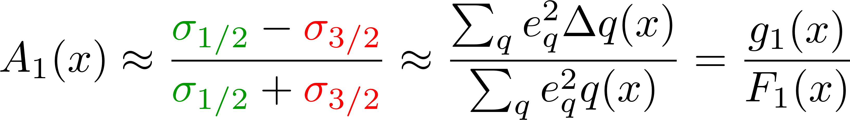
Polarized inclusive DIS
Virtual photon γ* can only couple to quarks of opposite helicity
Select q⁺(x) or q⁻(x) by changing the orientation of target nucleon spin or helicity of incident lepton beam
Δq(x) = q⁺(x) – q⁻(x)
Asymmetry definition:
L.O.
inclusive DIS: only e’ info used

Slide 8
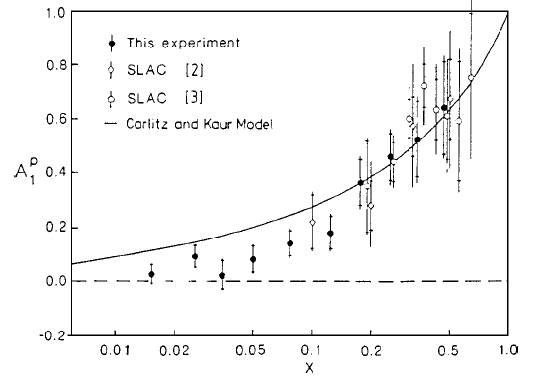
First polarized DIS measurements and spin crisis
First SLAC measurements consistent with naïve quark model (valence quarks make up proton spin)
EMC finds quark contribution of only ~12%
  Anomaly?: huge gluon
  and orbital angular momentum contribution?
20 years later ΔΣ around 0.3

Slide 9
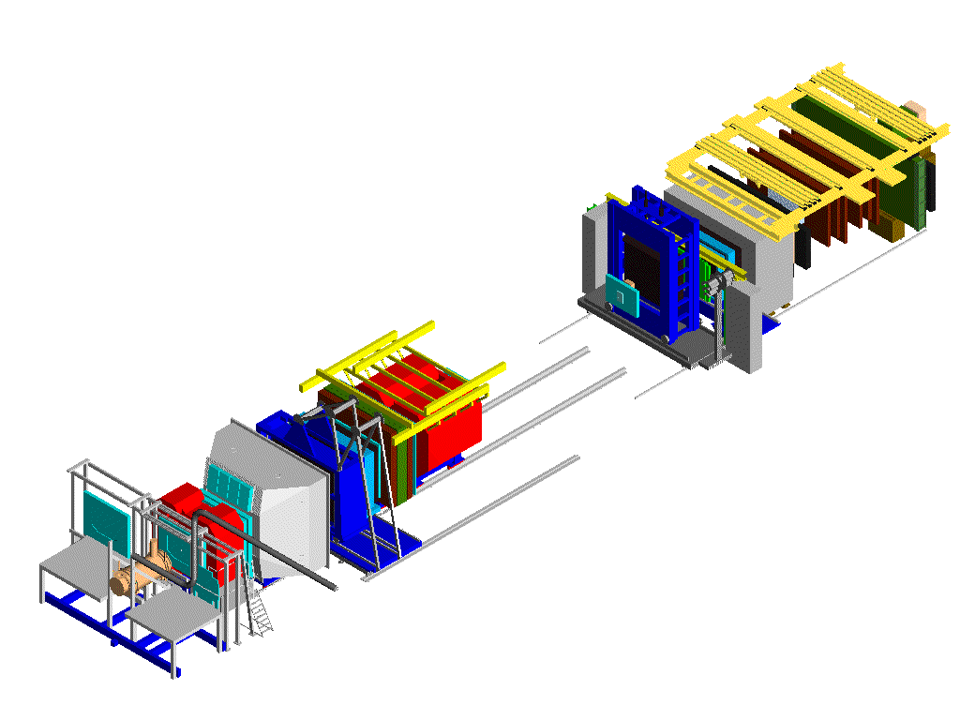

Polarized DIS Experiments
EMC/NMC/SMC/COMPASS
  Pol.μ from π decay (why polarized?)
  Energy 160-200 GeV
  Solid state targets (NH3,LiD), longitudinal, transverse
Ecal2 &
Hcal2
μ filter 2
μ filter 1
SM2
RICH-1
Ecal1 &
Hcal1
SM1
RICH-2
SAS
2-stage spectrometer
LAS (Large angle) Kπ
SAS(Small angle) μ
LAS
Pol.μ Beam:
Pol.
Target

Slide 10


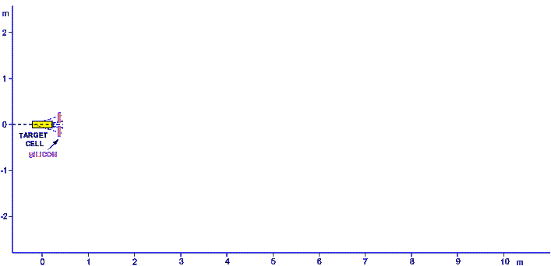
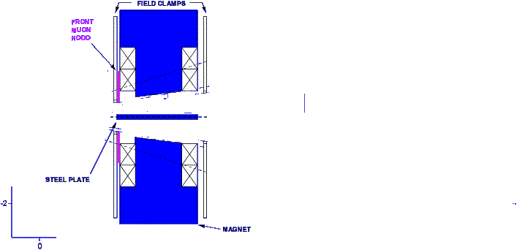
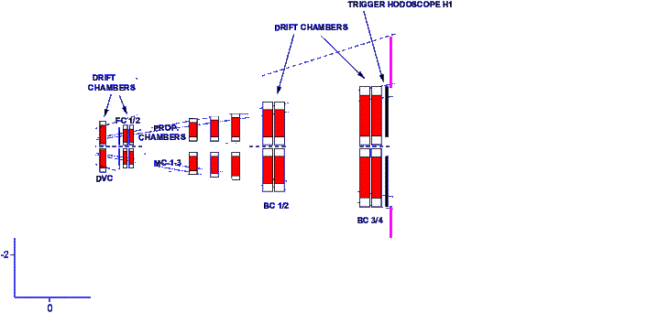
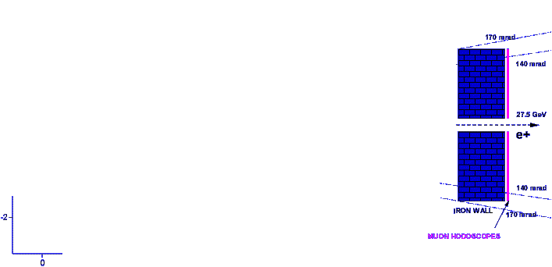
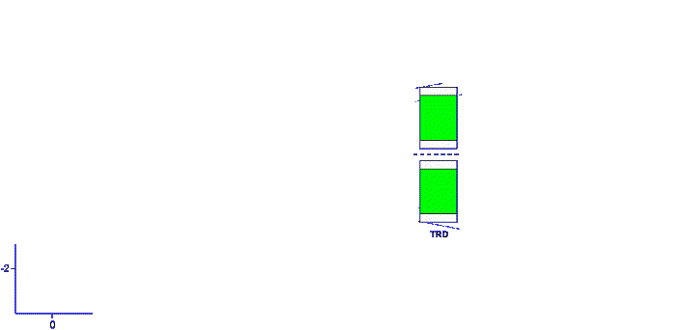
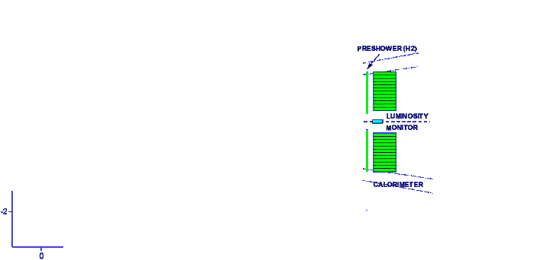
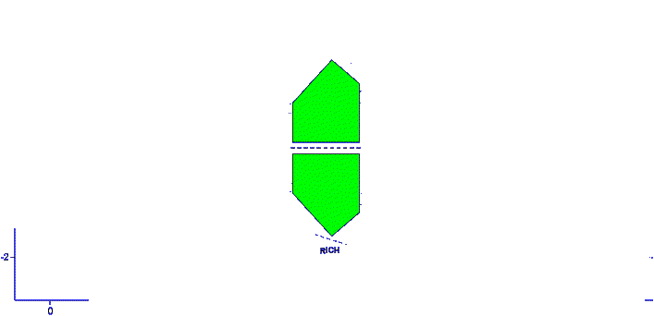
Polarized DIS Experiments
HERMES
  Polarized e± from Sokolov-Ternov effect
  27.5 GeV
  Pure transversely or longitudinally polarized H, D, ³He gas target
  Also many unpolarized gases with higher density for unpolarized/nuclear effects

Slide 11
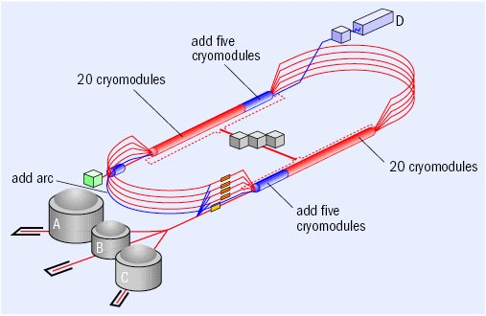
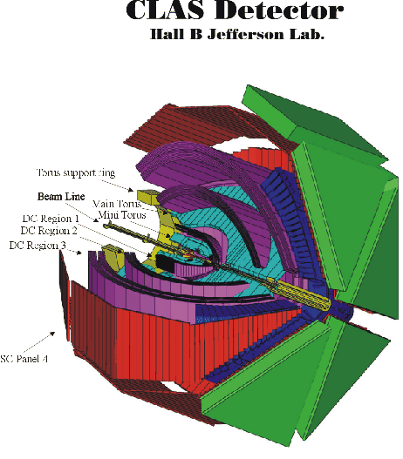

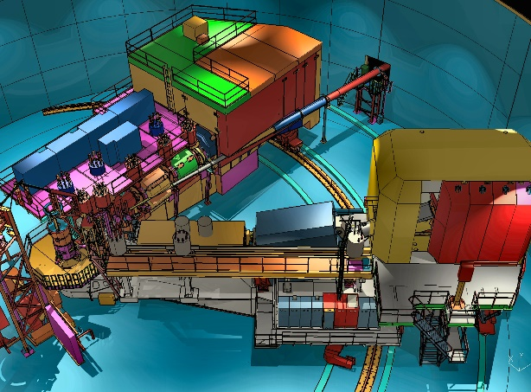
Polarized DIS Experiments
JLab Exp’s
  Pol.e-
  Initially up to 6 GeV, upgraded to 11 GeV for (SI)DIS experiments
  Mostly solid state, longitudinally polarized targets, one ³He transverse target
  ~3 Experiments in the 3 experimental halls
  Very high rates → large statistics
Hall A
Hall C

Slide 12
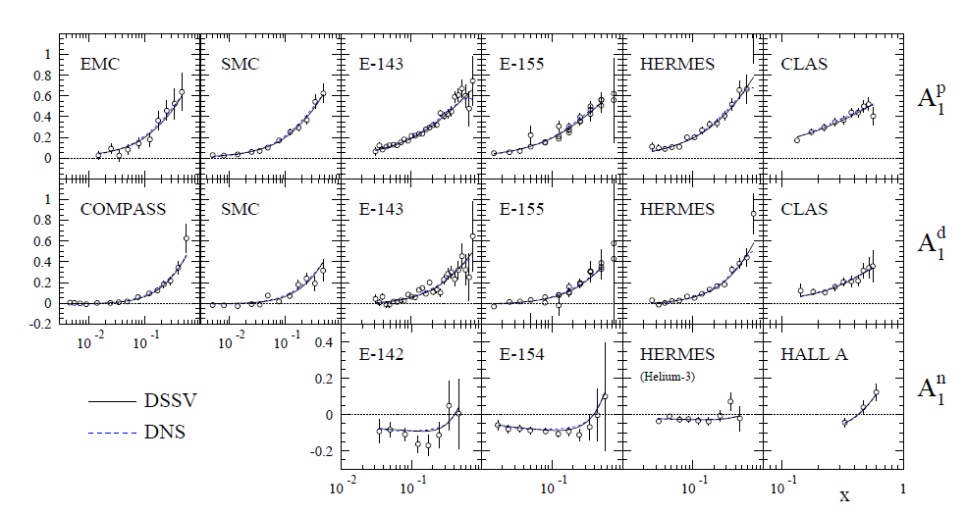
Polarized DIS world data
Notes:
Compass p is missing

Slide 13
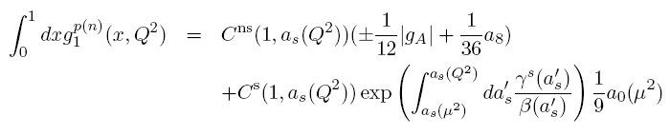
Flavor information from DIS
g₁ is charge weighted sum of quark helicities:
4/9 (Δ u + Δ‾u) + 1/9 (Δ d + Δ‾d) + 1/9 (Δ s + Δ‾s)
Necessary for spin sum rule :
Δ Σ = Δ u + Δ‾u + Δ d + Δ‾d + Δ s + Δ‾s
Decompose Γ₁=∫g₁dx into singlet and non-singlet SU(3)_{f} contributions:
g_{A} ≈a₃ ≈ (Δ u + Δ‾u) - (Δ d + Δ‾d)
a₈ ≈ (Δ u + Δ‾u) + (Δ d + Δ‾d) - 2 (Δ s + Δ‾s)
LO: a₀ = Δ Σ NLO: a₀ = Δ Σ – 3 α_{s}/2π Δ g

Slide 14
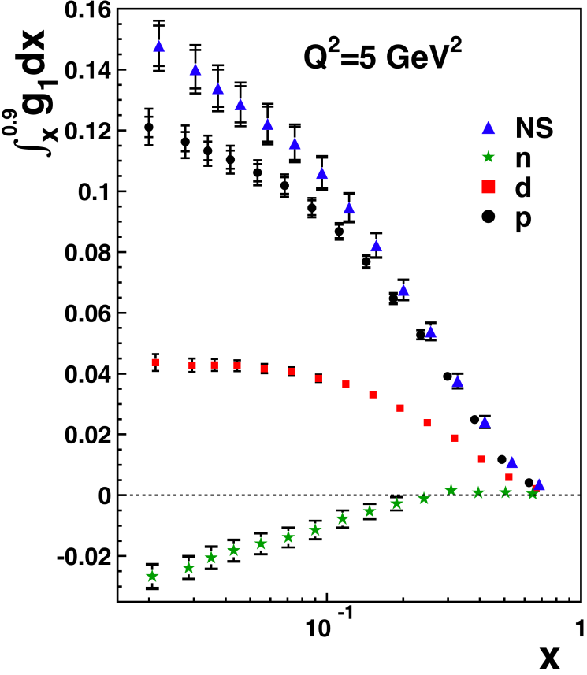
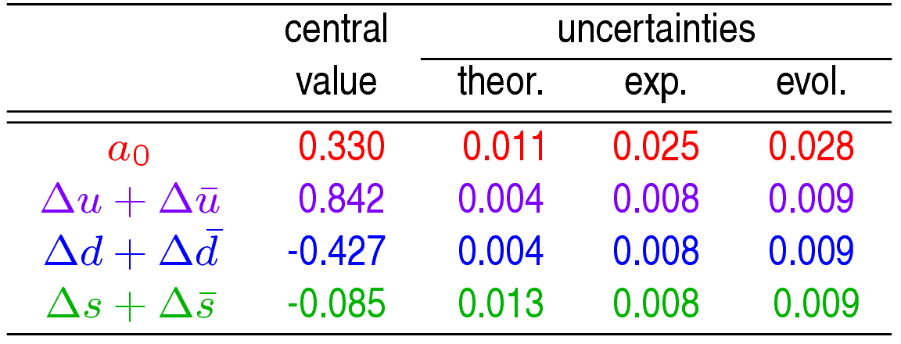
Example: Hermes g₁ Integrals
Saturation in deuteron integral is assumed
  use only deuterium
From hyperon beta decay
a₈=0.586±0.031
From neutron beta decay
g_{A} = a₃=1.269±0.003
COMPASS:
Q²=5 GeV², NNLO in MS scheme

Slide 15
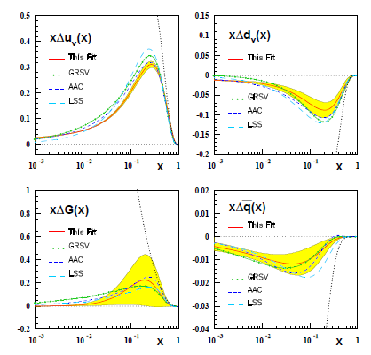
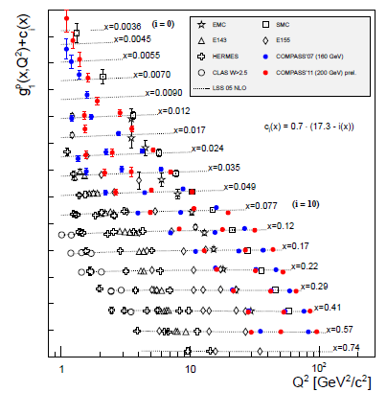
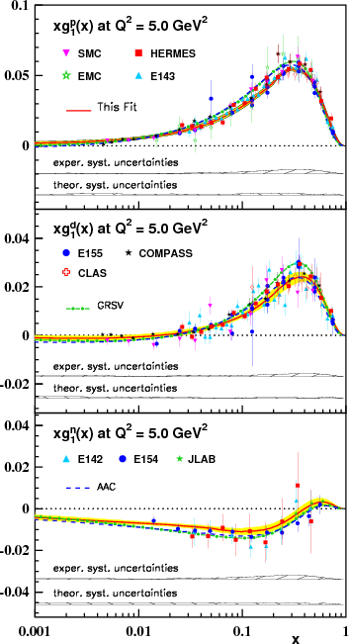
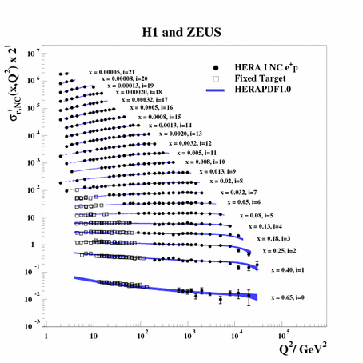
Polarized Global inclusive analysis
Blümlein, Böttcher: Nucl.Phys.B 841 (2010) 205
Using only inclusive data is rarely performed with the wealth of semi-inclusive and pp data
Most recent: JAM fit and NNPDFpol1.0
Valence quarks relatively well determined
Gluons in inclusive DIS only accessible over QCD evolution:
g₁(x,Q₀) → g₁(x,Q>Q₀)

Slide 16
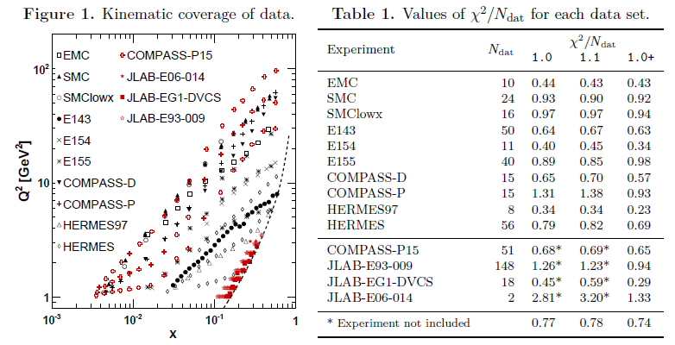
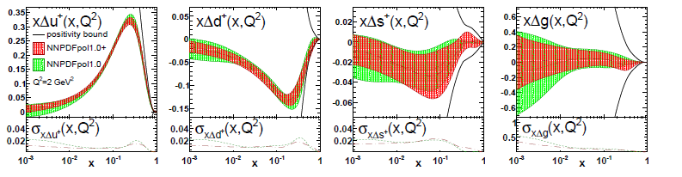
NNPDFpol1.0+
NNPDFpol1.0+: E.Nocera
Low Energy JLAB data requires target mass and higher twist corrections to be taken into account
Valence dominated quark helicities reasonably well determined
Sea quarks and gluons poorly determined from DIS data alone

Slide 17
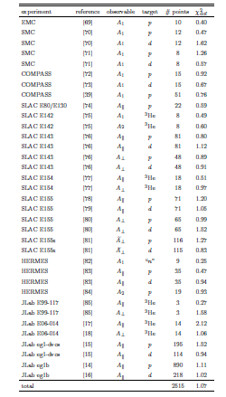
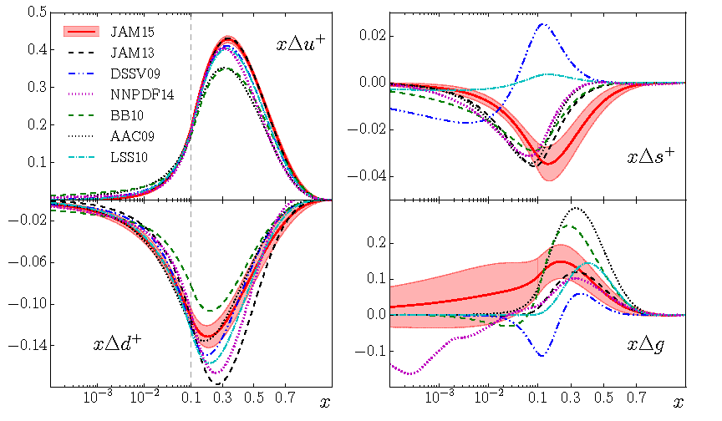
JAM15 fit
Sato, et. al (JAM collaboration)
JAM: even more low energy DIS data, additional corrections required
Strange quarks “optimistic”, based on SU(3) assumptions alone
Gluons poorly constrained

Slide 18
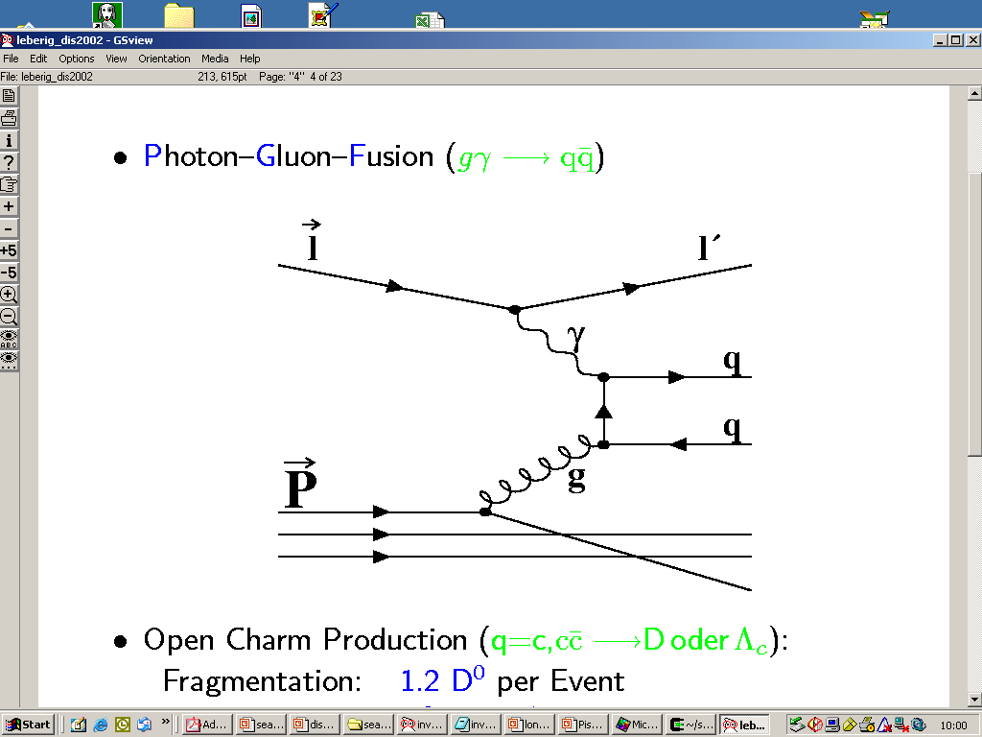
Gluon polarization
Barely access via DIS data through DGLAP evolution (no large Q² lever arm)
Some access in SIDIS through high Pt hadrons and charmed mesons

Slide 19
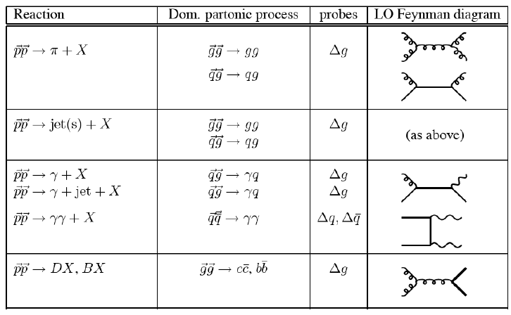
Hard processes at RHIC
Most processes are dominated by gluon hard interactions at RHIC energies
➔Acccess to Gluon related spin and
transverse spin effects!
Relative contributions different for different final states (flavor sensitivity)
p+p→pion(s),eta + X
p+p→jet(s)+ X
p+p→γ + X
p+p→ B,D,J/ψ + X
Underwood`92 Direct photons as golden
channel for RHIC spin physics

Slide 20
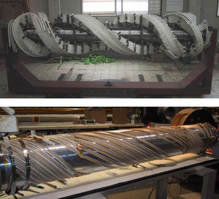
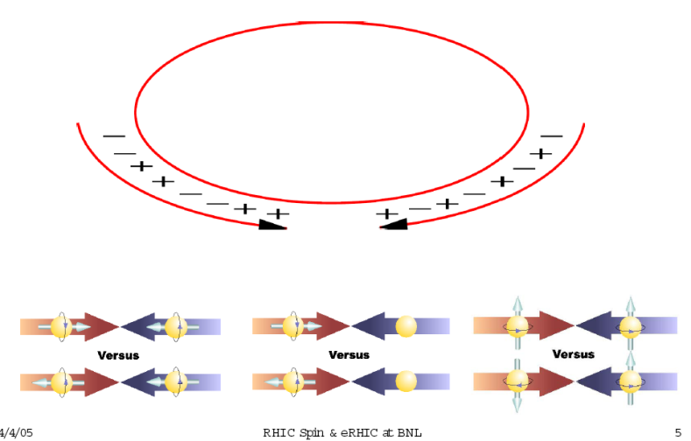
The RHIC ring(s) with polarized protons
RHIC pC Polarimeters
Absolute Polarimeter (H jet)
Siberian Snakes
BRAHMS & PP2PP
PHOBOS
Siberian Snakes
PHENIX
Spin Flipper
STAR
Spin Rotators
Partial Snake
Helical Partial
Snake
Strong Snake
LINAC
AGS
BOOSTER
200 MeV Polarimeter
Rf Dipole
AGS Internal Polarimeter
2 × 10¹¹ Pol. Protons / Bunch
ε = 20 π mm mrad
AGS pC Polarimeter

Slide 21
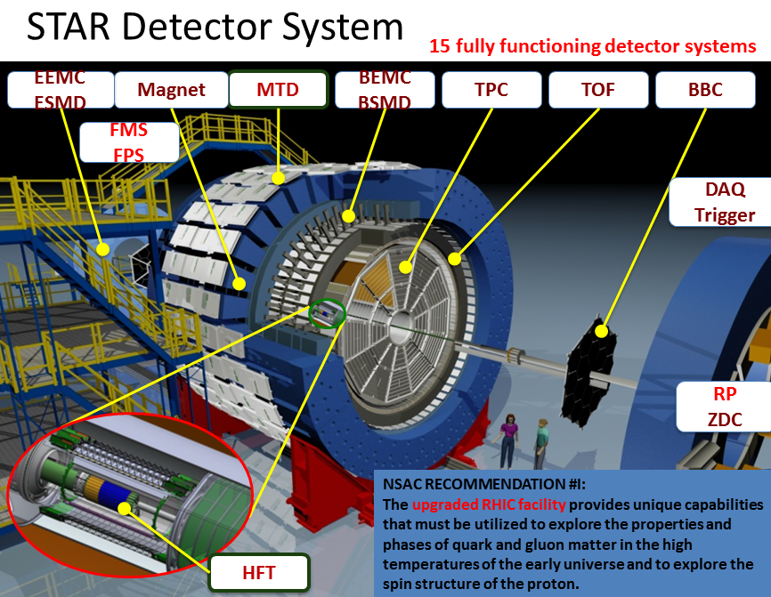
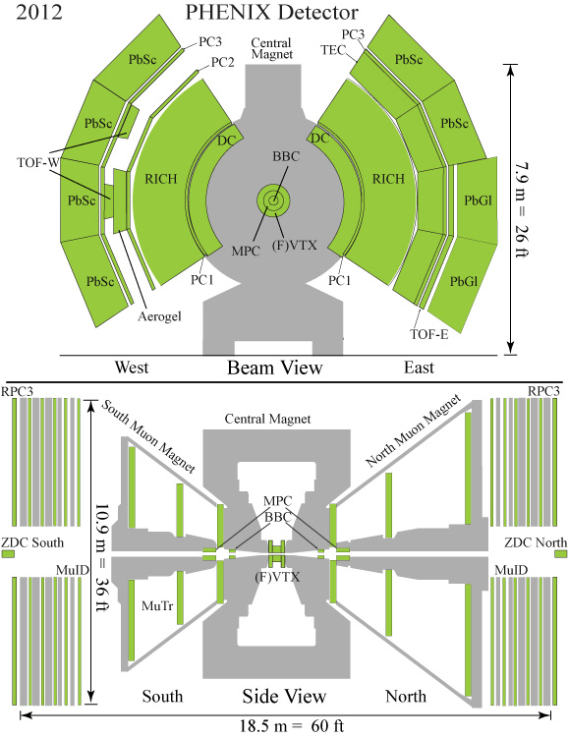
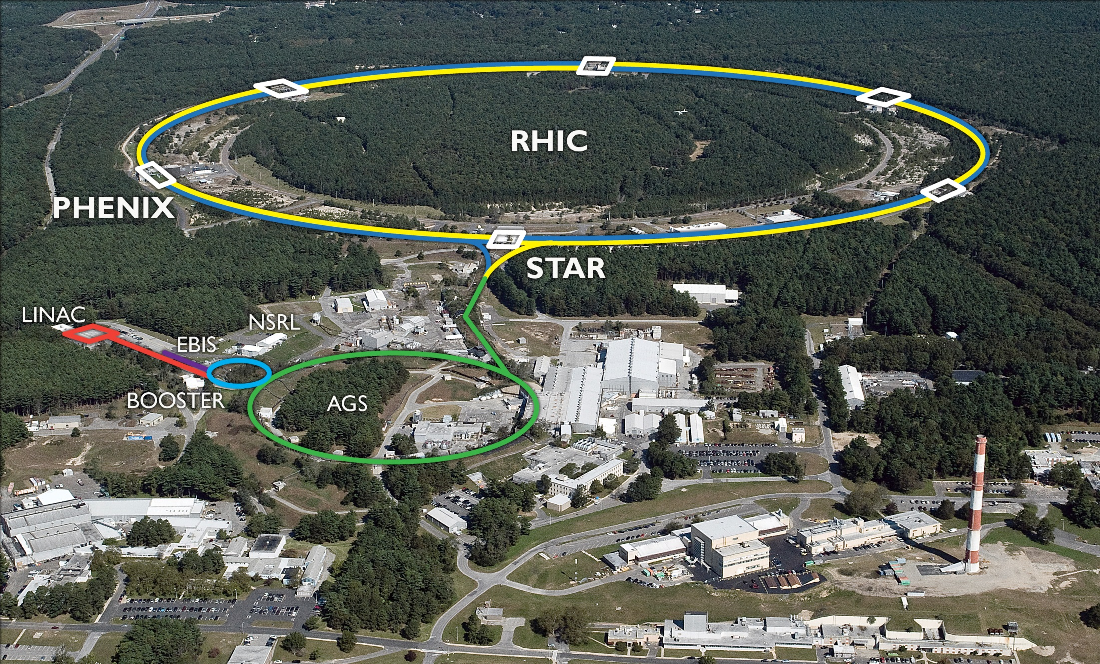
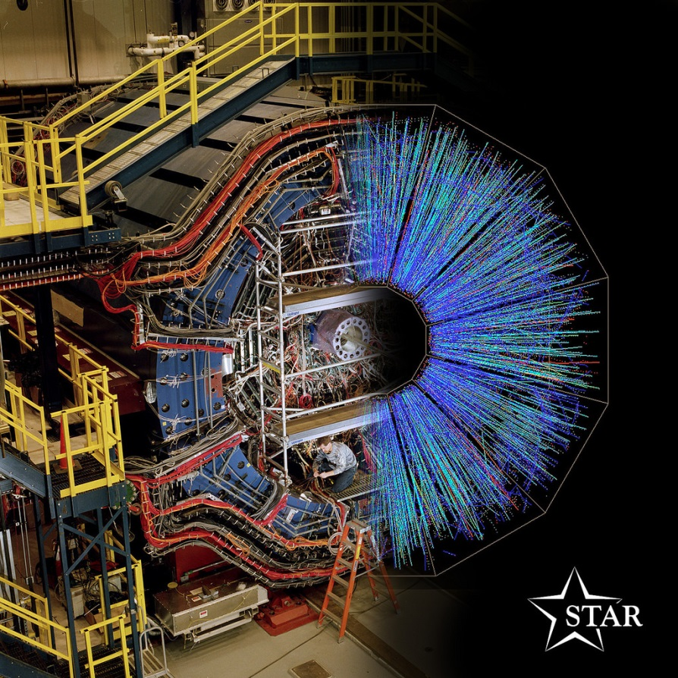
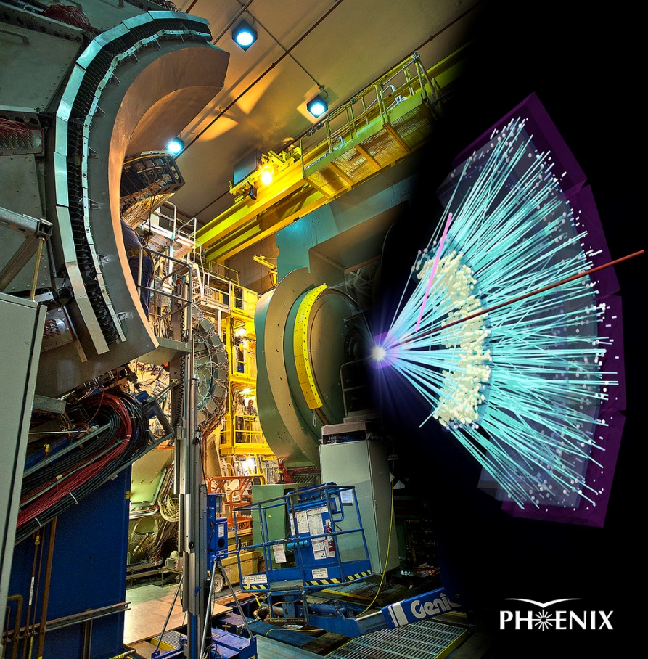
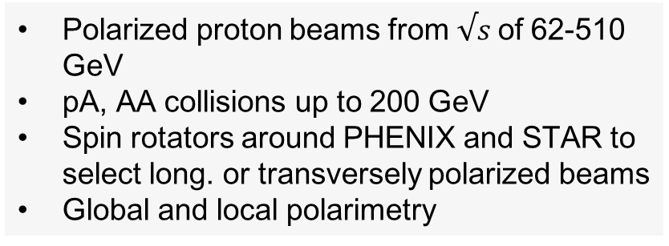
RHIC, PHENIX and STAR
Polarized proton beams from $√s$of 62-510 GeV
pA, AA collisions up to 200 GeV
Spin rotators around PHENIX and STAR to select long. or transversely polarized beams
Global and local polarimetry

Slide 22
Main measurements at RHIC
PHENIX:
π⁰ measurements
  EMCal triggering
  High rate readout to access even lowest scales (x down to 0.01 at 510 GeV)
  Clean measurement
Direct photons
  Linear gluon contribution
  em process
STAR:
jet measurements
  Jet Patch triggering in EMCal
  Together with TPC tracking good jet reconstruction
  Highest scales possible
Di-jet: ability to tune x1,x2 via rapidities and invariant masses

Slide 23
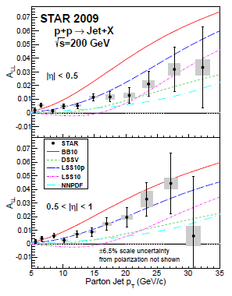
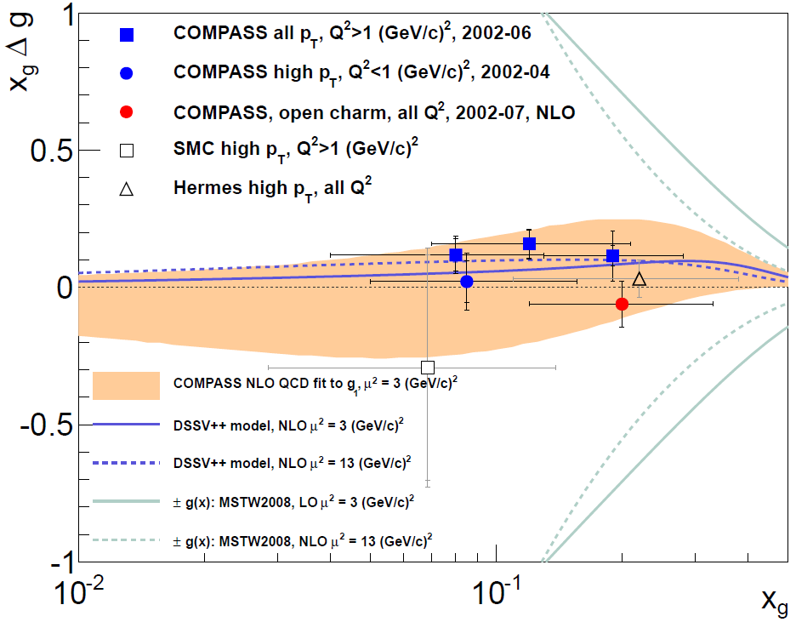
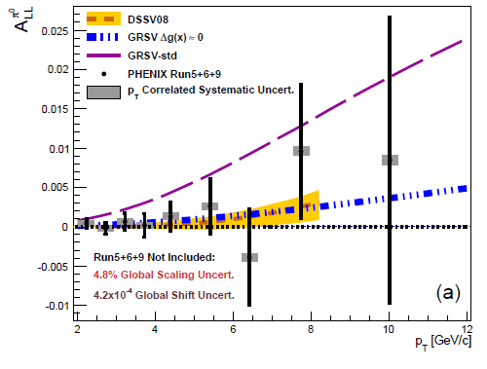
Gluon helicities at 200 GeV
COMPASS, PLB718(2013), PRD87 (2013)
STAR: arXiv:1405.5134
PHENIX: Phys.Rev. D90 (2014) 012007

Slide 24
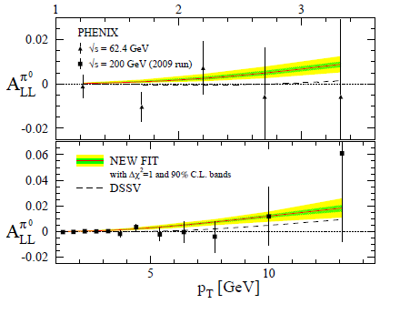
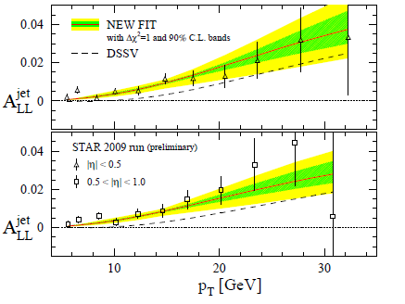
DSSV2014: Nonzero gluon polarization
DSSV:Phys.Rev.Lett. 113 (2014) 012001
Nonzero gluon spin in measured x range
Similar conclusion from NNPDFpol1.1 arXiv:1406.5539
Pions at slightly smaller x
and smaller Pt → Δg smaller due to evolution

Slide 25
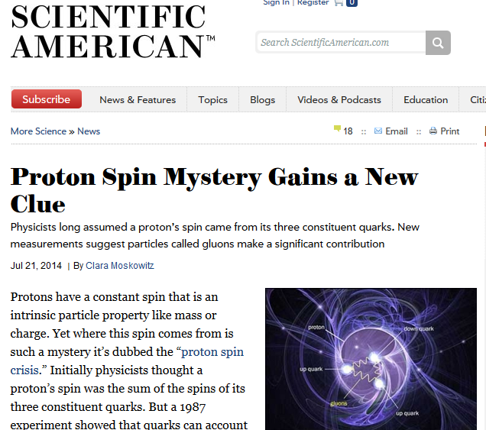



Press interest in nonzero gluon spin
Low x, not covered so far →more forward pp, EIC
x region covered by current RHIC and DIS results

Slide 26

Near future: extend gluon x range
Forward π⁰ in 3.1<η<3.9, p_{T}>1GeV
forward η
RHIC
500 GeV
DIS
RHIC
200 GeV
Existing 2013 + future data will extend gluon x coverage below x=10⁻² in forward pion and jet measurements
Di-jets to scan x range
Improved precision in central jet and pion measurements

Slide 27



Gluon spin: To higher energies
Nonzero gluon polarization established with RHIC √s = 200 GeV data
RHIC 510 GeV data (>2011) now confirms it in workhorse (jet, pion) measurements
Extend access to lower x by higher energy (now~ 10⁻²)
PHENIX result:
RIKEN press release
BNL and DOE research highlights
DOE labs 2016 research highlights report

Slide 28

First direct photon xsec and A_{LL} at 510 GeV
PRL 130 (2023) 251901
Part of initial RHIC-Spin suggestions in the `90s
Theoretically, the Golden channel to access gluon polarization as hard interaction mostly q-g
Since EM process, statistically limited but consistent with global fit results
Clear preference for positive gluon polarization in measured range

Slide 29



other gluon spin measurements
Phys.Rev. D94 (2016)
PHENIX forward J/ψ measurements reach close to x~10⁻³
Including feed-down almost entirely produced from gg
Due lack of knowing production mechanism interpretation still difficult
RHIC cold QCD plan 2023 https://arxiv.org/abs/2302.00605
STAR Dijet asymmetries also define gluon spin sign well
Other forward π⁰ measurements ongoing to get better precision down to x~10⁻³

Slide 30

Individual (sea)quark helicities→SIDIS, EW DIS/pp
DIS
SIDIS
l’
Lepton l
Ok, total quark spin contribution kind of known (~30%)
How is this distributed between up, down, strange and light sea quarks?
Total up and down contributions kind of known from DIS, but sea not so much
Enter: semi-inclusive DIS (SIDIS): look at the produced hadrons for flavor sensitivity
Or use electroweak reactions with different coupling to flavor
Hadron h
q
Parton xP
Nucleon P,s
W±

Slide 31

Help of Fragmentation Functions (FF) in DIS → SIDIS
General idea: Try to correlate a hadron in the final state with the struck parton:
The fragmentation of a u quark into a π⁺ is favored (favored fragmentation) over the fragmentation of a d quark (disfavored fragmentation)
s, ubar quarks favored in K⁺ fragmentation
At low momentum fraction z nearly comparable, at high z favored $≫$ disfavored
Use the fragmentation functions to solve set of linear equations for (polarized) parton distribution functions in the nucleon
Important for pp-collisions: substantial gluon fragmentation into (all) pions

Slide 32


Fragmentation
Quark-antiquark
potential (Lattice)
Confinement:
  Only color neutral objects at large distances allowed – expanding quarks carry gluonic string (flux tube) …
  until string tension is large enough to produce another quark-antiquark pair
Fragmentation functions (FF)s:
  What particles (and how many) get created?
  What fraction of the initial parton momentum (z) do they carry? Scaling variable of FFs (similar to x in PDFs)
  Use this final state information to learn about fragmenting parton flavor, spin, momentum → nucleon structure at EIC

Slide 33
What are fragmentation functions (FF)?
Fragmentation of a parton i (quarks, antiquarks, gluons) with energy E_{i} into a hadron h with a fractional energy z=E_{h}/E_{i} .
Similar to parton distribution functions (PDFs) in the nucleon, but only one sum rule (total momentum):
Later: extension to spin dependent and transverse momentum dependent fragmentation functions

Slide 34


Access to Fragmentation functions
SIDIS
k’
lepton k,s
Hadron P_{h}
SIDIS:
  Relies on unpol PDFs
  Parton momentum known at LO
  Flavor structure directly accessible
  Transverse momenta convoluted between FF and PDF
pp:
  Relies on unpol PDFs
  leading access to gluon FF
  Parton momenta not directly known
e⁺e⁻:
  No PDFs necessary
  Clean initial state, parton momentum known at LO
  Flavor structure not directly accessible*
Q
nucleon
P,s
quark xP, helicity ±
pp collisions
Hadron P_{h1}
nucleon
P₁,s₁
q,g: x₁P₁
nucleon
P₂,s₂
q,g: x₂P₂
e⁺e⁻ Annihilation
Hadron P_{h1}
e⁺ p
quark
e⁻ k
antiquark
Hadron P_{h2}

Slide 35


Fragmentation functions in e⁺e⁻ annihilation
e⁻
Process:
e⁺ e⁻→hX
At leading order sum of unpolarized fragmentation functions from quark and anti-quark side
h
e⁺

Slide 36



Belle Detector and KEKB
Asymmetric collider
8GeV e⁻ + 3.5GeV e⁺
√s = 10.58GeV (Υ(4S))
e⁺e⁻→Υ(4S)→B‾B
e⁺e⁻→q‾q (u,d,s,c)
Integrated Luminosity: >1000 fb⁻¹
Continuum production: 10.52 GeV
>70fb⁻¹ => continuum
Similarly also BABAR at SLAC
older e⁺e⁻ contributions to FFs from LEP, SLD and PETRA, CLEO
Belle detector
KEKB
SC solenoid
1.5T
Aerogel Cherenkov cnt.
n=1.015~1.030
CsI(Tl)
16X₀
3.5 GeV e⁺
TOF counter
8 GeV e⁻
Central Drift Chamber
small cell +He/C₂H₆
Good tracking and particle identification!
ε(K)~85%,
ε(π→K)<10%
Si vtx. det.
3/4 lyr. DSSD
μ / K_{L} detection
14/15 lyr. RPC+Fe

Slide 37



Fragmentation functions
e⁺e⁻
de Florian, Sassot, Stratmann
results for π±, K±, chg. hadrons
full flavor separation for D_{i}^{H}(z) and D_{g}^{H}
fits to all LEP, HERMES, SMC, RHIC, … data
supersede old fits based only on e⁺e⁻ data
SIDIS
pp collisions

Slide 38




B factory data (Q$\sim$10GeV)
High precision pion and kaon data from both B factory experiments
Precision up to very high z
Lever arm to much higher energy (Q$\sim 20−200$GeV) data allows for determination of gluon fragmentation over evolution

Slide 39

Pion fragmentation
DSS15: deFlorian et.al., Phys.Rev. D91 (2015) 014035
Light quarks symmetric
Dominated by favored fragmentation especially at high z
Gluon substantial but falling off faster than quarks

Slide 40

Kaon fragmentation
Strange quarks are dominating kaon fragmentation
Also dominated by favored u quark fragmentation at high-z
At lower z penalty for producing ss̅ pair in fragmentation (u+u̅ < s+s̅)
Charm fragmentation comparable (what about weak decays?)

Slide 41

SIDIS: access to individual quark polarizations
Correlation between detected hadron and struck q_{f}
“Flavor – Separation”
Inclusive DIS:
ΔΣ =Δ u + Δ‾u + Δ d + Δ‾d + Δ s + Δ‾s
FF
Semi-inclusive DIS:
DF
(Δ u , Δ‾u , Δ d , Δ‾d , Δ s , Δ‾s )
In LO-QCD:
MC or DSSxPDF
Extract Δq by solving:

Slide 42

Purities as example
Simply put: probability of having initial quark type a when having detected a hadron h
Here: leading order only (no gluons at LO in DIS)
Due to u-quark dominance (charge 2/3 vs 1/3 and 2 vs 1 valence quarks) even π- most likely from u-quark on proton target
But: Use to solve set of linear equations for quark helicities

Slide 43

Semi-inclusive World data

Slide 44


newer COMPASS results
Deuterium
Phys.Lett. B680 (2009) 217-224
Phys.Lett. B690 (2010) 466-472
Proton

Slide 45




SIDIS results
HERMES, PRL 92 (2004) 012005, PRD 71 (2005) 012003
HERMES semi-inclusive LO extraction of quark helicities from p and d targets
semi-inclusive results from COMPASS, asymmetries and helicities consistent
Small strangeness seen in measured range in both experiments
Consistent with a symmetric light sea within errors
COMPASS: PLB 693 (2010) 227
L.O.

Slide 46

DSSV08 global fit
PRL 101 (2008) 072001
A first real global fit including DIS data, SIDIS data and (early) RHIC data
Valence quark helicities reasonably well determined
Some (weak) indication of asymmetric sea
Relatively small gluon spin
Negative strange helicities at low x due to hyperon decays

Slide 47




Real W production as access to (anti)quark helicities
p helicity + p helicity -
Maximally parity violating V-A interaction selects only lefthanded quarks and righthanded antiquarks:
➔Having different helicities for the incoming proton then selects spin parallel or antiparallel of the quarks
➔Difference of the cross sections gives quark helicities Δq(x)
No Fragmentation function required
Very high scale defined by W mass
Bourrely , Soffer
Nucl.Phys. B423 (1994) 329-348

Slide 48


Sea quark polarization via W production
Single spin asymmetry proportional to quark polarizations
Large asymmetries
Forward/backward separation smeared by W decay kinematics
μ⁺
e⁺
μ⁺
μ⁻
e⁻
μ⁻

Slide 49
Forward W+Z →μ asymmetries
STAR: Phys.Rev.D 99 (2019) 051102
Precise measurements of W→e/m asymmetries
Asymmetries overall as expected (dominated by quark helicities)
clear preference wrt to parameterization uncertainty bands determines sea quark helicities
PHENIX:
Phys.Rev.D 98 (2018) 032007 ,
Phys.Rev.D 93 (2016) 051103

Slide 50


Sea quark helicites
RHIC data at boundary of DSSV/NNPDFpol1.1 uncertainty bands
Reweighted NNPDFpol1.1 and DSSV14 fits shows substantial polarized light sea asymmetry
opposite sign to most pion cloud models (where polarized and unpolarized light sea asymmetries have same sign)
NNPDFpol1.1: arXiv:1406.7122

Slide 51

Open questions for polarized nucleon structure/PDFs
PRD92 (2015), 094030
Gluon spin contribution positive and large but so far only measured from x>0.01 need to understand lower x for spin sum rule
Hyperon decays + SU(3)_{F} push Δs negative but current data consistent with zero: hidden at low-x or issues with symmetry assumptions?
Do the integrals over Δg(x) and ΔΣ(x) leave room for net orbital angular momentum?
PRD 102 (2020), 094018

