Slide 1

Experimental overview of the nucleon (spin) structure leading up to the EIC
TIDC Autumn School on the EIC,
NTU, Taipei, August 28-30
Ralf Seidl (RIKEN)

Slide 2
Outline
QCD and unpolarized nucleon structure
Spin sum rule and helicity structure
  Inclusive DIS
  Gluon Spin from p+p
  Interlude: Fragmentation functions
  (anti)quark helicities from SIDIS, EW pp
Transverse spin and momentum structure and effects
  Transversity and tensor charge
  Sivers function and other TMDs
3-dimensional structure in position space
  GPDs and DVCS
  Energy momentum tensor and related topics
Low-x physics

Slide 3
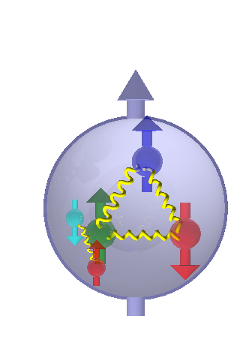
Transverse spin and TMDs

Slide 4
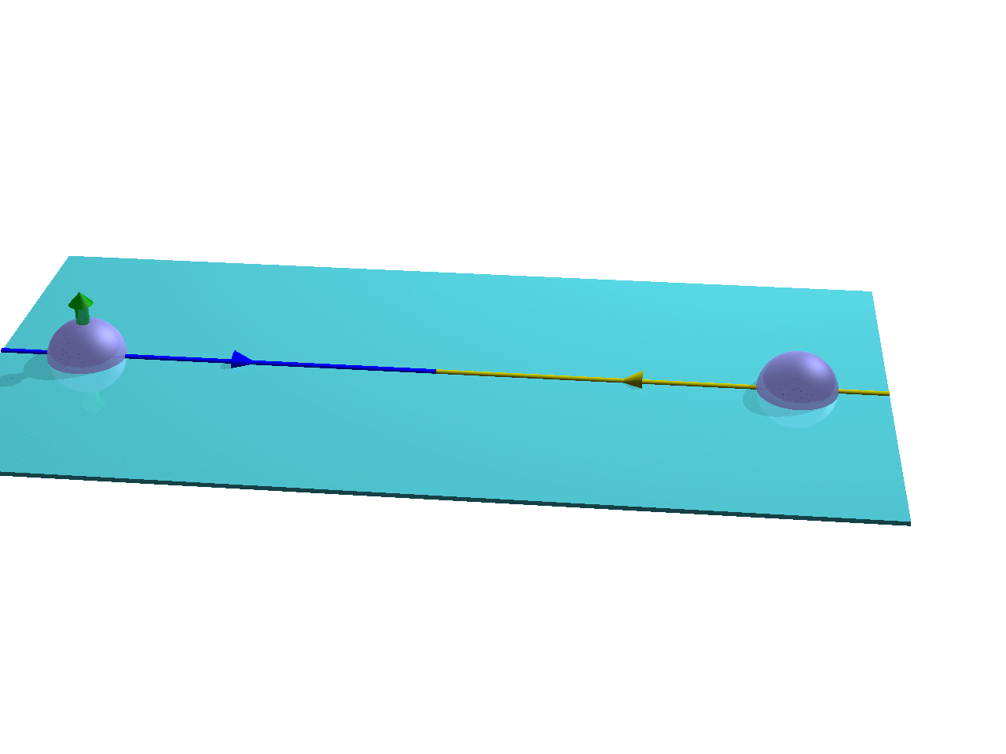
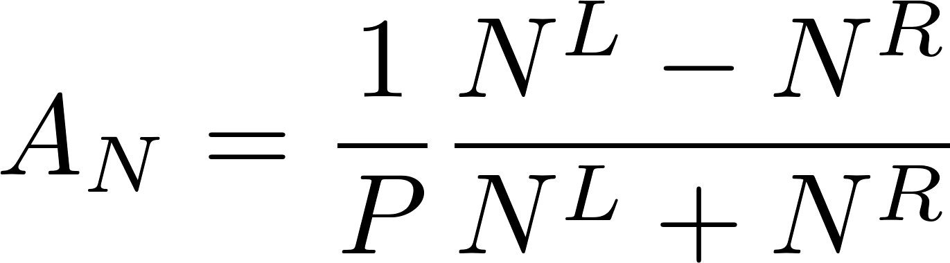
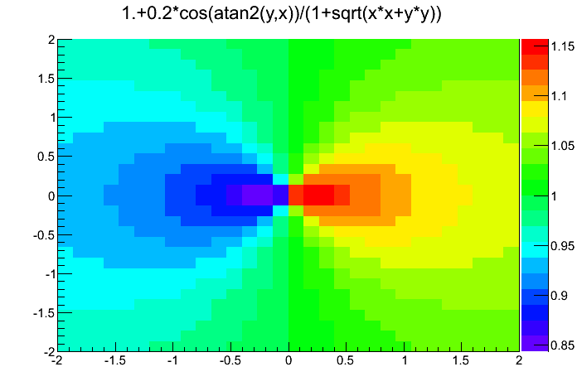
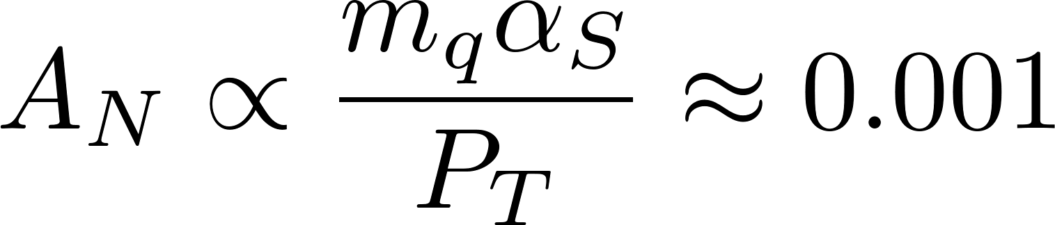
Transverse Single spin asymmetries (TSSAs)
Left-Right asymmetries :
Relative to the polarized proton spin direction more particles get produced to the left than to the right wrt. spin direction
The cross section is spin (and azimuthal angle) dependent
Initially expected to be zero in perturbative QCD (helicity-flip of nearly massless quarks) - G. L. Kane, J. Pumplin, and W. Repko PRL41, 1689 (1978):

Slide 5
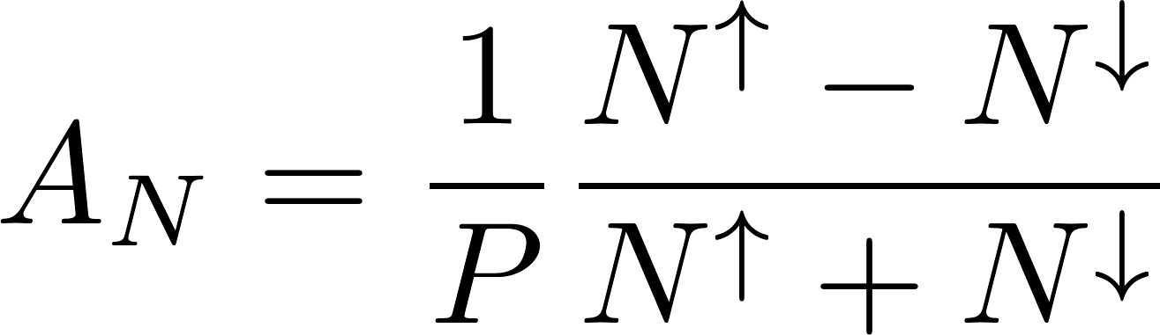
Transverse single spin asymmetries (TSSA)
Large left-right asymmetries A_{N} seen in polarized p+p collisions from low energies up to RHIC energies at forward rapidities
Both initial state and final state effects can contribute in forward pion asymmetries
other origins (diffractive) could potentially also contribute
A_{N}s in p+A collisions of interest for low x behavior of cold nuclear matter → A dependence of single spin asymmetries?
π⁰ A_{N}

Slide 6
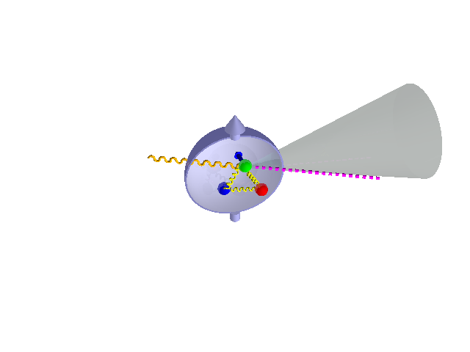
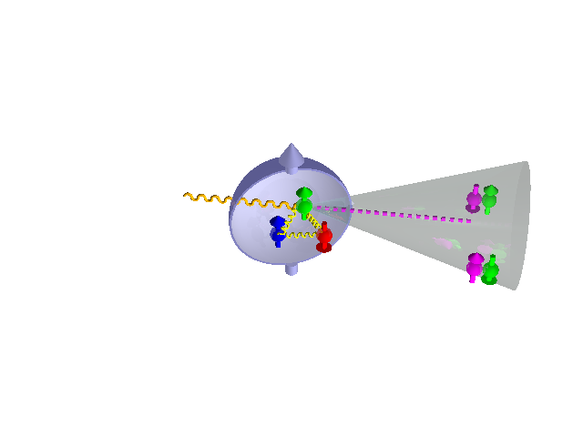
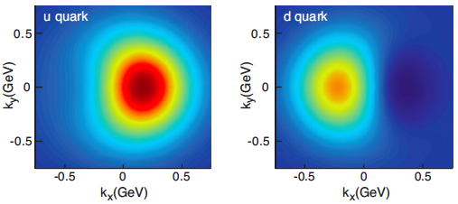
Sivers Function
Collins Function (x Transversity)
Collins: Nucl.Phys.B 396 (1993) 161
Sivers: Phys.Rev.D 41 (1990) 83
Proton–spin – quark orbit (k_{T}) correlation (relation to orbital angular momentum)
Transverse momentum imbalance in nucleon creates asymmetry
Suggested by Sivers (1990), initially dismissed by Collins, resurrected by Brodsky (2002), Collins →special process dependence (sign change DY↔SIDIS)
Quark spin – hadron transverse momentum correlation (in fragmentation)
Preferred direction of hadron creates asymmetry
Analyzer for quark transversity (transverse quark spin) → access to tensor charge (Lattice, BSM?)
A polarized (ie signed) fragmentation function
Both effects measured separately for quarks in SIDIS, FFs in e⁺e⁻

Slide 7
Transverse quark polarization
Sum of quarks with parallel and antiparallel polarization relative to proton spin
(well known from Collider DIS experiments)
q(x),G(x)
Unpolarized distribution function q(x)
Difference of quarks with parallel and antiparallel polarization relative to longitudinally polarized proton
(known from fixed target (SI)DIS experiments)
Δq(x), ΔG(x)
Helicity distribution function Δq(x)
Difference of quarks with parallel and antiparallel polarization relative to transversely polarized proton
(first results from HERMES and COMPASS – with the help of Belle)
δq(x)
Transversity distribution function δq(x)

Slide 8
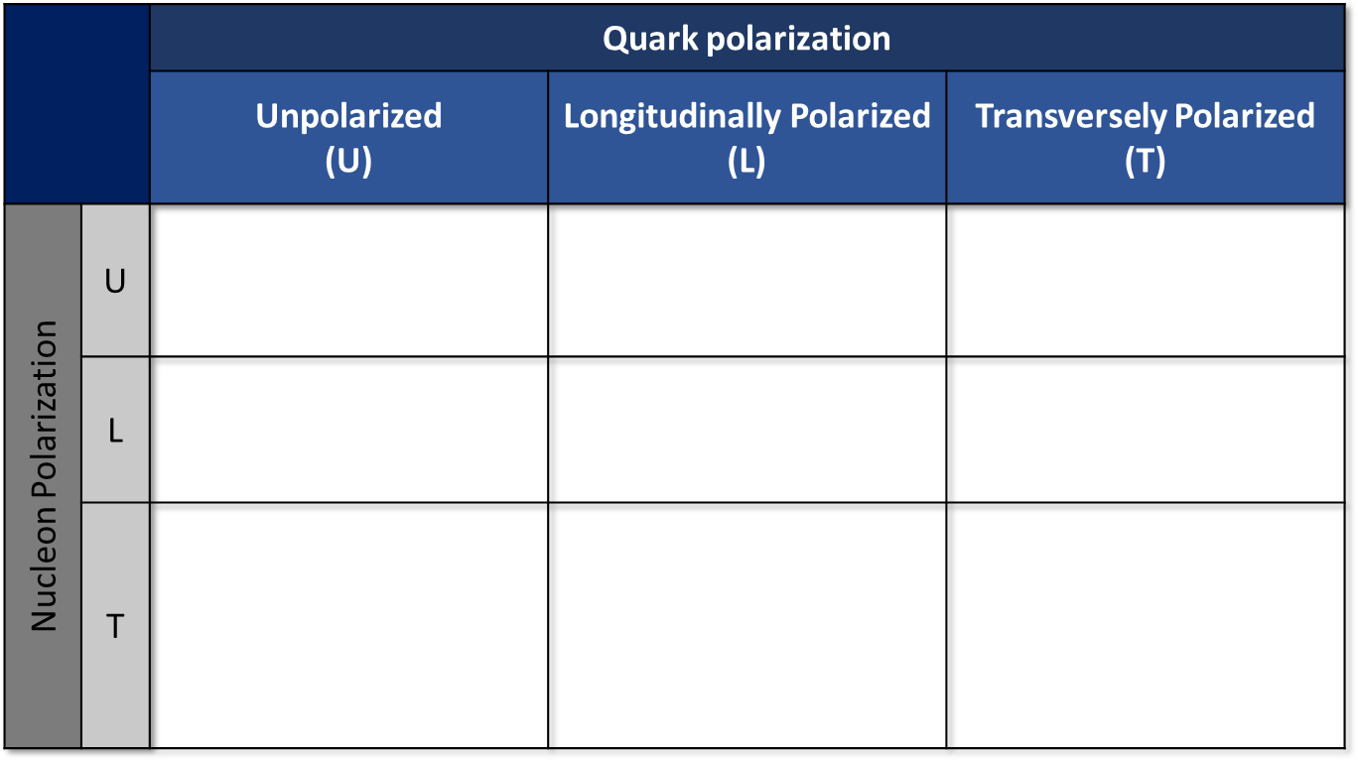




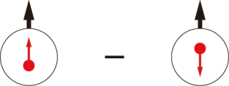
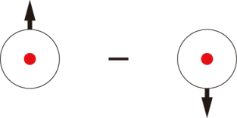
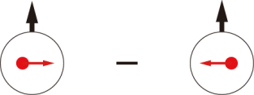
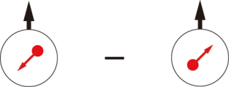
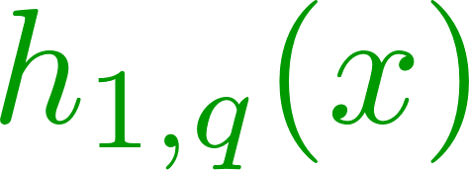
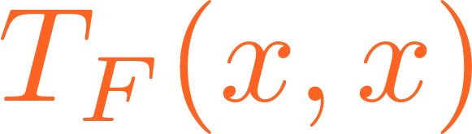
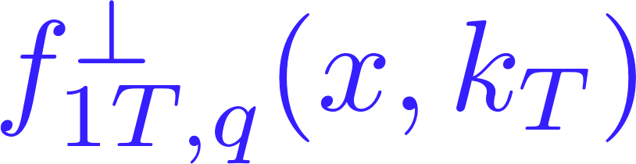
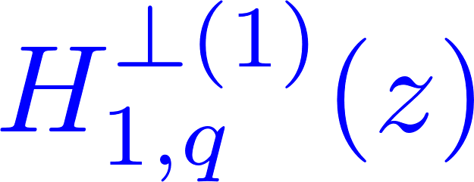
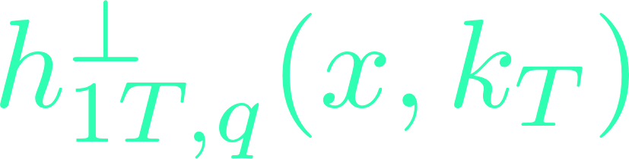
Transverse Spin and TMDs
S.Pisano, Transversity 14
TMD: transverse momentum dependent distribution and fragmentation functions, all except f₁,g₁ and h₁ cancel upon integration over k_{T}
Transversity
Sivers Function
Boer Mulders function
Closely related:
Higher Twist correlations (TMD moments)
TMD FFs (Collins, polarizing FFs, etc)

Slide 9
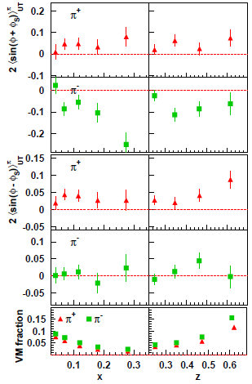
Early HERMES findings (ca 2002)
ep↑ → e’hX
Both azimuthal modulations related to Sivers effect (sin(φ-φ_{s})) and Collins effect (sin(φ+φ_{s})) nonzero
Large, negative Collins effect for negative pions hard to explain in u quark dominance
Collins
Sivers
HERMES:
PRL 94 (2005) 012002

Slide 10
Collins fragmentation function
J. Collins, Nucl. Phys. B396, (1993) 161
q
Spin of quark correlates with hadron transverse momentum
➔translates into azimuthal anisotropy of final state hadrons

Slide 11
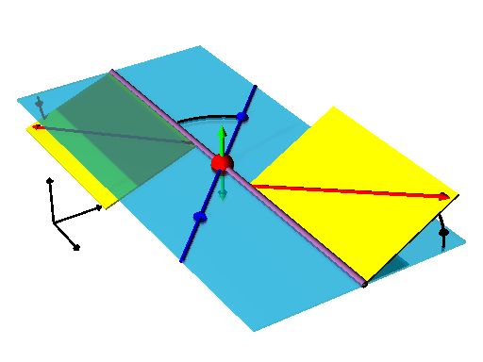
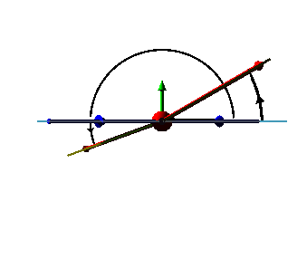
Collins fragmentation in e⁺e⁻ :
Angles and Cross section cos(φ₁+φ₂) method
e⁺e⁻ CMS frame:
ϕ₂−π
D.Boer: Nucl.Phys. B806 (2009) 23-6
e⁻
Θ
ϕ₁
ϕ₂
ϕ₁
e⁺
2-hadron inclusive transverse momentum dependent cross section:
Net (anti-)alignment of
transverse quark spins

Slide 12

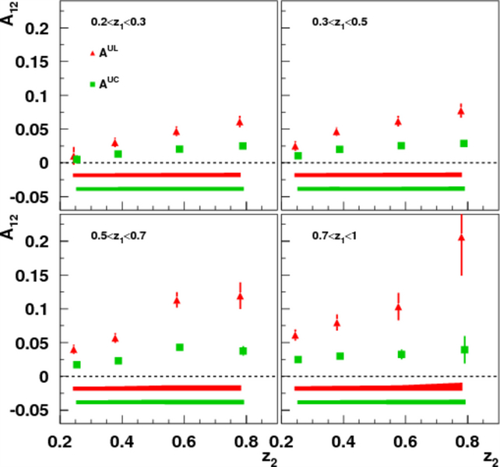
Belle Collins asymmetries
Red points : cos(φ₁ + φ₂) moment of Unlike sign pion pairs over like sign pion pair ratio : A^{UL}
Green points : cos(φ₁ + φ₂) moment of Unlike sign pion pairs over any charged pion pair ratio : A^{UC}
Collins fragmentation is large effect
Consistent with SIDIS indication of sign change between favored and disfavored Collins FF
RS et al (Belle), PRL96: 232002
PRD 78:032011, Erratum D86:039905

Slide 13
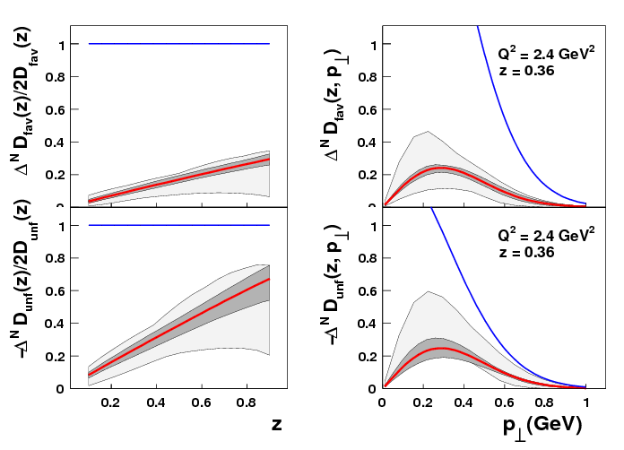
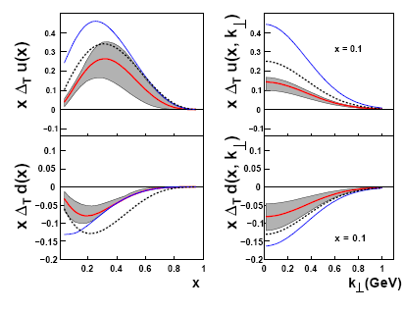
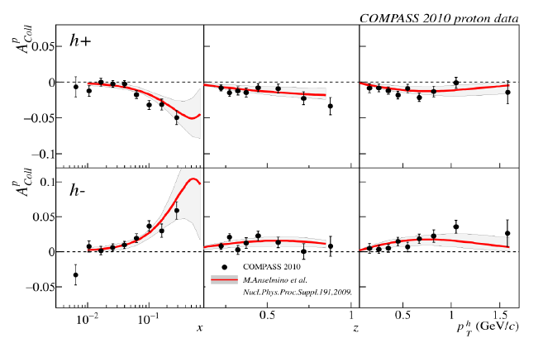

Global Fit of Collins FF and Transversity （HERMES, COMPASS d, Belle)
Collins function
Transversity
Phys.Rev.D75:054032,2007,
update in Nucl.Phys.Proc.Suppl.191:98-107,2009
Latest SIDIS data not included inFIT
TMD evolution poorly known
K_{T} dependence from Assumption
Interference FF（IFF) as independent Cross check

Slide 14
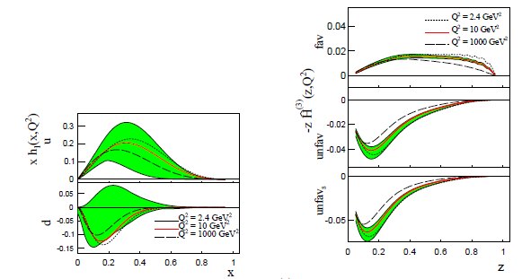
Collins evolution
Kang, Prokudin, Sun and Yuan,
arXiv:1505.05589
First Transversity extraction taking TMD evolution into account
Still many assumptions on transverse momentum dependence necessary
Only moderate scale dependence in final results but large effect on e⁺e⁻ asymmetries

Slide 15
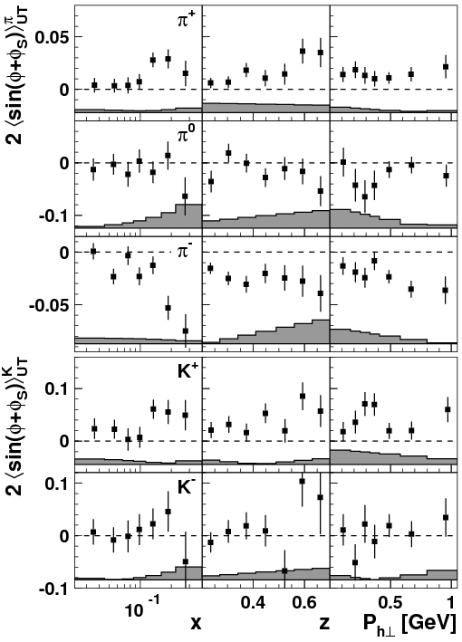
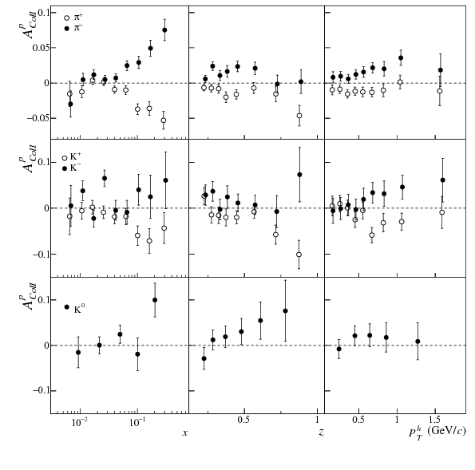
Latest SIDIS data
HERMES: Phys.Lett.B 693 (2010) 11
COMPASS: Phys.Lett.B 744(2015) 250
Final Collins asymmetries of HERMES and COMPASS (<2017) published, including kaons
More deuteron data being analyzed by COMPASS
Transverse target data expected from JLAB in near future

Slide 16
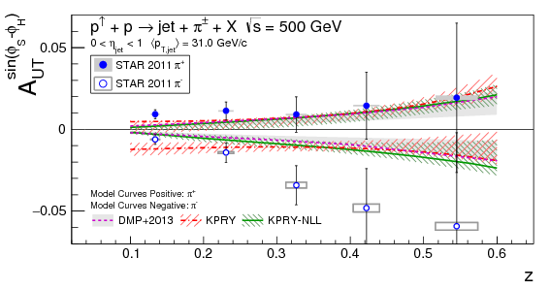
Transversity in proton collisions
STAR: Phys.Rev.D 106 (2022) 072010, 2022
Nonzero Collins asymmetries (hadron in jets) at central rapidities at 200 and 500 GeV
Substantial theoretical progress for hadron in jet measurements
  unpolarized: Kaufmann et al.
  polarized Kang et al.
For roughly same x and kt similar size → evolution effects moderate?
But generally slightly larger than global fits from SIDIS/e+e-
More to come from sPHENIX in near future
STAR: Phys.Rev.D 97 (2018) 032004

Slide 17
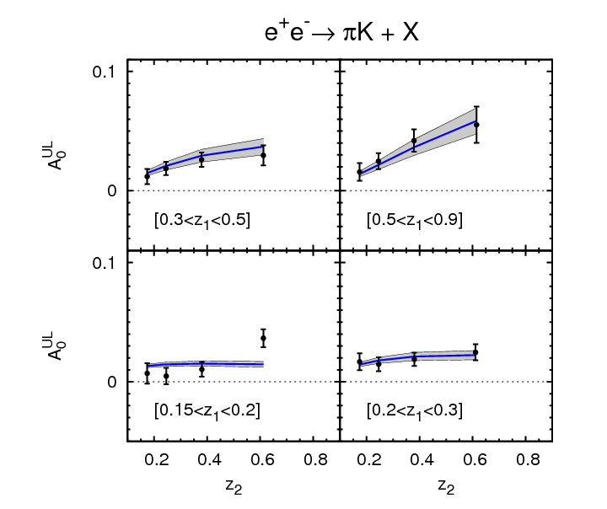
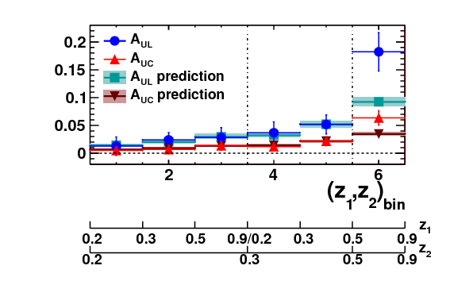
Toward sea-quark transversity via Collins into Kaons
BABAR: PRD 92 (2015) 111101
Anselmino et al: PRD 93 (2016) 034025
Addition of kaon Collins fragmentation strongly needed for flavor decomposition of quark transversity
Large amount of potentially participating FFs well described by light and “heavy” favored and disfavored FFs (but still many assumptions)
Allows inclusion of HERMES and COMPASS kaon asymmetries (+eventually EIC) in fits
Also: pion Collins at lower scale(BESIII) consistent with TMD evolution
unpolarized kaon multiplicities from COMPASS exist for baseline unpol.FFs
BESIII:PRL 116 (2016) 042001

Slide 18
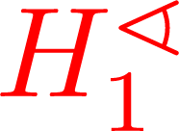
Interference fragmentation as alternative Transversity channel
Interference fragmentation function
J. Collins, S.Heppelmann, G. Ladinsky, Nucl. Phys. B, 420 (1994) 565
h₁
h₂
Di-hadron vs single hadron
  Collinear factorization is shown to be valid → TMD factorization is less certain in p+p (Rogers, Mulders, arXiv:1010.2977)
  No model uncertainties from transverse momentum dependence of FF and PDF
  No need to separate Sivers/Collins effects as in single hadron measurement
  Completely independent measurement
  Doesn’t need jet reconstruction
  Evolution is known
  But unpolarized and polarized di-hadron fragmentation functions needed
Quark spin


quark
quark
h₂
h₁
Collins fragmentation function
Requires knowledge on quark kinematics
J. Collins, Nucl. Phys. B396, (1993) 161
h


quark
quark
h
(courtesy A. Bacchetta)

Slide 19
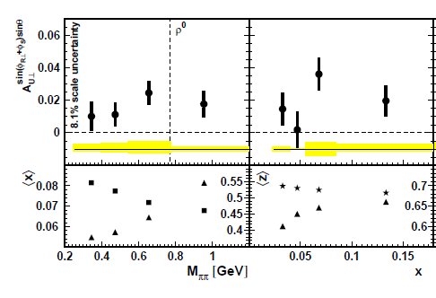
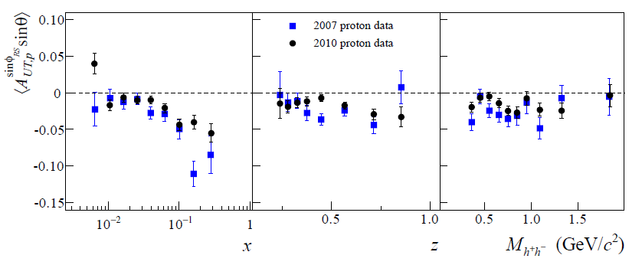
SIDIS IFF measurments
HERMES: JHEP 0806, 017 (2008)
Again sizeable asymmetries in SIDIS seen from HERMES and COMPASS
Consistent with each other
COMPASS: Phys.Lett. B736 (2014)

Slide 20
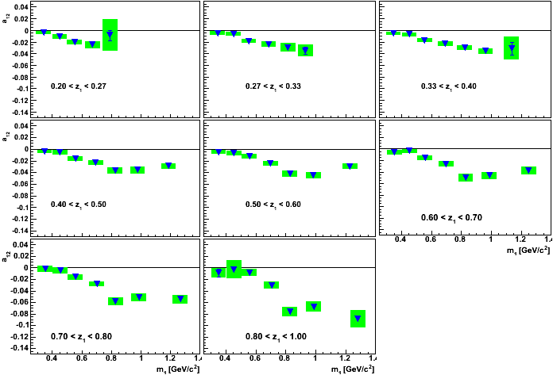
Also Belle fragmentation measurements available
Belle:
PRL107:072004(2011)

Slide 21
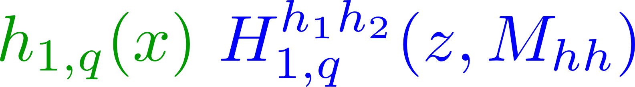
STAR IFF results
STAR 510 GeV: PLB780 (2018) 332
200GeV: PRL 115 (2015) 242501
Now both 200 and 510 GeV results finalized
Both with substantial nonzero effects at:
  Forward rapdities
  Higher Pt
  Masses around 1 GeV
First theory predictions from SIDIS+Belle consistent with magnitude
→ will help improve
transversity uncertainties
→but gluon DIFFs not well
known
Radici et al: PRD97 (2018) 074019

Slide 22
Global fits of Dihadron FFs
Cocuzza et al. https://arxiv.org/abs/2306.12998
Also Radici et al. PRL 120 (2018) 19, 192001
Global fits taking SIDIS data, RHIC data, Belle data (polarized and unpolarized) into account

Slide 23
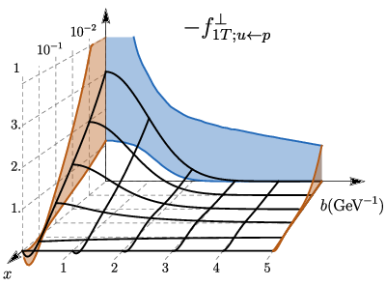
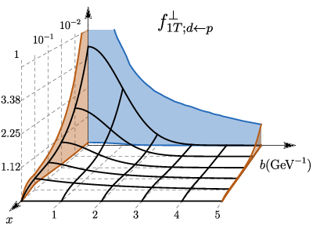
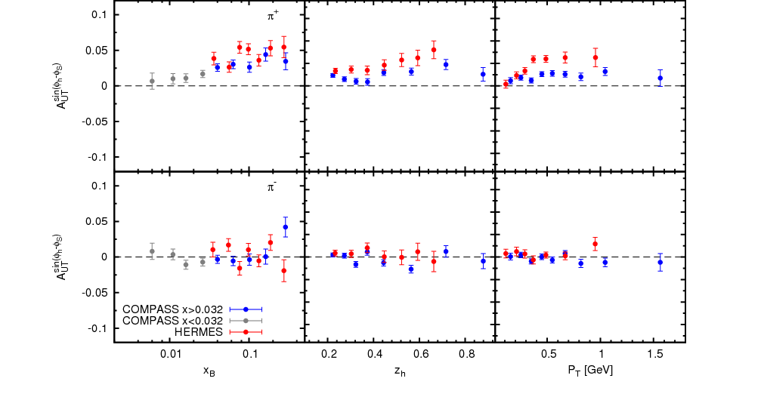
Sivers Function measurements
Anselmino et al. Eur.Phys.J.A 39 (2009) 89
Early fits of SIDIS data show opposite signs, d quarks possibly larger
Recent updates including evolution higher orders, and STAR W data
Bury et al. Phys.Rev.Lett. 126 (2021) 112002

Slide 24
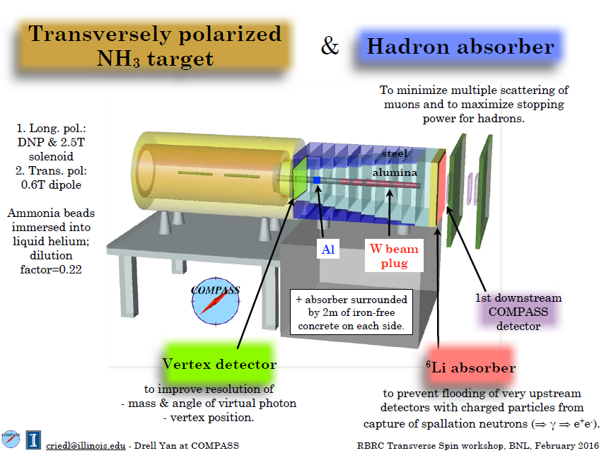
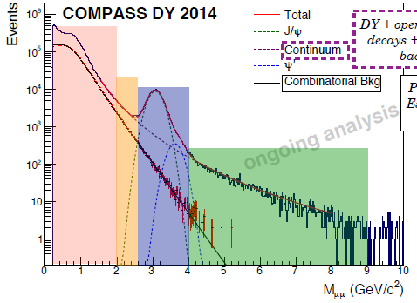
Sivers Sign change and sea
?
COMPASS: polarized NH₃ target + 160 GeV π⁻ beam → Sensitivity to u quark Sivers and sign change
Presentation by C.Riedl

Slide 25
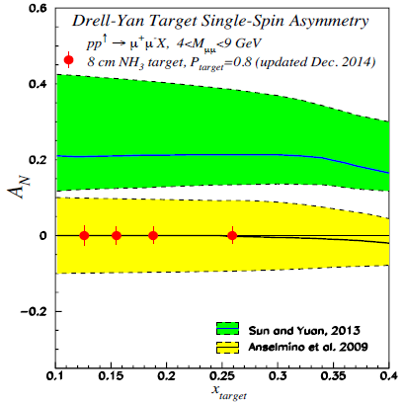
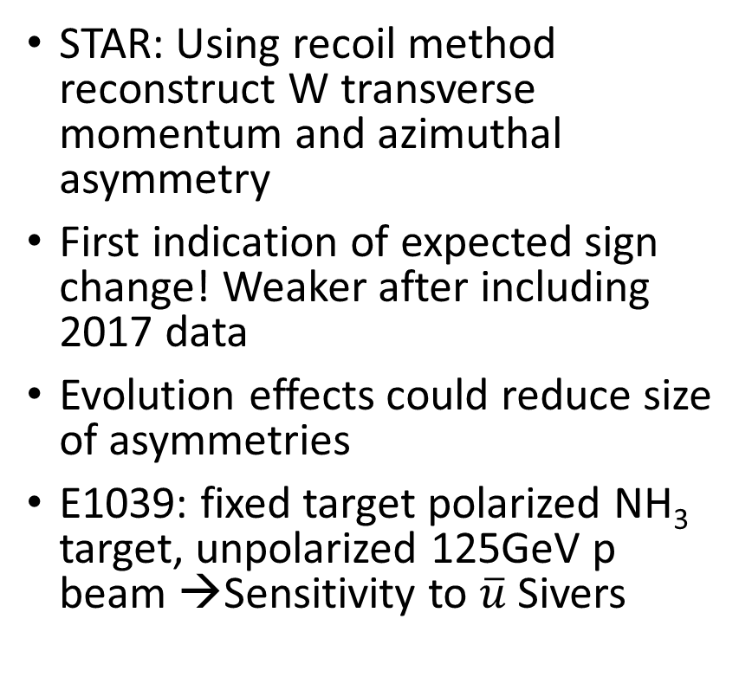
Towards the Sivers sign change
?
STAR: PRL 116 (2016) 132301
STAR: Using recoil method reconstruct W transverse momentum and azimuthal asymmetry
First indication of expected sign change! Weaker after including 2017 data
Evolution effects could reduce size of asymmetries
E1039: fixed target polarized NH₃ target, unpolarized 125GeV p beam →Sensitivity to $\overline{u}$ Sivers
projection for 1year running

Slide 26
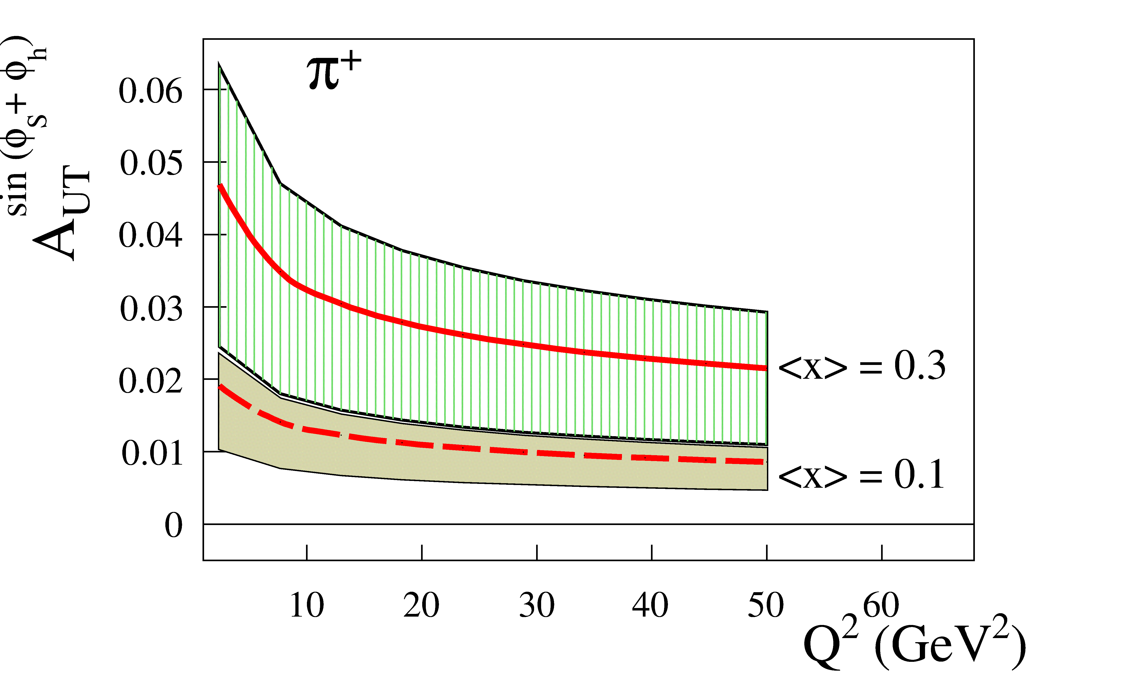
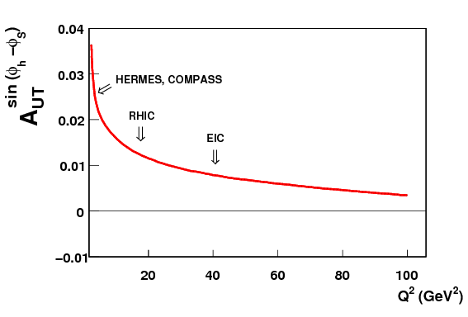
About TMD evolution
Moos et al. https://arxiv.org/abs/2305.07473
Large theoretical effort to understand TMD evolution (see for example Evolution and REF workshop series)
Large overlap with low-x community
Despite predominantly using CSS formalism large differences due to treatment of non-perturbative terms in evolution → relevant for many spin related TMDs
Data needed
Kang, Prokudin, Sun, Yuan
PRD 93 (2016) 014009
Aybat, Prokudin, Rogers
PRL 108 (2012) 242003

Slide 27
TMD evolution
Spin
Tomography
Low-x
Nucleii
Mass
Other
Very important aspect is the study of TMD evolution
Part of the evolution kernel is non-perturbative, but current lever arm not sufficient
Sivers asymmetries are expected to decrease at higher scales, but only logarithmically (ie they do NOT “disappear”)
At higher x Asymmetries of several % expected
➔Well accessible with EIC over wide range in x and Q²
Vladimirov et al.

Slide 28

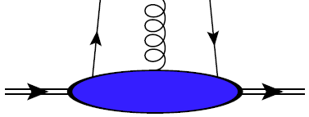

TSSAs at RHIC→Quark-gluon dynamics!
Sivers and Collins effects rely on an explicitly transverse momentum dependent (TMD) framework where two scales are observed: high scale (typically Q²) and intermediate scale (transverse momentum P_{T} << Q²)
In inclusive pp measurements usually only one, hard scale accessible (transverse momentum P_{T} )
➔requires higher Twist, collinear framework, contributions are multi-parton correlators (both in initial state and final state)
Both frameworks found to be related via moments over intrinsic transverse momenta
q-g correlation (↔ quark Sivers)
g-g correlation (trigluon ↔ gluon Sivers)
q-g FF correlation (↔ Collins)

Slide 29
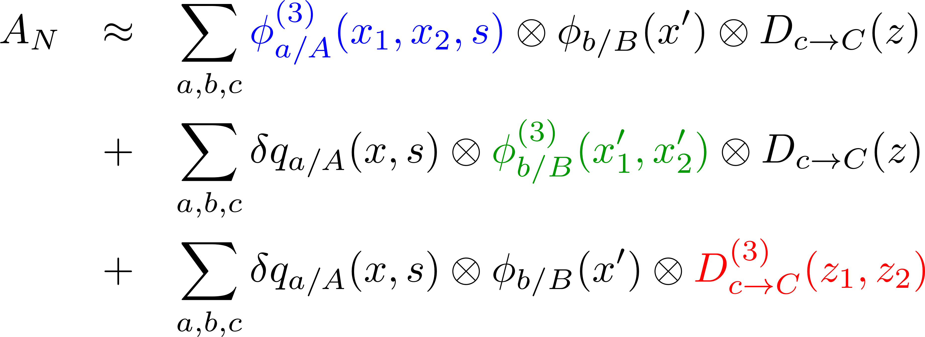
Single spin asymmetry contributions in p+p
pol proton
unpol proton
FS particle
Generally three pieces to p+p single transverse spin asymmetries:
  Twist three correlation functions (quarks or gluons) in polarized proton ↔ Sivers function
  Twist three correlation function in unpolarized proton (with transversity) ↔ Boer Mulders function
  Twist three correlation in fragmentation ↔ Collins function
a,b/c initial/final parton flavors
A,B/C initial/final hadron/particle types
Efremov, Teryaev Phys.Lett.B 348 (1995) 577
Qiu, Sterman Phys.Rev.D 59 (1999) 014004
Kanazawa, Koike Phys.Lett.B 478 (2000) 121-126
Metz, Pitonyak Phys.Lett.B 723 (2013) 365-370

Slide 30
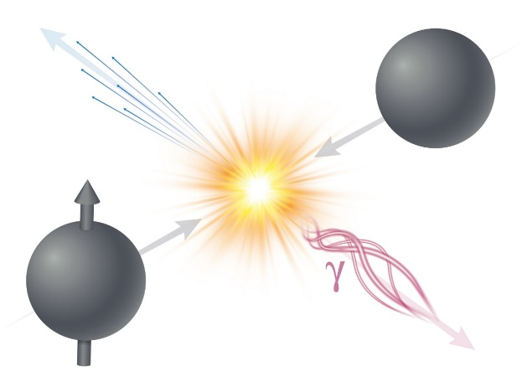
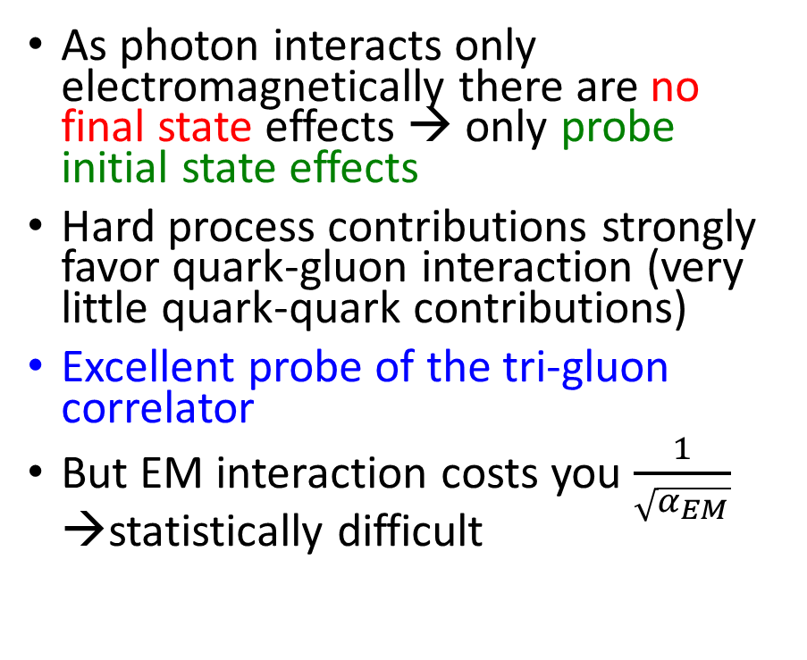
Direct photon measurements: the golden channel
As photon interacts only electromagnetically there are no final state effects → only probe initial state effects
Hard process contributions strongly favor quark-gluon interaction (very little quark-quark contributions)
Excellent probe of the tri-gluon correlator
But EM interaction costs you $\frac{1}{\sqrt{α_{EM}}}$ →statistically difficult
Also not all photons produced directly → need to understand and measure Background and its asymmetry

Slide 31

First direct photon A_{N}s
First direct photon A_{N} extracted at RHIC
Mostly sensitive to initial state effects (no fragmentation) → quark-gluon and gluon-gluon correlation functions
Power to constrain gluon-gluon correlation function well, since quark impact expected to be small
Phys.Rev.Lett. 127 (2021) 162001

Slide 32

Gluon dynamics via direct photons in sPHENIX
TSSA of prompt photon
EMCal-based trigger
Substantial improvement possible with sPHENIX
sPHENIX BUP2021 [sPH-TRG-2021-001]

Slide 33

Where to go from here? Global fits on transverse quark-gluon structure
Cammarota et al, PRD 102 (2020) 054002
Transversity
Sivers function
Collins FF
RHIC, SIDIS, DY included
Recent central rapidity PHENIX results (π,η,Heavy flavor electons, direct photons) not yet included
Impact on gluon Sivers function (tri-gluon correlator) expected

Slide 34





A dependence of A_{N}s
Phys.Rev.Lett. 123 (2019) 122001
Asymmetries consistent with A^{1/3} dependence as (initially) predicted by some CGC related nuclear effects (Hatta`17)
No A dependence is ruled out
Also consistent with suppression with increasing number of binary collisions
However, probed x and scale too large for expected CGC effects! (S.Benic and Y.Hatta, PRD99, 094012 - Twist-3 fragmentation + gluon saturation)

Slide 35


Transverse spin asymmetries in pA
2015: p↑+A collision at $\sqrt{s_{NN}}=200$GeV
Several theory predictions of diminished pA asymmetries due to nonlinear low-x behavior (either final or initial state effects)
No substantial reduction seen in 2015 STAR data
However, origin of A_{N} asymmetries still unclear

Slide 36
Open transverse spin/TMD questions
All Transversity and Sivers data only for 0.01<x<0.3
(almost) no information on sea quarks
Transversity integrals needed for Tensor charge <-> Lattice/BSM
Many TMD extractions still in LO or with substantial theoretical assumptions
TMD evolution uncertainties
True 3D pictures in x and kt
Phys.Lett.B 816 (2021) 136255

