Slide 1
Towards a New Science Frontier: The Electron Ion Collider – Science, Detector and Status
Rolf Ent (Jefferson Lab)
TIDC Autumn School on Electron-Ion Collider
August 28-30, 2023

Slide 2
Four Lectures
Lecture 1 Introduction and Electron Scattering Basics
Lecture 2 EIC Science
Lecture 3 EIC Detector
Lecture 4 EIC Project Status

Slide 3
Outline of This Lecture
EIC Requirements
Project History and Plans
Management and Organization
Funding and Schedule Plans
CD-3A and CD-2 Planning Perspective
Accomplishments
Opportunities and Challenges
Summary
This outline and many slides are directly from the introductory talk by Jim Yeck, the EIC Project Director, at the very recent comprehensive design reviews of the EIC accelerator (last week) and EIC detector (this week),
I interspersed some slides from the detector overview talk by Elke/me, of relevance to the detector/experimental program.

Slide 4
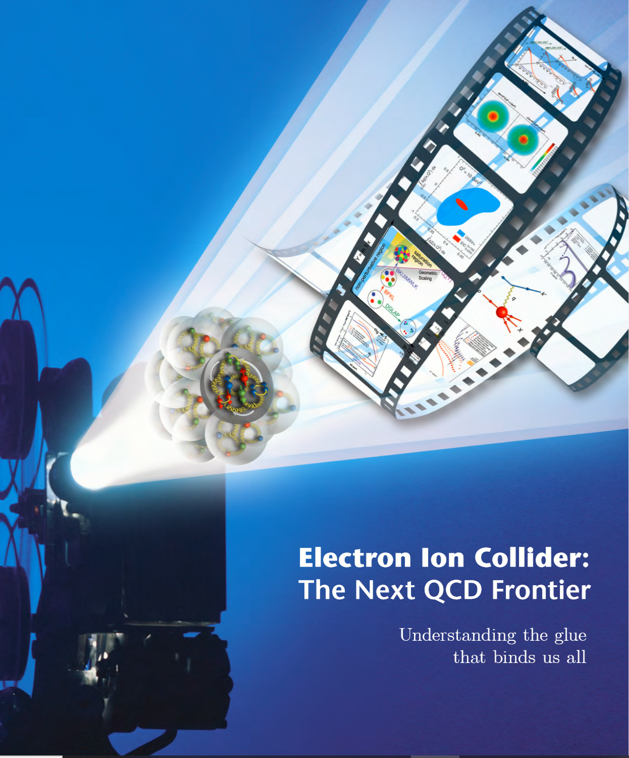

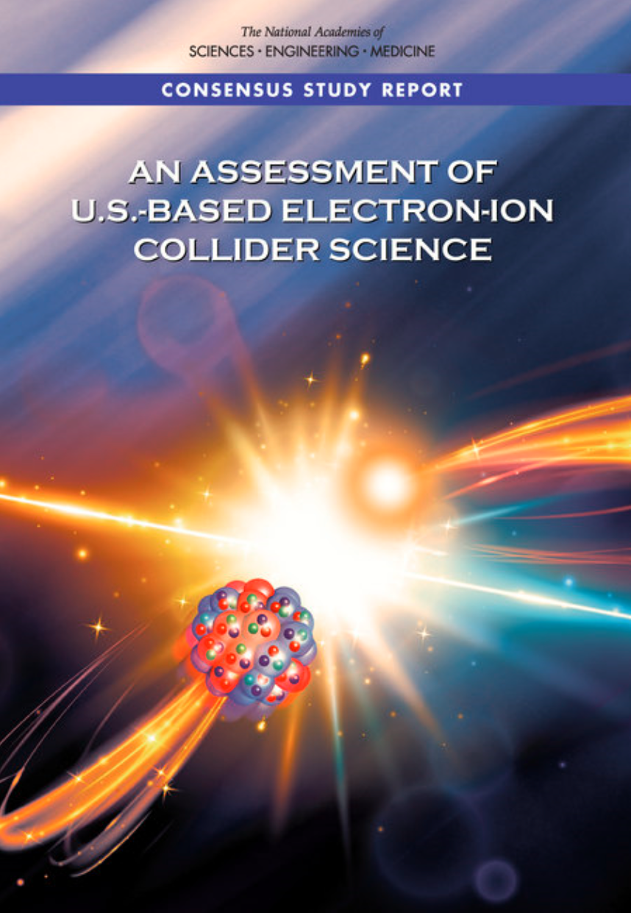

Project Requirements
Project Design Goals
High Luminosity: L= 10³³ – 10³⁴cm⁻²sec⁻¹, 10 – 100 fb⁻¹/year
Highly Polarized Beams: 70%
Large Center of Mass Energy Range: E_{cm} = 29 – 140 GeV
Large Ion Species Range: protons – Uranium
Large Detector Acceptance and Good Background Conditions
Accommodate a Second Interaction Region (IR)
IR-8
IR-6, ePIC Detector
IR-8
Conceptual design scope and expected performance meets or exceed NSAC Long Range Plan (2015) and the EIC White Paper requirements endorsed by NAS (2018).

Slide 5
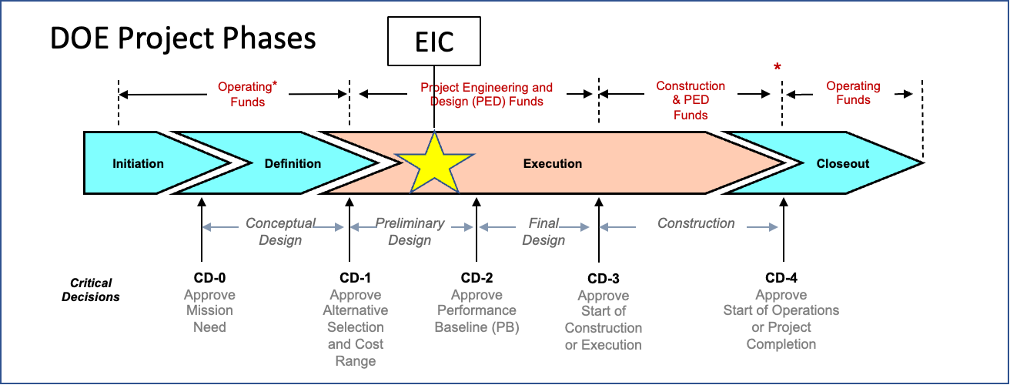
EIC Project History and Plans
CD-0, Mission Need Approved | December 2019
DOE Site Selection Announced | January 2020
CD-1, Alternative Selection and Cost Range, Approved | June 2021
CD-3A, Long Lead Procurement | January 2024
CD-2/3, Performance Baseline/Construction Start | April 2025
RHIC Shut Down | June 2025

Slide 6
Intermezzo – What do the CD milestones mean?
CD-0 – Approve mission need: this documents that a scientific goal or a new capability, requiring material investment exists.
CD-1 – Approve Alternative Selection and Cost Range: serves as a determination that the selected alternative and approach is optimized to meet the mission need defined at CD-0. What is perhaps most relevant is that CD-1 allows for release of Project Engineering and Design (PED) funds, which means the next phases of design of accelerator and detector can begin.
CD-2 – Approve Performance Baseline: CD-2 is an approval of the preliminary design of the project and the baseline scope, cost, and schedule. What is most relevant is that CD-2 means there is now a definitive plan that the project will be measured against in cost, schedule and technical performance.
CD-3 – Approve Start of Construction: CD-3 is an approval of the project’s final design and authorizes release of funds for construction. What is most relevant is that projects can now proceed with construction related procurements and activities. CD-3 is sometimes split in CD-3A in a tailored approach to approve start construction for long-lead procurements.
CD-4 – Approve Start of Operations or Project Completion: CD-4 provides recognition that the project’s objectives have been met. CD-4 is sometimes split in CD-4A that allows, after agreed-upon criteria for technical success have been met, for transition into operations, and CD-4B that provides the formal closeout of the project.

Slide 7
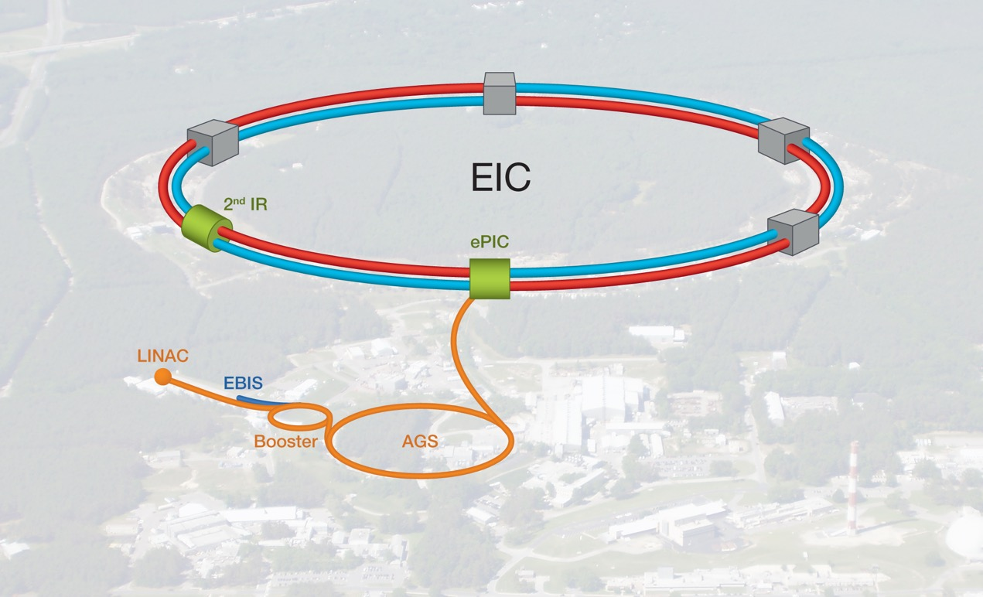
EIC Double Ring Design
Based on Existing RHIC Facility
RHIC Operations Concludes in 2025

Slide 8
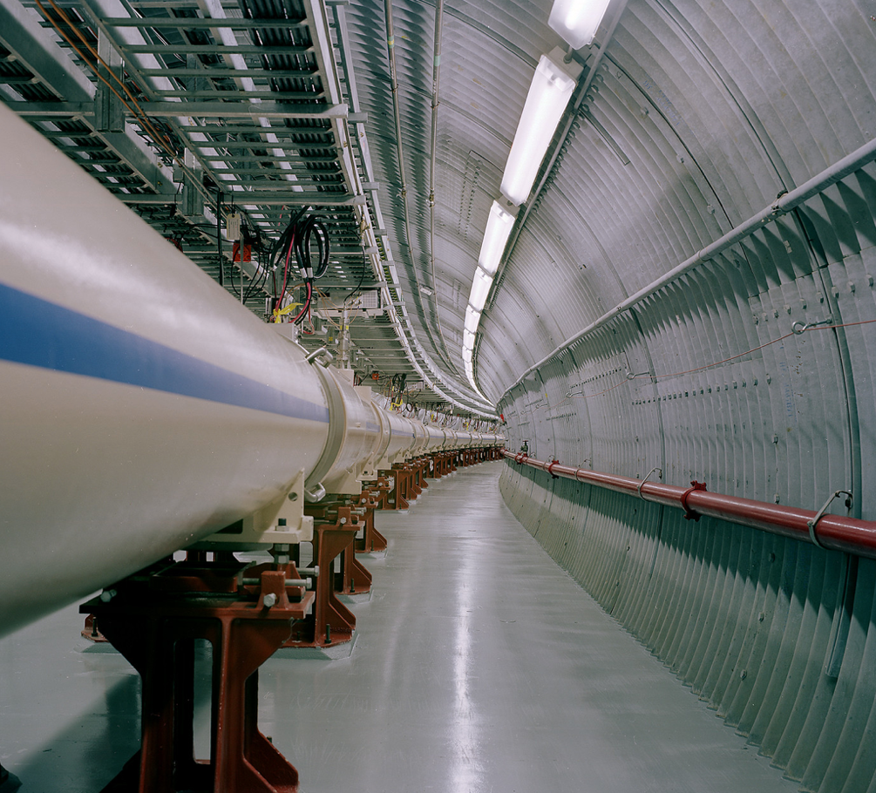
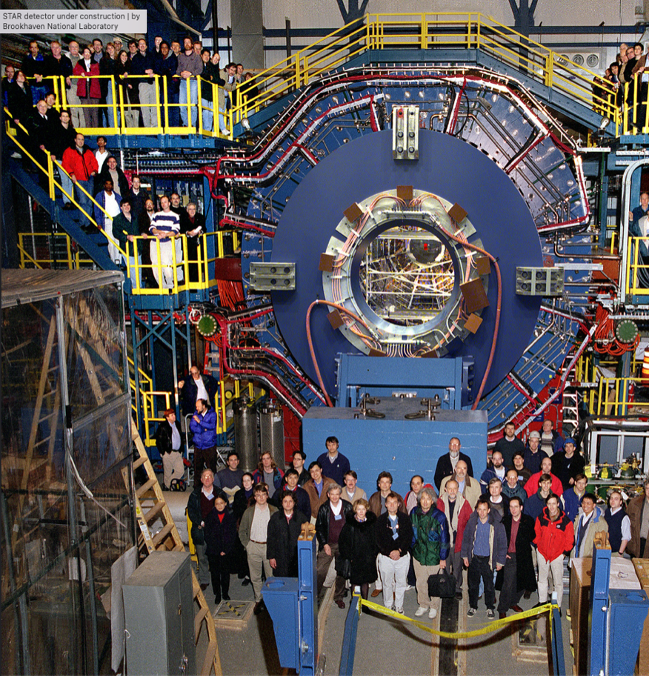
RHIC Infrastructure

Slide 9
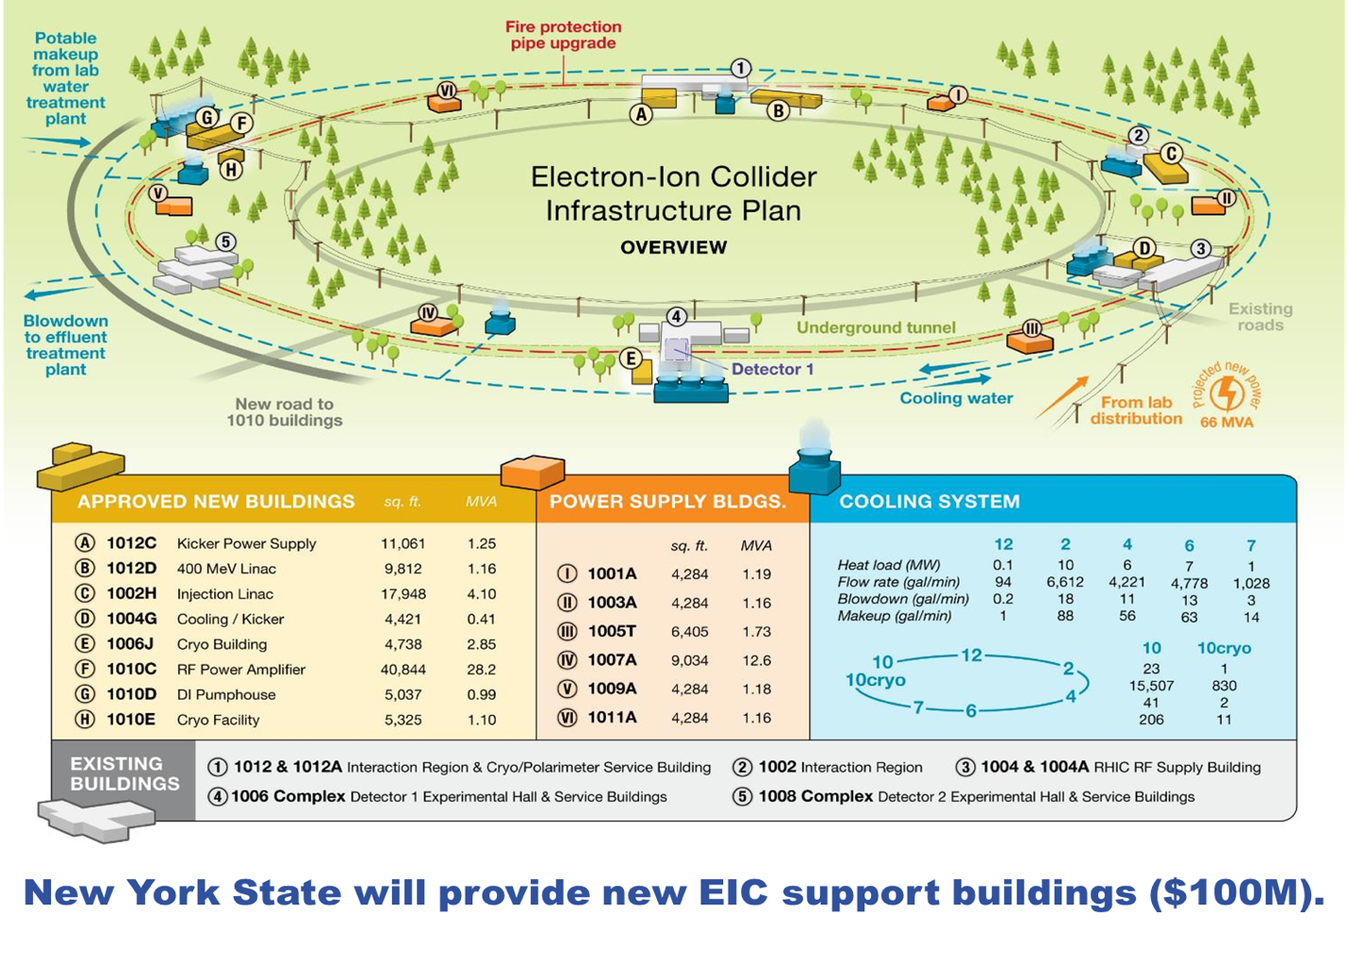

Slide 10
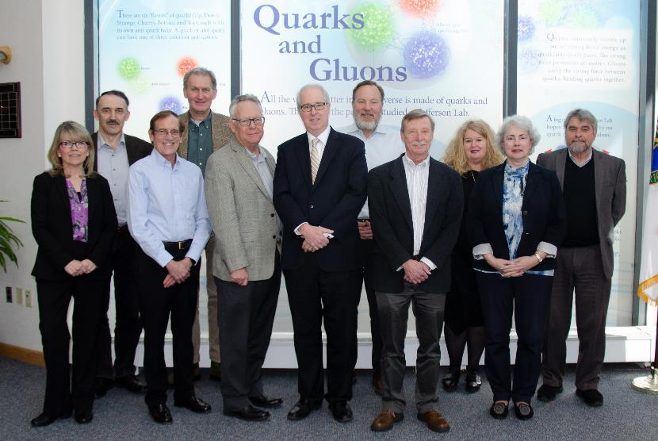
BNL/TJNAF Special Partnership
BNL/JLab partnership established in early 2020
Integrated management and scope
Serve together as hosts for the EIC experimental program

Slide 11
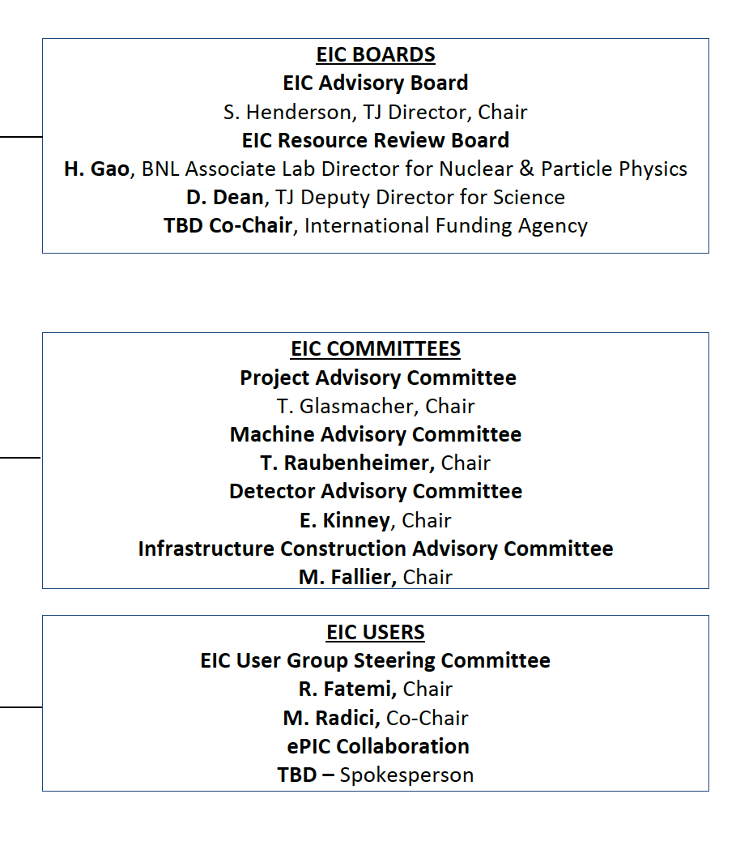
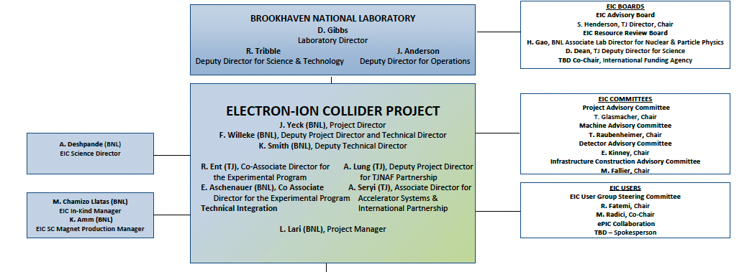
Boards and Advisory Committees
11
D. Bettoni,
DOE, BNL, and JLab envision an EIC facility that is “fully international in character.”
International EIC Advisory Board provides oversight and advice on the construction of the facility, focusing on the accelerator: ANL, BNL, FNAL, LBNL, TJNAF, TRIUMF - Canada, IN2P3 and CEA - France, STFC - UK, INFN - Italy.
International EIC Resource Review Board provides oversight of experiments, 1st meeting April 2023. Delegates from Africa, Asia, Europe, North and South America.
International EIC Project Advisory Committee provides advice on the successful delivery of the DOE Project including management, scope, schedule, cost, and performance.
John Lajoie, Spokesperson
Silvia Dalla Torre, Deputy Spokesperson

Slide 12
EIC Advisory Board
Directors of labs participating in the EIC accelerator design and construction, chaired by JLab Director
Meets 3-4 times per year, last meeting on June 29, 2023
June meeting approved charter and provided recommendations:
  BNL: Expeditiously move forward with a design contract with Saclay for the solenoid spin rotator magnets.
  JLAB: Evaluate the benefit/risk to the project of the PERLE cryomodule proposal.
  BNL/JLab: Establish an accelerator collaboration with the proper structure and regular meetings.
  EIC Project and Partners: Finalize scope with partners.
  EIC Project: Define high-level risks and milestones at the appropriate level to be monitored by the EIC Advisory Board.

Slide 13
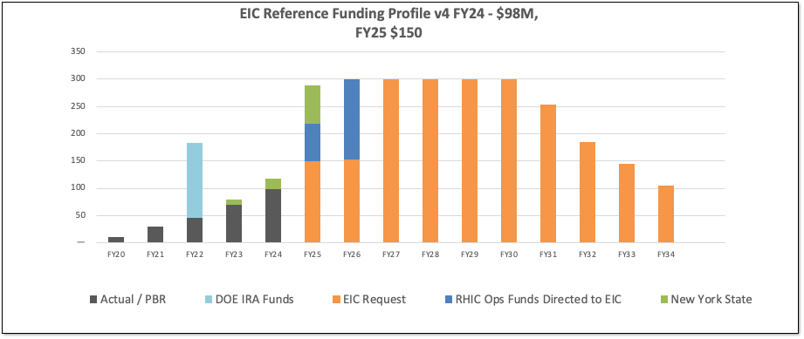
DOE Reference Funding Plan
13
DOE Inflation Reduction Act funding of $138M allocated in September 2022. Actual FY2023 funding is $70M. DOE request for FY2024 is $98M.
RHIC shut down planned for June 2025. Significant RHIC Operations funding will be redirected to EIC construction starting in FY2025 and reaching ~$150M/year in FY2026.
Current funding supports DOE CD-3A, Long Lead Procurement Approval, in January 2024. Long lead procurement mitigate risks: technical, supply chain, inflation, and schedule.

Slide 14
Funding and DOE Critical Decisions
Inflation Reduction Act (IRA) funding of $138M provided at the end of 2022 supports CD-3A, Long Lead Procurement Approval, plans
FY2024 funding is expected to be $98M
Substantial redirection of funding from RHIC operations into EIC construction starting in 2025
FY2025 funding will be critical to achieving the CD-2/3 approval schedule
  Priority is securing CD-2 prior to planned conclusion of RHIC ops in 2025 and the efficient transition from RHIC ops into EIC construction

Slide 15
EIC Project & Design Reviews
Event | Date
Office of Project Assessment Status Review | October 19-21, 2021
Fundamental Power Coupler Design Review (PDR) | June 18, 2021
Federal Project Director Status Update | June 28-30, 2021
EIC ESR Vacuum Systems and Impedance (CDR) | November 8, 2021
IR Design & MDI Review (CDR) | April 6, 2022
EIC Source and 400 MeV Pre-Injector Linac Systems Review (PDR) | July 14, 2022
Electronics/Computing Subsystem Status Review (CDR) | August 29, 2023
DET - Magnet Subsystem Design (PDR) | October 18, 2022
ESR Single Cell Cavity Review (PDR) | October 27, 2022
Crab Cavity R&D Prototype (PDR) | November 2, 2022
Cryogenics Satellite Plant and 2K & 4k Distribution (PDR-1) | November 15, 2022
Electromagnetic and Hadronic Calorimetry Subsystem Status Review (PDR-1) | December 6, 2022

Slide 16
EIC Project & Design Reviews (cont.)
Event | Date
Polarimetry & Luminosity Detector Status Review (PDR-1) | January 17, 2023
Office of Project Assessment Status Review | January 31-February 2, 2023
591 MHz First Article Single Cell Cavity String Components (PDR) | April 20, 2023
EIC High Power FPC (FDR-1) | April 28, 2023
591 MHz HP-SSA Engineering Demonstration Units (FDR) | May 16, 2021
RCS Arc Vacuum Chambers (PDR) | June 9, 2023
SC Magnet Wire Specification (FDR) | June 15, 2023
HSR BPM Cryo Buttons & Cryo Cables (PDR) | June 20, 2023
400 MeV Linac System (FDR) | June 23, 2023
Long-Lead Procurement Cost Review | June 26-29, 2023
SC Magnet Schedule Review | June 26-29, 2023
Particle Identification Systems Detector Status Review (PDR) | July 5-6, 2023
Backward EM Calorimeter PbWO4 (FDR) | July 21, 2023
Secondary Unit Substations (FDR) | July 24, 2023

Slide 17
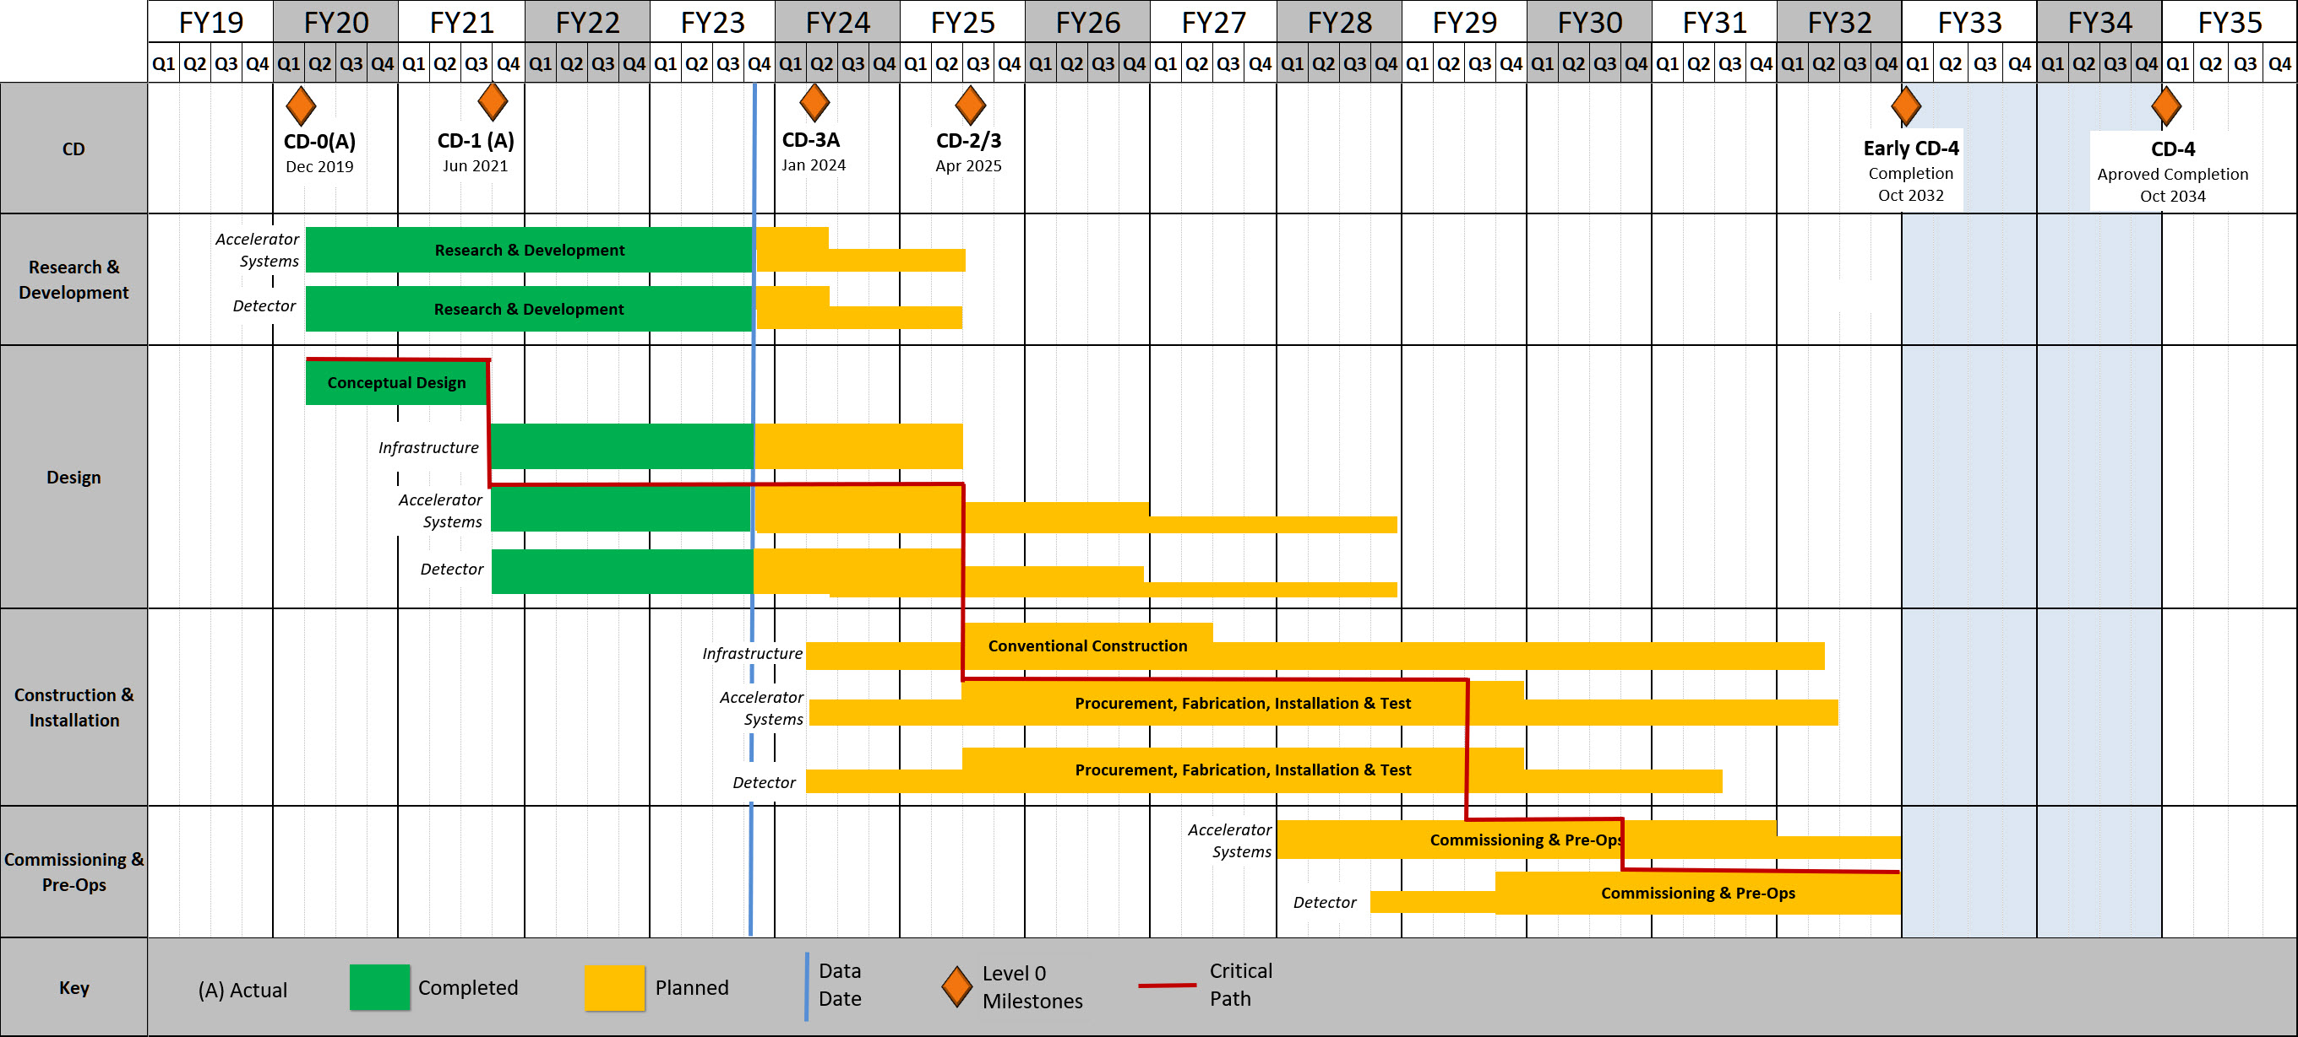
EIC High Level Project Schedule
Construction Phase
Science Phase
Conclusion of RHIC Operations
The thinner bars indicate that R&D and design
can continue at a small level beyond CD-2 and CD-3
for LLP construction
starts at CD-3A
Recent change replaced CD-4A with project internal milestones
The logic remains the same though, we start accelerator commissioning with an instrumented beam pipe and the detector in the Assembly Hall. The detector only rolls in later.

Slide 18
Intermezzo: Detector – Long Lead Procurements for CD-3A
Selection already accounts for design changes and recent technology choices
WBS 6.10.07 1.7 T Solenoid
  Magnet is long-lead as the detector assembly and installation requires the availability of the fully-tested magnet
  limited world-wide vendors and long production time (estimated from recent 12 GeV magnets)
  CD-3A scope is for full magnet but does neither include a final phase of testing nor the cryo can/cryo flex line and power supply.
Electromagnetic and Hadronic Calorimeters and SiPMs
  WBS 6.10.04, 05, 06 SiPMs for calorimeters and dRICH
  → Need 778907 SiPMs - 7 different types
  CD-3A scope is one phase (321096 SiPMs) out of two for forward HCal
  WBS 6.10.05 PbWO4 crystals – CD-3A scope is first two years of procurements (1500 pieces)
  WBS 6.10.05 fECAL and Barrel ECal SciFi need in total ~7500 km
  CD-3A scope is 1875 km first of four phases
  WBS 6.10.06 forward HCal: Steel and Tungsten plates
  CD-3A scope is first of two phases (~50%)
All these long-lead items are driven by
  limited world-wide vendors → competition by other projects around the world
  production times and capability and/or labor-intensive manufacturing tasks
  SiPMs staggered procurement
Final Design Reviews for LLPs: for magnet complete design to initiate a vendor design-build contract, for other systems a review to justify specifications for procurement.

Slide 19
Recent Accomplishments
Contract for Architecture / Engineering Services for Infrastructure signed in June. Construction Management / General Contractor acquisition plans prepared. New York State funding buildings. Team clarifying requirements and sustainability goals.
Increased Accelerator staffing and collaboration with US labs and international partners. Overall design and lattice stabilized to serve as the basis of engineering design.
Detector technology choices and design prepared by the ePIC collaboration with support from the project. Resource Review Board established to engage funding agencies in planning.
CD-3A case and viability established. Performance measurement baseline in preparation (CD-3A & CD-2) by the Project Management team (L1, L2, L3, L4, …).
International partners participating in the development of the Governance model. Working to prepare a facility that is international in character.

Slide 20
Detector Technical Change Control Board (TCCB)
Copy process as has been used for the accelerator as it works well.
Will have more people with detector expertise in the TCCB for such change requests. We need to involve the detector collaboration to initiate documentation for change requests and use their technical board or equivalent to ensure the change request is consistent with the NAS science requirements, and then use the "detector TCCB" to ensure the project part.
As final step it goes to the EIC Management Team (EMT) for the formal approval.
Proposed detector TCCB:
  Qiong Wu (chair)
  Person with detector experience to take notes and help Qiong
  Elke Aschenauer
  Rolf Ent
  detector lead mechanical engineer (Rahul Sharma, 6.10.10 CAM)
  detector lead electronics engineer (Fernando Barbosa, 6.10.08 CAM)
  two members of the ePIC collaboration (Silvia Dalla Torre, Technical Coordinator)
  three accelerator L2 leads or alternate: HSR, ESR and IR to ensure overlap
  relevant L3 CAM of the WBS the change is requested for
  add subject matter experts as needed (for example Charlie Folz for infrastructure).
Always included in TCCB process: Ferdinand Willeke and Todd Satogata
Note: After the TCCB advise, the formal baseline change control is done through the EMT but in obeyance of the various thresholds in the Project Execution Plan.

Slide 21
Technical Change Control Process - Detector
This is a five-step change control process:
  The detector collaboration initiates a possible change in baseline scope
  The collaboration technical board or equivalent ensures the change is consistent
  with the NAS science requirements and initiates the change request
  → The above process was recently used for the two final ePIC detector technology decisions (after the detector proposal process): the backward particle identification detector choice and the barrel EM calorimeter detector choice
  → What then follows is to prepare input for the detector TCCB
  This includes detailed changes in cost, schedule and risk → implement in P6
  and science and technical justification for the change ← input from ePIC
  The detector TCCB collects wide input, discusses, and gives advise
  The Project Technical Director gives approval
  The EIC Management Team needs to approve the formal baseline change control

Slide 22
Recent ePIC Detector Changes
Up to now, we have not needed to invoke the full detector technical change process as after deliberations with the EIC Management Team the changes were accepted through a Record of Decision.
Three changes were made:
  Adopt a new magnet with 1.7 T design goal and 2 T stretch goal (Initiated Summer 2022)
    This required +5M$ but was a must for the tracking requirements
    The existing BaBar/sPHENIX magnet could only reach 1.15T – engineering risk assessment also captured as Technical Note.
  Change from a modular to a proximity-focusing RICH in the backward region (Initiated Spring 2023)
    No change in cost, schedule or risk
  Change from a Sci-glass based to an imaging EM calorimeter in barrel region (Initiated Spring 2023)
    Costs absorbed in EIC scope cost changes list (and reduced to before)
Changes are fully integrated in P6 for all systems affected (for example, for the barrel EM calorimeter change this could impact the 6.10.05 EM calorimetry, the 6.10.08 electronics, the 6.10.09 DAQ/computing (was nil), and the 6.10.10 Infrastructure (was in the end small)).

Slide 23
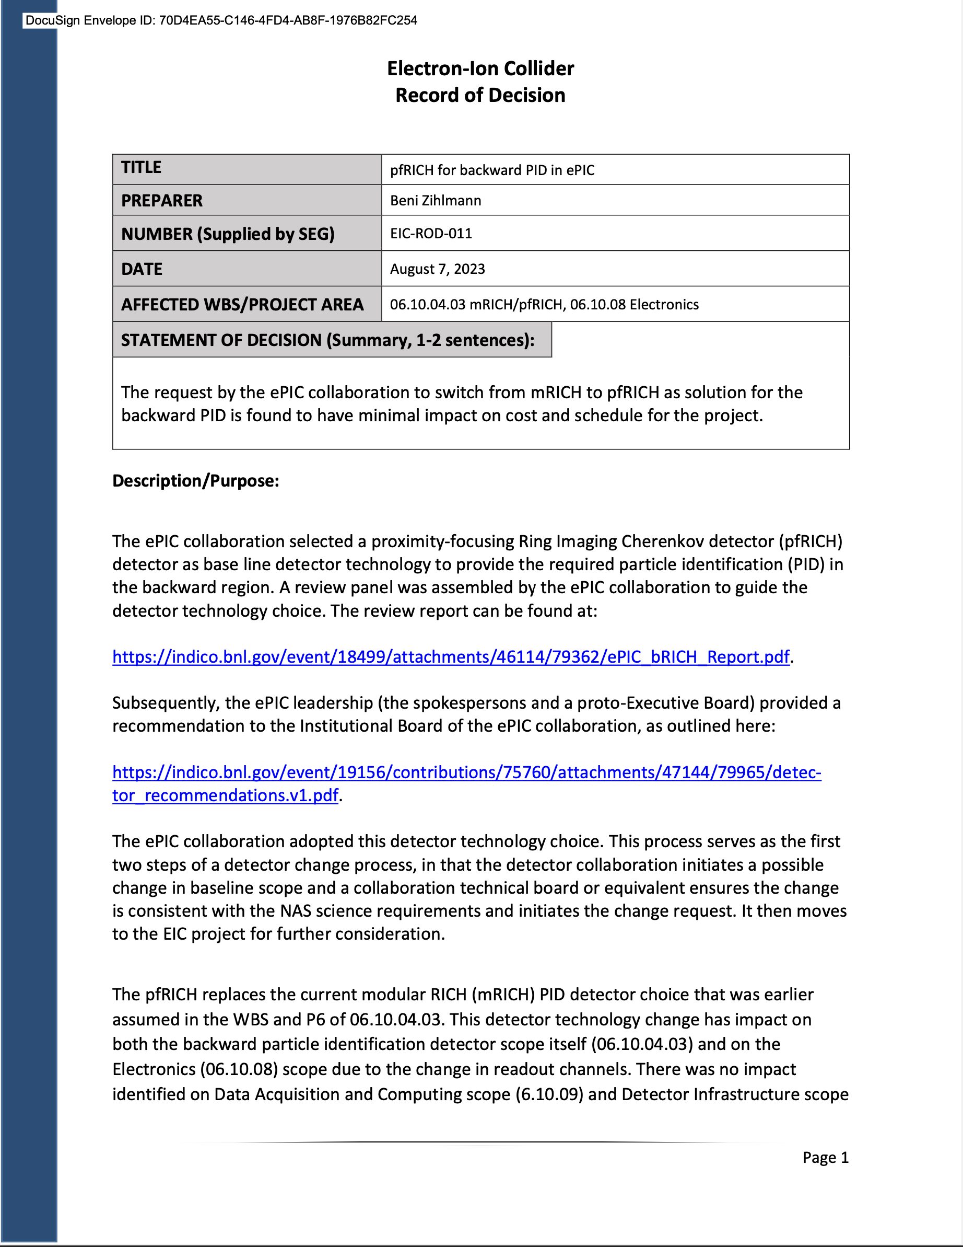
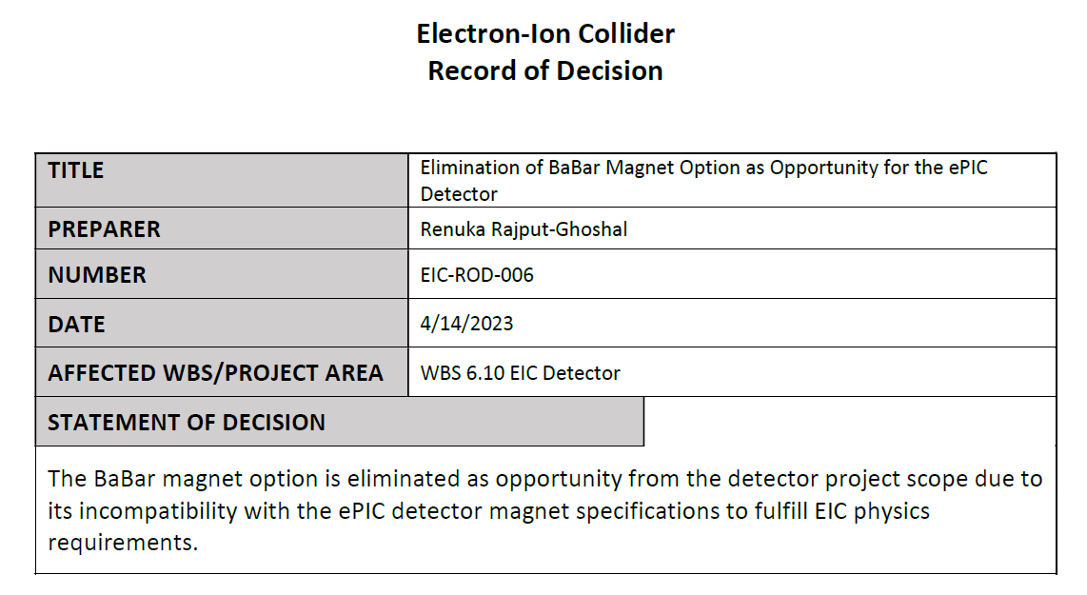
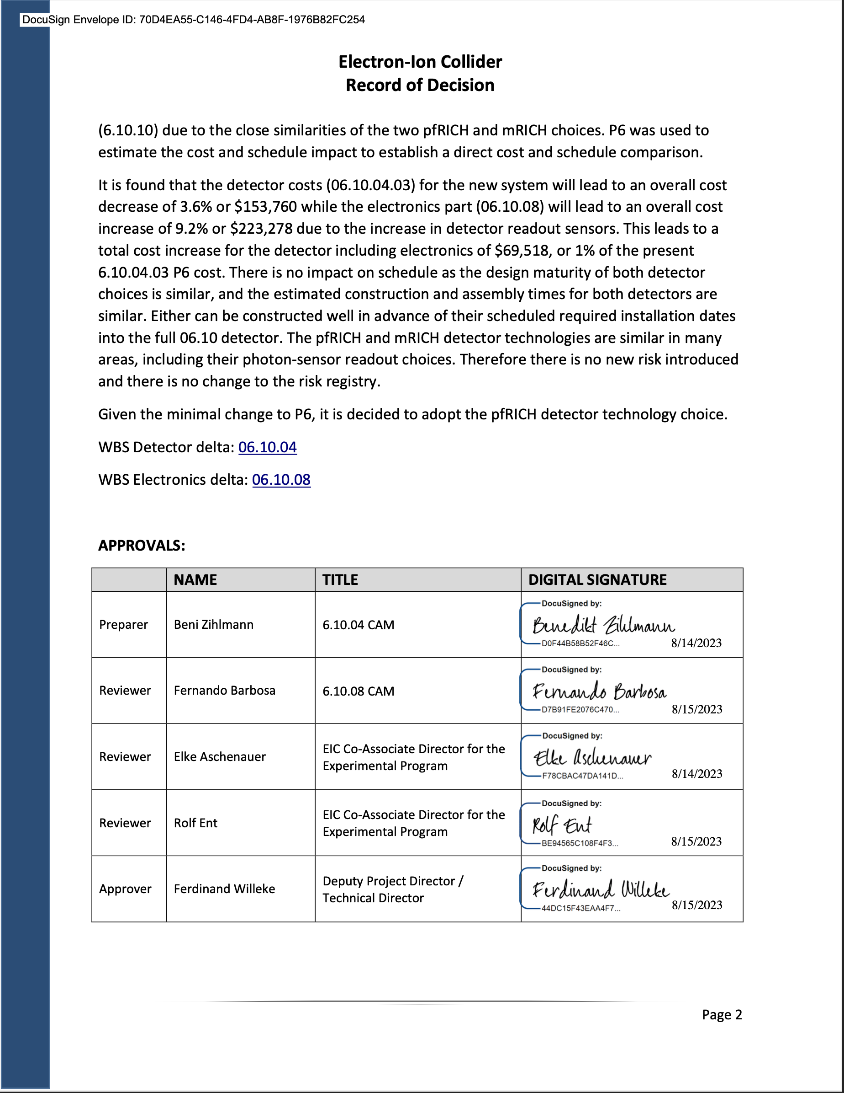
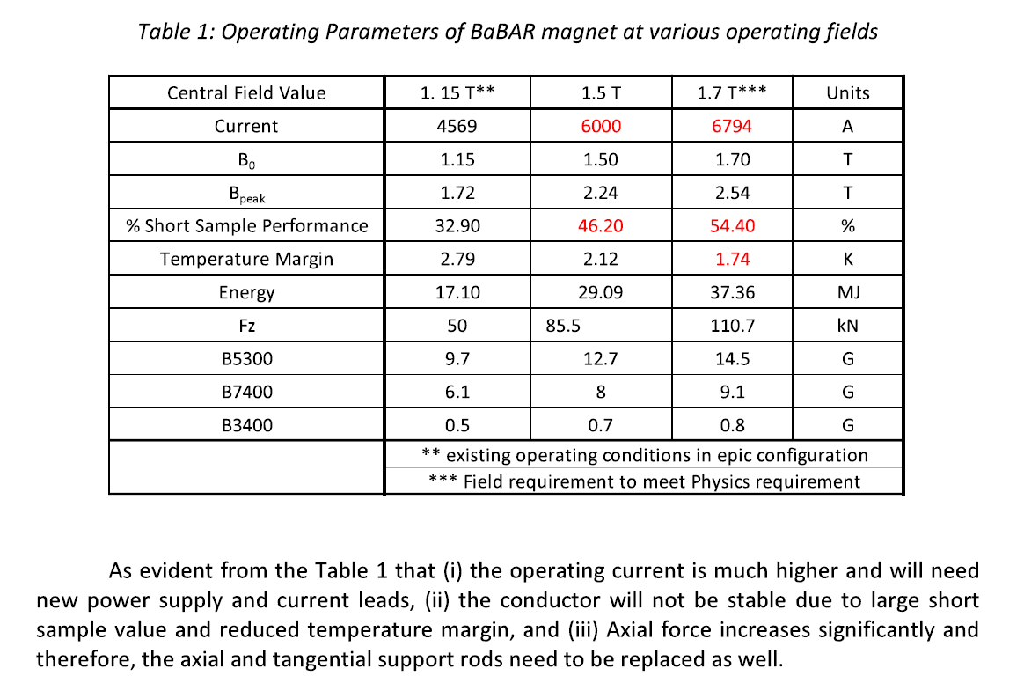
Detector Record of Decisions - Examples
Adopt pfRICH
Rule out reuse of BaBar magnet

Slide 24
Project – Challenges
Affordability – The cost range for the EIC project is higher than can be accommodated by current DOE ONP funding levels. The EIC construction phase requires an increase in the annual funding for ONP/EIC followed by the substantial redirection of funding from RHIC operations. The reference funding plan assumes $300M/year starting in FY2026.
DOE M&O Contractor SOP vs Project Needs – Successful large science projects require modifying many of the host Laboratory’s operational functions to facilitate the project’s construction. The EIC project team is working with the host labs and the EIC Project Advisory Committee (PAC) to position the EIC project for success (recent PAC report).
In-kind Schedules – Schedule of in-kind contributions are often a challenge given the timing of funding agency decisions. A proactive approach is taken to ensure issues are resolved.

Slide 25
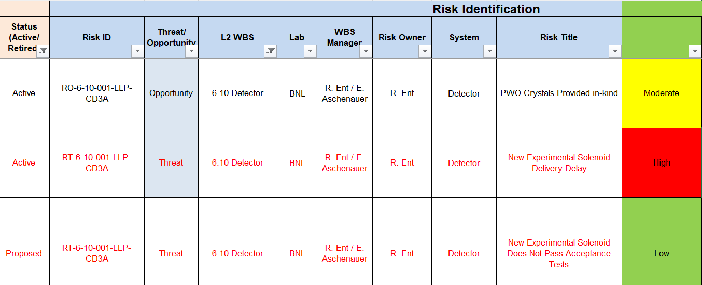
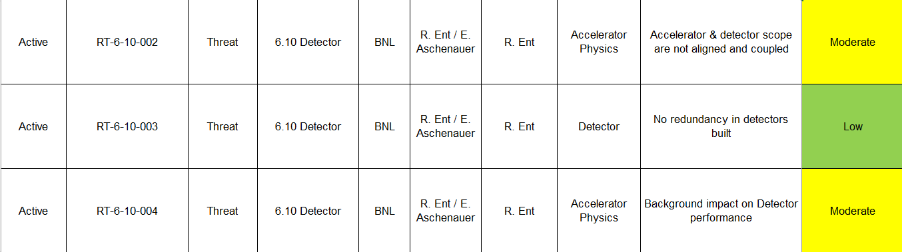
Detector Risk – High-Level View
@10/21 OPA Status Review → @06/22 FPD Review → @08/23 DAC review
3 High risk s → 2 retired, 1 High Risk → 1 High Risk (magnet delay)
7 Moderate risks → 1 retired, 1 new → 2 retired, 1 new, 6 moderate risks
4 Low risks → 1 retired, 1 new → several new (11 low risks now)
→ now also opportunities (in-kind)
Detector high risk: magnet delay
Detector moderate risks: accelerator/detector integration, backgrounds, DIRC bar reuse (or not), failure to reach $100M in-kind goal, hadron polarimetry @ EIC beam currents, AC-LGAD.

Slide 26
Detector – Other Ongoing Challenges
Funding for and completion of project detector R&D.
  Setting up procurements at national labs causes often long delay of detector R&D contracts (and thus) milestones
  Expectation is for detector R&D to be completed by CD-2/CD-3 (with as possible exception some remaining R&D on Si/ITS3 sensors & ASICs).
  ITS3 sensor dependency is a single point of failure vulnerability.
Formalizing interest of international EIC user community into formal in-kind agreements.
Ensuring IR and detector scope remain to go hand in hand and in phase.
The lack of high energy hadron test beam in the years after 2025
  We collect current ePIC current test beam needs at ePIC.Interface Control Document for Services.052023.xlsx
Familiarizing the international ePIC collaboration with working in DOE Project mode.
Vigilance about user-provided equipment and US/DOE safety codes and equipment requirements.

Slide 27
EIC Detector Incremental Design Reviews – up to March 2023
We have periodic incremental design reviews, with some serving as Preliminary Design Review and ultimately Final Design Reviews.
Completed:
  Magnet Incremental Design and Safety Review (6.10.07) – Preliminary 30% Design – Feb. 23, 2022
  IR Integration and Ancillary detectors (6.10.11) – April 27, 2022
  Electronics/Computing Subsystem Status Review (6.10.08 & 6.10.09) – August 29-30, 2022
  Magnet Incremental Design and Safety Review (6.10.07) – 60% Design – October 18-19, 2022
  Calorimetry Review (6.10.05 & 6.10.06) – December 6-8, 2022
  Polarimetry Review (6.10.14) – January 17-18, 2023
The project detector R&D (6.10.02) is separately reviewed by the DAC
Scientific computing & associated infrastructure is a dependency for the EIC
  EIC Detector Software Infrastructure Review held in collaboration with host labs – August 22, 2022
  Review of ePIC Software and Computing is planned for October 19-20, 2023

Slide 28

Since April & Upcoming in EIC Detector Arena
April 3 + 4: 1st Resource Review Board meeting @ SBU & BNL
July 5 + 6: Particle Id Detectors Interim Design Review
    Reviewers: Peter Krizan (U Ljubljana), Floris Keizer (CERN),
    Ana Amelia Machado (UniCamp), Koji Nakumura (KEK), Justin Stevens (W&M)
July 21: Final Design Review of the PbWO4 Crystals for the ePIC Backward EM Calorimeter
    Reviewers: Eugene Chudakov (JLab), Dipangkar Dutta (MSU)
August 28 + August 31: DAC Review of Detector R&D
            FY23 progress and FY24 continuation requests
August 29 + 30: DOE CD-3A Design Review by DAC
September 13: Final Design Review of the SciFi for cECal & fECal
September 14: Final Design Review of the SiPMs for ECals, HCals & dRICH
September 25: Final Design Review of the forward HCal W & steel
October 5 + 6: Final Design Review of Magnet (MARCO)
October 10-12: DOE CD-3A Director’s Review
November 14-16: DOE CD-3A Independent Project Review
December 7 + 8: 2nd Resource Review Board meeting @ Washington
December (TBD): Preliminary Design Review of Far-Forward/Far- Backward Detectors

Slide 29
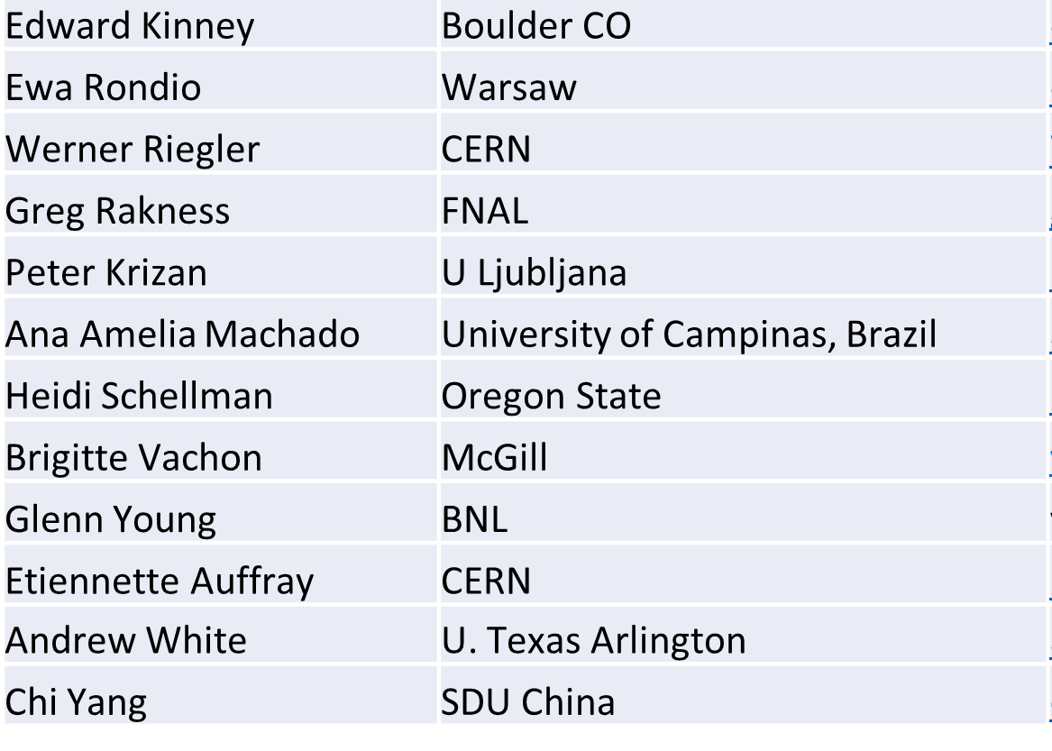
Detector Advisory Committee (DAC)
We assembled the DAC in 2020
Per the charter, 1/3 of the committee was replaced early 2023
Meetings to date:
  September 28-29, 2020. Bring the DAC up to speed and prepare them for upcoming charges, e.g., related to input on assessment of the call for Expressions of Interest (EoI).
  December 18, 2020. Update DAC on the EIC Project and Yellow Report status, the EoI assessment, international engagement, and planning for call for detector proposals.
  March 24-26, 2021. Transition from the generic EIC detector R&D to the Project detector R&D.
  December 2021 – January 2022. Evaluation of detector technologies, cost and schedule as input to the Detector Proposal Advisory Panel.
  October 19-21, 2022. Review the ongoing project detector R&D. Advise for the FY23 detector R&D.
This week: Review next phase of Project Detector R&D and status of ePIC design.
Edward Kinney (Chair) | Boulder CO
Ken Wyllie | CERN
Petra Merkel | FNAL
Antonis Papanestis | Rutherford Appleton Laboratory
Peter Krizan | U Ljubljana
Ana Amelia Machado | University of Campinas, Brazil
Heidi Schellman | Oregon State
Brigitte Vachon | McGill
Stefano Miscetti | INFN Frascati
Etiennette Auffray | CERN
Andrew White | U. Texas Arlington
Chi Yang | SDU China

Slide 30
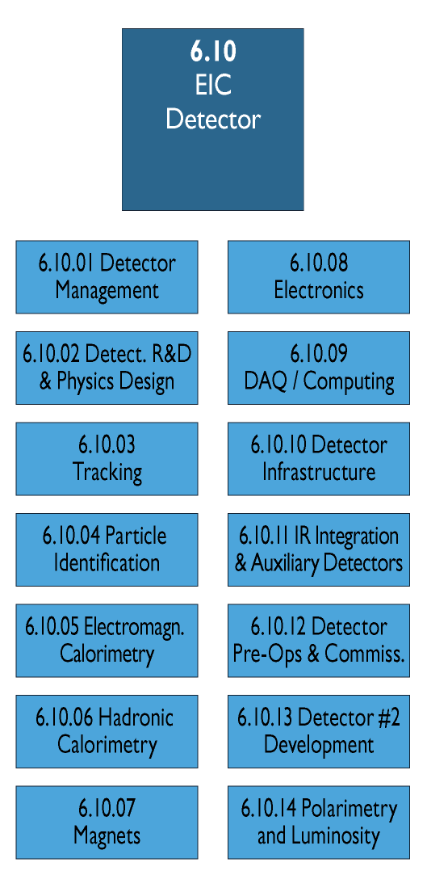
WBS 6.10 EIC Detector & 6.10.01 Management
How We Work:
The highest-level detector management consists of:
Elke & Rolf L2 Leads
Walt Akers 6.10 Systems Engineer
Fernando Barbosa Chief Electrical Engineer
Rahul Sharma Chief Mechanical Engineer
We have
Weekly meetings with ePIC spokesperson and deputy
Weekly meetings with the mechanical engineering team
Biweekly meetings with the electrical engineering team
Weekly meetings with the Detector Control Account Managers
As needed meetings with various detector subsystems
Walt, Fernando and Rahul have also separate meetings, for Walt with the Systems Engineering Group, for Rahul with also various non-BNL/non-Jlab engineers/designers, etc.
We report at the biweekly ePIC meetings and many other meetings on general detector progress or requested topics

Slide 31
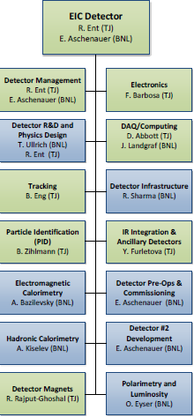
WBS 6.10 EIC Detector & 6.10.01 Management
Green/blue shows nominal JLab/BNL responsibility
Do not use this CAM responsibility organization as Black and White, we work together as a scientific collaboration
  L4 Electron Polarimetry “in the blue” does have a JLab CAM, Detector R&D and DAQ/Computing is joined
  The Si sensor design is much more natural to BNL
  The Si sensor QA or Si tracker integration and MPGDs JLab does have valuable expertise
  The PbWO4 Electromagnetic Calorimetry is much more aligned with JLab user experience
  The experience in Hadronic Calorimetry is very limited at JLab but BNL has built HCals
We include user efforts where it makes sense, and lean to more
We use synergy with BNL’s and Jlab’s science programs and Advanced Computing efforts at each lab as much as possible
  Natural for EIC future science goals
  Natural synergy with streaming readout and AI/ML
  Also natural synergy in certain detector technologies and user interests (RICH, DIRC, PbWO4, MPGDs)

Slide 32

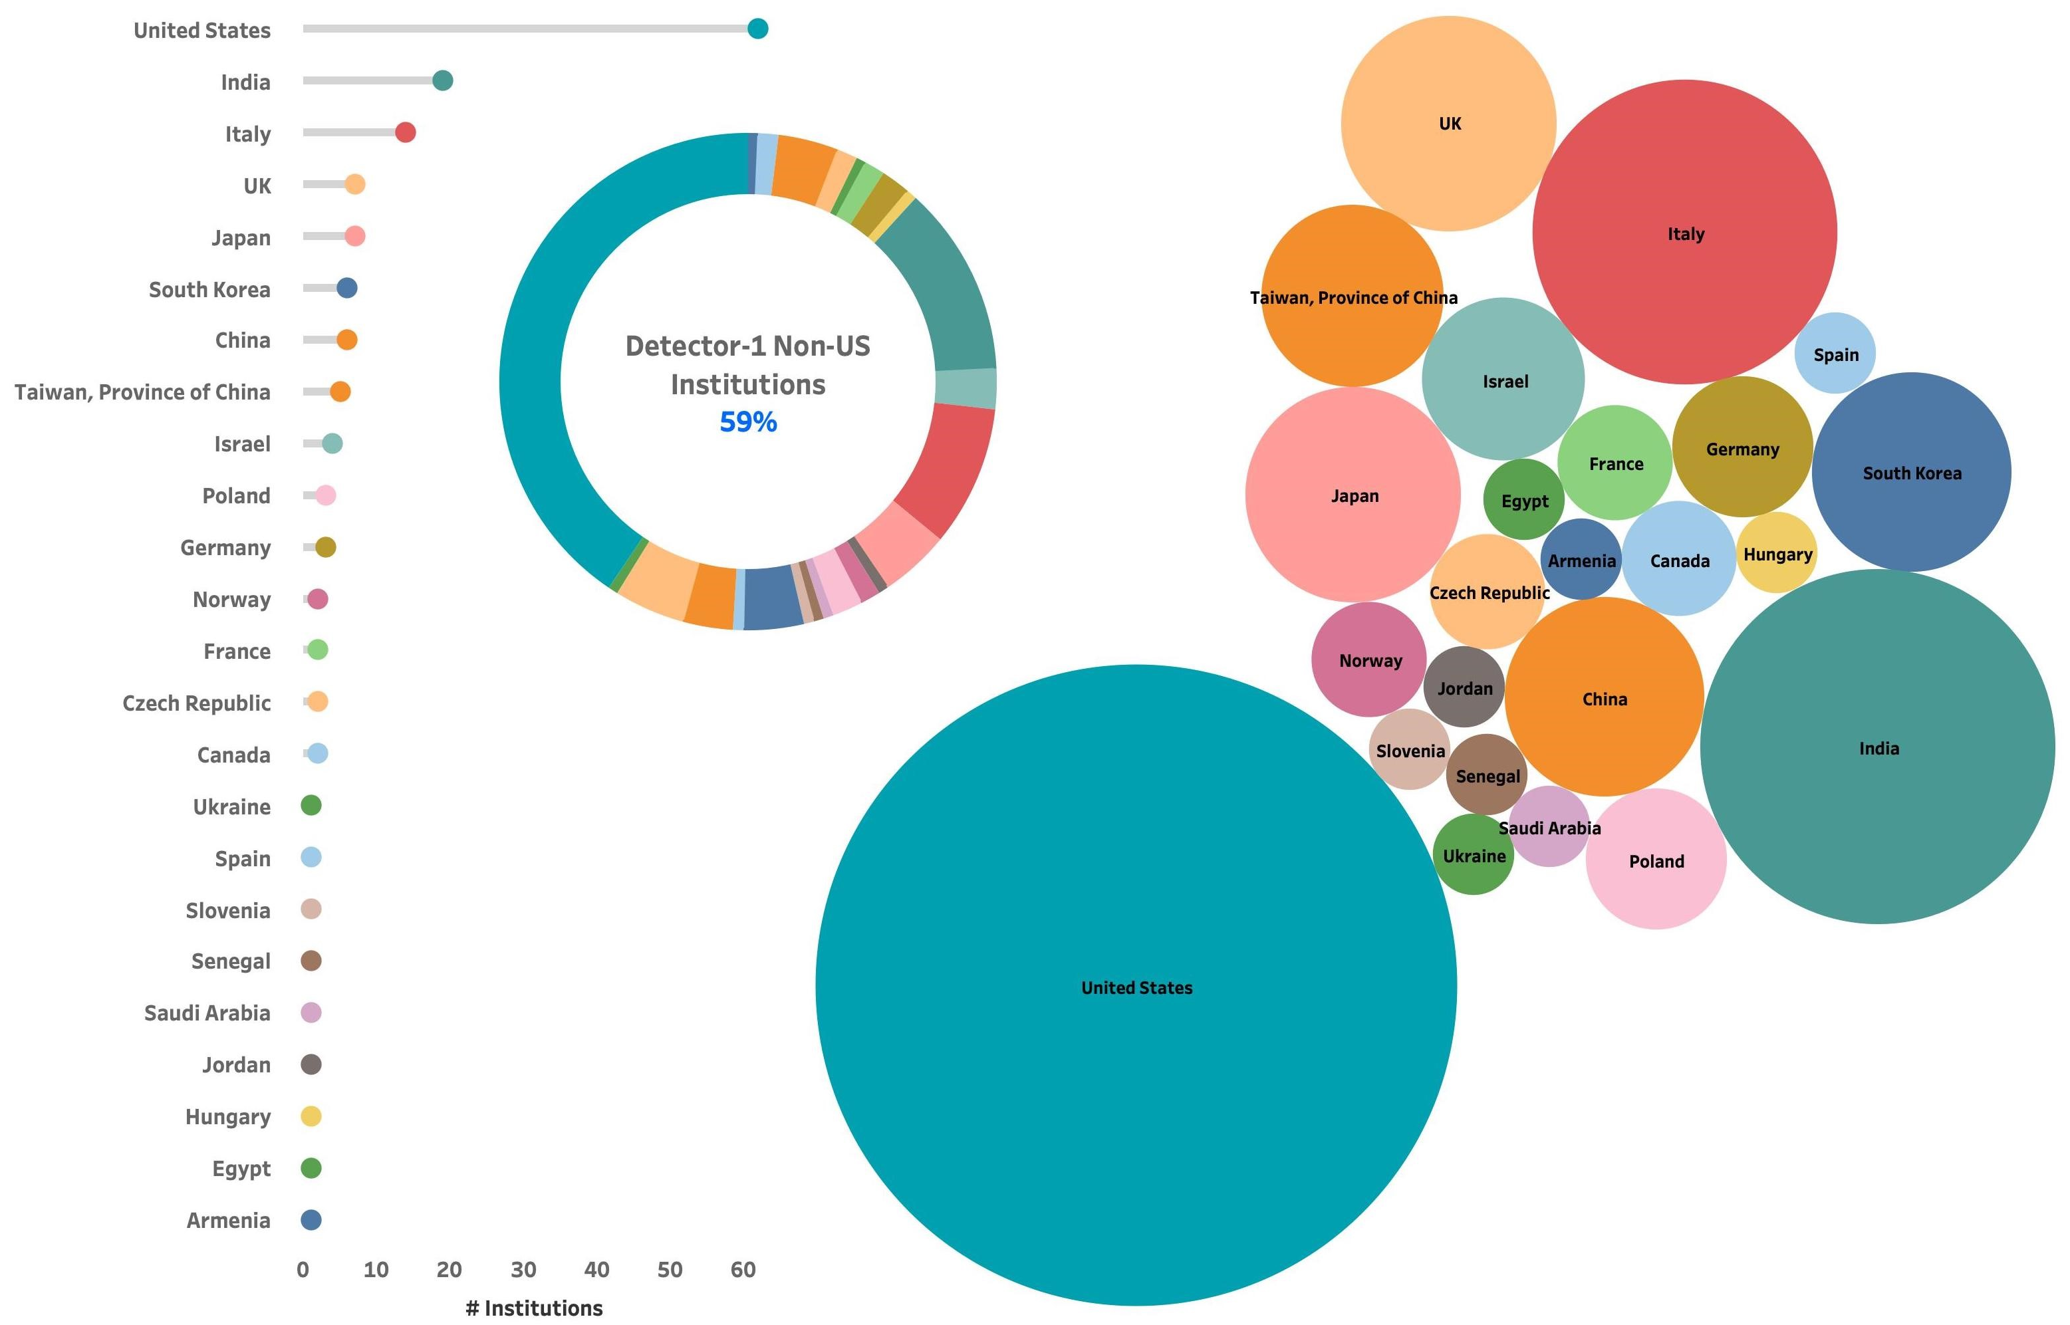
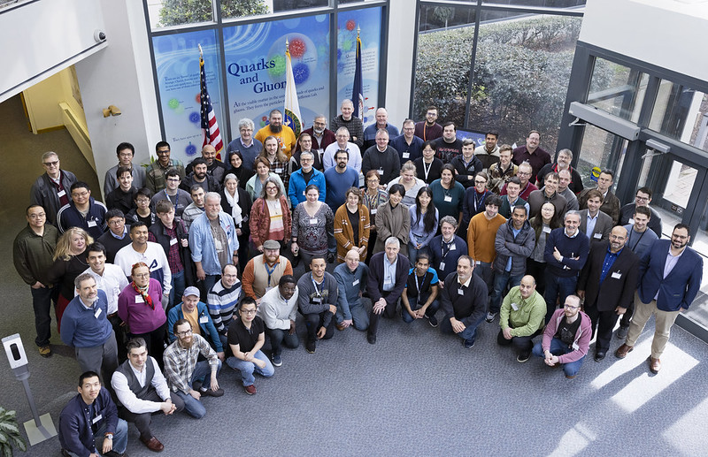
The ePIC Collaboration
ePIC formed a year ago.
ePIC is now 171 institutions including 11 new institutions that joined this July 2023.
Representing 24 countries
500+ participants
A truly global pursuit for a new experiment at the EIC!
ePIC non-US
Institutions
59%
ePIC Spokesperson:
John Lajoie (Iowa State)
ePIC Deputy Spokesperson:
Silvia Dalla Torre (INFN Trieste)

Slide 33

Next Stage (ongoing) – integrating ePIC collaboration
6.10.04 Particle
Identification
Level-3
L4 CAM from Project
+
DSTC from
L3 CAM from Project
6.10.04.01 Backward RICH
Level-4
6.10.04.02 Barrel DIRC
Level-4
6.10.04.03 dRICH
Level-4
6.10.04.04 Time-of-Flight
Level-4
Work Package lead
from
6.10.04.04.01
bToF
Level-5
6.10.04.04.02
fToF
Level-5
Work Package lead
from
Work Package lead
from
Work Package lead
from
Work Package lead
from
Work Package lead
from
Here a bit trickier as we have
to think how to roll up at L5 and
the collaboration suggested to
add a common system at L5

Slide 34
Next – Technical Design Report Planning
We will start the process of writing a draft TDR later this 2023, and then this will continue towards a first version of a TDR in 2024.
Working model will be similar as we used to create the CDR, Elke/Rolf with engagement of ePIC leadership, and a mix of the project CAMs and EPIC WG representatives. At the late phases the editing rights will become more restricted. We plan to use where we can input from the CDR, YR, proposals, technical notes, etc.
Chapter 2: Physics Goals and Requirements (should be short, < 50 pages)
2.1 EIC Context and History (like CDR 2.2 or YR section 1)
2.2 The Science Goals of the EIC and the Machine Parameters (like CDR 2.3)
2.3 The EIC Science (follow YR structure)
2.4 Scientific Requirements
Chapter 3: Interaction Region 6 Overview (Elke/Rolf contributing)
Chapter 8: Experimental Systems (can be long such that we can use as standalone detector TDR)
8.1 Experimental Equipment Requirements Summary (like CDR 8.2)
8.2 General Detector Considerations and Operations Challenges (YR 10, CDR 8.3)
8.3 EIC Detector
8.4 Detector R&D Summary
8.5 Detector Integration
8.6 Detector Commissioning and Pre-Operations
Chapter 11: Commissioning (Elke/Rolf contributing)
Appendix-B: Integration of a Second Experiment (mainly emphasizing feasibility, luminosity sharing, polarization with two experiments, and first-order checks of magnets/acceptance)

Slide 35
EIC International Engagement
EIC is a unique high-energy, high-luminosity polarized beam collider that will be one of the most challenging and exciting accelerator complexes ever built.
There is large international interest in the EIC, EIC Science and the ePIC detector.
  Large international component of EIC Yellow Report (417 authors; 175 (42%) are non-US).
  Large in-kind component of detector R&D (US universities and international).
  Excellent progress on Engineering and Design (PED) in detector – designs are maturing with help of our many friends. This constitutes a ~$5M in-kind non-DOE PED contribution.
DOE, BNL, and JLab envision an EIC facility that is “fully international in character.”
  Governance is evolving to include international partners.
International EIC Project Advisory Committee provides advice on the successful delivery of the DOE Project (management, scope, schedule, cost, and performance).
EIC Advisory Board provides oversight and advice on the construction of the facility, focusing on the accelerator (ANL, BNL, LBNL, TJNAF, TRIUMF, IN2P3, IRFU, STFC, INFN).
EIC Resource Review Board (RRB) provides oversight of the experiments
  1st RRB meeting April 2023 at Long Island, hosted by SBU
    member countries: Canada, Czech, France (IN2P3 & IRFU), Italy/INFN, Korea, UK/STFC, US;
    observer countries: Brazil, India, Japan, Taiwan, Senegal, South Africa;
    further anticipated at next RRB meeting: Armenia, Israel, Poland, hopefully US/NSF.
  2nd RRB meeting December 2023 in Washington DC, hosted by GWU.

Slide 36
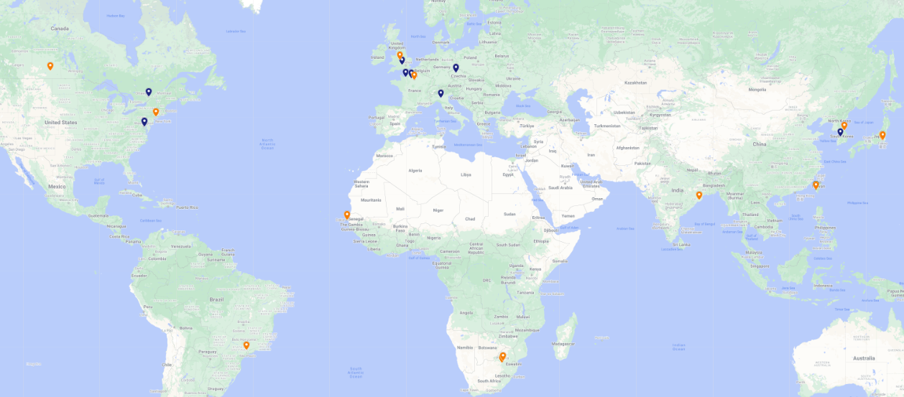
1st Resource Review Board (RRB) Meeting
First meeting on April 3-4, 2023, at Stony Brook University.
DOE and the host labs promoting the EIC as a facility “fully international in character.”
12 countries participating: Blue markers: RRB members; Orange markers: Observers
Agenda reflected what we expect to have in future RRB meetings.
RRB Charter ratified at 1st meeting. Initial Co-Chairs: Haiyan Gao (BNL), Diego Bettoni (INFN).
2nd meeting planned for December 7 + 8 in Washington, DC.
  Topics will include: Common Fund (or not) discussion, Computing (What is expected from partners), Governance (How does change control work for in-kind contributions), Quality Assurance (how does that get folded in reviews and planning documents), International agreements.

Slide 37
Detector: Non-DOE Interest & In-Kind Updated 07/05/23
Entity | Interest and Important Facts
NSF | NSF-MSRI pre-proposal submitted by 10 US universities – aims at full scope of backward EM calorimetry (eECal). Armenia, Czech, France/IN2P3 as unfunded contributors. Invited to submit proposal. Final NSF review is ongoing.
CERN | MAPS sensor design developed by CERN/ITS-3 Group providing synergy with ALICE. Synergy of gaseous-based Cherenkov detectors and photon-sensors with ALICE & LHCb. Synergy of Forward AC-LGAD design with CMS endcap timing layer.
Armenia | Contributions, mainly labor to eECal and many EM calorimetry and particle id detectors component tests.
Canada | EIC included in 2022 Canadian Subatomic Physics Long-Range Plan; Interested in Compton Polarimetry, Barrel Electromagnetic Calorimetry and Software
China | Forward EM Calorimeter
Czech | Working with funding agency; Interested in eECal (PbWO4 crystals and glass) and Silicon
France/IRFU | Interested in MPGD/racking, electronics. Provided in-kind contributions to SC magnet design and interested to continue labor oversight during magnet construction.
France/IN2P3 | International contribution to backward EM calorimetry (including in-kind design) and to readout electronics (two ASICs for AC-LGAD detectors and Calorimetry). IRFU & IN2P3 discussing together for higher-level contributions.
India | Consortium is working with Funding agency; Interested in detector software (non-project scientific contribution), contributions to DAQ/slow controls. Investigating further hardware contributions (including possible links with Si plants).
Italy/INFN | Aims at major scope of forward particle identification detector (dRICH), at (part of) the Si/MAPS tracker scope, and at photo-sensor contributions. Further investigating possible interest in EIC detector magnet scope.
Israel | B0 Detectors (Si tracking and PbWO4)
Japan | Interested in a US-Japan agreement; Aims at full scope of Zero-Degree Calorimeter in collaboration with Taiwan/Korea. Pursuit of full scope of barrel AC-LGAD detector as EIC-Asia consortium. Contribution to DAQ/streaming. Possible aerogel.
Korea | Aims at major scope for fiber-based barrel EM calorimeter, Also work packages for barrel AC-LGAD and Si-based hadronic calorimetry for ZDC.as part of EIC-Asia consortium (includes also Japan,Taiwan), Collaboration on Si tracking detector.
Poland | Actively working with ministry/funding agency; Interested in detectors along the beam line (luminosity detector, Roman Pots)
Taiwan | Pursuit of full scope of barrel AC-LGAD as part of EIC-Asia consortium. LYSO-based EM calorimeter for ZDC, Also optical readout/fiber. Possible later interest in PCBs. Computing.
UK | STFC seed funding for UK detector R&D (3M£). Interest in Si/MAPS tracker, polarimetry and detectors along the beams (Low-Q2/TimePix). Follow-up STFC/UKRI request for 5-7 years submitted early 2023 (includes accelerator part).

Slide 38
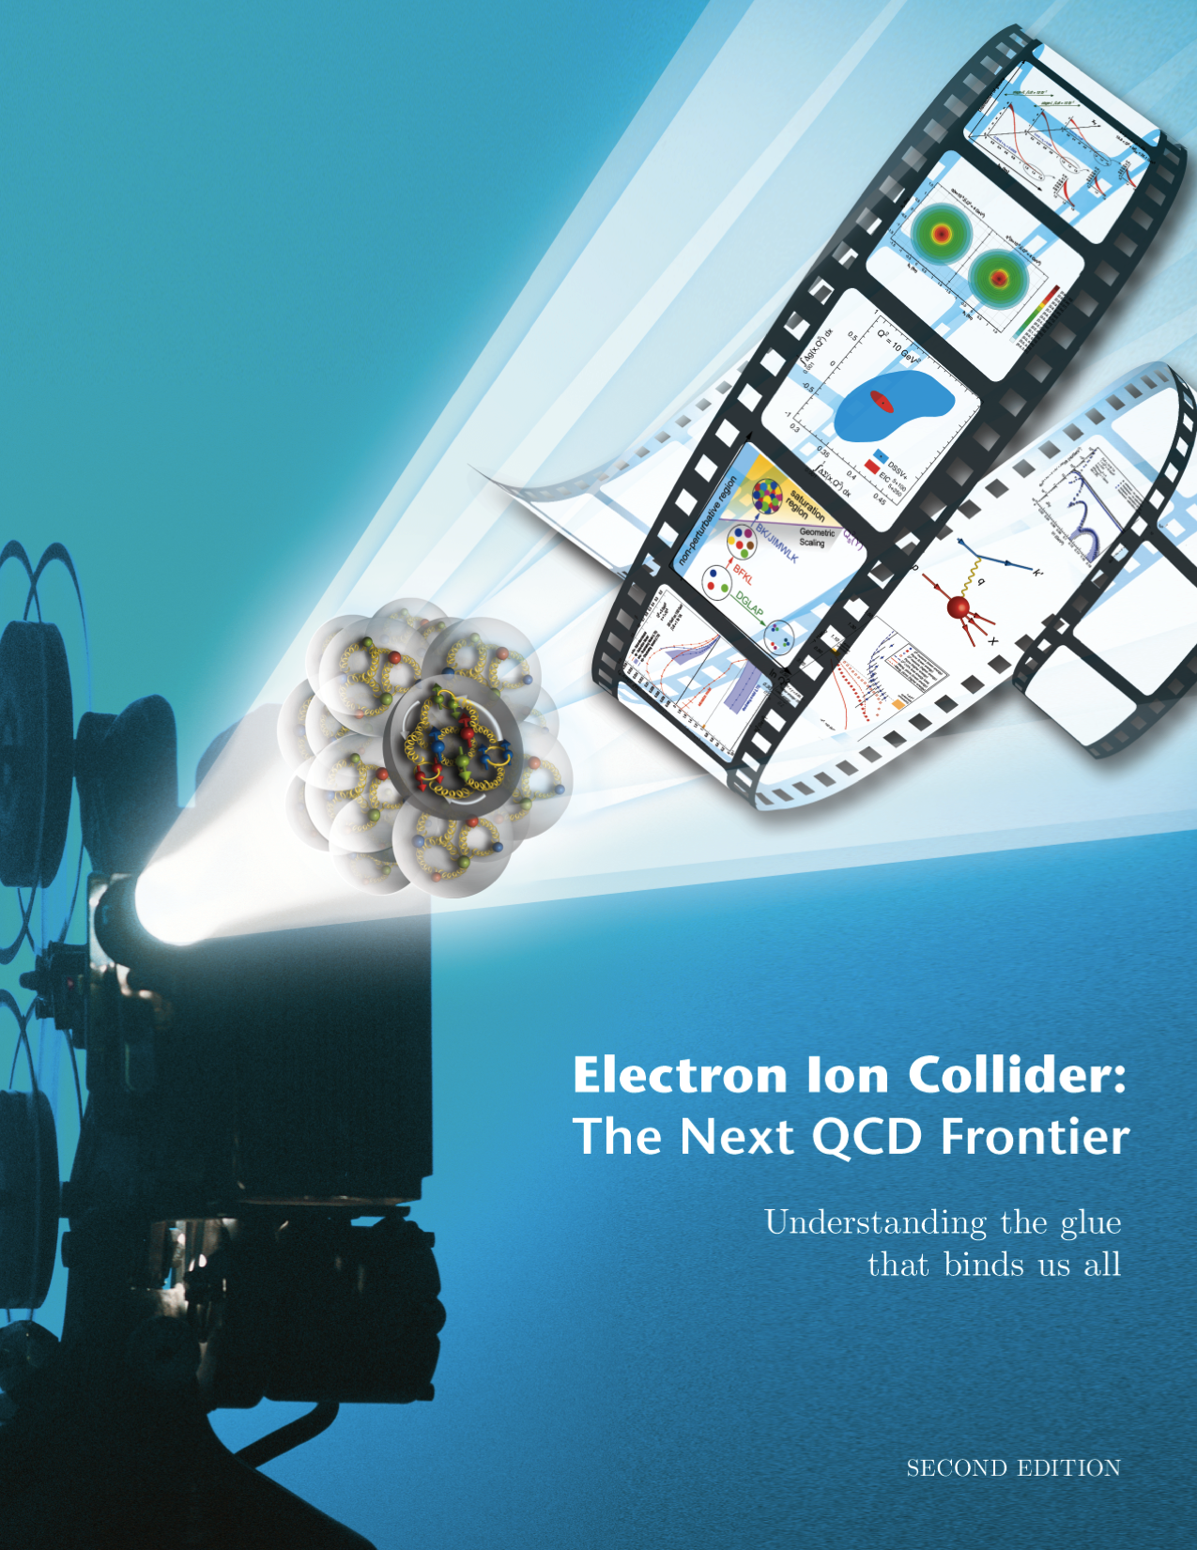
EIC Science is Well Known and Highly Cited
EIC White Paper that guided the EIC science written following a 10-week program at the Institute for Nuclear Theory
  Electron-Ion Collider: The Next QCD Frontier: understanding the glue that binds us all
  arXiV:1212.1701 & Eur. Phys. J. A 52 (2016) 9, 268 – 1459 citations (08/20/2023)
Year-long EIC User Group driven EIC Yellow Report activity (December 2019 – February 2021)
  Science Requirements and Detector Concepts for the EIC
  arXiv:2103.05419 & Nucl. Phys. A 1026 (2022) 122447 – 595 citations (08/20/2023)
The EIC is a facility for the world

Slide 39
Summary
EIC is a unique, high-energy, high-luminosity, polarized beam collider that will be one of the most challenging and exciting accelerator complexes ever built -- only collider in next decade(s).
EIC project scope includes the complete infrastructure, accelerators, and detector required to meet the performance and science requirements.
Strong support for the EIC with increasing international engagement.
  ePIC Collaboration formed
  1st Resource Review Board meeting in April 2023 and 2nd meeting planned for December 2023
We are successfully building the collaborations and project team, establishing partnerships, preparing for DOE CD-3A, and making the maximum technical progress with the funding available.

Slide 40
Take-Away Messages
“Now is the time to realize the EIC in the U.S.” (LRP 2015).
  The scientific foundation for an EIC was built over two decades, from an initiative in LRP 2002 through an unnumbered recommendation in LRP 2007 to a formal numbered recommendation in LRP 2015.
  The 2018 NAS Report concluded: “EIC science is compelling, timely and fundamental.”
  The QCD community support for EIC remains broad and near-unanimous.
The EIC User Group currently stands at 1405 members in 37 countries.
  This is a strong community that has delivered on the EIC Science White Paper(s), the EIC Yellow Report, and three detector proposals now culminating in ePIC.
  Efforts towards the ePIC detector and a path to a 2nd detector are ongoing.
Recent IRA funding resulted in a phase change – the schedule for EIC to CD-3 (~2025) is likely to be technically driven.
  This underscores DOE/SC is committed to EIC as a top priority.
  The immediate focus of the EIC Project will be to reach CD-3A (Early 2024).
There will be one EIC with this high level of performance in the world.
  The EIC will be on the frontiers of nuclear science, accelerator, and detector technologies.
  Strong support for the EIC with increasing international engagement – Various possible in-kind contributions to detector construction are maturing with funding agencies worldwide.

Slide 41


Slide 42
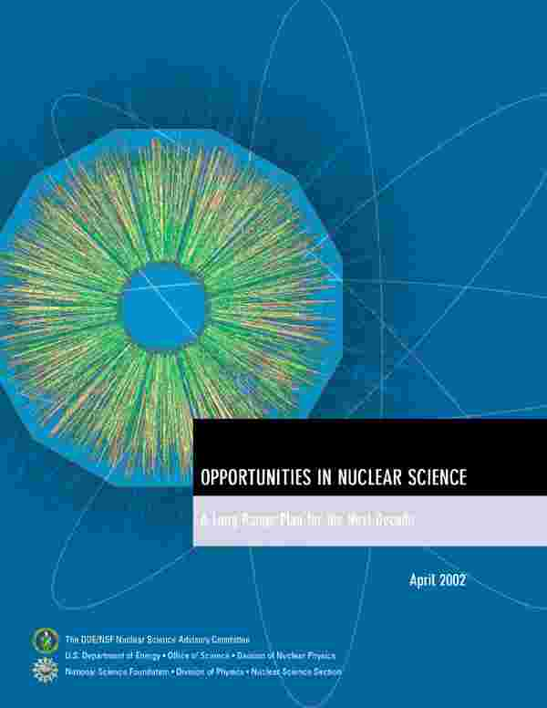
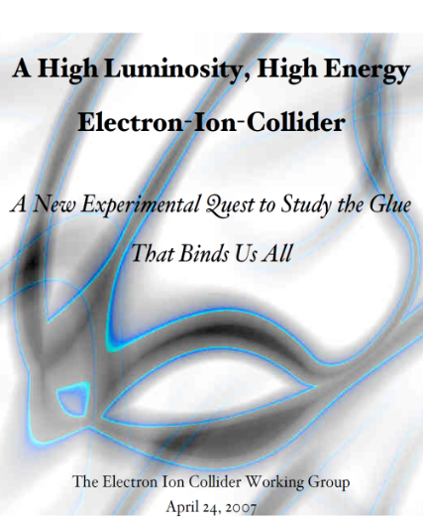
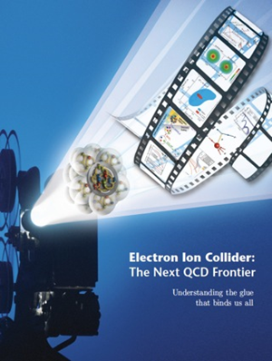

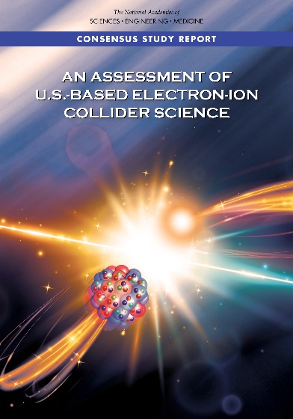
The Scientific Foundation for an EIC was Built Over Two Decades
Electron-Ion Collider..absolutely central to the nuclear science program of the next decade.
2002
“a high-energy high-luminosity polarized EIC [is] the highest priority for new facility construction following the completion of FRIB.”
2007
The science questions that an EIC will answer are central to completing an understanding of atoms as well as being integral to the agenda of nuclear physics today.”
2009
2010
Gluons and the Quark Sea at High Energies
2012
2013
2015
Major Nuclear Physics Facilities for the Next Decade
2018
NSAC
2021
“…essential accelerator and detector R&D [for EIC] should be given very high priority
in the short term.”
“We recommend the allocation of resources …to lay the foundation for a polarized Electron-Ion Collider…”
March 14, 2013
“..a new dedicated facility will be essential for answering some of the most central questions.”
“The quantitative study of matter in this new regime [where abundant gluons dominate] requires a new experimental facility: an Electron Ion Collider..”

Slide 43
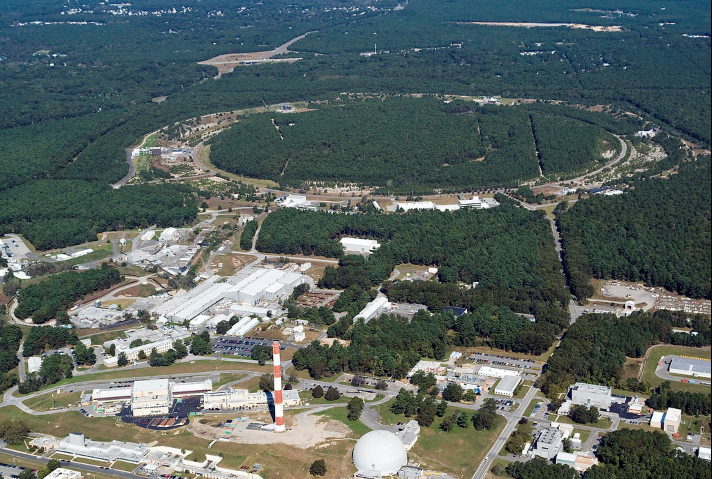

EIC Accelerator Design Overview
Hadron storage ring (HSR): 40-275 GeV (existing)
  up to 1160 bunches, 1A beam current (3x RHIC)
  bright vertical beam emittance (1.5 nm)
  strong cooling (coherent electron cooling, ERL)
Electron storage ring (ESR): 2.5–18 GeV (new)
  up to 1160 polarized bunches
    high polarization by continual reinjection from RCS
  large beam current (2.5 A) ➔ 9 MW SR power
  superconducting RF cavities
Rapid cycling synchrotron (RCS): 0.4-18 GeV (new)
  2 bunches at 1 Hz; spin transparent due to high periodicity
High luminosity interaction region(s) (new)
  L = 10³⁴ cm⁻²s⁻¹
  superconducting magnets
  25 mrad crossing angle with crab cavities
  spin rotators (produce longitudinal spin at IP)
EIC

Slide 44
EIC International Engagement
EIC is a unique high-energy, high-luminosity polarized beam collider that will be one of the most challenging and exciting accelerator complexes ever built.
There is large international interest in the EIC, EIC Science and the ePIC detector.
  Large international component of EIC Yellow Report (417 authors; 175 (42%) are non-US).
  Large in-kind component of detector R&D (US universities and international).
  Excellent progress on Engineering and Design (PED) in detector – designs are maturing with help of our many friends. This constitutes a ~$5M in-kind non-DOE PED contribution.
DOE, BNL, and JLab envision an EIC facility that is “fully international in character.”
  Governance is evolving to include international partners.
International EIC Project Advisory Committee provides advice on the successful delivery of the DOE Project (management, scope, schedule, cost, and performance).
EIC Advisory Board provides oversight and advice on the construction of the facility, focusing on the accelerator (ANL, BNL, LBNL, TJNAF, TRIUMF, IN2P3, IRFU, STFC, INFN).
EIC Resource Review Board (RRB) provides oversight of the experiments
  1st RRB meeting April 2023 at Long Island, hosted by SBU
    member countries: Canada, Czech, France (IN2P3 & IRFU), Italy/INFN, Korea, UK/STFC, US;
    observer countries: Brazil, India, Japan, Taiwan, Senegal, South Africa;
    further anticipated at next RRB meeting: Armenia, Israel, Poland, hopefully US/NSF.
  2nd RRB meeting December 7-8, 2023 in Washington DC, hosted by GWU.

Slide 45
Non-DOE Interest & In-Kind – Updated 07/05/23
Entity | Interest and Important Facts
NSF | NSF-MSRI pre-proposal submitted by 10 US universities – aims at full scope of backward EM calorimetry (eECal). Armenia, Czech, France/IN2P3 as unfunded contributors. Invited to submit proposal. Final NSF review is ongoing.
CERN | MAPS sensor design developed by CERN/ITS-3 Group providing synergy with ALICE. Synergy of gaseous-based Cherenkov detectors and photon-sensors with ALICE & LHCb. Synergy of Forward AC-LGAD design with CMS endcap timing layer.
Armenia | Contributions, mainly labor to eECal and many EM calorimetry and particle id detectors component tests.
Canada | EIC included in 2022 Canadian Subatomic Physics Long-Range Plan; Interested in Compton Polarimetry, Barrel Electromagnetic Calorimetry and Software
China | Forward EM Calorimeter
Czech | Working with funding agency; Interested in eECal (PbWO4 crystals and glass) and Silicon
France/IRFU | Interested in MPGD/racking, electronics. Provided in-kind contributions to SC magnet design and interested to continue labor oversight during magnet construction.
France/IN2P3 | International contribution to backward EM calorimetry (including in-kind design) and to readout electronics (two ASICs for AC-LGAD detectors and Calorimetry). IRFU & IN2P3 discussing together for higher-level contributions.
India | Consortium is working with Funding agency; Interested in detector software (non-project scientific contribution), contributions to DAQ/slow controls. Investigating further hardware contributions (including possible links with Si plants).
Italy/INFN | Aims at major scope of forward particle identification detector (dRICH), at (part of) the Si/MAPS tracker scope, and at photo-sensor contributions. Further investigating possible interest in EIC detector magnet scope.
Israel | B0 Detectors (Si tracking and PbWO4)
Japan | Interested in a US-Japan agreement; Aims at full scope of Zero-Degree Calorimeter in collaboration with Taiwan/Korea. Pursuit of full scope of barrel AC-LGAD detector as EIC-Asia consortium. Contribution to DAQ/streaming. Possible aerogel.
Korea | Aims at major scope for fiber-based barrel EM calorimeter, Also work packages for barrel AC-LGAD and Si-based hadronic calorimetry for ZDC.as part of EIC-Asia consortium (includes also Japan,Taiwan), Collaboration on Si tracking detector.
Poland | Actively working with ministry/funding agency; Interested in detectors along the beam line (luminosity detector, Roman Pots)
Taiwan | Pursuit of full scope of barrel AC-LGAD as part of EIC-Asia consortium. LYSO-based EM calorimeter for ZDC, Also optical readout/fiber. Possible later interest in PCBs. Computing.
UK | STFC seed funding for UK detector R&D (3M£). Interest in Si/MAPS tracker, polarimetry and detectors along the beams (Low-Q2/TimePix). Follow-up STFC/UKRI request for 5-7 years submitted early 2023 (includes accelerator part).

Slide 46
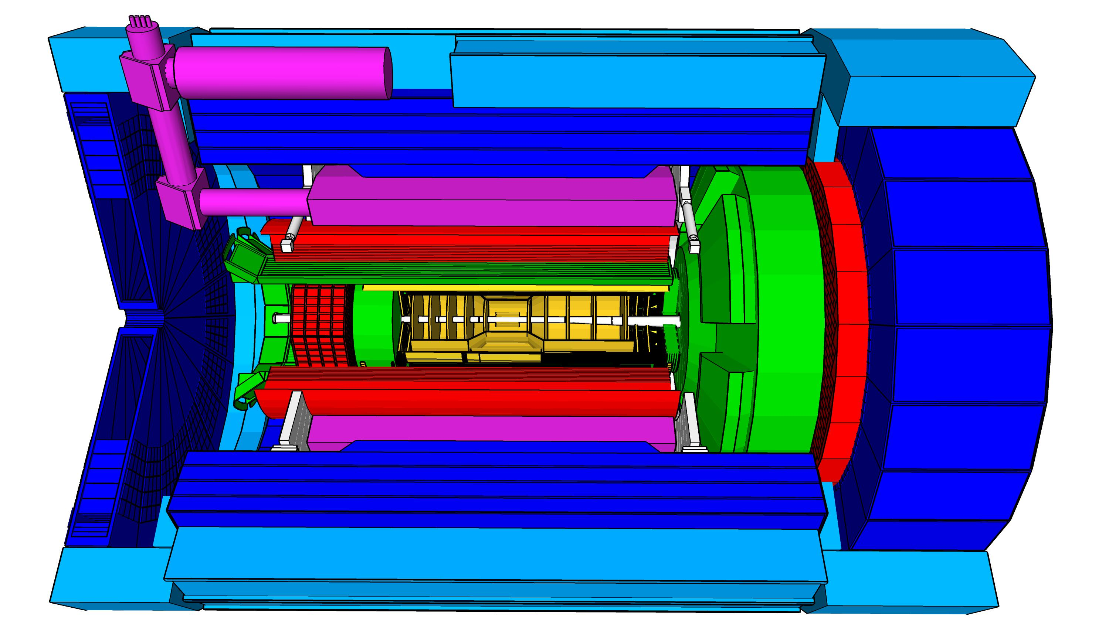
High Level Installation Schedule for Detector
Oct 2028
Jan 2029
CD-3
04/2025
April 2029
Milestone
P0_0305_0900
CD-4
09/2034
Dec 2029
early CD-4
09/2032
June 2030
Oct 2030
Jan 2031
Construction
Pre-OPS
IR-6 ready
for installation
Transition into
Operations
Early start of
Operations
&
Science
Start of
Operations
&
Science
lower half
barrel Hcal
installed
Solenoid
delivered
Endcap HCals
completed
Solenoid
Field mapping
done in beam position
Hadron Endcap
Detectors
installed
Trackers, dRICH
ECal
done in IP-6 Assembly Hall
Barrel Ecal
ready
for installation
Barrel Hcal
& Solenoid
installed
followed by low
power test
Lepton Endcap
Detectors
installed
Trackers, bRICH
ECal
Barrel Detectors
installed
ECal, DIRC,
ToF, Trackers
Take Away:
Solenoid and Barrel HCal need to be ready by Jan 2029
all other subdetectors need to be ready between 06/29 to 06/30 depending on their location in the detector

Slide 47
WBS 6.10 EIC Detector & 6.10.01 Management
6.10 Scope:
This WBS covers the cost for R&D, PED and construction of a general-purpose reference detector capable of the physics program detailed in the NAS review at full center-of-mass energy range (20 GeV and 140 GeV) and luminosity (10³³⁻³⁴ cm⁻²s⁻¹). The detector consists of a solenoidal magnet, the central detector with 5 subsystems and a lepton and hadron endcap with each 5 subsystems. Further data-acquisition and trigger, infrastructure and integration as well as online and offline software efforts are included in the scope. In addition, the auxiliary detectors needed to tag particles with very small scattering angles both in the outgoing lepton and hadron beam direction (Roman Pots, Zero-degree Calorimeter and low Q2-tagger).
6.10.01 Scope:
This WBS covers the effort to manage the EIC experimental equipment project, this includes amongst others a project director, a lead engineer, people to work on the resource loaded schedule and support the EVMS reporting. It also includes travel to visit production sites.
Deliverables:
EIC detector designed, constructed and commissioned.

Slide 48
WBS 6.10 EIC Detector & 6.10.01 Management
Green/blue shows nominal JLab/BNL responsibility
Do not use this CAM responsibility organization as Black and White, we work together as a scientific collaboration
  L4 Electron Polarimetry “in the blue” does have a JLab CAM, Detector R&D and DAQ/Computing is joined
  The Si sensor design is much more natural to BNL
  The Si sensor QA or Si tracker integration and MPGDs JLab does have valuable expertise
  The PbWO4 Electromagnetic Calorimetry is much more aligned with JLab user experience
  The experience in Hadronic Calorimetry is very limited at JLab but BNL has built HCals
We include user efforts where it makes sense, and lean to more
We use synergy with BNL’s and Jlab’s science programs and Advanced Computing efforts at each lab as much as possible
  Natural for EIC future science goals
  Natural synergy with streaming readout and AI/ML
  Also natural synergy in certain detector technologies and user interests (RICH, DIRC, PbWO4, MPGDs)

Slide 49
Next Stage (ongoing) – integrating ePIC collaboration
6.10.04 Particle
Identification
Level-3
L4 CAM from Project
+
DSTC from
L3 CAM from Project
6.10.04.01 Backward RICH
Level-4
6.10.04.02 Barrel DIRC
Level-4
6.10.04.03 dRICH
Level-4
6.10.04.04 Time-of-Flight
Level-4
Work Package lead
from
6.10.04.04.01
bToF
Level-5
6.10.04.04.02
fToF
Level-5
Work Package lead
from
Work Package lead
from
Work Package lead
from
Work Package lead
from
Work Package lead
from
Here a bit trickier as we have
to think how to roll up at L5 and
the collaboration suggested to
add a common system at L5

Slide 50
Extra

