Slide 1
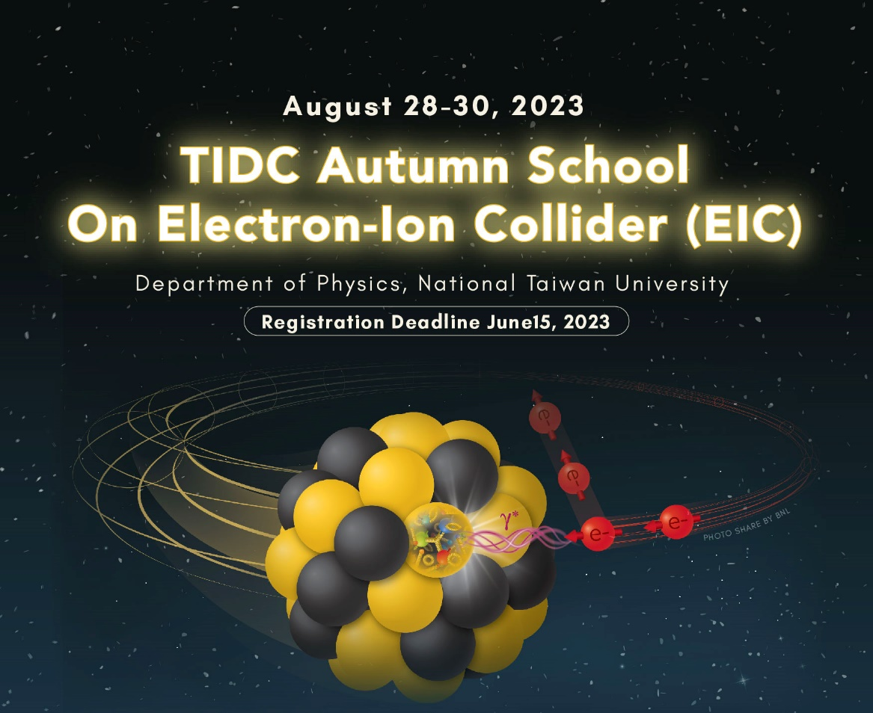
Experimental overview of the nucleon (spin) structure leading up to the EIC
TIDC Autumn School on the EIC,
NTU, Taipei, August 28-30
Ralf Seidl (RIKEN)

Slide 2
Outline
QCD and unpolarized nucleon structure
Spin sum rule and helicity structure
  Inclusive DIS
  Gluon Spin from p+p
  Interlude: Fragmentation functions
  (anti)quark helicities from SIDIS, EW pp
Transverse spin and momentum structure and effects
  Transversity and tensor charge
  Sivers function and other TMDs
3-dimensional structure in position space
  GPDs and DVCS
  Energy momentum tensor and related topics
Low-x physics

Slide 3
Generalized Parton distributions
Spatial 3D structure

Slide 4


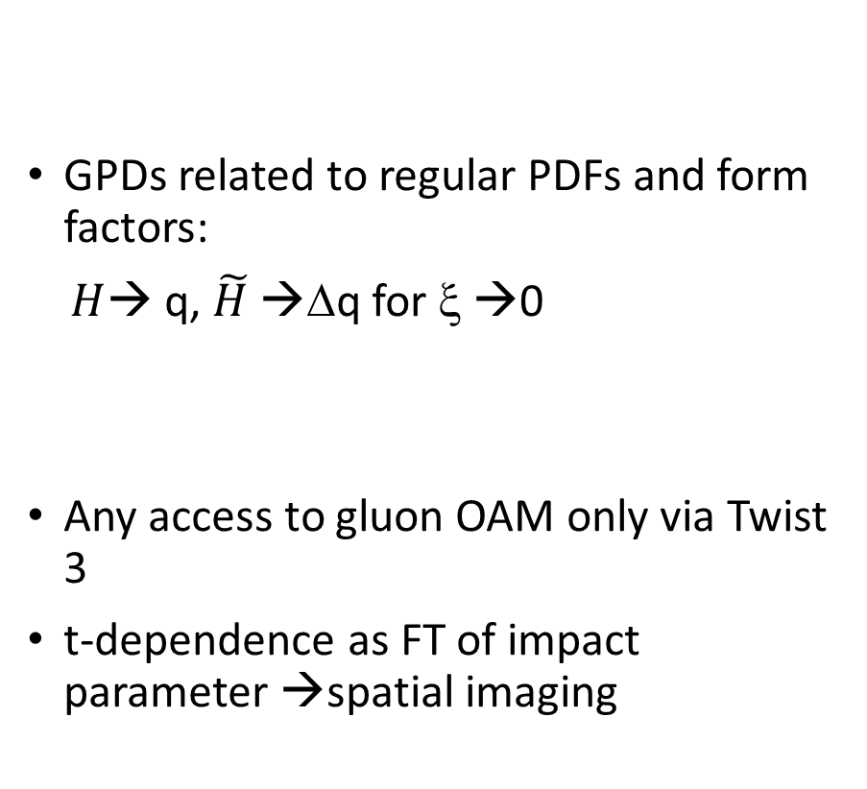
Spatial imaging of quarks →DVCS
Spin
Low-x
Tomography
Nucleii
Mass
e’
Other
Deeply virtual Compton scattering:
e
γ, π
γ_{L}*
(Q²)
x+ξ
GPDs related to regular PDFs and form factors:
$H$→ q, $\tilde{H}$ →Δq for ξ →0
Any access to gluon OAM only via Twist 3
t-dependence as FT of impact parameter →spatial imaging
~
~
x-ξ
H, H, E, E (x,ξ,t)
p
p’
Access to generalized parton distributions and orbital angular momentum (OAM)
Ji sum rule allows access to J_{q} (total angular momentum) via exclusive reactions:
t

Slide 5
Generalized Parton Distributions
4 Chiral-even and 4 chiral odd GPDs at leading twist:
GPDs are off-forward amplitudes
Related to Compton Form Factors that are accessible experimentally
Chiral Even odd
Also related to the Energy-Momentum tensor

Slide 6
DVCS cross sections → proton size
At high enough energies (HERA, EIC, ~COMPASS) ability to directly extract the DVCS cross section where dominating over Bethe-Heitler
Extrapolation to t=0 provides the “size” of the nucleon as seen by individual quarks

Slide 7
DVCS and BH amplitudes

Slide 8
DVCS asymmetries
At lower energies BH plays an important role, but interference terms between DVCS and BH can be accessed via asymmetries
Various asymmetries available (beam helicity, beam charge) related to different parts of Compton form factors (CFFs)
Hall A: Phys. Rev. Lett. 128, 252002 (2022)

Slide 9
HERMES and COMPASS results
Various azimuthal moments and asymmetries extracted for DVCS and VMs
COMPASS Transverse target exclusive ρ,ω production: Access to GPD E
COMPASS: Nucl.Phys.B 915 (2017) 454

Slide 10
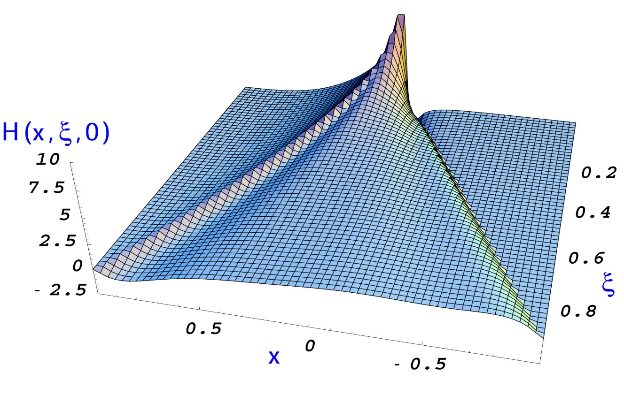
Open questions for GPDs
Deconvolution of CFFs to GPDs requires Models→ still a long way to Ji Sum rule
Still very little known about CFFs/GPDs; apart from some HERA unpol DVCS measurements only high-x/low Q² → get to true 3D imaging
Access to total gluon spin contribution only at higher twist
Wigner functions as 5D mother functions for GPDs and TMDs

Slide 11
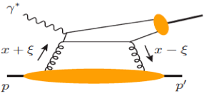
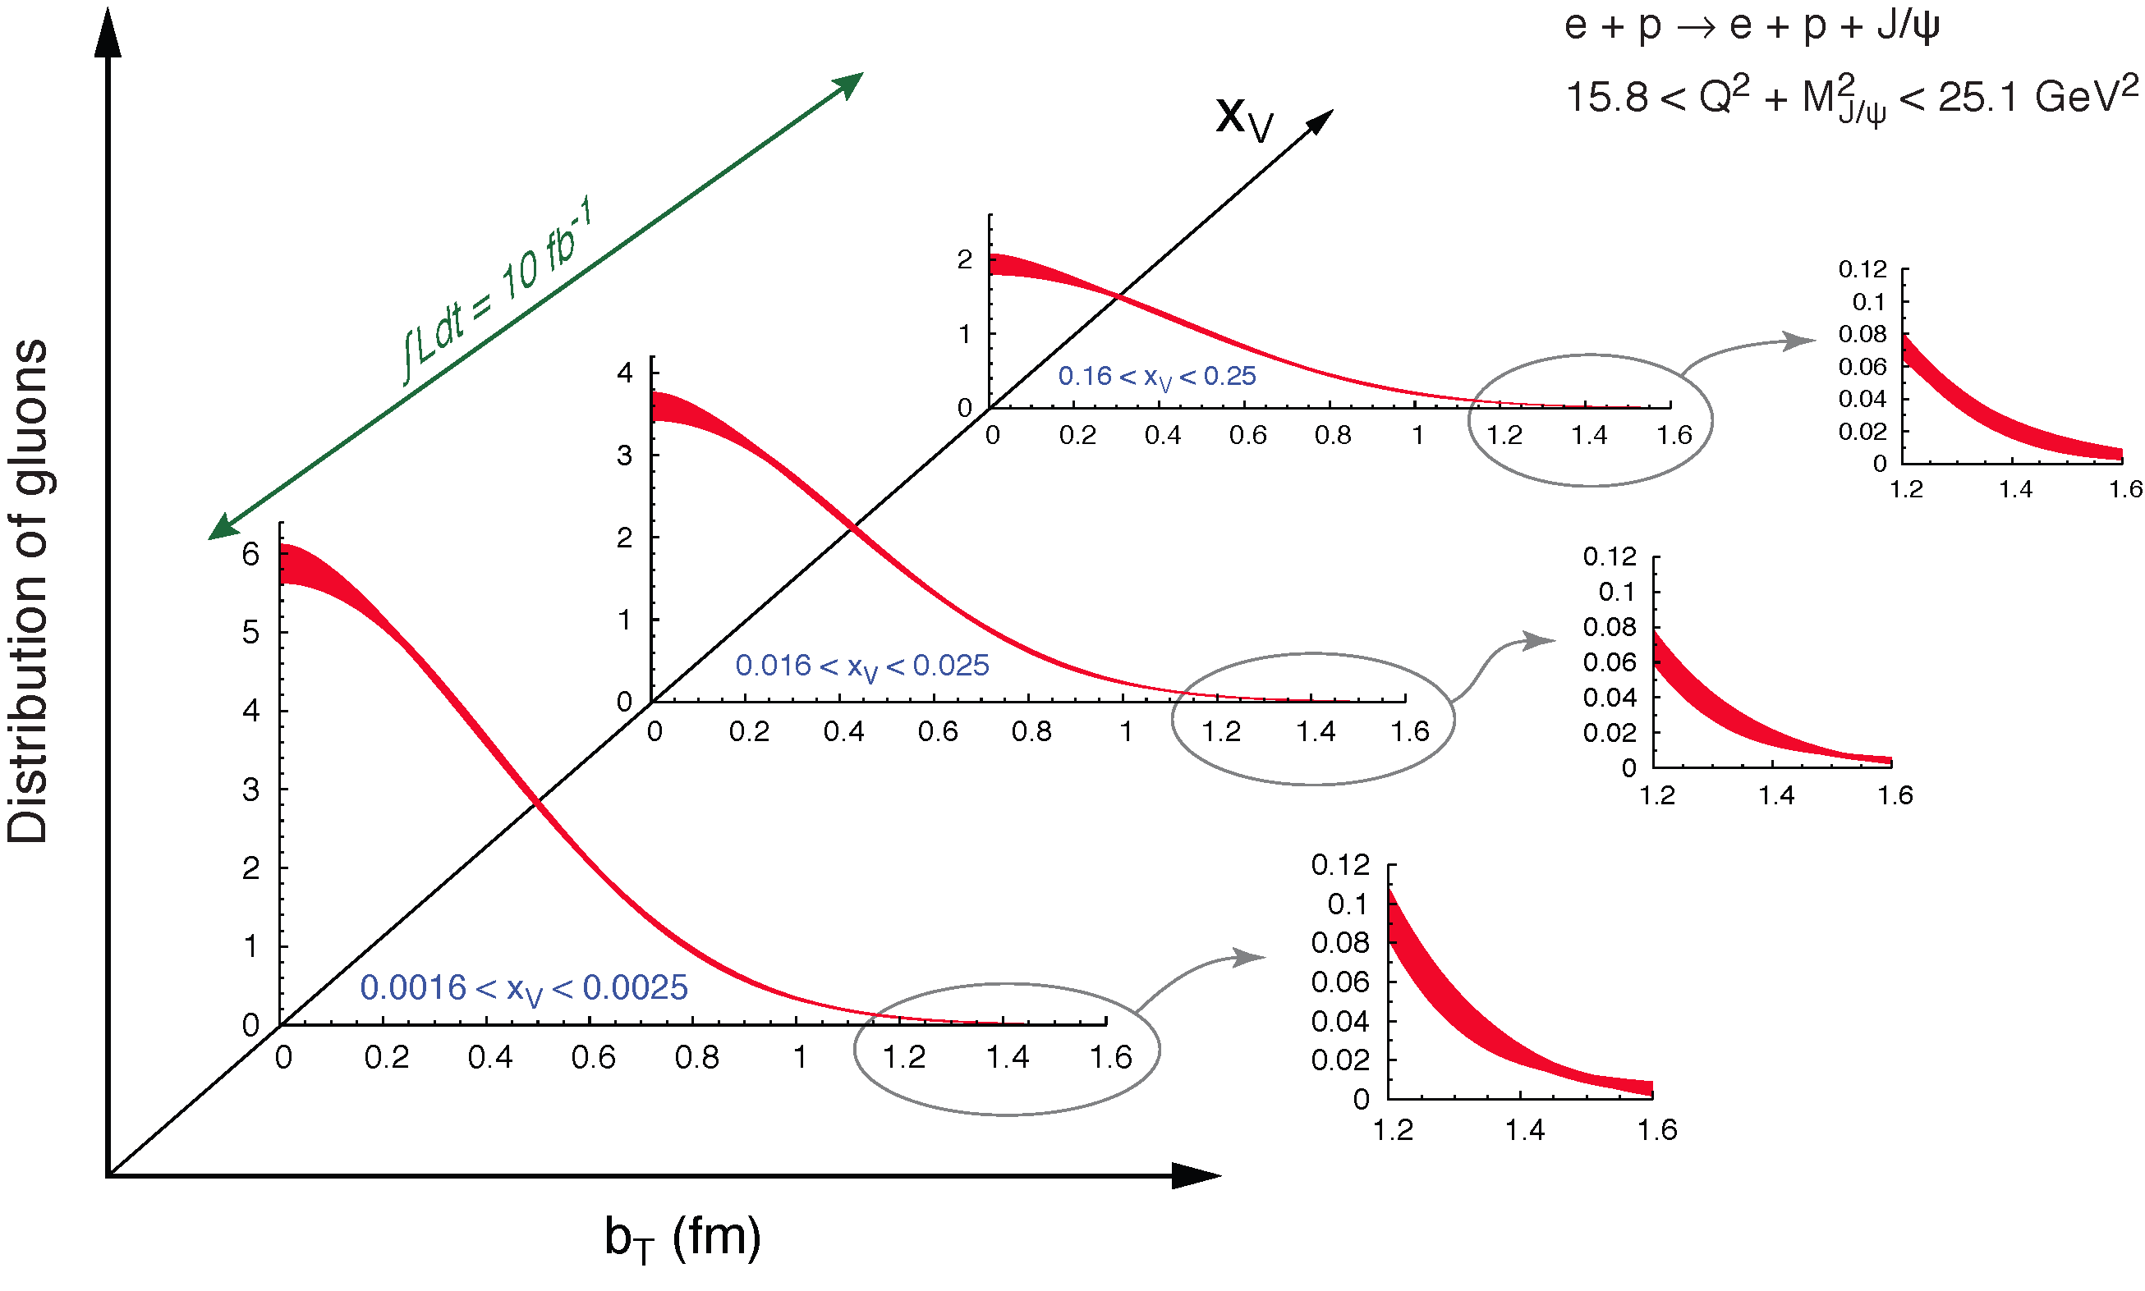
Spatial imaging of gluon density
Spin
Low-x
Tomography
Exclusive vector meson production:
Nucleii
Mass
Q
J/Ψ, Φ, …
Other
Fourier transform of the t-dependence
Spatial imaging of glue density
t-dep
Gluon imaging from simulation:
Only possible at the EIC: From the valence quark
region deep into the sea quark region
Images of gluons from exclusive J/ψ production

Slide 12
Nuclear PDFs and low-x physics

Slide 13
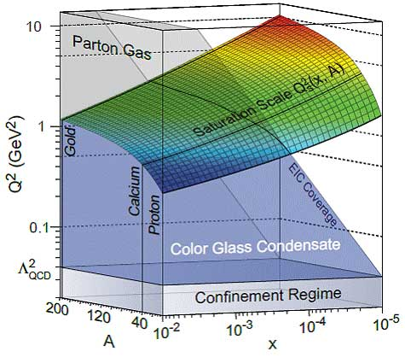
Cold nuclear matter effects
Main questions:
  Are there nonlinear effects at low x when gluon densities get too large?
  Is the saturation scale at x to be reached in p(d)-A collisions and e-A collisions large enough to be perturbative?
  What are actual smoking guns for such effects?
=

Slide 14
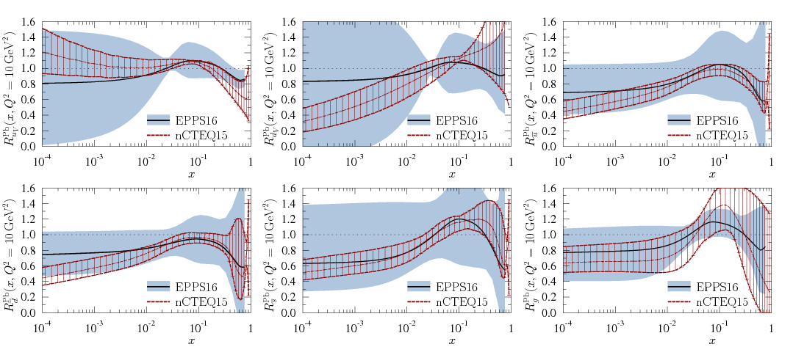
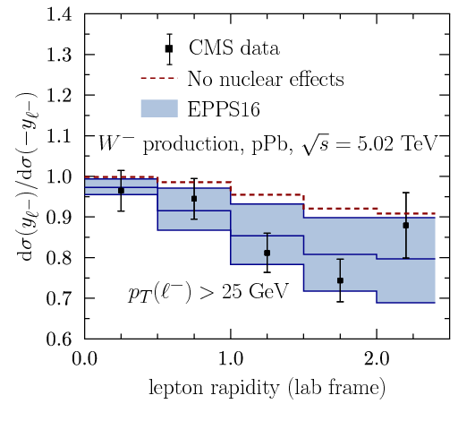
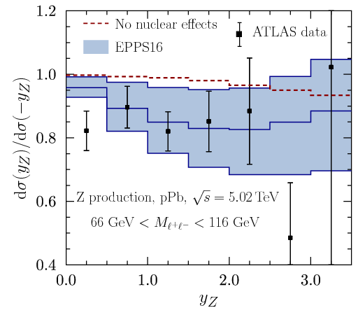
Current knowledge on nuclear PDFs
Various old DY data, DIS data, RHIC pions and LHC W, Z results
EPS16: Eur.Phys.J.C 77 (2017) 163
nCTEQ15: Phys.Rev.D 93 (2016) 085037

Slide 15
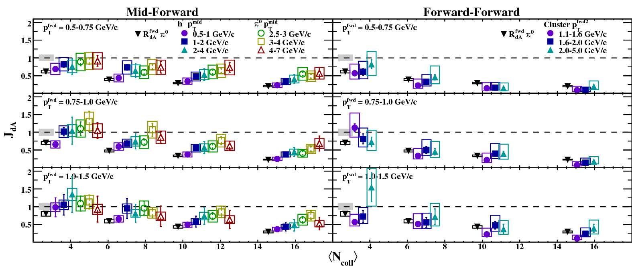
Dijet suppression in dAu vs pp collisions
Suppression increasing with increasing N_{coll}
Decreasing with increasing momentum (related to increasing x)
Phys.Rev.Lett. 107 (2011) 172301

Slide 16
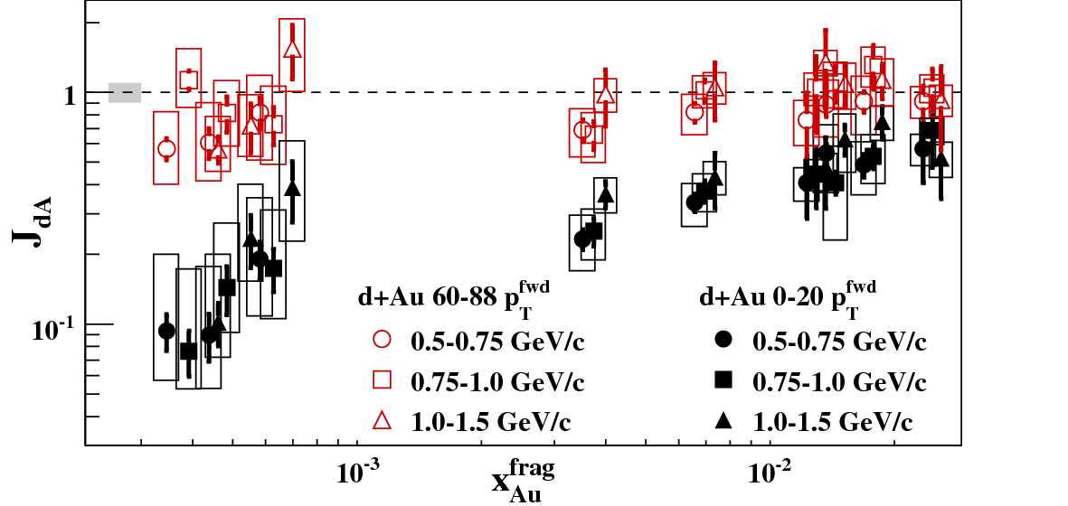
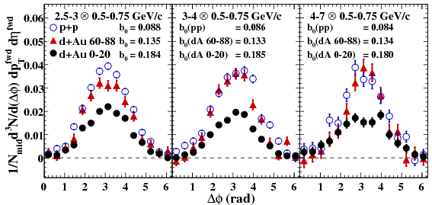
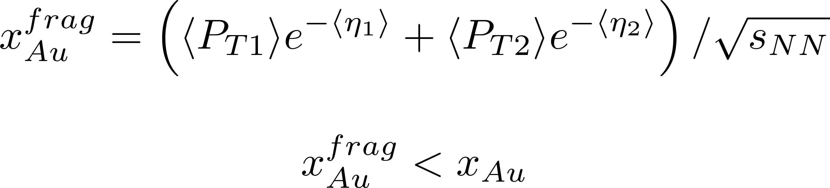
Indications of CNM effects at low x
Peripheral collisions: little to no di-jet suppression
Central collisions: Strong suppression at lowest x visible
Au

Slide 17
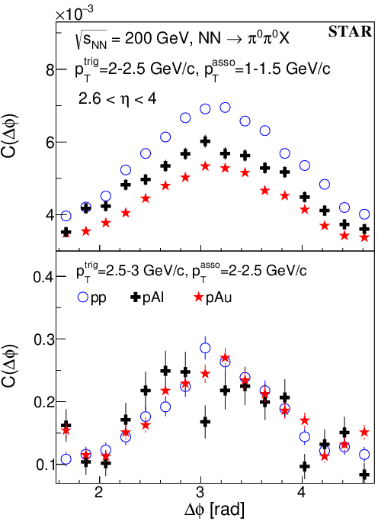
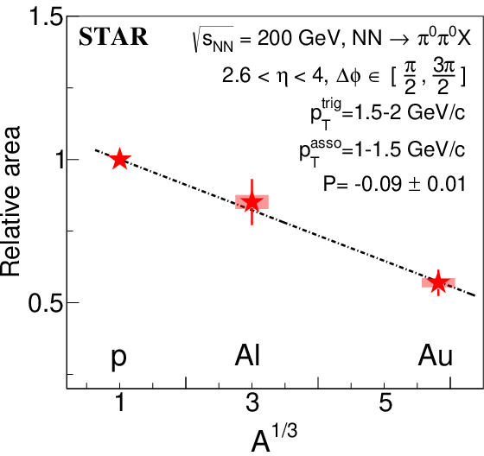
STAR back-to-back forward pion pairs
Suppression seen, comparable to previous PHENIX d+Au measurements for pAl and pAu
STAR Phys.Rev.Lett. 129 (2022) 092501

Slide 18
pA data
STAR took pA data in Run15 with new preshower in front of FMS → possibility of direct photon measurements
Substantial improvement of gluon nuclear pdfs (even over LHC pPb data)
Complementarity to EIC

Slide 19
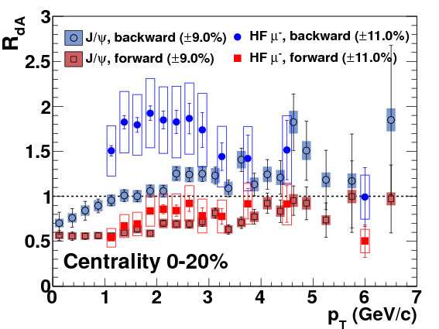
CNM effects at moderately forward rapidities
J/Psi and open heavy flavor production at rapidities 1.4<|η|<2.0 in dAu collisions extracted
For lower-x_{Au} (d-forward) suppression up to 50% seen in both particle types
Higher xAu show pronounced enhancement in HF muons at lower pT but not for J/Psi
Phys.Rev.Lett. 112 (2014), 252301

Slide 20
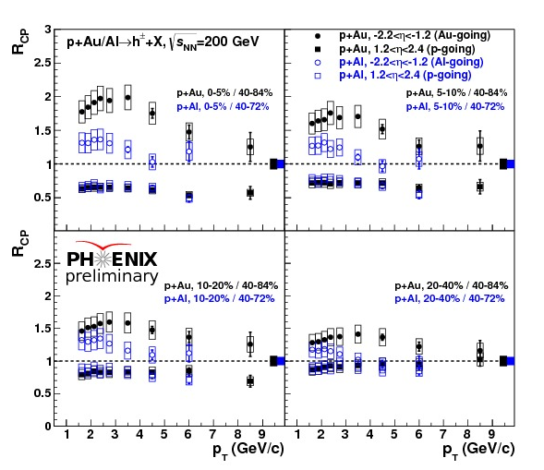
R_{CP} in pA for charged hadrons
Similar suppression seen for charged hadrons in pA collisions in p going direction
Similar enhancement seen in A going direction
Effects strongest for central collisons, much smaller for peripheral collisions
pAl and pAu suppression consistent within uncertainties but enhancement different

Slide 21
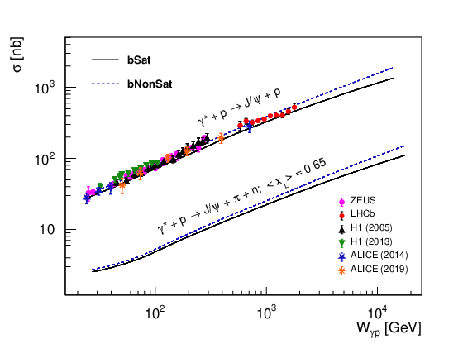
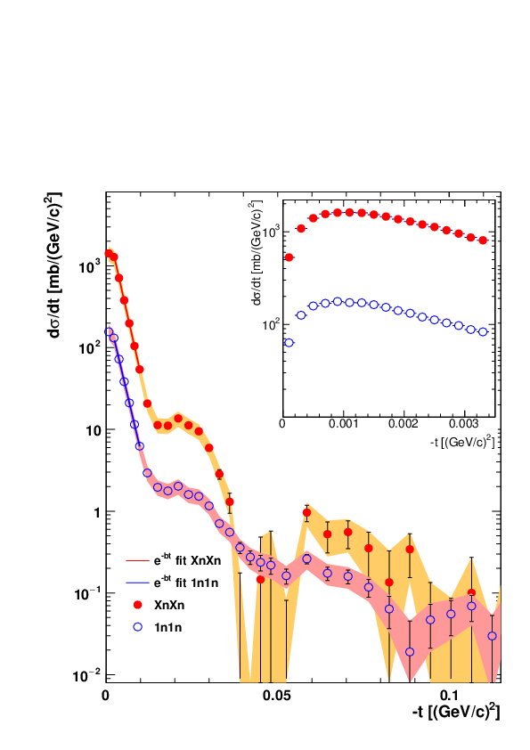
Diffractive rho/Jpsi production
Phys.Rev.D 105 (2022) 114045
HERA data on diffractive J/Psi production exists, sensitive to g² in dipole picture, no clear inidication for saturation effects
Ultraperipheral collisions in Au+Au similar to DIS -> two-gluon exchange with photon to create VM

Slide 22
Open questions for low-x PDFs
Suppressions seen, but no clear indication for CGC
Nuclear PDFs with very large uncertainties still
Only some J/Psi production information from pp and HERA, need more data from EIC

Slide 23
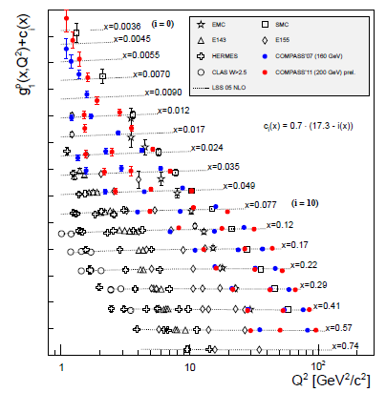

Inclusive DIS and Δg(x)
Spin
Tomography
Low-x
Nucleii
Mass
Other
Currently no lever arm to access gluon helicities via DIS (lepton-proton scattering)
Nonzero gluon polarization found from 200/510 GeV RHIC data
EIC: Several orders of magnitude of Q² at same x allows to determine gluon helicity via DGLAP (scale) evolution
PRD92 (2015), 094030
PRD92 (2015), 094030

Slide 24
Gluon and sea polarization
Spin
Tomography
Low-x
Nucleii
Mass
Other
1 year of EIC running will pin down gluon polarization
Using SIDIS: precise determination of sea quark helicities, especially strange contribution of interest
Indirect determination of orbital angular momentum via sum rule
Also interesting access to flavor via charged current reactions
PRD 102 (2020), 094018

Slide 25
EIC impact for Sivers Functions
Spin
Tomography
Low-x
Transverse momentum imbalance of unpolarized partons in a transversely polarized nucleon <-> model dependent relation to orgbital angular momentum
Nucleii
Mass
Other
Precise nucleon image in momentum space for quarks, sea-quarks and gluons
Bacchetta, Radici,
PRL 107 (2011) 212001
YR: Fig 7.53
Vladimirov, et al
YR Fig 7.55
Xiao, et al

Slide 26
Tensor charges
Spin
Tomography
Low-x
Nucleii
Mass
Other
Precise determination of tensor charges via Collins and di-hadron channels
Better precision than lattice → potential access to BSM physics in case of discrepancies
Preform full integrals, study role of sea quark transversity
Similarly:
Single hadron channel (YR : Fig 7.54 Gamberg et al Phys.Lett.B 816 (2021) 136255)
Di-hadron channel (YR : Fig 7.56, Radici)
hep-ex:2207.10890

Slide 27
Spatial imaging of gluon density
Spin
Low-x
Tomography
Exclusive vector meson production:
Nucleii
Mass
Q
J/Ψ, Φ, …
Other
Fourier transform of the t-dependence
Spatial imaging of glue density
t-dep
Gluon imaging from simulation:
Only possible at the EIC: From the valence quark
region deep into the sea quark region
Images of gluons from exclusive J/ψ production

Slide 28
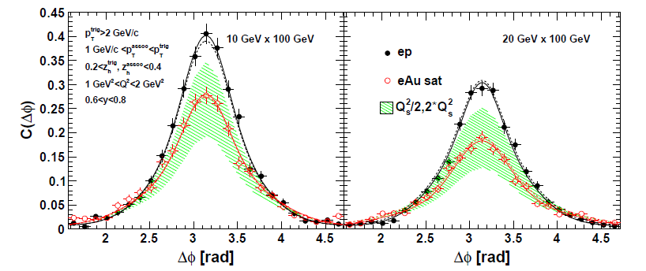
Di-hadron de-correlations to cleanly probe saturation
Spin
Tomography
Low-x
Nucleii
Mass
 | PRD89 (2014) 074037
Other
Measure back-to-back hadron(jet) - hadron or hadron(jet) - photon correlations
Suppression of away peak as indication for saturation
Different probes to access different low-x gluon TMDs

Slide 29
Unpolarized PDFs
Spin
Tomography
Low-x
Nucleii
Mass
Other
Impact on unpolarized PDFs from plain (NC) DIS, PV (CC) DIS and SIDIS
SIDIS (flavor sensitivity)→Sea quarks, especially strangeness suppression
Also potential access to intrinsic charm?
YR Figs 7.8, Aschenauer

Slide 30
FFs
Spin
Tomography
Low-x
Nucleii
Mass
Other
Fragmentation functions provide information on struck parton, its flavor and spin
They are a staple of all SIDIS measurements
Also their understanding will improve further with the EIC
YR Fig 7.84, Aschenauer

Slide 31
Nuclear PDFs
Spin
Tomography
Low-x
Nucleii
Mass
Other
Very precise nuclear PDFs will open way to quantitative HI physics
Also F_{L} and F_{L,charm} for nuclei will be extracted
EPPS16*

Slide 32
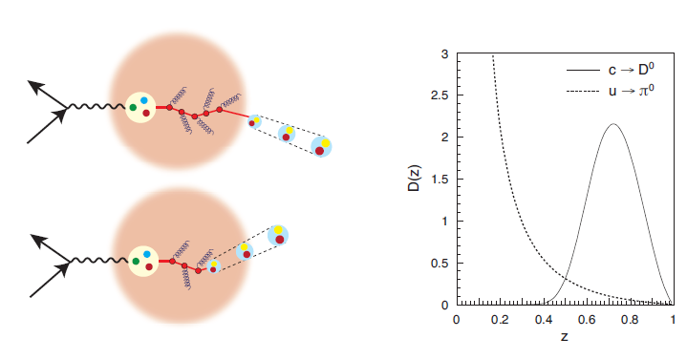
Fragmentation in the nucleus
Spin
Low-x
Tomography
Nucleii
Mass
Other
Does the it affect hadron/quark mass?
Comparison of Multiplicity ratios for light and heavy hadrons and various parton energies ν

Slide 33
nFFs
Spin
Tomography
Low-x
Nucleii
Mass
Other
Expected impact from EIC on light hadron nuclear FFs
Also more sophisticated studies ongoing (transverse momentum broadening, nu dependence, etc)
Similar studies for heavy flavor
YR Figs 7.90, 7.91, Zurita

Slide 34
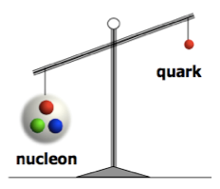
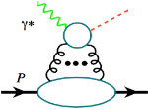
Understanding Mass of Hadrons
MeV
Spin
Low-x
Tomography
GeV
Nucleii
Mass
“… The vast majority of the nucleon’s mass is due to quantum fluctuations of quark-antiquark pairs, the gluons, and the energy associated with quarks moving around at close to the speed of light. …”
Other
The 2015 Long Range Plan for Nuclear Science
J/ψ,Υ
Access at the EIC:
  Study trace anomaly contribution via J/Psi/Υ production at threshold

Slide 35
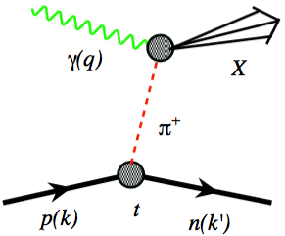
Pion/Kaon structure
Spin
Tomography
Low-x
Nucleii
Mass
Other
Quark-gluon energy contribution to mass: Use Sullivan process (scattering on virtual meson emitted from nucleon) to extract pion/Kaon Form Factors and PDFs

Slide 36
Summary
From HERA +LHC good knowledge on unpolarized PDFs, but still open questions
Spin sum rule: 30% by quark spins, substantial gluon polarization, but low x for integrals, role of strange sea, etc. still needed to measure
Many transverse spin effects discovered, but detailed three-dimensional momentum picture still elusive
GPDs to access 3D position structure
The future at the EIC: A dedicated accelerator to study QCD and answer most of the questions I mentioned in this lecture

