Slide 1
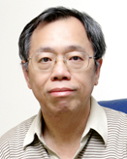
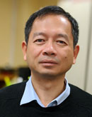
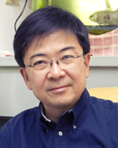
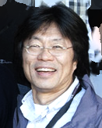
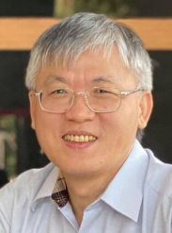
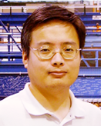
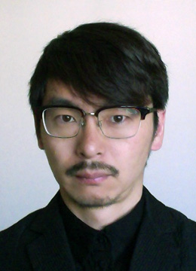
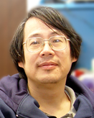
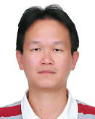
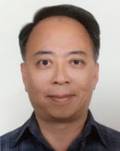
Institute of Physics, Academia Sinica
AAC Review 2023 MHEP – Experiment [since ~1990]: 9 Faculty Members
Wen-Chen Chang (章文箴) [as convener]
Recent Retirement:
Faculty Scientists:
Shih-Chang Lee
李世昌
Yuan-Hann Chang 張元翰
Henry Tsz-King Wong
王子敬
Suen Hou
侯書雲
Wen-Chen Chang
章文箴
Sadakazu Haino 灰野禎一
1
Song Ming Wang 王嵩銘
Ming-Lee Chu
朱明禮
Chih-Hsun Lin 林志勳
Eric Yen 嚴漢偉

Slide 2
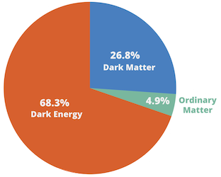
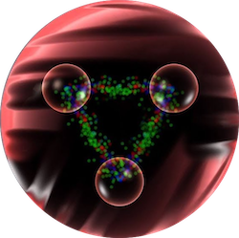
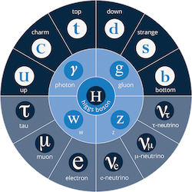
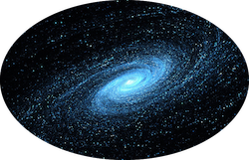
Success of Standard Model in HEP But Unknown Remains
Antimatter, Parity Violation
Dark Matter, Dark Energy
https://atlas.web.cern.ch/Atlas/GROUPS/PHYSICS/PUBNOTES/ATL-PHYS-PUB-2022-009/
Early Universe, gravity
https://atlas.cern/Discover/Physics

Slide 3
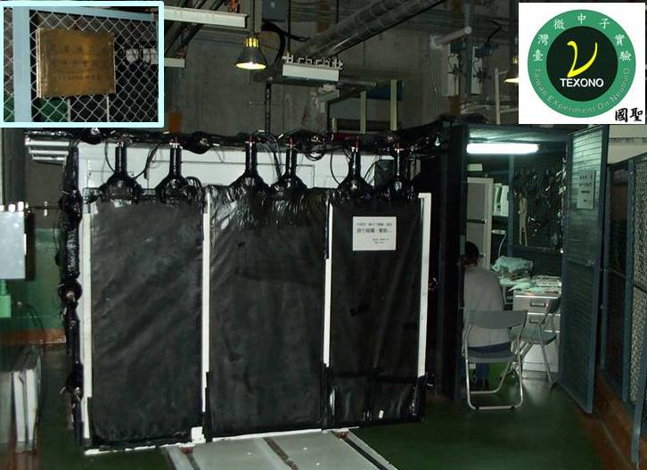
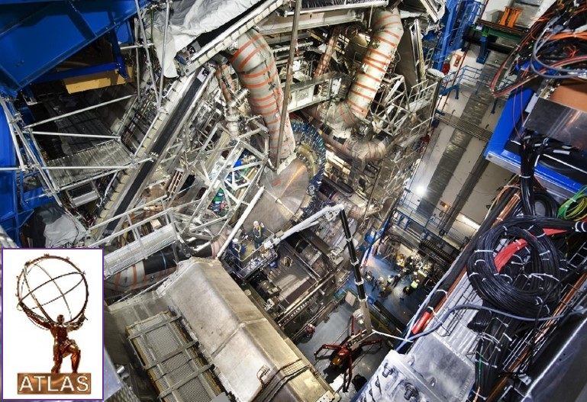
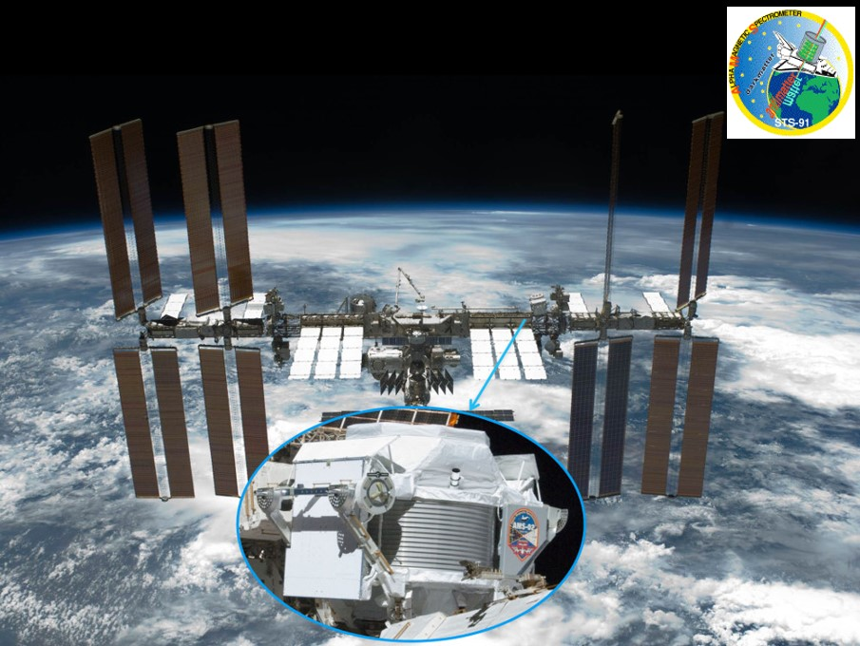
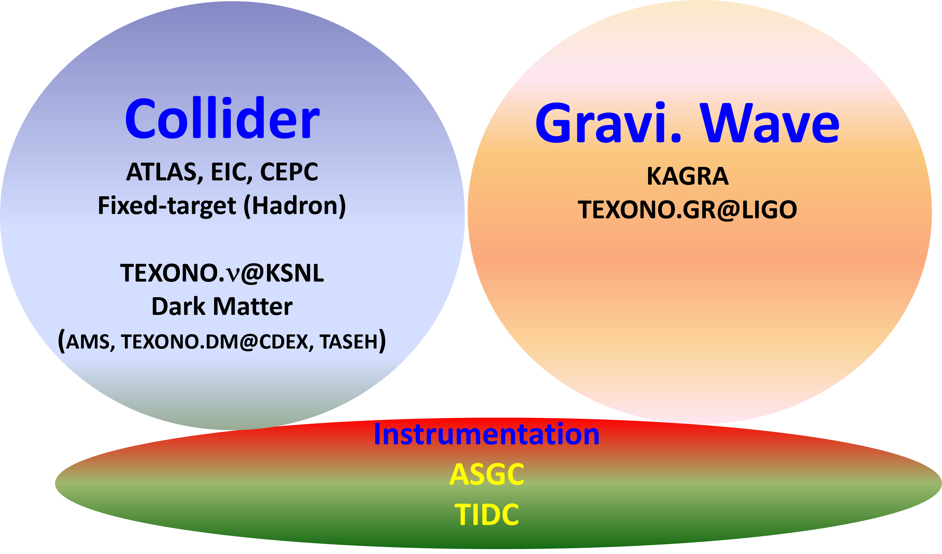
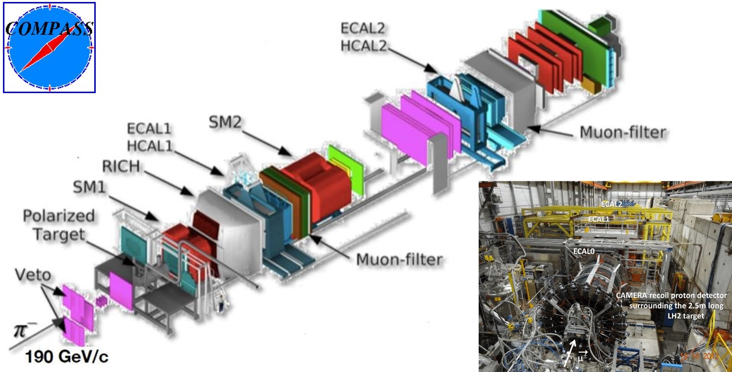
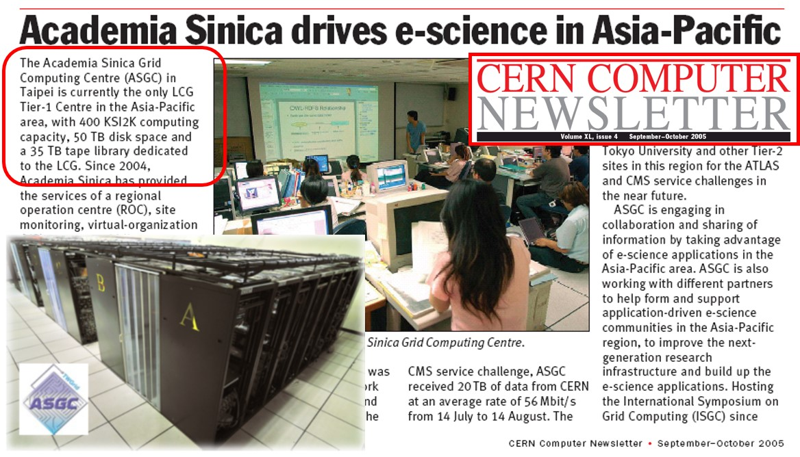
3

Slide 4
Institute of Physics, Academia Sinica
MHEP-EXP
Collider Physics
Search for new particles and new physics
Astroparticle Physics
Study cosmic-rays, search for anti-matter, dark matter
Experimental support; Detectors Construction & Applications
ATLAS
1999 ~
S.M. Wang/ S. Hou
AMS
1995 ~
S. Haino/ Y.H. Chang
Instrumentation
TIDC
M.L. Chu/C.H. Lin/
Y.H. Chang
Neutrino & Dark Matter Physics
With low energy detectors
Axion Physics
Micro-wave Cavity Searches
ASGC (Academia Sinica Grid Computing Center) From HEP to e-Science
CEPC – Higgs factory
S. Hou
TEXONO
1996 ~
H.T. Wong
TASEH
2020 ~
Y.H. Chang + QMP
Computing
Y.H. Chang/ E. Yen
Hadron Physics
probing nucleons by GeV photons and hadrons
Gravitational Wave
New tool to study our universe
World wide GW detector network (LVK)
Information & Details: Refer to Individuals’ Reports ………
LEPS, SeaQuest, COMPASS, J-PARC
1999 ~
W.C. Chang
2016 ~ S. Haino
2021 ~ H.T. Wong
Notes:
Our group has been working on 6 experiments, which cover collider physics, astroparticle physics, neutrino physics and Gravitational wave. We also have teams to support instrument development and computing. Both are important to all experiments.
4

Slide 5
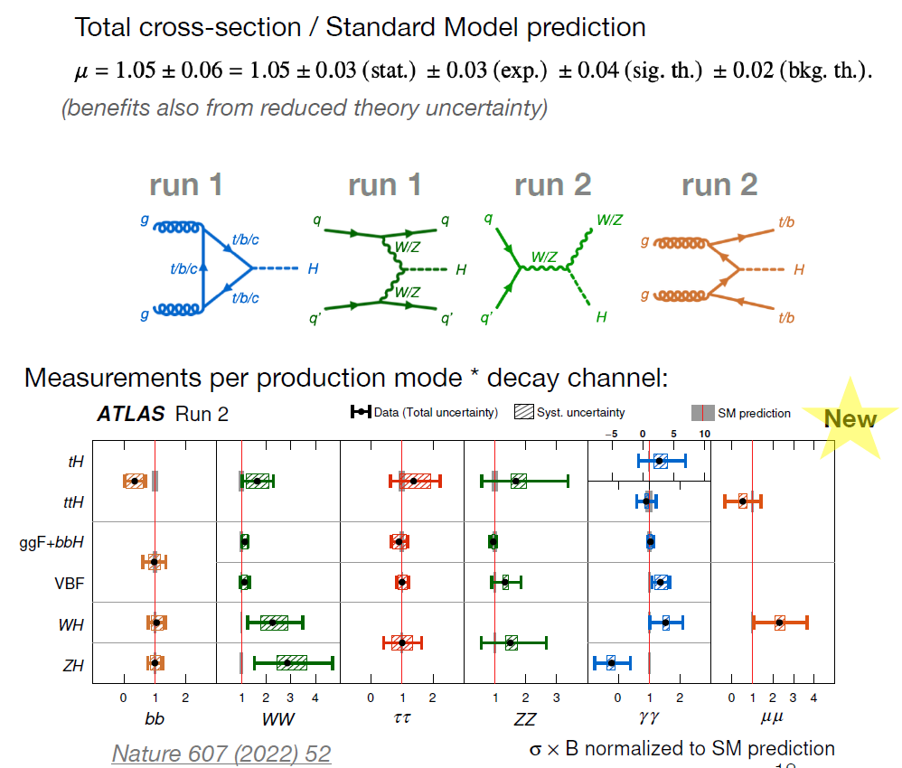
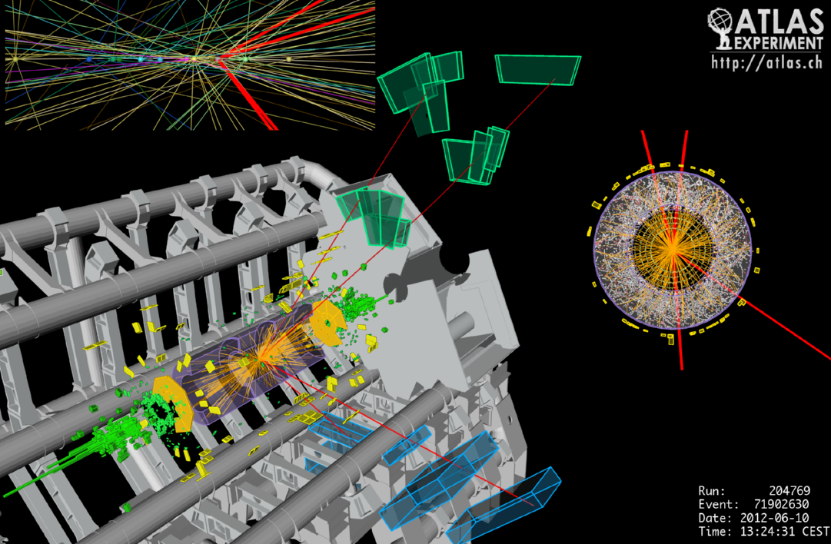
Institute of Physics, Academia Sinica
MHEP (Expt)
Collider Physics
Search for new particles and new physics
ATLAS
1999 ~
王嵩銘/侯書雲
CEPC – Higgs factory
侯書雲
[ATLAS Collaboration]
Notes:
Our group has been working on 6 experiments, which cover collider physics, astroparticle physics, neutrino physics and Gravitational wave. We also have teams to support instrument development and computing. Both are important to all experiments.
5

Slide 6
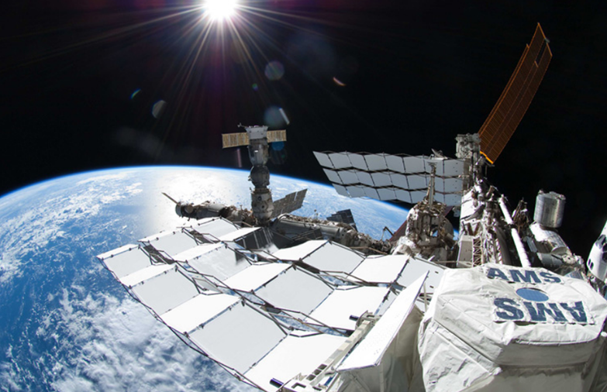
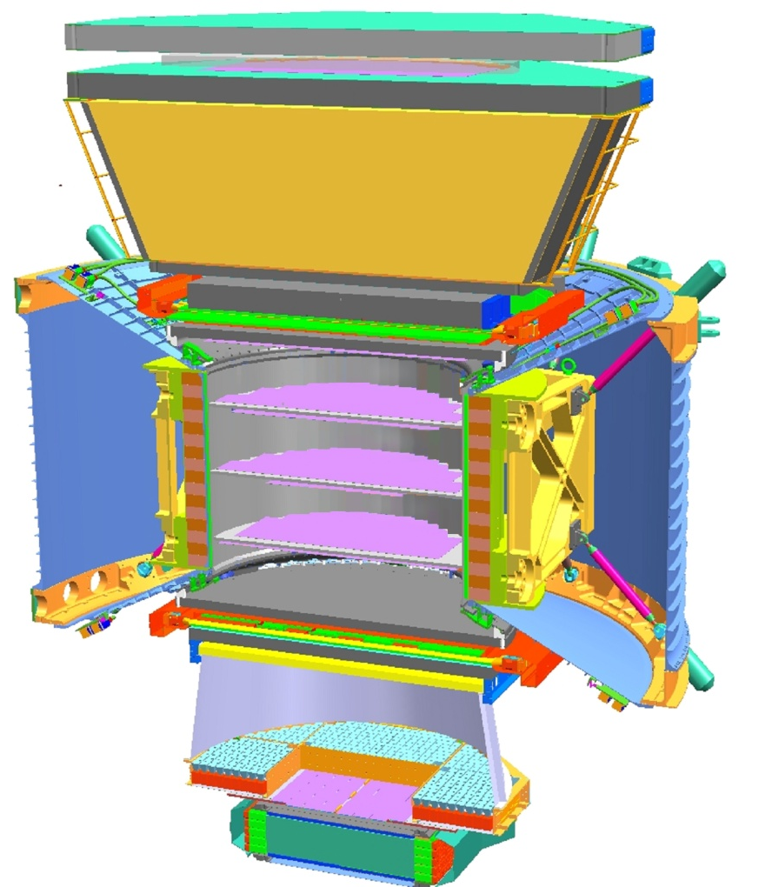
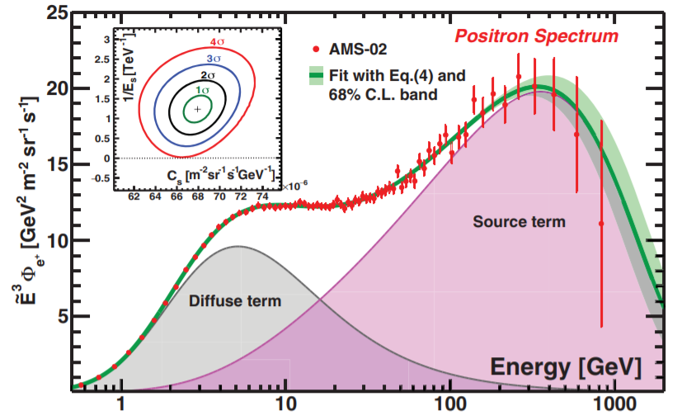
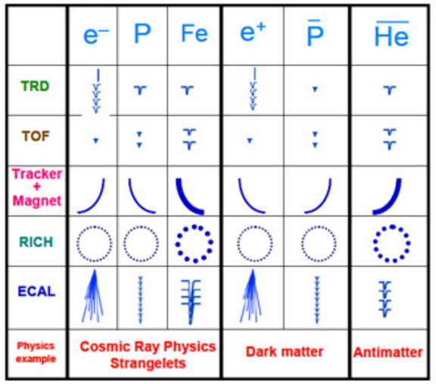
Institute of Physics, Academia Sinica
MHEP (Expt)
Astroparticle Physics
Study cosmic-rays, search for anti-matter, dark matter
TRD
AMS
1995 ~ 灰野禎一/張元翰
TOF
Magnet
Tracker
TOF
RICH
ECAL
PRL 122, 041102 (2019)
Notes:
Our group has been working on 6 experiments, which cover collider physics, astroparticle physics, neutrino physics and Gravitational wave. We also have teams to support instrument development and computing. Both are important to all experiments.
6

Slide 7
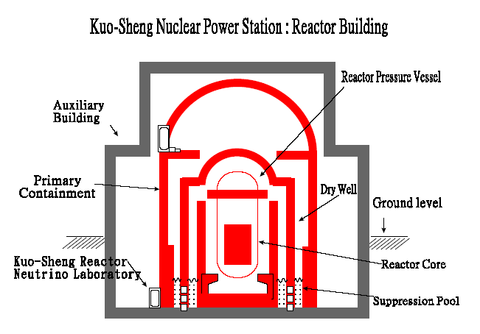
Institute of Physics, Academia Sinica
MHEP (Expt)
Neutrino & Dark Matter Physics
With low energy detectors
TEXONO
1996 ~
王子敬
Notes:
Our group has been working on 6 experiments, which cover collider physics, astroparticle physics, neutrino physics and Gravitational wave. We also have teams to support instrument development and computing. Both are important to all experiments.
7

Slide 8
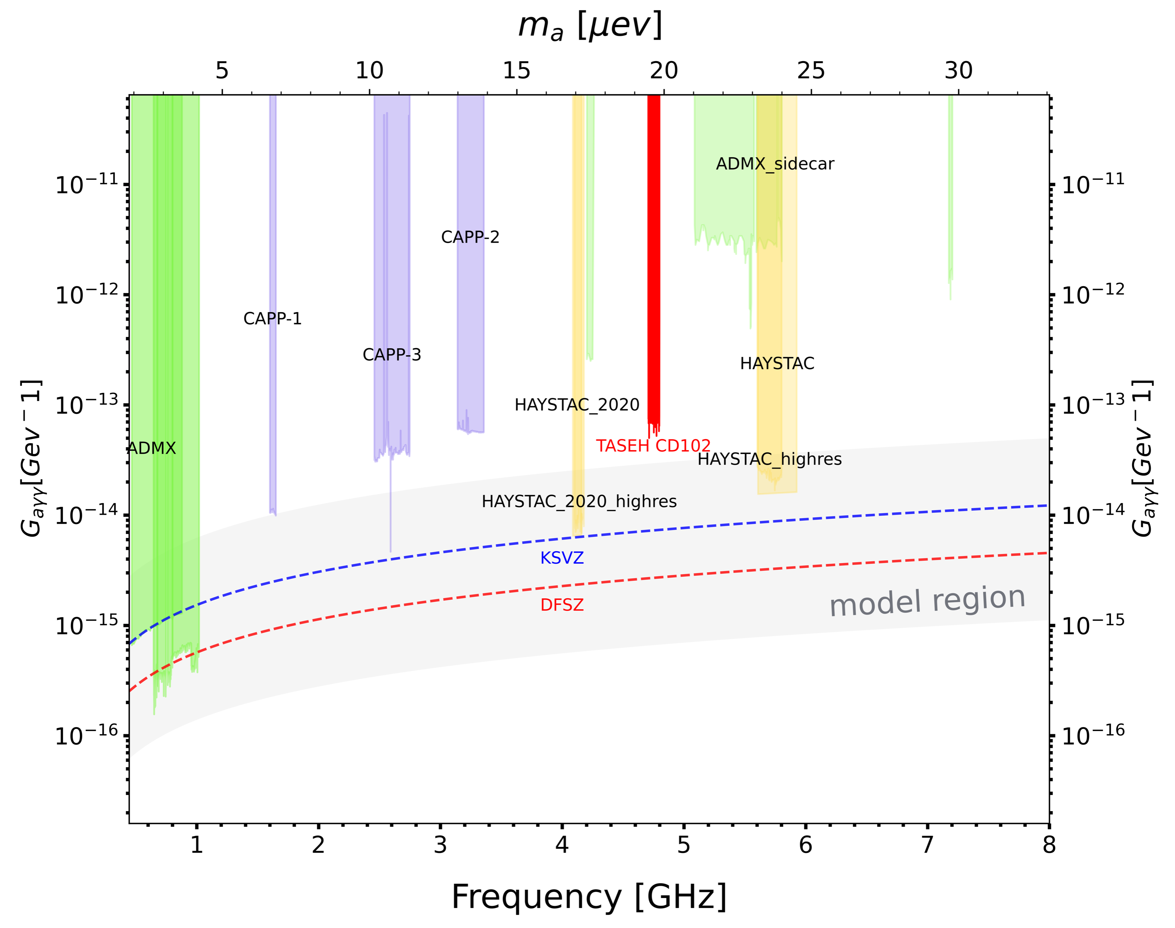
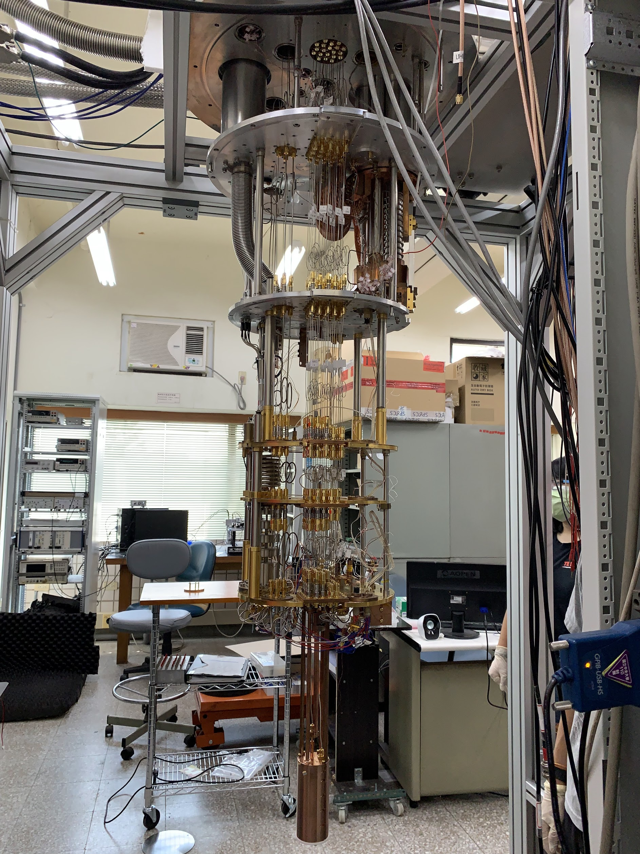
Institute of Physics, Academia Sinica
MHEP (Expt)
Axion Physics
Micro-wave Cavity Searches
TASEH
2020 ~
Y.H. Chang + QMP
Search for Axion Dark Matter with Haloscope type experiment:
Measure Axion-converted photons (in microwave band) with a cavity in a 20mK environment with 9 Tesla field.
Project started in 2020 with NSTC Vanguard project, first result obtained in 2021 and published 2022.
Developing quantum-limited-added-noise amplifier in Taiwan to improve the sensitivity by a factor of 10.
Notes:
8

Slide 9
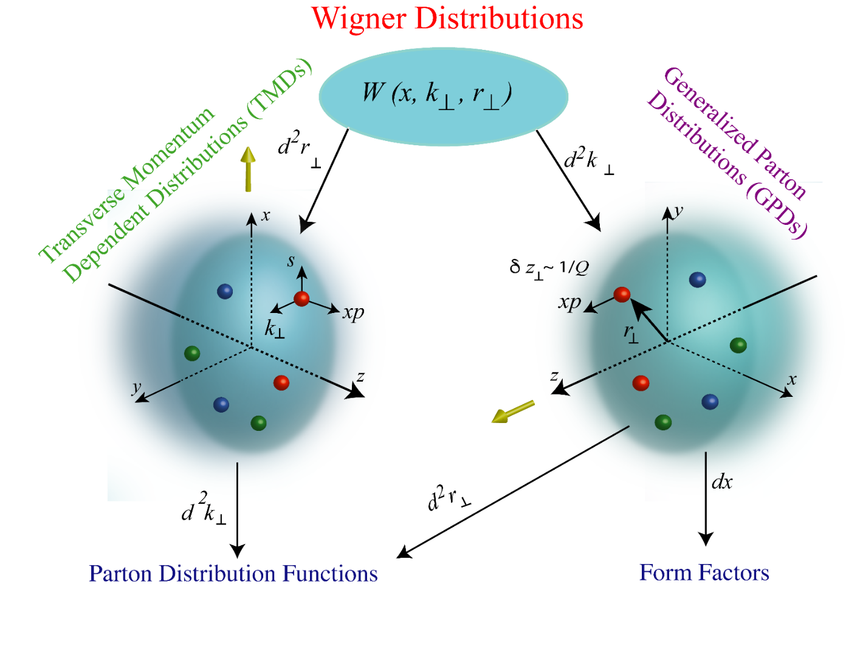
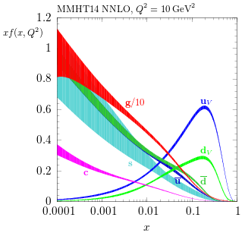
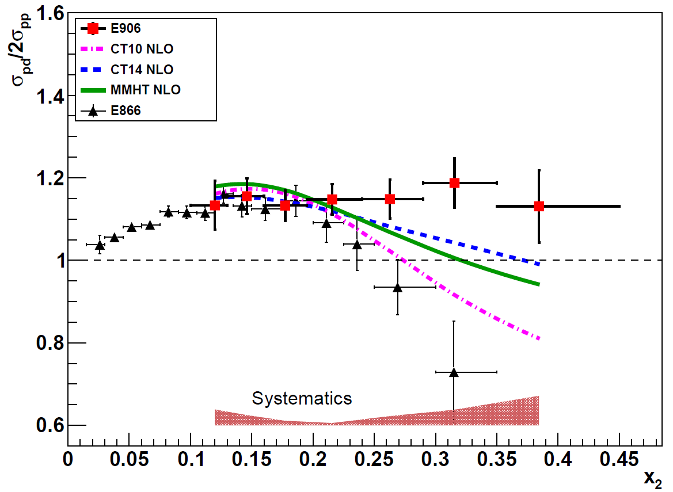
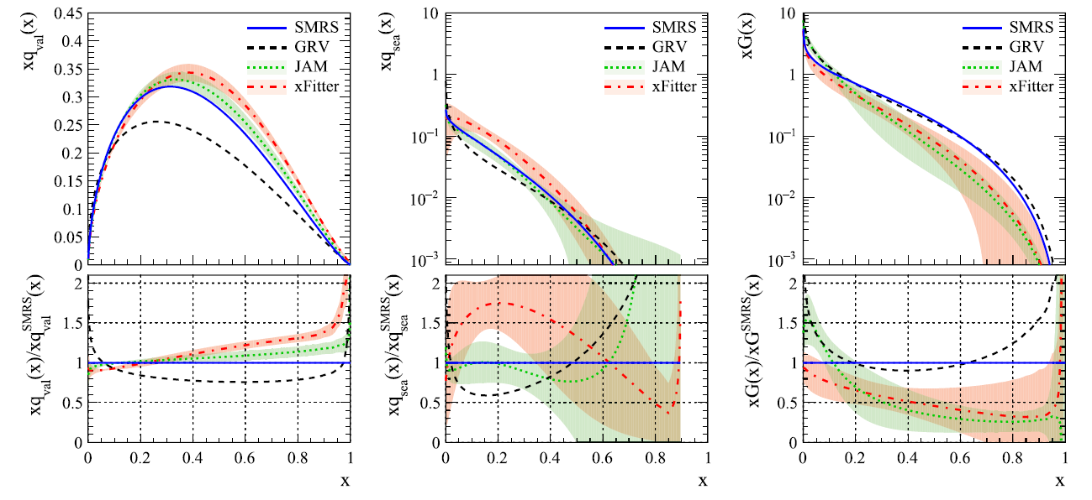
Institute of Physics, Academia Sinica
MHEP (Expt)
Hadron Physics
probing nucleons by GeV photons and hadrons
LEPS, SeaQuest, COMPASS, J-PARC
1999 ~
章文箴
p
$$π$$
Notes:
Our group has been working on 6 experiments, which cover collider physics, astroparticle physics, neutrino physics and Gravitational wave. We also have teams to support instrument development and computing. Both are important to all experiments.
9

Slide 10
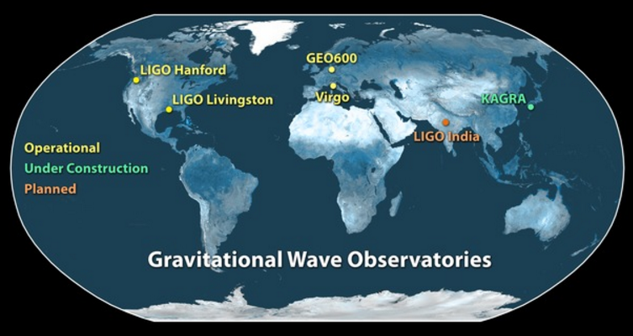
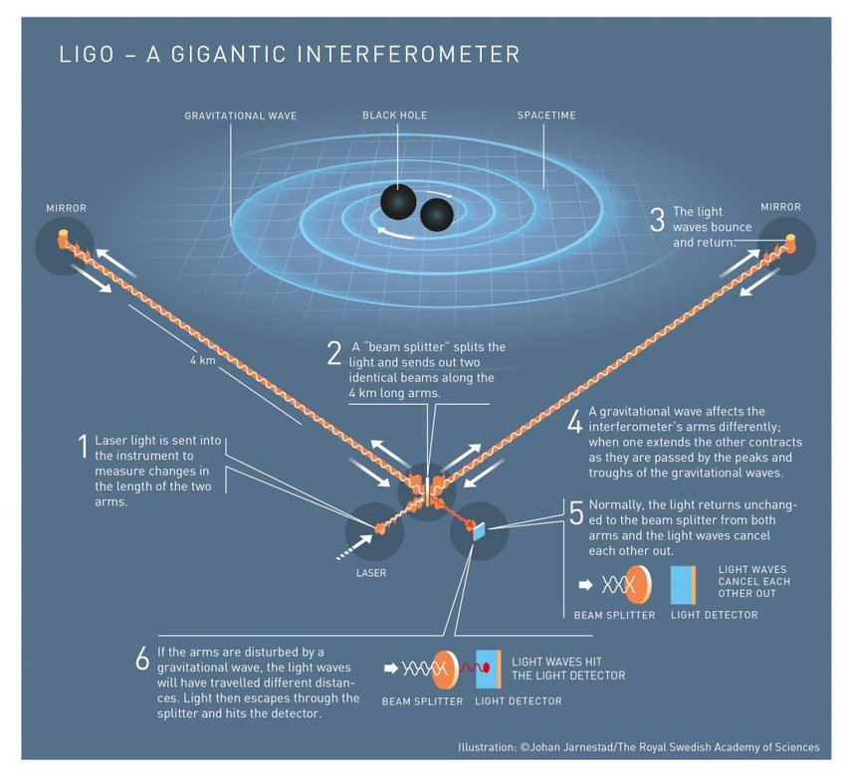
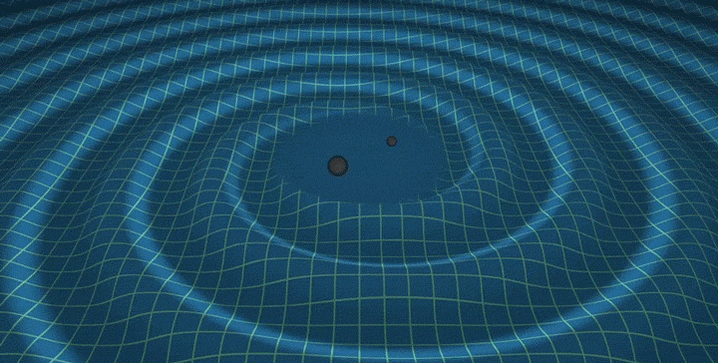
Institute of Physics, Academia Sinica
MHEP (Expt)
Gravitational Wave
New tool to study our universe
World wide GW detector network (LVK)
2016 ~ S. Haino
2021 ~ H.T. Wong
Notes:
Our group has been working on 6 experiments, which cover collider physics, astroparticle physics, neutrino physics and Gravitational wave. We also have teams to support instrument development and computing. Both are important to all experiments.
10

Slide 11
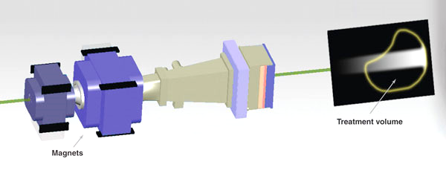
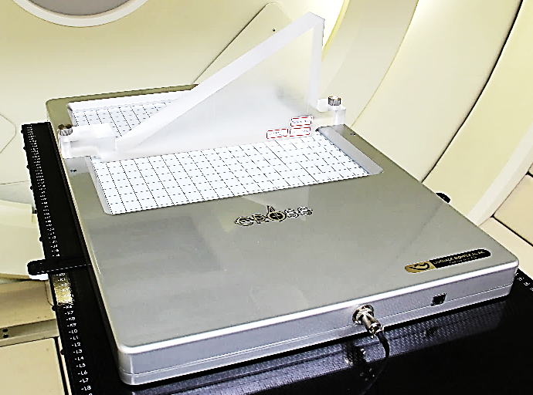
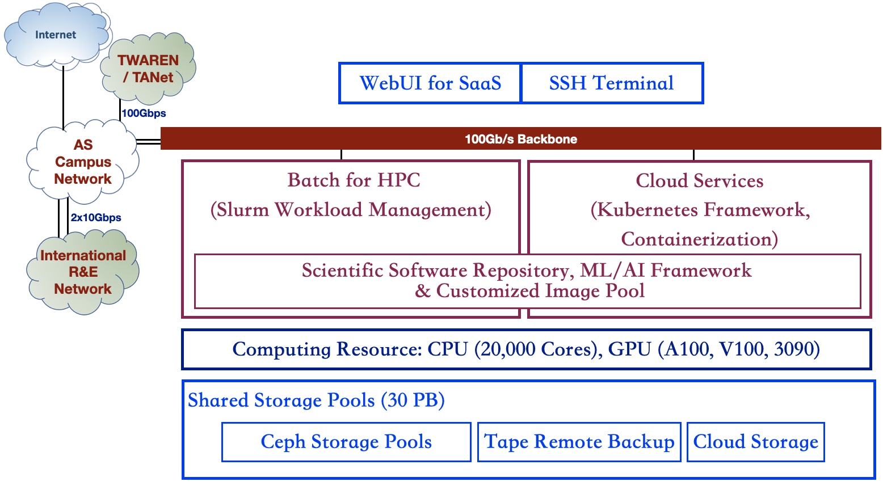
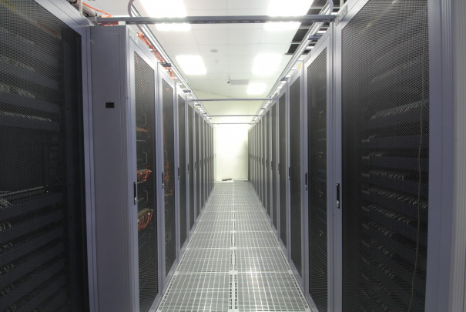
Institute of Physics, Academia Sinica
MHEP (Expt)
Proton Therapy Detector 質子治療探測器
Experimental support; novel detectors & applications
Instrumentation
朱明禮/林志勳
ASGC
From HEP to e-Science
ASGC System Diagram
Computing
張元翰/嚴漢偉
Notes:
Our group has been working on 6 experiments, which cover collider physics, astroparticle physics, neutrino physics and Gravitational wave. We also have teams to support instrument development and computing. Both are important to all experiments.
11

Slide 12
ASGC
ASGC was established in 2006 to support the large computing requirement for ATLAS and CMS experiments
One of the 11 initial Tier 1 center. The only Tier-1 in Asia, jointly funded by NSC and AS
Provided ~6% of computing resources to ATLAS at the start of LHC.
Actively participated in the development of the GRID technology with WLCG (World LHC Computing Grid). Very well respected by WLCG colleagues.
NSC withdrawn its support in 2012. Subsequently ASGC terminated the Tier-1 operation for CMS.
New challenges to ASGC
AS has decided to downgrade ASGC Tier-1 to Tier-2 center for WLCG in 2022.
2024 budget for ASGC is down to ~20% of 2022. Network down from 2x10Gbps to 2.5 Gbps.
Establish an AS Core facility to support computing requirements within AS. However, with very limited budget support and request ”User charge” policy.
Major reduction in manpower and hardware is required based on this level of support.
2022 NSTC called for proposal to establish a medium sized computing facility
To have O(5000) core and O(10) petabytes storage, mainly for projects in the Physics division.
Among 10 competing proposals, ASGC won this project with a grant of 25M NT$/yr ➔ The expertise and experiences learned as WLCG Tier-1 is unmatched by any other computing center in Taiwan.
ASGC is capable of supporting the NSTC core facility together with ATLAS Tier-2 and AS core-facility, but quite marginally.
Infrastructure is old (almost 20 years) and very challenging to maintain.
12

Slide 13
Achievements Highlights: In Addition to -- Facilities & Teams & “Traditions” Building
Participating in ATLAS@LHC@CERN
Discovery of the Higgs Boson (2012), observation of H->bb (2018)
Search for New Physics at High Energy Frontiers
National Leadership in Participation in AMS@ISS
Payload Operation Control Center in Asia ; Major Space Electronics Production
Precision Measurements of Primary Cosmic Rays
Observation of Anomalous Features consistent with Dark Matter
Studies of Cosmic Anti-matter
TEXONO program at Kuo-Sheng Reactor Neutrino Laboratory
Studies of Neutrino Electromagnetic Effects at Kuo-Sheng Neutrino Laboratory
Still-Best Cross-section Measurement on {electron + electron-anti-neutrinos}
Pioneered searches of Light Dark Matter & sub-GeV Germanium Detectors
Catalyzed Realization of Jinping Underground Laboratory
Hadron Physics
Several Generations of Experiments across the Globe; Diverse spectrum of topics
Characterize d-bar/u-bar in proton (Nature 2021) and pion/kaon partonic structure
ASGC Computing “GRID” Center
WLCG (Worldwide LHC Computing Grid) Tier 2 Center
Core Facility of AS and Taiwan, for big data analysis and scientific computing
13

Slide 14
TIDC (Taiwan Instrument and Detector Center)
A consortium of HEP experimental groups for hardware development. The purpose is to share the instrument and technical expertise to maximize the benefit of hardware investment.
2020-2021: A first TIDC project supported by MoST, with 3M NT$ grant, operated by AS, as a pilot program, mainly for organization work.
2022-2024: Expect a 8M NT$/year project, with actual funding for engineers and instruments. Now host by NTU group. (1.7M NT$ for 2022-2023)
Development of Silicon detector related technology is the first goal ➔ basically done with the establishment of NTU’s silicon detector assembly lab and NCU’s silicon detector test lab. Very strong support from AS machine shop.
Prospects to expand the capacity of TIDC in this 3 year:
Establish strong connection with ASGC in ASIoP, to support computing.
Radiation hardness test facility

Slide 15
TIDC (https://tidc.phys.ntu.edu.tw/WordPress/)

Slide 16
Schools/Workshops
ISGC (International Symposium on Grids and Clouds) 2022 (21-25 March, 2022)
TIDC summer school (June 27 - July 2, 2022)
10th anniversary of the Higgs boson discovery (July 4, 2022)
The 1st TIDC EIC workshop (August 18 - 19, 2022)
The 2nd TIDC EIC workshop (January 3, 2023)
ISGC 2023 (19-24 March, 2023)
HEPiX Spring 2023 (27-31 March 2023)
PIRE GEMADARC Summer School , Collaboration Meeting and Undergraduate Research Experience (24 May - 2 Jun, 2023)
2023 TIDC Summer School Of Experimental High Energy (June 26-30, 2023)
TIDC Autumn School On Electron-Ion Collider (EIC) (August 28-30, 2023)
Asia EIC workshop (November, 2023)

Slide 17
Future Evolution and Directions:
Continuation of On-Going Programs :
ATLAS ; AMS ; TEXONO ; TASEH; Hadron ; GW(KAGRA/LIGO) ; TWGRID
Future Collider Projects R&D [TIDC, S. Hou …]
ASIC for Si-Detector for CEPC …
Hadron Physics Program [W.C. Chang]
E16,E50 experiments at J-PARC hadron physics
Towards Electron-Ion Collider, as part of TW-team (>2030)
Experimental Gravitational [S. Haino, H.T. Wong, with Y. Inoue(NCU)]
In-House R&D on “deci-hertz” GW Detection (CHRONOS project)
Cryogenic Techniques; Mirror Coating ; Calibration ; GW-inspired Physics
Integrated domestic GW-related (HEP, Cosmo) Theorists
Explore room in High-Energy Neutrino Astrophysics [with Theory Gp. A. Fedynitch]
17

Slide 18
Concerns Raised in 2021 Reviews
Advanced analysis tool: “At the same time, the group seems to be lacking expertise in advanced physics analysis. In particular, despite strong expertise in scientific computing, there seems to be no machine learning expertise within the group. “
Being focused: “As the MHEP experimental group is pursuing many ongoing programs as well as developing several future programs, it is clear that some hard decisions must be made to select the most promising areas of research. This represents a considerable challenge to the leaders of IOP and the MHEP group.”
Being focused: “the Review Committee feels that the group may be overstretched in terms of how many areas they are trying to cover, and recommends that new projects and initiatives are carefully weighed against the existing activities, and that forthcoming retirements are used to strengthen these new initiatives.”

Slide 19
Regarding the Analysis Tools
Machine learning algorithms (e.g. Boosted Decision Tree, Neural Net) are already employed in the ATLAS analyses and we will apply more machine learning techniques in future analyses to gain more experience in it.
Machine learning (use of AI packages to run on GPU for data analysis) has been our emphasis for years and routinely used in AMS data analysis, TOF-PET image reconstruction, ASGC data center monitoring and control.

Slide 20
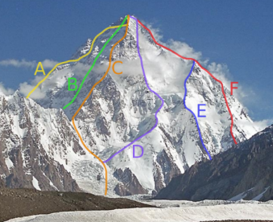
TEXONO Program – Future Road Map [H.T. Wong]
TEXONO.ν @ neutrino physicis towards reactor νN observation
Reactor decommissioned 2023, operation till 2025, DM analysis
sub-keV EC-PCGe R&D, reduce threshold via new configuration
Options of moving [O(100eV) ECGe’s] to international labs to continue (>2025)
TEXONO.DM @ CDEX-300 @CJPL
14-m diameter cryostat → operation & DAQ & Analysis
0νββ grade background control for DM searches
Light DM Searches with Diverse BDM scenario
Explore Ge1T “World Experiment” for 0νββ
TEXONO.Th
ν/χ-atom interactions; Time-of-Flight in DM & BSM; QM coherency in νN elastic
TEXONO.GR @LIGO,CHRONOS @ASGRAF
LIGO: Calibraion, Mirror Coating, Cryogenics, Physics
CHRONOS project
Notes:
TEXONO program will pursue New Physics through various complementary routes.

Slide 21
Urgent Issusion: Recruiting
In 2022, we interviewed three candidates with BGs on collider physics: one junior and two senior ones.
The junior one did not match our expectations well. One senior colleague did not fit because he would like to stay at CERN due to family constrain. The other senior colleague was not considered due to age and his immediate/long-term research plan.
We keep looking for the candidates on collider physics and GW.

Slide 22
Summary
Future projects are classified under two themes of “Collider” and “Gravitational Wave”, commonly supported by “Instrumentation”.
TIDC is a framework where the HEP expertise is shared among the whole Taiwan HEP community.
We participates in World-wide GW Observatories, via contributions to two different sub-programs.
Faculty recruiting in the order of preference: Collider (LHC, EIC, CEPC(ILC/CLIC/FCC)); GW.

Slide 23
Backup

Slide 24
MHEP-EXP
Collider ATLAS, EIC, CEPC
Fixed-target (Hadron)
TEXONO.ν@KSNL
Dark Matter (AMS, TEXONO.DM@CDEX, TASEH)
Gravi. Wave
KAGRA
TEXONO.GR@LIGO
Instrumentation ASGC
TIDC

Slide 25
Diversified & Balanced & Complementing Teams:
Different Scale & Size & Style & Nature of Challenges
Group O(1000) to O(10)
Participation // national leadership // key component contributor // overall leadership // small team on advanced hardware
Expertise & Tools Developed
Detectors // Electronics // Computing H+S-ware // Analysis // Physics
Collaborators Profiles
Domestic & Foreign // Universities , Research Institutes, Industrial Partners // + theorists , engineers …..
Applications/Impact
Instrumentation support for other researchers // Detectors for Medical Therapy & Other Applications
Large-Scale Computing beyond Particle Physics
International Alumni // Team & Subjects Propagation

