Slide 1



Muography Detectors and Analysis of Result
in Shimen Reservoir, Daxi, Taiwan
Kai-Yu Cheng*
Chia-Ming Kuo, Chih-Hsun Lin, Chien-Chih Chen, Yo-Shen Lin
Yu-Siang Xiao, Pin-Hsun Wang, Shao-Yang Lu, Bo-Yi Hong, Cheng-Wei Shih

Slide 2
MuoGraphy
An image technique that uses the cosmic-ray muons to take the tomography.
Can take a tomography or of huge object, such as building and mountain.
Experiment :
  Egypt’s Great Pyramid of Giza (Kunihiro Morishima)
  Volcanoes, Mt. Asama (Hiroyuki K.M. Tanaka)
  Civil Structures (Subhendu Das)
  Our Experiment:
    Collaboration with Dept. of Geoscience, Professor Chien-Chih Chen and Dept. EE., Professor Yo-Shen Lin for geological exploration
    Compare the result with other method of geological exploration
2

Slide 3
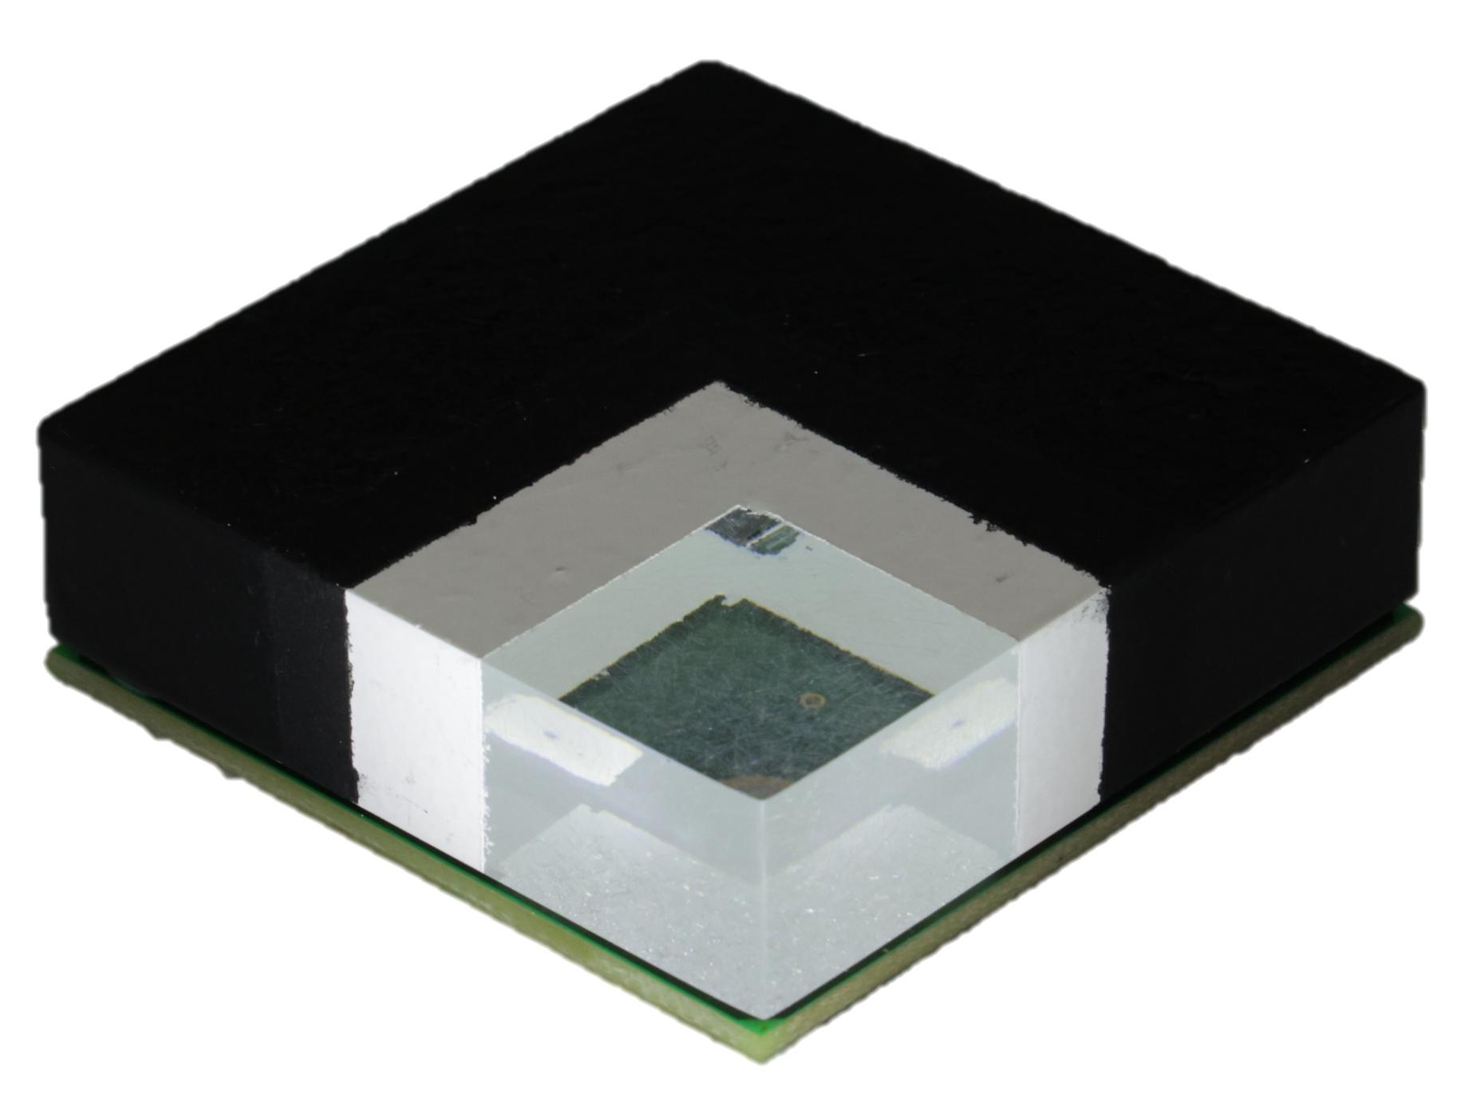
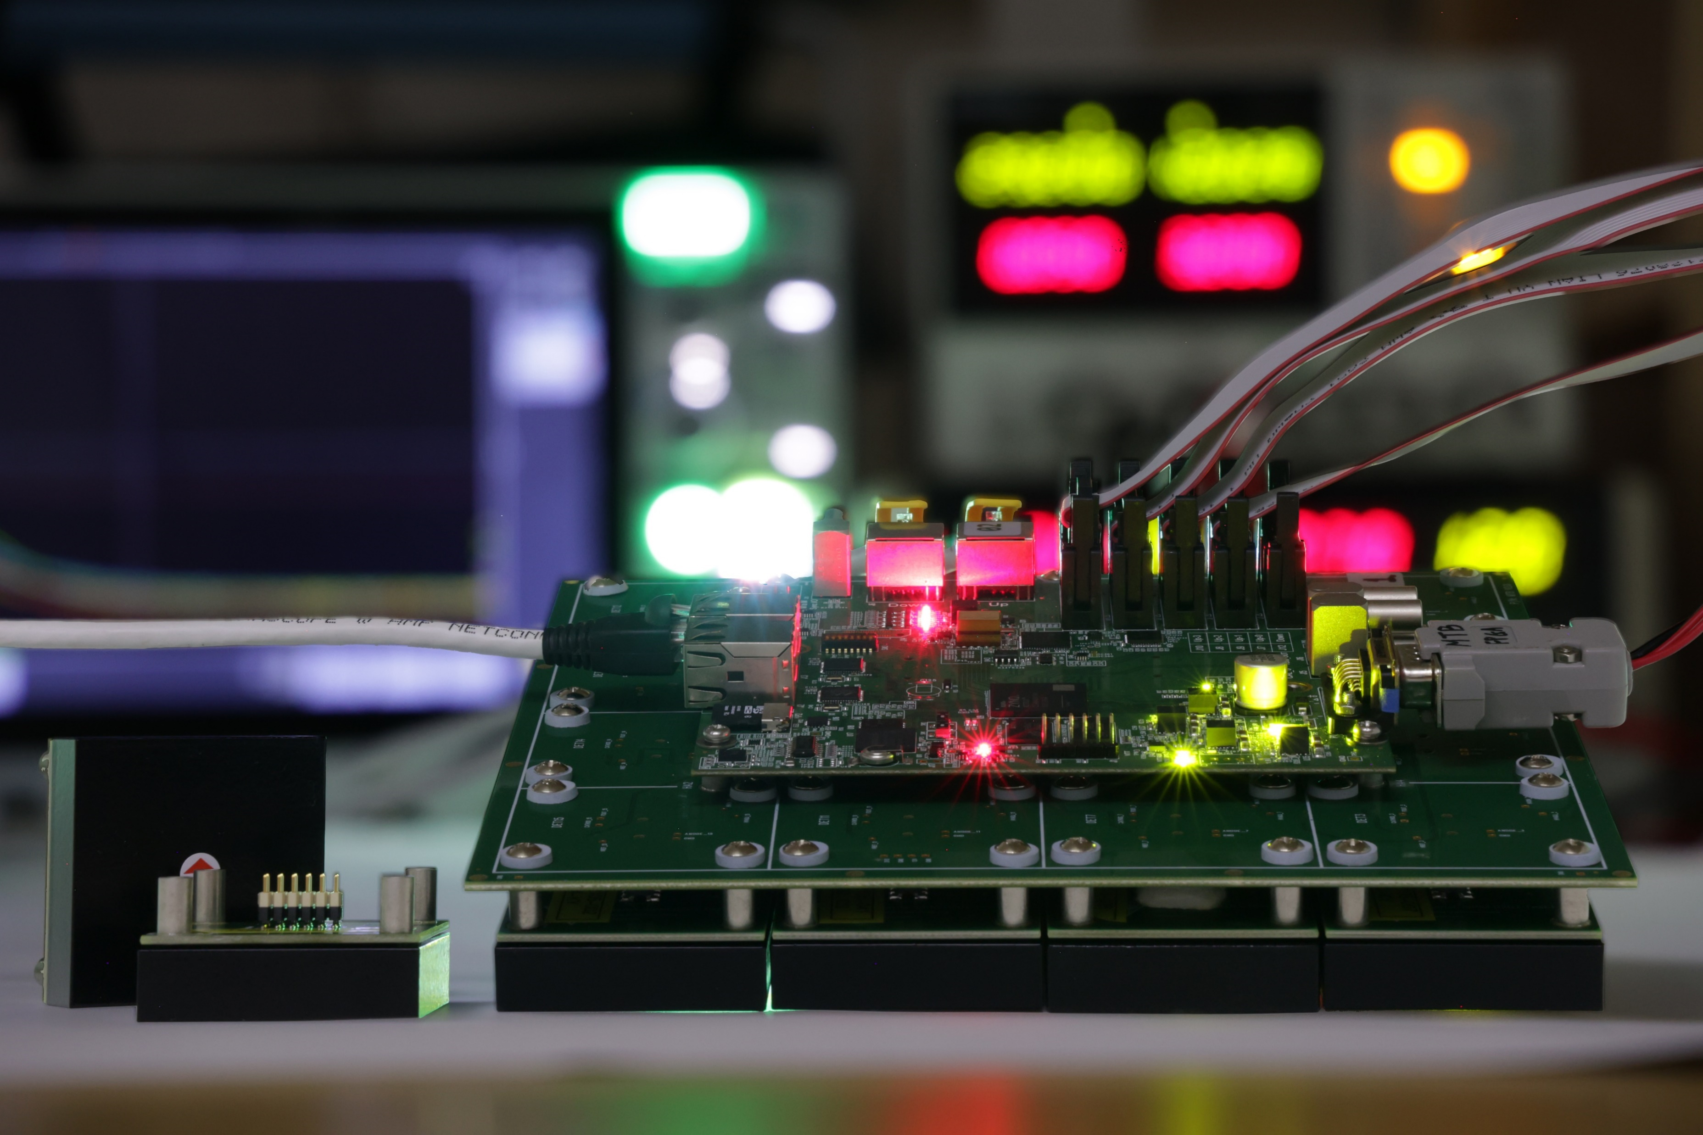
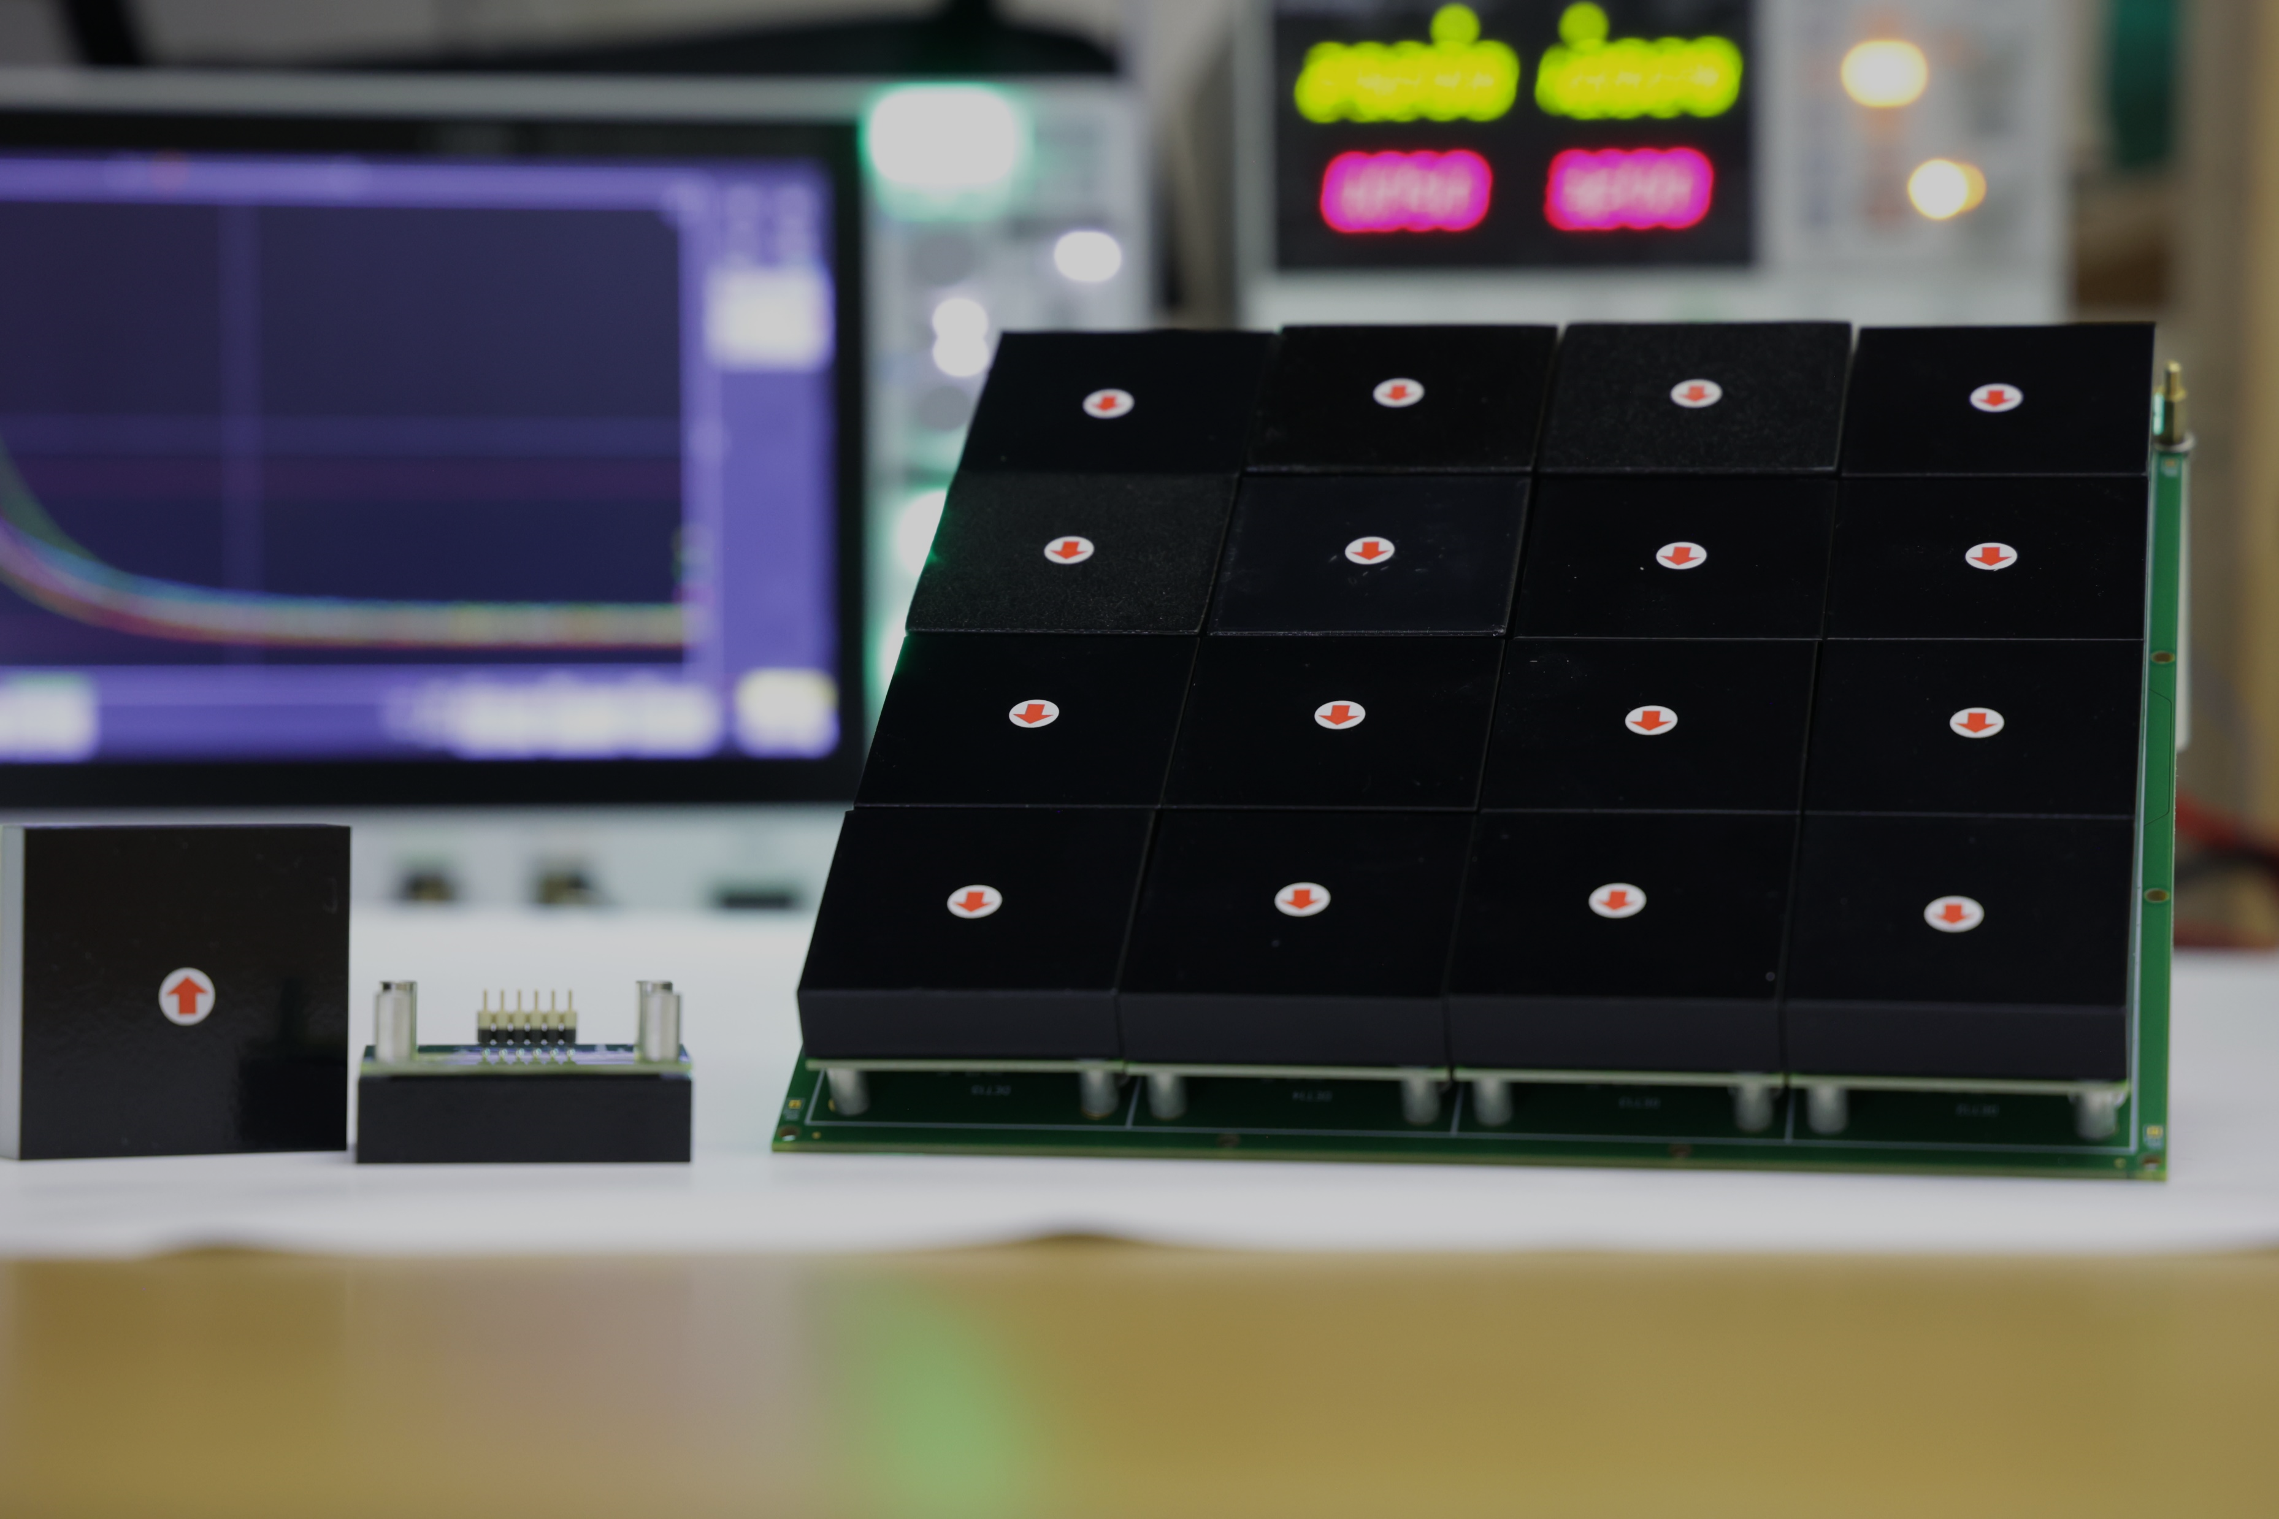
Detector
Black + Clear Paint
4.95cm x 4.95cm Scintillator + SiPM Module
Scintillator : BC408 / SiPM: MicroFC-60035
4x4 channels array MTB(Muon Tracker Board)
FPGA readout board
White Paint
SiPM
Scintillator
3

Slide 4
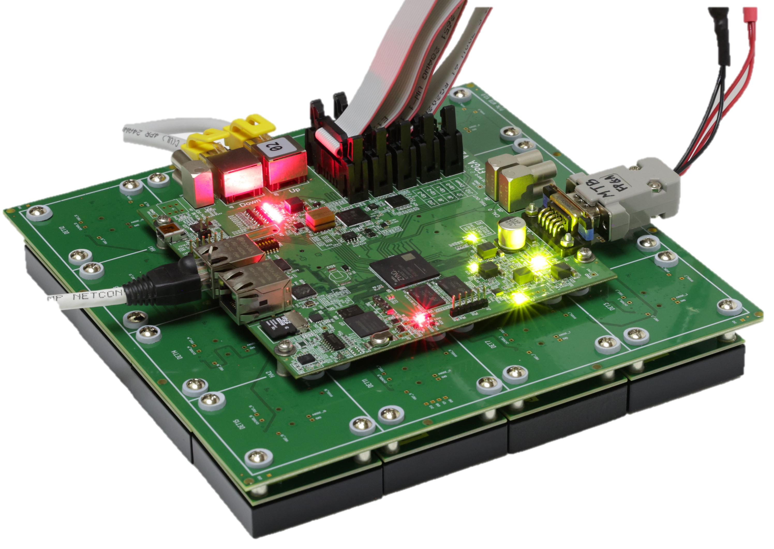
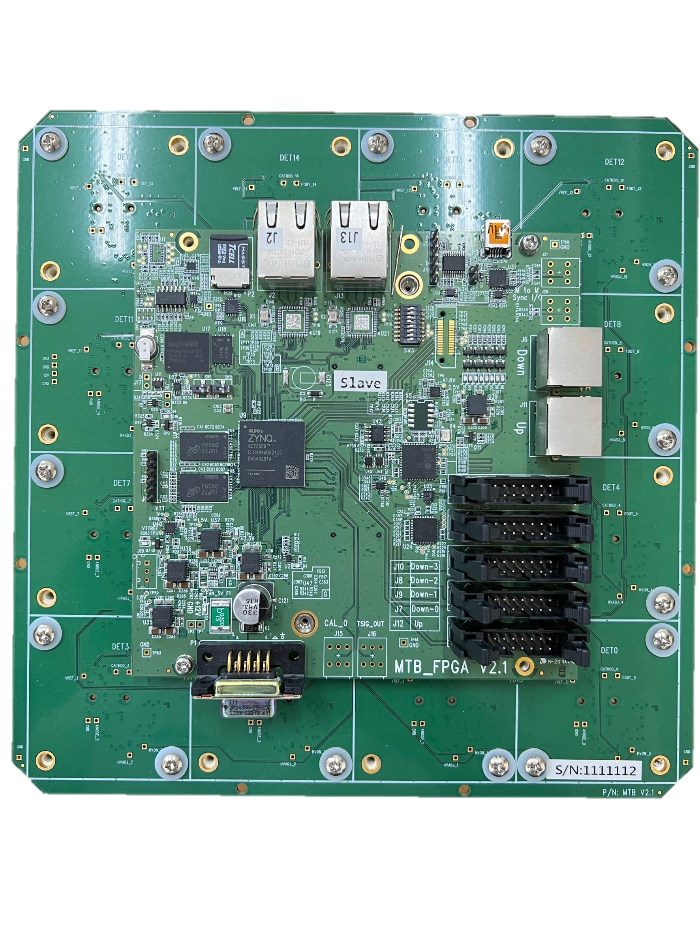



Muon Tracker Board (MTB)
4*Down
1*Up
Down
Up
Each MTB has:
16*comparator +16*30V DC/DC converter
5 temperature + 1 humidity sensors
FPGA
One Up-stream port to send data flow
Five Down-stream ports (1*RJ45 + 4* IDC) to collect data flow
TCNT : Counter along 2.56GHz clock
PCNT : Counter per second
Master Board:
Communicate with computer
Send 10MHz clock to slave board
More stable clock
Slave Board:
Synchronize the clock phase with 10MHz clock
Power
Network
Master
10MHz
2.56GHz
Slave
TCNT
10MHz
2.56GHz
Slave
TCNT
4

Slide 5



Muon Tracker Board (MTB)
Each MTB counts the TCNT according to its own 2.56GHz clock
The master board sends pps signal per second to reset TCNT
When the MTB receives the pps signal, the TCNT is reset to zero, and PCNT adds one count
Time = PCNT * 1s + TCNT * 0.390625ns
Each MTB can set the phase delay caused by cable
Master
Master
10MHz
2.56GHz
Reset
TCNT
pps
Slave
Slave
TCNT
PCNT+1
2.56GHz
10MHz
pps
Reset
TCNT
Slave
Slave
TCNT
PCNT+1
5

Slide 6
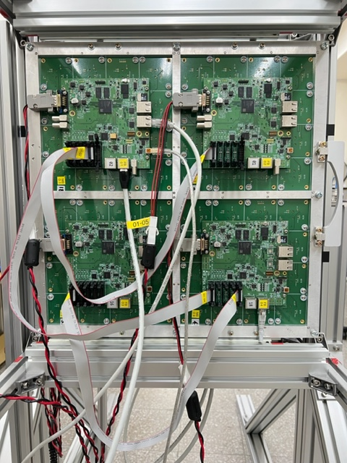

Set Up
50cm
1*Master + 15*Slave :
4 MTB layers
Each layer :
  2x2 MTB = 8x8 channels
  40cm x 40cm area
  50cm pitch
2 lead layers
  1cm thickness
  Before layer 3 and layer 4
40cm
40cm
L1
L2
L3
L4
RJ45
Master
Slave
Slave
Slave
RJ45
RJ45
RJ45
IDC
IDC
IDC
IDC
Slave
Slave
Slave
Slave
Slave
Slave
Slave
Slave
Slave
Slave
Slave
Slave
6

Slide 7

MTB Data
7
Event Packet
Which channel has signal
Start time (PCNT + TCNT) of this signal
The width of digital signal (PWidth) (resolution : 100ns)
The master board collects the signal from all boards and sends it to the computer when the buffer is full (121 events).
Housekeeping Packet
The status of MTB board
  Bias/Threshold/Clock
The environment data
  Temperature/Humidity
MTB sends housekeeping package per minute.
PWidth
MTB #
Channel #
PCNT
TCNT
PWidth
FPGA
V_{thr}
LVDS

Slide 8
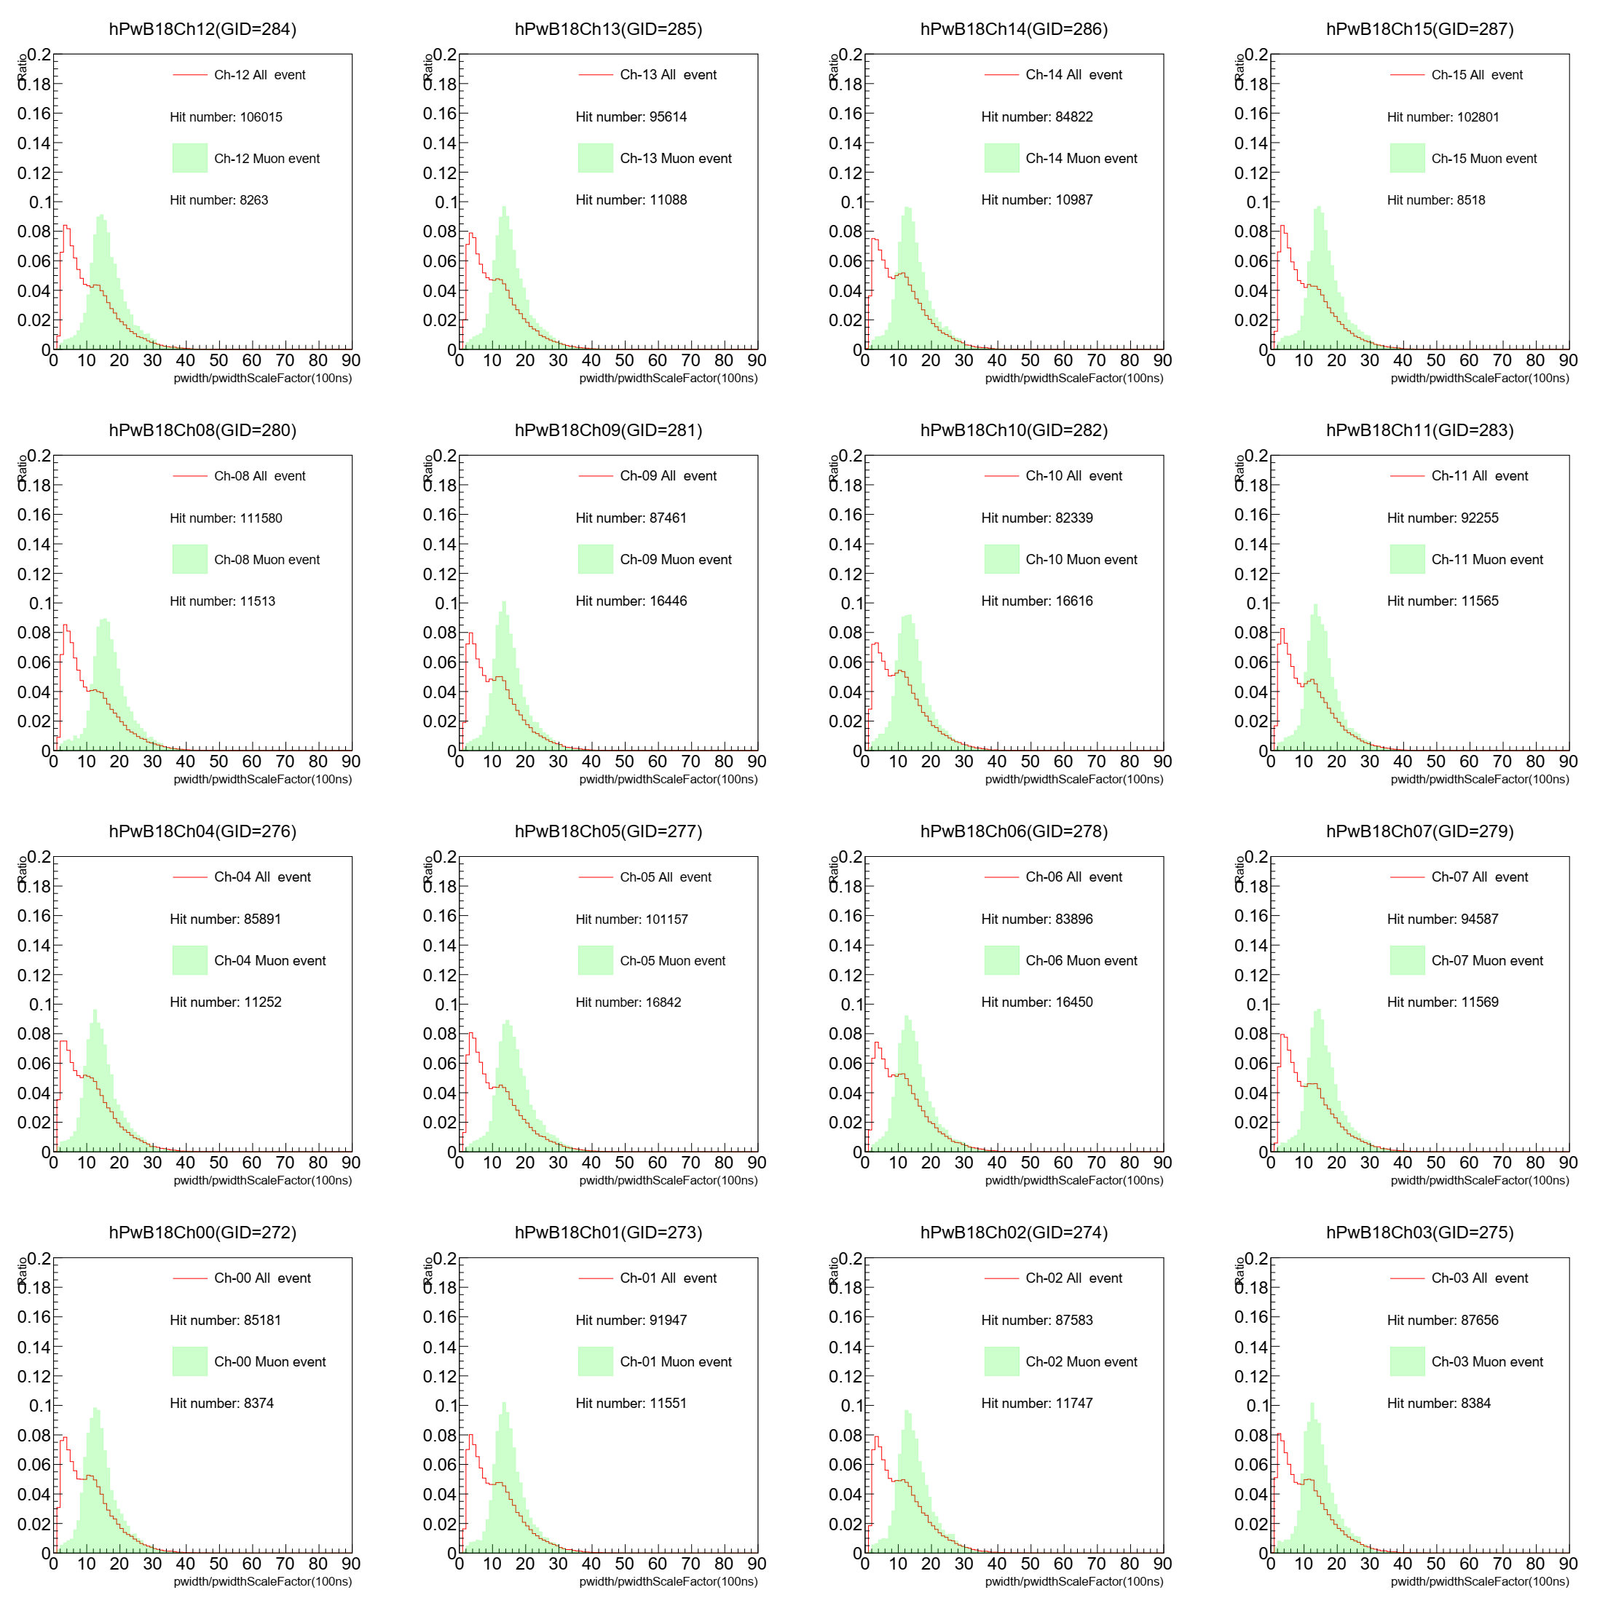
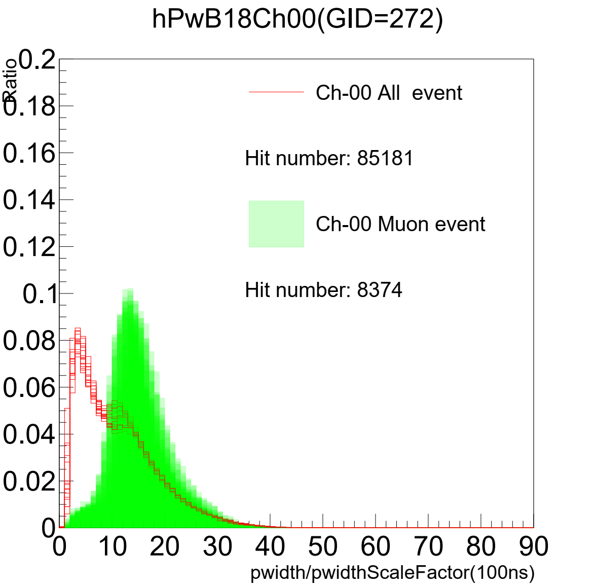
Threshold
8
Take the data with 0˚ zenith angle
Adjusting the threshold of each channel base on the PWidth distribution.
All channels bias with 29.2V
Each channel has different thresholds.

Slide 9
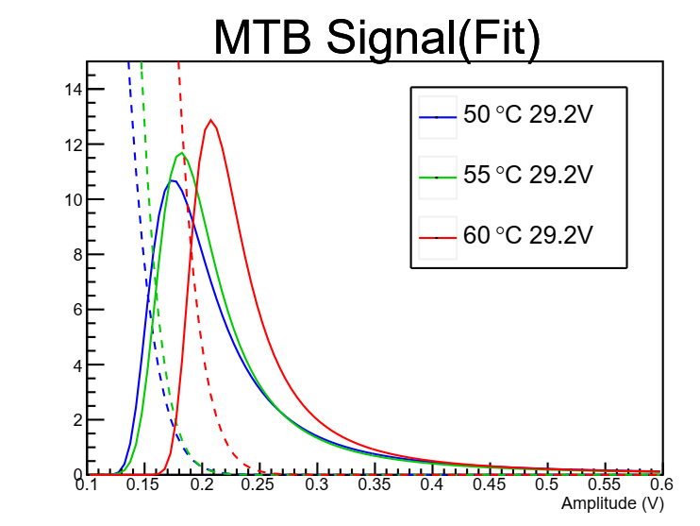
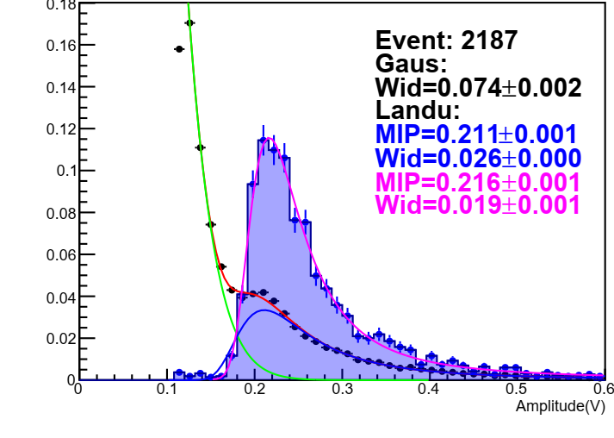
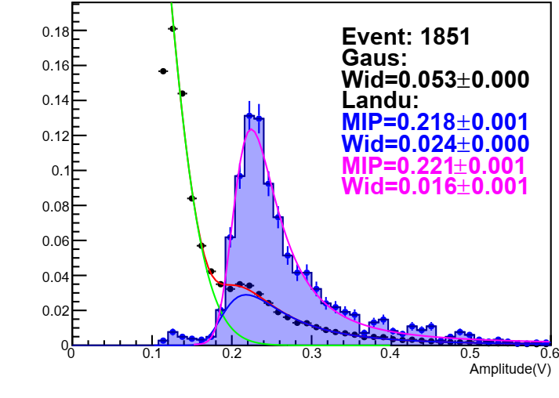
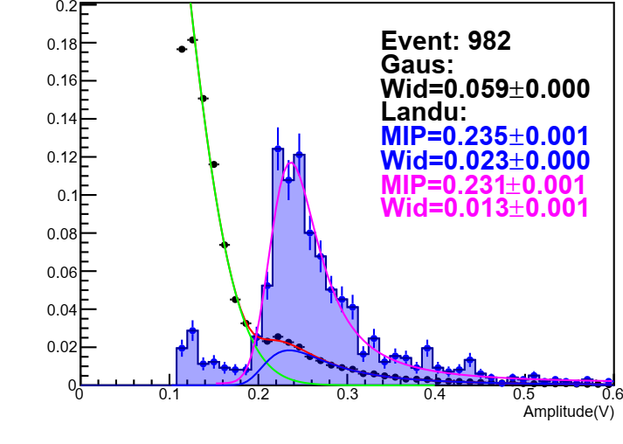
Temperature Testing
9
Fit the amplitude distribution of test module (bottom) and MTB (top) signals at different temperatures.
The pedestal increase with temperature.
Signal is stable when temperature < 55 ⁰C
Test module at 50 ⁰C
Test module at 55 ⁰C
Test module at 60 ⁰C

Slide 10
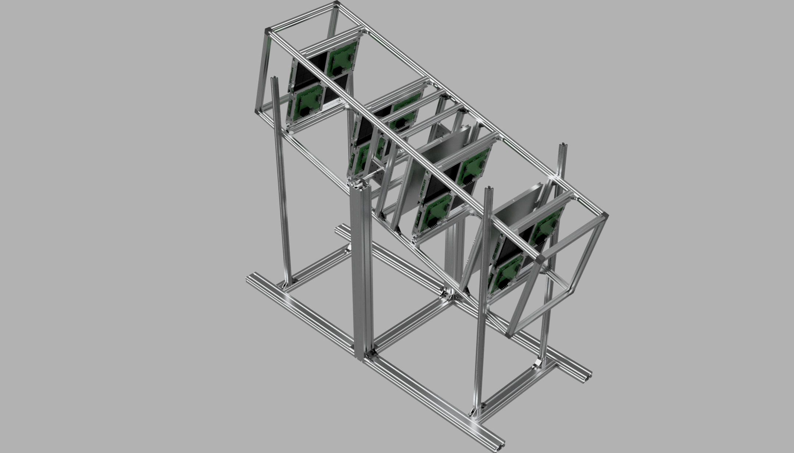
Set Up
50cm
Build with aluminum profile system
Four pillars to fix the zenith angle
Zenith angle : 75.4˚
Detector size : 40cm x 40cm x 150cm
Opening Angle : ±14.93˚
200cm
14.6˚
147~215cm
14.93˚
10

Slide 11
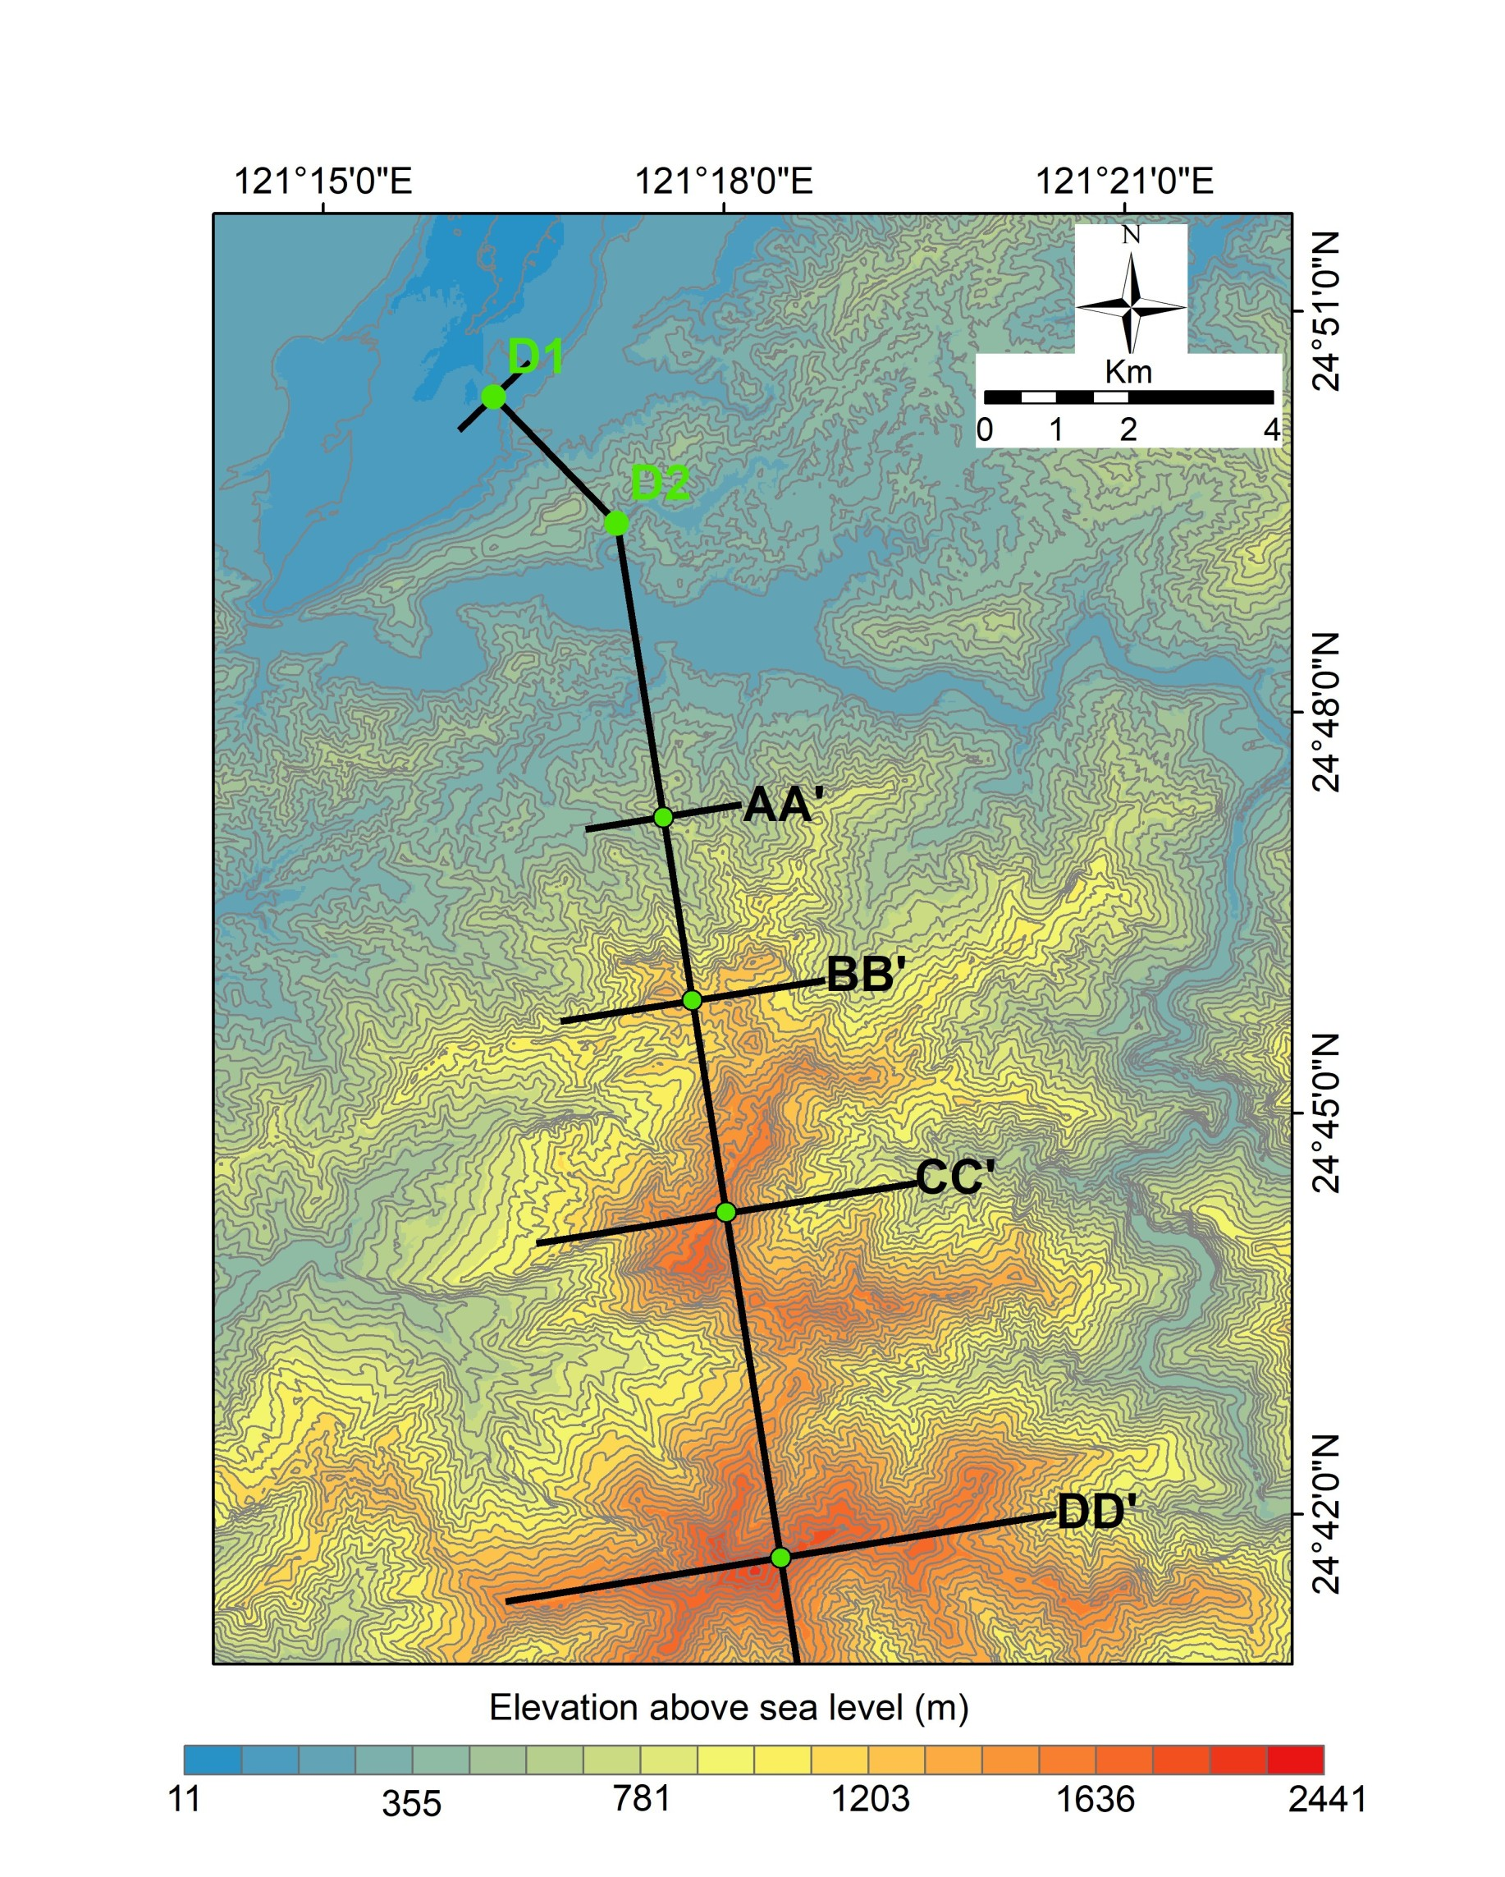
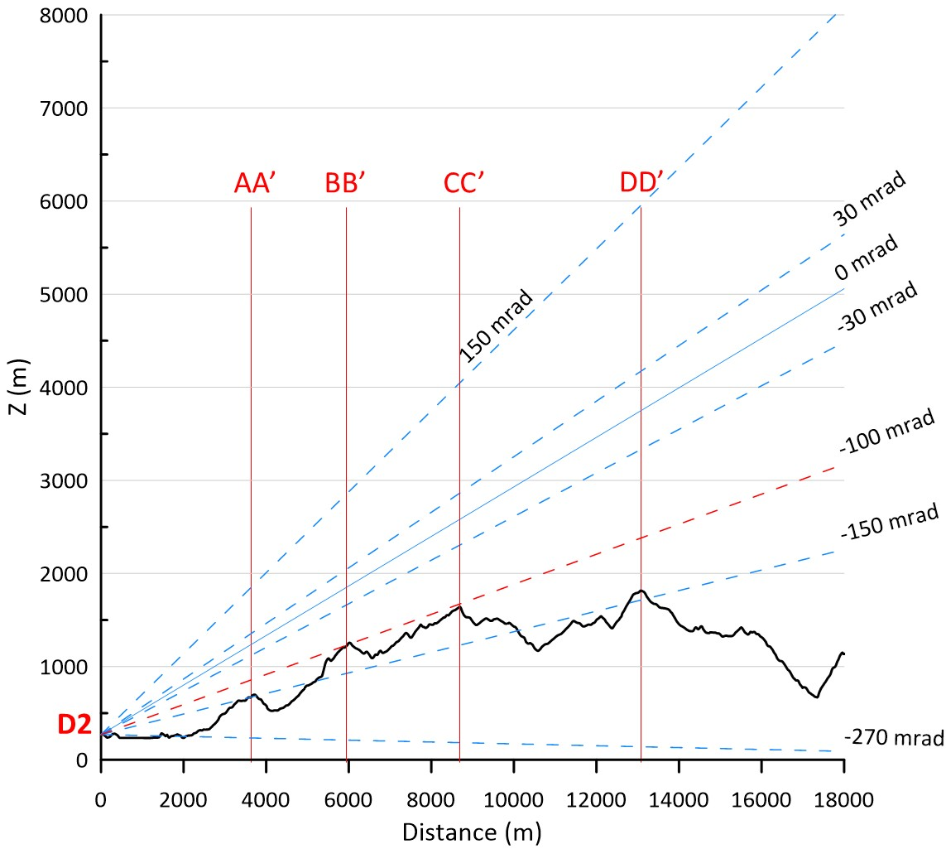
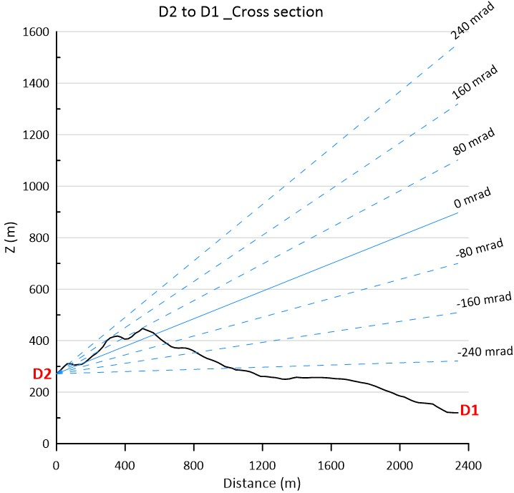
Experimental Location
11
Located at Shimen Reservoir, Daxi region. (D2)
Face to two direction (two step)
  Toward the sky (background)
  Toward the mountain

Slide 12
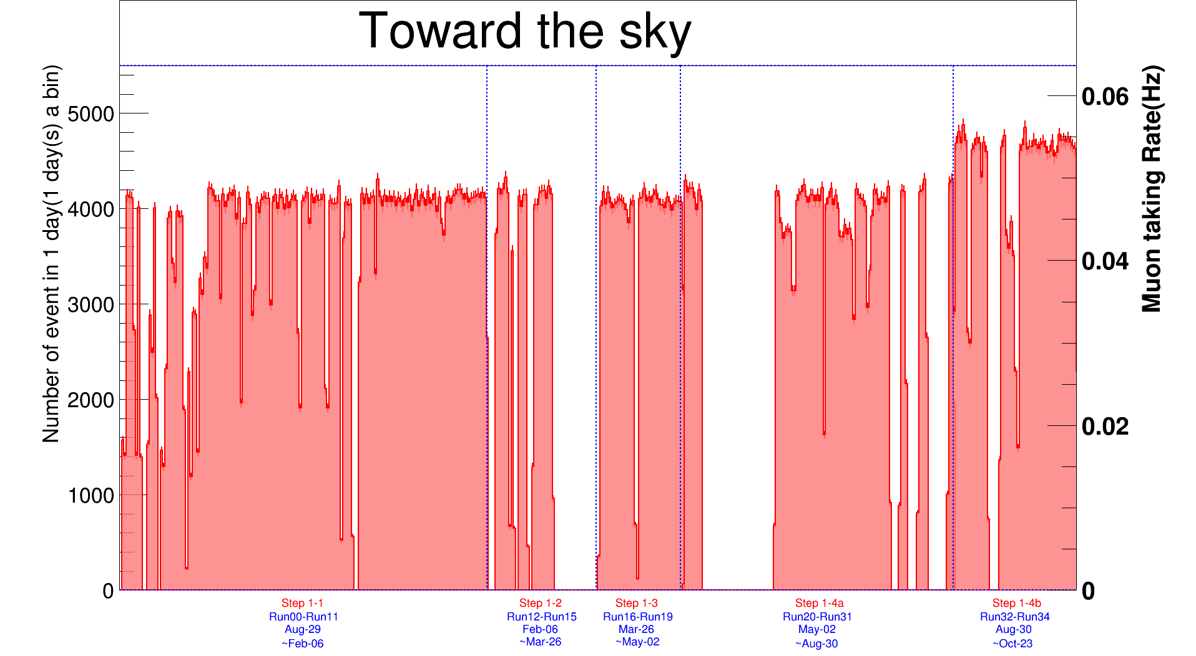
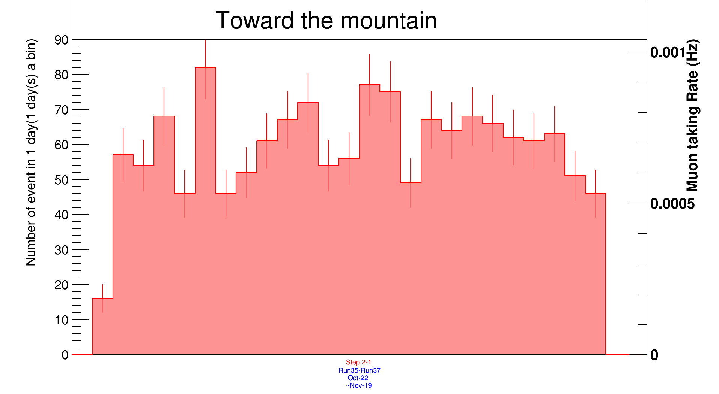
Data Collection
12
Take 1 year of sky data
  4200 events per days
Take 3 weeks of mountain data
  65 events per days
Toward the Sky
Toward the Mountain

Slide 13
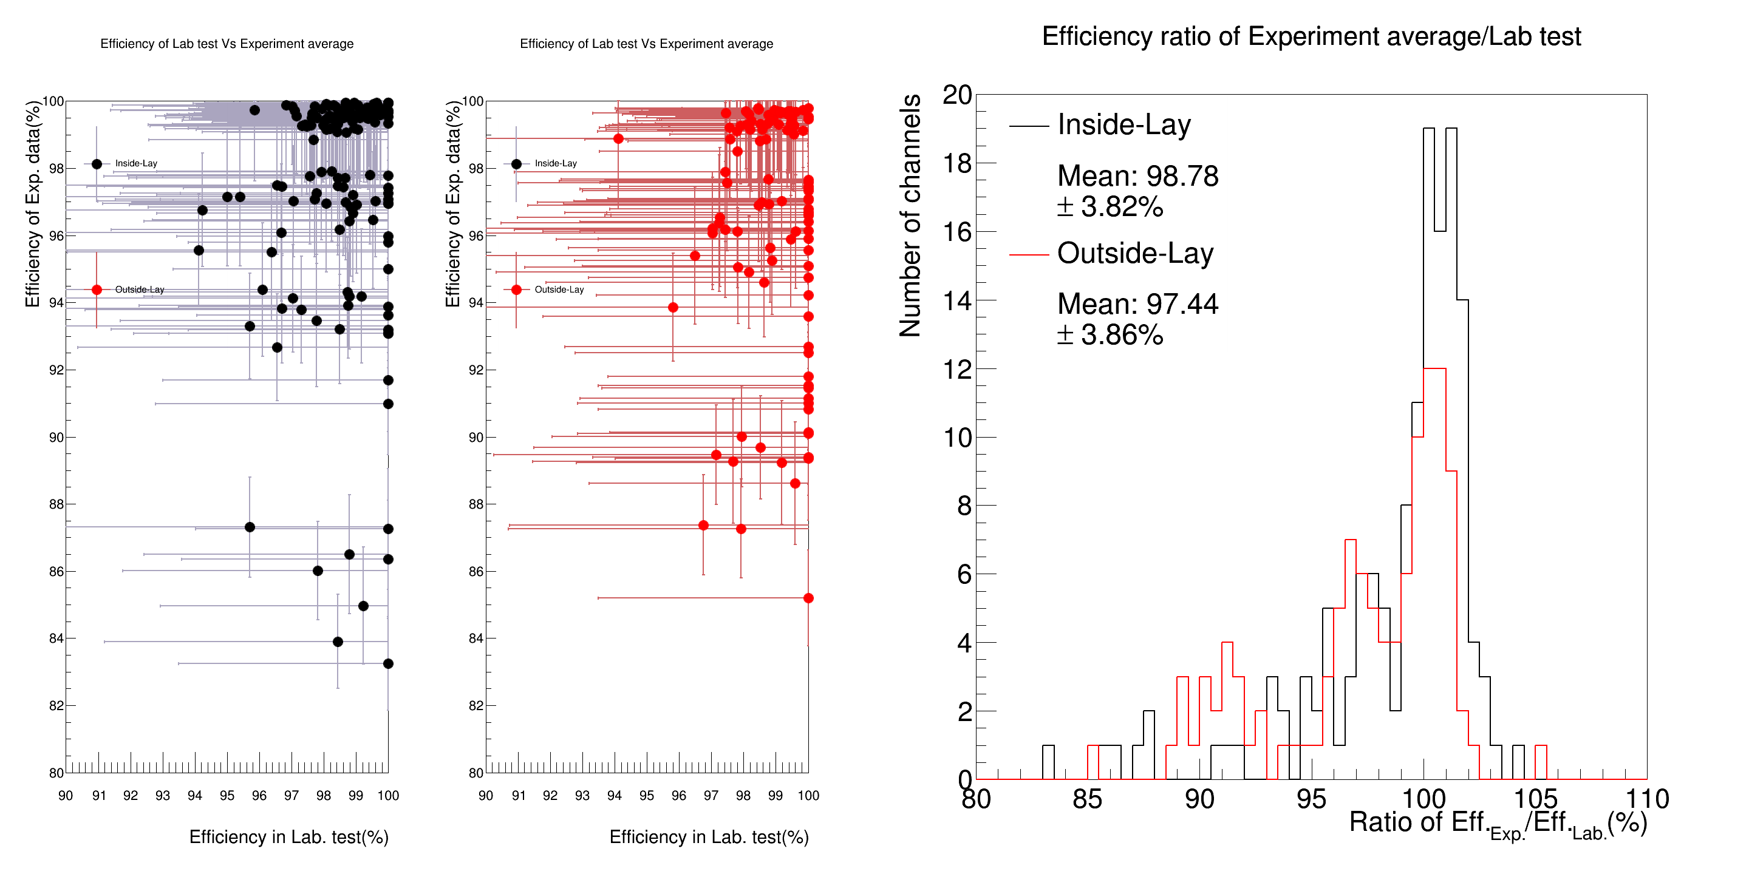
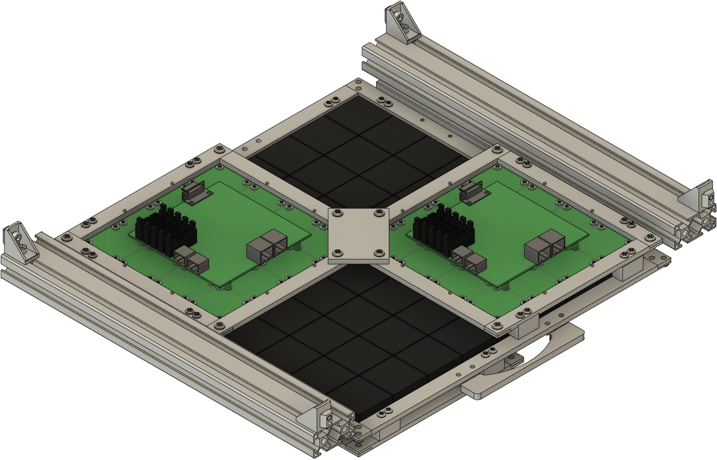
Channel Efficiency
13
Calculate only the track parallel to the z-axis of the detector (vertical incidence)
$Eff.=\frac{4 layers have signals}{Other 3 layers has signals}$

Slide 14
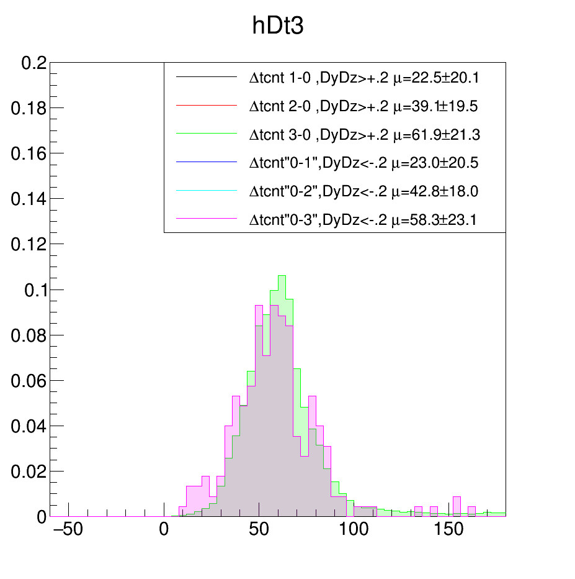
Event Data Selection
14
∆t L4-L1
Define events.
  The different times of all signals need < 300 TCNT
The particles pass through the whole detector
  All layers have a signal
Remove the shower case
  1st and 2nd layer only has one hit.
  3rd and 4th layer < 3 hits.
Restructure the track
  Order all possible trackers with fitting errors
  Compare the four hit channels with the geometry result
1st
2nd
3rd
4th
1hit
1hit
<3hits
<3hits

Slide 15
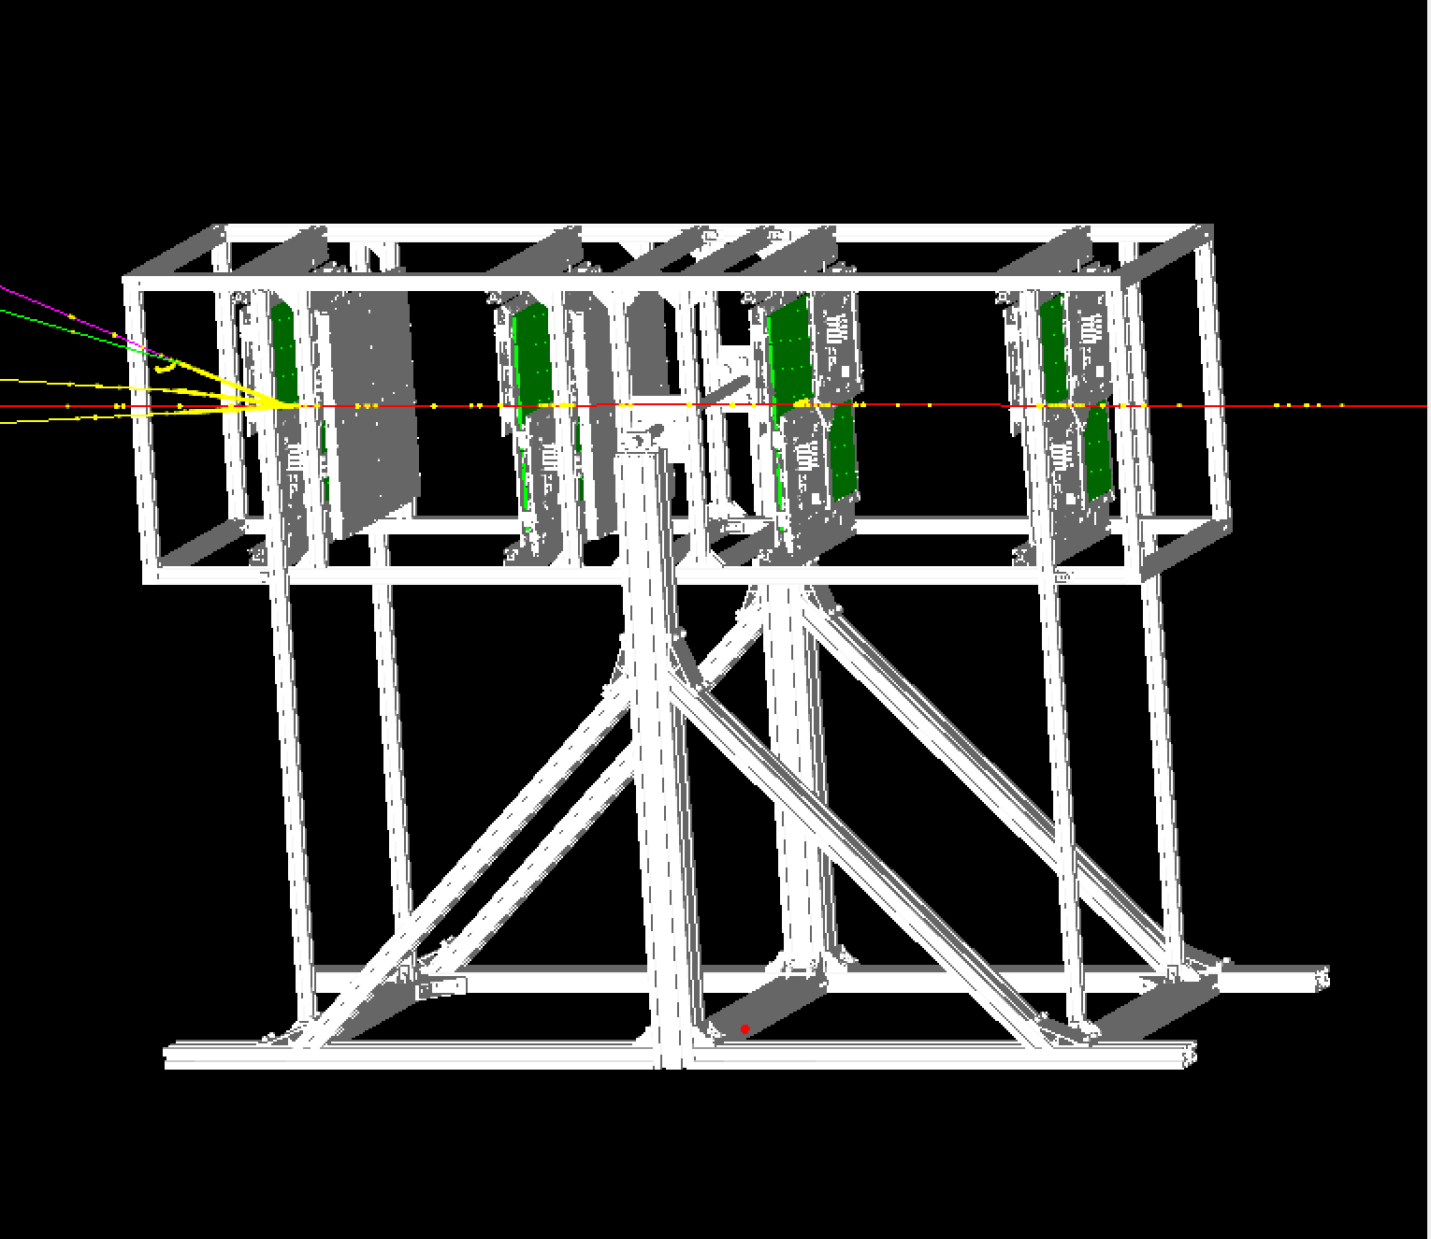
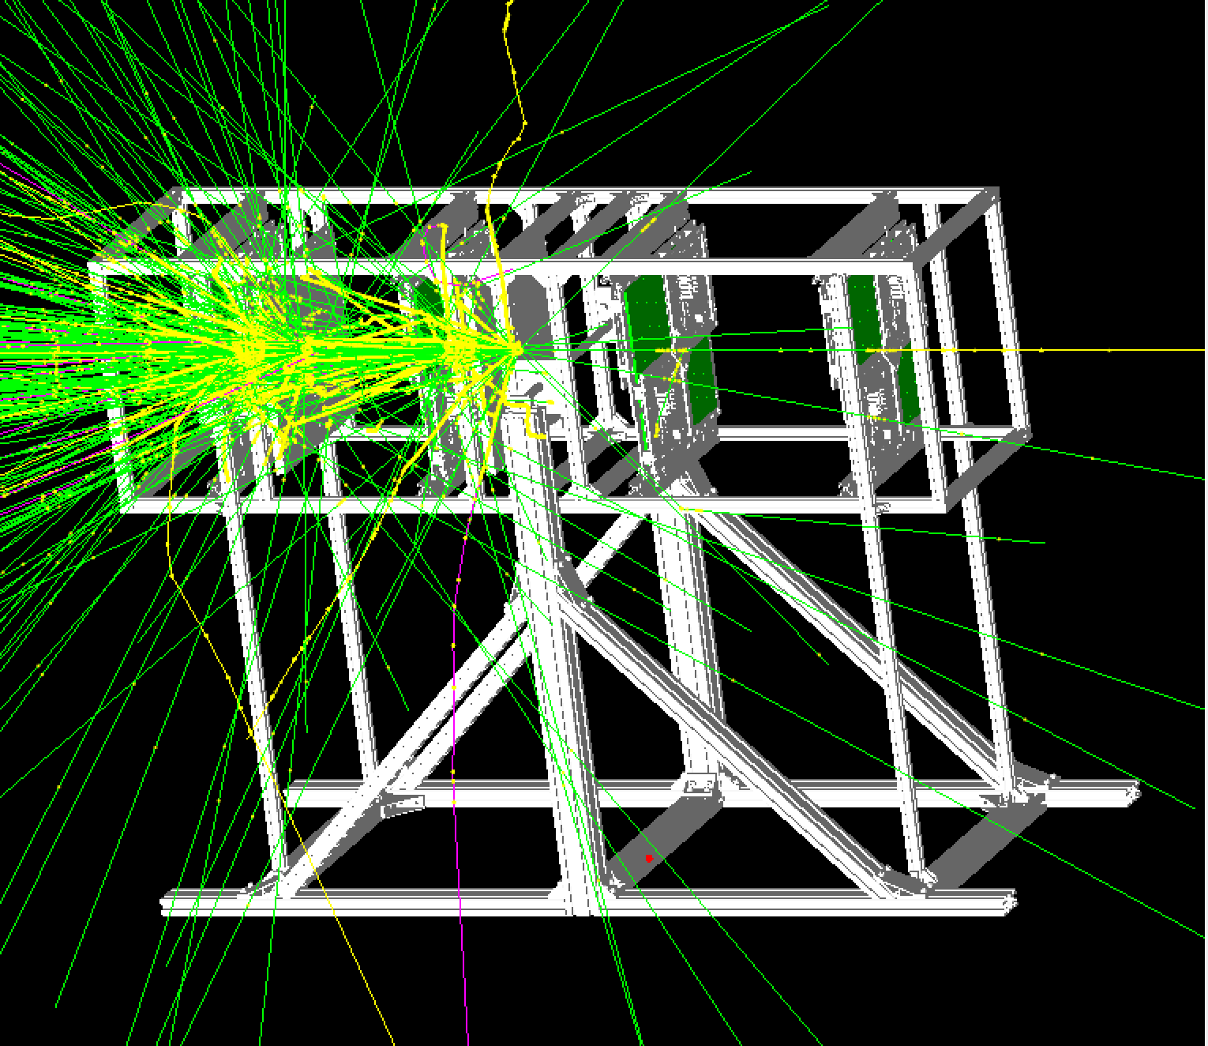
Geant4 Simulation
15
The shower cases of muon and electron in geant4 simulation.
5GeV μ⁻
5GeV e⁻

Slide 16
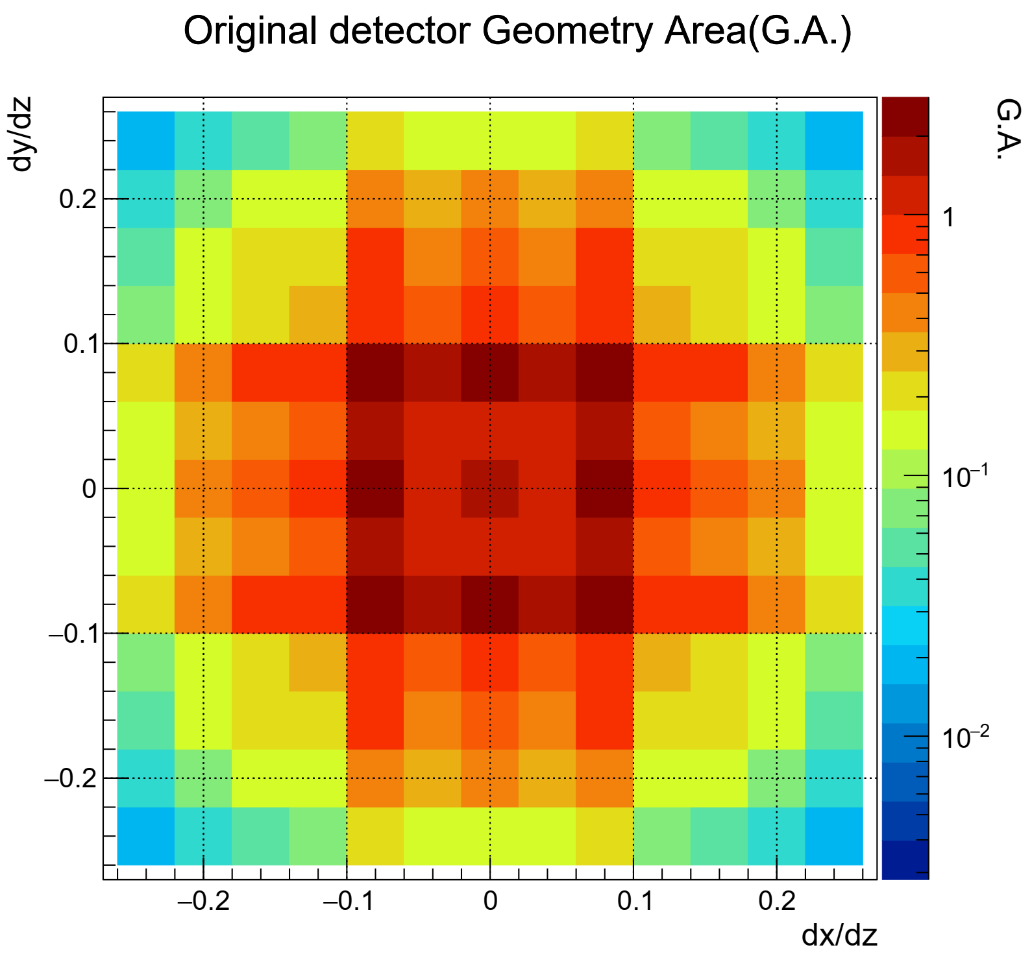
Solid Angles
16
The different combinations of channels (direction) have different solid angles (Ω).
Calculate which straight lines can pass through which channels in different layers.
Calculate a solid angle and center direction for each combination.
Sr

Slide 17
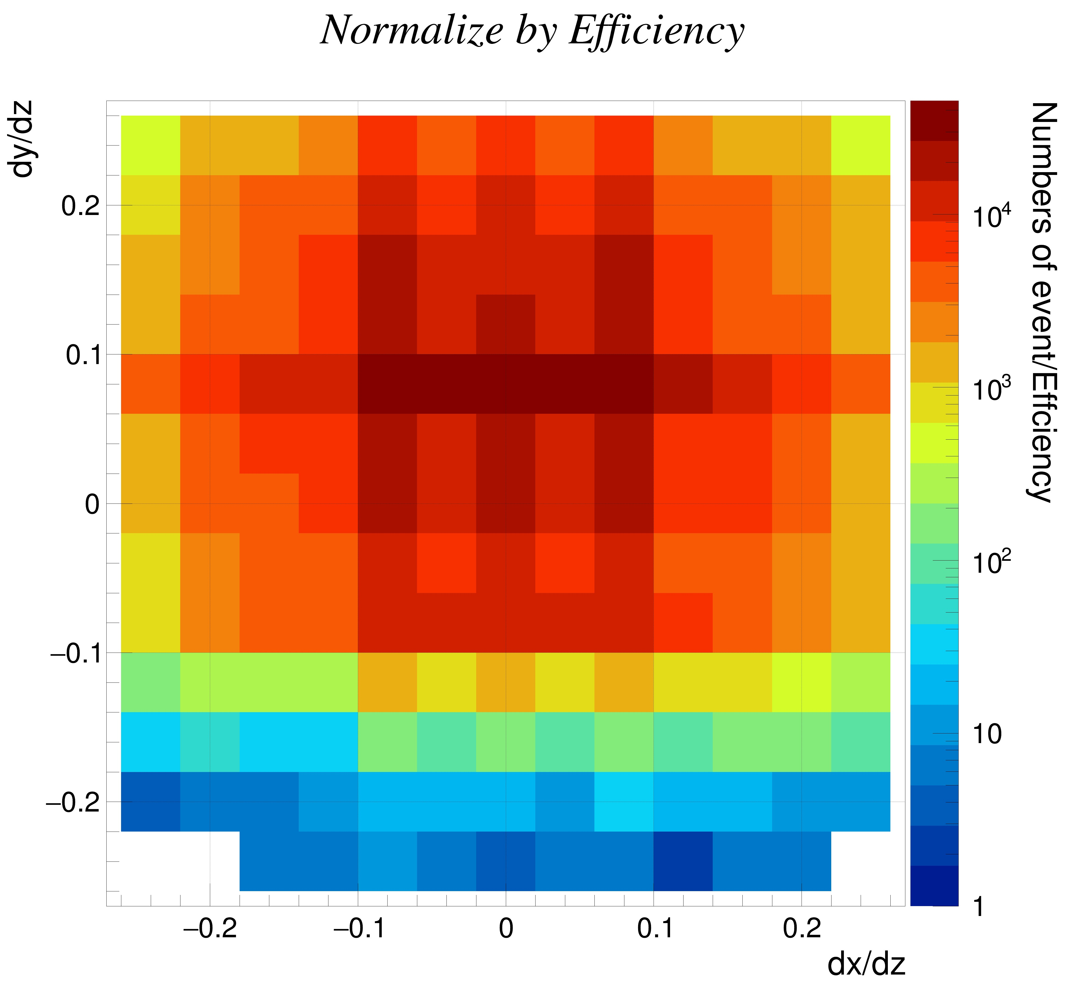
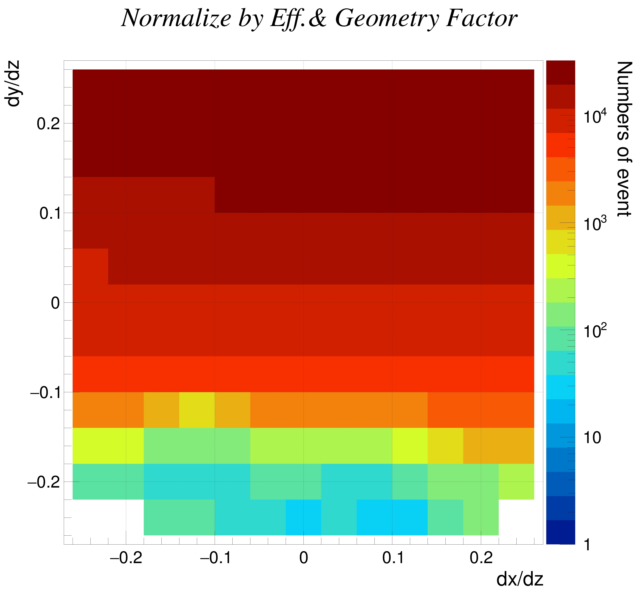
Corrected N_{mu}
17
N_{mu} corrected with efficiencies
N_{mu} corrected with efficiencies and solid angles
Numbers of event/(Efficiency∙cm²∙sr)

Slide 18
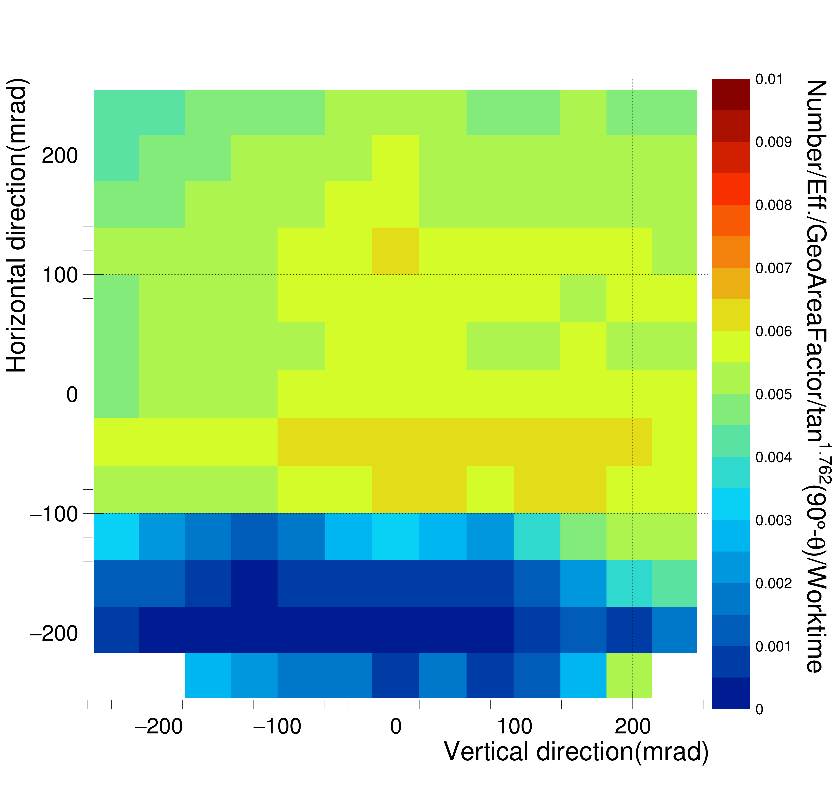
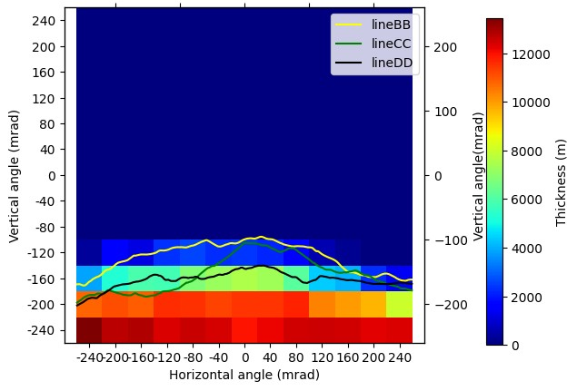
Flux and Thickness for Sky Direction
18
Left : N_{mu} corrected by the angular effect and divide by the time to obtain the muon flux.
  Right : The thickness of the mountain
Muon flux
Mountain Thickness (D2 to DD)
N_{μ}/(Efficiency∙cm²∙sr∙s∙tan(90˚-θ)^{1.76})

Slide 19
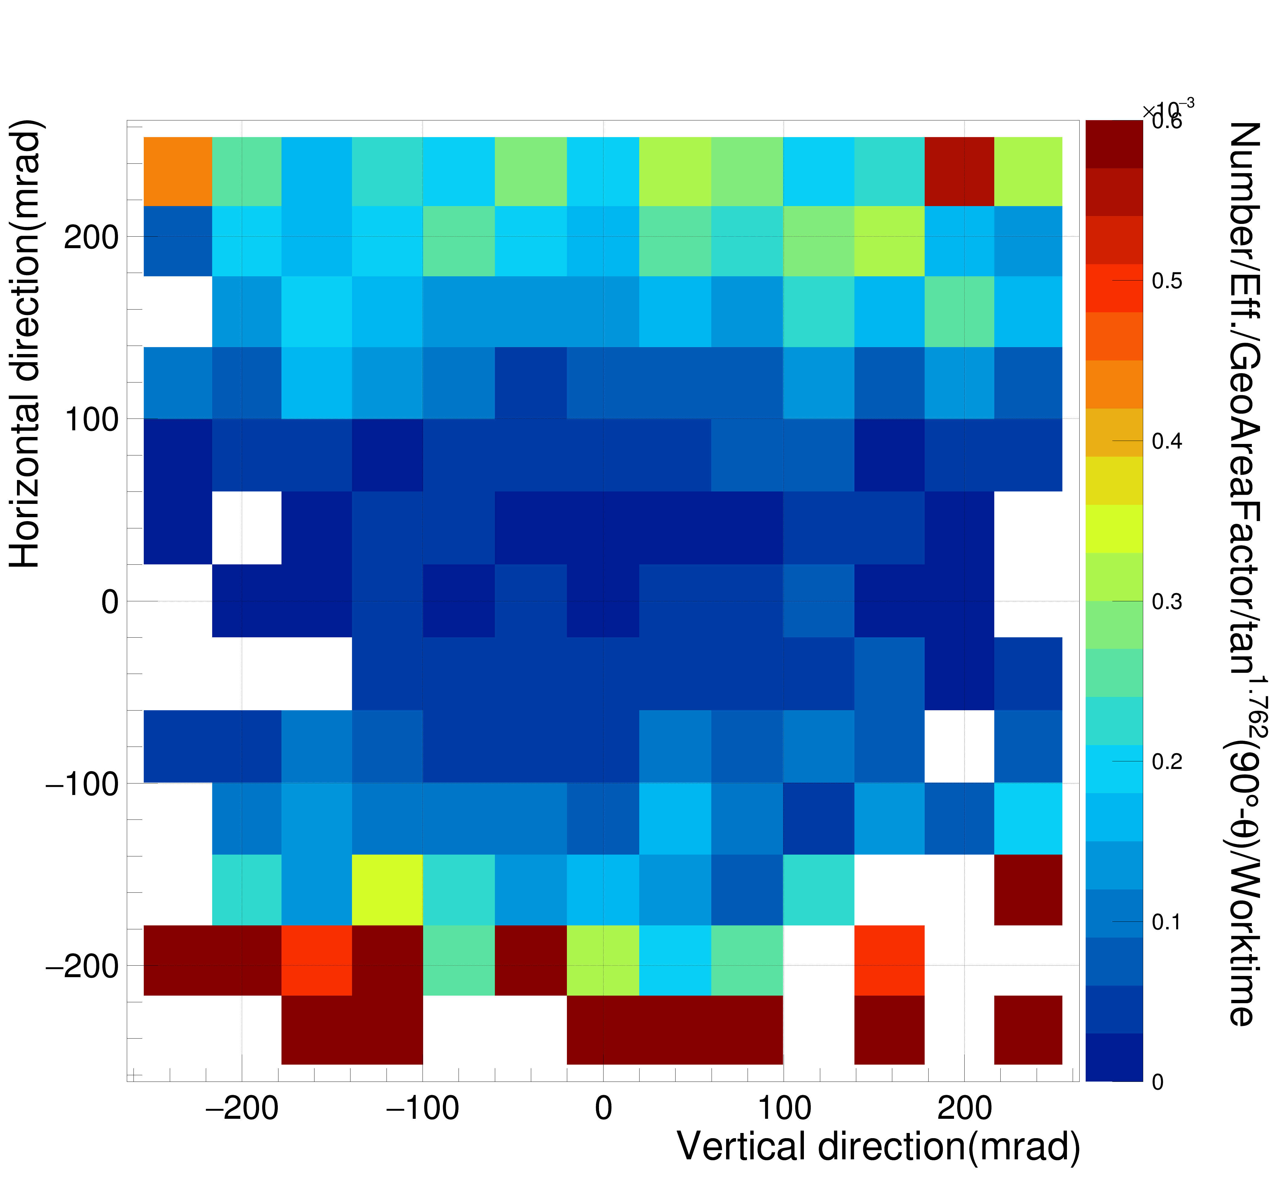
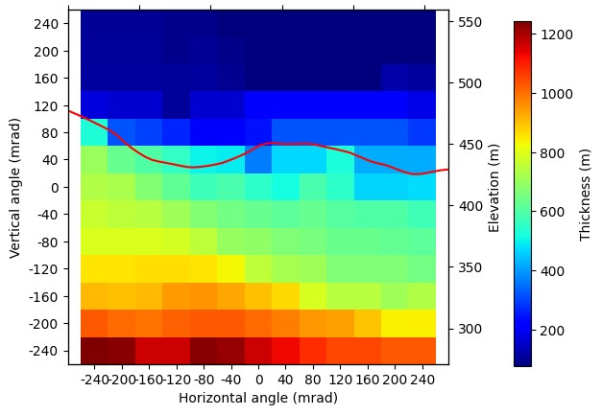
Flux and Thickness for Mountain Direction
19
Muon flux
Mountain Thickness
N_{μ}/(Efficiency∙cm²∙sr∙s∙tan(90˚-θ)^{1.76})

Slide 20
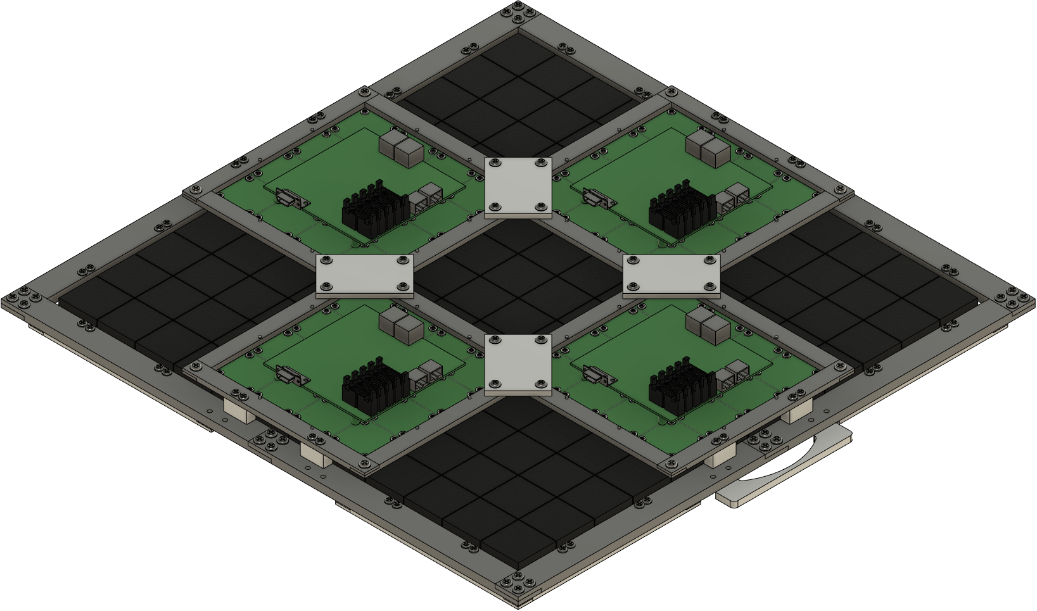
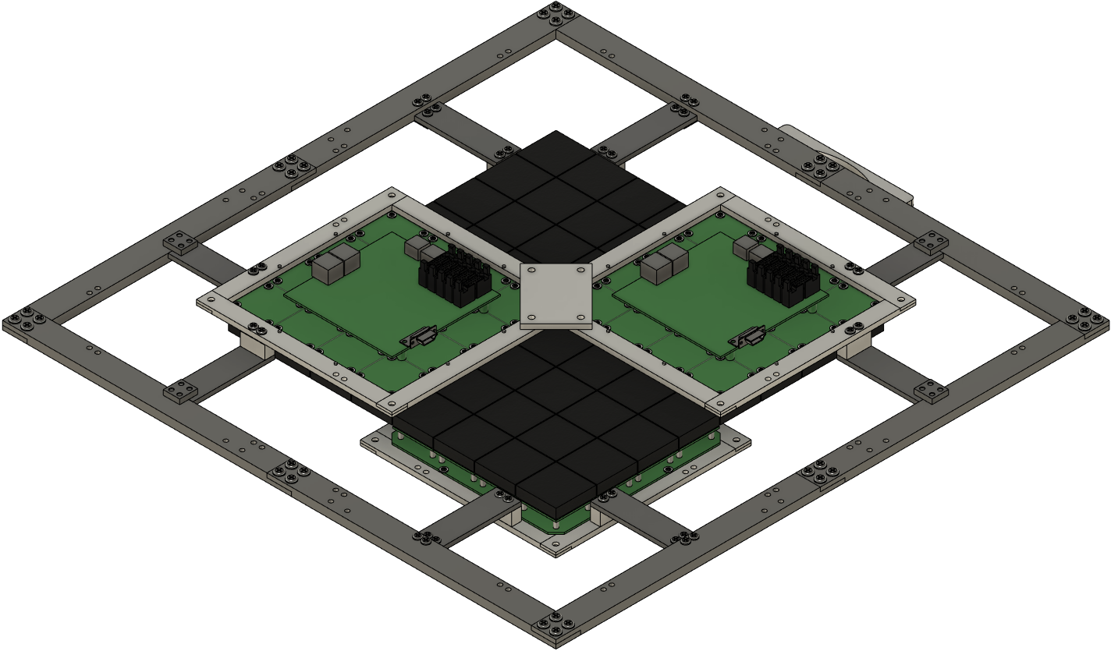
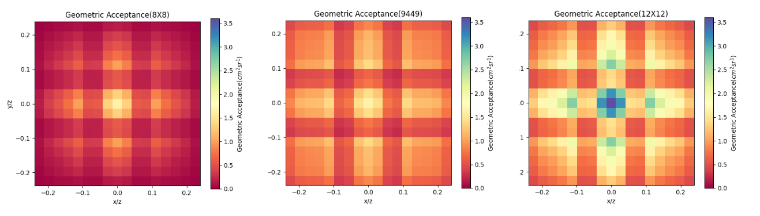
Upgrade Plan
20
8*8 ch
4*MTB
12*12 ch
9*MTB
8*8 ch
4*MTB
8*8 ch
4*MTB
8*8 ch
4*MTB
8*8 ch
4*MTB
8*8 ch
4*MTB
12*12 ch
9*MTB
4-4-4-4
9-4-4-9
9-9-9-9

Slide 21
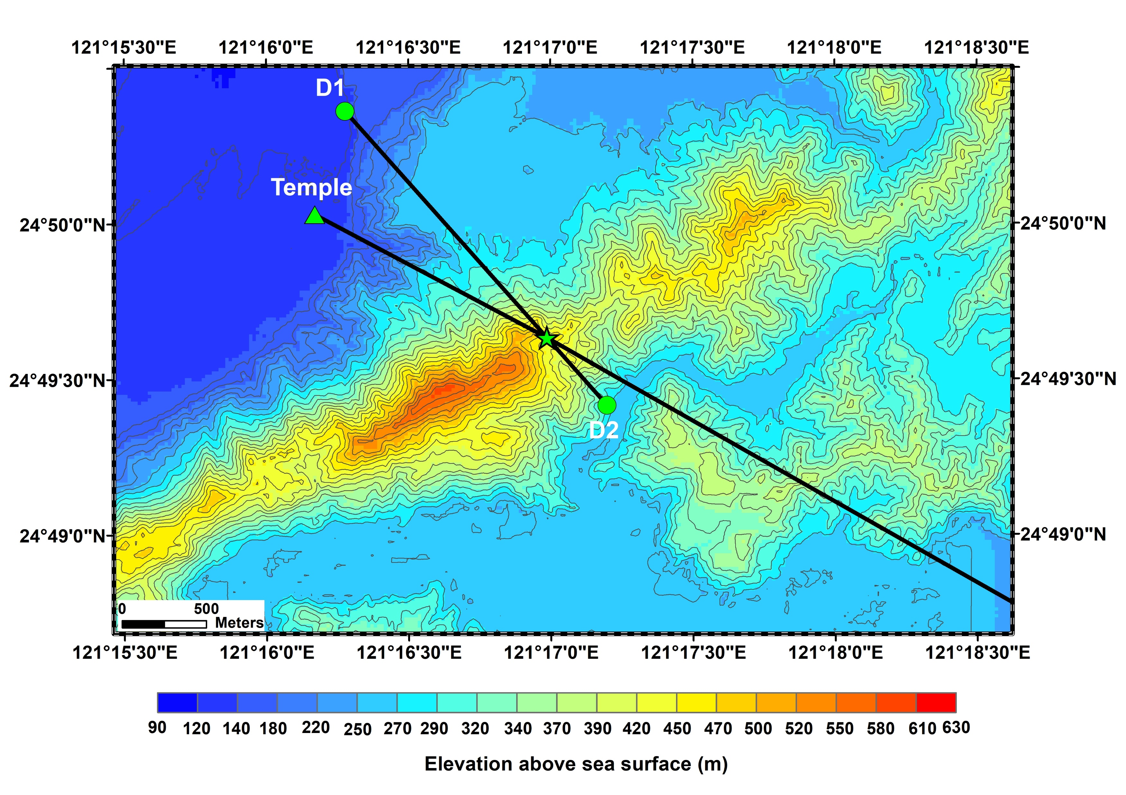
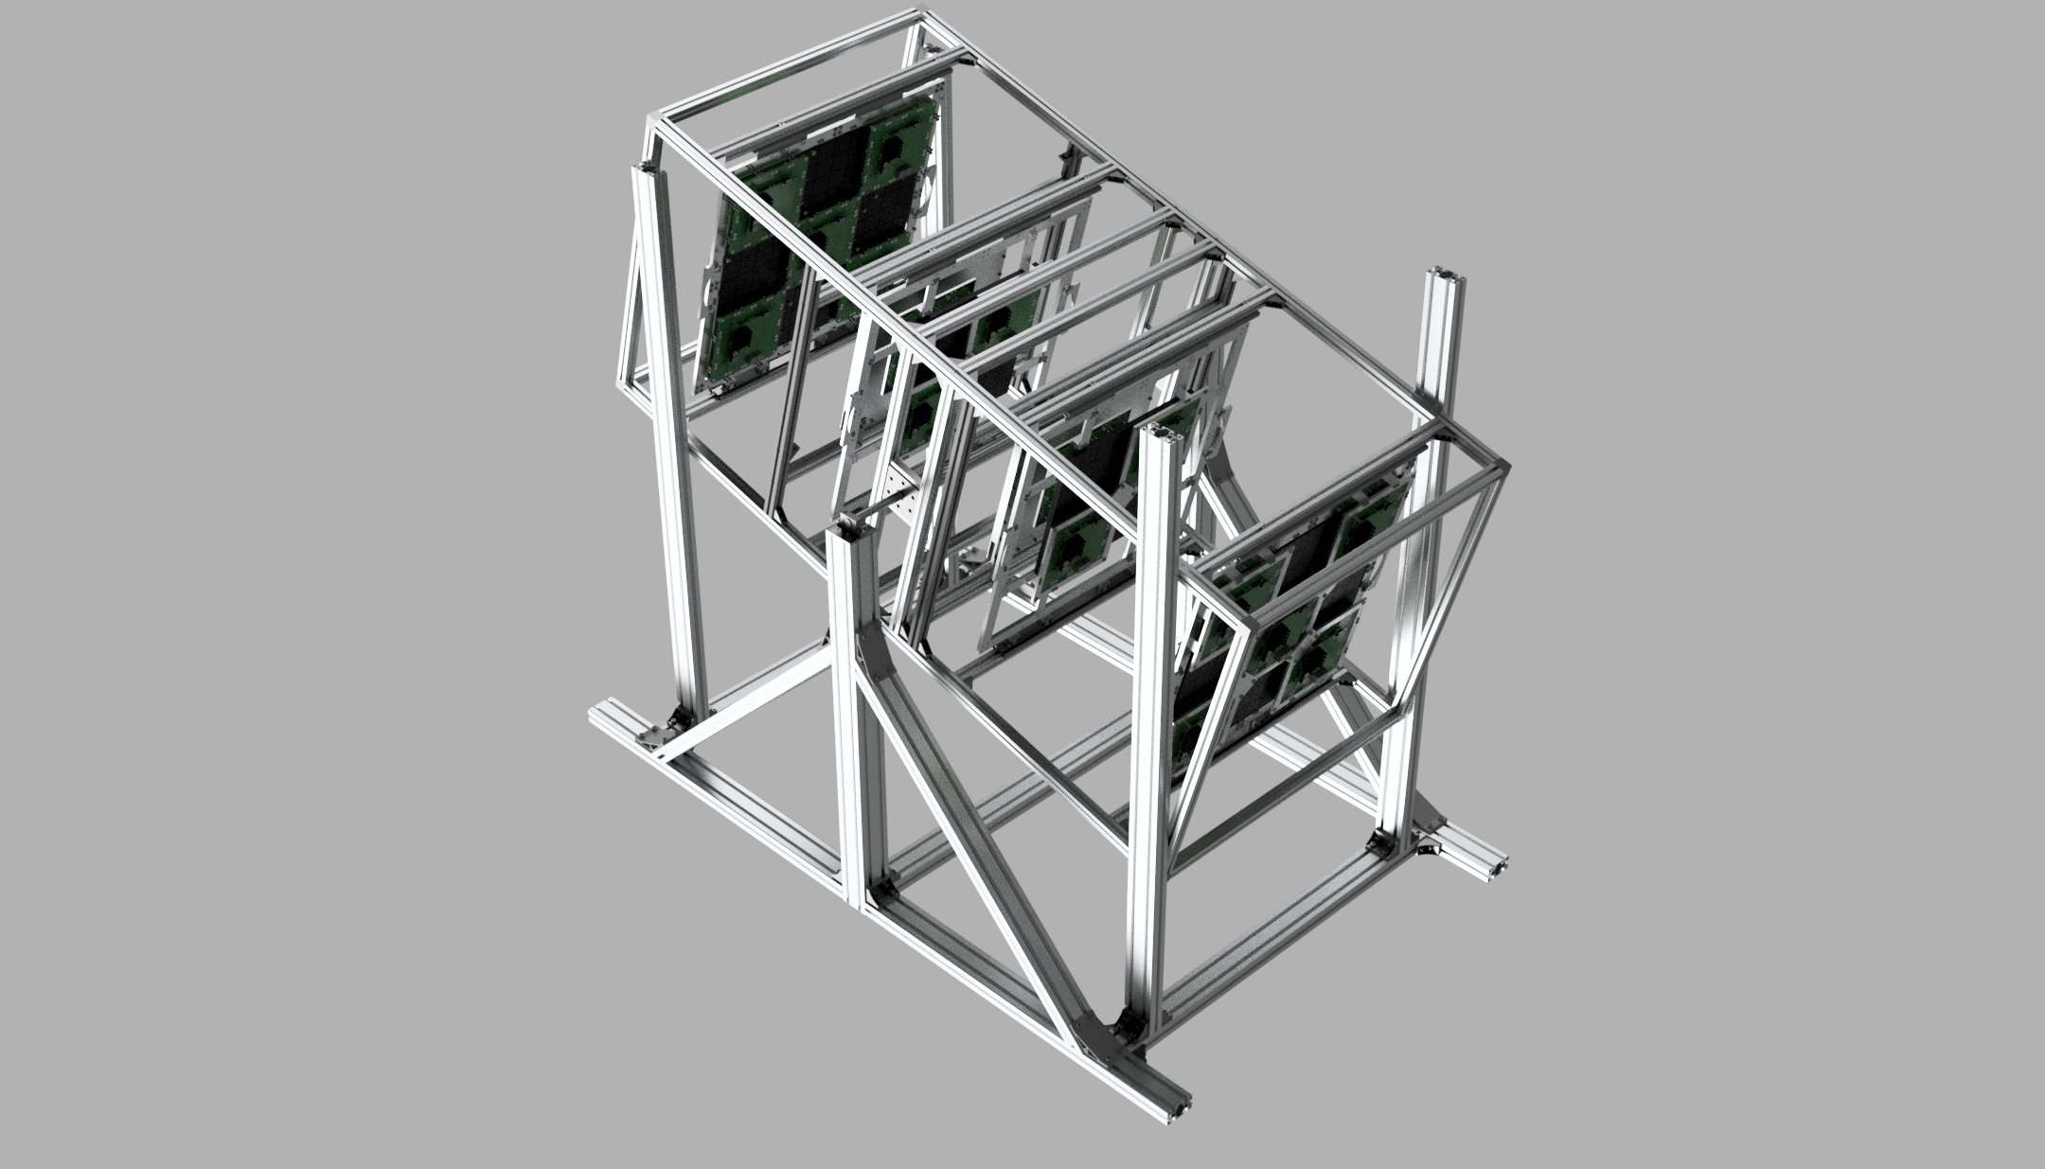
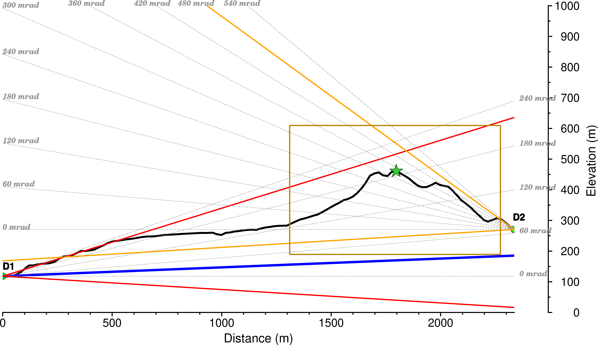


Upgrade Plan
21
D3
The second detector is being constructed.
It will be installed in the D3 location.
The view angle of 10$°$ from a D3
30$°$

Slide 22
Summary
22
The muons flux of toward the sky shows the background pattern and clear mountain shape.
There are ~4500 events per day for toward the sky, and ~65 events per day for toward the mountain.
We expect to obtain <10% tolerance of muons flux at central region for toward the mountain after a few months.
In the Future
Make the solid angles more uniform to increase the resolution of the periphery region.
The new detector will be tested at NCU to toward the sky or the building first. Then, it will be installed at new location of Daxi to obtain two dimension muons flux of mountain.
More complete Geant4 simulation comparison.

Slide 23
Back up

Slide 24
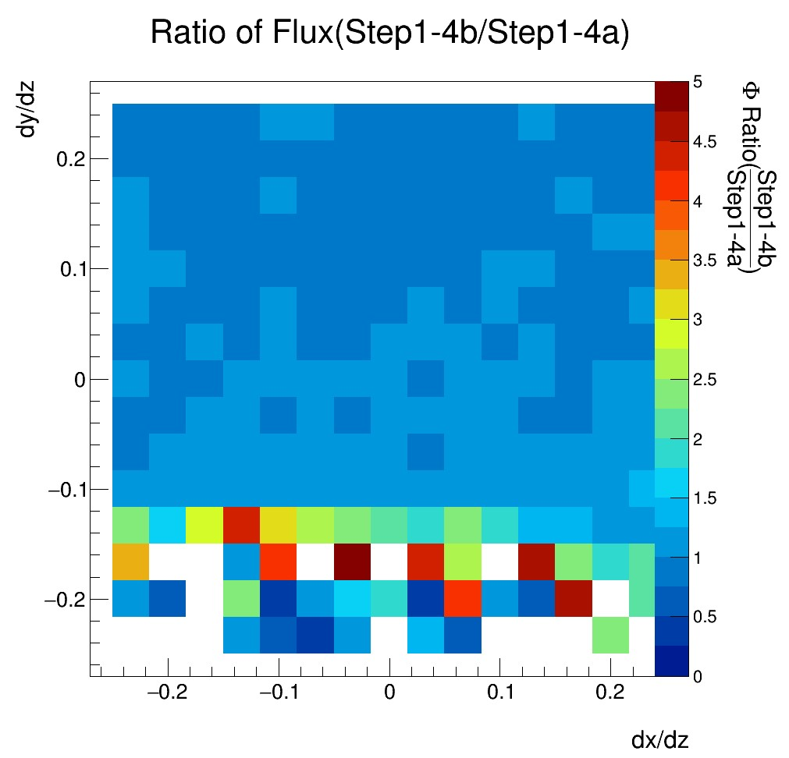
Flux Ratio in Different Time
24
Step1-4a
1-4b

Slide 25
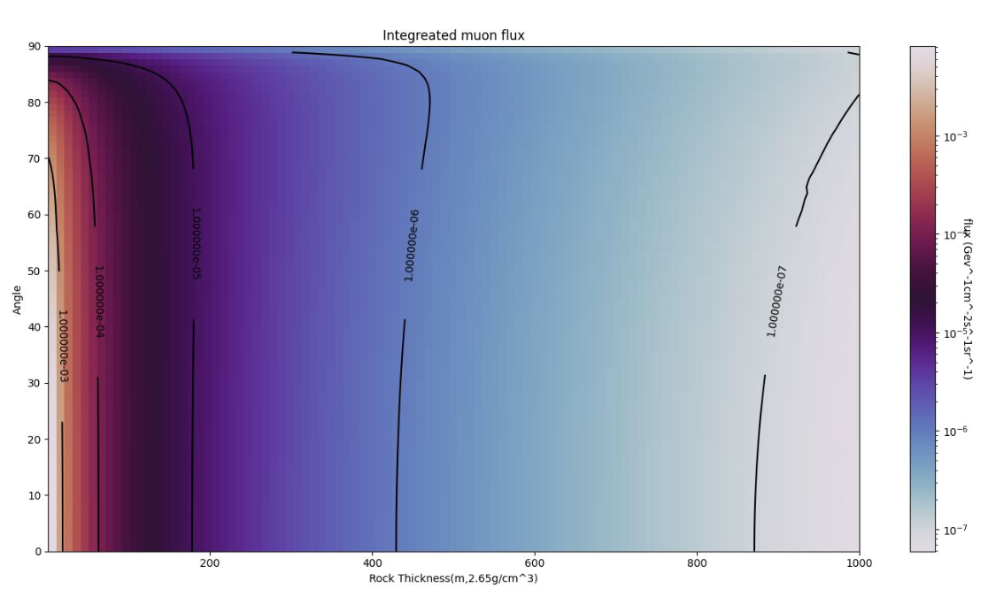
Muon Flux of different Thickness
25
The flux variation with passing rock thickness is expected based on the muon energy distribution and energy loss.

Slide 26
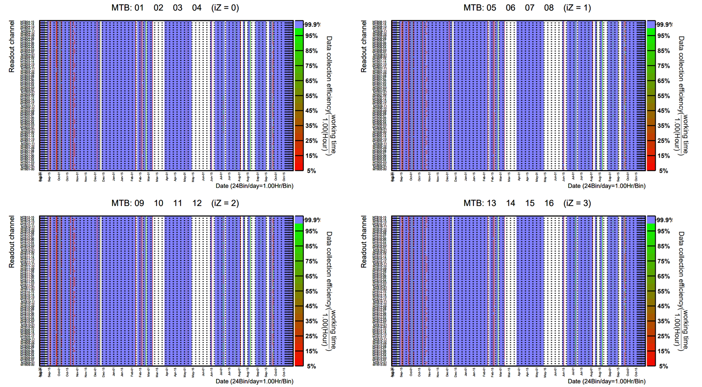
Collection Efficiency
26

Slide 27
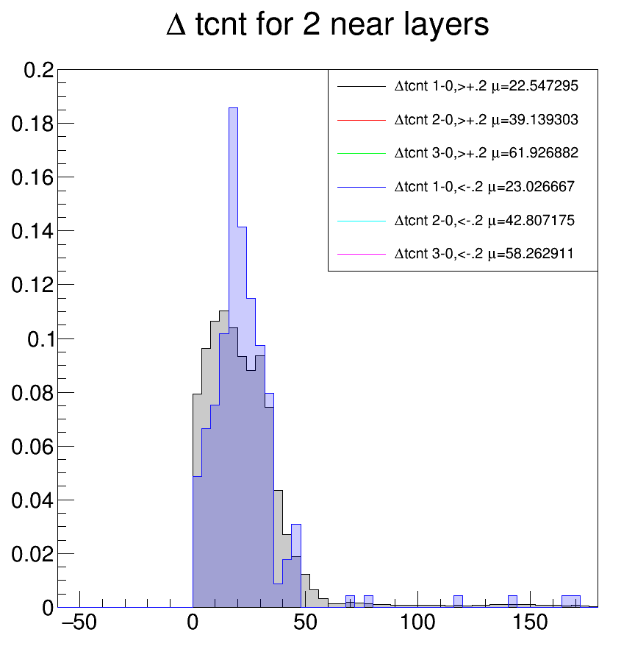
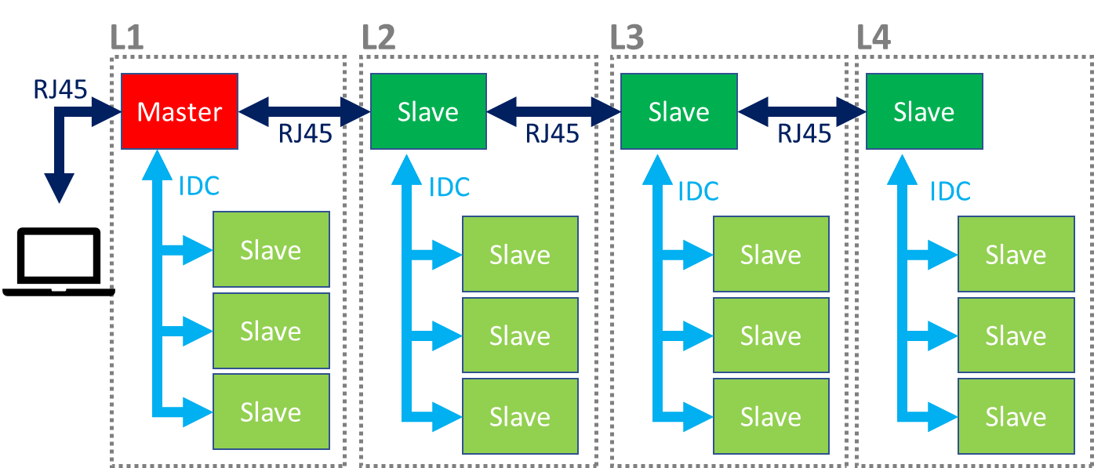
∆t L2-L1
27

Slide 28
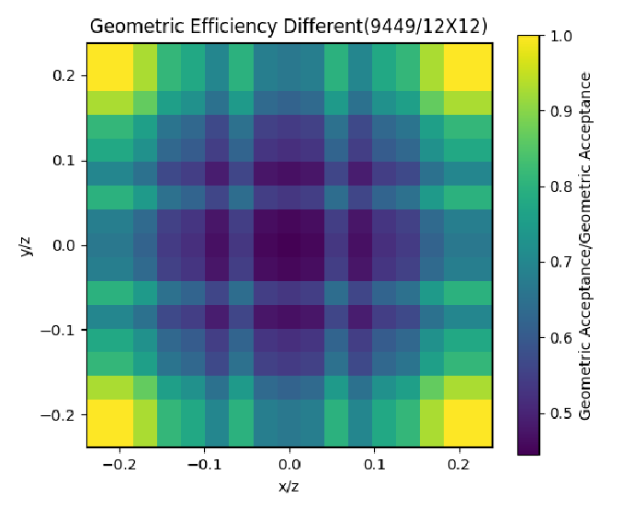
Upgrade Plan
28
8*8 ch
4*MTB
12*12 ch
9*MTB
8*8 ch
4*MTB
8*8 ch
4*MTB
8*8 ch
4*MTB
8*8 ch
4*MTB
8*8 ch
4*MTB
12*12 ch
9*MTB
9-4-4-9
9-9-9-9
9-4-4-9/9-9-9-9

Slide 29
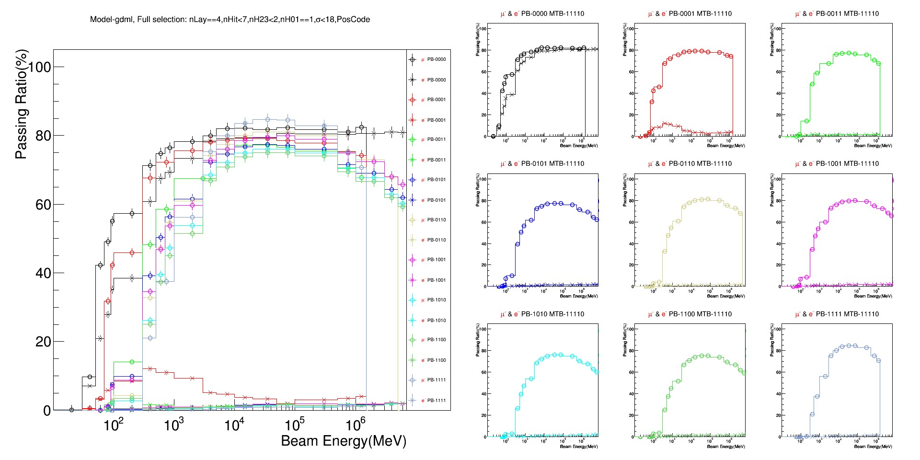
Lead Layers (G4 Simulation)
29
Simulation of different energies of muons and electrons injected to different setup
  0000 - No lead layers
  0001 - One lead layer in last layer
  0011 - Two lead layers in last two layers
  1111 - Four lead layers
O : μ⁻
X : e⁻

