Slide 1
Implementing JPA in the TASEH Axion Detection Chain
洪偉晟 (Wei-Cheng Hung),張景陽 (Jing-Yang Chang)
Advisor : 陳永富(Yung-Fu Chen), 張元翰(Yuan-Hann Chang)
JPAs team ,Low Temperature Physics Lab, NCU
Taiwan Axion Search Experiment with Haloscope, NCU&AS

Slide 2
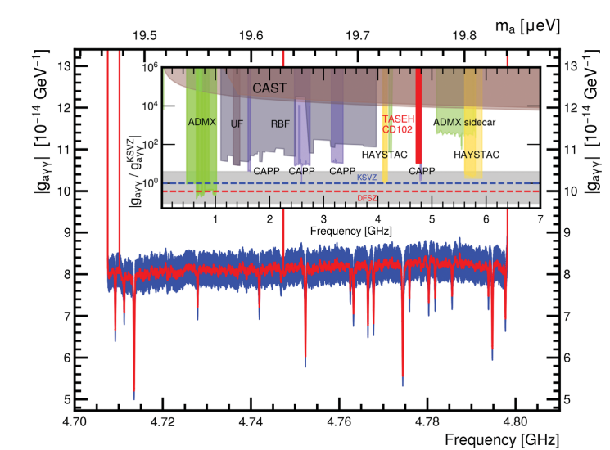
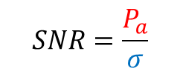
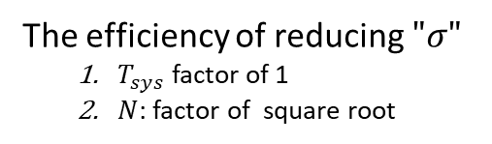
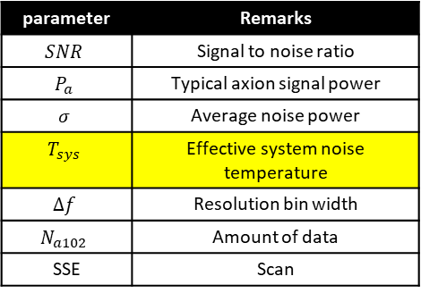


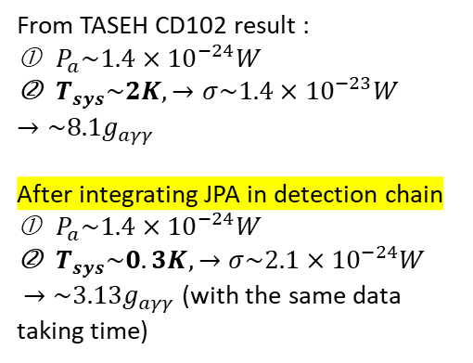
Axion Detecting Sensitivity
Cavity & Magnet
parameter | Remarks
$$SNR$$ | Signal to noise ratio
$$P_{a}$$ | Typical axion signal power
$$σ$$ | Average noise power
$$T_{sys}$$ | Effective system noise temperature
$$∆f$$ | Resolution bin width
$$N_{a102}$$ | Amount of data
SSE | Scan
$$P_{a}=\left(g_{aγγ}^{2}\frac{ℏ^{3}c^{3}ρ_{a}}{m_{a}^{2}}\right)×{(ω}_{c}\frac{1}{μ_{0}}B_{0}^{2}{VCQ}_{L}\frac{β}{1+β})$$
$$SNR=\frac{P_{a}}{σ}$$
$$σ=\frac{k_{B}T_{sys}∆f}{SSE\sqrt{N}}$$
JPA & data taking strategy
From TASEH CD102 result :
$P_{a}\sim 1.4×{10}^{−24}W$
$T_{sys}\sim 2K,→σ\sim 1.4×{10}^{−23}W$
$$→\sim 8.1g_{aγγ}$$
After integrating JPA in detection chain
$P_{a}\sim 1.4×{10}^{−24}W$
$T_{sys}\sim 0.3K,→σ\sim 2.1×{10}^{−24}W$
$→\sim 3.13g_{aγγ}$ (with the same data taking time)
The efficiency of reducing $"σ"$
  $T_{sys}$ factor of 1
  $N$: factor of square root
Hsin Chang et al, Phys. Rev. Lett. 129, 111802 (2022)
Notes:
To explore the importance of the parametric amplifier is, we start from the axion detecting sensitivity. The axion sensitivity are proportional to the SNR. To improve the SNR, we commence from two parts . The design of the cavity try to enhance the signal power received by the cavity. The denominator determine by the system noise power. The JPA is the device can significantly reduce the system noise by reasonable gain and quantum limited add noise.

Slide 3
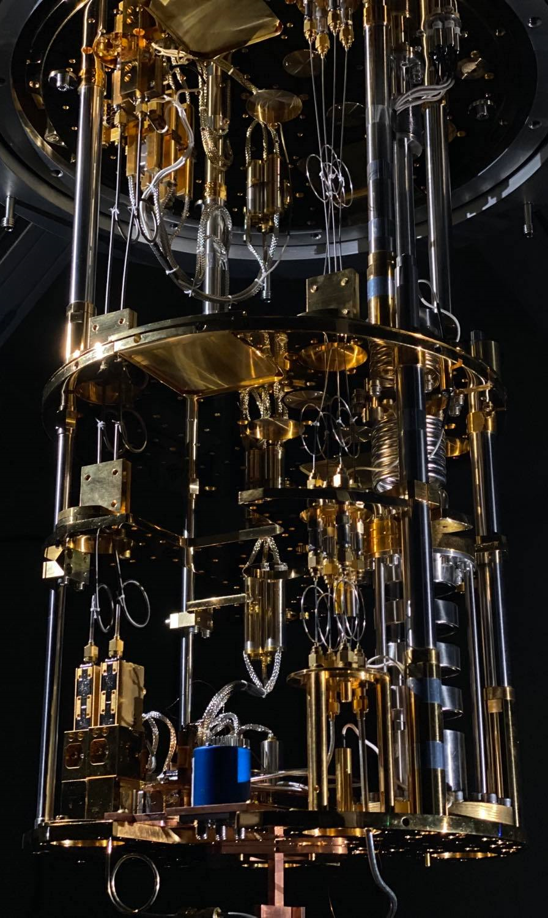





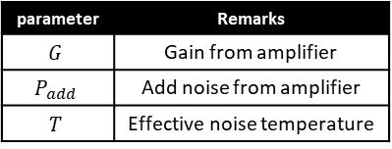
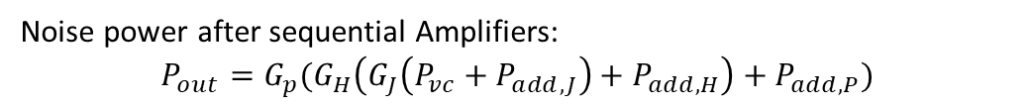







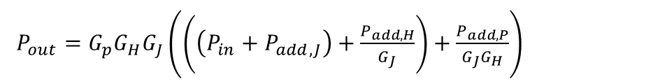
Noise in Amplification/Detection Chain
$$P_{add,J}$$
$$P_{add,H}$$
$$P_{add,P}$$
$$P_{out}$$
$$P_{in}$$
JPAs
HEMT
post
post
post
$$G_{J}$$
$$G_{H}$$
$$G_{P}$$
$$20mK$$
$$4K$$
$$RT$$
Noise power after sequential Amplifiers:
$$P_{out}=G_{p}(G_{H}\left(G_{J}\left(P_{vc}+P_{add,J}\right)+P_{add,H}\right)+P_{add,P})$$
$P_{out}=G_{p}G_{H}G_{J}\left(\left(\left(P_{in}+P_{add,J}\right)+\frac{P_{add,H}}{G_{J}}\right)+\frac{P_{add,P}}{G_{J}G_{H}}\right)$
Amplification chain
$P_{out}=G_{tot}k_{B}T_{sys}∆f=G_{p}G_{H}G_{J}∆f(T_{in}+T_{add,J}+\frac{T_{add,H}}{G_{J}}+\frac{T_{add,P}}{G_{J}G_{H}})$
$T_{sys}=$ $T_{in}+T_{add,J}+\frac{T_{add,H}}{G_{J}}+\frac{T_{add,P}}{G_{J}G_{H}}$
parameter | Remarks
$$G$$ | Gain from amplifier
$$P_{add}$$ | Add noise from amplifier
$$T$$ | Effective noise temperature

Slide 4

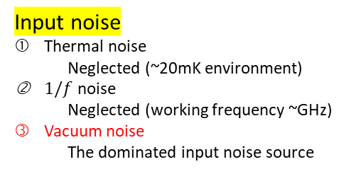






Potential Noise Source in Amplification Chain
Input noise
Thermal noise
  Neglected (~20mK environment)
$1/f$ noise
  Neglected (working frequency ~GHz)
Vacuum noise
  The dominated input noise source
HEMT add noise
Suppressed by gain from previous stage amplifier
JPA add noise
Electrons related noise
  Electrons are condensate to cooper pairs(superconductivity)
Vacuum noise
  The dominated add noise source
Post add noise
Suppressed by gain from previous stage amplifier
$$P_{in}$$
$$P_{add,J}$$
$$P_{add,H}$$
$$P_{add,P}$$
$$P_{out}$$
JPAs
HEMT
post
post
post
$$G_{J}$$
$$G_{H}$$
$$G_{P}$$
$$20mK$$
$$4K$$
$$RT$$
Maintaining the cryogenic Temperature 20mK helps suppress the noise generated by electrons.

Slide 5
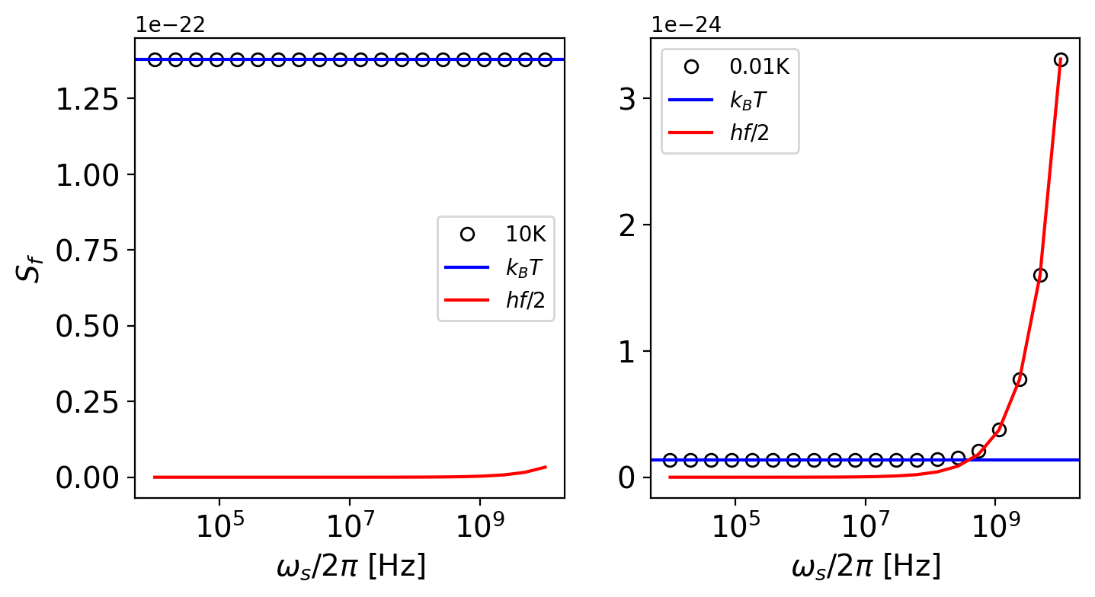
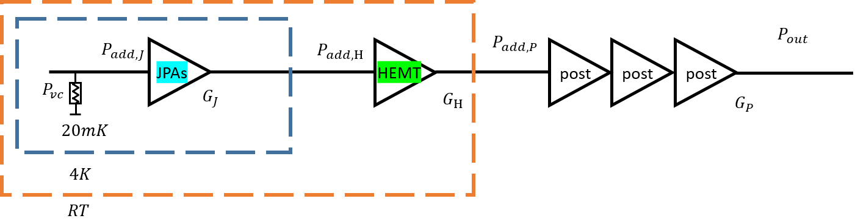
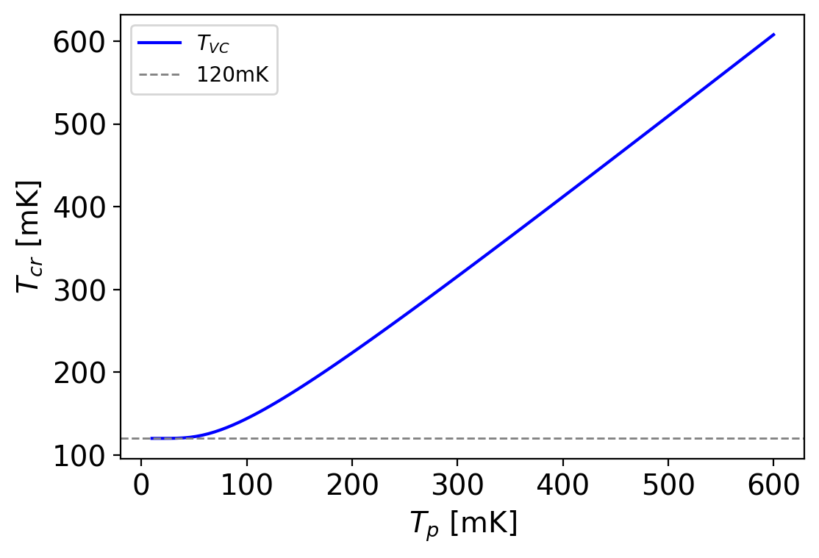
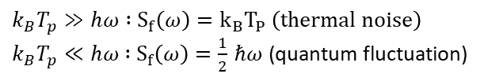


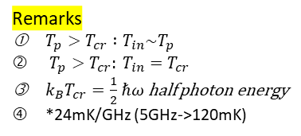

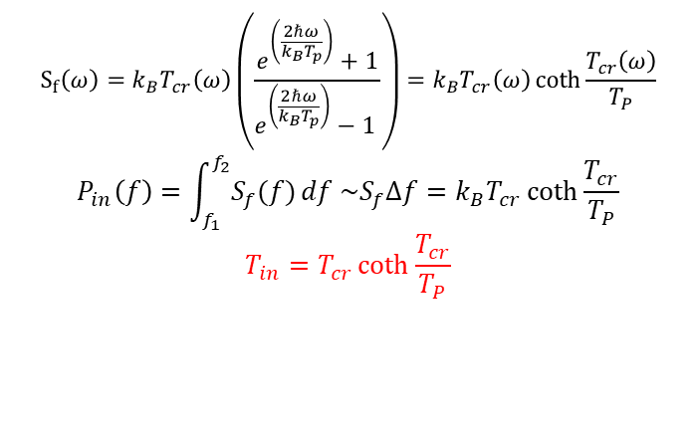
Emitted Noise From Black Body Source
$T_{sys}=$ $T_{in}+T_{add,J}+\frac{T_{add,H}}{G_{J}}+\frac{T_{add,P}}{G_{J}G_{H}}$
$$S_{f}\left(ω\right)=ℏω\left\langle {\hat{N}}_{th}\right\rangle =ℏω\left(\frac{1}{e^{(ℏω/k_{B}T_{p})}−1}+\frac{1}{2}\right)$$
$k_{B}T_{p}≫hω :$ $S_{f}\left(ω\right)=k_{B}T_{P} \left(thermal noise\right)$
$k_{B}T_{p}≪hω$ $:$ $S_{f}\left(ω\right)=\frac{1}{2}$ $ℏω$ (quantum fluctuation)
$T_{p}$ : physical Temperature
$$S_{f}\left(ω\right)=k_{B}T_{cr}\left(ω\right)\left(\frac{e^{\left(\frac{2ℏω}{k_{B}T_{p}}\right)}+1}{e^{\left(\frac{2ℏω}{k_{B}T_{p}}\right)}−1 }\right)=k_{B}T_{cr}\left(ω\right)\coth{\frac{T_{cr}\left(ω\right)}{T_{P}}}$$
$$P_{in}\left(f\right)=\int_{f_{1}}^{f_{2}}{S_{f}(f)}df \sim S_{f}∆f=k_{B}T_{cr}\coth{\frac{T_{cr}}{T_{P}}}$$
$$T_{in}=T_{cr}\coth{\frac{T_{cr}}{T_{P}}}$$
Remarks
$T_{p}>T_{cr} :T_{in}\sim T_{p}$
$T_{p}>T_{cr}: T_{in}=T_{cr}$
${k_{B}T}_{cr}=\frac{1}{2}$ $ℏω$ half photon energy
*24mK/GHz (5GHz->120mK)

Slide 6
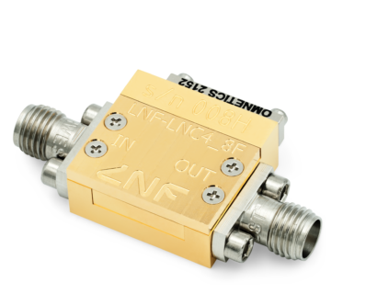
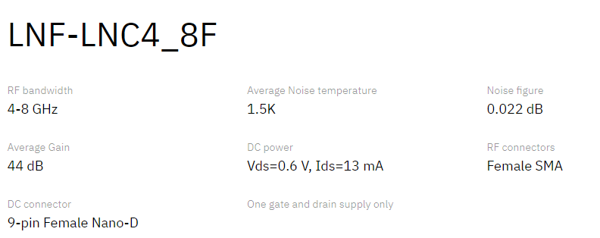
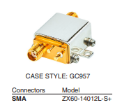
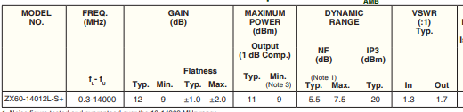

Standard-Quantum-Limited System Noise
$T_{sys}=$ $T_{in}+T_{add,J}+\frac{T_{add,H}}{G_{J}}+\frac{T_{add,P}}{G_{J}G_{H}}$
Amplifier | Gain (dB) | Add noise (K) | Remarks
JPA | 20 | ~0.3
HEMT | 40 | ~2 | Commercial product
Post | 60 | ~100 | Commercial product, triple stages
$$T_{sys} at 5GHz=0.12+0.12+\frac{2}{{10}^{2}}+\frac{100}{{10}^{6}}=0.24+0.02+0.0001\sim 0.26K$$

Slide 7
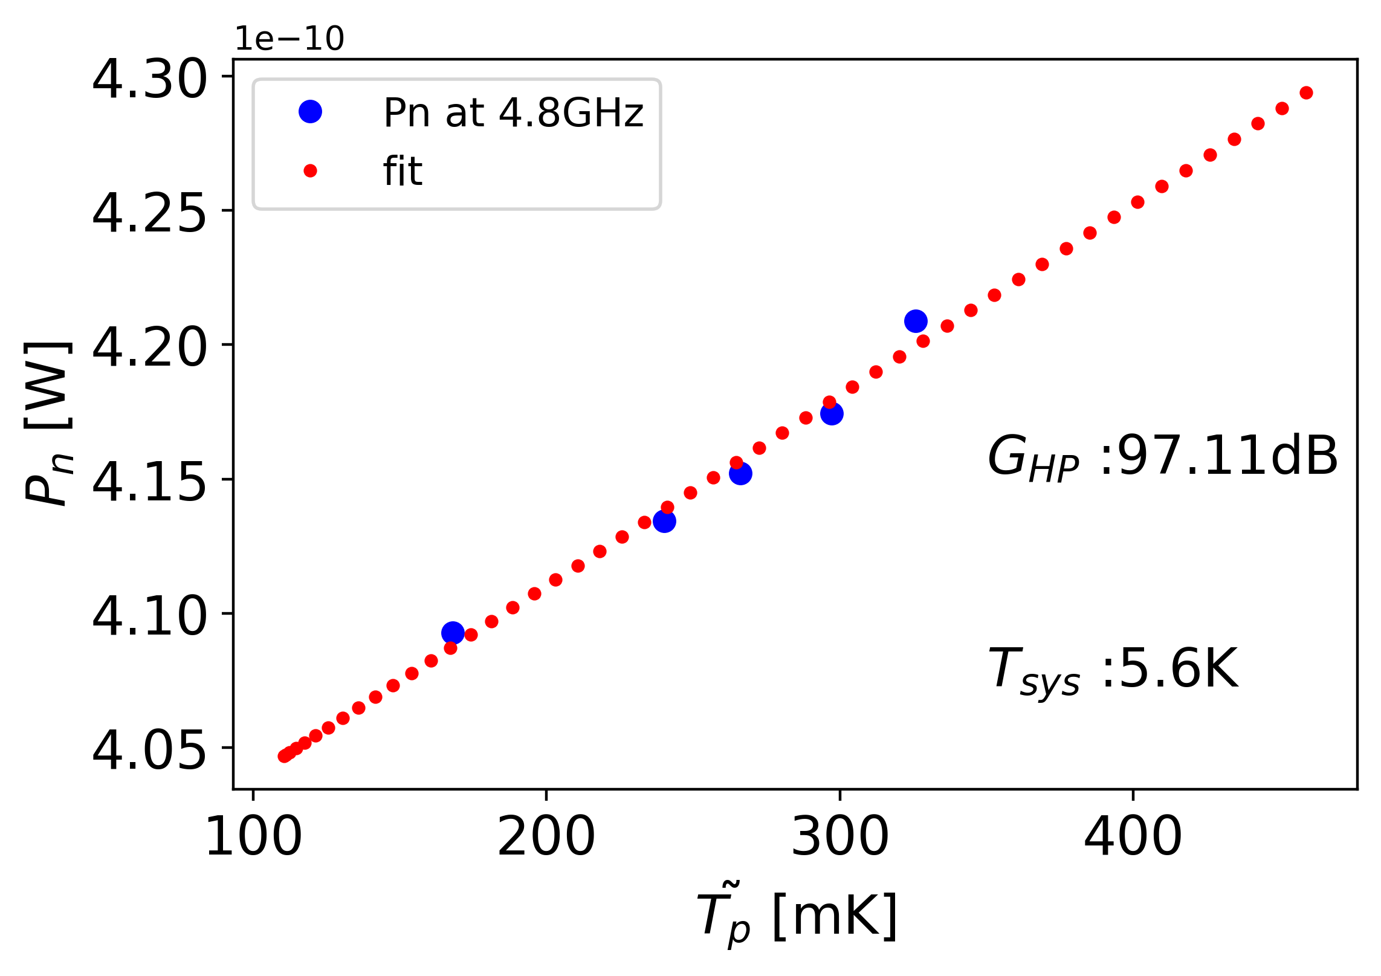
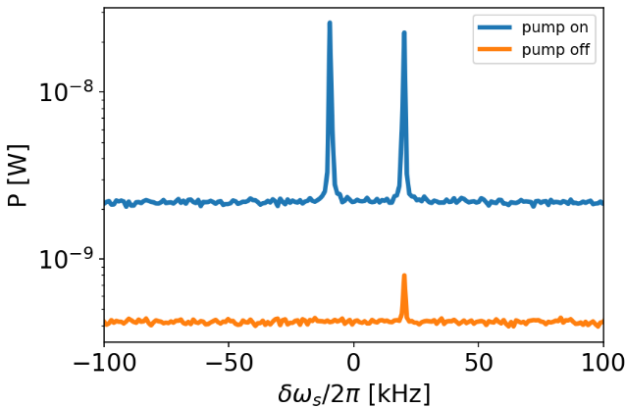

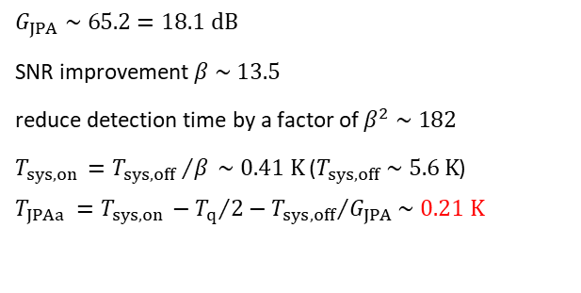
JPA Added Noise
$T_{sys}=$ $T_{in}+T_{add,J}+\frac{T_{add,H}}{G_{J}}+\frac{T_{add,P}}{G_{J}G_{H}}$
$$P_{out}=G_{tot}k_{B}T_{sys}∆f=G_{p}G_{H}∆f(T_{in}(T_{P})+T_{add,H}+\frac{T_{add,P}}{G_{H}})$$
$$P_{out}=G_{tot}k_{B}T_{sys}∆f=G_{p}G_{H}G_{J}∆f(T_{in}(T_{P})+T_{add,J}+\frac{T_{add,H}}{G_{J}}+\frac{T_{add,P}}{G_{J}G_{H}})$$
$$G_{JPA} \sim 65.2=18.1 dB$$
SNR improvement $β \sim 13.5$
reduce detection time by a factor of $β^{2} \sim 182$
$T_{sys,on }={T_{sys,off }}/β \sim 0.41 K$ ($T_{sys,off} \sim 5.6 K$)
$$T_{JPAa }=T_{sys,on }−{T_{q}}/2−{T_{sys,off}}/{G_{JPA}}\sim 0.21 K$$
0.21K~1 photon

Slide 8
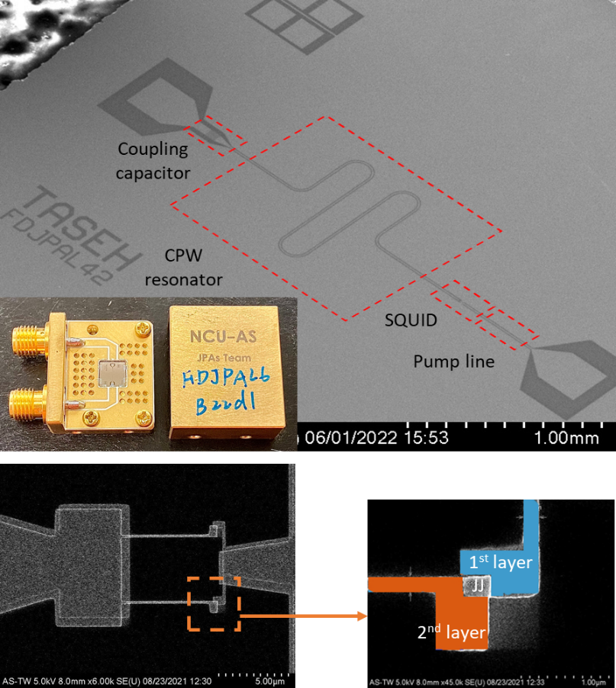
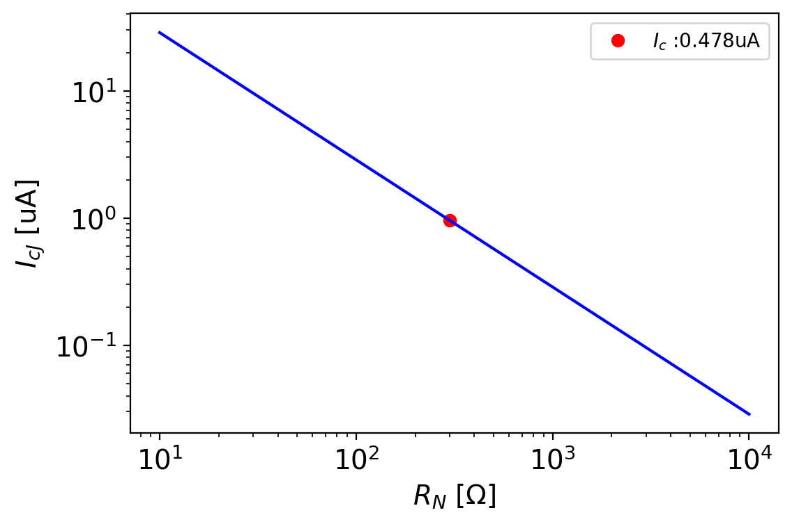
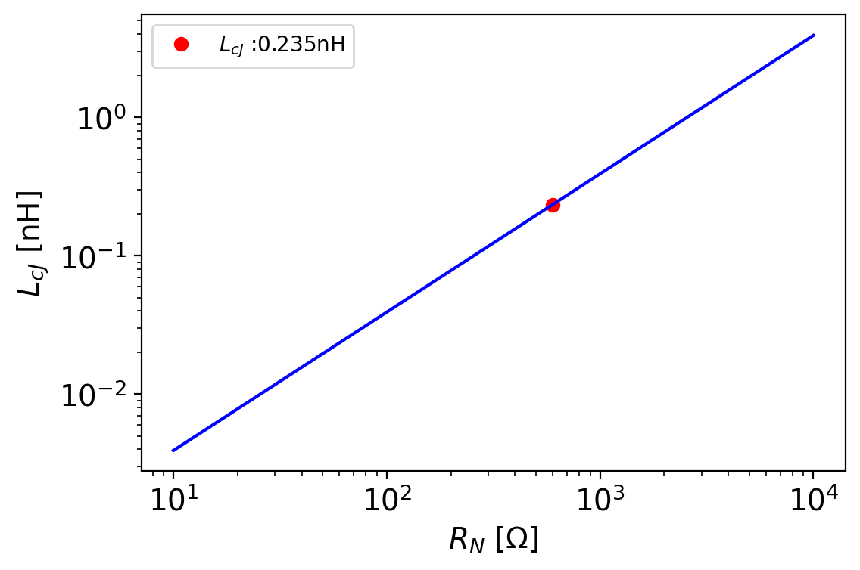


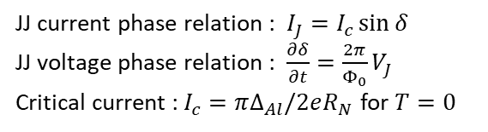


Josephson Parametric Amplifier
$$L_{J}$$
$$C_{J}$$
Al
$$C_{ext}$$
AlOx
Al
Si
$$b$$
JJ current phase relation : $I_{J}=I_{c}\sin{δ}$
JJ voltage phase relation : $\frac{∂δ}{∂t}=\frac{2π}{Φ_{0}}V_{J}$
Critical current : $I_{c}=π∆_{Al}/2eR_{N}$ for $T=0$
Effective capacitor
Josephson Junction

Slide 9
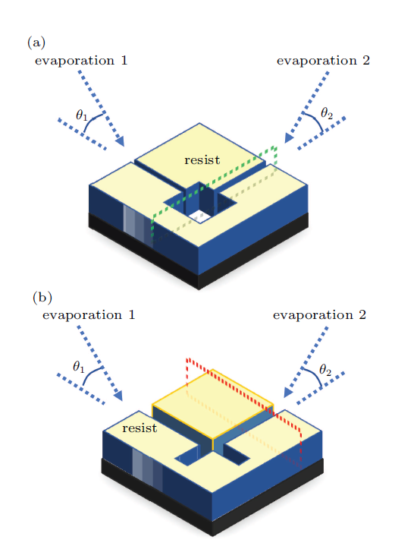
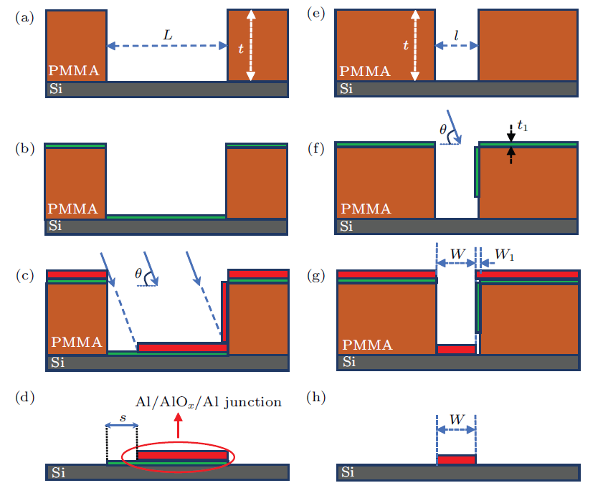
Bridge Free Junction Fabrication Technique
Al
Si
1st Al deposition
AlOx
Al
Si
Deposited Al oxidization
Al
AlOx
Al
Si
2nd Al deposition
Z. Ke et al., Chin. Phys. B 26, 078501 (2017)

Slide 10
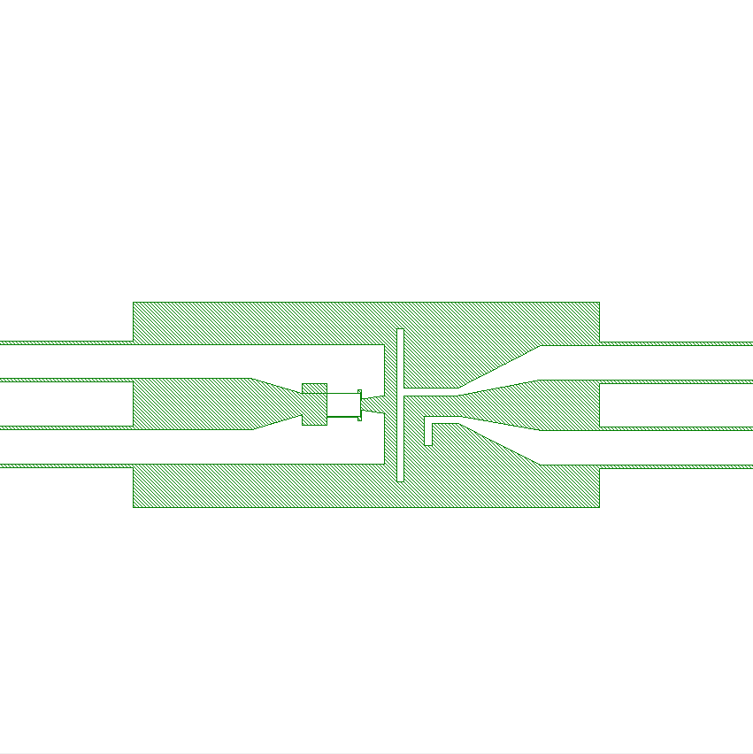
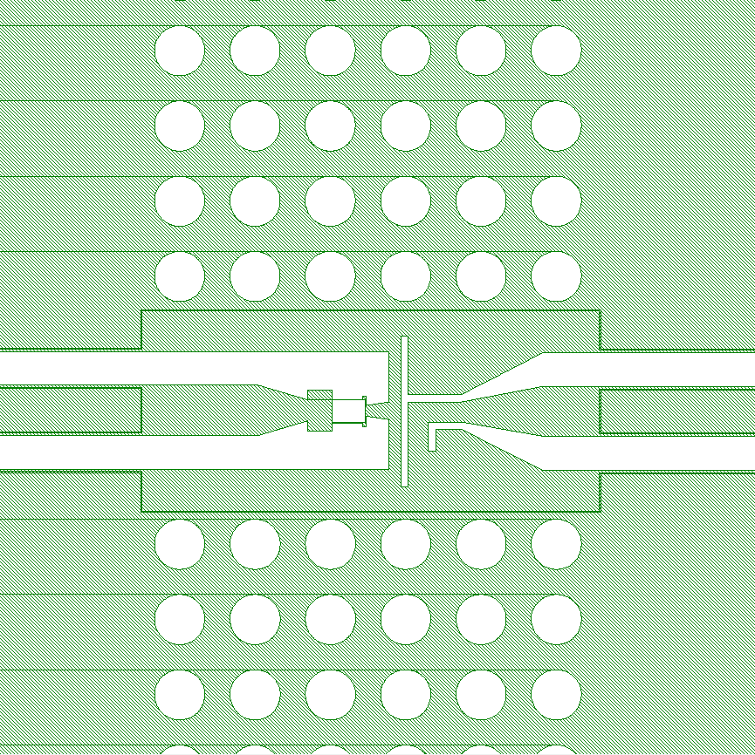
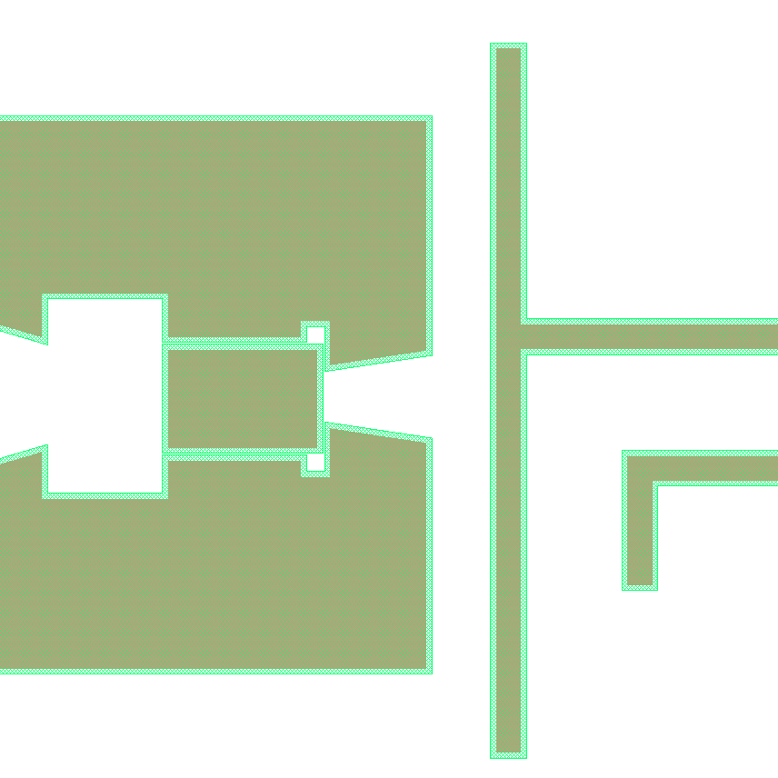
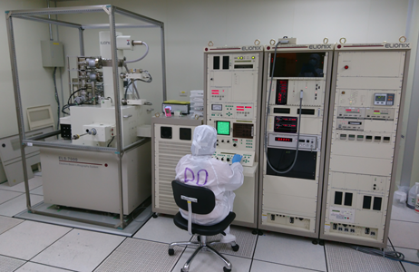
All E-beam Lithography
Resist application
SC exposure
LC exposure
development
PR: AR-P 617.06
PR: AR-P 6200.13
Beam current: 1nA
Spot distance: 10nm
Beam current: 40nA
Spot distance: 230nm
TR: AR 600-546
BR: XAR 600-50/2
Elionix ELS-7000
Accelerating voltage | 100 keV
Beam current | 10 pA – 70 nA
Minimum dose time | 50 ns/dot
Writing field size | 75, 150, 300, 600, 1200 µm
Field dot number | 20000, 60000, 240000
resources and support are from the Quantum Materials Shared Facilities of Institute of Physics at Academia Sinica.

Slide 11
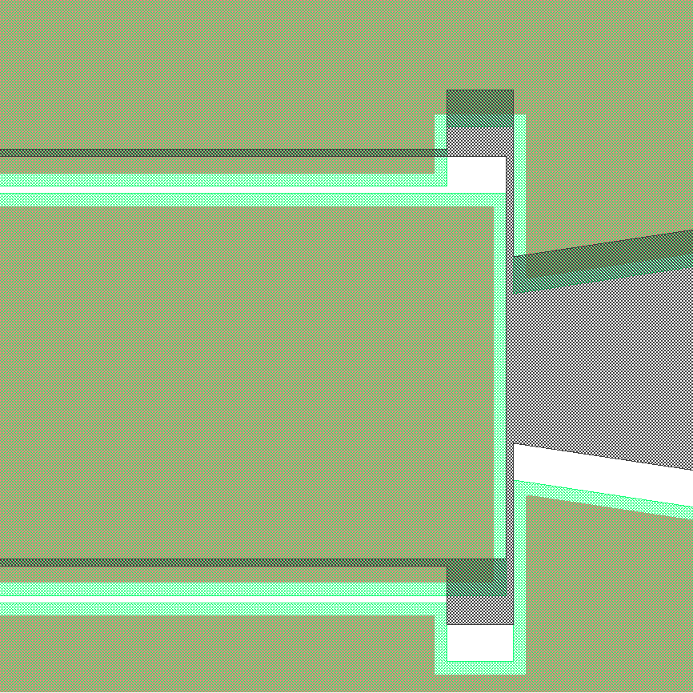
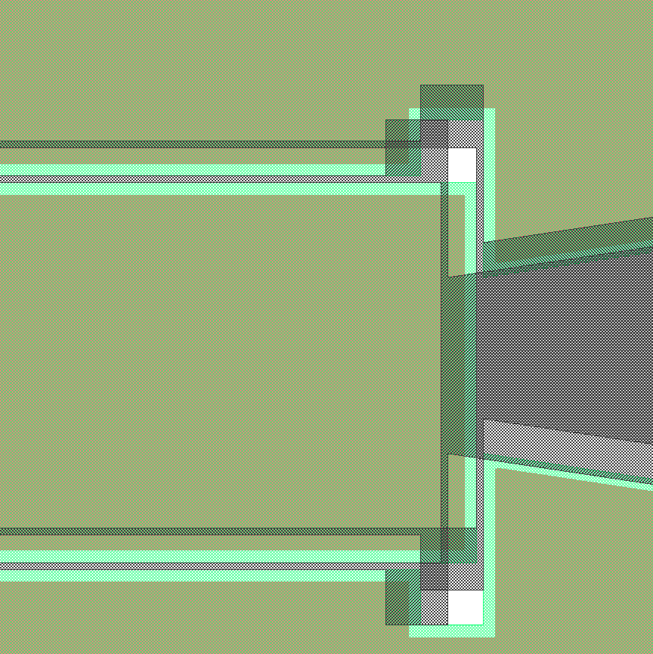
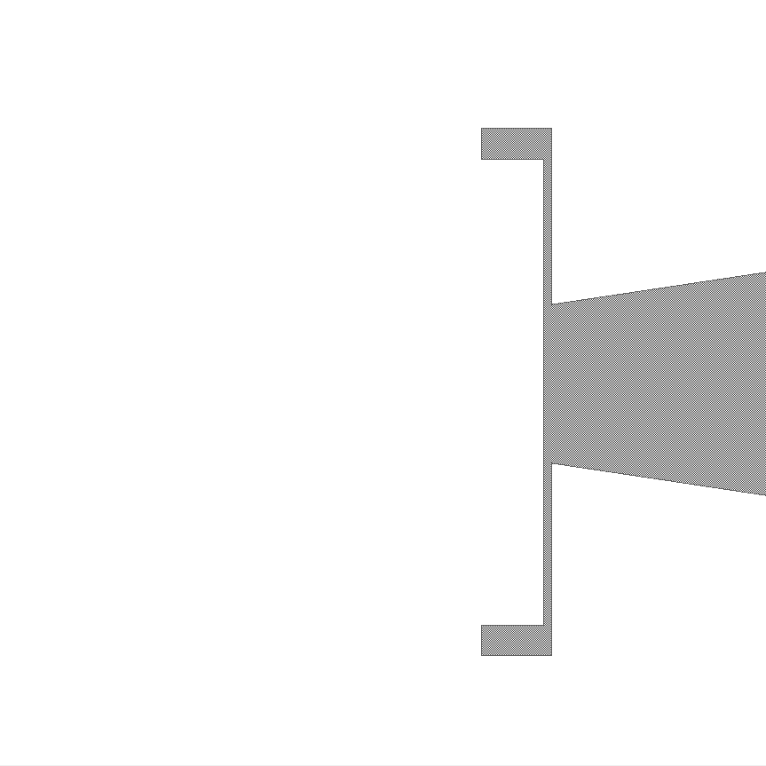
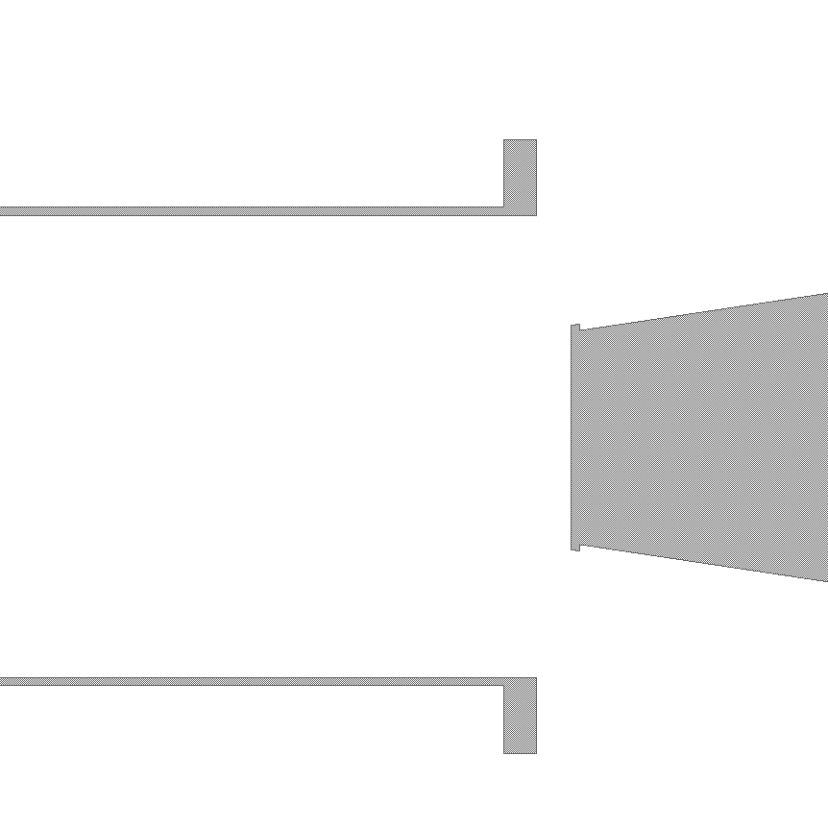
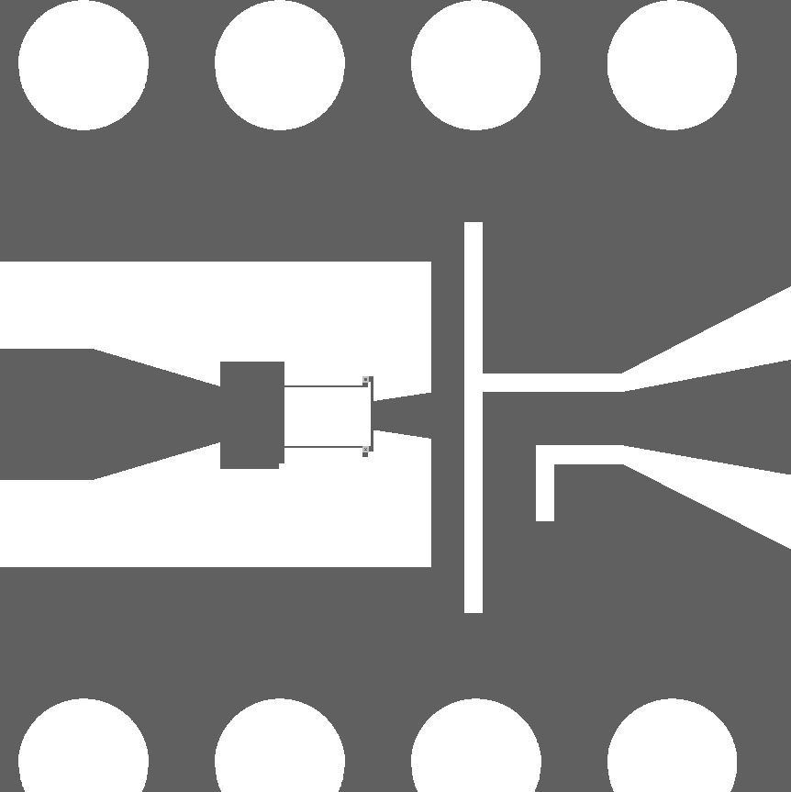
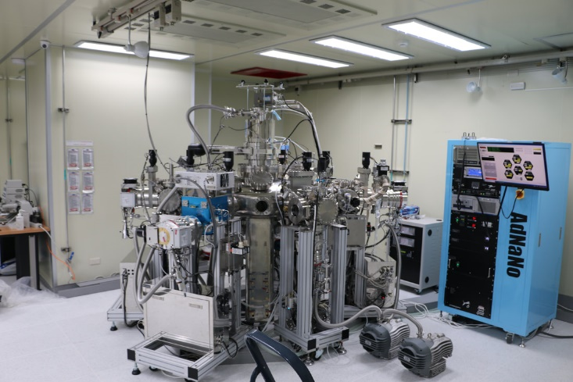
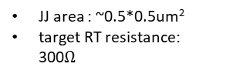
Deposition & Lift-off
1st Al deposition
2nd Al deposition
Lift off
Final pattern
Incident Angle: 25
Thickness : 30nm
Incident Angle : 25
Thickness : 60nm
Blue: 1st Al layer
Brown: 2nd Al layer
JJ area : ~0.5*0.5um²
target RT resistance: 300$Ω$
AdNaNo JEB diamond
E-gun based pressure | 3e-9 torr
Accelerating voltage | 10kV
Oxidation based pressure | 3e-10torr
O2 Flow control | 4-220 sccm
O2 pressure control | 0.04 to 1 torr ( dynamics & statistics)
resources and support are from the Prof. Chii-Dong Chen’s lab, IoP, AS

Slide 12
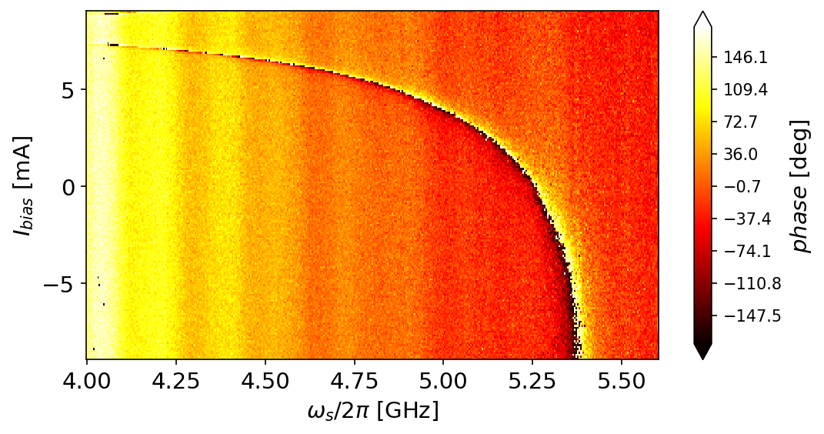
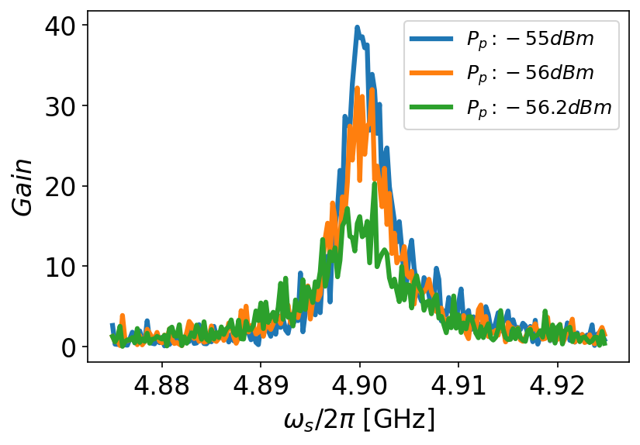

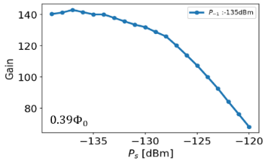
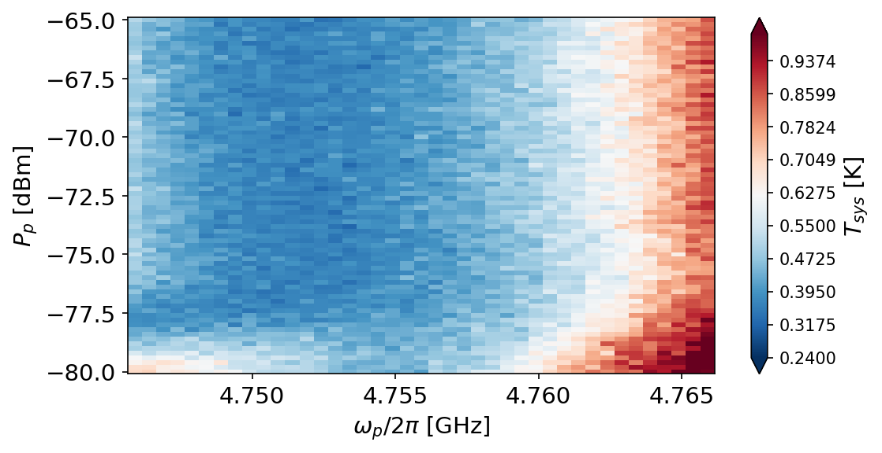
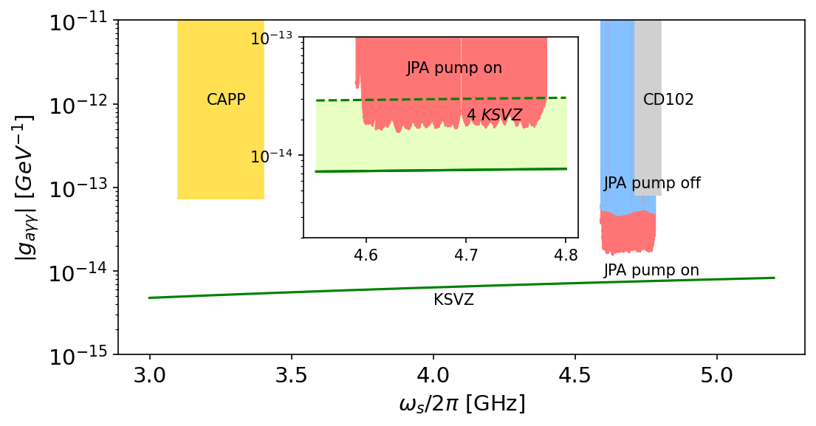
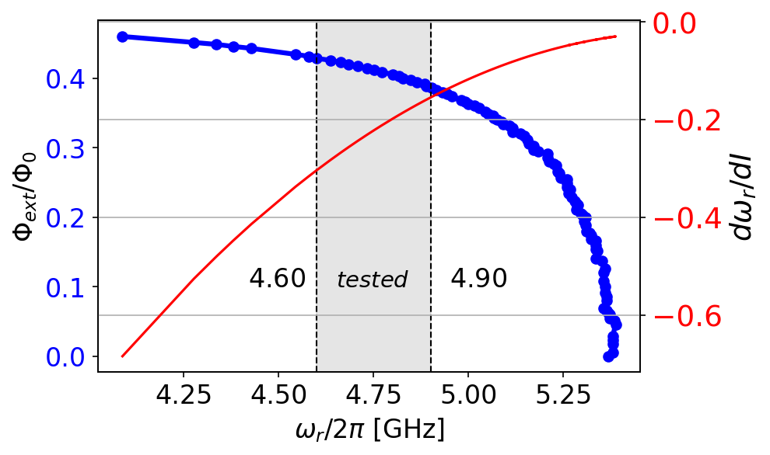
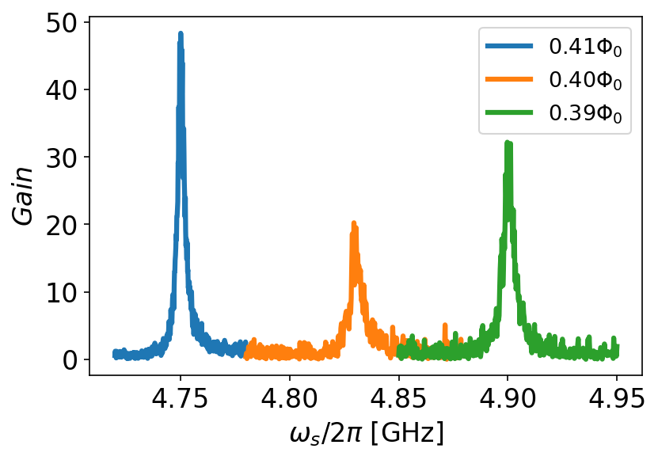
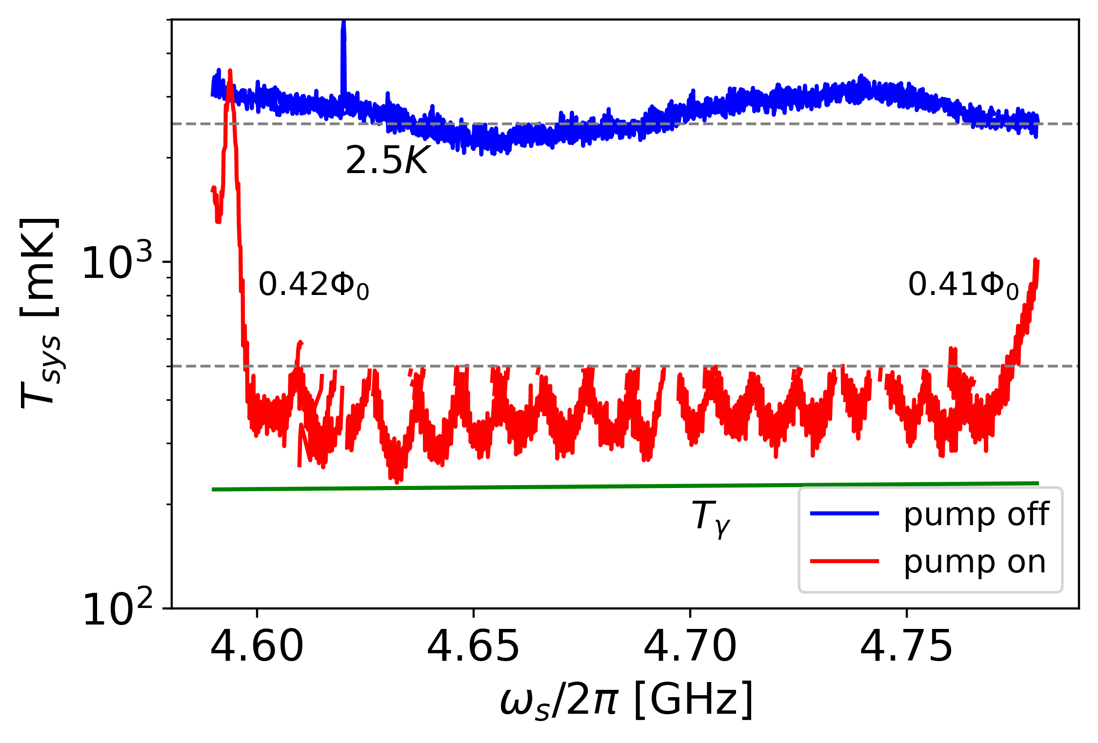
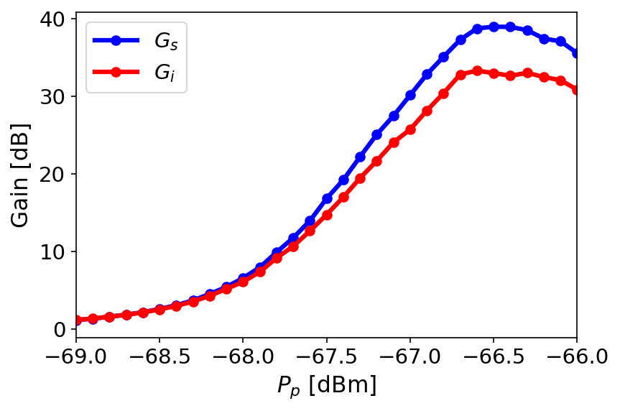
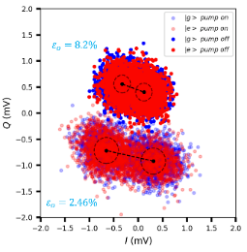

JPA Tune Up Process Flow
Flux dependence
Gain and Noise mapping
Saturation power
optimization
Operations
0.5 day
4 days
0.5 day
3 days
In total 8 days
Key parameters
Maximum resonance
Junction properties
Flux quantum with current
Key parameters
Gain
Bandwidth
Operation range
Key parameters
System noise
On/off noise
Key parameters
Signal Saturation power
Pump power limitation
Key parameters
Frequency matching
Best SNR
Implementation
Qubit readout chain
Axion detection chain
Noise squeeze
Remarks :
Full characterization ~8 days
Tune up JPA ~2days

Slide 13



Operation Range for FDL4B8d2
Criteria of gain
18dB gain
2MHz BW
-> 400MHz covering range
-> optimized gain shows under the trade off btw duffing & flux nonlinearity

Slide 14






Continuous JPA Operation Mapping
Covering Searching range for ~200MHz
With JPA gain BW~2MHz
$$\frac{1}{2}f_{p}$$
$$f_{p}$$
BW: 2MHz
$f_{p}$ shift :1MHz
Span :600kHz
$f_{c}$ shift :0.5MHz
$δf_{s}$ :20kHz
Sweeping f range :40MHz

Slide 15




Static Magnetic Field Shielding
$$P_{a}=\left(g_{aγγ}^{2}\frac{ℏ^{3}c^{3}ρ_{a}}{m_{a}^{2}}\right)×{(ω}_{c}\frac{1}{μ_{0}}B_{0}^{2}{VCQ}_{L}\frac{β}{1+β})$$
JPA shielding set
Goal: reduced by a factor of 10³

Slide 16




Shielding Sets Field Reduction Capacity
Shield
Hall sensor
Magnetic Field(~500G)
Torrance of leaked field
$Φ_{0}=B∙A$
->2e-15/1e-10 (T)
-> 0.1G

Slide 17




Current Status of JPA in TASEH Research
Adjusted target range
About JPA
New wider BW devices working around 2 GHz
Continue tuning procedure to cover ~100MHz span
About shielding
Stronger solder joint for compensate current survive above 4T
reduce the field strength lower than 0.1G

Slide 18
















Josephson Parametric Amplifier
$T_{sys}=$ $T_{in}+T_{add,J}+\frac{T_{add,H}}{G_{J}}+\frac{T_{add,P}}{G_{J}G_{H}}$
$$v_{b}=f(Q)=\frac{Q}{C_{ext}}+\frac{Q}{C_{J}}$$
$$i_{b}=g(φ)=I_{c}\sin{(\frac{2e}{ℏ}φ)}$$
$$C_{ext}$$
$$L_{J}$$
$$C_{J}$$
$$H=T+U=\int_{0}^{φ′}{g\left(φ\right)dφ}+\int_{0}^{q}{f\left(Q\right)dQ}$$
$$b$$
$$H=\frac{1}{2C_{Σ}}q^{2}+\frac{ℏI_{c}}{2e}(1−\cos{δ})$$
Remarks
JPA is a nonlinear oscillator based on the Josephson junctions, nonlinear inductor $L_{J}$, and a linear capacitor $C_{ext}$
Taylor expansion of $\cos{δ}$, Quantum description
$$\hat{H}=\frac{1}{2C_{Σ}}{\hat{q}}^{2}+\frac{ℏI_{c}}{2e}(\frac{1}{2!}{\hat{δ}}^{2}−\frac{1}{4!}{\hat{δ}}^{4})$$
parameter | description
$$C_{ext}$$ | Geometric capacitance
$$L_{J}$$ | Josephson inductance
$$C_{J}$$ | Shunt capacitance
$$ω_{r}$$ | $$1/\sqrt{L_{J}(C_{ext}+C_{J})}$$
$\hat{H}=ℏω_{0}\left({\hat{a}}^{†}\hat{a}+\frac{1}{2}\right)+\frac{1}{12}$ $ℏΚ$ ${\left(\left({\hat{a}}^{†}+\hat{a}\right)\right)}^{4}$
RWA: ${\hat{H}}^{′}=\hat{U}\hat{H}{\hat{U}}^{†}+i\dot{\hat{U}}{\hat{U}}^{†}$
$\hat{H}=ℏ\tilde{ω_{0}}\left({\hat{a}}^{†}\hat{a}\right)+\frac{1}{2}$ $ℏΚ({\hat{a}}^{†}{\hat{a}}^{†}\hat{a}\hat{a})$
JPA can be modeled as Duffing oscillator/ an oscillator with Kerr effect

Slide 19













Retrieving Output Mode in JPA Dynamics
$${\hat{b}}_{in}(t)$$
$${\hat{c}}_{in}(t)$$
${\hat{H}}_{sys}=ℏω_{0}\left({\hat{a}}^{†}\hat{a}\right)+\frac{1}{2}$ $ℏΚ({\hat{a}}^{†}{\hat{a}}^{†}\hat{a}\hat{a})$
$$κ_{e}$$
$$κ_{i}$$
$${\hat{c}}_{out}(t)$$
$$C_{ext}$$
$$L_{J}$$
$$C_{J}$$
$${\hat{H}}_{int,b}=\int{dω_{k}ℏω_{k}{{\hat{b}}_{k}}^{†}{\hat{b}}_{k}}−iℏ\int{dω_{k}(f\left(ω_{k}\right){\hat{b}}_{k}{\hat{a}}^{†}−f^{∗}\left(ω_{k}\right){{\hat{b}}_{k}}^{†}\hat{a})}$$
External thermal bath
$${\hat{b}}_{out}(t)$$
Internal thermal bath
$${\hat{H}}_{int,c}=\int{dω_{k}ℏω_{k}{{\hat{c}}_{k}}^{†}{\hat{c}}_{k}}−iℏ\int{dω_{k}(g\left(ω_{k}\right){\hat{c}}_{k}{\hat{a}}^{†}−g^{∗}\left(ω_{k}\right){{\hat{c}}_{k}}^{†}\hat{a})}$$
On chip
Quantum Langevin equation:
$$\dot{\hat{a}}=\frac{i}{ℏ}\left[{\hat{H}}_{sys},\hat{a}\right]−\frac{1}{2}κ_{t}\hat{a}+\sqrt{k_{e}}{\hat{b}}_{in}+\sqrt{k_{i}}{\hat{c}}_{in}$$
$${\dot{\hat{a}}}^{†}=\frac{i}{ℏ}\left[{\hat{H}}_{sys},{\hat{a}}^{†}\right]−\frac{1}{2}κ_{t}{\hat{a}}^{†}+\sqrt{k_{e}}{\hat{b}}_{in}^{†}+\sqrt{k_{i}}{\hat{c}}_{in}^{†}$$
B.C.
${\hat{b}}_{out}+{\hat{b}}_{in}=\sqrt{κ_{e}}\hat{a} ,{\hat{c}}_{out}+{\hat{c}}_{in}=\sqrt{κ_{i}}\hat{a}$
$κ_{t}=κ_{i}+κ_{e}$
${\hat{F}}_{in}=\sqrt{κ_{e}}{\hat{b}}_{in}+\sqrt{κ_{i}}{\hat{c}}_{in}$
$$\left({\hat{a} (ω) \atop {\hat{a}}^{†}(ω)}\right)= Χ_{mn} \left({{\hat{F}}_{in} (ω) \atop {\hat{F}}_{in}^{†}(ω)}\right)$$
$${\hat{b}}_{out}=\sqrt{κ_{e}}\hat{a}−{\hat{b}}_{in}=\sqrt{κ_{e}}x_{11}{\hat{F}}_{in}+\sqrt{κ_{e}}x_{12}{\hat{F}}_{in}^{†}−{\hat{b}}_{in}$$
$${\hat{b}}_{out}=\sqrt{κ_{e}}x_{11}\left(\sqrt{κ_{e}}{\hat{b}}_{in}+\sqrt{κ_{i}}{\hat{c}}_{in}\right)+\sqrt{κ_{e}}x_{12}\left(\sqrt{κ_{e}}{\hat{b}}_{in}^{†}+\sqrt{κ_{i}}{\hat{c}}_{in}^{†}\right)−{\hat{b}}_{in}$$
$${\hat{b}}_{out}=\left(−1+κ_{e}x_{11}\right){\hat{b}}_{in}+\sqrt{κ_{e}}\sqrt{κ_{i}}x_{11}{\hat{c}}_{in}+κ_{e}x_{12}{\hat{b}}_{in}^{†}+\sqrt{κ_{e}}\sqrt{κ_{i}}x_{12}{\hat{c}}_{in}^{†}$$
The output mode are contributed by 4 modes

Slide 20








Standard Quantum Limited Noise
$${\hat{b}}_{out}=J_{b}{\hat{b}}_{in}+k_{b}{\hat{c}}_{in}+J_{c}{\hat{b}}_{in}^{†}+k_{c}{\hat{c}}_{in}^{†}$$
$S_{f}\left(ω\right)=ℏω\left\langle {\hat{b}}_{out}^{†}{\hat{b}}_{out}+\frac{1}{2}\right\rangle ={\left|J_{b}\left(ω\right)\right|}^{2}\left\langle ℏω\left({\hat{b}}_{in}^{†}{\hat{b}}_{in}+\frac{1}{2}\right)\right\rangle$+ ${\left|k_{b}\left(ω\right)\right|}^{2}\left\langle ℏω\left({\hat{b}}_{in}{\hat{b}}_{in}^{†}+\frac{1}{2}\right)\right\rangle$+ ${\left|J_{c}\left(ω\right)\right|}^{2}\left\langle ℏω\left({\hat{c}}_{in}^{†}{\hat{c}}_{in}+\frac{1}{2}\right)\right\rangle +{\left|k_{c}\left(ω\right)\right|}^{2}\left\langle ℏω\left({\hat{c}}_{in}{\hat{c}}_{in}^{†}+\frac{1}{2}\right)\right\rangle$
0 : $for T_{b}, T_{c}→20mK$
0 : $for κ_{i}=0$
0 : $for T_{b}, T_{c}→20mK$
$$S_{f}\left(ω\right)=ℏω\left(G_{sb}\left(\frac{1}{e^{\left(\frac{ℏω}{k_{B}T_{b}}\right)}−1}+\frac{1}{2}\right)+G_{ib}\left(\frac{1}{e^{\left(\frac{ℏω}{k_{B}T_{b}}\right)}−1}+\frac{1}{2}\right)+G_{sc}\left(\frac{1}{e^{\left(\frac{ℏω}{k_{B}T_{c}}\right)}−1}+\frac{1}{2}\right)+G_{ic}\left(\frac{1}{e^{\left(\frac{ℏω}{k_{B}T_{c}}\right)}−1}+\frac{1}{2}\right)\right)$$
$$G_{sb}−G_{si}=1$$
$${\hat{b}}_{in}(t)$$
$${\hat{c}}_{in}(t)$$
0 : $for κ_{i}=0$
$$N_{f}\left(ω\right)={S_{f}\left(ω\right)/G}_{sb}=\left(\left(\frac{1}{2}ℏω\right)+\frac{G_{sb}−1}{G_{sb}}\left(\frac{1}{2}ℏω\right)\right)$$
$$κ_{e}$$
$$κ_{i}$$
$${\hat{c}}_{out}(t)$$
$$C_{ext}$$
$$L_{J}$$
$$C_{J}$$
superconductivity
External thermal bath
$${\hat{b}}_{out}(t)$$
Internal thermal bath
$$for T_{b}, T_{c}→20mK$$
From theoretical prediction , JPA could only add half photon noise, system noise could be 1 photon strength (half from vacuum, half from complex conjugated mode.
Fine thermal equilibrium
On chip

