Slide 1

Exploring the strangness in the proton at EIC
Memorial session for Prof. Yongseok Oh

Slide 2
Yongseok and I
I first met Yongseok at NTU campus in 1993. By then I was just discharged from army and entered NTU as a TA and Yongseok started his postdoc in NTU. Yongseok and I met reguarly in Prof. S.N.Yang’s group meeting.
Yongseok worked on the strangeness in the proton and φ meson production.

Slide 3
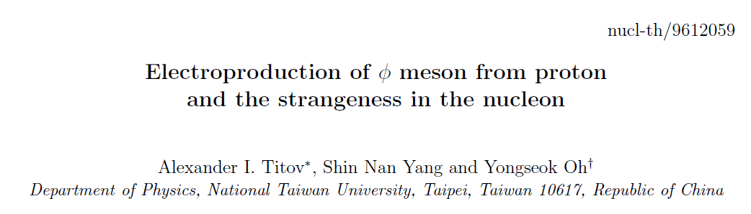

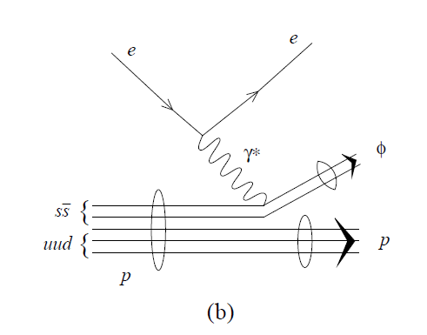
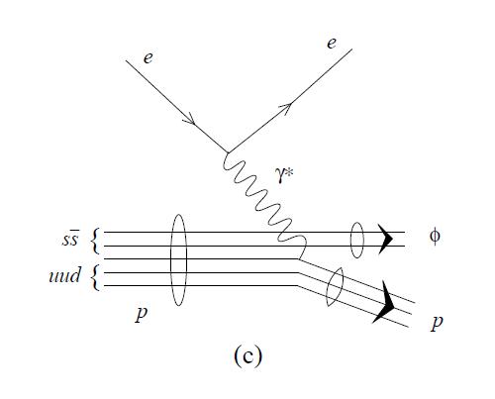
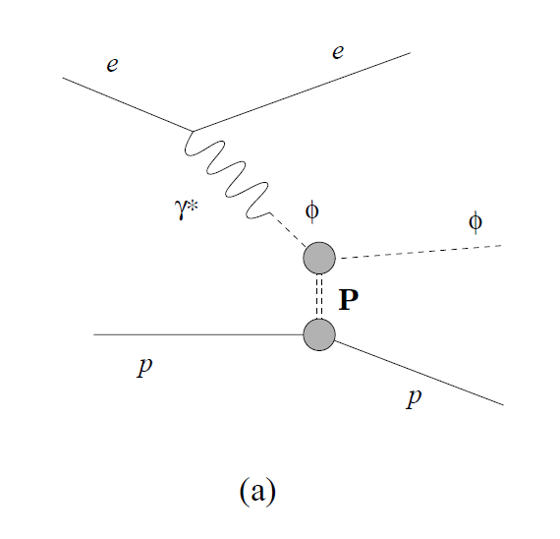
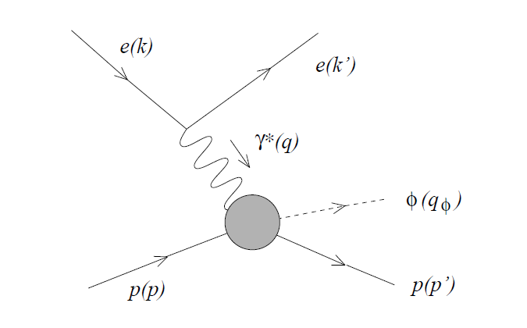
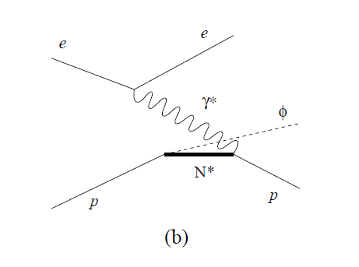
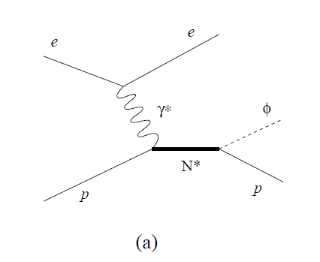
Published in: Nucl.Phys.A 618 (1997) 259-290

Slide 4
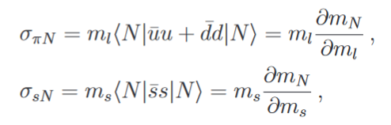
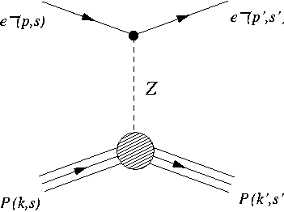
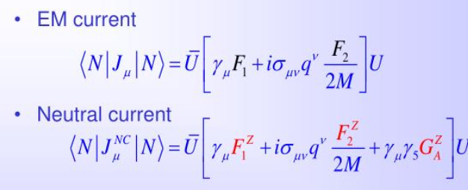

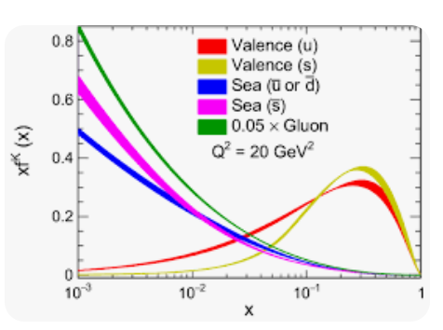

Strangess in the nucleon
Strange form factors: G^{s}_{E} and G^{s}_{M}
Sigma term
Strange Parton Distribution Functions

Slide 5
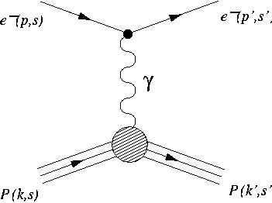
Parity Violating Electron Scattering
Interference: σ ~ |M^{EM} |² + |M^{NC} |² + 2Re(M^{EM*})M^{NC}
Interference with EM amplitude makes Neutral Current (NC) amplitude accessible
Tiny (~10⁻⁶) cross section asymmetry isolates weak interaction

Slide 6
Flavour decomposition
NC probes same hadronic flavour structure, with different couplings:
  G^{Z}_{E/M} provide an important new benchmark for testing
  non-perturbative QCD structure of the nucleon

Slide 7
Apply Charge Symmetry
G^{γ,p}_{E,M}
G^{u}_{E,M}
G^{p}_{E,M}
Well Measured
G^{γ,n}_{E,M}
Charge symmetry
G^{d}_{E,M}
Shuffle
G^{n}_{E,M}
G^{Ζ,p}_{E,M}
G^{s}_{E,M}
G^{s}_{E,M}
<N| sγ^{μ} s |N>

Slide 8


Isolating the form factors: vary the kinematics or target
For a proton:
~ few parts per million
Forward angle
Backward angle

Slide 9
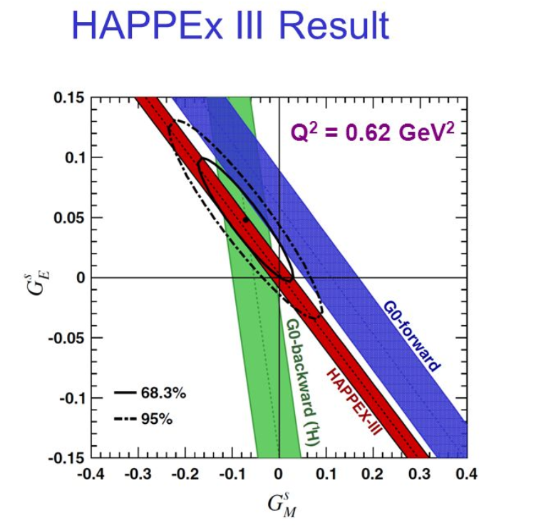
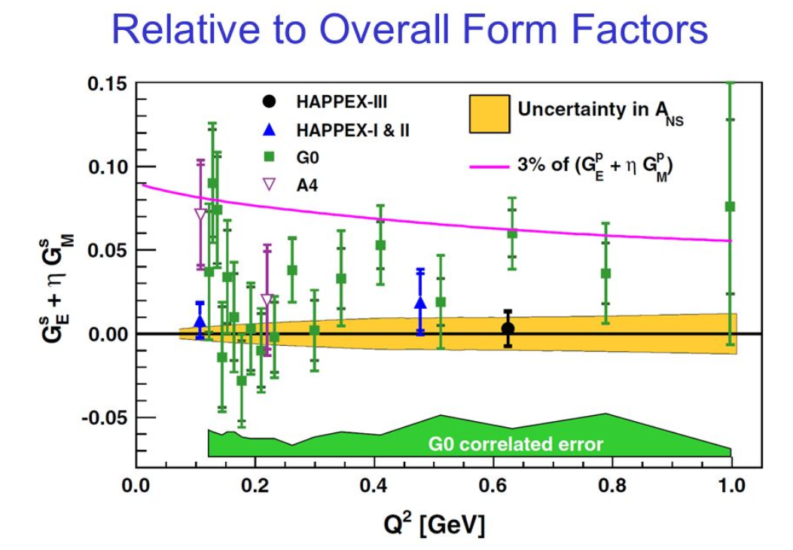
Current knowledge of G^{s}

Slide 10
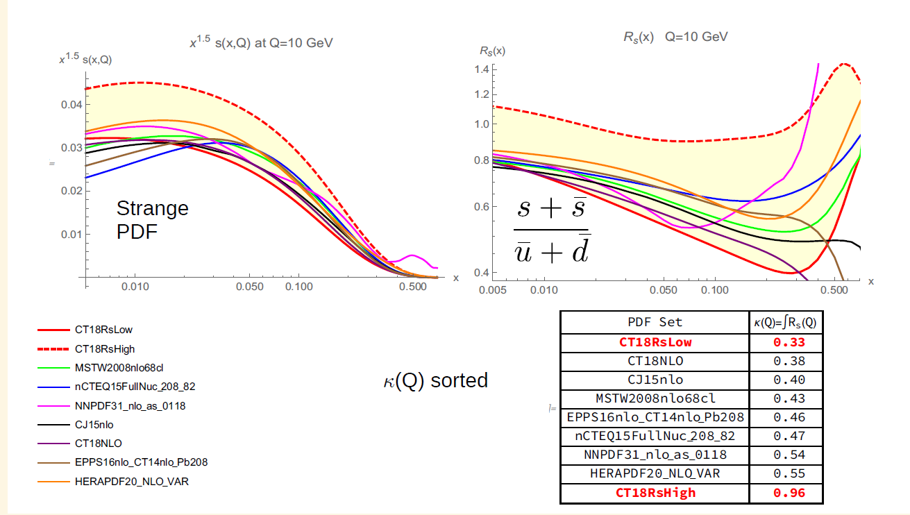
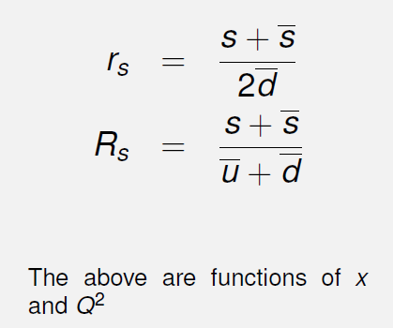
Strange PDFs

Slide 11
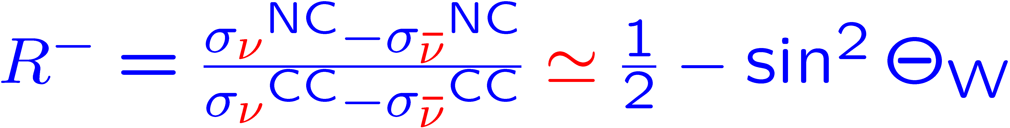
The “NuTeV Anomaly”
The NuTeV measurement:
PRL 88, (2002)
It was inspired by, and is related (but not identical) to, the Paschos-Wolfenstein (1973) Ratio:
(isoscalar target, …)
NuTeV
LEP EWWG
a 3.1 σ discrepancy
Must be corrected for a target with a fractional neutron excess, , , …
SM explanation(s) or Signal for New Physics?

Slide 12
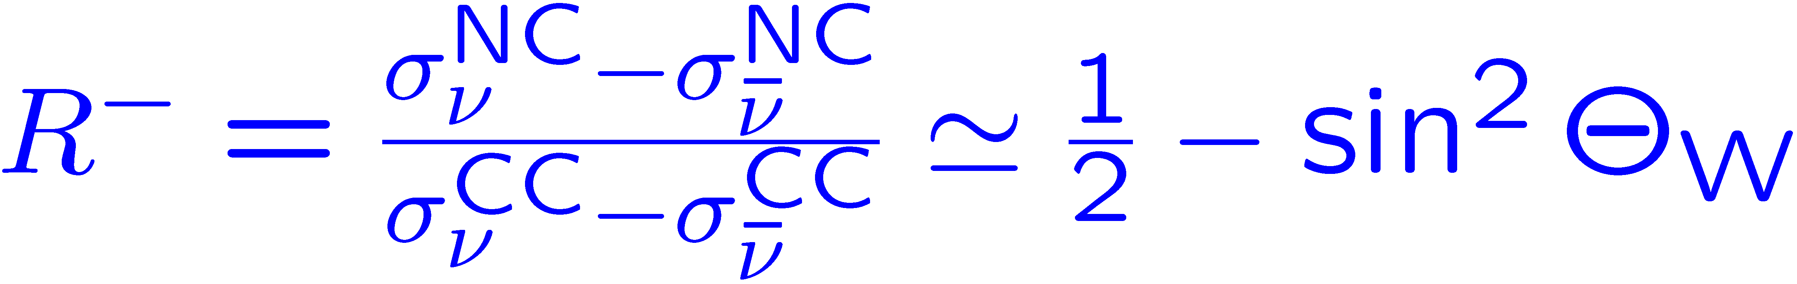
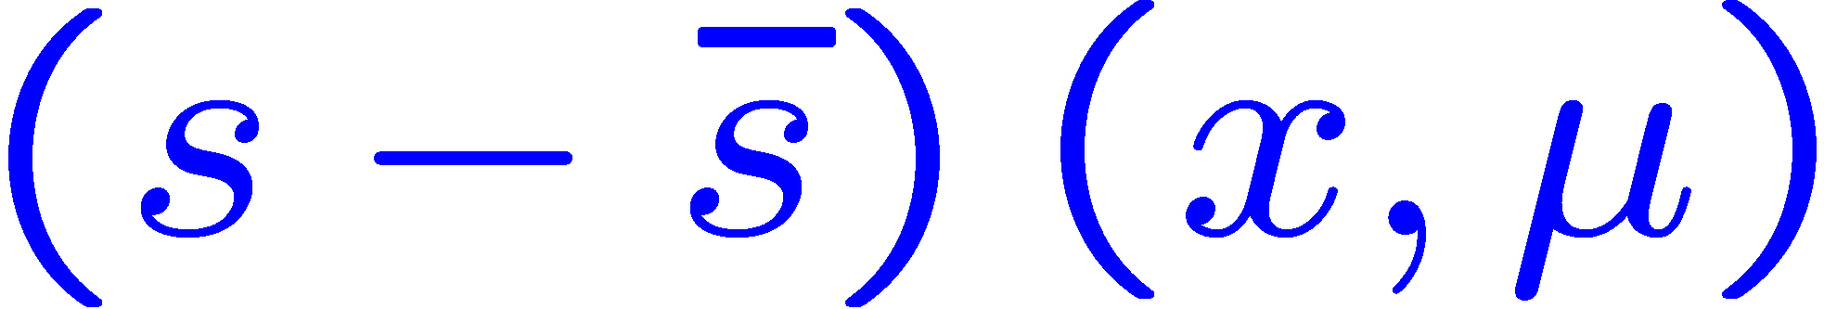
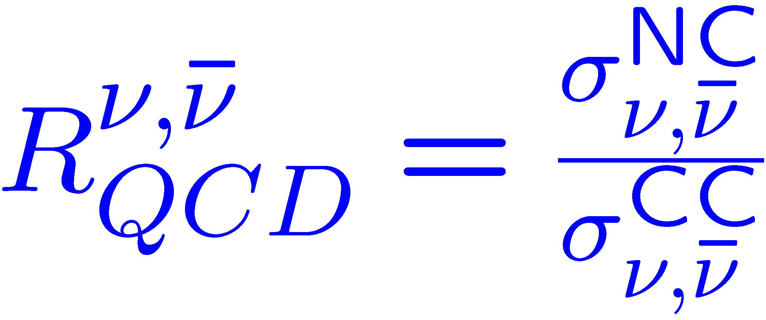
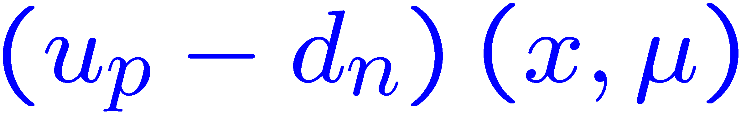
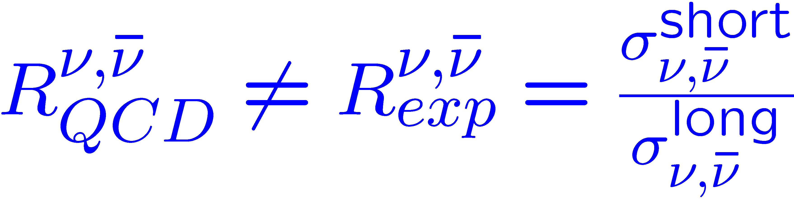
Theorist’s Observables
Paschos-Wolfenstein:
    Parton model
    Isoscalar target
“technical” (“standard”) effects:
  EW radiative corrections
  Non-isoscalarity (Fe)
  NLO QCD and masses
“physical” (“new”) effects:
  Higher twist
  Nuclear effects (A' 56)
Cross section ratios
Notes:
Check what’s in the SM fit!

Slide 13
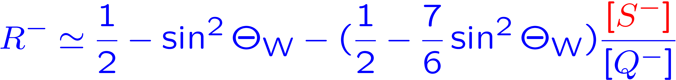
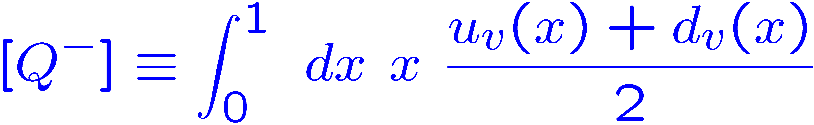
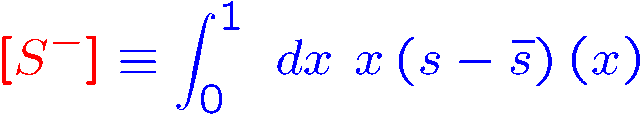

Then:
is not protected by any symmetry:

Slide 14
Future prospects for [S⁻]?
W and associated charm (jet)
production:
conceivable @ Tevatron, RHIC, LHC
But statistics (efficiency driven)
and high scale are unlikely to permit
to access a small asymmetry.
CC charm @ HERA: ditto
Lattice:
The moment [S⁻] itself does not correspond to a local operator.
Higher, uneven moments (n=3,5,…)
can be related to local operators and could presumably clarify the sign of the x! 1 behaviour, though not the magnitude of [S⁻].
Semi-Inclusive DIS (eRHIC)?
g
c
s
W
Baur, Halzen, Keller, Mangano, Riesselmann

Slide 15
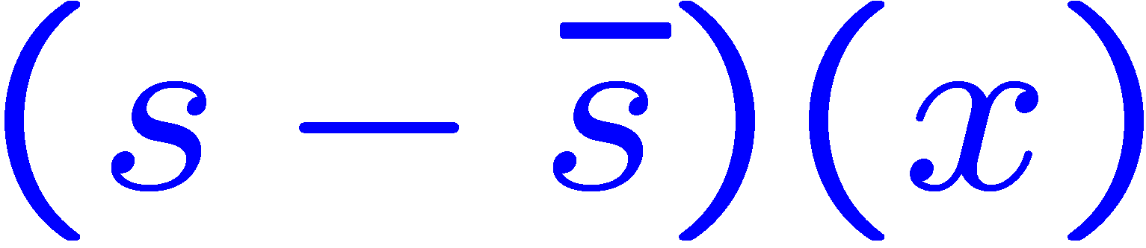
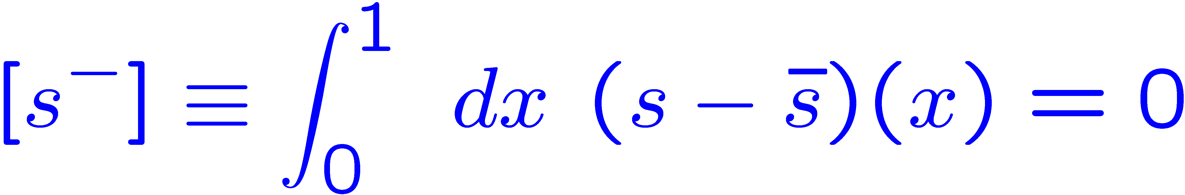
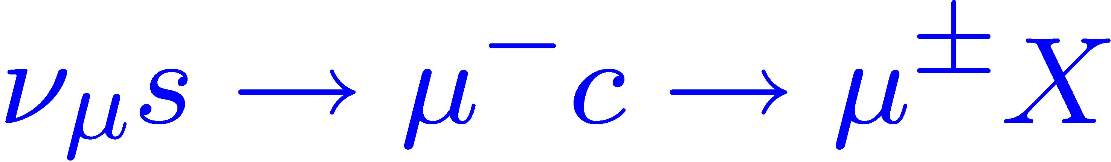
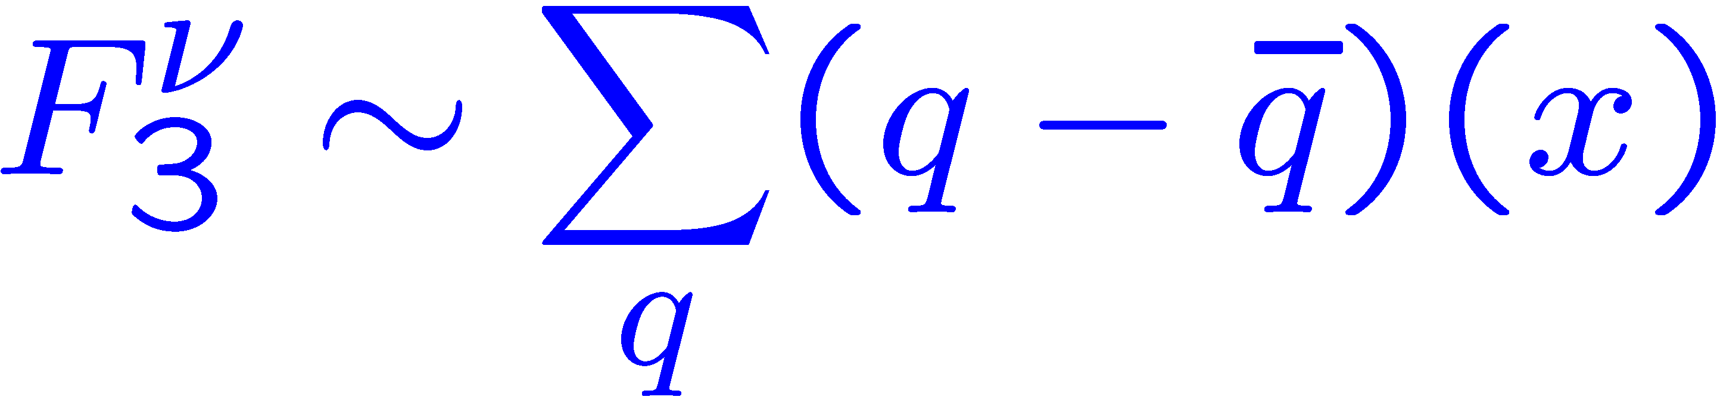
What do we know about ?
Before any data, two things:
(exact sum rule )oscillation)
(positivity)
For more information, we have to ask data:
dimuon production: (CCFR, NuTeV, …)
further (weak) constraints:
  s g ! c W⁻ background to sign-selected W production (“W charge asymmetry”) at the Tevatron

Slide 16
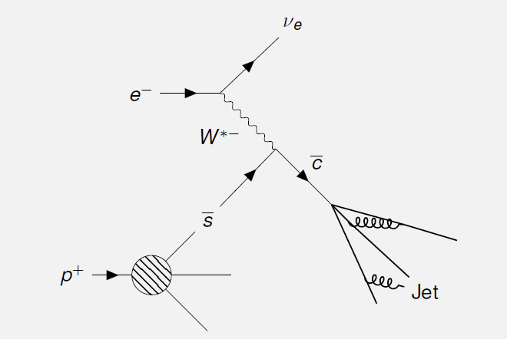
Charm Jet and anti-strange
The neutrino beam experiments, kaon semi-inclusive DIS, and LHC data (for example) have improved our knowledge of s(x;Q²) but there is so much more to be learned, especially at high-x. SIDIS and CC DIS will be important tools for the EIC

Slide 17
Future prospects for [S⁻]?
W and associated charm (jet)
production:
conceivable @ Tevatron, RHIC, LHC
But statistics (efficiency driven)
and high scale are unlikely to permit
to access a small asymmetry.
CC charm @ HERA: ditto
Lattice:
The moment [S⁻] itself does not correspond to a local operator.
Higher, uneven moments (n=3,5,…)
can be related to local operators and could presumably clarify the sign of the x! 1 behaviour, though not the magnitude of [S⁻].
Semi-Inclusive DIS (eRHIC)?
g
c
s
W
Baur, Halzen, Keller, Mangano, Riesselmann

Slide 18
How to extract Fragmentation functions?

Slide 20
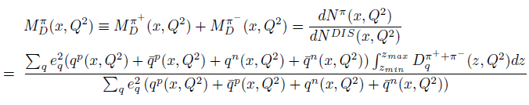
SIDIS using deuteron target
Charge Conjugation of fragmentation functions

Slide 21
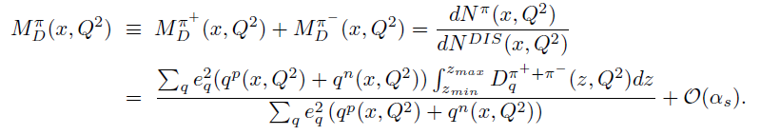
SIDIS off deuteron target
p: proton, n: neutron

Slide 22
SIDIS using deuteron target
Assume PDFs are charge symmetric:

Slide 23
SIDIS using deuteron target
D_{Q}>>D_{S}

Slide 24
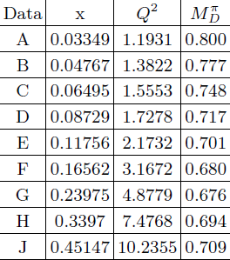
HERMES Data of Pion multiplicity

Slide 25

Kaon Multiplicity

Slide 26
HERMES Kaon Data
A. Airapetian et al. (HERMES Collaboration), Phys. Rev. D
448 89, 097101 (2014).

Slide 27

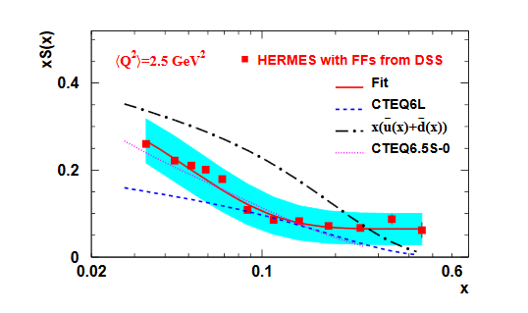
Pion and kaon multiplicities
For pion and kaon multiplicities of SIDIS off the deuteron target:
Combine the HERMES data of kaon and DSS
Fragmentation functions, the strange quark PDF
was extracted.
Phys. Rev. D 89, 097101 (2014)

Slide 28
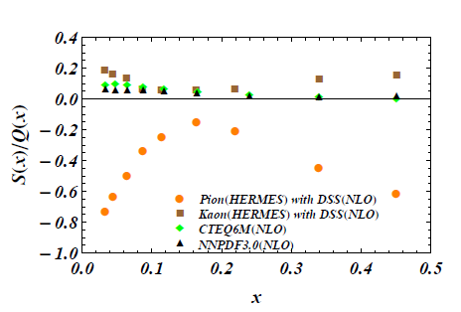


Phys.Lett. B755 (2016) 393-402

Slide 29
Constrains on A and B
Since S(x)>0, Q(x)>0, then S(x)/Q(x) is positive!
At fixed x and Q² :
Note that the values of and are independent of x!

Slide 30
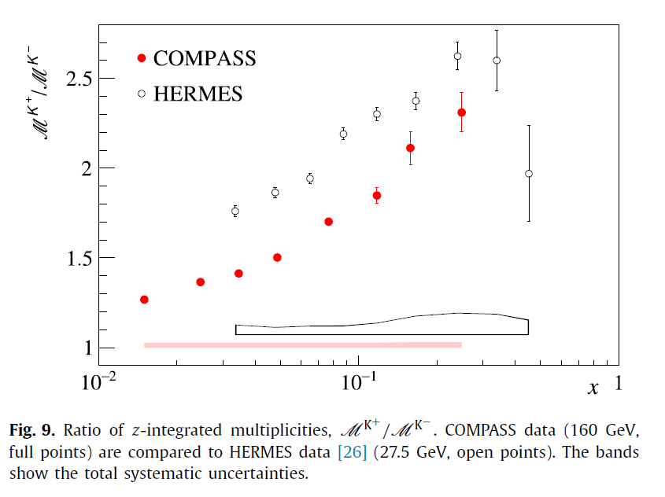
COMPASS and HERMES

Slide 31
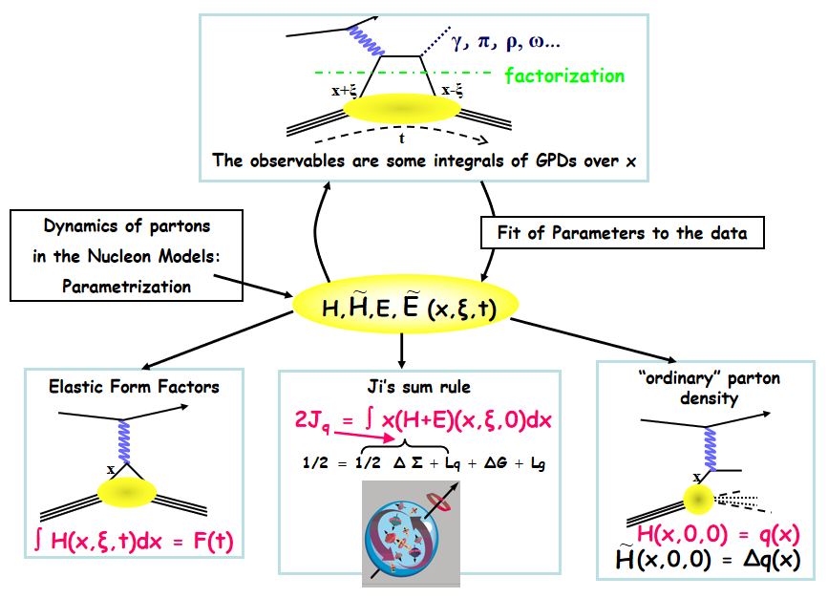

Slide 32
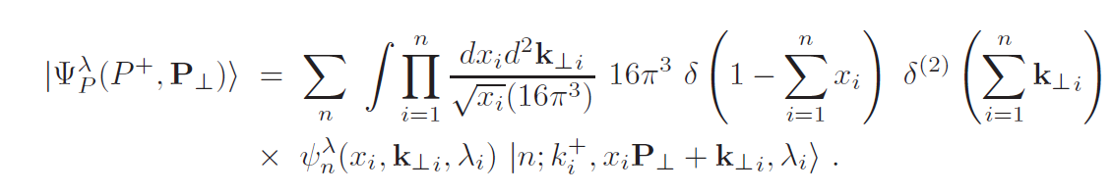
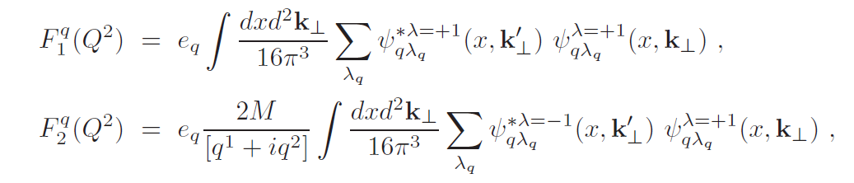
light-front wave functions (LFWFs)
Form Factors given by LFWFs

Slide 33
Conclusion and Outlook
The strangeness in the proton still requires a lot of effort.
With the excellent polarization technique, EIC definitely will help us to know the strangeness much better in the further.
The non-valence content in the hadrons is also needed
to be explored, probably by lattice?
Let us wait and see.

