Slide 1

Spin dynamics of the phi meson in pA reactions probed at KEK and J-PARC
Philipp Gubler (JAEA)
H.J. Kim, P. Gubler and S.H. Lee, Phys. Lett. B 772, 194 (2017).
H.J. Kim and P. Gubler, Phys. Lett. B 805, 135412 (2020).
I.W. Park, H. Sako, K. Aoki, P. Gubler and S.H. Lee, Phys. Rev. D 107, 074033 (2023).
A. Kumar, D.-L. Yang and P. Gubler, 2312.16900 [nucl-th], to be published in PRD.
Work done in collaboration with:
HyungJoo Kim (Hiroshima U.)
InWoo Park (Yonsei U.)
Hiroyuki Sako (JAEA)
Kazuya Aoki (KEK)
Su Houng Lee (Yonsei U.)
Di-Lun Yang (Academia Sinica)
Avdhesh Kumar (Academia Sinica)
Talk at the “ExHIC-p workshop on polarization phenomena in nuclear collisions”, Academia Sinica
Taipei, Taiwan
March 17, 2024

Slide 2
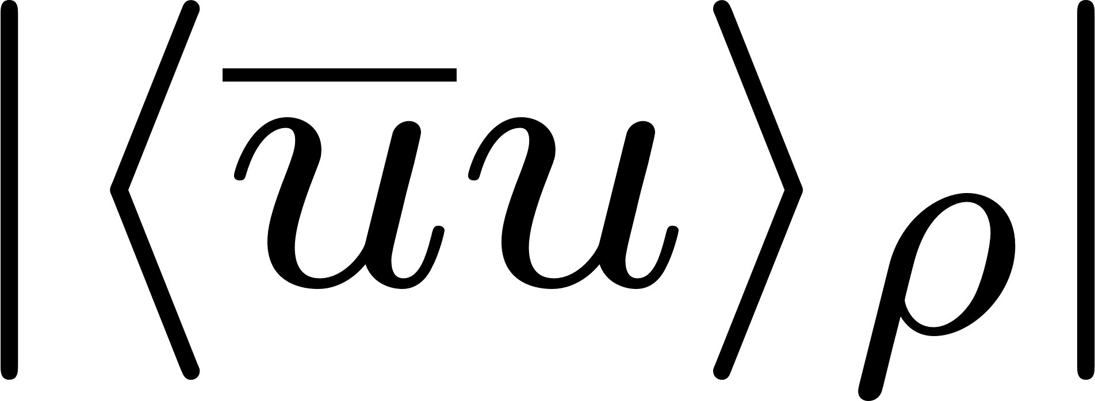
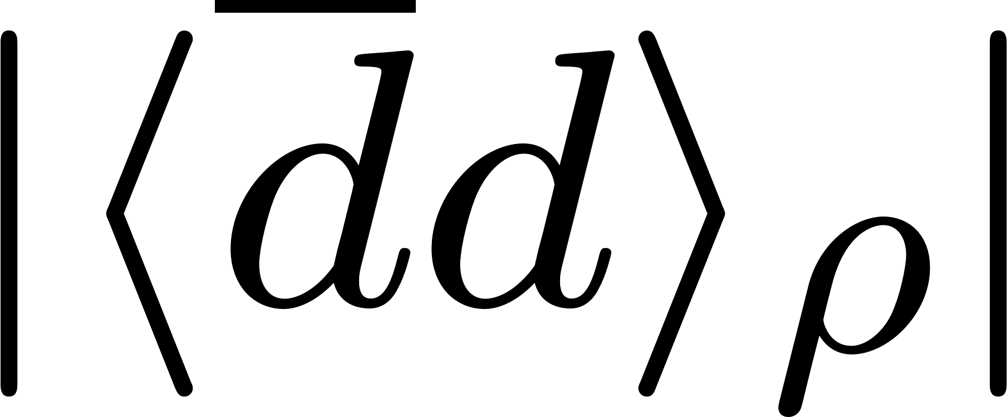
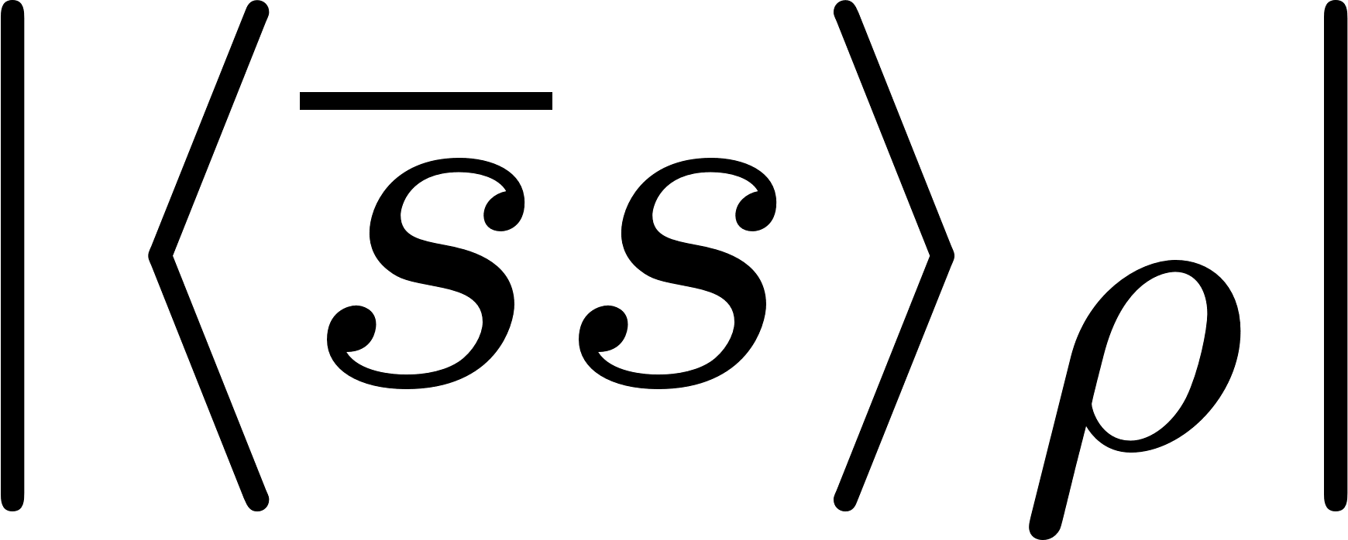


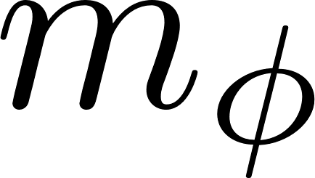
Topics of this talk
?
ϕ
See talk by K. Aoki

Slide 3
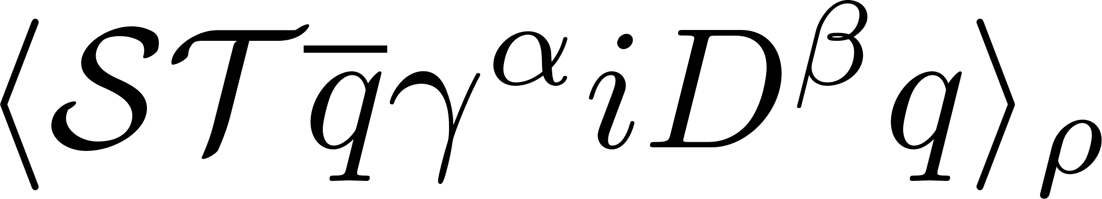
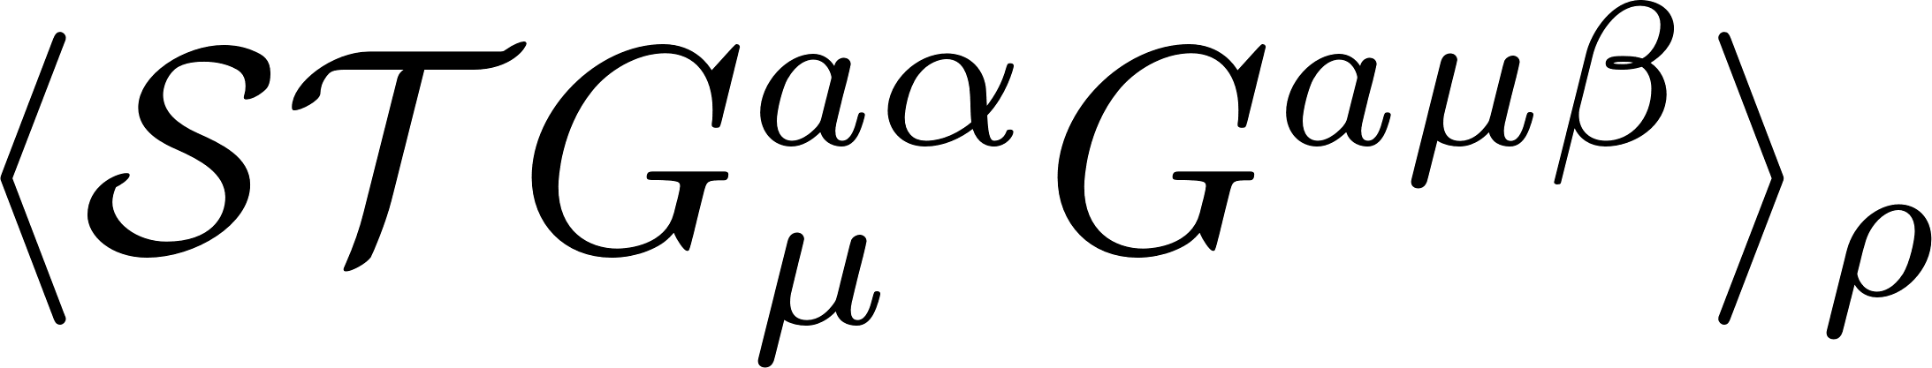
Topics of this talk
?
ϕ
See talk by K. Aoki

Slide 4
The ϕ meson in pA collisions
Experiments to be discussed in this talk
no strong interaction
strong interaction
no distortion of signal due to interaction with nuclear medium
e-
approximate density: normal nuclear density ρ₀
distortion of signal due to interaction with nuclear medium
K⁻
p
p
φ
φ
e⁺
K⁺
nucleus
nucleus
low (zero?) temperature
E325 (KEK)
E16 (J-PARC)
pion beam (HADES)
E88 (J-PARC)

Slide 5
In reality, things are more complicated…
Proton induced generation of vector mesons in nuclei
e
large probability of vector meson decay outside of the nucleus
Non-trivial non-equilibrium process??
e
p
ϕ
density much below ρ₀

Slide 6
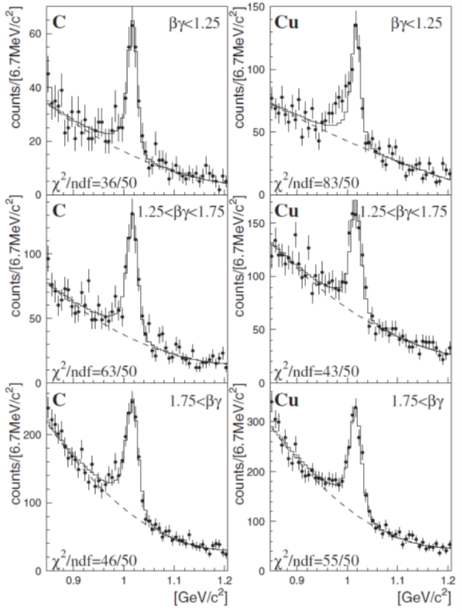
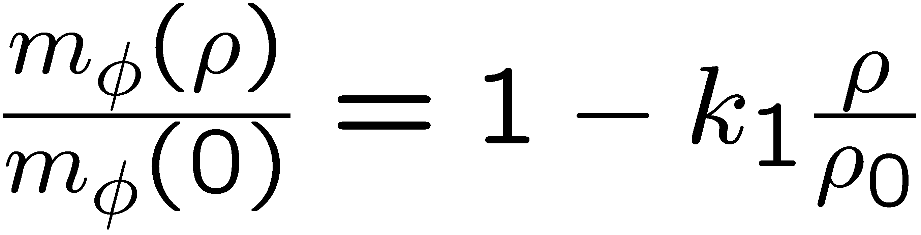

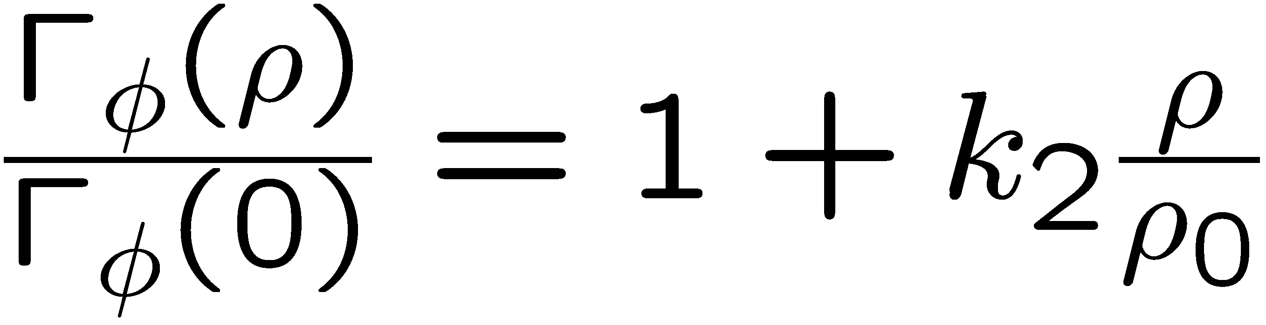
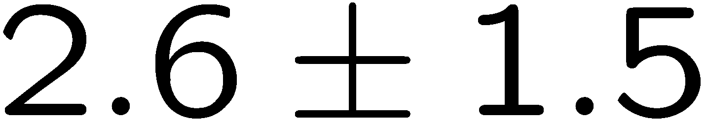
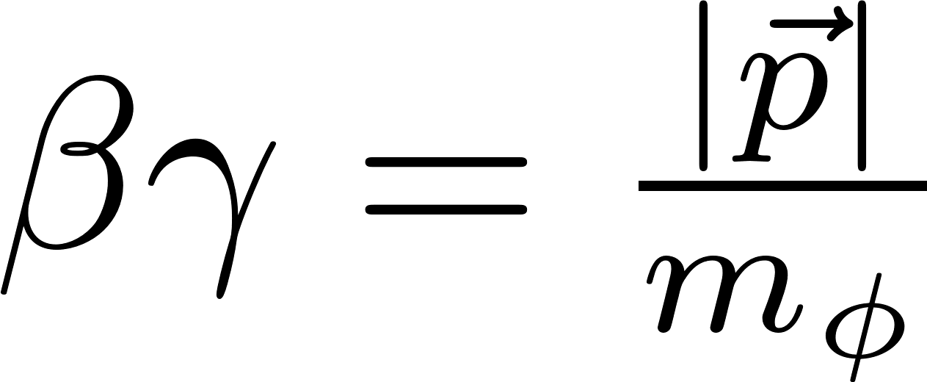
Previous experimental results
e
KEK
E325
12 GeV
pA-reaction
p
slow ϕs
φ
e
Pole mass:
intermediate ϕs
Pole width:
Measurement is being repeated with 100x increased statistics at the J-PARC E16 experiment!
fast ϕs
~
See talk by K. Aoki
R. Muto et al. (E325 Collaboration), Phys. Rev. Lett. 98, 042501 (2007).

Slide 7
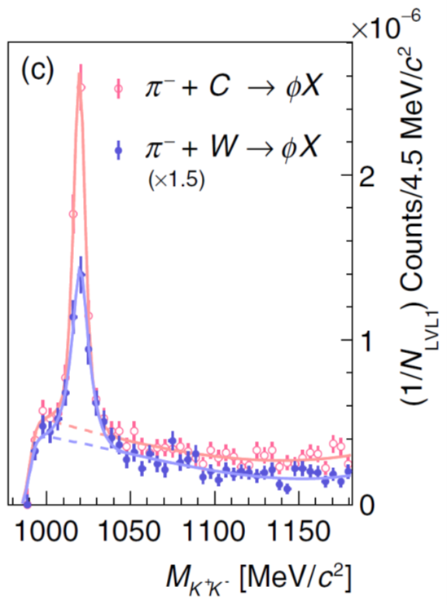
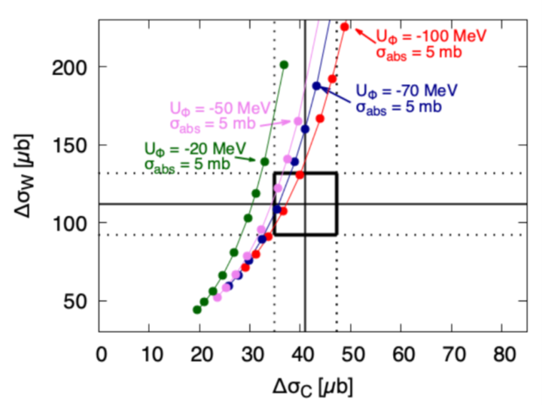
More recent results
HADES:
1.7 GeV π⁻A-reaction
K⁺K⁻ - invariant mass spectrum
Theoretical analysis of the of the total ϕ meson production cross section:
E. Ya. Paryev, Nucl. Phys. A 1032, 122624 (2023).
Attractive ϕ-nucleus potential:
-(50 - 100) MeV
J. Adamczewski-Musch et al. (HADES Coll.),
Phys. Rev. Lett. 123, 022002 (2019).
Relatively small imaginary part:
20 – 25 MeV

Slide 8
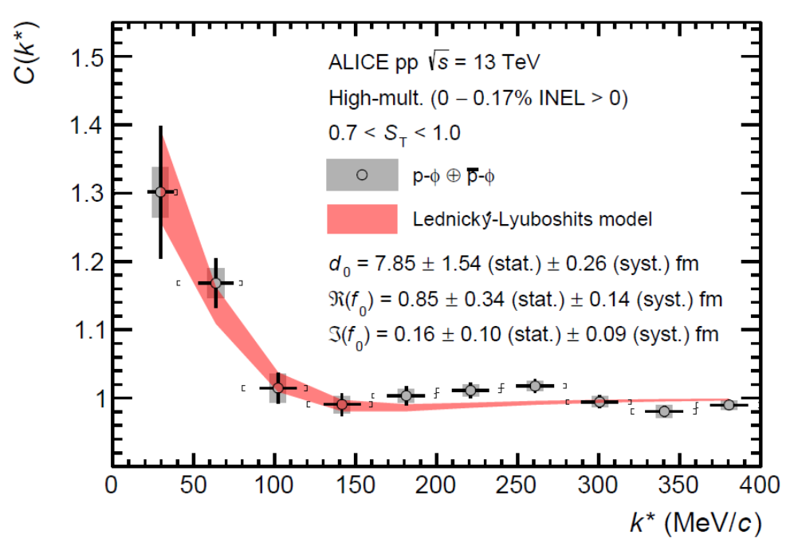
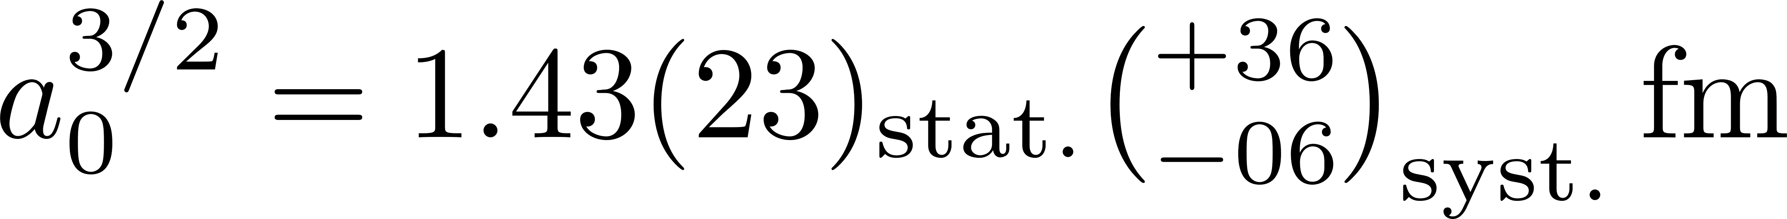
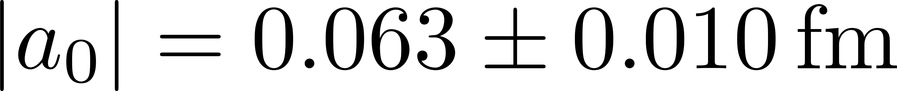
More recent results
ALICE: pp
Measurement of ϕN correlation
Qualitatively agrees with:
Y. Lyu et al. (Lattice QCD, HAL QCD Collaboration),
Phys. Rev. D 106, 074507 (2022).
Attraction!
Disagrees with:
Photoproduction measurement at CLAS
I.I. Strakovsky et al.,
Phys. Rev. C 101, 045201 (2020).
S. Acharya et al. (ALICE Coll.), Phys. Rev. Lett. 127, 172301 (2021).

Slide 9
Role of spin
meson at rest in nuclear matter
meson moving in nuclear matter
spin direction does not change physics (rotational symmetry)
spin direction changes physics (broken rotational symmetry)

Slide 10
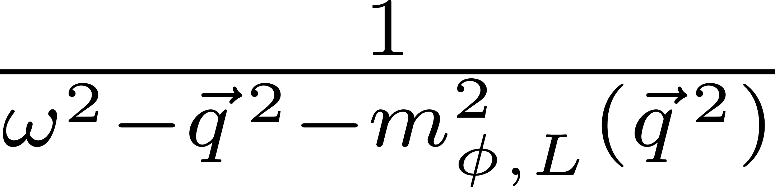
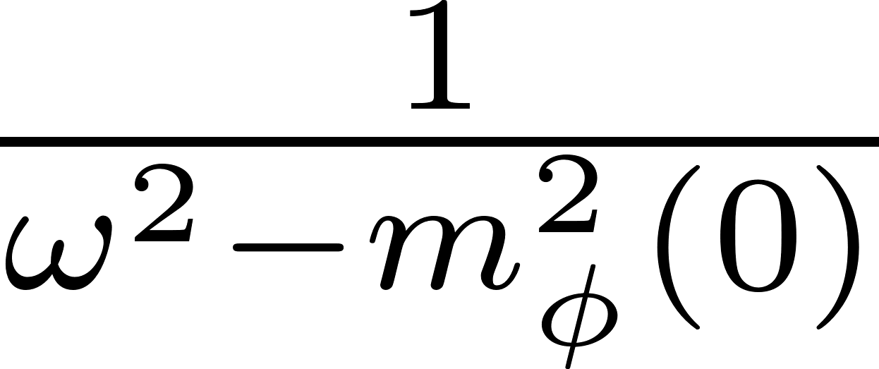
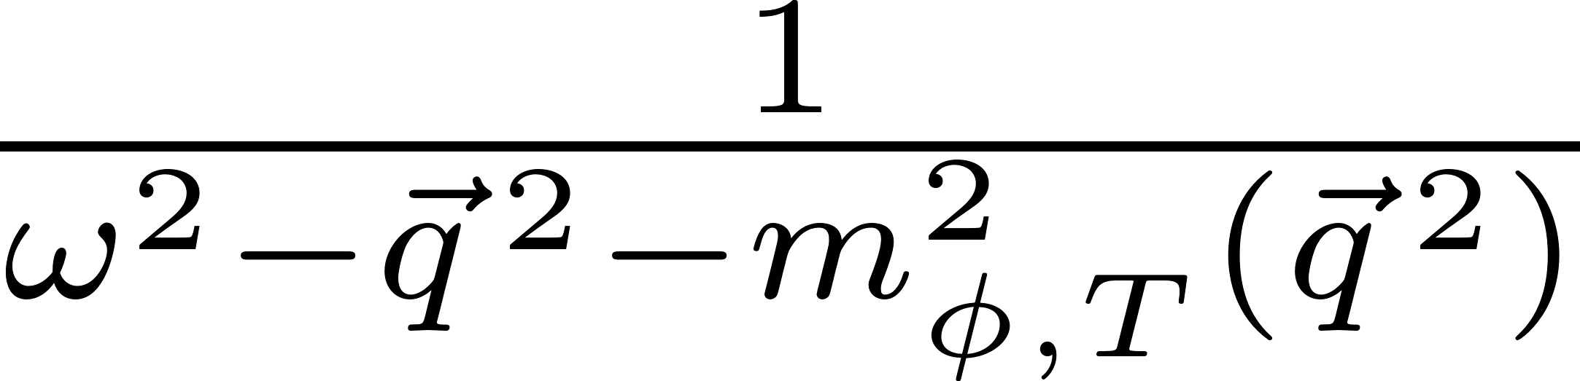
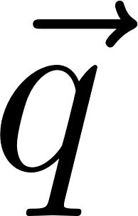
The φ meson with non-zero momentum
longitudinal part
transverse part
zero momentum
non-zero momentum

Slide 11
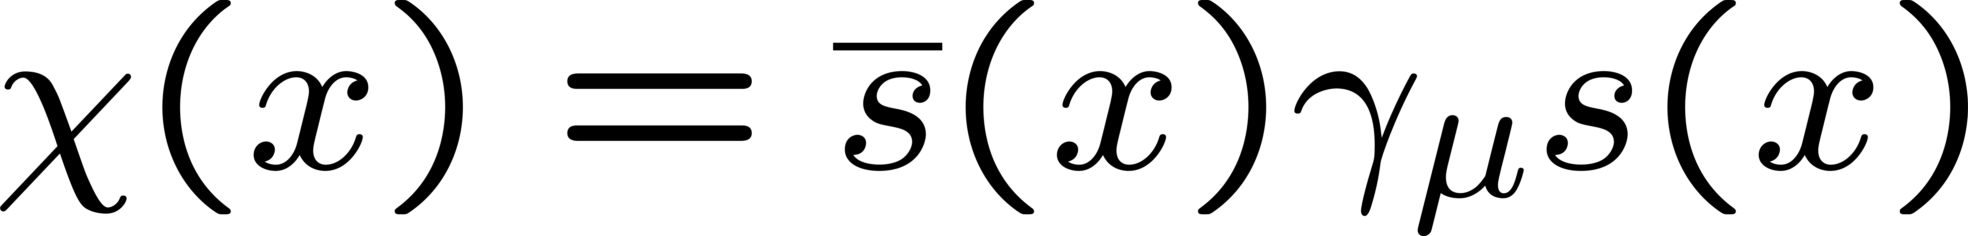
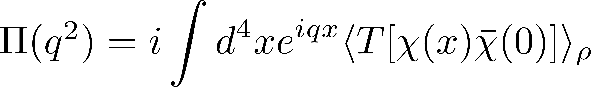
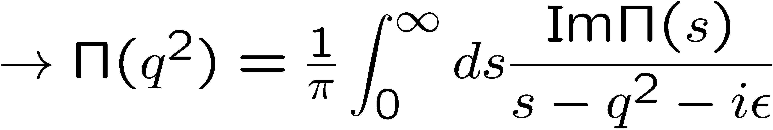
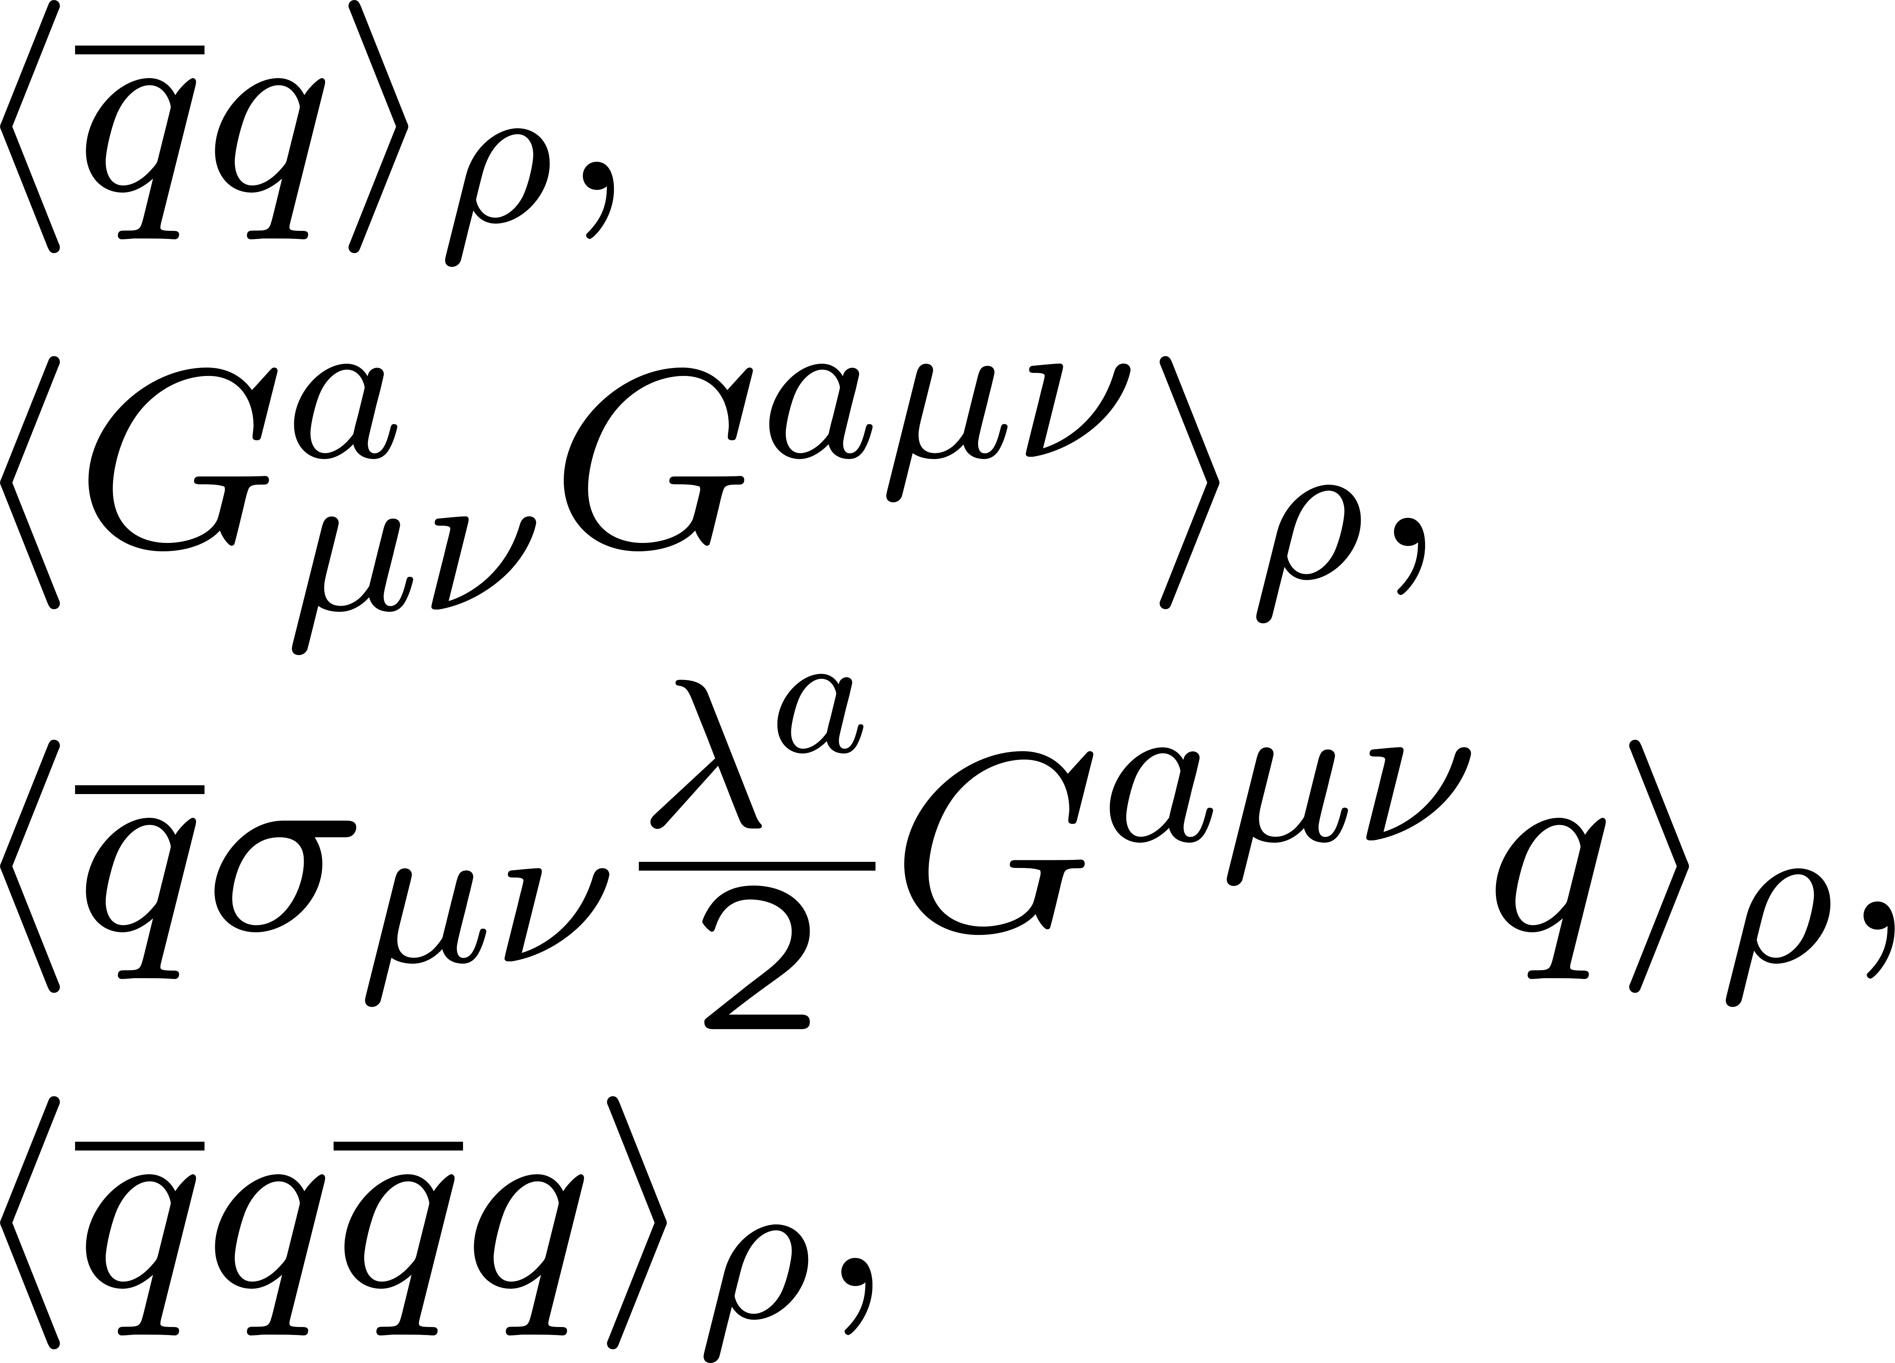
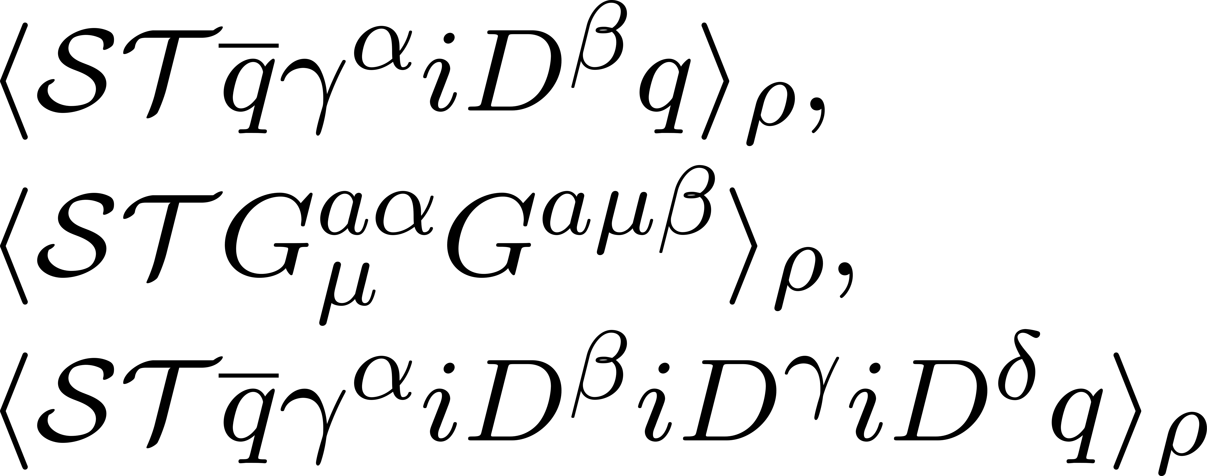
QCD sum rules
M.A. Shifman, A.I. Vainshtein and V.I. Zakharov, Nucl. Phys. B147, 385 (1979); B147, 448 (1979).
T. Hatsuda and S.H. Lee, Phys. Rev. C 46, R34 (1992).
Provides relation between QCD condensates and the hadron spectrum
spectral function
q²
OPE
scalar condensates:
same for longitudinal and transverse modes
non-scalar condensates:
cause difference between longitudinal and transverse modes

Slide 12
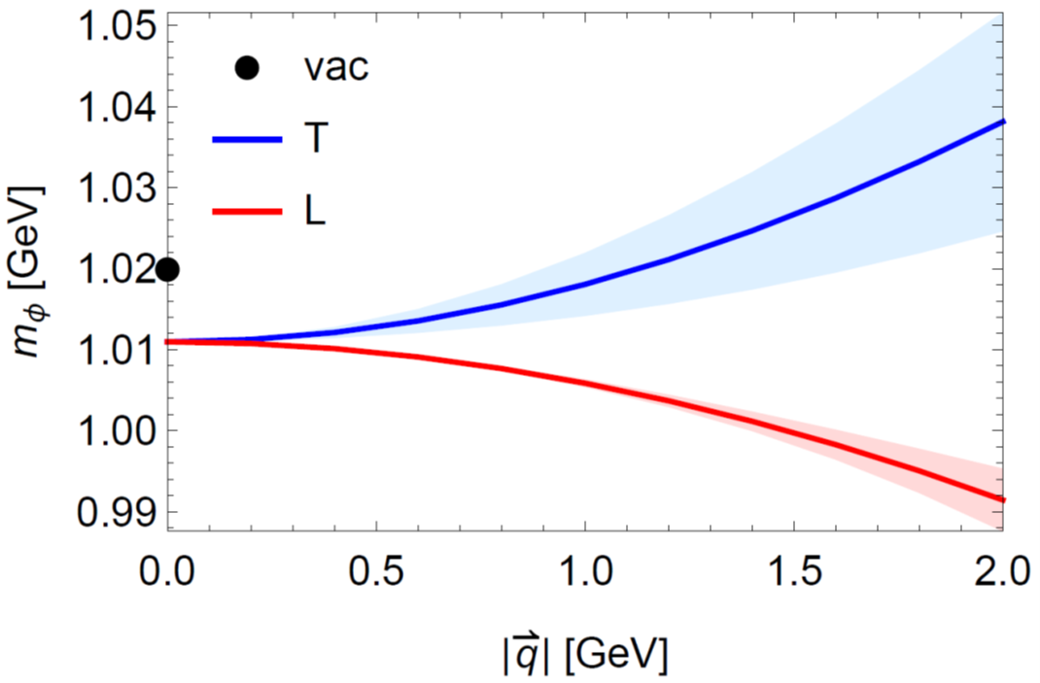
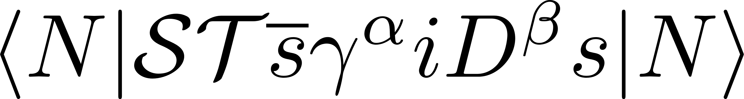
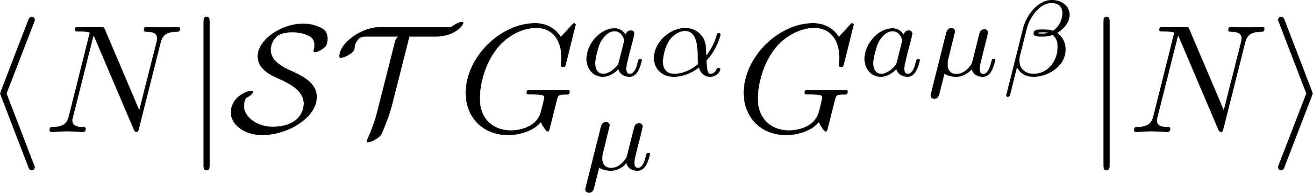
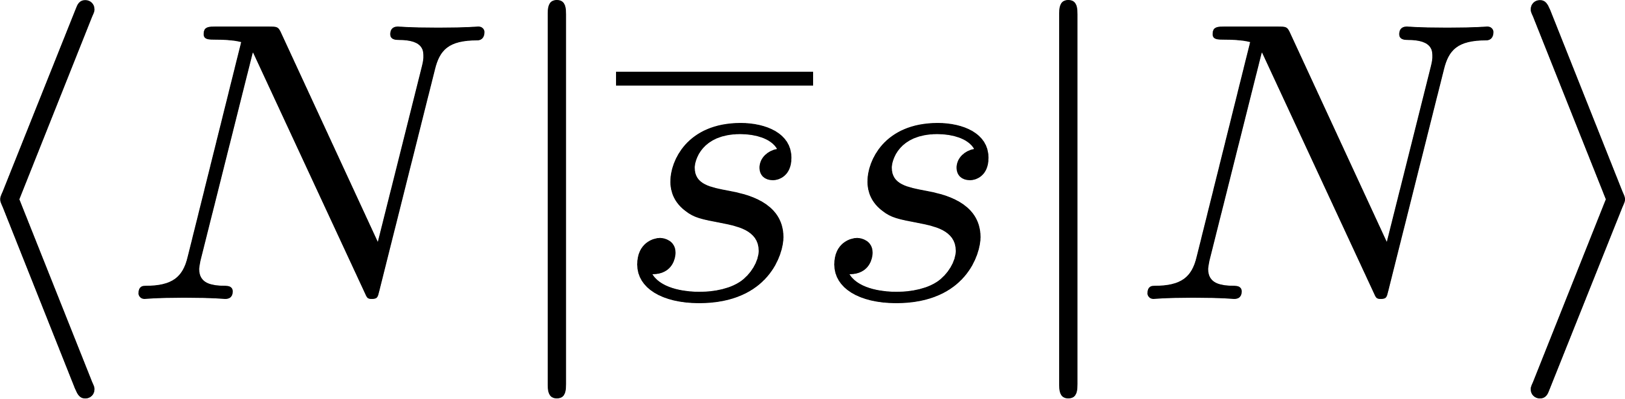
Results for the φ meson mass with non-zero momentum
caused by
＋
depends on
caused by
computed at normal nuclear matter density
Any sizable effect on polarization?
H.J. Kim and P. Gubler, Phys. Lett. B 805, 135412 (2020).

Slide 13
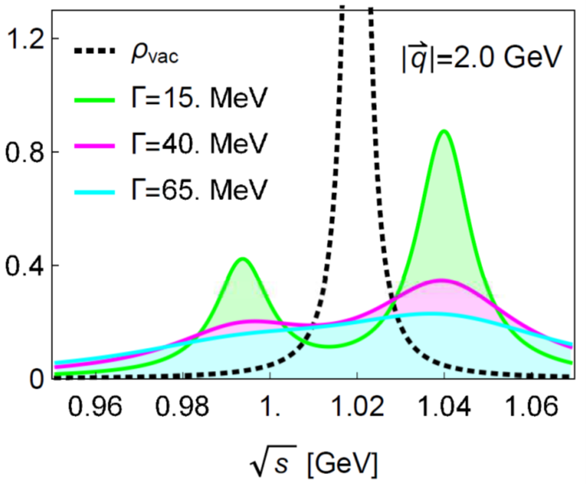
The angle-averaged di-lepton spectrum
Computed at normal nuclear matter density
A double peak?
H.J. Kim and P. Gubler, Phys. Lett. B 805, 135412 (2020).

Slide 14
The angle-averaged di-lepton spectrum
Even without a double peak, momentum effects can be observed
Results of one-peak fits
H.J. Kim and P. Gubler, Phys. Lett. B 805, 135412 (2020).

Slide 15

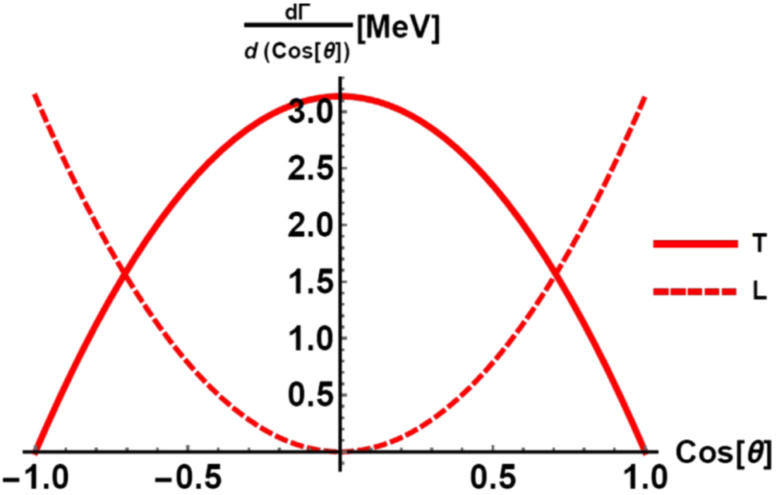
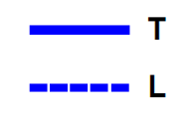
Angular distributions of ϕ meson dilepton and K⁺K⁻ decays
e⁺
ϕ
e⁻
Dilepton decay angular distribution
K⁺K⁻ decay angular distribution
c.m. frame
c.m. frame
I.W. Park, H. Sako, K. Aoki, P. Gubler and S.H. Lee, Phys. Rev. D 107, 074033 (2023).

Slide 16
Further tasks for theory
Have a good understanding of the production mechanisms of the ϕ mesons in nuclei
from pA reactions.
e⁺
K⁻
p
e⁻
p
φ
φ
K⁺
Where (and at what densities) is the ϕ meson produced and where does it decay?
How do the final state interactions of the decay particles influence the decay
spectrum (especially for K⁺K⁻)?
Realistic transport simulations using a transport approach
(calculations using the PHSD code are ongoing)
See talk by L. Oliva

Slide 17
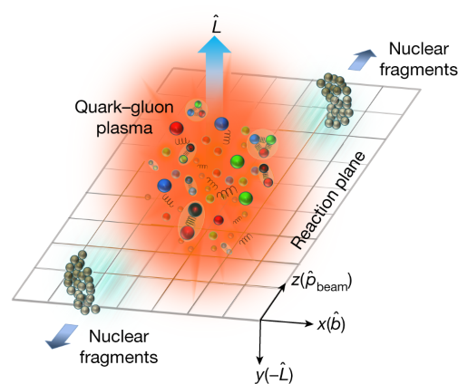
New mechanism for spin alignment of vector mesons:
hydrondynamic gradients
Spin alignment can be induced by the mere existence of gradients of distribution functions!
A. Kumar, D.-L. Yang and P. Gubler, 2312.16900 [nucl-th], to be published in PRD.

Slide 18
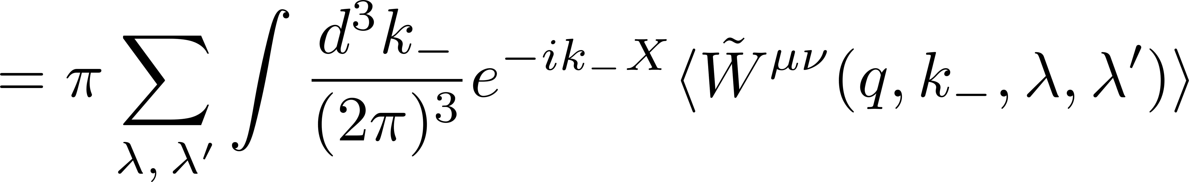
Outline of derivation
Starting point: Wigner function for vector mesons
general effect!
_{(should always be considered)}
Expand around small k₋
Gradient expansion in position space
A. Kumar, D.-L. Yang and P. Gubler, 2312.16900 [nucl-th], to be published in PRD.

Slide 19
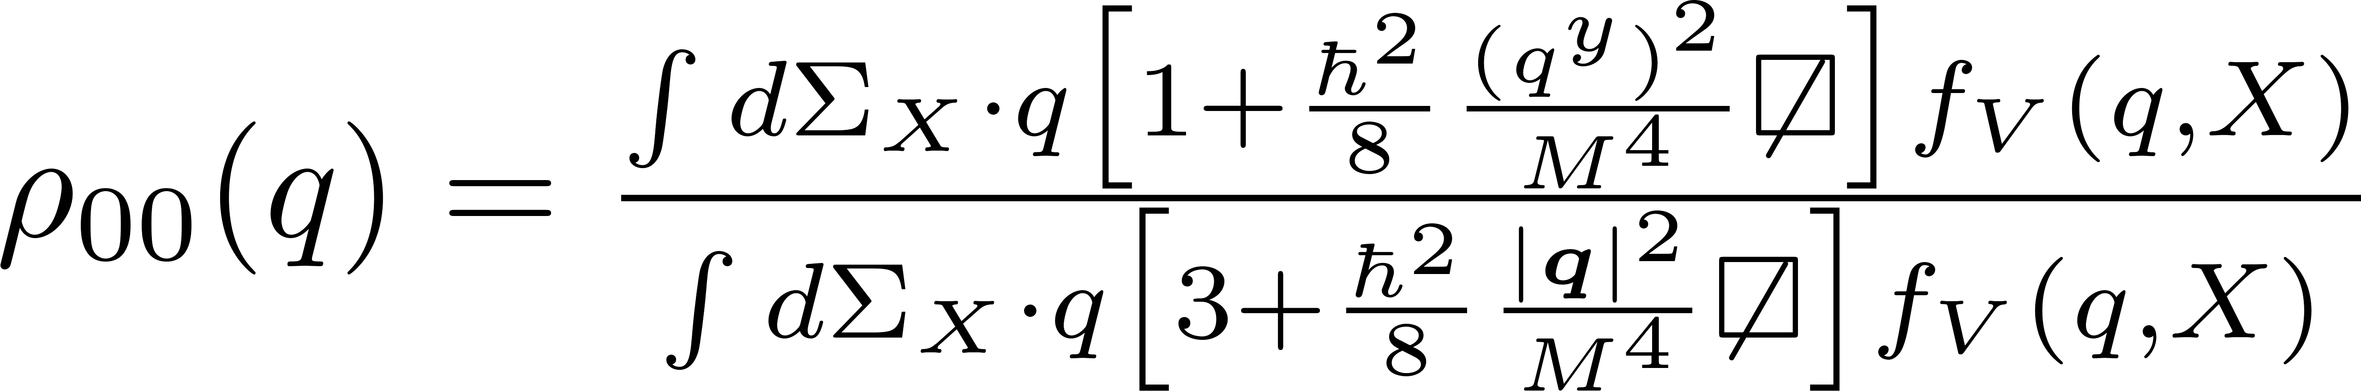
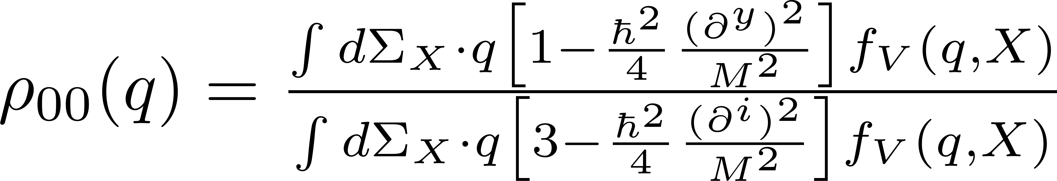
Relate to spin density matrix
freeze-out hypersurface
_{Polarization vectors}
Large-momentum limit
Small-momentum limit
with
(polarization averaged) distribution functions of vector mesons
A. Kumar, D.-L. Yang and P. Gubler, 2312.16900 [nucl-th], to be published in PRD.

Slide 20
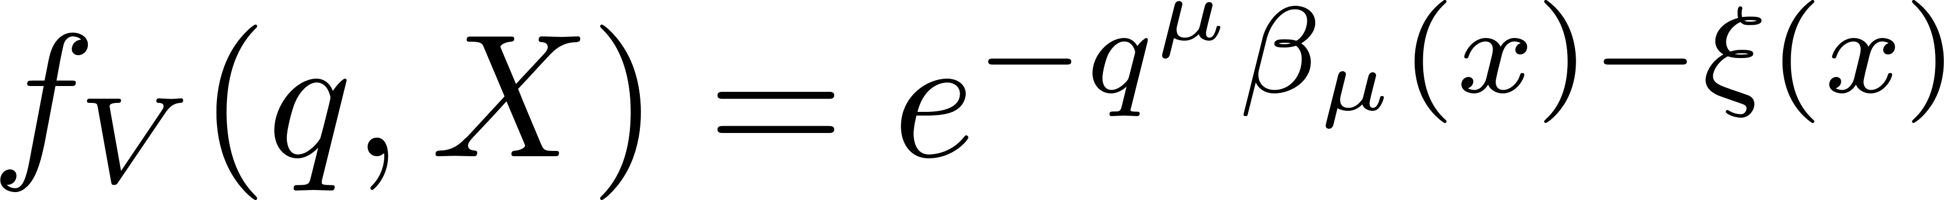
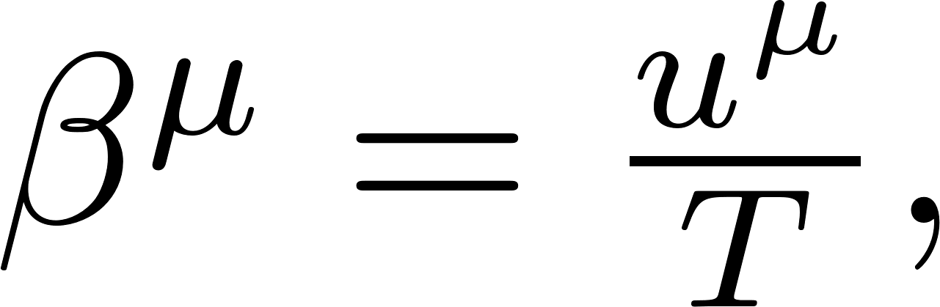
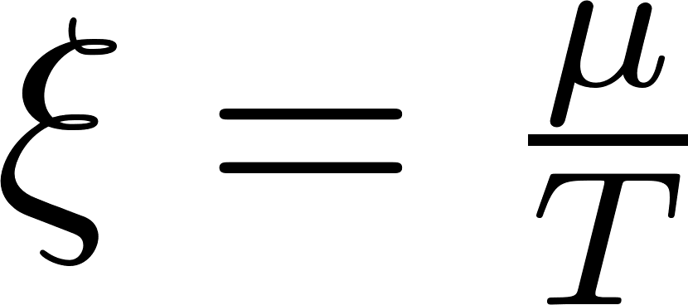
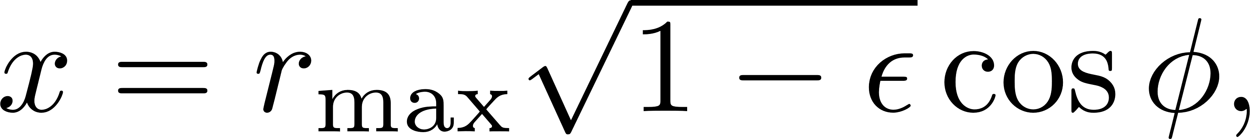
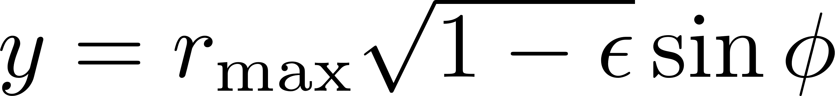
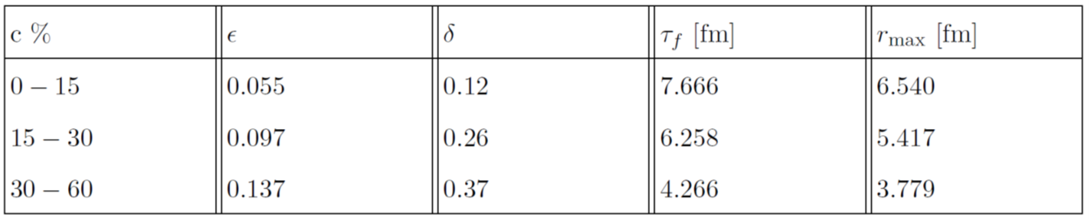
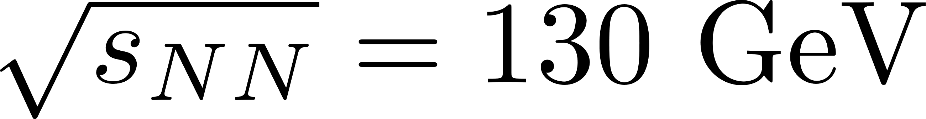
First application of our formalism
Thermal model with single freeze-out to describe soft hadron production for Au + Au collisions at top RHIC energies:
(Jüttner distribution)
elliptical asymmetry:
elliptical flow:
PHOENIX data at
A. Kumar, D.-L. Yang and P. Gubler, 2312.16900 [nucl-th], to be published in PRD.

Slide 21
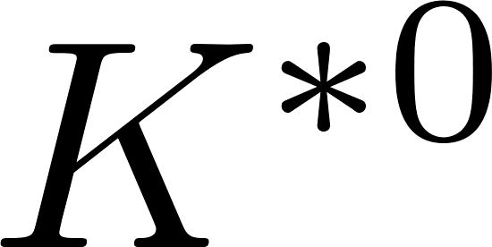

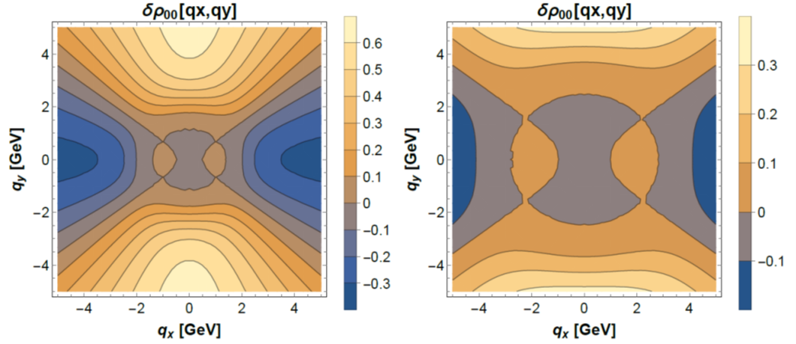
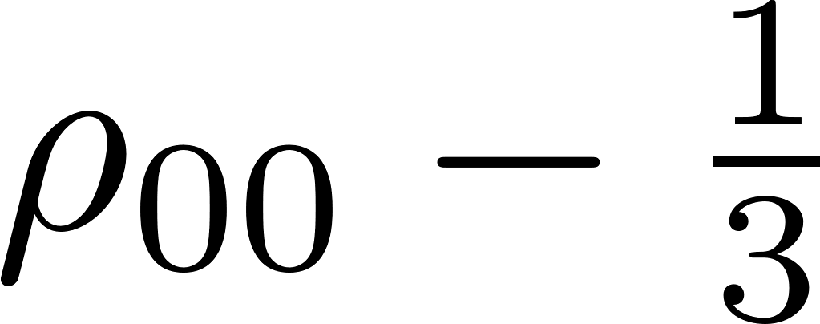
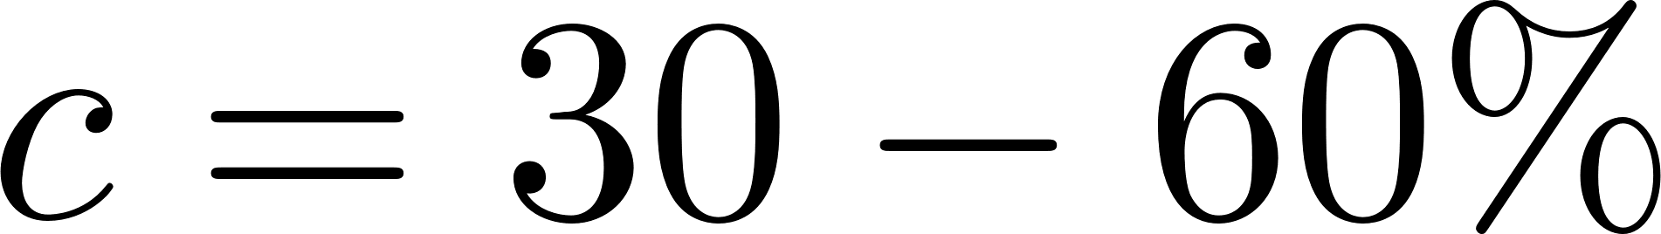
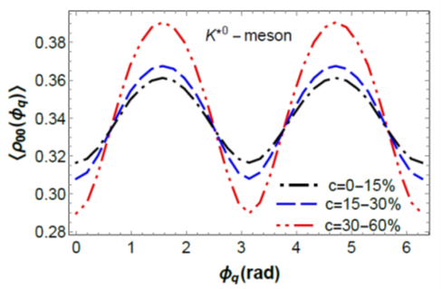

First application of our formalism
Azimuthal angle dependence
A. Kumar, D.-L. Yang and P. Gubler, 2312.16900 [nucl-th], to be published in PRD.

Slide 22
Next:
Application to ϕ mesons in pA collisions at KEK/J-PARC

Slide 23
Summary and conclusions
Dispersion relations of hadrons can be non-trivially modified in nuclear matter.
For the ϕ meson, the longitudinal and transverse modes are shifted in opposite directions with increasing momentum.
May be observed as a small positive mass shift + width increase at the E16 experiment at J-PARC
A lot of new experimental information about the ϕN and ϕ-nucleus interactions is becoming available (LHC, J-PARC, HADES)
Strong hadronic medium effect?
New formalism was developed to study vector meson spin alignment from thermodynamic gradients

Slide 24
Backup slides

Slide 25
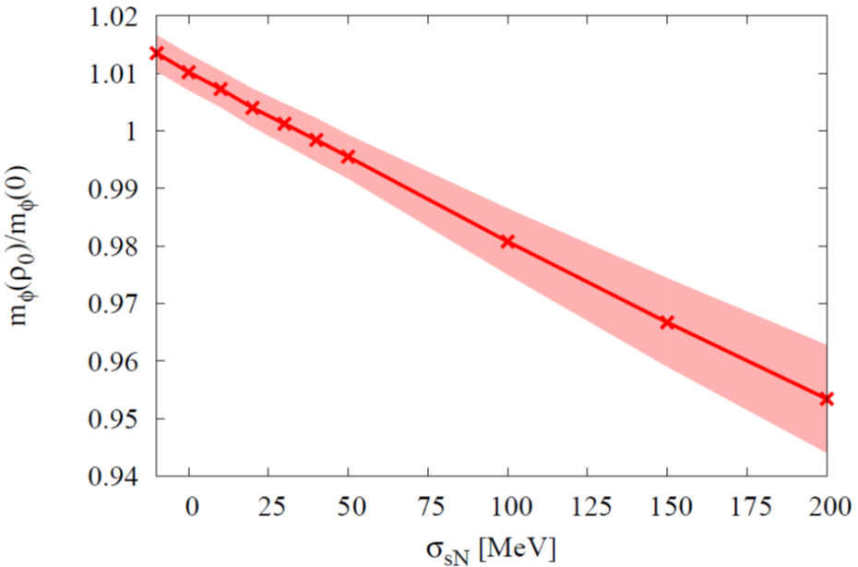
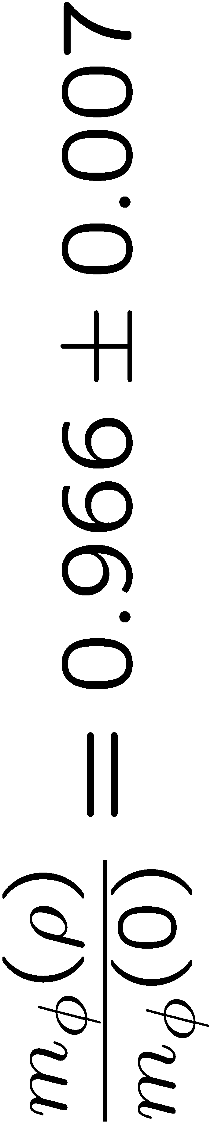

ϕ meson at rest in nuclear matter
The ϕ meson mass in nuclear matter probes the strange quark condensate at finite density!
Sum Rules + Experiment
Not consistent?
R. Muto et al.
(KEK, E325 Collaboration),
Phys. Rev. Lett. 98,
042501 (2007).
Lattice QCD
Experiment
Measurement will be repeated at the
J-PARC E16 experiment (with 100 times increased statistics!)

Slide 26


Condensates that appear in the vector channel
scalar
non-scalar
Wilson coefficients were not yet available until recently

Slide 27



OPE calculation
Mass singularities in chiral limit!
Subtract corresponding quark condensate contribution
S. Kim and S.H. Lee, Nucl. Phys. 679, 517 (2001).
H.J. Kim, P. Gubler and S.H. Lee, Phys. Lett. B 772, 194 (2017).

Slide 28

Experimental di-lepton spectrum
e
e
p
e
+
p
=
Experimentally observed spectrum
φ
φ
e
outside decay
inside decay

Slide 29


Can the two polarizations be disentangled?
Look at the angular distributions of various decay channels
To be measured soon at the J-PARC E16 experiment
New E88 experiment
at J-PARC (in a few years)

Slide 30




A simple example of dilepton decay of a longitudinally polarized ϕ
after decay
$$e^{+}$$
before decay
decay perpendicular to the ϕ meson momentum:
allowed
$$e^{−}$$
ϕ
decay parallel to the ϕ meson momentum:
not allowed
$$e^{−}$$
$$e^{+}$$
measurement in this direction can be used to observe purely transverse mode

Slide 31





A simple example of K⁺K⁻ decay of a transversely polarized ϕ
after decay
decay perpendicular to the ϕ meson momentum:
allowed
$$K^{+}$$
before decay
$$K^{−}$$
ϕ
decay parallel to the ϕ meson momentum:
not allowed
$$K^{−}$$
$$K^{+}$$
measurement in this direction can be used to observe purely longitudinal mode

Slide 32






Full angular distribution of dilepton decay
Initial polarization:
Transverse polarization
Longitudinal polarization
other φ-dependent terms

Slide 33


Full angular distribution of dilepton decay
With
00-component of spin-density matrix
Unpolarized case: vanishing θ-dependence
φ-dependent terms

Slide 34
Full angular distribution of K⁺K⁻ decay
Transverse modes
Longitudinal mode
φ-dependent terms

