Slide 1
Charmless Two-body Baryonic B Decays and Baryonic Semileptonic B Decays
2024 TQCD 1st meeting
Jan. 24, 2024
IoP, Academia Sinica
Chun-Khiang Chua
Chung Yuan Christian University
Based on 2 PRD
arXiv: 2205.14026,
2304.11871, CKC

Slide 2
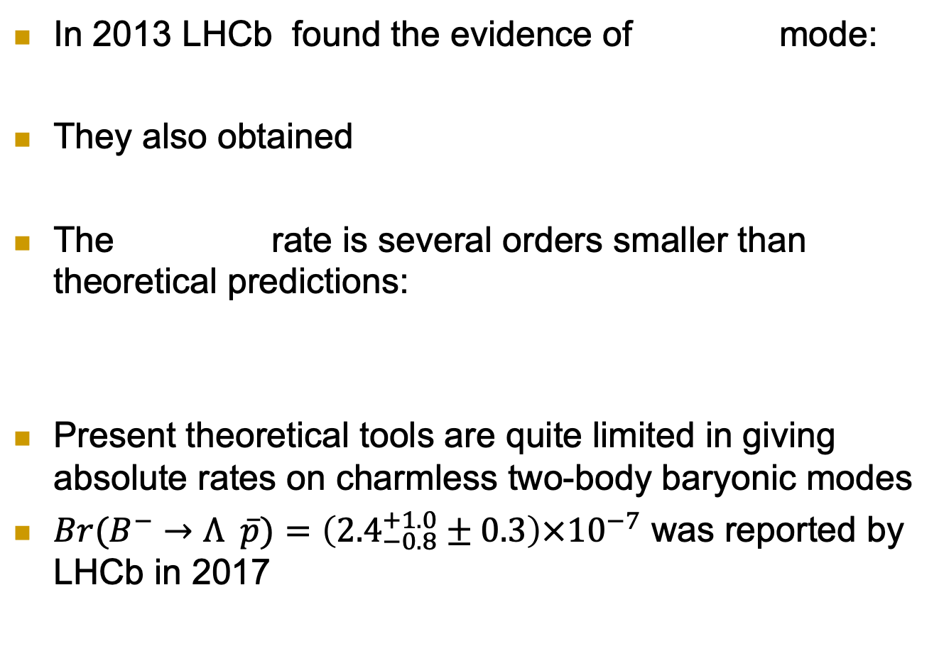
Motivation
In 2013 LHCb found the evidence of mode:
They also obtained
The rate is several orders smaller than theoretical predictions:
Present theoretical tools are quite limited in giving absolute rates on charmless two-body baryonic modes
${Br(B}^{−}→Λ \overline{p})=\left({2.4}_{−0.8}^{+1.0}±0.3\right)×{10}^{−7}$ was reported by LHCb in 2017 (1-6 magnitude improvements are expected in future)
 | CZ(1990) | Jarfi(1990) | CY(2002)
 | 1.2x10⁻⁶ | 7.0x10⁻⁶ | 1.1x10⁻⁷

Slide 3
Current experimental status:
More to come, it is interesting to study these modes

Slide 4
In fact, more B to come…
Taken from arXiv:2101.08326

Slide 5
Our approach
Since the absolute rate is too hard to obtain, we use symmetry to get relative rates
We use the topological amplitude approach (Chau, Cheng 87; Gronau, Hernandez, London, Rosner 94)
  It is highly related to SU(3) symmetry
  It provide estimation on size (hierarchy) on TA
  It does not rely on factorization
  It may include FSI (B→DP Chiang 01; Chiang, Rosner 02)
There are asymptotic relations in the large m_{B} limit (Brodsky, Lepage, Zaidi 81; Chua, Hou, 03; Chua 03)
Use the measured rate to predict other rates
Can be improved when more modes are observed

Slide 6
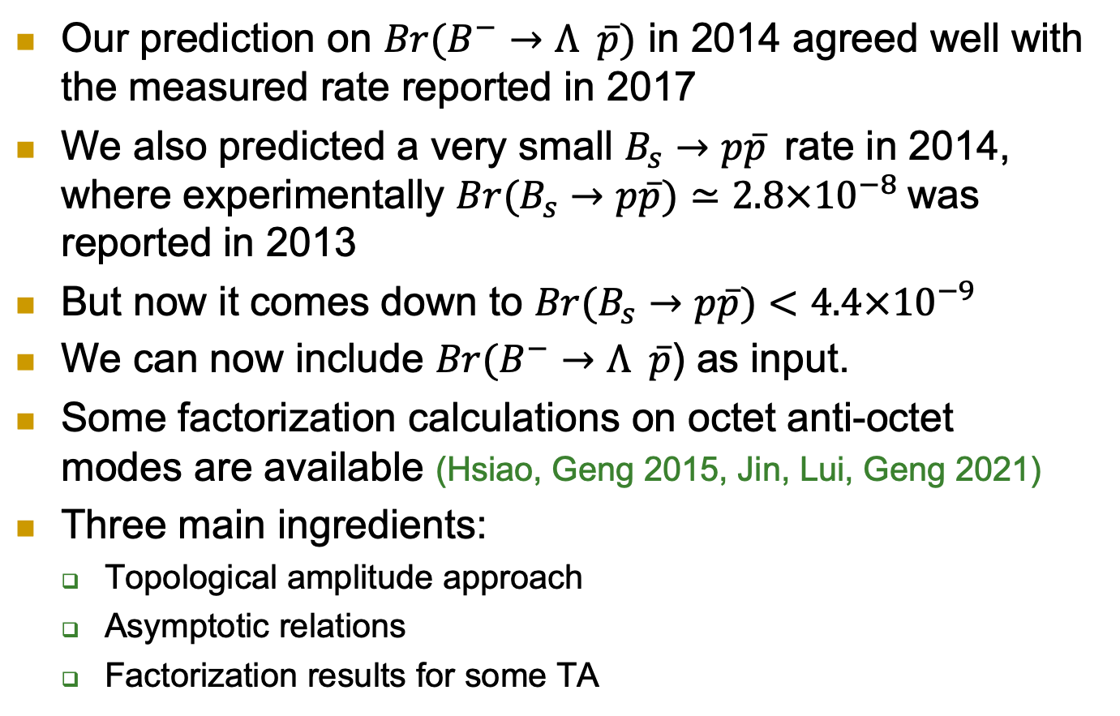
Our approach
Our prediction on ${Br(B}^{−}→Λ \overline{p})$ in 2014 agreed well with the measured rate reported in 2017
We also predicted a very small $B_{s}→p\overline{p}$rate in 2014, where experimentally ${Br(B}_{s}→p\overline{p})≃2.8×{10}^{−8}$was reported in 2013
But now it comes down to ${Br(B}_{s}→p\overline{p})<4.4×{10}^{−9}$
We can now include ${Br(B}^{−}→Λ \overline{p}$) as input.
Some factorization calculations on octet anti-octet modes are available (Hsiao, Geng 2015, Jin, Lui, Geng 2021)
Three main ingredients:
  Topological amplitude approach
  Asymptotic relations
  Factorization results for some TA

Slide 7
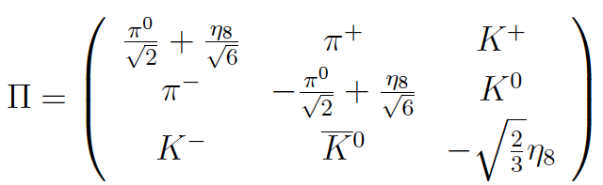
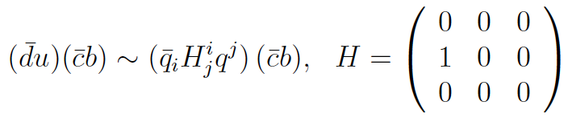
An example: Charmful case
Quark diagram is a representation of flavor SU(3), they should be related (Zeppenfeld 1980)
Under SU(3),
H_{W}:
Spurion

Slide 8
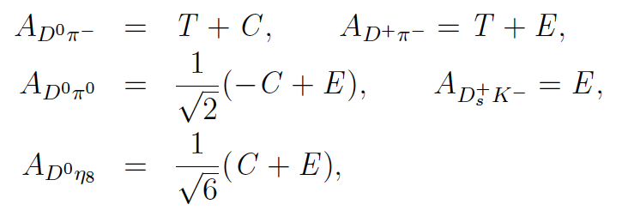
From SU(3) symmetry (Savage, Wise 1989)
Gives
Identical to the usual topological amplitudes
T: Tree C: Color-suppressed Tree E: Exchange

Slide 9

This is not a coincidence
Tree operator generates
Giving
Which is precisely the first term of H_{eff}
Using field convention: denotes initial (final) anti-quark

Slide 10
Similarly
T: Tree
C: Color-sup. Tree
E: Exchange

Slide 11
Note that
These are flavor flow diagrams
Using the SU(3) method is a convenient way to obtain the flavor flow structure
Flavor flow diagrams can have SU(3) breaking effects

Slide 12
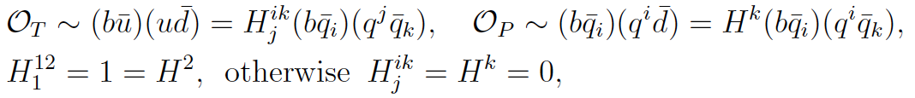
Charmless case
Tree operator
Penguin operator

Slide 13
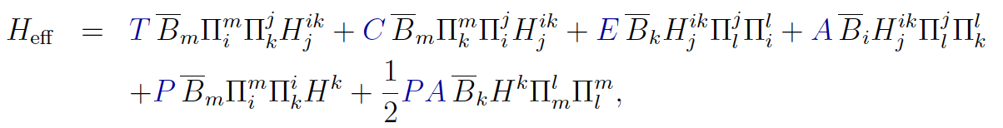
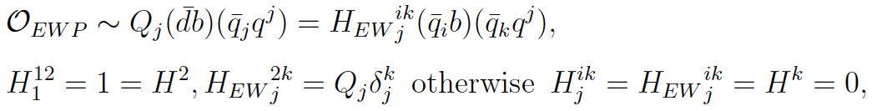
Another example: Charmless B to PP decays
Similarly
reproduces well-known topological amplitudes for B to
pseudoscalar-pseudoscalar modes
Electroweak penguin can be incorporated similarly

Slide 14
Similarly
T
C
E
A
P
PA

Slide 15
B to decuplet anti-decuplet baryonic decays
We start from the tree amplitude

Slide 16
Similarly
T
P
E
A
PA
P_{EW}

Slide 17
Modes with (anti)octet final state
The octet field is
It suggests that
They are not independent (2 indep. terms)

Slide 18
Effective Hamiltonian for decays
Replacing in the hamiltonian by
There are 2 T, 1 P, 2 Pew, 1 E, 1 A, 0 PA
Prefactors are assigned for later purpose

Slide 19
Similarly, for , decays
We have

Slide 20
A short summary
modes | # of modes ΔS=0(1) | # of T | # of P | # of Pew | # of E | # of A | # of PA
Dbar D | 22(22) | 1(1) | 1(1) | 1(1) | 1(1) | 1(1) | 1(1)
Dbar B | 20(20) | 2(2) | 1(1) | 2(2) | 1(1) | 1(1) | 0
Bbar D | 20(20) | 2(2) | 1(1) | 2(2) | 1(1) | 1(1) | 0
Bbar B | 22(22) | 4(4) | 2(2) | 4(4) | 2(2) | 2(2) | 1
More than 160 modes

Slide 21
Some sample amplitudes:
… see PRD89.056003

Slide 22
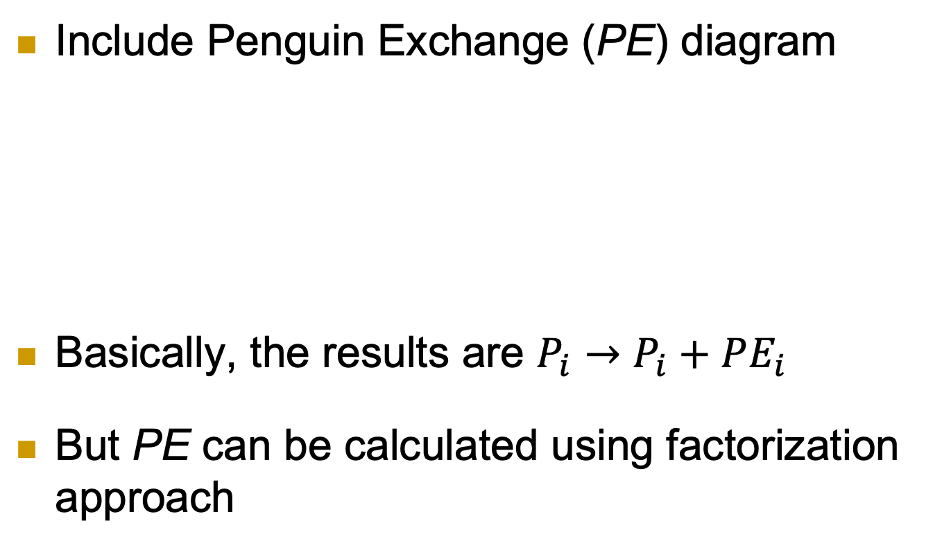
Recent update
Include Penguin Exchange (PE) diagram
Basically, the results are $P_{i}→P_{i}+PE_{i}$
But PE can be calculated using factorization approach

Slide 23
For example,

Slide 24
P and PE have same flavor flow structure
PE
P

Slide 25
Factorization calculation
A typical factorization amplitude is given by
With

Slide 26
More explicitly…

Slide 27
Relating factorization amp. with TA
Matching the amplitudes with diagrams
c are some Clebsch-Gordan coefficients

Slide 28
Flavor flow diagrams
A
E
PA
PE

Slide 29
EOM and asymptotic relations
EOM
Asymptotic relations

Slide 30
We obtain A, A^{c}, E, PE and PA

Slide 31
Form factor
Matching the matrix element with the one obtained in Chua, Hou 03
Obtain
The sizes agree with those obtained using a bag model calculation (Jin, Lui, Geng 21)

Slide 32
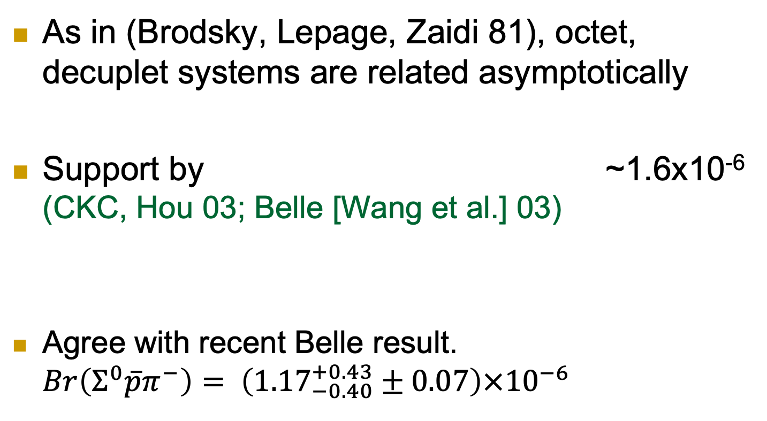
Asymptotic Relations:
As in (Brodsky, Lepage, Zaidi 81), octet, decuplet systems are related asymptotically
Support by ~1.6x10⁻⁶ (CKC, Hou 03; Belle [Wang et al.] 03)
Agree with recent Belle result. $Br\left(Σ^{0}\overline{p}π^{−}\right)= \left({1.17}_{−0.40}^{+0.43}±0.07\right)×{10}^{−6}$

Slide 33

Make use of m_{B} is large and the weak int. is a chiral theory
And the previous asymptotic relations
Estimate:
Use the measured $B^{0}→\overline{p}p$ and $B^{−}→Λ\overline{p}$ rates to extract $χ$ and $κ$

Slide 34
Numerical Results
Sizes of TA
The P/T ratio is as expected
PE are sizable, about 30% of P

Slide 35
A, E and PA are highly suppressed (chiral suppression)

Slide 36
Baryons are grouped according to their detectability.

Slide 37

$B^{0}→\overline{p}p$ most accessible
Not surprised to be the 1st detected one

Slide 38
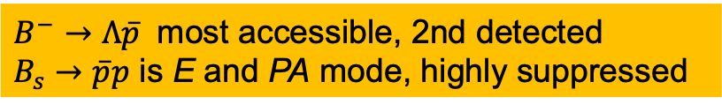
$B^{−}→Λ\overline{p}$ most accessible, 2nd detected
$B_{s}→\overline{p}p$ is E and PA mode, highly suppressed

Slide 39
2 unsuppressed detectable modes

Slide 40
1 unsuppressed detectable mode

Slide 41
2 unsuppressed detectable modes

Slide 42
3 unsuppressed detectable modes

Slide 43
Results
2 modes can cascadely decay to all charge final states with unsuppressed rate…

Slide 44
7 unsuppressed detectable modes

Slide 45
CPs

Slide 49


CP of $ΔS=−1$ pure penguin modes
Direct CP violation of $ΔS=−1$ pure penguin modes are small
U-penguin CKM suppressed

Slide 50
Direct CP violations of pure exchange modes are vanishing
These are null tests of the SM

Slide 51
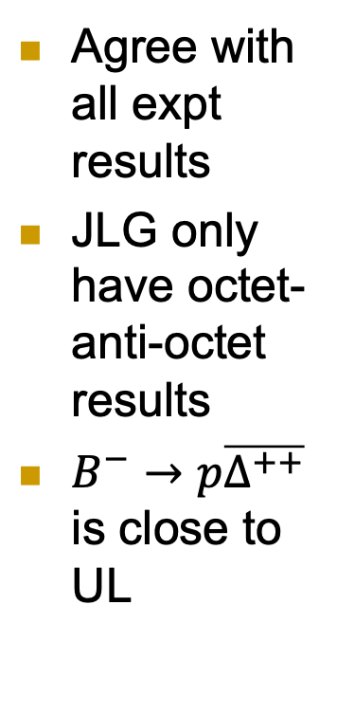
Agree with all expt results
JLG only have octet-anti-octet results
$B^{−}→p\overline{Δ^{++}}$ is close to UL

Slide 52
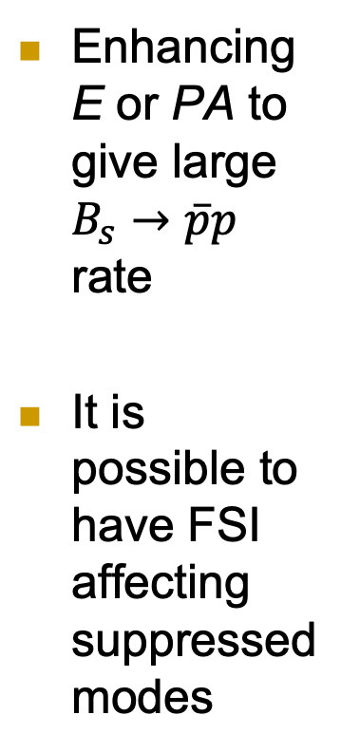
Enhancing E or PA to give large $B_{s}→\overline{p}p$ rate
It is possible to have FSI affecting suppressed modes

Slide 53
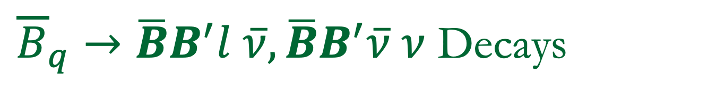
${\overline{B}}_{q}→\overline{B}B^{′}l \overline{ν},\overline{B}B^{′}\overline{ν} ν$ Decays
Experimental results

Slide 54
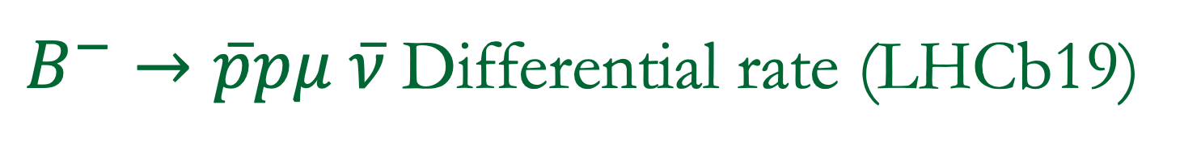
$B^{−}→\overline{p}pμ \overline{ν}$Differential rate (LHCb19)
Exibites threshold enhancement
Shape agrees with Geng-Hsiao 11, QCD counting rule

Slide 55
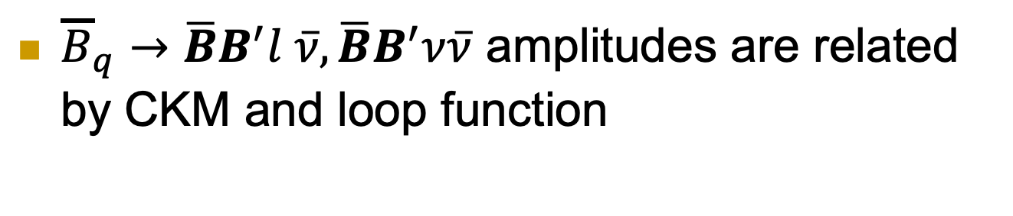
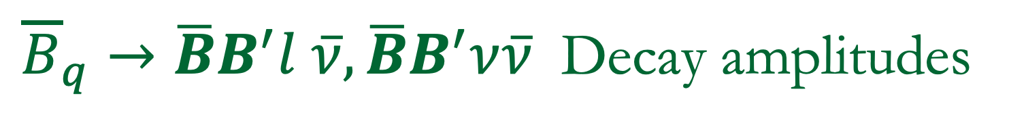
${\overline{B}}_{q}→\overline{B}B^{′}l \overline{ν},\overline{B}B^{′}ν\overline{ν}$ Decay amplitudes
${\overline{B}}_{q}→\overline{B}B^{′}l \overline{ν},\overline{B}B^{′}ν\overline{ν}$ amplitudes are related by CKM and loop function

Slide 56
Topological amplitudes
T
A
PB
PBA

Slide 57
A short summary
modes | # of modes | # of T | # of A | modes | # of modes | # of PB | # of PBA
Dbar D l nu | 22 | 2 | 1 | Dbar D nu nu | 22 | 2 | 1
Dbar B l nu | 17 | 1 | 0 | Dbar B nu nu | 17 | 1 | 0
Bbar D l nu | 18 | 1 | 0 | Bbar D nu nu | 15 | 1 | 0
Bbar B l nu | 22 | 2 | 1 | Bbar B nu nu | 20 | 2 | 1
Many relations
More than 150 modes

Slide 58

Example, ${\overline{B}}_{q}→\overline{B}B^{′}l \overline{ν}$ Decays

Slide 59

Example, ${\overline{B}}_{q}→\overline{B}B^{′}ν\overline{ν}$ Decays

Slide 60
Using model inputs…
Model 1 (O), FF basically from Geng-Liu-Tsai, 21
Model 2 (G), FF basically from Hsiao, 22
Use asymptotic relations (with some assumptions) to other B Dbar, D Bbar, D Dbar

Slide 61
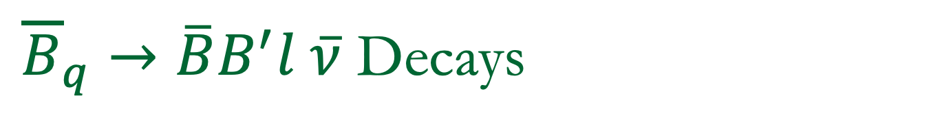
${\overline{B}}_{q}→\overline{B}B^{′}l \overline{ν}$ Decays
3 unsuppressed detectable modes
In most cases, Br₂ > Br₁

Slide 62
Huge SU(3) breaking

Slide 63
Threshold enhancement-> Huge SU(3) breaking
Threshold enhancement-> Effectively squezing PS to thrs. -> Enlarge SU(3) breaking

Slide 64
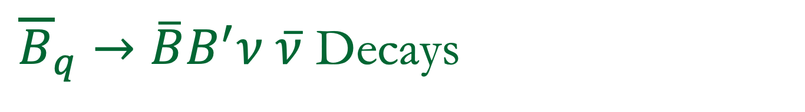
${\overline{B}}_{q}→\overline{B}B^{′}ν \overline{ν}$ Decays
3 relatively unsuppressed detectable modes

Slide 65
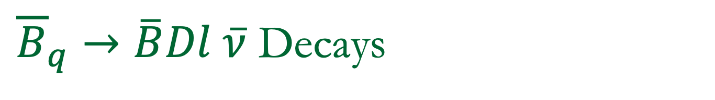
${\overline{B}}_{q}→\overline{B}Dl \overline{ν}$ Decays
Huge SU(3) breaking
1 unsuppressed detectable mode
Br₂ > Br₁

Slide 66
Only one T
Rates should be of similar sizes…

Slide 67
Differential rates
Threshold enhancement -> huge SU(3) breaking

Slide 68
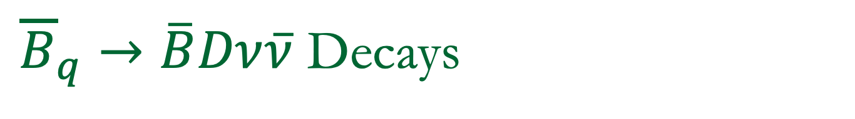
${\overline{B}}_{q}→\overline{B}Dν\overline{ν}$ Decays
1 relatively unsuppressed detectable mode

Slide 69

${\overline{B}}_{q}→\overline{D}Bl \overline{ν}$ Decays
Huge SU(3) breaking
4 relatively unsuppressed detectable modes
Br₂ > Br₁

Slide 70
Only one T
Rates should be of similar sizes…

Slide 71
Differential rates
Threshold enhancement -> huge SU(3) breaking

Slide 72

${\overline{B}}_{q}→\overline{D}Bν\overline{ν}$ Decays
2 relatively unsuppresed detectable modes

Slide 73
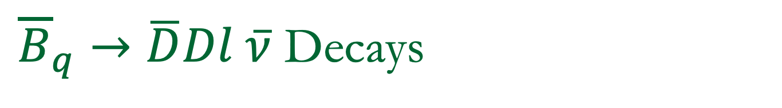
${\overline{B}}_{q}→\overline{D}Dl \overline{ν}$ Decays
6 unsuppressed detectable modes

Slide 74
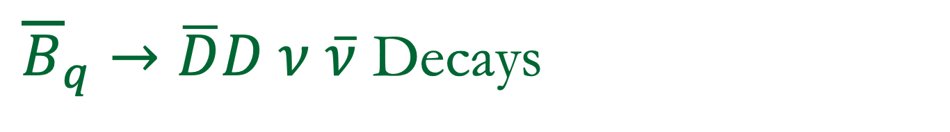
${\overline{B}}_{q}→\overline{D}D ν \overline{ν}$ Decays
6 relatively unsuppressed detectable modes

Slide 75
Differential rate
Threshold enhancement-> Huge SU(3) breaking

Slide 76
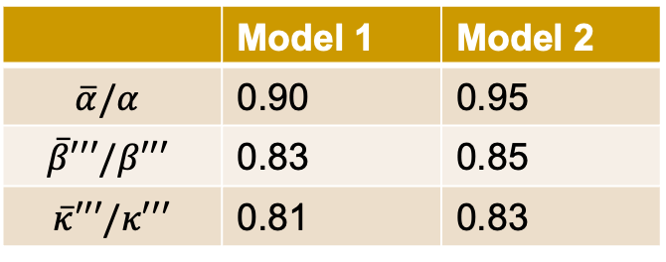
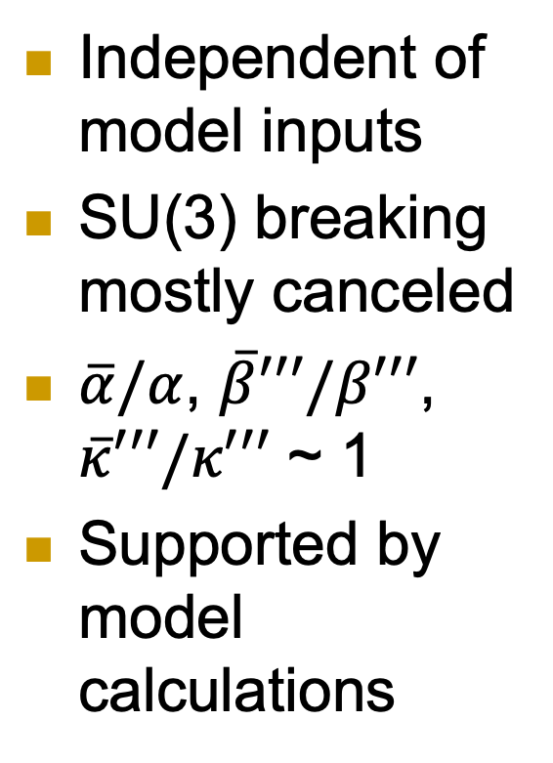
Loop and tree ratios, tests of SM
Independent of model inputs
SU(3) breaking mostly canceled
$\overline{α}/α$, $\overline{β}′′′/β′′′$, $\overline{κ}′′′/κ′′′$ ~ 1
Supported by model calculations
 | Model 1 | Model 2
$$\overline{α}/α$$ | 0.90 | 0.95
$$\overline{β}′′′/β′′′$$ | 0.83 | 0.85
$$\overline{κ}′′′/κ′′′$$ | 0.81 | 0.83

Slide 77
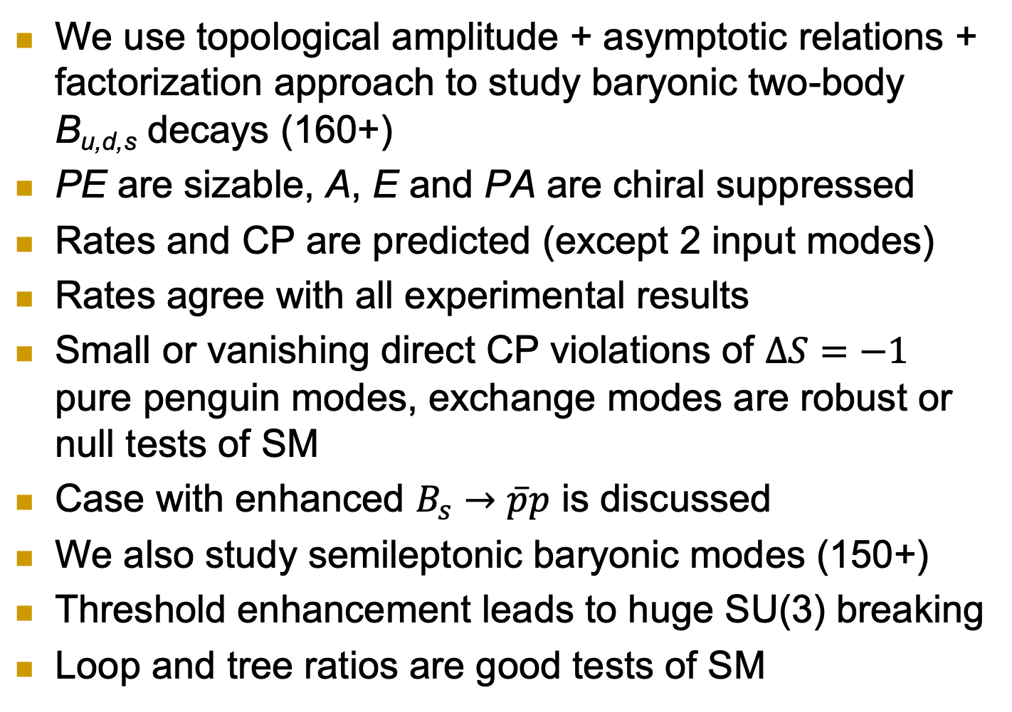
Conclusion
We use topological amplitude + asymptotic relations + factorization approach to study baryonic two-body B_{u,d,s} decays (160+)
PE are sizable, A, E and PA are chiral suppressed
Rates and CP are predicted (except 2 input modes)
Rates agree with all experimental results
Small or vanishing direct CP violations of $ΔS=−1$ pure penguin modes, exchange modes are robust or null tests of SM
Case with enhanced $B_{s}→\overline{p}p$ is discussed
We also study semileptonic baryonic modes (150+)
Threshold enhancement leads to huge SU(3) breaking
Loop and tree ratios are good tests of SM

