Slide 1
The strangest lifetime: a bizzar story of $τ(Ω_{c}^{0})$
Charmed Baryons
Hai-Yang Cheng
Academia Sinica, Taipei
In collaboration with Chia-Wei Liu (TDLI)
2024 TQCD Meeting
January 12, 2024

Slide 2
 | ps $({10}^{−12} s)$
Λ_{b}⁰ | 1.471±0.009
Ξ_{b}⁰ | 1.480±0.030
Ξ_{b}⁻ | 1.572±0.040
Ω_{b}⁻ | 1.64^{+0.18}_{-0.17}
PDG current values of bottom baryon lifetimes become stable since 2018
$τ(Ξ_{b}^{−})$ $>τ\left(Ξ_{b}^{0}\right)≃τ(Λ_{b}^{0})$
Uncertainty in $τ(Ω_{b}^{−})$ is too large to draw a conclusion

Slide 3
in units of fs (${10}^{−15}$ s)
 | $$τ(Ξ_{c}^{+})$$ | $$τ(Λ_{c}^{+})$$ | $$τ(Ξ_{c}^{0})$$ | $$τ(Ω_{c}^{0})$$
PDG (’04 ~ ’18) | 442 ± 26 | 200 ± 6 | ${112}_{−10}^{+13}$ | 69 ± 12
LHCb (’18) |  |  |  | 268 ± 26
LHCb (’19) | 457 ± 6 | 203.5 ± 2.2 | 154.5 ± 2.6
PDG (’20) | 456 ± 5 | 202.4 ± 3.1 | 153 ± 6 | 268 ± 26
LHCb (’21) |  |  | 148.0 ± 3.2 | 276.5 ± 14.1
PDG (’22,’23) | 453 ± 5 | 201.5 ± 2.7 | 151.9 ± 2.4 | 268 ± 26
Belle II (’22) |  | 203.20 ± 1.18 |  | 243 ± 49
World Ave (’23) | 453 ± 5 | 202.9 ± 1.1 | 150.5 ± 1.9 | 272.6 ± 12.0
$τ(Ω_{c}^{0})$ obtained by LHCb (’18) from semileptonic $Ω_{b}^{−}$ decays is nearly four times larger. It has been confirmed by LHCb (’21) using promptly produced $Ω_{c}^{0}$ baryons
$τ\left(Ξ_{c}^{+}\right)>τ\left(Λ_{c}^{+}\right)>τ\left(Ξ_{c}^{0}\right)>τ\left(Ω_{c}^{0}\right)$ before 2018
$τ\left(Ξ_{c}^{+}\right)>τ\left(Ω_{c}^{0}\right)>τ\left(Λ_{c}^{+}\right)>τ\left(Ξ_{c}^{0}\right)$ after 2018
$τ(Ξ_{c}^{0})$ becomes 3.3σ larger due to new measurements from LHCb (’19, ’21)

Slide 4
Lifetimes of heavy baryons
Heavy quark expansion:
A₀ term from the decay of heavy quark Q
⇒ Lifetimes of all heavy hadrons H_{Q} are the same in m_{Q}→∞ limit
No linear 1/m_{Q} correction from A₁ term , known as Luke’s theorem
A₂ term arises from dim-5 kinetic & chromomagnetic operators $μ_{π}^{2}, { μ}_{G}^{2}$
A₃ term consists of dim-6 2-quark Darwin operator & 4-quark operators
which will induce the spectator effects responsible for lifetime differences
A₄ term includes dim-7 4-quark operators which will induce 1/m_{c}
corrections to spectator effects

Slide 5
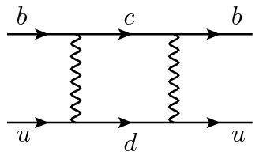
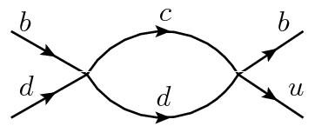
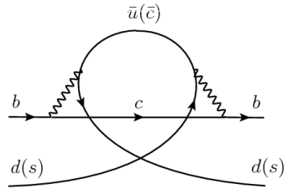
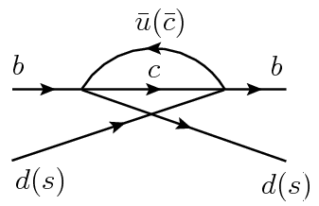
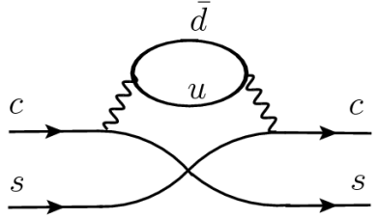
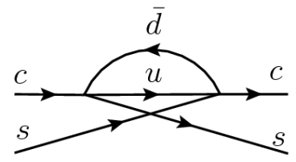
Spectator effects described by dim-6 four-quark operators: dim-7 4-quark
W-exchange
destructive P.I. constructive
(Pauli interference)
constructive P.I. destructive
(only for charmed baryons)
Although spectator effects are 1/m_{Q}³ suppressed, they are
numerically important due to a p.s. enhancement factor of 16π²
relative to heavy quark decay

Slide 6
Subleading $1/m_{Q}$ corrections to spectator effects are obtained by expanding forward scattering amplitude in light quark momentum and matching the result onto operators containing derivative insertions
Gabbiani, Onishchenko, Petrov (’03,’04)
⇒ dim-7 four-quark operators:
and ${\tilde{P}}_{i}^{q}$ obtained from $P_{i}^{q}$ by interchanging colors of Q and $\overline{q}$
dim-7 4-quark operator is either dim-6 4-quark operator times m_{q} or 4-quark
operator with two derivatives suppressed by 1/$m_{Q}$
Beneke, Buchalla, Dunietz (’96): width difference in B_{s}-B_{s} system
Gabbiani, Onishchenko, Petrov (’03,’04): lifetime difference of heavy hadrons
Lenz, Rauh (’13): D meson lifetimes

Slide 7
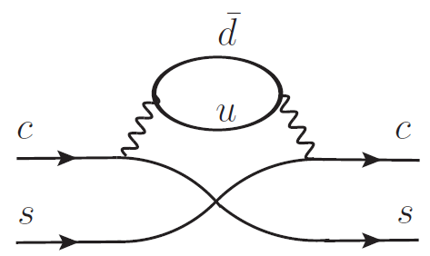
 | Dec | Ann | Int (-) | Int (+) | Semi | τ (10⁻¹³s) | Expt (10⁻¹³s)
Ξ_{c}⁺ | 1 | s² | 1 | c² | small P.I. | 3.06 | 4.42±0.26
Λ_{c}⁺ | 1 | c² | 1 | s² | no P.I. | 2.91 | 2.00±0.06
Ξ_{c}⁰ | 1 | 1 |  | c² | small P.I. | 1.62 | 1.12^{+0.13}_{-0.10}
Ω_{c}⁰ | 1 | 6s² |  | 10/3 c² | large P.I. | 1.06 | 0.69±0.12
s=sinθ_{C}, c=cosθ_{C}
additional constructive
P.I. contribution to Γ^{semi}
Voloshin (’96)
Lifetime hierarchy τ(Ξ_{c}⁺) > τ(Λ_{c}⁺) > τ(Ξ_{c}⁰) > τ(Ω_{c}⁰) according to
PDG is understood qualitatively, but not quantitatively.
It is difficult to explain τ(Ξ_{c}⁺)/τ(Λ_{c}⁺) = 2.21±0.15,
τ(Ξ_{c}⁺)/τ(Ξ_{c}⁰) = 3.95±0.47
1/m_{c} expansion not well convergent and sensible
7

Slide 8
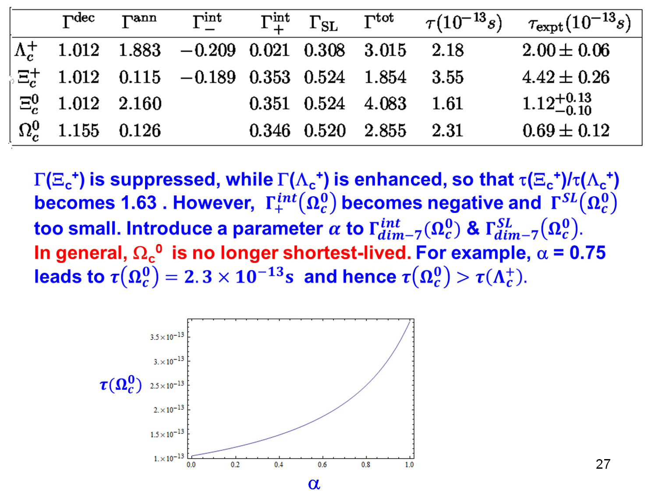
Effects of dim-7 4-quark operators were explored in 2017-2018. Preliminary results with the conjecture that $Ω_{c}^{0 }$ is no longer shortest-lived and that $τ\left(Ω_{c}^{0}\right)>τ\left(Λ_{c}^{+}\right)$ were first reported at 2018 HIEPA Workshop (March 19-21, 2018, Beijing).
An ad hoc parameter α was introduced to ensure the validity of HQE for $Ω_{c}^{0 }$
τ(Ω_{c}⁰) = 231 fs for α = 0.25
to dim-6 ⇒ $τ\left(Ξ_{c}^{+}\right)>τ\left(Λ_{c}^{+}\right)>τ\left(Ξ_{c}^{0}\right)>τ\left(Ω_{c}^{0}\right)$
to dim-7 ⇒ $τ\left(Ξ_{c}^{+}\right)>τ\left(Ω_{c}^{0}\right)>τ\left(Λ_{c}^{+}\right)>τ\left(Ξ_{c}^{0}\right)$

Slide 9
Less than three months later, LHCb’s new measurement of τ(Ω_{c}⁰) = (268±24±10±2) fs was first reported by Mariana Fontana on June 8th of 2018, which is nearly four-times larger than the world average of (69±12) fs obtained from fixed target experiments!
events
64
86
25
~ 1000 events

Slide 10
Criticism:
Some additional parameters introduced before are arbitrary and ad hoc
$α:$ to suppress 1/$m_{c}^{4}$ corrections to ensure the validity of HQE
$y:$ to enhance the matrix element of charmed baryons
Wilson coefficients and spectator effects calculated only to LO
Quark mass is not precisely defined.
Quark mass scheme: MS, pole, kinetic, 1S, MSR,…
$m_{b}^{1S}=4.691±0.037$ GeV, $m_{b}^{pole}∼4.65$ GeV,
${ m}_{b}^{kin}=4.554±0.018$ GeV, ${\overline{m}}_{b}\left({\overline{m}}_{b}\right)=4.19±0.04$ GeV
Physics is independent of the mass scheme!
Darwin term is missing
…

Slide 11
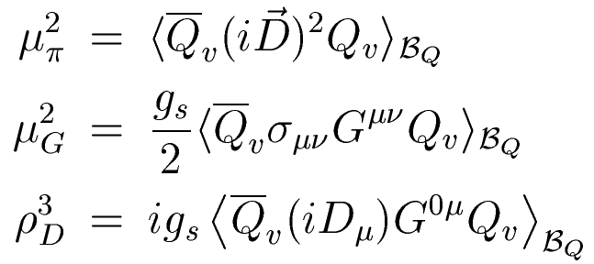
In this talk, I’ll focus on the baryon matrix elements which constitute the major uncertainties in the predictions of heavy baryon lifetimes
Nonperturbative baryonic matrix elements:
2-quark operator m.e. $μ_{π}^{2}, { μ}_{G}^{2}, ρ_{D}^{3};$ 4-quark operator m.e. $〈O_{4q}〉$
Matrix elements $μ_{π}^{2}, { μ}_{G}^{2}, ρ_{D}^{3}$ should be independent of heavy quark mass $m_{Q}$ , so are $〈O_{4q}〉$ in heavy quark limit
$〈O_{4q}〉$ are conventionally evaluated using NRQM

Slide 12
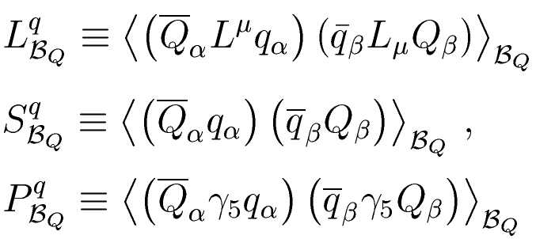
( in units of ${10}^{−3}{GeV}^{3}$ )
Gratrex, Melic, Nisandzic (’22) for c-baryons;
Gratrex, Lenz, Melic, Nisandzic, Piscopo, Rusov (’23) for b-baryons
In $m_{Q}→∞$ limit, $L_{Λ_{Q}}^{ }$, $S_{Λ_{Q}}^{ }$, $P_{Λ_{Q}}^{ }$ are independent of $m_{Q}$
Within NRQM, the magnitudes of 4-quark operator matrix elements in the bottom sector are much larger than that in the charm sector
$$L_{Λ_{b}}^{q}=−{\left|ψ_{bq}^{Λ_{b}}\left(0\right)\right|}^{2}∝−{\left|ψ_{b\overline{q}}^{B}\left(0\right)\right|}^{2}=−\frac{1}{12}f_{B}^{2}m_{B}$$
$$\left|ψ_{b\overline{q}}^{B}\left(0\right)\right|≫\left|ψ_{c\overline{q}}^{D}\left(0\right)\right|$$
$$L_{Λ_{c}}^{q}=−{\left|ψ_{cq}^{Λ_{c}}\left(0\right)\right|}^{2}∝−{\left|ψ_{c\overline{q}}^{D}\left(0\right)\right|}^{2}=−\frac{1}{12}f_{D}^{2}m_{D}$$
⇒ $\left|L_{Λ_{b}}^{q}\right|$ >> $\left|L_{Λ_{c}}^{q}\right|$
$\left|L_{Λ_{b}}^{ }\right|$ ≈ 2.5$\left|L_{Λ_{c}}^{ }\right|\sim \left|L_{Λ_{ }}^{ }\right|$ ⇒ far from expectation of heavy quark limit

Slide 13
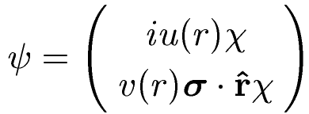
In MIT bag model $L_{Λ_{Q}}^{ }$=$−\int{d^{3}r \{{[u}_{Q}^{2}\left(r\right)u_{q}^{2}\left(r\right)+v_{Q}^{2}\left(r\right)v_{q}^{2}\left(r\right)]+{[u}_{Q}^{2}\left(r\right)v_{q}^{2}\left(r\right)+v_{Q}^{2}\left(r\right)u_{q}^{2}\left(r\right)]\} }$
with $u\left(r\right)$, $v(r)$ being the large and small components of the quark wave function
${|L}_{Λ_{b}}^{ }|=3.23×{10}^{−3},$ ${|L}_{Λ_{c}}^{ }|=2.39×{10}^{−3}$ ⇒ weak dependence on heavy flavor
In NR limit, $v_{Q}→0, v_{q}→0, L_{Λ_{Q}}^{ }$= $−\int{d^{3}r u_{Q}^{2}\left(r\right)u_{q}^{2}\left(r\right)=−{\left|ψ_{Qq}^{Λ_{Q}}\left(0\right)\right|}^{2}}.$ It is customary to consider hyperfine splittings in heavy baryons and mesons and then apply the relation ${\left|ψ_{Q\overline{q}}^{M}\left(0\right)\right|}^{2}=\frac{1}{12}f_{M}^{2}m_{M}$ which is derived and valid under heavy quark limit
In NRQM, it is important to evaluate 4-quark matrix elements directly in terms of baryon wave functions in momentum space. The momentum integrals are expressed in terms of harmonic oscillator parameters $α_{ρ}$, $α_{λ}$ for ρ- and λ-mode excitation, respectively. ⇒ check dependence of 4-quark m.e. on $m_{Q}$
Alternatively, we consider the improved bag model
HYC, Liu, JHEP 07 (2023) 114

Slide 14
Improved bag model
MIT bag model yields too small baryonic matrix elements compared to NRQM
Static bag model has an issue with center-of-mass motion (CMM) of the bag
Chao-Qiang Geng, Chia-Wei Liu, Ten-Hsueh Tsai (’20);
Liu, Geng (’22)
Bag quarks are unentangled; they obey free Dirac equation
(recall that )
because
The variance of is referred to CMM of the bag. A physical bag with a definite momentum should not have CMM as
MIT bag model: Poincare invariance is not kept

Slide 15
In the homogeneous bag model (HBM) of Geng, Liu, Tsai (’20)
Wave function is invariant under space translation
Quarks are no longer constrained in specific regions
Quarks are bounded and entangled in the following way:
CMM is thus taken away from the static bag

Slide 16
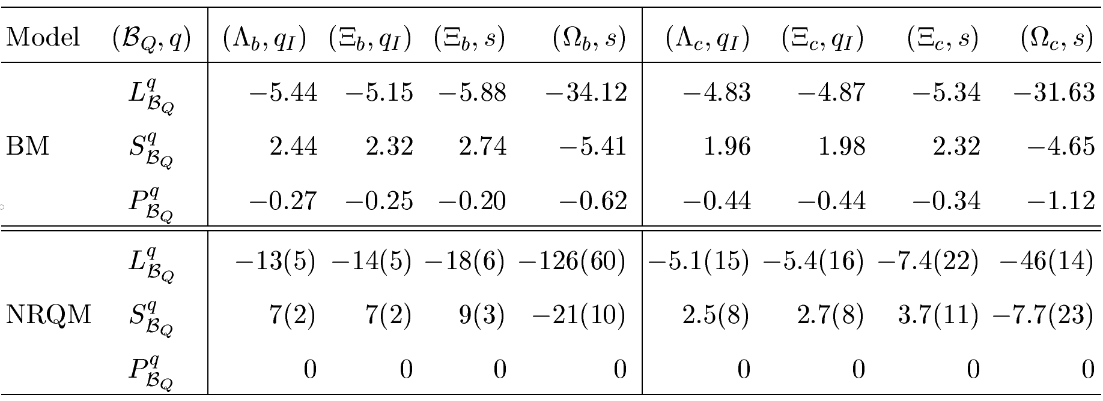
in units of
${10}^{−3}{GeV}^{3}$
evaluated at $μ_{H}$ scale
The matrix element $P_{B_{Q}}^{ }$ is nonzero in the BM. Unlike the case in NRQM,
${ L}_{B_{Q}}^{ }$ and $S_{B_{Q}}^{ }−P_{B_{Q}}^{ }$ in the BM vary less than 10% w.r.t. heavy flavor,
Both BM & NRQM are consistent for $L_{B_{c}}^{ }$ but differ largely in $L_{B_{b}}^{ }$
QCDSR evaluated at ${μ=m}_{b}$:
$$L_{Λ_{b}}^{ }=$$
− (14.3 ± 2.8)
Zhen-Xing Zhao, Xiao-Yu Sun,
Fu-Wei Zhang, Zhi-Peng Xing (’23)
$$L_{Λ_{b}}^{ }=$$
− (7.6 ± 1.5) $μ_{H}=0.8$ GeV
Evolution to $μ_{H}$:
− (9.6 ± 1.9) $μ_{H}=1.2$ GeV

Slide 17
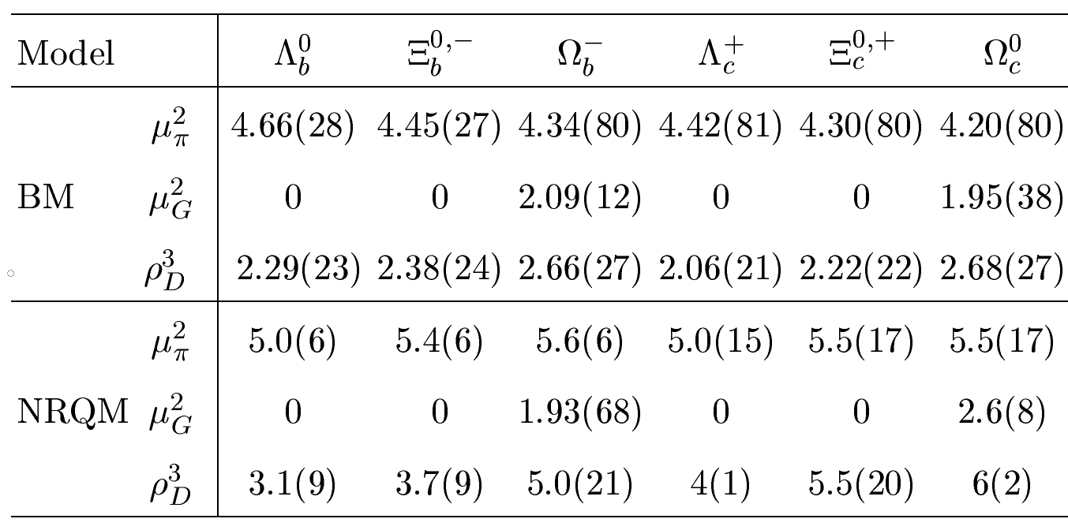
$μ_{π,G}^{2}$ in units of ${10}^{−1}{GeV}^{2}$
$ρ_{D}^{3}$ in units of ${10}^{−2}{GeV}^{3}$
NRQM: Gratrex, Melic, Nisandzic (’22) for c-baryons; Gratrex, Lenz, Melic, Nisandzic, Piscopo, Rusov (’23) for b-baryons
In the bag model $μ_{π}^{2}, { μ}_{G}^{2}, ρ_{D}^{3}$ all depend weakly on the heavy quark flavor
In both BM & NRQM, $ρ_{D}^{3}$ respects the same hierarchy $Ω_{Q}>Ξ_{Q}>Λ_{Q}$ induced by the strange quark mass. It shares similar values for $T_{Q}$ & $Ω_{Q}$ in the bag model.

Slide 18
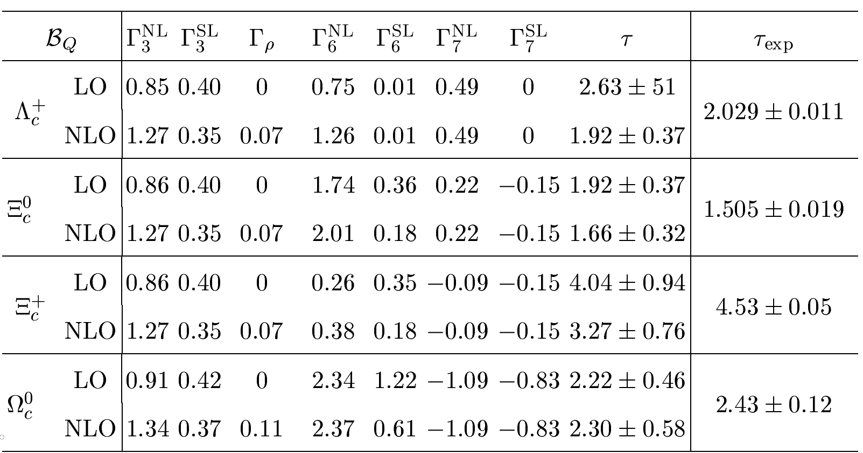
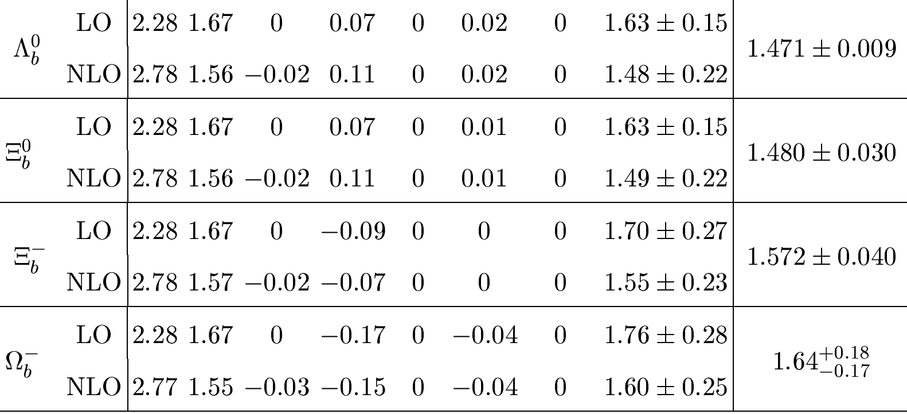
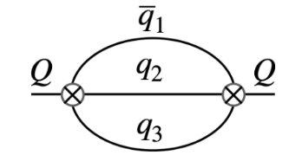
Lifetimes of bottom baryons
τ in units of ${10}^{−12}$ s
Uncertainties arise from $m_{b}, μ_{H},I_{B_{b}}^{q}$, and the deviation of full QCD from HQET
All predicted lifetimes are improved to NLO. Contributions from dim-7 operators are very small, although NLO corrections to them are still absent
$Γ_{7}^{NL}$ contributes constructively (destructively) to $Γ_{ }^{NL}$ for $Λ_{b}^{0}$ & $Ξ_{b}^{0}$ ($Ω_{b}^{−}$)
$Γ_{3}≫Γ_{6}>Γ_{7}$ for b-baryons
$$Γ_{3}:$$
$τ\left(Ω_{b}^{−}\right)>τ(Ξ_{b}^{−})$ $>τ\left(Ξ_{b}^{0}\right)≃τ(Λ_{b}^{0})$
18

Slide 19
Lifetimes of bottom baryons
 | BM | NRQM | Expt
$$Λ_{b}^{0}$$ | 1.48 ± 0.22 | ${ 1.490}_{−0.207}^{+0.176}$ | 1.471 ± 0.009
$$Ξ_{b}^{0}$$ | 1.49 ± 0.22 | ${ 1.493}_{−0.207}^{+0.177}$ | 1.480 ± 0.030
$$Ξ_{b}^{−}$$ | 1.55 ± 0.23 | ${ 1.608}_{−0.230}^{+0.194}$ | 1.572 ± 0.040
$$Ω_{b}^{−}$$ | 1.60 ± 0.25 | ${ 1.692}_{−0.261}^{+0.231}$ | ${ 1.64}_{−0.17}^{+0.18}$
NRQM: Gratrex, Lenz, Melic, Nisandzic, Piscopo, Rusov (’23) in kinetic mass scheme to dim-6 level
We use the pole mass $m_{b}=4.70±0.10$ GeV, 2-loop (1-loop) result for upper
(lower) bounds
Excellent agreement between theory and experiment for bottom baryon lifetimes even at dim-6 level

Slide 20
$τ$ in units of ${10}^{−13}$ s
Uncertainties arise from $m_{c}, μ_{H},I_{B_{c}}^{q}$, and the deviation of full QCD from HQET
All predicted lifetimes are improved to NLO except for $Ξ_{c}^{+}$
$Γ_{6}>Γ_{3}$ for c-baryons, recalling that $Γ_{3}>Γ_{6}$ for b-baryons
To dim-6 ⇒ $τ\left(Ξ_{c}^{+}\right)>τ\left(Λ_{c}^{+}\right)>τ\left(Ξ_{c}^{0}\right)>τ\left(Ω_{c}^{0}\right)$
to dim-7 ⇒ $τ\left(Ξ_{c}^{+}\right)>τ\left(Ω_{c}^{0}\right)>τ\left(Λ_{c}^{+}\right)>τ\left(Ξ_{c}^{0}\right)$
Because of large destructive contributions from $Γ_{7}^{NL}$ and $Γ_{7}^{SL},$ $Ω_{c}^{0}$ could
live longer than $Λ_{c}^{+}$

Slide 21
($τ$ in units of ${10}^{−13}$ s )
 | BM | NRQM | Expt
$$Λ_{c}^{+}$$ | 1.92 ± 0.37 | ${ 3.04}_{−0.80}^{+1.06}$ | 2.029 ± 0.011
$$Ξ_{c}^{0}$$ | 1.66 ± 0.32 | ${ 2.31}_{−0.59}^{+0.84}$ | 1.505 ± 0.019
$$Ξ_{c}^{+}$$ | 3.27 ± 0.76 | ${ 4.25}_{−1.00}^{+1.22}$ | 4.53 ± 0.05
$$Ω_{c}^{0}$$ | 2.30 ± 0.58 | ${ 2.59}_{−0.70}^{+1.03}$ | 2.73 ± 0.12
NRQM: Gratrex, Melic, Nisandzic (’22) in the pole mass scheme
We use the pole mass $m_{c}=1.59±0.09$ GeV, 2-loop (1-loop) result for upper
(lower) bounds
While the predicted lifetimes for $Λ_{c}^{+}$ and $Ξ_{c}^{0}$ are improved in the bag model, $τ(Ξ_{c}^{+})$ becomes even worse.

Slide 22
Conclusions
Baryonic matrix elements are evaluated in the improved bag model.
Heavy quark limit holds reasonably well in BM but is badly respected
in NRQM.
HQE in 1/m_{b} works well for the lifetimes of bottom baryons.
HQE in 1/m_{c} fails to provide a satisfactory description of the lifetimes
charmed baryons to O(1/m_{c}³). Need to consider subleading 1/m_{c}
corrections to spectator effects.
The Ω_{c}⁰ lifetime could live longer than Λ_{c}⁰ due to the suppression from
1/m_{c} corrections arising from dim-7 4-quark operators

Slide 23
Backup Slides

Slide 24
Charm quark mass
Consider a mass scheme X at NLO related to the pole scheme as
$$m_{c}^{pole}=m_{c}^{X}(1+\frac{α_{s}}{π}a_{X}^{ })$$
scheme | 1-loop | 2-loop | 3-loop
$${\overline{m}}_{c}^{ }({\overline{m}}_{c}^{ })$$ | 1.28 | 1.28 | 1.28
$$m_{c}^{pole}$$ | 1.49 | 1.68 | 1.95
$$m_{c}^{kin}$$ | 1.36 | 1.39 | 1.40
$$m_{c}^{MSR}$$ | 1.33 | 1.35 | 1.36

Slide 25
Lifetimes of charmed mesons
in units of ${ps}^{−1}$
taken from Gratrex, Melic, Nisandzic (’22)
A negative $τ\left(D^{+}\right)$ due to a significant destructive contribution from Pauli interference

Slide 26
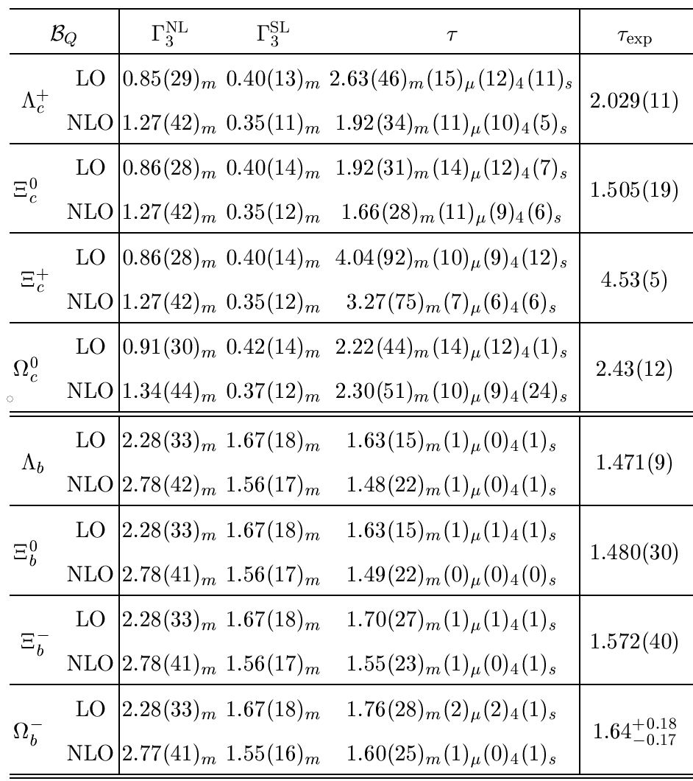
Uncertainties from $m_{Q}, μ_{H}, \left\langle O_{4q}\right\rangle$,
deviation of full QCD from HQET are denoted by the subscripts $m, μ, 4, s,$ respectively.

Slide 27
Semileptonic inclusive BFs:
( in %)
 | BM | NRQM | Expt
$$Λ_{c}^{+}$$ | 4.57 ± 0.54 | ${ 3.80}_{−0.57}^{+0.58}$ | 3.95 ± 0.35
$$Ξ_{c}^{0}$$ | 4.40 ± 0.61 | ${ 4.31}_{−0.84}^{+0.87}$ | ⎯
$$Ξ_{c}^{+}$$ | 8.57 ± 0.49 | ${ 12.74}_{−2.45}^{+2.54}$ | ⎯
$$Ω_{c}^{0}$$ | 1.88 ± 1.69 | ${ 7.59}_{−2.24}^{+2.49}$ | ⎯
$$Λ_{b}^{0}$$ | 9.90 ± 0.03 | ${ 11.0}_{−0.5}^{+0.6}$ | ⎯
$$Ξ_{b}^{0}$$ | 9.94 ± 0.06 | ${11.0}_{−0.6}^{+0.6}$ | ⎯
$$Ξ_{b}^{−}$$ | 10.38 ± 0.09 | ${11.7}_{−0.6}^{+0.7}$ | ⎯
$$Ω_{b}^{−}$$ | 10.76 ± 0.14 | ${ 12.0}_{−1.4}^{+1.4}$ | ⎯
Predicted BFs of $Ξ_{c}^{+}→Xe^{+}ν_{e}, Ω_{c}^{0}→Xe^{+}ν_{e}$ in bag model and NRQM both in the pole mass scheme are in sharp contrast ⇒ allowed to discriminate between different models

Slide 28
Matrix elements of dim-7 4-quark operators:

